Slide 1
Introduction to
Machine Learning
Regularization
Instructor: Pat Virtue

Slide 2
Announcements
Assignments:
HW3
    Planned for release tonight
    Due Tue, 2/11, 11:59 pm

Slide 3
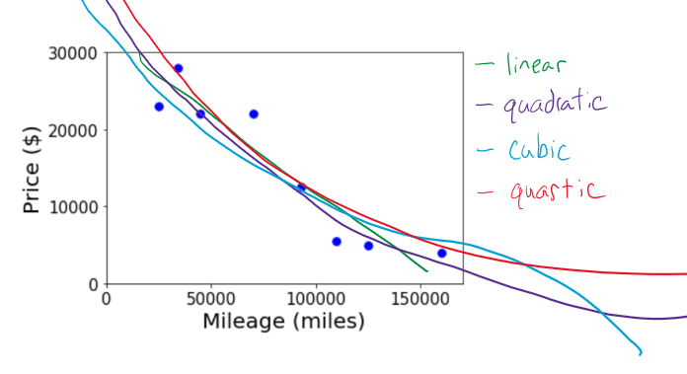
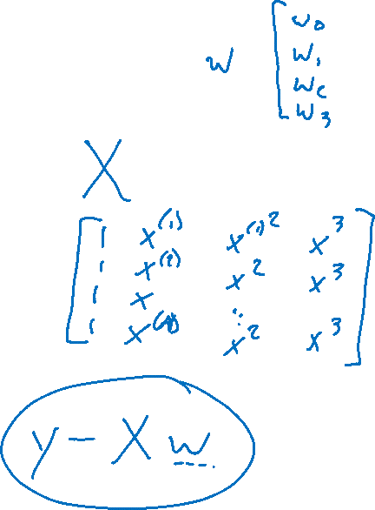
Overfitting with Polynomial Linear Regression
Better fit training data with higher model complexity

Slide 4
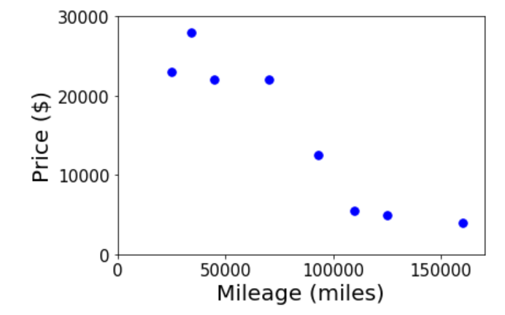
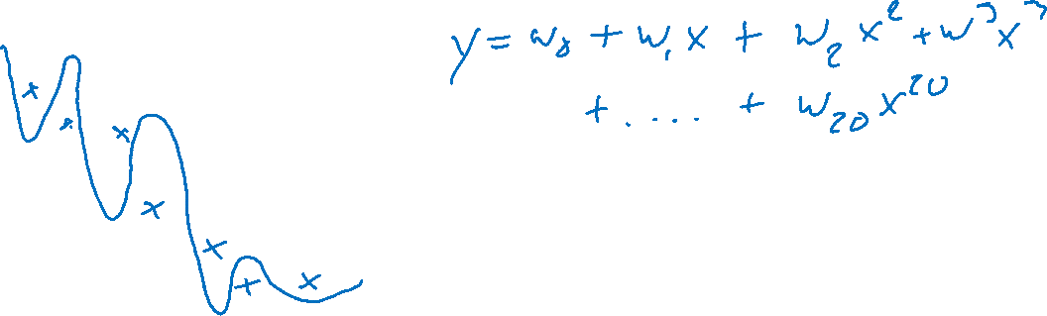
Overfitting with Polynomial Linear Regression
Better fit training data with higher model complexity
How can we deal with overfitting? Use validation. More training data
What are some symptoms of overfitting? Huge weights!

Slide 5
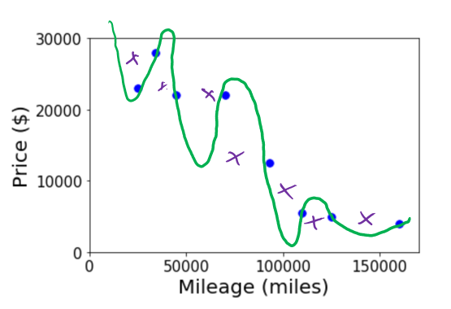
Overfitting with Polynomial Linear Regression
How can we deal with overfitting?
Use validation set to detect overfitting
Collect more training data
Reduce model complexity
  Lower degree polynomial
  But then we might underfit ☹
Try fitting to many different degrees
  Use validation data to decide which level of model complexity to use
Penalize the weights

Slide 6
Overfitting with Polynomial Linear Regression
What are symptoms of overfitting?
Poor validation score
HUGE weights!

Slide 7
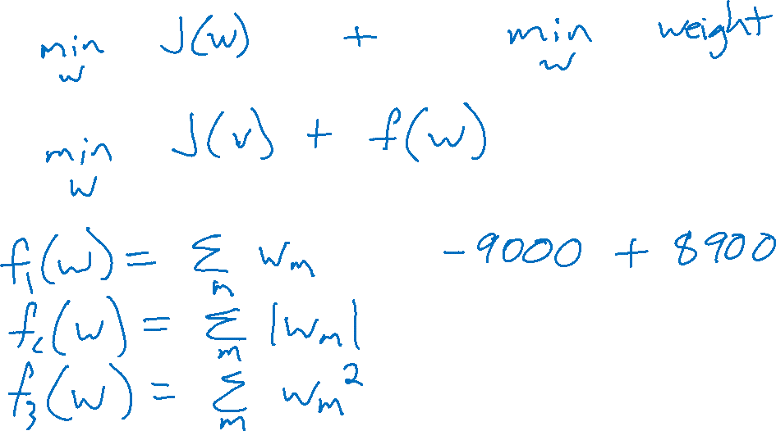
Regularization
Combine original objective with penalty on parameters

Slide 8
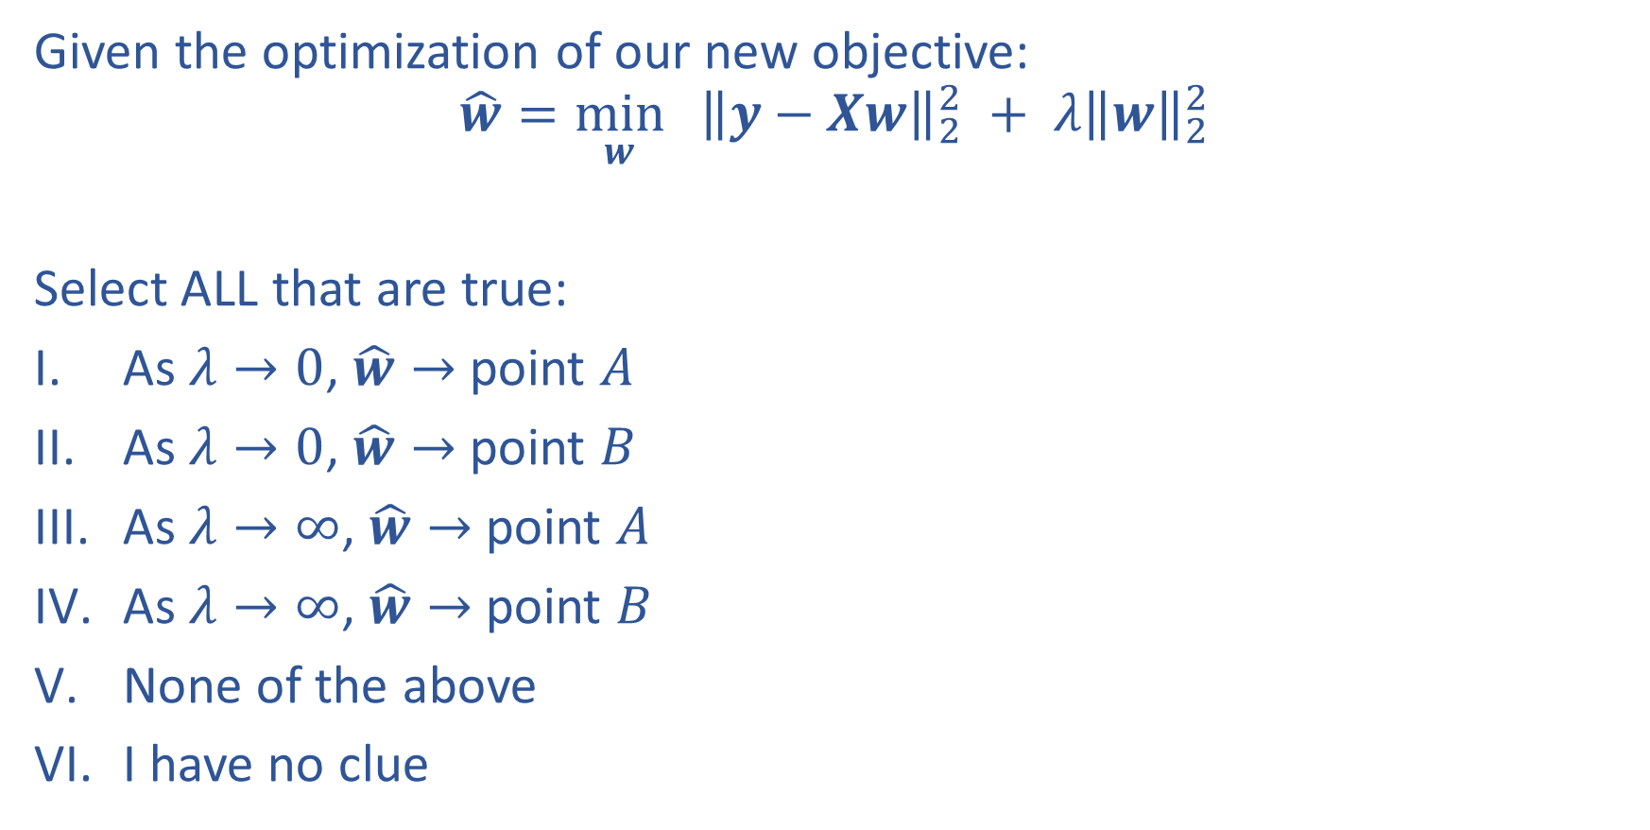
Piazza Poll 1:
Given the optimization of our new objective:
$$\hat{w}=\min_{w}{ {\left\|y−Xw\right\|}_{2}^{2} + λ{\left\|w\right\|}_{2}^{2}}$$
Select ALL that are true:
As $λ→0$, $\hat{w}→$ point $A$
As $λ→0$, $\hat{w}→$ point $B$
As $λ→∞$, $\hat{w}→$ point $A$
As $λ→∞$, $\hat{w}→$ point $B$
None of the above
I have no clue

Slide 9
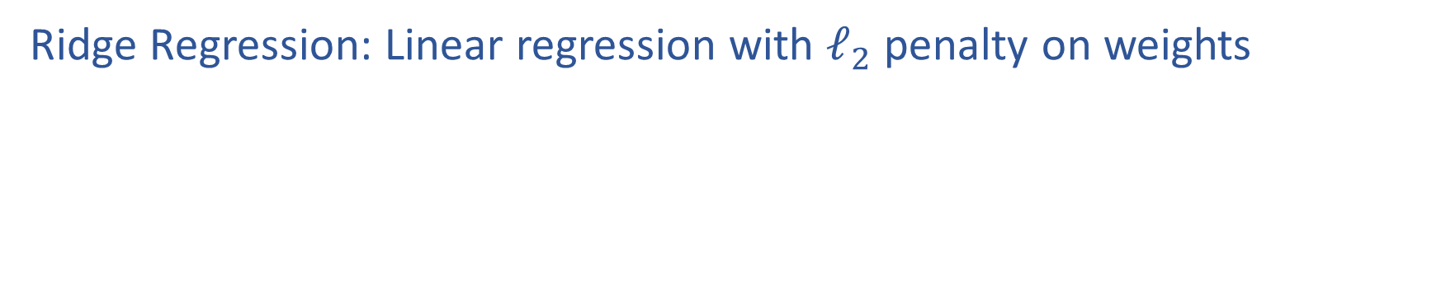
Regularization
Ridge Regression: Linear regression with $ℓ_{2}$ penalty on weights

Slide 10
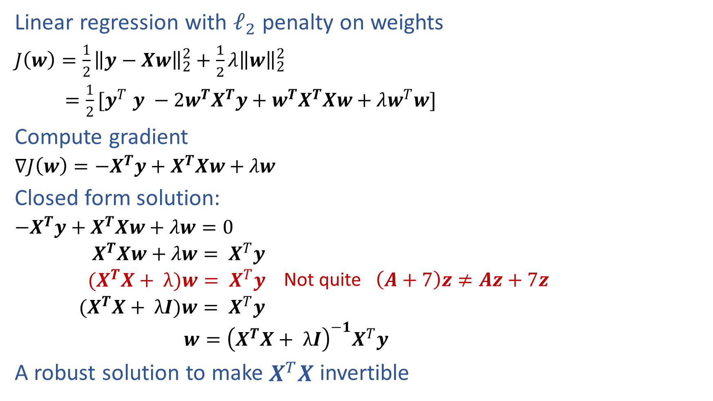
Ridge Regression
Linear regression with $ℓ_{2}$ penalty on weights
$J\left(w\right)=\frac{1}{2}{\left\|y−Xw\right\|}_{2}^{2}+\frac{1}{2}λ{\left\|w\right\|}_{2}^{2}$
${=\frac{1}{2}[y}^{T}y −{2w}^{T}X^{T}y+w^{T}X^{T}Xw+λw^{T}w]$
Compute gradient
  $∇J\left(w\right)={−X}^{T}y+X^{T}Xw+λw$
Closed form solution:
  ${−X}^{T}y+X^{T}Xw+λw=0$
  $X^{T}Xw+λw= X^{T}y$
  ${(X}^{T}X+ λ)w= X^{T}y$ Not quite $\left(A+7\right)z≠Az+7z$
  ${(X}^{T}X+ λI)w= X^{T}y$
  $w={\left(X^{T}X+ λI\right)}^{−1}X^{T}y$
A robust solution to make $X^{T}X$ invertible

Slide 11
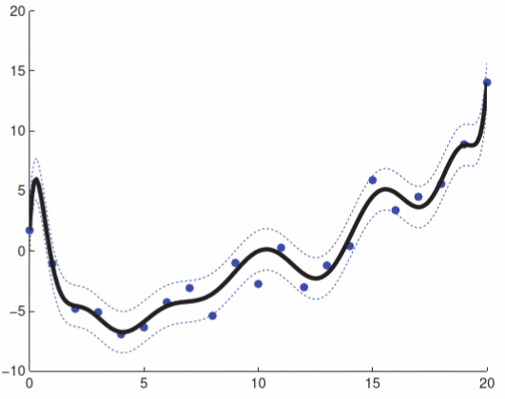
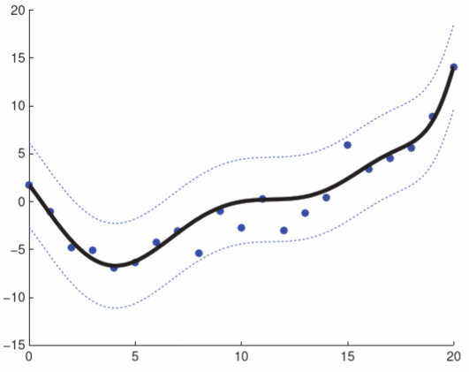

Regularization
But how do we choose $λ$?
Figures: Murphy, Ch 7.5

Slide 12
Probabilistic Interpretation
What assumptions are we making about our parameters?

Slide 13
MLE and MAP

Slide 14
Coin Flipping Example

Slide 15
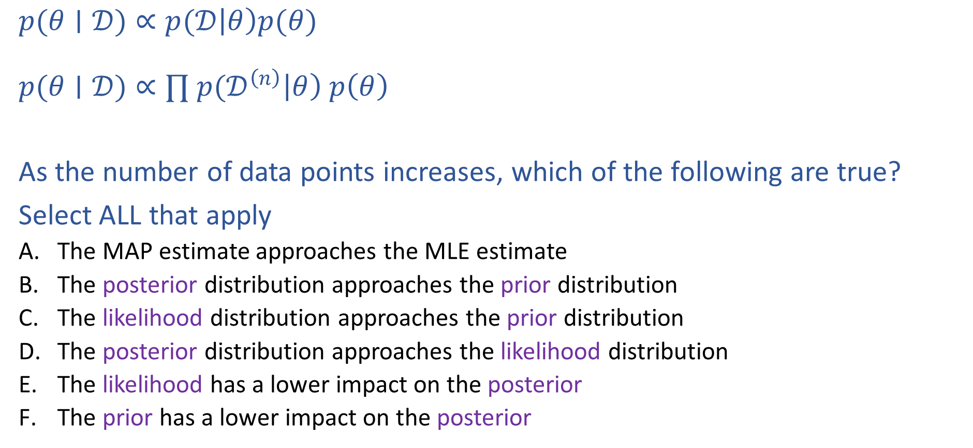
Piazza Poll 2:
$p(θ∣𝒟)∝p(𝒟\left|θ\right)p(θ)$
$p(θ∣𝒟)∝∏ p(𝒟^{\left(n\right)}\left|θ\right) p\left(θ\right)$
As the number of data points increases, which of the following are true?
Select ALL that apply
  The MAP estimate approaches the MLE estimate
  The posterior distribution approaches the prior distribution
  The likelihood distribution approaches the prior distribution
  The posterior distribution approaches the likelihood distribution
  The likelihood has a lower impact on the posterior
  The prior has a lower impact on the posterior

Slide 16
Coin Flipping Example

Slide 17
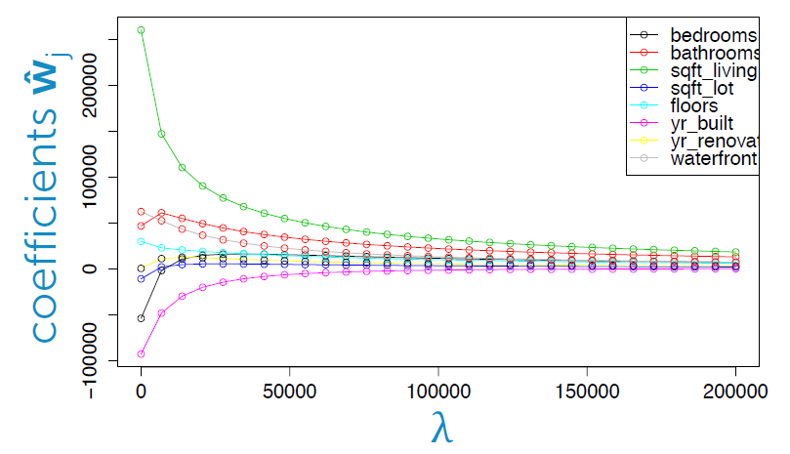
Housing Price Example
Predict housing price from several features
Figure: Emily Fox, University of Washington

Slide 18
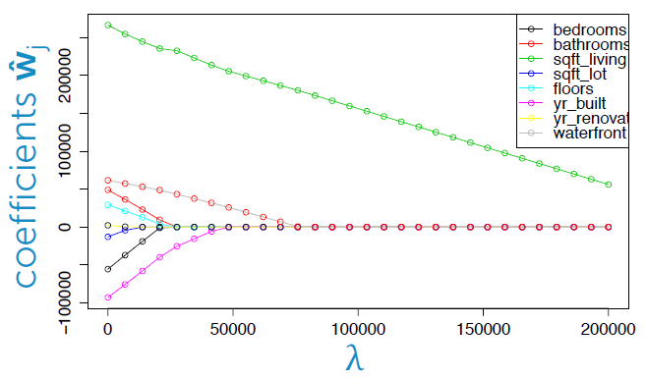
Housing Price Example
Predict housing price from several features
Figure: Emily Fox, University of Washington

Slide 19
Regularization
Combine original objective with penalty on parameters

Slide 20
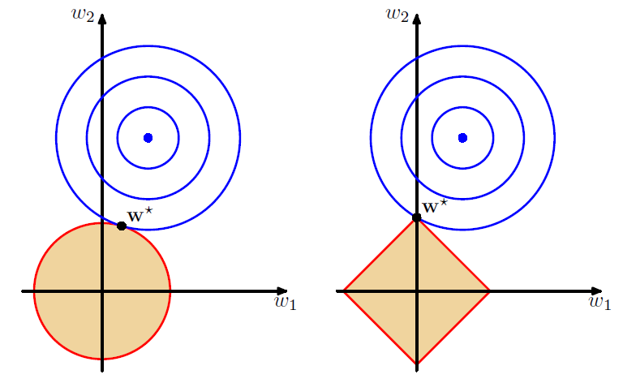
Regularization
Combine original objective with penalty on parameters
Figures: Bishop, Ch 3.1.4

Slide 21
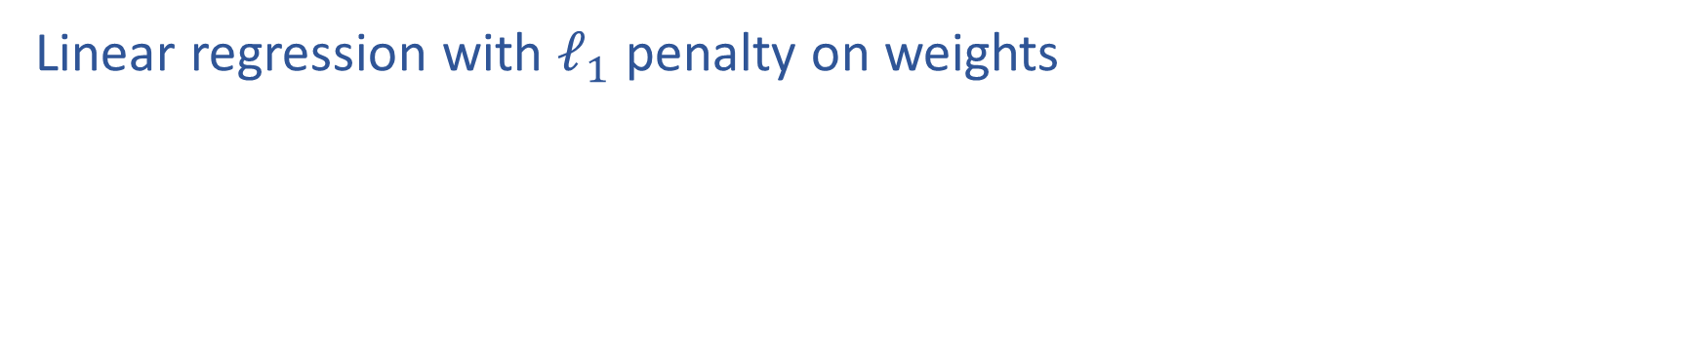
LASSO
Linear regression with $ℓ_{1}$ penalty on weights

Slide 22
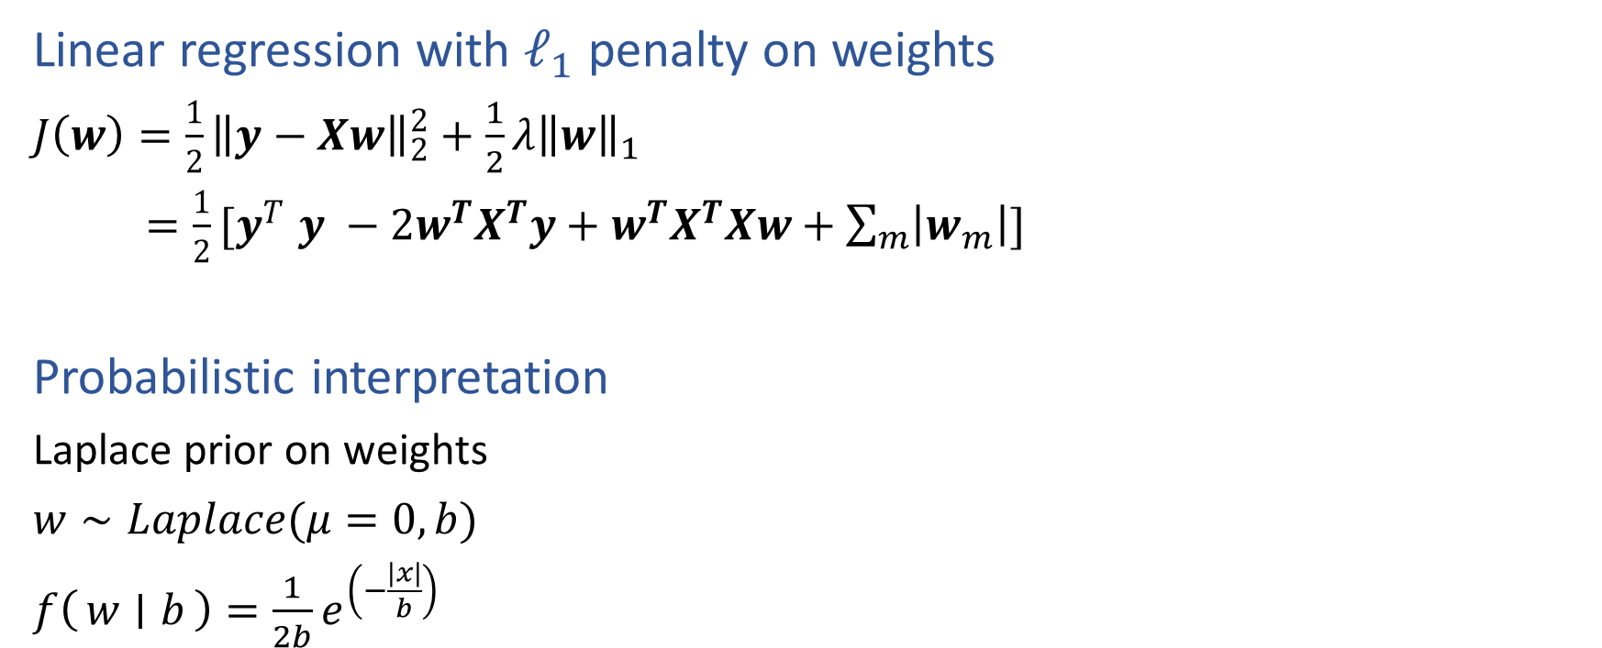
LASSO
Linear regression with $ℓ_{1}$ penalty on weights
$J\left(w\right)=\frac{1}{2}{\left\|y−Xw\right\|}_{2}^{2}+\frac{1}{2}λ{\left\|w\right\|}_{1}$
${=\frac{1}{2}[y}^{T}y −{2w}^{T}X^{T}y+w^{T}X^{T}Xw+\sum_{m}{\left|w_{m}\right|}]$
Probabilistic interpretation
Laplace prior on weights
$w∼Laplace(μ=0, b)$
$f\left(w ∣ b\right)=\frac{1}{2b}e^{\left(−\frac{|x|}{b}\right)}$

