Slide 1

Introduction to
Machine Learning
Regularization
Instructor: Pat Virtue

Slide 2
Announcements
Assignments:
HW2 (written & programming)
    Due Tomorrow, Tue 2/4, 11:59 pm
    FAQ on Piazza
    Come see us for help!
A few logistics:
E-mail Daniel for any logistic related questions, including extensions
    dpbird@andrew.cmu.edu
Public/private Piazza posts
Continuing to improve based on your feedback

Slide 3

Plan
Last time
Wrap up MLE for linear regression
Classification models
(MLE for logistic regression)
Today
Logistic regression
    Updated lecture 5 notes on website
    Jupyter notebook on website
Begin regularization

Slide 4
Logistic Regression
See Lecture 5 slides

Slide 5
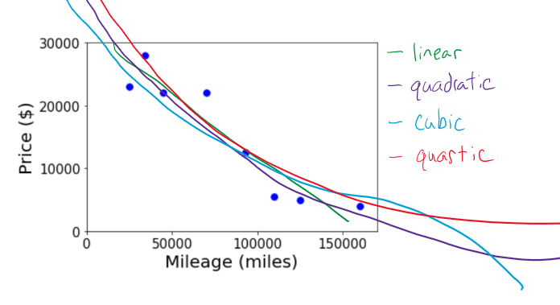
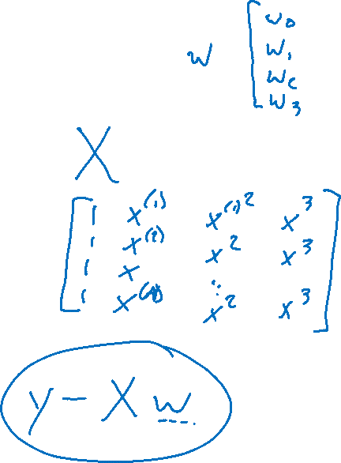
Overfitting with Polynomial Linear Regression
Better fit training data with higher model complexity

Slide 6
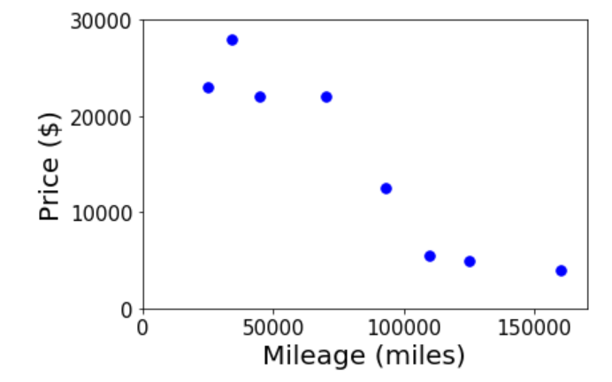
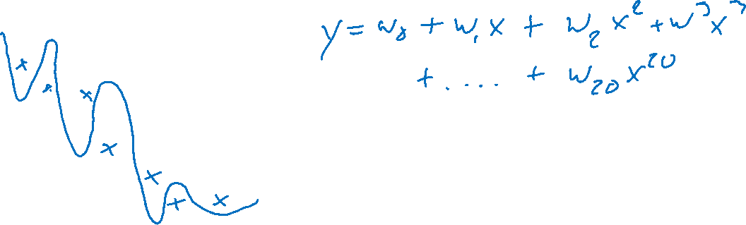
Overfitting with Polynomial Linear Regression
Better fit training data with higher model complexity

Slide 7
Overfitting with Polynomial Linear Regression
How can we deal with overfitting?

Slide 8
Overfitting with Polynomial Linear Regression
What are additional symptoms of overfitting?

Slide 9
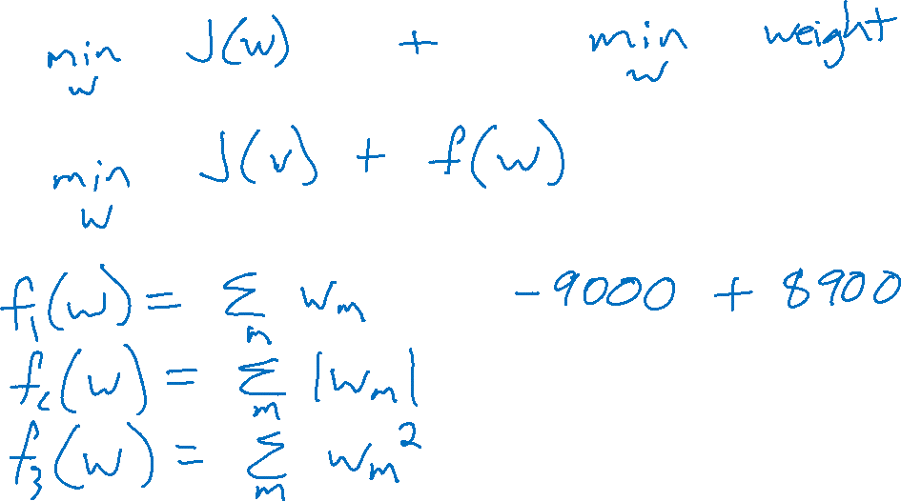
Regularization
Combine original objective with penalty on parameters

Slide 10
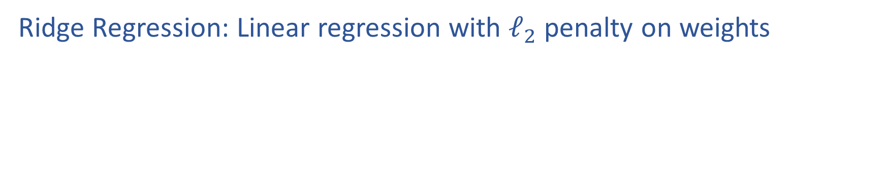
Regularization
Ridge Regression: Linear regression with $ℓ_{2}$ penalty on weights

Slide 11
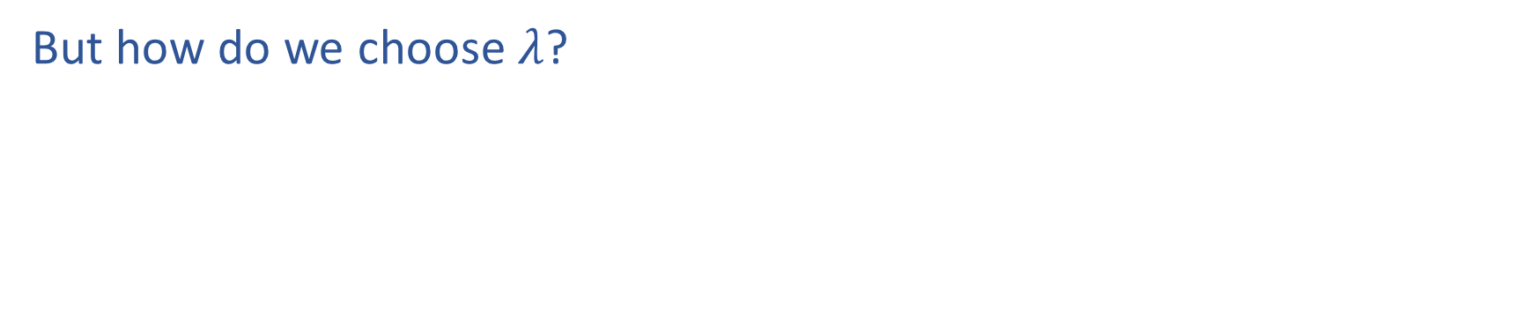
Regularization
But how do we choose $λ$?

