Slide 1
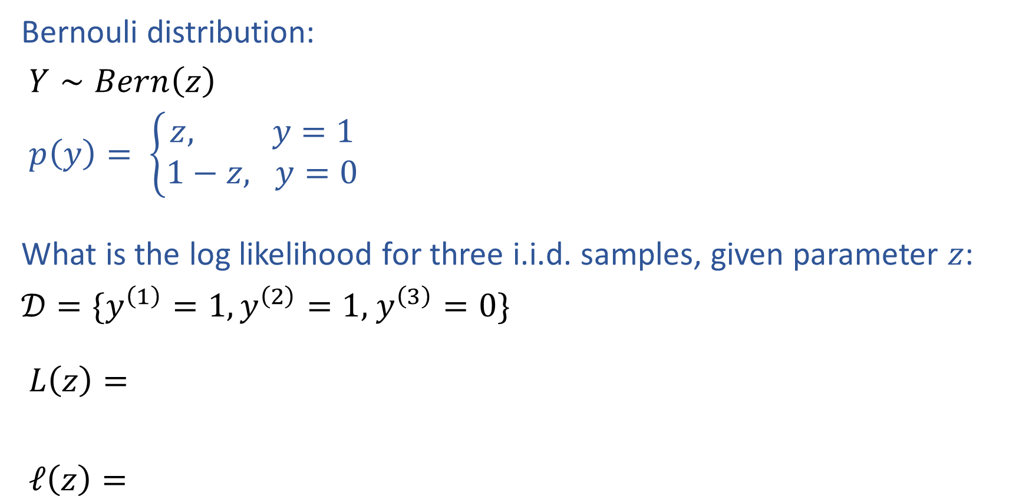
Warm-up as You Walk In
Bernouli distribution:
$Y∼Bern\left(z\right)$
$p\left(y\right)= \left\{\begin{aligned}z, y=1 \\ 1−z, y=0\end{aligned}\right.$
What is the log likelihood for three i.i.d. samples, given parameter $z$:
$𝒟=\{y^{\left(1\right)}=1,y^{\left(2\right)}=1,$ $y^{\left(3\right)}=0\}$
$L\left(z\right)=$
$ℓ\left(z\right)=$

Slide 2
Introduction to
Machine Learning
Logistic Regression
Instructor: Pat Virtue

Slide 3
Announcements
Assignments:
HW2 (written & programming)
    Due Tue 2/4, 11:59 pm
Early Feedback
More mathematical rigor
Consolidated course notes
Lots of concepts, how does it all fit together?

Slide 4
Plan
Last time
Likelihood
Density Estimation
MLE for Density Estimation
Today
Wrap up MLE for linear regression
Classification models
MLE for logistic regression

Slide 5
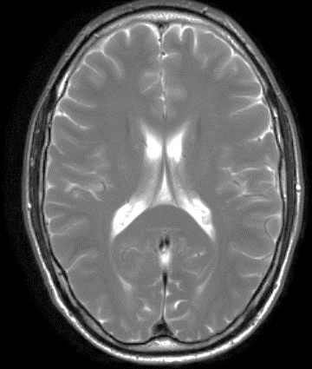


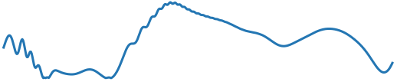
MR Fingerprinting Assumptions
Forgot a really important assumption!!
T1
T2
0
250
500

Slide 6
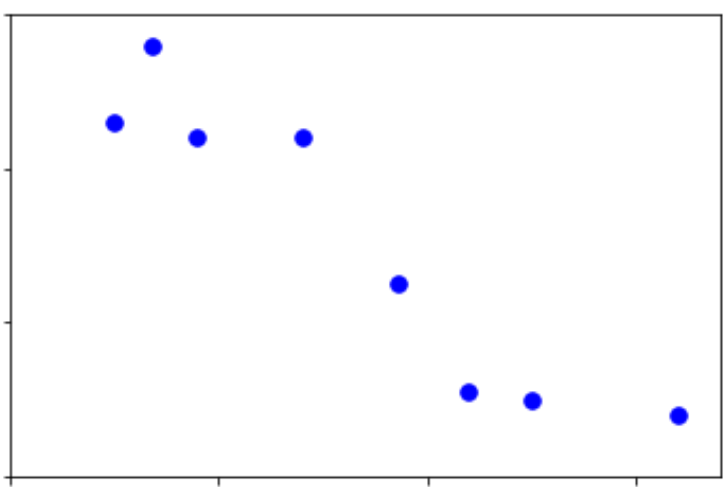
Assumptions
What assumptions do we make with this data?
Output y
Input x

Slide 7
Modelling $f(Y|X, θ)$

Slide 8
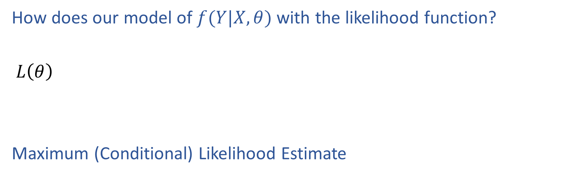
MLE for Linear Regression
How does our model of $f(Y|X, θ)$ with the likelihood function?
$L\left(θ\right)$
Maximum (Conditional) Likelihood Estimate

Slide 9
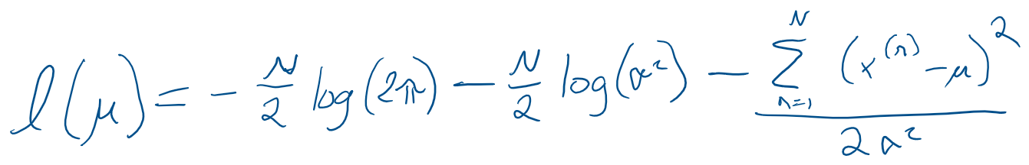
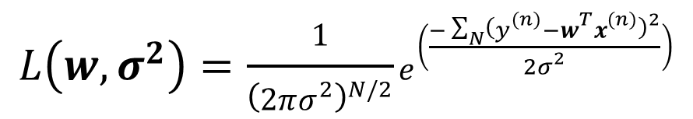
M(C)LE for Linear Regression
$$L\left(w, σ^{2}\right)=\frac{1}{{\left(2πσ^{2}\right)}^{N/2}}e^{\left(\frac{−\sum_{N}{{\left(y^{(n)}−w^{T}x^{(n)}\right)}^{2}}}{2σ^{2}}\right)}$$

Slide 10
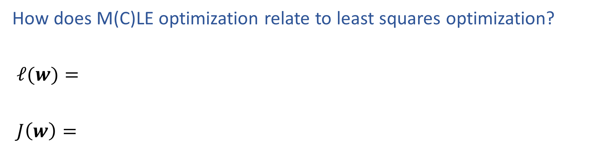
M(C)LE for Linear Regression
How does M(C)LE optimization relate to least squares optimization?
$ℓ(w)=$
$J\left(w\right)=$

Slide 11
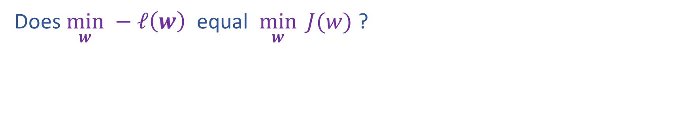
Piazza Poll 2:
Does $\min_{w} −ℓ\left(w\right)$ equal $\min_{w}{ J(w)}$ ?

Slide 12
Linear Regression with Multiple Input Features

Slide 13
Poll 1: Which vector is the correct $θ$?

Slide 14
Classification Models
Linear Regression

Slide 15
Classification Models
Linear Regression with Decision Boundary

Slide 16
Classification Models
Linear Regression with Probability

Slide 17
Modelling $p(Y|X, θ)$
Bernoulli distribution of logistic function of linear model

Slide 18
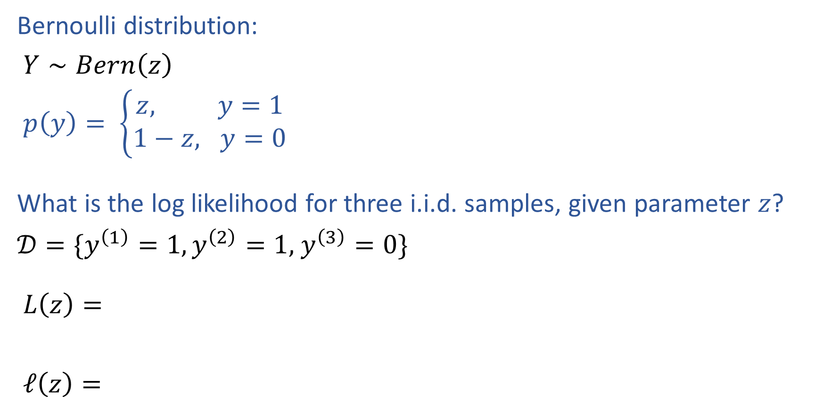
MLE for Bernoulli
Bernoulli distribution:
$Y∼Bern\left(z\right)$
$p\left(y\right)= \left\{\begin{aligned}z, y=1 \\ 1−z, y=0\end{aligned}\right.$
What is the log likelihood for three i.i.d. samples, given parameter $z$?
$𝒟=\{y^{\left(1\right)}=1,y^{\left(2\right)}=1,$ $y^{\left(3\right)}=0\}$
$L\left(z\right)=$
$ℓ\left(z\right)=$

Slide 19
MLE for Bernoulli
Bernoulli distribution:
$Y∼Bern\left(z\right)$
$p\left(y\right)= \left\{\begin{aligned}z, y=1 \\ 1−z, y=0\end{aligned}\right.$
What is the log likelihood for three i.i.d. samples, given parameter $z$?
$𝒟=\{y^{\left(1\right)}=1,y^{\left(2\right)}=1,$ $y^{\left(3\right)}=0\}$
$L\left(z\right)=$
$ℓ\left(z\right)=$

Slide 20
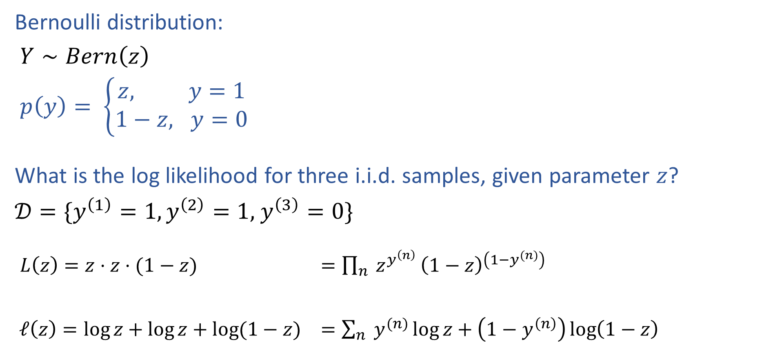
MLE for Bernoulli
Bernoulli distribution:
$Y∼Bern\left(z\right)$
$p\left(y\right)= \left\{\begin{aligned}z, y=1 \\ 1−z, y=0\end{aligned}\right.$
What is the log likelihood for three i.i.d. samples, given parameter $z$?
$𝒟=\{y^{\left(1\right)}=1,y^{\left(2\right)}=1,$ $y^{\left(3\right)}=0\}$
$L\left(z\right)=z⋅z⋅(1−z)$ $=\prod_{n}{ z^{y^{\left(n\right)}}}{\left(1−z\right)}^{\left(1−y^{(n)}\right)}$
$ℓ\left(z\right)=\log{z}+\log{z}+\log{(1−z)}$ $=\sum_{n}{ y^{(n)}\log{z}}+\left(1−y^{\left(n\right)}\right)\log\left(1−z\right)$

Slide 21
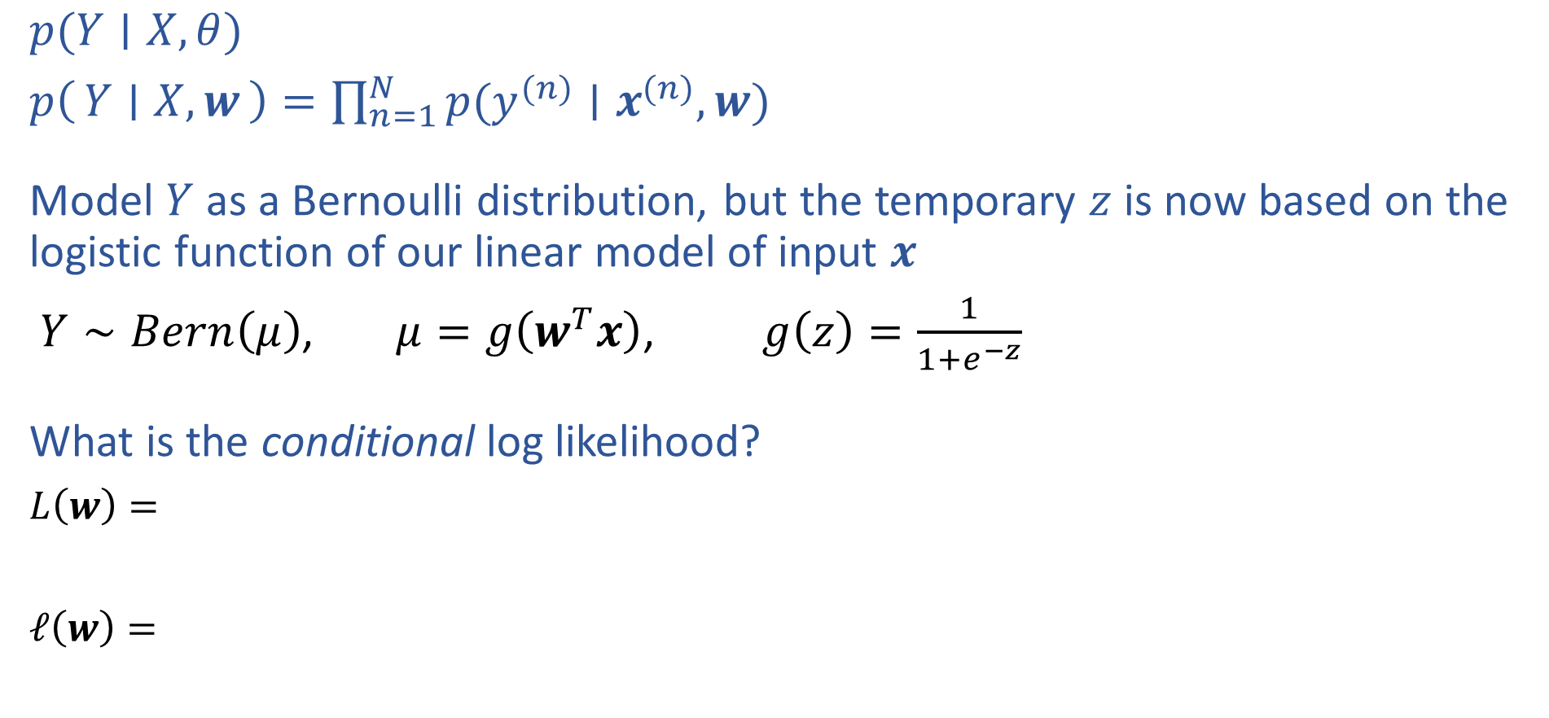
M(C)LE for Logistic Regression
$p(Y∣X, θ)$
$p\left(Y ∣ X, w\right)=\prod_{n=1}^{N}{p(y^{(n)}∣x^{(n)}, w)}$
Model $Y$ as a Bernoulli distribution, but the temporary $z$ is now based on the logistic function of our linear model of input $x$
$Y∼Bern\left(μ\right)$, $μ=g\left(w^{T}x\right)$, $g\left(z\right)=\frac{1}{1+e^{−z}}$
What is the conditional log likelihood?
$L\left(w\right)=$
$ℓ\left(w\right)=$

Slide 22
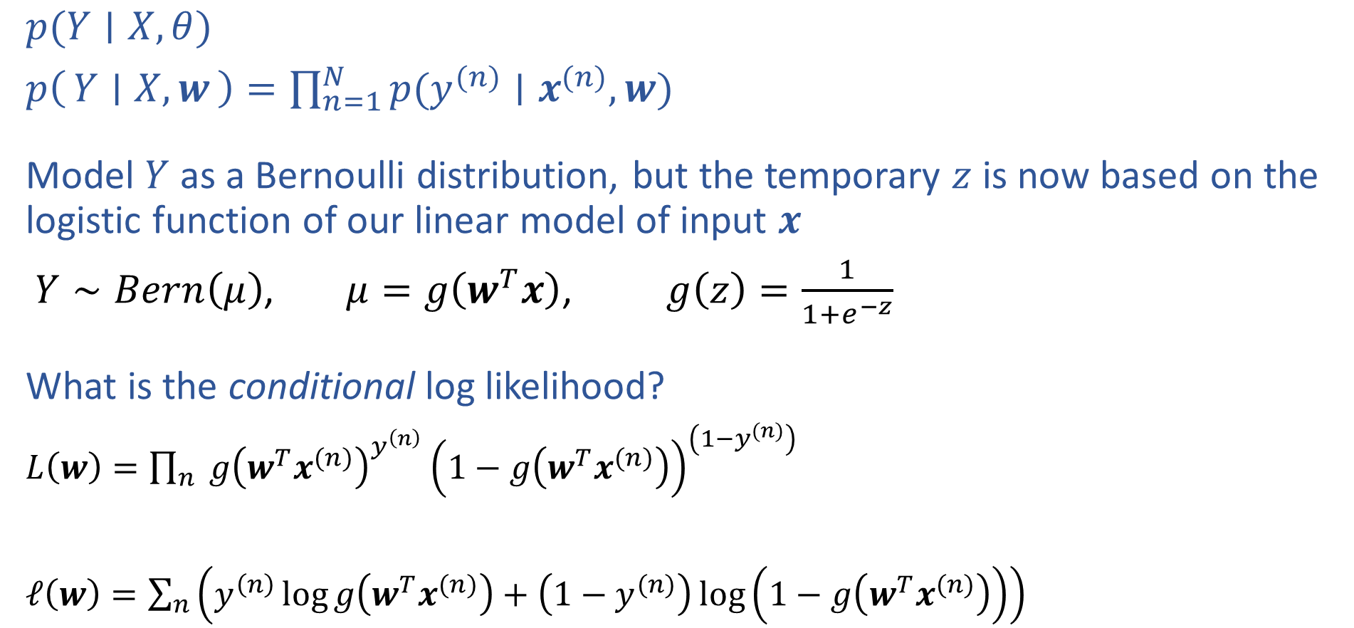
M(C)LE for Logistic Regression
$p(Y∣X, θ)$
$p\left(Y ∣ X, w\right)=\prod_{n=1}^{N}{p(y^{(n)}∣x^{(n)}, w)}$
Model $Y$ as a Bernoulli distribution, but the temporary $z$ is now based on the logistic function of our linear model of input $x$
$Y∼Bern\left(μ\right)$, $μ=g\left(w^{T}x\right)$, $g\left(z\right)=\frac{1}{1+e^{−z}}$
What is the conditional log likelihood?
$L\left(w\right)=\prod_{n}{ {g\left(w^{T}x^{(n)}\right)}^{y^{\left(n\right)}}}{\left(1−g\left(w^{T}x^{(n)}\right)\right)}^{\left(1−y^{(n)}\right)}$
$ℓ\left(w\right)=\sum_{n}{\left(y^{\left(n\right)}\log{g\left(w^{T}x^{(n)}\right)}+\left(1−y^{(n)}\right)\log\left(1−g\left(w^{T}x^{(n)}\right)\right)\right)}$

Slide 23
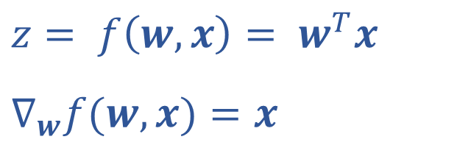
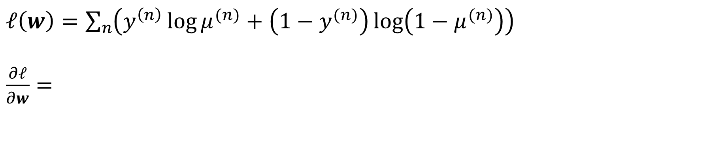
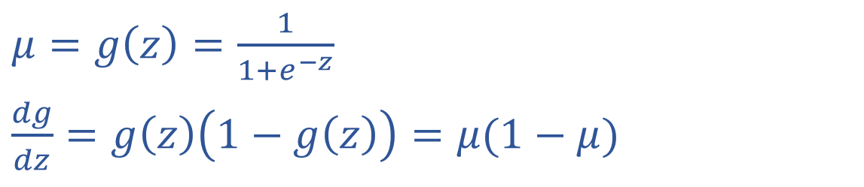
M(C)LE for Logistic Regression
$z= f\left(w, x\right)= w^{T}x$
$∇_{w}f(w, x)=x$
$μ=g\left(z\right)=\frac{1}{1+e^{−z}}$
$\frac{dg}{dz}=g\left(z\right)\left(1−g\left(z\right)\right)=μ(1−μ)$
$ℓ\left(w\right)=\sum_{n}{\left(y^{\left(n\right)}\log{μ^{(n)}}+\left(1−y^{(n)}\right)\log\left(1−μ^{(n)}\right)\right)}$
$\frac{∂ℓ}{∂w}=$

Slide 24
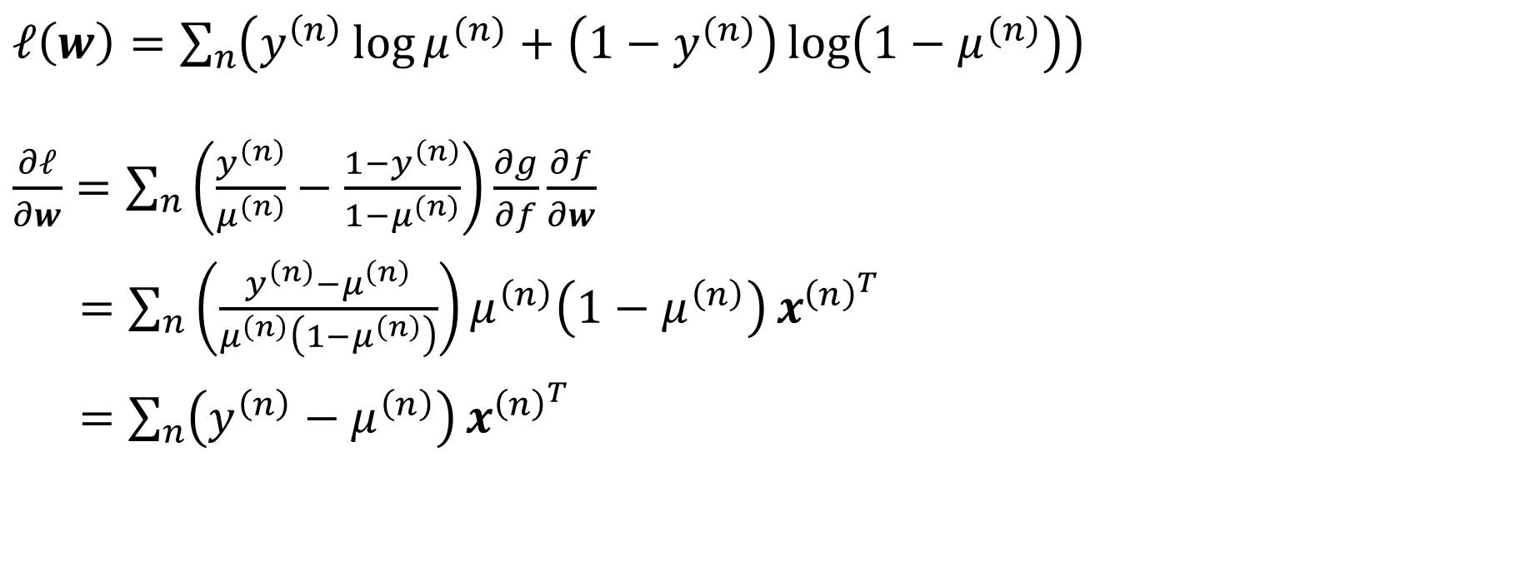
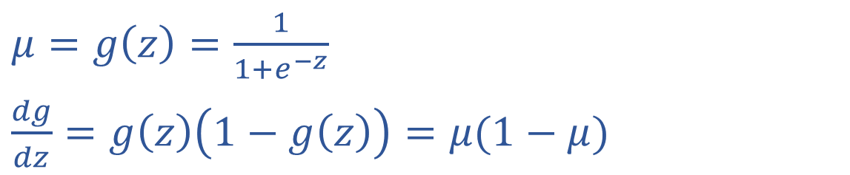
M(C)LE for Logistic Regression
$z= f\left(w, x\right)= w^{T}x$
$∇_{w}f(w, x)=x$
$μ=g\left(z\right)=\frac{1}{1+e^{−z}}$
$\frac{dg}{dz}=g\left(z\right)\left(1−g\left(z\right)\right)=μ(1−μ)$
$ℓ\left(w\right)=\sum_{n}{\left(y^{\left(n\right)}\log{μ^{(n)}}+\left(1−y^{(n)}\right)\log\left(1−μ^{(n)}\right)\right)}$
$\frac{∂ℓ}{∂w}=\sum_{n}{\left(\frac{y^{\left(n\right)}}{μ^{(n)}}−\frac{1−y^{\left(n\right)}}{1−μ^{(n)}}\right)\frac{∂g}{∂f}}\frac{∂f}{∂w}$
$=\sum_{n}{\left(\frac{y^{\left(n\right)}−μ^{\left(n\right)}}{μ^{\left(n\right)}\left(1−μ^{\left(n\right)}\right)}\right)μ^{\left(n\right)}\left(1−μ^{\left(n\right)}\right)}x^{{\left(n\right)}^{T}}$
$=\sum_{n}{\left(y^{\left(n\right)}−μ^{\left(n\right)}\right)}x^{{\left(n\right)}^{T}}$

Slide 25

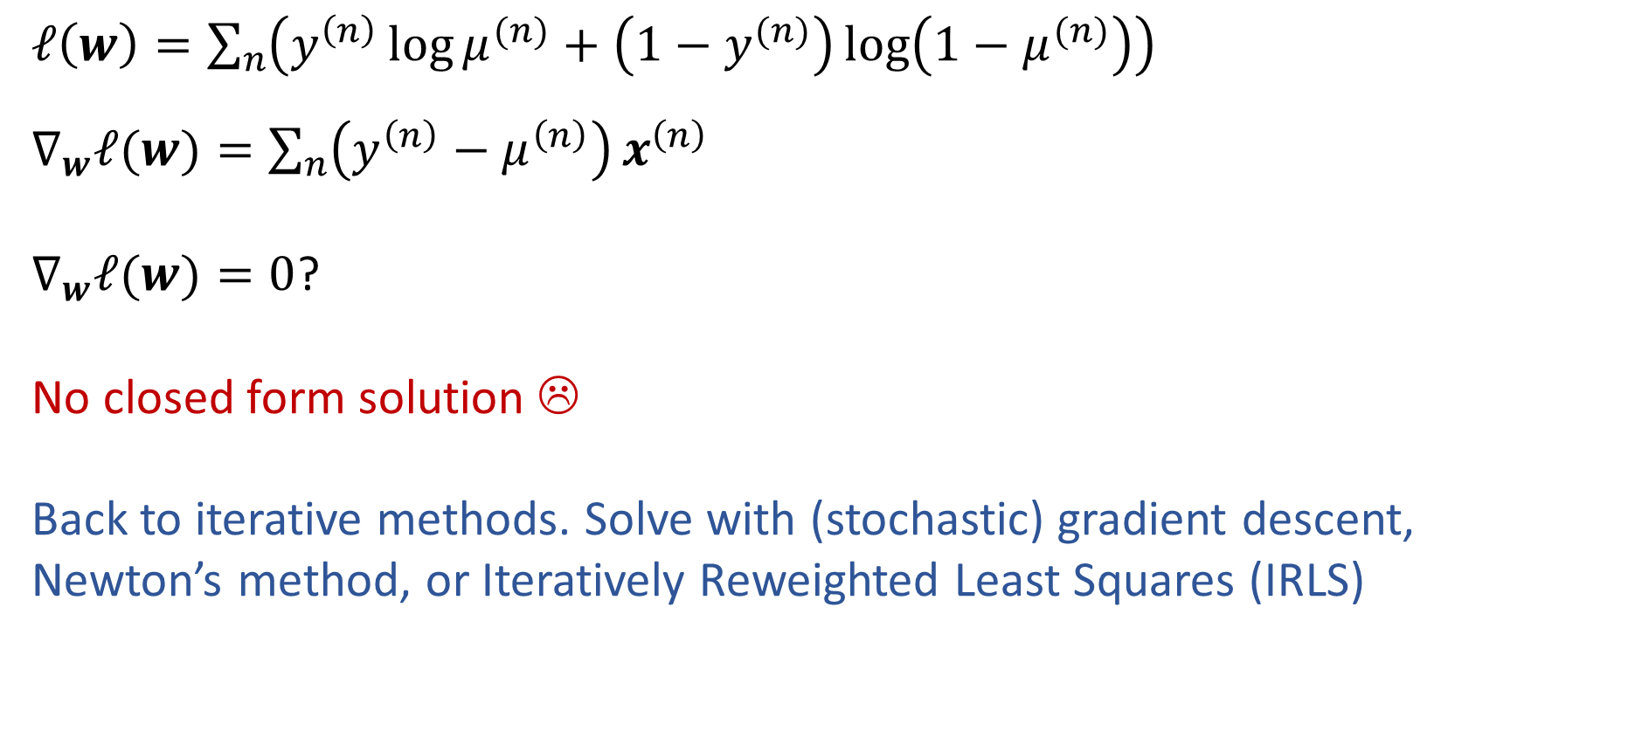
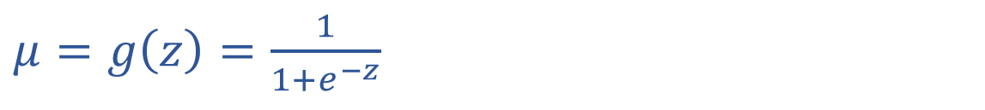
M(C)LE for Logistic Regression
$z= f\left(w, x\right)= w^{T}x$
$μ=g\left(z\right)=\frac{1}{1+e^{−z}}$
$ℓ\left(w\right)=\sum_{n}{\left(y^{\left(n\right)}\log{μ^{(n)}}+\left(1−y^{(n)}\right)\log\left(1−μ^{(n)}\right)\right)}$
$∇_{w}ℓ(w)=\sum_{n}{\left(y^{\left(n\right)}−μ^{\left(n\right)}\right)}x^{\left(n\right)}$
$∇_{w}ℓ(w)=0$?
No closed form solution ☹
Back to iterative methods. Solve with (stochastic) gradient descent, Newton’s method, or Iteratively Reweighted Least Squares (IRLS)

Slide 26
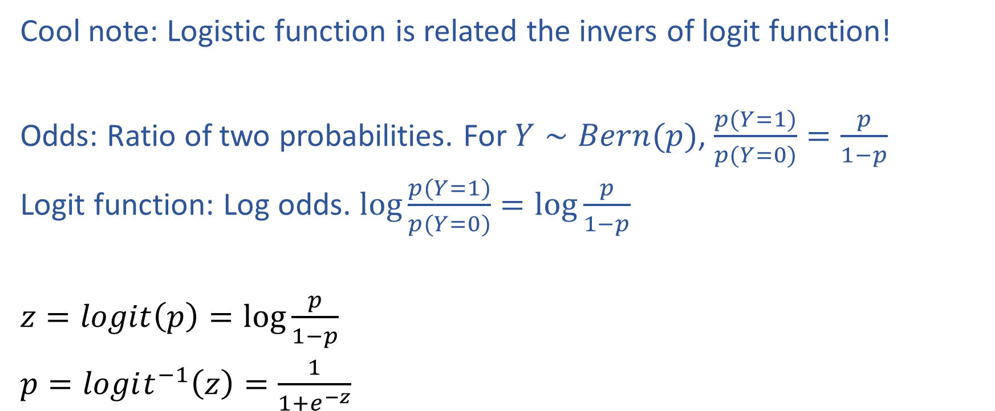
Logistic Function
Cool note: Logistic function is related the invers of logit function!
Odds: Ratio of two probabilities. For $Y∼Bern(p)$, $\frac{p(Y=1)}{p(Y=0)}=\frac{p}{1−p}$
Logit function: Log odds. $log\frac{p(Y=1)}{p(Y=0)}=\log{\frac{p}{1−p}}$
$z=logit\left(p\right)=\log{\frac{p}{1−p}}$
$p=logit^{−1}\left(z\right)=\frac{1}{1+e^{−z}}$

Slide 27
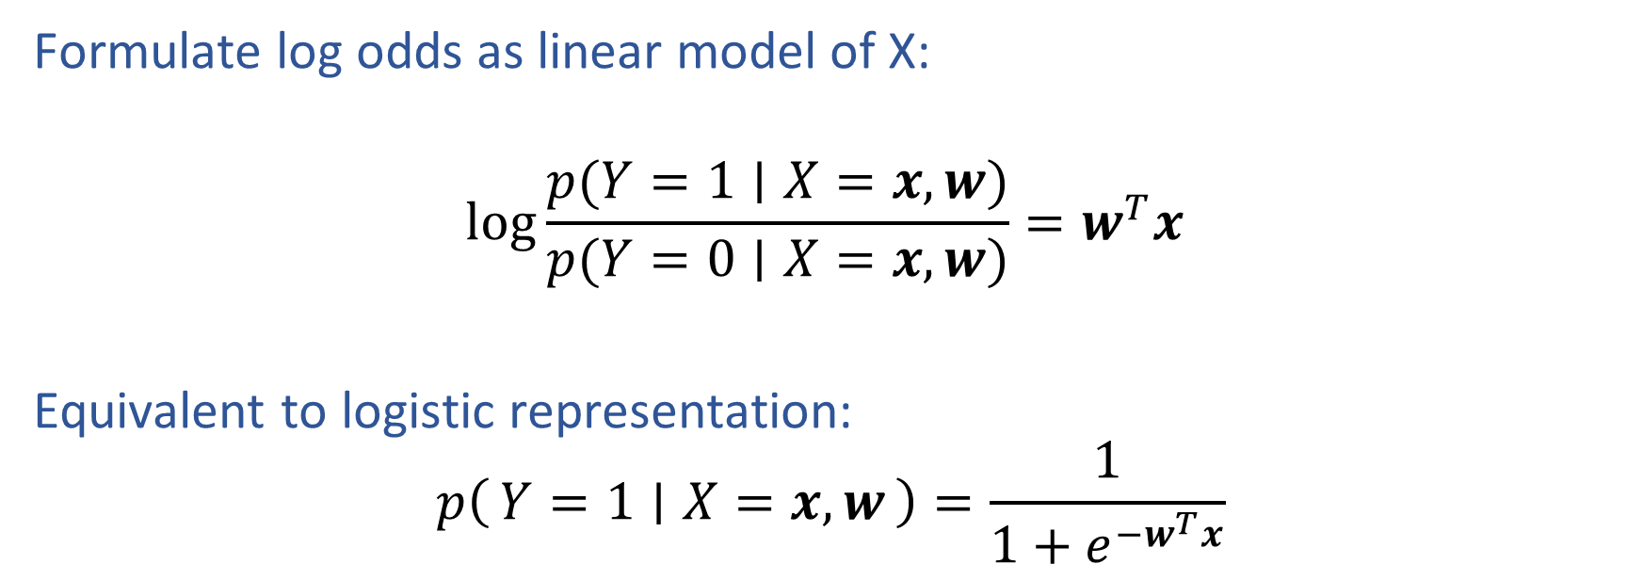
Log Odds and Logistic Regression
Formulate log odds as linear model of X:
$$log\frac{p(Y=1∣X=x,w)}{p(Y=0∣X=x,w)}=w^{T}x$$
Equivalent to logistic representation:
$$p\left(Y=1 ∣ X=x, w\right)=\frac{1}{1+e^{−w^{T}x}}$$

Slide 28
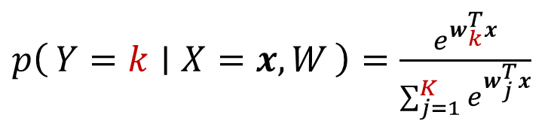
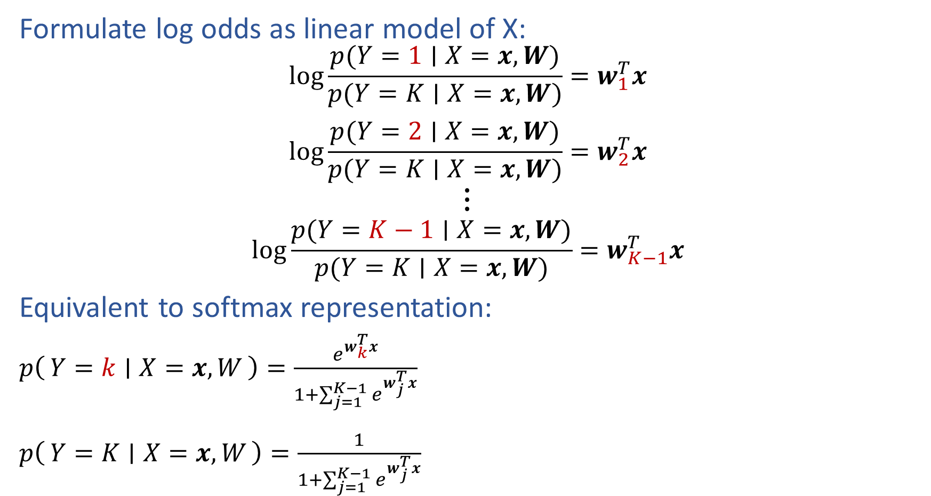
Log Odds and Logistic Regression (Multi-class!)
Formulate log odds as linear model of X:
$$log\frac{p(Y=1∣X=x,W)}{p(Y=K∣X=x,W)}=w_{1}^{T}x$$
$$log\frac{p(Y=2∣X=x,W)}{p(Y=K∣X=x,W)}=w_{2}^{T}x$$
$$⋮$$
$$log\frac{p(Y=K−1∣X=x,W)}{p(Y=K∣X=x,W)}=w_{K−1}^{T}x$$
Equivalent to softmax representation:
$p\left(Y=k ∣ X=x, W\right)=\frac{e^{w_{k}^{T}x}}{1+\sum_{j=1}^{K−1}{e^{w_{j}^{T}x}}}$
$p\left(Y=K ∣ X=x, W\right)=\frac{1}{1+\sum_{j=1}^{K−1}{e^{w_{j}^{T}x}}}$
$p\left(Y=k ∣ X=x, W\right)=\frac{e^{w_{k}^{T}x}}{\sum_{j=1}^{K}{e^{w_{j}^{T}x}}}$
OR

Slide 29
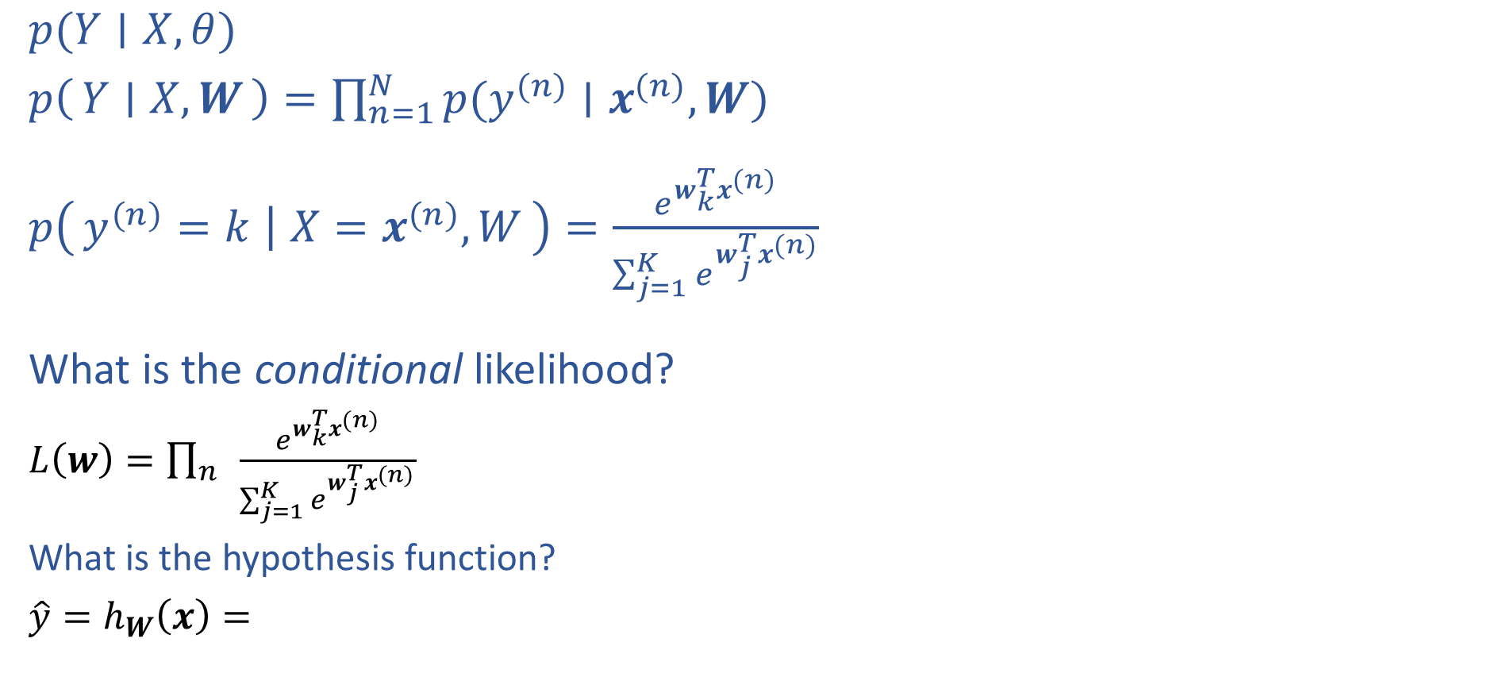
Multi-class Logistic Regression
$p(Y∣X, θ)$
$p\left(Y ∣ X, W\right)=\prod_{n=1}^{N}{p(y^{(n)}∣x^{(n)}, W)}$
$p\left(y^{(n)}=k ∣ X=x^{(n)}, W\right)=\frac{e^{w_{k}^{T}x^{(n)}}}{\sum_{j=1}^{K}{e^{w_{j}^{T}x^{(n)}}}}$
What is the conditional likelihood?
$L\left(w\right)=\prod_{n}{ }\frac{e^{w_{k}^{T}x^{(n)}}}{\sum_{j=1}^{K}{e^{w_{j}^{T}x^{(n)}}}}$
What is the hypothesis function?
$\hat{y}=h_{W}\left(x\right)=$

