Slide 1
Announcements
Assignments
HW10 (programming + “written”)
    Due Thu 4/30, 11:59 pm
Final Exam
Stay tuned to Piazza for details
Date: Mon 5/11, 5:30 – 8:30 pm
Format: “online assignment” in Gradescope
Practice exam: Out later this week
Recitation this Friday: Review session

Slide 2
Announcements
Course Evaluation Survey
https://cmu.smartevals.com/
Take time now to fill this out please

Slide 3
Piazza Poll 1
Did you fill out the FCE survey?
Yes
Why not?

Slide 4
Introduction to
Machine Learning
Ensemble Methods
Instructor: Pat Virtue

Slide 5
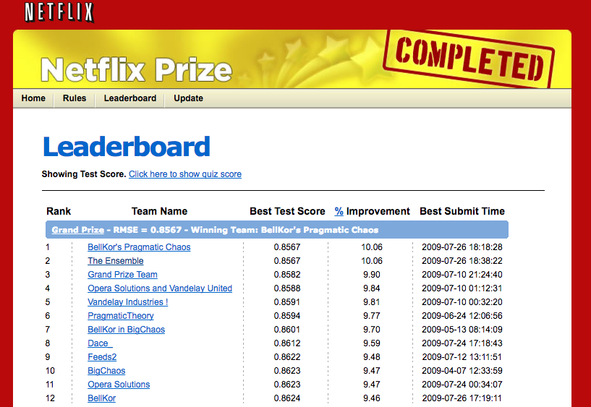
Recommender Systems
Top performing systems were ensembles
Slide credit: CMU MLD Matt Gormley

Slide 6
Ensemble Methods
Given: pool A of learners (that you know nothing about)
Goal: design a new learner that uses the predictions of the pool to make new predictions
Techniques
Bagging (Bootstraping)
    e.g. Random Forests
Boosting
    e.g. Adaboost

Slide 7
Bagging
[Breiman, 1996]
Run independent weak learners on bootstrap replicates (sample with replacement) of the training set
Average/vote over weak hypotheses

Slide 8
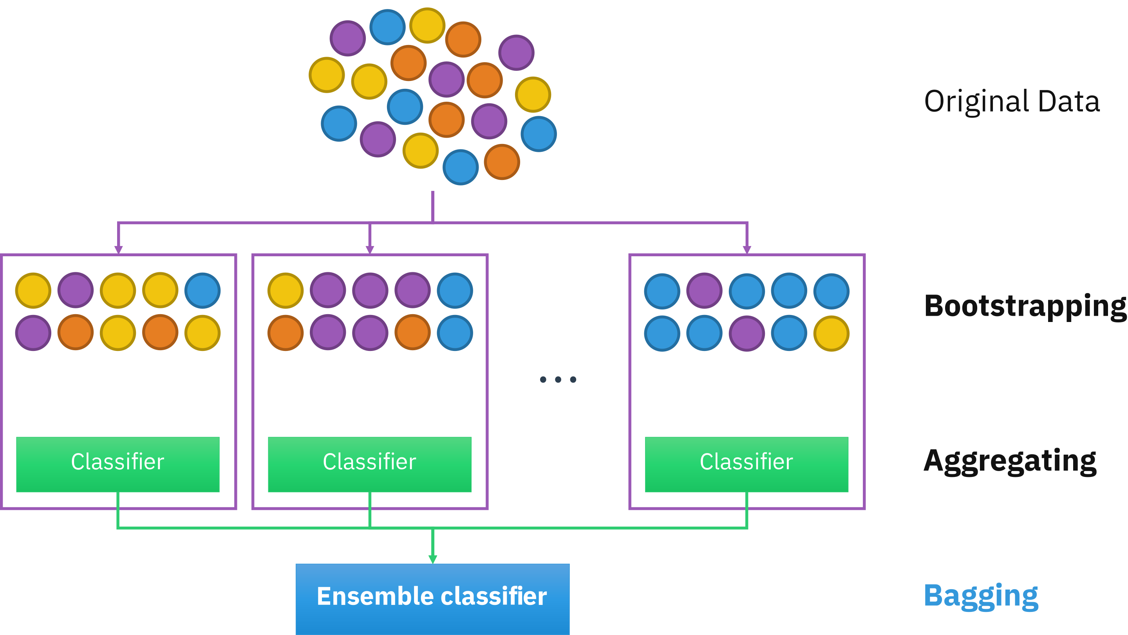
Bagging
Image: https://en.m.wikipedia.org/wiki/Bootstrap_aggregating

Slide 9
Random Forests
Bagging over Features
A collection of decision trees
For each tree we select a subset of the attributes (recommended square root of |A|) and build tree using just these attributes
An input sample is classified using majority voting
TAP
GeneExpress
GeneExpress
Y2H
GeneExpress
Domain
GOProcess
N
HMS_PCI
N
SynExpress
HMS-PCI
Y2H
ProteinExpress
GeneOccur
Y
GOLocalization
Y
ProteinExpress
Slide credit: CMU MLD Ameet Talwalkar

Slide 10
Weighted Majority Algorithm
(Littlestone & Warmuth, 1994)
Given: pool A of binary classifiers (that you know nothing about)
Goal: design a new learner that uses the predictions of the pool to make new predictions
Algorithm:
  Initially weight all classifiers equally
  Receive a training example and predict the (weighted) majority vote of the classifiers in the pool
  Down-weight classifiers that contribute to a mistake by a factor of β
Slide credit: CMU MLD Matt Gormley

Slide 11
Weighted Majority Algorithm
(Littlestone & Warmuth, 1994)

Slide 12
Weighted Majority Algorithm
(Littlestone & Warmuth, 1994)

Slide 13
Adaboost

Slide 14
Comparison
Weighted Majority Algorithm
AdaBoost
an example of an ensemble method
assumes the classifiers are learned ahead of time
only learns (majority vote) weight for each classifiers
an example of a boosting method
simultaneously learns:
  the classifiers themselves
  (majority vote) weight for each classifiers
Slide credit: CMU MLD Matt Gormley

Slide 15
AdaBoost: Toy Example
Slide from Schapire NIPS Tutorial

Slide 16
AdaBoost: Toy Example
Slide from Schapire NIPS Tutorial

Slide 17
AdaBoost: Toy Example
Slide from Schapire NIPS Tutorial

Slide 18
AdaBoost: Toy Example
Slide from Schapire NIPS Tutorial

Slide 19
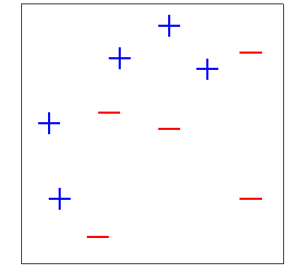







Piazza Poll 2-4
$$H_{final}=sign( 0.42$$
$$+0.65$$
$$+0.92$$
$$)$$
What is the final classification of points 2, 3, 4?
$$4$$
$$2$$
$$3$$
Slide from Schapire NIPS Tutorial

Slide 20
AdaBoost: Toy Example
Slide from Schapire NIPS Tutorial

Slide 21
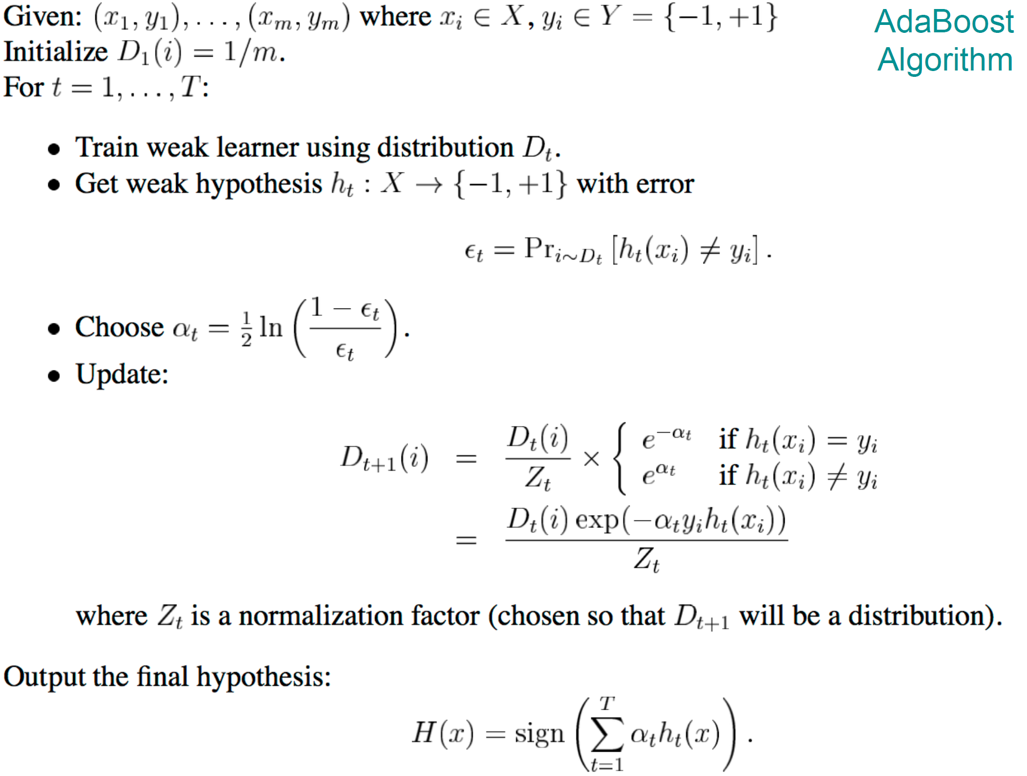
AdaBoost
Algorithm from Freund & Schapire, 1999

Slide 22
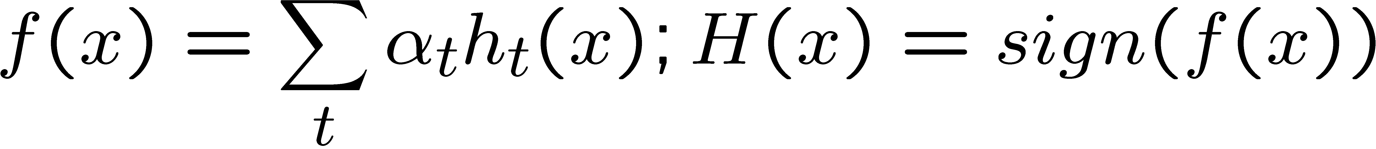
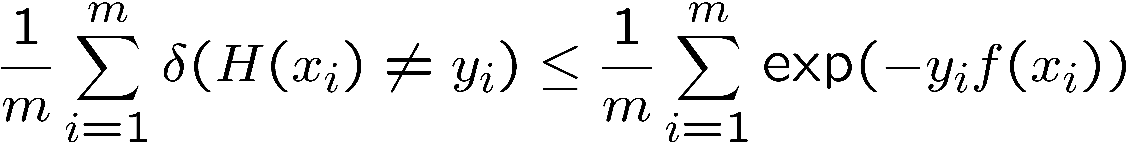
Analysis for Boosting
Choice of α_{t} and hypothesis h_{t} obtained by coordinate descent on exp loss (convex upper bound on 0/1 loss)
exp loss
0/1 loss
1
0/1 loss
exp loss
0
Analysis from Freund & Schapire, 1999

Slide 23
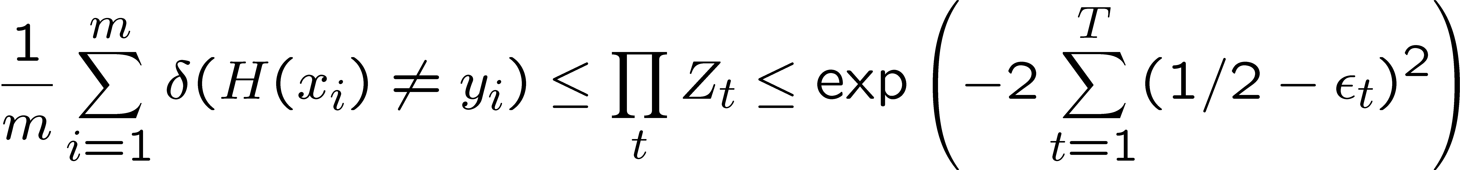
Analysis for Boosting
Analysis reveals:
If each weak learner h_{t} is slightly better than random guessing (ε_{t} < 0.5),
then training error of AdaBoost decays exponentially fast in number of rounds T.
Training Error
What about test error?
Analysis from Freund & Schapire, 1999

Slide 24
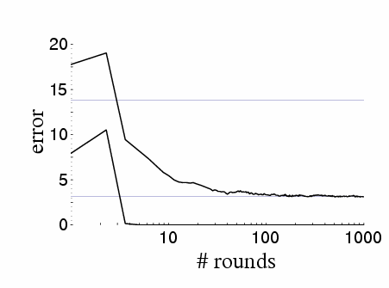
Boosting results – Digit recognition
[Schapire, 1989]
Test Error
Training Error
Boosting often,
  Robust to overfitting
  Test set error decreases even after training error is zero
  If margin between classes is large, subsequent weak learners agree and hence more rounds does not necessarily imply that final classifier is getting more complex.

Slide 25
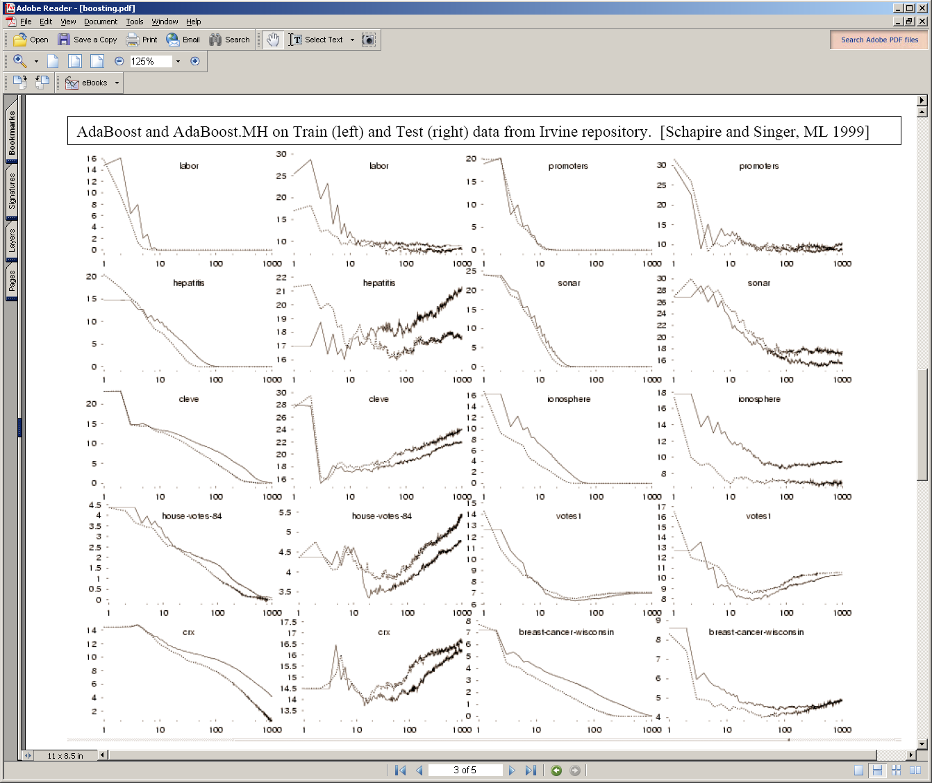
Train
Test
Train
Test
Overfits
Train→0
Test→
Overfits
Boosting can overfit if margin between classes is too small (high label noise) or weak learners are too complex.

Slide 26
AdaBoost
Algorithm from Freund & Schapire, 1999

Slide 27
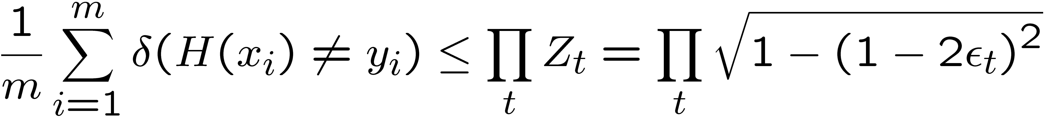
Dumb classifiers made Smart
Training error of final classifier is bounded by:
grows as ε_{t} moves
away from 1/2
If each classifier is (at least slightly) better than random ε_{t} < 0.5
AdaBoost will achieve zero training error exponentially fast (in number of rounds T) !!
What about test error?

Slide 28
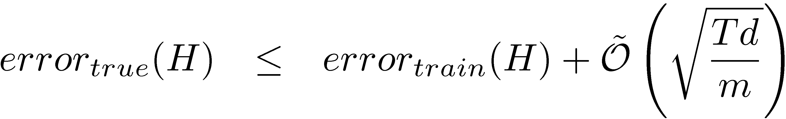
Generalization Error Bounds
[Freund & Schapire’95]
With high
probability

Slide 29
Generalization Error Bounds
[Freund & Schapire’95]
With high
probability
Boosting can overfit if T is large
Boosting often, Contradicts experimental results
  Robust to overfitting
  Test set error decreases even after training error is zero
  Need better analysis tools – margin based bounds
Slide credit: CMU MLD Aarti Singh and Carlos Guestrin

Slide 30
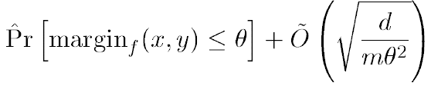
Margin Based Bounds
[Schapire, Freund, Bartlett, Lee’98]
With high
probability
  Boosting increases the margin very aggressively since it concentrates on the hardest examples.
  If margin is large, more weak learners agree and hence more rounds does not necessarily imply that final classifier is getting more complex.
  Bound is independent of number of rounds T!
  Boosting can still overfit if margin is too small (can perform arbitrarily close to random guessing) or weak learners are too complex
Slide credit: CMU MLD Aarti Singh and Carlos Guestrin

Slide 31
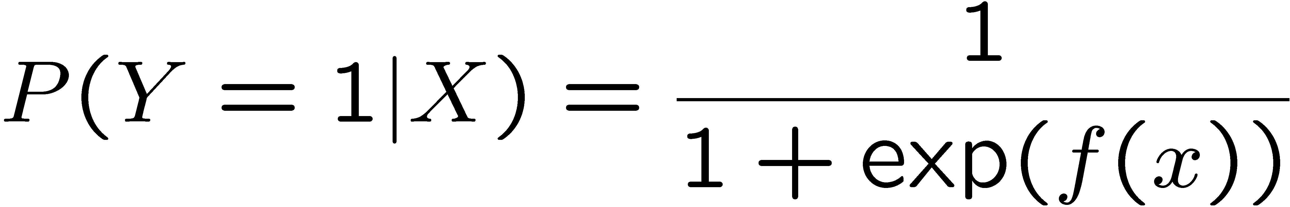
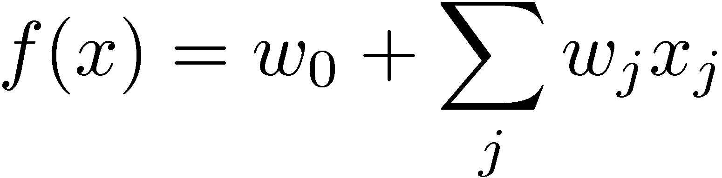
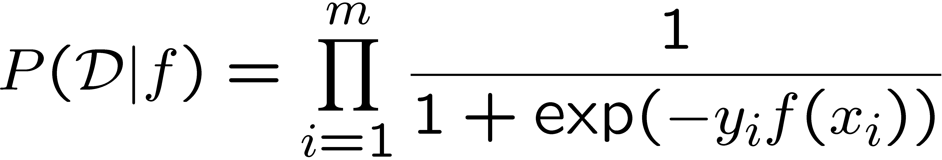
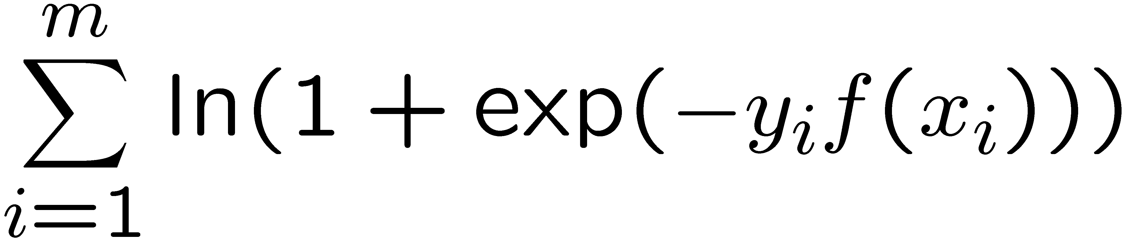
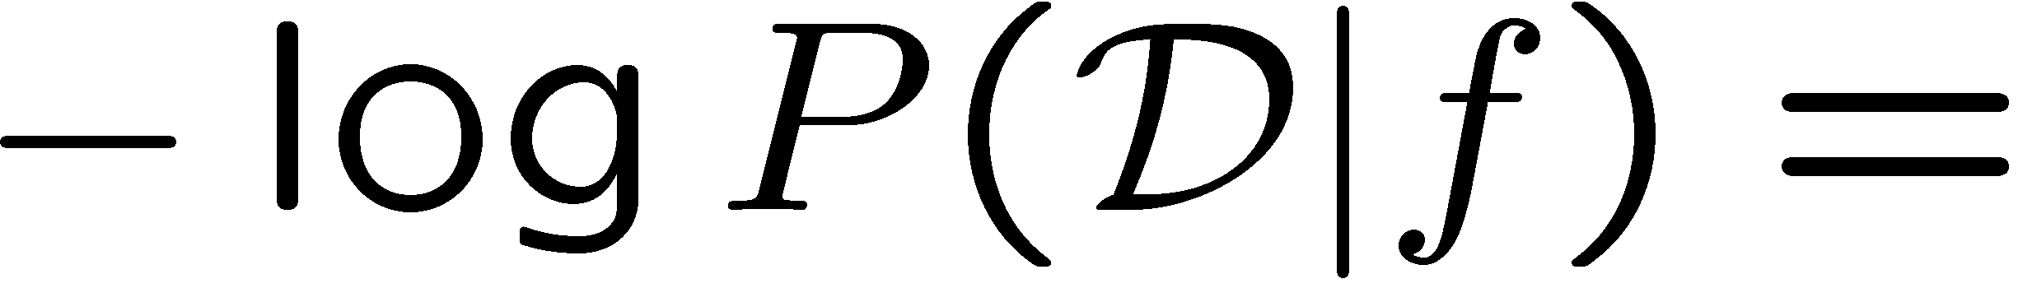
Boosting and Logistic Regression
Logistic regression assumes:
And tries to maximize data likelihood:
Equivalent to minimizing log loss
iid
Slide credit: CMU MLD Aarti Singh and Carlos Guestrin

Slide 32
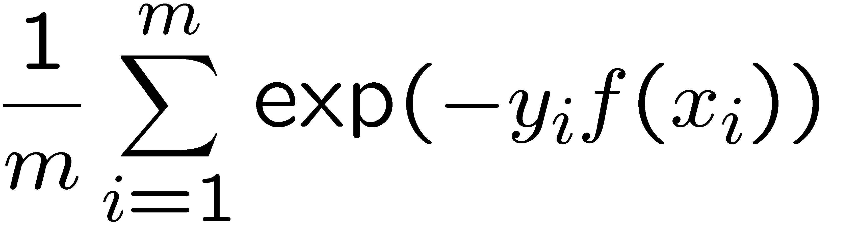

Boosting and Logistic Regression
Logistic regression equivalent to minimizing log loss
Boosting minimizes similar loss function!!
Analysis from:
Schapire. MSRI Workshop on Nonlinear Estimation and Classification, 2002.
Weighted average of weak learners
log loss
exp loss
Both smooth approximations
of 0/1 loss!
0/1 loss
1
0

Slide 33
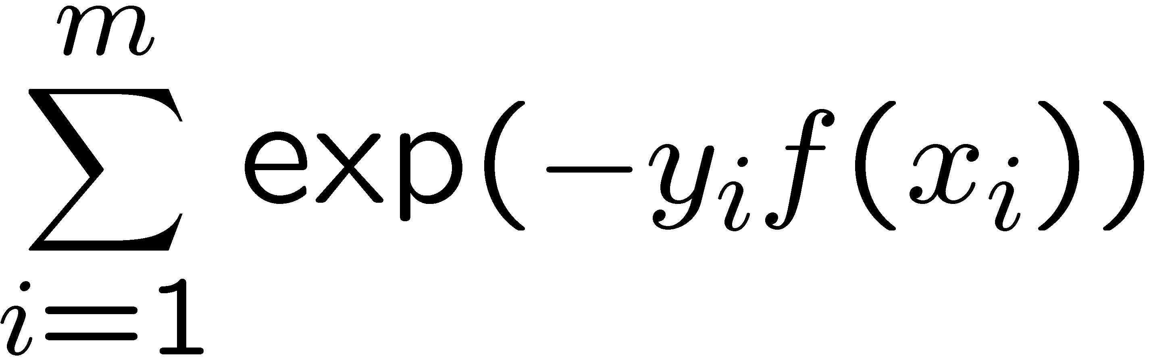
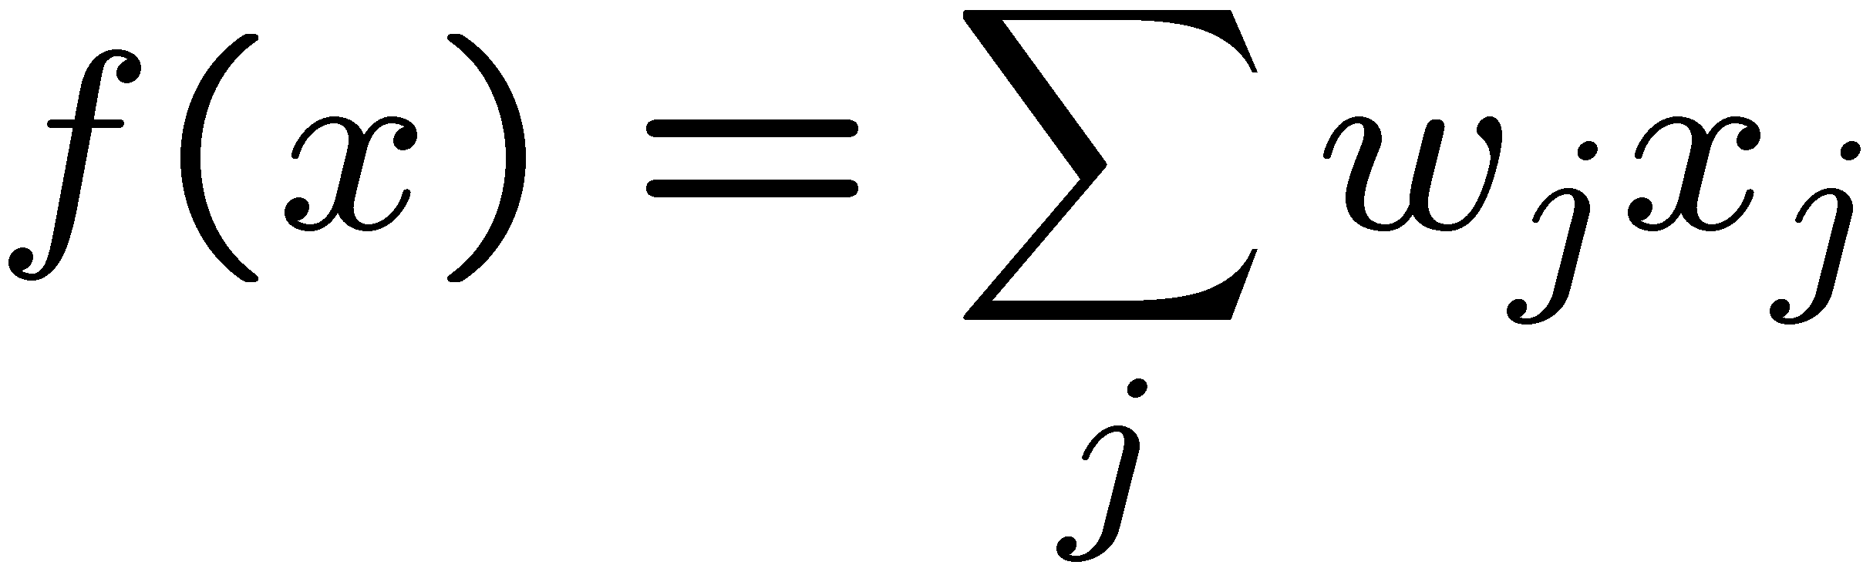
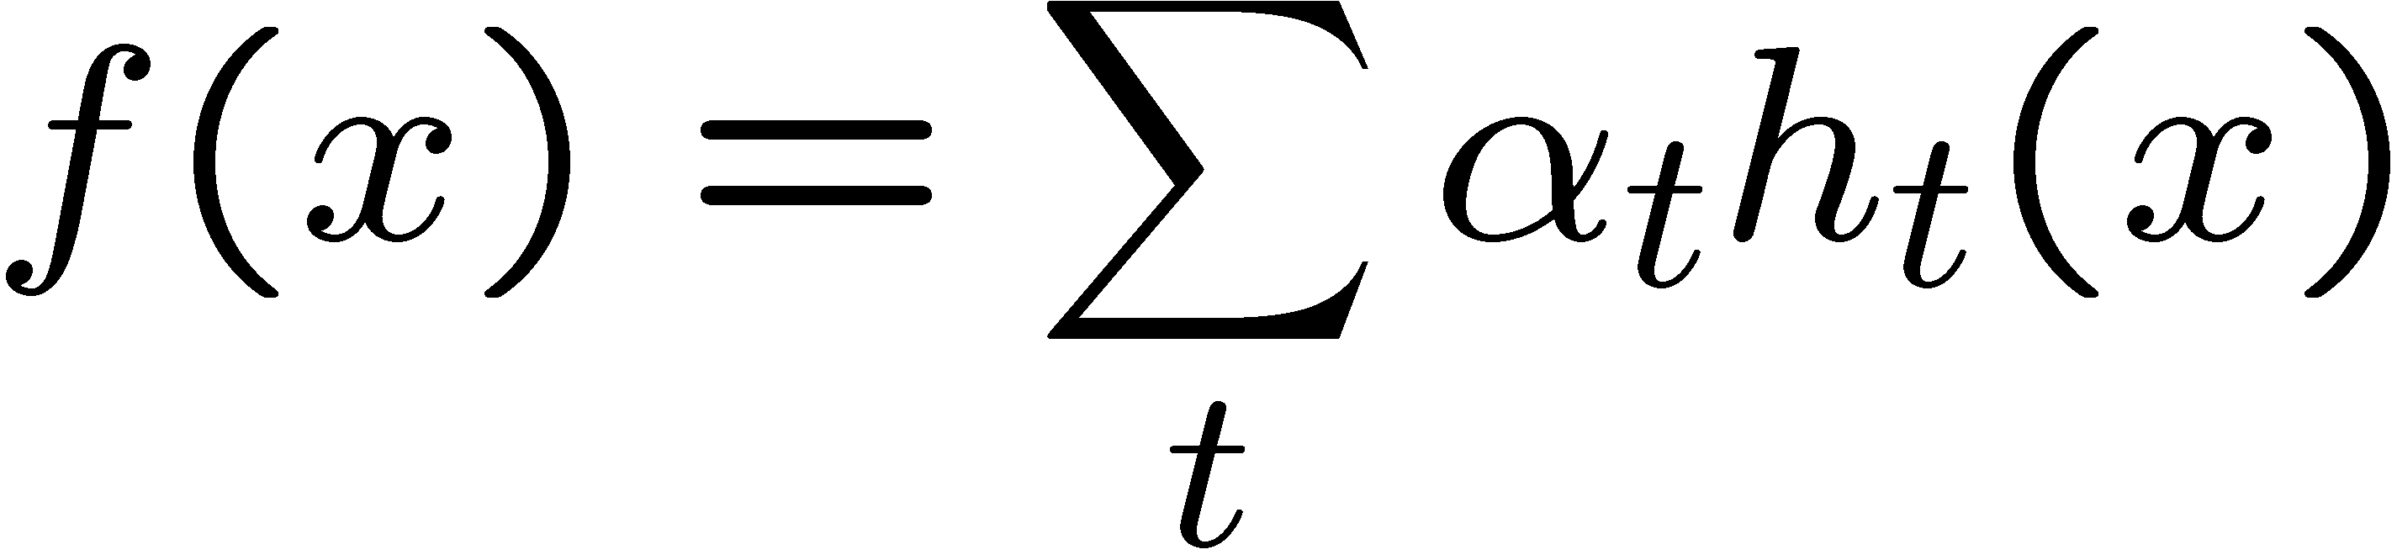
Boosting and Logistic Regression
Logistic regression:
Minimize log loss
Define
where x_{j} predefined features
(linear classifier)
Jointly optimize over all weights w0, w1, w2…
Boosting:
Minimize exp loss
Define
where h_{t}(x) defined dynamically
to fit data
(not a linear classifier)
Weights α_{t} learned per iteration t incrementally
Slide credit: CMU MLD Aarti Singh and Carlos Guestrin

Slide 34
Hard & Soft Decision
Weighted average of weak learners
Hard Decision/Predicted label:
Soft Decision:
(based on analogy with
logistic regression)
Slide credit: CMU MLD Aarti Singh and Carlos Guestrin

Slide 35
Bagging vs Boosting
Bagging vs. Boosting
Resamples data points Reweights data points (modifies their distribution)
Weight of each classifier Weight is dependent on
is the same classifier’s accuracy
Only variance reduction Both bias and variance reduced –
learning rule becomes more complex
with iterations
Slide credit: CMU MLD Aarti Singh and Carlos Guestrin

Slide 36
Thanks to all of you!

Slide 37





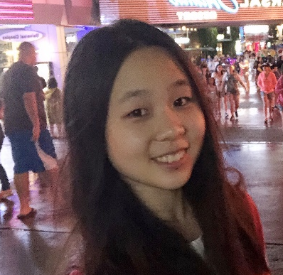


Thanks to Our Course Staff!
Teaching Assistants
Education Associate
Alex Singh
Annie Hu
George Brown
Haoran Fei
Daniel Bird
Michell Ma
Nidhi Jain
Vicky Zeng

Slide 38
Additional Analysis

Slide 39


Analyzing training error
Training error of final classifier is bounded by:
Where
Convex
upper
bound
exp loss
If boosting can make
upper bound → 0, then
training error → 0
0/1 loss
1
Slide credit: CMU MLD Aarti Singh and Carlos Guestrin
0

Slide 40
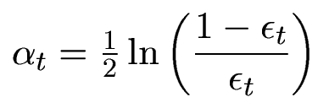
Analyzing training error
Analysis reveals:
What α_{t} to choose for hypothesis h_{t}?
What h_{t} to choose?
ε_{t} - weighted training error
If each weak learner h_{t} is slightly better than random guessing (ε_{t} < 0.5),
then training error of AdaBoost decays exponentially fast in number of rounds T.
Training Error
Slide credit: CMU MLD Aarti Singh and Carlos Guestrin

Slide 41
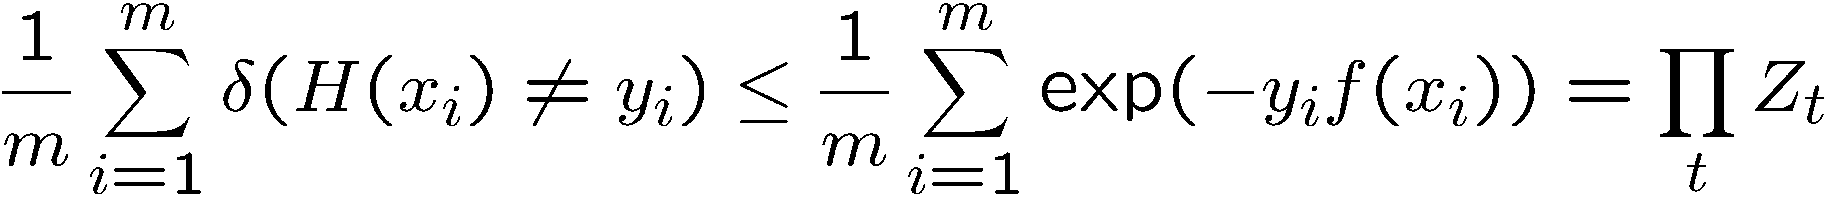
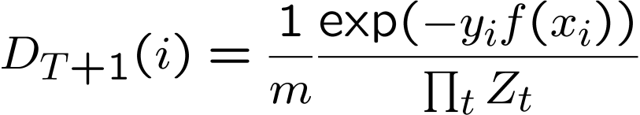
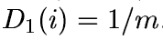
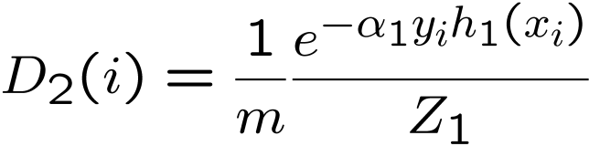
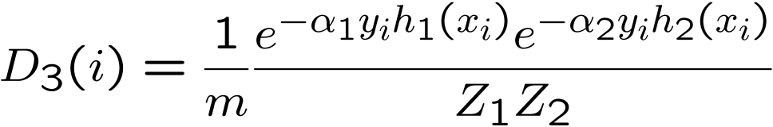
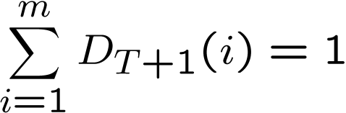
Analyzing training error
Training error of final classifier is bounded by:
Where
Proof:
Using Weight Update Rule
Wts of all pts add to 1
…
Slide credit: CMU MLD Aarti Singh and Carlos Guestrin

Slide 42
Analyzing training error
Training error of final classifier is bounded by:
Where
If Zt < 1, training error decreases exponentially (even though weak learners may
not be good ε_{t} ~0.5)
Upper bound
Training
error
Slide credit: CMU MLD Aarti Singh and Carlos Guestrin
t

Slide 43
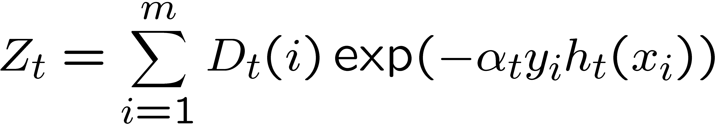
What α_{t} to choose for hypothesis h_{t}?
Training error of final classifier is bounded by:
Where
If we minimize ∏_{t} Z_{t}, we minimize our training error
We can tighten this bound greedily, by choosing α_{t} and h_{t} on each iteration
to minimize Z_{t.}
Slide credit: CMU MLD Aarti Singh and Carlos Guestrin

Slide 44
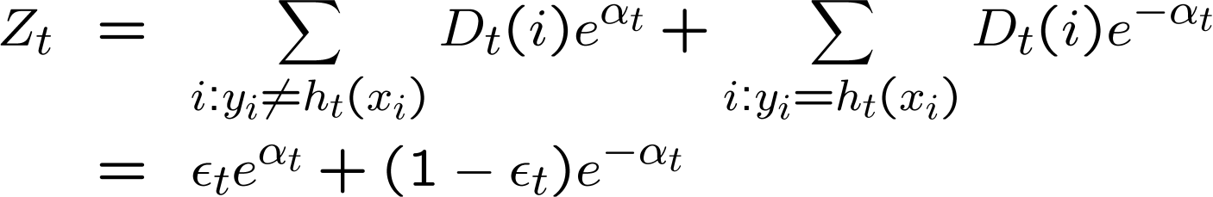
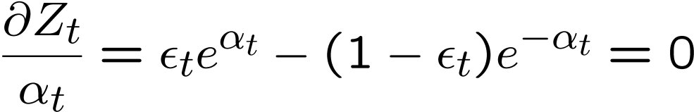
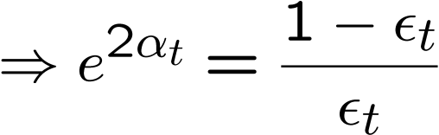
What α_{t} to choose for hypothesis h_{t}?
We can minimize this bound by choosing α_{t} on each iteration to minimize Z_{t.}
For boolean target function, this is accomplished by [Freund & Schapire ’97]:
Proof:
Slide credit: CMU MLD Aarti Singh and Carlos Guestrin

Slide 45

Bounding the error with choice of α_{t}
We can minimize this bound by choosing α_{t} on each iteration to minimize Z_{t.}
For boolean target function, this is accomplished by [Freund & Schapire ’97]:
Proof:
Slide credit: CMU MLD Aarti Singh and Carlos Guestrin

Slide 46
Dumb classifiers made Smart
Training error of final classifier is bounded by:
grows as ε_{t} moves
away from 1/2
If each classifier is (at least slightly) better than random ε_{t} < 0.5
AdaBoost will achieve zero training error exponentially fast (in number of rounds T) !!
What about test error?
Slide credit: CMU MLD Aarti Singh and Carlos Guestrin

Slide 47
Generalization Error Bounds
[Freund & Schapire’95]
With high
probability
Boosting can overfit if T is large
Boosting often, Contradicts experimental results
  Robust to overfitting
  Test set error decreases even after training error is zero
  Need better analysis tools – margin based bounds
Slide credit: CMU MLD Aarti Singh and Carlos Guestrin

Slide 48
Margin Based Bounds
[Schapire, Freund, Bartlett, Lee’98]
With high
probability
  Boosting increases the margin very aggressively since it concentrates on the hardest examples.
  If margin is large, more weak learners agree and hence more rounds does not necessarily imply that final classifier is getting more complex.
  Bound is independent of number of rounds T!
  Boosting can still overfit if margin is too small (can perform arbitrarily close to random guessing) or weak learners are too complex
Slide credit: CMU MLD Aarti Singh and Carlos Guestrin

