Slide 1

Announcements
Assignments
HW10 (programming + “written”)
Due Thu 4/30, 11:59 pm
Final Exam
Stay tuned to Piazza for details
Date: Mon 5/11, 5:30 – 8:30 pm
Format: “online assignment” in Gradescope
Scope: Content before this week
Practice exam: Out later this week
Recitation this Friday: Review session

Slide 2
Introduction to Machine Learning
Learning Theory
Instructor: Pat Virtue

Slide 3

Questions For Today
Given a classifier with zero training error, what can we say about true error (aka. generalization error)? (Sample Complexity, Realizable Case)
Given a classifier with low training error, what can we say about true error (aka. generalization error)? (Sample Complexity, Agnostic Case)
Is there a theoretical justification for regularization to avoid overfitting? (Structural Risk Minimization)
Slide credit: CMU MLD Matt Gormley

Slide 4
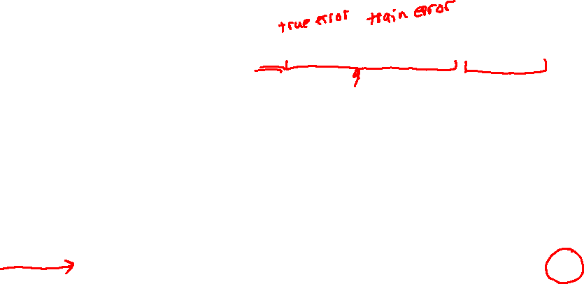
PAC Learning
Slide credit: CMU MLD Matt Gormley

Slide 5
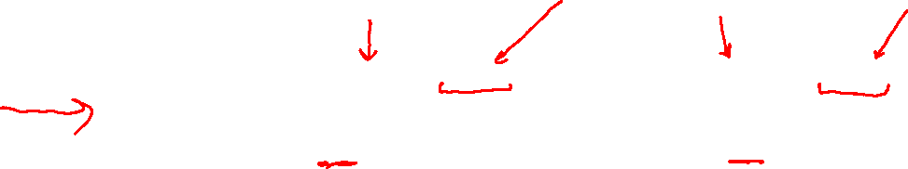
Sample Complexity Results
Four Cases we care about…
Realizable
Agnostic
Slide credit: CMU MLD Matt Gormley

Slide 6
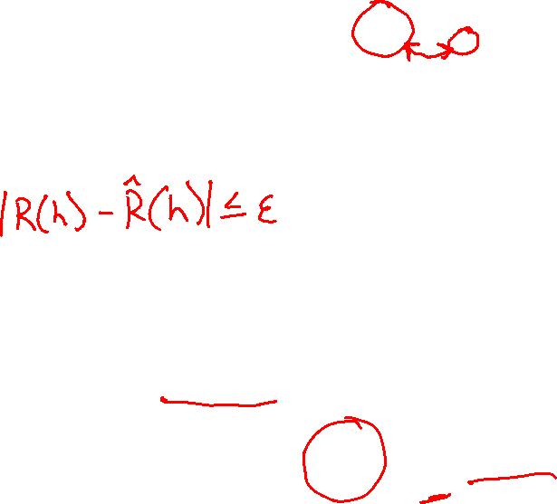
SLT-style Corollaries
Solve the inequality in Thm.1 for epsilon to obtain Corollary 1
We can obtain similar corollaries for each of the theorems…
Slide credit: CMU MLD Matt Gormley

Slide 7

Using a PAC bound
Given ε and δ, yields sample complexity
#training data,
Given m and δ, yields error bound
error,
Slide credit: CMU MLD Aarti Singh and Carlos Guestrin

Slide 8
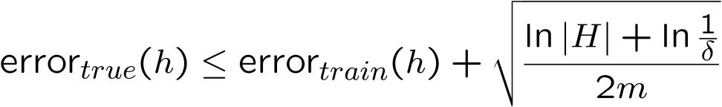
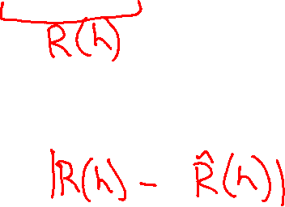
Summary of PAC bounds for finite model classes
With probability ≥ 1-δ,
1) For all h ∈ H s.t. error_{train}(h) = 0,
error_{true}(h) ≤ ε =
For all h ∈ H
|error_{true}(h) – error_{train}(h)| ≤ ε =
Haussler’s bound
Hoeffding’s bound
Slide credit: CMU MLD Aarti Singh and Carlos Guestrin

Slide 9


PAC bound and Bias-Variance tradeoff
Equivalently, with probability
Fixed |H|
Training size
m small
m large
small
large
large
small
Slide credit: CMU MLD Aarti Singh and Carlos Guestrin

Slide 10
PAC bound and Bias-Variance tradeoff
Equivalently, with probability
Fixed m
Model class
|H| large (complex)
|H| small (simple)
small
large
large
small
Slide credit: CMU MLD Aarti Singh and Carlos Guestrin

Slide 11
PAC bound for decision trees with k leaves – Bias-Variance revisited
With prob ≥ 1-δ
With , we get
k = m 0 large (~ > ½)
k < m >0 small (~ <½)
Slide credit: CMU MLD Aarti Singh and Carlos Guestrin

Slide 12

What about continuous hypothesis spaces?
Continuous model class (e.g. linear classifiers):
|H| = ∞
Infinite gap???
As with decision trees, complexity of model class only depends on maximum number of points that can be classified exactly (and not necessarily its size)!
Slide credit: CMU MLD Aarti Singh and Carlos Guestrin

Slide 13
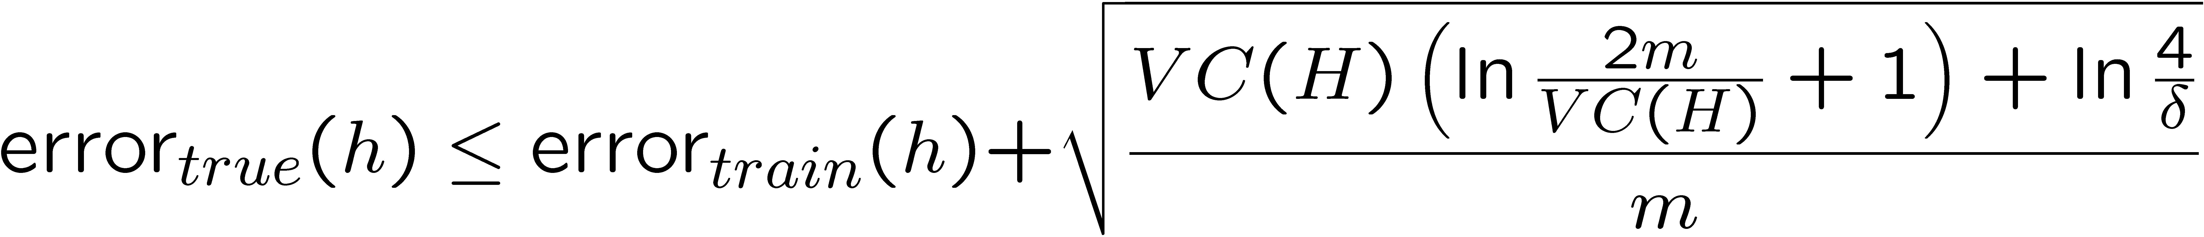
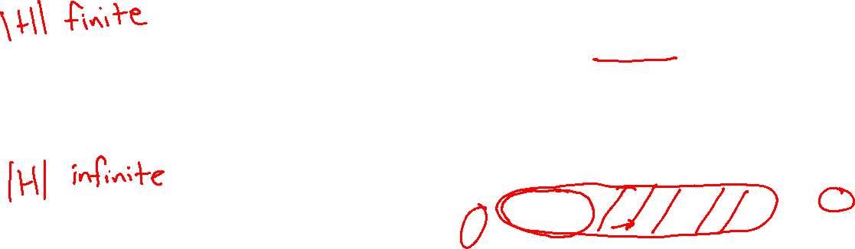
What about continuous hypothesis spaces?
Instead of ln|H|
Slide credit: CMU MLD Aarti Singh and Carlos Guestrin

Slide 14
Sample Complexity Results
Four Cases we care about…
Realizable
Agnostic
Slide credit: CMU MLD Matt Gormley

Slide 15

Sample Complexity Results
Four Cases we care about…
Realizable
Agnostic
Slide credit: CMU MLD Matt Gormley
Notes:
https://giphy.com/gifs/pacman-gba-d9QiBcfzg64Io

Slide 16
VC Dimension

Slide 17

Slide credit: CMU MLD Nina Balcan

Slide 18
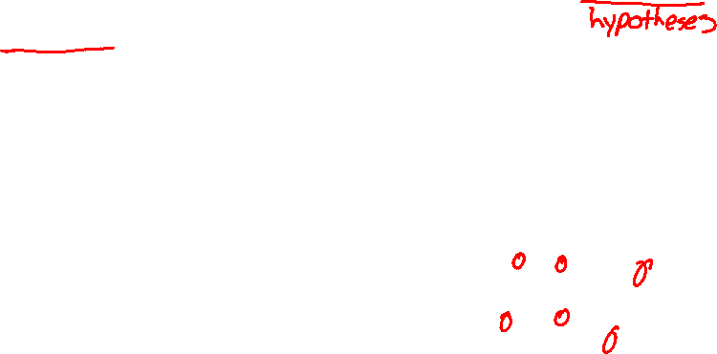
Slide credit: CMU MLD Nina Balcan

Slide 19
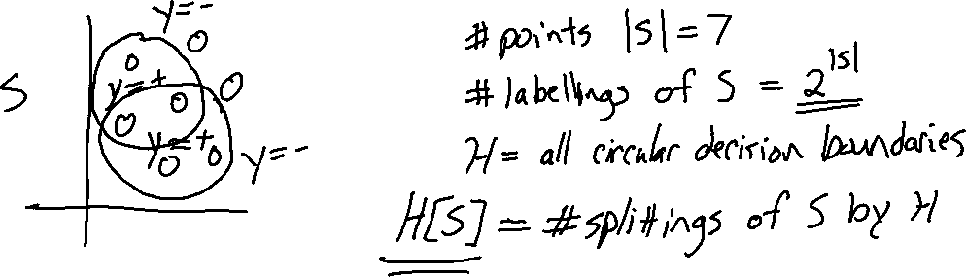
Example: Shattering for Binary Classification
Slide credit: CMU MLD Matt Gormley

Slide 20
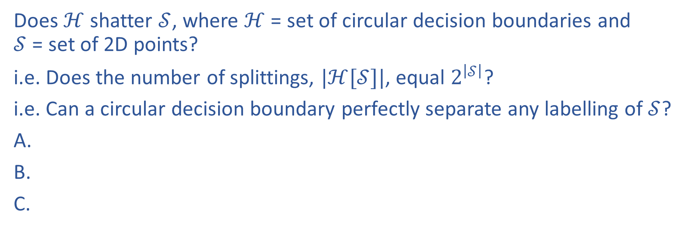
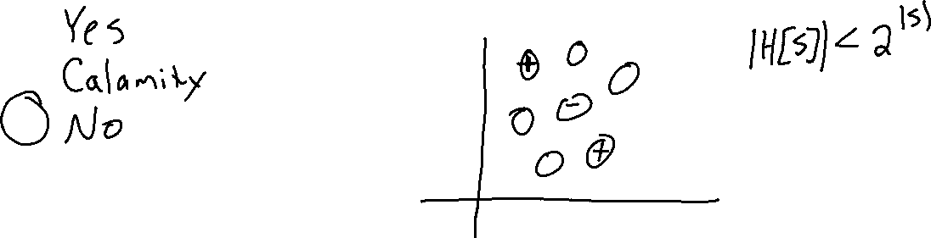
Piazza Poll 1
Does $ℋ$ shatter $𝒮$, where $ℋ$ = set of circular decision boundaries and $𝒮$ = set of 2D points?
i.e. Does the number of splittings, $|ℋ[𝒮]|$, equal $2^{\left|𝒮\right|}$?
i.e. Can a circular decision boundary perfectly separate any labelling of $𝒮$?

Slide 21
Slide credit: CMU MLD Nina Balcan

Slide 22
Slide credit: CMU MLD Nina Balcan

Slide 23
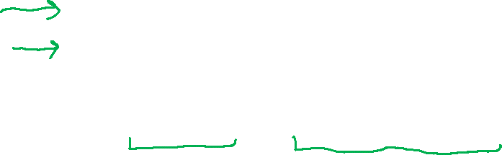
Slide credit: CMU MLD Nina Balcan

Slide 24
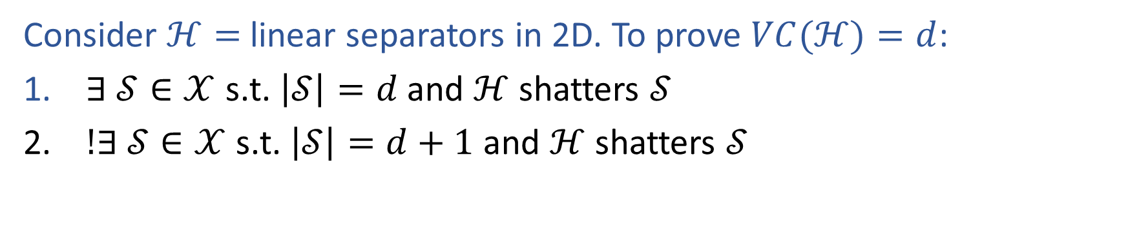
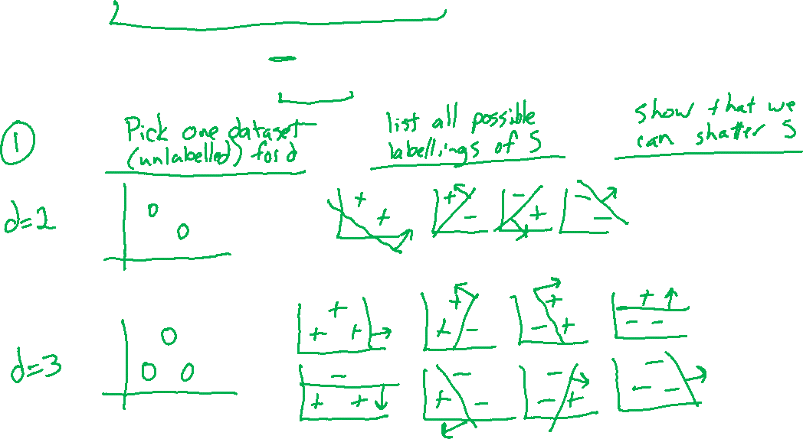
Example: VC Dimension for Linear Separators
Consider $ℋ=$ linear separators in 2D. To prove $VC(ℋ)=d$:
$∃ 𝒮∈𝒳$ s.t. $\left|𝒮\right|=d$ and $ℋ$ shatters $𝒮$
$!∃ 𝒮∈𝒳$ s.t. $\left|𝒮\right|=d+1$ and $ℋ$ shatters $𝒮$
Slide credit: CMU MLD Matt Gormley

Slide 25
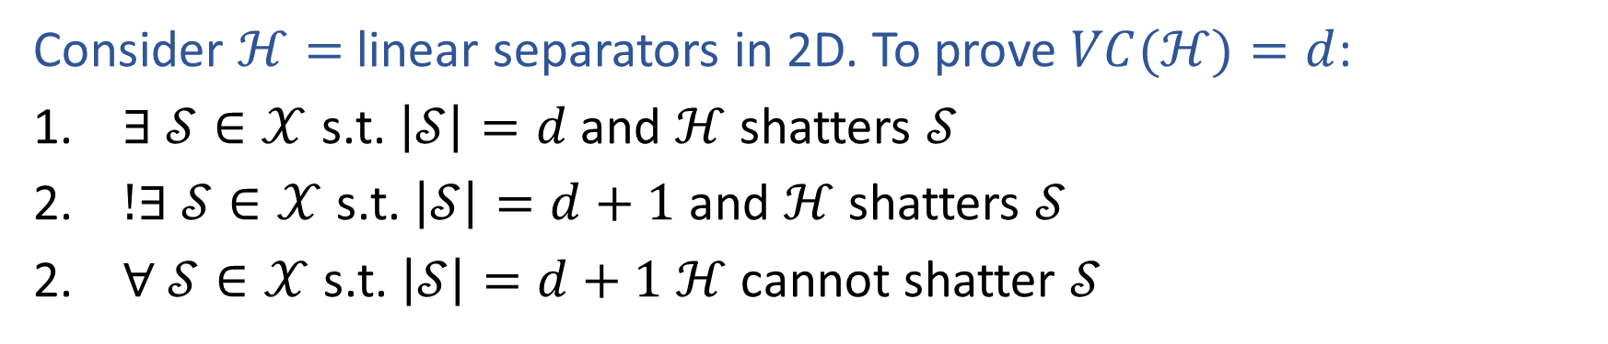
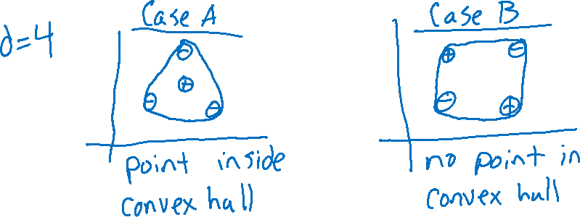
Example: VC Dimension for Linear Separators
Consider $ℋ=$ linear separators in 2D. To prove $VC(ℋ)=d$:
$∃ 𝒮∈𝒳$ s.t. $\left|𝒮\right|=d$ and $ℋ$ shatters $𝒮$
$!∃ 𝒮∈𝒳$ s.t. $\left|𝒮\right|=d+1$ and $ℋ$ shatters $𝒮$
$∀ 𝒮∈𝒳$ s.t. $\left|𝒮\right|=d+1$ $ℋ$ cannot shatter $𝒮$
Slide credit: CMU MLD Matt Gormley

Slide 26
Example: VC Dimension for Linear Separators
Consider $ℋ=$ linear separators in 2D. To prove $VC(ℋ)=d$:
$∃ 𝒮∈𝒳$ s.t. $\left|𝒮\right|=d$ and $ℋ$ shatters $𝒮$
$!∃ 𝒮∈𝒳$ s.t. $\left|𝒮\right|=d+1$ and $ℋ$ shatters $𝒮$
$∀ 𝒮∈𝒳$ s.t. $\left|𝒮\right|=d+1$ $ℋ$ cannot shatter $𝒮$
Slide credit: CMU MLD Matt Gormley

Slide 27
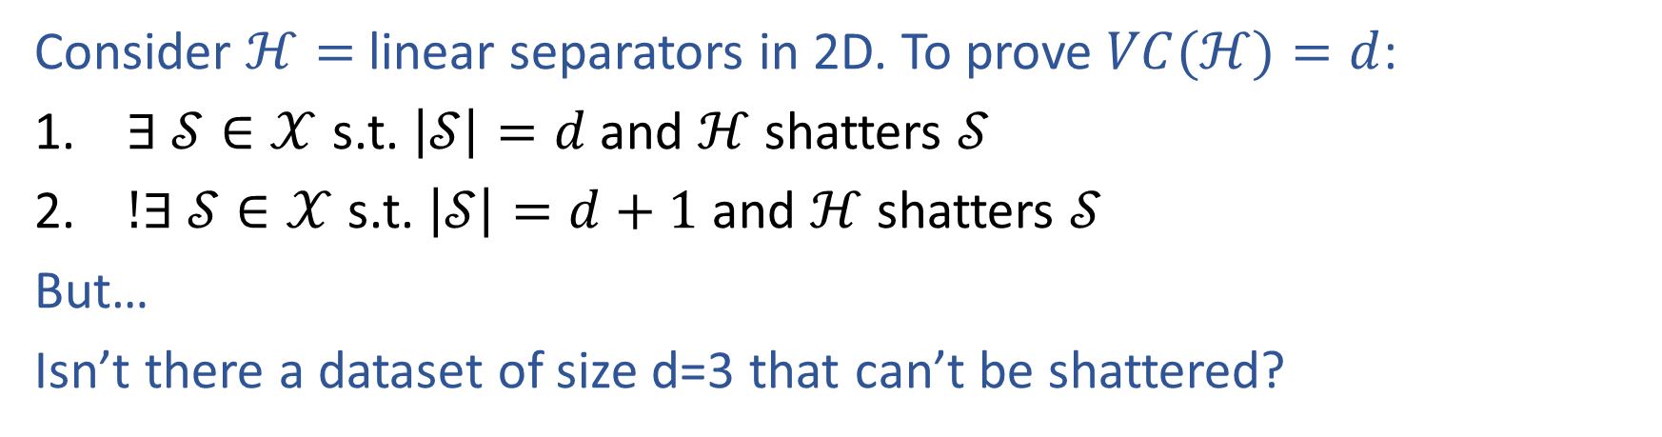
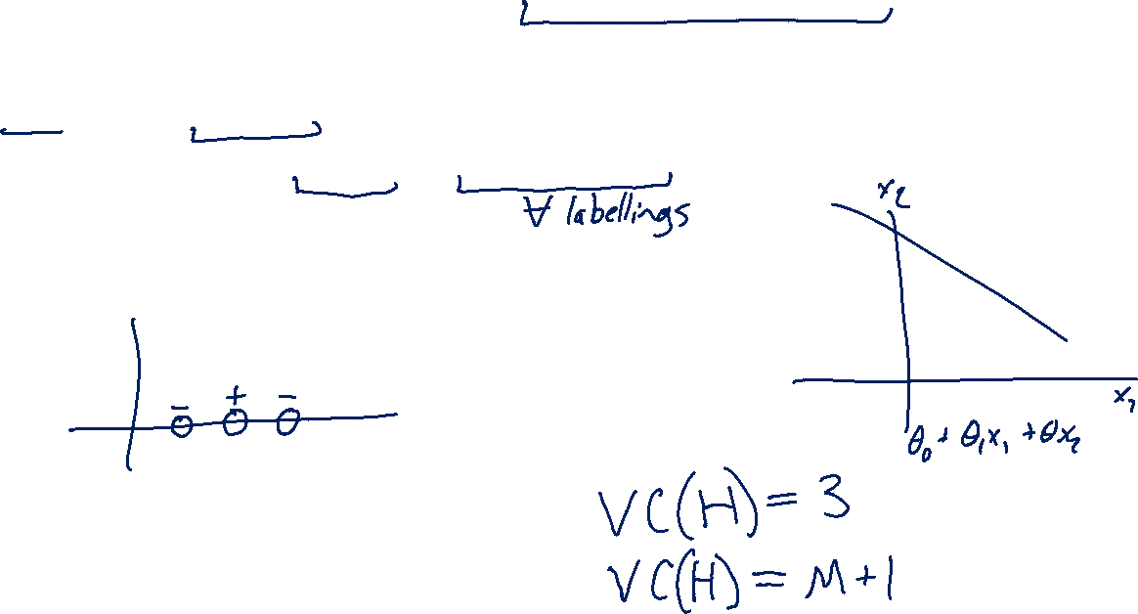
Example: VC Dimension for Linear Separators
Consider $ℋ=$ linear separators in 2D. To prove $VC(ℋ)=d$:
$∃ 𝒮∈𝒳$ s.t. $\left|𝒮\right|=d$ and $ℋ$ shatters $𝒮$
$!∃ 𝒮∈𝒳$ s.t. $\left|𝒮\right|=d+1$ and $ℋ$ shatters $𝒮$
But…
Isn’t there a dataset of size d=3 that can’t be shattered?
Slide credit: CMU MLD Matt Gormley

Slide 28
Slide credit: CMU MLD Nina Balcan

Slide 29
Slide credit: CMU MLD Nina Balcan
Notes:
convex hull: imagine throwing a lasso around the points and pulling it tight

Slide 30

∃ vs. ∀
VCDim
Proving VC Dimension requires us to show that there exists (∃) a dataset of size d that can be shattered and that there does not exist (∄) a dataset of size d+1 that can be shattered
Shattering
Proving that a particular dataset can be shattered requires us to show that for all (∀) labelings of the dataset, our hypothesis class contains a hypothesis that can correctly classify it
Slide credit: CMU MLD Matt Gormley

Slide 31
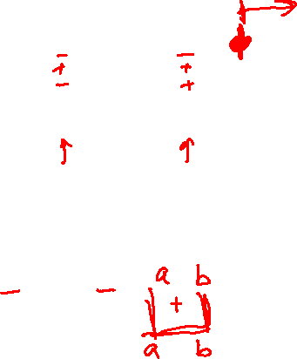
Slide credit: CMU MLD Nina Balcan

Slide 32
Slide credit: CMU MLD Nina Balcan

Slide 33
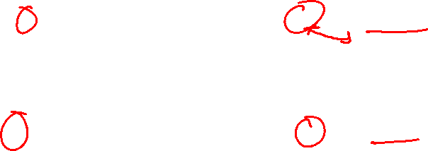
Sample Complexity Results
Four Cases we care about…
Realizable
Agnostic
Slide credit: CMU MLD Matt Gormley

Slide 34
SLT-style Corollaries
Solve the inequality in Thm.1 for epsilon to obtain Corollary 1
We can obtain similar corollaries for each of the theorems…
Slide credit: CMU MLD Matt Gormley

Slide 35

SLT-style Corollaries
Slide credit: CMU MLD Matt Gormley

Slide 36

SLT-style Corollaries
Slide credit: CMU MLD Matt Gormley

Slide 37
SLT-style Corollaries
Should these corollaries inform how we do model selection?
Slide credit: CMU MLD Matt Gormley

Slide 38
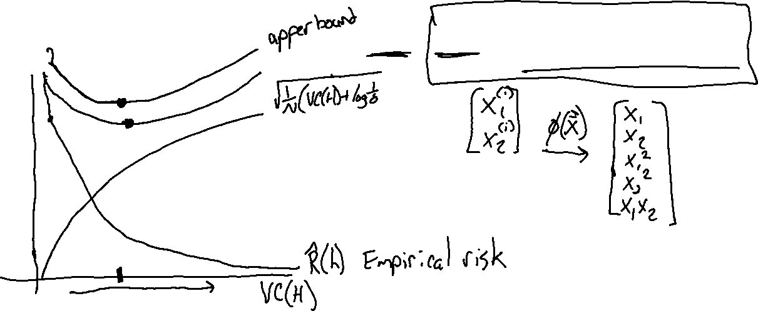
PAC Bounds and Model Selection
Is Corollary 4 useful?

Slide 39
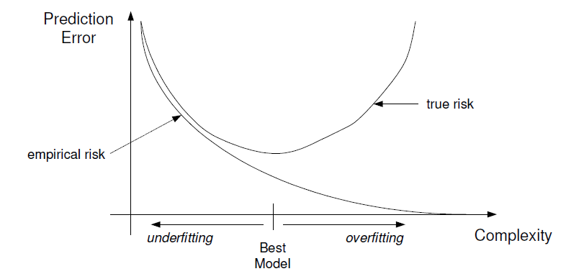
PAC Bounds
With probability ≥ 1-δ, for all h ∈ H,
|error_{true}(h) – error_{train}(h)| ≤ ε(H)
High probability
Upper bound
on true risk
True error
Training error
ε(H) - large for complex models
Slide credit: CMU MLD Aarti Singh and Carlos Guestrin

Slide 40
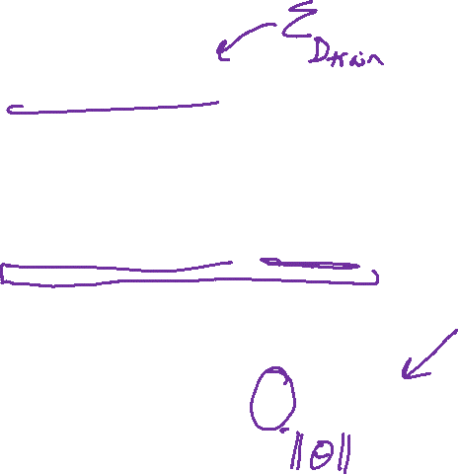
Using PAC Bounds to pick a hypothesis and model selection
Empirical Risk Minimization (ERM):
Structural Risk Minimization (SRM):
Provide insights, but often too loose in practice: optimize
where λ is chosen by cross-validation
Slide credit: CMU MLD Aarti Singh and Carlos Guestrin

Slide 41
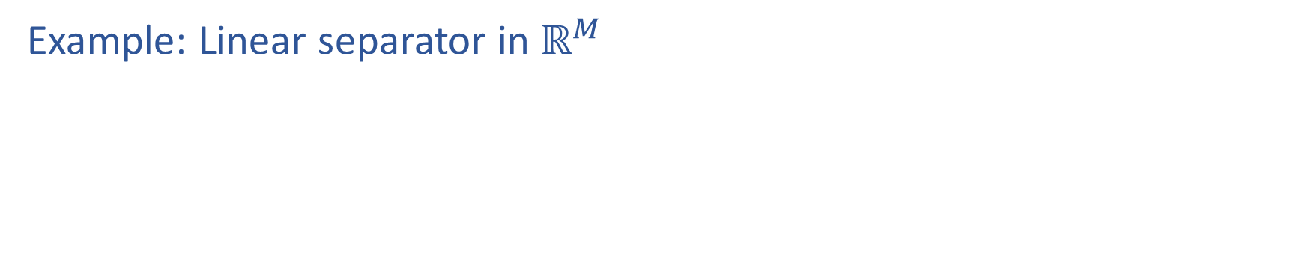
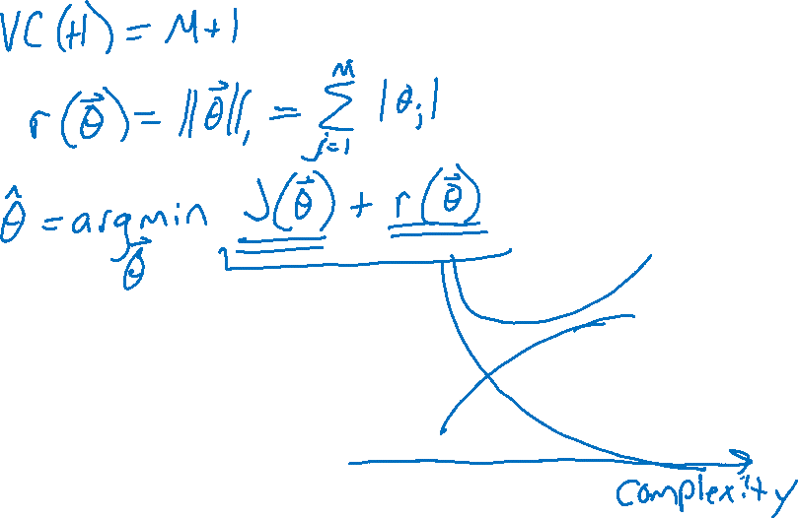
PAC Bounds and Regularization
Example: Linear separator in $ℝ^{M}$

Slide 42
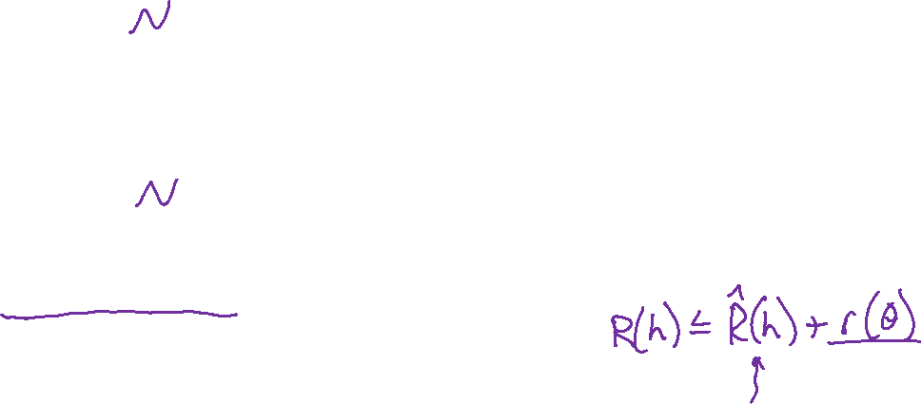
Questions For Today
Given a classifier with zero training error, what can we say about generalization error? (Sample Complexity, Realizable Case)
Given a classifier with low training error, what can we say about generalization error? (Sample Complexity, Agnostic Case)
Is there a theoretical justification for regularization to avoid overfitting? (Structural Risk Minimization)
Slide credit: CMU MLD Matt Gormley

Slide 43
PAC Learning Objectives
You should be able to…
Identify the properties of a learning setting and assumptions required to ensure low generalization error
Distinguish true error, train error, test error
Define PAC and explain what it means to be approximately correct and what occurs with high probability
Apply sample complexity bounds to real-world learning examples
Distinguish between a large sample and a finite sample analysis
Theoretically motivate regularization
Slide credit: CMU MLD Matt Gormley

