Slide 1
Announcements
Assignments
HW10 (programming + “written”)
    Due Thu 4/30, 11:59 pm

Slide 2
Introduction to
Machine Learning
Learning Theory
Instructor: Pat Virtue

Slide 3
Questions For Today
Given a classifier with zero training error, what can we say about true error (aka. generalization error)?
(Sample Complexity, Realizable Case)
Given a classifier with low training error, what can we say about true error (aka. generalization error)?
(Sample Complexity, Agnostic Case)
Is there a theoretical justification for regularization to avoid overfitting?
(Structural Risk Minimization)
Slide credit: CMU MLD Matt Gormley

Slide 4
Model for Supervised Learning
Slide credit: CMU MLD Nina Balcan

Slide 5
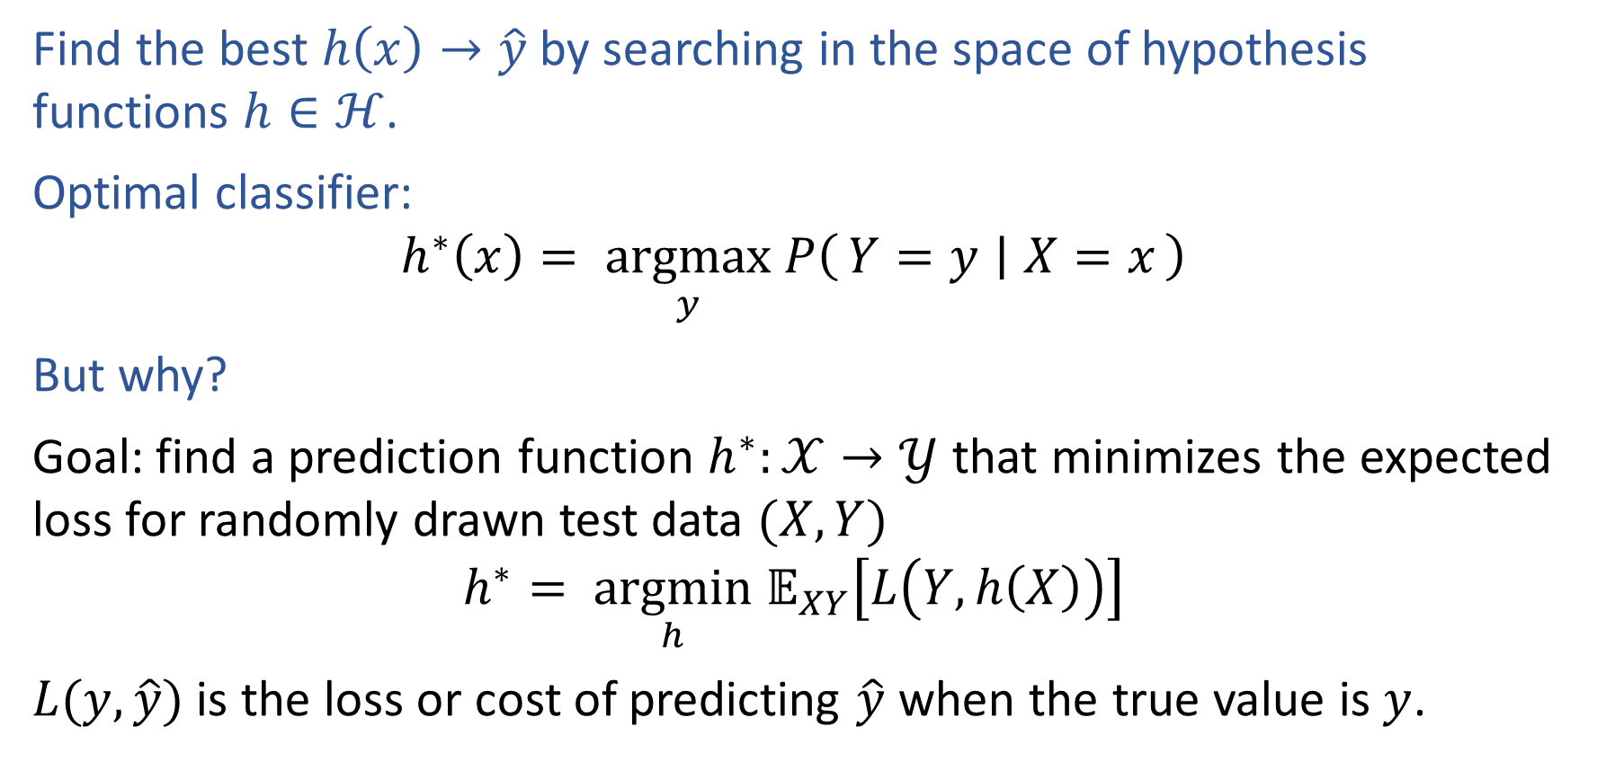
Optimal Classification Function
Find the best $h\left(x\right)→\hat{y}$ by searching in the space of hypothesis functions $h∈ℋ$.
Optimal classifier:
$$h^{∗}\left(x\right)= \underset{y}{argmax} P\left(Y=y ∣ X=x\right)$$
But why?
Goal: find a prediction function $h^{∗}:𝒳→𝒴$ that minimizes the expected loss for randomly drawn test data $(X, Y)$
$$h^{∗}= \underset{h}{argmin} 𝔼_{XY}\left[L\left(Y, h\left(X\right)\right)\right]$$
$L(y, \hat{y})$ is the loss or cost of predicting $\hat{y}$ when the true value is $y$.

Slide 6

Loss Functions
$$h^{∗}= \underset{h}{argmin} 𝔼_{XY}\left[L\left(Y, h\left(X\right)\right)\right]$$
Loss function:
$L:𝒴×𝒴→ℝ$
Classification:
Two-class, 0,1 loss
Two-class, arbitrary loss
Regression:

Slide 7
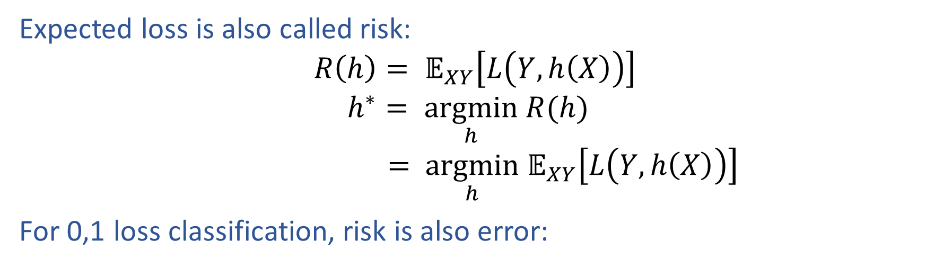
Optimal Classification Function
Expected loss is also called risk:
$$R\left(h\right)= 𝔼_{XY}\left[L\left(Y, h\left(X\right)\right)\right]$$
$$h^{∗}= \underset{h}{argmin} R(h)$$
$$= \underset{h}{argmin} 𝔼_{XY}\left[L\left(Y, h\left(X\right)\right)\right]$$
For 0,1 loss classification, risk is also error:

Slide 8
Two Types of Error
1. True Error (aka. expected risk)
This quantity is always unknown
2. Train Error (aka. empirical risk)
We can measure this on the training data
Slide credit: CMU MLD Matt Gormley

Slide 9
PAC / SLT Model
Slide credit: CMU MLD Matt Gormley

Slide 10
Three Hypotheses of Interest
Question:
True or False: h* and c* are always equal.
Slide credit: CMU MLD Matt Gormley
Notes:
Question: Are c* and h* the same? Justify your answer.
Chalkboard: Example of squiggly c* decision boundary vs. \Hc = linear decision boundaries. Show actual sample points and highlight a case where we obtain zero training error.

Slide 11
Piazza Poll 1
True or False: h* and c* are always equal.
Slide credit: CMU MLD Matt Gormley

Slide 12
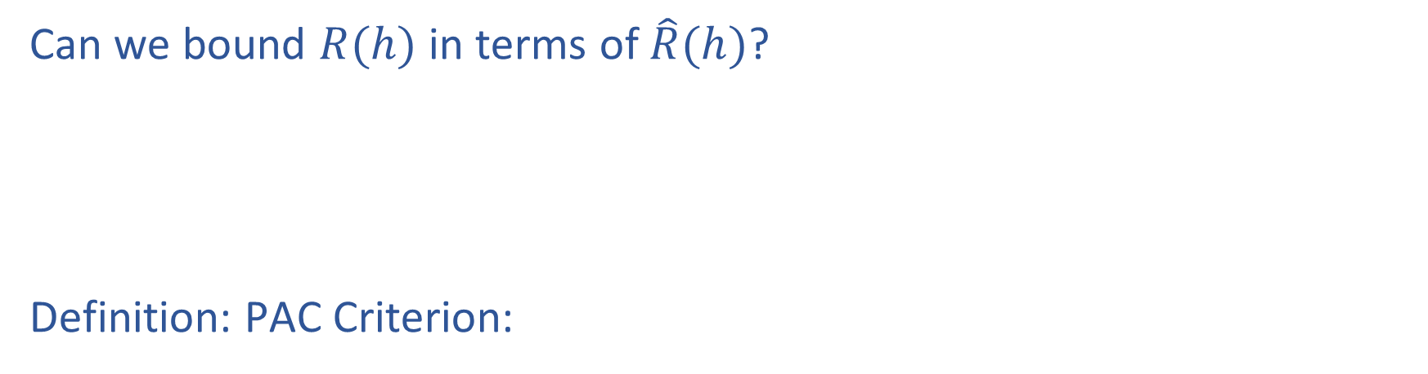
PAC Learning
Can we bound $R(h)$ in terms of $\hat{R}(h)$?
Definition: PAC Criterion:
Slide credit: CMU MLD Matt Gormley

Slide 13
PAC Learning
Definition: sample complexity
Definition: consistent hypothesis
Slide credit: CMU MLD Matt Gormley

Slide 14
PAC Learning
Slide credit: CMU MLD Matt Gormley

Slide 15
PAC Learning
Four types of problems
Slide credit: CMU MLD Matt Gormley

Slide 16
Sample Complexity Results
We’ll start with the finite case…
Four Cases we care about…
Realizable
Agnostic
Slide credit: CMU MLD Matt Gormley
Notes:
https://giphy.com/gifs/pacman-gba-d9QiBcfzg64Io
Question: What is an example of a Finite hypothesis space? an Infinite hypothesis space?

Slide 17
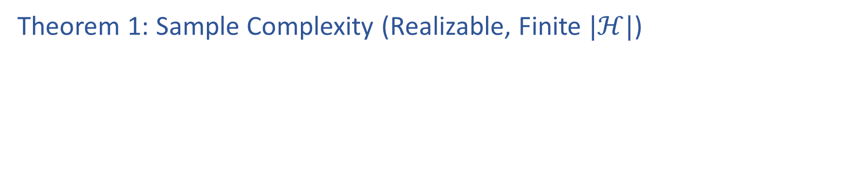
PAC Learning
Theorem 1: Sample Complexity (Realizable, Finite $|ℋ|$)
Slide credit: CMU MLD Matt Gormley

Slide 18
PAC Learning
Proof of Theorem 1
{To the whiteboard…}
Slide credit: CMU MLD Matt Gormley

Slide 19
Sample Complexity Results
Four Cases we care about…
Realizable
Agnostic
Slide credit: CMU MLD Matt Gormley

Slide 20
Piazza Poll 2
Question:
Suppose H = class of conjunctions over x in {0,1}^{M}
Example hypotheses:
h(x) = x₁ (1-x₃) x₅
h(x) = x₁ (1-x₂) x₄ (1-x₅)
If M = 10, 𝜀 = 0.1, δ = 0.01, how many examples suffice according to Theorem 1?
Answer:
10*(2*ln(10)+ln(100 )) ≈ 92
10*(3*ln(10)+ln(100)) ≈ 116
10*(10*ln(2)+ln(100 )) ≈ 116
10*(10*ln(3)+ln(100)) ≈ 156
100*(2*ln(10)+ln(10 )) ≈ 691
100*(3*ln(10)+ln(10)) ≈ 922
100*(10*ln(2)+ln(10 )) ≈ 924
100*(10*ln(3)+ln(10)) ≈ 1329
Slide credit: CMU MLD Matt Gormley

Slide 21
Sample Complexity Results
Four Cases we care about…
Realizable
Agnostic
Slide credit: CMU MLD Matt Gormley

Slide 22
Sample Complexity Results
Bound is inversely linear in epsilon (e.g. halving the error requires double the examples)
Bound is only logarithmic in |H| (e.g. quadrupling the hypothesis space only requires double the examples)
Bound is inversely quadratic in epsilon (e.g. halving the error requires 4x the examples)
Bound is only logarithmic in |H| (i.e. same as Realizable case)
Four Cases we care about…
Realizable
Agnostic
Slide credit: CMU MLD Matt Gormley

Slide 23
Using a PAC bound
Given ε and δ, yields sample complexity
#training data,
Given m and δ, yields error bound
error,
Slide credit: CMU MLD Aarti Singh and Carlos Guestrin

Slide 24
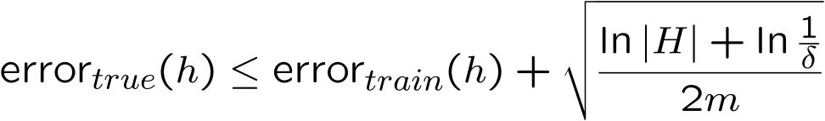
Summary of PAC bounds for finite model classes
With probability ≥ 1-δ,
1) For all h ∈ H s.t. error_{train}(h) = 0,
error_{true}(h) ≤ ε =
For all h ∈ H
|error_{true}(h) – error_{train}(h)| ≤ ε =
Haussler’s bound
Hoeffding’s bound
Slide credit: CMU MLD Aarti Singh and Carlos Guestrin

Slide 25

PAC bound and Bias-Variance tradeoff
Equivalently, with probability
Fixed |H|
Training size
m small
m large
small
large
large
small
Slide credit: CMU MLD Aarti Singh and Carlos Guestrin

Slide 26
PAC bound and Bias-Variance tradeoff
Equivalently, with probability
Fixed m
Model class
|H| large (complex)
|H| small (simple)
small
large
large
small
Slide credit: CMU MLD Aarti Singh and Carlos Guestrin

Slide 27
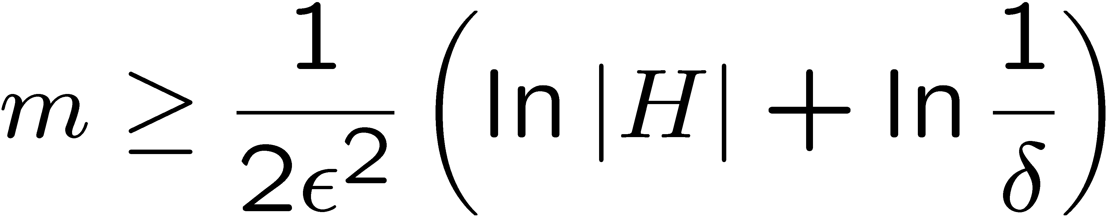
Number of decision trees of depth k
Recursive solution:
Given n binary attributes
H_{k} = Number of binary decision trees of depth k
2
(#choices of root attribute)
*(# possible left subtrees)
*(# possible right subtrees) = n * H_{k-1} * H_{k-1}
Write L_{k} = log₂ H_{k}
L₀ = 1
L_{k} = log₂ n + 2L_{k-1} = log₂ n + 2(log₂ n + 2L_{k-2})
= log₂ n + 2log₂ n + 2²log₂ n + … +2^{k-1}(log₂ n + 2L₀)
So L_{k} = (2^{k}-1)(1+log₂ n) +1
H₀ =
H_{k} =
Slide credit: CMU MLD Aarti Singh and Carlos Guestrin

Slide 28
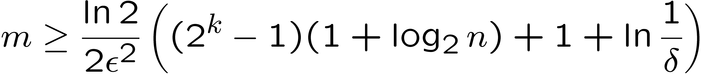
PAC bound for decision trees of depth k
Bad!!!
  Number of points is exponential in depth k!
But, for m data points, decision tree can’t get too big…
Number of leaves never more than number data points
Slide credit: CMU MLD Aarti Singh and Carlos Guestrin

Slide 29
Number of decision trees with k leaves
H_{k} = Number of binary decision trees with k leaves
H₁ =2
H_{k} = (#choices of root attribute) *
[(# left subtrees wth 1 leaf)*(# right subtrees wth k-1 leaves)
+ (# left subtrees wth 2 leaves)*(# right subtrees wth k-2 leaves)
+ …
+ (# left subtrees wth k-1 leaves)*(# right subtrees wth 1 leaf)]
= n^{k-1} C_{k-1} (C_{k-1} : Catalan Number)
Loose bound (using Sterling’s approximation):
Slide credit: CMU MLD Aarti Singh and Carlos Guestrin

Slide 30
Number of decision trees
With k leaves
                linear in k
number of points m is linear in #leaves
With depth k
                exponential in k
number of points m is exponential in depth
log₂ H_{k} = (2^{k}-1)(1+log₂ n) +1
Slide credit: CMU MLD Aarti Singh and Carlos Guestrin

Slide 31
PAC bound for decision trees with k leaves – Bias-Variance revisited
With prob ≥ 1-δ
With , we get
k = m 0 large (~ > ½)
k < m >0 small (~ <½)
Slide credit: CMU MLD Aarti Singh and Carlos Guestrin

Slide 32
What did we learn from decision trees?
Moral of the story:
Complexity of learning not measured in terms of size of model space, but in maximum number of points that allows consistent classification
Slide credit: CMU MLD Aarti Singh and Carlos Guestrin

Slide 33
Sample Complexity Results
Four Cases we care about…
Realizable
Agnostic
Slide credit: CMU MLD Matt Gormley

