Slide 1

Announcements
Assignments
HW10 (programming + “written”)
    Due Thu 4/30, 11:59 pm

Slide 2
Introduction to
Machine Learning
Learning Theory
Instructor: Pat Virtue

Slide 3
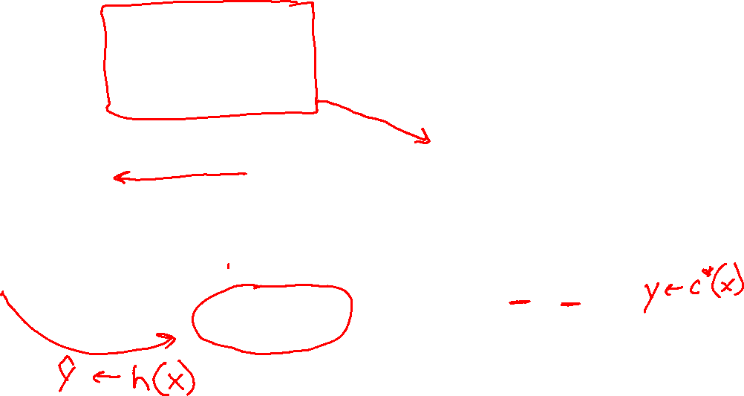
Model for Supervised Learning
Slide credit: CMU MLD Nina Balcan

Slide 4
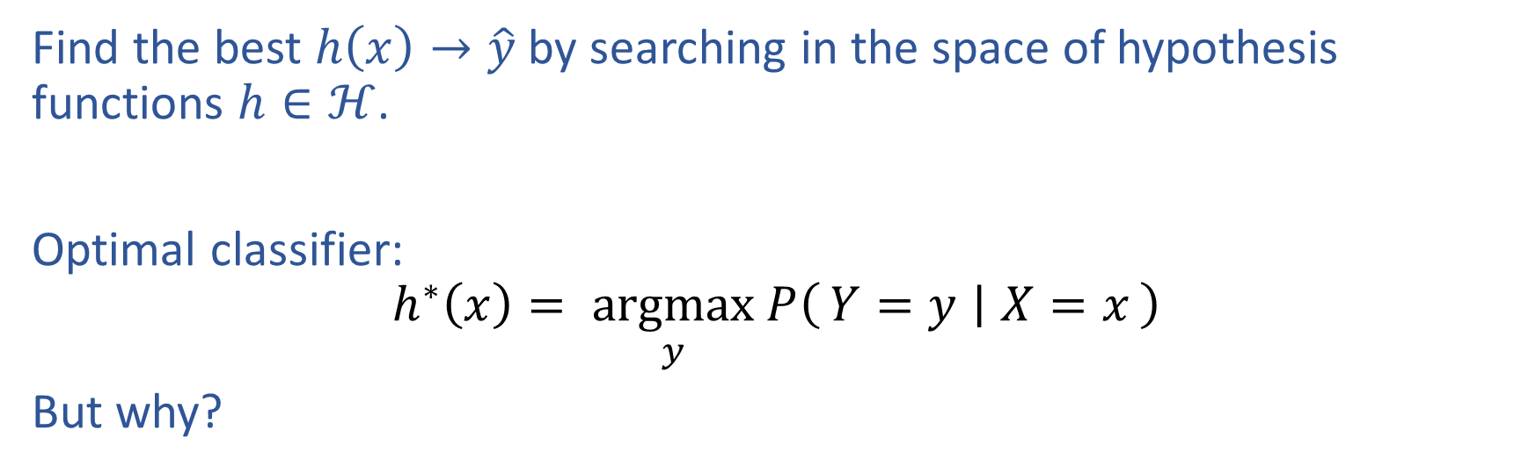
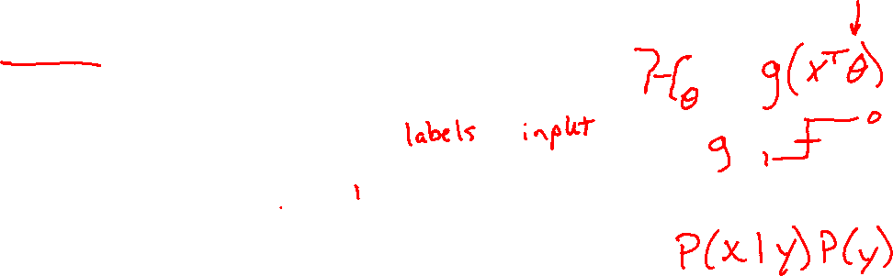
Optimal Classification Function
Find the best $h\left(x\right)→\hat{y}$ by searching in the space of hypothesis functions $h∈ℋ$.
Optimal classifier:
$$h^{∗}\left(x\right)= \underset{y}{argmax} P\left(Y=y ∣ X=x\right)$$
But why?

Slide 5
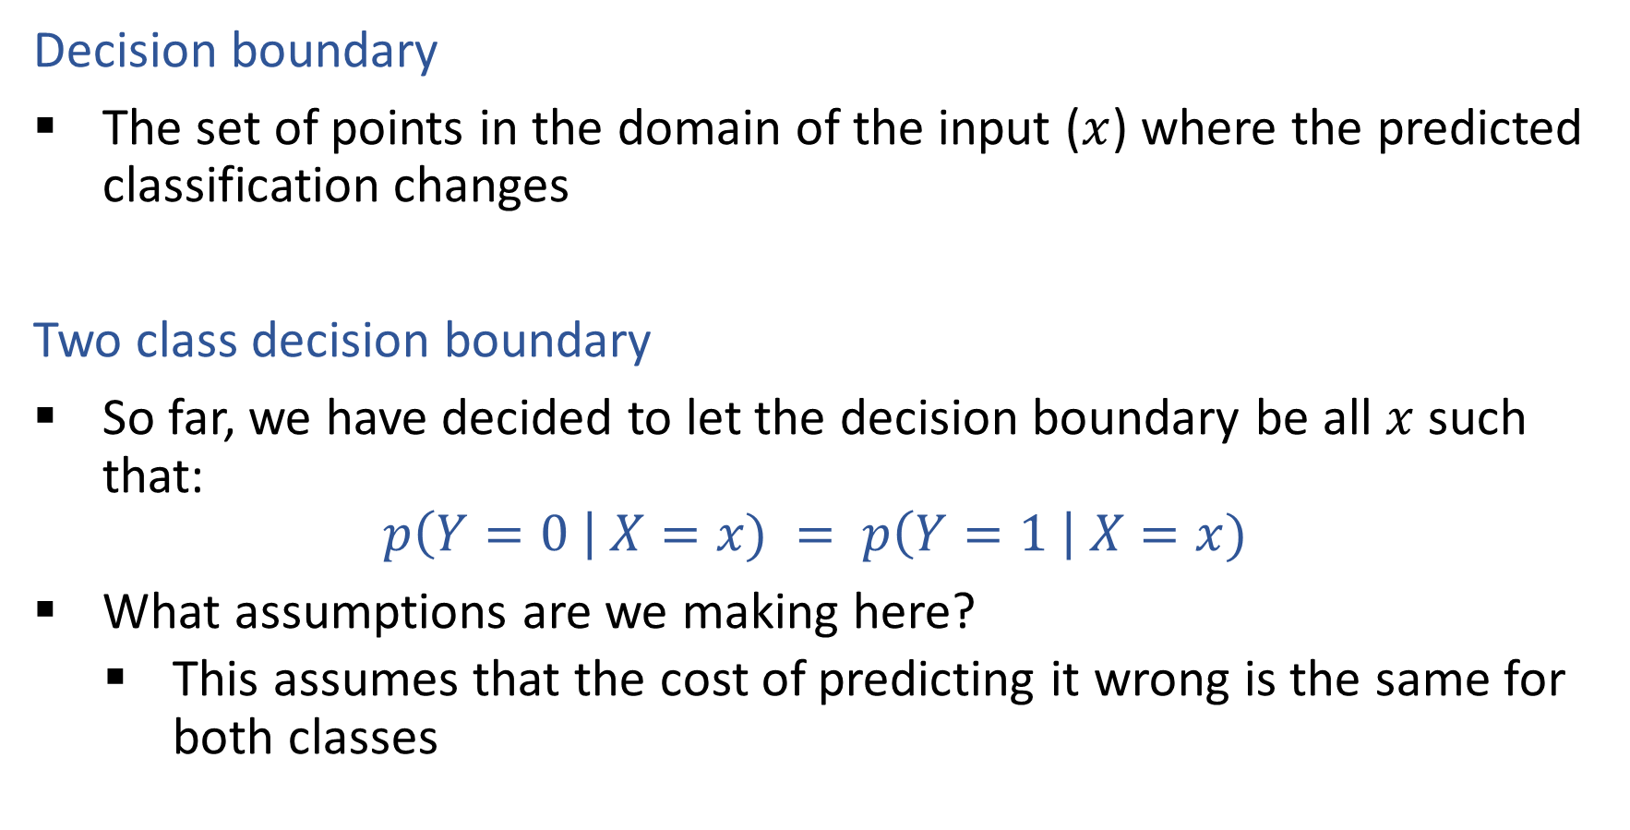
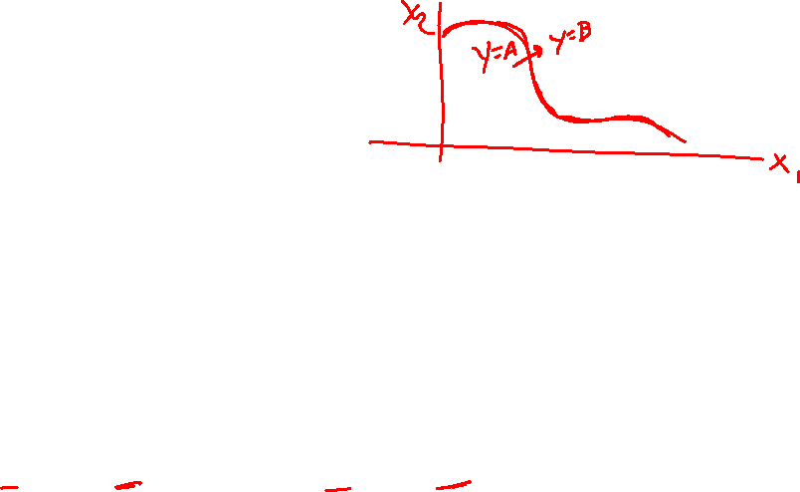
Optimal Decision Boundaries
Decision boundary
The set of points in the domain of the input ($x$) where the predicted classification changes
Two class decision boundary
So far, we have decided to let the decision boundary be all $x$ such that:
$$p\left(Y=0 \right| X=x) = p\left(Y=1 \right| X=x)$$
What assumptions are we making here?
    This assumes that the cost of predicting it wrong is the same for both classes

Slide 6
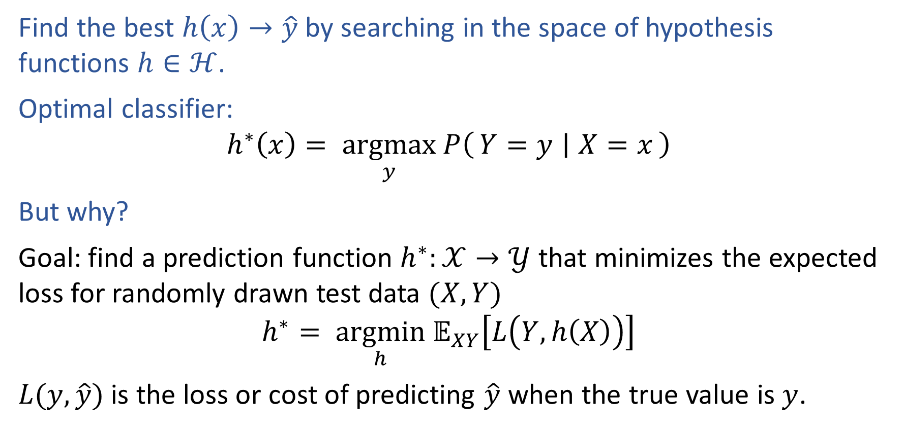
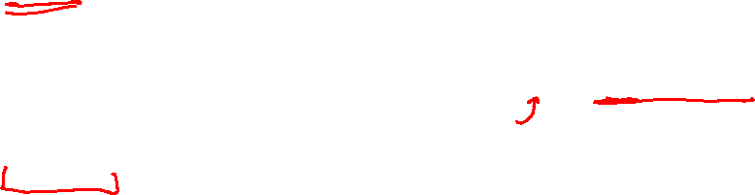
Optimal Classification Function
Find the best $h\left(x\right)→\hat{y}$ by searching in the space of hypothesis functions $h∈ℋ$.
Optimal classifier:
$$h^{∗}\left(x\right)= \underset{y}{argmax} P\left(Y=y ∣ X=x\right)$$
But why?
Goal: find a prediction function $h^{∗}:𝒳→𝒴$ that minimizes the expected loss for randomly drawn test data $(X, Y)$
$$h^{∗}= \underset{h}{argmin} 𝔼_{XY}\left[L\left(Y, h\left(X\right)\right)\right]$$
$L(y, \hat{y})$ is the loss or cost of predicting $\hat{y}$ when the true value is $y$.

Slide 7

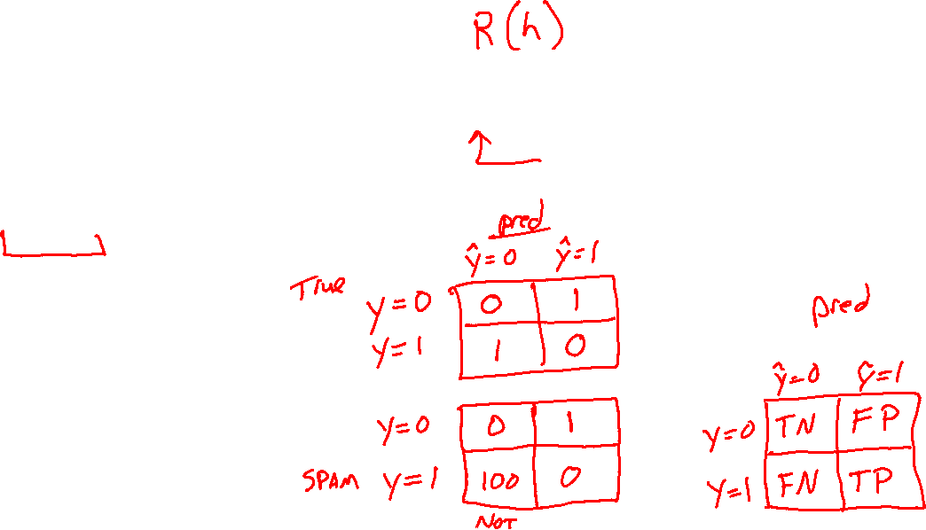
Loss Functions
$$h^{∗}= \underset{h}{argmin} 𝔼_{XY}\left[L\left(Y, h\left(X\right)\right)\right]$$
Loss function:
$L:𝒴×𝒴→ℝ$
Classification:
Two-class, 0,1 loss
Two-class, arbitrary loss
False positives and false negatives:

Slide 8

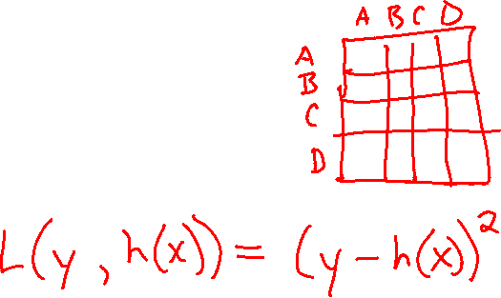
Loss Functions
$$h^{∗}= \underset{h}{argmin} 𝔼_{XY}\left[L\left(Y, h\left(X\right)\right)\right]$$
Loss function:
$L:𝒴×𝒴→ℝ$
Classification:
Two-class, 0,1 loss
Two-class, arbitrary loss
Regression:

Slide 9
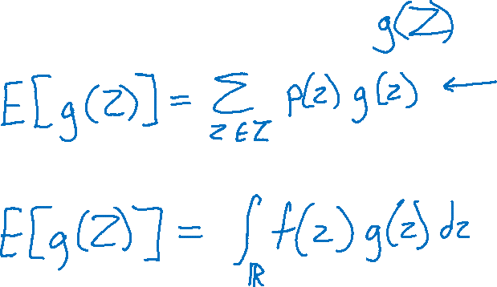
Expected Value
Quick review

Slide 10
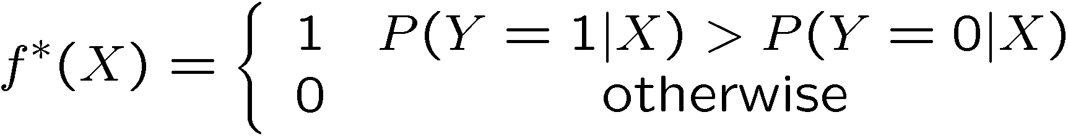
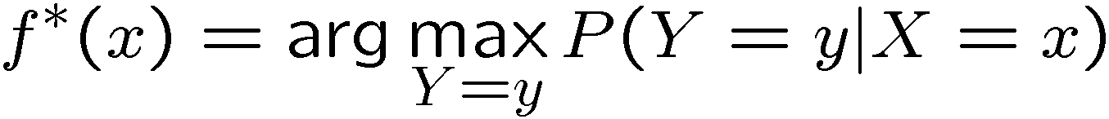

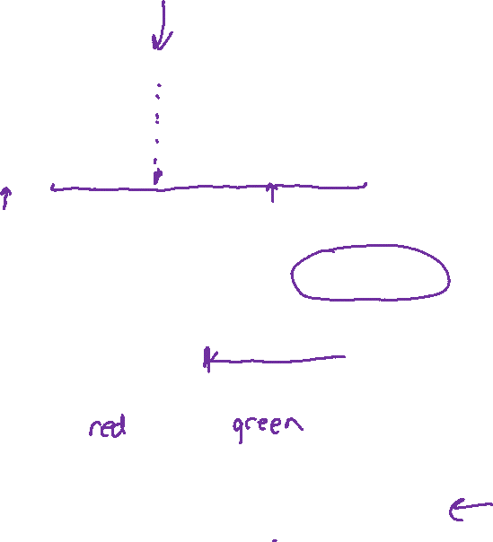



Binary Classification
Science
low
high
Sports
X, frequency of word “play”
Test document
$$h(x)$$
Model X and Y as random variables
For a given $x$, $h(x)$ = label Y which is more likely
1
0.5
0
$$h(x)$$
$h\left(x\right)=$

Slide 11
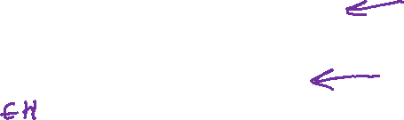


Optimal Classification Function
$$h^{∗}\left(x\right)= \underset{y ∈ \left\{0,1\right\}}{argmax} P\left(Y=y ∣ X=x\right)$$
$$h^{∗}= \underset{h}{argmin} 𝔼_{XY}\left[L\left(Y, h\left(X\right)\right)\right]$$
Start with arbitrary two-class loss $L(y, \hat{y})$
1
0.5
0
$$h(x)$$

Slide 12
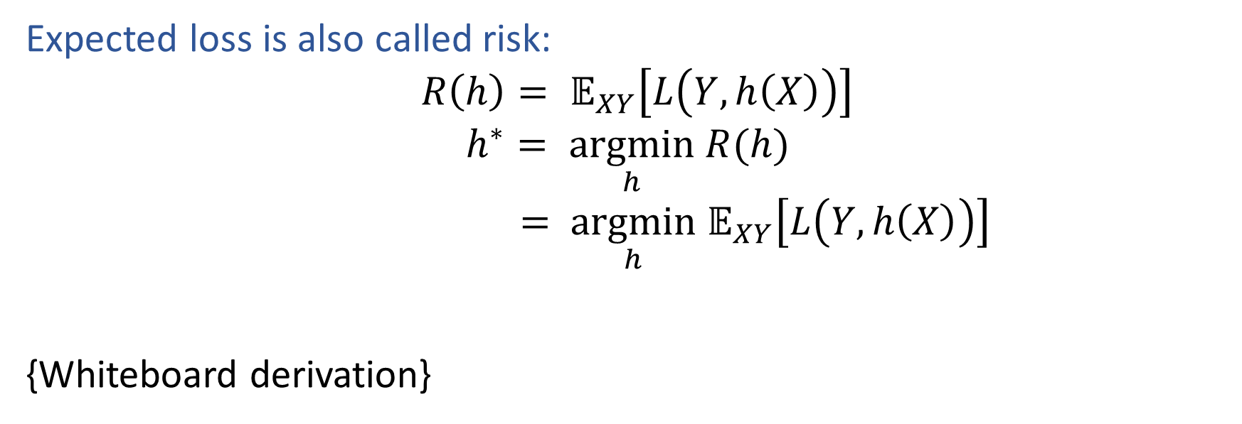
Optimal Classification Function
Expected loss is also called risk:
$$R\left(h\right)= 𝔼_{XY}\left[L\left(Y, h\left(X\right)\right)\right]$$
$$h^{∗}= \underset{h}{argmin} R(h)$$
$$= \underset{h}{argmin} 𝔼_{XY}\left[L\left(Y, h\left(X\right)\right)\right]$$
{Whiteboard derivation}

Slide 13
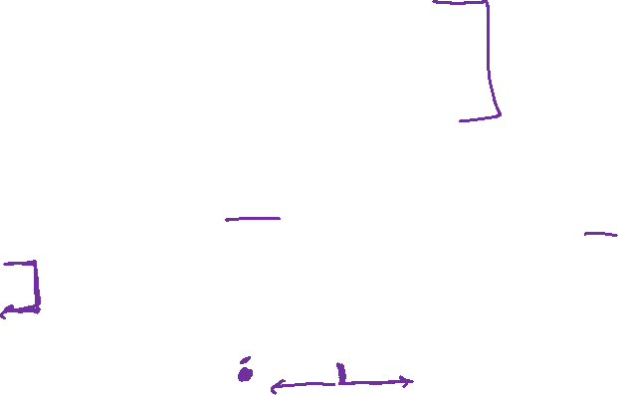

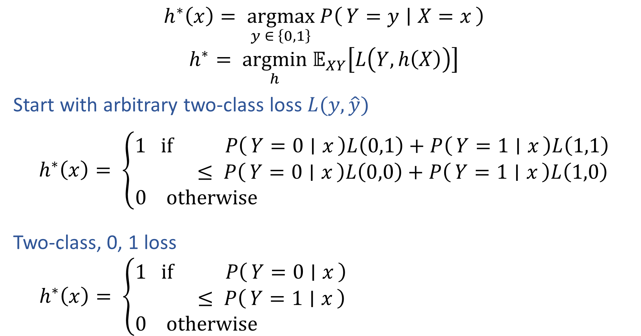
Optimal Classification Function
$$h^{∗}\left(x\right)= \underset{y ∈ \left\{0,1\right\}}{argmax} P\left(Y=y ∣ X=x\right)$$
$$h^{∗}= \underset{h}{argmin} 𝔼_{XY}\left[L\left(Y, h\left(X\right)\right)\right]$$
Start with arbitrary two-class loss $L(y, \hat{y})$
$$h^{∗}\left(x\right)= \left\{\begin{aligned}1 if P\left(Y=0 ∣ x\right)L\left(0,1\right)+P\left(Y=1 ∣ x\right)L\left(1,1\right) \\ ≤ P\left(Y=0 ∣ x\right)L\left(0,0\right)+P\left(Y=1 ∣ x\right)L\left(1,0\right) \\ 0 otherwise \end{aligned}\right.$$
Two-class, 0, 1 loss
$$h^{∗}\left(x\right)= \left\{\begin{aligned}1 if P\left(Y=0 ∣ x\right) \\ ≤ P\left(Y=1 ∣ x\right) \\ 0 otherwise \end{aligned}\right.$$
1
0.5
0
$$h(x)$$

Slide 14

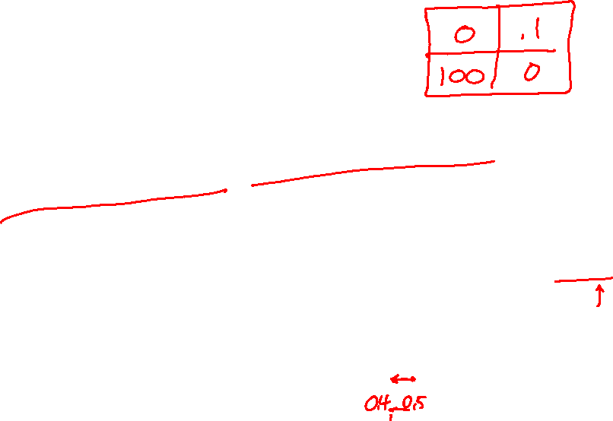
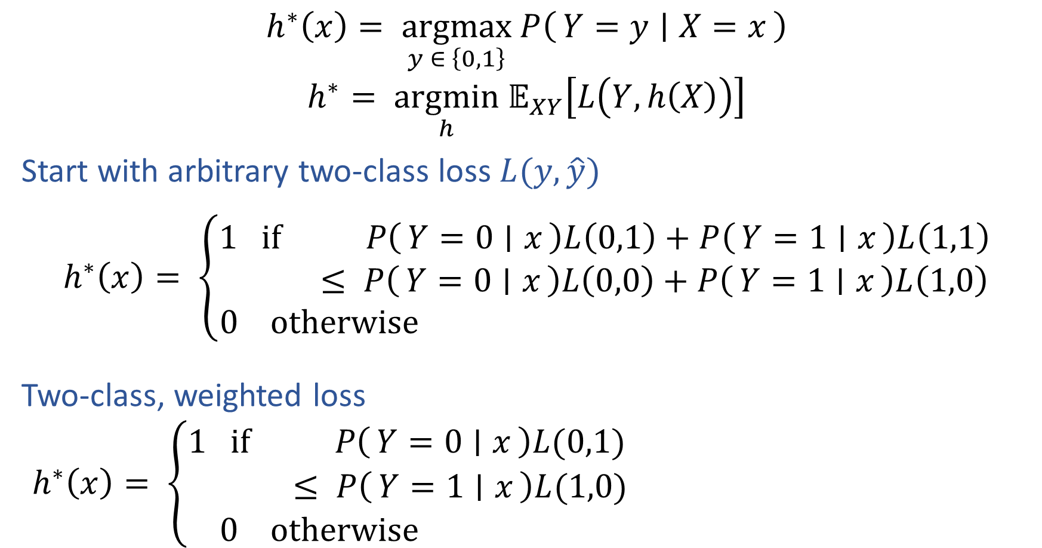


Optimal Classification Function
$$h^{∗}\left(x\right)= \underset{y ∈ \left\{0,1\right\}}{argmax} P\left(Y=y ∣ X=x\right)$$
$$h^{∗}= \underset{h}{argmin} 𝔼_{XY}\left[L\left(Y, h\left(X\right)\right)\right]$$
Start with arbitrary two-class loss $L(y, \hat{y})$
$$h^{∗}\left(x\right)= \left\{\begin{aligned}1 if P\left(Y=0 ∣ x\right)L\left(0,1\right)+P\left(Y=1 ∣ x\right)L\left(1,1\right) \\ ≤ P\left(Y=0 ∣ x\right)L\left(0,0\right)+P\left(Y=1 ∣ x\right)L\left(1,0\right) \\ 0 otherwise \end{aligned}\right.$$
Two-class, weighted loss
$$h^{∗}\left(x\right)= \left\{\begin{aligned}1 if P\left(Y=0 ∣ x\right)L(0,1) \\ ≤ P\left(Y=1 ∣ x\right)L(1,0) \\ 0 otherwise \end{aligned}\right.$$
$$L(1,0)$$
$$0$$
$$L(0,1)$$
0
$$h(x)$$

Slide 15
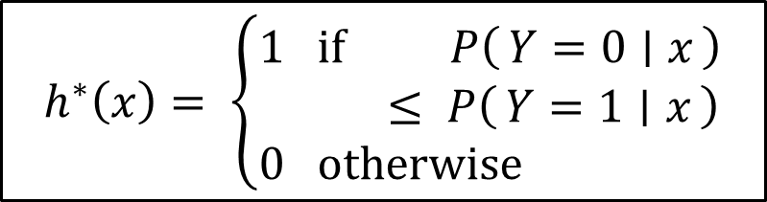

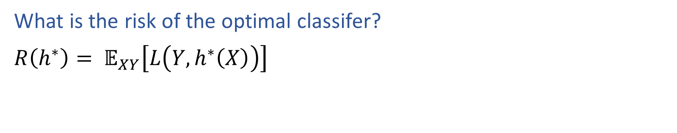
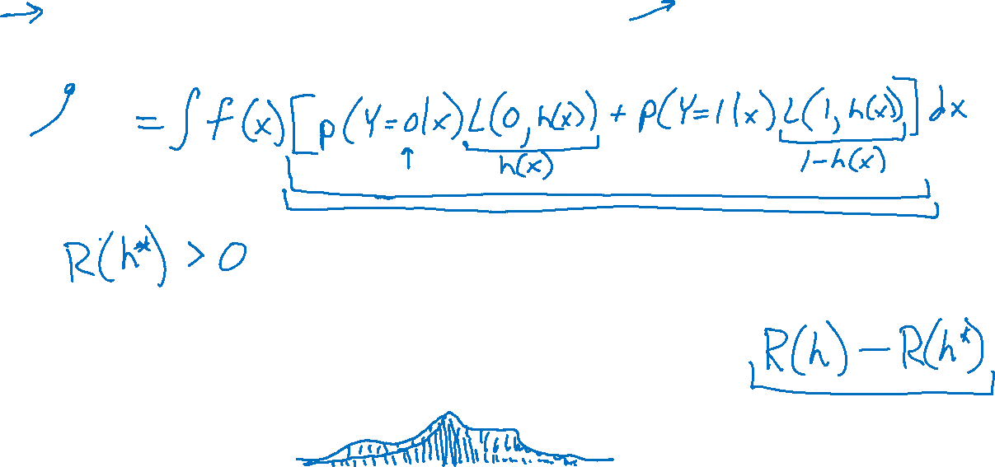
Optimal Classification Function
$$h^{∗}\left(x\right)= \left\{\begin{aligned}1 if P\left(Y=0 ∣ x\right) \\ ≤ P\left(Y=1 ∣ x\right) \\ 0 otherwise \end{aligned}\right.$$
What is the risk of the optimal classifer?
$R\left(h^{∗}\right)= 𝔼_{XY}\left[L\left(Y, h^{∗}\left(X\right)\right)\right]$
1
0.5
0
$$h(x)$$

Slide 16
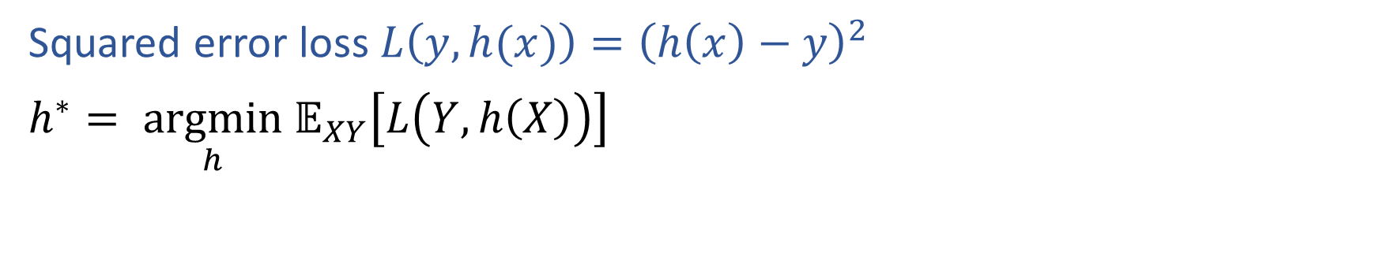
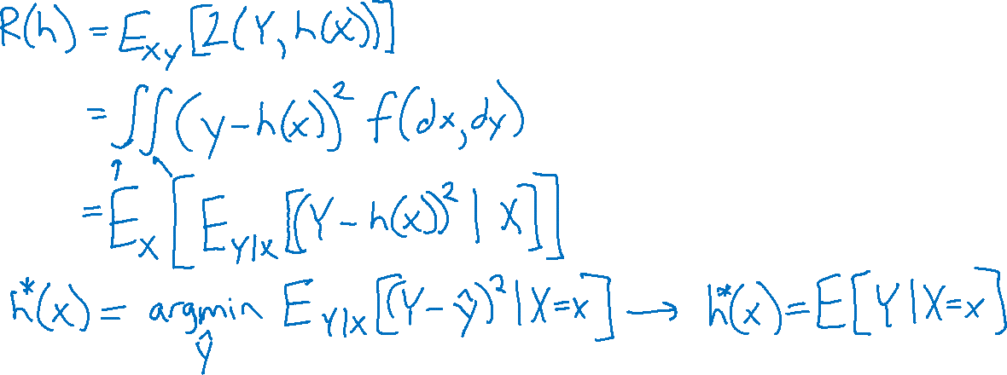
Risk in Regression
Squared error loss $L\left(y, h(x)\right)={\left(h\left(x\right)−y\right)}^{2}$
$h^{∗}= \underset{h}{argmin} 𝔼_{XY}\left[L\left(Y, h\left(X\right)\right)\right]$

Slide 17
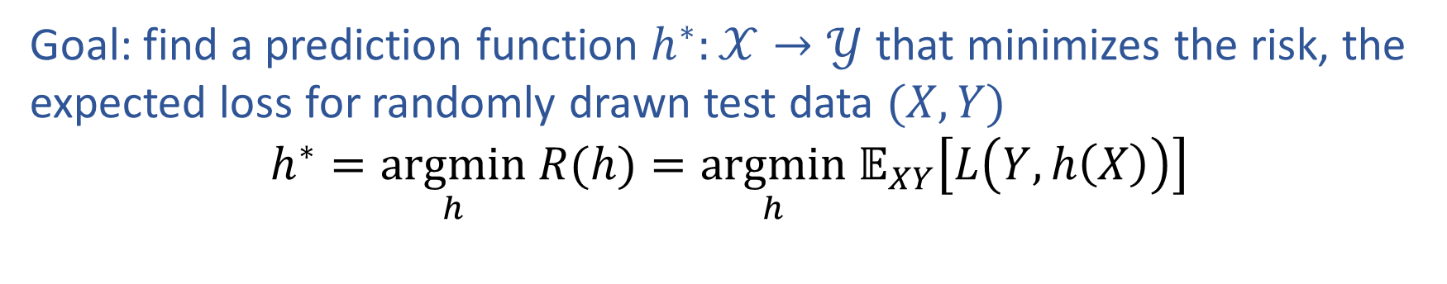

Optimal Hypothesis Function
Goal: find a prediction function $h^{∗}:𝒳→𝒴$ that minimizes the risk, the expected loss for randomly drawn test data $(X, Y)$
$$h^{∗}=\underset{h}{argmin} R(h)=\underset{h}{argmin} 𝔼_{XY}\left[L\left(Y, h\left(X\right)\right)\right]$$

Slide 18
Learning from Training Data
But we want our hypothesis function to generalize well?
How do we characterize and quantify this trade-off?
{Back to the whiteboard}

