Slide 1
Announcements
Assignments
HW9 (online)
    Due Thu 4/16, 11:59 pm

Slide 2
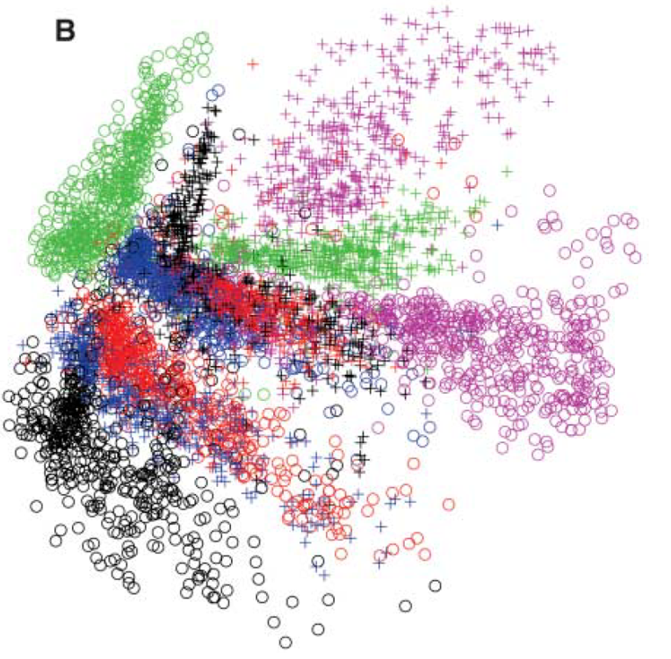
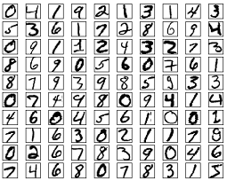
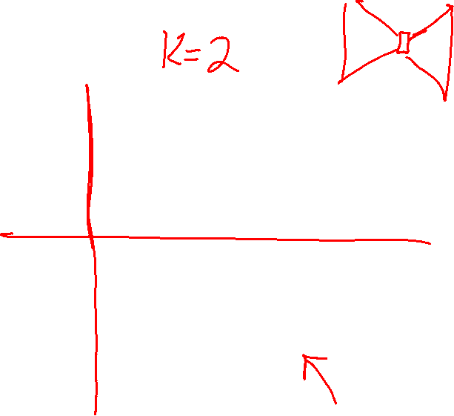
Dimensionality Reduction
MNIST digit autoencoder
Image: Hinton & Salakhutdinov. Science 313.5786 (2006): 504-507.

Slide 3
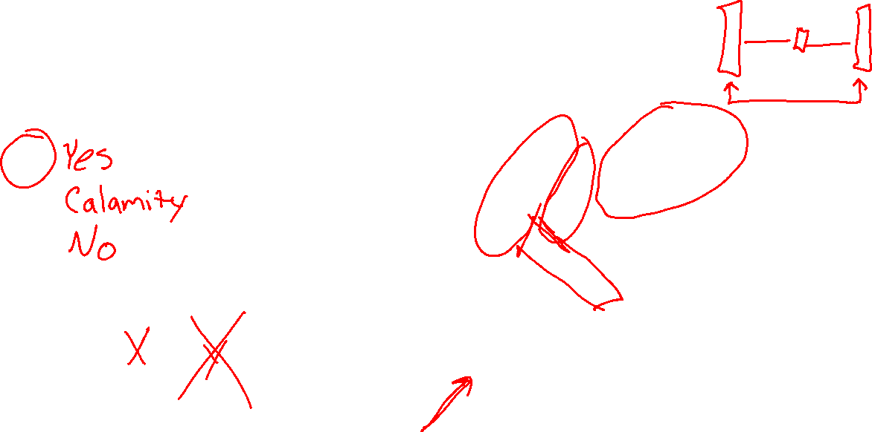
Piazza Poll 1
Are autoencoders an example of unsupervised learning?
Image: Hinton & Salakhutdinov. Science 313.5786 (2006): 504-507.

Slide 4
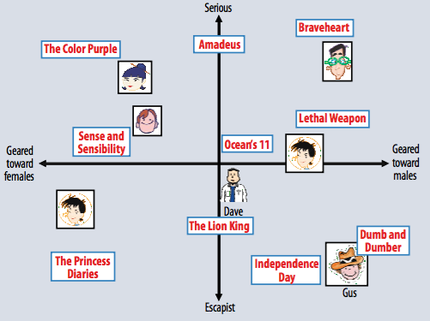
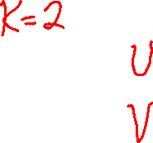
Recommender Systems
Matrix Factorization
Figures from Koren et al. (2009)

Slide 5
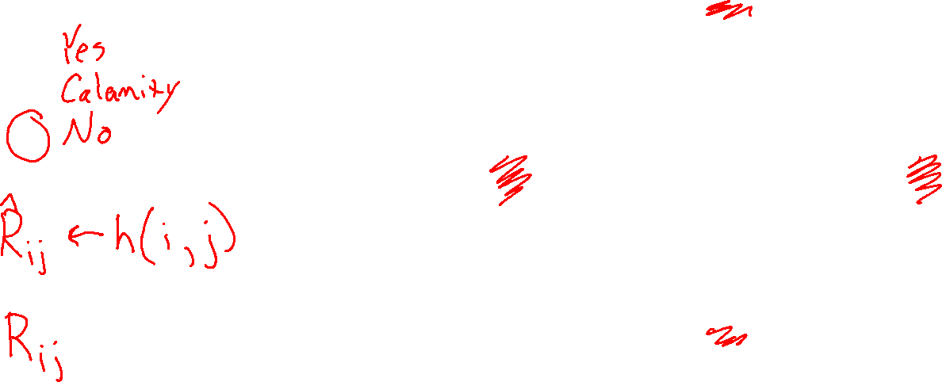
Piazza Poll 2
Are recommender systems an example of unsupervised learning?
Figures from Koren et al. (2009)

Slide 6
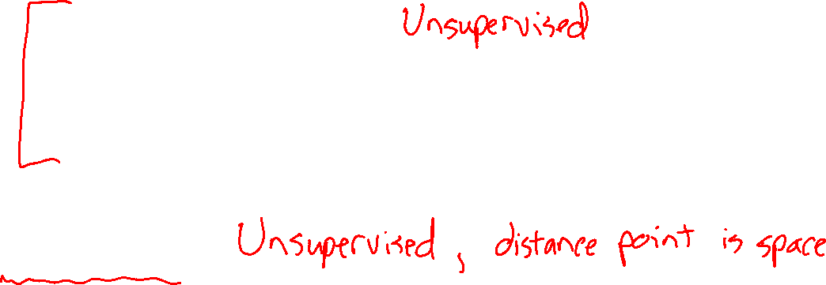
Plan
Last week
Dimensionality reduction
    PCA
    Autoencoders
Recommender systems
This week
Clustering
Next week
Learning Theory

Slide 7
Introduction to
Machine Learning
Clustering
Instructor: Pat Virtue

Slide 8
Clustering, Informal Goals
Goal: Automatically partition unlabeled data into groups of similar datapoints.
Question: When and why would we want to do this?
Useful for:
• Automatically organizing data.
• Understanding hidden structure in data.
• Preprocessing for further analysis.
• Representing high-dimensional data in a low-dimensional space (e.g., for visualization purposes).
Slide credit: CMU MLD Nina Balcan

Slide 9





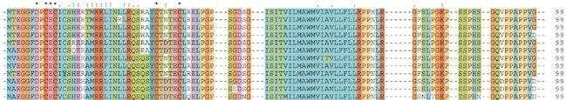
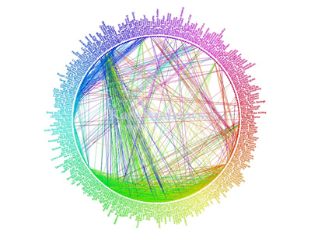
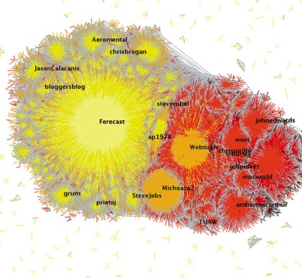
Applications (Clustering comes up everywhere…)
Cluster news articles or web pages or search results by topic.
Cluster protein sequences by function or genes according to expression profile.
Cluster users of social networks by interest (community detection).
Facebook network
Twitter Network
Slide credit: CMU MLD Nina Balcan

Slide 10

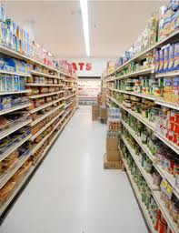
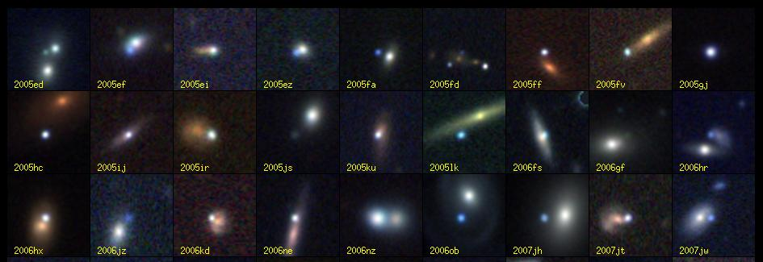
Applications (Clustering comes up everywhere…)
Cluster customers according to purchase history.
Cluster galaxies or nearby stars (e.g. Sloan Digital Sky Survey)
And many many more applications….
Slide credit: CMU MLD Nina Balcan

Slide 11
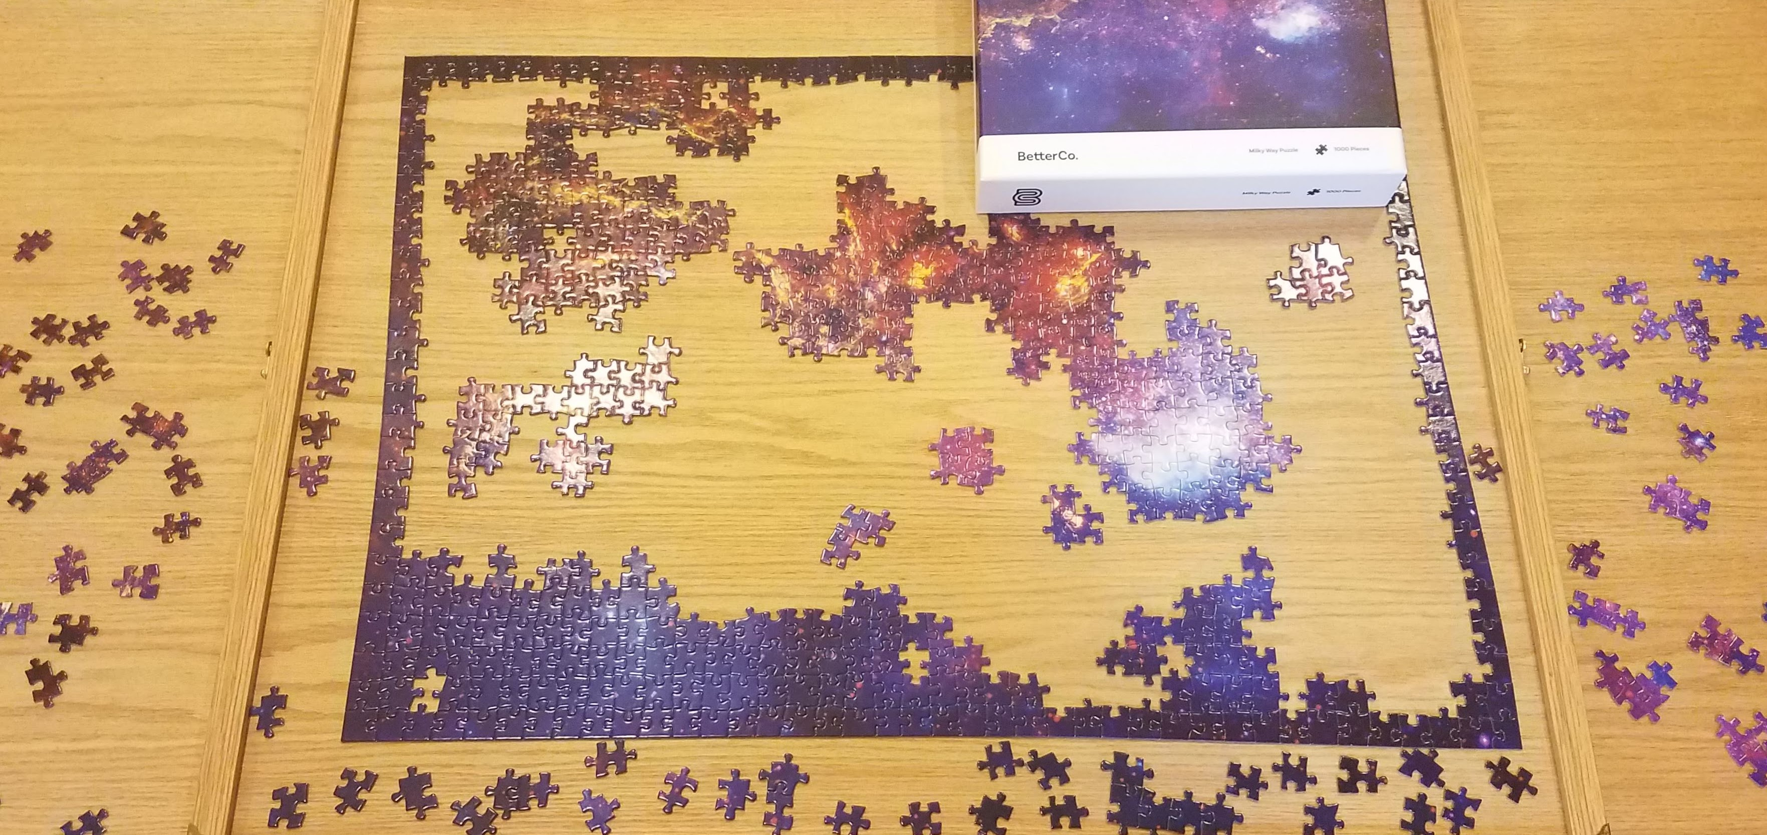
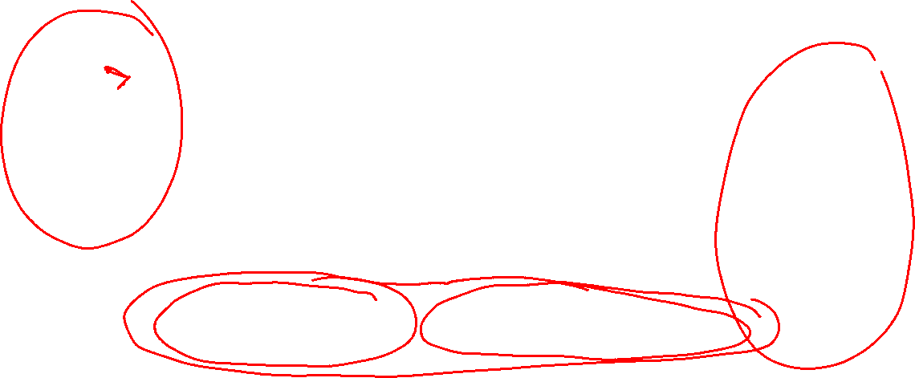
Clustering Applications
Jigsaw puzzles!

Slide 12
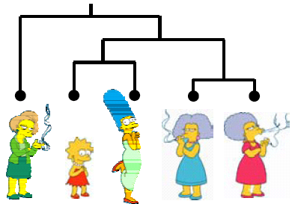
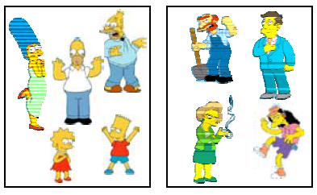
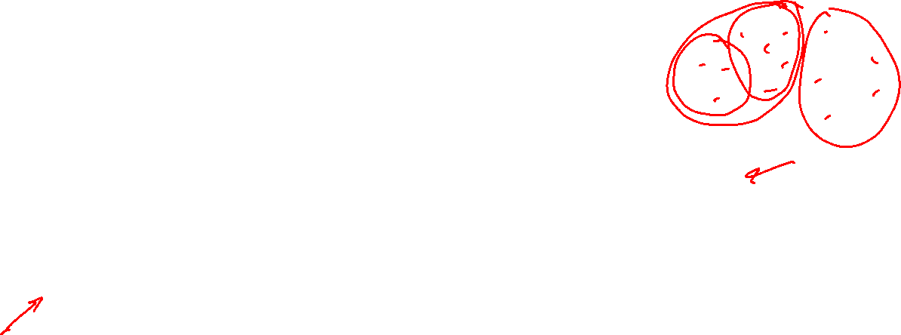
Clustering Algorithms
Hierarchical algorithms
    Bottom-up: Agglomerative Clustering
    Top-down: Divisive
Partition algorithms
    K means clustering
    Mixture-Model based clustering
Slide credit: CMU MLD Aarti Singh and Eric Xing

Slide 13
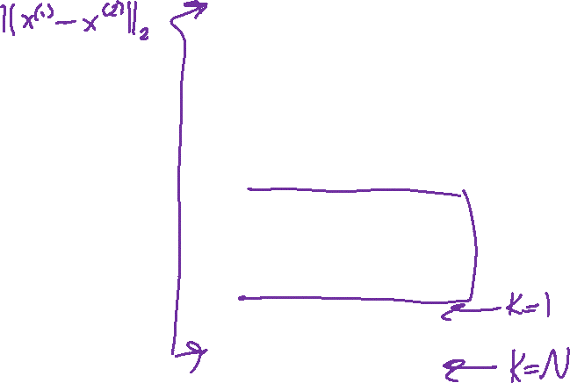
Hierarchical Clustering
Bottom-Up Agglomerative Clustering
  Starts with each object in a separate cluster, and repeat:
  Joins the most similar pair of clusters,
  Update the similarity of the new cluster to others
  until there is only one cluster.
  Greedy – less accurate but simple to implement
Top-Down divisive
  Starts with all the data in a single cluster, and repeat:
  Split each cluster into two using a partition algorithm
  Until each object is a separate cluster.
  More accurate but complex to implement
Slide credit: CMU MLD Aarti Singh and Eric Xing

Slide 14
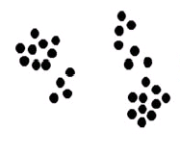
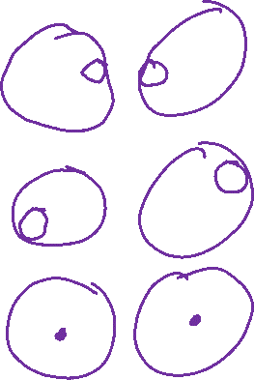
Bottom-up Agglomerative clustering
Different algorithms differ in how the similarities are defined (and hence updated) between two clusters
Single-Linkage
  Nearest Neighbor: similarity between
  their closest members.
Complete-Linkage
  Furthest Neighbor: similarity between
  their furthest members.
Centroid
  Similarity between the centers of gravity
Average-Linkage
  Average similarity of all cross-cluster pairs.
Slide credit: CMU MLD Aarti Singh

Slide 15
Single-Linkage Method
Euclidean Distance
a
a,b
b
a,b,c
a,b,c,d
c
d
c
d
d
(1)
(2)
(3)
Distance Matrix
Slide credit: CMU MLD Aarti Singh and Eric Xing

Slide 16
Complete-Linkage Method
Euclidean Distance
a
a,b
a,b
b
a,b,c,d
c,d
c
d
c
d
(1)
(2)
(3)
Distance Matrix
Slide credit: CMU MLD Aarti Singh and Eric Xing

Slide 17
Dendrograms
Single-Linkage
Complete-Linkage
0
2
4
6
Slide credit: CMU MLD Aarti Singh and Eric Xing

Slide 18
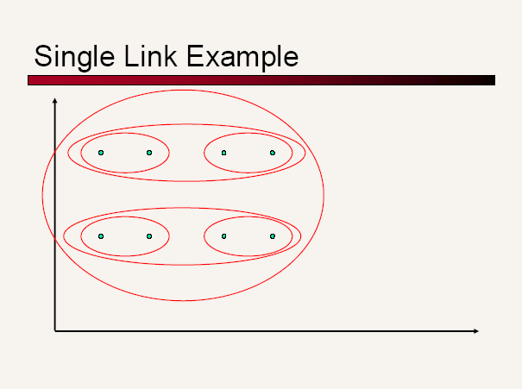
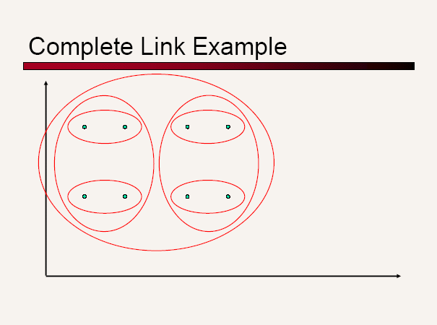
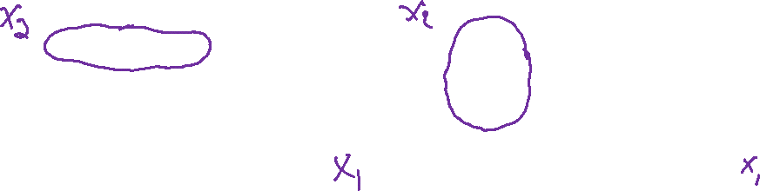
Another Example
Slide credit: CMU MLD Aarti Singh

Slide 19
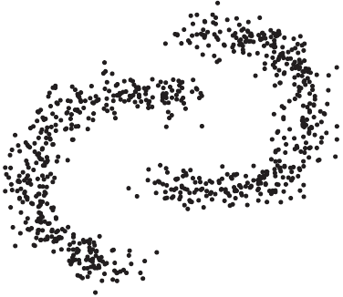
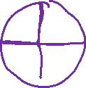
Single vs. Complete Linkage
Shape of clusters
Single-linkage allows anisotropic and
non-convex shapes
Complete-linkage assumes isotopic, convex
shapes
Slide credit: CMU MLD Aarti Singh

Slide 20
Computational Complexity
All hierarchical clustering methods need to compute similarity of all pairs of n individual instances which is O(n²).
At each iteration,
  Sort similarities to find largest one O(n²log n).
  Update similarity between merged cluster and other clusters.
  Computing similarity to each other cluster can be done in constant time.
So we get O(n² log n) or O(n³) (if naïvely implemented)
Slide credit: CMU MLD Aarti Singh
Notes:
Constant time?

Slide 21
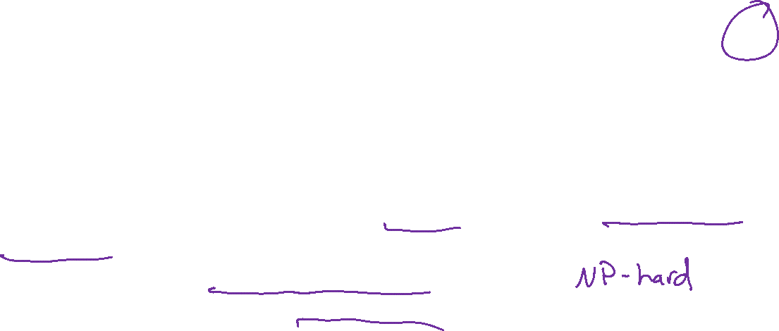
Partitioning Algorithms
Partitioning method: Construct a partition of N objects into a set of K clusters
Given: a set of objects and the number K
Find: a partition of K clusters that optimizes the chosen partitioning criterion
  Globally optimal: exhaustively enumerate all partitions
  Effective heuristic method: K-means algorithm
Slide credit: CMU MLD Aarti Singh

Slide 22
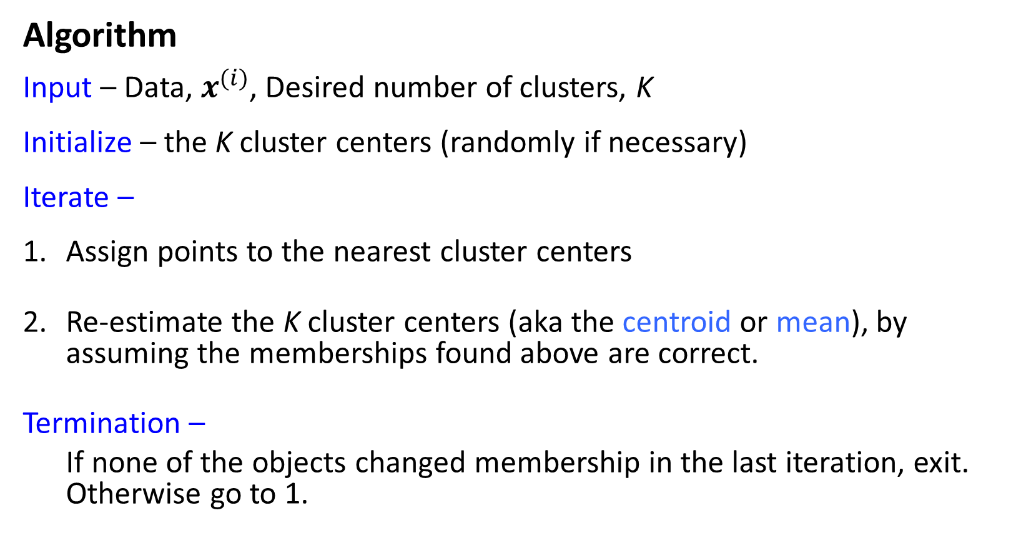
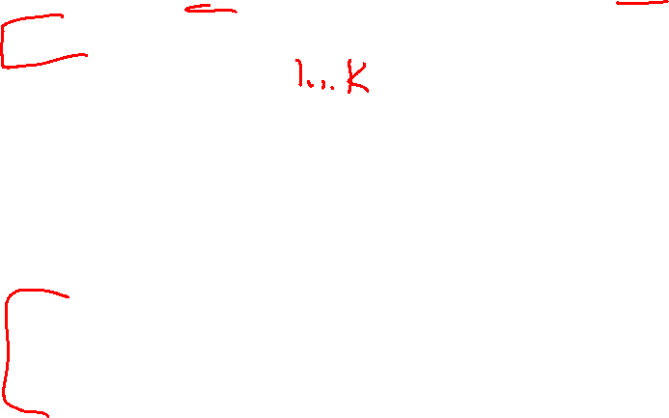
K-Means
Algorithm
Input – Data, $x^{(i)}$, Desired number of clusters, K
Initialize – the K cluster centers (randomly if necessary)
Iterate –
Assign points to the nearest cluster centers
Re-estimate the K cluster centers (aka the centroid or mean), by assuming the memberships found above are correct.
Termination –
If none of the objects changed membership in the last iteration, exit. Otherwise go to 1.
Slide credit: CMU MLD Aarti Singh

Slide 23
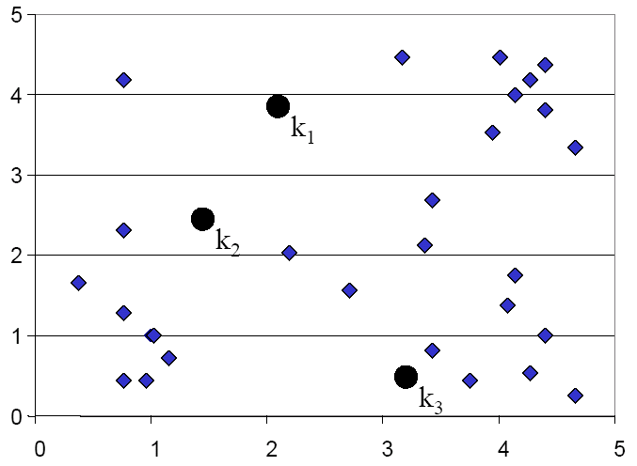
K-means Clustering: Step 1
Voronoi
diagram
Slide credit: CMU MLD Eric Xing

Slide 24
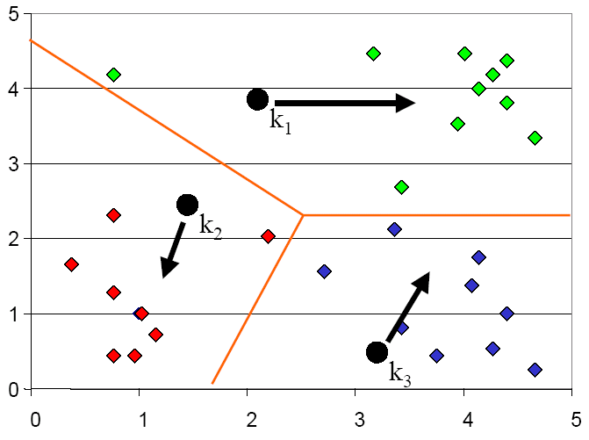
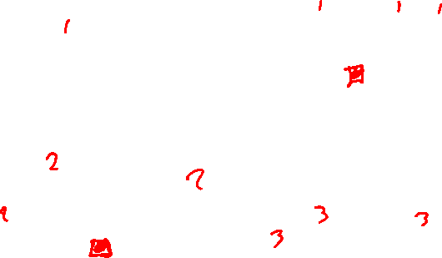
K-means Clustering: Step 2
Slide credit: CMU MLD Eric Xing

Slide 25
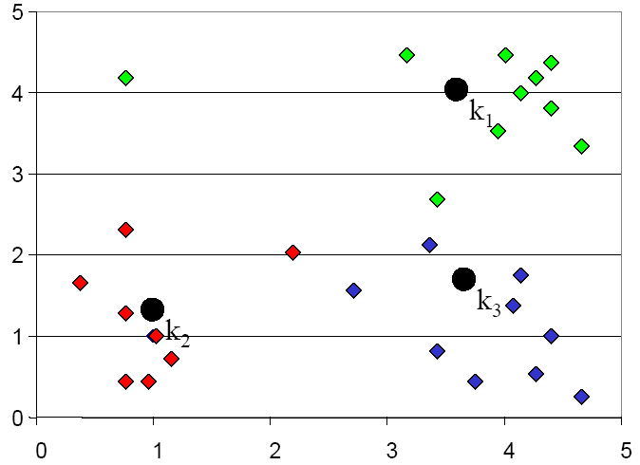
K-means Clustering: Step 3
Slide credit: CMU MLD Eric Xing

Slide 26
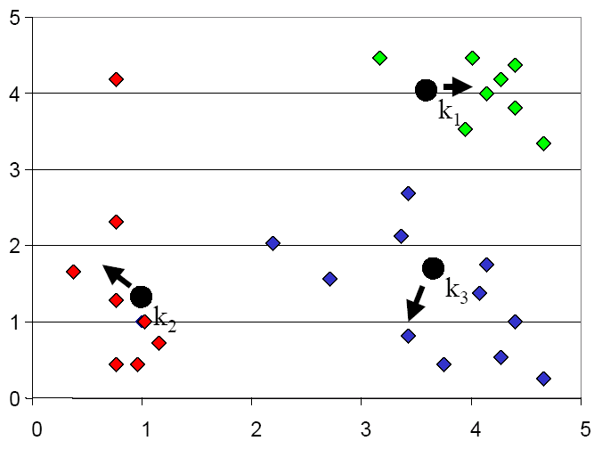
K-means Clustering: Step 4
Slide credit: CMU MLD Eric Xing

Slide 27
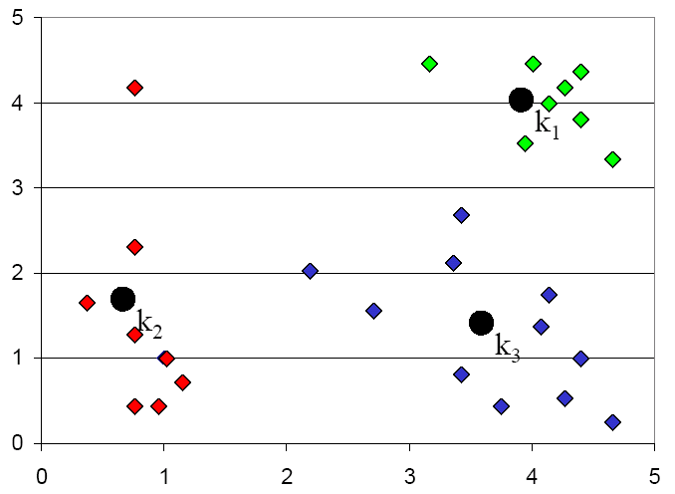
K-means Clustering: Step 5
Slide credit: CMU MLD Eric Xing

Slide 28
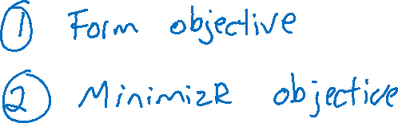
K-means Optimization
Optimization recipe
Slide credit: CMU MLD Matt Gormley

Slide 29
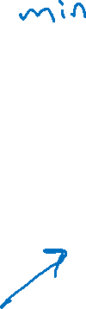
K-means Optimization
Question: Which of these partitions is “better”?
Slide credit: CMU MLD Matt Gormley

Slide 30
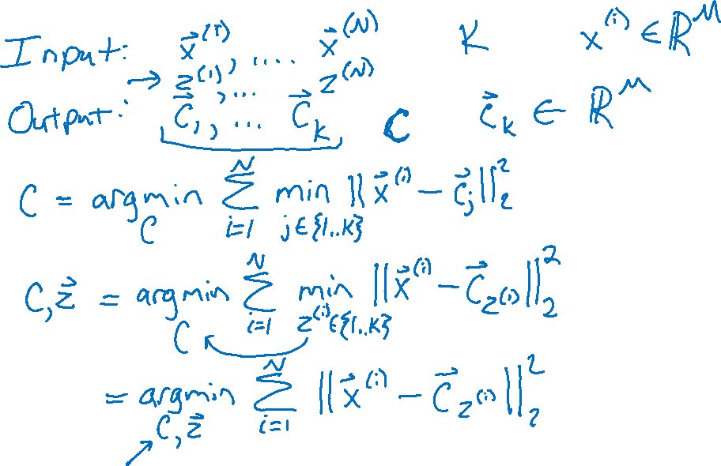
K-means Optimization
Slide credit: CMU MLD Matt Gormley

Slide 31
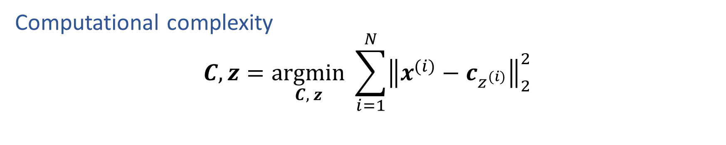
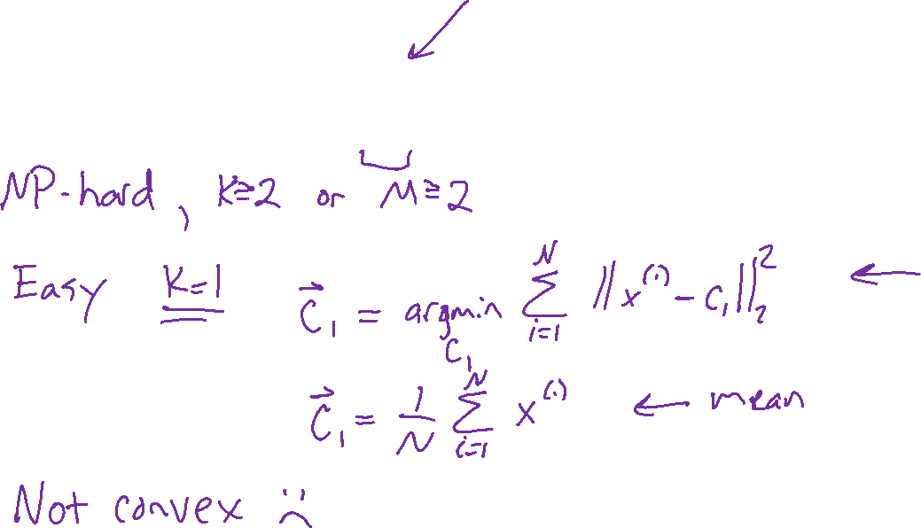
K-means Optimization
Computational complexity
$$C,z=\underset{C, z}{argmin} \sum_{i=1}^{N}{{\left\|x^{(i)}−c_{z^{(i)}}\right\|}_{2}^{2}}$$
Slide credit: CMU MLD Matt Gormley

Slide 32
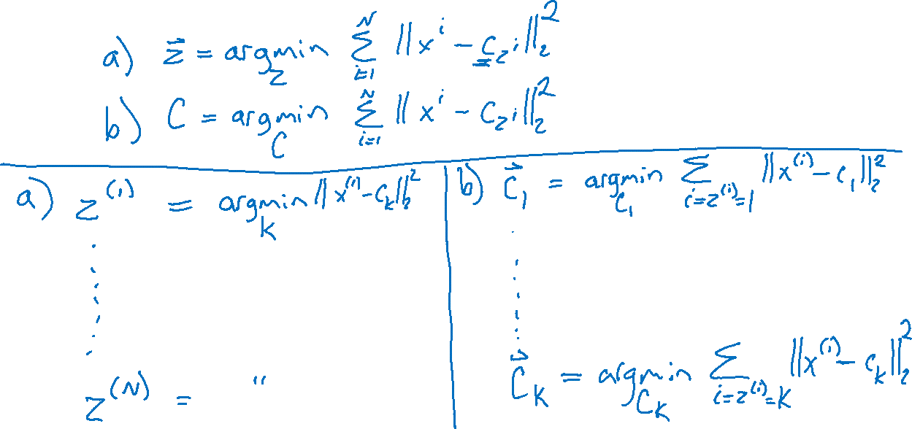
K-means Optimization
Alternating minimization
Slide credit: CMU MLD Matt Gormley

Slide 33
K-means Optimization
Alternating minimization

Slide 34
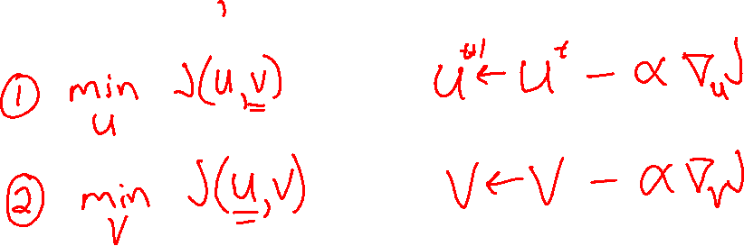
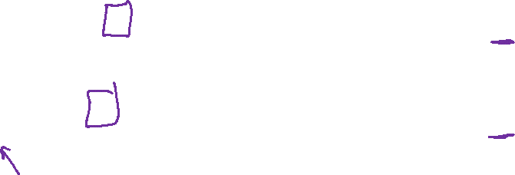
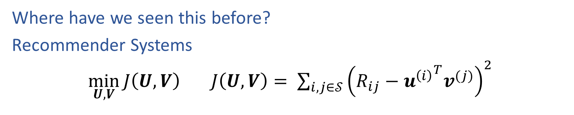
Alternating minimization
Where have we seen this before?
Recommender Systems
$\min_{U,V}{J\left(U,V\right)}$ $J\left(U,V\right)= \sum_{i,j∈𝒮}{{\left(R_{ij}−{u^{\left(i\right)}}^{T}v^{(j)}\right)}^{2}}$

Slide 35
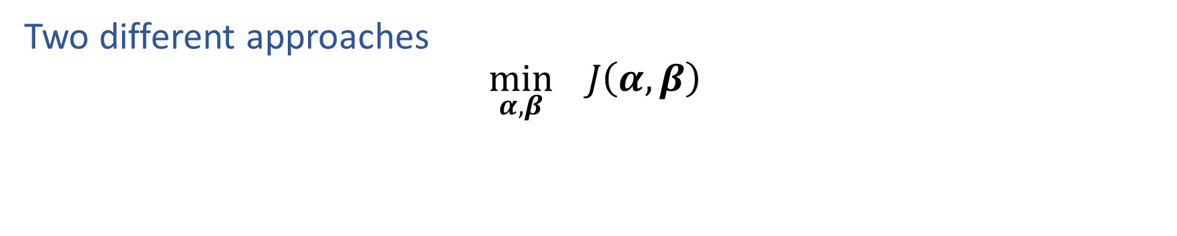
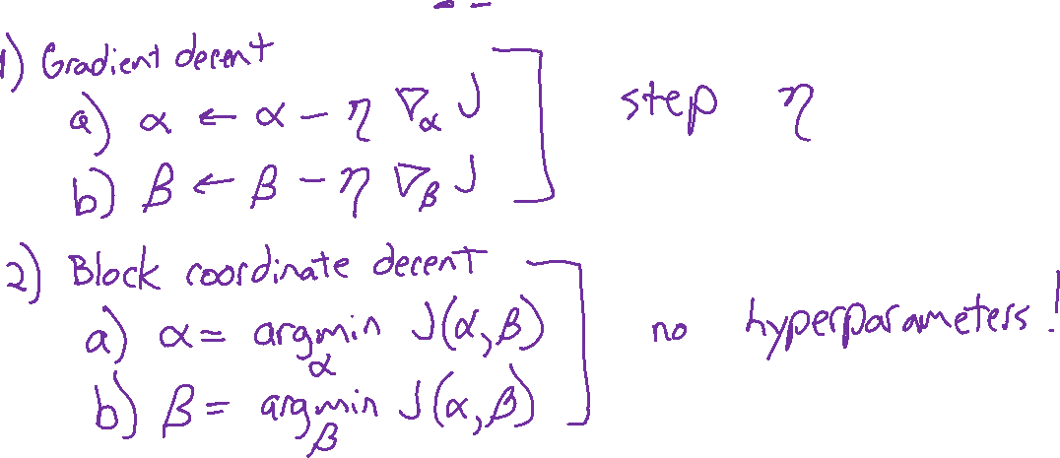
Alternating minimization
Two different approaches
$$\min_{α,β}{ J\left(α,β\right)}$$

Slide 36
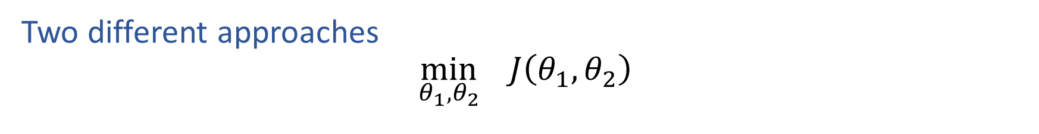
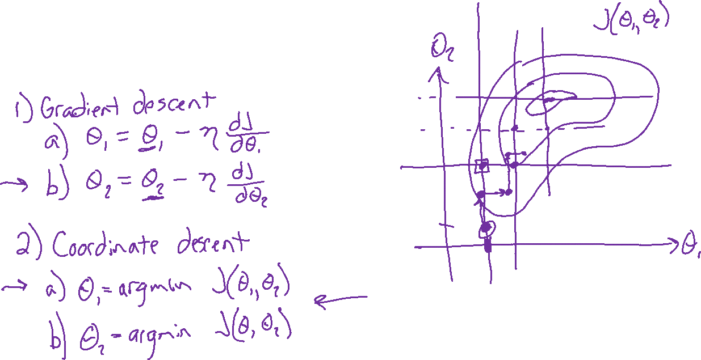
Alternating minimization
Two different approaches
$$\min_{θ_{1},θ_{2}}{ J\left(θ_{1},θ_{2}\right)}$$

Slide 37
Computational Complexity
At each iteration,
  Computing cluster centers: Each object gets added once to some cluster: O(N)
  Computing distance between each of the N objects and the K cluster centers is O(KN)
Assume these two steps are each done once for l iterations: O(lKN)
Slide credit: CMU MLD Aarti Singh
Notes:
Why does k-means converge? How many steps?

Slide 38
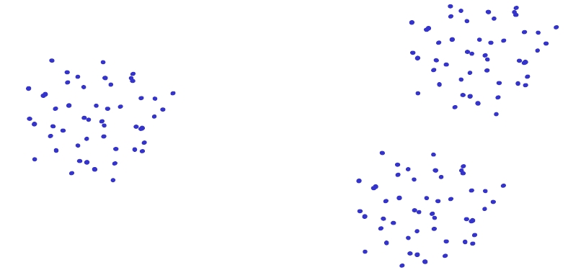
Issues: Seed Choice
Results are quite sensitive to seed selection.
Slide credit: CMU MLD Aarti Singh

Slide 39
Issues: Seed Choice
Results are quite sensitive to seed selection.
Slide credit: CMU MLD Aarti Singh

Slide 40
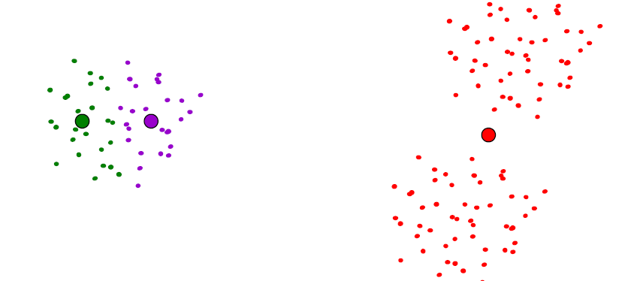
Issues: Seed Choice
Results are quite sensitive to seed selection.
Slide credit: CMU MLD Aarti Singh

Slide 41

Issues: Seed Choice
K-means always converges, but it may converge at a local optimum that is different from the global optimum, and in fact could be arbitrarily worse in terms of its objective.
Slide credit: CMU MLD Nina Balcan

Slide 42

Issues: Seed Choice
Results can vary based on random seed selection.
Some seeds can result in poor convergence rate, or convergence to sub-optimal clustering.
  Try out multiple starting points (very important!!!)
  k-means ++ algorithm of Arthur and Vassilvitskii
  key idea: choose centers that are far apart
  (probability of picking a point as cluster center distance from nearest center picked so far)
Slide credit: CMU MLD Aarti Singh

Slide 43



Other Issues
Shape of clusters
  Assumes isotropic, equal variance, convex clusters
Sensitive to Outliers
– use K-medoids
Slide credit: CMU MLD Aarti Singh

Slide 44

K-medoids
Use actual training point as cluster center (medoid) rather than mean
More robust to outliers pulling the mean away
Better interpretability, can “visualize” the medoid
More work to compute medoid than mean

Slide 45



Other Issues
Number of clusters K
  Objective function
  Look for “Knee” in objective function
  Can you pick K by minimizing the objective over K?
Slide credit: CMU MLD Aarti Singh

Slide 46




K-means algorithm
K-means algorithm: (coordinate descent on F)
(1)
(2)
Expected cluster assignment
Maximum likelihood for center
Next lecture, we will see a generalization of this approach:
EM algorithm
Slide credit: CMU MLD Aarti Singh
TexPoint fonts used in EMF.
Read the TexPoint manual before you delete this box.: AAAAAAAAA

