Slide 1
Announcements
Assignments
HW8 (written + programming)
    Due Thu 4/9, 11:59 pm

Slide 2
Introduction to
Machine Learning
Recommender Systems
Instructor: Pat Virtue

Slide 3
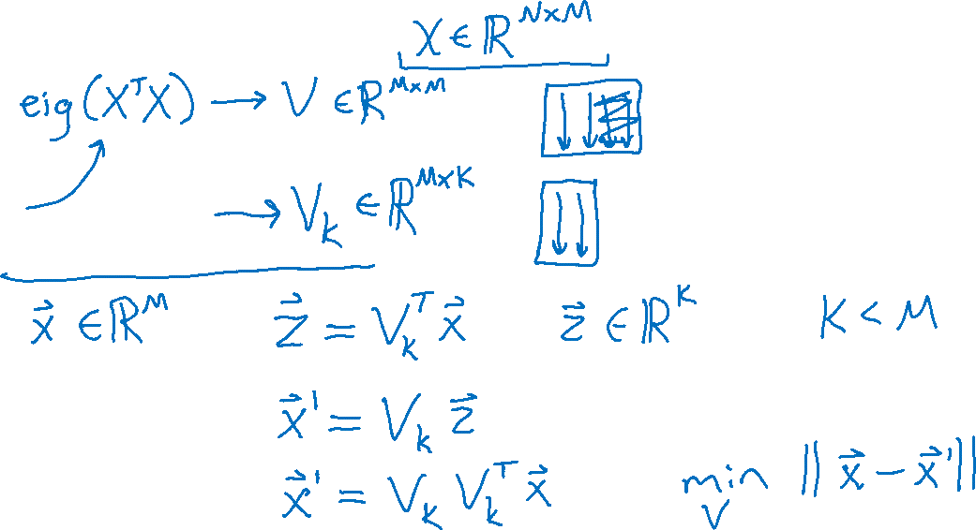
Background: Low Dimensional Embeddings
PCA: What did we do?

Slide 4
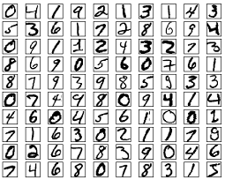

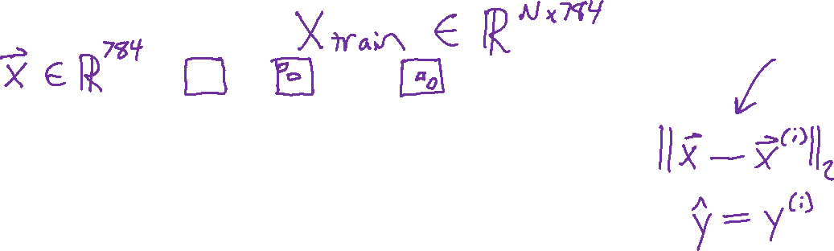
Background: Low Dimensional Embeddings
Why might low dimensional embeddings be useful?
Example: MNIST digit classification with nearest neighbor

Slide 5
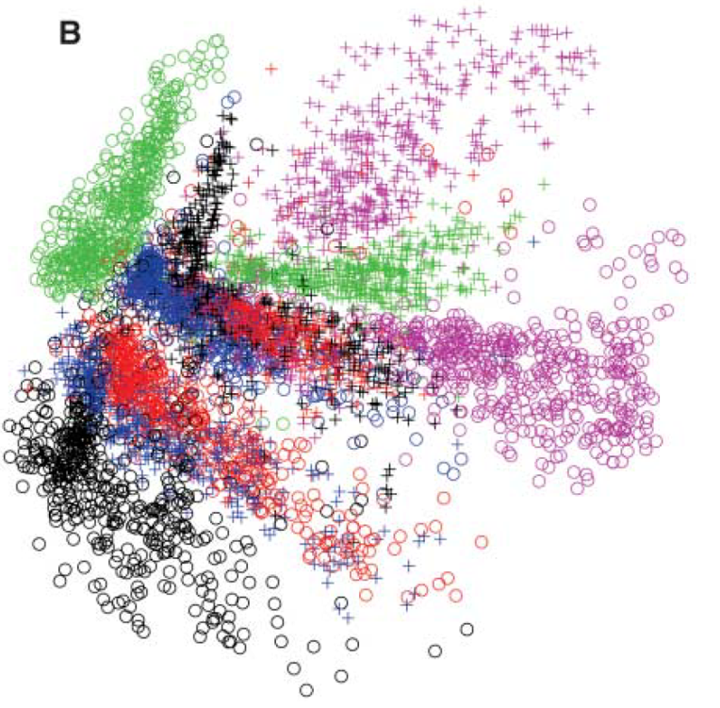
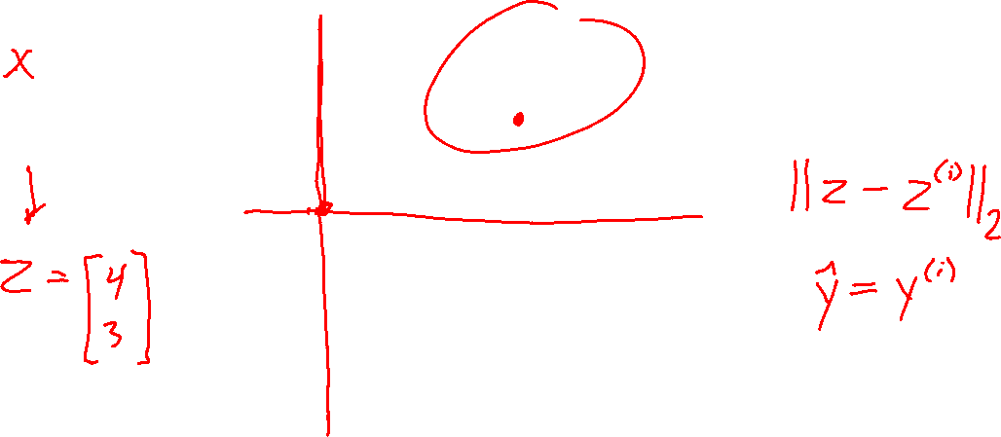
Background: Low Dimensional Embeddings
Why might low dimensional embeddings be useful?
Example: MNIST digit classification with nearest neighbor
Image: Hinton & Salakhutdinov. Science 313.5786 (2006): 504-507.

Slide 6
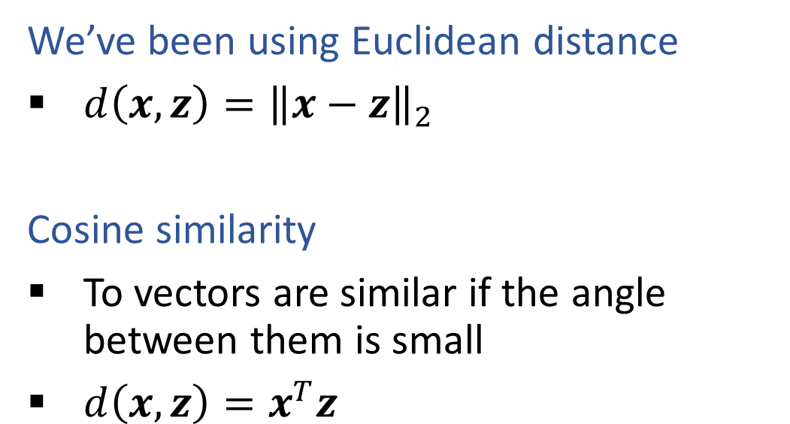
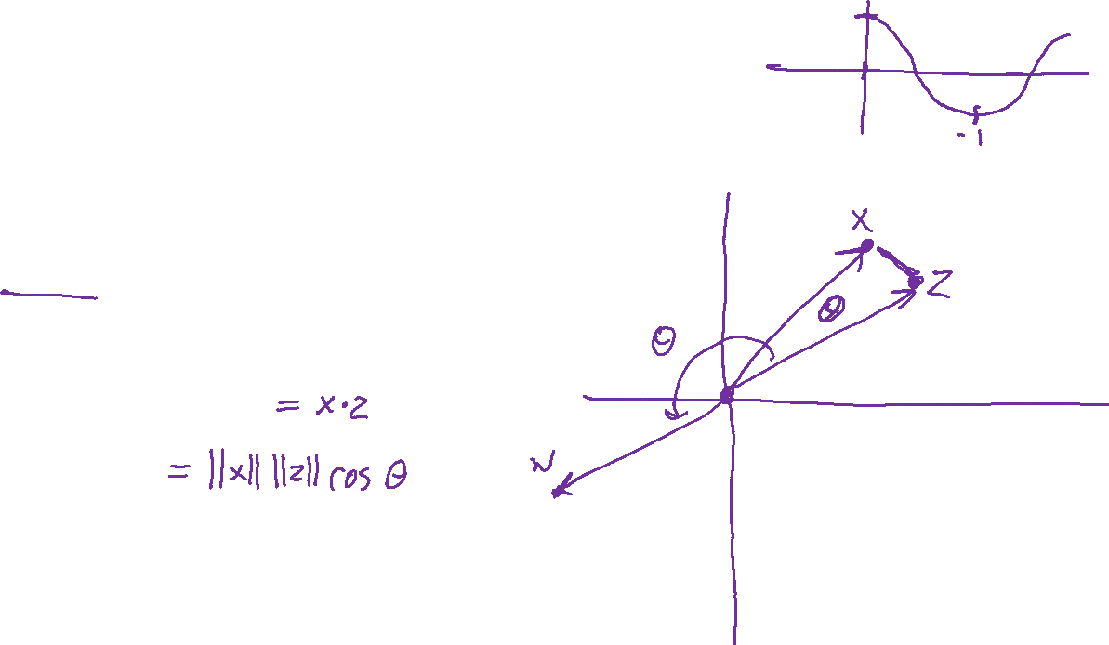
Background: Measure of Similarity
We’ve been using Euclidean distance
$d\left(x, z\right)={\left\|x−z\right\|}_{2}$
Cosine similarity
To vectors are similar if the angle between them is small
$d\left(x, z\right)=x^{T}z$
Image: Hinton & Salakhutdinov. Science 313.5786 (2006): 504-507.

Slide 7
Recommender Systems
A Common Challenge:
  Assume you’re a company selling items of some sort: movies, songs, products, etc.
  Company collects millions of ratings from users of their items
  To maximize profit / user happiness, you want to recommend items that users are likely to want
Slide credit: CMU MLD Matt Gormley

Slide 8

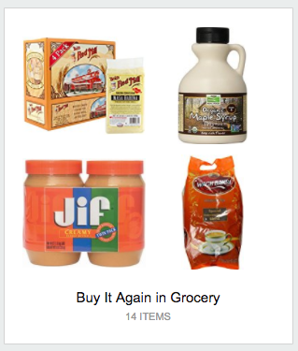
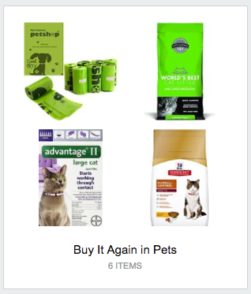
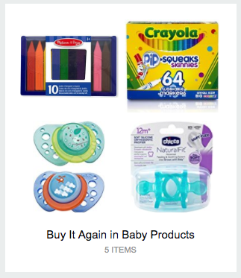
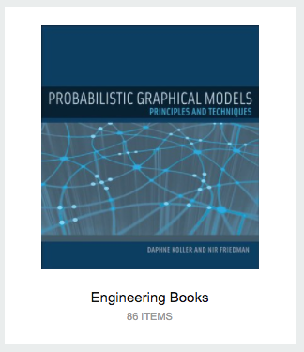
Recommender Systems
Slide credit: CMU MLD Matt Gormley

Slide 9
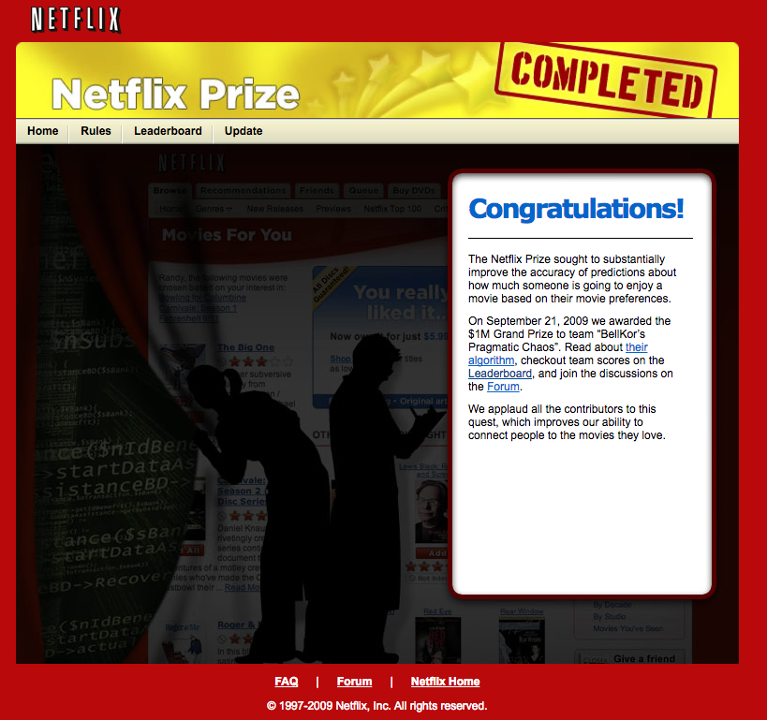
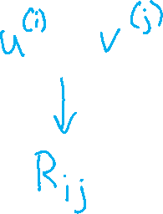
Recommender Systems
Slide credit: CMU MLD Matt Gormley

Slide 10

Recommender Systems
Slide credit: CMU MLD Matt Gormley

Slide 11
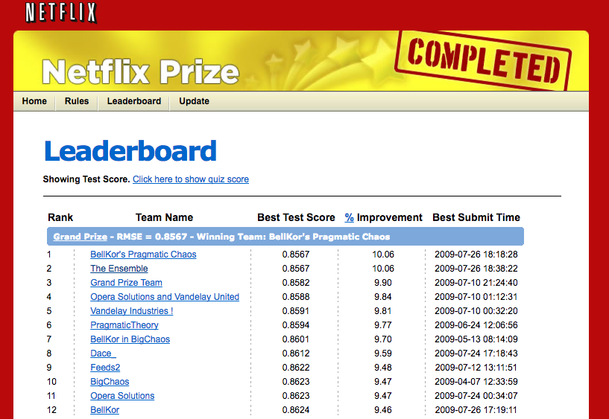

Recommender Systems
Problem Setup
500,000 users
20,000 movies
100 million ratings
Goal: To obtain lower root mean squared error (RMSE) than Netflix’s existing system on 3 million held out ratings
Slide credit: CMU MLD Matt Gormley

Slide 12

Recommender Systems
Setup:
  Items:
  movies, songs, products, etc.
  (often many thousands)
  Users:
  watchers, listeners, purchasers, etc.
  (often many millions)
  Feedback:
  5-star ratings, not-clicking ‘next’, purchases, etc.
Key Assumptions:
  Can represent ratings numerically as a user/item matrix
  Users only rate a small number of items (the matrix is sparse)
 | Doctor Strange | Star Trek: Beyond | Zootopia
Alita | 1 |  | 5
BB-8 | 3 | 4
C-3P0 | 3 | 5 | 2
Slide credit: CMU MLD Matt Gormley

Slide 13
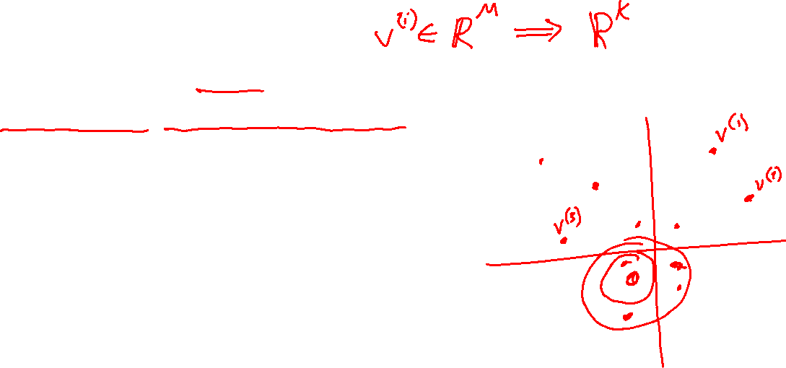
Different Approaches
Item-based (Content filtering)
Features about each item
Given an item, other “close” items have similar values
e.g. Pandora.com, music genome project

Slide 14

Different Approaches
Item-based (Content filtering)
Features about each item
Given an item, other “close” items have similar values
e.g. Pandora.com, music genome project
User-based
Features about each user
Given a user, other “close” users have similar preferences
Market segmentation
Learning user-item relationship
Can be done without features on either user or item
Collaborative filtering techniques

Slide 15
Collaborative Filtering

Slide 16

Collaborative Filtering
Everyday Examples of Collaborative Filtering...
  Bestseller lists
  Top 40 music lists
  The “recent returns” shelf at the library
  Unmarked but well-used paths thru the woods
  The printer room at work
  “Read any good books lately?”
  …
Common insight: personal tastes are correlated
  If Alita and BB-8 both like X and Alita likes Y then BB-8 is more likely to like Y
  especially (perhaps) if BB-8 knows Alita
Slide from William Cohen

Slide 17
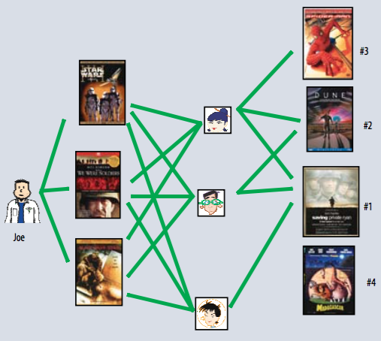
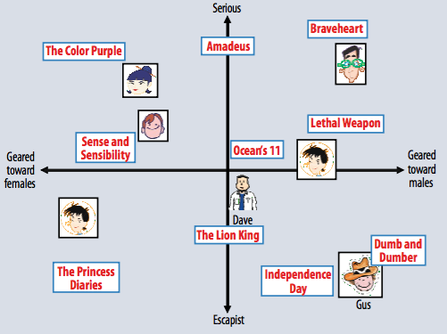
Two Types of Collaborative Filtering
1. Neighborhood Methods
2. Latent Factor Methods
Figures from Koren et al. (2009)

Slide 18
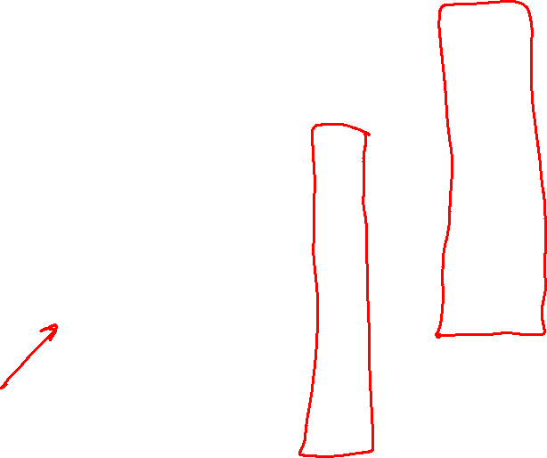
Two Types of Collaborative Filtering
1. Neighborhood Methods
In the figure, assume that a green line indicates the movie was watched
Algorithm:
Find neighbors based on similarity of movie preferences
Recommend movies that those neighbors watched
Figures from Koren et al. (2009)

Slide 19
Two Types of Collaborative Filtering
2. Latent Factor Methods
Assume that both movies and users live in some low-dimensional space describing their properties
Recommend a movie based on its proximity to the user in the latent space
Example Algorithm: Matrix Factorization
Figures from Koren et al. (2009)

Slide 20
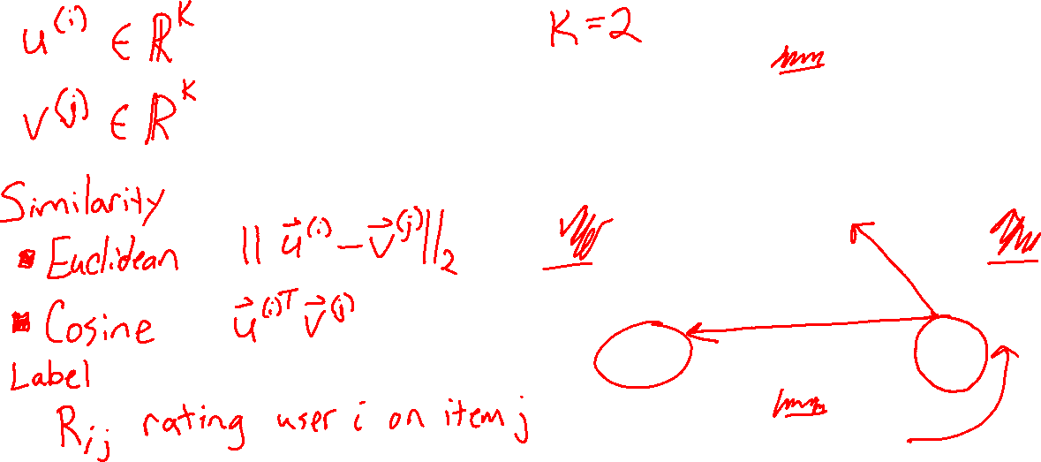
Recommender System: Matrix Factorization
Learning to map items and users to the same lower dimensional space
Figures from Koren et al. (2009)

Slide 21
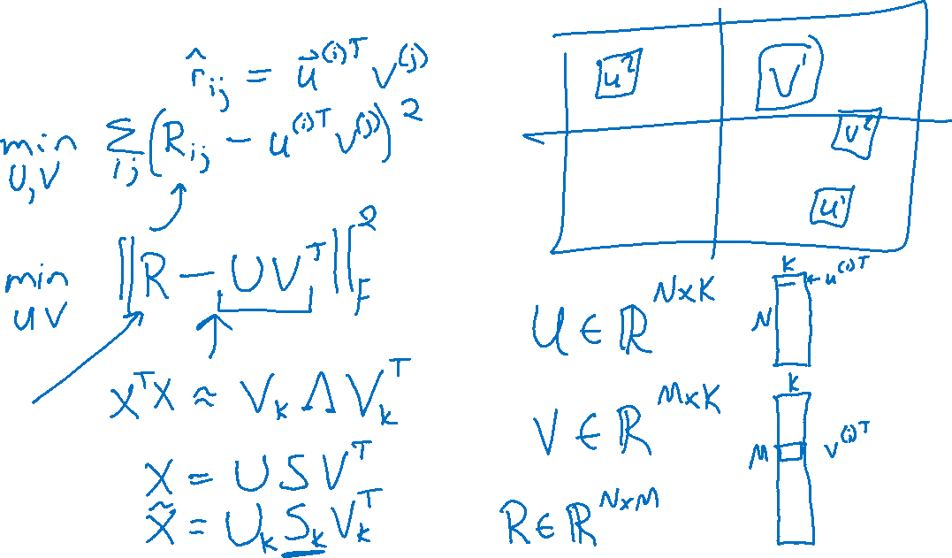
Recommender System: Matrix Factorization
Optimization

Slide 22
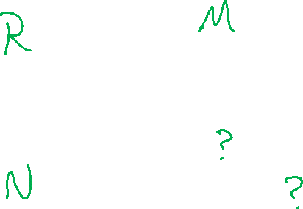
Recommender System: Matrix Factorization
Sparse labels ☹
 | Doctor Strange | Star Trek: Beyond | Zootopia
Alita | 1 |  | 5
BB-8 | 3 | 4
C-3P0 | 3 | 5 | 2

Slide 23

Example: MF for Netflix Problem
Figures from Aggarwal (2016)

Slide 24
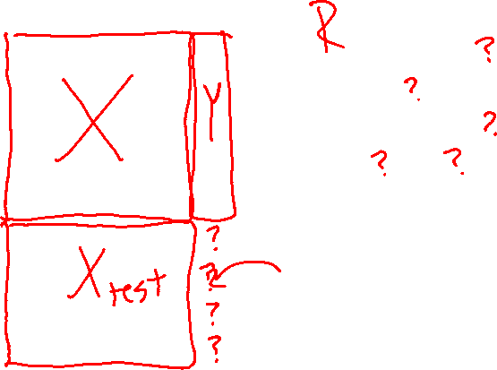
Regression vs. Collaborative Filtering
Regression
Collaborative Filtering
Figures from Aggarwal (2016)

Slide 25
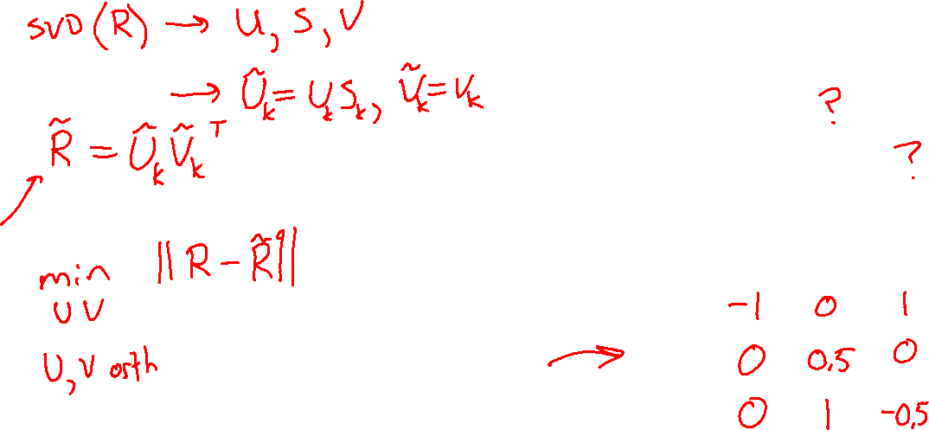
Matrix Factorization: SVD
We can use SVD, but as you’ll see it has issues
 | Doctor Strange | Star Trek: Beyond | Zootopia
Alita | 1 |  | 5
BB-8 | 3 | 4
C-3P0 | 3 | 5 | 2
Alita
BB-8
C-3P0

Slide 26
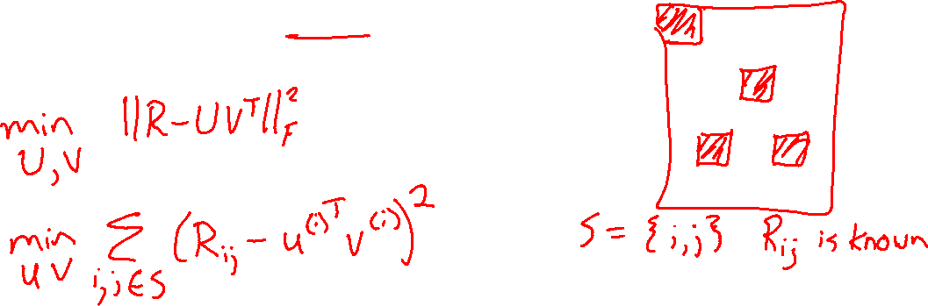
Matrix Factorization: SGD
Objective function using only the labels we have

Slide 27
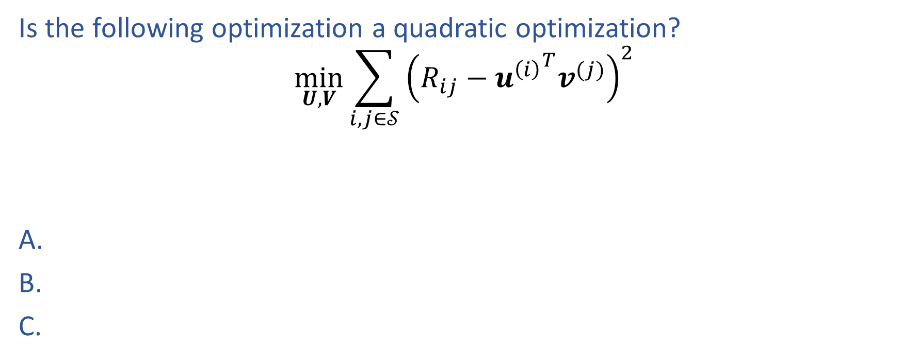
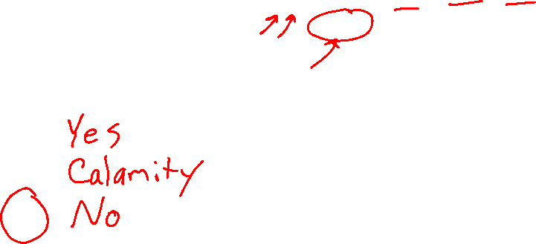
Piazza Poll 1
Is the following optimization a quadratic optimization?
$$\min_{U,V}{\sum_{i,j∈𝒮}{{\left(R_{ij}−{u^{\left(i\right)}}^{T}v^{(j)}\right)}^{2}}}$$

Slide 28
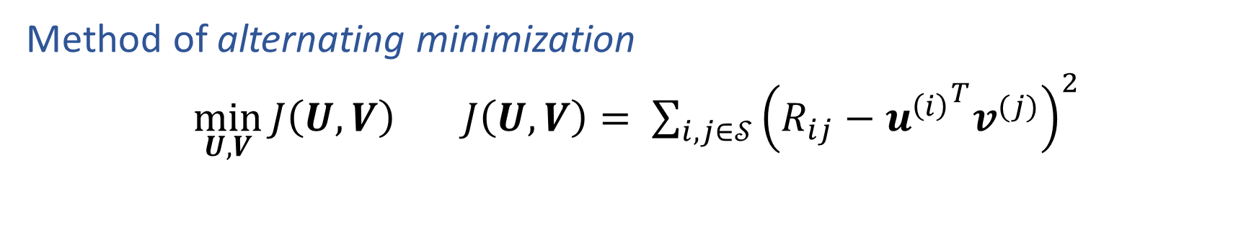
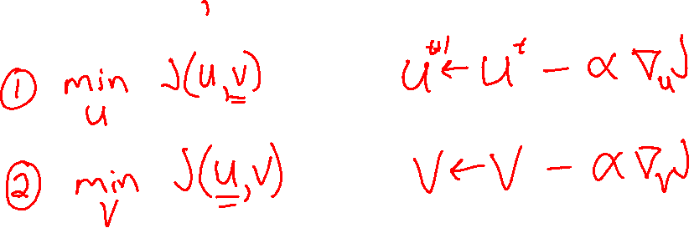
Matrix Factorization: SGD
Method of alternating minimization
$\min_{U,V}{J\left(U,V\right)}$ $J\left(U,V\right)= \sum_{i,j∈𝒮}{{\left(R_{ij}−{u^{\left(i\right)}}^{T}v^{(j)}\right)}^{2}}$

Slide 29
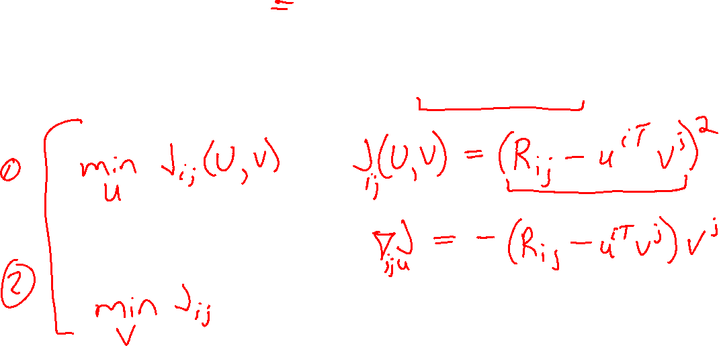
Matrix Factorization: SGD
Method of alternating minimization
$\min_{U,V}{J\left(U,V\right)}$ $J\left(U,V\right)= \sum_{i,j∈𝒮}{{\left(R_{ij}−{u^{\left(i\right)}}^{T}v^{(j)}\right)}^{2}}$

Slide 30
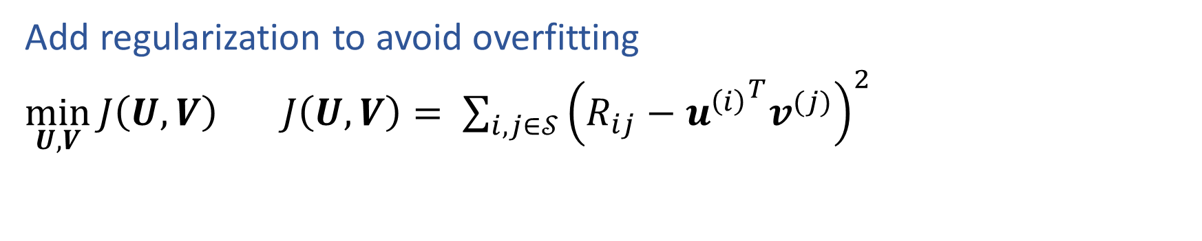
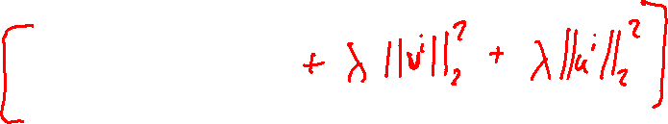
Matrix Factorization: SGD
Add regularization to avoid overfitting
$\min_{U,V}{J\left(U,V\right)}$ $J\left(U,V\right)= \sum_{i,j∈𝒮}{{\left(R_{ij}−{u^{\left(i\right)}}^{T}v^{(j)}\right)}^{2}}$

Slide 31
Summary
Recommender systems solve many real-world (*large-scale) problems
Collaborative filtering by Matrix Factorization (MF) is an efficient and effective approach
(SVD for MF is a bit broken)
MF is just another example of a common recipe:
    define a model
    define an objective function
    optimize with SGD
Optimization
Need alternating minimization
Add regularization to avoid overfitting

