Slide 1
Announcements
Assignments
HW8 (written + programming)
    Due Thu 4/9, 11:59 pm

Slide 2
Introduction to
Machine Learning
Dimensionality Reduction
PCA
Instructor: Pat Virtue

Slide 3
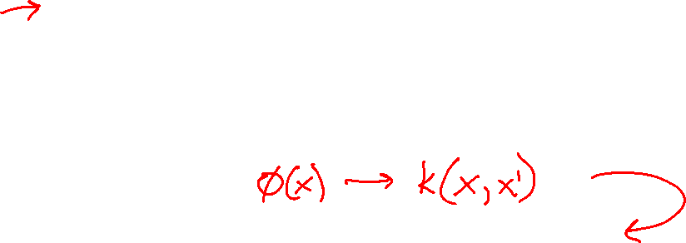
Outline
Principal Component Analysis (PCA)
  Projections
  PCA objective functions
  PCA, Eigenvectors, and Eigenvalues, SVD
  Examples
  Kernel PCA
Deep Learning Dimensionality Reduction

Slide 4
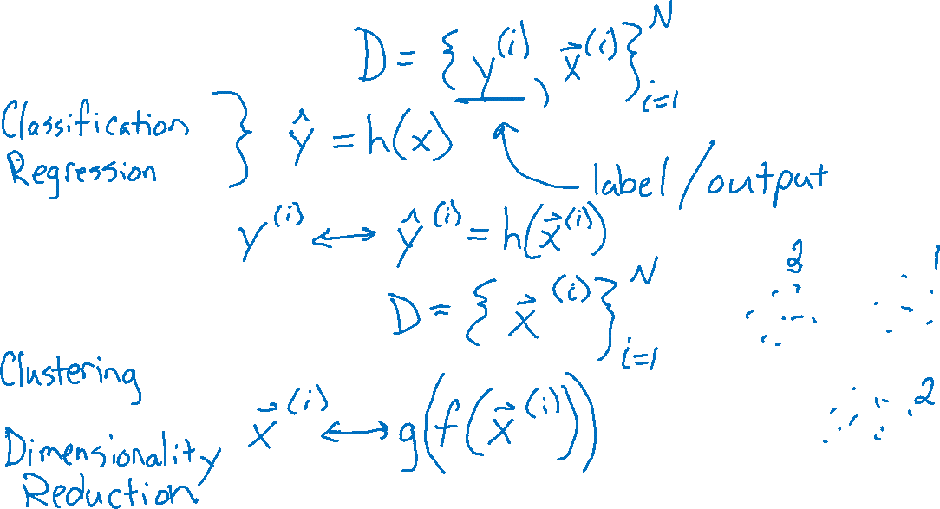

Supervised vs Unsupervised Learning
Supervised Learning
Unsupervised Learning

Slide 5


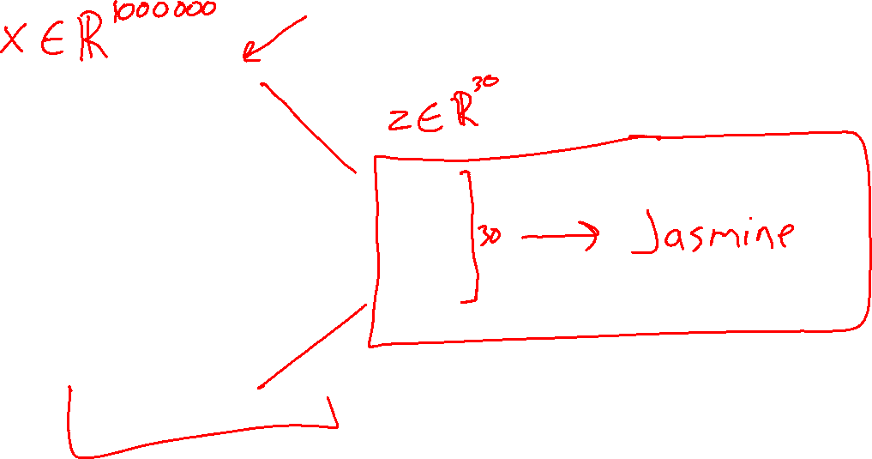
Dimensionality Reduction

Slide 6
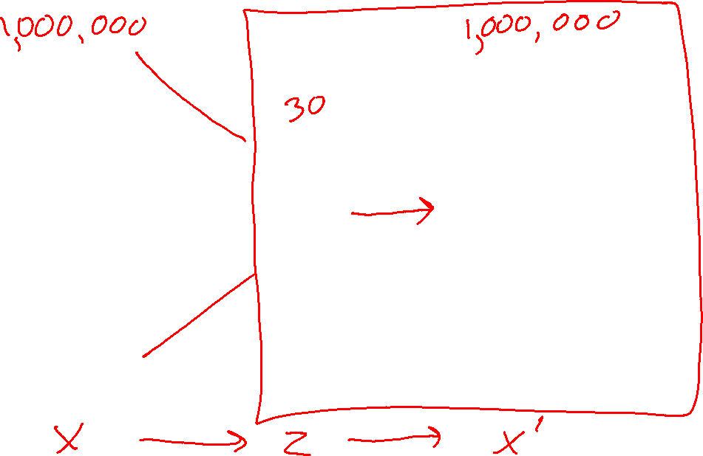
Dimensionality Reduction

Slide 7

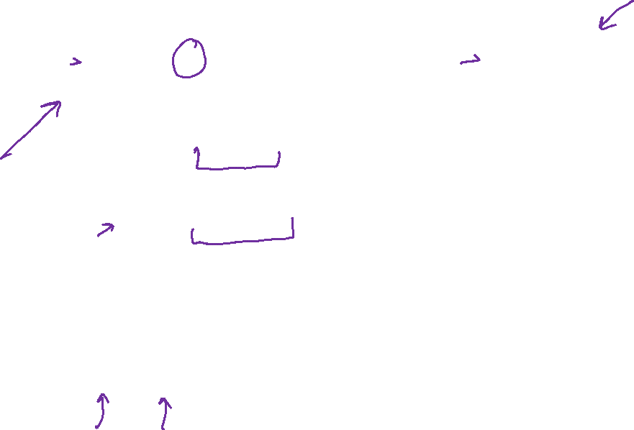
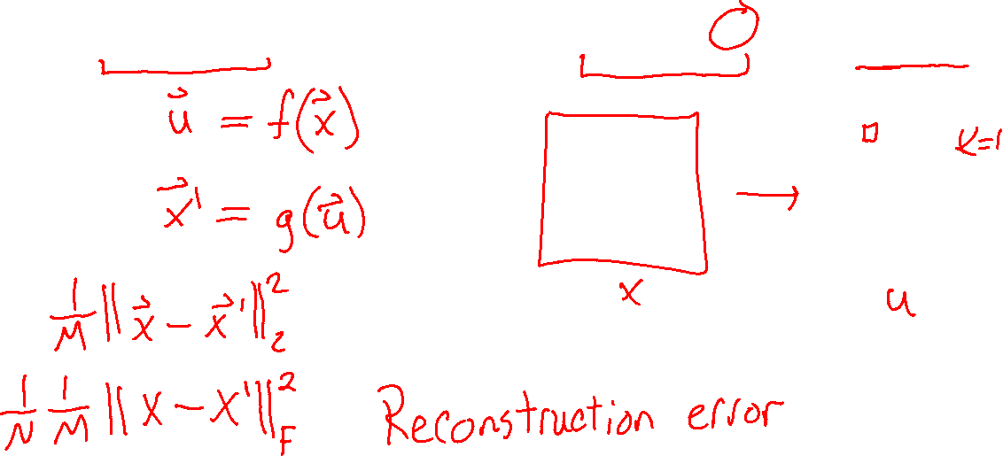
Dimensionality Reduction
For each $x^{(i)}∈ℝ^{M}$ find representation $u^{(i)}∈ℝ^{K}$ where $K≪M$

Slide 8
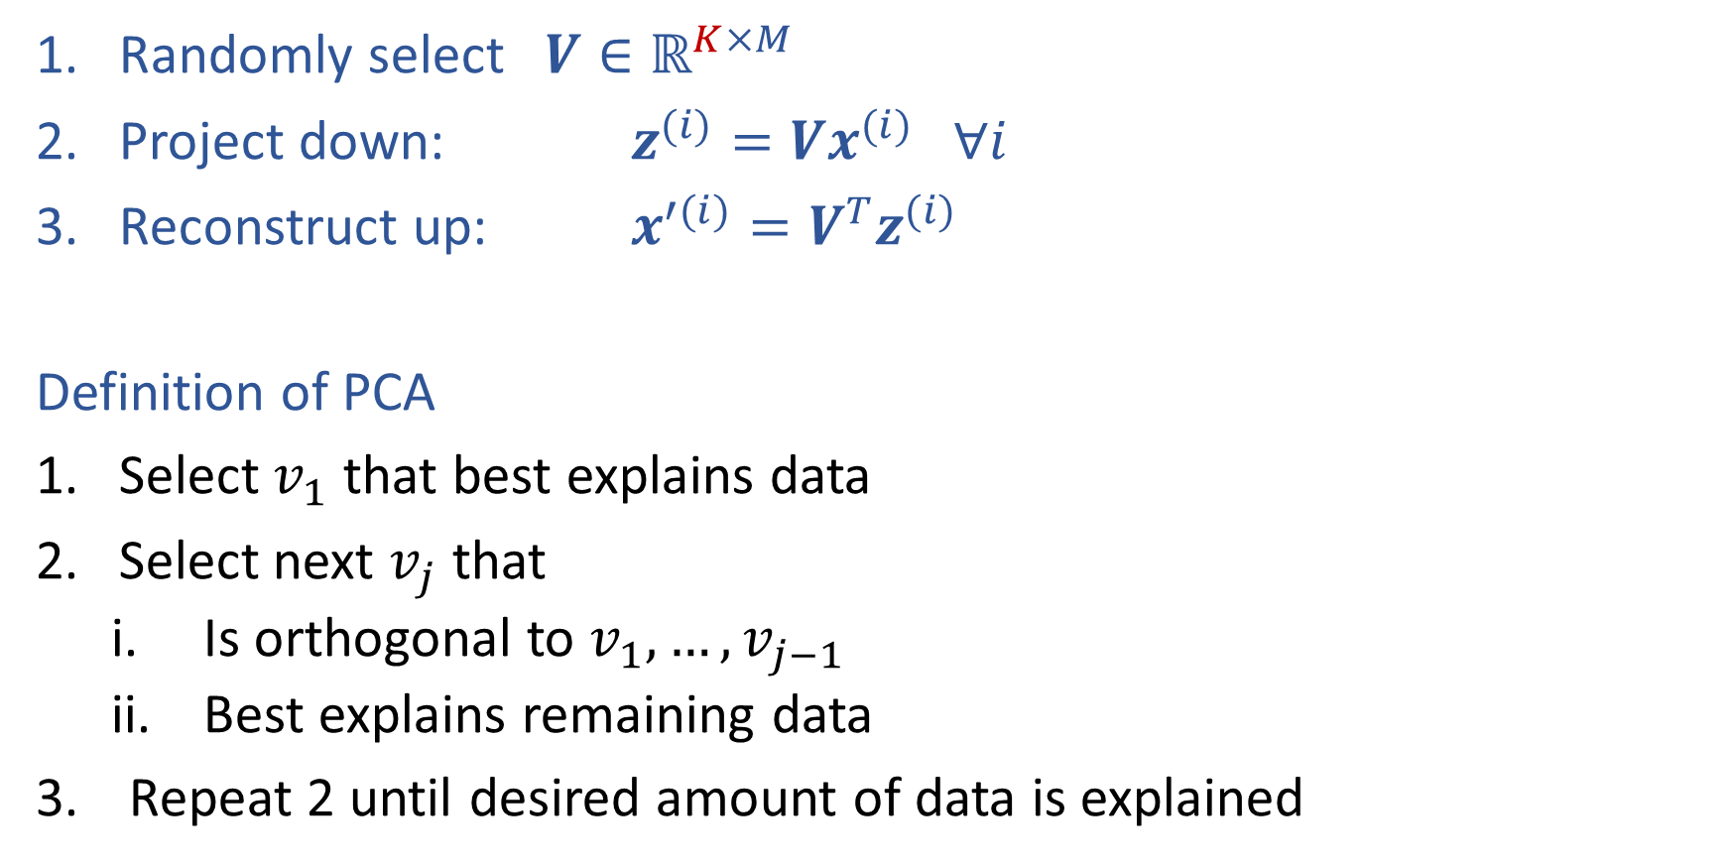
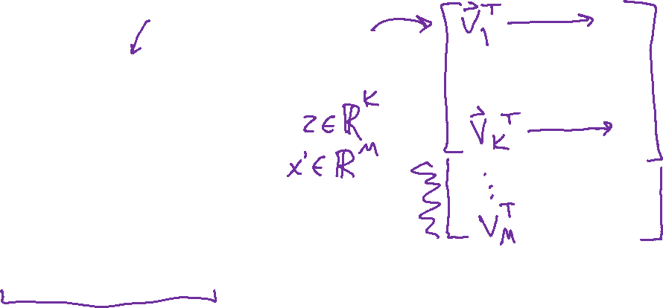
Sketch of PCA
Randomly select $V∈ℝ^{K×M}$
Project down: $z^{(i)}=Vx^{(i)} ∀i$
Reconstruct up: $x^{′(i)}=V^{T}z^{(i)}$
Definition of PCA
Select $v_{1}$ that best explains data
Select next $v_{j}$ that
    Is orthogonal to $v_{1}, …,v_{j−1}$
    Best explains remaining data
Repeat 2 until desired amount of data is explained

Slide 9
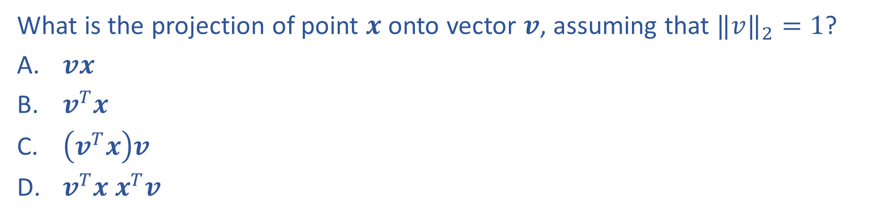
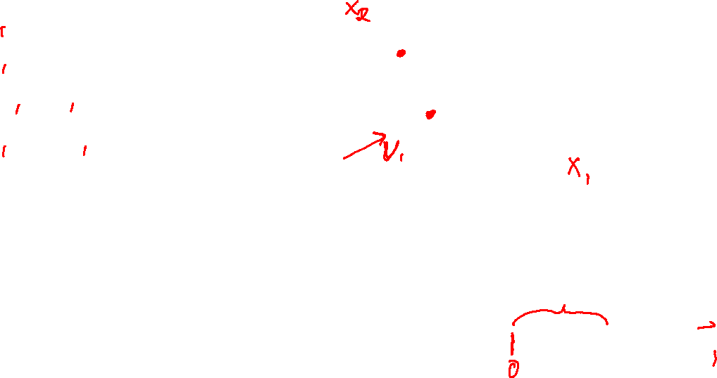
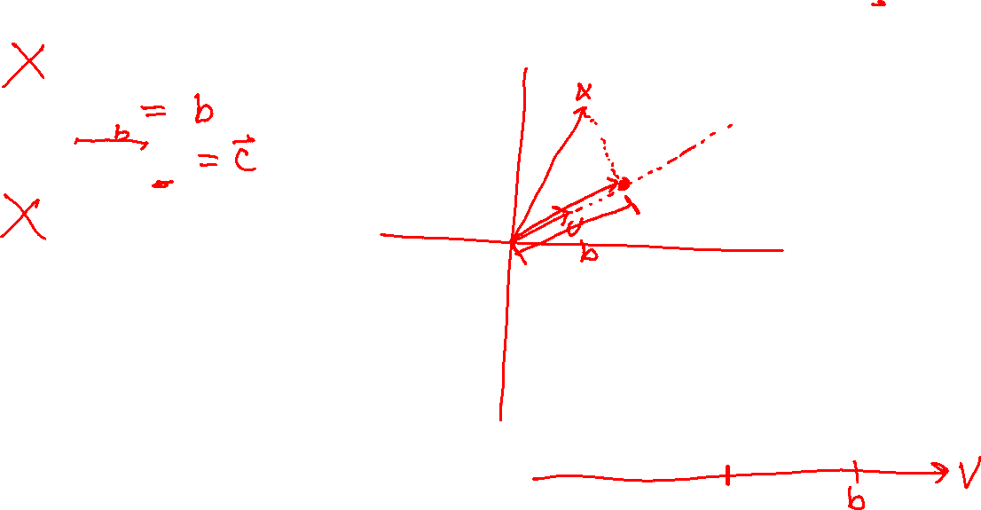
Previous Piazza Poll
What is the projection of point $x$ onto vector $v$, assuming that ${‖v‖}_{2}=1$?
$vx$
$v^{T}x$
$\left(v^{T}x\right)v$
$v^{T}x x^{T}v$

Slide 10
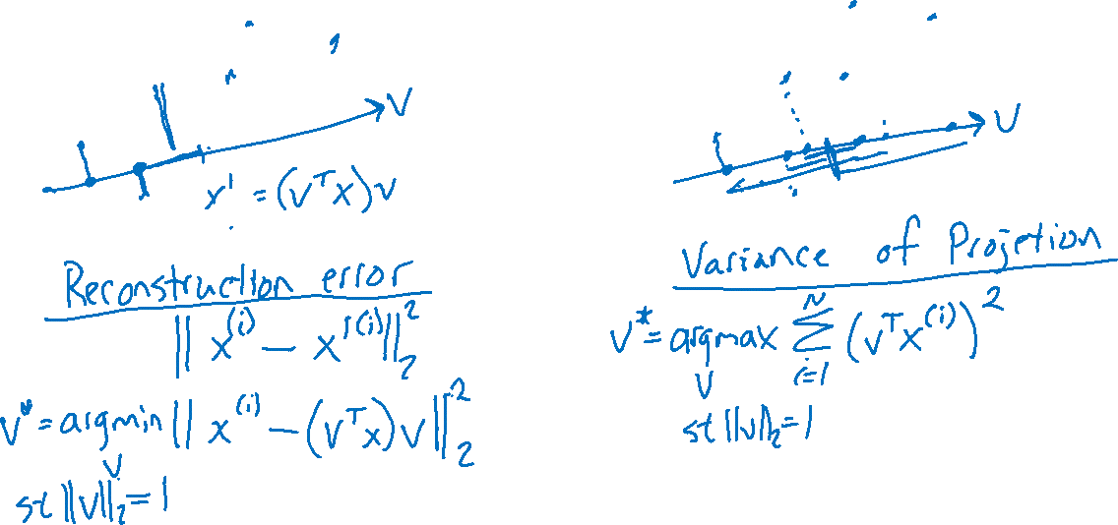
Select “Best” Vector
Reconstruction Error vs Variance of Projection

Slide 11
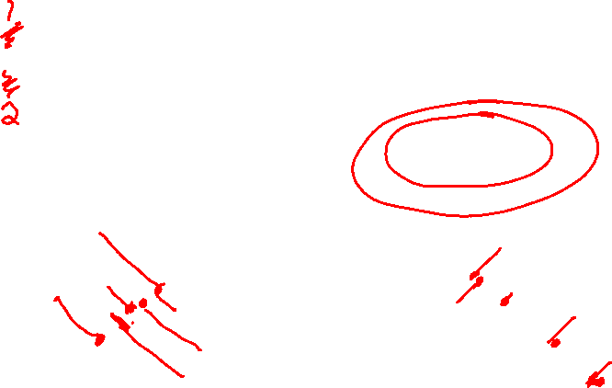
Piazza Poll 1 & Poll 2
Consider the two projections below
Poll 2: Which maximizes the variance?
Poll 3: Which minimizes the reconstruction error?
Option A
Option B
Option C

Slide 12
Select “Best” Vector
Reconstruction Error vs Variance of Projection

Slide 13
PCA
Equivalence of Maximizing Variance and Minimizing Reconstruction Error

Slide 14
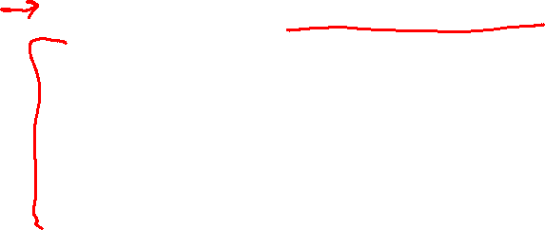
Sketch of PCA
Randomly select $V∈ℝ^{K×M}$
Project down: $z^{(i)}=Vx^{(i)} ∀i$
Reconstruct up: $x^{′(i)}=V^{T}z^{(i)}$
Definition of PCA
Select $v_{1}$ that best explains data
Select next $v_{j}$ that
    Is orthogonal to $v_{1}, …,v_{j−1}$
    Best explains remaining data
Repeat 2 until desired amount of data is explained

Slide 15
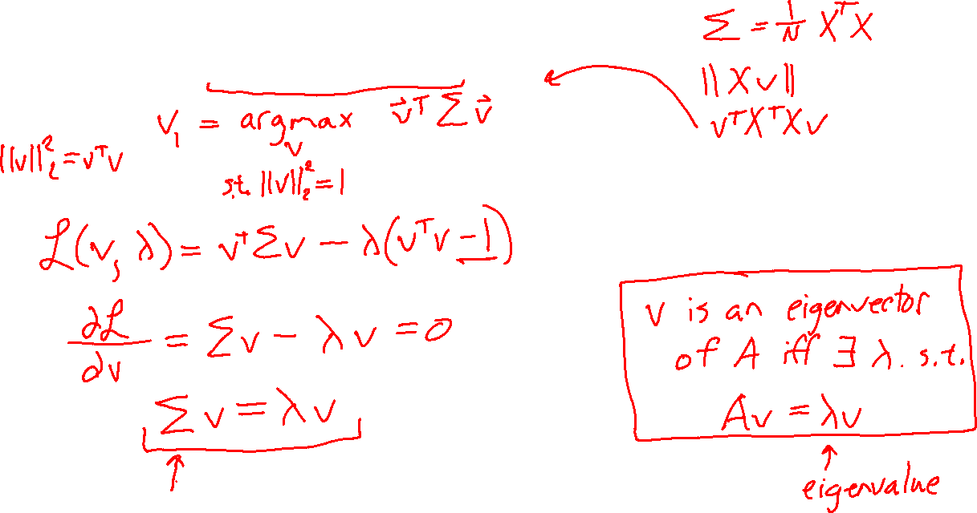
PCA: The First Principal Component
Use method of Lagrange multipliers

Slide 16
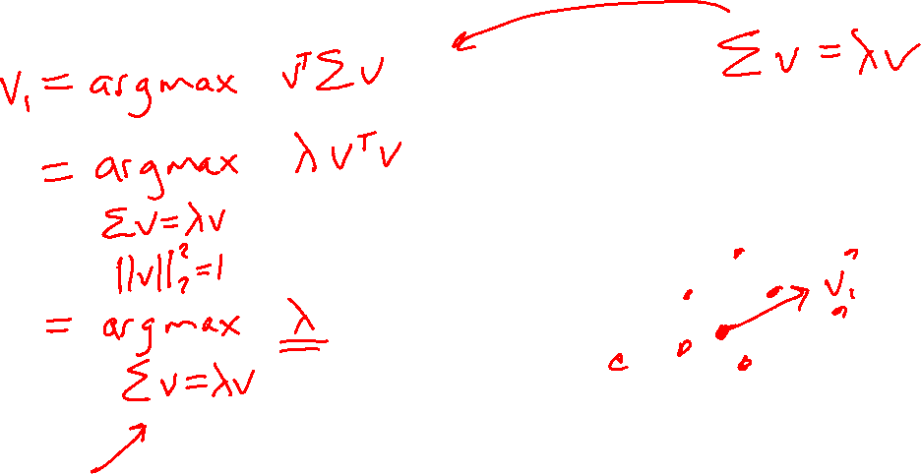
PCA: The First Principal Component
Use method of Lagrange multipliers

Slide 17
PCA: the First Principal Component

Slide 18
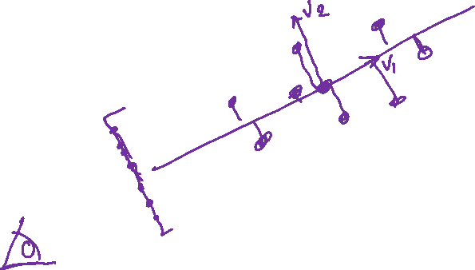
PCA: The Next Principal Component
Compute the next principal component from the residuals

Slide 19
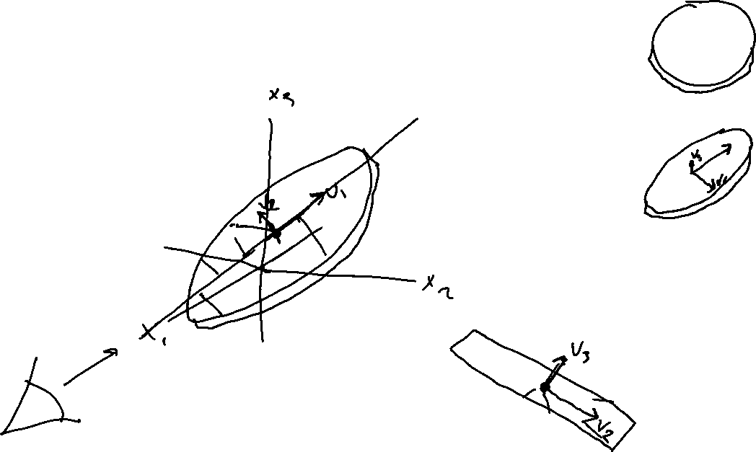
PCA: The Next Principal Component
Compute the next principal component from the residuals

Slide 20
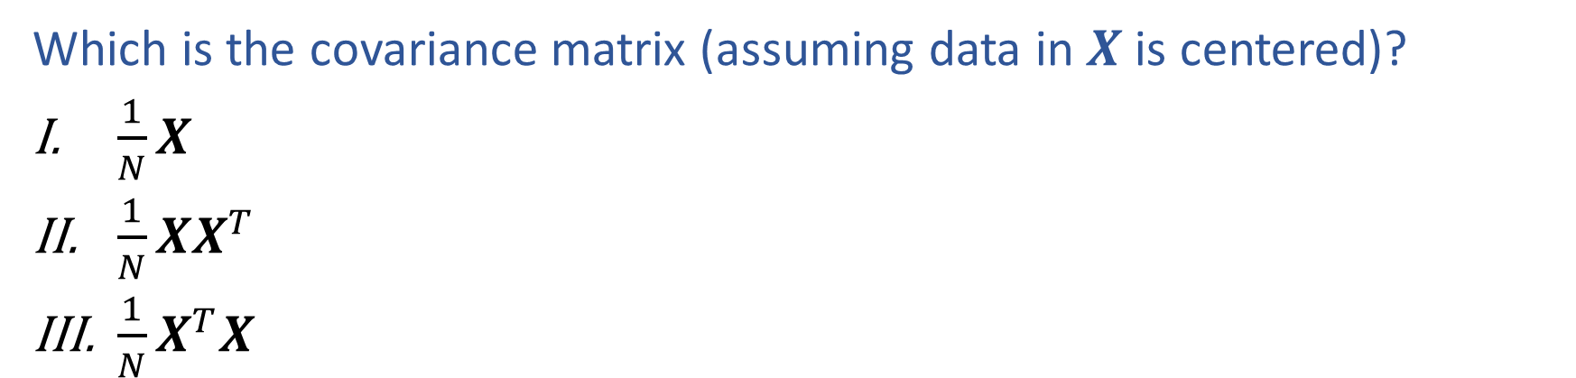
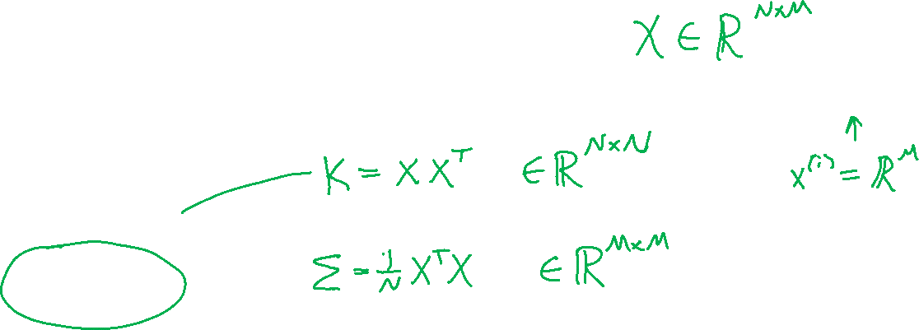
Piazza Poll 3
Which is the covariance matrix (assuming data in $X$ is centered)?
$\frac{1}{N}X$
$\frac{1}{N}XX^{T}$
$\frac{1}{N}X^{T}X$

Slide 21
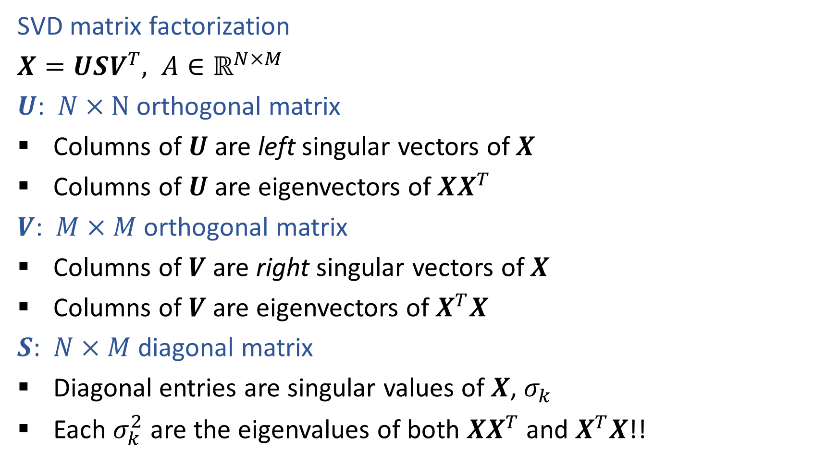
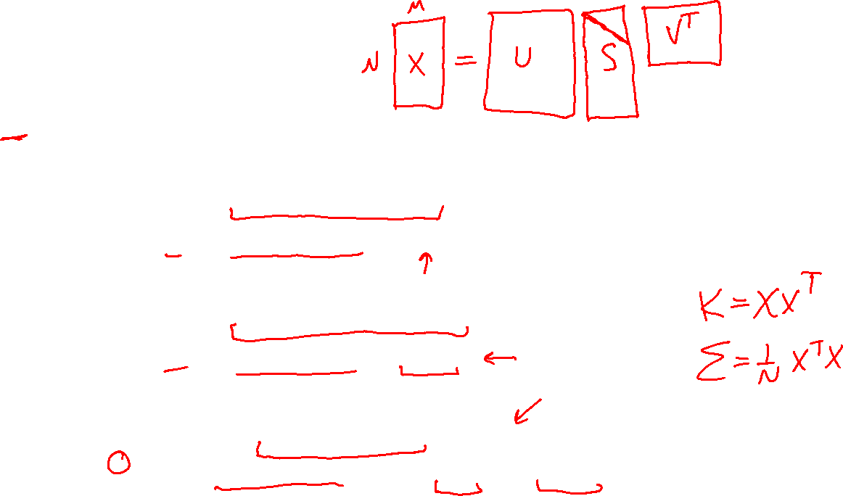
SVD for PCA
SVD matrix factorization
$X=USV^{T}, A∈ℝ^{N×M}$
$U$: $N×N$ orthogonal matrix
Columns of $U$ are left singular vectors of $X$
Columns of $U$ are eigenvectors of $XX^{T}$
$V$: $M×M$ orthogonal matrix
Columns of $V$ are right singular vectors of $X$
Columns of $V$ are eigenvectors of $X^{T}X$
$S$: $N×M$ diagonal matrix
Diagonal entries are singular values of $X$, $σ_{k}$
Each $σ_{k}^{2}$ are the eigenvalues of both $XX^{T}$ and $X^{T}X$!!

Slide 22
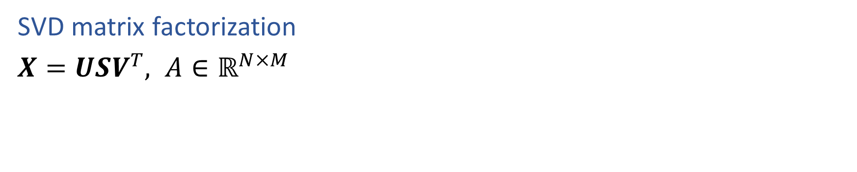
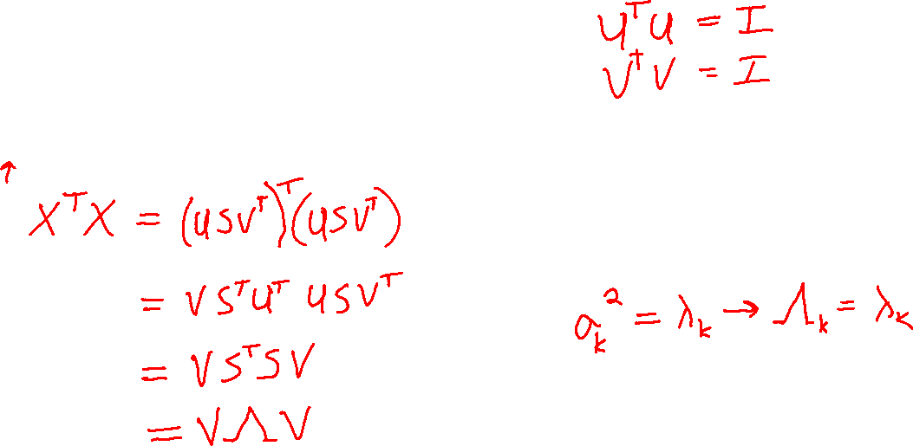
SVD for PCA
SVD matrix factorization
$X=USV^{T}, A∈ℝ^{N×M}$

Slide 23
SVD for PCA

Slide 24
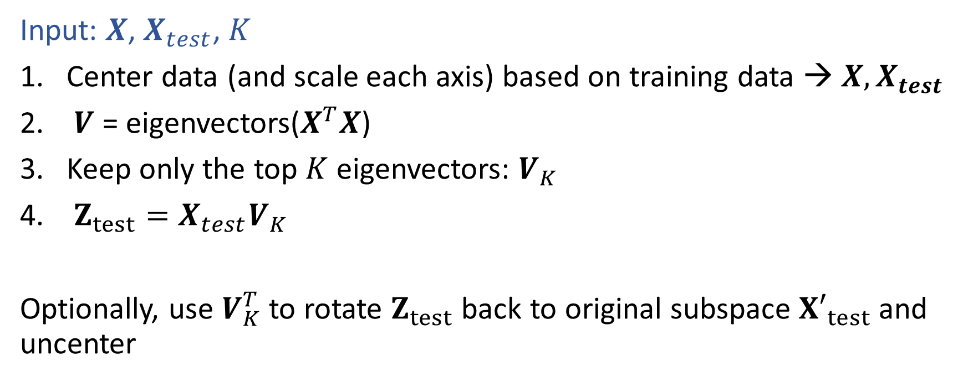
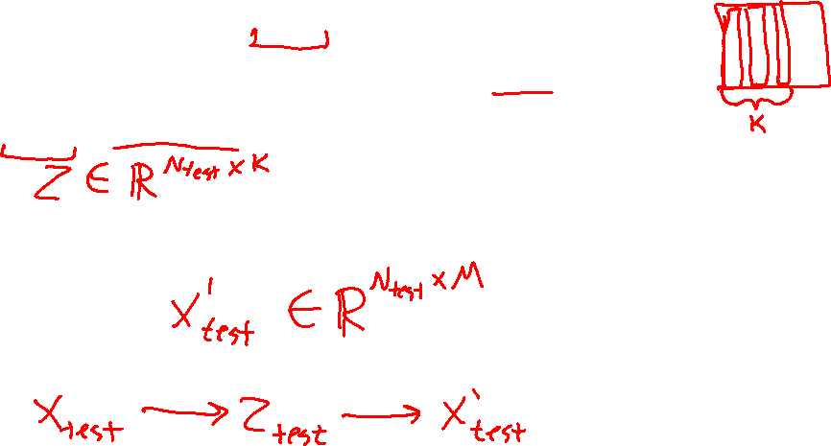
PCA Algorithm
Input: $X$, $X_{test}$, $K$
Center data (and scale each axis) based on training data → $X, X_{test}$
$V$ = eigenvectors($X^{T}X$)
Keep only the top $K$ eigenvectors: $V_{K}$
$Z_{test}=X_{test}V_{K}$
Optionally, use $V_{K}^{T}$ to rotate $Z_{test}$ back to original subspace ${X′}_{test}$and uncenter

Slide 25
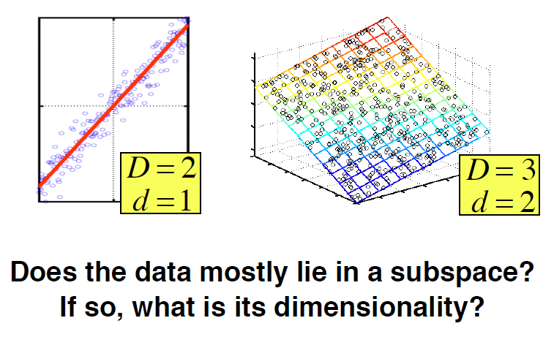
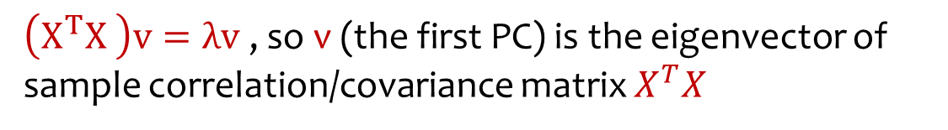
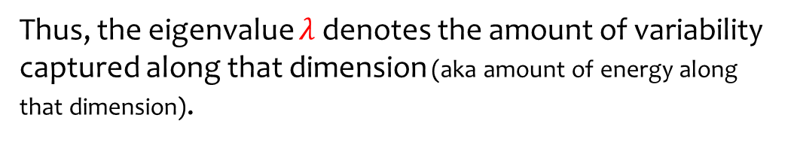

Principal Component Analysis (PCA)
$\left(X^{T}X \right)v=λv$, so v (the first PC) is the eigenvector of sample correlation/covariance matrix $X^{T}X$
Sample variance of projection $v^{T}X^{T}X v=λv^{T}v=λ$
Thus, the eigenvalue $λ$denotes the amount of variability captured along that dimension (aka amount of energy along that dimension).
Eigenvalues $λ_{1}≥λ_{2}≥λ_{3}≥…$
The 1st PC $v_{1}$ is the eigenvector of the sample covariance matrix$X^{T}X$associated with the largest eigenvalue
The 2nd PC $v_{2}$ is the eigenvector of the sample covariance matrix$X^{T}X$associated with the second largest eigenvalue
And so on …
Slide from Nina Balcan

Slide 26

How Many PCs?
For M original dimensions, sample covariance matrix is MxM, and has up to M eigenvectors. So M PCs.
Where does dimensionality reduction come from?
Can ignore the components of lesser significance.
Variance (%) = ratio of variance along given principal component to total variance of all principal components
You do lose some information, but if the eigenvalues are small, you don’t lose much
  M dimensions in original data
  calculate M eigenvectors and eigenvalues
  choose only the first D eigenvectors, based on their eigenvalues
  final data set has only D dimensions

Slide 27
PCA Examples

Slide 28
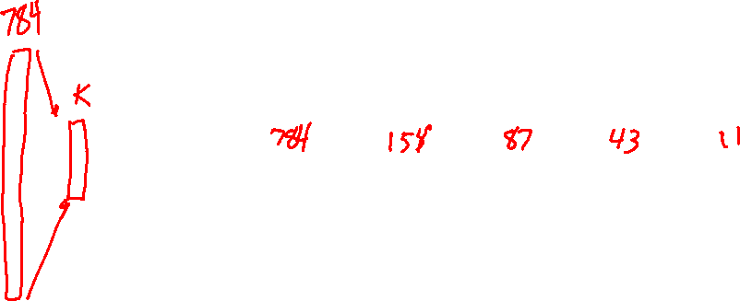
Projecting MNIST digits
Task Setting:
Take 28x28 images of digits and project them down to K components
Report percent of variance explained for K components
Then project back up to 28x28 image to visualize how much information was preserved

Slide 29
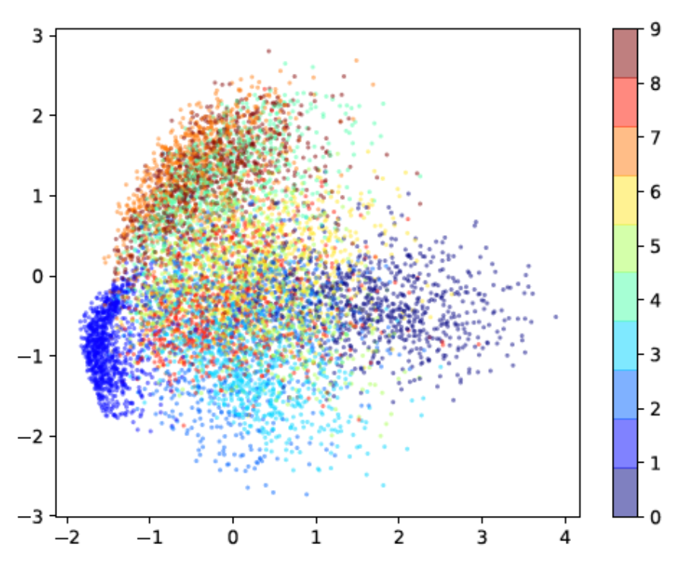

Projecting MNIST digits
Task Setting:
Take 28x28 images of digits and project them down to 2 components
Plot the 2 dimensional points

Slide 30
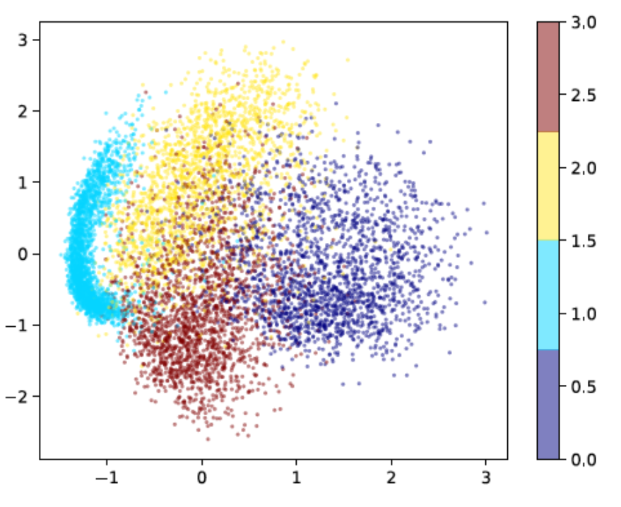
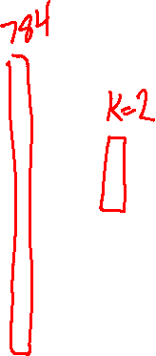
Projecting MNIST digits
Task Setting:
Take 28x28 images of digits and project them down to 2 components
Plot the 2 dimensional points

Slide 31
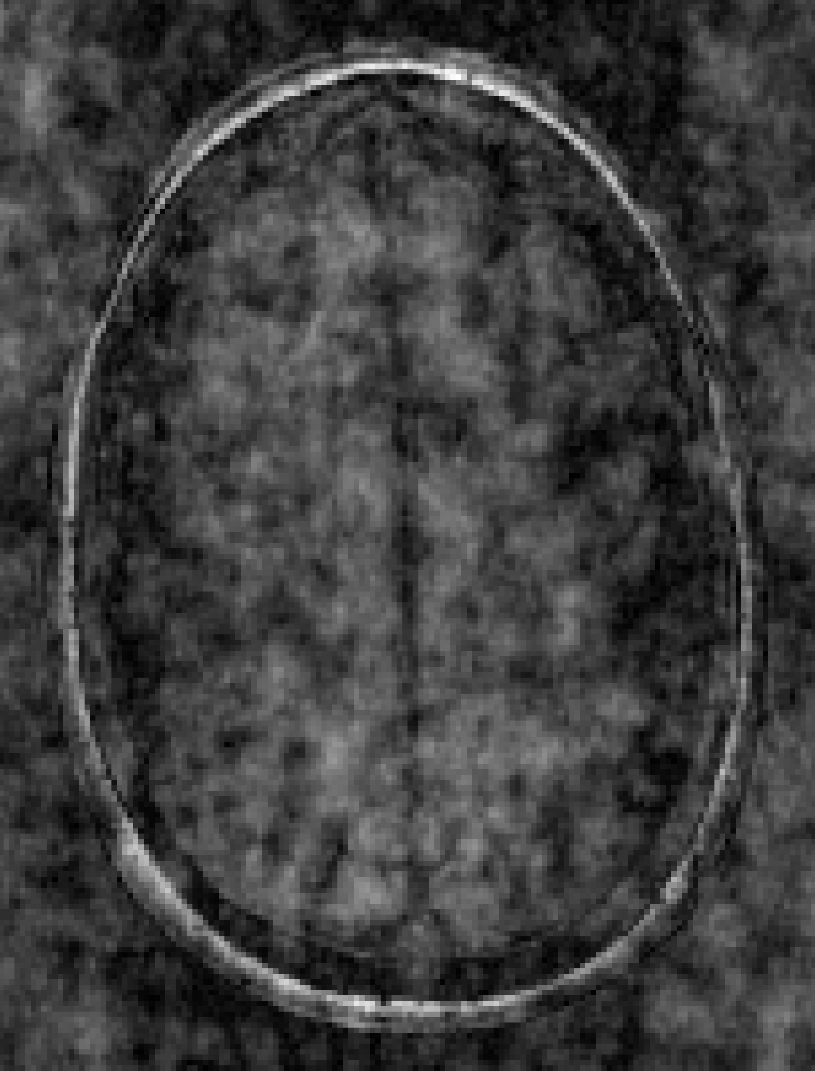
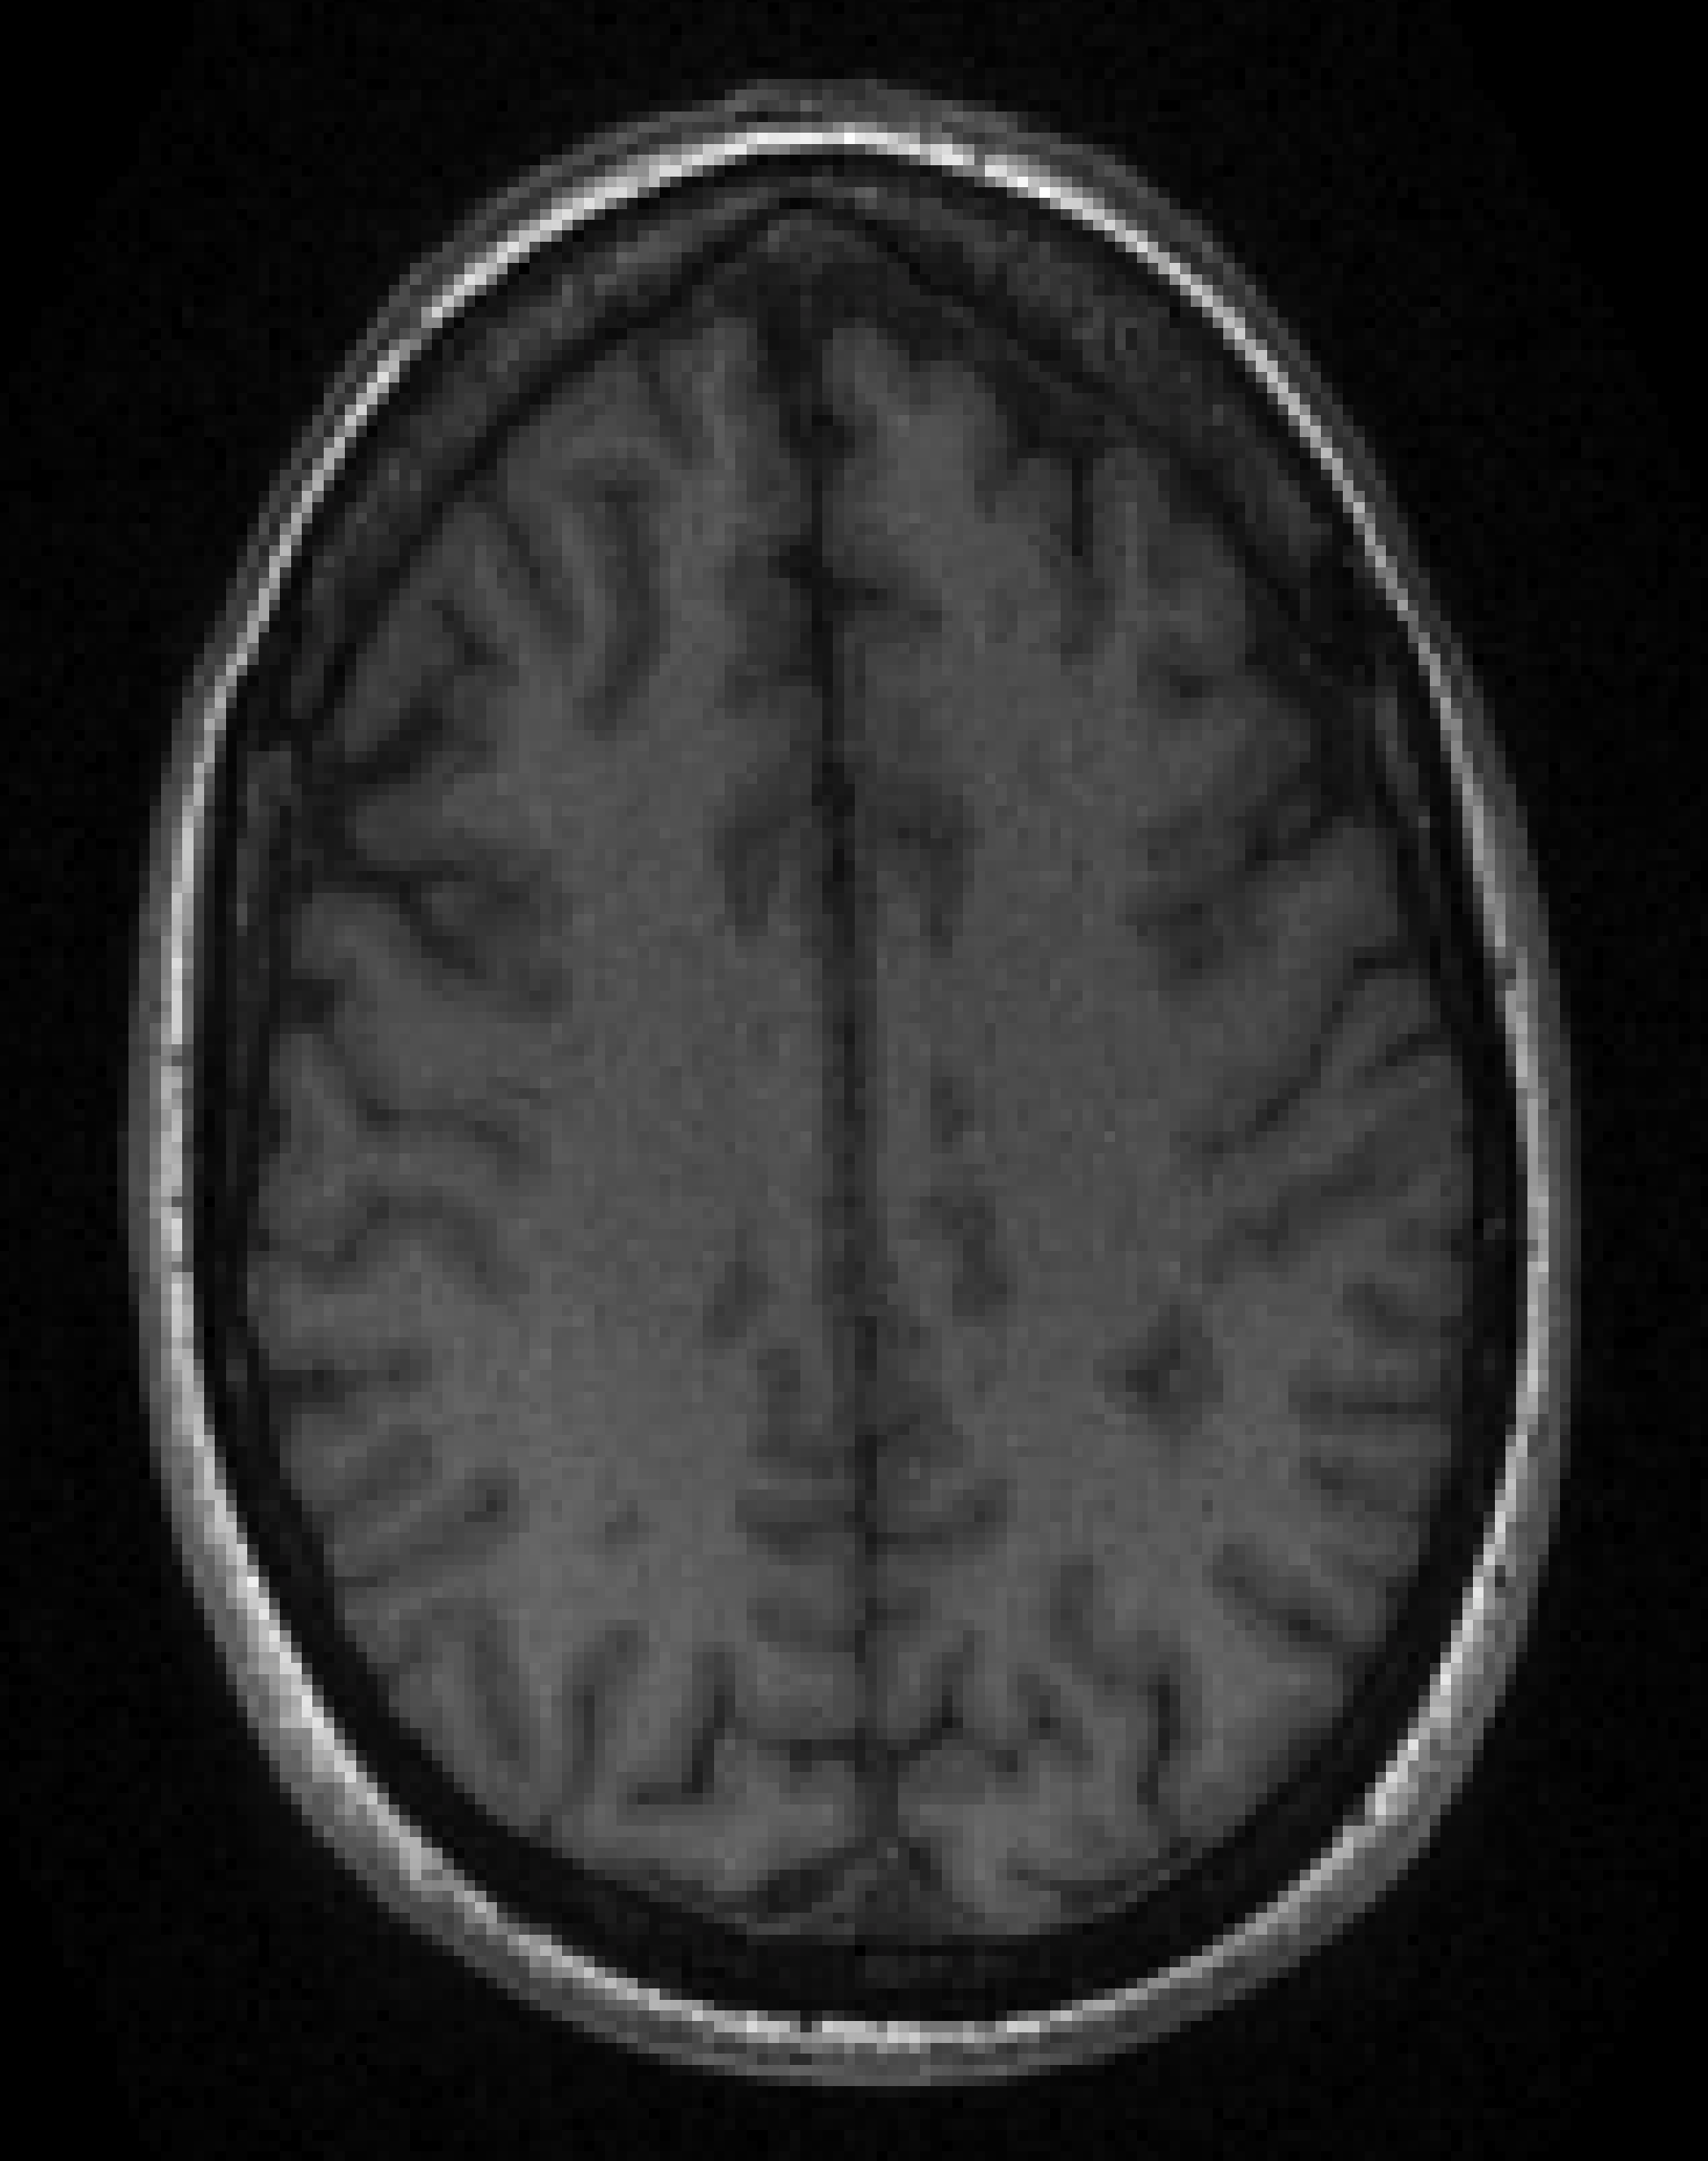
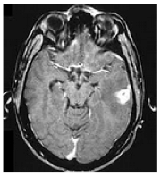
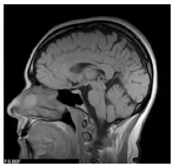
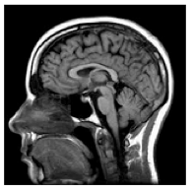
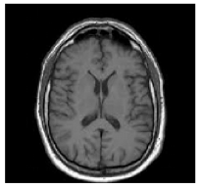
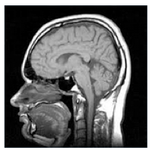
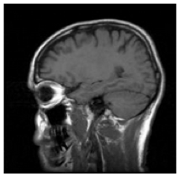
MRI Image Reconstruction

Slide 32
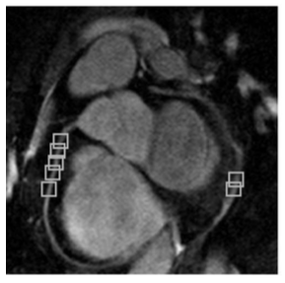

MRI Image Reconstruction
Lots of redundant structure at patch level
Heart MR Image: Akçakaya, et al, BM3D (2011)

Slide 33
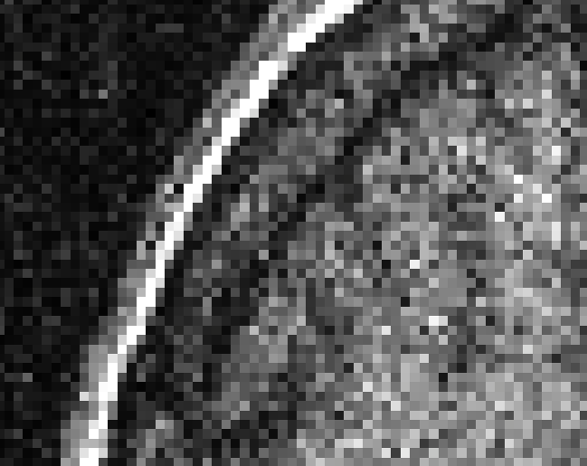
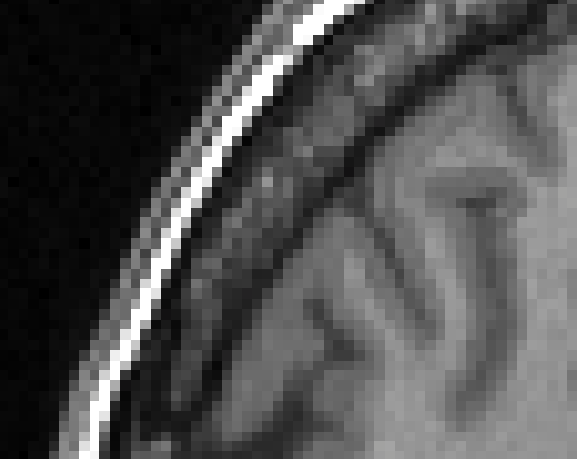



MRI Image Reconstruction
Image Denoising
Noisy
v₁ v₂ v₃
Clean
α₁ + α₂ + α₃ =

Slide 34
MRI Image Reconstruction
Quiz: If I have a 10x10 patch from a noisy image, which number of principal components kept will allow more noise in the resulting patch?
100
10

Slide 35

Piazza Poll 3
If I have a 10x10 patch from a noisy image, which number of principal components kept will allow more noise in the resulting patch?
100
10

Slide 36
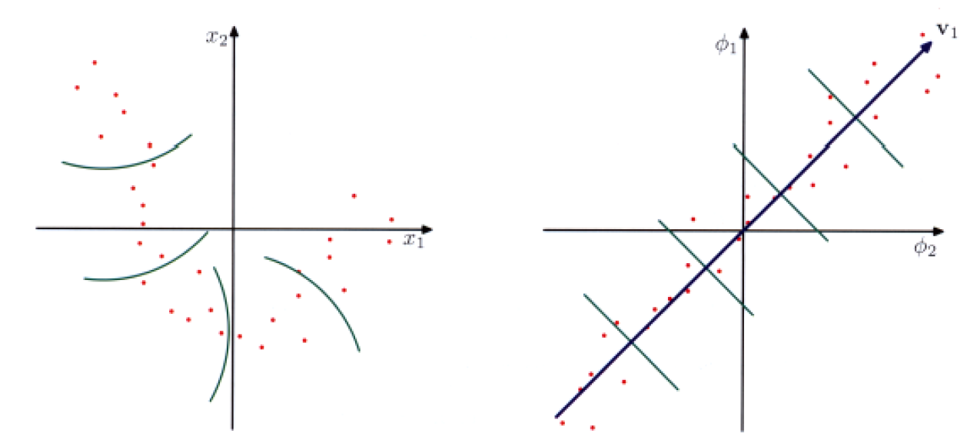
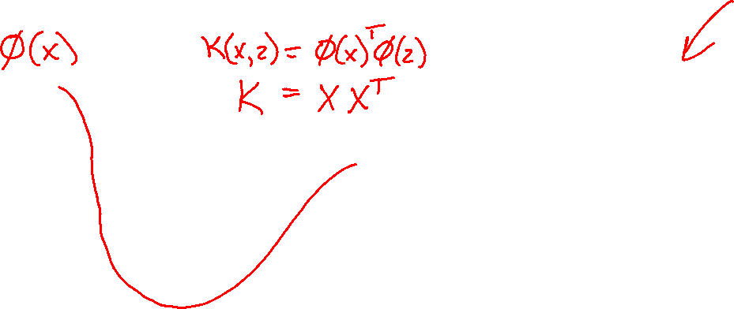
Kernel PCA
Use feature maps and kernel trick to linearize data for PCA
Figure: Bishop, Figure 12.16

Slide 37
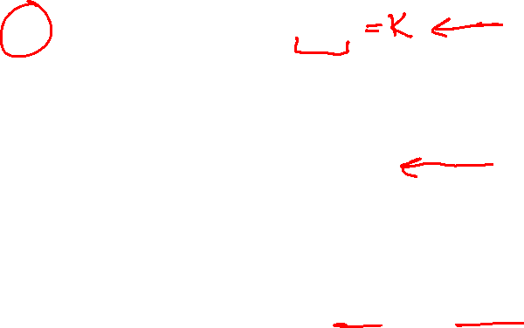
SVD for Kernel PCA
SVD matrix factorization
$X=USV^{T}, A∈ℝ^{N×M}$
$U$: $N×N$ orthogonal matrix
Columns of $U$ are left singular vectors of $X$
Columns of $U$ are eigenvectors of $XX^{T}$
$V$: $M×M$ orthogonal matrix
Columns of $V$ are right singular vectors of $X$
Columns of $V$ are eigenvectors of $X^{T}X$
$S$: $N×M$ diagonal matrix
Diagonal entries are singular values of $X$, $σ_{k}$
Each $σ_{k}^{2}$ are the eigenvalues of both $XX^{T}$ and $X^{T}X$!!

Slide 38
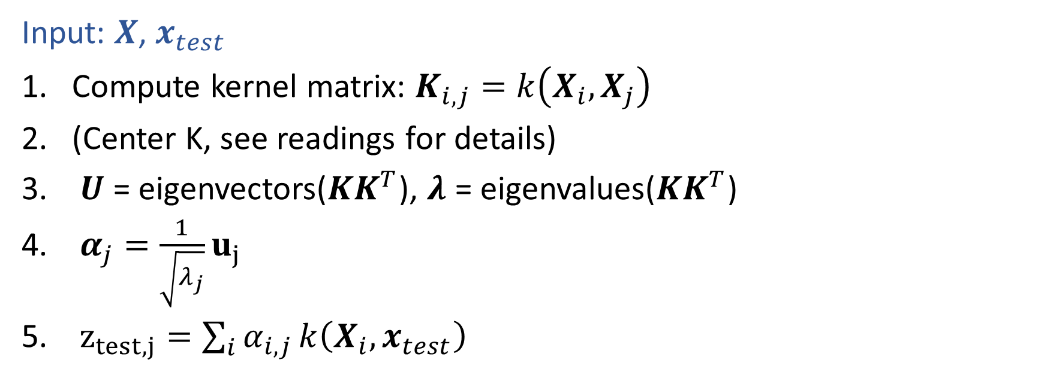
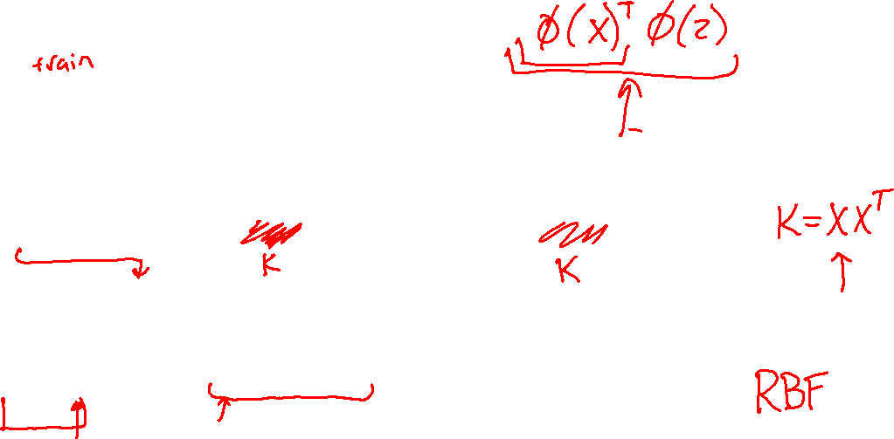
Kernel PCA Algorithm
Input: $X$, $x_{test}$
Compute kernel matrix: $K_{i,j}=k\left(X_{i}, X_{j}\right)$
(Center K, see readings for details)
$U$ = eigenvectors($KK^{T}$), $λ$ = eigenvalues($KK^{T}$)
$α_{j}=\frac{1}{\sqrt{λ_{j}}}u_{j}$
$z_{test,j}=\sum_{i}{α_{i,j}}k\left(X_{i}, x_{test}\right)$

Slide 39


Dimensionality Reduction with Deep Learning
Hinton, Geoffrey E., and Ruslan R. Salakhutdinov.
"Reducing the dimensionality of data with neural networks.”
Science 313.5786 (2006): 504-507.

Slide 40


Dimensionality Reduction with Deep Learning
Hinton, Geoffrey E., and Ruslan R. Salakhutdinov.
"Reducing the dimensionality of data with neural networks.”
Science 313.5786 (2006): 504-507.
Neural Network
PCA

