Slide 1

Introduction to
Machine Learning
Introduction to ML Concepts,
Regression, and Classification
Instructor: Pat Virtue

Slide 2









Course Staff
Education Associate
Teaching Assistants
Daniel Bird
Alex Singh
Annie Hu
George Brown
Haoran Fei
Instructor
Michell Ma
Nidhi Jain
Vicky Zeng
Pat Virtue

Slide 3



Course Information
Website: https://www.cs.cmu.edu/~10315
Canvas: canvas.cmu.edu
Gradescope: gradescope.com
Communication: piazza.com
E-mail: dpbird@andrew.cmu.edu
pvirtue@andrew.cmu.edu

Slide 4
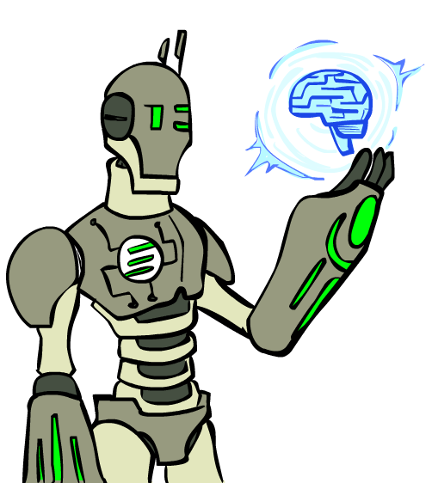
Today
What is AI/ML?
A brief history of AI/ML
Some logistics
Introduction to important ML concepts that we’ll use throughout the semester
Images: ai.berkeley.edu

Slide 5
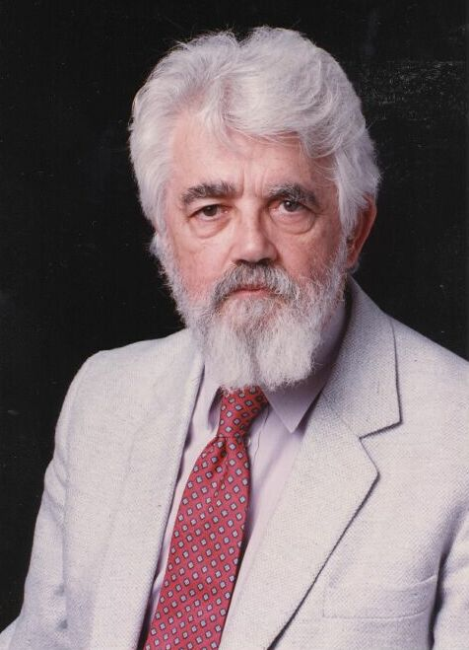
AI Definition by John McCarthy
What is artificial intelligence
  It is the science and engineering of making intelligent machines, especially intelligent computer programs
What is intelligence
  Intelligence is the computational part of the ability to achieve goals in the world
http://www-formal.stanford.edu/jmc/whatisai/whatisai.html

Slide 6
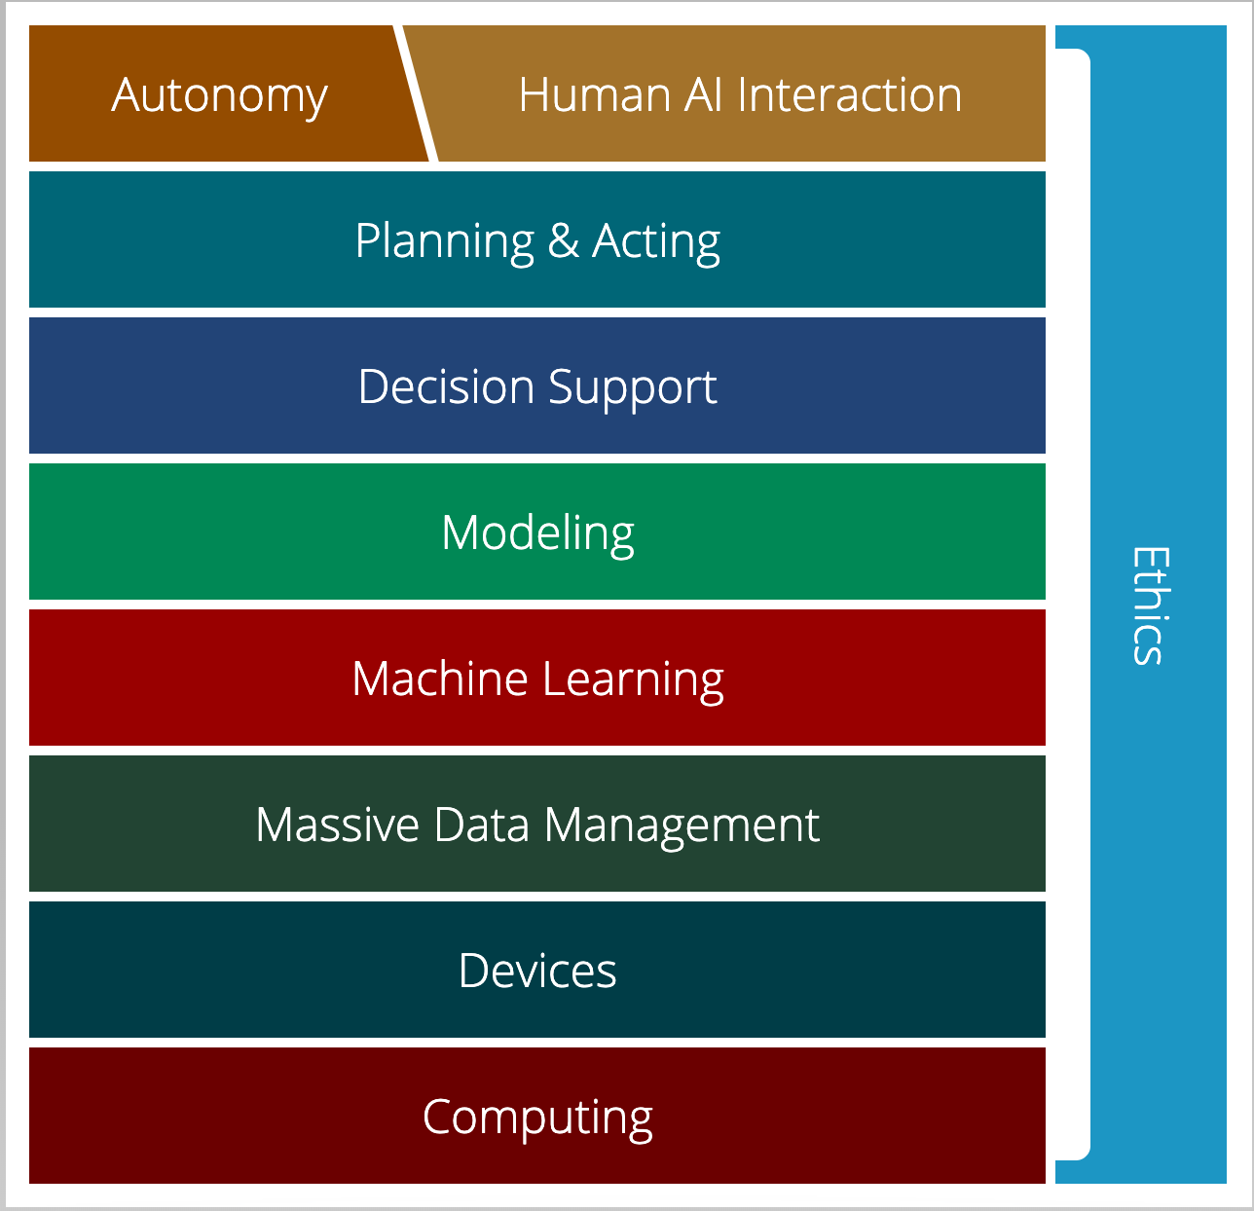

AI Stack for CMU AI
“AI must understand the human needs and it must make smart design decisions based on that understanding”
AI Stack
https://ai.cs.cmu.edu/about
Notes:
Proposed by Andrew Moore, CMU is using AI Stack to illustrate what they consider as AI. AI must understand the human needs and it must make smart design decisions based on that understanding. Despite the simple definition, though, AI isn't just one thing. It's a giant thing, built from technology blocks we call the AI Stack. At Carnegie Mellon, we view it as a toolbox — each block houses a set of technologies that scientists and researchers can reach for as they work on new initiatives. Expertise in all areas? Not required. Instead, we believe you can focus on one area and draw on other parts of the stack for help. Each block depends on the other for support. And AI endeavors that ignore parts of the stack won't succeed.

Slide 7
AI Stack for CMU AI
“Machine learning focuses on creating programs that learn from experience.”
“It advances computing through exposure to new scenarios, testing and adaptation, while using pattern- and trend-detection to help the computer make better decisions in similar, subsequent situations.”
AI Stack
https://ai.cs.cmu.edu/about

Slide 8
Artificial Intelligence vs Machine Learning?
Artificial Intelligence
Machine Learning
Deep Learning

Slide 9
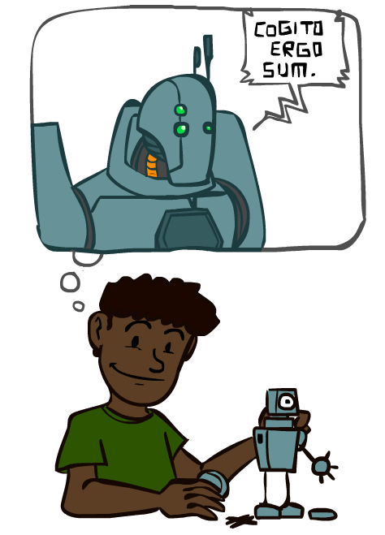
A Brief History of AI
Images: ai.berkeley.edu

Slide 10
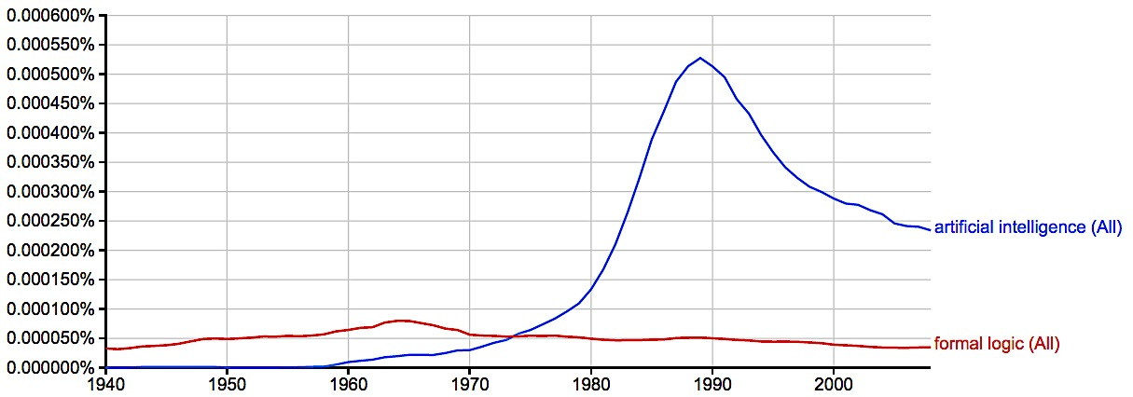
A Brief History of AI
Knowledge Based
Systems
1970-1990
AI
Excitement!
1950-1970
artificial intelligence
formal logic
https://books.google.com/ngrams

Slide 11
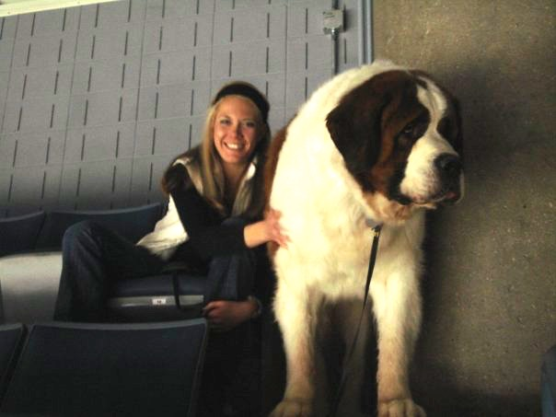
What went wrong?
Dog
  Barks
  Has Fur
  Has four legs
Buster

Slide 12

Knowledge-based Systems
Write programs that simulate how people do it.
Problems:
Will never get better than a person
Requires deep introspection
Sometimes requires experts (“expert systems”, “knowledge elicitation”)
Often, we don’t know how we do things (e.g. ride bicycle)
      Difference between knowing and knowing-how-we-know
Sometimes we think we know, but we’re wrong
Slide: CMU ML, Roni Rosenfeld

Slide 13
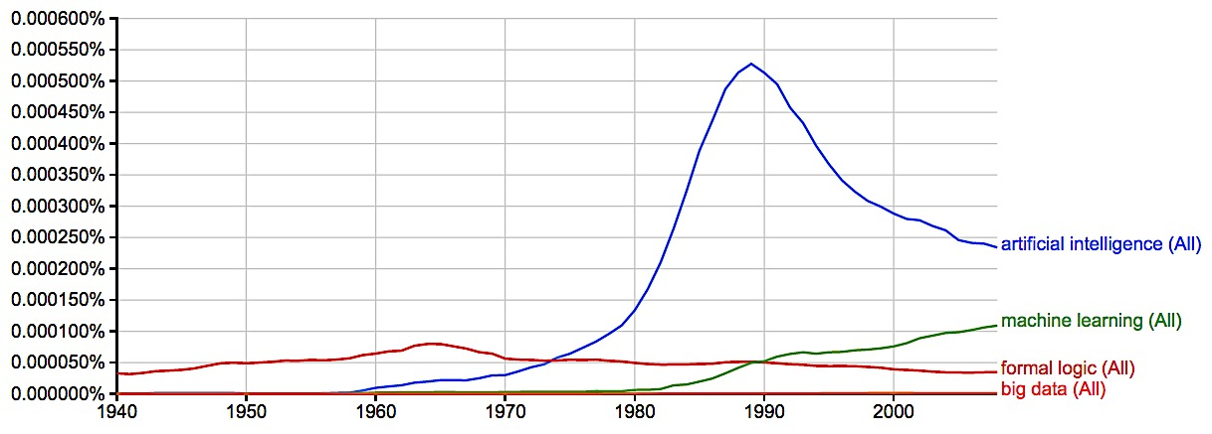
A Brief History of AI
Knowledge Based
Systems
1970-1990
AI
Excitement!
1950-1970
Statistical Approaches
1990--
artificial intelligence
machine learning
formal logic
https://books.google.com/ngrams

Slide 14
Statistical Methods
Write programs that learn the task from examples
+ You don’t need to know how to do it yourself
+ Performance (should) improve with more examples
But:
- Need lots of examples!
- When it finally works, you may not understand how
Slide: CMU ML, Roni Rosenfeld

Slide 15
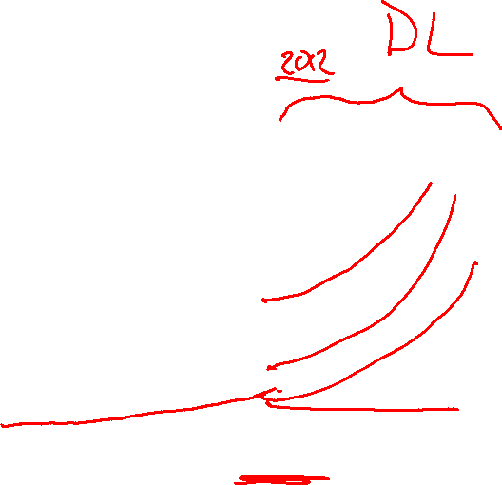
A Brief History of AI
Knowledge Based
Systems
1970-1990
AI
Excitement!
1950-1970
Statistical Approaches
1990--
artificial intelligence
machine learning
formal logic
2008
https://books.google.com/ngrams

Slide 16
A Brief History of AI
1940-1950: Early days
  1943: McCulloch & Pitts: Boolean circuit model of brain
  1950: Turing's “Computing Machinery and Intelligence”
1950—70: Excitement: Look, Ma, no hands!
  1950s: Early AI programs, including Samuel's checkers program, Newell & Simon's Logic Theorist, Gelernter's Geometry Engine
  1956: Dartmouth meeting: “Artificial Intelligence” adopted
1970—90: Knowledge-based approaches
  1969—79: Early development of knowledge-based systems
  1980—88: Expert systems industry booms
  1988—93: Expert systems industry busts: “AI Winter”
1990—: Statistical approaches
  Resurgence of probability, focus on uncertainty
  General increase in technical depth
  Agents and learning systems… “AI Spring”?
2012—: Deep learning
  2012: ImageNet & AlexNet
Images: ai.berkeley.edu
Notes:
Million dollar computer with less computation than your phone
MT was

Slide 17
Machine Learning and Statistics
Statistics is also about learning from data
Statistics has been around from much longer!
What’s the difference?
Until the mid 1990s:
Statistics:
  A branch of mathematics
  Emphasized rigor, correctness, provable properties (“is it correct?”)
  Was not very concerned with scaling
    Not much awareness of computational complexity
Machine Learning:
  A branch of Computer Science / AI
  Focus on heuristics, making things work in practice (“does it work?”)
  Not much awareness of statistical theory
Slide: CMU ML, Roni Rosenfeld

Slide 18

Machine Learning and Statistics
From the mid 1990s:
The two fields have effectively merged
  Carnegie Mellon has led the way!
ML is now often called “Statistical Machine Learning”
  There is very little non-statistical ML today
Slide: CMU ML, Roni Rosenfeld

Slide 19

The Machine Learning Framework
Formalize the task as a mapping from input to output
  Task examples will usually be pairs: (input, correct_output)
Formalize performance as an error measure
  or more generally, as an objective function (aka Loss function)
Examples:
  Medical Diagnosis
    mapping input to one of several classes/categories (aka classification)
  Predict tomorrow’s Temperature
    mapping input to a number (aka regression)
  Chance of Survival: From patient data to p(survive >= 5 years)
    mapping input to probability (aka logistic regression)
  Driving recommendation
    mapping input into a plan (aka Planning)
Slide: CMU ML, Roni Rosenfeld

Slide 20
Choices in ML Problem Formulation
Often, the same task can be formulated in more than one way:
Ex. 1: Loan applications
  creditworthiness/score (regression)
  probability of default (logistic regression)
  loan decision (classification)
Ex. 2: Chess
  Nature of available training examples/experience:
    expert advice (painful to experts)
    games against experts (less painful but limited, and not much control)
    experts’ games (almost unlimited, but only ”found data” – no control)
    games against self (unlimited, flexible, but can you learn this way?)
  Choice of target function: board→move vs. board→score
Slide: CMU ML, Roni Rosenfeld

Slide 21
Machine Learning
We cannot learn from data
We can learn from data + assumptions

Slide 22
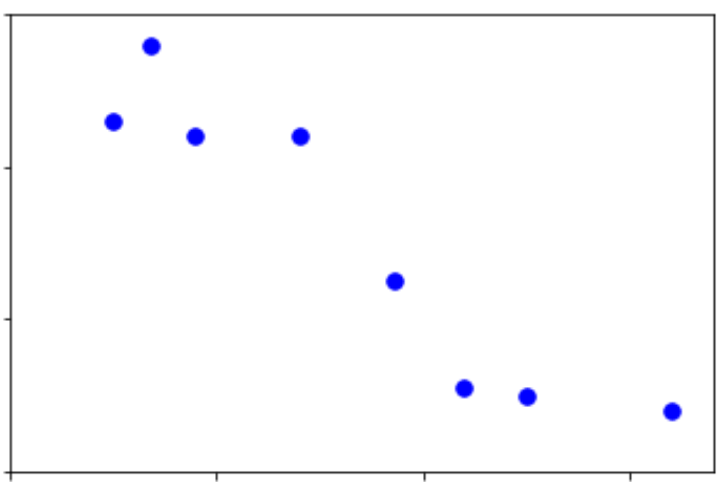
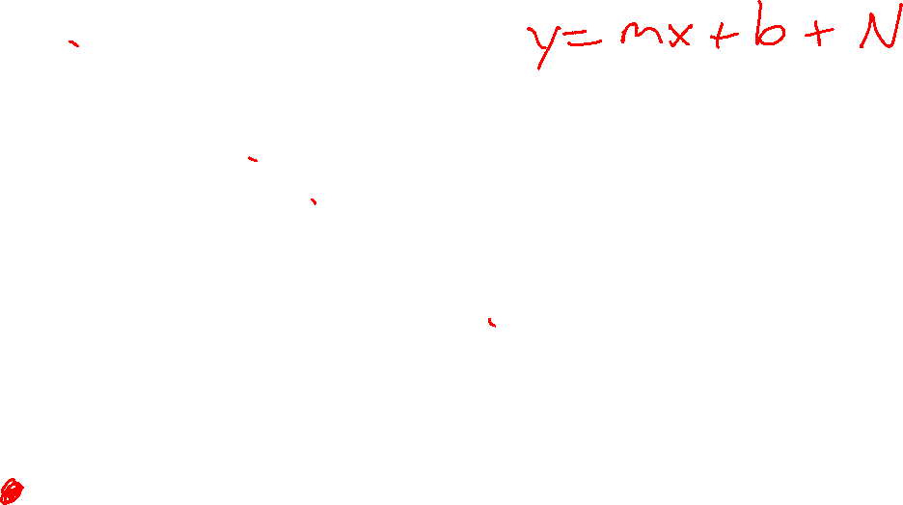
Assumptions
What assumptions do we make with this data?
Output y
Input x

Slide 23
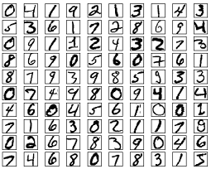
Assumptions
What assumptions do we make with this data?
More robust examples: http://yann.lecun.com/exdb/lenet/index.html

Slide 24
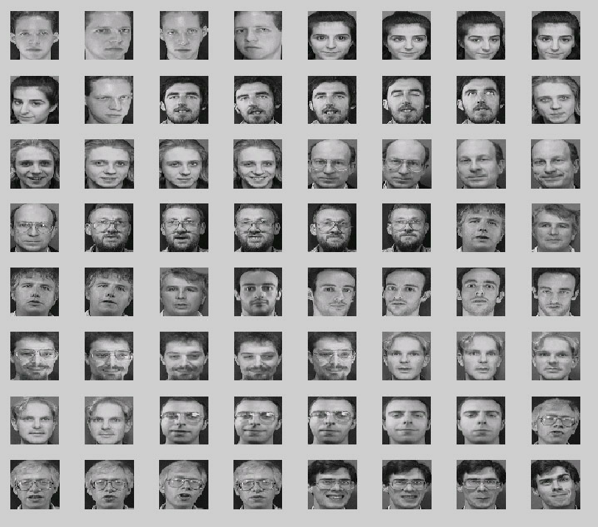
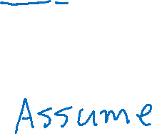
Assumptions
Face dataset

Slide 25
Course Information
Website: https://www.cs.cmu.edu/~10315
Canvas: canvas.cmu.edu
Gradescope: gradescope.com
Communication: piazza.com
E-mail: dpbird@andrew.cmu.edu
pvirtue@andrew.cmu.edu

Slide 26
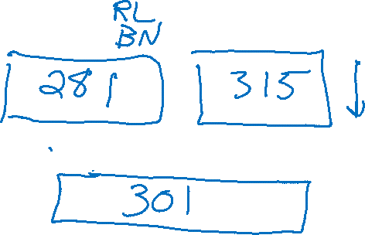
Course Information
Course Levels and Course Scope
Participation
Video
Waitlist
Prerequisites
Teamwork
Mental health

Slide 27
Announcements
Recitation starting this Friday
  Recommended. Materials are fair game for exams
  One Section
Assignments:
HW1 (online)
    Released this week
    Due next week

Slide 28
How to Approach a Machine Learning Problem
Consider your goal → definition of task T
  E.g. make good loan decisions, win chess competitions, …
Consider the nature of available (or potential) experience E
  How much data can you get? What would it cost (in money, time or effort)?
Choose type of output Y to learn
  (Numerical? Category? Probability? Plan?)
Choose the Performance measure P (error/loss function)
Choose a representation for the input X
Choose a set of possible solutions H (hypothesis space)
  set of functions h: X ➔ Y
  (often, by choosing a representation for them)
Choose or design a learning algorithm
  for using examples (E) to converge on a member of H that optimizes P
Slide: CMU ML, Roni Rosenfeld, Tom Mitchel

Slide 29
Notation

Slide 30
Vocab: General ML Concepts
Data / examples / experience
  Input
  Output (labels)
Model
Parameters
  Model complexity
Hypothesis function
  Prediction
Error/loss, accuracy
Objective function
Global/local min/max
Training, validation, test set
Over (under) fitting
Classification
Regression
Supervised (unsupervised) learning

Slide 31
Vocab: Specific ML Concepts / Techniques
Linear model
Mean squared error
Gradient Descent
Stochastic Gradient Descent
Learning rate
Batch
Sigmoid
ReLU
Softmax
Cross entropy
Neural network

