Slide 1
Warm-up as you log in
https://www.sporcle.com/games/MrChewypoo/minimalist_disney
https://www.sporcle.com/games/Stanford0008/minimalist-cartoons-slideshow
https://www.sporcle.com/games/MrChewypoo/minimalist

Slide 2

Announcements
Assignments
HW7 (online)
    Due Tue 3/31, 11:59 pm
HW8 (written + programming)
    Out this week
    Due Tue 4/7, 11:59 pm

Slide 3
Introduction to
Machine Learning
Dimensionality Reduction
PCA
Instructor: Pat Virtue

Slide 4
Outline
Supervised vs Unsupervised Learning
Dimensionality Reduction
  High-dimensional data
  Learning (low dimensional) representations
Principal Component Analysis (PCA)
  Examples: 2D and 3D
  Data for PCA
  PCA Definition
  Objective functions for PCA
  PCA, Eigenvectors, and Eigenvalues

Slide 5
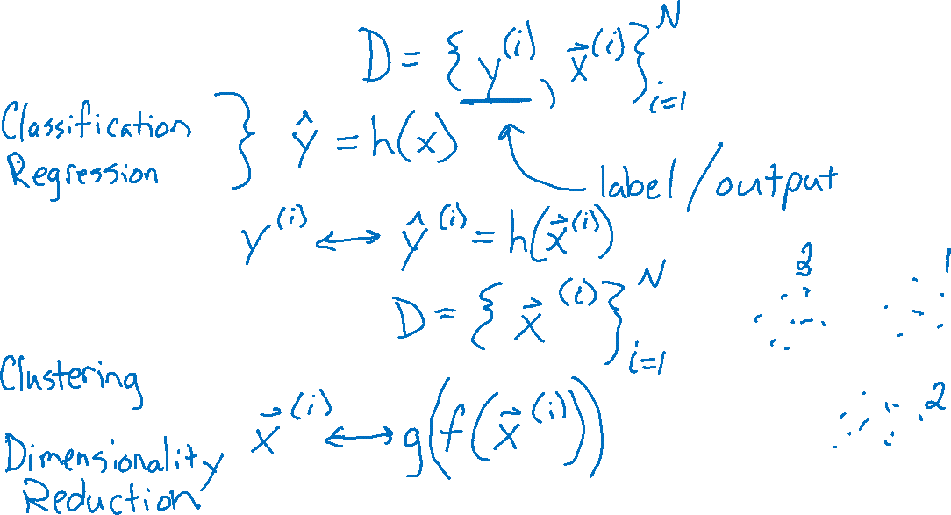
Supervised vs Unsupervised Learning
Supervised Learning
Unsupervised Learning

Slide 6
Warm-up as you log in
https://www.sporcle.com/games/MrChewypoo/minimalist_disney
https://www.sporcle.com/games/Stanford0008/minimalist-cartoons-slideshow
https://www.sporcle.com/games/MrChewypoo/minimalist

Slide 7


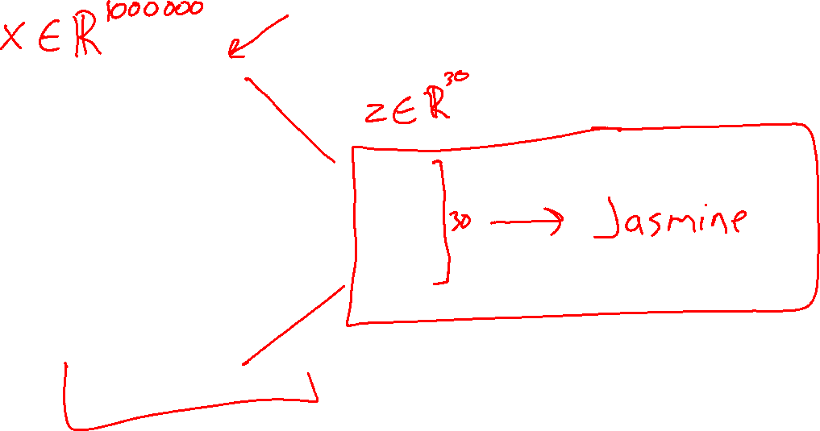
Dimensionality Reduction

Slide 8
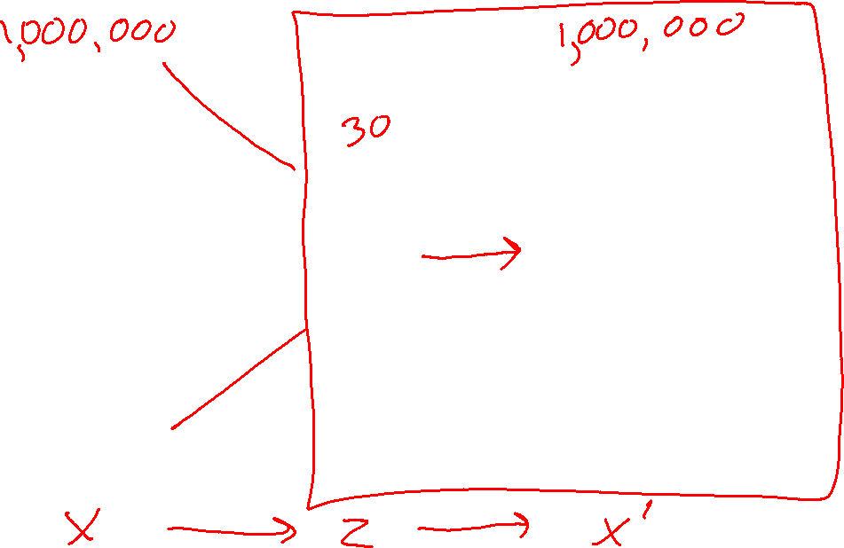
Dimensionality Reduction

Slide 9

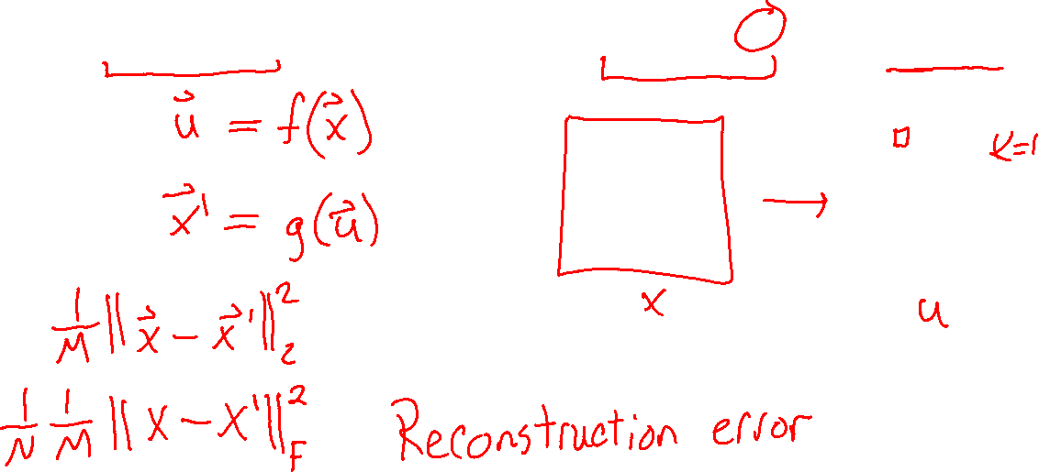
Dimensionality Reduction
For each $x^{(i)}∈ℝ^{M}$ find representation $u^{(i)}∈ℝ^{K}$ where $K≪M$

Slide 10
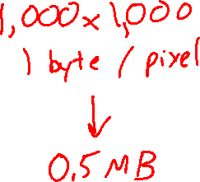
High Dimension Data
Examples of high dimensional data:
  High resolution images (millions of pixels)

Slide 11
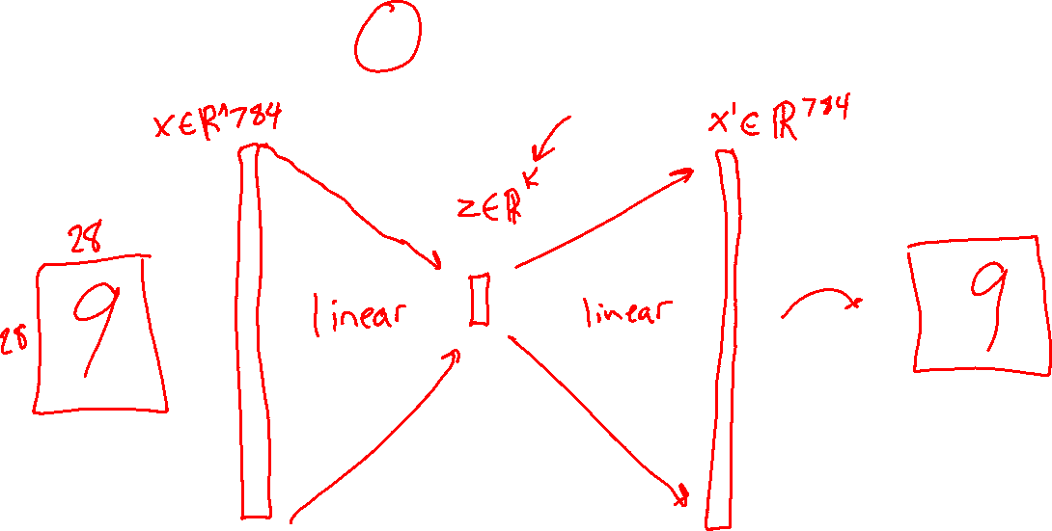
Dimensionality Reduction
http://timbaumann.info/svd-image-compression-demo/
https://cs.stanford.edu/people/karpathy/convnetjs/demo/autoencoder.html

Slide 12
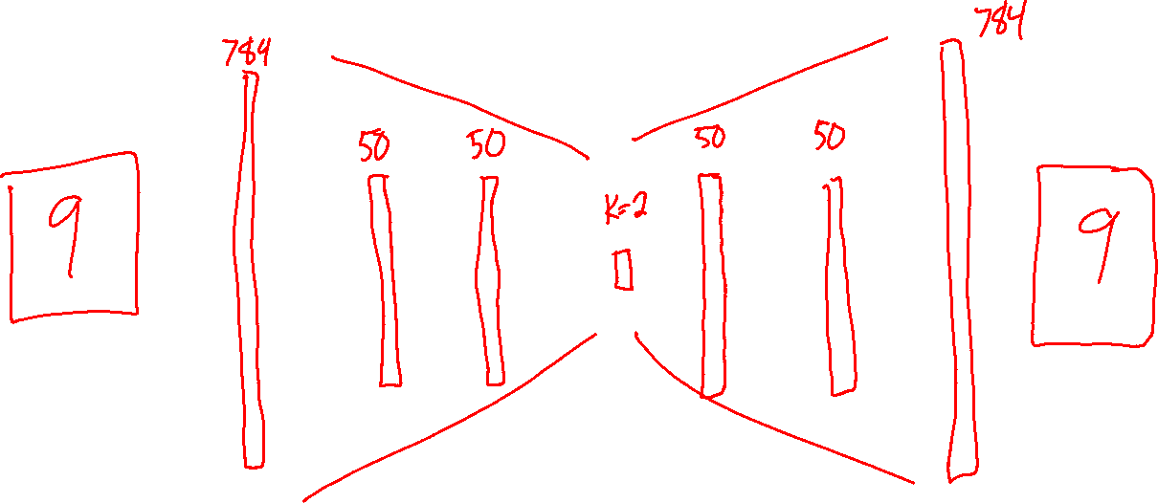
Dimensionality Reduction
http://timbaumann.info/svd-image-compression-demo/
https://cs.stanford.edu/people/karpathy/convnetjs/demo/autoencoder.html

Slide 13
High Dimension Data
Examples of high dimensional data:
  Multilingual News Stories
  (vocabulary of hundreds of thousands of words)

Slide 14
High Dimension Data
Examples of high dimensional data:
  Brain Imaging Data (100s of MBs per scan)
Image from (Wehbe et al., 2014)
Image from https://pixabay.com/en/brain-mrt-magnetic-resonance-imaging-1728449/

Slide 15
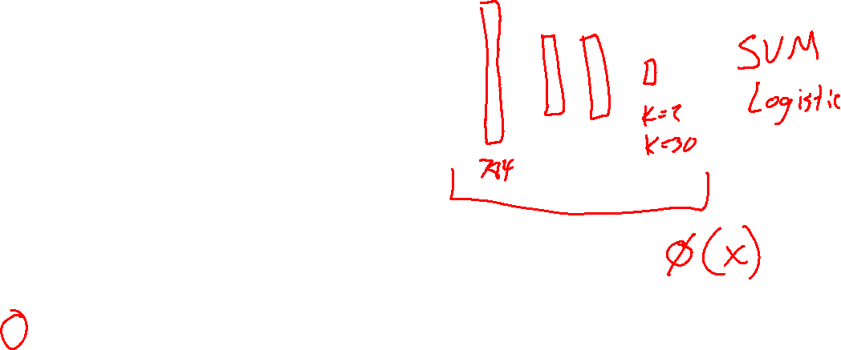
Learning Representations
PCA, Kernel PCA, ICA: Powerful unsupervised learning techniques for extracting hidden (potentially lower dimensional) structure from high dimensional datasets.
Useful for:
Visualization
More efficient use of resources
(e.g., time, memory, communication)
Statistical: fewer dimensions → better generalization
Noise removal (improving data quality)
Further processing by machine learning algorithms
Slide from Nina Balcan

Slide 16
Principal Component Analysis (PCA)

Slide 17
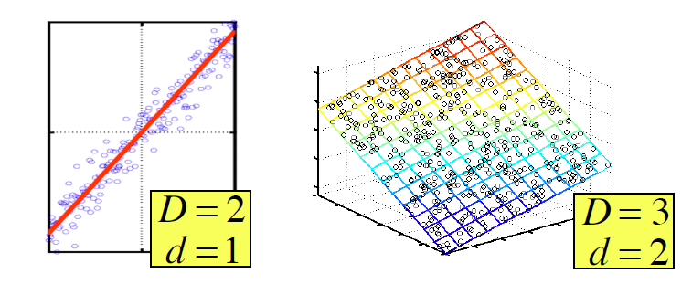
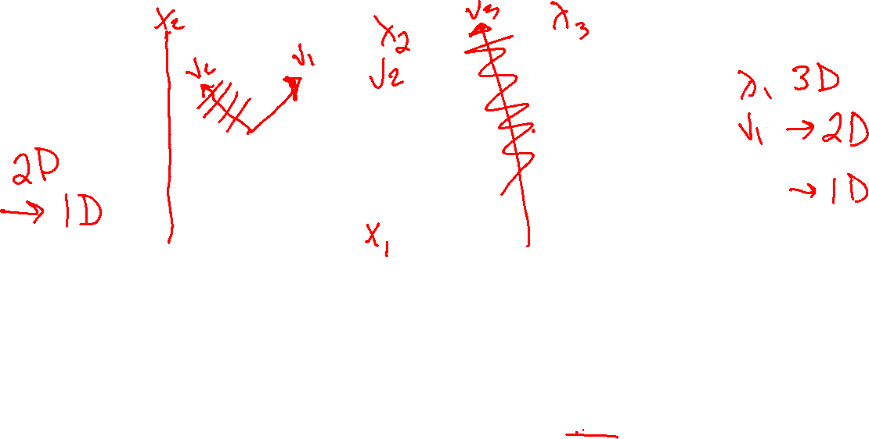
Principal Component Analysis (PCA)
In case where data lies on or near a low d-dimensional linear subspace, axes of this subspace are an effective representation of the data.
Identifying the axes is known as Principal Components Analysis, and can be obtained by using classic matrix computation tools (Eigen or Singular Value Decomposition).
Slide from Nina Balcan

Slide 18
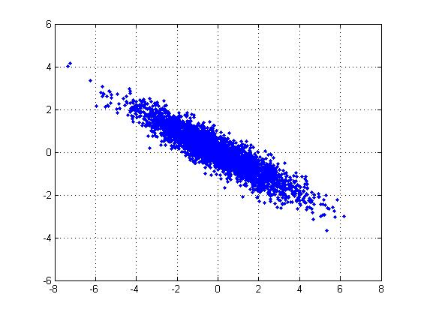
2D Gaussian dataset
Slide from Barnabas Poczos

Slide 19
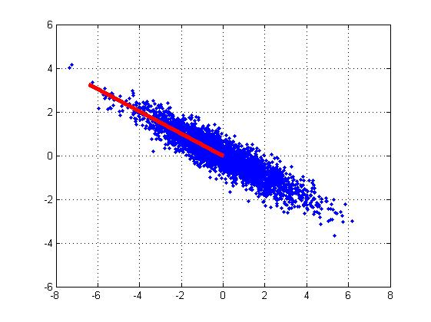
1st PCA axis
Slide from Barnabas Poczos

Slide 20


2nd PCA axis
Slide from Barnabas Poczos

Slide 21
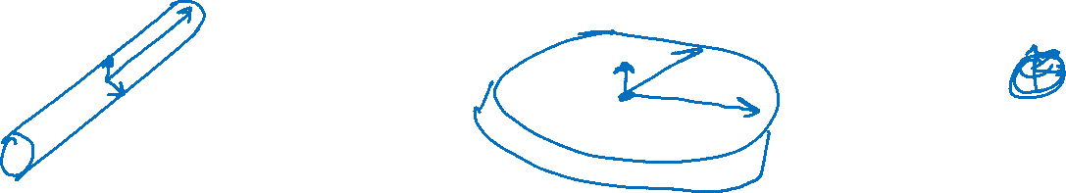
PCA Axes

Slide 22
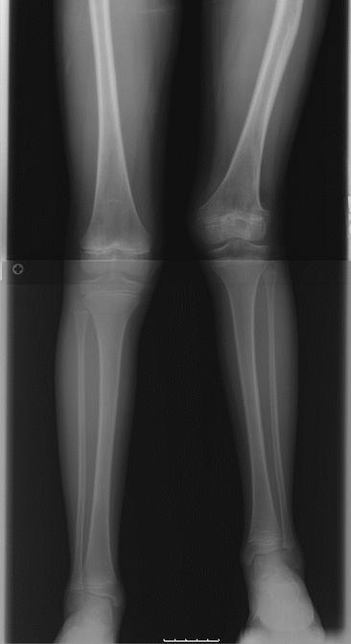
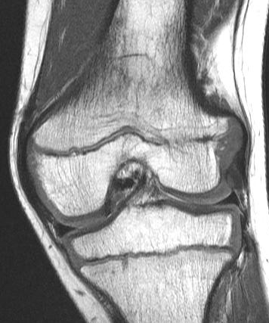
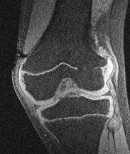
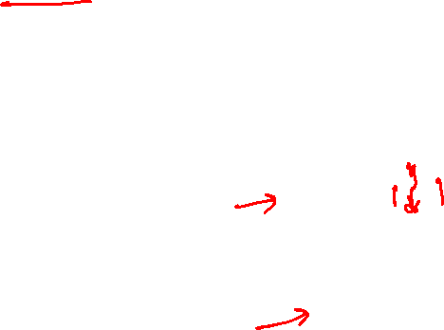
Growth Plate Imaging
Growth Plate Disruption and Limb Length Discrepancy
8 year-old boy with previous fracture and 4cm leg length discrepancy
Images Courtesy
H. Potter, H.S.S.

Slide 23
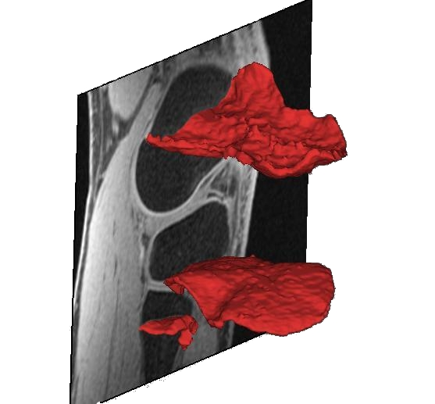
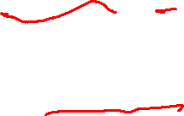
Growth Plate Imaging
Growth Plate Disruption and Limb Length Discrepancy
8 year-old boy with previous fracture and 4cm leg length discrepancy
Images Courtesy
H. Potter, H.S.S.

Slide 24
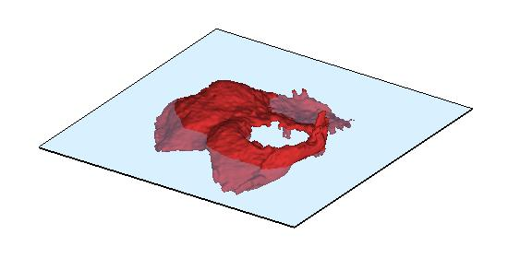
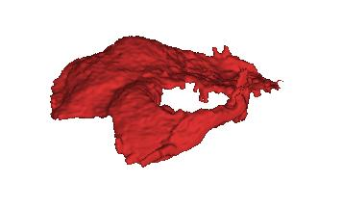
Growth Plate Imaging
Area Measurement

Slide 25
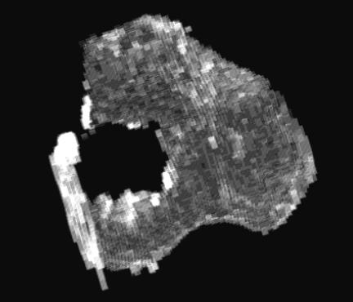
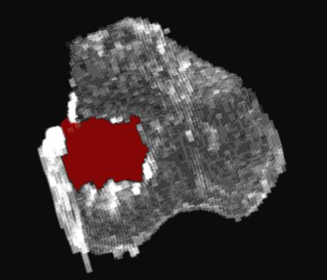
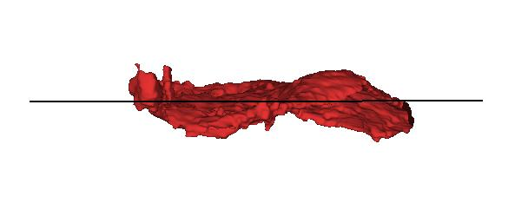
Growth Plate Imaging
Area Measurement
Flatten Growth Plate to Enable 2D Area Measurement

Slide 26
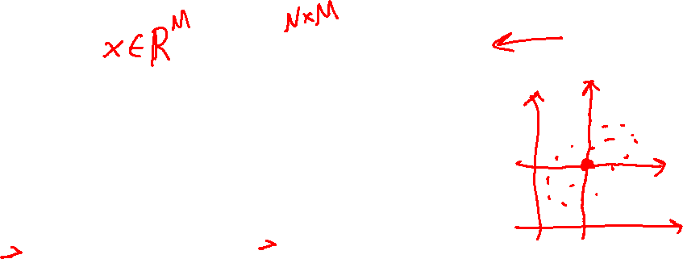
Data for PCA
We assume the data is centered
Q: What if your data is not centered?
A: Subtract off the sample mean
Slide from Matt Gormley

Slide 27
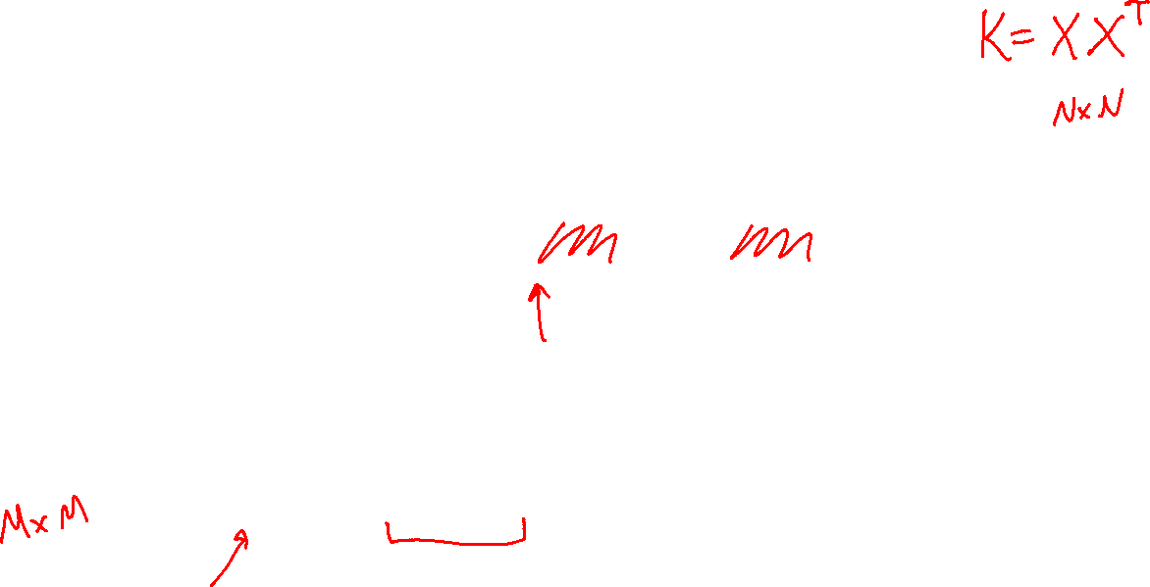
Sample Covariance Matrix
The sample covariance matrix is given by:
Since the data matrix is centered, we rewrite as:
Slide from Matt Gormley

Slide 28
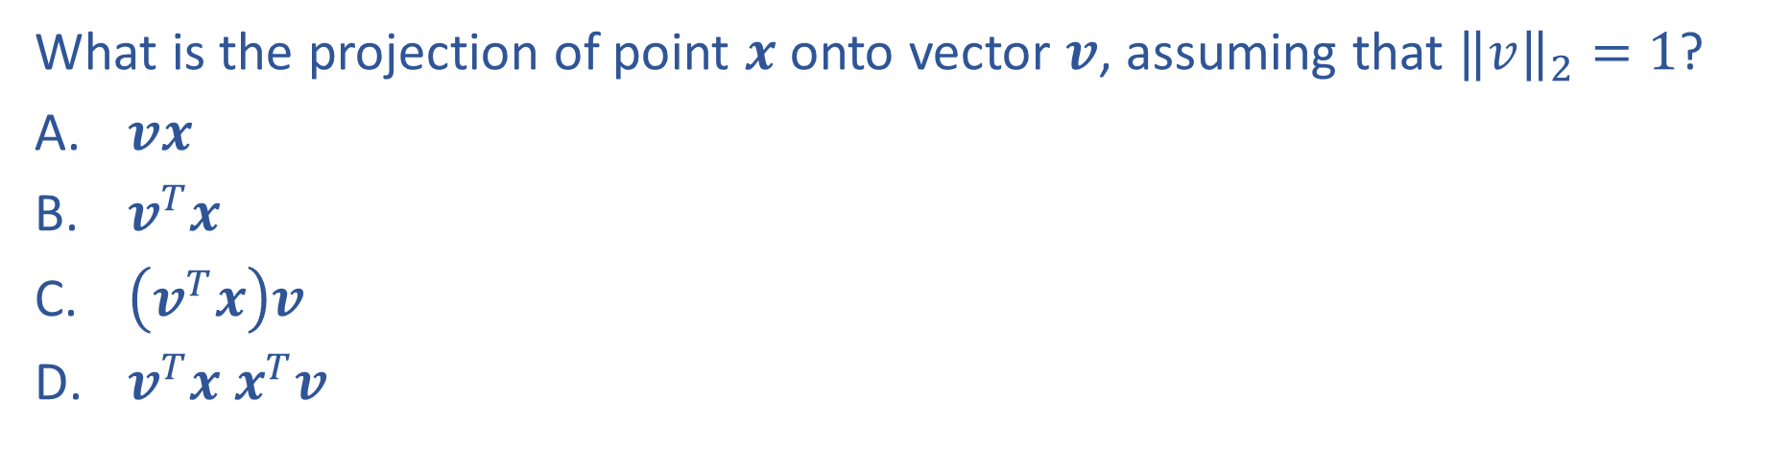
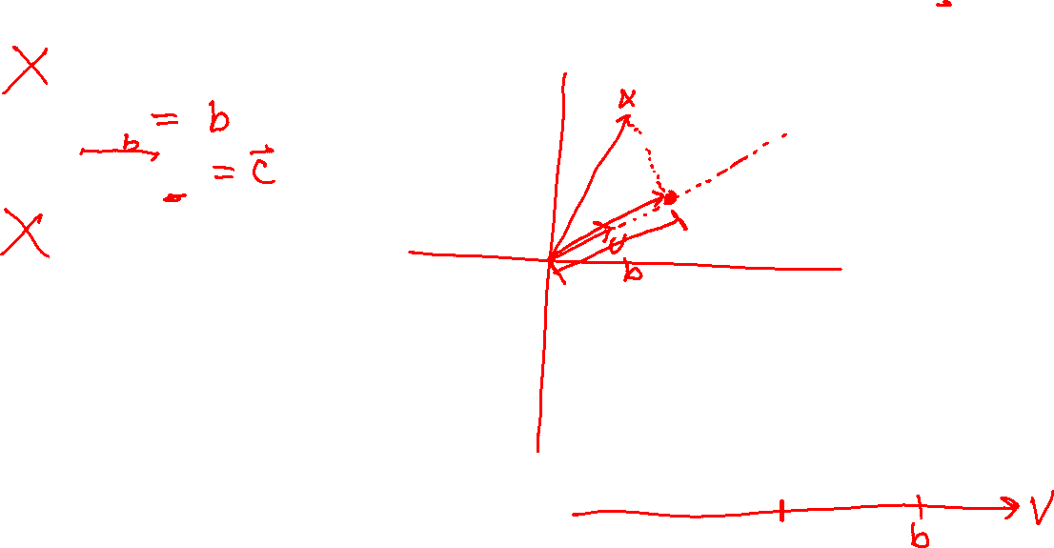
Piazza Poll 1
What is the projection of point $x$ onto vector $v$, assuming that ${‖v‖}_{2}=1$?
$vx$
$v^{T}x$
$\left(v^{T}x\right)v$
$v^{T}x x^{T}v$

Slide 29
Principle Component Analysis PCA)
Sketch of PCA algorithm
Two PCA objective functions

Slide 30
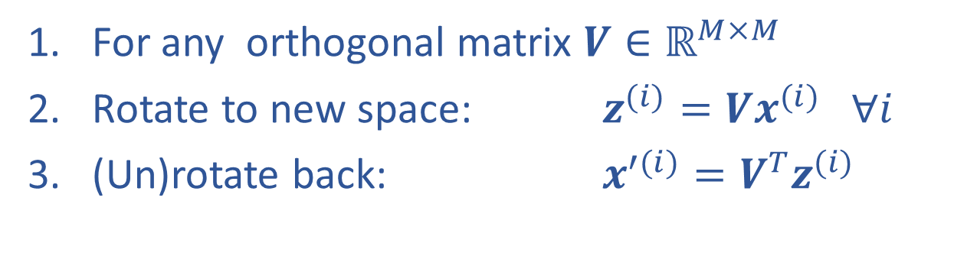
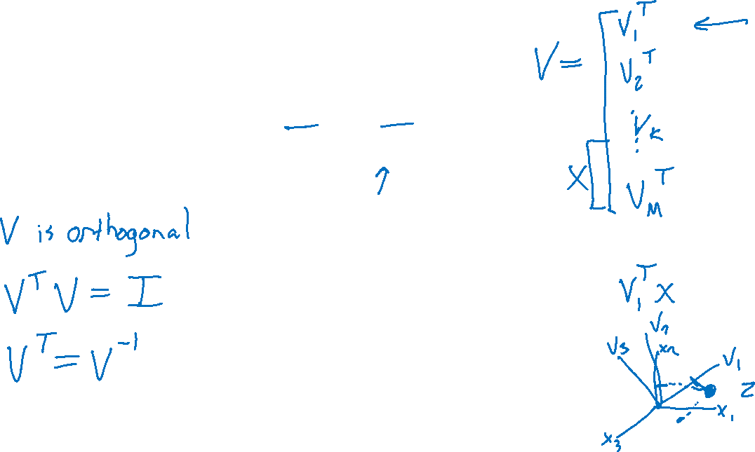
Rotation of Data (and back)
For any orthogonal matrix $V∈ℝ^{M×M}$
Rotate to new space: $z^{(i)}=Vx^{(i)} ∀i$
(Un)rotate back: $x^{′(i)}=V^{T}z^{(i)}$

Slide 31

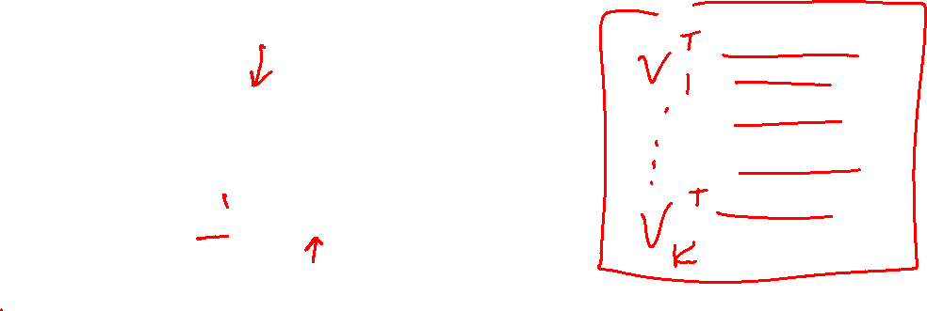
Sketch of PCA
Randomly select $V∈ℝ^{K×M}$
Project down: $z^{(i)}=Vx^{(i)} ∀i$
Reconstruct up: $x^{(i)}=V^{T}z^{(i)}$

Slide 32
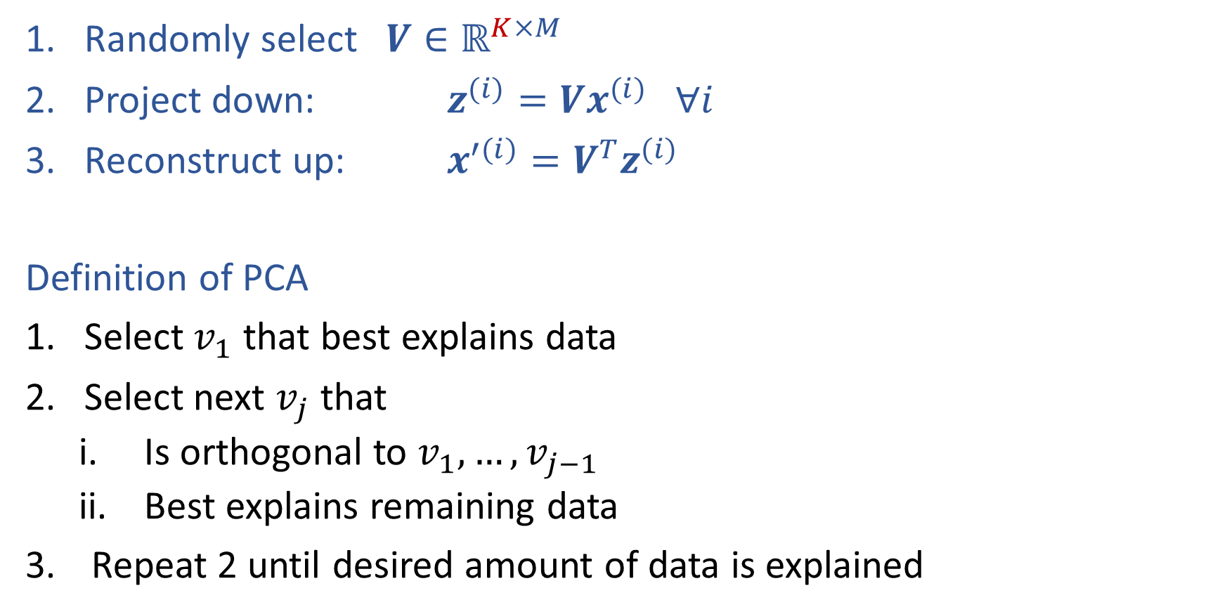
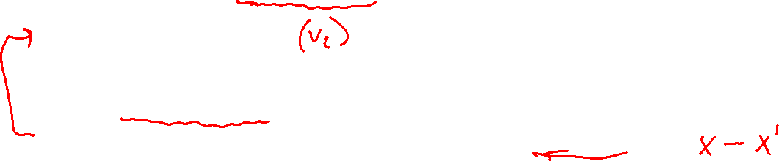
Sketch of PCA
Randomly select $V∈ℝ^{K×M}$
Project down: $z^{(i)}=Vx^{(i)} ∀i$
Reconstruct up: $x^{′(i)}=V^{T}z^{(i)}$
Definition of PCA
Select $v_{1}$ that best explains data
Select next $v_{j}$ that
    Is orthogonal to $v_{1}, …,v_{j−1}$
    Best explains remaining data
Repeat 2 until desired amount of data is explained

Slide 33
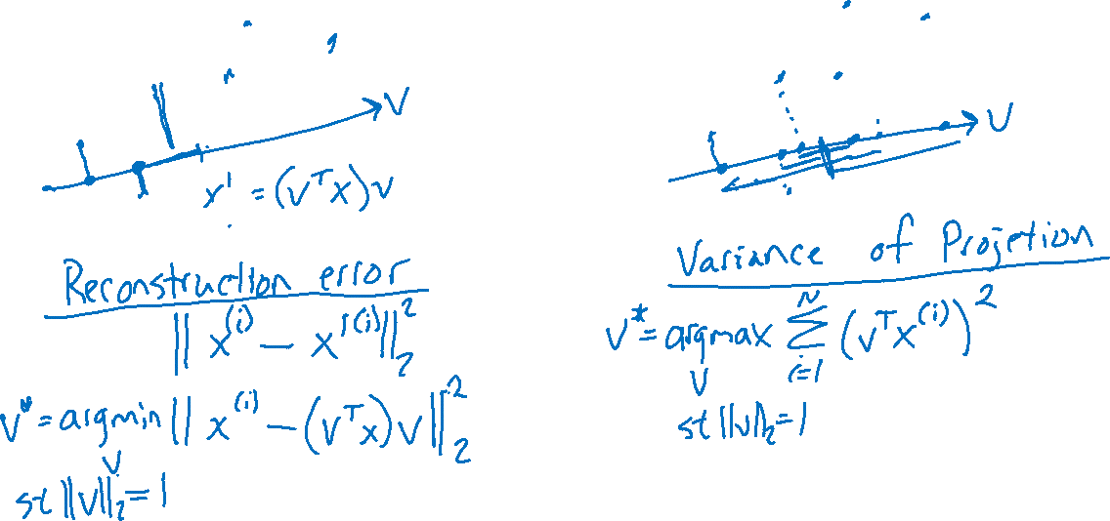
Select “Best” Vector
Reconstruction Error vs Variance of Projection

