Slide 1

Announcements
Assignments
HW6 (written + programming)
Due Thu 3/26, 11:59 pm
HW7 (online)
Out later tonight
Due Tue 3/31, 11:59 pm

Slide 2
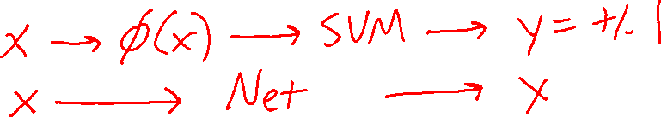
Introduction to Machine Learning
Support Vector Machines
Instructor: Pat Virtue

Slide 3
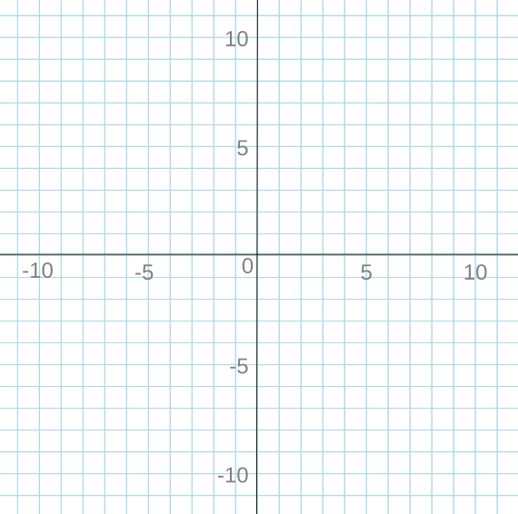
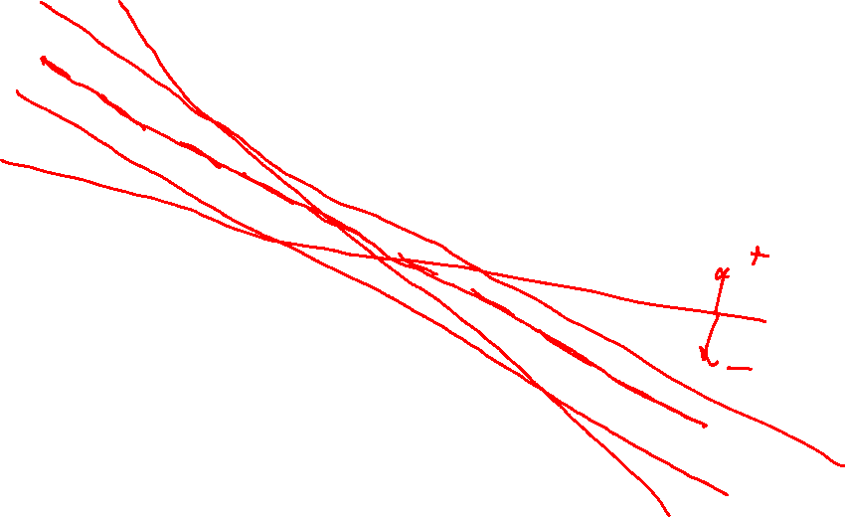
Support Vector Machines
Linear Classification
x₂
x₁

Slide 4
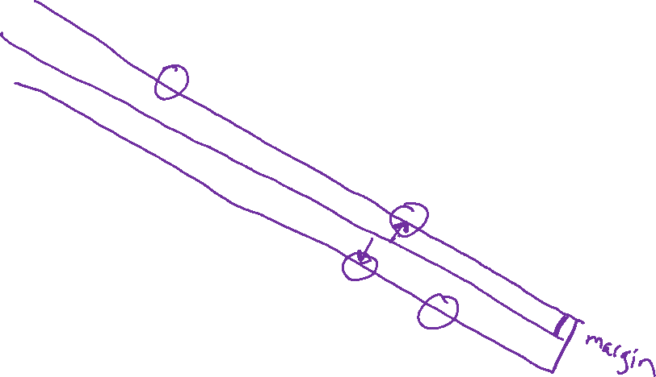
Support Vector Machines
Max Margin
x₂
x₁

Slide 5

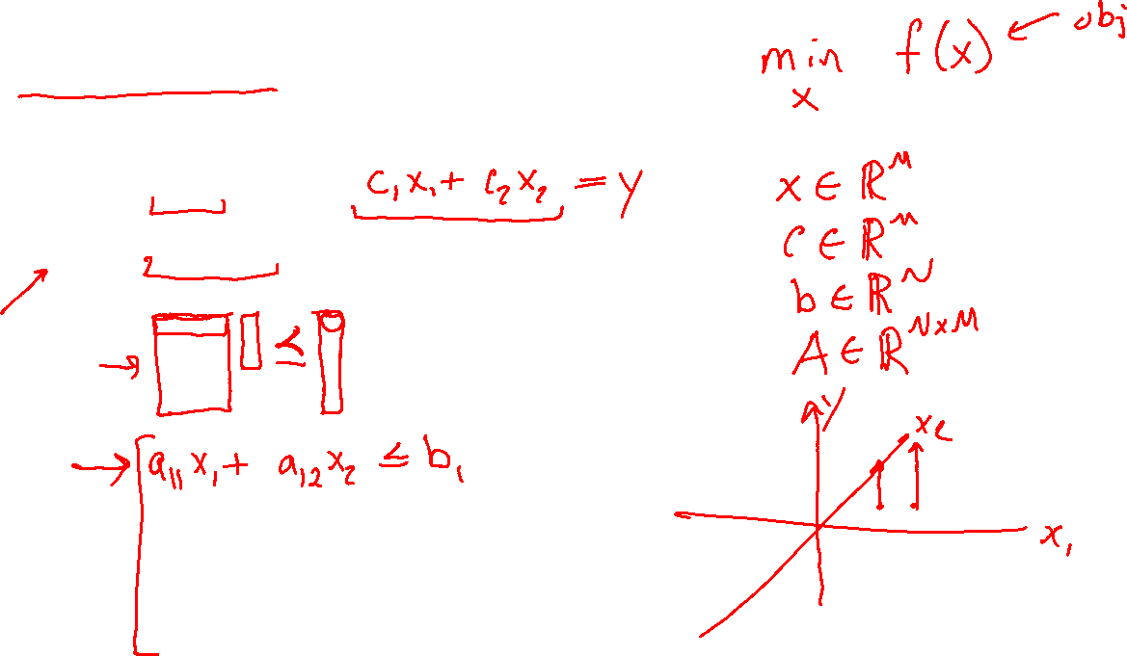
Constrained Optimization
Linear Program
$\min_{x}{ c^{T}x}$
s.t. $Ax⪯b$

Slide 6
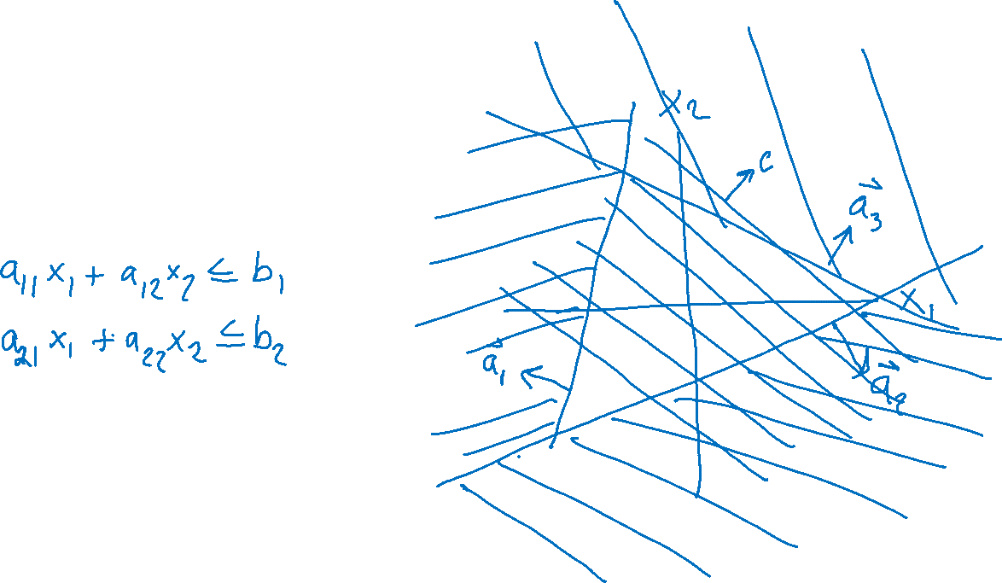
Constrained Optimization
Linear Program
$\min_{x}{ c^{T}x}$
s.t. $Ax⪯b$

Slide 7
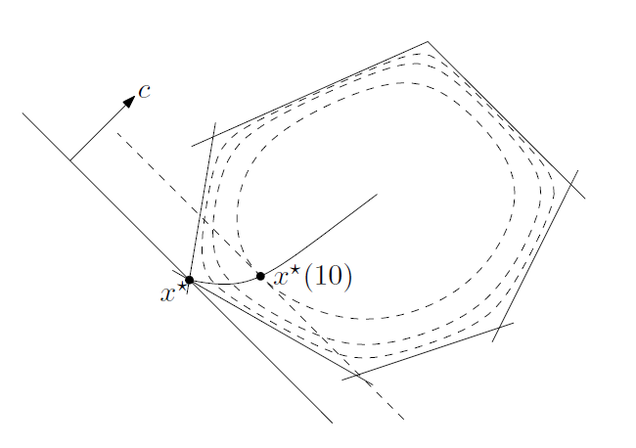


Constrained Optimization
Linear Program
$\min_{x}{ c^{T}x}$
s.t. $Ax⪯b$
Solvers
Simplex
Interior point methods
Figure: Fig 11.2 from Boyd and Vandenberghe, Convex Optimization

Slide 8

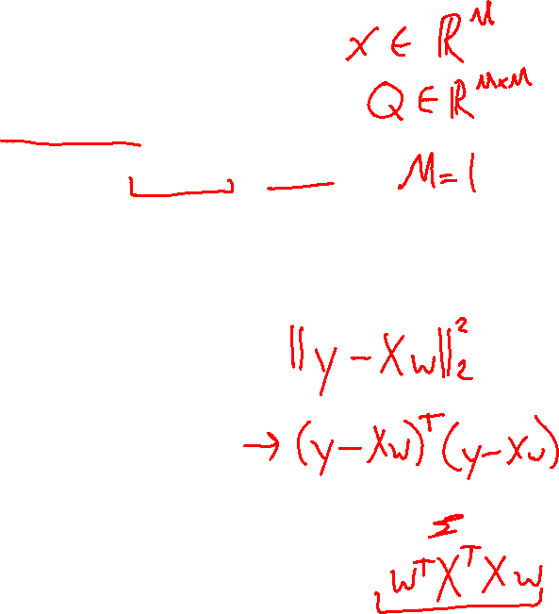
Constrained Optimization
Linear Program
$\min_{x}{ c^{T}x}$
s.t. $Ax⪯b$
Solvers
Simplex
Interior point methods
Quadratic Program
$\min_{x}{ x^{T}Qx+}$ $c^{T}x$
s.t. $Ax⪯b$

Slide 9
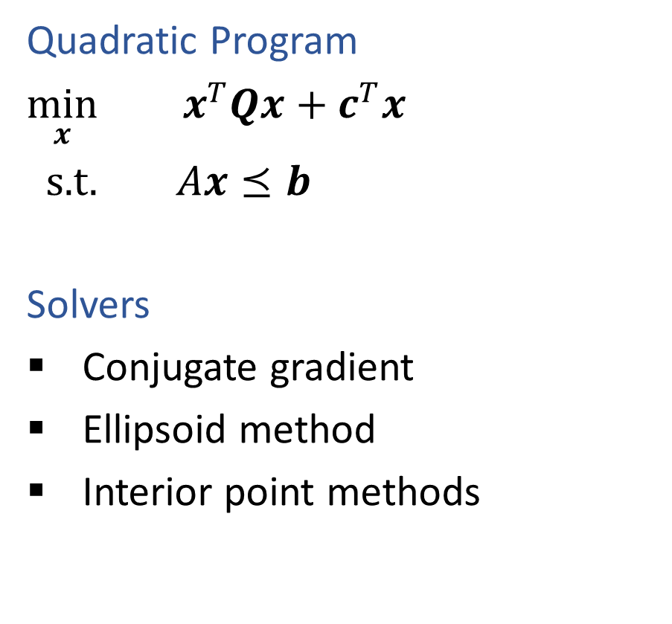
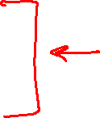
Constrained Optimization
Linear Program
$\min_{x}{ c^{T}x}$
s.t. $Ax⪯b$
Solvers
Simplex
Interior point methods
Quadratic Program
$\min_{x}{ x^{T}Qx+}$ $c^{T}x$
s.t. $Ax⪯b$
Solvers
Conjugate gradient
Ellipsoid method
Interior point methods

Slide 10
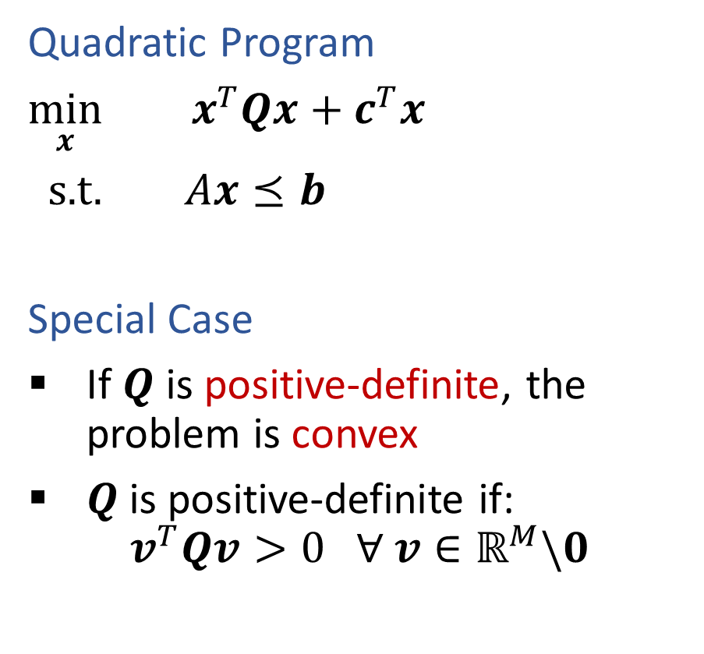

Constrained Optimization
Linear Program
$\min_{x}{ c^{T}x}$
s.t. $Ax⪯b$
Solvers
Simplex
Interior point methods
Quadratic Program
$\min_{x}{ x^{T}Qx+}$ $c^{T}x$
s.t. $Ax⪯b$
Special Case
If $Q$ is positive-definite, the problem is convex
$Q$is positive-definite if:
$$v^{T}Qv>0 ∀ v∈ℝ^{M}\backslash 0$$

Slide 11

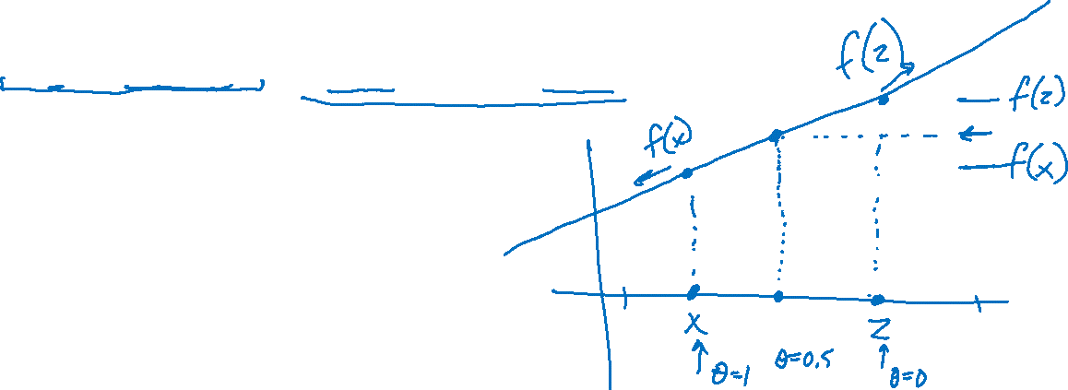
Convex Optimization
Linear function
If $f(x)$ is linear, then:
$f\left(x+z\right)=f\left(x\right)+f\left(z\right)$
$f\left(θx\right)=θf\left(x\right) ∀ θ$
$f\left(θx+\left(1−θ\right)z\right)=θf\left(x\right)+\left(1−θ\right)f\left(z\right) ∀ θ$

Slide 12



Convex Optimization
Convex function
If $f(x)$ is convex, then:
$f\left(θx+\left(1−θ\right)z\right)≤θf\left(x\right)+\left(1−θ\right)f\left(z\right) ∀ 0≤θ≤1$
Convex optimization
If $f(x)$ is convex, then:
Every local minimum is also a global minimum ☺

Slide 13

Constrained Optimization
Linear Program
$\min_{x}{ c^{T}x}$
s.t. $Ax⪯b$
Solvers
Simplex
Interior point methods
Quadratic Program
$\min_{x}{ x^{T}Qx+}$ $c^{T}x$
s.t. $Ax⪯b$
Special Case
If $Q$ is positive-definite, the problem is convex
$Q$is positive-definite if:
$$v^{T}Qv>0 ∀ v∈ℝ^{M}\backslash 0$$

Slide 14
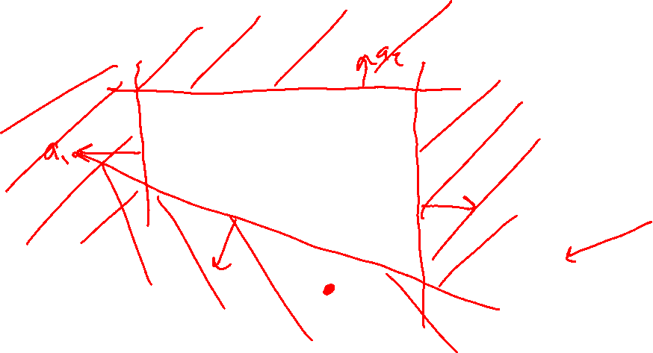
Quadratic Program
Slide credit: CMU MLD Matt Gormley

Slide 15
Quadratic Program
Slide credit: CMU MLD Matt Gormley

Slide 16
Quadratic Program
Slide credit: CMU MLD Matt Gormley

Slide 17
Quadratic Program
Slide credit: CMU MLD Matt Gormley

Slide 18
Quadratic Program
Slide credit: CMU MLD Matt Gormley

Slide 19
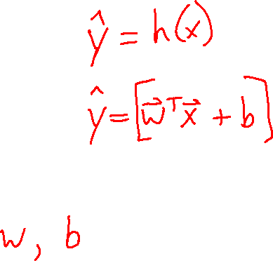
Support Vector Machines
Find linear separator with maximum margin

Slide 20
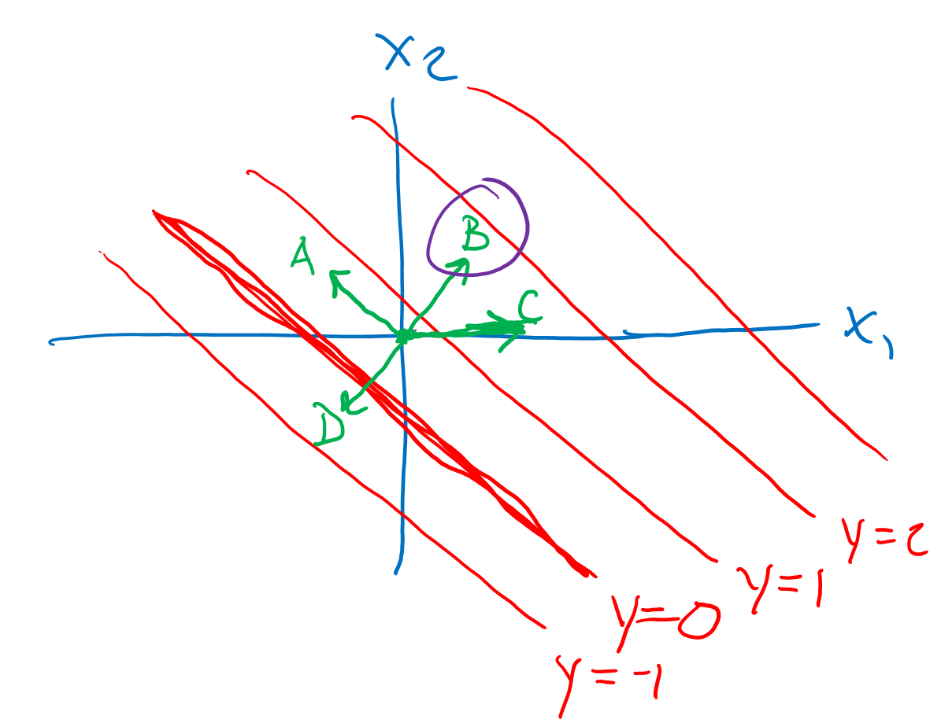
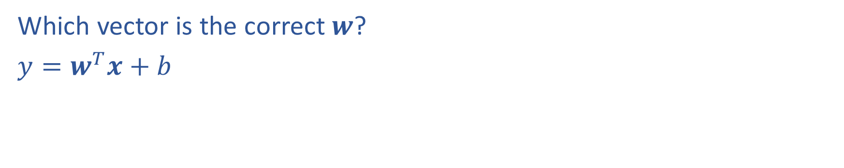
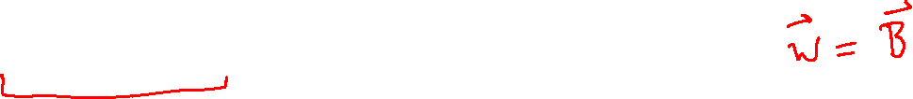
(Lecture 5) Poll
Which vector is the correct $w$?
$y=w^{T}x+b$

Slide 21
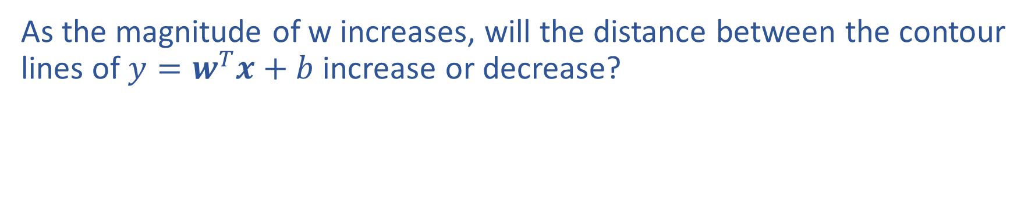
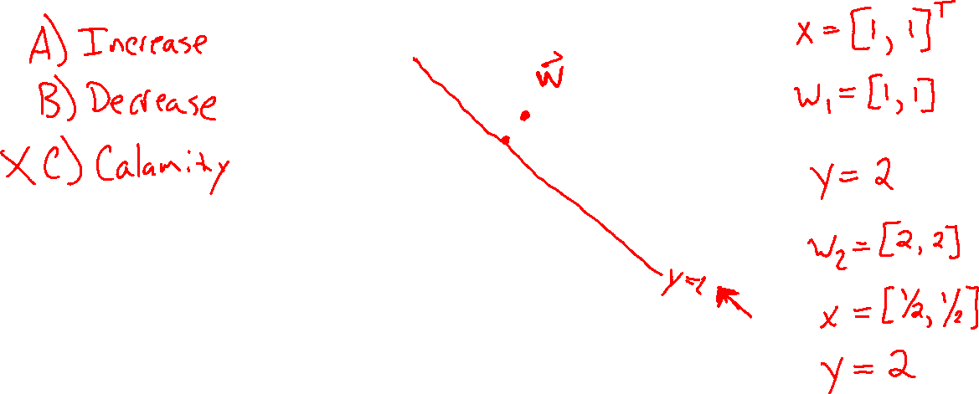
Piazza Poll 1
As the magnitude of w increases, will the distance between the contour lines of $y=w^{T}x+b$ increase or decrease?

Slide 22
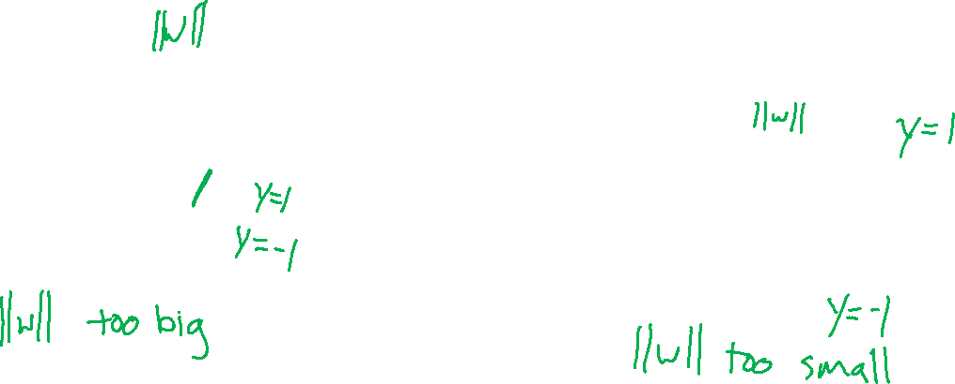
Support Vector Machines
Find linear separator with maximum margin
x₂
x₂
x₂
x₁
x₁
x₁

Slide 23
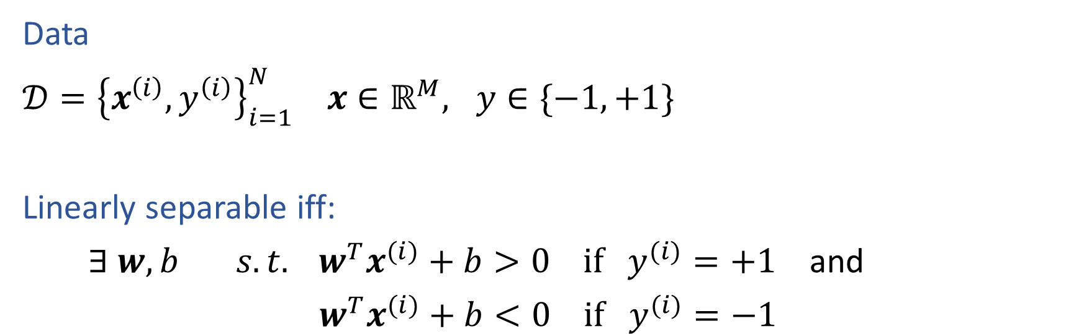
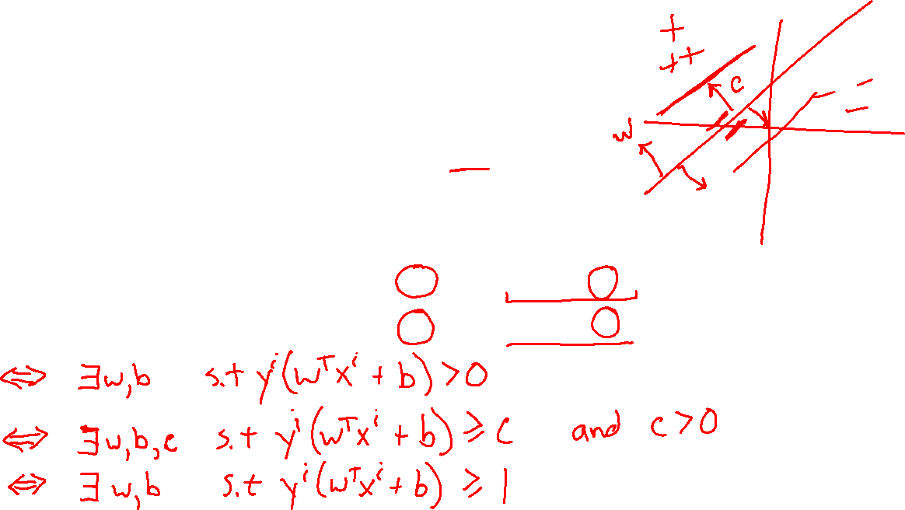
Linear Separability
Data
$𝒟={\left\{x^{\left(i\right)}, y^{\left(i\right)}\right\}}_{i=1}^{N} x∈ℝ^{M}, y∈\{−1, +1\}$
Linearly separable iff:
$∃ w, b s.t. w^{T}x^{(i)}+b>0 if y^{(i)}=+1$ and
$w^{T}x^{(i)}+b<0 if y^{(i)}=−1$
Slide credit: CMU MLD Matt Gormley

Slide 24
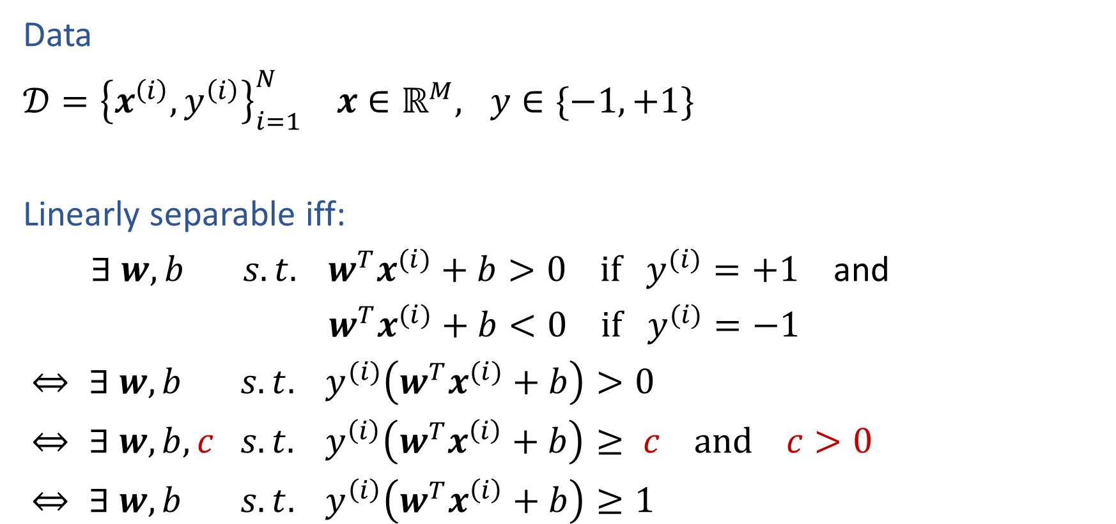
Linear Separability
Data
$𝒟={\left\{x^{\left(i\right)}, y^{\left(i\right)}\right\}}_{i=1}^{N} x∈ℝ^{M}, y∈\{−1, +1\}$
Linearly separable iff:
$∃ w, b s.t. w^{T}x^{(i)}+b>0 if y^{(i)}=+1$ and
$w^{T}x^{(i)}+b<0 if y^{(i)}=−1$
$⇔ ∃ w, b s.t. y^{(i)}\left(w^{T}x^{(i)}+b\right)>0$
$⇔ ∃ w, b,c s.t. y^{\left(i\right)}\left(w^{T}x^{\left(i\right)}+b\right)≥ c and c>0$
$⇔ ∃ w, b s.t. y^{\left(i\right)}\left(w^{T}x^{\left(i\right)}+b\right)≥1$
Slide credit: CMU MLD Matt Gormley

Slide 25
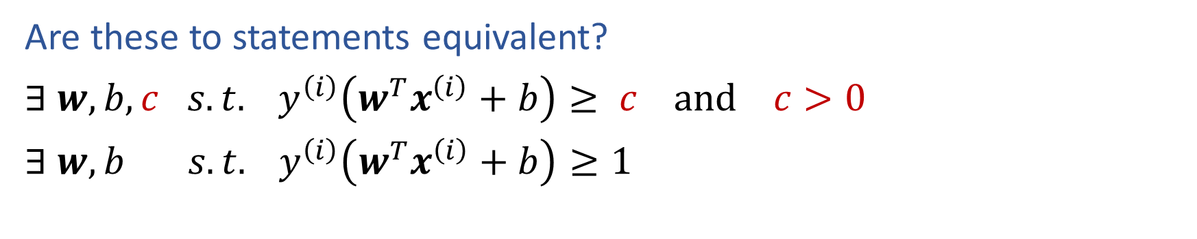
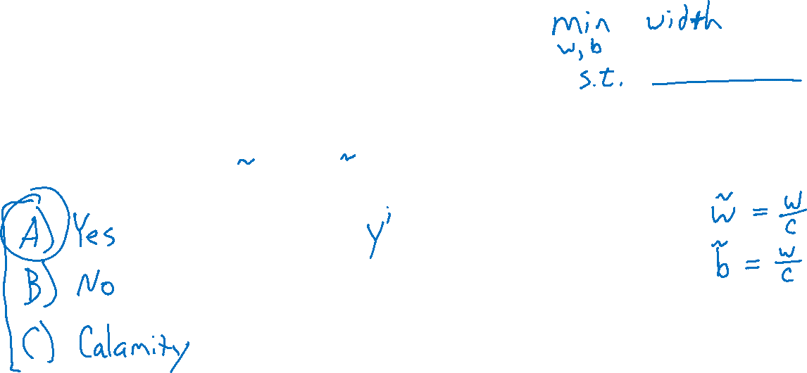
Piazza Poll 2
Are these to statements equivalent?
$∃ w, b,c s.t. y^{\left(i\right)}\left(w^{T}x^{\left(i\right)}+b\right)≥ c and c>0$
$∃ w, b s.t. y^{\left(i\right)}\left(w^{T}x^{\left(i\right)}+b\right)≥1$

Slide 26

Linear Separability
Data
$𝒟={\left\{x^{\left(i\right)}, y^{\left(i\right)}\right\}}_{i=1}^{N} x∈ℝ^{M}, y∈\{−1, +1\}$
Linearly separable iff:
$∃ w, b s.t. w^{T}x^{(i)}+b>0 if y^{(i)}=+1$ and
$w^{T}x^{(i)}+b<0 if y^{(i)}=−1$
$⇔ ∃ w, b s.t. y^{(i)}\left(w^{T}x^{(i)}+b\right)>0$
$⇔ ∃ w, b,c s.t. y^{\left(i\right)}\left(w^{T}x^{\left(i\right)}+b\right)≥ c and c>0$
$⇔ ∃ w, b s.t. y^{\left(i\right)}\left(w^{T}x^{\left(i\right)}+b\right)≥1$
Slide credit: CMU MLD Matt Gormley

Slide 27
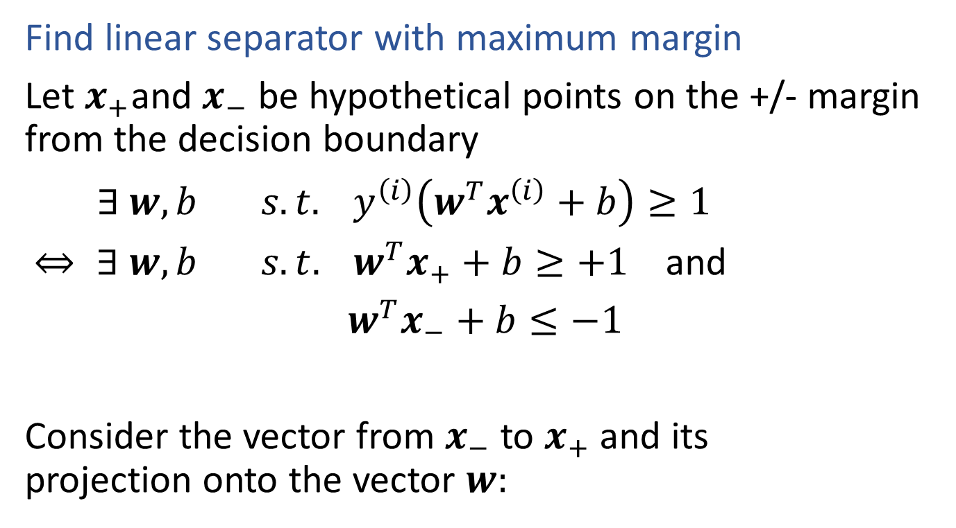
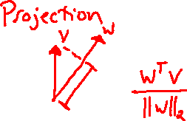
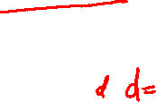
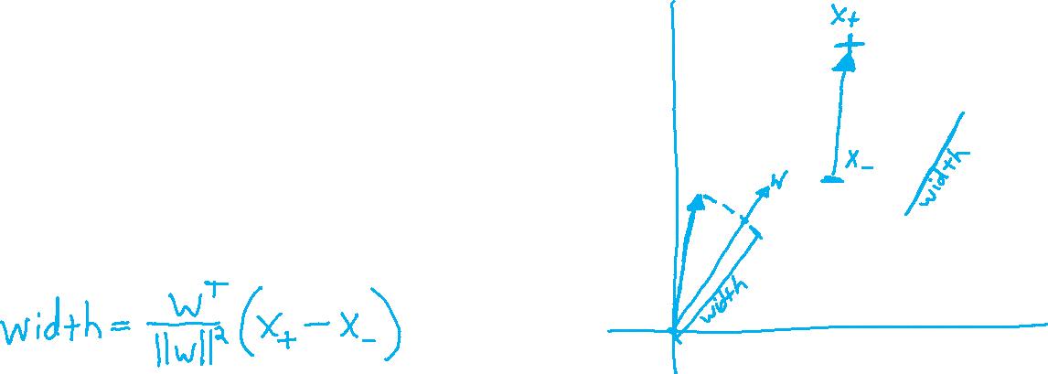
Support Vector Machines
Find linear separator with maximum margin
Let $x_{+}$and $x_{−}$ be hypothetical points on the +/- margin from the decision boundary
$∃ w, b s.t. y^{\left(i\right)}\left(w^{T}x^{\left(i\right)}+b\right)≥1$
$⇔ ∃ w, b s.t. w^{T}x_{+}+b≥+1$ and
$w^{T}x_{−}+b≤−1$
Consider the vector from $x_{−}$ to $x_{+}$ and its projection onto the vector $w:$

Slide 28
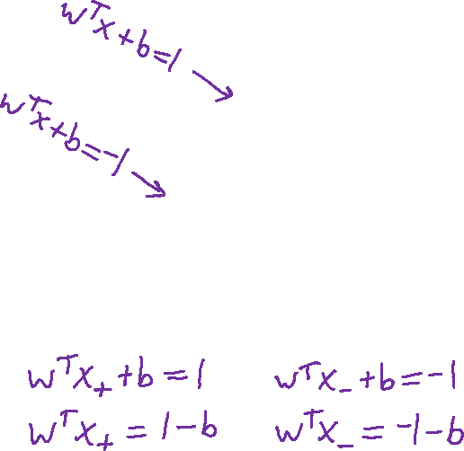
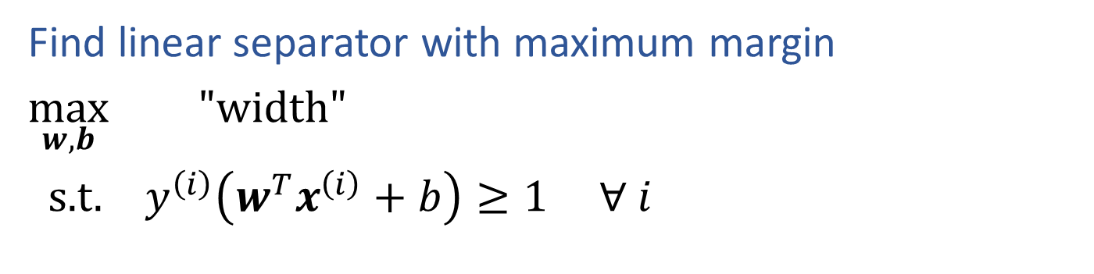
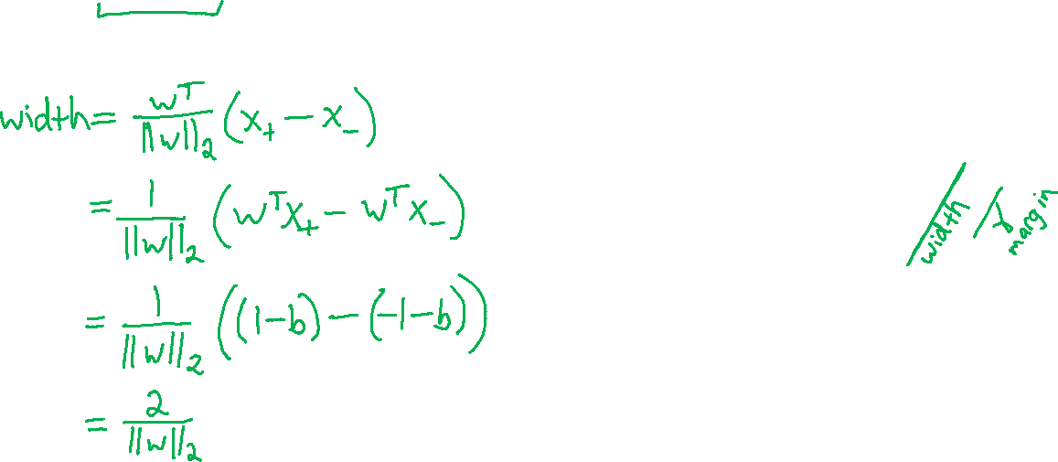

Support Vector Machines
$width= \frac{w^{T}}{{\left\|w\right\|}_{2}}(x_{+}$- $x_{−}$)
Find linear separator with maximum margin
$\max_{w,b}{ "width"}$
s.t. $y^{\left(i\right)}\left(w^{T}x^{\left(i\right)}+b\right)≥1 ∀ i$

Slide 29
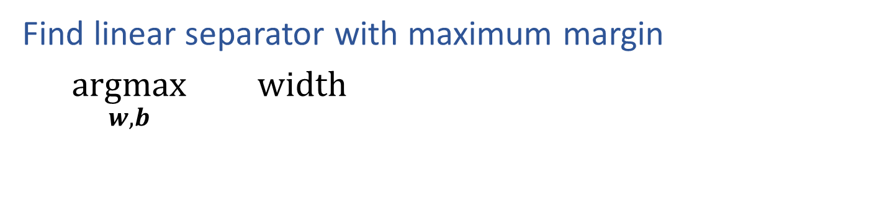

Support Vector Machines
$$width=\frac{2}{{\left\|w\right\|}_{2}}$$
Find linear separator with maximum margin
$\underset{w,b}{argmax}{ width}$

Slide 30
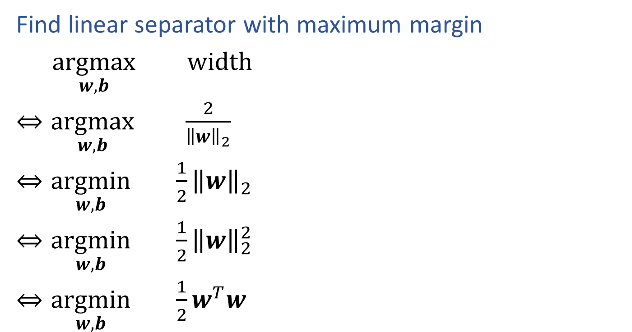
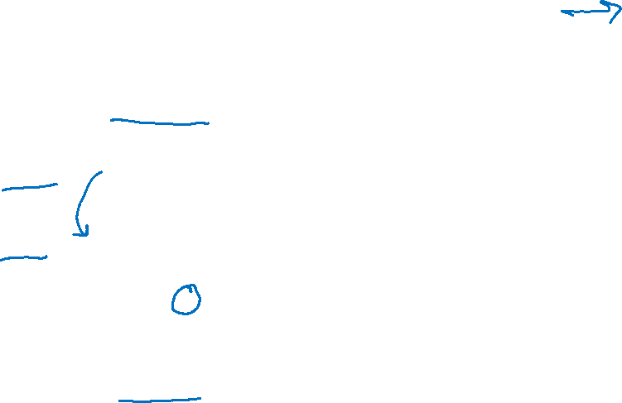

Support Vector Machines
$$width=\frac{2}{{\left\|w\right\|}_{2}}$$
Find linear separator with maximum margin
$\underset{w,b}{argmax}{ width}$
$⇔\underset{w,b}{argmax}{ \frac{2}{{\left\|w\right\|}_{2}}}$
$⇔\underset{w,b}{argmin}{ \frac{1}{2}{\left\|w\right\|}_{2}}$
$⇔\underset{w,b}{argmin}{ \frac{1}{2}{\left\|w\right\|}_{2}^{2}}$
$⇔\underset{w,b}{argmin}{ \frac{1}{2}w^{T}w}$

Slide 31
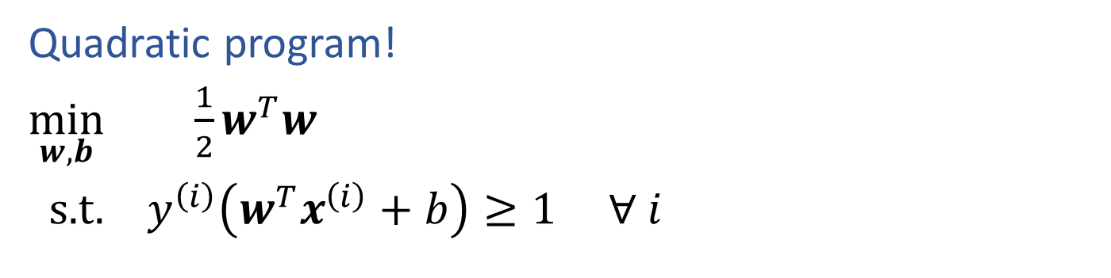
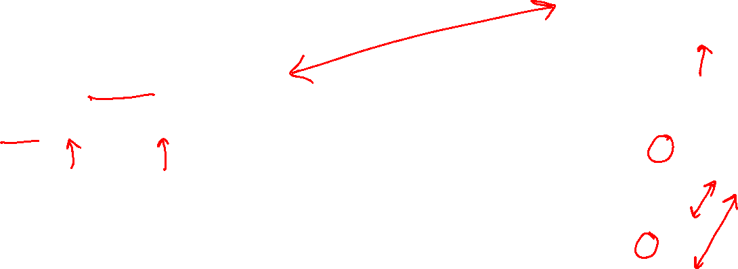
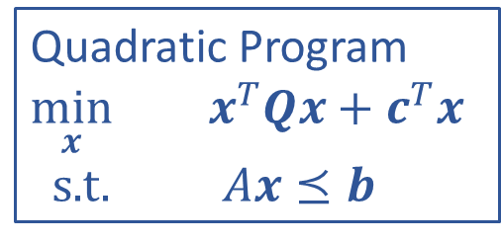
SVM Optimization
Quadratic Program
$\min_{x}{ x^{T}Qx+}$ $c^{T}x$
s.t. $Ax⪯b$
Quadratic program!
$\min_{w,b}{ \frac{1}{2}w^{T}w}$
s.t. $y^{\left(i\right)}\left(w^{T}x^{\left(i\right)}+b\right)≥1 ∀ i$

