Slide 1
Announcements
Assignments
HW6 (written + programming)
    Due Thu 3/26, 11:59 pm
HW7 (online)
    Out later tonight
    Due Tue 3/31, 11:59 pm

Slide 2
Introduction to
Machine Learning
Support Vector Machines
Instructor: Pat Virtue

Slide 3
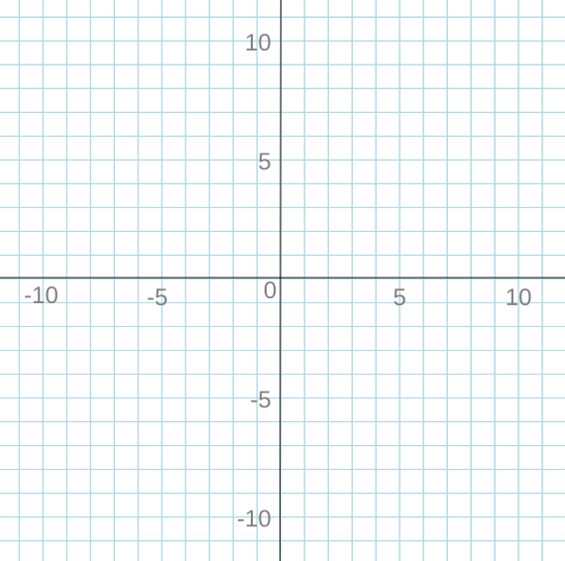
Support Vector Machines
Linear Classification
x₂
x₁

Slide 4
Support Vector Machines
Max Margin
x₂
x₁

Slide 5

Constrained Optimization
Linear Program
$\min_{x}{ c^{T}x}$
s.t. $Ax⪯b$

Slide 6
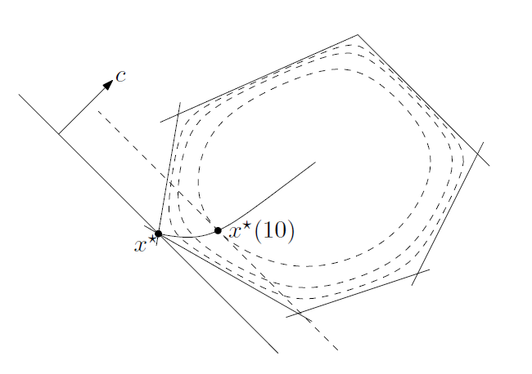

Constrained Optimization
Linear Program
$\min_{x}{ c^{T}x}$
s.t. $Ax⪯b$
Solvers
Simplex
Interior point methods
Figure: Fig 11.2 from Boyd and Vandenberghe, Convex Optimization

Slide 7

Constrained Optimization
Linear Program
$\min_{x}{ c^{T}x}$
s.t. $Ax⪯b$
Solvers
Simplex
Interior point methods
Quadratic Program
$\min_{x}{ x^{T}Qx+}$ $c^{T}x$
s.t. $Ax⪯b$

Slide 8
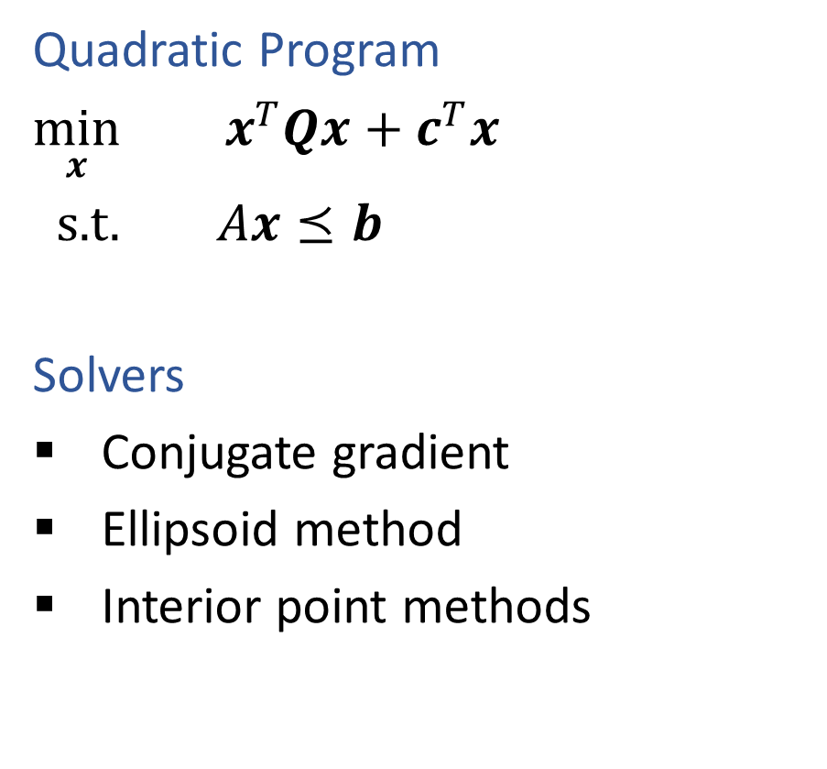
Constrained Optimization
Linear Program
$\min_{x}{ c^{T}x}$
s.t. $Ax⪯b$
Solvers
Simplex
Interior point methods
Quadratic Program
$\min_{x}{ x^{T}Qx+}$ $c^{T}x$
s.t. $Ax⪯b$
Solvers
Conjugate gradient
Ellipsoid method
Interior point methods

Slide 9
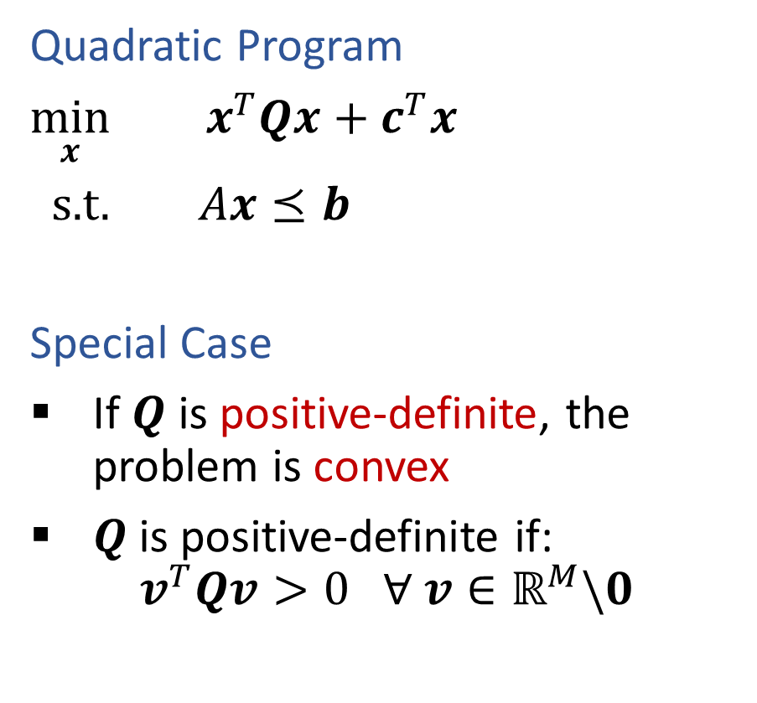
Constrained Optimization
Linear Program
$\min_{x}{ c^{T}x}$
s.t. $Ax⪯b$
Solvers
Simplex
Interior point methods
Quadratic Program
$\min_{x}{ x^{T}Qx+}$ $c^{T}x$
s.t. $Ax⪯b$
Special Case
If $Q$ is positive-definite, the problem is convex
$Q$is positive-definite if:
$$v^{T}Qv>0 ∀ v∈ℝ^{M}\backslash 0$$

Slide 10

Convex Optimization
Linear function
If $f(x)$ is linear, then:
$f\left(x+z\right)=f\left(x\right)+f\left(z\right)$
$f\left(θx\right)=θf\left(x\right) ∀ θ$
$f\left(θx+\left(1−θ\right)z\right)=θf\left(x\right)+\left(1−θ\right)f\left(z\right) ∀ θ$

Slide 11


Convex Optimization
Convex function
If $f(x)$ is convex, then:
$f\left(θx+\left(1−θ\right)z\right)≤θf\left(x\right)+\left(1−θ\right)f\left(z\right) ∀ 0≤θ≤1$
Convex optimization
If $f(x)$ is convex, then:
Every local minimum is also a global minimum ☺

Slide 12
Constrained Optimization
Linear Program
$\min_{x}{ c^{T}x}$
s.t. $Ax⪯b$
Solvers
Simplex
Interior point methods
Quadratic Program
$\min_{x}{ x^{T}Qx+}$ $c^{T}x$
s.t. $Ax⪯b$
Special Case
If $Q$ is positive-definite, the problem is convex
$Q$is positive-definite if:
$$v^{T}Qv>0 ∀ v∈ℝ^{M}\backslash 0$$

Slide 13
Quadratic Program
Slide credit: CMU MLD Matt Gormley

Slide 14
Quadratic Program
Slide credit: CMU MLD Matt Gormley

Slide 15
Quadratic Program
Slide credit: CMU MLD Matt Gormley

Slide 16
Quadratic Program
Slide credit: CMU MLD Matt Gormley

Slide 17
Quadratic Program
Slide credit: CMU MLD Matt Gormley

Slide 18
Support Vector Machines
Find linear separator with maximum margin

Slide 19
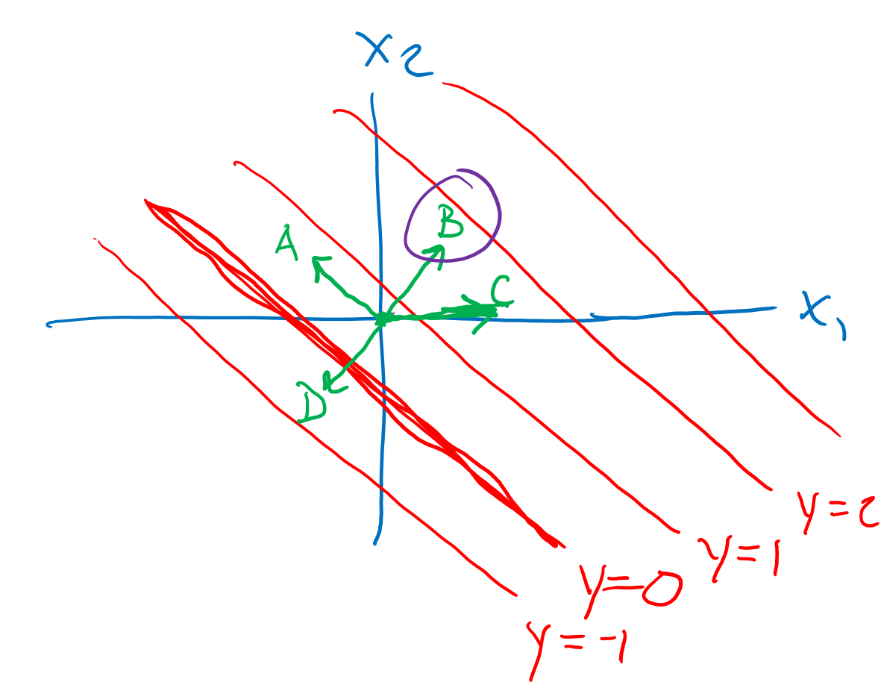
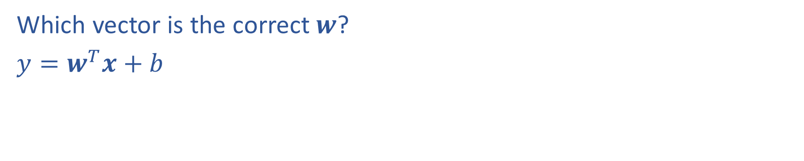
(Lecture 5) Poll
Which vector is the correct $w$?
$y=w^{T}x+b$

Slide 20
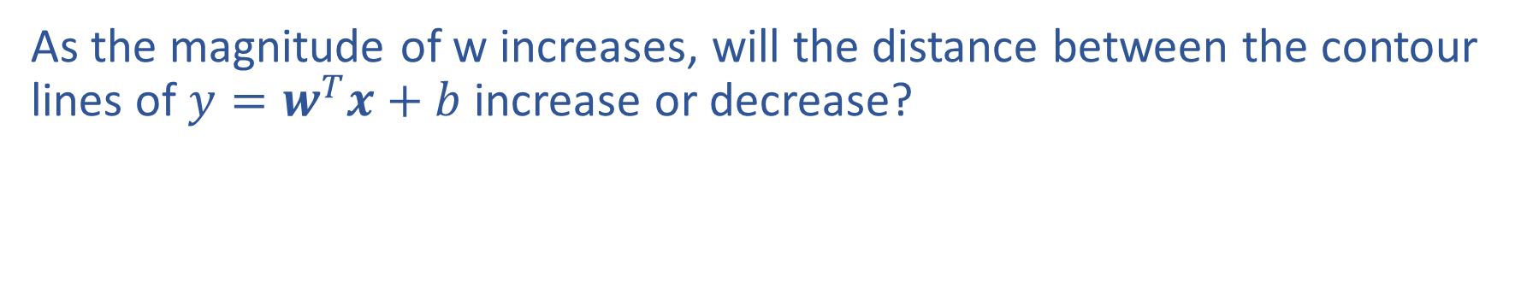
Piazza Poll 1
As the magnitude of w increases, will the distance between the contour lines of $y=w^{T}x+b$ increase or decrease?

Slide 21
Support Vector Machines
Find linear separator with maximum margin
x₂
x₂
x₂
x₁
x₁
x₁

Slide 22
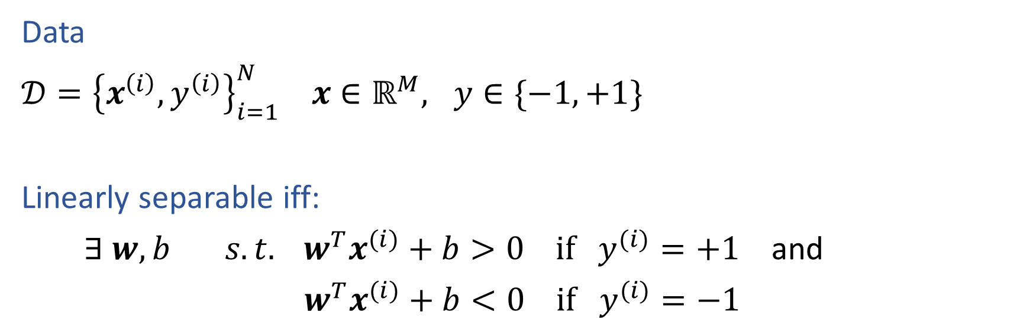
Linear Separability
Data
$𝒟={\left\{x^{\left(i\right)}, y^{\left(i\right)}\right\}}_{i=1}^{N} x∈ℝ^{M}, y∈\{−1, +1\}$
Linearly separable iff:
$∃ w, b s.t. w^{T}x^{(i)}+b>0 if y^{(i)}=+1$ and
$w^{T}x^{(i)}+b<0 if y^{(i)}=−1$
Slide credit: CMU MLD Matt Gormley

Slide 23
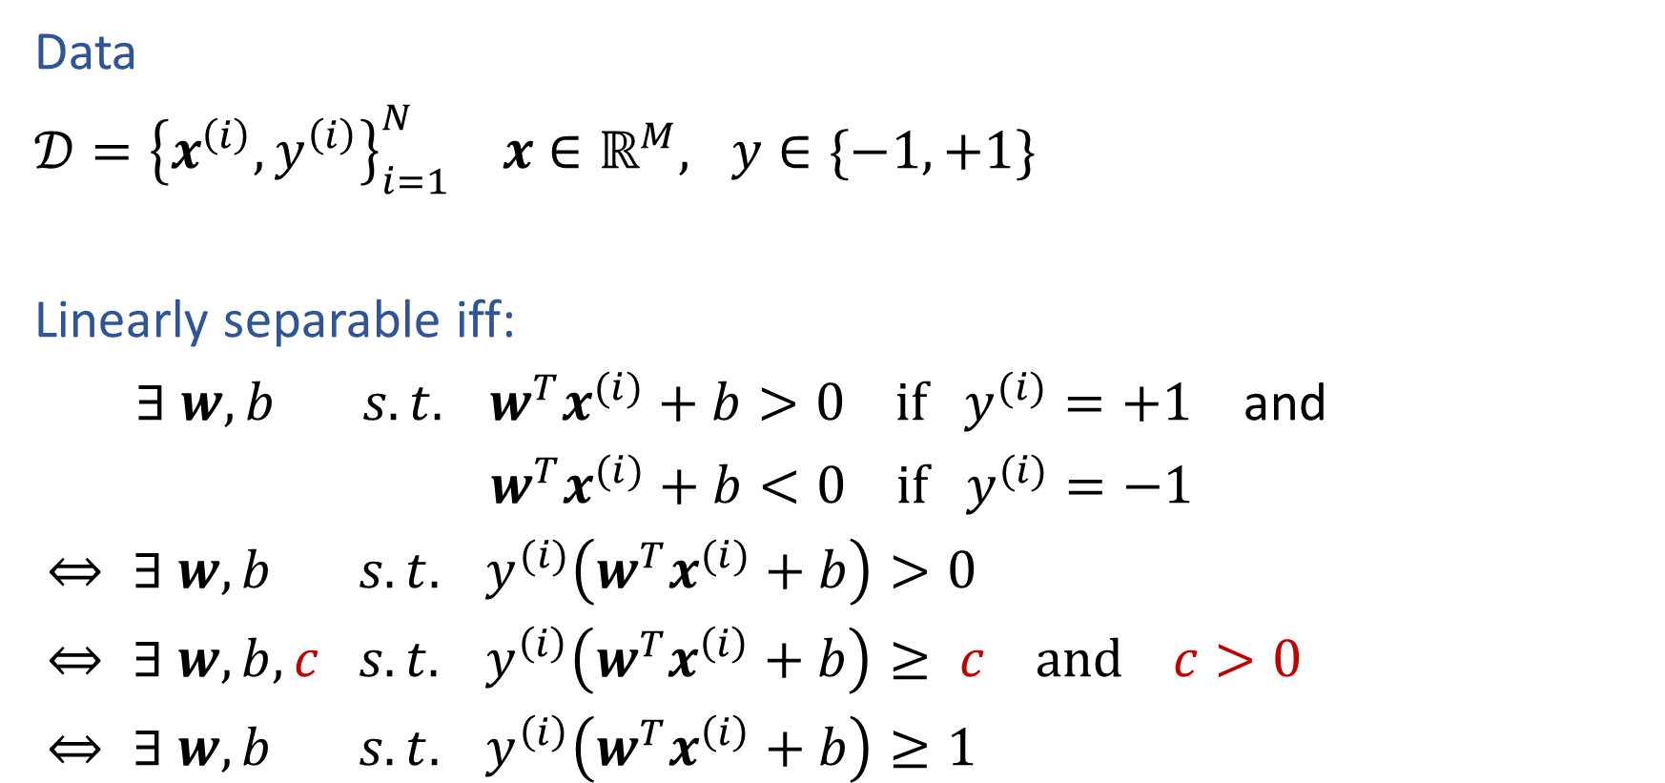
Linear Separability
Data
$𝒟={\left\{x^{\left(i\right)}, y^{\left(i\right)}\right\}}_{i=1}^{N} x∈ℝ^{M}, y∈\{−1, +1\}$
Linearly separable iff:
$∃ w, b s.t. w^{T}x^{(i)}+b>0 if y^{(i)}=+1$ and
$w^{T}x^{(i)}+b<0 if y^{(i)}=−1$
$⇔ ∃ w, b s.t. y^{(i)}\left(w^{T}x^{(i)}+b\right)>0$
$⇔ ∃ w, b,c s.t. y^{\left(i\right)}\left(w^{T}x^{\left(i\right)}+b\right)≥ c and c>0$
$⇔ ∃ w, b s.t. y^{\left(i\right)}\left(w^{T}x^{\left(i\right)}+b\right)≥1$
Slide credit: CMU MLD Matt Gormley

Slide 24
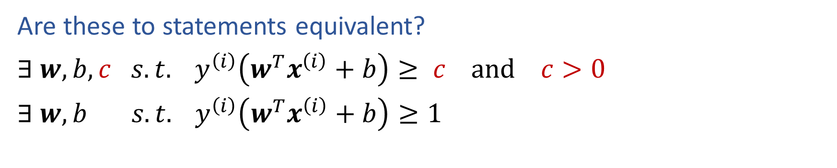
Piazza Poll 2
Are these to statements equivalent?
$∃ w, b,c s.t. y^{\left(i\right)}\left(w^{T}x^{\left(i\right)}+b\right)≥ c and c>0$
$∃ w, b s.t. y^{\left(i\right)}\left(w^{T}x^{\left(i\right)}+b\right)≥1$

Slide 25
Linear Separability
Data
$𝒟={\left\{x^{\left(i\right)}, y^{\left(i\right)}\right\}}_{i=1}^{N} x∈ℝ^{M}, y∈\{−1, +1\}$
Linearly separable iff:
$∃ w, b s.t. w^{T}x^{(i)}+b>0 if y^{(i)}=+1$ and
$w^{T}x^{(i)}+b<0 if y^{(i)}=−1$
$⇔ ∃ w, b s.t. y^{(i)}\left(w^{T}x^{(i)}+b\right)>0$
$⇔ ∃ w, b,c s.t. y^{\left(i\right)}\left(w^{T}x^{\left(i\right)}+b\right)≥ c and c>0$
$⇔ ∃ w, b s.t. y^{\left(i\right)}\left(w^{T}x^{\left(i\right)}+b\right)≥1$
Slide credit: CMU MLD Matt Gormley

Slide 26
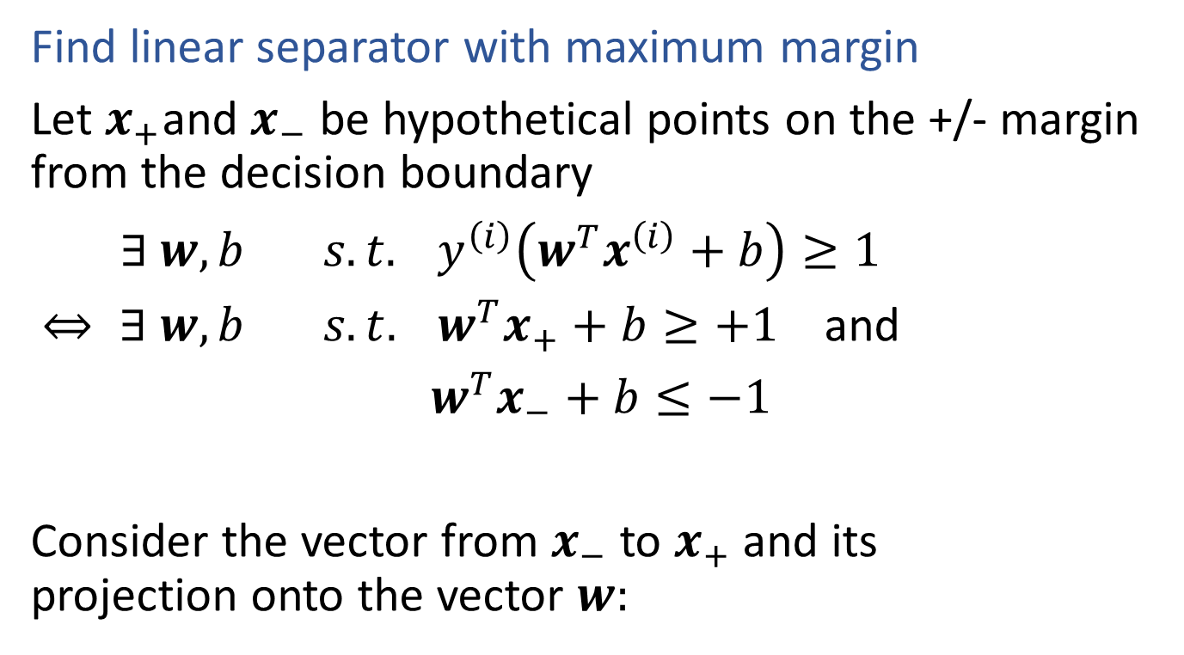
Support Vector Machines
Find linear separator with maximum margin
Let $x_{+}$and $x_{−}$ be hypothetical points on the +/- margin from the decision boundary
$∃ w, b s.t. y^{\left(i\right)}\left(w^{T}x^{\left(i\right)}+b\right)≥1$
$⇔ ∃ w, b s.t. w^{T}x_{+}+b≥+1$ and
$w^{T}x_{−}+b≤−1$
Consider the vector from $x_{−}$ to $x_{+}$ and its projection onto the vector $w:$

Slide 27
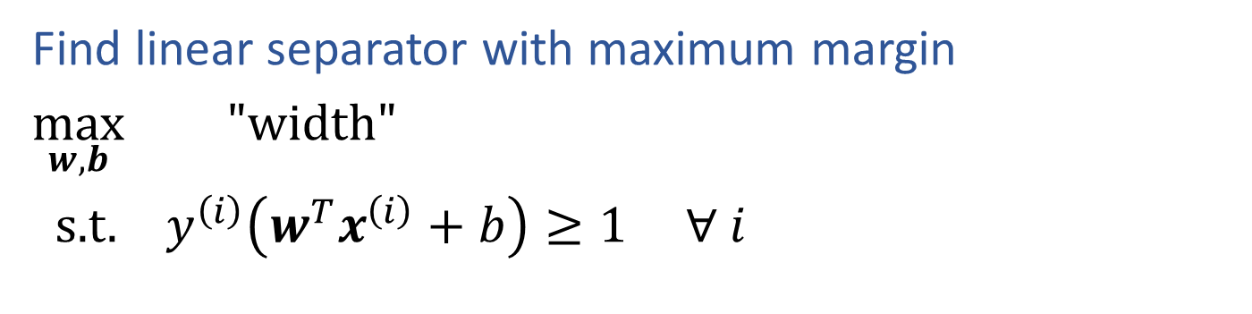

Support Vector Machines
$width= \frac{w^{T}}{{\left\|w\right\|}_{2}}(x_{+}$- $x_{−}$)
Find linear separator with maximum margin
$\max_{w,b}{ "width"}$
s.t. $y^{\left(i\right)}\left(w^{T}x^{\left(i\right)}+b\right)≥1 ∀ i$

Slide 28
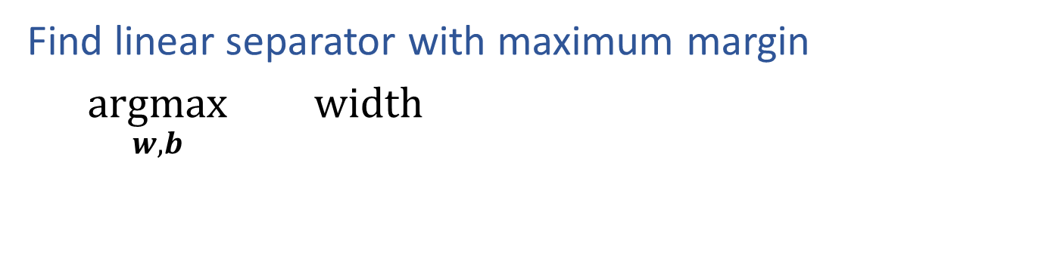

Support Vector Machines
$$width=\frac{2}{{\left\|w\right\|}_{2}}$$
Find linear separator with maximum margin
$\underset{w,b}{argmax}{ width}$

Slide 29
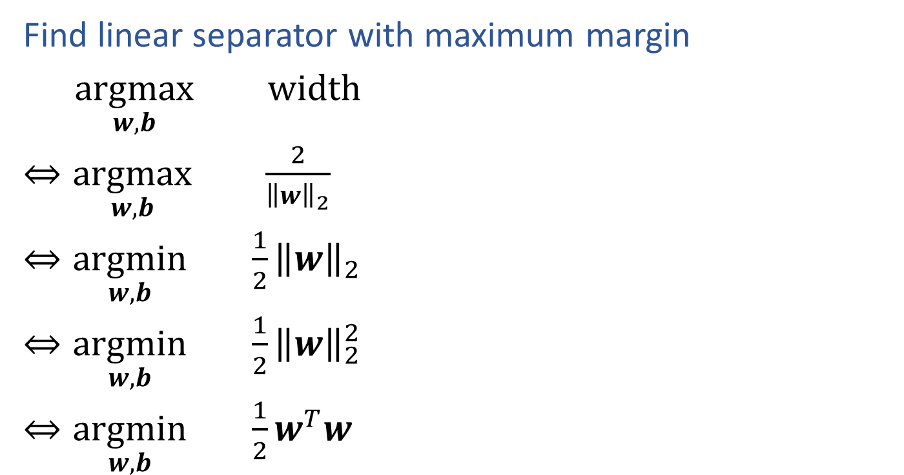

Support Vector Machines
$$width=\frac{2}{{\left\|w\right\|}_{2}}$$
Find linear separator with maximum margin
$\underset{w,b}{argmax}{ width}$
$⇔\underset{w,b}{argmax}{ \frac{2}{{\left\|w\right\|}_{2}}}$
$⇔\underset{w,b}{argmin}{ \frac{1}{2}{\left\|w\right\|}_{2}}$
$⇔\underset{w,b}{argmin}{ \frac{1}{2}{\left\|w\right\|}_{2}^{2}}$
$⇔\underset{w,b}{argmin}{ \frac{1}{2}w^{T}w}$

Slide 30
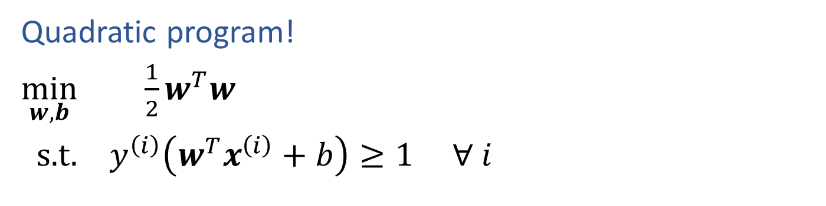
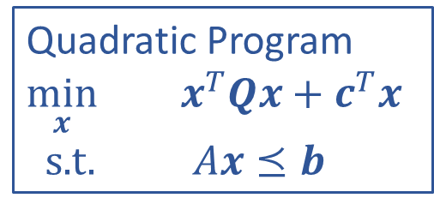
SVM Optimization
Quadratic Program
$\min_{x}{ x^{T}Qx+}$ $c^{T}x$
s.t. $Ax⪯b$
Quadratic program!
$\min_{w,b}{ \frac{1}{2}w^{T}w}$
s.t. $y^{\left(i\right)}\left(w^{T}x^{\left(i\right)}+b\right)≥1 ∀ i$

Slide 31

SVM Optimization
How did we go from maximizing margin to minimizing ${\left\|w\right\|}_{2}$?

Slide 32
Find a θ vector that causes f(x) to separate the data in to positive and negative based on class
x₂
θ
x₁
Note: We added y = ±1 to the function to make any correct
classification have an f(x, y) > 0
Notes:
f(x_1,x_2) = \theta_1 x_1 + \theta_2 x_2
f(x_1,x_2, {\color{red}y}) = {\color{red}y}(\theta_1 x_1 + \theta_2 x_2)
\theta = [1; 2]
f(x_1,x_2, y) = y( x_1 + 2 x_2)

Slide 33
Given θ, what is the value of f(x, y)
for the points closest to the hyperplane?
x₂
θ
x₁
Closest positive point (a support vector)
x = [6; -1], y = 1
Notes:
f(x_1,x_2,y) = y(\theta_1 x_1 + \theta_2 x_2)
\theta = [1; 2]
f(x_1,x_2,y) = y( x_1 + 2 x_2)
f(6,-1,1) = 1(1\cdot6+2\cdot-1) = 4

Slide 34
What happens to the value of f(x, y) if we scale θ?
x₂
θ
x₁
Closest positive point (a support vector)
x = [6; -1], y = 1
The value of f(x, y) increases even though the hyperplane does not change
Notes:
f(x_1,x_2, y) = y(\theta_1 x_1 + \theta_2 x_2)
{\color{red}\theta = [5; 10]}
f(x_1,x_2, y) = y( {\color{red}5} x_1 + {\color{red}10} x_2)
f(6,-1, 1) = 1({\color{red}5}\cdot6+{\color{red}10}\cdot-1) = {\color{red}20}

Slide 35
We can scale θ, such that f(x, y) = 1 for
the support vector points
x₂
θ
x₁
Closest positive point (a support vector)
x = [6; -1], y = 1
Notes:
f(x_1,x_2, y) = y(\theta_1 x_1 + \theta_2 x_2)
{\color{red}\theta = [\frac14; \frac12]}
f(x_1,x_2, y) = y({\color{red} \frac14} x_1 + {\color{red}\frac12} x_2)
f(6,-1, 1) = 1({\color{red}\frac14}\cdot6+{\color{red}\frac12}\cdot-1) = {\color{red}20}

Slide 36
With f(x, y) = 1 for the support vector points,
f(x^{i}, y^{i}) ≥ 1 for all points
x₂
x₁

Slide 37
Although f(x, y) is dependent on the magnitude of θ,
we define the margin by the Euclidean distance
(normalized by the magnitude of θ)
x₂
Margin γ is the distance from the hyperplane to the support vector points
x₁
Notes:
\gamma = \underset{i}{\text{min}}\text{ } \frac{y^i\text{ }\theta \cdot x^i}{||\theta||}

Slide 38
Our decision to make f(x, y) = 1 for the support vector points, helps to simplify the definition of margin
For support vectors,
x₂
The minimum in the margin equation is realized by the support vectors. Thus:
x₁
becomes
Notes:
f(x, y) = y\text{ }\theta \cdot x = 1
\gamma = \underset{i}{\text{min}}\text{ } \frac{{\color{red}y^i\text{ }\theta \cdot x^i}}{||\theta||}
\gamma = \frac{{\color{red}1}}{||\theta||}

Slide 39
Now, we can finally get to optimization
We want to maximize the margin, while still
making sure that all points are on the correct
side of the margin: f(x^{i}, y^{i}) ≥ 1
From the previous slide
Invert the objective to switch from max to min
Notes:
\theta^* = \underset{\theta}{\text{argmax}}\text{ } \gamma
\text{s.t. } y^i(\theta\cdot x^i) \ge 1 \text{, } \forall I
= \underset{\theta}{\text{argmax}}\text{ } \frac{1}{||\theta||}
= \underset{\theta}{\text{argmin}}\text{ } ||\theta||

Slide 40
The margin is now fixed to the locations where
Now, let’s see what happens when we scale θ
x₂
x₂
x₂
x₁
x₁
x₁
Notes:
f(x,y) = y(\theta \cdot x) = 1
||\theta|| = 2
\frac{1}{||\theta||} = \frac12

