Slide 1
Announcements
Coronavirus – COVID-19
Take care of yourself and others around you
Follow CMU and government guidelines
We’re “here” to help in any capacity that we can
Use tools like zoom to communicate with each other too!
Zoom
Let us know if you have issues
Etiquette: Turn on video when talking or your turn in OH
Feedback: See Piazza post

Slide 2
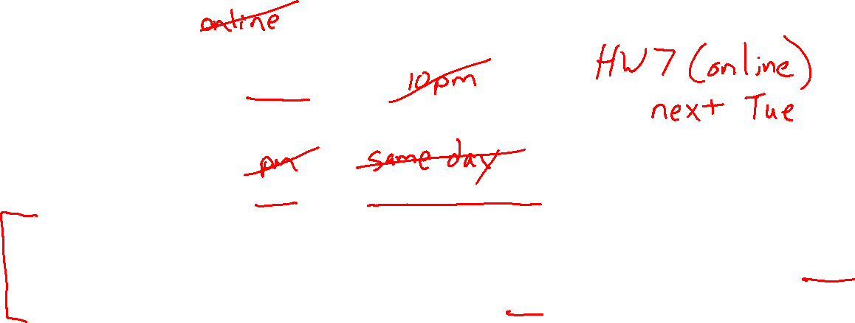
Announcements
Assignments
HW6 (written + programming)
    Due Thu 3/26, 11:59 pm
“Participation” Points
Polls open until 10 am (EDT) day after lecture
“Calamity” option announced in recorded lecture
    Don’t select this calamity option or you’ll lose credit for one poll (-1) rather than gaining credit for one poll (+1).
Participation percent calculated as usual

Slide 3
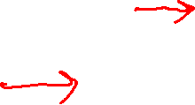
Introduction to
Machine Learning
Cross-Validation
Nonparametric Regression
Instructor: Pat Virtue

Slide 4
Validation
Why do we need validation?
  Choose hyperparameters
  Choose technique
  Help make any choices beyond our parameters
But now, we have another choice to make!
  How do we split training and validation?
Trade-offs
  More held-out data, better meaning behind validation numbers
  More held-out data, less data to train on!

Slide 5
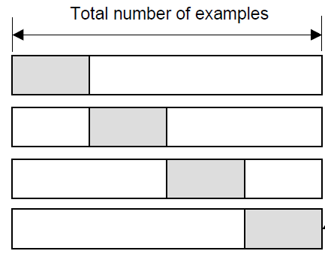
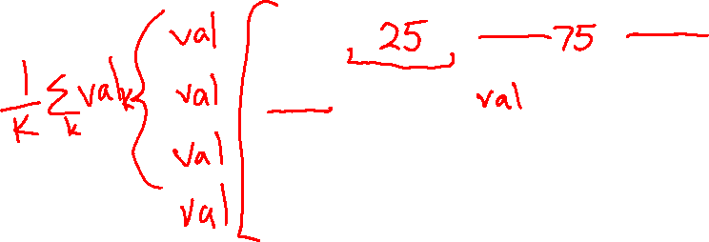
Cross-validation
K-fold cross-validation
Create K-fold partition of the dataset.
Do K runs: train using K-1 partitions and calculate validation error on remaining partition (rotating validation partition on each run).
Report average validation error
training
validation
Run 1
Run 2
Run K
Slide credit: CMU MLD Aarti Singh
TexPoint fonts used in EMF.
Read the TexPoint manual before you delete this box.: AAAAAAA

Slide 6
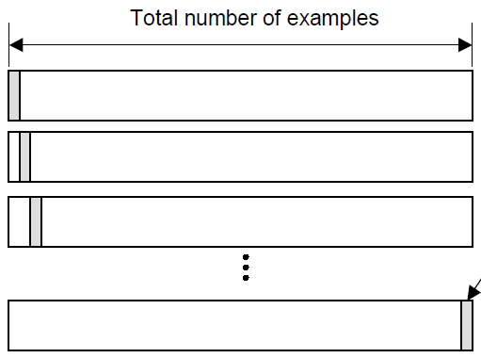
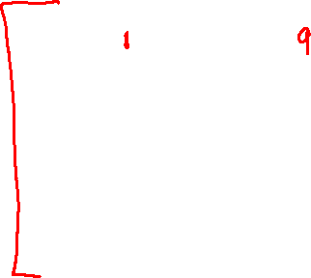
Cross-validation
Leave-one-out (LOO) cross-validation
Special case of K-fold with K=N partitions
Equivalently, train on N-1 samples and validate on only one sample per run for N runs
training
validation
Run 1
Run 2
Run K
Slide credit: CMU MLD Aarti Singh
TexPoint fonts used in EMF.
Read the TexPoint manual before you delete this box.: AAAAAAA

Slide 7
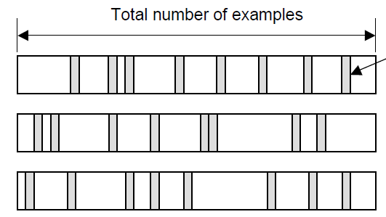

Cross-validation
Random subsampling
Randomly subsample a fixed fraction αN (0< α <1) of the dataset for validation.
Compute validation error with remaining data as training data.
Repeat K times
Report average validation error
training
validation
Run 1
Run 2
Run K
Slide credit: CMU MLD Aarti Singh
TexPoint fonts used in EMF.
Read the TexPoint manual before you delete this box.: AAAAAAA

Slide 8
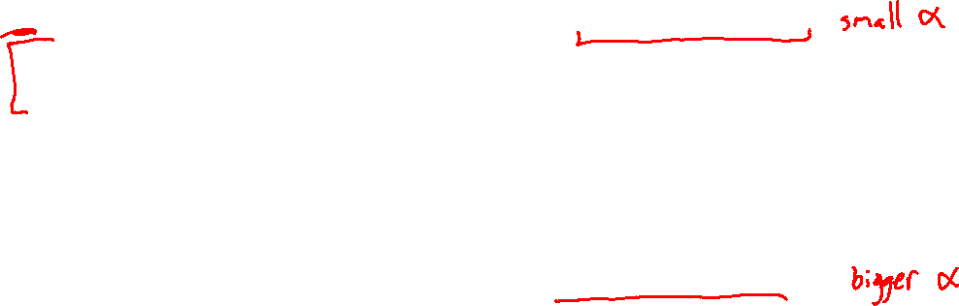
Practical Issues in Cross-validation
How to decide the values for K and α ?
Large K
+ Validation error can approximate test error well
- Observed validation error will be unstable (few validation pts)
- The computational time will be very large as well (many experiments)
Small K
+ The # experiments and, therefore, computation time are reduced
+ Observed validation error will be stable (many validation pts)
- Validation error cannot approximate test error well
Common choice: K = 10, α = 0.1 ☺
Slide credit: CMU MLD Aarti Singh
TexPoint fonts used in EMF.
Read the TexPoint manual before you delete this box.: AAAAAAA

Slide 9
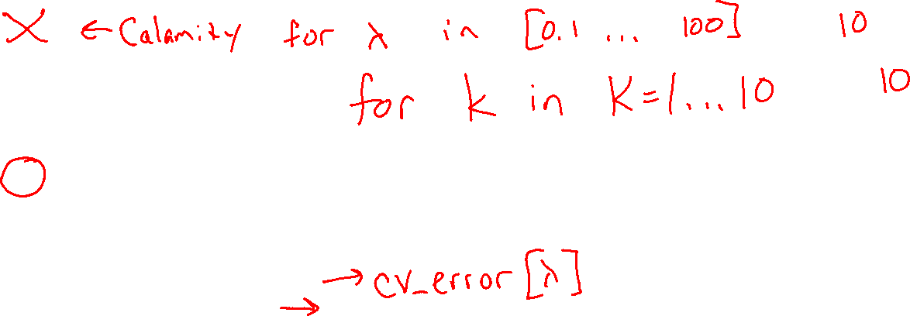
Piazza Poll 1
Say you are choosing amongst 10 values of lambda, and you want to do K=10 fold cross-validation.
How many times do I have to train my model?
  0
  1
  10
  20
  100
  10¹⁰
Notes:
0

Slide 10
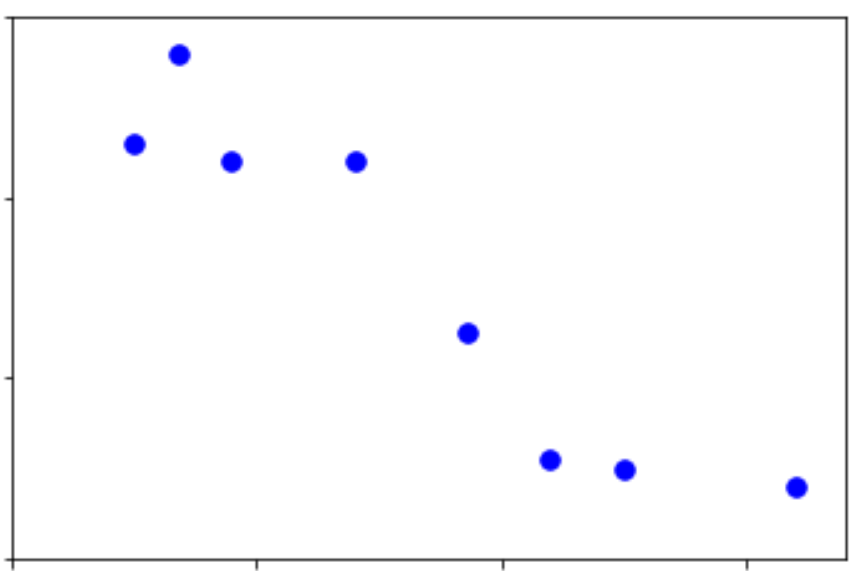

Nonparametric Regression
Output y
Input x

Slide 11
Reminder: Parametric models
Assume some model (Gaussian, Bernoulli, Multinomial, logistic, network of logistic units, Linear, Quadratic) with fixed number of parameters
  Linear/Logistic Regression, Naïve Bayes, Discriminant Analysis, Neural Networks
Estimate parameters (μ,σ²,θ,w,β) using MLE/MAP and plug in
Pro – need fewer data points to learn parameters
Con – Strong distributional assumptions, not satisfied in practice

Slide 12
Reminder: Nonparametric models
Nonparametric: number of parameters scales with number of training data
Typically don’t make any distributional assumptions
As we have more data, we should be able to learn more complex models
Example
  Nearest Neighbor (k-Nearest Neighbor) Classifier

Slide 13
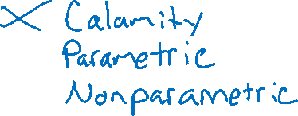
Piazza Poll 2
Are decision trees parametric or non-parametric?
Notes:
0

Slide 14
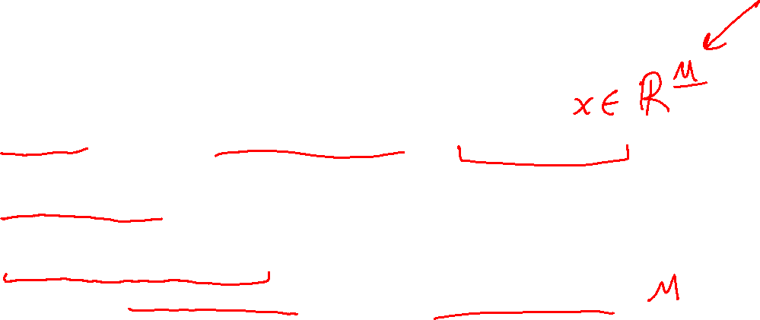
Piazza Poll 2
Are decision trees parametric or non-parametric?
It depends :)
  If no limits on depth or reuse of attributes, then non-parametric
    Model complexity will grow with data
  If pruned/limited to fix size
    Parametric
  If attributes only used once
    Parametric; model complexity is limited by number of features
Trade-offs
  Non-parametric methods have very powerful representation capabilities
  But
    Easily overfit
    Can take up memory proportional to training size too
Notes:
0

Slide 15
Nonparametric Regression
Decision Trees
Output y
Input x

Slide 16
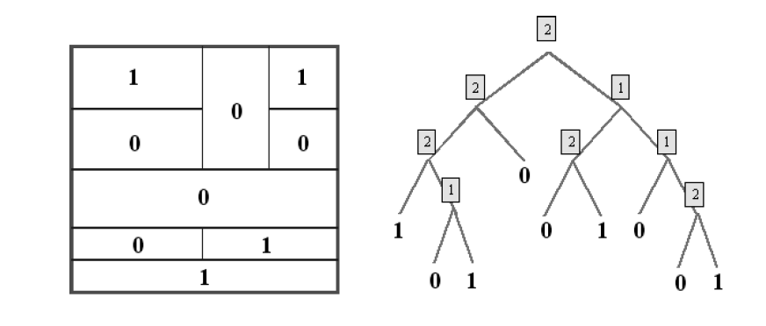

Dyadic decision trees
(split on mid-points of features)
feature 2
feature 1
Slide credit: CMU MLD Aarti Singh

Slide 17
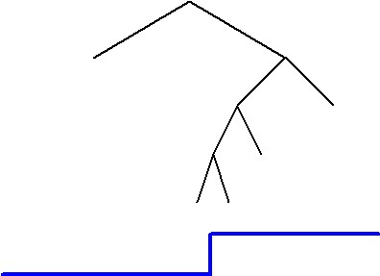
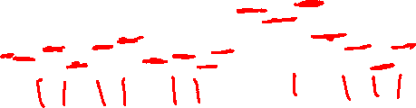
How to assign label to each leaf
Classification – Majority vote Regression – Constant/Linear/Poly fit

Slide 18
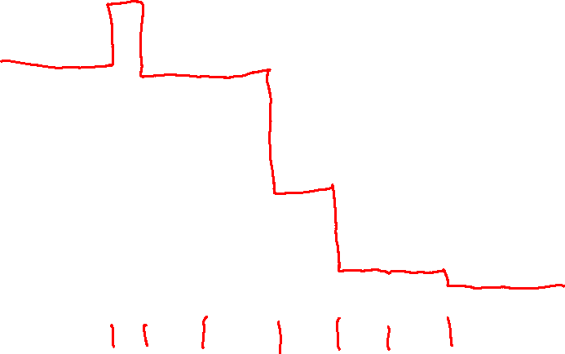
Nonparametric Regression
Decision Trees
Output y
Input x

Slide 19
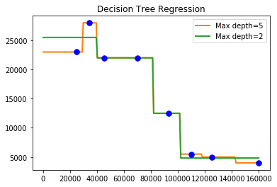
Nonparametric Regression
Decision Trees

Slide 20
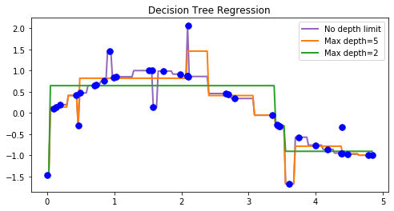
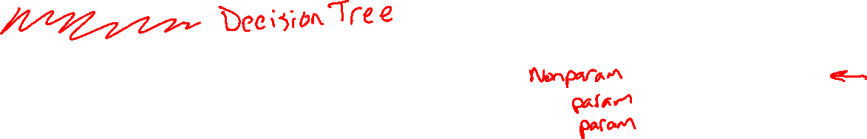
Nonparametric Regression
Nearest Neighbor

Slide 21
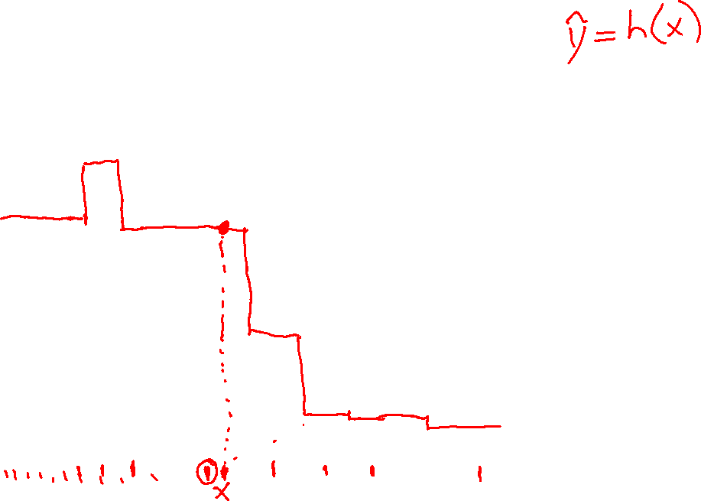
Nonparametric Regression
Nearest Neighbor
Output y
Input x

Slide 22
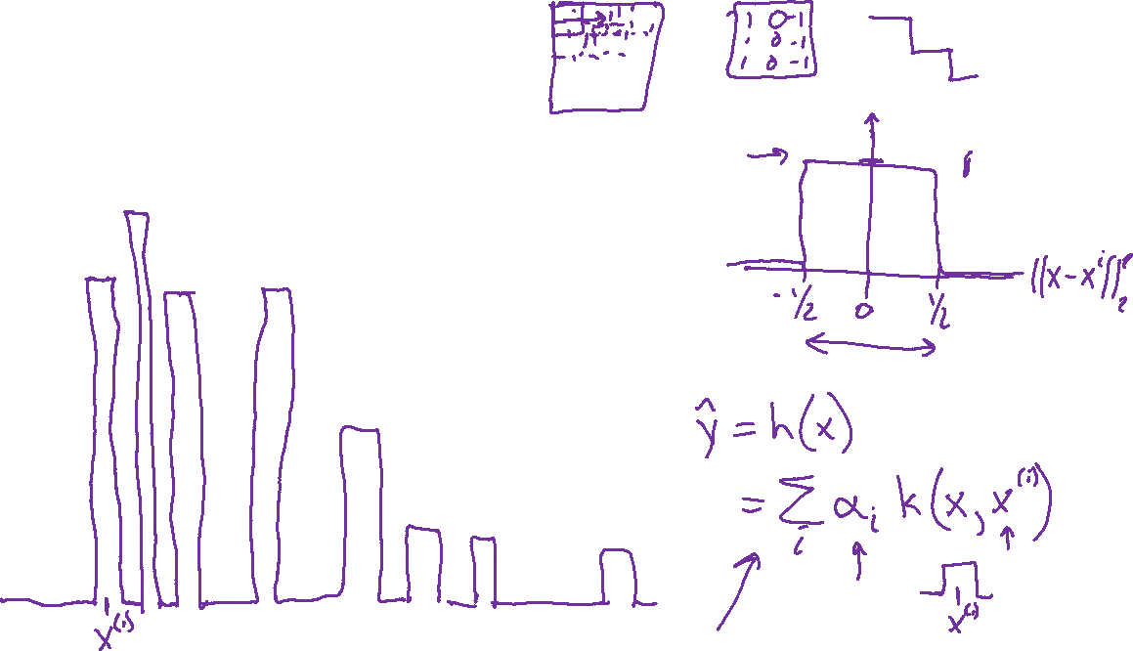
Nonparametric Regression
Kernel Regression
Output y
Input x

Slide 23
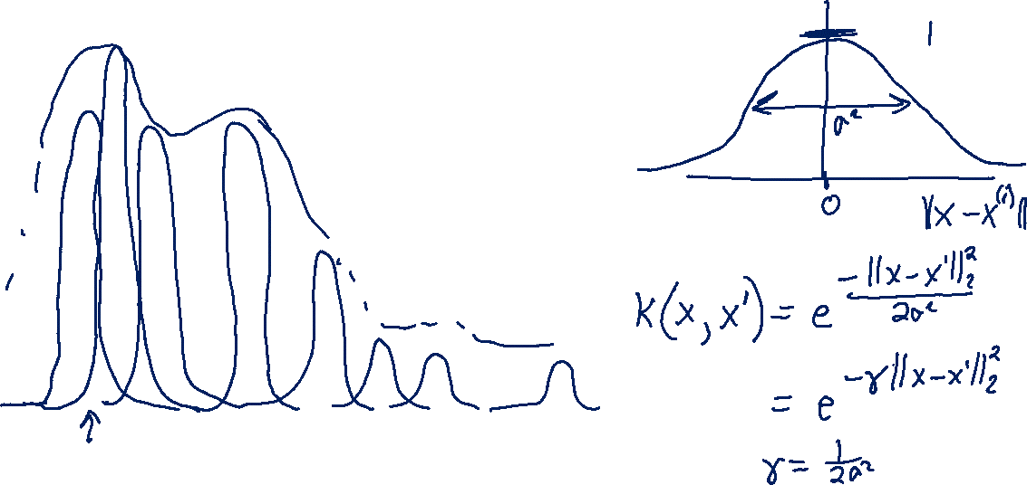
Nonparametric Regression
Kernel Regression
Output y
Input x

Slide 24
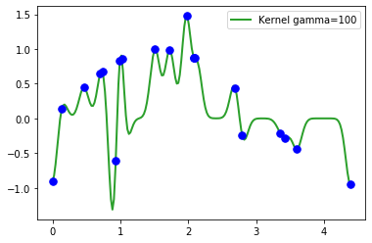
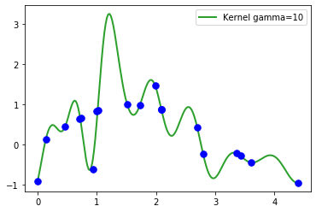
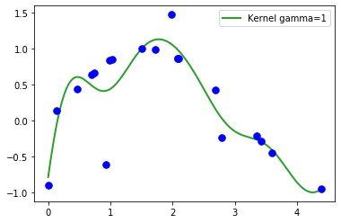
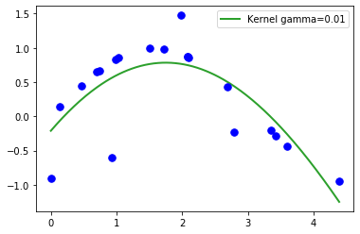
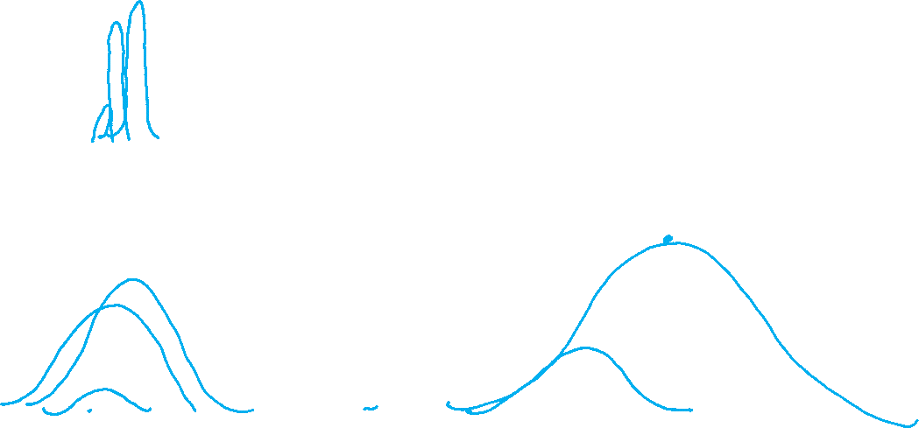
Kernel Regression

Slide 25
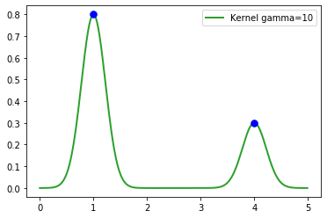
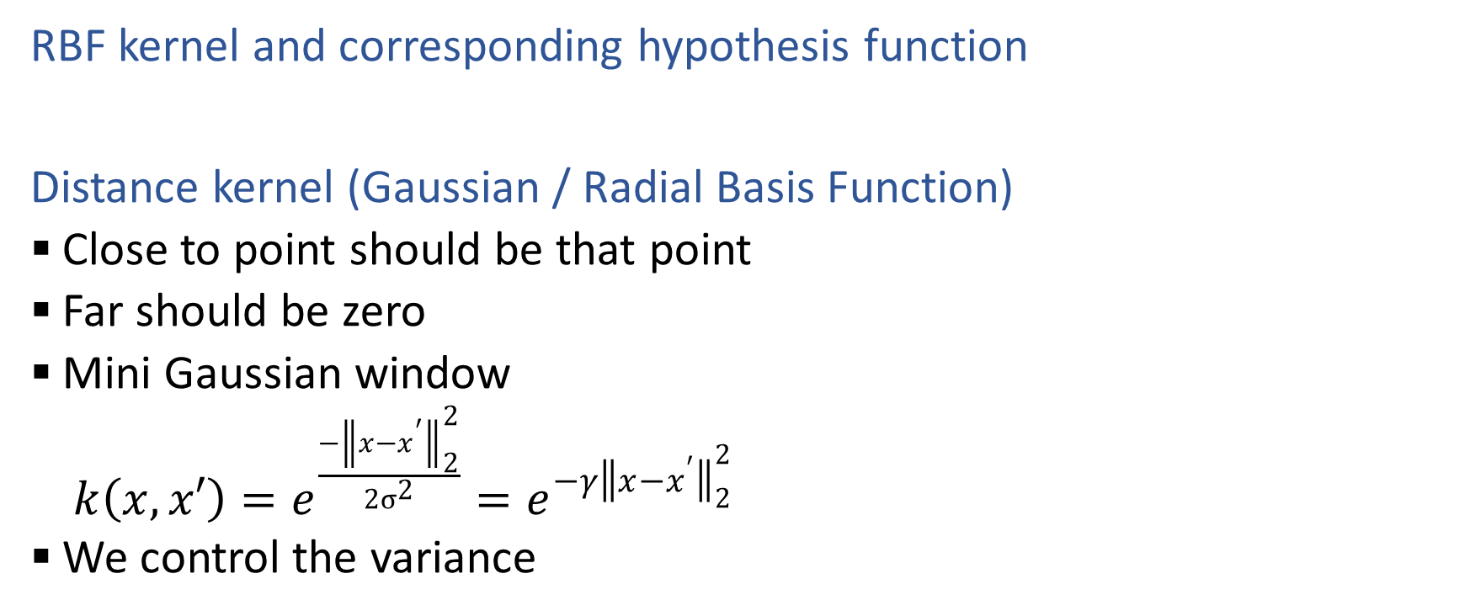
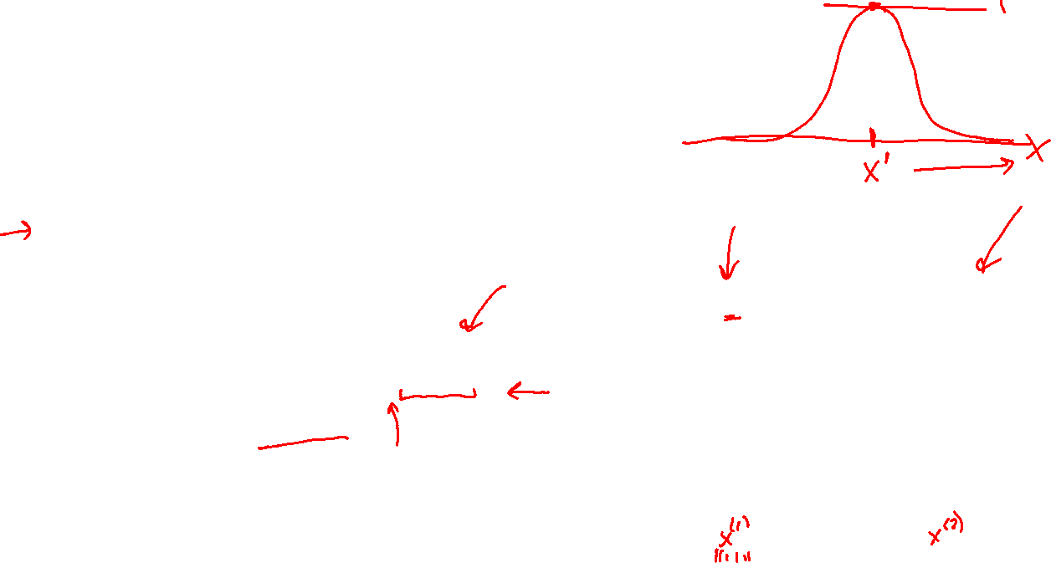
Kernel Regression
RBF kernel and corresponding hypothesis function
Distance kernel (Gaussian / Radial Basis Function)
  Close to point should be that point
  Far should be zero
  Mini Gaussian window
    $k\left(x, x′\right)=e^{\frac{{−\left\|x−x^{′}\right\|}_{2}^{2}}{2σ^{2}}}=e^{{−γ\left\|x−x^{′}\right\|}_{2}^{2}}$
  We control the variance

Slide 26
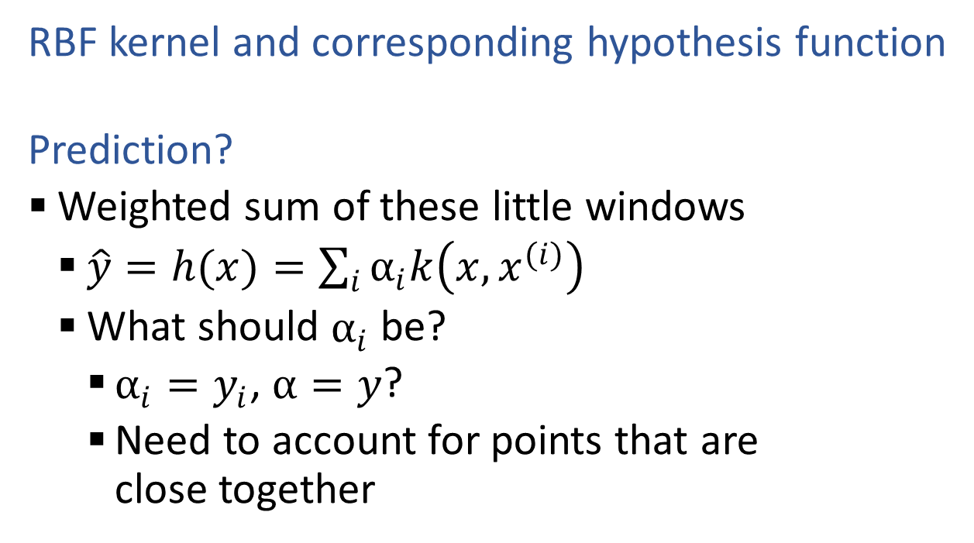
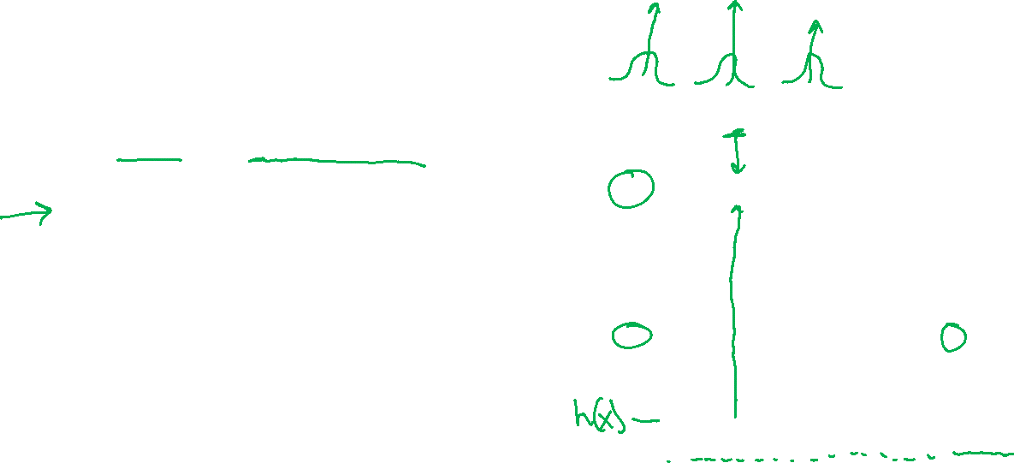
Kernel Regression
RBF kernel and corresponding hypothesis function
  Prediction?
  Weighted sum of these little windows
    $\hat{y}=h(x)=\sum_{i}{α_{i}k\left(x, x^{(i)}\right)}$
    What should $α_{i}$ be?
      $α_{i}=y_{i}$, $α=y$?
      Need to account for points that are close together

Slide 27
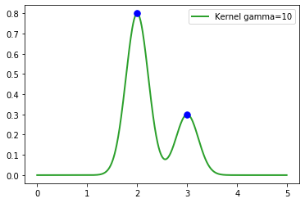

Kernel Regression
RBF kernel and corresponding hypothesis function
  Prediction?
  Weighted sum of these little windows
    $\hat{y}=h(x)=\sum_{i}{α_{i}k\left(x, x^{(i)}\right)}$
    What should $α_{i}$ be?
      $α_{i}=y_{i}$, $α=y$?
      Need to account for points that are close together

Slide 28
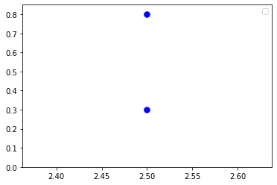
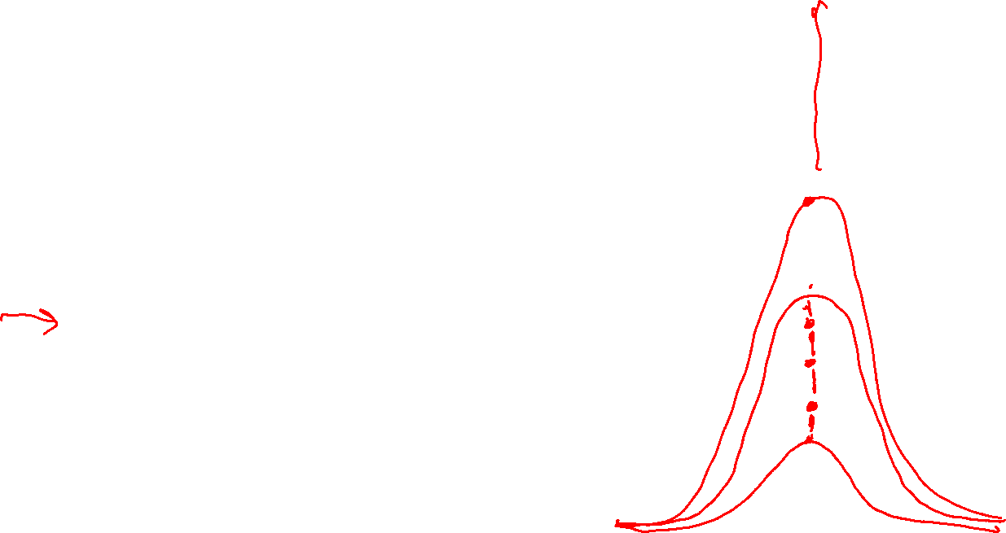
Kernel Regression
RBF kernel and corresponding hypothesis function
  Prediction?
  Weighted sum of these little windows
    $\hat{y}=h(x)=\sum_{i}{α_{i}k\left(x, x^{(i)}\right)}$
    What should $α_{i}$ be?
      $α_{i}=y_{i}$, $α=y$?
      Need to account for points that are close together

Slide 29
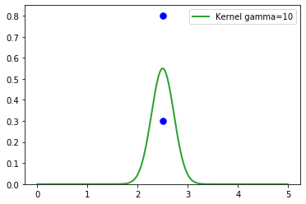
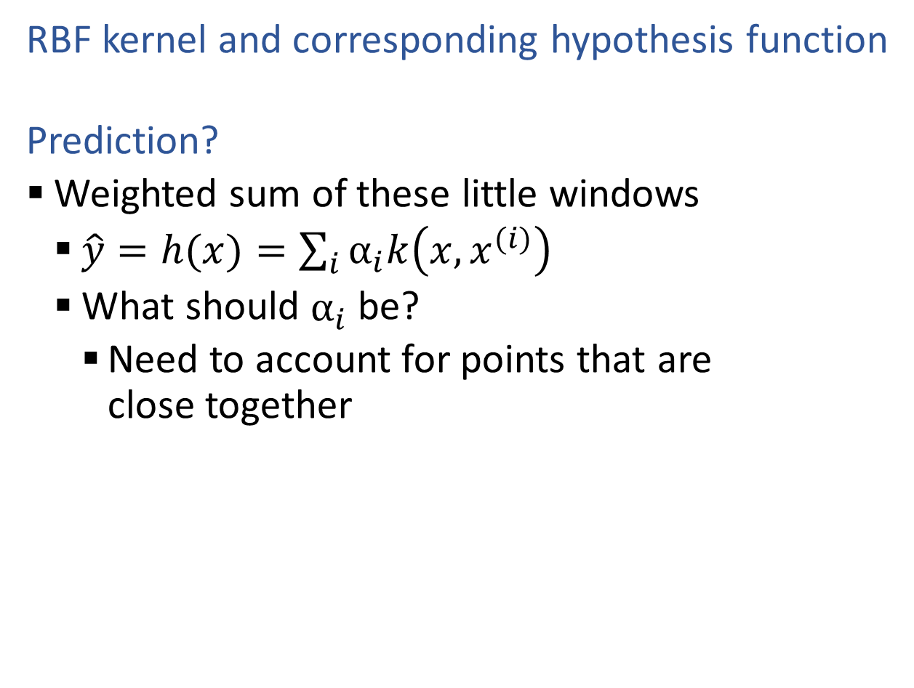
Kernel Regression
RBF kernel and corresponding hypothesis function
  Prediction?
  Weighted sum of these little windows
    $\hat{y}=h(x)=\sum_{i}{α_{i}k\left(x, x^{(i)}\right)}$
    What should $α_{i}$ be?
      Need to account for points that are close together

Slide 30
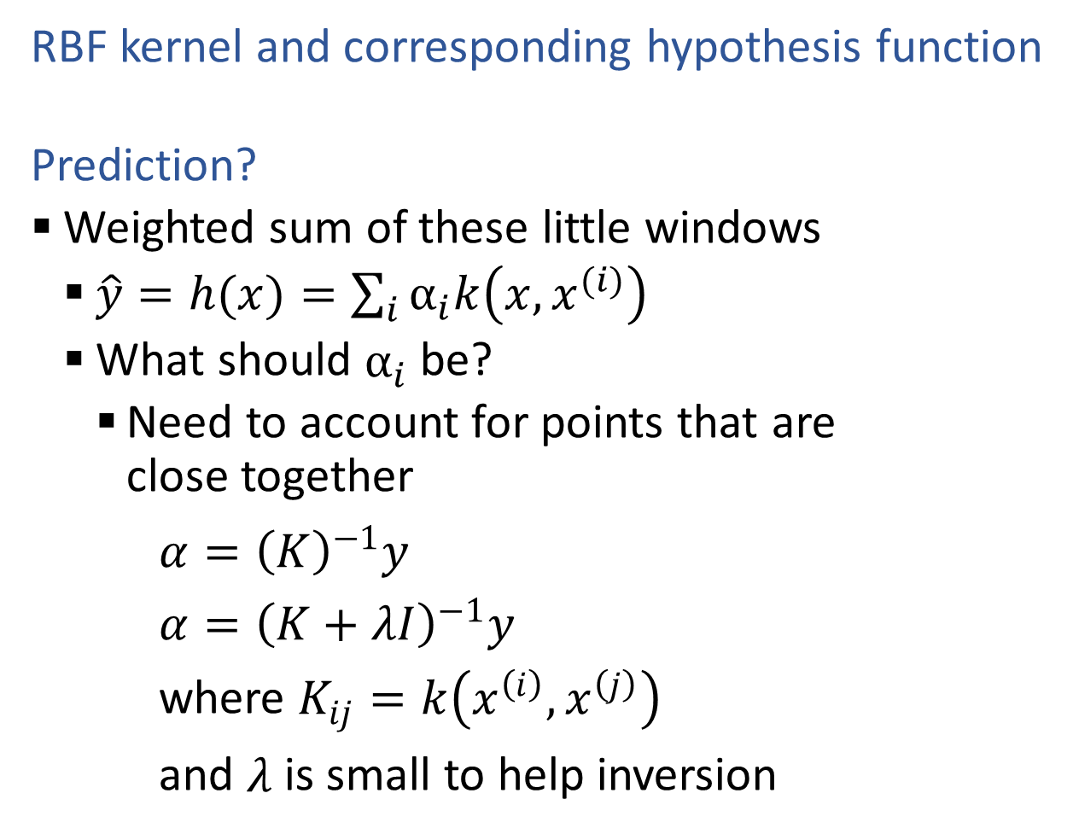
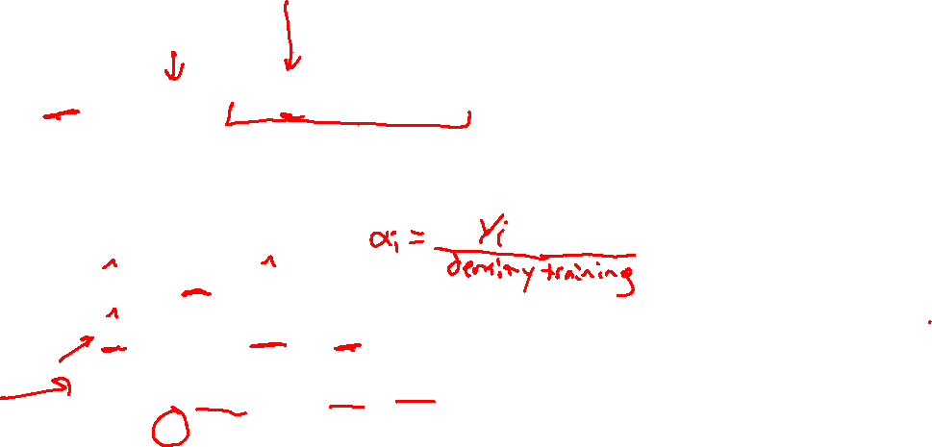
Kernel Regression
RBF kernel and corresponding hypothesis function
  Prediction?
  Weighted sum of these little windows
    $\hat{y}=h(x)=\sum_{i}{α_{i}k\left(x, x^{(i)}\right)}$
    What should $α_{i}$ be?
      Need to account for points that are close together
$α={\left(K\right)}^{−1}y$
$α={\left(K+λI\right)}^{−1}y$
where $K_{ij}=k\left(x^{\left(i\right)}, x^{\left(j\right)}\right)$
and $λ$ is small to help inversion

Slide 31
Kernelized Linear Regression

Slide 32
Reminder: Polynomial Linear Regression
Polynomial feature function
Least squares formulation
Least squares solution

Slide 33
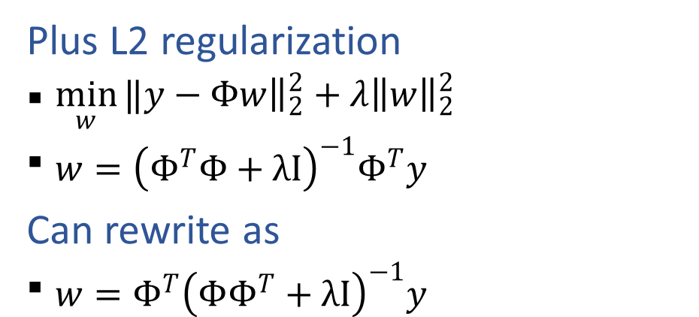
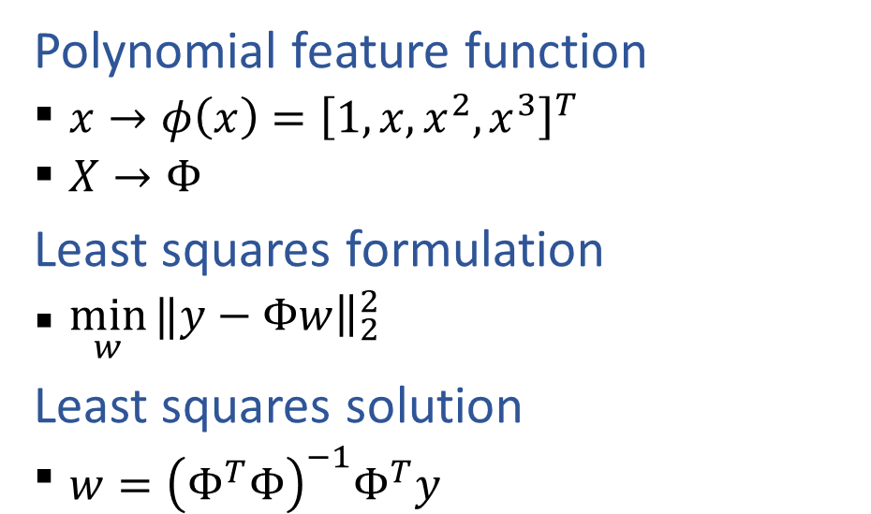
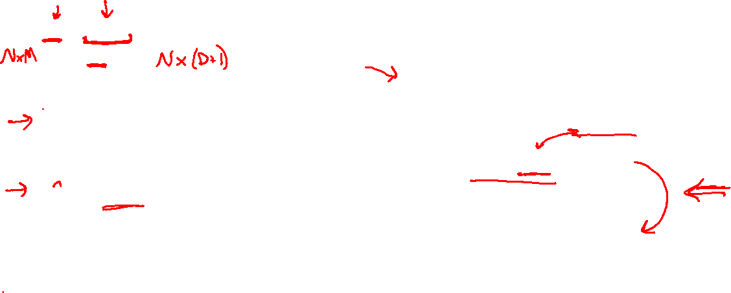
Reminder: Polynomial Linear Regression
Polynomial feature function
  $x→φ\left(x\right)={\left[1, x, x^{2}, x^{3}\right]}^{T}$
  $X→Φ$
Least squares formulation
  $\min_{w}{‖y−{\left.​Φw\right\|}_{2}^{2}}$
Least squares solution
  $w={\left(Φ^{T}Φ\right)}^{−1}Φ^{T}y$
Plus L2 regularization
  $\min_{w}{‖y−{\left.​Φw\right\|}_{2}^{2}}+λ{\left\|w\right\|}_{2}^{2}$
  $w={\left(Φ^{T}Φ+λI\right)}^{−1}Φ^{T}y$
Can rewrite as
  $w={Φ^{T}\left(ΦΦ^{T}+λI\right)}^{−1}y$

Slide 34

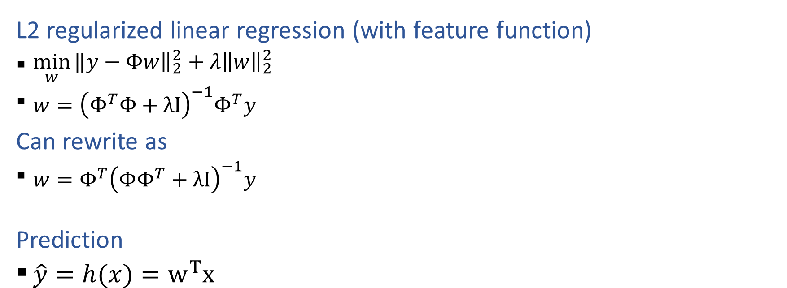
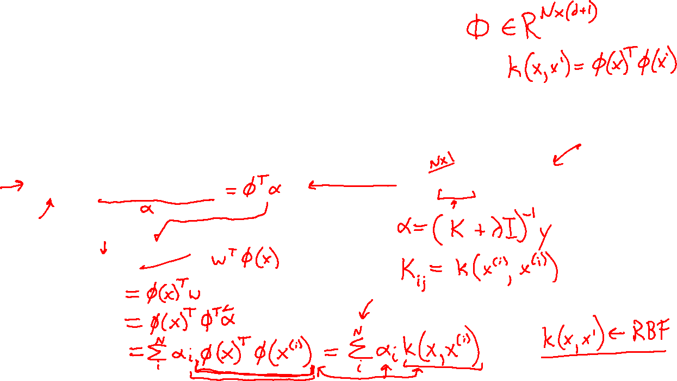
Kernelized Linear Regression
L2 regularized linear regression (with feature function)
  $\min_{w}{‖y−{\left.​Φw\right\|}_{2}^{2}}+λ{\left\|w\right\|}_{2}^{2}$
  $w={\left(Φ^{T}Φ+λI\right)}^{−1}Φ^{T}y$
Can rewrite as
  $w={Φ^{T}\left(ΦΦ^{T}+λI\right)}^{−1}y$
  Prediction
  $\hat{y}=h(x)=w^{T}x$
Let
  $α={\left(ΦΦ^{T}+λI\right)}^{−1}y$

