Slide 1
Announcements
Coronavirus – COVID-19
Take care of yourself and others around you
Follow CMU and government guidelines
We’re “here” to help in any capacity that we can
Use tools like zoom to communicate with each other too!

Slide 2
Announcements
Assignments
HW6 (online)
Due Thu 3/26, 10 pm
Final Exam
Format TBD

Slide 3
Announcements
Office Hours
Zoom + OHQueue
See piazza for details
Recitation
Zoom session during normal recitation time slot
See piazza for details
Zoom
Let us know if you have issues
Recommend turning on video when talking (mute when not talking)

Slide 4
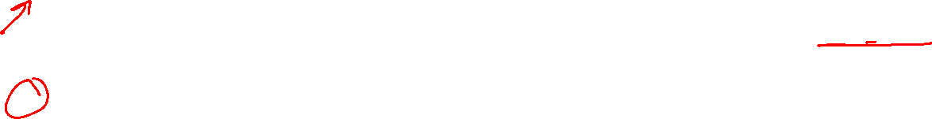
Announcements
Lecture
Recorded ahead of time and posted on Canvas
Encouraged to watch during lecture time slot
Zoom session during lecture time slot to answer any questions (optional)
“Participation” Points
Polls open until 10 pm (EDT) day of lecture
“Calamity” option announced in recorded lecture
Don’t select this calamity option or you’ll lose credit for one poll (-1) rather than gaining credit for one poll (+1).
Participation percent calculated as usual

Slide 5
Introduction to Machine Learning
Decision Trees
Instructor: Pat Virtue

Slide 6
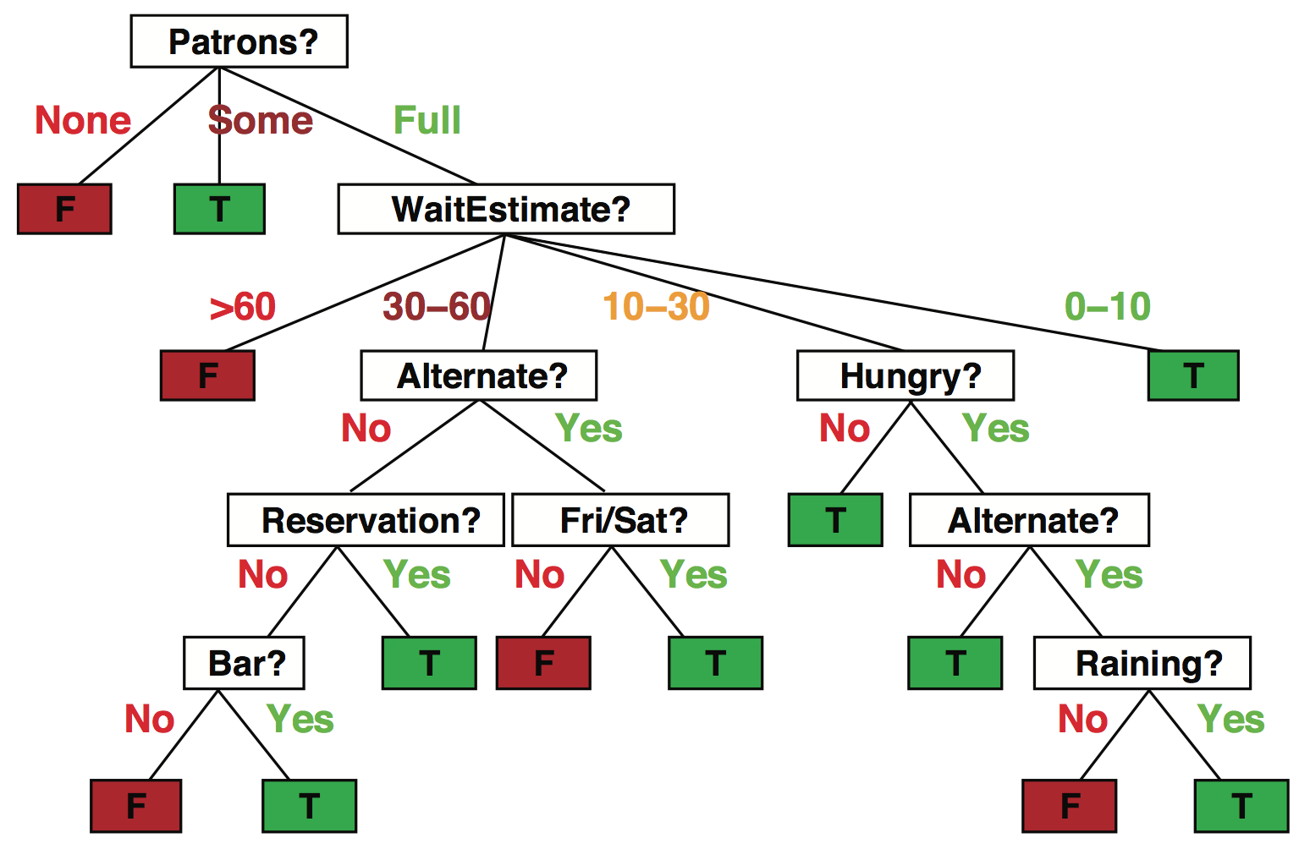

Decision trees
Popular representation for classifiers
Even among humans!
I’ve just arrived at a restaurant: should I stay (and wait for a table) or go elsewhere?
Slide credit: ai.berkeley.edu

Slide 7
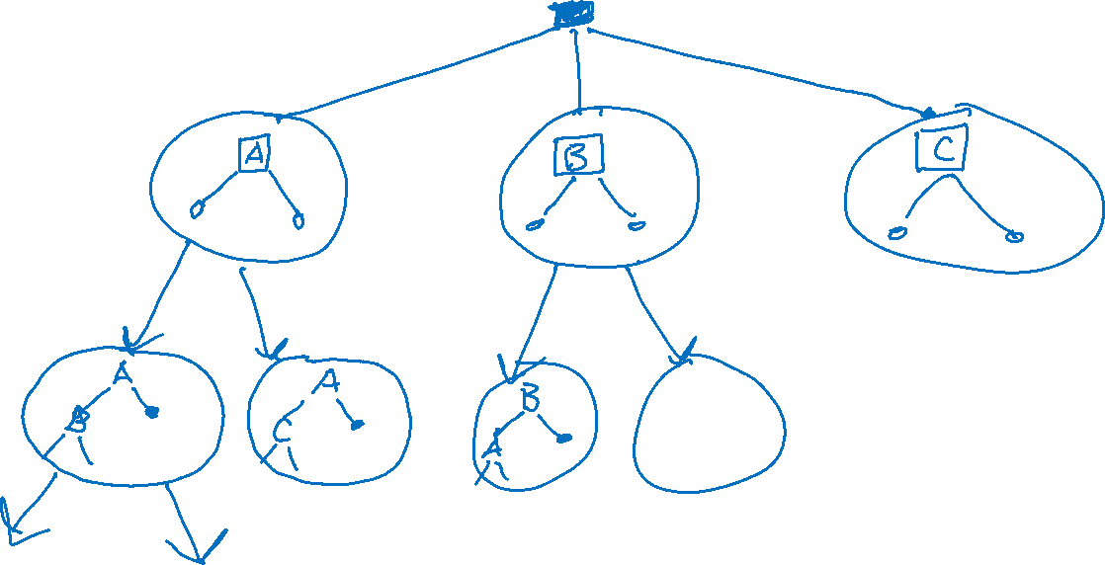
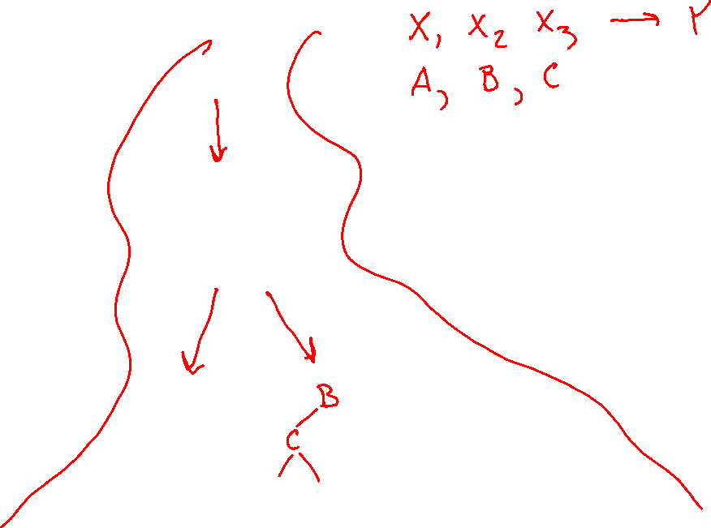
Build a decision tree
Search problem

Slide 8

Building a decision tree
Function BuildTree(n,A) // n: samples, A: set of attributes
If empty(A) or all n(L) are the same
status = leaf
class = most common class in n(L)
else
status = internal
a ⇐ bestAttribute(n,A)
LeftNode = BuildTree(n(a=1), A \ {a})
RightNode = BuildTree(n(a=0), A \ {a})
end
end
n(L): Labels for samples in this set
Decision: Which attribute?
Recursive calls to create left and right subtrees, n(a=1) is the set of samples in n for which the attribute a is 1
Slide credit: CMU MLD Ziv Bar-Joseph

Slide 9
Identifying ‘bestAttribute’
There are many possible ways to select the best attribute for a given set.
We started with using error rate to select the best attribute
We will discuss one possible way which is based on information theory.
Slide credit: CMU MLD Ziv Bar-Joseph

Slide 10
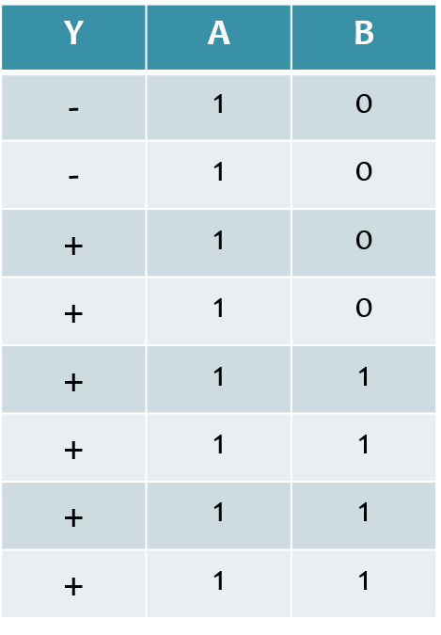
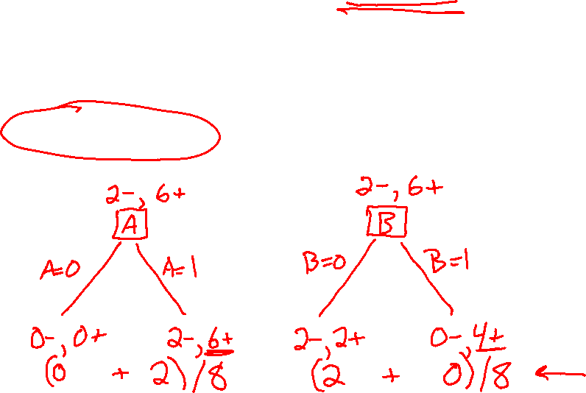
Previous Lecture Poll 4
Dataset: Output Y, Attributes A and B
Which attribute {A, B} would error rate select for the next split?
A
B
A or B (tie)
I don’t know
Slide credit: CMU MLD Matt Gormley

Slide 11
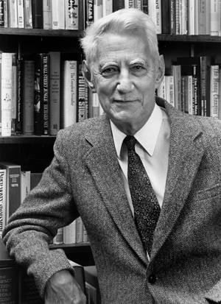
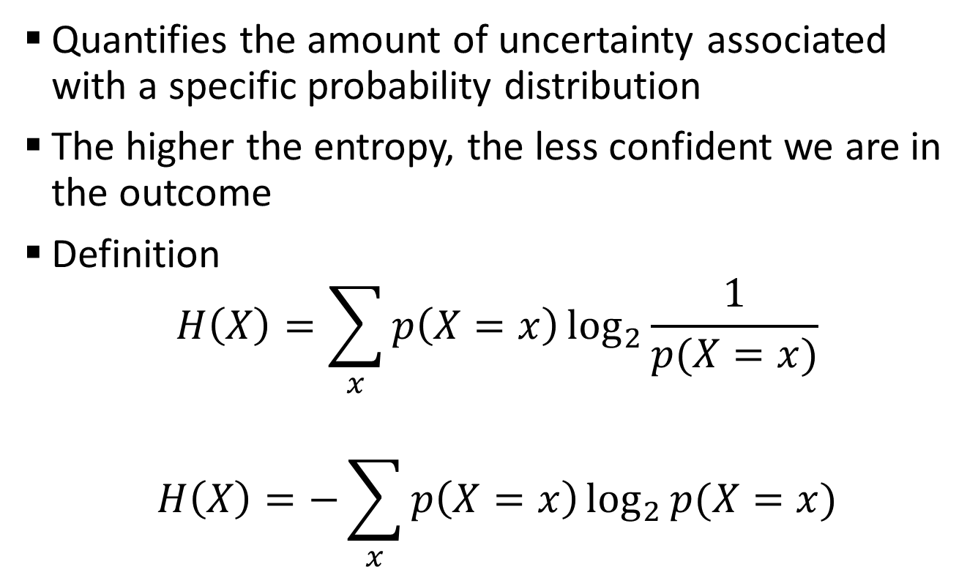
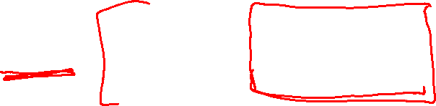
Entropy
Quantifies the amount of uncertainty associated with a specific probability distribution
The higher the entropy, the less confident we are in the outcome
Definition
$$H\left(X\right)=\sum_{x}{p\left(X=x\right)\log_{2}{\frac{1}{p(X=x)}}}$$
$$H\left(X\right)=−\sum_{x}{p\left(X=x\right)\log_{2}{p(X=x)}}$$
Claude Shannon (1916 – 2001), most of the work was done in Bell labs
Slide credit: CMU MLD Ziv Bar-Joseph

Slide 12
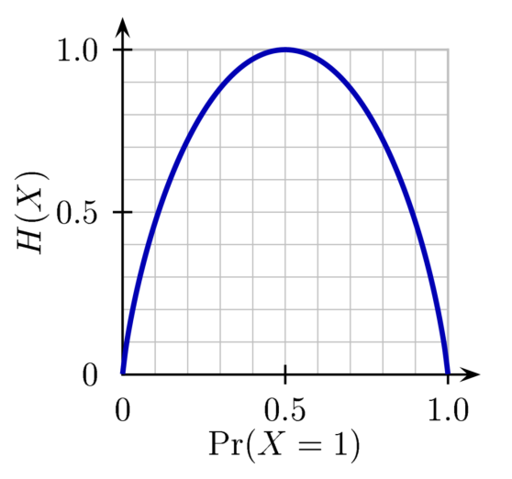
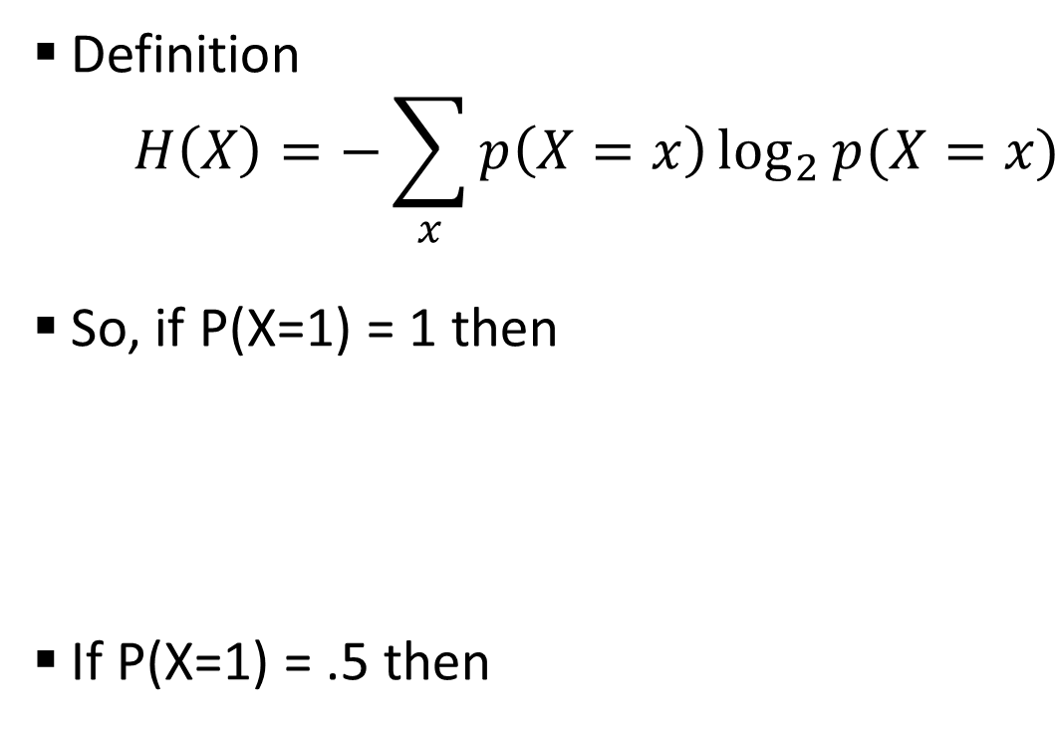
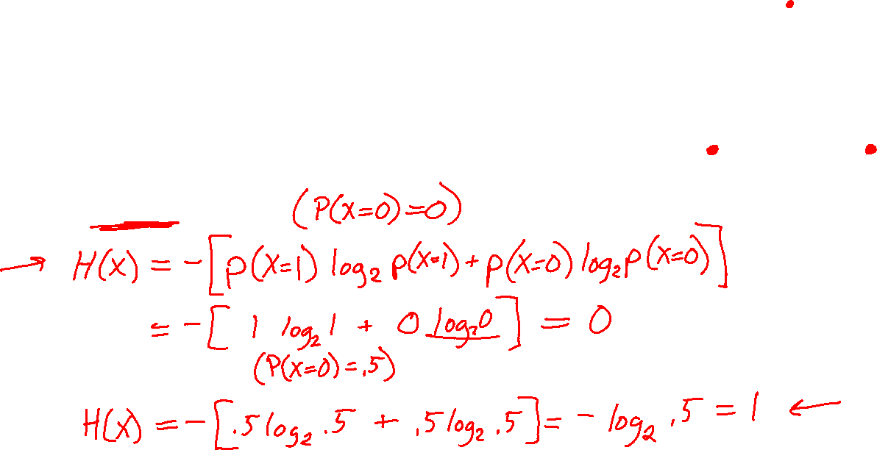
Entropy
H(X)
Definition
$$H\left(X\right)=−\sum_{x}{p\left(X=x\right)\log_{2}{p(X=x)}}$$
So, if P(X=1) = 1 then
If P(X=1) = .5 then
Slide credit: CMU MLD Ziv Bar-Joseph
Notes:
Is the entropy between 0 and 1?

Slide 13
Entropy
H(X)
Definition
$$H\left(X\right)=−\sum_{x}{p\left(X=x\right)\log_{2}{p(X=x)}}$$
So, if P(X=1) = 1 then
If P(X=1) = .5 then
Slide credit: CMU MLD Ziv Bar-Joseph
Notes:
Is the entropy between 0 and 1?

Slide 14
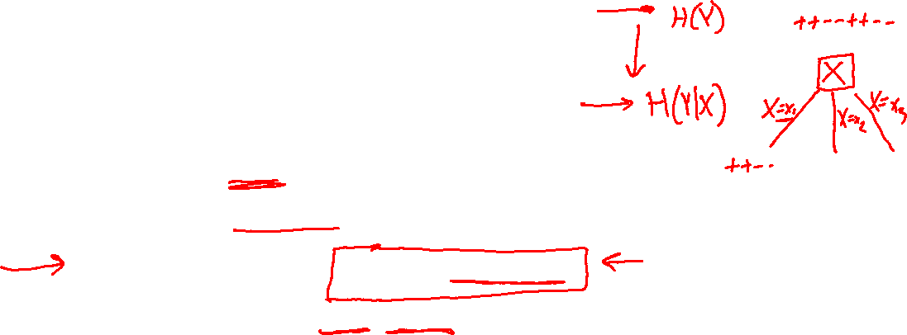
Mutual Information
Slide credit: CMU MLD Matt Gormley
For a decision tree, we can use mutual information of the output class Y and some attribute X on which to split as a splitting criterion
Given a dataset D of training examples, we can estimate the required probabilities as…
Notes:
In the preamble: \usepackage[fleqn]{amsmath}
Entropy:
\begin{align*} H(Y) = - \sum_{y \in \Yc} P(Y=y) \log_2 P(Y=y) \end{align*}
Specific Conditional Entropy:
\begin{align*} H(Y \mid X=x) = - \sum_{y \in \Yc} P(Y=y \mid X=x) \log_2 P(Y=y \mid X=x) \end{align*}
Conditional Entropy:
\begin{align*} H(Y \mid X) = \sum_{x \in \Xc} P(X=x) H(Y \mid X=x) \end{align*}
Mutual Information:
\begin{align*} I(Y; X) = H(Y) - H(Y|X) = H(X) - H(X|Y) \end{align*}

Slide 15
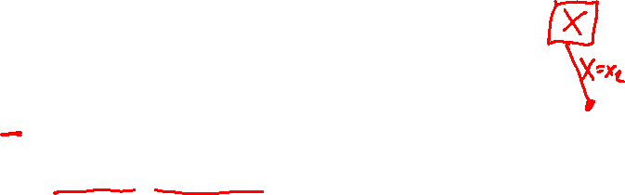
Mutual Information
Entropy measures the expected # of bits to code one random draw from X.
For a decision tree, we want to reduce the entropy of the random variable we are trying to predict!
Slide credit: CMU MLD Matt Gormley
For a decision tree, we can use mutual information of the output class Y and some attribute X on which to split as a splitting criterion
Given a dataset D of training examples, we can estimate the required probabilities as…
Conditional entropy is the expected value of specific conditional entropy E_{P(X=x)}[H(Y | X = x)]
Informally, we say that mutual information is a measure of the following: If we know X, how much does this reduce our uncertainty about Y?
Notes:
In the preamble: \usepackage[fleqn]{amsmath}
Entropy:
\begin{align*} H(Y) = - \sum_{y \in \Yc} P(Y=y) \log_2 P(Y=y) \end{align*}
Specific Conditional Entropy:
\begin{align*} H(Y \mid X=x) = - \sum_{y \in \Yc} P(Y=y \mid X=x) \log_2 P(Y=y \mid X=x) \end{align*}
Conditional Entropy:
\begin{align*} H(Y \mid X) = \sum_{x \in \Xc} P(X=x) H(Y \mid X=x) \end{align*}
Mutual Information:
\begin{align*} I(Y; X) = H(Y) - H(Y|X) = H(X) - H(X|Y) \end{align*}

Slide 16

Piazza Poll 1
Dataset: Output Y, Attributes A and B
Which attribute {A, B} would mutual information select for the next split?
A
B
A or B (tie)
I don’t know
Slide credit: CMU MLD Matt Gormley

Slide 17
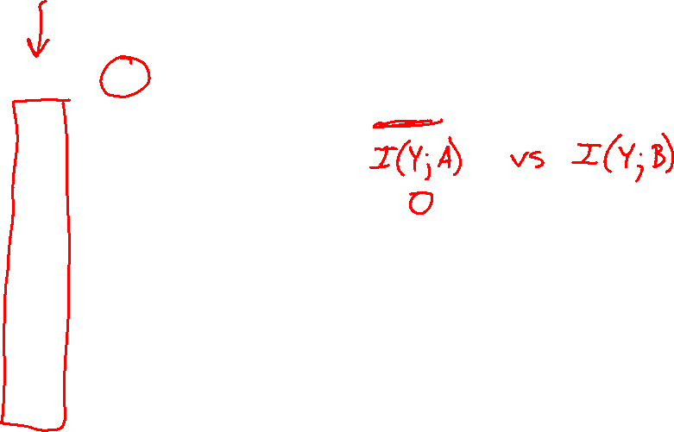
Decision Tree Learning Example
Y | A | B
- | 1 | 0
- | 1 | 0
+ | 1 | 0
+ | 1 | 0
+ | 1 | 1
+ | 1 | 1
+ | 1 | 1
+ | 1 | 1
Slide credit: CMU MLD Matt Gormley

Slide 18
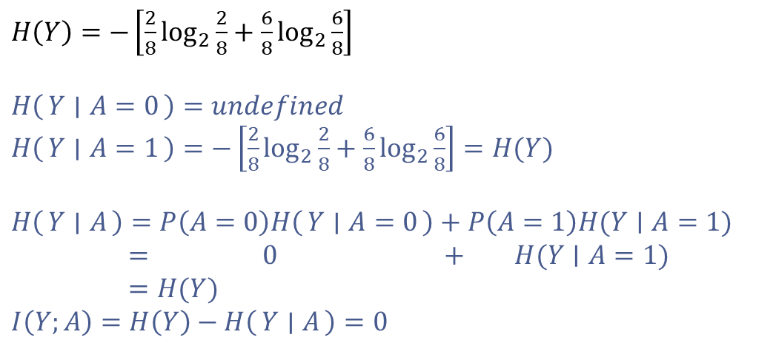
Decision Tree Learning Example
Y | A | B
- | 1 | 0
- | 1 | 0
+ | 1 | 0
+ | 1 | 0
+ | 1 | 1
+ | 1 | 1
+ | 1 | 1
+ | 1 | 1
$H\left(Y\right)=−\left[\frac{2}{8}\log_{2}{\frac{2}{8}}+\frac{6}{8}\log_{2}{\frac{6}{8}}\right]$
$H\left(Y ∣ A=0\right)=undefined$
$H\left(Y ∣ A=1\right)=−\left[\frac{2}{8}\log_{2}{\frac{2}{8}}+\frac{6}{8}\log_{2}{\frac{6}{8}}\right]=H(Y)$
$H\left(Y ∣ A\right)=P\left(A=0\right)H\left(Y ∣ A=0\right)+P\left(A=1\right)H(Y∣A=1)$
$= 0 + H(Y∣A=1)$
$=H(Y)$
$I\left(Y;A\right)=H\left(Y\right)−H\left(Y ∣ A\right)=0$
[2-, 6+]
A
A=0
A=1
[0-, 0+]
P(A=0) = 0
[2-, 6+]
P(A=1)=1
Slide credit: CMU MLD Matt Gormley

Slide 19
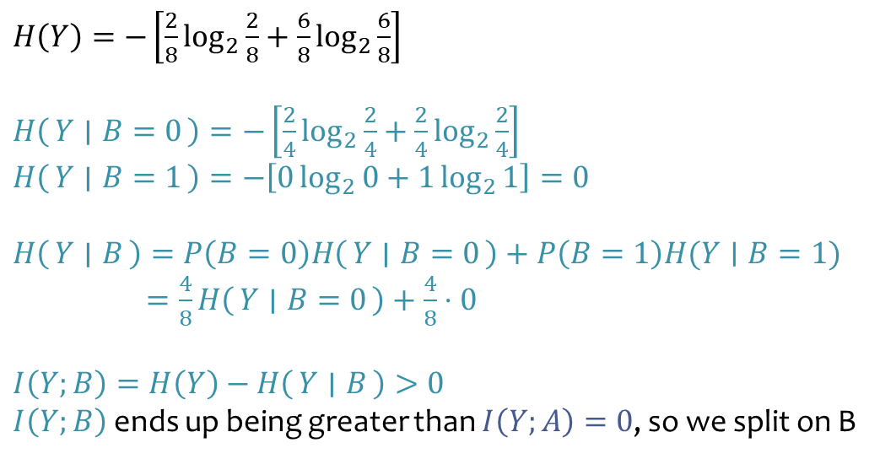
Decision Tree Learning Example
Y | A | B
- | 1 | 0
- | 1 | 0
+ | 1 | 0
+ | 1 | 0
+ | 1 | 1
+ | 1 | 1
+ | 1 | 1
+ | 1 | 1
$H\left(Y\right)=−\left[\frac{2}{8}\log_{2}{\frac{2}{8}}+\frac{6}{8}\log_{2}{\frac{6}{8}}\right]$
$H\left(Y ∣ B=0\right)=−\left[\frac{2}{4}\log_{2}{\frac{2}{4}}+\frac{2}{4}\log_{2}{\frac{2}{4}}\right]$
$H\left(Y ∣ B=1\right)=−\left[0\log_{2}{0}+1\log_{2}{1}\right]=0$
$H\left(Y ∣ B\right)=P\left(B=0\right)H\left(Y ∣ B=0\right)+P\left(B=1\right)H(Y∣B=1)$
$=\frac{4}{8}H\left(Y ∣ B=0\right)+\frac{4}{8}⋅0$
$I\left(Y;B\right)=H\left(Y\right)−H\left(Y ∣ B\right)>0$ $I\left(Y;B\right)$ ends up being greater than $I\left(Y;A\right)=0$, so we split on B
[2-, 6+]
B
B=0
B=1
[2-, 2+]
P(B=0)=4/8
[0-, 4+]
P(B=1)=4/8
Slide credit: CMU MLD Matt Gormley

Slide 20
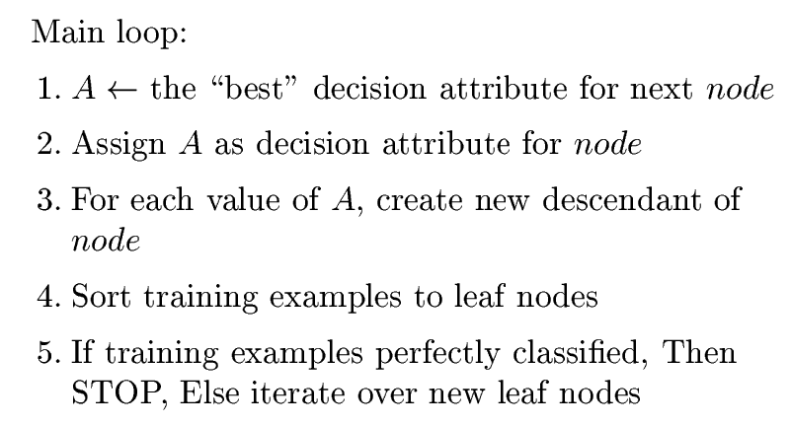
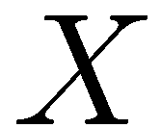
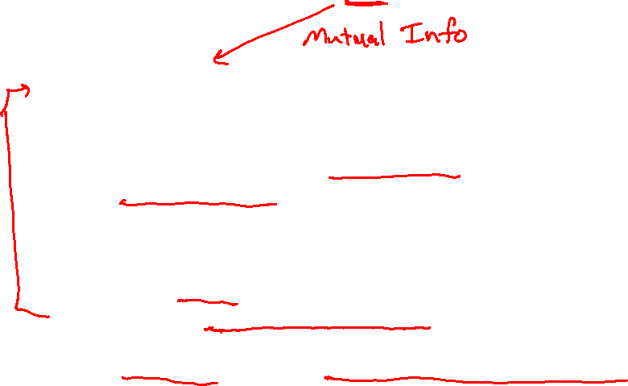
How to learn a decision tree
Top-down induction [ID3]
(Discrete features)
(steps 1-5) after removing current feature
6. When all features exhausted, assign majority label to the leaf node
Slide credit: CMU MLD Aarti Singh

Slide 21
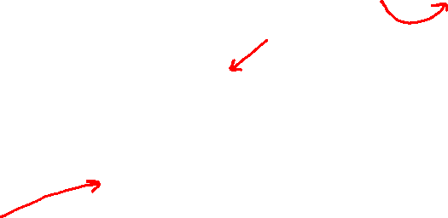
How to learn a decision tree
Top-down induction [ID3, C4.5, C5, …]
C4.5
6. Prune back tree to reduce overfitting
7. Assign majority label to the leaf node
Slide credit: CMU MLD Aarti Singh

Slide 22

Handling continuous features (C4.5)
Convert continuous features into discrete by setting a threshold.
What threshold to pick?
Search for best one as per information gain. Infinitely many??
Don’t need to search over more than ~ n (number of training data),e.g. say X₁ takes values x₁⁽¹⁾, x₁⁽²⁾, … , x₁^{(n)} in the training set. Then possible thresholds are
[x₁⁽¹⁾ + x₁⁽²⁾]/2, [x₁⁽²⁾ + x₁⁽³⁾]/2, … , [x₁^{(n-1)} + x₁^{(n)}]/2
Slide credit: CMU MLD Aarti Singh

Slide 23
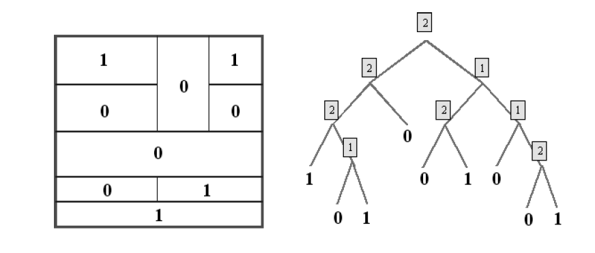
Dyadic decision trees (split on mid-points of features)
feature 2
feature 1
Slide credit: CMU MLD Aarti Singh

Slide 24
When to Stop?
Many strategies for picking simpler trees:
Pre-pruning
Fixed depth (e.g. ID3)
Fixed number of leaves
Post-pruning
Penalize complexity of tree
Slide credit: CMU MLD Aarti Singh

Slide 25
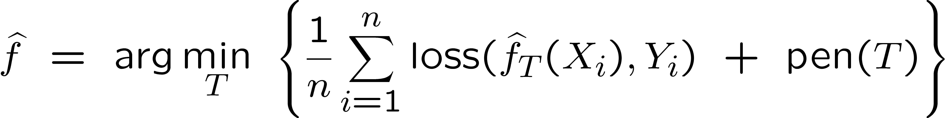
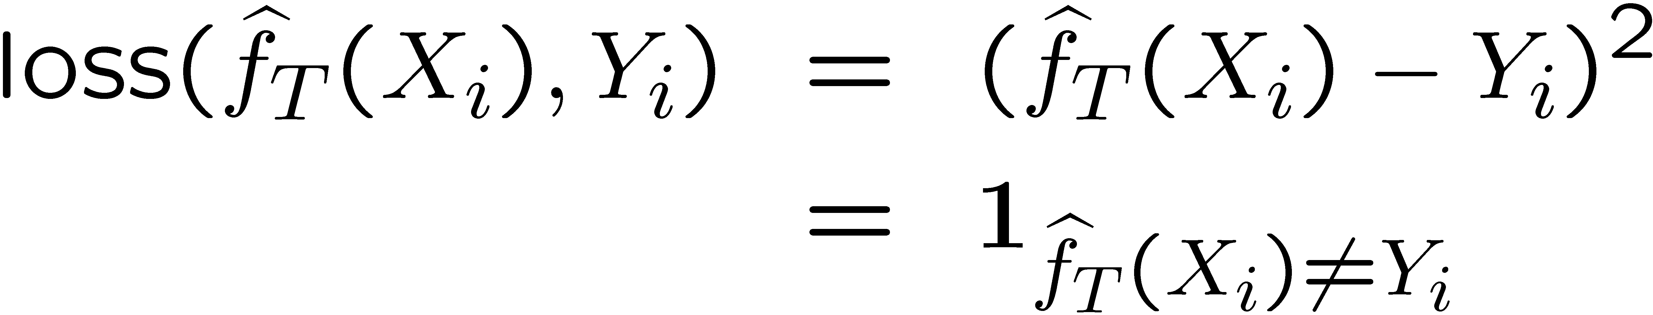
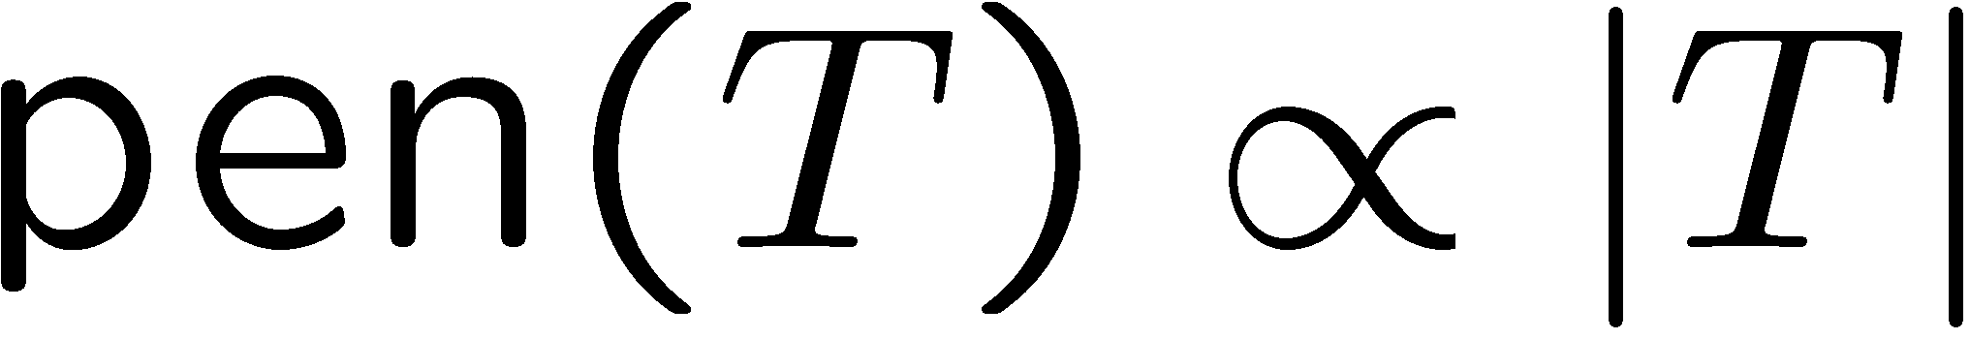

Penalize Complexity of Tree
Penalize complex models by introducing cost
log likelihood
cost
regression
classification
penalize trees with more leaves
Slide credit: CMU MLD Aarti Singh

Slide 26
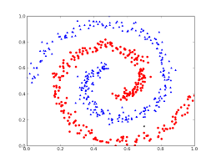
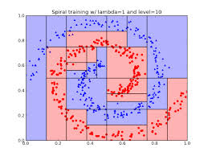
Example of 2-feature decision tree classifier
Slide credit: cs.uchicago.edu

Slide 27
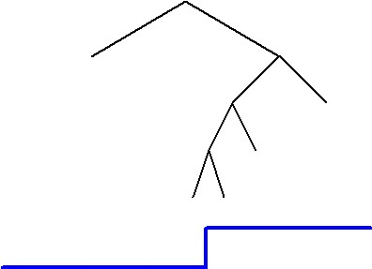
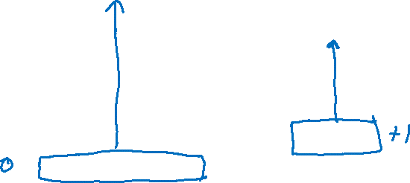
How to assign label to each leaf
Classification – Majority vote Regression – ?
Slide credit: CMU MLD Aarti Singh

Slide 28

How to assign label to each leaf
Classification – Majority vote Regression – Constant/Linear/Poly fit
Slide credit: CMU MLD Aarti Singh

Slide 29
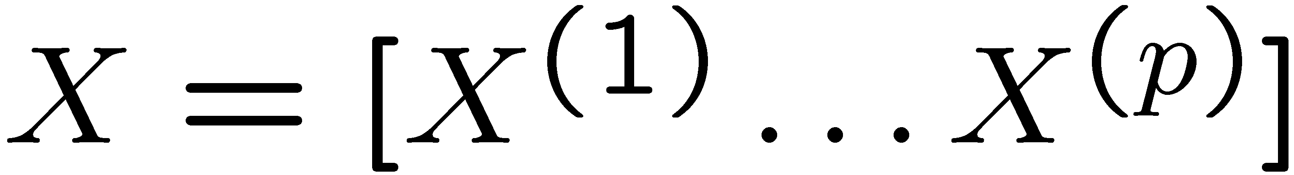
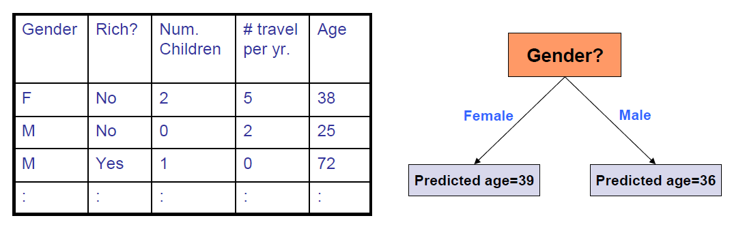
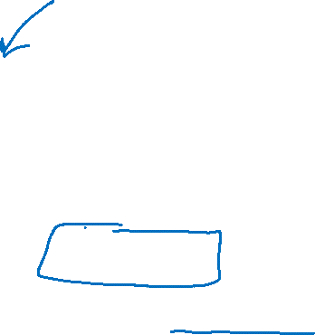
Regression trees
Num Children?
≥ 2
< 2
Average (fit a constant ) using
training data at the leaves

Slide 30
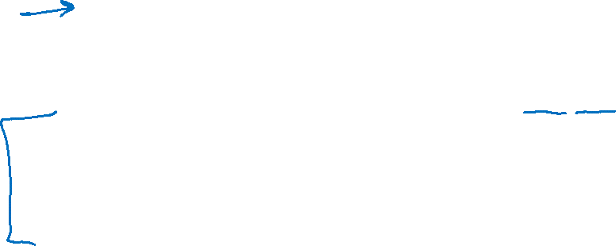
What you should know
Decision trees are one of the most popular data mining tools
Simplicity of design
Interpretability
Ease of implementation
Good performance in practice (for small dimensions)
Mutual Information (entropy) to select attributes (ID3, C4.5,…)
Decision trees will overfit!!!
Must use tricks to find “simple trees”, e.g.,
Pre-Pruning: Fixed depth/Fixed number of leaves
Post-Pruning
Complexity penalized model selection
Can be used for classification, regression and density estimation too
Slide credit: CMU MLD Aarti Singh

