Slide 1

Announcements
Midterm
Grading over the next few days
Scores will be included in mid-semester grades
Assignments:
HW6
Out late tonight
Due date Tue, 3/24, 11:59 pm

Slide 2
Plan
Last time
Nearest Neighbor Classification
kNN
Non-parametric vs parametric
Today
Decision Trees!

Slide 3
Introduction to Machine Learning
Decision Trees
Instructor: Pat Virtue

Slide 4
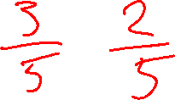
k-NN classifier (k=5)
Test document
Whales
Seals
Sharks
Slide credit: CMU MLD Aarti Singh

Slide 5
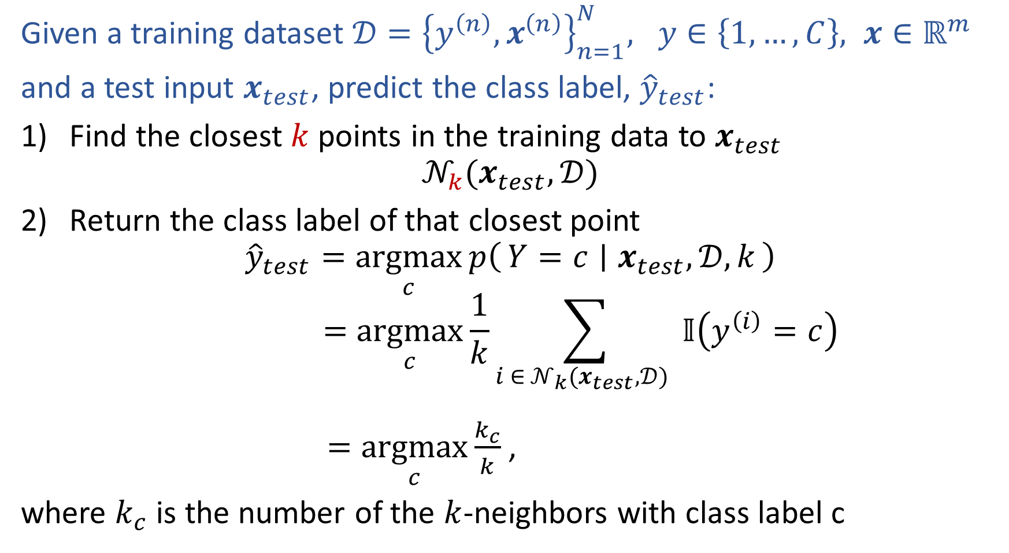

k-Nearest Neighbor Classification
Given a training dataset $𝒟={\left\{y^{\left(n\right)}, x^{\left(n\right)}\right\}}_{n=1}^{N}, y∈\left\{1,…,C\right\}, x∈ℝ^{m}$
and a test input $x_{test}$, predict the class label, ${\hat{y}}_{test}$:
Find the closest $k$ points in the training data to $x_{test}$
$$𝒩_{k}(x_{test},𝒟)$$
Return the class label of that closest point
$${\hat{y}}_{test}=\underset{c}{argmax}{p\left(Y=c ∣ x_{test},𝒟, k\right)}$$
$$=\underset{c}{argmax}{\frac{1}{k}\sum_{i ∈ 𝒩_{k}(x_{test},𝒟) }{𝕀\left(y^{\left(i\right)}=c\right)}}$$
$=\underset{c}{argmax}{\frac{k_{c}}{k}}$,
where $k_{c}$ is the number of the $k$-neighbors with class label c
Slide credit: Murphy, 1.4

Slide 6
k-NN on Fisher Iris Data
Special Case: Nearest Neighbor
Slide credit: CMU MLD Matt Gormley

Slide 7
k-NN on Fisher Iris Data
Slide credit: CMU MLD Matt Gormley

Slide 8
k-NN on Fisher Iris Data
Special Case: Majority Vote
Slide credit: CMU MLD Matt Gormley

Slide 9
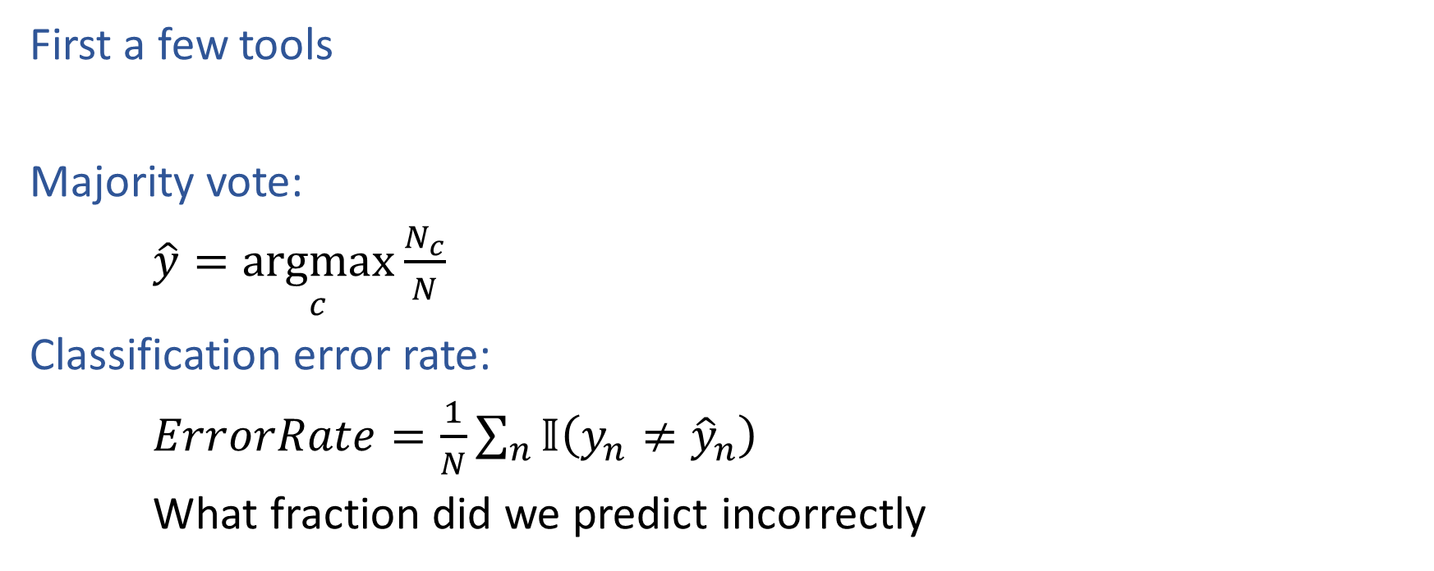
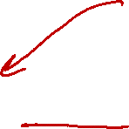
Decision Trees
First a few tools
Majority vote:
$\hat{y}=\underset{c}{argmax}{\frac{N_{c}}{N}}$
Classification error rate:
$ErrorRate=\frac{1}{N}\sum_{n}{𝕀\left(y_{n}≠{\hat{y}}_{n}\right)}$
What fraction did we predict incorrectly

Slide 10
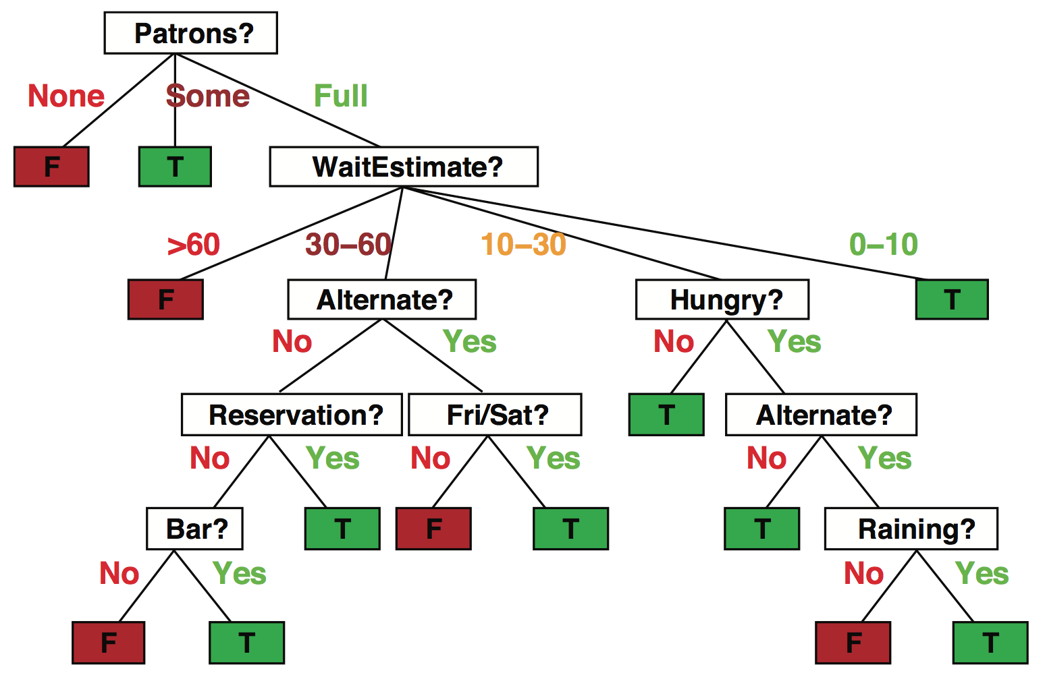
Decision trees
Popular representation for classifiers
Even among humans!
I’ve just arrived at a restaurant: should I stay (and wait for a table) or go elsewhere?
Slide credit: ai.berkeley.edu

Slide 11
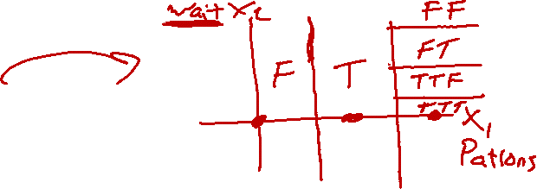
Decision trees
It’s Friday night and you’re hungry
You arrive at your favorite cheap but really cool happening burger place
It’s full up and you have no reservation but there is a bar
The host estimates a 45 minute wait
There are alternatives nearby but it’s raining outside
Decision tree partitions the input space, assigns a label to each partition
Slide credit: ai.berkeley.edu

Slide 12
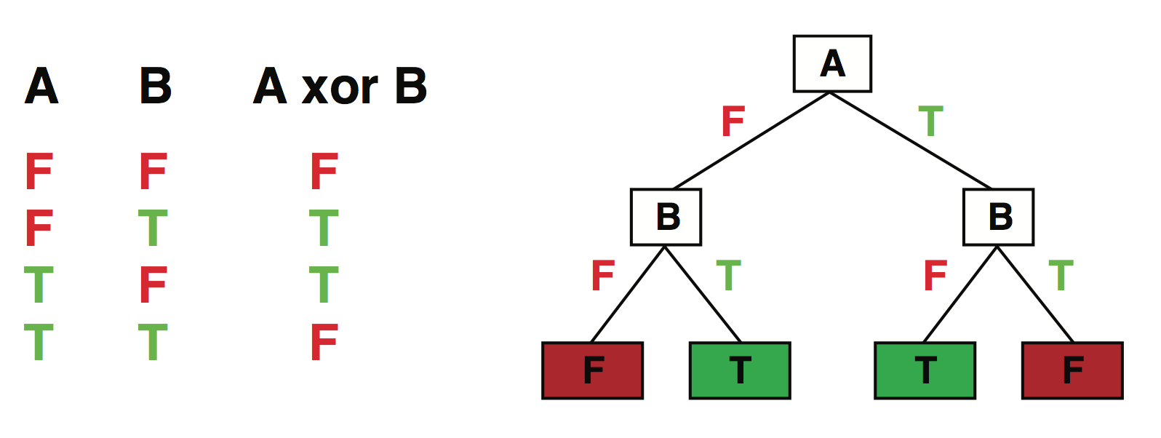
Expressiveness
Discrete decision trees can express any function of the input
E.g., for Boolean functions, build a path from root to leaf for each row of the truth table:
True/false: there is a consistent decision tree that fits any training set exactly
But a tree that simply records the examples is essentially a lookup table
To get generalization to new examples, need a compact tree
Slide credit: ai.berkeley.edu

Slide 13
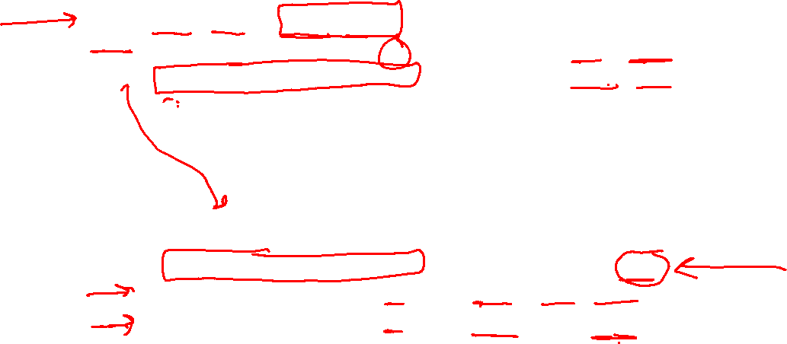
Tree to Predict C-Section Risk
Slide credit: CMU MLD Tom Mitchell

Slide 14
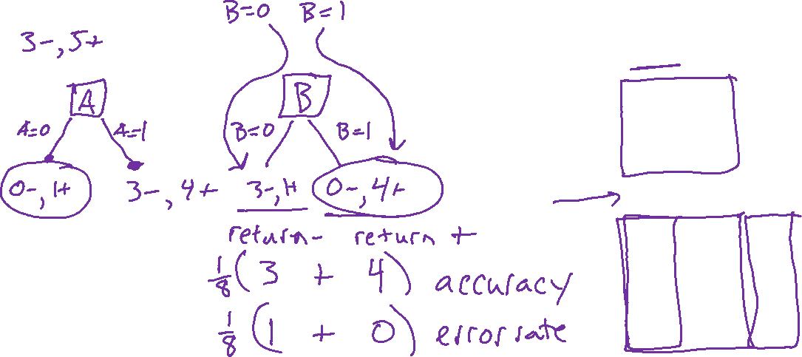
Decision Stumps
Split data based on a single attribute
Dataset: Output Y, Attributes A, B, C
Y | A | B | C
- | 1 | 0 | 0
- | 1 | 0 | 1
- | 1 | 0 | o
+ | 0 | 0 | 1
+ | 1 | 1 | 0
+ | 1 | 1 | 1
+ | 1 | 1 | 0
+ | 1 | 1 | 1
Slide credit: CMU MLD Matt Gormley

Slide 15
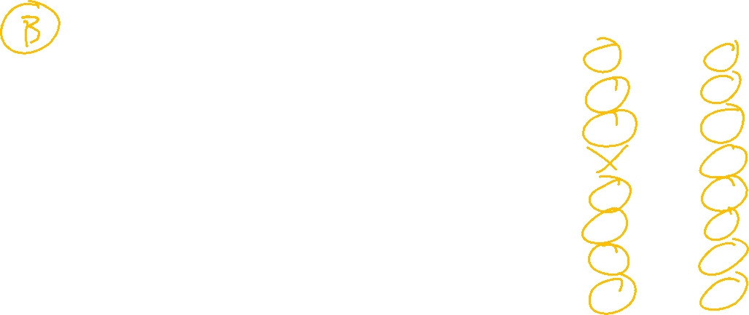
Piazza Poll 1
Splitting on which attribute {A, B, C} creates a decision stump with the lowest training error?
Dataset: Output Y, Attributes A, B, C
Y | A | B | C
- | 1 | 0 | 0
- | 1 | 0 | 1
- | 1 | 0 | o
+ | 0 | 0 | 1
+ | 1 | 1 | 0
+ | 1 | 1 | 1
+ | 1 | 1 | 0
+ | 1 | 1 | 1
Slide credit: CMU MLD Matt Gormley

Slide 16
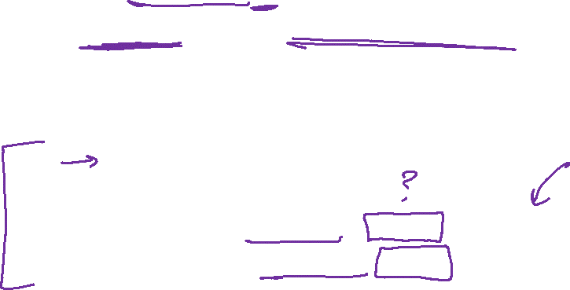
Building a decision tree
Function BuildTree(n,A) // n: samples, A: set of attributes
If empty(A) or all n(L) are the same
status = leaf
class = most common class in n(L)
else
status = internal
a ⇐ bestAttribute(n,A)
LeftNode = BuildTree(n(a=1), A \ {a})
RightNode = BuildTree(n(a=0), A \ {a})
end
end
Slide credit: CMU MLD Ziv Bar-Joseph

Slide 17
Building a decision tree
Function BuildTree(n,A) // n: samples, A: set of attributes
If empty(A) or all n(L) are the same
status = leaf
class = most common class in n(L)
else
status = internal
a ⇐ bestAttribute(n,A)
LeftNode = BuildTree(n(a=1), A \ {a})
RightNode = BuildTree(n(a=0), A \ {a})
end
end
n(L): Labels for samples in this set
Decision: Which attribute?
Recursive calls to create left and right subtrees, n(a=1) is the set of samples in n for which the attribute a is 1
Slide credit: CMU MLD Ziv Bar-Joseph

Slide 18
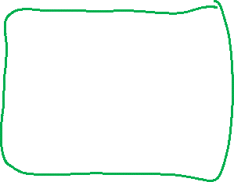
Piazza Poll 2
Dataset: Output Y, Attributes A, B, C
Which of the following trees would be learned by the the decision tree learning algorithm using “error rate” as the splitting criterion?
(Assume ties are broken alphabetically.)
Y | A | B | C
+ | 0 | 0 | 0
+ | 0 | 0 | 1
- | 0 | 1 | 0
+ | 0 | 1 | 1
- | 1 | 0 | 0
- | 1 | 0 | 1
- | 1 | 1 | 0
+ | 1 | 1 | 1
1
A
2
A
3
A
0
1
0
1
0
1
C
C
B
C
B
B
0
1
0
1
0
1
0
1
0
1
0
1
+
-
-
+
+
-
-
+
+
C
-
C
0
1
0
1
4
C
5
B
-
+
-
+
0
1
0
1
6
B
B
A
A
C
0
1
0
1
0
1
0
1
0
1
A
A
+
-
-
+
+
-
-
+
0
1
0
1
+
-
C
C
0
1
0
1
+
-
-
+
Slide credit: CMU MLD Matt Gormley

Slide 19
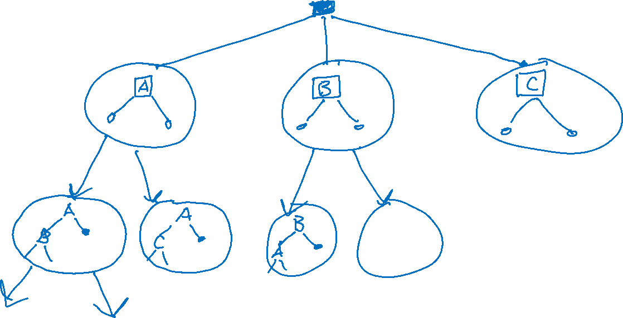
Decision Trees as a Search Problem

Slide 20
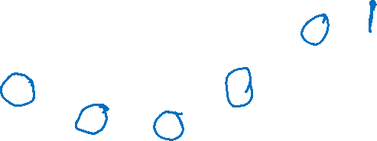
Background: Greedy Search
Goal:
Search space consists of nodes and weighted edges
Goal is to find the lowest (total) weight path from root to a leaf
Greedy Search:
At each node, selects the edge with lowest (immediate) weight
Heuristic method of search (i.e. does not necessarily find the best path)
End States
2
7
4
3
8
Start State
1
7
3
9
3
4
8
5
3
1
6
5
2
4
2
Slide credit: CMU MLD Matt Gormley

Slide 21
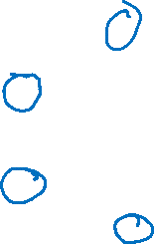
Background: Greedy Search
Goal:
Search space consists of nodes and weighted edges
Goal is to find the lowest (total) weight path from root to a leaf
Greedy Search:
At each node, selects the edge with lowest (immediate) weight
Heuristic method of search (i.e. does not necessarily find the best path)
End States
2
7
4
3
8
Start State
1
7
3
9
3
4
8
5
3
1
6
5
2
4
9
2
9
1
9
Slide credit: CMU MLD Matt Gormley

Slide 22
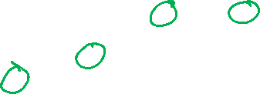
Background: Greedy Search
Goal:
Search space consists of nodes and weighted edges
Goal is to find the lowest (total) weight path from root to a leaf
Greedy Search:
At each node, selects the edge with lowest (immediate) weight
Heuristic method of search (i.e. does not necessarily find the best path)
5
3
2
1
End States
7
5
1
1
2
2
3
2
5
7
4
3
8
Start State
1
7
3
9
3
4
8
5
3
1
6
5
2
4
9
2
9
1
9

Slide 23
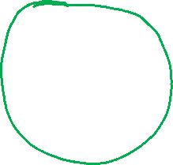
Piazza Poll 3
Dataset: Output Y, Attributes A, B, C
Suppose you had an algorithm that found the tree with lowest training error that was as small as possible (i.e. exhaustive global search), which tree would it return?
(Assume ties are broken alphabetically.)
Y | A | B | C
+ | 0 | 0 | 0
+ | 0 | 0 | 1
- | 0 | 1 | 0
+ | 0 | 1 | 1
- | 1 | 0 | 0
- | 1 | 0 | 1
- | 1 | 1 | 0
+ | 1 | 1 | 1
1
A
2
A
3
A
0
1
0
1
0
1
C
C
B
C
B
B
0
1
0
1
0
1
0
1
0
1
0
1
+
-
-
+
+
-
-
+
+
C
-
C
0
1
0
1
4
C
5
B
-
+
-
+
0
1
0
1
6
B
B
A
A
C
0
1
0
1
0
1
0
1
0
1
A
A
+
-
-
+
+
-
-
+
0
1
0
1
+
-
C
C
0
1
0
1
+
-
-
+
Slide credit: CMU MLD Matt Gormley

Slide 24
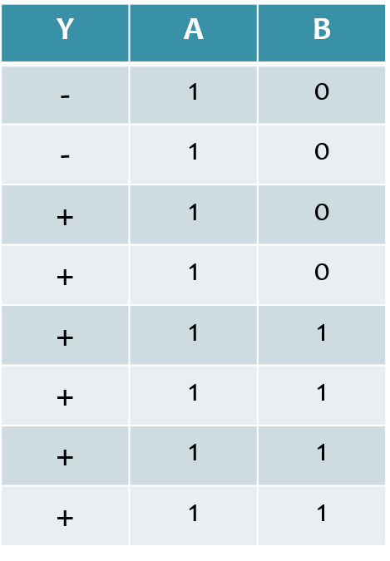
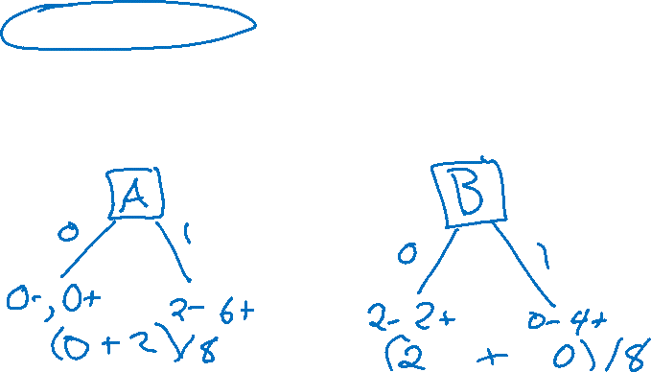
Piazza Poll 4
Dataset: Output Y, Attributes A and B
Which attribute {A, B} would error rate select for the next split?
A
B
A or B (tie)
I don’t know
Slide credit: CMU MLD Matt Gormley

Slide 25
Building a decision tree
Function BuildTree(n,A) // n: samples, A: set of attributes
If empty(A) or all n(L) are the same
status = leaf
class = most common class in n(L)
else
status = internal
a ⇐ bestAttribute(n,A)
LeftNode = BuildTree(n(a=1), A \ {a})
RightNode = BuildTree(n(a=0), A \ {a})
end
end
n(L): Labels for samples in this set
Decision: Which attribute?
Recursive calls to create left and right subtrees, n(a=1) is the set of samples in n for which the attribute a is 1
Slide credit: CMU MLD Ziv Bar-Joseph

Slide 26
Identifying ‘bestAttribute’
There are many possible ways to select the best attribute for a given set.
We will discuss one possible way which is based on information theory.
Slide credit: CMU MLD Ziv Bar-Joseph

Slide 27
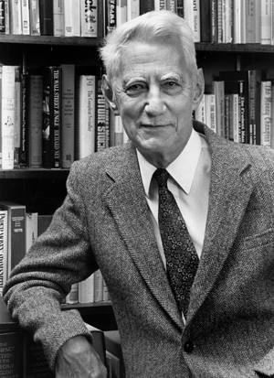

Entropy
Quantifies the amount of uncertainty associated with a specific probability distribution
The higher the entropy, the less confident we are in the outcome
Definition
Claude Shannon (1916 – 2001), most of the work was done in Bell labs
Slide credit: CMU MLD Ziv Bar-Joseph

Slide 28
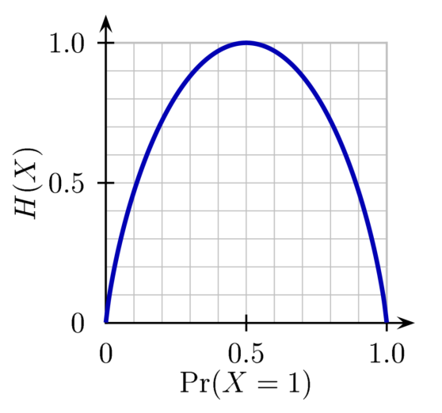
Entropy
H(X)
Definition
So, if P(X=1) = 1 then
If P(X=1) = .5 then
Slide credit: CMU MLD Ziv Bar-Joseph
Notes:
Is the entropy between 0 and 1?

Slide 29

Mutual Information
Slide credit: CMU MLD Matt Gormley
For a decision tree, we can use mutual information of the output class Y and some attribute X on which to split as a splitting criterion
Given a dataset D of training examples, we can estimate the required probabilities as…
Notes:
In the preamble: \usepackage[fleqn]{amsmath}
Entropy:
\begin{align*} H(Y) = - \sum_{y \in \Yc} P(Y=y) \log_2 P(Y=y) \end{align*}
Specific Conditional Entropy:
\begin{align*} H(Y \mid X=x) = - \sum_{y \in \Yc} P(Y=y \mid X=x) \log_2 P(Y=y \mid X=x) \end{align*}
Conditional Entropy:
\begin{align*} H(Y \mid X) = \sum_{x \in \Xc} P(X=x) H(Y \mid X=x) \end{align*}
Mutual Information:
\begin{align*} I(Y; X) = H(Y) - H(Y|X) = H(X) - H(X|Y) \end{align*}

Slide 30
Mutual Information
Entropy measures the expected # of bits to code one random draw from X.
For a decision tree, we want to reduce the entropy of the random variable we are trying to predict!
Slide credit: CMU MLD Matt Gormley
For a decision tree, we can use mutual information of the output class Y and some attribute X on which to split as a splitting criterion
Given a dataset D of training examples, we can estimate the required probabilities as…
Conditional entropy is the expected value of specific conditional entropy E_{P(X=x)}[H(Y | X = x)]
Informally, we say that mutual information is a measure of the following: If we know X, how much does this reduce our uncertainty about Y?
Notes:
In the preamble: \usepackage[fleqn]{amsmath}
Entropy:
\begin{align*} H(Y) = - \sum_{y \in \Yc} P(Y=y) \log_2 P(Y=y) \end{align*}
Specific Conditional Entropy:
\begin{align*} H(Y \mid X=x) = - \sum_{y \in \Yc} P(Y=y \mid X=x) \log_2 P(Y=y \mid X=x) \end{align*}
Conditional Entropy:
\begin{align*} H(Y \mid X) = \sum_{x \in \Xc} P(X=x) H(Y \mid X=x) \end{align*}
Mutual Information:
\begin{align*} I(Y; X) = H(Y) - H(Y|X) = H(X) - H(X|Y) \end{align*}

Slide 31
Decision Tree Learning Example
Dataset: Output Y, Attributes A and B
Which attribute would mutual information select for the next split?
A
B
A or B (tie)
Neither
Y | A | B
- | 1 | 0
- | 1 | 0
+ | 1 | 0
+ | 1 | 0
+ | 1 | 1
+ | 1 | 1
+ | 1 | 1
+ | 1 | 1
Slide credit: CMU MLD Matt Gormley

Slide 32
Decision Tree Learning Example
Y | A | B
- | 1 | 0
- | 1 | 0
+ | 1 | 0
+ | 1 | 0
+ | 1 | 1
+ | 1 | 1
+ | 1 | 1
+ | 1 | 1
Slide credit: CMU MLD Matt Gormley

