Slide 1
Announcements
Midterm
Grading over the next few days
Scores will be included in mid-semester grades
Assignments:
HW6
    Out late tonight
    Due date Tue, 3/24, 11:59 pm

Slide 2
Plan
Last time
Nearest Neighbor Classification
    kNN
    Non-parametric vs parametric
Today
Decision Trees!

Slide 3
Introduction to
Machine Learning
Decision Trees
Instructor: Pat Virtue

Slide 4
k-NN classifier (k=5)
Test document
Whales
Seals
Sharks
Slide credit: CMU MLD Aarti Singh

Slide 5
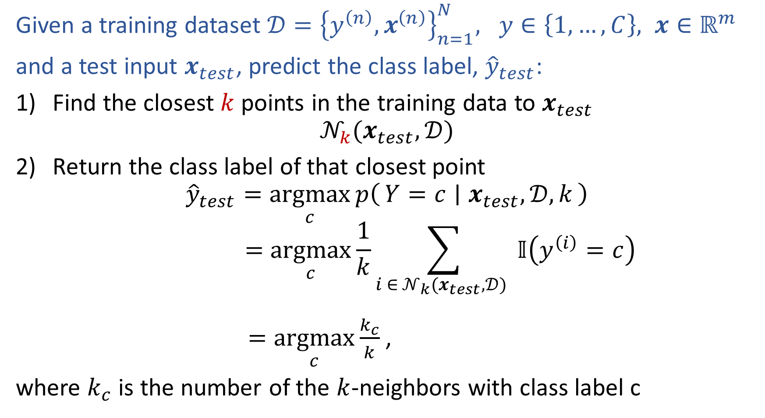
k-Nearest Neighbor Classification
Given a training dataset $𝒟={\left\{y^{\left(n\right)}, x^{\left(n\right)}\right\}}_{n=1}^{N}, y∈\left\{1,…,C\right\}, x∈ℝ^{m}$
and a test input $x_{test}$, predict the class label, ${\hat{y}}_{test}$:
Find the closest $k$ points in the training data to $x_{test}$
$$𝒩_{k}(x_{test},𝒟)$$
Return the class label of that closest point
$${\hat{y}}_{test}=\underset{c}{argmax}{p\left(Y=c ∣ x_{test},𝒟, k\right)}$$
$$=\underset{c}{argmax}{\frac{1}{k}\sum_{i ∈ 𝒩_{k}(x_{test},𝒟) }{𝕀\left(y^{\left(i\right)}=c\right)}}$$
$=\underset{c}{argmax}{\frac{k_{c}}{k}}$,
where $k_{c}$ is the number of the $k$-neighbors with class label c
Slide credit: Murphy, 1.4

Slide 6
k-NN on Fisher Iris Data
Special Case: Nearest Neighbor
Slide credit: CMU MLD Matt Gormley

Slide 7
k-NN on Fisher Iris Data
Slide credit: CMU MLD Matt Gormley

Slide 8
k-NN on Fisher Iris Data
Special Case: Majority Vote
Slide credit: CMU MLD Matt Gormley

Slide 9
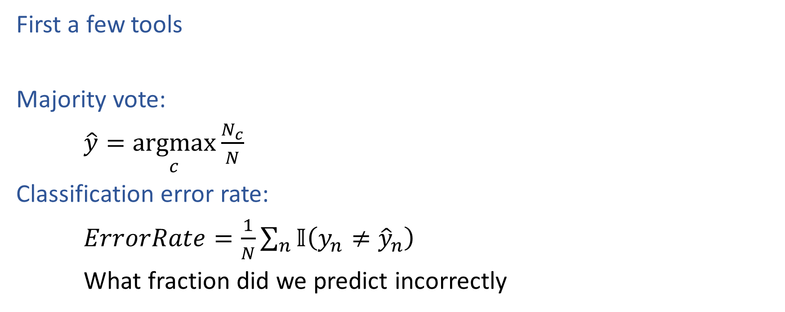
Decision Trees
First a few tools
Majority vote:
$\hat{y}=\underset{c}{argmax}{\frac{N_{c}}{N}}$
Classification error rate:
$ErrorRate=\frac{1}{N}\sum_{n}{𝕀\left(y_{n}≠{\hat{y}}_{n}\right)}$
What fraction did we predict incorrectly

Slide 10
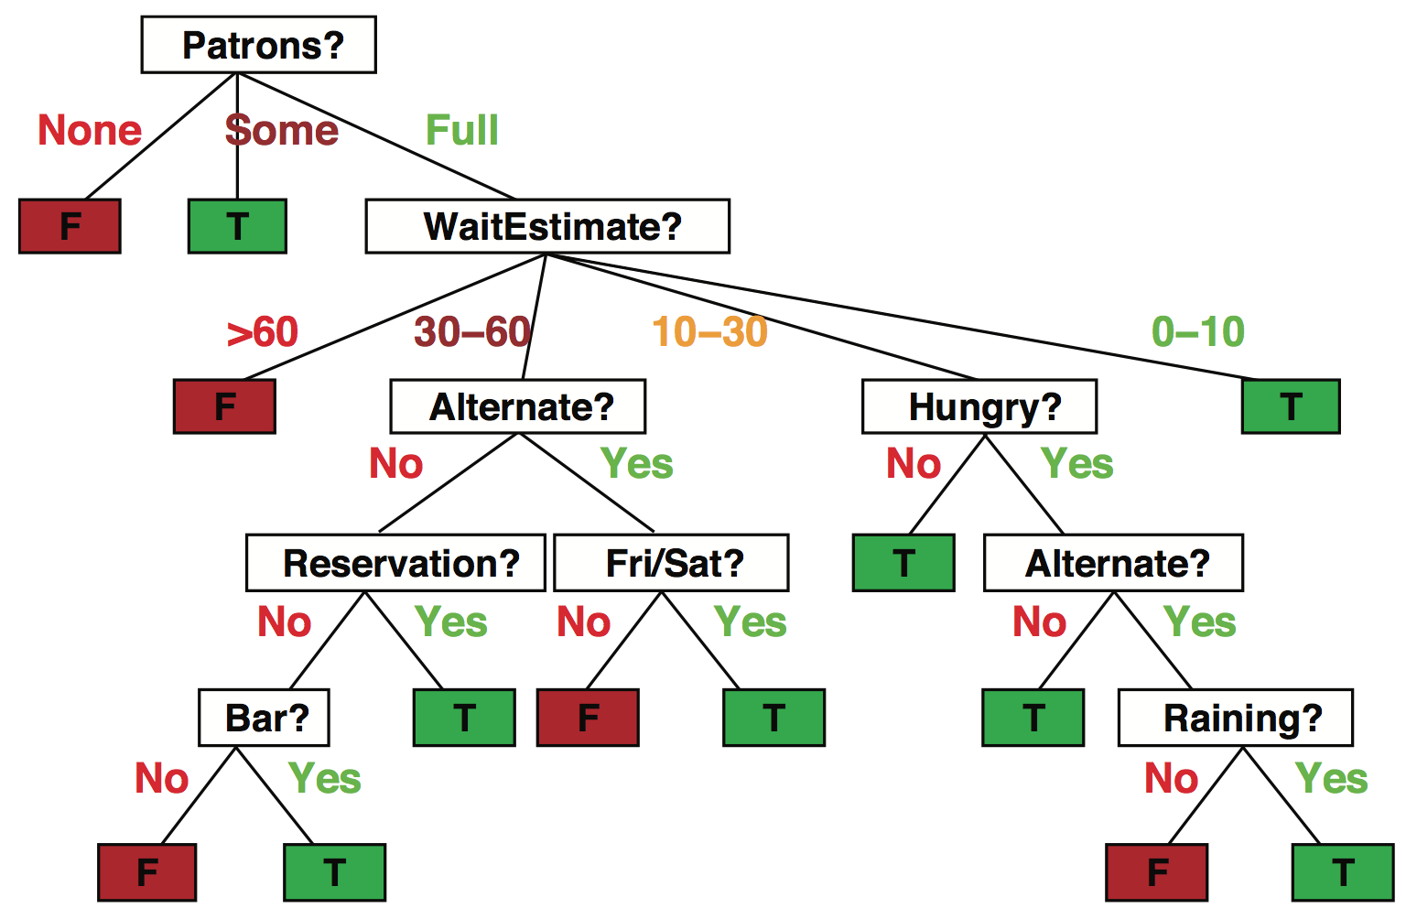
Decision trees
Popular representation for classifiers
  Even among humans!
I’ve just arrived at a restaurant: should I stay (and wait for a table) or go elsewhere?
Slide credit: ai.berkeley.edu

Slide 11
Decision trees
It’s Friday night and you’re hungry
You arrive at your favorite cheap but really cool happening burger place
It’s full up and you have no reservation but there is a bar
The host estimates a 45 minute wait
There are alternatives nearby but it’s raining outside
Decision tree partitions the input space, assigns a label to each partition
Slide credit: ai.berkeley.edu

Slide 12
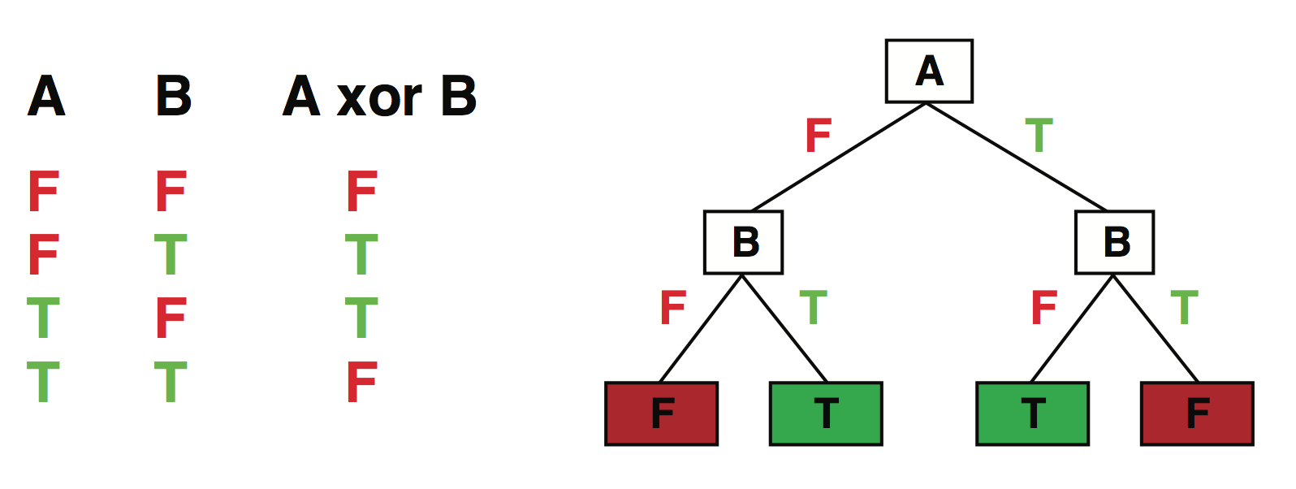
Expressiveness
Discrete decision trees can express any function of the input
E.g., for Boolean functions, build a path from root to leaf for each row of the truth table:
True/false: there is a consistent decision tree that fits any training set exactly
But a tree that simply records the examples is essentially a lookup table
To get generalization to new examples, need a compact tree
Slide credit: ai.berkeley.edu

Slide 13
Tree to Predict C-Section Risk
Slide credit: CMU MLD Tom Mitchell

Slide 14
Decision Stumps
Split data based on a single attribute
Dataset:
Output Y, Attributes A, B, C
Y | A | B | C
- | 1 | 0 | 0
- | 1 | 0 | 1
- | 1 | 0 | o
+ | 0 | 0 | 1
+ | 1 | 1 | 0
+ | 1 | 1 | 1
+ | 1 | 1 | 0
+ | 1 | 1 | 1
Slide credit: CMU MLD Matt Gormley

Slide 15
Piazza Poll 1
Splitting on which attribute {A, B, C} creates a decision stump with the lowest training error?
Dataset:
Output Y, Attributes A, B, C
Y | A | B | C
- | 1 | 0 | 0
- | 1 | 0 | 1
- | 1 | 0 | o
+ | 0 | 0 | 1
+ | 1 | 1 | 0
+ | 1 | 1 | 1
+ | 1 | 1 | 0
+ | 1 | 1 | 1
Slide credit: CMU MLD Matt Gormley

Slide 16
Piazza Poll 1
Splitting on which attribute {A, B, C} creates a decision stump with the lowest training error?
Answer: B
Dataset:
Output Y, Attributes A, B, C
Y | A | B | C
- | 1 | 0 | 0
- | 1 | 0 | 1
- | 1 | 0 | o
+ | 0 | 0 | 1
+ | 1 | 1 | 0
+ | 1 | 1 | 1
+ | 1 | 1 | 0
+ | 1 | 1 | 1
Slide credit: CMU MLD Matt Gormley

Slide 17
Building a decision tree
Function BuildTree(n,A) // n: samples, A: set of attributes
If empty(A) or all n(L) are the same
status = leaf
class = most common class in n(L)
else
status = internal
a ⇐ bestAttribute(n,A)
LeftNode = BuildTree(n(a=1), A \ {a})
RightNode = BuildTree(n(a=0), A \ {a})
end
end
Slide credit: CMU MLD Ziv Bar-Joseph

Slide 18
Building a decision tree
Function BuildTree(n,A) // n: samples, A: set of attributes
If empty(A) or all n(L) are the same
status = leaf
class = most common class in n(L)
else
status = internal
a ⇐ bestAttribute(n,A)
LeftNode = BuildTree(n(a=1), A \ {a})
RightNode = BuildTree(n(a=0), A \ {a})
end
end
n(L): Labels for samples in this set
Decision: Which attribute?
Recursive calls to create left and right subtrees, n(a=1) is the set of samples in n for which the attribute a is 1
Slide credit: CMU MLD Ziv Bar-Joseph

Slide 19
Piazza Poll 2
Dataset:
Output Y, Attributes A, B, C
Which of the following trees would be learned by the the decision tree learning algorithm using “error rate” as the splitting criterion?
(Assume ties are broken alphabetically.)
Y | A | B | C
+ | 0 | 0 | 0
+ | 0 | 0 | 1
- | 0 | 1 | 0
+ | 0 | 1 | 1
- | 1 | 0 | 0
- | 1 | 0 | 1
- | 1 | 1 | 0
+ | 1 | 1 | 1
1
A
2
A
3
A
0
1
0
1
0
1
C
C
B
C
B
B
0
1
0
1
0
1
0
1
0
1
0
1
+
-
-
+
+
-
-
+
+
C
-
C
0
1
0
1
4
C
5
B
-
+
-
+
0
1
0
1
6
B
B
A
A
C
0
1
0
1
0
1
0
1
0
1
A
A
+
-
-
+
+
-
-
+
0
1
0
1
+
-
C
C
0
1
0
1
+
-
-
+
Slide credit: CMU MLD Matt Gormley

Slide 20
Piazza Poll 2
Dataset:
Output Y, Attributes A, B, C
Which of the following trees would be learned by the the decision tree learning algorithm using “error rate” as the splitting criterion?
(Assume ties are broken alphabetically.)
Y | A | B | C
+ | 0 | 0 | 0
+ | 0 | 0 | 1
- | 0 | 1 | 0
+ | 0 | 1 | 1
- | 1 | 0 | 0
- | 1 | 0 | 1
- | 1 | 1 | 0
+ | 1 | 1 | 1
1
A
2
A
3
A
0
1
0
1
0
1
C
C
B
C
B
B
0
1
0
1
0
1
0
1
0
1
0
1
+
-
-
+
+
-
-
+
+
C
-
C
0
1
0
1
4
C
5
B
-
+
-
+
0
1
0
1
6
B
B
A
A
C
0
1
0
1
0
1
0
1
0
1
A
A
+
-
-
+
+
-
-
+
0
1
0
1
+
-
C
C
0
1
0
1
+
-
-
+
Slide credit: CMU MLD Matt Gormley

Slide 21
Decision Trees as a Search Problem

Slide 22
Background: Greedy Search
Goal:
Search space consists of nodes and weighted edges
Goal is to find the lowest (total) weight path from root to a leaf
Greedy Search:
At each node, selects the edge with lowest (immediate) weight
Heuristic method of search (i.e. does not necessarily find the best path)
End
States
2
7
4
3
8
Start
State
1
7
3
9
3
4
8
5
3
1
6
5
2
4
2
Slide credit: CMU MLD Matt Gormley

Slide 23
Background: Greedy Search
Goal:
Search space consists of nodes and weighted edges
Goal is to find the lowest (total) weight path from root to a leaf
Greedy Search:
At each node, selects the edge with lowest (immediate) weight
Heuristic method of search (i.e. does not necessarily find the best path)
End
States
2
7
4
3
8
Start
State
1
7
3
9
3
4
8
5
3
1
6
5
2
4
9
2
9
1
9
Slide credit: CMU MLD Matt Gormley

Slide 24
Background: Greedy Search
Goal:
Search space consists of nodes and weighted edges
Goal is to find the lowest (total) weight path from root to a leaf
Greedy Search:
At each node, selects the edge with lowest (immediate) weight
Heuristic method of search (i.e. does not necessarily find the best path)
5
3
2
1
End
States
7
5
1
1
2
2
3
2
5
7
4
3
8
Start
State
1
7
3
9
3
4
8
5
3
1
6
5
2
4
9
2
9
1
9

Slide 25
Piazza Poll 3
Dataset:
Output Y, Attributes A, B, C
Suppose you had an algorithm that found the tree with lowest training error that was as small as possible (i.e. exhaustive global search), which tree would it return?
(Assume ties are broken alphabetically.)
Y | A | B | C
+ | 0 | 0 | 0
+ | 0 | 0 | 1
- | 0 | 1 | 0
+ | 0 | 1 | 1
- | 1 | 0 | 0
- | 1 | 0 | 1
- | 1 | 1 | 0
+ | 1 | 1 | 1
1
A
2
A
3
A
0
1
0
1
0
1
C
C
B
C
B
B
0
1
0
1
0
1
0
1
0
1
0
1
+
-
-
+
+
-
-
+
+
C
-
C
0
1
0
1
4
C
5
B
-
+
-
+
0
1
0
1
6
B
B
A
A
C
0
1
0
1
0
1
0
1
0
1
A
A
+
-
-
+
+
-
-
+
0
1
0
1
+
-
C
C
0
1
0
1
+
-
-
+
Slide credit: CMU MLD Matt Gormley

Slide 26
Piazza Poll 3
Dataset:
Output Y, Attributes A, B, C
Suppose you had an algorithm that found the tree with lowest training error that was as small as possible (i.e. exhaustive global search), which tree would it return?
(Assume ties are broken alphabetically.)
Y | A | B | C
+ | 0 | 0 | 0
+ | 0 | 0 | 1
- | 0 | 1 | 0
+ | 0 | 1 | 1
- | 1 | 0 | 0
- | 1 | 0 | 1
- | 1 | 1 | 0
+ | 1 | 1 | 1
1
A
2
A
3
A
0
1
0
1
0
1
C
C
B
C
B
B
0
1
0
1
0
1
0
1
0
1
0
1
+
-
-
+
+
-
-
+
+
C
-
C
0
1
0
1
4
C
5
B
-
+
-
+
0
1
0
1
6
B
B
A
A
C
0
1
0
1
0
1
0
1
0
1
A
A
+
-
-
+
+
-
-
+
0
1
0
1
+
-
C
C
0
1
0
1
+
-
-
+
Slide credit: CMU MLD Matt Gormley

Slide 27
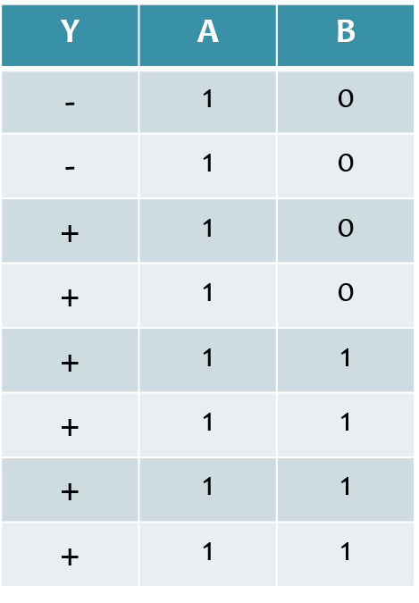
Piazza Poll 4
Dataset:
Output Y, Attributes A and B
Which attribute {A, B} would error rate select for the next split?
A
B
A or B (tie)
I don’t know
Slide credit: CMU MLD Matt Gormley

Slide 28
Piazza Poll 4
Dataset:
Output Y, Attributes A and B
Which attribute {A, B} would error rate select for the next split?
A
B
A or B (tie)
I don’t know
Slide credit: CMU MLD Matt Gormley

Slide 29
Building a decision tree
Function BuildTree(n,A) // n: samples, A: set of attributes
If empty(A) or all n(L) are the same
status = leaf
class = most common class in n(L)
else
status = internal
a ⇐ bestAttribute(n,A)
LeftNode = BuildTree(n(a=1), A \ {a})
RightNode = BuildTree(n(a=0), A \ {a})
end
end
n(L): Labels for samples in this set
Decision: Which attribute?
Recursive calls to create left and right subtrees, n(a=1) is the set of samples in n for which the attribute a is 1
Slide credit: CMU MLD Ziv Bar-Joseph

Slide 30
Identifying ‘bestAttribute’
There are many possible ways to select the best attribute for a given set.
We will discuss one possible way which is based on information theory.
Slide credit: CMU MLD Ziv Bar-Joseph

Slide 31
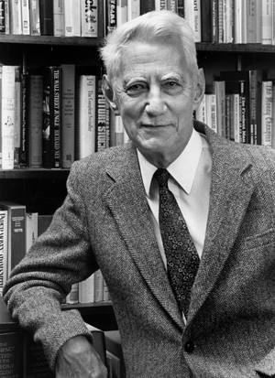
Entropy
Quantifies the amount of uncertainty associated with a specific probability distribution
The higher the entropy, the less confident we are in the outcome
Definition
Claude Shannon (1916 – 2001), most of the work was done in Bell labs
Slide credit: CMU MLD Ziv Bar-Joseph

Slide 32
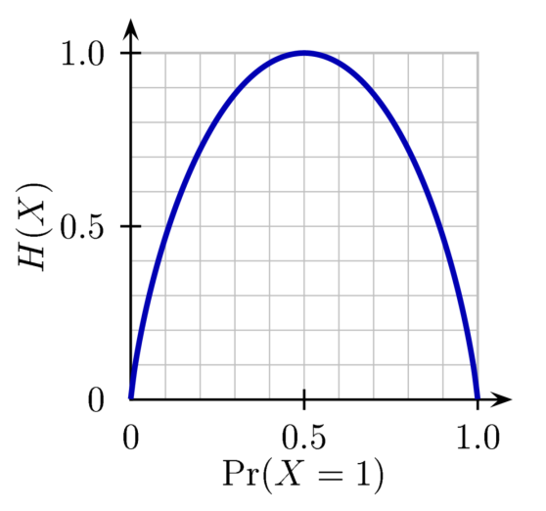
Entropy
H(X)
Definition
So, if P(X=1) = 1 then
If P(X=1) = .5 then
Slide credit: CMU MLD Ziv Bar-Joseph
Notes:
Is the entropy between 0 and 1?

Slide 33
Mutual Information
Slide credit: CMU MLD Matt Gormley
For a decision tree, we can use mutual information of the output class Y and some attribute X on which to split as a splitting criterion
Given a dataset D of training examples, we can estimate the required probabilities as…
Notes:
In the preamble: \usepackage[fleqn]{amsmath}
Entropy:
\begin{align*} H(Y) = - \sum_{y \in \Yc} P(Y=y) \log_2 P(Y=y) \end{align*}
Specific Conditional Entropy:
\begin{align*} H(Y \mid X=x) = - \sum_{y \in \Yc} P(Y=y \mid X=x) \log_2 P(Y=y \mid X=x) \end{align*}
Conditional Entropy:
\begin{align*} H(Y \mid X) = \sum_{x \in \Xc} P(X=x) H(Y \mid X=x) \end{align*}
Mutual Information:
\begin{align*} I(Y; X) = H(Y) - H(Y|X) = H(X) - H(X|Y) \end{align*}

Slide 34
Mutual Information
Entropy measures the expected # of bits to code one random draw from X.
For a decision tree, we want to reduce the entropy of the random variable we are trying to predict!
Slide credit: CMU MLD Matt Gormley
For a decision tree, we can use mutual information of the output class Y and some attribute X on which to split as a splitting criterion
Given a dataset D of training examples, we can estimate the required probabilities as…
Conditional entropy is the expected value of specific conditional entropy E_{P(X=x)}[H(Y | X = x)]
Informally, we say that mutual information is a measure of the following: If we know X, how much does this reduce our uncertainty about Y?
Notes:
In the preamble: \usepackage[fleqn]{amsmath}
Entropy:
\begin{align*} H(Y) = - \sum_{y \in \Yc} P(Y=y) \log_2 P(Y=y) \end{align*}
Specific Conditional Entropy:
\begin{align*} H(Y \mid X=x) = - \sum_{y \in \Yc} P(Y=y \mid X=x) \log_2 P(Y=y \mid X=x) \end{align*}
Conditional Entropy:
\begin{align*} H(Y \mid X) = \sum_{x \in \Xc} P(X=x) H(Y \mid X=x) \end{align*}
Mutual Information:
\begin{align*} I(Y; X) = H(Y) - H(Y|X) = H(X) - H(X|Y) \end{align*}

Slide 35
Decision Tree Learning Example
Dataset:
Output Y, Attributes A and B
Which attribute would mutual information select for the next split?
A
B
A or B (tie)
Neither
Y | A | B
- | 1 | 0
- | 1 | 0
+ | 1 | 0
+ | 1 | 0
+ | 1 | 1
+ | 1 | 1
+ | 1 | 1
+ | 1 | 1
Slide credit: CMU MLD Matt Gormley

Slide 36
Decision Tree Learning Example
Y | A | B
- | 1 | 0
- | 1 | 0
+ | 1 | 0
+ | 1 | 0
+ | 1 | 1
+ | 1 | 1
+ | 1 | 1
+ | 1 | 1
Slide credit: CMU MLD Matt Gormley

