Slide 1

Announcements
Assignments:
HW5
Due date Thu, 2/27, 11:59 pm
Midterm
See Piazza post for details
Added Friday OH and OH appointments
Feedback

Slide 2
Plan
Last time
Neural Networks
Universal Approximation
Optimization / Backpropagation
Today
Wrap-up Convolutional Neural Networks
Nearest Neighbor Classification

Slide 3
Introduction to Machine Learning
Nearest Neighbor
Instructor: Pat Virtue

Slide 4
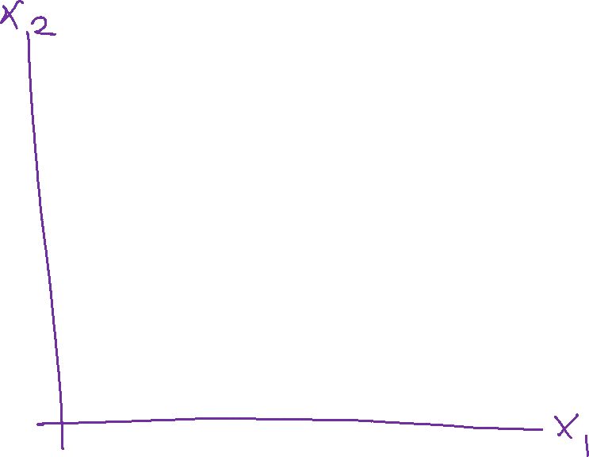
Nearest Neighbor Classifier
Test subject
Whales
Seals
Sharks

Slide 5
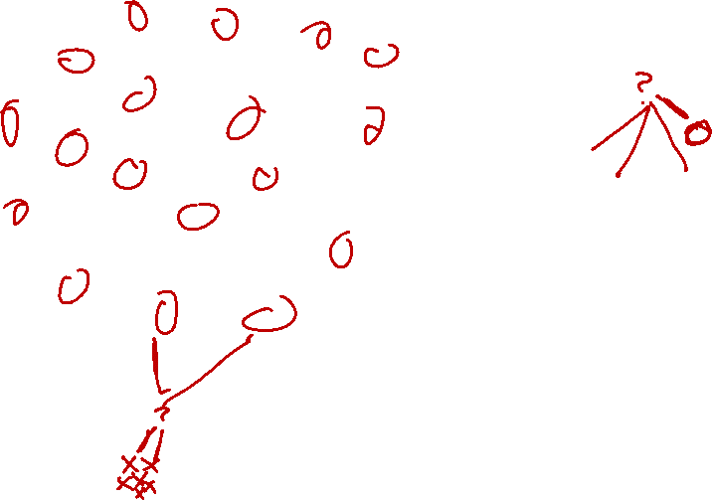
Nearest Neighbor Classifier
Test subject
Whales
Seals
Sharks

Slide 6
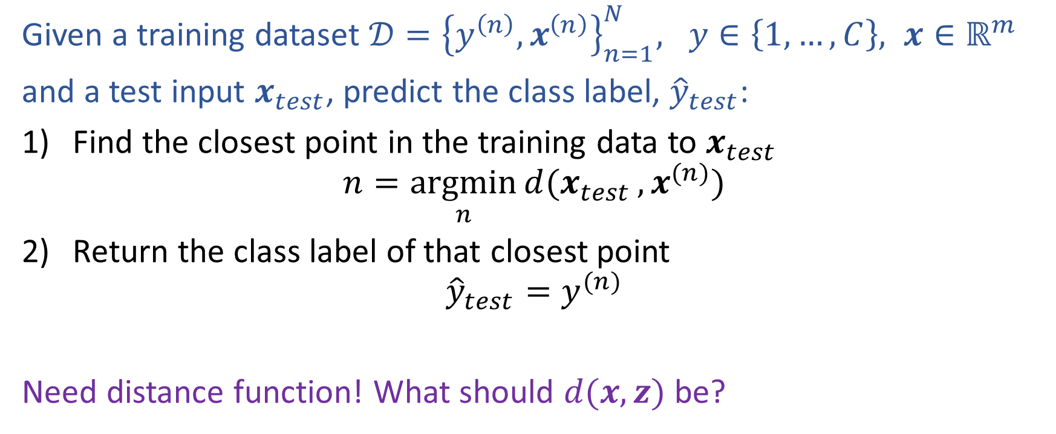
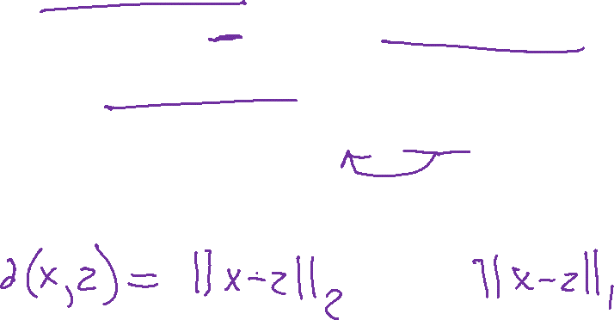
Nearest Neighbor Classification
Given a training dataset $𝒟={\left\{y^{\left(n\right)}, x^{\left(n\right)}\right\}}_{n=1}^{N}, y∈\left\{1,…,C\right\}, x∈ℝ^{m}$
and a test input $x_{test}$, predict the class label, ${\hat{y}}_{test}$:
Find the closest point in the training data to $x_{test}$
$$n=\underset{n}{argmin}{d(x_{test}}, x^{(n)})$$
Return the class label of that closest point
$${\hat{y}}_{test}=y^{(n)}$$
Need distance function! What should $d(x, z)$ be?

Slide 7
Fisher Iris Dataset
Fisher (1936) used 150 measurements of flowers from 3 different species: Iris setosa (0), Iris virginica (1), Iris versicolor (2) collected by Anderson (1936)
Species | Sepal Length | Sepal Width | Petal Length | Petal Width
0 | 4.3 | 3.0 | 1.1 | 0.1
0 | 4.9 | 3.6 | 1.4 | 0.1
0 | 5.3 | 3.7 | 1.5 | 0.2
1 | 4.9 | 2.4 | 3.3 | 1.0
1 | 5.7 | 2.8 | 4.1 | 1.3
1 | 6.3 | 3.3 | 4.7 | 1.6
1 | 6.7 | 3.0 | 5.0 | 1.7
Full dataset: https://en.wikipedia.org/wiki/Iris_flower_data_set

Slide 8
Fisher Iris Dataset
Fisher (1936) used 150 measurements of flowers from 3 different species: Iris setosa (0), Iris virginica (1), Iris versicolor (2) collected by Anderson (1936)
Species | Sepal Length | Sepal Width
0 | 4.3 | 3.0
0 | 4.9 | 3.6
0 | 5.3 | 3.7
1 | 4.9 | 2.4
1 | 5.7 | 2.8
1 | 6.3 | 3.3
1 | 6.7 | 3.0
Deleted two of the four features, so that input space is 2D
Full dataset: https://en.wikipedia.org/wiki/Iris_flower_data_set

Slide 9
Nearest Neighbor on Fisher Iris Data

Slide 10
Nearest Neighbor on Fisher Iris Data

Slide 11
Nearest Neighbor on Gaussian Data

Slide 12
Nearest Neighbor on Gaussian Data

Slide 13
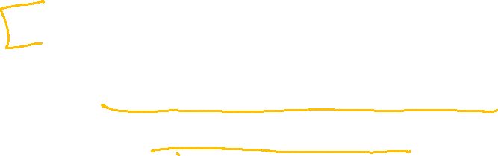
Parametric models
Assume some model (Gaussian, Bernoulli, Multinomial, logistic, network of logistic units, Linear, Quadratic) with fixed number of parameters
Linear/Logistic Regression, Naïve Bayes, Discriminant Analysis, Neural Networks
Estimate parameters (μ,σ²,θ,w,β) using MLE/MAP and plug in
Pro – need few data points to learn parameters
Con – Strong distributional assumptions, not satisfied in practice

Slide 14
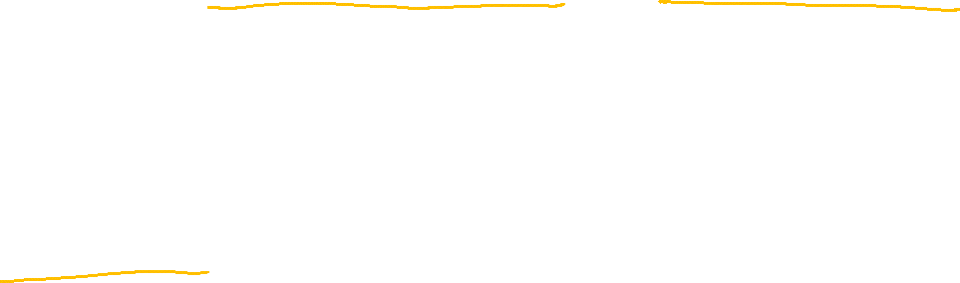
Nonparametric models
Nonparametric: number of parameters scales with number of training data
Typically don’t make any distributional assumptions
As we have more data, we should be able to learn more complex models
Some nonparametric methods
Nearest Neighbor (k-Nearest Neighbor) Classifier
Decision Trees

Slide 15
Parametric vs Nonparametric
Nonparametric models place very mild assumptions on the data distribution and provide good models for complex data
Parametric models rely on very strong (simplistic) distributional assumptions
Nonparametric models requires storing and computing with the entire data set.
Parametric models, once fitted, are much more efficient in terms of storage and computation

Slide 16
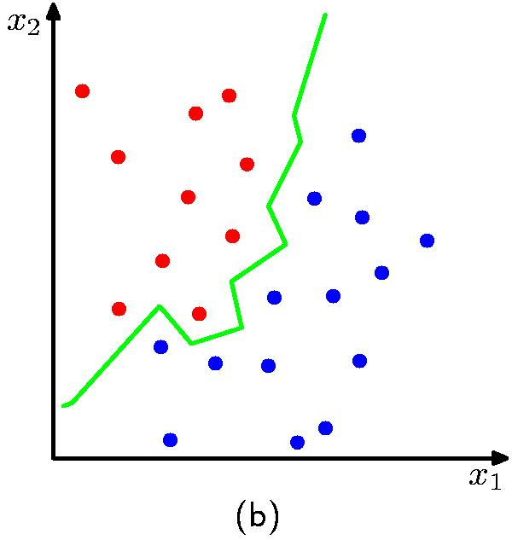
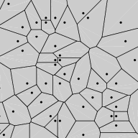
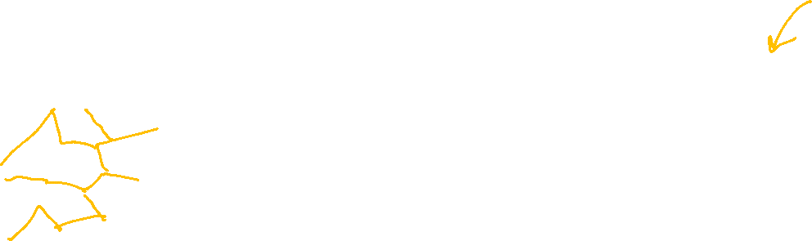
Nearest Neighbor Decision Boundary
Nearest neighbor classifier decision boundary
Voronoi Diagram
K = 1

Slide 17

k-NN classifier (k=5)
Test document
Whales
Seals
Sharks

Slide 18
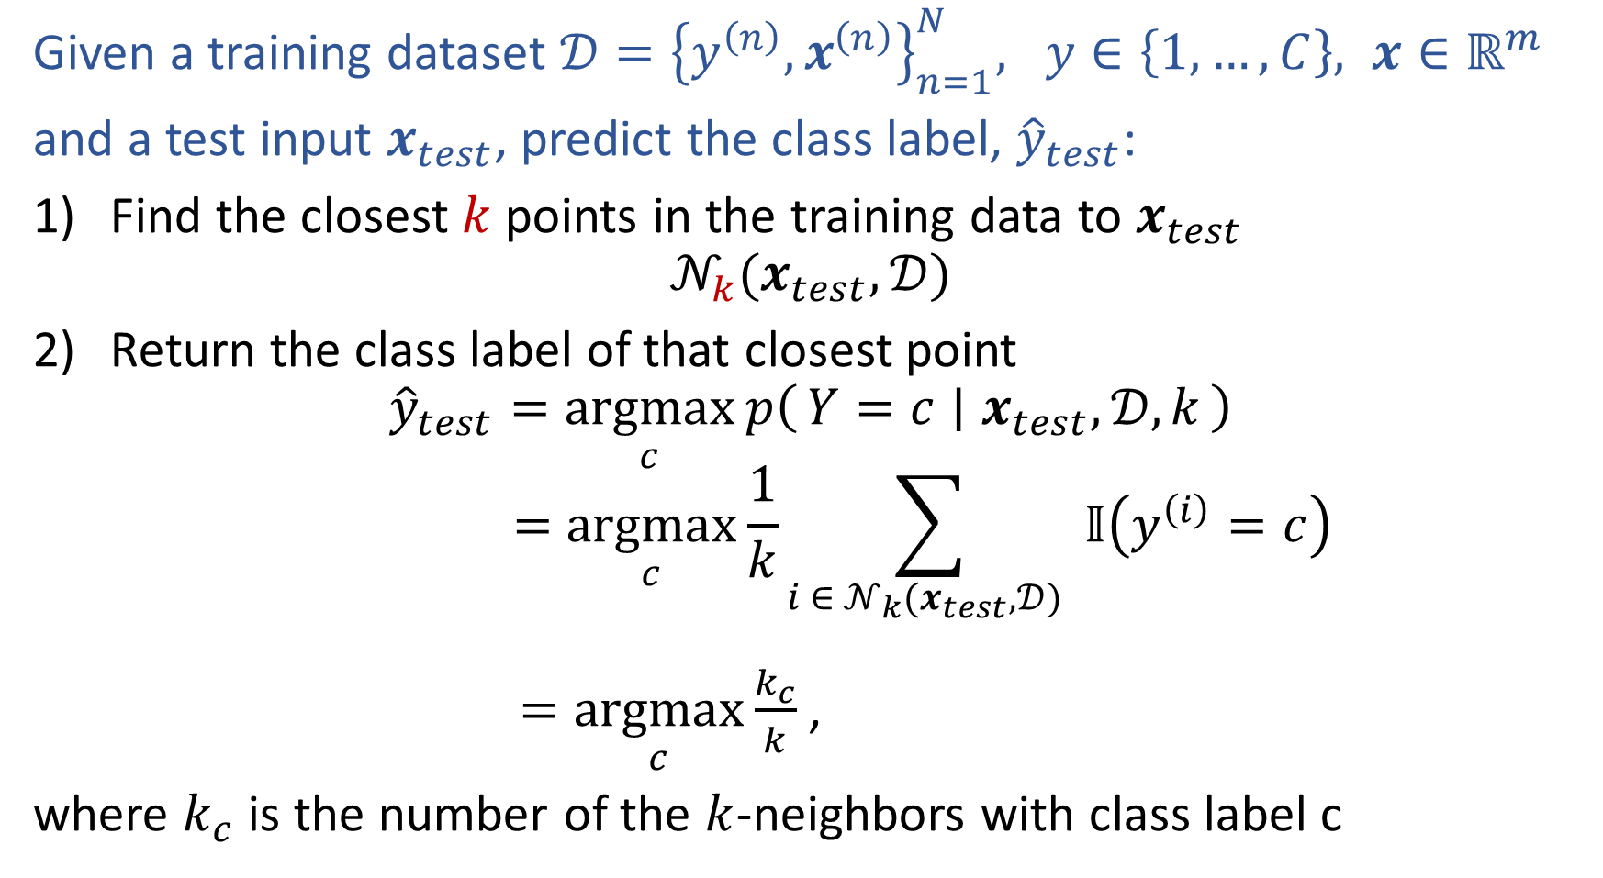
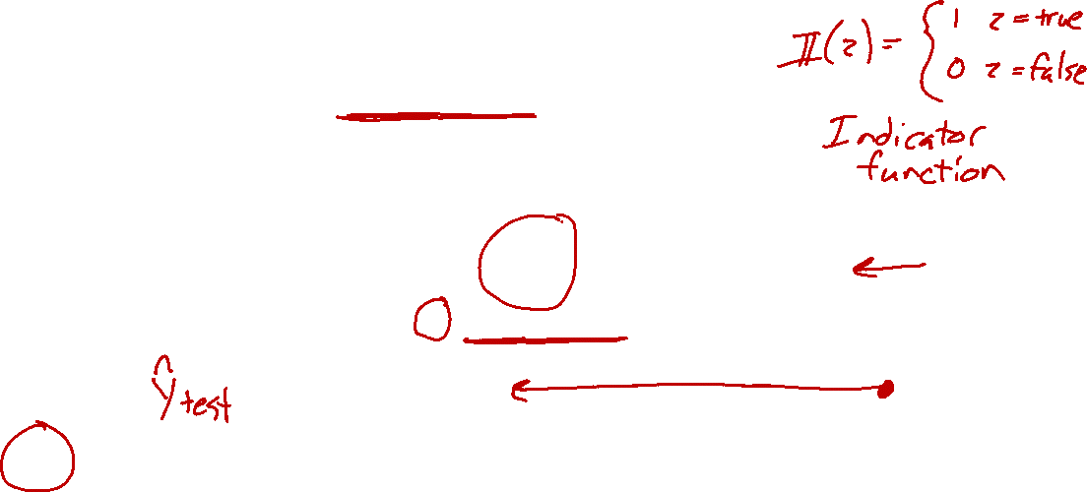
k-Nearest Neighbor Classification
Given a training dataset $𝒟={\left\{y^{\left(n\right)}, x^{\left(n\right)}\right\}}_{n=1}^{N}, y∈\left\{1,…,C\right\}, x∈ℝ^{m}$
and a test input $x_{test}$, predict the class label, ${\hat{y}}_{test}$:
Find the closest $k$ points in the training data to $x_{test}$
$$𝒩_{k}(x_{test},𝒟)$$
Return the class label of that closest point
$${\hat{y}}_{test}=\underset{c}{argmax}{p\left(Y=c ∣ x_{test},𝒟, k\right)}$$
$$=\underset{c}{argmax}{\frac{1}{k}\sum_{i ∈ 𝒩_{k}(x_{test},𝒟) }{𝕀\left(y^{\left(i\right)}=c\right)}}$$
$=\underset{c}{argmax}{\frac{k_{c}}{k}}$,
where $k_{c}$ is the number of the $k$-neighbors with class label c

Slide 19
1-Nearest Neighbor (kNN) classifier
Sports
Science
Arts

Slide 20
2-Nearest Neighbor (kNN) classifier
Sports
Science
Arts

Slide 21
3-Nearest Neighbor (kNN) classifier
Sports
Science
Arts

Slide 22
5-Nearest Neighbor (kNN) classifier
Sports
Science
Arts

Slide 23
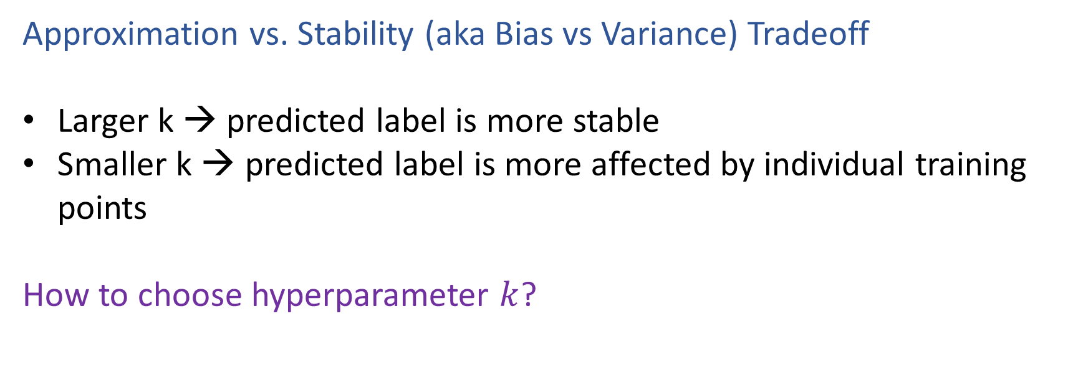

What is the best k?
Approximation vs. Stability (aka Bias vs Variance) Tradeoff
Larger k → predicted label is more stable
Smaller k → predicted label is more affected by individual training points
How to choose hyperparameter $k$?

Slide 24
k-NN on Fisher Iris Data
Special Case: Nearest Neighbor

Slide 25
k-NN on Fisher Iris Data

Slide 26
k-NN on Fisher Iris Data

Slide 27
k-NN on Fisher Iris Data

Slide 28
k-NN on Fisher Iris Data

Slide 29
k-NN on Fisher Iris Data

Slide 30
k-NN on Fisher Iris Data
Special Case: Majority Vote

Slide 31
Nearest Neighbor
Assumptions!
Similar points have similar neighbors
All feature dimensions are created equally!
Example: two features for kNN
big problem: feature scale could dramatically influence classification results
length (cm)
length (cm)
width (cm)
width (m)

Slide 32
Nearest Neighbor and Deep Learning
Use neural networks to learn to transform input data into a feature space where distance is more meaningful
Example: Face recognition

