Slide 1
Announcements
Assignments:
HW4
    Due tonight!
HW5
    Due date Thu, 2/27, 11:59 pm
Midterm
See Piazza post for details
Canvas updated
Participation points

Slide 2
Plan
Last time
Neural Networks
    Universal Approximation
    Optimization / Backpropagation
Today
Wrap-up Optimization / Backpropagation
Course Survey
Convolutional Neural Networks

Slide 3
Introduction to
Machine Learning
Neural Networks
Instructor: Pat Virtue

Slide 4

Reminder: Calculus Chain Rule (scalar version)
$$y=f\left(z\right)$$
$$z=g\left(x\right)$$
$$\frac{dy}{dx}=\frac{dy}{dz}\frac{dz}{dx}$$

Slide 5
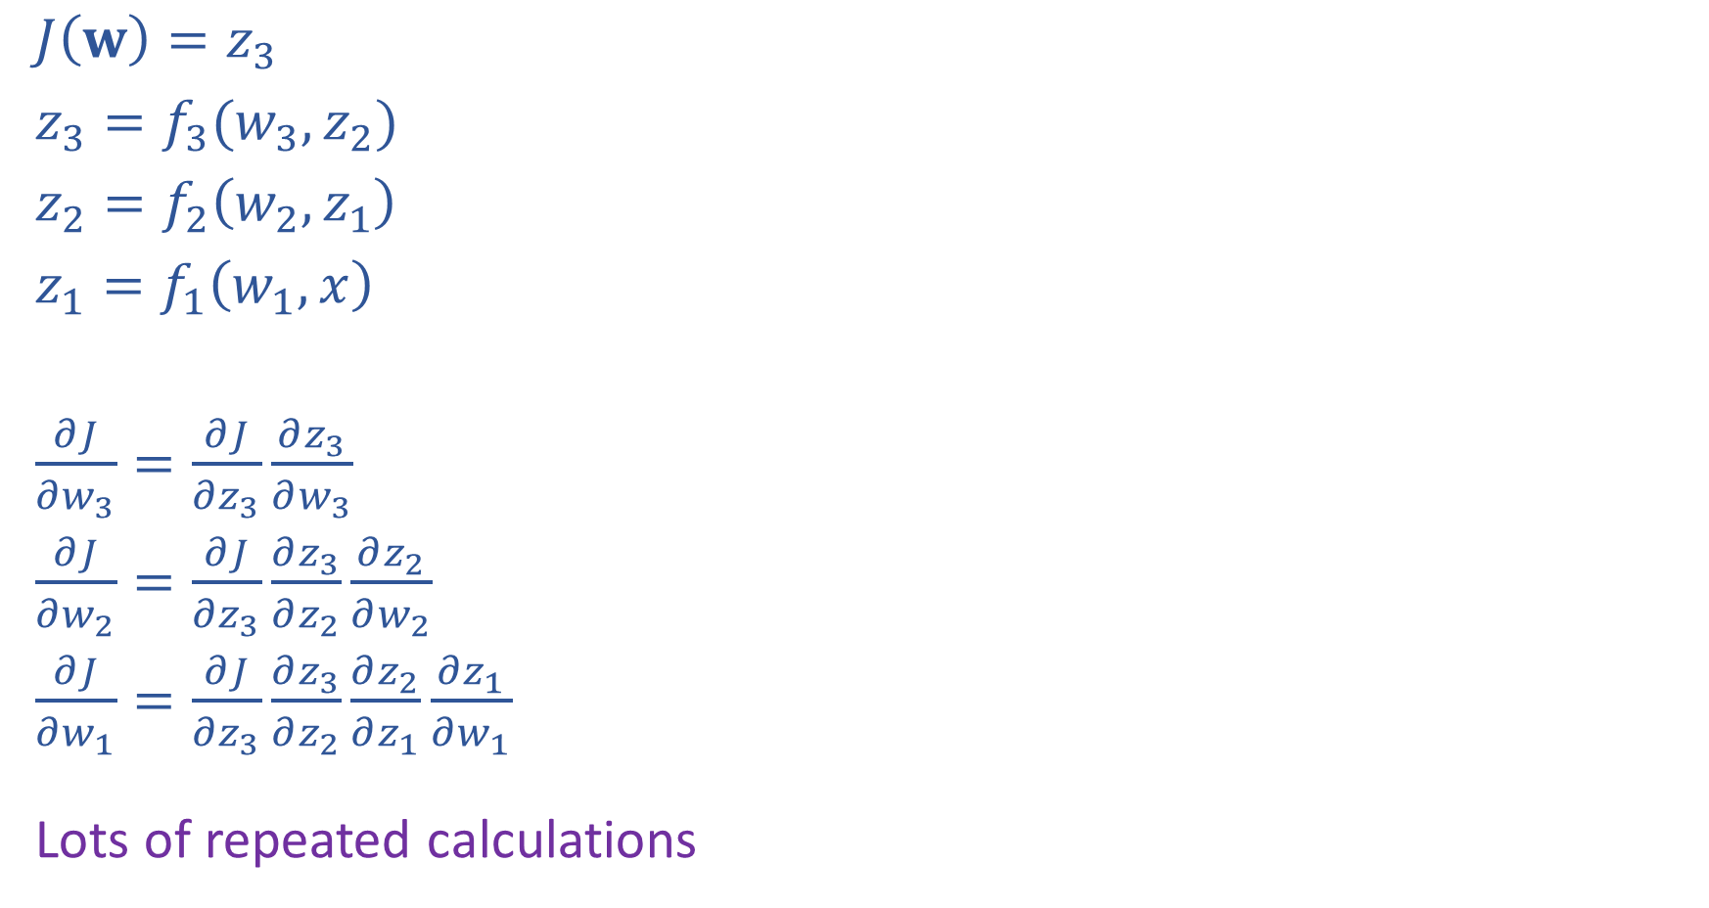
Network Optimization
$J\left(w\right)=z_{3}$
$z_{3}=f_{3}(w_{3}, z_{2})$
$z_{2}=f_{2}\left(w_{2}, z_{1}\right)$
$z_{1}=f_{1}\left(w_{1}, x\right)$
$\frac{∂J}{∂w_{3}}=\frac{∂J}{∂z_{3}}\frac{∂z_{3}}{∂w_{3}}$
$\frac{∂J}{∂w_{2}}=\frac{∂J}{∂z_{3}}\frac{∂z_{3}}{∂z_{2}}\frac{∂z_{2}}{∂w_{2}}$
$\frac{∂J}{∂w_{1}}=\frac{∂J}{∂z_{3}}\frac{∂z_{3}}{∂z_{2}}\frac{∂z_{2}}{∂z_{1}}\frac{∂z_{1}}{∂w_{1}}$
Lots of repeated calculations

Slide 6
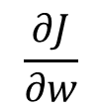
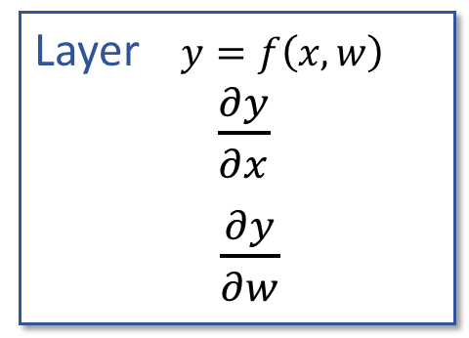

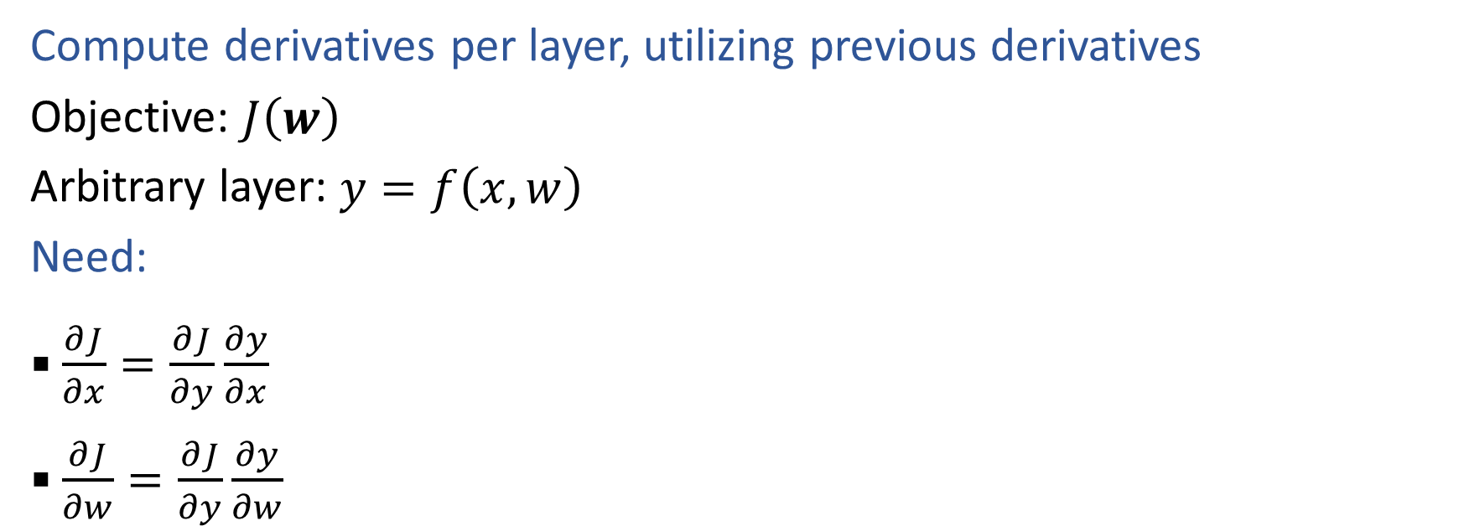




Backpropagation (so-far)
Compute derivatives per layer, utilizing previous derivatives
Objective: $J\left(w\right)$
Arbitrary layer: $y=f\left(x, w\right)$
Need:
  $\frac{∂J}{∂x}=\frac{∂J}{∂y}\frac{∂y}{∂x}$
  $\frac{∂J}{∂w}=\frac{∂J}{∂y}\frac{∂y}{∂w}$
$$x$$
Layer $y=f\left(x, w\right)$
$\frac{∂y}{∂x}$
$\frac{∂y}{∂w}$
$$y$$
$$\frac{∂J}{∂x}$$
$$\frac{∂J}{∂y}$$
$$w$$
$$\frac{∂J}{∂w}$$

Slide 7
Reminder: Matrix Calculus
Gradient, Jacobian, etc

Slide 8
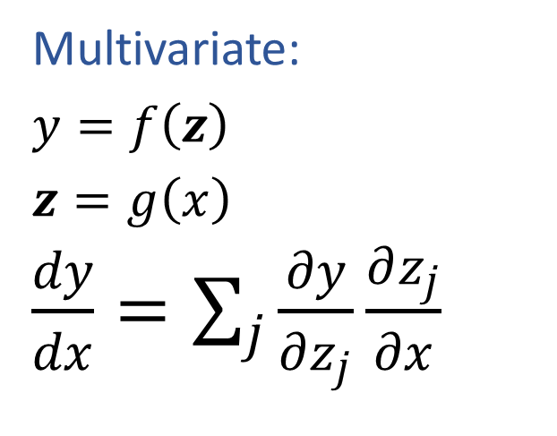
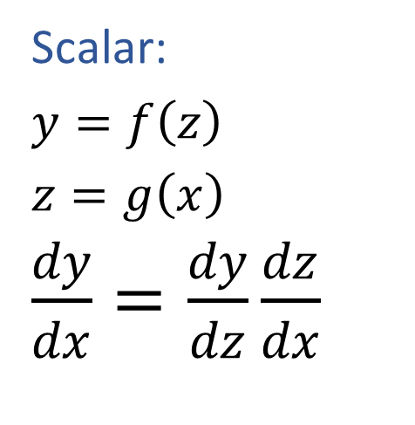
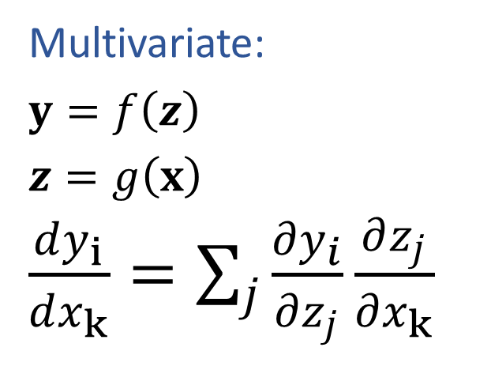
Calculus Chain Rule
Scalar:
$y=f\left(z\right)$
$z=g\left(x\right)$
$\frac{dy}{dx}=\frac{dy}{dz}\frac{dz}{dx}$
Multivariate:
$y=f\left(z\right)$
$z=g\left(x\right)$
$\frac{dy}{dx}=\sum_{j}{\frac{∂y}{∂z_{j}}\frac{∂z_{j}}{∂x}}$
Multivariate:
$y=f\left(z\right)$
$z=g\left(x\right)$
$\frac{dy_{i}}{dx_{k}}=\sum_{j}{\frac{∂y_{i}}{∂z_{j}}\frac{∂z_{j}}{∂x_{k}}}$

Slide 9
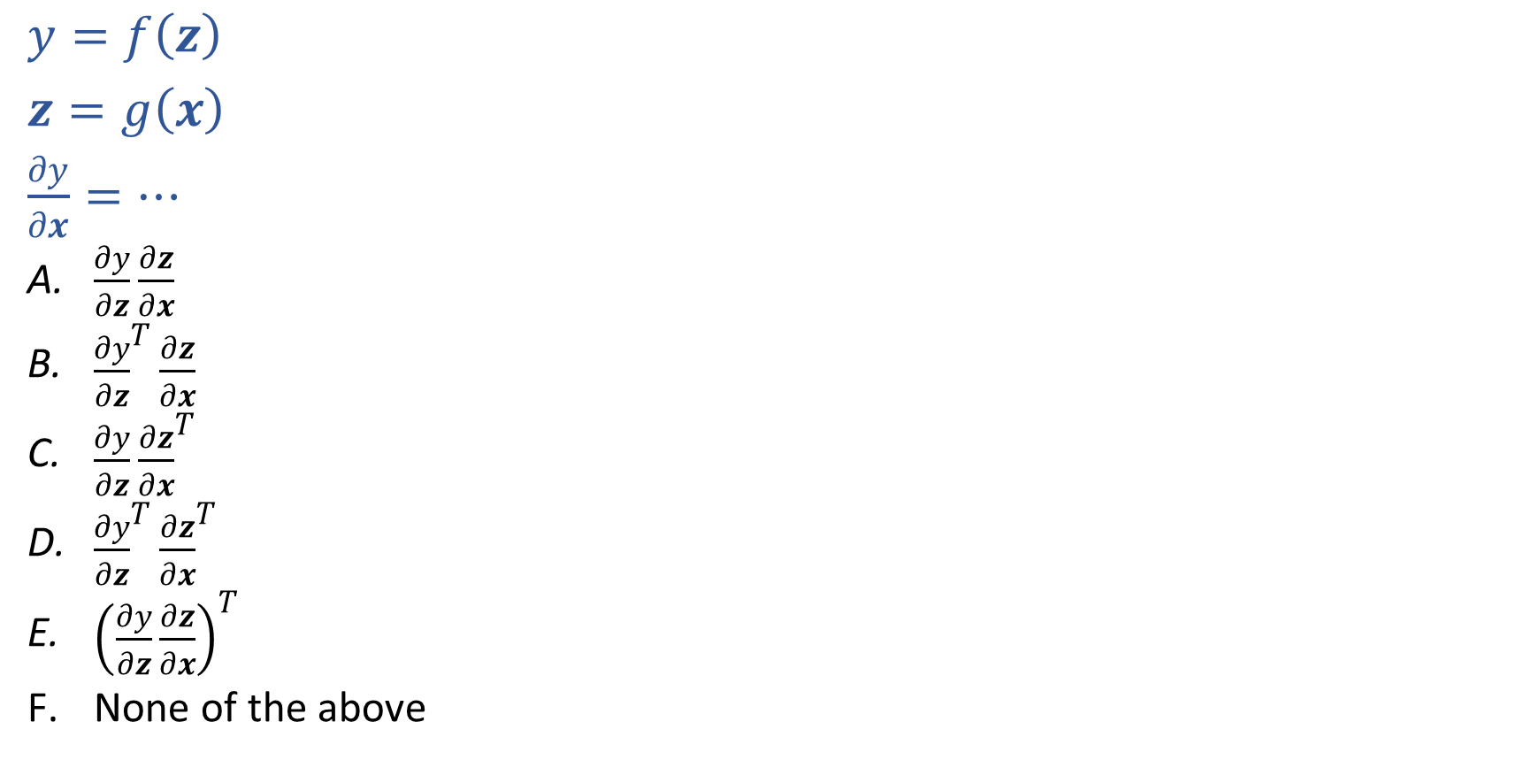
Piazza Poll 1:
$y=f\left(z\right)$
$z=g\left(x\right)$
$\frac{∂y}{∂x}=…$
  $\frac{∂y}{∂z}\frac{∂z}{∂x}$
  ${\frac{∂y}{∂z}}^{T}\frac{∂z}{∂x}$
  $\frac{∂y}{∂z}{\frac{∂z}{∂x}}^{T}$
  ${\frac{∂y}{∂z}}^{T}{\frac{∂z}{∂x}}^{T}$
  ${\left(\frac{∂y}{∂z}\frac{∂z}{∂x}\right)}^{T}$
  None of the above

Slide 10
Piazza Poll 1:
$y=f\left(z\right)$
$z=g\left(x\right)$
$\frac{∂y}{∂x}=…$
  $\frac{∂y}{∂z}\frac{∂z}{∂x}$
  ${\frac{∂y}{∂z}}^{T}\frac{∂z}{∂x}$
  $\frac{∂y}{∂z}{\frac{∂z}{∂x}}^{T}$
  ${\frac{∂y}{∂z}}^{T}{\frac{∂z}{∂x}}^{T}$
  ${\left(\frac{∂y}{∂z}\frac{∂z}{∂x}\right)}^{T}$
  None of the above

Slide 11

Network Optimization
$J\left(w\right)=z_{4}$
${z_{4}=f}_{4}\left(w_{D}, w_{E}, z_{2},z_{3}\right)$
$z_{3}=f_{3}\left(w_{C}, z_{1}\right)$
$z_{2}=f_{2}\left(w_{B}, z_{1}\right)$
$z_{1}=f_{1}\left(w_{A}, x\right)$
Need multivariate chain rule!

Slide 12










Network Optimization
$$\frac{∂J}{∂w_{E}}=\frac{∂J}{∂z_{4}}\frac{∂z_{4}}{∂w_{E}}$$
$$\frac{∂J}{∂w_{D}}=\frac{∂J}{∂z_{4}}\frac{∂z_{4}}{∂w_{D}}$$
$$\frac{∂J}{∂z_{3}}=\frac{∂J}{∂z_{4}}\frac{∂z_{4}}{∂z_{3}}$$
$$\frac{∂J}{∂z_{2}}=\frac{∂J}{∂z_{4}}\frac{∂z_{4}}{∂z_{2}}$$
$$\frac{∂J}{∂w_{C}}=\frac{∂J}{∂z_{3}}\frac{∂z_{3}}{∂w_{C}}$$
$$\frac{∂J}{∂w_{B}}=\frac{∂J}{∂z_{2}}\frac{∂z_{2}}{∂w_{B}}$$
$$\frac{∂J}{∂z_{1}}=\frac{∂J}{∂z_{2}}\frac{∂z_{2}}{∂z_{1}}+ \frac{∂J}{∂z_{3}}\frac{∂z_{3}}{∂z_{1}}$$
$$\frac{∂J}{∂w_{A}}=\frac{∂J}{∂z_{1}}\frac{∂z_{1}}{∂w_{A}}$$
$J\left(w\right)=z_{4}$
${z_{4}=f}_{4}\left(w_{D}, w_{E}, z_{2},z_{3}\right)$
$z_{3}=f_{3}\left(w_{C}, z_{1}\right)$
$z_{2}=f_{2}\left(w_{B}, z_{1}\right)$
$z_{1}=f_{1}\left(w_{A}, x\right)$
Need multivariate chain rule!
$$z_{2}$$
$$f_{2}$$
$$z_{1}$$
$$z_{4}$$
$$x$$
$$f_{1}$$
$$f_{4}$$
$$z_{3}$$
$$f_{3}$$

Slide 13
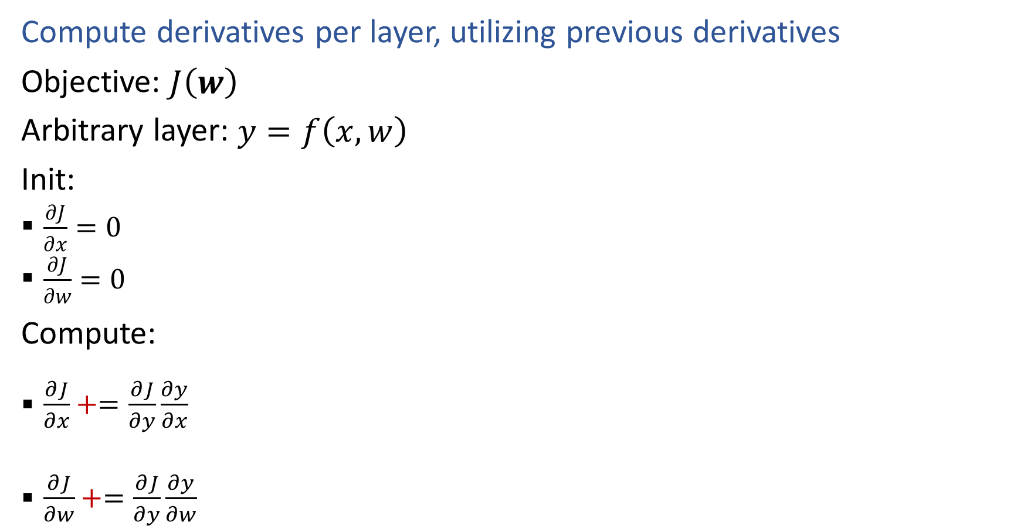
Backpropagation (updated)
Compute derivatives per layer, utilizing previous derivatives
Objective: $J\left(w\right)$
Arbitrary layer: $y=f\left(x, w\right)$
Init:
  $\frac{∂J}{∂x}=0$
  $\frac{∂J}{∂w}=0$
Compute:
  $\frac{∂J}{∂x}+=\frac{∂J}{∂y}\frac{∂y}{∂x}$
  $\frac{∂J}{∂w}+=\frac{∂J}{∂y}\frac{∂y}{∂w}$
$$x$$
Layer $y=f\left(x, w\right)$
$\frac{∂y}{∂x}$
$\frac{∂y}{∂w}$
$$y$$
$$\frac{∂J}{∂x}$$
$$\frac{∂J}{∂y}$$
$$w$$
$$\frac{∂J}{∂w}$$

Slide 14
Course Survey

Slide 15
Introduction to
Machine Learning
Convolutional Neural Networks
Instructor: Pat Virtue

Slide 16
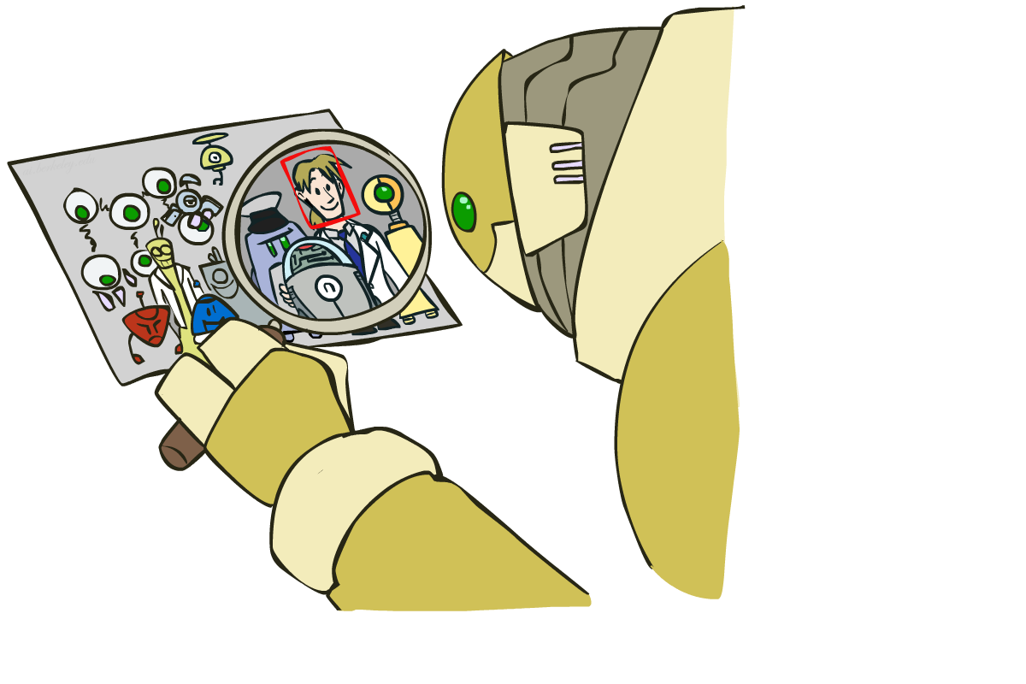
Computer Vision: How far along are we?

Slide 17
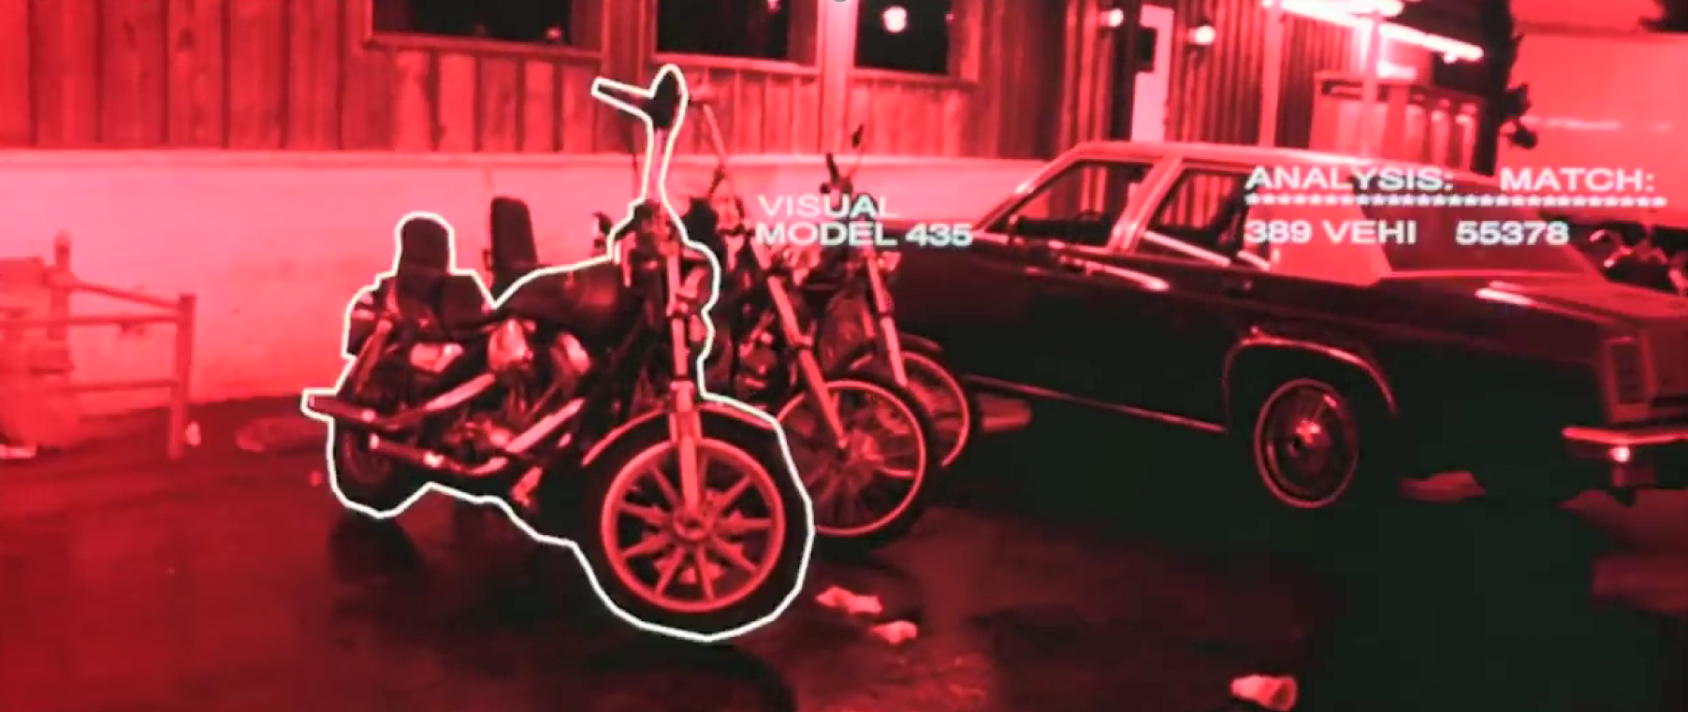
Computer Vision: How far along are we?
Terminator 2, 1991

Slide 18
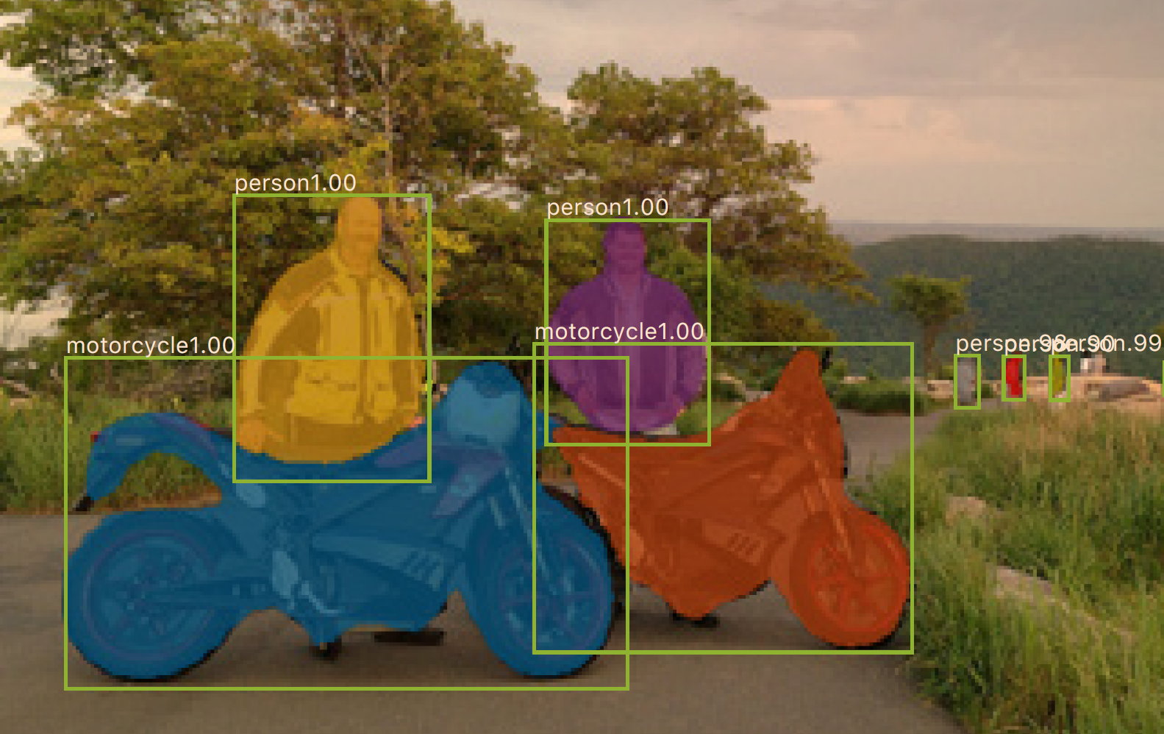
Computer Vision: How far along are we?
0.2 seconds per image
Mask R-CNN
He, Kaiming, et al. "Mask R-CNN." Computer Vision (ICCV), 2017 IEEE International Conference on. IEEE, 2017.

Slide 19
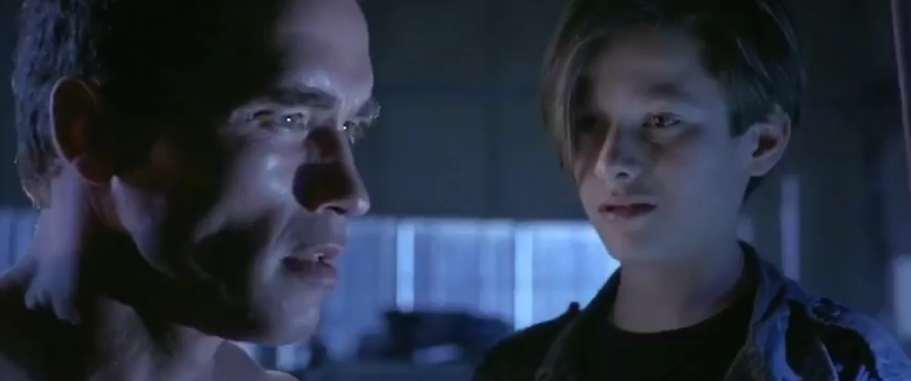
Computer Vision: How far along are we?
“My CPU is a neural net processor, a learning computer”
Terminator 2, 1991

Slide 20
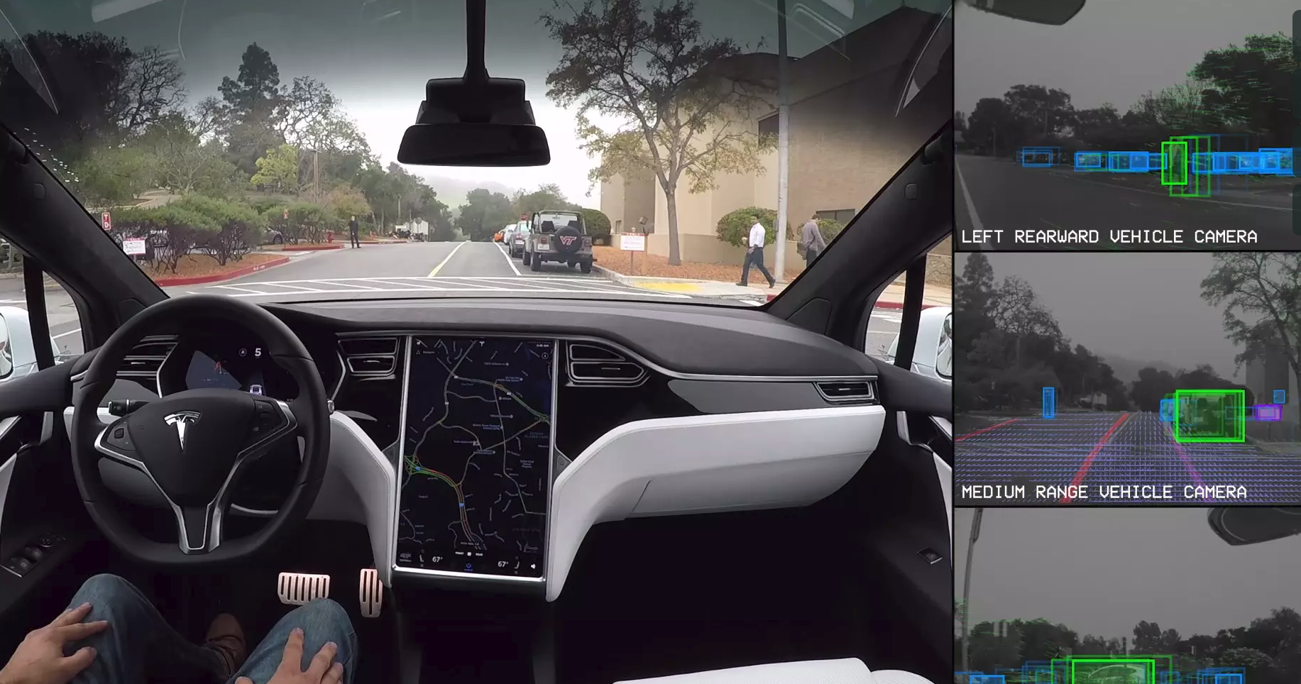
Computer Vision: Autonomous Driving
Tesla, Inc: https://vimeo.com/192179726

Slide 21
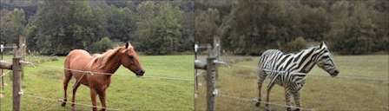
Computer Vision: Domain Transfer
CycleGAN
Jun-Yan Zhu*, Taesung Park*, Phillip Isola, and Alexei A. Efros. "Unpaired Image-to-Image Translation using Cycle-Consistent Adversarial Networks", ICCV 2017.

Slide 22
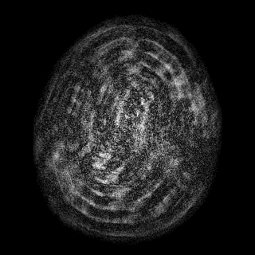
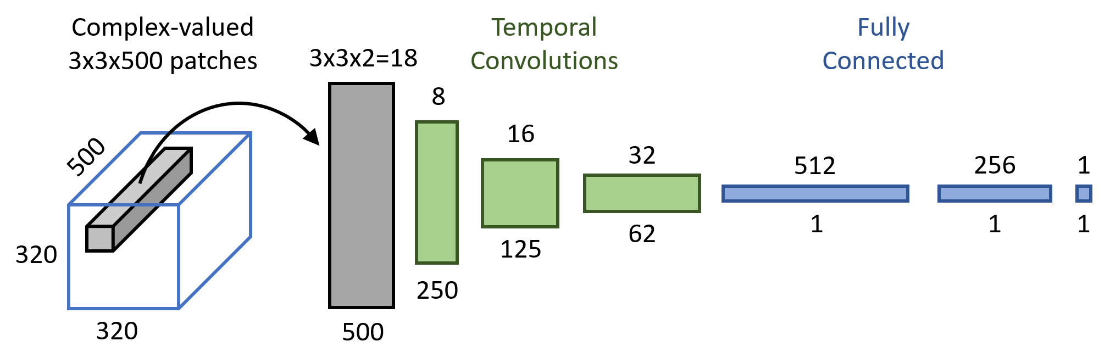
Temporal Convolution
MR Fingerprinting
Patrick Virtue , Jonathan I Tamir , Mariya Doneva , Stella X Yu , and Michael Lustig. "Learning Contrast Synthesis from MR Fingerprinting", ISMRM 2018.

Slide 23
Outline
Measuring the current state of computer vision
Why convolutional neural networks
      Old school computer vision
      Image features and classification
Convolution “nuts and bolts”

Slide 24
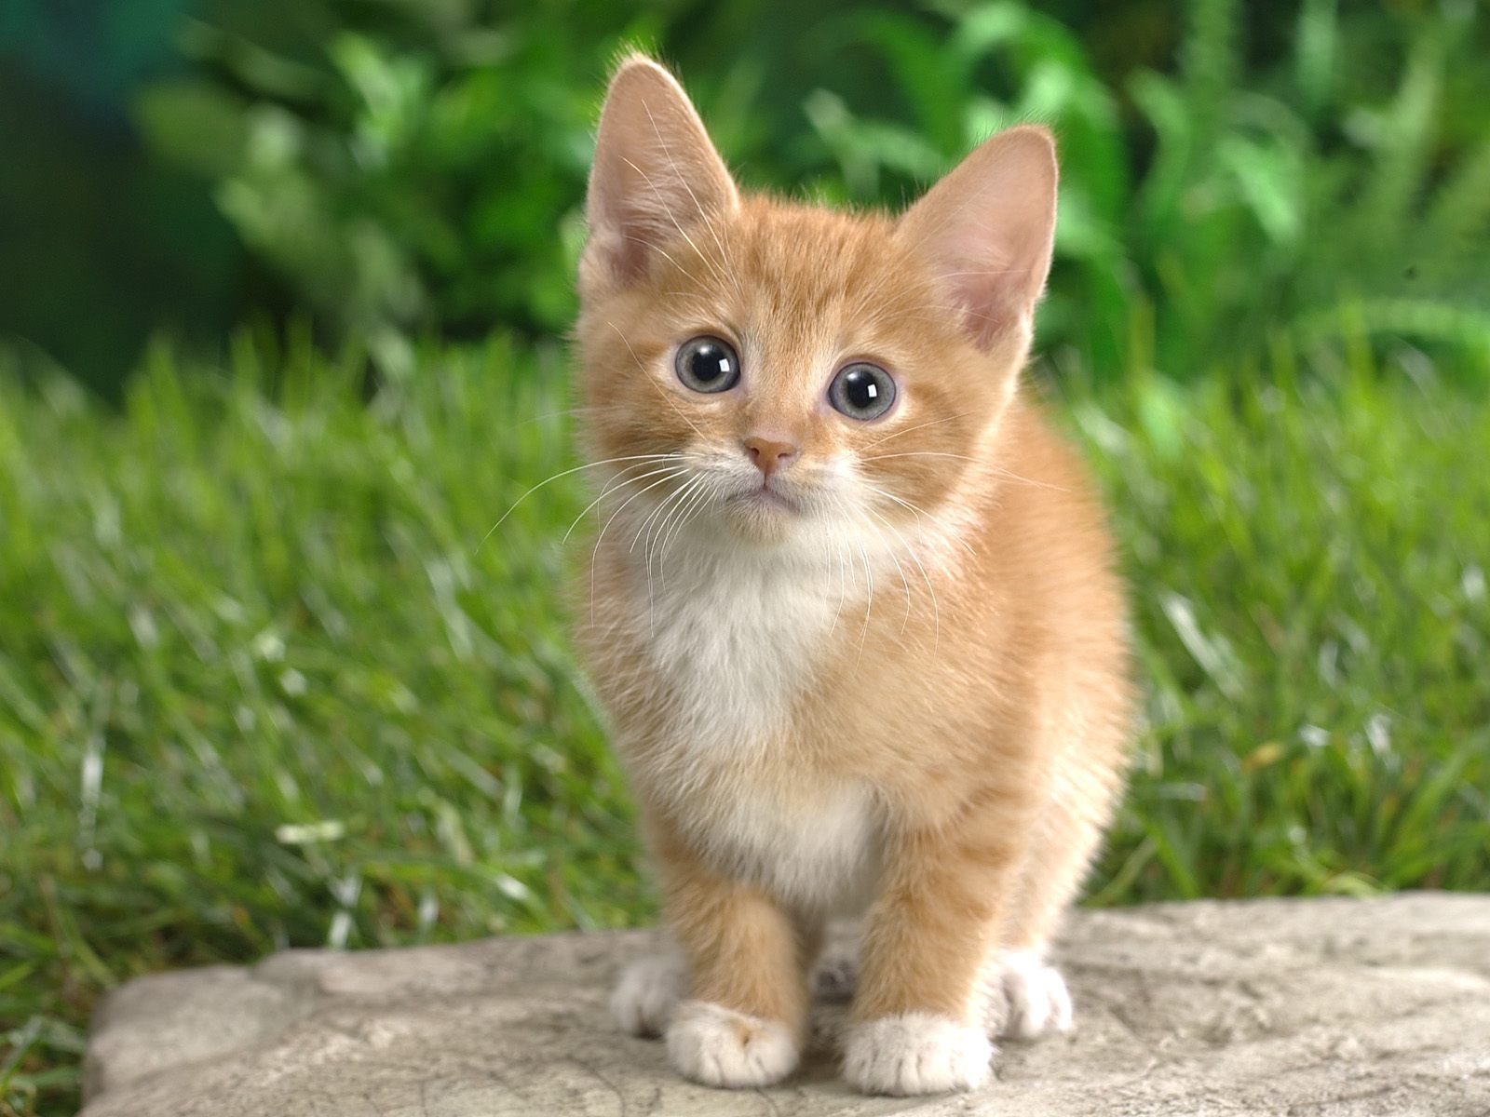
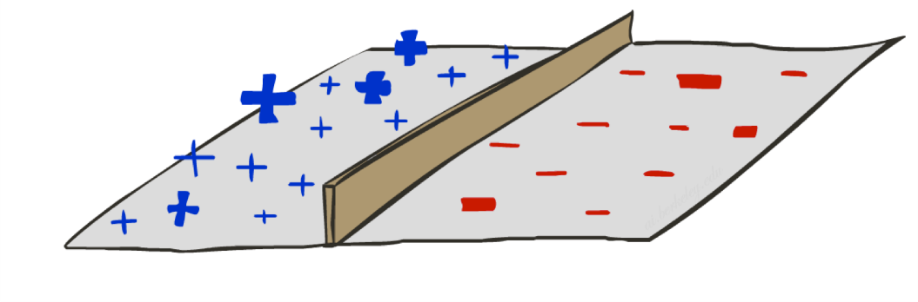
Image Classification
What’s the problem with just directly classifying raw pixels in high dimensional space?
Not CAT
CAT
CAT

Slide 25
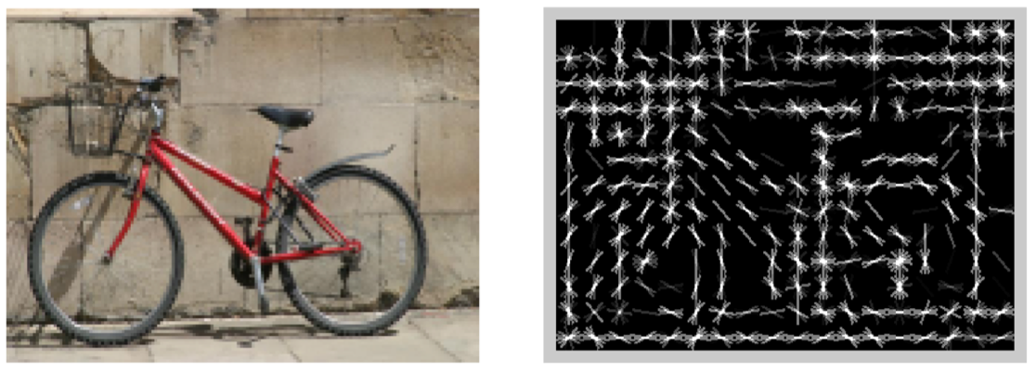
Image Classification
[Dalal and Triggs, 2005]

Slide 26
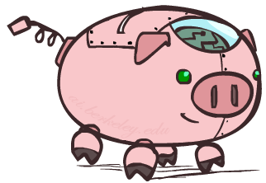
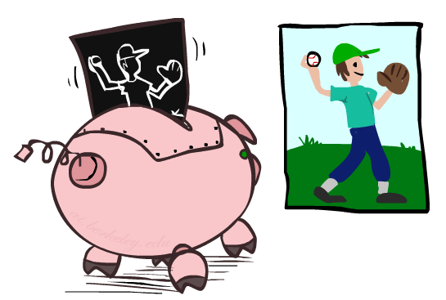

HoG Filter
HoG: Histogram of oriented gradients
[Dalal and Triggs, 2005]

Slide 27
Image Classification
HOG features passed to a linear classifier (SVM)
Not CAT
CAT
CAT

Slide 28
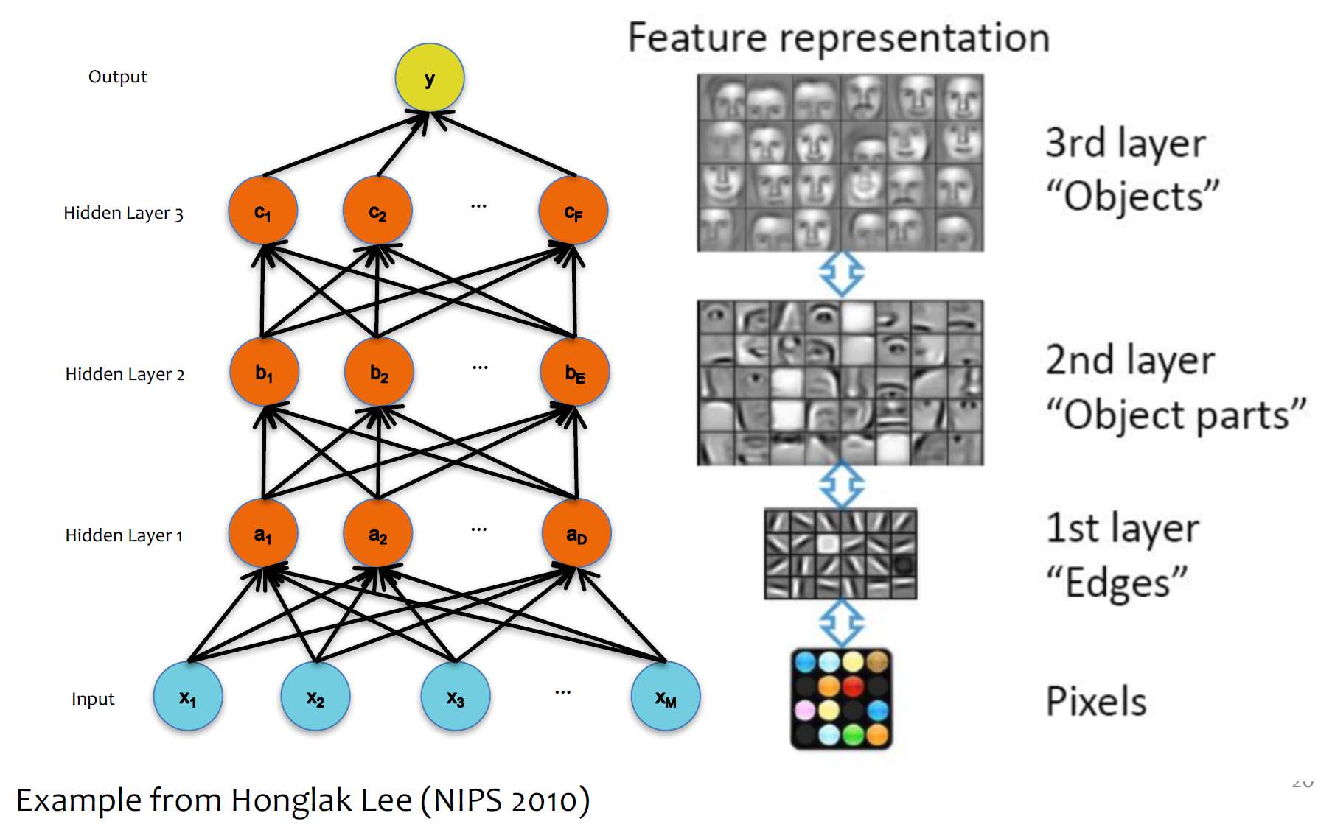
Classification: Learning Features

Slide 29
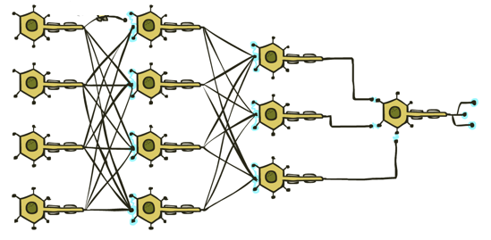
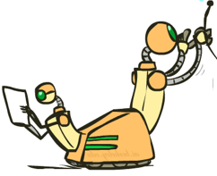
Classification: Deep Learning
Fully connected neural network?
CAT

Slide 30
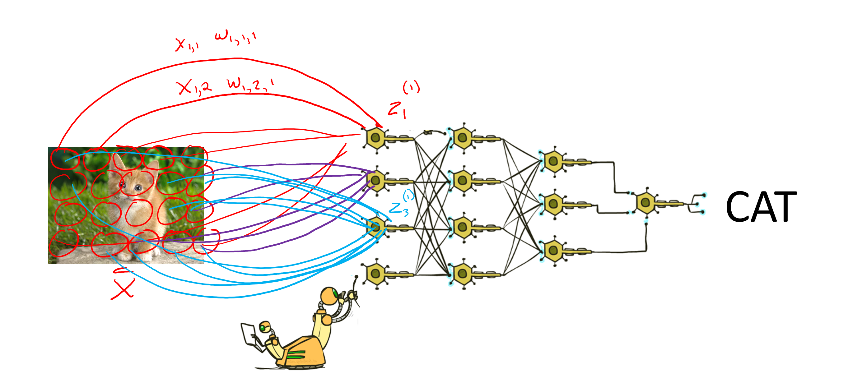
Classification: Deep Learning
CAT
Lost spatial content after first layer
Not spatially invariant
Too many weights to learn

Slide 31

Convolution
Signal processing definition
$$z\left[i,j\right]= \sum_{u=−∞}^{∞}{\sum_{v=−∞}^{∞}{x\left[i−u, j−v\right]⋅w[u},v]}$$
Relaxed definition
  Drop infinity; don’t flip kernel
$$z\left[i,j\right]= \sum_{u=0}^{K−1}{\sum_{v=0}^{K−1}{x\left[i+u, j+v\right]⋅w[u},v]}$$
-1 | 0 | 1
-2 | 0 | 2
-1 | 0 | 1

Slide 32
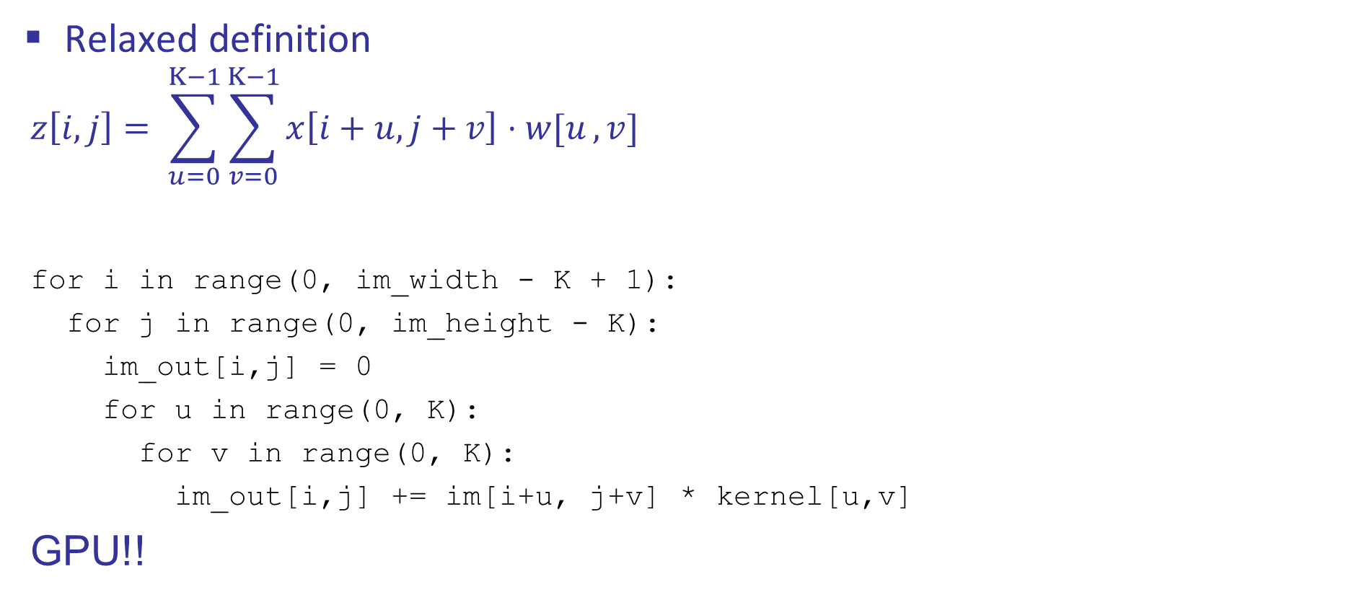
Convolution
Relaxed definition
$$z\left[i,j\right]= \sum_{u=0}^{K−1}{\sum_{v=0}^{K−1}{x\left[i+u, j+v\right]⋅w[u},v]}$$
for i in range(0, im_width - K + 1):
for j in range(0, im_height - K):
im_out[i,j] = 0
for u in range(0, K):
for v in range(0, K):
im_out[i,j] += im[i+u, j+v] * kernel[u,v]
GPU!!
-1 | 0 | 1
-2 | 0 | 2
-1 | 0 | 1

Slide 33
Convolution
-1 | 0 | 1
-1 | 0 | 1
-1 | 0 | 1

Slide 34
Convolution
0 | 0 | 0 | 1 | 1 | 1 | 1 | 0 | 0 | 0
0 | 0 | 0 | 1 | 1 | 1 | 1 | 0 | 0 | 0
0 | 0 | 0 | 1 | 1 | 1 | 1 | 0 | 0 | 0
0 | 0 | 0 | 1 | 1 | 1 | 1 | 0 | 0 | 0
0 | 0 | 0 | 1 | 1 | 1 | 1 | 0 | 0 | 0
0 | 0 | 0 | 1 | 1 | 1 | 1 | 0 | 0 | 0
0 | 0 | 0 | 1 | 1 | 1 | 1 | 0 | 0 | 0
0 | 0 | 0 | 1 | 1 | 1 | 1 | 0 | 0 | 0
0 | 0 | 0 | 1 | 1 | 1 | 1 | 0 | 0 | 0
0 | 0 | 0 | 1 | 1 | 1 | 1 | 0 | 0 | 0
-1 | 0 | 1
-1 | 0 | 1
-1 | 0 | 1

Slide 35
Convolution
-1 | 0 | 1
-1 | 0 | 1
-1 | 0 | 1

Slide 36
Convolution: Padding
0 | 0 | 1 | 1 | 1 | 1 | 0 | 0
0 | 0 | 1 | 1 | 1 | 1 | 0 | 0
0 | 0 | 1 | 1 | 1 | 1 | 0 | 0
0 | 0 | 1 | 1 | 1 | 1 | 0 | 0
0 | 0 | 1 | 1 | 1 | 1 | 0 | 0
0 | 0 | 1 | 1 | 1 | 1 | 0 | 0
0 | 0 | 1 | 1 | 1 | 1 | 0 | 0
0 | 0 | 1 | 1 | 1 | 1 | 0 | 0
0 | 2 | 2 | 0 | 0 | -2 | -2 | 0
0 |  |  |  |  |  |  | 0
0 |  |  |  |  |  |  | 0
0 |  |  |  |  |  |  | 0
0 |  |  |  |  |  |  | 0
0 |  |  |  |  |  |  | 0
0 |  |  |  |  |  |  | 0
0 | 2 | 2 | 0 | 0 | -2 | -2 | 0
3 | 3 | 0 | 0 | -3 | -3
3 | 3 | 0 | 0 | -3 | -3
3 | 3 | 0 | 0 | -3 | -3
3 | 3 | 0 | 0 | -3 | -3
3 | 3 | 0 | 0 | -3 | -3
3 | 3 | 0 | 0 | -3 | -3

Slide 37
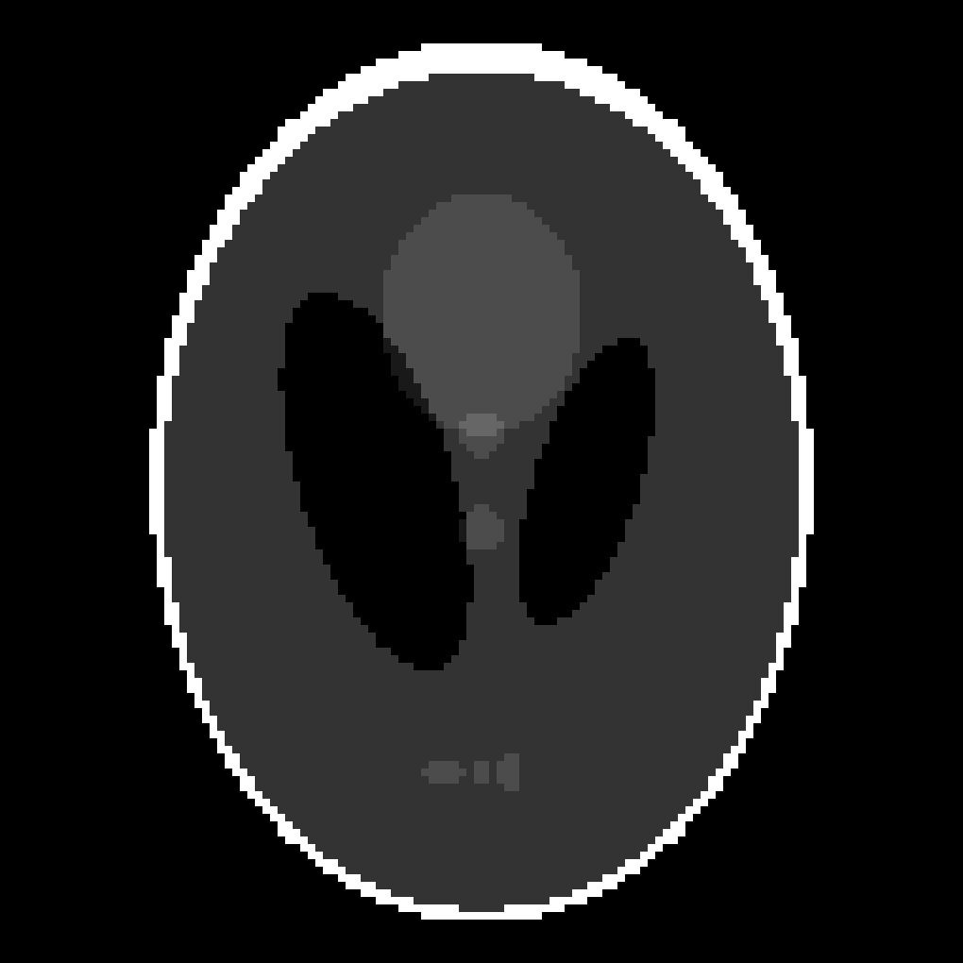
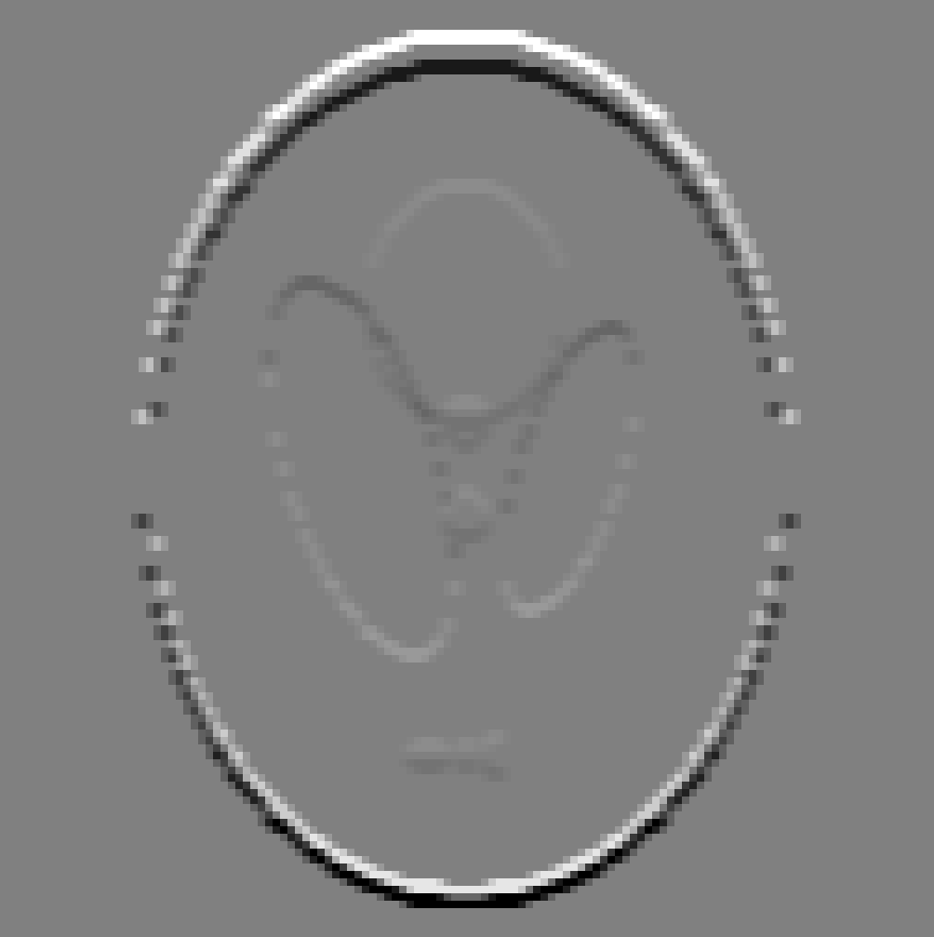

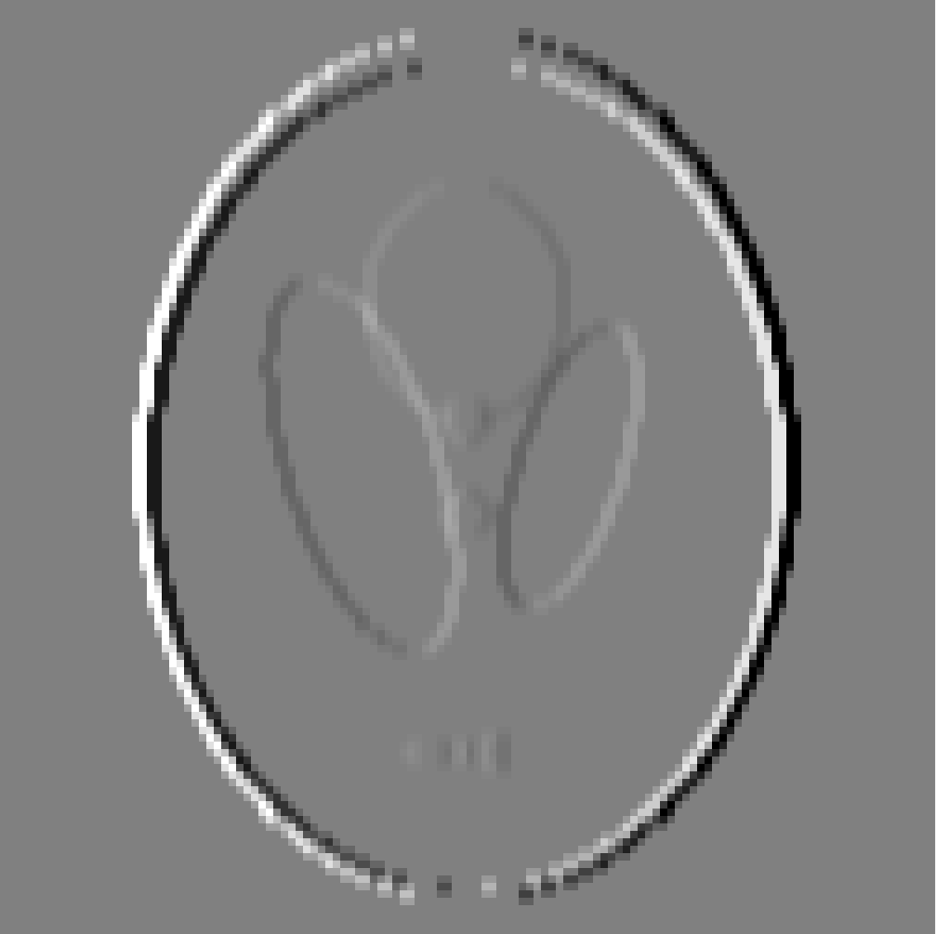
Piazza Poll 2 : Which kernel goes with which output image?
Input
K1
K2
K3
-1 | 0 | 1
-2 | 0 | 2
-1 | 0 | 1
-1 | -2 | -1
0 | 0 | 0
1 | 2 | 1
0 | 0 | -1 | 0
0 | -2 | 0 | 1
-1 | 0 | 2 | 0
0 | 1 | 0 | 0
Im1
Im2
Im3

Slide 38
Piazza Poll 2 : Which kernel goes with which output image?
Input
K1
K2
K3
-1 | 0 | 1
-2 | 0 | 2
-1 | 0 | 1
-1 | -2 | -1
0 | 0 | 0
1 | 2 | 1
0 | 0 | -1 | 0
0 | -2 | 0 | 1
-1 | 0 | 2 | 0
0 | 1 | 0 | 0
Im1
Im2
Im3

Slide 39
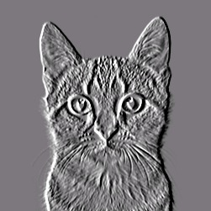
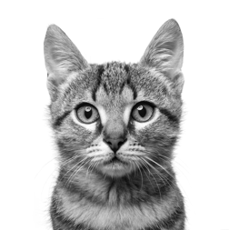
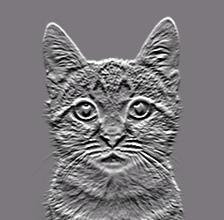
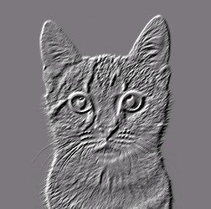
Convolutional Neural Networks
Convolution
-1 | 0 | 1
-2 | 0 | 2
-1 | 0 | 1
-1 | -2 | -1
0 | 0 | 0
1 | 2 | 1
CAT
0 | 0 | -1 | 0
0 | -2 | 0 | 1
-1 | 0 | 2 | 0
0 | 1 | 0 | 0

Slide 40
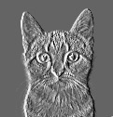
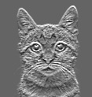
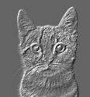
Convolutional Neural Networks
Pooling
Convolution
-1 | 0 | 1
-2 | 0 | 2
-1 | 0 | 1
-1 | -2 | -1
0 | 0 | 0
1 | 2 | 1
0 | 0 | -1 | 0
0 | -2 | 0 | 1
-1 | 0 | 2 | 0
0 | 1 | 0 | 0

Slide 41
Convolution: Stride=2
0 | 0 | 0 | 1 | 1 | 1 | 1 | 0 | 0 | 0
0 | 0 | 0 | 1 | 1 | 1 | 1 | 0 | 0 | 0
0 | 0 | 0 | 1 | 1 | 1 | 1 | 0 | 0 | 0
0 | 0 | 0 | 1 | 1 | 1 | 1 | 0 | 0 | 0
0 | 0 | 0 | 1 | 1 | 1 | 1 | 0 | 0 | 0
0 | 0 | 0 | 1 | 1 | 1 | 1 | 0 | 0 | 0
0 | 0 | 0 | 1 | 1 | 1 | 1 | 0 | 0 | 0
0 | 0 | 0 | 1 | 1 | 1 | 1 | 0 | 0 | 0
0 | 0 | 0 | 1 | 1 | 1 | 1 | 0 | 0 | 0
0 | 0 | 0 | 1 | 1 | 1 | 1 | 0 | 0 | 0
.25 | .25
.25 | .25

Slide 42
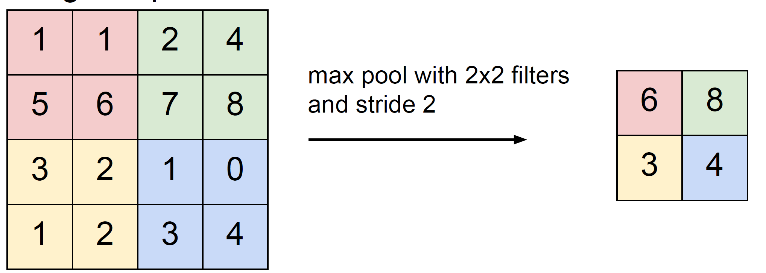
Stride: Max Pooling
Stanford CS 231n, Spring 2017

Slide 43
Convolutional Neural Networks
Pooling
Convolution
-1 | 0 | 1
-2 | 0 | 2
-1 | 0 | 1
-1 | -2 | -1
0 | 0 | 0
1 | 2 | 1
0 | 0 | -1 | 0
0 | -2 | 0 | 1
-1 | 0 | 2 | 0
0 | 1 | 0 | 0

Slide 44
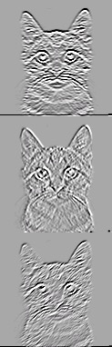

Convolutional Neural Networks
Pooling
Convolution
-1 | 0 | 1
-2 | 0 | 2
-1 | 0 | 1
-1 | -2 | -1
0 | 0 | 0
1 | 2 | 1
0 | 0 | -1 | 0
0 | -2 | 0 | 1
-1 | 0 | 2 | 0
0 | 1 | 0 | 0

Slide 45
Convolutional Neural Networks
Pooling
Convolution
-1 | 0 | 1
-2 | 0 | 2
-1 | 0 | 1
-1 | -2 | -1
0 | 0 | 0
1 | 2 | 1
0 | 0 | -1 | 0
0 | -2 | 0 | 1
-1 | 0 | 2 | 0
0 | 1 | 0 | 0

Slide 46
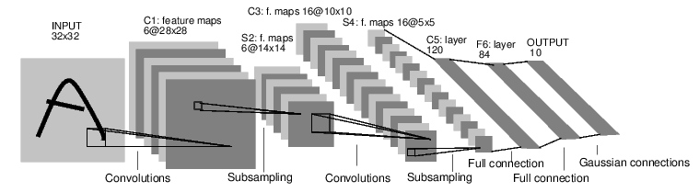
Convolutional Neural Networks
Lenet5 – Lecun, et al, 1998
  Convnets for digit recognition
LeCun, Yann, et al. "Gradient-based learning applied to document recognition." Proceedings of the IEEE 86.11 (1998): 2278-2324.

Slide 47
Question:
How big many convolutional weights between S2 and C3?
  S2: 6 channels @14x14
  Conv: 5x5, pad=0, stride=1
  C3: 16 channels @ 10x10

Slide 48
Question:
How big many convolutional weights between S2 and C3?
  S2: 6 channels @14x14
  Conv: 5x5, pad=0, stride=1
  C3: 16 channels @ 10x10
One image in C3 is actually the result of a 3D convolution
Kernel_1: 6x5x5
C3_1: 1x10x10
S2: 6x14x14

Slide 49
Question:
How big many convolutional weights between S2 and C3?
  S2: 6 channels @14x14
  Conv: 5x5, pad=0, stride=1
  C3: 16 channels @ 10x10
Each image in C3 convolved S2 convolved with a different 3D kernel
Kernel_2: 6x5x5
C3_2: 1x10x10
Kernel_1: 6x5x5
C3_1: 1x10x10
S2: 6x14x14

Slide 50
Question:
How big many convolutional weights between S2 and C3?
  S2: 6 channels @14x14
  Conv: 5x5, pad=0, stride=1
  C3: 16 channels @ 10x10
The 16 images in C3 are the result of doing 16 3D convolutions of S2 with 16 different 6x5x5 kernels.
Assuming no bias term, this is 16x6x5x5 weights!
Kernels: 16@6x5x5
S2: 6x14x14
C3: 16@10x10

Slide 51
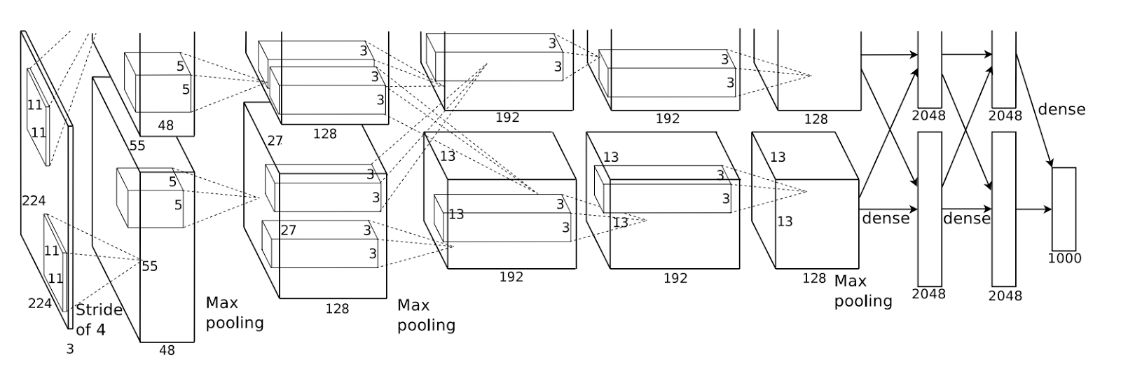
Convolutional Neural Networks
Alexnet – Lecun, et al, 2012
  Convnets for image classification
  More data & more compute power
Krizhevsky, Alex, Ilya Sutskever, and Geoffrey E. Hinton. "ImageNet classification with deep convolutional neural networks." NIPS, 2012.

