Slide 1
Announcements
Assignments:
HW4
    Due date Mon, 2/24, 11:59 pm
HW5
    Out tomorrow
    Due date Thu, 2/27, 11:59 pm
Midterm Conflicts
See Piazza post
Due 11:59pm on Wednesday the 19th of February

Slide 2
Plan
Last time
Decision Boundaries
Gaussian Generative Models
Neural Networks
Today
Neural Networks
    Universal Approximation
    Optimization / Backpropagation
    (Convolutional Neural Networks)

Slide 3
Introduction to
Machine Learning
Neural Networks
Instructor: Pat Virtue

Slide 4

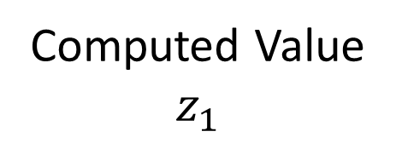

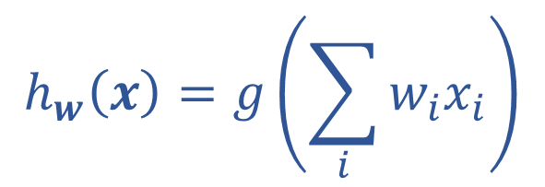
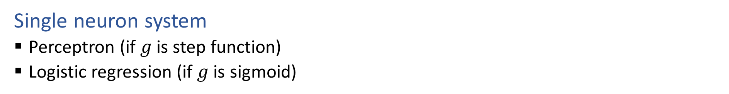



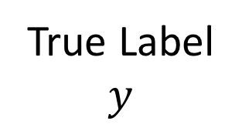


Single Neuron
Single neuron system
  Perceptron (if $g$ is step function)
  Logistic regression (if $g$ is sigmoid)
$$x1$$
$$w1$$
Computed Value
$$z_{1}$$
True Label
$$y$$
$$∑$$
$$g$$
$$x2$$
$$h_{w}\left(x\right)=z_{1}$$
$$w2$$
$$h_{w}\left(x\right)=g\left(\sum_{i}{w_{i}x_{i}}\right)$$

Slide 5
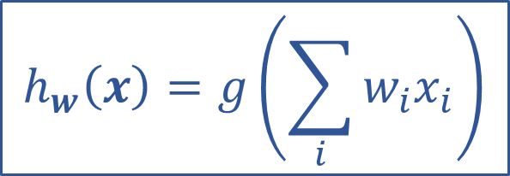
Optimizing
How do we find the “best” set of weights?
$$h_{w}\left(x\right)=g\left(\sum_{i}{w_{i}x_{i}}\right)$$

Slide 6
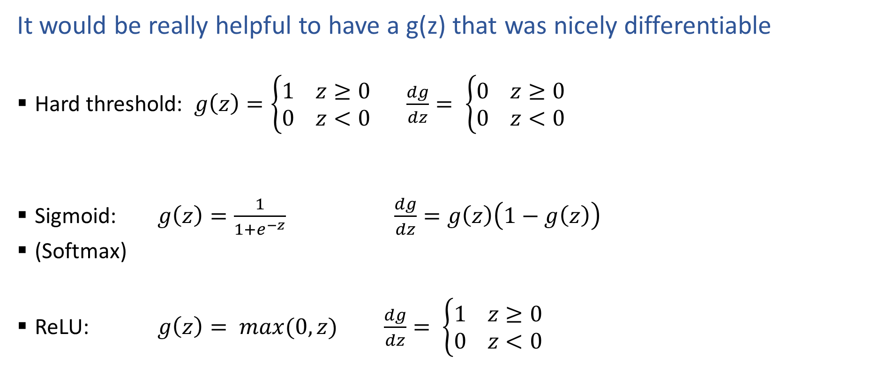
Activation Functions
It would be really helpful to have a g(z) that was nicely differentiable
  Hard threshold: $g\left(z\right)=\left\{\begin{aligned}1 z≥0 \\ 0 z<0\end{aligned}\right.$ $\frac{dg}{dz}= \left\{\begin{aligned}0 z≥0 \\ 0 z<0\end{aligned}\right.$
  Sigmoid: $g\left(z\right)=\frac{1}{1+e^{−z}}$ $\frac{dg}{dz}=g\left(z\right)\left(1−g\left(z\right)\right)$
  (Softmax)
  ReLU: $g\left(z\right)= max(0,z)$ $\frac{dg}{dz}= \left\{\begin{aligned}1 z≥0 \\ 0 z<0\end{aligned}\right.$

Slide 7

Loss Functions
Regression
  MSE (SSE): $ℓ\left(y, \hat{y}\right)={\left\|y−\hat{y}\right\|}_{2}^{2}=\sum_{n}{{\left(y_{n}−\hat{y_{n}}\right)}^{2}}$
  Classification
  Cross entropy: $ℓ\left(y, \hat{y}\right)=−\sum_{n}{ y_{n}\log{{\hat{y}}_{n}}}$

Slide 8
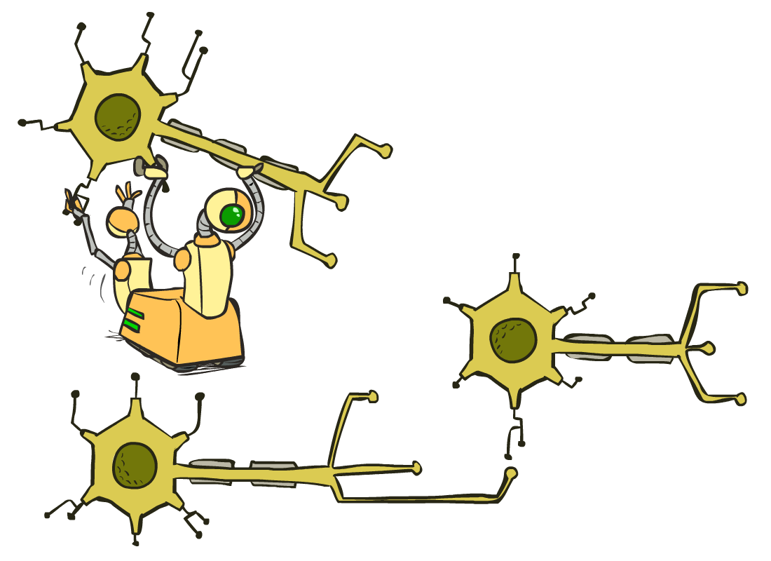
Multilayer Perceptrons
A multilayer perceptron is a feedforward neural network with at least one hidden layer (nodes that are neither inputs nor outputs)
MLPs with enough hidden nodes can represent any function
Slide from UC Berkeley AI

Slide 9












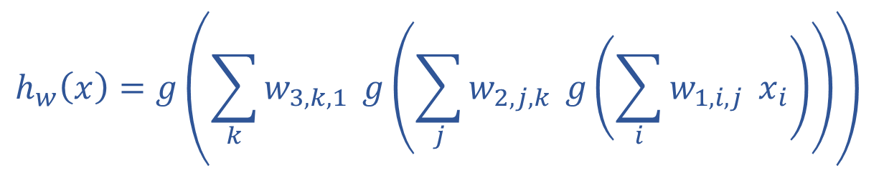
























Neural Network Equations
$$z11$$
$$w111$$
$$z21$$
$$x1$$
$$∑$$
$$g$$
$$w211$$
$$w112$$
$$w113$$
$$w212$$
$$z31$$
$$∑$$
$$g$$
$$w311$$
$$w121$$
$$w221$$
$$z12$$
$$z22$$
$$z41$$
$$x2$$
$$∑$$
$$g$$
$$∑$$
$$g$$
$$w123$$
$$w221$$
$$z32$$
$$w321$$
$$w131$$
$$∑$$
$$g$$
$$z13$$
$$z23$$
$$w232$$
$$x3$$
$$∑$$
$$g$$
w₁₃₃
$$h_{w}\left(x\right)=z_{4,1}$$
$z_{1,1}=x_{1}$
$z_{4,1}=g\left(\sum_{i}{w_{3,i,1} z_{3,i}}\right)$
$$h_{w}\left(x\right)=g\left(\sum_{k}{w_{3,k,1}} g\left(\sum_{j}{w_{2,j,k}} g\left(\sum_{i}{w_{1,i,j}} x_{i}\right)\right)\right)$$
$z_{3,1}=g\left(\sum_{i}{w_{2,i,1} z_{2,i}}\right)$
$z_{d,1}=g\left(\sum_{i}{w_{d−1,i,1} z_{d−1,i}}\right)$

Slide 10
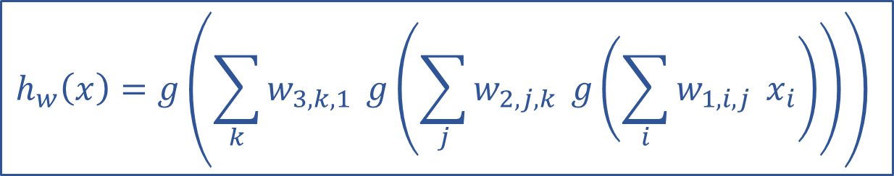
Optimizing
How do we find the “best” set of weights?
$$h_{w}\left(x\right)=g\left(\sum_{k}{w_{3,k,1}} g\left(\sum_{j}{w_{2,j,k}} g\left(\sum_{i}{w_{1,i,j}} x_{i}\right)\right)\right)$$

Slide 11
Neural Network Equations
$$z11$$
$$w111$$
$$z21$$
$$x1$$
$$∑$$
$$g$$
$$w211$$
$$w112$$
$$w113$$
$$w212$$
$$z31$$
$$∑$$
$$g$$
$$w311$$
$$w121$$
$$w221$$
$$z12$$
$$z22$$
$$z41$$
$$x2$$
$$∑$$
$$g$$
$$∑$$
$$g$$
$$w123$$
$$w221$$
$$z32$$
$$w321$$
$$w131$$
$$∑$$
$$g$$
$$z13$$
$$z23$$
$$w232$$
$$x3$$
$$∑$$
$$g$$
w₁₃₃
How would you represent this specific network in PyTorch?

Slide 12
Neural Networks Properties
Practical considerations
  Large number of neurons
      Danger for overfitting
  Modelling assumptions vs data assumptions trade-off
  Gradient descent can easily get stuck local optima
What if there are no non-linear activations?
A deep neural network with only linear layers can be reduced to an exactly equivalent single linear layer
Universal Approximation Theorem:
A two-layer neural network with a sufficient number of neurons can approximate any continuous function to any desired accuracy.

Slide 13
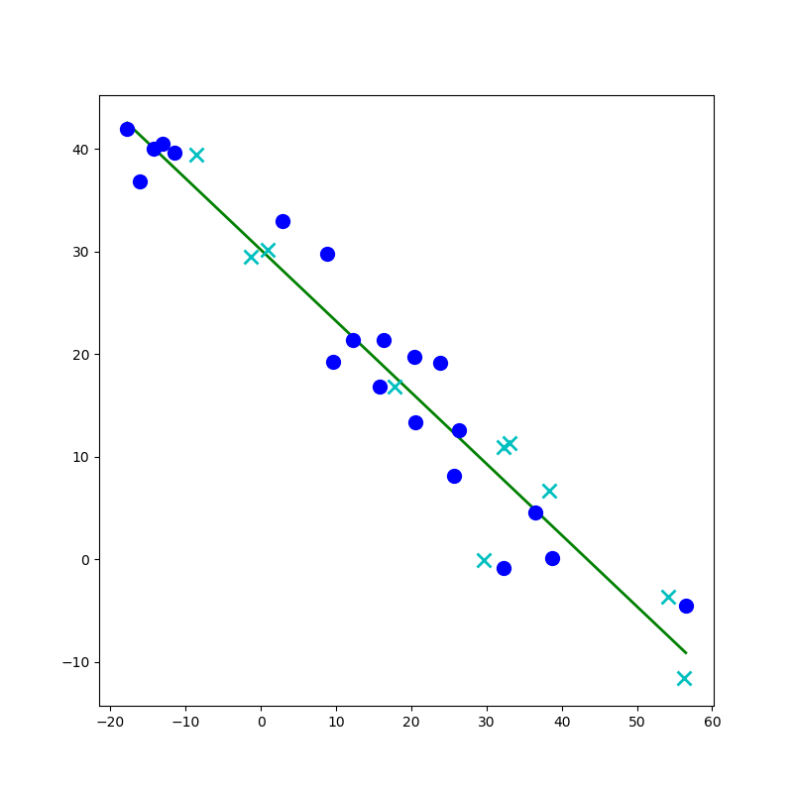
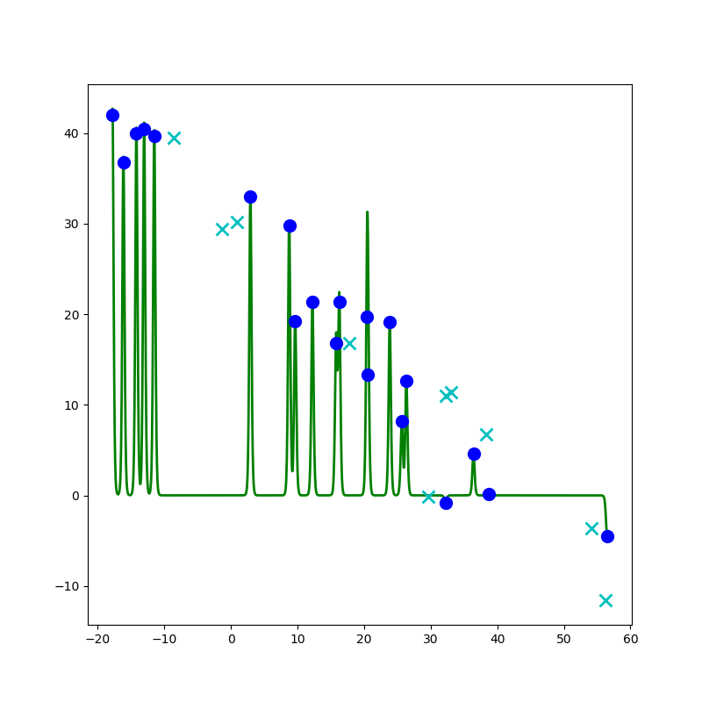
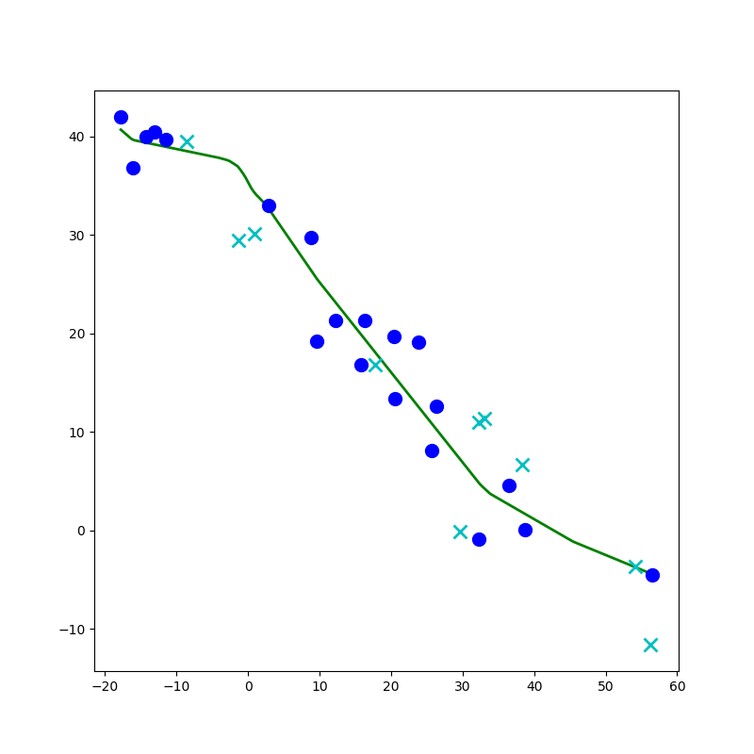
Network to Approximate a 1-D Function

Slide 14
Network to Approximate a 1-D Function
Design a network to approximate this function using:
Linear, Sigmoid, Step, or ReLU

Slide 15
Network to Approximate a 1-D Function
Design a network to approximate this function using:
Linear, Sigmoid, Step, or ReLU

Slide 16
Network to Approximate a 1-D Function

Slide 17
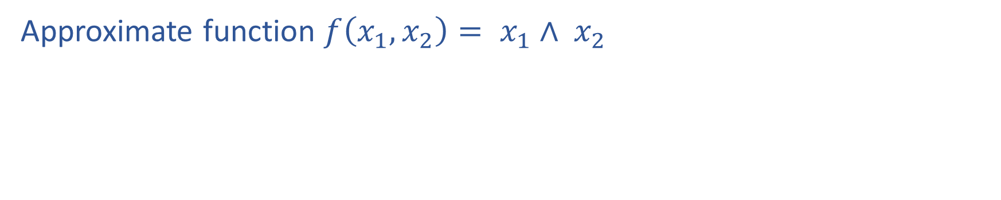
Network to Approximate Binary Classification
Approximate function $f\left(x_{1}, x_{2}\right)= x_{1}∧ x_{2}$

Slide 18
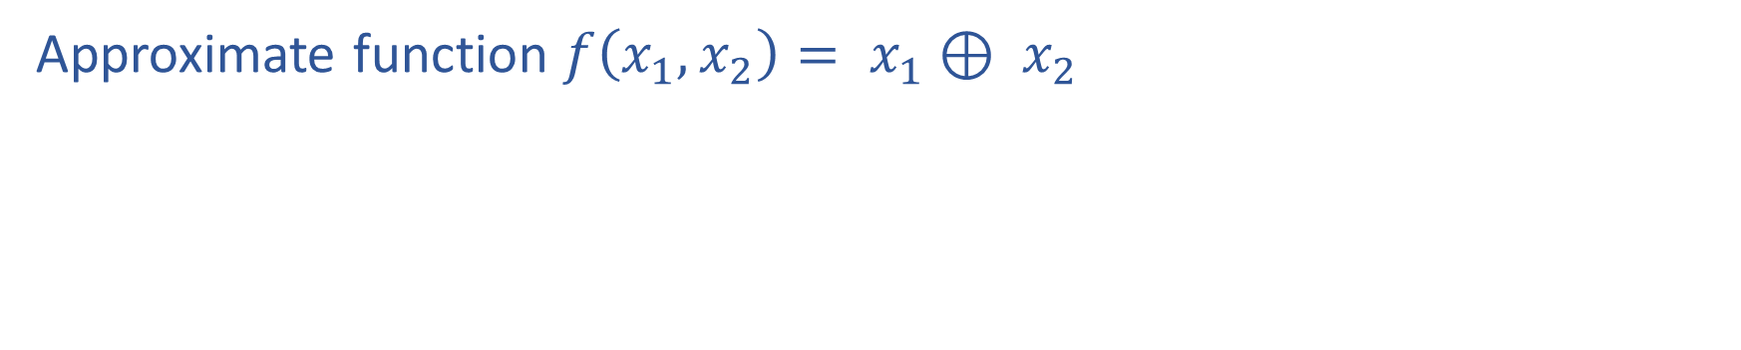
Network to Approximate Binary Classification
Approximate function $f\left(x_{1}, x_{2}\right)= x_{1}⊕ x_{2}$

Slide 19
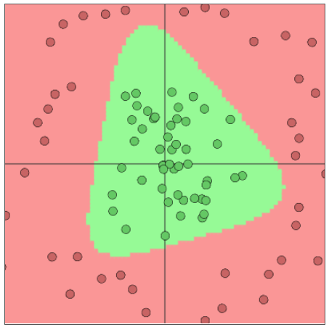
Network to Approximate Binary Classification
Approximate arbitrary decision boundary
https://cs.stanford.edu/people/karpathy/convnetjs/demo/classify2d.html

Slide 20
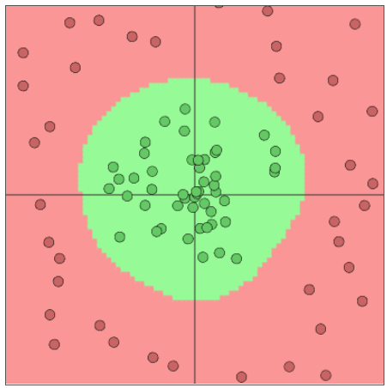
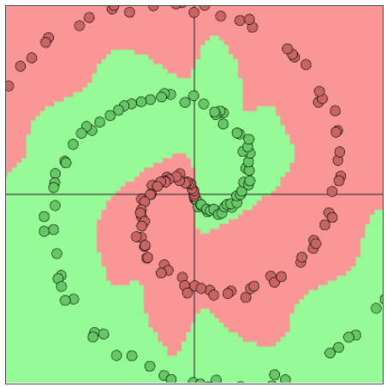
Network to Approximate Binary Classification
Approximate arbitrary decision boundary
https://cs.stanford.edu/people/karpathy/convnetjs/demo/classify2d.html

Slide 21
Network Optimization

Slide 22

Reminder: Calculus Chain Rule (scalar version)
$$y=f\left(z\right)$$
$$z=g\left(x\right)$$
$$\frac{dy}{dx}=\frac{dy}{dz}\frac{dz}{dx}$$

Slide 23
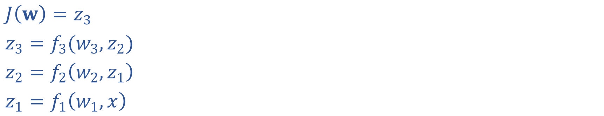
Network Optimization
$J\left(w\right)=z_{3}$
$z_{3}=f_{3}(w_{3}, z_{2})$
$z_{2}=f_{2}\left(w_{2}, z_{1}\right)$
$z_{1}=f_{1}\left(w_{1}, x\right)$

Slide 24
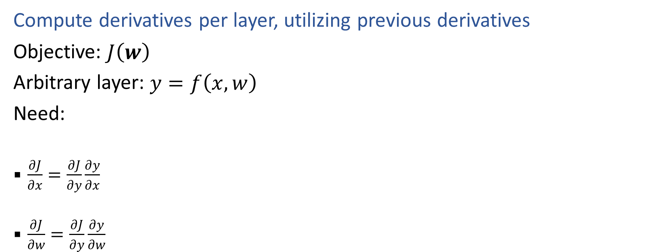
Backpropagation (so-far)
Compute derivatives per layer, utilizing previous derivatives
Objective: $J\left(w\right)$
Arbitrary layer: $y=f\left(x, w\right)$
Need:
  $\frac{∂J}{∂x}=\frac{∂J}{∂y}\frac{∂y}{∂x}$
  $\frac{∂J}{∂w}=\frac{∂J}{∂y}\frac{∂y}{∂w}$

