Slide 1
Announcements
Assignments:
HW4
    Due date Mon, 2/24, 11:59 pm
Midterm
Monday the 2nd of March from 5:00pm-6:30pm
Midterm Conflicts
See Piazza post
Due 11:59pm on Wednesday the 19th of February

Slide 2
Plan
Last time
Naïve Bayes Assumptions
Naïve Bayes MLE and MAP
MLE vs MAP
Generative vs Discriminative Models
Today
Decision Boundaries
Gaussian Generative Models
Neural Networks

Slide 3
Introduction to
Machine Learning
Generative Models
then
Intro to Neural Networks
Instructor: Pat Virtue

Slide 4
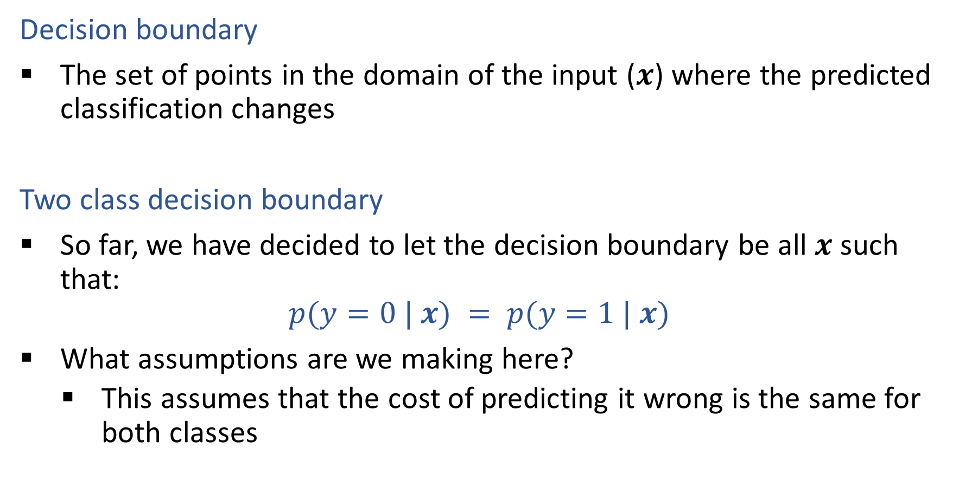
Decision Boundaries
Decision boundary
The set of points in the domain of the input ($x$) where the predicted classification changes
Two class decision boundary
So far, we have decided to let the decision boundary be all $x$ such that:
$$p(y=0 | x) = p(y=1 | x)$$
What assumptions are we making here?
    This assumes that the cost of predicting it wrong is the same for both classes

Slide 5
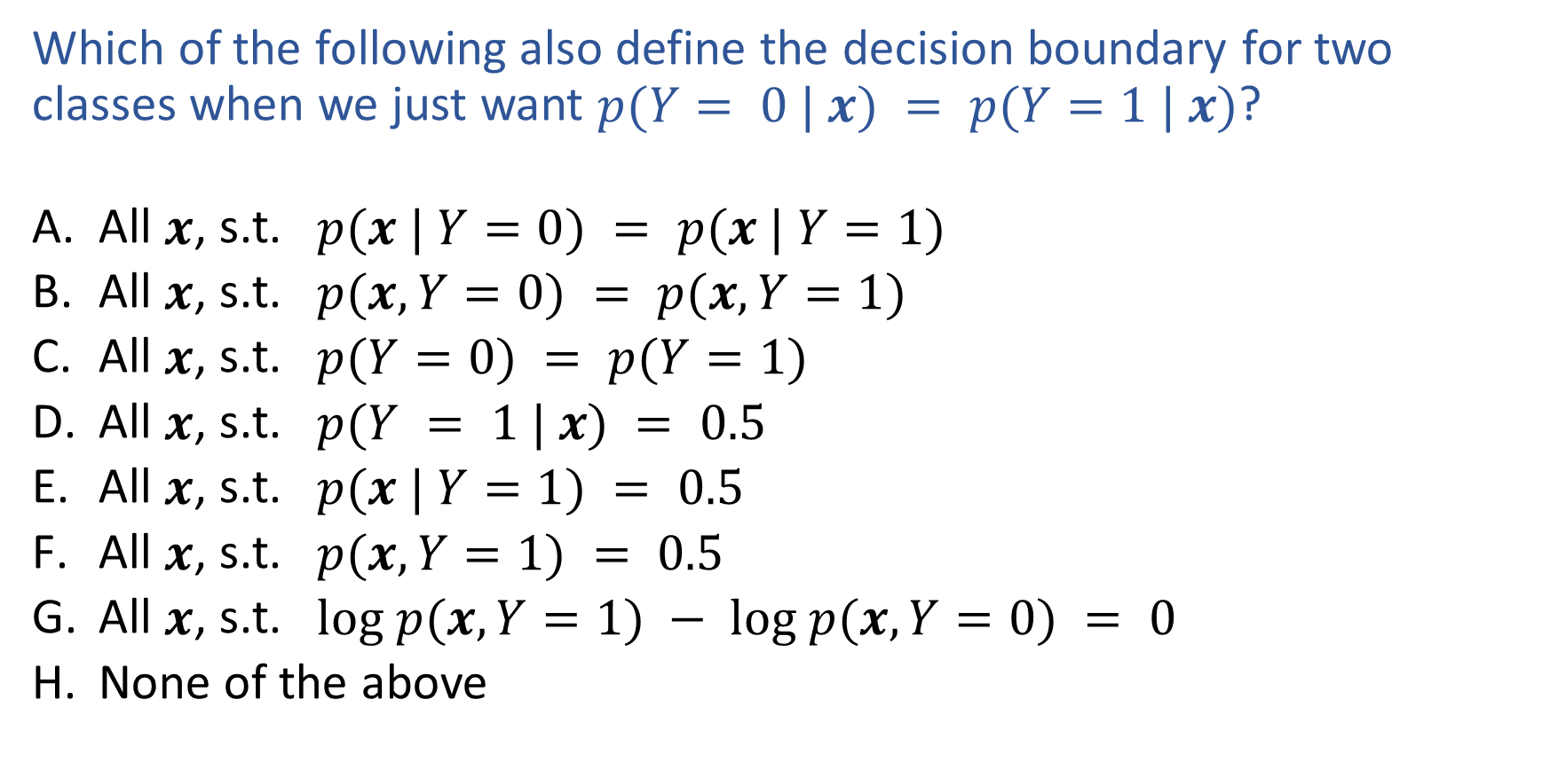
Piazza Poll 1
Which of the following also define the decision boundary for two classes when we just want $p(Y= 0 | x) = p(Y=1 | x)$?
  All $x$, s.t. $p(x | Y=0) = p(x | Y=1)$
  All $x$, s.t. $p(x, Y=0) = p(x, Y=1)$
  All $x$, s.t. $p(Y=0) = p(Y=1)$
  All $x$, s.t. $p(Y = 1 | x) = 0.5$
  All $x$, s.t. $p(x | Y=1) = 0.5$
  All $x$, s.t. $p(x, Y=1) = 0.5$
  All $x$, s.t. $log p(x, Y=1) − log p(x, Y=0) = 0$
  None of the above

Slide 6
Piazza Poll 1
Which of the following also define the decision boundary for two classes when we just want $p(Y= 0 | x) = p(Y=1 | x)$?
  All $x$, s.t. $p(x | Y=0) = p(x | Y=1)$
  All $x$, s.t. $p(x, Y=0) = p(x, Y=1)$
  All $x$, s.t. $p(Y=0) = p(Y=1)$
  All $x$, s.t. $p(Y = 1 | x) = 0.5$
  All $x$, s.t. $p(x | Y=1) = 0.5$
  All $x$, s.t. $p(x, Y=1) = 0.5$
  All $x$, s.t. $log p(x, Y=1) − log p(x, Y=0) = 0$
  None of the above

Slide 7
Piazza Poll 2
True/False: Logistic regression always produces a linear decision boundary.
I don’t know
True
False

Slide 8
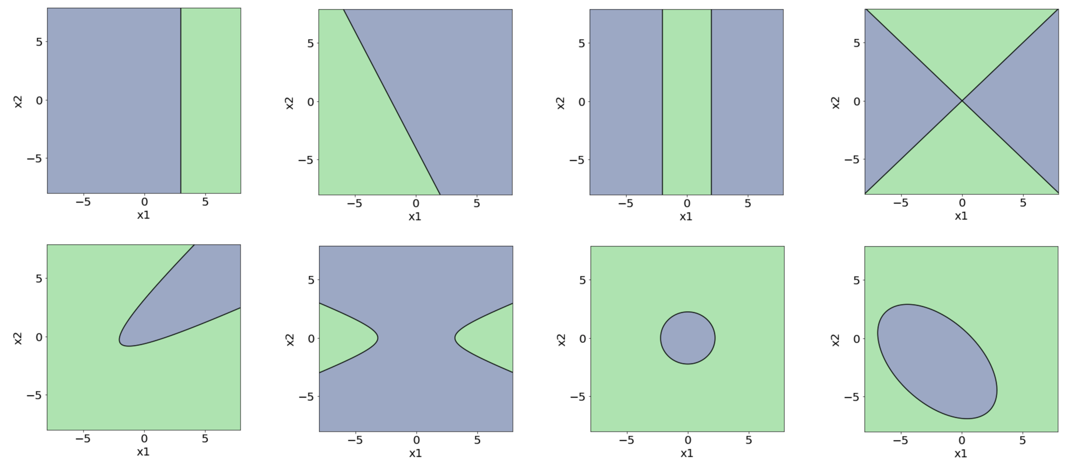
Piazza Poll 2
True/False: Logistic regression always produces a linear decision boundary.
I don’t know
True
False

Slide 9
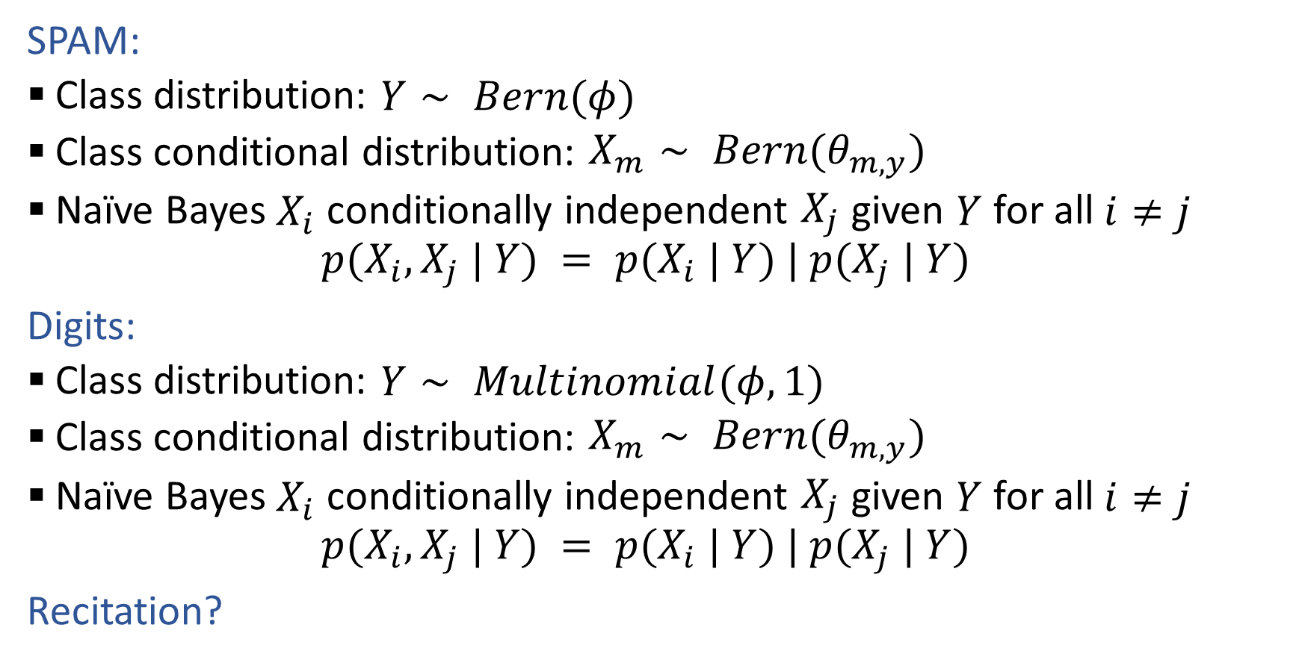
Generative Models
SPAM:
  Class distribution: $Y∼ Bern(φ)$
  Class conditional distribution: $X_{m}∼ Bern(θ_{m,y})$
  Naïve Bayes $X_{i}$ conditionally independent $X_{j}$ given $Y$ for all $i≠j$
    $$p(X_{i}, X_{j} | Y) = p(X_{i} | Y) | p(X_{j} | Y)$$
Digits:
  Class distribution: $Y∼ Multinomial(φ, 1)$
  Class conditional distribution: $X_{m}∼ Bern(θ_{m,y})$
  Naïve Bayes $X_{i}$ conditionally independent $X_{j}$ given $Y$ for all $i≠j$
    $$p(X_{i}, X_{j} | Y) = p(X_{i} | Y) | p(X_{j} | Y)$$
Recitation?

Slide 10



Fisher Iris Dataset
https://en.wikipedia.org/wiki/Iris_flower_data_set

Slide 11
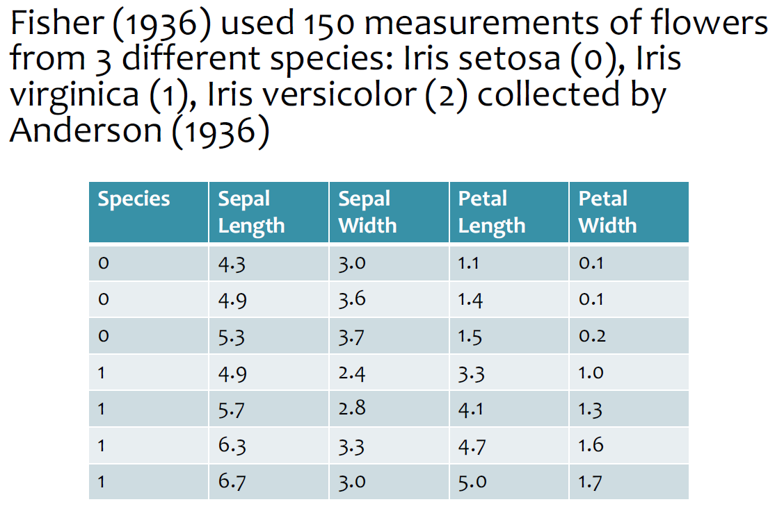
Fisher Iris Dataset
https://en.wikipedia.org/wiki/Iris_flower_data_set
Slides from Matt Gormley, CMU

Slide 12
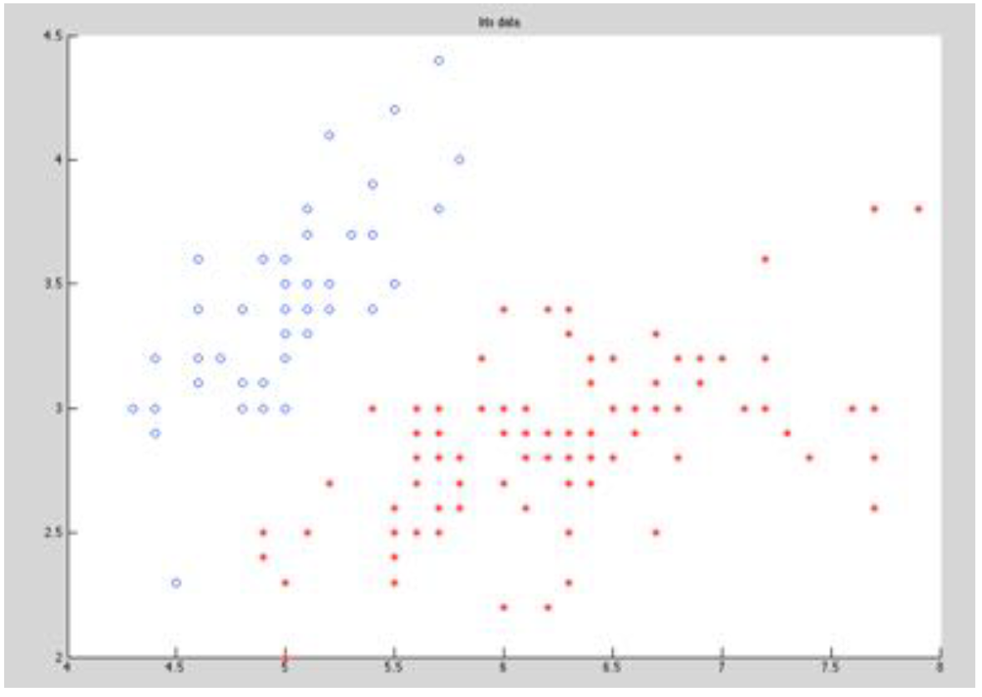
Fisher Iris Dataset
Slides from William Cohen, CMU

Slide 13
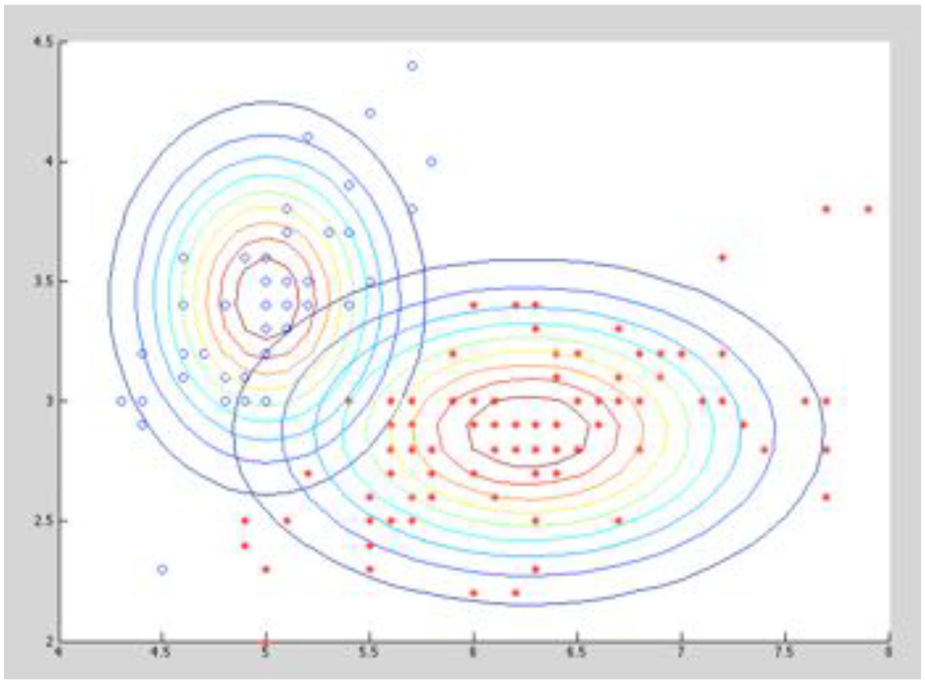
Fisher Iris Dataset
Slides from William Cohen, CMU

Slide 14
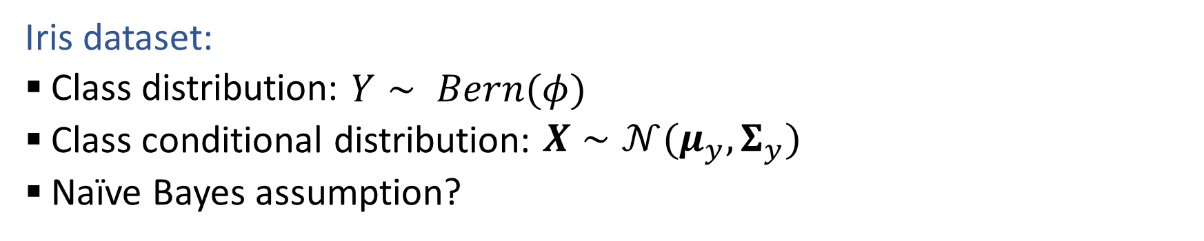
Generative Models with Continuous Features
Iris dataset:
  Class distribution: $Y∼ Bern(φ)$
  Class conditional distribution: $X∼𝒩(μ_{y}, Σ_{y})$
  Naïve Bayes assumption?

Slide 15
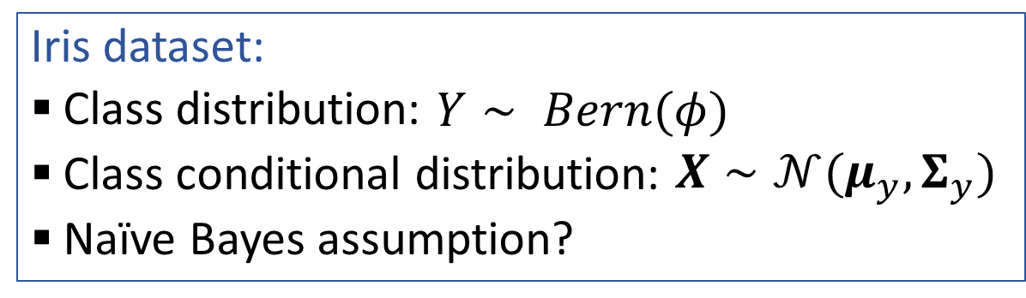
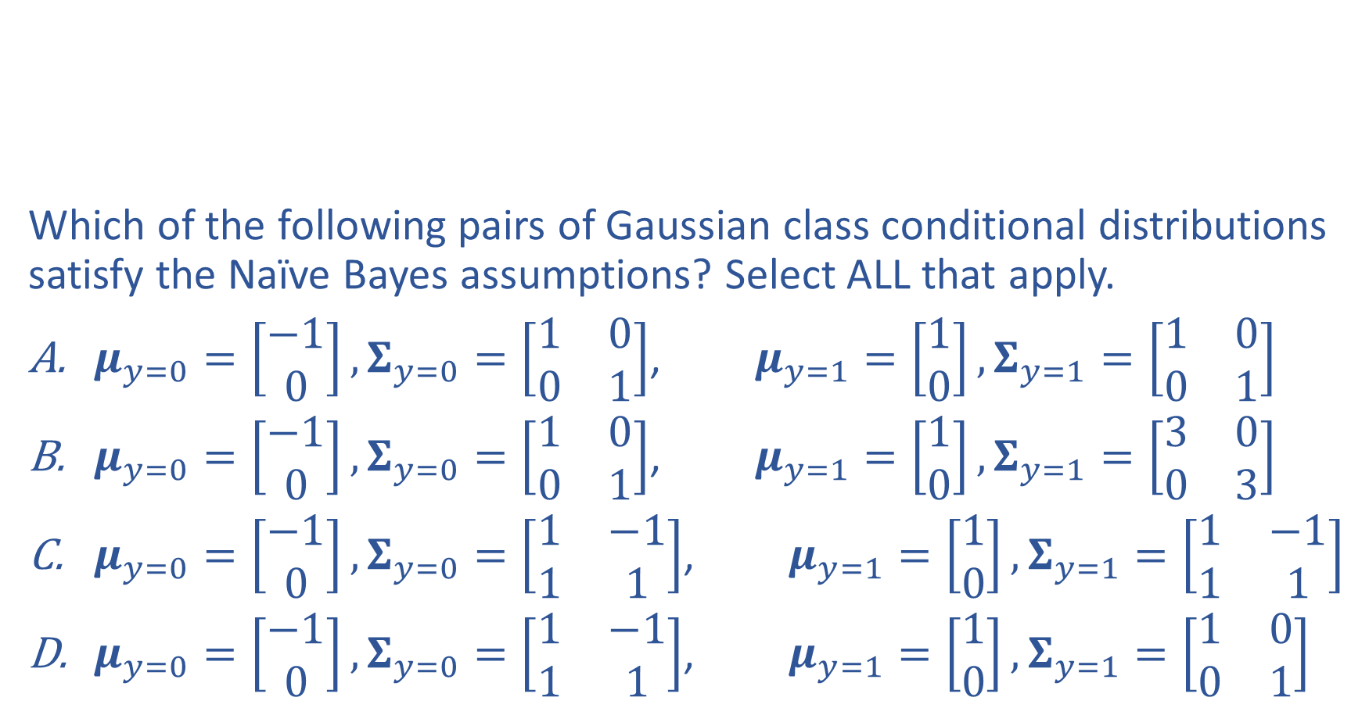
Piazza Poll 3
Iris dataset:
  Class distribution: $Y∼ Bern(φ)$
  Class conditional distribution: $X∼𝒩(μ_{y}, Σ_{y})$
  Naïve Bayes assumption?
Which of the following pairs of Gaussian class conditional distributions satisfy the Naïve Bayes assumptions? Select ALL that apply.
$μ_{y=0}=\left[\begin{aligned}−1 \\ 0\end{aligned}\right],Σ_{y=0}=\left[\begin{matrix}1 & 0 \\ 0 & 1\end{matrix}\right]$, $μ_{y=1}=\left[\begin{aligned}1 \\ 0\end{aligned}\right],Σ_{y=1}=\left[\begin{matrix}1 & 0 \\ 0 & 1\end{matrix}\right]$
$μ_{y=0}=\left[\begin{aligned}−1 \\ 0\end{aligned}\right],Σ_{y=0}=\left[\begin{matrix}1 & 0 \\ 0 & 1\end{matrix}\right]$, $μ_{y=1}=\left[\begin{aligned}1 \\ 0\end{aligned}\right],Σ_{y=1}=\left[\begin{matrix}3 & 0 \\ 0 & 3\end{matrix}\right]$
$μ_{y=0}=\left[\begin{aligned}−1 \\ 0\end{aligned}\right],Σ_{y=0}=\left[\begin{matrix}1 & −1 \\ 1 & 1\end{matrix}\right]$, $μ_{y=1}=\left[\begin{aligned}1 \\ 0\end{aligned}\right],Σ_{y=1}=\left[\begin{matrix}1 & −1 \\ 1 & 1\end{matrix}\right]$
$μ_{y=0}=\left[\begin{aligned}−1 \\ 0\end{aligned}\right],Σ_{y=0}=\left[\begin{matrix}1 & −1 \\ 1 & 1\end{matrix}\right]$, $μ_{y=1}=\left[\begin{aligned}1 \\ 0\end{aligned}\right],Σ_{y=1}=\left[\begin{matrix}1 & 0 \\ 0 & 1\end{matrix}\right]$

Slide 16
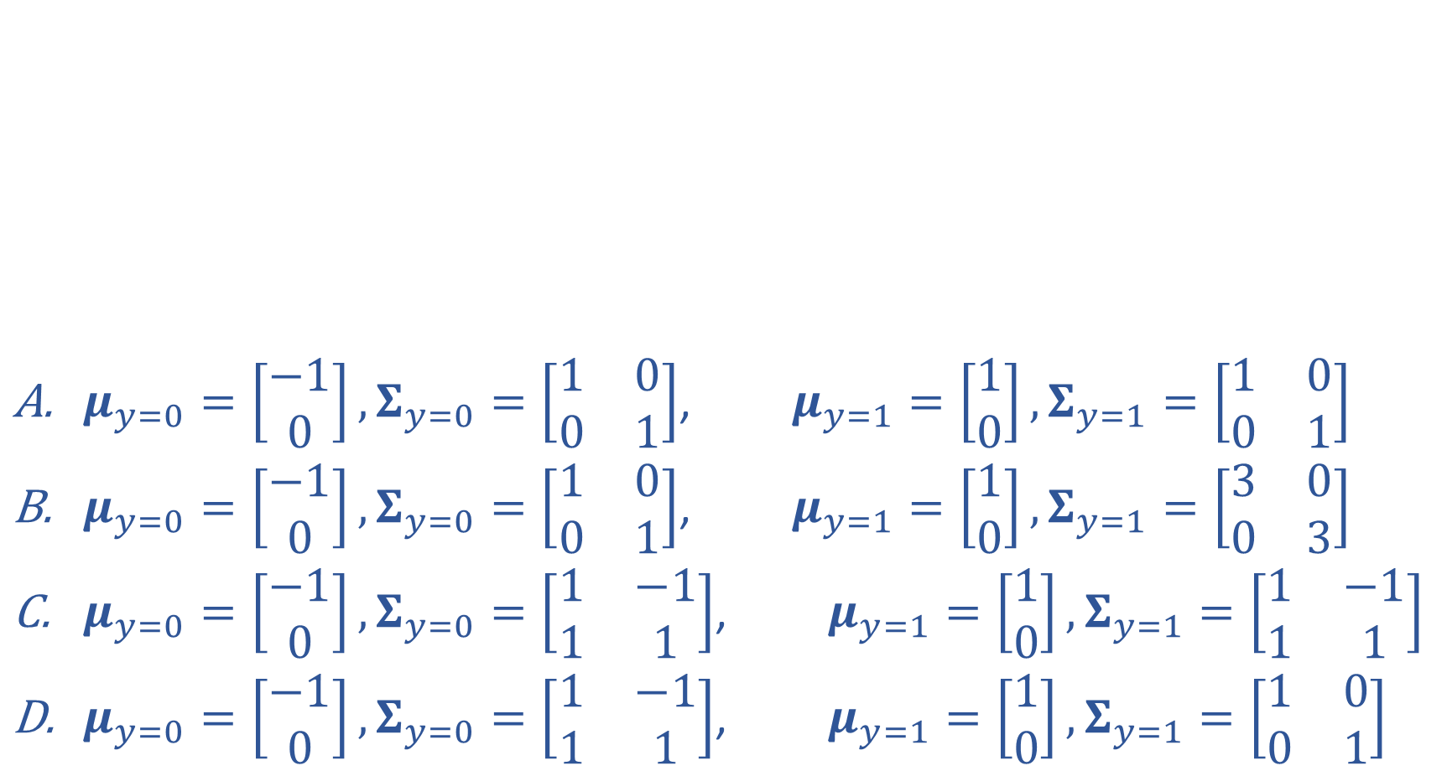
Piazza Poll 3
$μ_{y=0}=\left[\begin{aligned}−1 \\ 0\end{aligned}\right],Σ_{y=0}=\left[\begin{matrix}1 & 0 \\ 0 & 1\end{matrix}\right]$, $μ_{y=1}=\left[\begin{aligned}1 \\ 0\end{aligned}\right],Σ_{y=1}=\left[\begin{matrix}1 & 0 \\ 0 & 1\end{matrix}\right]$
$μ_{y=0}=\left[\begin{aligned}−1 \\ 0\end{aligned}\right],Σ_{y=0}=\left[\begin{matrix}1 & 0 \\ 0 & 1\end{matrix}\right]$, $μ_{y=1}=\left[\begin{aligned}1 \\ 0\end{aligned}\right],Σ_{y=1}=\left[\begin{matrix}3 & 0 \\ 0 & 3\end{matrix}\right]$
$μ_{y=0}=\left[\begin{aligned}−1 \\ 0\end{aligned}\right],Σ_{y=0}=\left[\begin{matrix}1 & −1 \\ 1 & 1\end{matrix}\right]$, $μ_{y=1}=\left[\begin{aligned}1 \\ 0\end{aligned}\right],Σ_{y=1}=\left[\begin{matrix}1 & −1 \\ 1 & 1\end{matrix}\right]$
$μ_{y=0}=\left[\begin{aligned}−1 \\ 0\end{aligned}\right],Σ_{y=0}=\left[\begin{matrix}1 & −1 \\ 1 & 1\end{matrix}\right]$, $μ_{y=1}=\left[\begin{aligned}1 \\ 0\end{aligned}\right],Σ_{y=1}=\left[\begin{matrix}1 & 0 \\ 0 & 1\end{matrix}\right]$

Slide 17
Piazza Poll 3
Iris dataset:
  Class distribution: $Y∼ Bern(φ)$
  Class conditional distribution: $X∼𝒩(μ_{y}, Σ_{y})$
  Naïve Bayes assumption?
Which of the following pairs of Gaussian class conditional distributions satisfy the Naïve Bayes assumptions? Select ALL that apply.
$μ_{y=0}=\left[\begin{aligned}−1 \\ 0\end{aligned}\right],Σ_{y=0}=\left[\begin{matrix}1 & 0 \\ 0 & 1\end{matrix}\right]$, $μ_{y=1}=\left[\begin{aligned}1 \\ 0\end{aligned}\right],Σ_{y=1}=\left[\begin{matrix}1 & 0 \\ 0 & 1\end{matrix}\right]$
$μ_{y=0}=\left[\begin{aligned}−1 \\ 0\end{aligned}\right],Σ_{y=0}=\left[\begin{matrix}1 & 0 \\ 0 & 1\end{matrix}\right]$, $μ_{y=1}=\left[\begin{aligned}1 \\ 0\end{aligned}\right],Σ_{y=1}=\left[\begin{matrix}3 & 0 \\ 0 & 3\end{matrix}\right]$
$μ_{y=0}=\left[\begin{aligned}−1 \\ 0\end{aligned}\right],Σ_{y=0}=\left[\begin{matrix}1 & −1 \\ 1 & 1\end{matrix}\right]$, $μ_{y=1}=\left[\begin{aligned}1 \\ 0\end{aligned}\right],Σ_{y=1}=\left[\begin{matrix}1 & −1 \\ 1 & 1\end{matrix}\right]$
$μ_{y=0}=\left[\begin{aligned}−1 \\ 0\end{aligned}\right],Σ_{y=0}=\left[\begin{matrix}1 & −1 \\ 1 & 1\end{matrix}\right]$, $μ_{y=1}=\left[\begin{aligned}1 \\ 0\end{aligned}\right],Σ_{y=1}=\left[\begin{matrix}1 & 0 \\ 0 & 1\end{matrix}\right]$

Slide 18
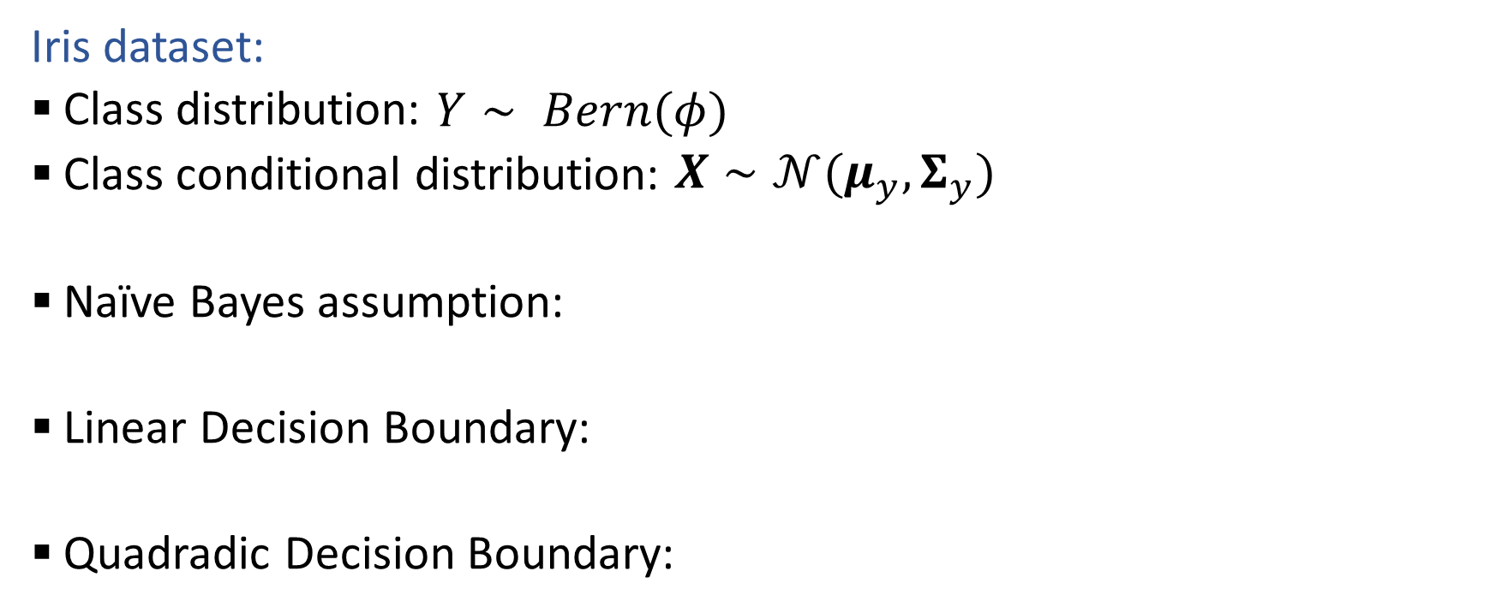
Decision Boundaries
Iris dataset:
  Class distribution: $Y∼ Bern(φ)$
  Class conditional distribution: $X∼𝒩(μ_{y}, Σ_{y})$
  Naïve Bayes assumption:
  Linear Decision Boundary:
  Quadradic Decision Boundary:

Slide 19
Introduction to
Machine Learning
Intro to Neural Networks
Instructor: Pat Virtue

Slide 20
Neural Networks from HW2
1-D Regression

Slide 21
Neural Networks from HW2
Digit Classification

Slide 22
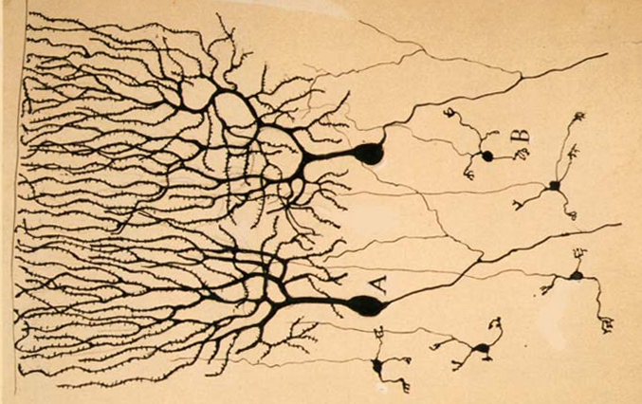

Neural Networks
Inspired by actual human brain
Output
Signal
Input Signal
DOG
CAT
TREE
CAR
SKY
Image: https://en.wikipedia.org/wiki/Neuron

Slide 23
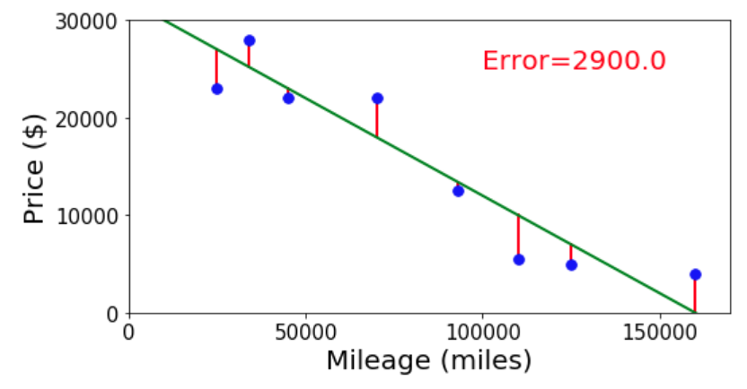
Neural Networks
Simple single neuron example:
Selling my car

Slide 24
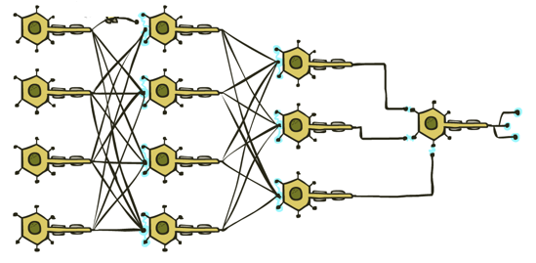

Neural Networks
Many layers of neurons, millions of parameters
Output
Signal
Input Signal
DOG
CAT
TREE
CAR
SKY

Slide 25
Neural Networks
Many layers of neurons, millions of parameters
Output
Signal
Input Signal
DOG
CAT
TREE
CAR
SKY

Slide 26

Neural Networks
Many layers of neurons, millions of parameters
Output
Signal
Input Signal
LEFT
RIGHT
UP
DOWN
BUTTON

Slide 27
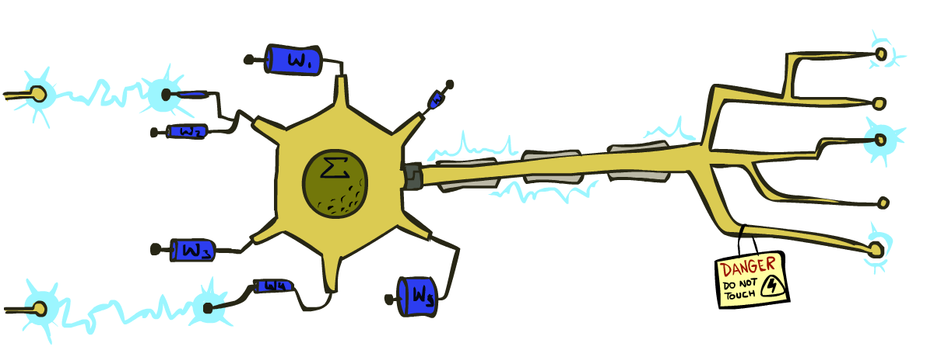
Very Loose Inspiration: Human Neurons
Slide from UC Berkeley AI

Slide 28
Simple Model of a Neuron (McCulloch & Pitts, 1943)
Inputs a_{i} come from the output of node i to this node j (or from “outside”)
Each input link has a weight w_{i,j}
There is an additional fixed input a₀ with bias weight w_{0,j}
The total input is in_{j} = Σ_{i} w_{i,j} a_{i}
The output is a_{j} = g(in_{j}) = g(Σ_{i} w_{i,j} a_{i}) = g(w.a)
Slide from UC Berkeley AI
Notes:
fix notation: x, a, h, etc, explain bias

Slide 29

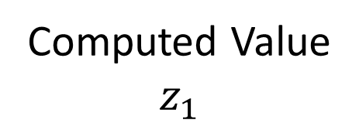

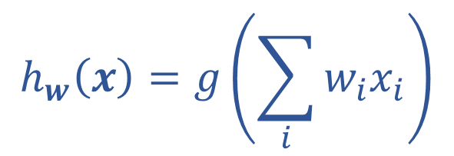
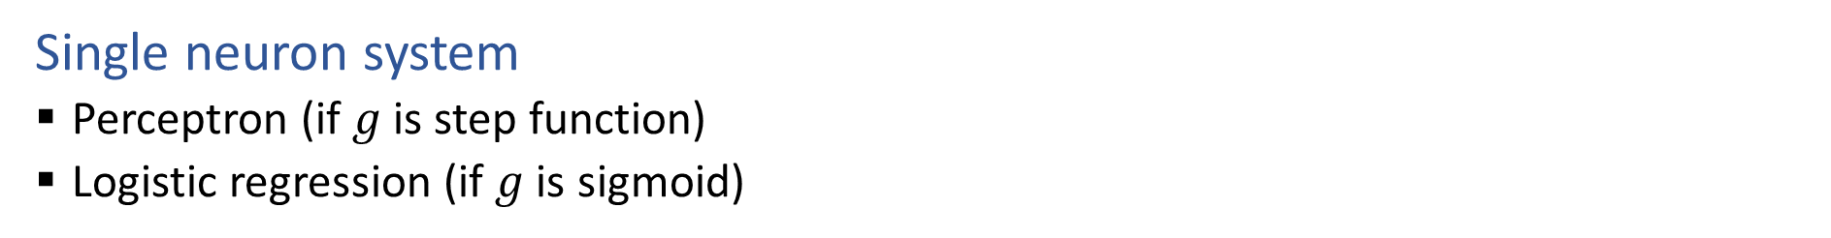






Single Neuron
Single neuron system
  Perceptron (if $g$ is step function)
  Logistic regression (if $g$ is sigmoid)
$$x1$$
$$w1$$
Computed Value
$$z_{1}$$
True Label
$$y$$
$$∑$$
$$g$$
$$x2$$
$$h_{w}\left(x\right)=z_{1}$$
$$w2$$
$$h_{w}\left(x\right)=g\left(\sum_{i}{w_{i}x_{i}}\right)$$

Slide 30
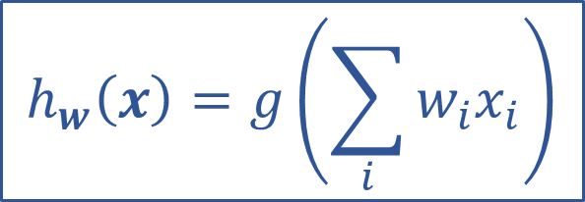
Optimizing
How do we find the “best” set of weights?
$$h_{w}\left(x\right)=g\left(\sum_{i}{w_{i}x_{i}}\right)$$

Slide 31
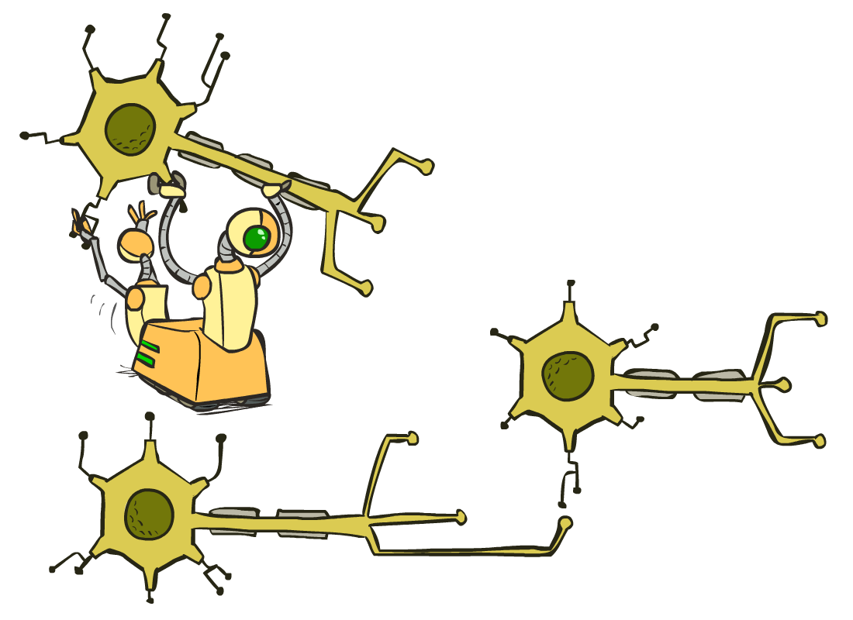
Multilayer Perceptrons
A multilayer perceptron is a feedforward neural network with at least one hidden layer (nodes that are neither inputs nor outputs)
MLPs with enough hidden nodes can represent any function
Slide from UC Berkeley AI

Slide 32












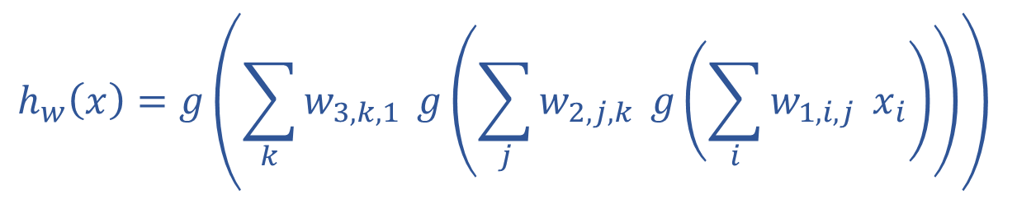
























Neural Network Equations
$$z11$$
$$w111$$
$$z21$$
$$x1$$
$$∑$$
$$g$$
$$w211$$
$$w112$$
$$w113$$
$$w212$$
$$z31$$
$$∑$$
$$g$$
$$w311$$
$$w121$$
$$w221$$
$$z12$$
$$z22$$
$$z41$$
$$x2$$
$$∑$$
$$g$$
$$∑$$
$$g$$
$$w123$$
$$w221$$
$$z32$$
$$w321$$
$$w131$$
$$∑$$
$$g$$
$$z13$$
$$z23$$
$$w232$$
$$x3$$
$$∑$$
$$g$$
w₁₃₃
$$h_{w}\left(x\right)=z_{4,1}$$
$z_{1,1}=x_{1}$
$z_{4,1}=g\left(\sum_{i}{w_{3,i,1} z_{3,i}}\right)$
$$h_{w}\left(x\right)=g\left(\sum_{k}{w_{3,k,1}} g\left(\sum_{j}{w_{2,j,k}} g\left(\sum_{i}{w_{1,i,j}} x_{i}\right)\right)\right)$$
$z_{3,1}=g\left(\sum_{i}{w_{2,i,1} z_{2,i}}\right)$
$z_{d,1}=g\left(\sum_{i}{w_{d−1,i,1} z_{d−1,i}}\right)$

Slide 33
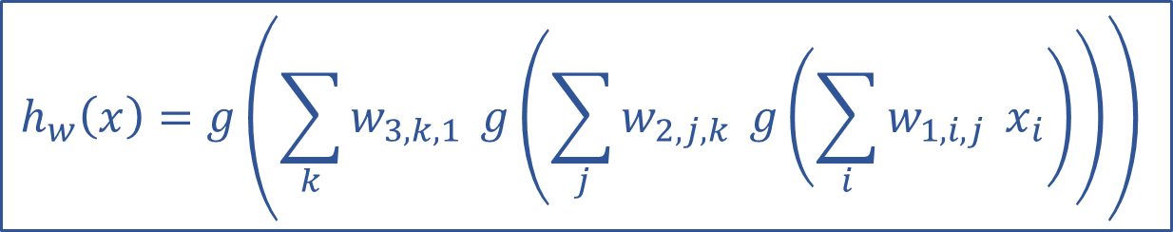
Optimizing
How do we find the “best” set of weights?
$$h_{w}\left(x\right)=g\left(\sum_{k}{w_{3,k,1}} g\left(\sum_{j}{w_{2,j,k}} g\left(\sum_{i}{w_{1,i,j}} x_{i}\right)\right)\right)$$

Slide 34
Neural Networks Properties
Practical considerations
  Large number of neurons
      Danger for overfitting
  Modelling assumptions vs data assumptions trade-off
  Gradient descent can get stuck in bad local optima
What if there are not non-linear activations?
A deep neural network with only linear layers can be reduced to an exactly equivalent single linear layer
Universal Approximation Theorem:
A two-layer neural network with a sufficient number of neurons can approximate any continuous function to any desired accuracy.

