Slide 1
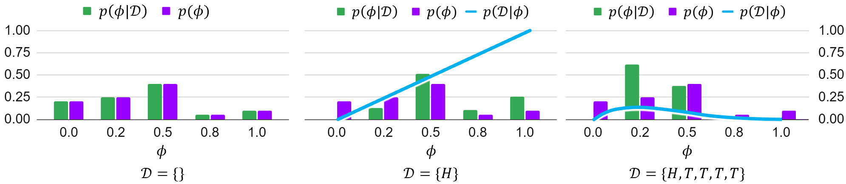
07-380 AI & ML II
Maximum a posteriori (MAP) Esitmation
Instructors: Pat Virtue & Mohammad Salameh

Slide 2
ML Probability Notation

Slide 3
Language of Probability
Like a magic key to open doors to learning SO much more...

Slide 4
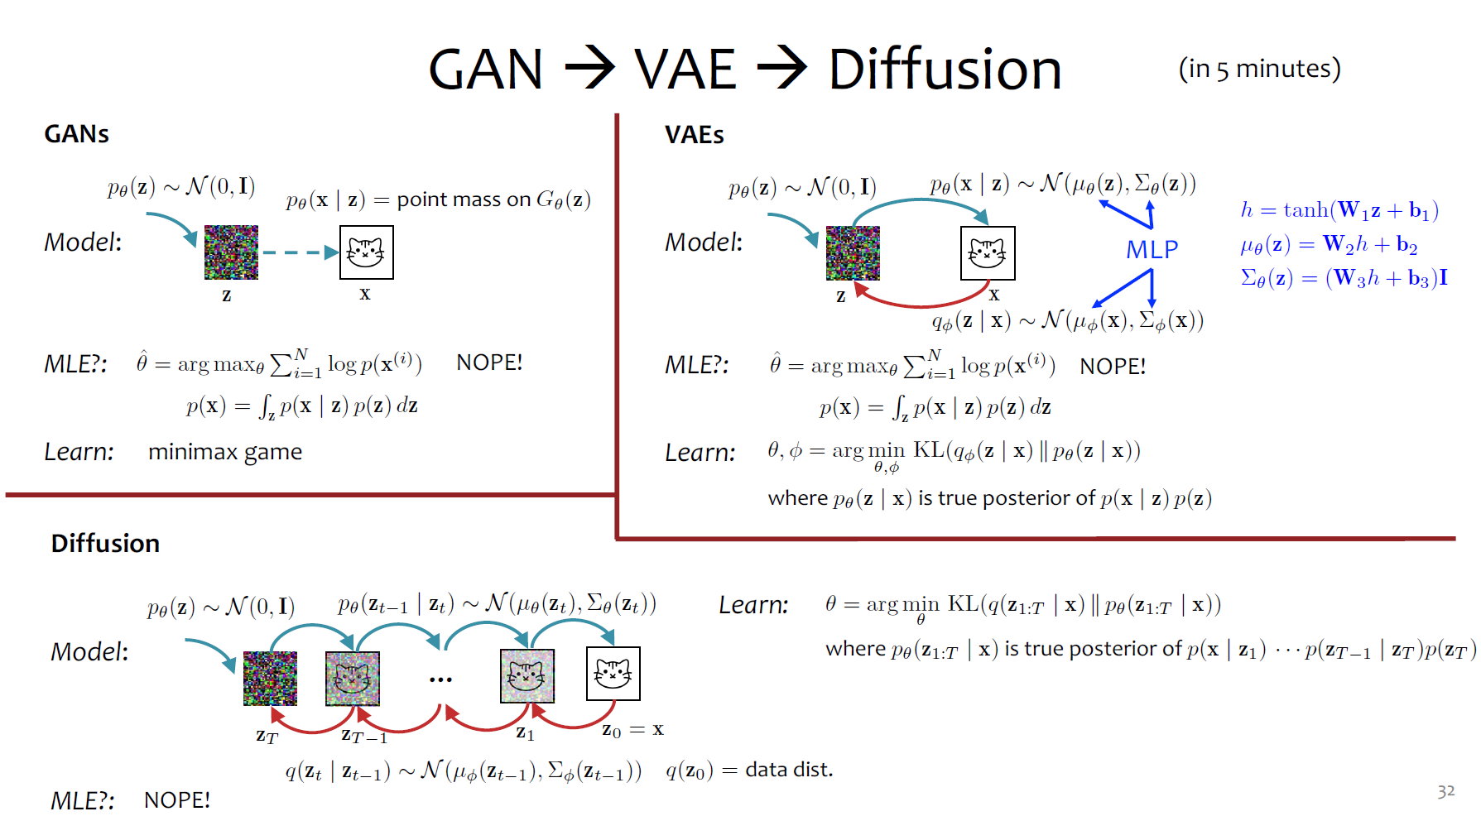


10-423 Gen AI

Slide 5
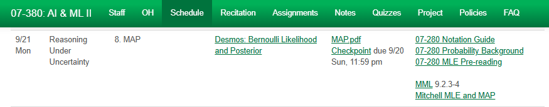
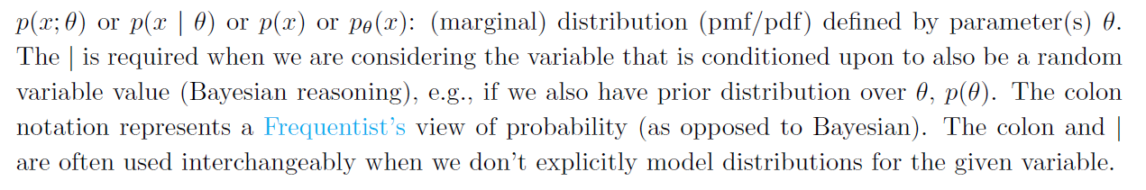


Links to Notes
Notation and Probability Notes

Slide 6
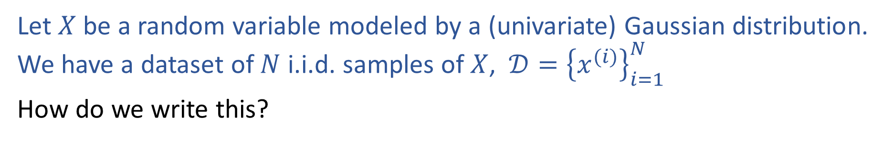
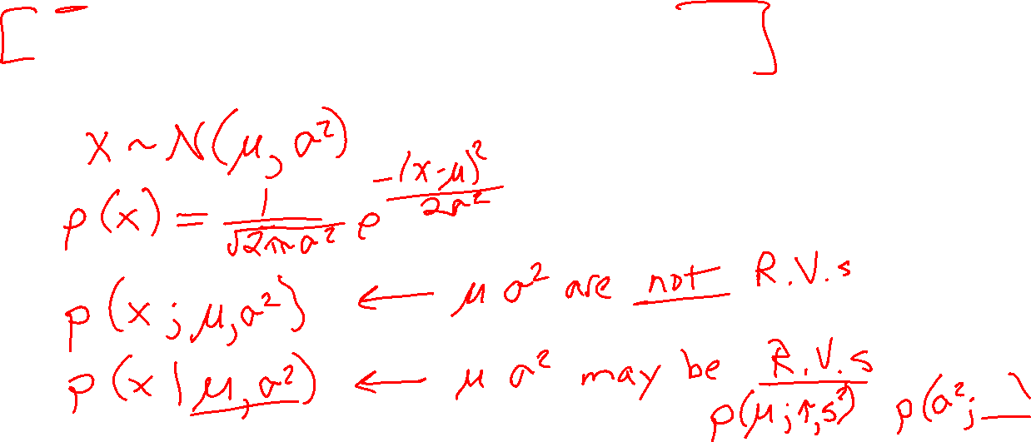
Probability Notation
Let $X$ be a random variable modeled by a (univariate) Gaussian distribution. We have a dataset of $N$ i.i.d. samples of $X$, $𝒟={\left\{x^{(i)}\right\}}_{i=1}^{N}$
How do we write this?

Slide 7
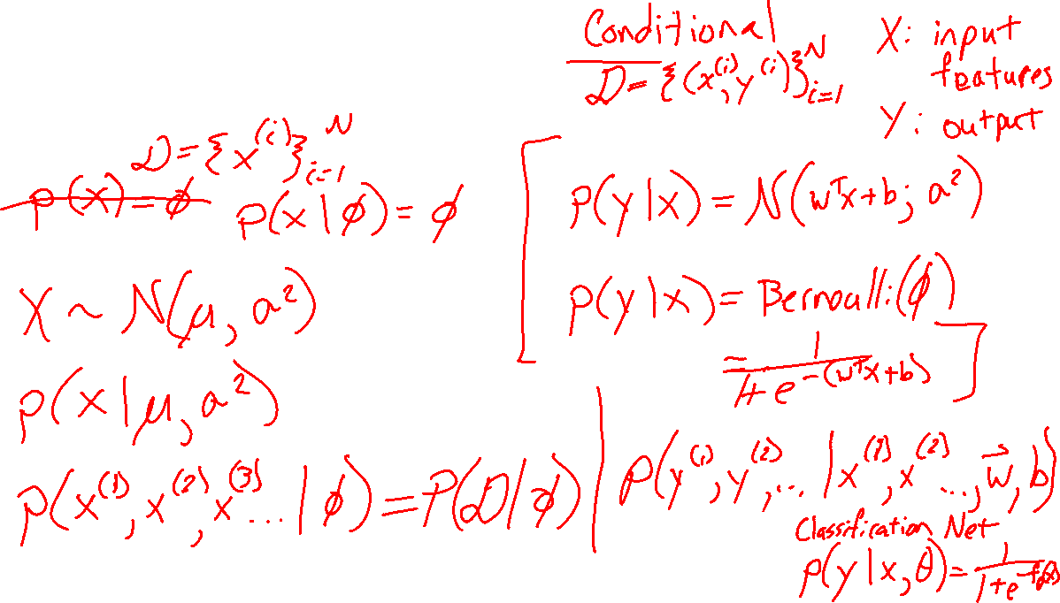
Probability Notation
Density estimation
Coin flips
Exam grades
Supervised learning
Linear regression
Logistic regression
Neural networks?

Slide 8
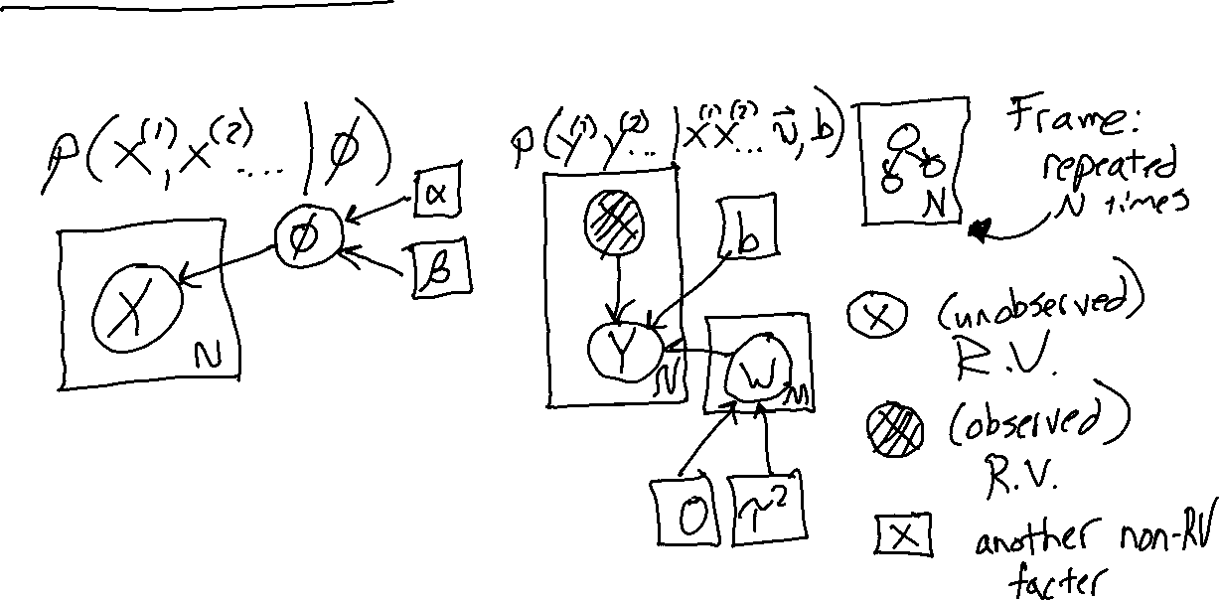
Graphical Model Notation (quick intro)
Density estimation
Coin flips
Supervised learning
Linear regression
Legend

Slide 9
ML Applications of Bayes Rule

Slide 10
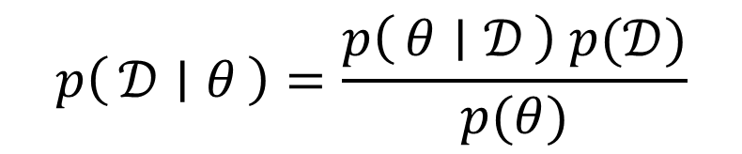
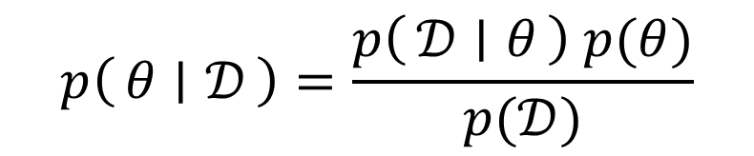
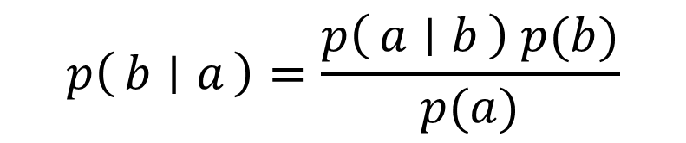
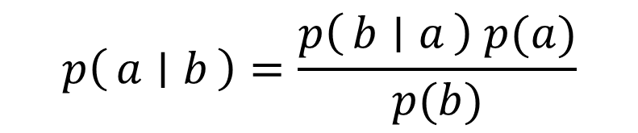
Bayes Rule
$$p\left(a ∣ b\right)=\frac{p\left(b ∣ a\right) p(a)}{p(b)}$$
$$p\left(b ∣ a\right)=\frac{p\left(a ∣ b\right) p(b)}{p(a)}$$
$$p\left(θ ∣ 𝒟\right)=\frac{p\left(𝒟 ∣ θ\right) p(θ)}{p(𝒟)}$$
$$p\left(𝒟 ∣ θ\right)=\frac{p\left(θ ∣ 𝒟\right) p(𝒟)}{p(θ)}$$

Slide 11
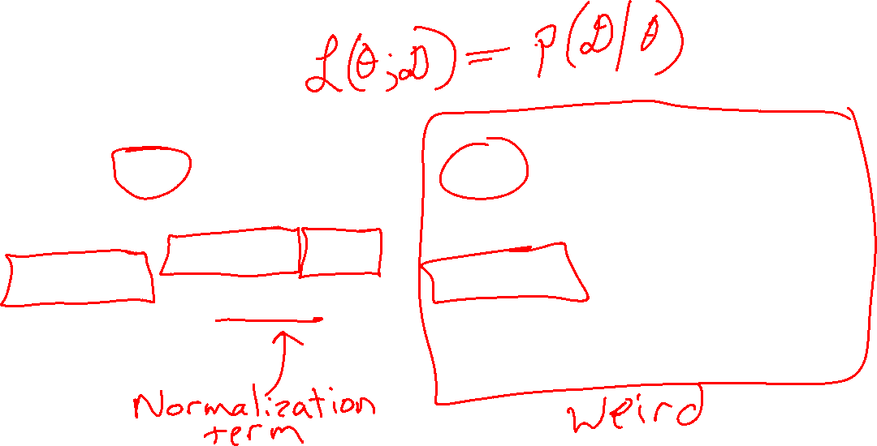
Poll 1
Which of these terms is the likelihood?
Select all that apply
A
B
C
E
F
G
$$p\left(θ ∣ 𝒟\right)=\frac{p\left(𝒟 ∣ θ\right) p(θ)}{p(𝒟)}$$
$$p\left(𝒟 ∣ θ\right)=\frac{p\left(θ ∣ 𝒟\right) p(𝒟)}{p(θ)}$$
D
H

Slide 12
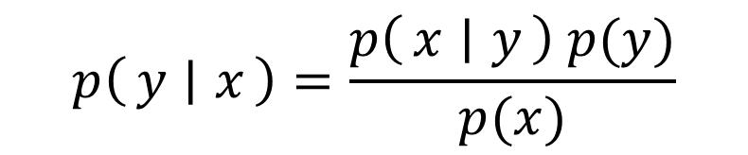
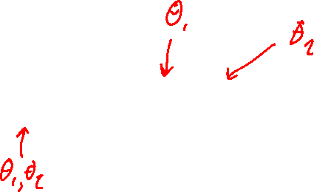
Poll
Which of these terms is the likelihood?
Select all that apply
A
B
C
E
F
G
$$p\left(θ ∣ 𝒟\right)=\frac{p\left(𝒟 ∣ θ\right) p(θ)}{p(𝒟)}$$
$$p\left(y ∣ x\right)=\frac{p\left(x ∣ y\right) p(y)}{p(x)}$$
D
H

Slide 13
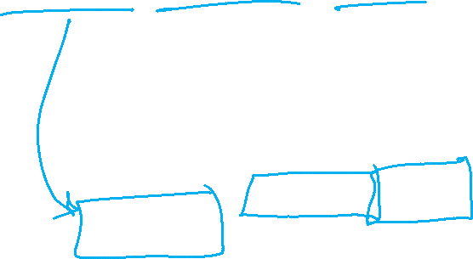
Bayes Rule
Terminology
Posterior Likelihood Prior
$$p\left(θ ∣ 𝒟\right)=\frac{p\left(𝒟 ∣ θ\right) p(θ)}{p(𝒟)}$$

Slide 14
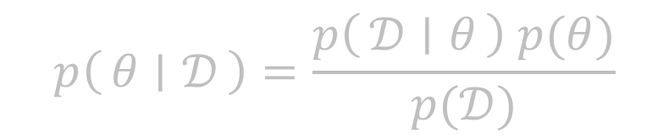
Bayes Rule
Terminology
Posterior Likelihood Prior
Posterior Class conditional Class prior
Conditional likelihood
$$p\left(θ ∣ 𝒟\right)=\frac{p\left(𝒟 ∣ θ\right) p(θ)}{p(𝒟)}$$
$$p\left(y ∣ x\right)=\frac{p\left(x ∣ y\right) p(y)}{p(x)}$$

Slide 15
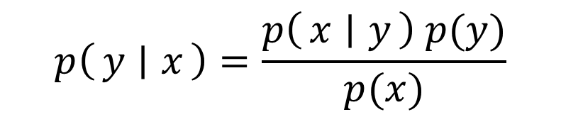
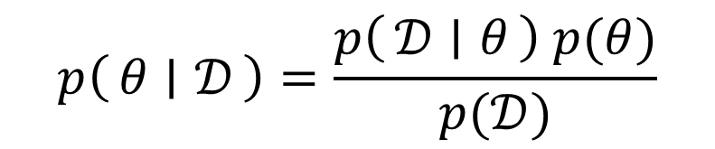
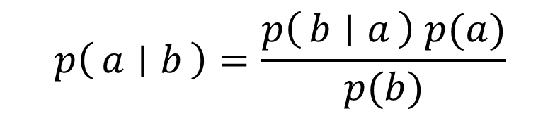
Two Applications of Bayes Rule
$$p\left(a ∣ b\right)=\frac{p\left(b ∣ a\right) p(a)}{p(b)}$$
$$p\left(θ ∣ 𝒟\right)=\frac{p\left(𝒟 ∣ θ\right) p(θ)}{p(𝒟)}$$
$$p\left(y ∣ x\right)=\frac{p\left(x ∣ y\right) p(y)}{p(x)}$$

Slide 16
MLE and MAP

Slide 17
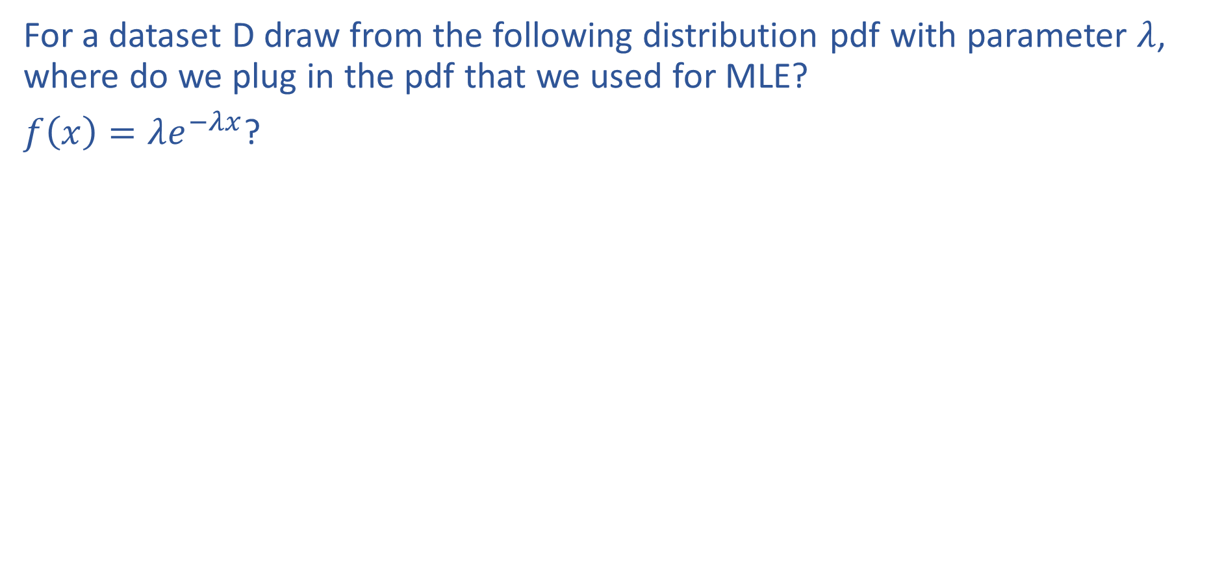
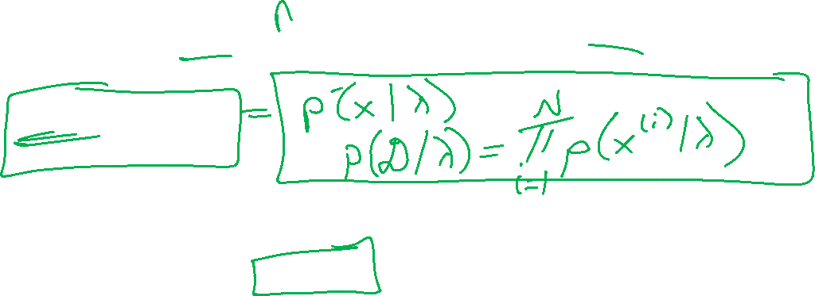
Poll 2
For a dataset D draw from the following distribution pdf with parameter $λ$, where do we plug in the pdf that we used for MLE?
$f\left(x\right)=λe^{−λx}$?
A
B
C
$$p\left(θ ∣ 𝒟\right)=\frac{p\left(𝒟 ∣ θ\right) p(θ)}{p(𝒟)}$$
D

Slide 18
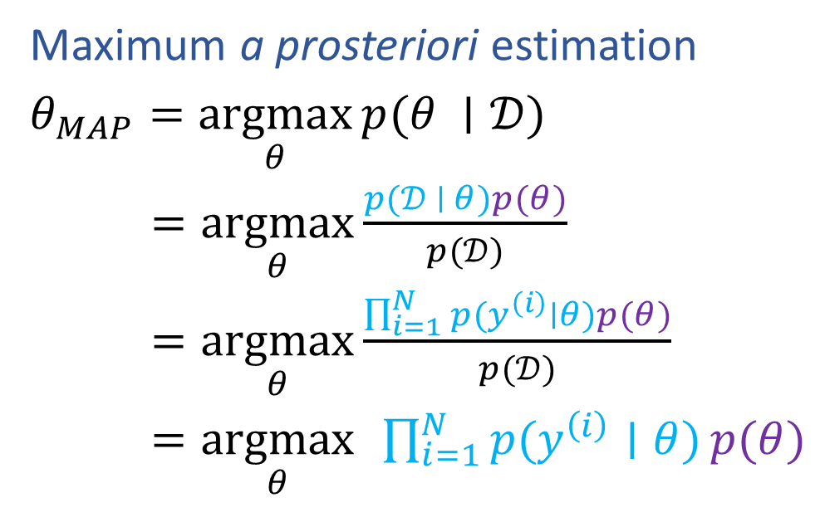
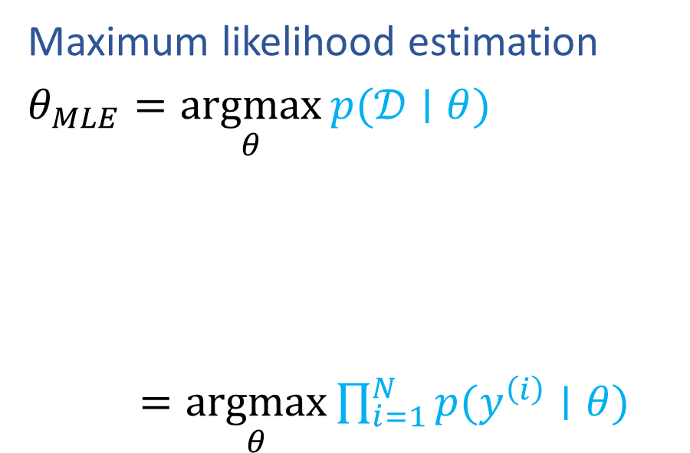
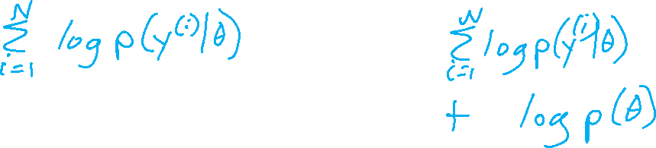
MLE and MAP
Maximum likelihood estimation
$θ_{MLE}=\underset{θ}{argmax}{p(𝒟∣θ)}$
$=\underset{θ}{argmax}{\prod_{i=1}^{N}{p(y^{\left(i\right)}∣θ)}}$
Maximum a prosteriori estimation
$θ_{MAP}=\underset{θ}{argmax}{p(θ ∣𝒟)}$
$=\underset{θ}{argmax}{\frac{p(𝒟 ∣ θ)p(θ)}{p(𝒟)}}$
$=\underset{θ}{argmax}{\frac{\prod_{i=1}^{N}{p(y^{\left(i\right)}∣θ)}p(θ)}{p(𝒟)}}$
$=\underset{θ}{argmax}{ }\prod_{i=1}^{N}{p(y^{\left(i\right)}∣θ)}p(θ)$

Slide 19
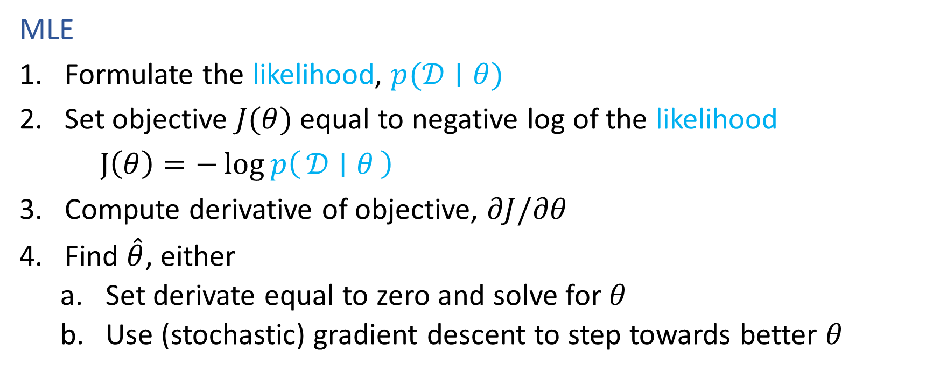
Recipe for Estimation
MLE
Formulate the likelihood, $p(𝒟∣θ)$
Set objective $J(θ)$ equal to negative log of the likelihood
$J\left(θ\right)=−\log{p\left(𝒟 ∣ θ\right)}$
Compute derivative of objective, $∂J/∂θ$
Find $\hat{θ}$, either
    Set derivate equal to zero and solve for $θ$
    Use (stochastic) gradient descent to step towards better $θ$

Slide 20
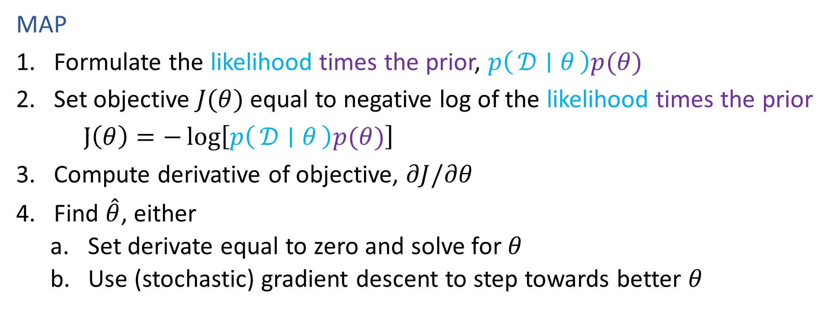
Recipe for Estimation
MAP
Formulate the likelihood times the prior, $p\left(𝒟 ∣ θ\right)p(θ)$
Set objective $J(θ)$ equal to negative log of the likelihood times the prior
$J\left(θ\right)=−\log\left[p\left(𝒟 ∣ θ\right)p(θ)\right]$
Compute derivative of objective, $∂J/∂θ$
Find $\hat{θ}$, either
    Set derivate equal to zero and solve for $θ$
    Use (stochastic) gradient descent to step towards better $θ$

Slide 21
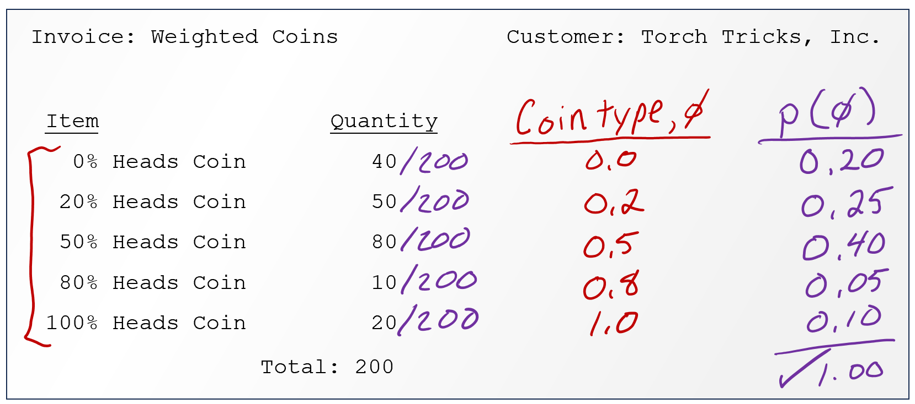

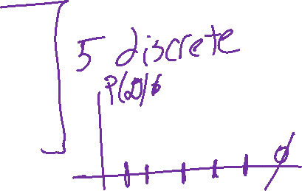
Coin Flipping Example
Trick coin from pre-reading
Initially: no information about the coin, so we just default to a uniform belief about the Bernoulli parameter $φ$

Slide 22
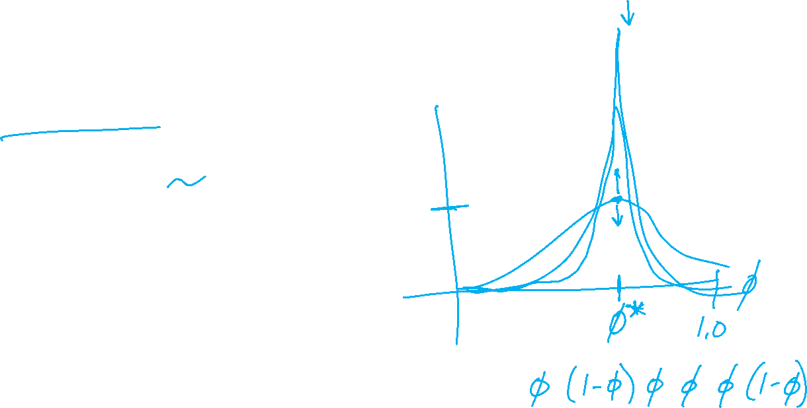
Poll 3
As we collect more and more data (more coin flips), will the peak of the likelihood curve increase or decrease?
Increase
Decrease
I have no idea

Slide 23

Coin Flipping Example
Trick coin from pre-reading
Suppose we discover information about the distribution of trick coin types? How can we use this information both before and after flipping coins?

Slide 24
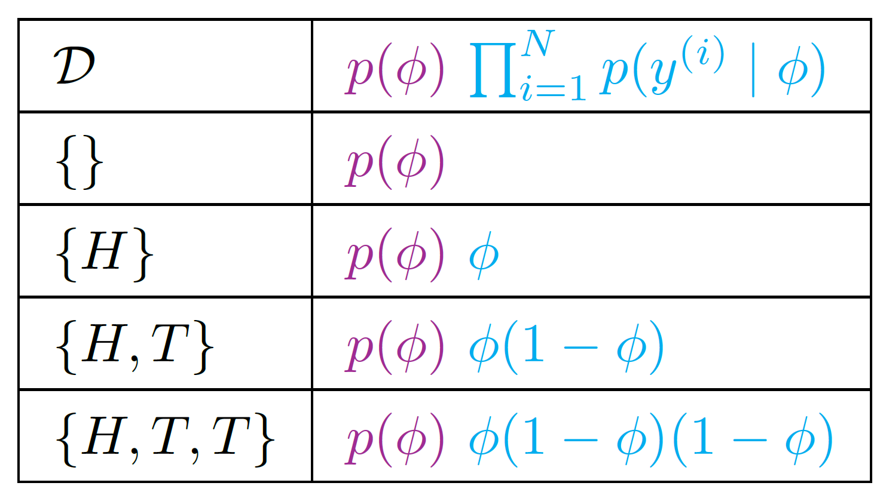
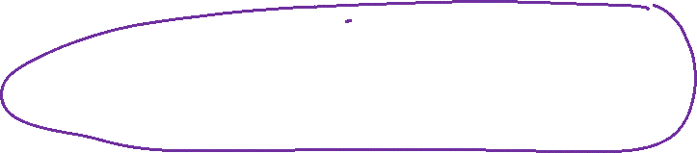
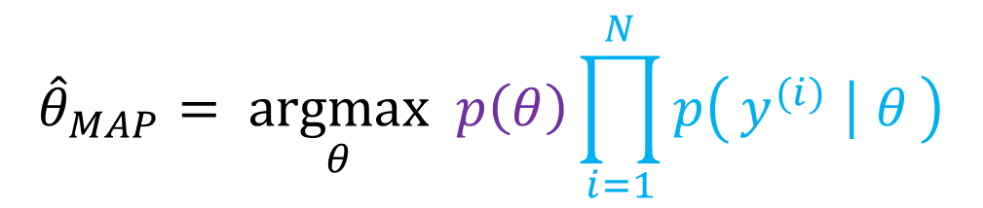
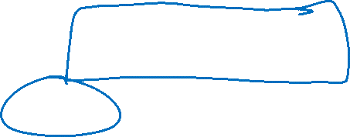
Coin Flipping Example
$${\hat{θ}}_{MAP}= \underset{θ}{argmax} p\left(θ\right)\prod_{i=1}^{N}{p\left(y^{(i)} ∣ θ\right)}$$
Trick coin from pre-reading
Suppose we discover information about the distribution of trick coin types? How can we use this information both before and after flipping coins?

Slide 25

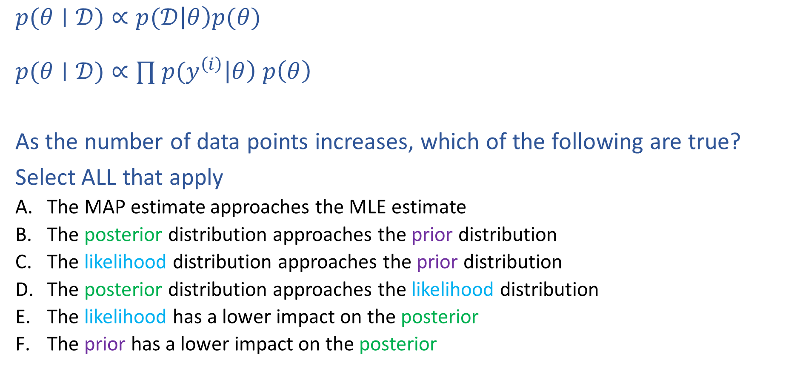
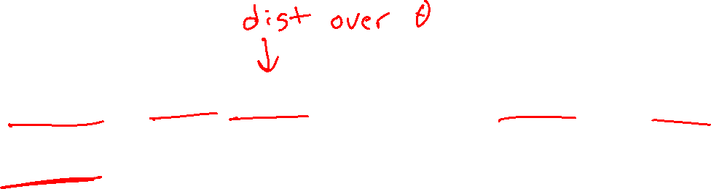
Poll 4
$$posterior∝likelihood⋅prior$$
$p(θ∣𝒟)∝p(𝒟\left|θ\right)p(θ)$
$p(θ∣𝒟)∝∏ p(y^{\left(i\right)}\left|θ\right) p\left(θ\right)$
As the number of data points increases, which of the following are true?
Select ALL that apply
  The MAP estimate approaches the MLE estimate
  The posterior distribution approaches the prior distribution
  The likelihood distribution approaches the prior distribution
  The posterior distribution approaches the likelihood distribution
  The likelihood has a lower impact on the posterior
  The prior has a lower impact on the posterior

Slide 26
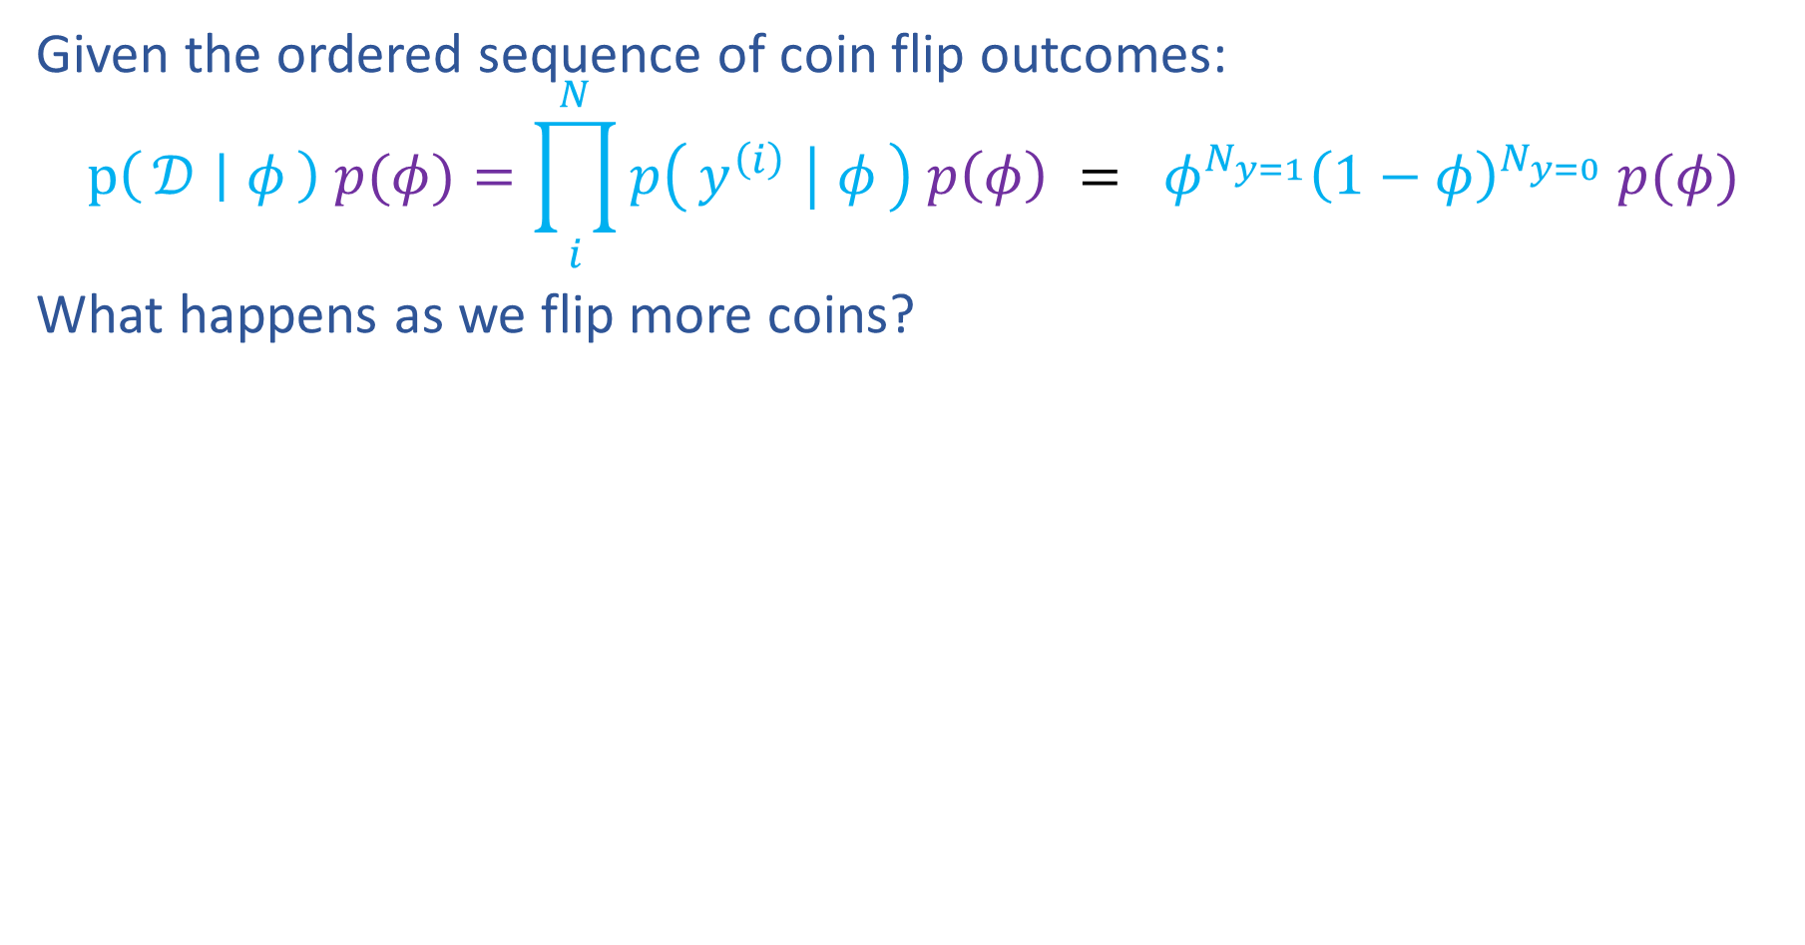
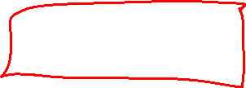
MAP as Data Increases
Given the ordered sequence of coin flip outcomes:
$$p\left(𝒟 ∣ φ\right) p(φ)=\prod_{i}^{N}{p\left(y^{\left(i\right)} ∣ φ\right) p\left(φ\right)} = φ^{N_{y=1}}{\left(1−φ\right)}^{N_{y=0}} p(φ)$$
What happens as we flip more coins?
$N=0: 𝒟=\{\}$

Slide 27
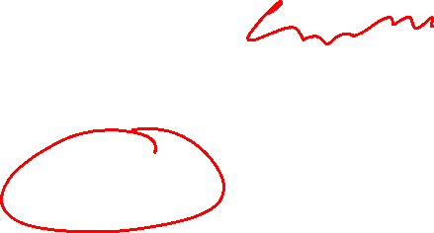

MAP as Data Increases
Given the ordered sequence of coin flip outcomes:
$$p\left(𝒟 ∣ φ\right) p(φ)=\prod_{i}^{N}{p\left(y^{\left(i\right)} ∣ φ\right) p\left(φ\right)} = φ^{N_{y=1}}{\left(1−φ\right)}^{N_{y=0}} p(φ)$$
What happens as we flip more coins?
$N=0: 𝒟=\{H\}$

Slide 28
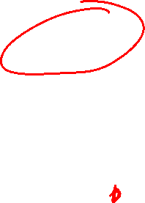

MAP as Data Increases
Given the ordered sequence of coin flip outcomes:
$$p\left(𝒟 ∣ φ\right) p(φ)=\prod_{i}^{N}{p\left(y^{\left(i\right)} ∣ φ\right) p\left(φ\right)} = φ^{N_{y=1}}{\left(1−φ\right)}^{N_{y=0}} p(φ)$$
What happens as we flip more coins?
$N=0: 𝒟=\{H,T,T,T,T\}$

Slide 29
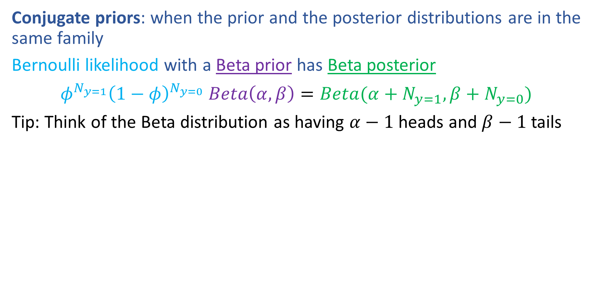
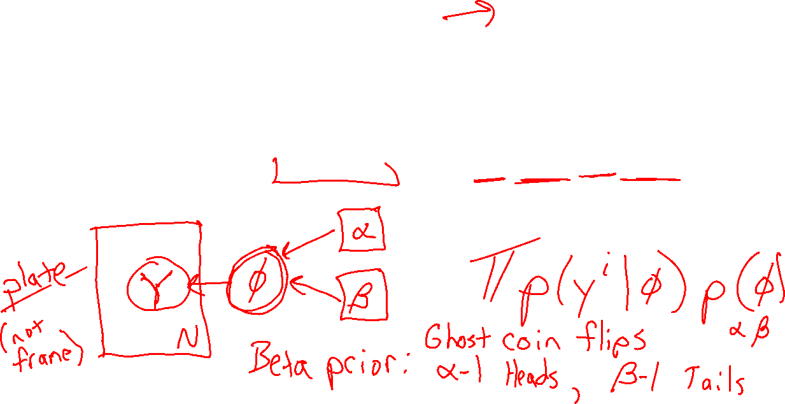
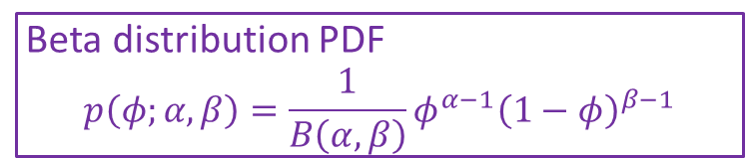
Prior Distributions for MAP
Beta distribution PDF
$$p\left(φ;α, β\right)=\frac{1}{B\left(α,β\right)}φ^{α−1}{\left(1−φ\right)}^{β−1}$$
Conjugate priors: when the prior and the posterior distributions are in the same family
Bernoulli likelihood with a Beta prior has Beta posterior
$φ^{N_{y=1}}{\left(1−φ\right)}^{N_{y=0}} Beta\left(α,β\right)=Beta(α+N_{y=1},β+N_{y=0})$
Tip: Think of the Beta distribution as having $α−1$ heads and $β−1$ tails
https://www.desmos.com/calculator/4528aa9fd0

Slide 30
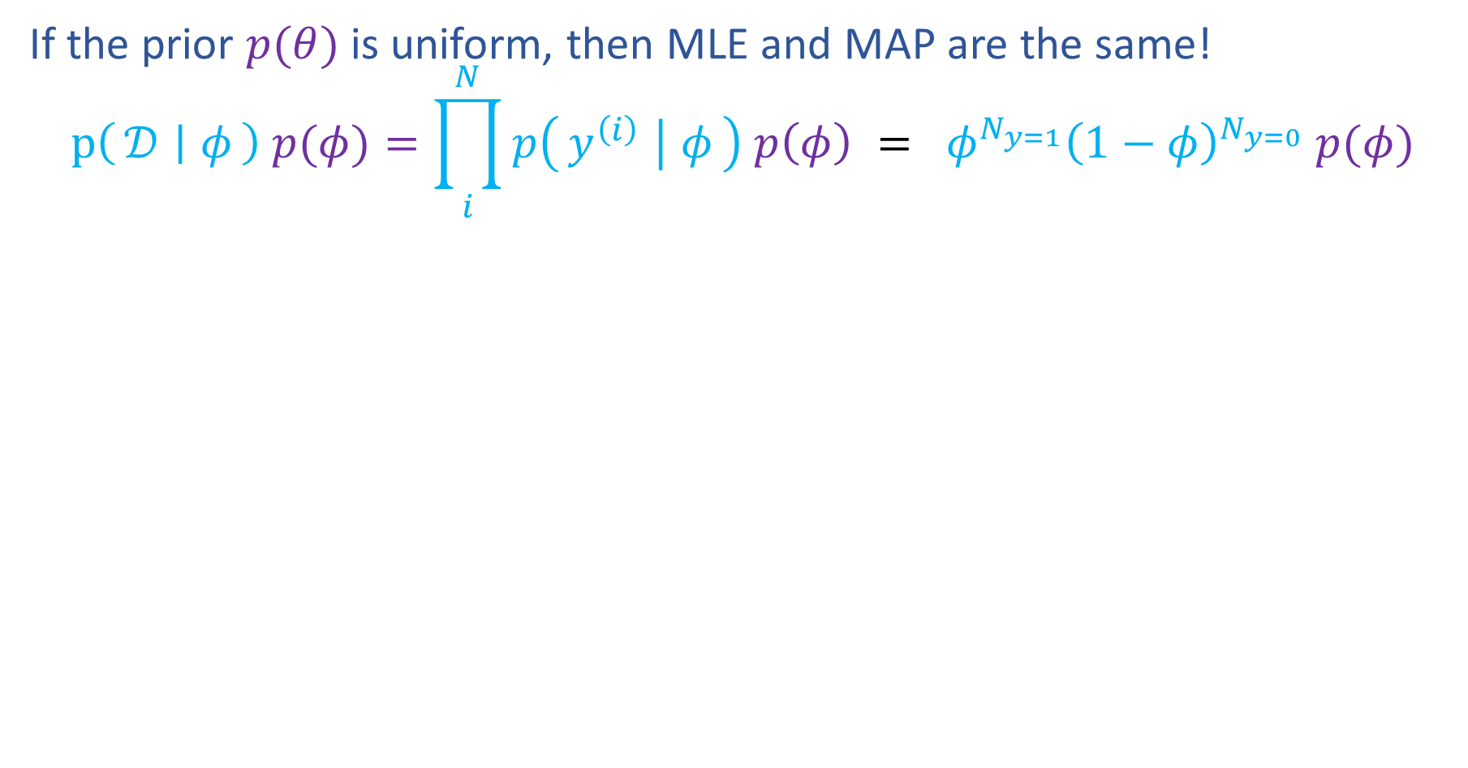
Prior Distributions for MAP
If the prior $p(θ)$ is uniform, then MLE and MAP are the same!
$$p\left(𝒟 ∣ φ\right) p(φ)=\prod_{i}^{N}{p\left(y^{\left(i\right)} ∣ φ\right) p\left(φ\right)} = φ^{N_{y=1}}{\left(1−φ\right)}^{N_{y=0}} p(φ)$$
https://www.desmos.com/calculator/kr7m2m6cf7

Slide 31
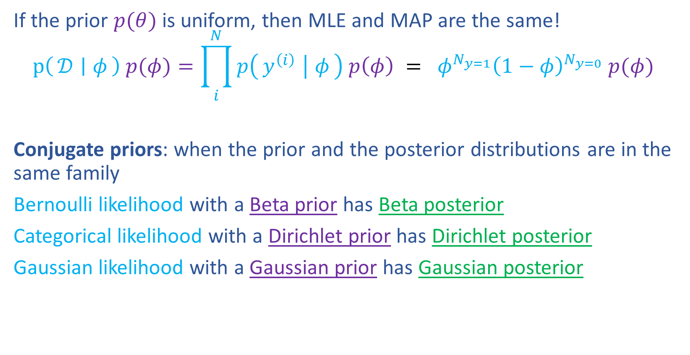

Prior Distributions for MAP
If the prior $p(θ)$ is uniform, then MLE and MAP are the same!
$$p\left(𝒟 ∣ φ\right) p(φ)=\prod_{i}^{N}{p\left(y^{\left(i\right)} ∣ φ\right) p\left(φ\right)} = φ^{N_{y=1}}{\left(1−φ\right)}^{N_{y=0}} p(φ)$$
Conjugate priors: when the prior and the posterior distributions are in the same family
Bernoulli likelihood with a Beta prior has Beta posterior
Categorical likelihood with a Dirichlet prior has Dirichlet posterior
Gaussian likelihood with a Gaussian prior has Gaussian posterior
https://www.desmos.com/calculator/kr7m2m6cf7

Slide 32
MLE & MAP
Linear Regression

Slide 33
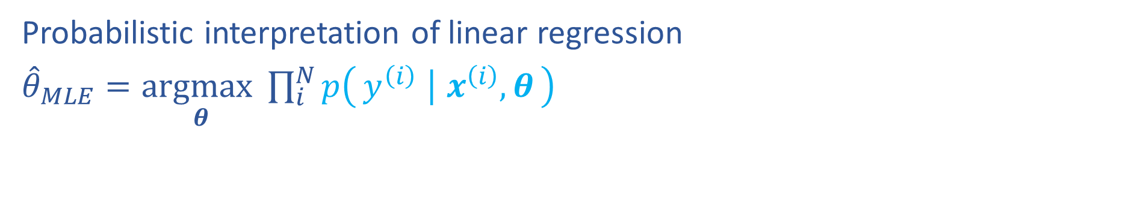
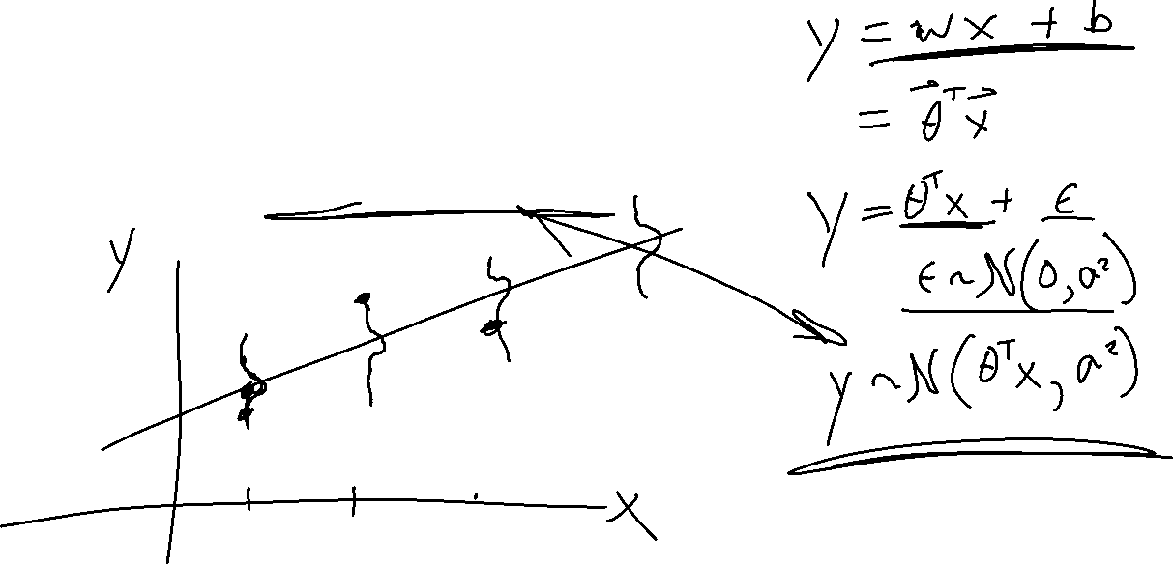
M(C)LE for Linear Regression
Probabilistic interpretation of linear regression
${\hat{θ}}_{MLE}=\underset{θ}{argmax}\prod_{i}^{N}{p\left(y^{\left(i\right)} ∣ x^{\left(i\right)}, θ\right)}$

Slide 34
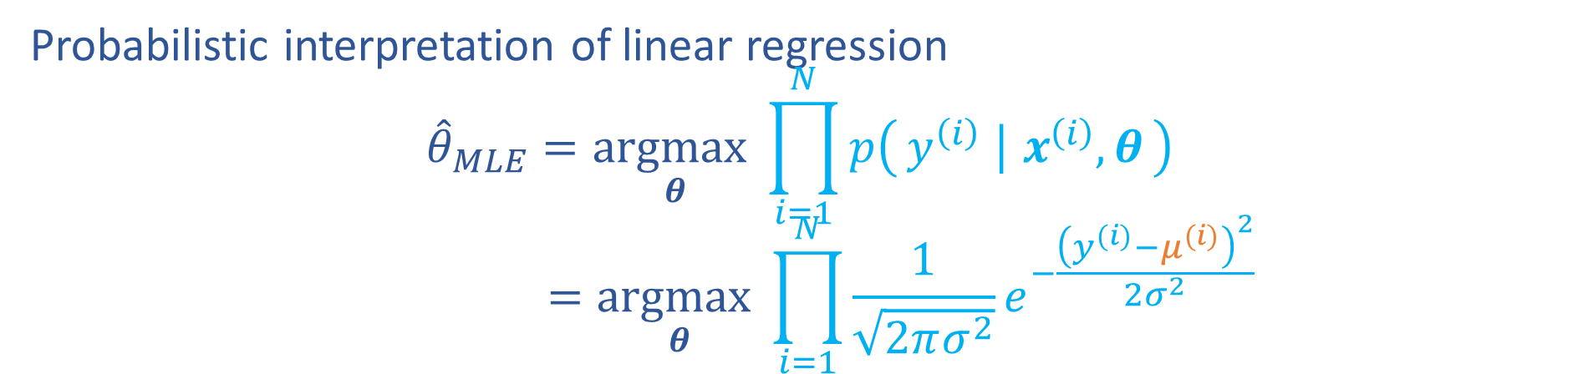
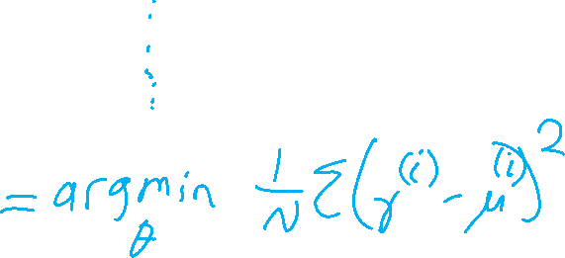
M(C)LE for Linear Regression
Probabilistic interpretation of linear regression
$${\hat{θ}}_{MLE}=\underset{θ}{argmax}\prod_{i=1}^{N}{p\left(y^{\left(i\right)} ∣ x^{\left(i\right)}, θ\right)}$$
$$=\underset{θ}{argmax}\prod_{i=1}^{N}{\frac{1}{\sqrt{2πσ^{2}}}e^{−\frac{{\left(y^{(i)}−μ^{(i)}\right)}^{2}}{2σ^{2}}}}$$
RECALL

Slide 35
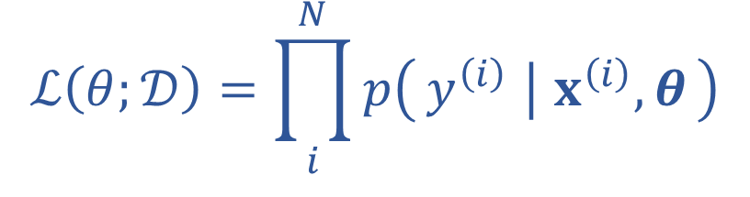




M(C)LE for Linear Regression
$$f\left(z;μ,σ^{2}\right)=\frac{1}{\sqrt{2πσ^{2}}}e^{\frac{−{\left(z−μ\right)}^{2}}{2σ^{2}}}$$
Probabilistic interpretation of linear regression
$$\prod_{i=1}^{N}{\frac{1}{\sqrt{2πσ^{2}}}e^{−\frac{{\left(z^{(i)}−μ\right)}^{2}}{2σ^{2}}}}$$
$$ℒ\left(θ;𝒟\right)=\prod_{i}^{N}{p\left(y^{\left(i\right)} ∣ x^{\left(i\right)}, θ\right)}$$
$$\sum_{i=1}^{N}{−log\sqrt{2πσ^{2}}−\frac{{\left(z^{(i)}−μ\right)}^{2}}{2σ^{2}}}$$
RECALL

Slide 36



MAP for Linear Regression
Example: Linear regression with polynomial feature maps
What do we want to make about our parameters?

Slide 37



MAP for Linear Regression
Recall prereading example of Gausssian prior for Gaussian likelihood
Linear Regression with Gaussian prior on weights

Slide 38




Regularization and MAP
$$y \sim 𝒩(w^{⊤}x+b,σ^{2})$$
Linear Regression
$${\hat{θ}}_{MAP}=\underset{θ}{argmax}\prod_{i=1}^{N}{p\left(y^{\left(i\right)} ∣ x^{\left(i\right)}, θ\right)}$$
$$=\underset{θ}{argmax}\prod_{i=1}^{N}{\frac{1}{\sqrt{2πσ^{2}}}e^{−\frac{{\left(y^{(i)}−μ^{(i)}\right)}^{2}}{2σ^{2}}}}$$

Slide 39

Regularization and MAP
Linear Regression

