Slide 1
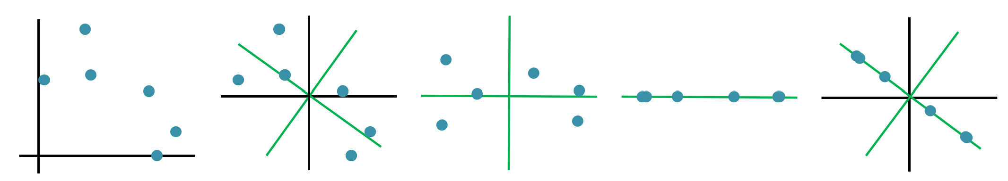
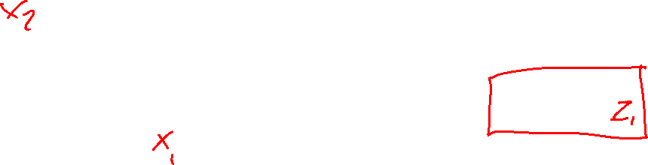
07-380 AI & ML II
Low-rank Optimization & PCA
Instructors: Pat Virtue & Mohammad Salameh
Slide credits: CMU AI with drawings from http://ai.berkeley.edu

Slide 2
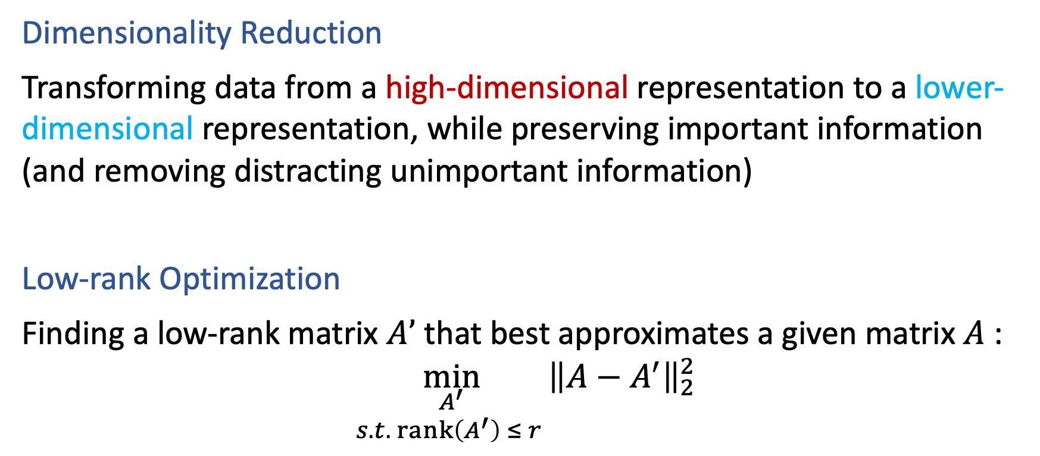
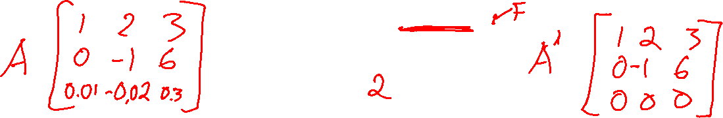
Some Definitions to Start
Dimensionality Reduction
Transforming data from a high-dimensional representation to a lower-dimensional representation, while preserving important information (and removing distracting unimportant information)
Low-rank Optimization
Finding a low-rank matrix $A’$ that best approximates a given matrix $A$:
$${\min_{\begin{aligned}A^{′} \\ s.t. rank\left(A^{′}\right) ≤ r \end{aligned}}\left\|A−A^{′}\right\|}_{2}^{2}$$

Slide 3
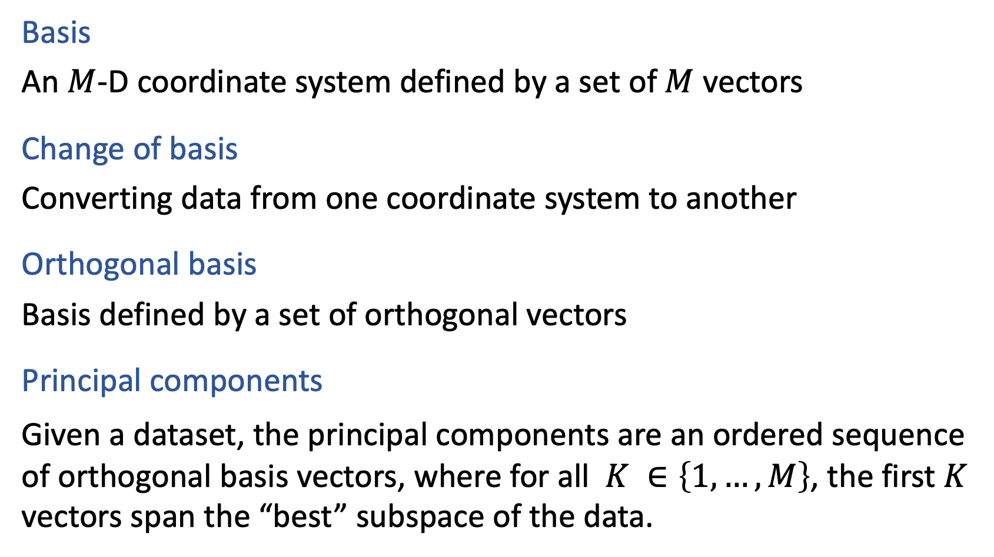

Some Definitions to Start
(pardon the simplification of linear algebra terms)
Basis
An $M$-D coordinate system defined by a set of $M$ vectors
Change of basis
Converting data from one coordinate system to another
Orthogonal basis
Basis defined by a set of orthogonal vectors
Principal components
Given a dataset, the principal components are an ordered sequence of orthogonal basis vectors, where for all $K ∈\left\{1,…,M\right\}$, the first $K$ vectors span the “best” subspace of the data.

Slide 4
PCA Example
MRI Growth Plate

Slide 5
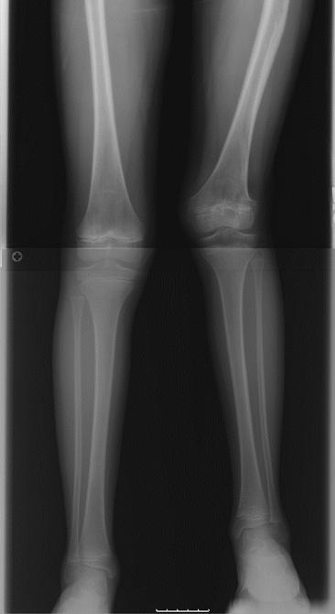
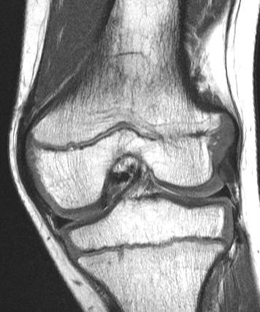
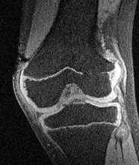
Growth Plate Imaging
Growth Plate Disruption and Limb Length Discrepancy
8 year-old boy with previous fracture and 4cm leg length discrepancy
Images Courtesy
H. Potter, H.S.S.

Slide 6
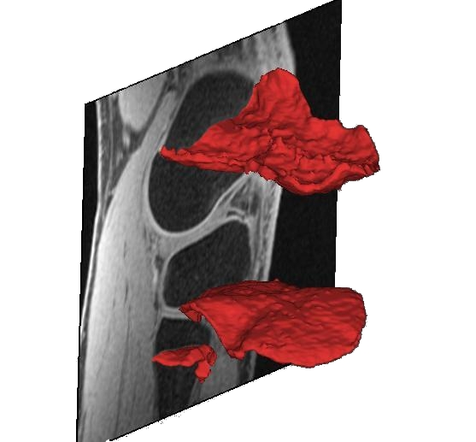


Growth Plate Imaging
Growth Plate Disruption and Limb Length Discrepancy
8 year-old boy with previous fracture and 4cm leg length discrepancy
Images Courtesy
H. Potter, H.S.S.

Slide 7
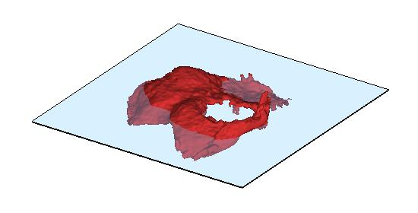
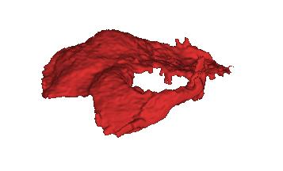
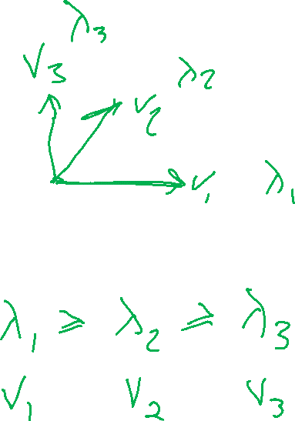
Growth Plate Imaging
Spoiler:
The PCA axes are eigenvectors!
Area Measurement

Slide 8
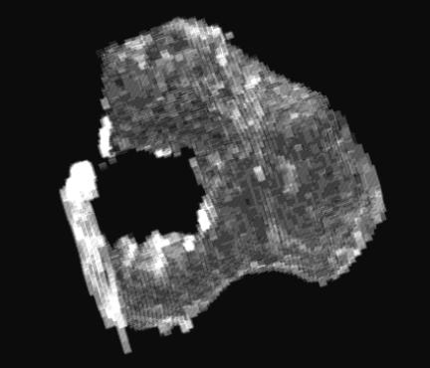
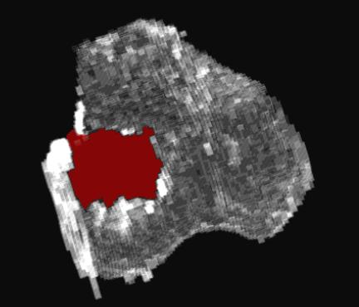
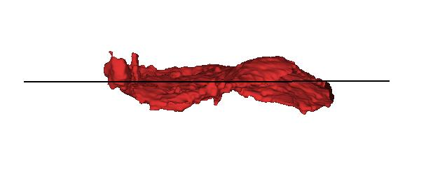
Growth Plate Imaging
Area Measurement
Flatten Growth Plate to Enable 2D Area Measurement

Slide 9
PCA Geometry Examples
2D: 1st and 2nd principal components
3D: 1st, 2nd, 3rd principal components

Slide 10
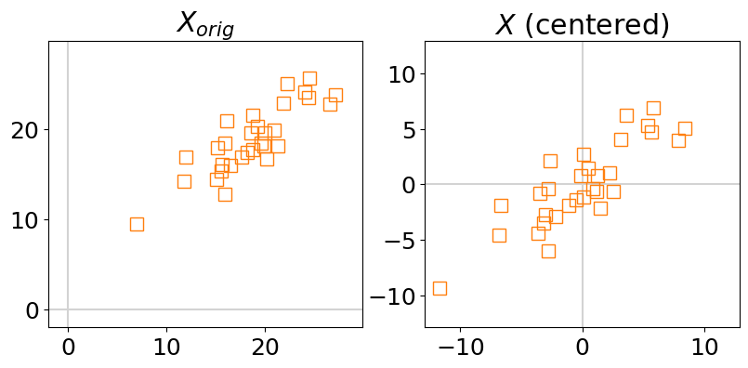
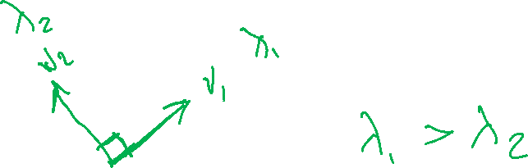
Principal Component Axes
2-D Gaussian Data: 1st and 2nd principal component axes
Spoiler: The PCA axes can be found using eigenvectors!

Slide 11
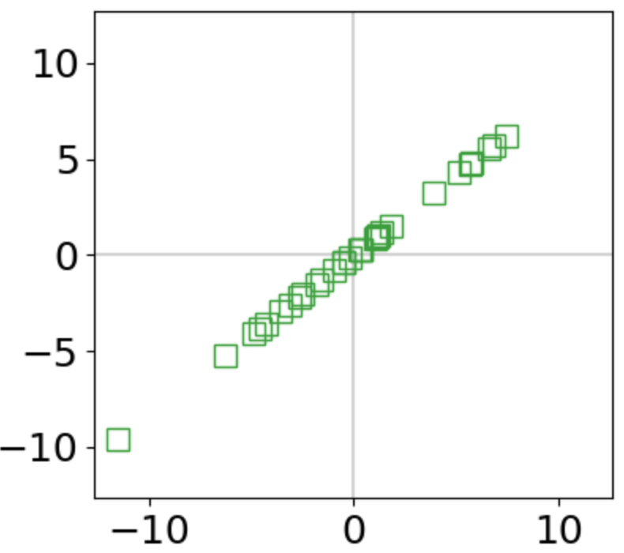
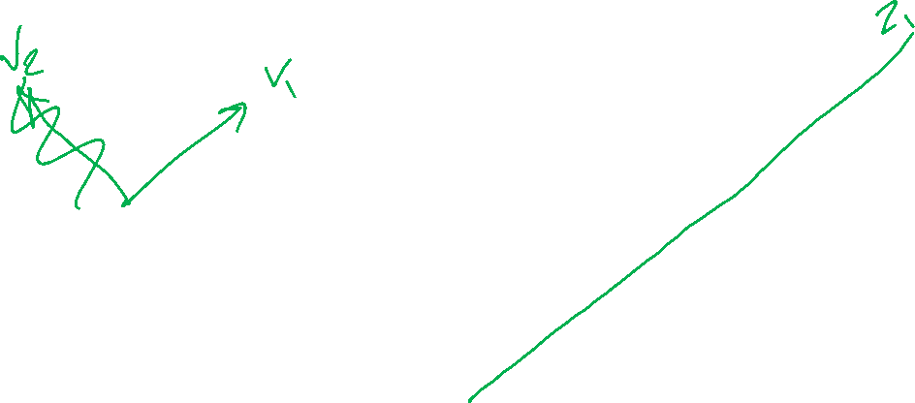
PCA Dimensionality Reduction
2-D Gaussian Data: Reduced along 1st principal component

Slide 12
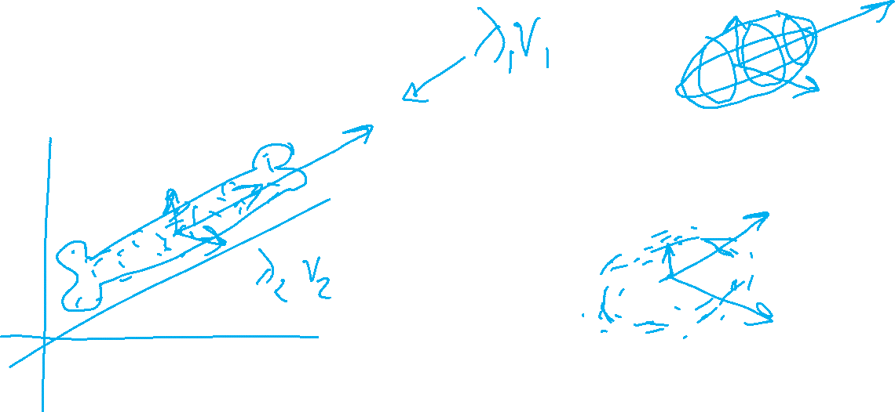
PCA Axes
3-D Data

Slide 13
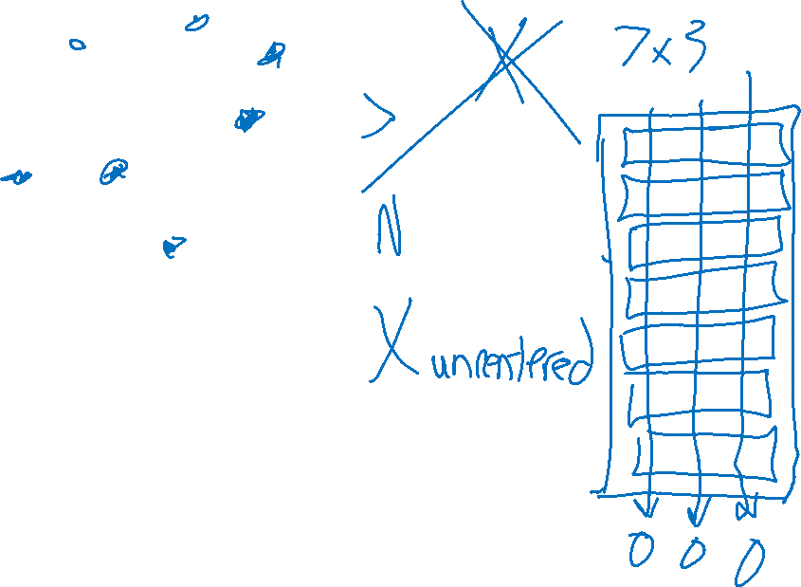
PCA Prepwork
Centering the data

Slide 14

PCA: Pre-processing
What if the data isn't centered

Slide 15
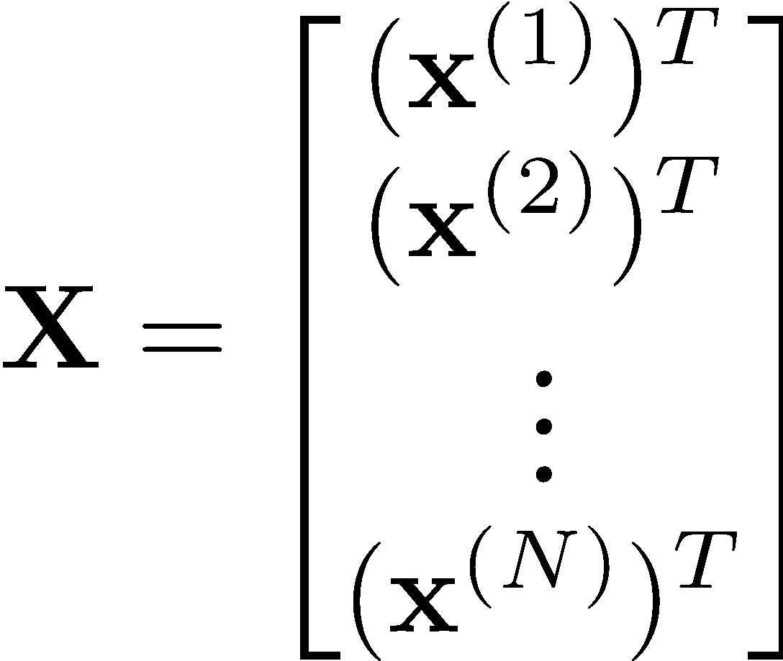
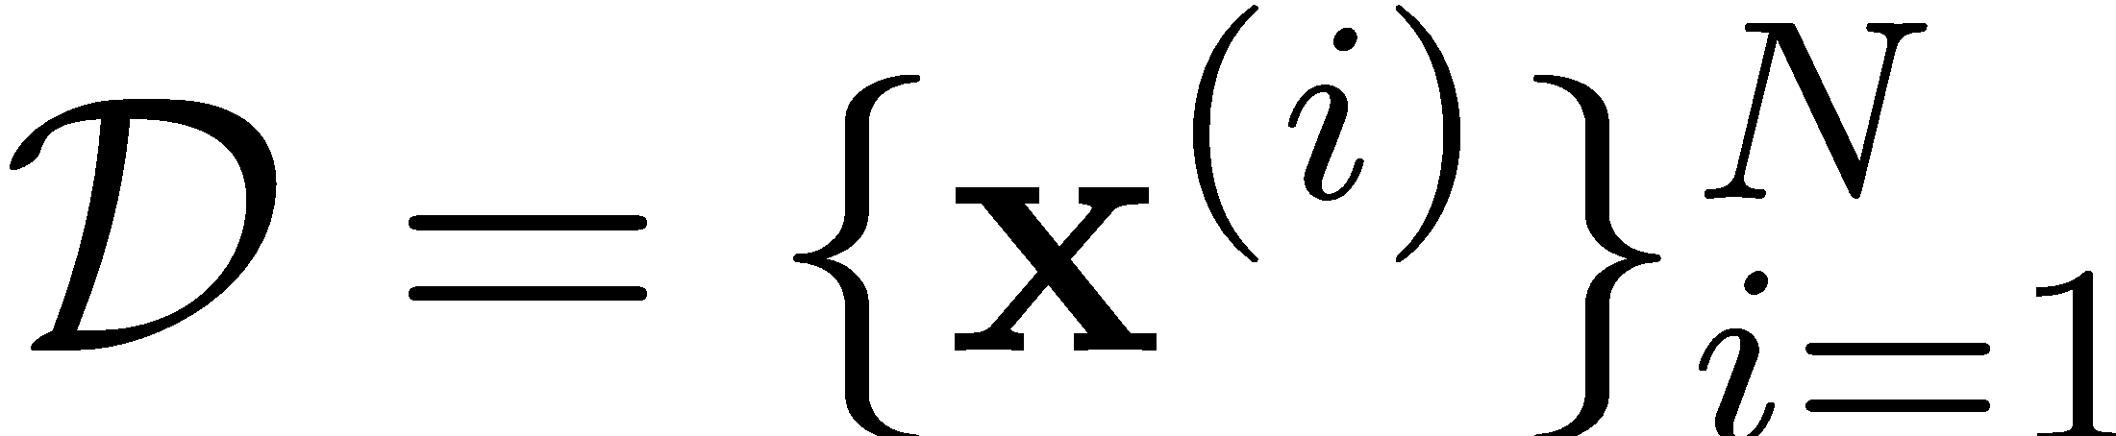
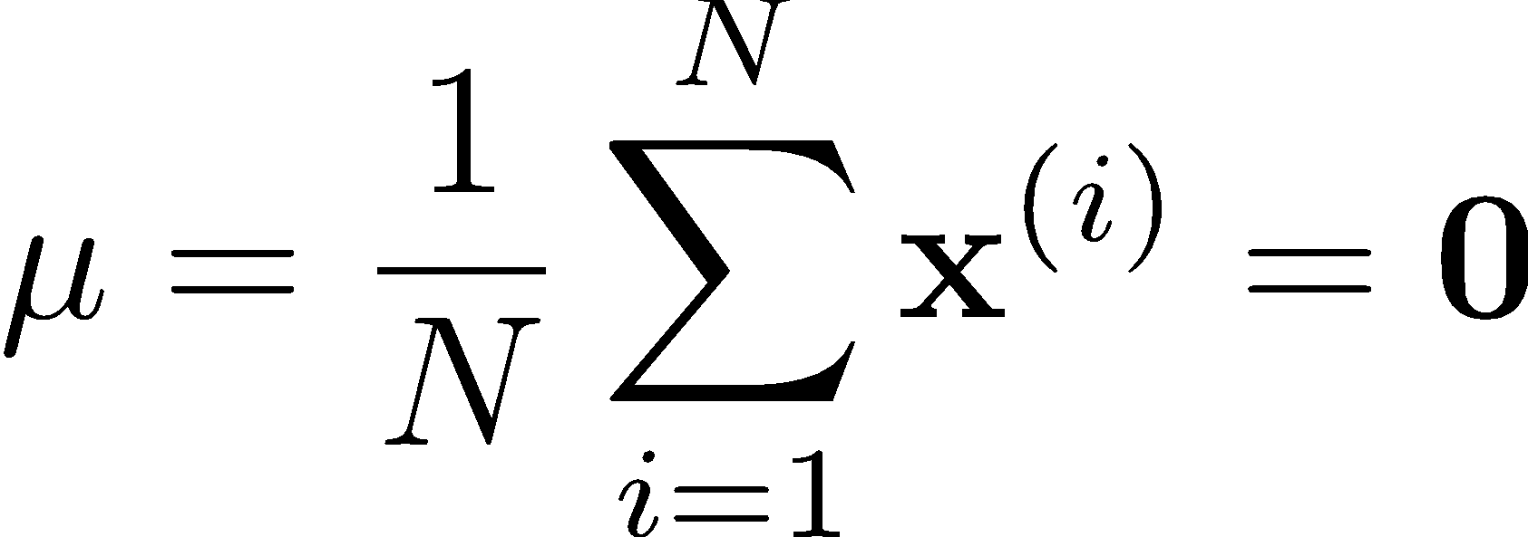

PCA: Centering Data
We assume the data is centered
Q: What if your data is not centered?
A: Subtract off the sample mean
Slide from Matt Gormley

Slide 16
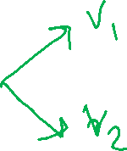
PCA Coordinate Transforms
Sketcing by hand

Slide 17
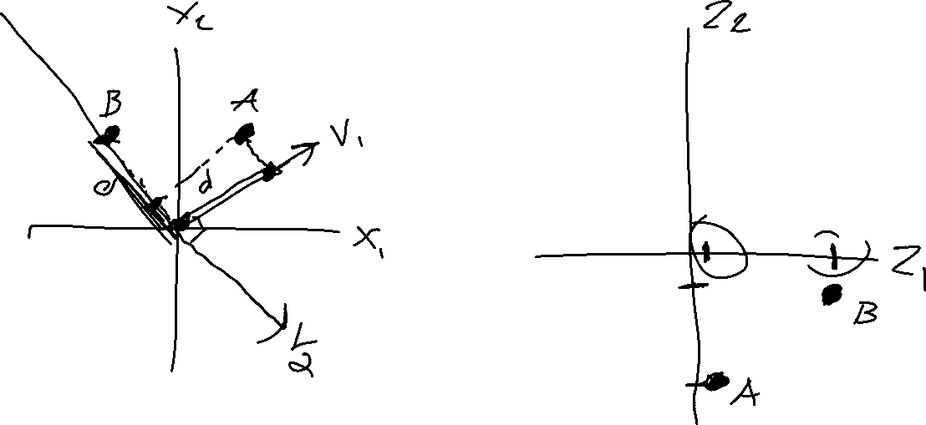

Slide 18
PCA Coordinate Transforms
Using Linear Algebra

Slide 19
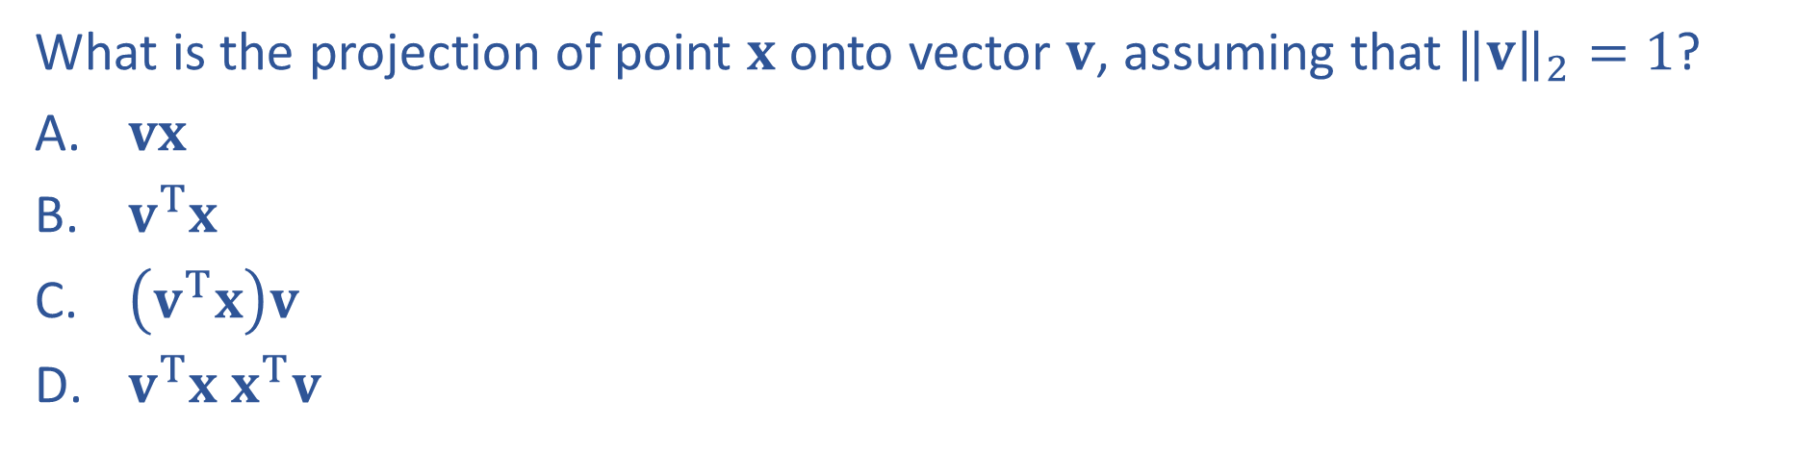
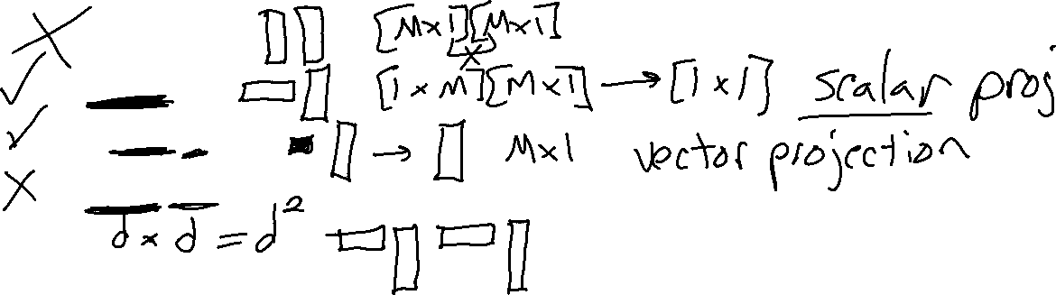
Poll 1

Slide 20
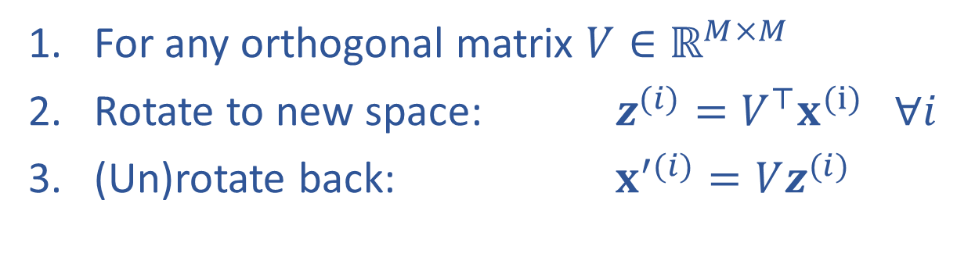
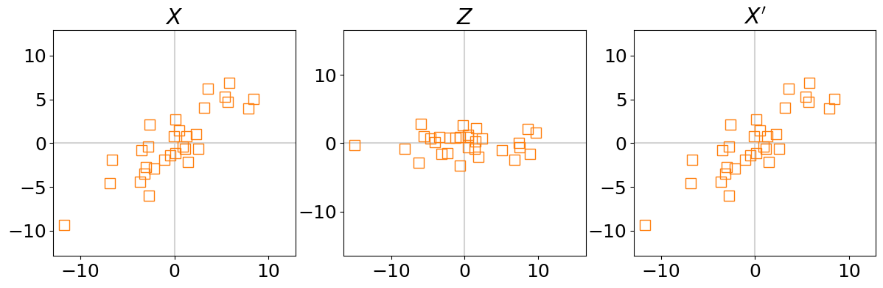

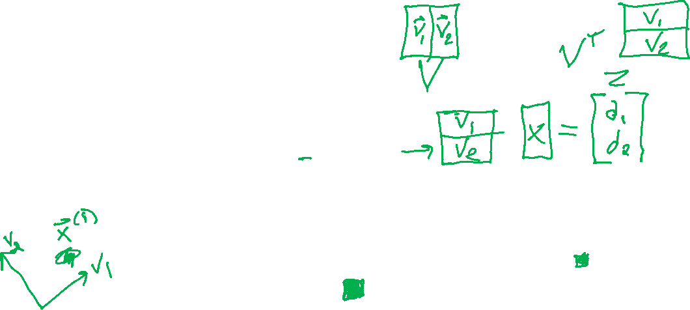
Rotation of Data (and back)

Slide 21
PCA Algorithm

Slide 22
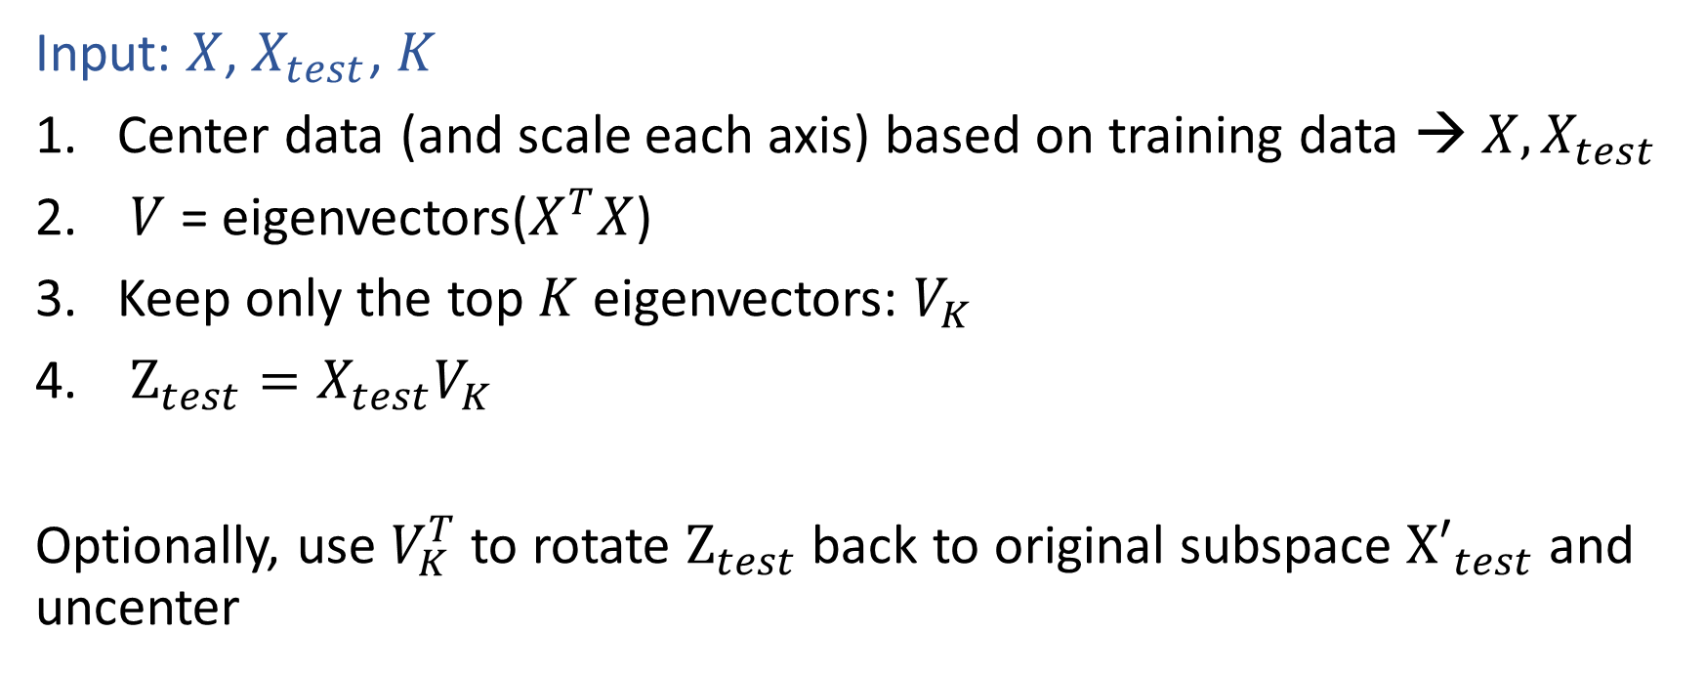

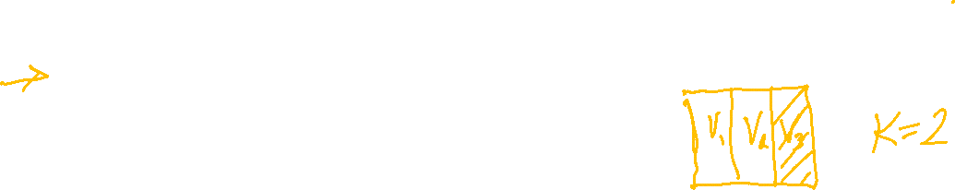
PCA Algorithm

Slide 23
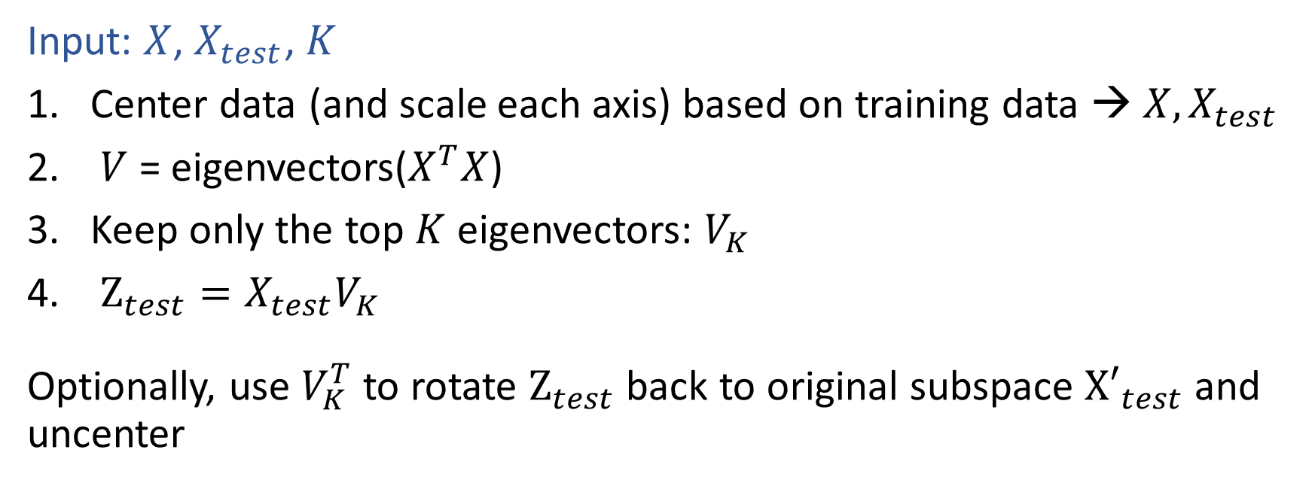
PCA Algorithm

Slide 24
PCA Algorithm

Slide 25

PCA Algorithm

Slide 26

PCA Objective for
Finding the 1st Principal Component
- Minimizing Reconstruction Error
- Maximizing Variance of (scalar) Projection

Slide 27
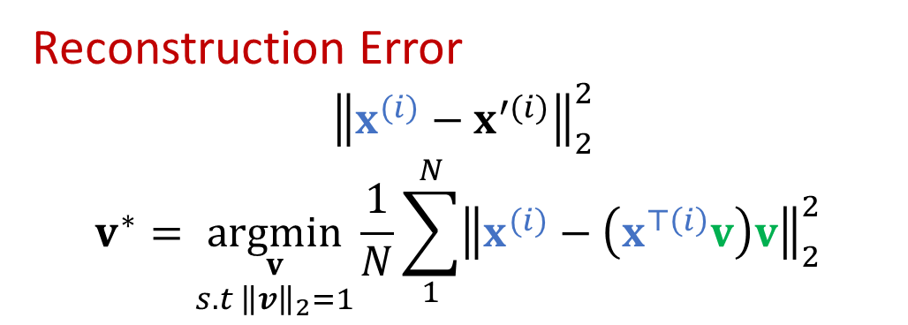
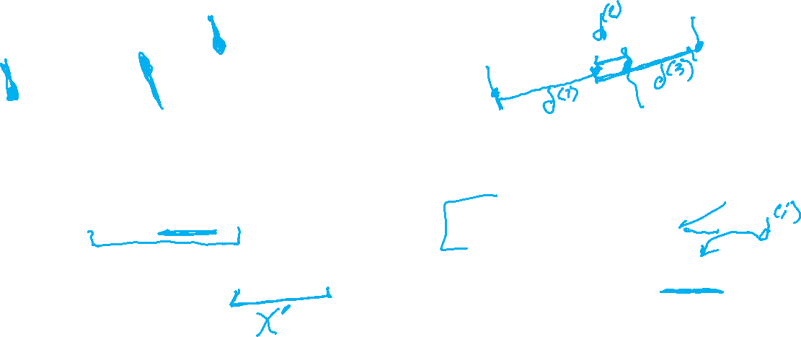
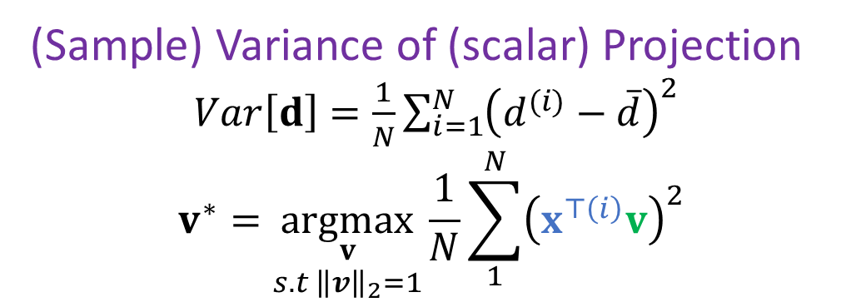
Select “Best” Vector
Reconstruction Error vs Variance of Projection
Reconstruction Error
$${\left\|x^{(i)}−x^{′(i)}\right\|}_{2}^{2}$$
$$v^{∗}=\underset{\begin{aligned}v \\ s.t {\left\|v\right\|}_{2}=1\end{aligned}}{argmin}{\frac{1}{N}\sum_{1}^{N}{{\left\|x^{(i)}−\left(x^{⊤\left(i\right)}v\right)v\right\|}_{2}^{2} }}$$
(Sample) Variance of (scalar) Projection
$Var\left[d\right]=\frac{1}{N}\sum_{i=1}^{N}{{\left(d^{(i)}−\overline{d}\right)}^{2}}$
$$v^{∗}=\underset{\begin{aligned}v \\ s.t {\left\|v\right\|}_{2}=1\end{aligned}}{argmax}{\frac{1}{N}\sum_{1}^{N}{{\left(x^{⊤\left(i\right)}v\right)}^{2} }}$$

Slide 28

Poll 2
Demo!
Play with the projection vector v in the Desmos Demo
What is the minimum Reconstruction MSE that you can find?
What is the maximum Variance of Scalar Projection that you can find?

Slide 29

Poll 3
Consider the two projections below
Q1) Which minimizes the reconstruction error?
Q2) Which maximizes the variance?
Option A
Option B

Slide 30
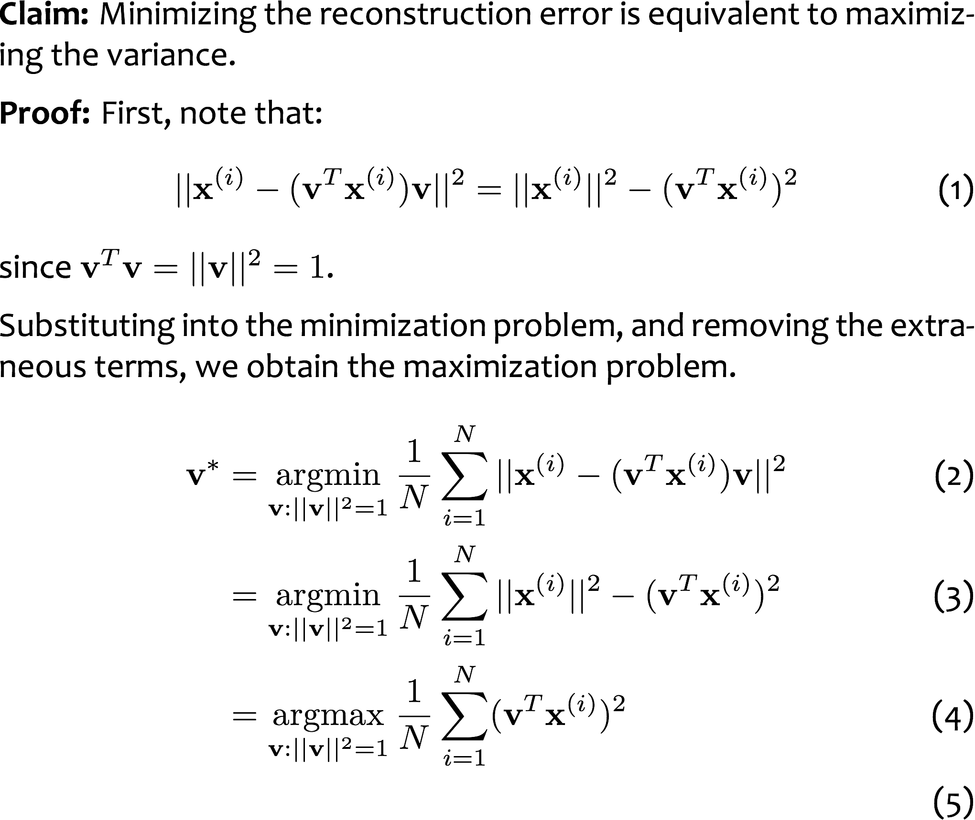
PCA Objective Equivalence
Equivalence of Maximizing Variance and Minimizing Reconstruction Error

Slide 31
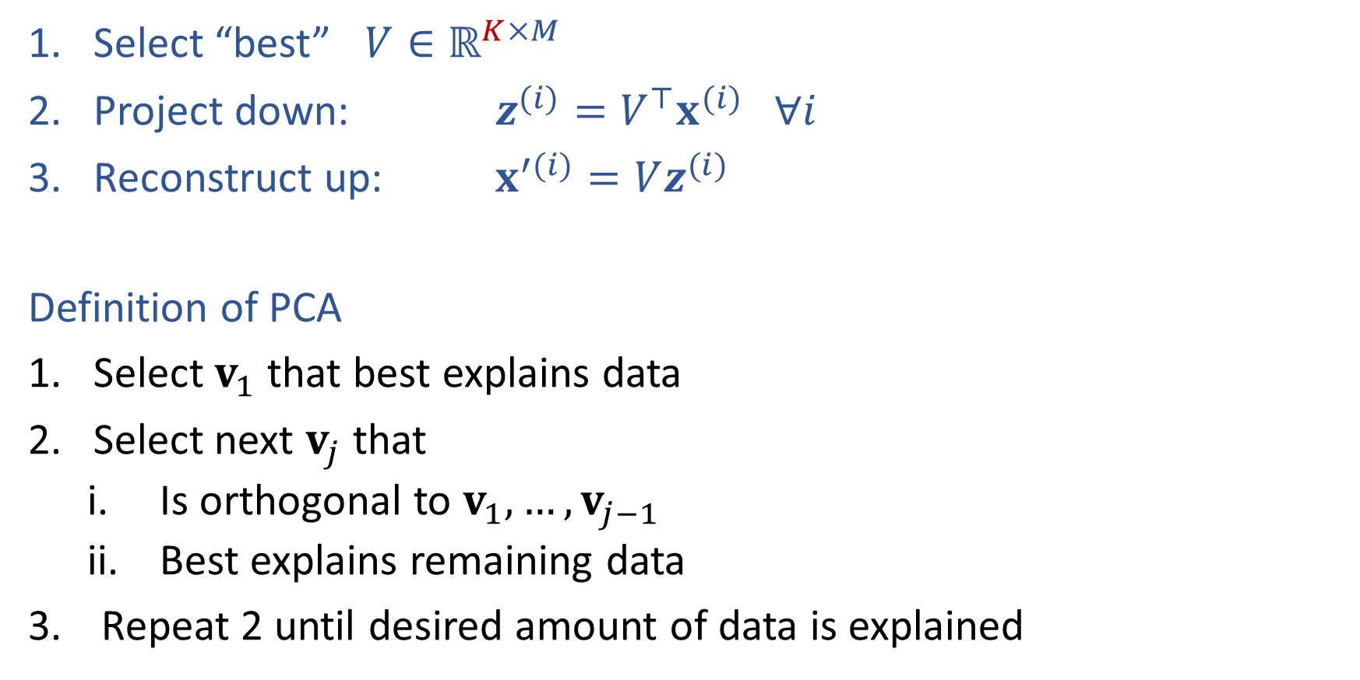


Sketch of PCA
Select "best" $V∈ℝ^{M×K}$
Project down: ${ z}^{(i)} =V^{⊤}x^{(i)} ∀ i$
Reconstruct up: $x^{′(i)}= V z^{(i)} ∀ i$

Slide 32
Eigenvectors of Covariance Matrix are the Principal Components!

Slide 33
PCA Eigenvalues and Eigenvectors

Slide 34
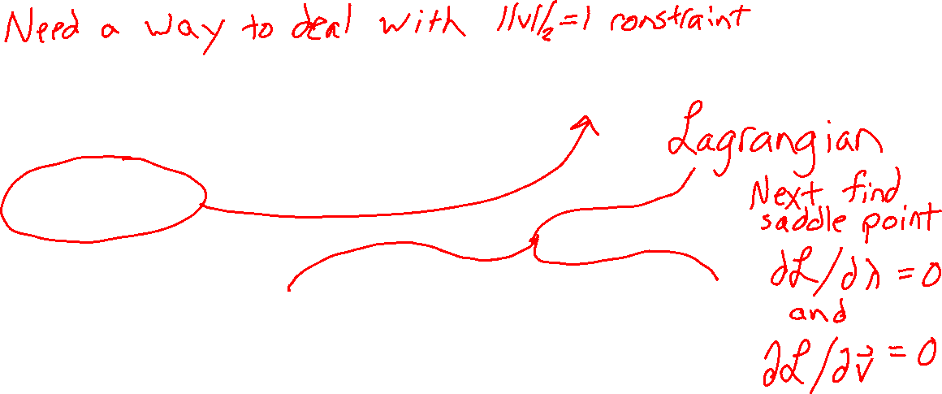
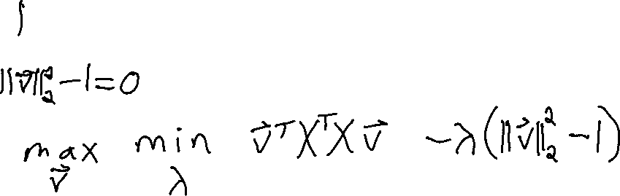
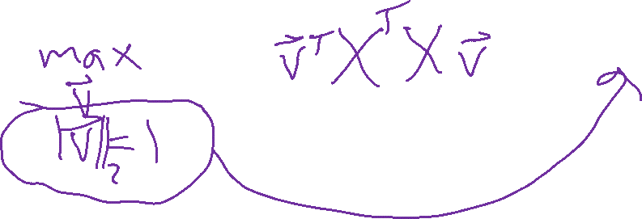
PCA: The First Principal Component
Use method of Lagrange multipliers to show that the first principal component is an eigenvalue of the covariance matrix

Slide 35
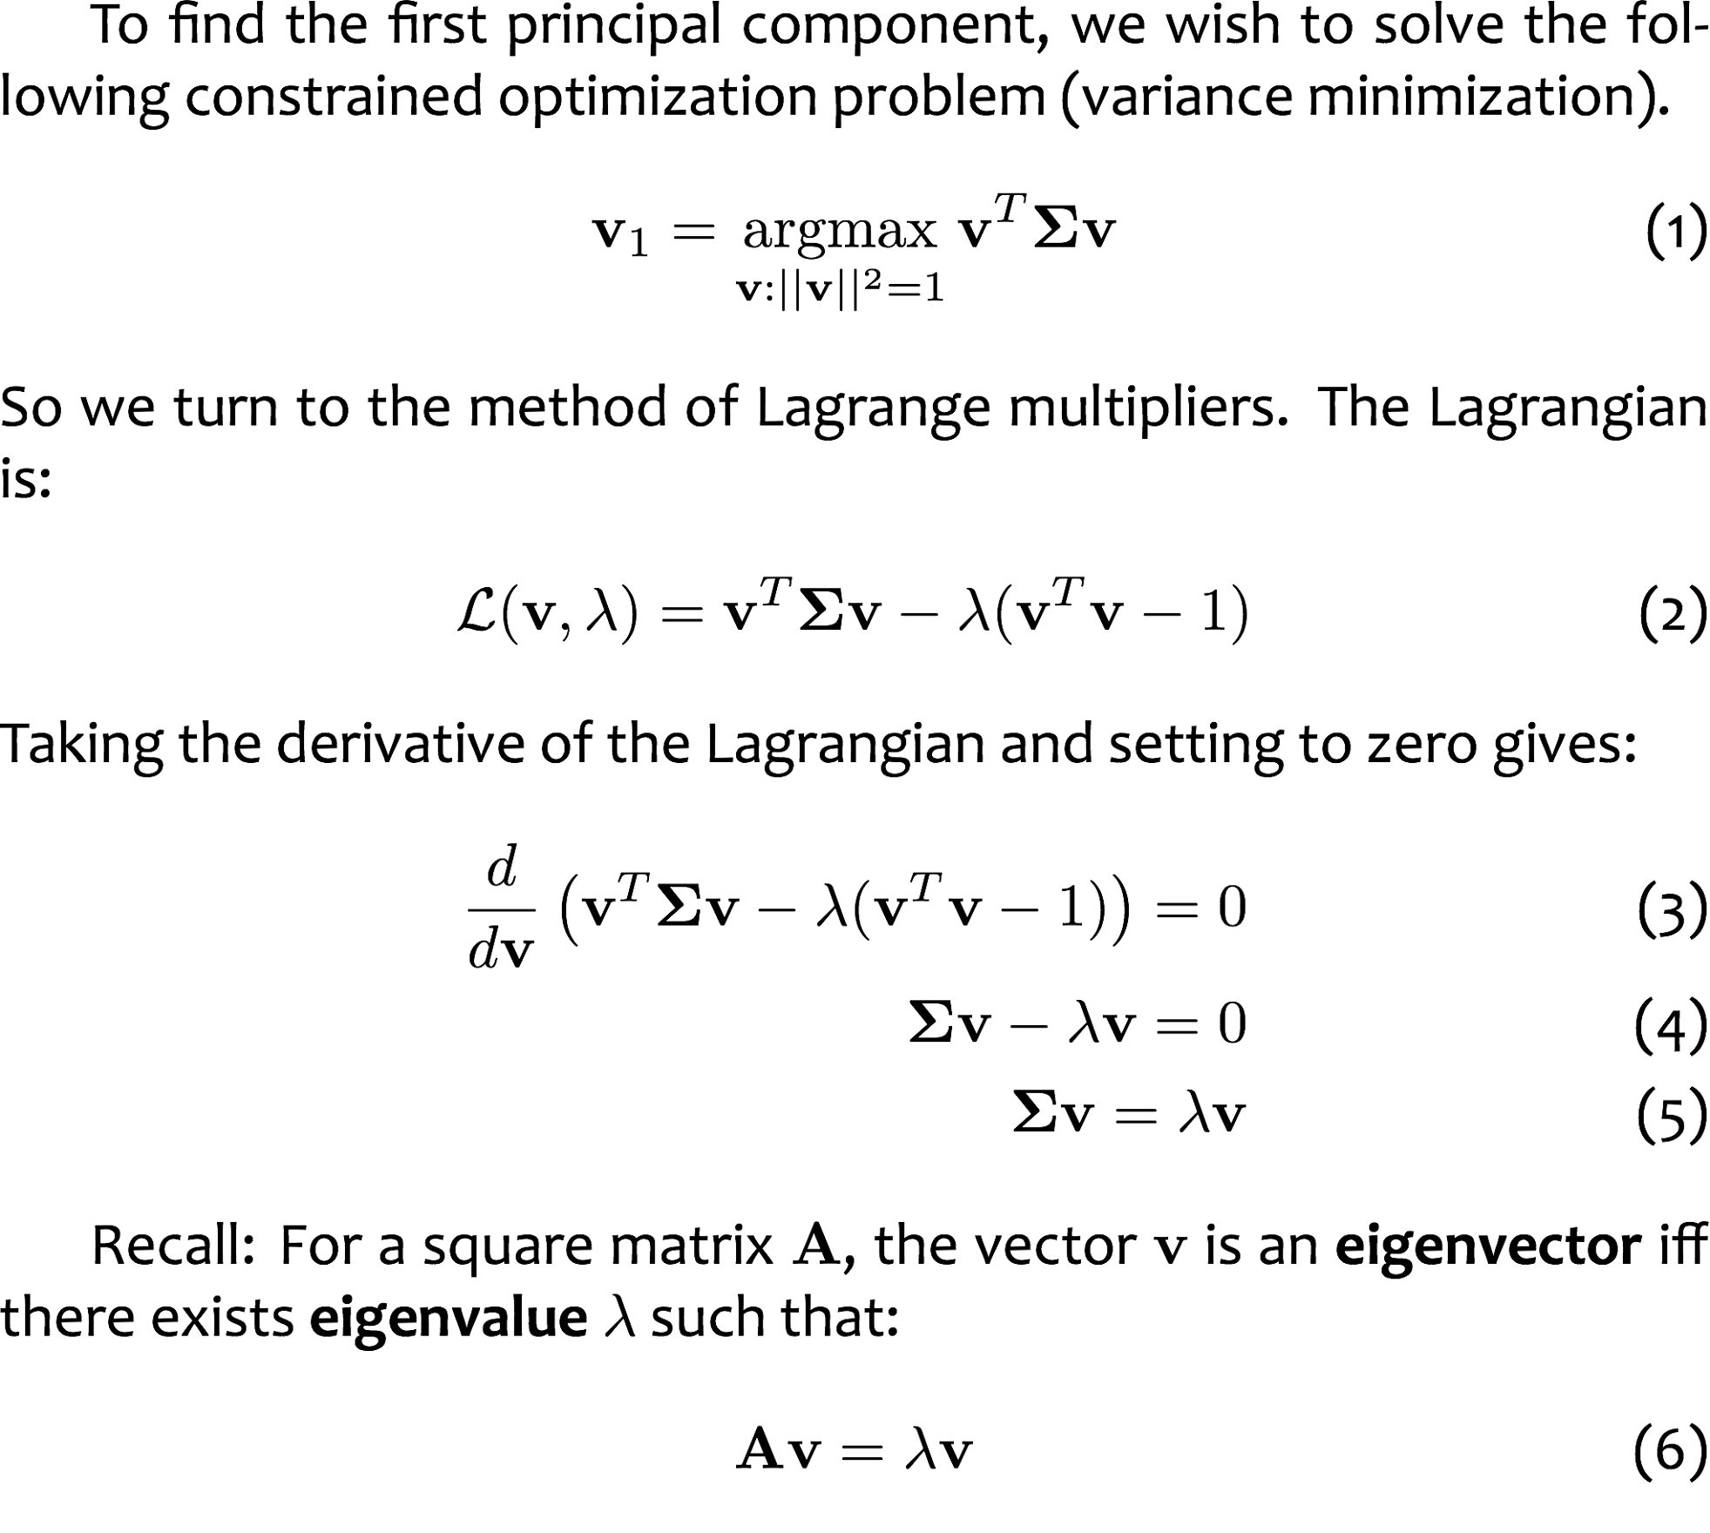

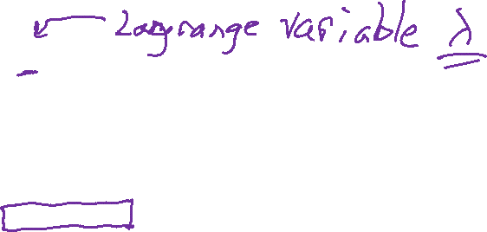
PCA: the First Principal Component

Slide 36
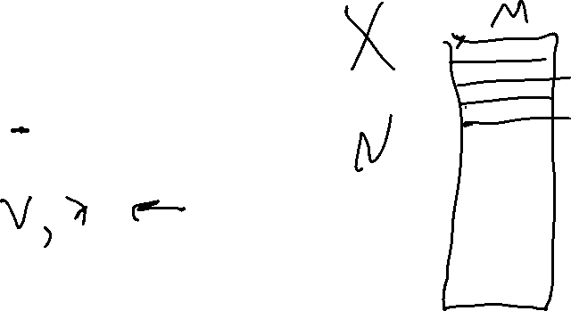
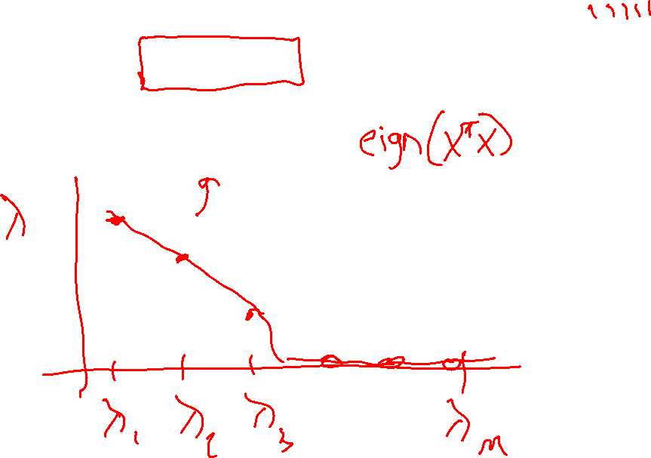
PCA: Choosing K
Look at the eigen values!

Slide 37
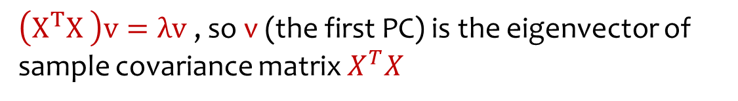
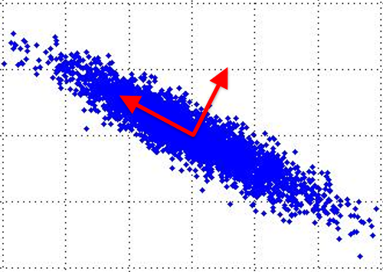



Principal Component Analysis (PCA)
And so on …
Slide from Nina Balcan

Slide 38
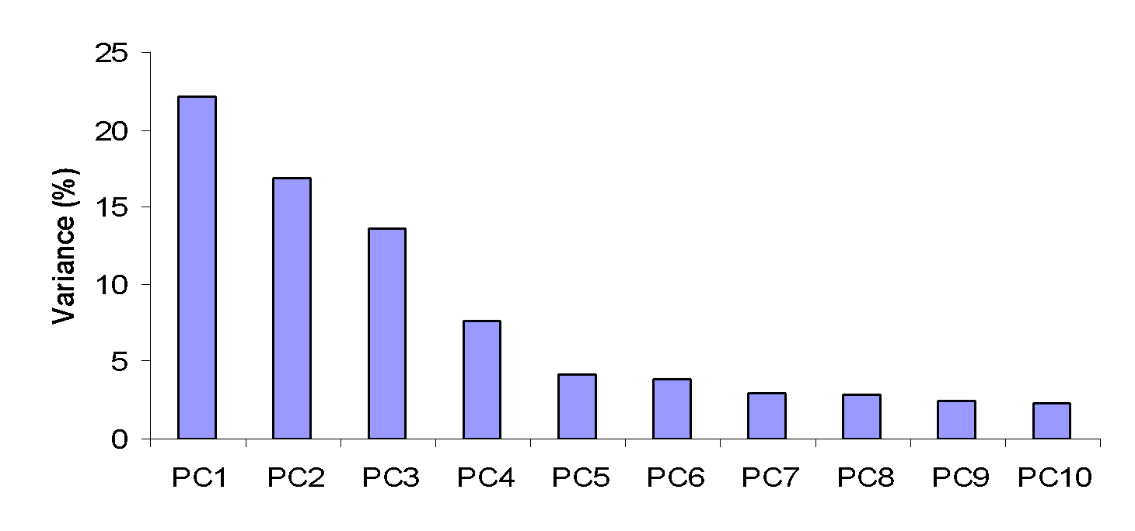
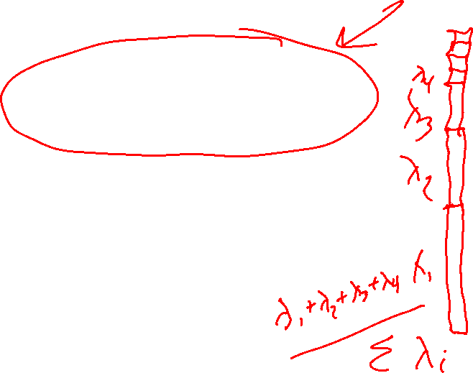
How Many PCs?
For M original dimensions, sample covariance matrix is MxM, and has up to M eigenvectors. So M PCs.
Where does dimensionality reduction come from?
Can ignore the components of lesser significance.
Variance (%) = ratio of variance along given principal component to total variance of all principal components
You do lose some information, but if the eigenvalues are small, you don’t lose much
  M dimensions in original data
  calculate M eigenvectors and eigenvalues
  choose only the first D eigenvectors, based on their eigenvalues
  final data set has only D dimensions

Slide 39


SVD for PCA

Slide 40
PCA versus other Linear Transforms

Slide 41
Where else have we seen linear transforms?

