Slide 1
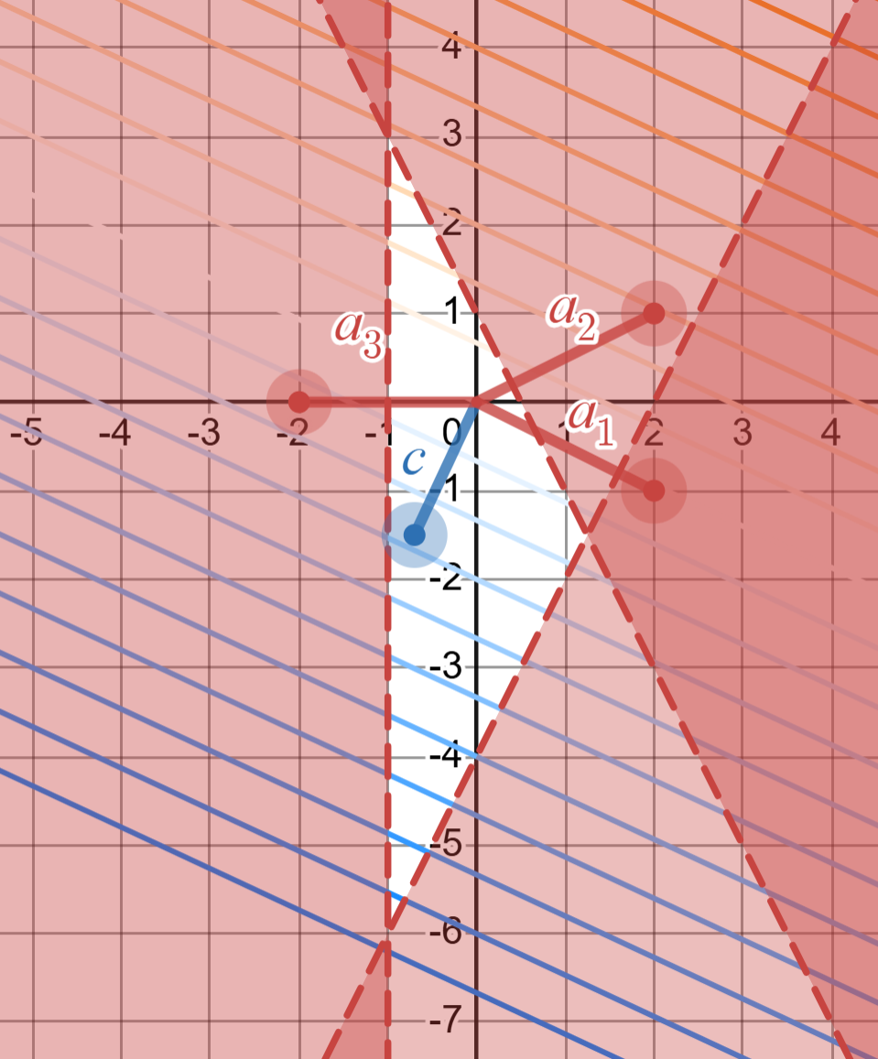
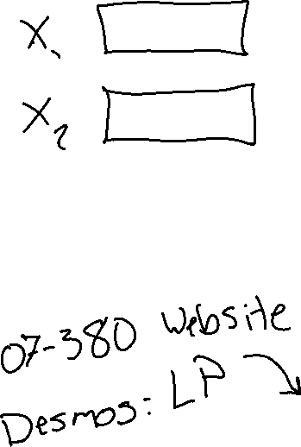
Poll 1
What is the solution to this LP?
https://www.desmos.com/calculator/tnlo7p5plp

Slide 2
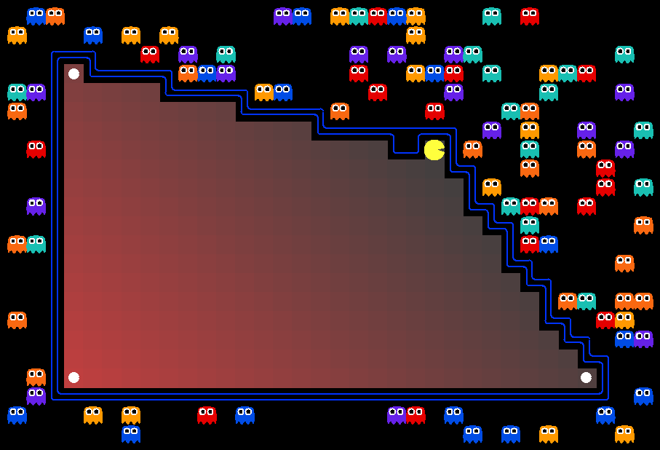
07-380 AI & ML II
Linear and Integer Programming
Instructors: Pat Virtue & Mohammad Salameh
Slide credits: CMU AI with drawings from http://ai.berkeley.edu

Slide 3
Integer Programming

Slide 4
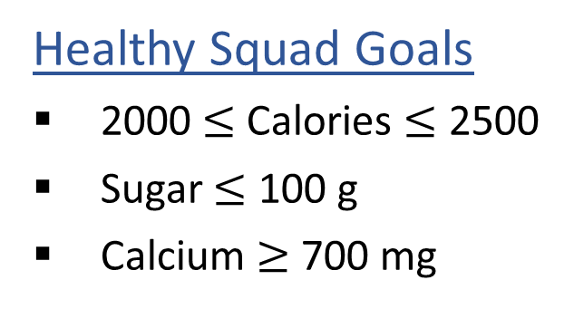

Linear Programming
We are trying healthy by finding the optimal amount of food to purchase.
We can choose the amount of stir-fry (ounce) and boba (fluid ounces).
Healthy Squad Goals
2000 $≤$ Calories $≤$ 2500
Sugar $≤$ 100 g
Calcium $≥$ 700 mg
Food | Cost | Calories | Sugar | Calcium
Stir-fry (per oz) | 1 | 100 | 3 | 20
Boba (per fl oz) | 0.5 | 50 | 4 | 70
What is the cheapest way to stay “healthy” with this menu?
How much stir-fry (ounce) and boba (fluid ounces) should we buy?

Slide 5
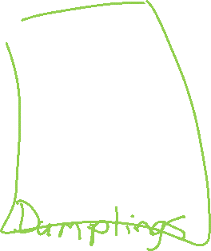
Linear Programming → Integer Programming
We are trying healthy by finding the optimal amount of food to purchase.
We can choose the amount of stir-fry (bowls) and boba (glasses).
Healthy Squad Goals
2000 $≤$ Calories $≤$ 2500
Sugar $≤$ 100 g
Calcium $≥$ 700 mg
Food | Cost | Calories | Sugar | Calcium
Stir-fry (per bowl) | 1 | 100 | 3 | 20
Boba (per glass) | 0.5 | 50 | 4 | 70
What is the cheapest way to stay “healthy” with this menu?
How much stir-fry (ounce) and boba (fluid ounces) should we buy?

Slide 6
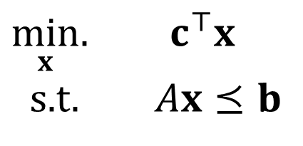
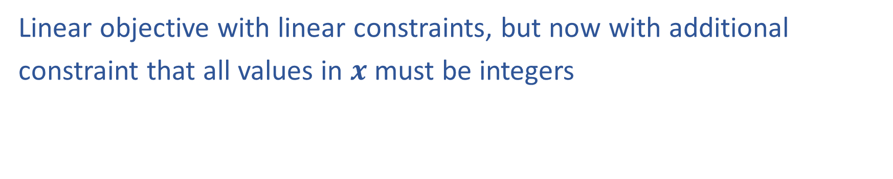
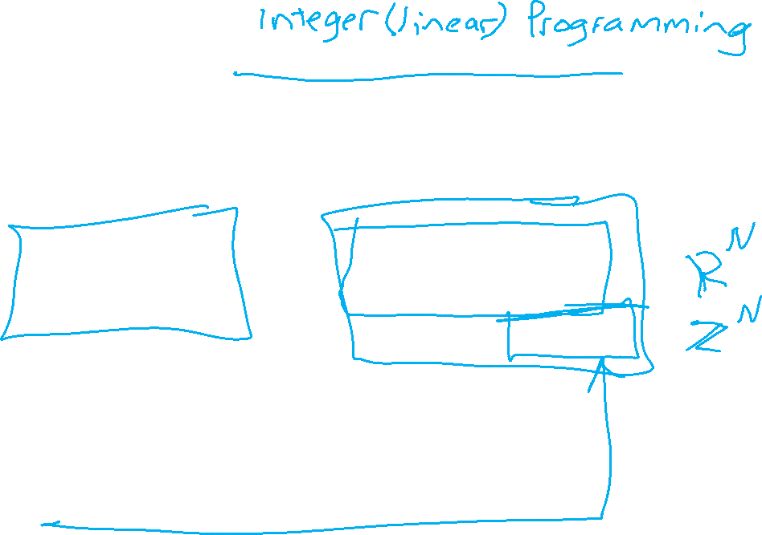
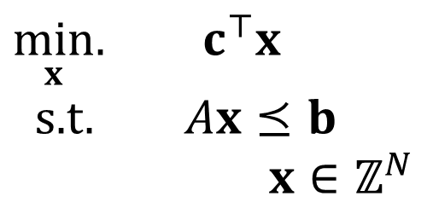
Linear Programming vs Integer Programming
Linear objective with linear constraints, but now with additional
constraint that all values in $x$ must be integers
$\min_{x}.{ c^{⊤}x}$
s.t. $Ax⪯b$
$\min_{x}.{ c^{⊤}x}$
s.t. $Ax⪯b$
$x∈ℤ^{N}$
We could also do:
Even more constrained: Binary Integer Programming
A hybrid: Mixed Integer Linear Programming
Notation Alert!

Slide 7
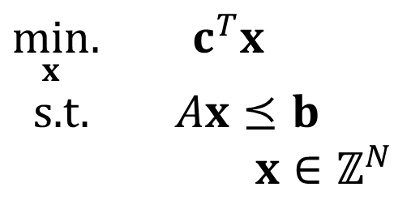
Integer Programming: Graphical Representation
Just add a grid of integer points onto our LP representation
$\min_{x}.{ c^{T}x}$
s.t. $Ax⪯b$
$x∈ℤ^{N}$

Slide 8
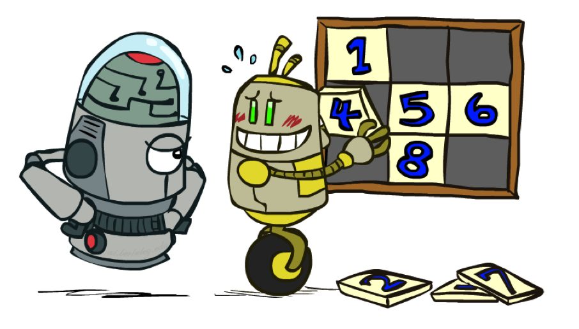
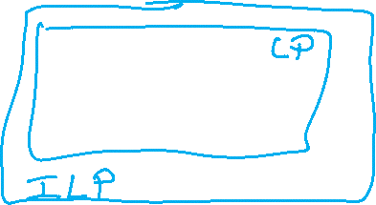
Relaxation
Relax IP to LP by dropping integer constraints
$\min_{x}.{ c^{T}x}$
s.t. $Ax⪯b$
$x∈ℤ^{N}$
Remember heuristics?

Slide 9
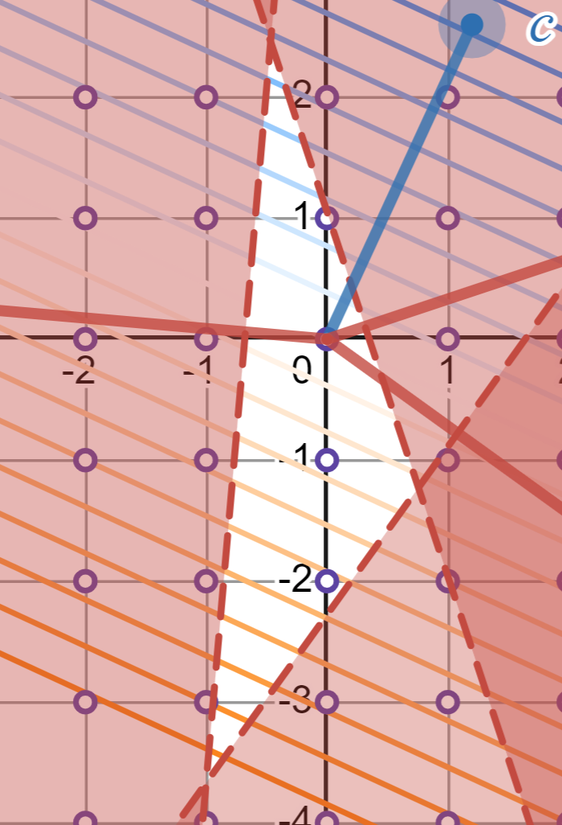
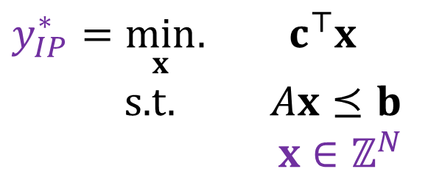
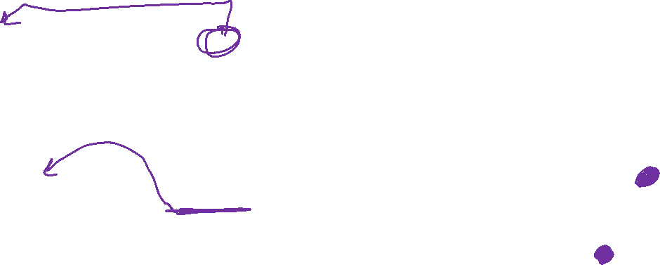
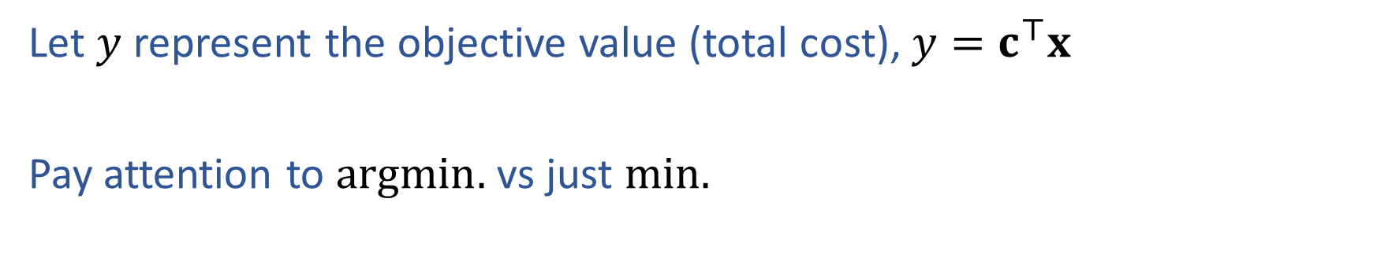
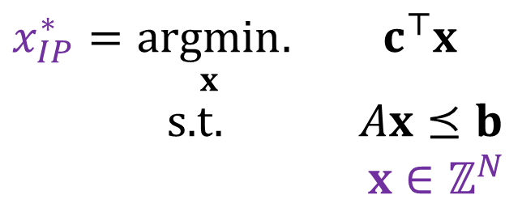
Notation Alert
Let $y$ represent the objective value (total cost), $y=c^{⊤}x$
Pay attention to $argmin.$ vs just $min.$
$x_{IP}^{∗}=\underset{x}{argmin}.{ c^{⊤}x}$
s.t. $Ax⪯b$
$x∈ℤ^{N}$
$y_{IP}^{∗}=\min_{x}.{ c^{⊤}x}$
s.t. $Ax⪯b$
$x∈ℤ^{N}$

Slide 10
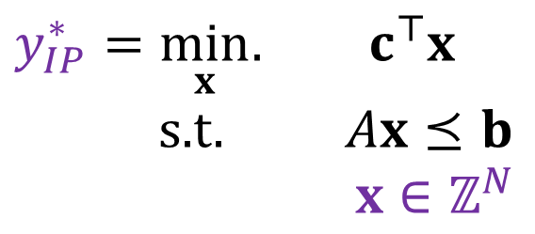
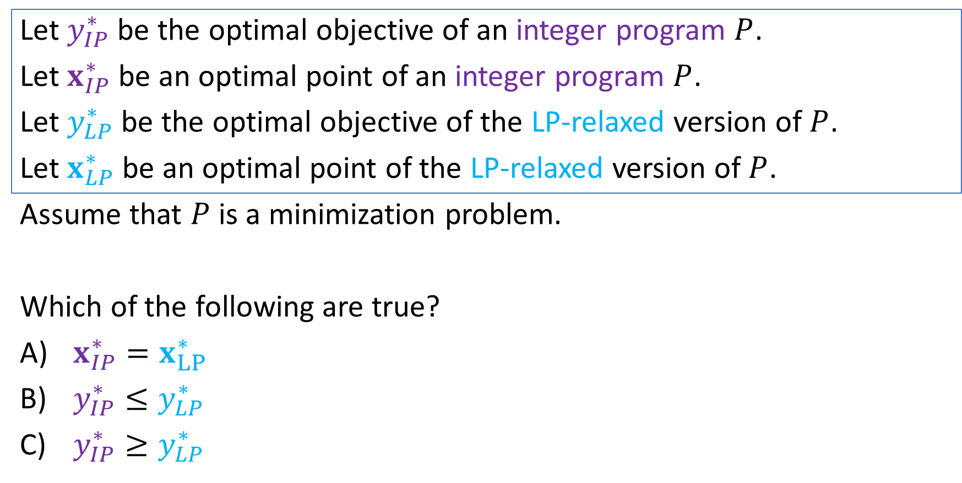
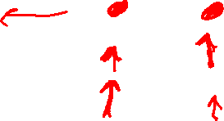
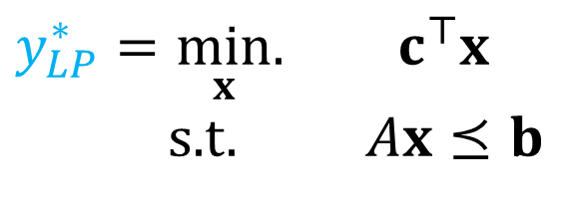
Poll 2:
Let $y_{IP}^{∗}$ be the optimal objective of an integer program $P$.
Let $x_{IP}^{∗}$ be an optimal point of an integer program $P$.
Let $y_{LP}^{∗}$ be the optimal objective of the LP-relaxed version of $P$.
Let $x_{LP}^{∗}$ be an optimal point of the LP-relaxed version of $P$.
Assume that $P$ is a minimization problem.
Which of the following are true?
$x_{IP}^{∗}=x_{LP}^{∗}$
$y_{IP}^{∗}≤y_{LP}^{∗}$
$y_{IP}^{∗}≥y_{LP}^{∗}$
$y_{IP}^{∗}=\min_{x}.{ c^{⊤}x}$
s.t. $Ax⪯b$
$x∈ℤ^{N}$
$y_{LP}^{∗}=\min_{x}.{ c^{⊤}x}$
s.t. $Ax⪯b$

Slide 11
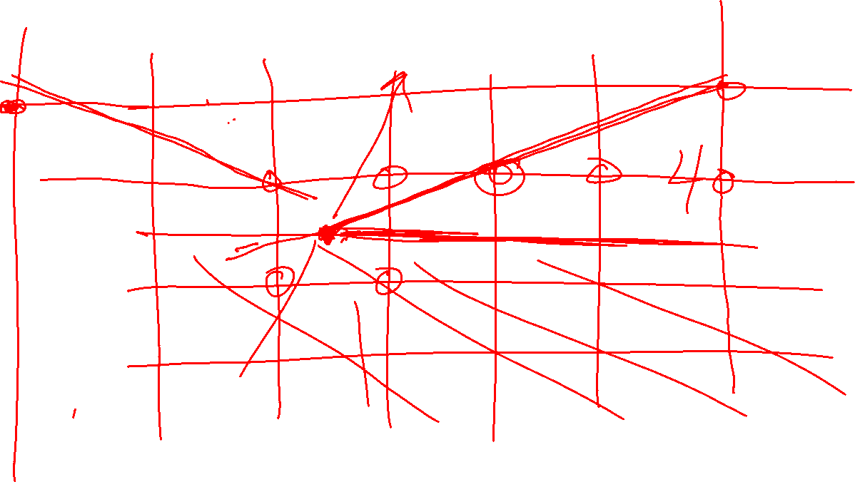


Poll 3:
True/False: It is sufficient to consider the integer points around the corresponding LP solution?

Slide 12
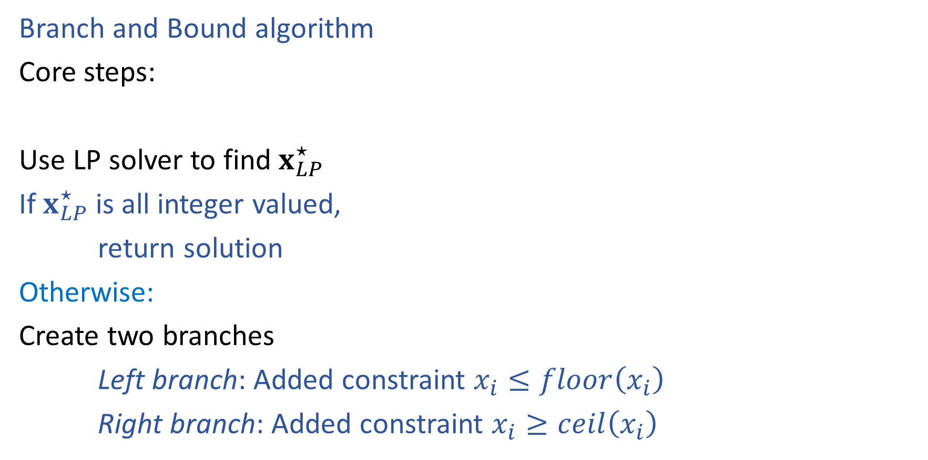
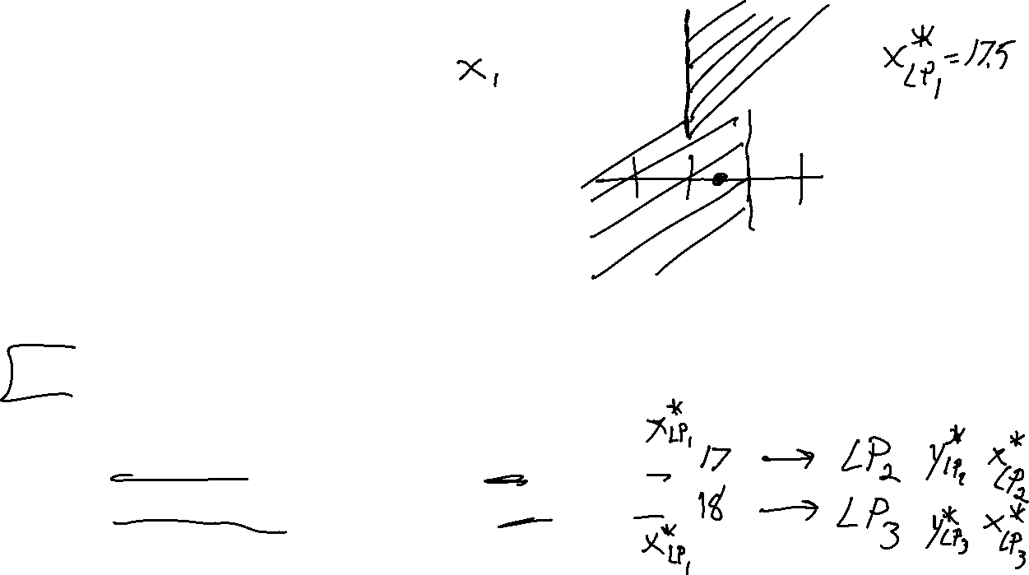
Solving an IP
16
17
18
19
5
Branch and Bound algorithm
Core steps:
Use LP solver to find $x_{LP}^{⋆}$
If $x_{LP}^{⋆}$ is all integer valued,
return solution
Otherwise:
Create two branches
Left branch: Added constraint $x_{i}≤floor\left(x_{i}\right)$
Right branch: Added constraint $x_{i}≥ceil\left(x_{i}\right)$
16
17
18
19
16
17
18
19
5
5

Slide 13
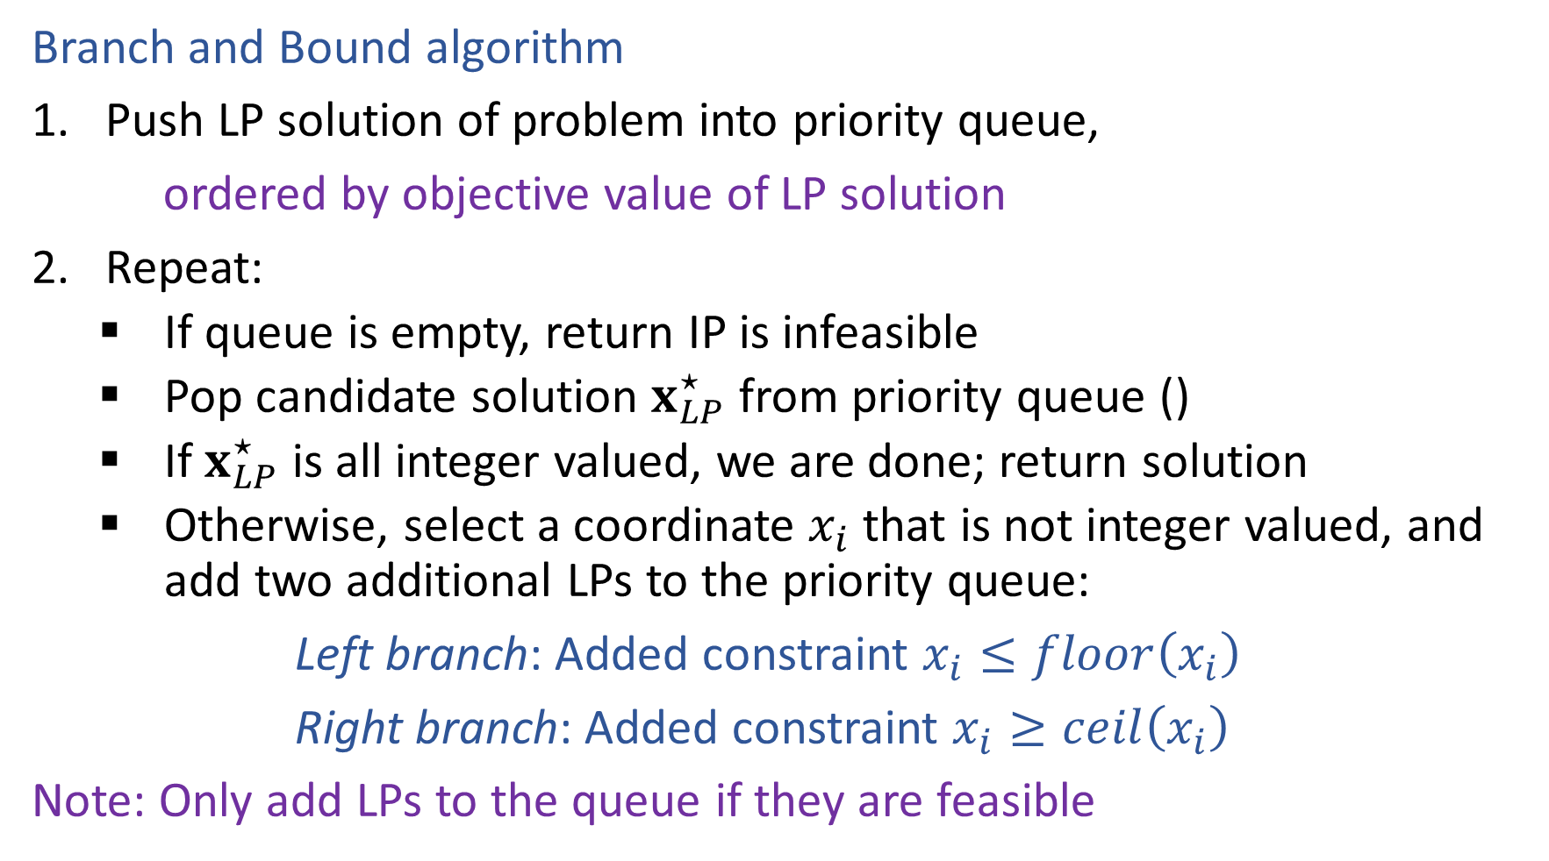
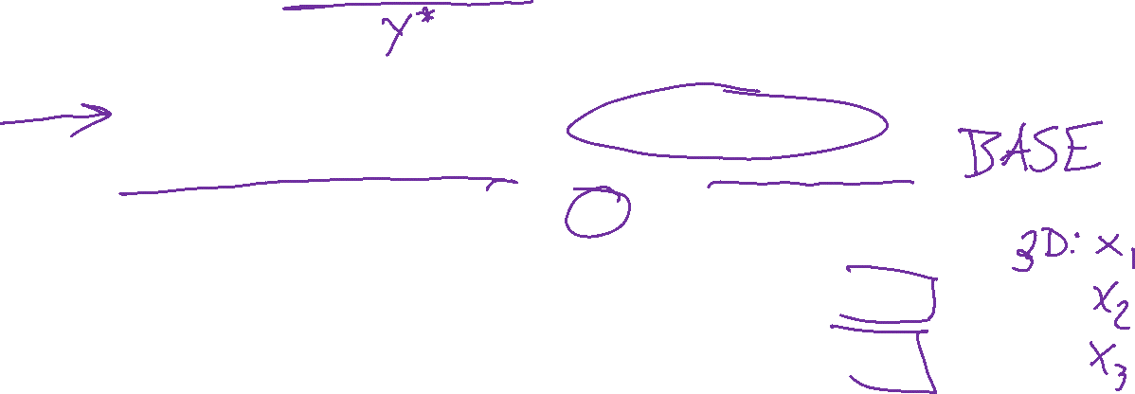
Solving an IP
Branch and Bound algorithm
Push LP solution of problem into priority queue,
ordered by objective value of LP solution
Repeat:
    If queue is empty, return IP is infeasible
    Pop candidate solution $x_{LP}^{⋆}$ from priority queue ()
    If $x_{LP}^{⋆}$ is all integer valued, we are done; return solution
    Otherwise, select a coordinate $x_{i}$ that is not integer valued, and add two additional LPs to the priority queue:
Left branch: Added constraint $x_{i}≤floor\left(x_{i}\right)$
Right branch: Added constraint $x_{i}≥ceil\left(x_{i}\right)$
Note: Only add LPs to the queue if they are feasible

Slide 14
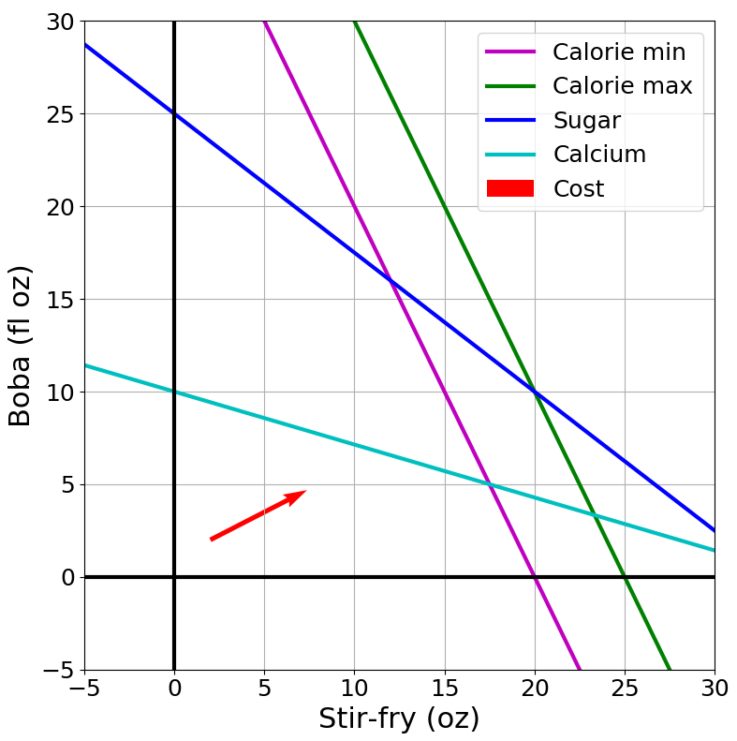

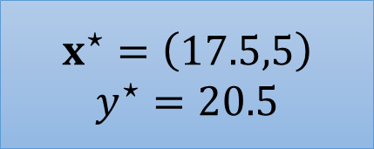

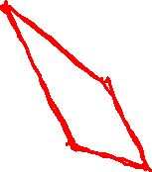


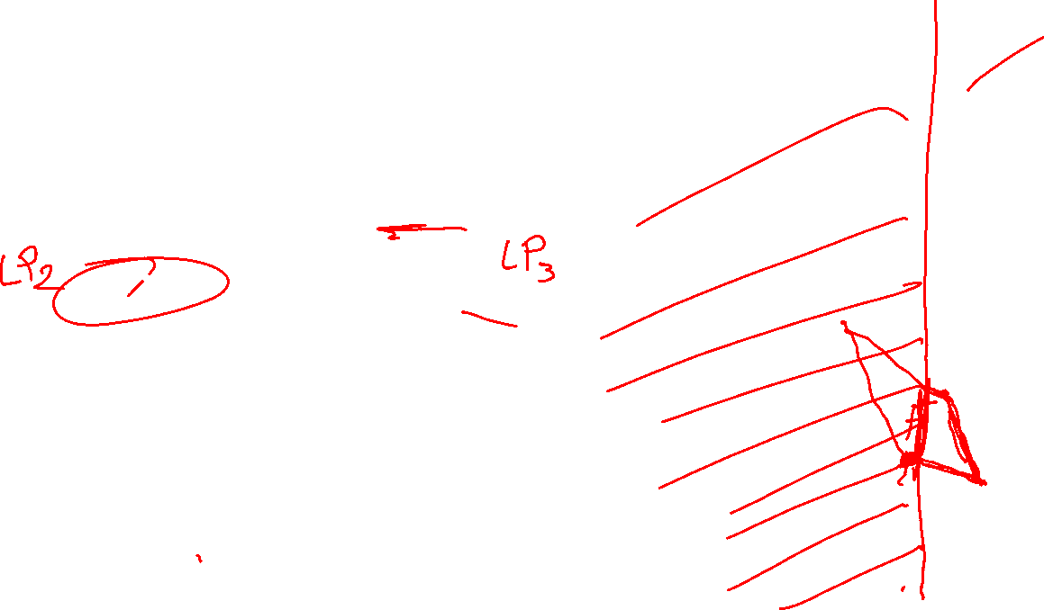
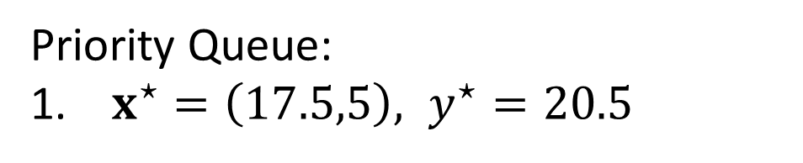

Branch and Bound Example
$$x^{⋆}=\left(17.5,5\right)$$
$$y^{⋆}=20.5$$
$$x_{1}≤17$$
$$x_{1}≥18$$
Priority Queue:
$x^{⋆}=\left(17.5,5\right), y^{⋆}=20.5$
$$c={\left[1, 0.6\right]}^{T}$$

Slide 15
Branch and Bound Example
$$x^{⋆}=\left(17.5,5\right)$$
$$y^{⋆}=20.5$$
$$x_{1}≤17$$
$$x_{1}≥18$$
Priority Queue:
$x^{⋆}=\left(17.5,5\right), y^{⋆}=20.5$
$$c={\left[1, 0.6\right]}^{T}$$

Slide 16
Branch and Bound Example
15
10
5
10
15
20
25

Slide 17



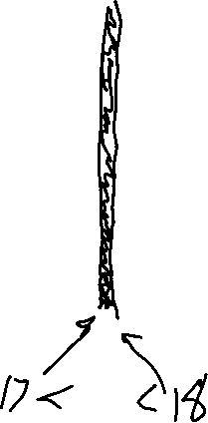
Branch and Bound Example
15
10
$$x_{1}≤17$$
$$x_{1}≥18$$
5
10
15
20
25
15
15
10
10
5
5
10
15
20
25
10
15
20
25

Slide 18
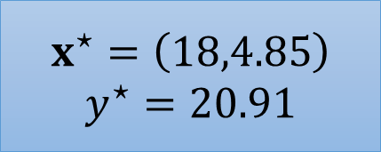
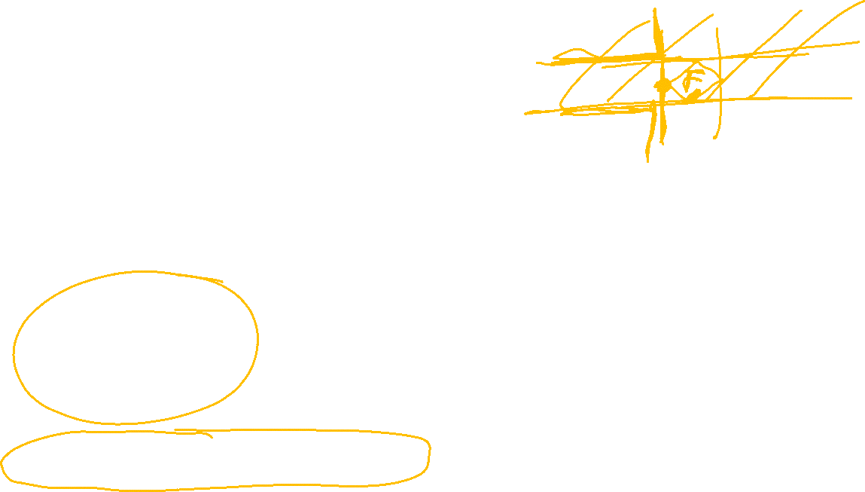
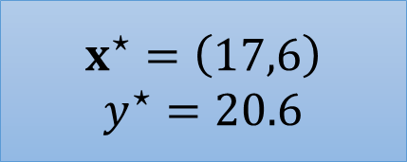
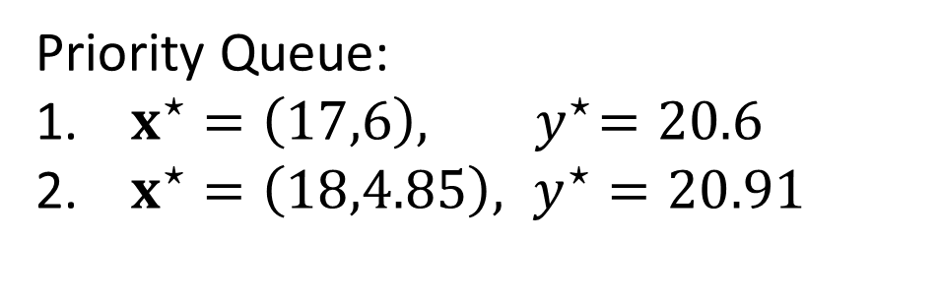
Branch and Bound Example
$$x^{⋆}=\left(17.5,5\right)$$
$$y^{⋆}=20.5$$
$$x_{1}≤17$$
$$x_{1}≥18$$
$$x^{⋆}=\left(17,6\right)$$
$$y^{⋆}=20.6$$
$$x^{⋆}=\left(18,4.85\right)$$
$$y^{⋆}=20.91$$
Priority Queue:
$x^{⋆}=\left(17,6\right), { y}^{⋆}=20.6$
$x^{⋆}=\left(18,4.85\right), y^{⋆}=20.91$
$$c={\left[1, 0.6\right]}^{T}$$

