Slide 1
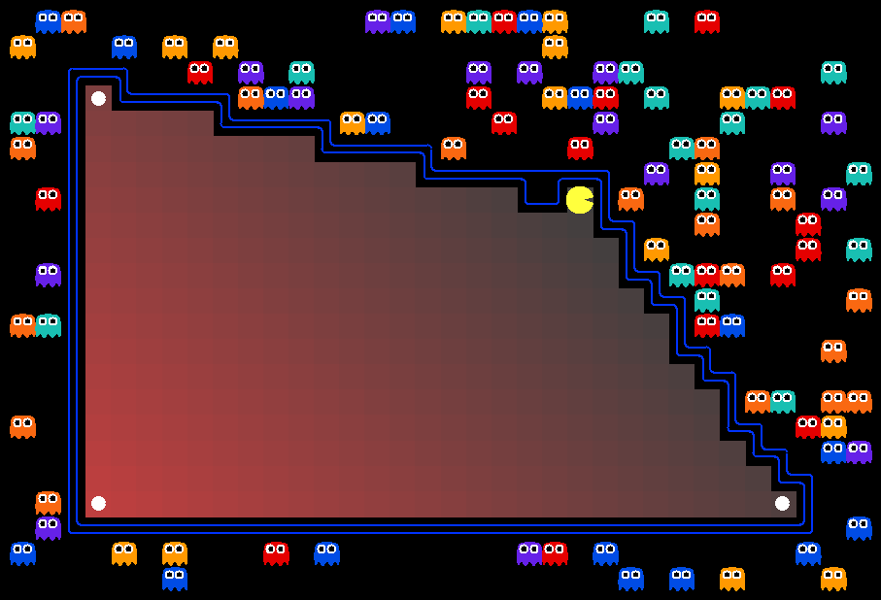

07-380 AI & ML II
Linear Programming
Instructors: Pat Virtue & Mohammad Salameh
Slide credits: CMU AI with drawings from http://ai.berkeley.edu

Slide 2
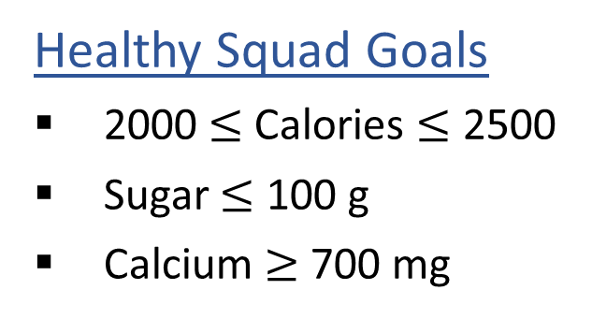
Warm-up: What to eat?
We are trying healthy by finding the optimal amount of food to purchase.
We can choose the amount of stir-fry (ounce) and boba (fluid ounces).
Healthy Squad Goals
2000 $≤$ Calories $≤$ 2500
Sugar $≤$ 100 g
Calcium $≥$ 700 mg
Food | Cost | Calories | Sugar | Calcium
Stir-fry (per oz) | 1 | 100 | 3 | 20
Boba (per fl oz) | 0.5 | 50 | 4 | 70
What is the cheapest way to stay “healthy” with this menu?
How much stir-fry (ounce) and boba (fluid ounces) should we buy?

Slide 3
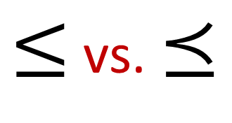
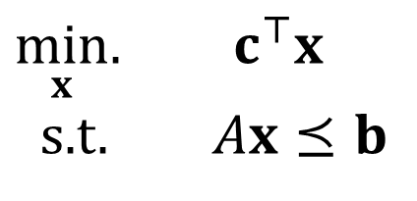
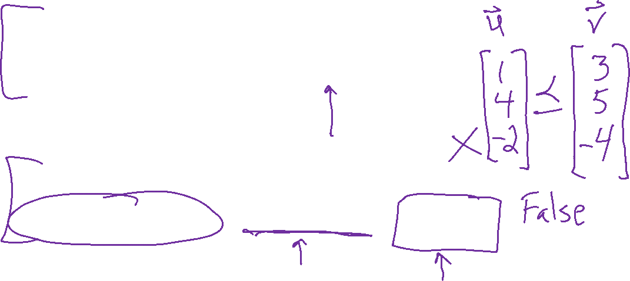
Linear Programming
Notation Alert!
Notation Alert!
Linear objective with linear constraints
$\min_{x}.{ c^{⊤}x}$
s.t. $Ax⪯b$
$≤$ vs. $⪯$
"such that"
Key point:
Problem description → LP formulation → LP Solver
Assume vectors are column vectors

Slide 4
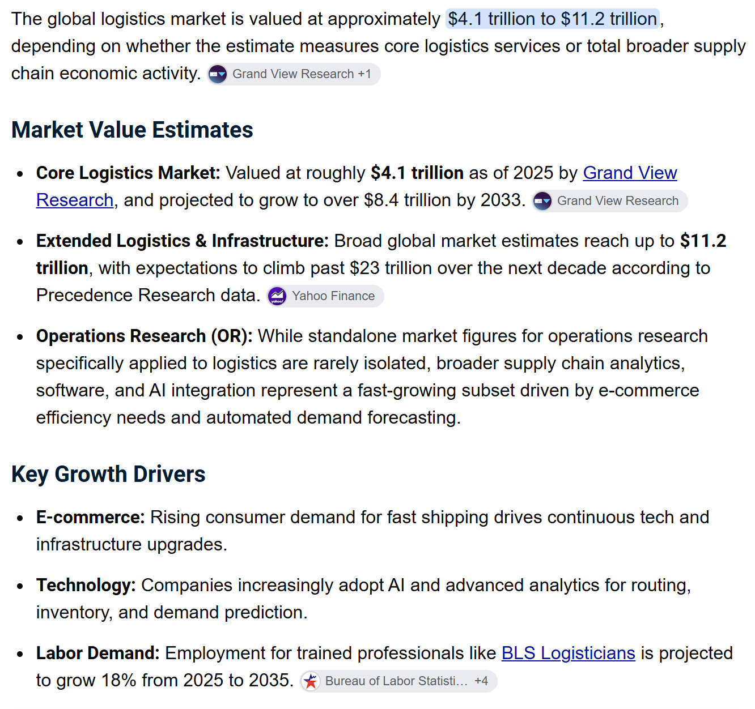

Linear Programming Applications
Many logistics / operations research problems can be modeled as an LP
Gemini summary of the size of the global logistics market:

Slide 5
Linear Programming Applications
Many logistics / operations research problems can be modeled as an LP
Gemini summary of the size of the global logistics market:

Slide 6
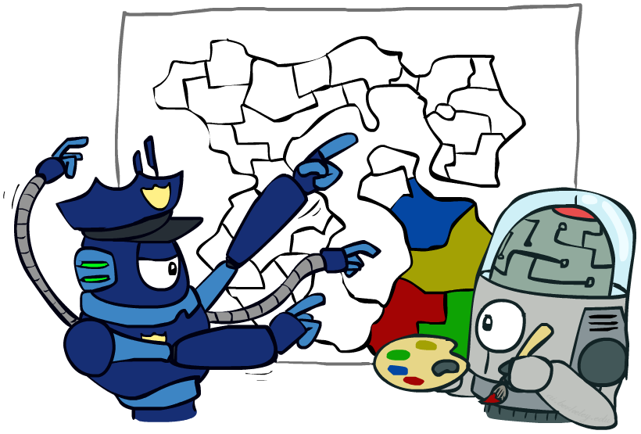
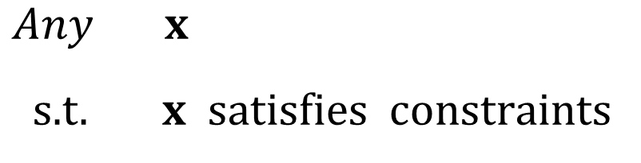
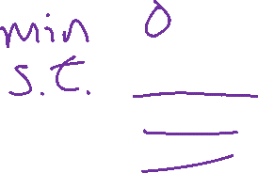
Optimization: Constraint Satisfaction Problems
Map coloring
$\operatorname{Any}{ x}$
s.t. $x satisfies constraints$

Slide 7
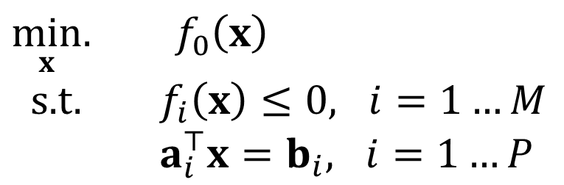
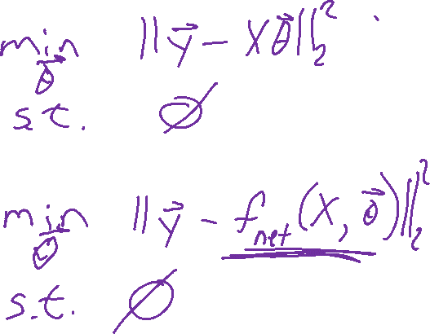
Linear Programming
Linear objective with linear constraints
$\min_{x}.{ c^{⊤}x}$
s.t. $Ax⪯b$
Linear regression optimization?
As opposed to general optimization
Neural net optimization?
$\min_{x}.{ f_{0}\left(x\right)}$
s.t. $f_{i}\left(x\right)≤0, i=1…M$
$a_{i}^{⊤}x=b_{i}, i=1…P$

Slide 8
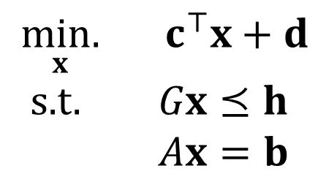
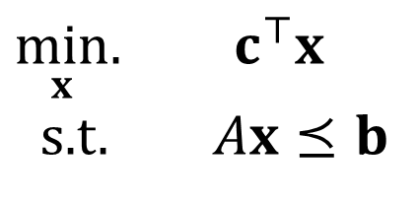

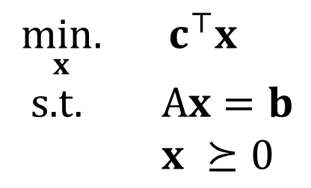
Linear Programming
Different formulations
Inequality form
General form
Standard form
$\min_{x}.{ c^{⊤}x}$
s.t. $Ax⪯b$
$\underset{x}{min.}{ c^{⊤}x}+d$
s.t. $Gx⪯h$
$Ax=b$
$\underset{x}{min.}{ c^{⊤}x}$
s.t. A$x=b$
$x ⪰0$
Important to pay attention to form!
We'll always use inequality form unless noted otherwise
Can switch between formulations!

Slide 9
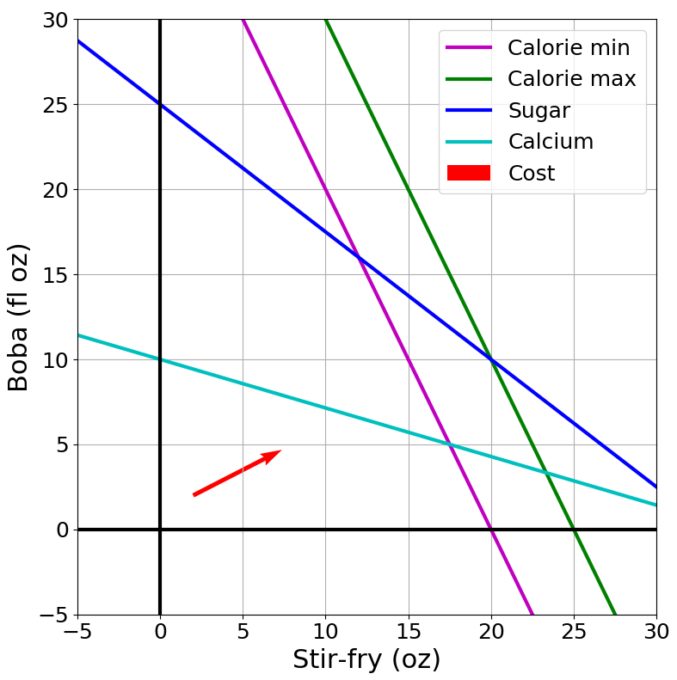
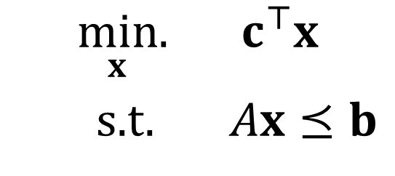
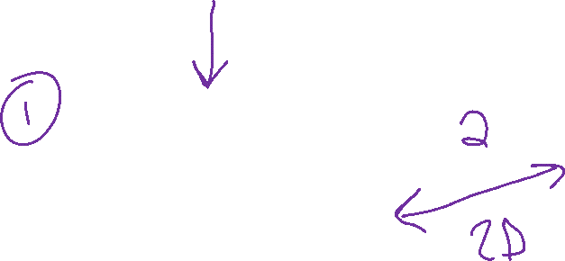
Optimization
Graphical Representation
Problem Description
Optimization Representation
$$\min_{x}.{ c^{⊤}x}$$
s.t. $Ax⪯b$

Slide 10

Pre-reading
Optimization formulation

Slide 11

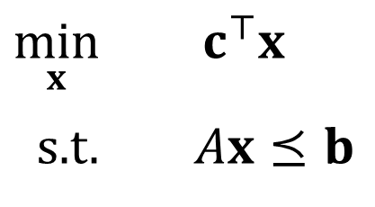
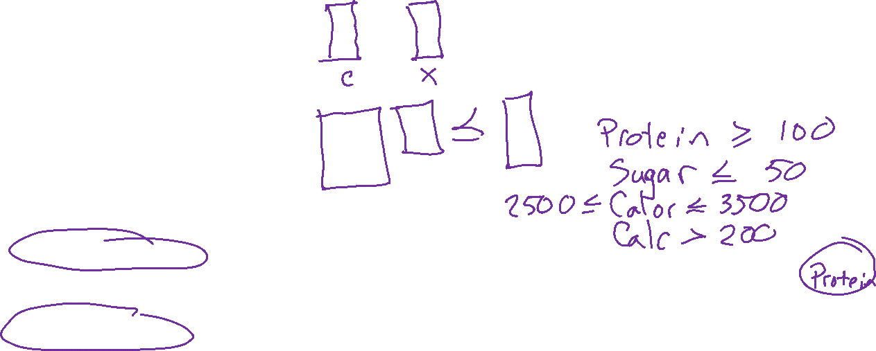
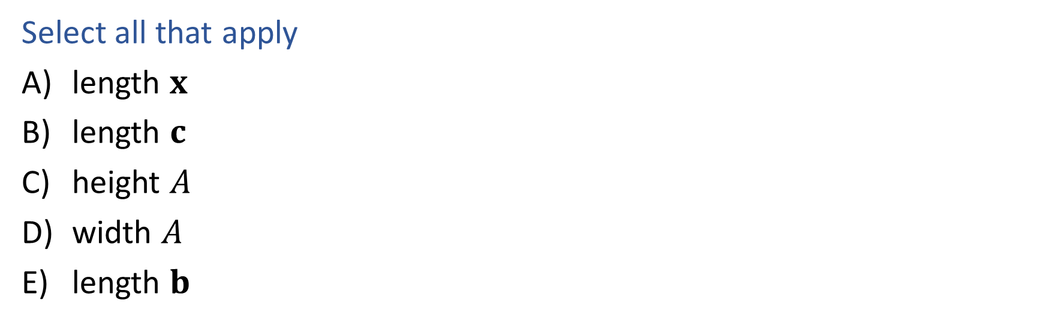
Poll 1
What has to increase to add more nutrition constraints?
$\min_{x}{ c^{⊤}x}$
s.t. $Ax⪯b$
Select all that apply
length $x$
length $c$
height $A$
width $A$
length $b$
Food | Cost | Calories | Sugar | Calcium
Stir-fry (per oz) | 1 | 100 | 3 | 20
Boba (per fl oz) | 0.5 | 50 | 4 | 70

Slide 12
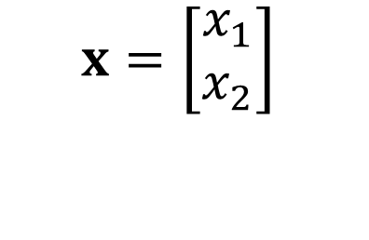
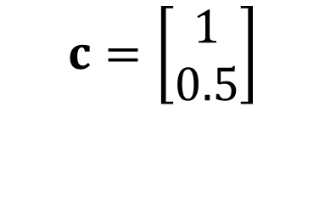
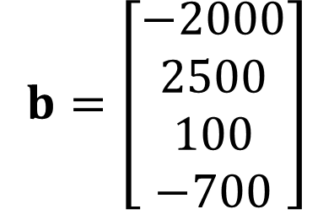
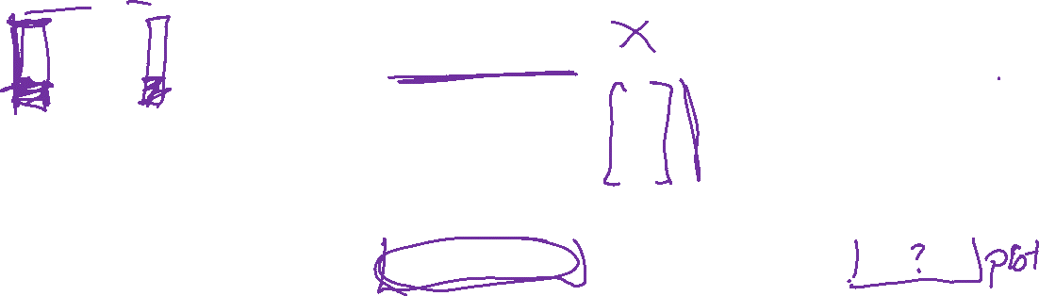
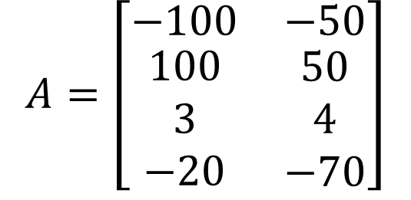
Poll 1
What has to increase to add more nutrition constraints?
$\min_{x}{ c^{⊤}x}$
s.t. $Ax⪯b$
$$A=\left[\begin{matrix}−100 & −50 \\ \begin{aligned}100 \\ 3 \\ −20\end{aligned} & \begin{aligned}50 \\ 4 \\ −70\end{aligned}\end{matrix}\right]$$
$$b=\left[\begin{aligned}−2000 \\ 2500 \\ 100 \\ −700\end{aligned}\right]$$
$$x=\left[\begin{aligned}x_{1} \\ x_{2}\end{aligned}\right]$$
$$c=\left[\begin{aligned}1 \\ 0.5\end{aligned}\right]$$

Slide 13
Poll 2
What has to increase to add more menu items?
$\min_{x}{ c^{⊤}x}$
s.t. $Ax⪯b$
Select all that apply
length $x$
length $c$
height $A$
width $A$
length $b$
Food | Cost | Calories | Sugar | Calcium
Stir-fry (per oz) | 1 | 100 | 3 | 20
Boba (per fl oz) | 0.5 | 50 | 4 | 70

Slide 14
Poll 2
What has to increase to add more menu items?
$\min_{x}{ c^{⊤}x}$
s.t. $Ax⪯b$
$$A=\left[\begin{matrix}−100 & −50 \\ \begin{aligned}100 \\ 3 \\ −20\end{aligned} & \begin{aligned}50 \\ 4 \\ −70\end{aligned}\end{matrix}\right]$$
$$b=\left[\begin{aligned}−2000 \\ 2500 \\ 100 \\ −700\end{aligned}\right]$$
$$x=\left[\begin{aligned}x_{1} \\ x_{2}\end{aligned}\right]$$
$$c=\left[\begin{aligned}1 \\ 0.5\end{aligned}\right]$$

Slide 15
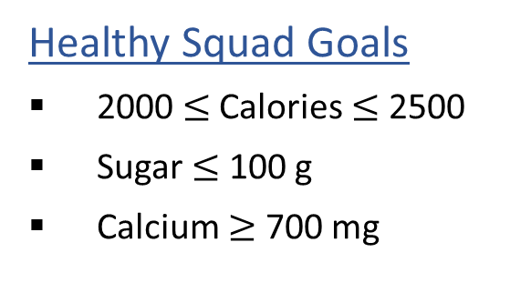

Optimization Formulation
Diet Problem
$\operatorname{Any}{ x}$
s.t. $x satisfies constraints$
Healthy Squad Goals
2000 $≤$ Calories $≤$ 2500
Sugar $≤$ 100 g
Calcium $≥$ 700 mg
Food | Cost | Calories | Sugar | Calcium
Stir-fry (per oz) | 1 | 100 | 3 | 20
Boba (per fl oz) | 0.5 | 50 | 4 | 70

Slide 16

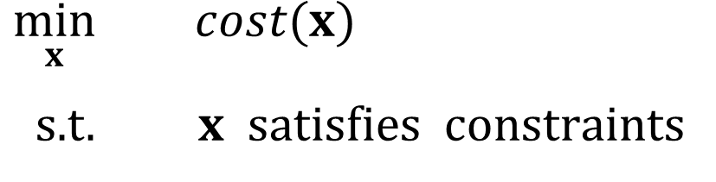
Optimization Formulation
Diet Problem
Objective function
$\min_{x}{ cost(x)}$
s.t. $x satisfies constraints$
Healthy Squad Goals
2000 $≤$ Calories $≤$ 2500
Sugar $≤$ 100 g
Calcium $≥$ 700 mg
Food | Cost | Calories | Sugar | Calcium
Stir-fry (per oz) | 1 | 100 | 3 | 20
Boba (per fl oz) | 0.5 | 50 | 4 | 70

Slide 17
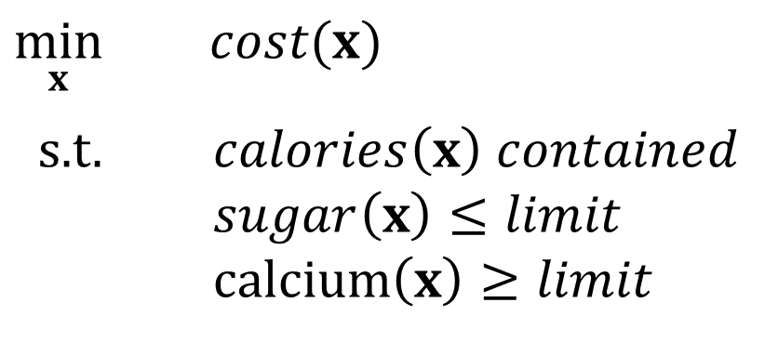
Optimization Formulation
Diet Problem
$\min_{x}{ cost(x)}$
s.t. $calories\left(x\right) contained$
$sugar\left(x\right)≤limit$
calcium$\left(x\right)≥limit$
Healthy Squad Goals
2000 $≤$ Calories $≤$ 2500
Sugar $≤$ 100 g
Calcium $≥$ 700 mg
Food | Cost | Calories | Sugar | Calcium
Stir-fry (per oz) | 1 | 100 | 3 | 20
Boba (per fl oz) | 0.5 | 50 | 4 | 70

Slide 18
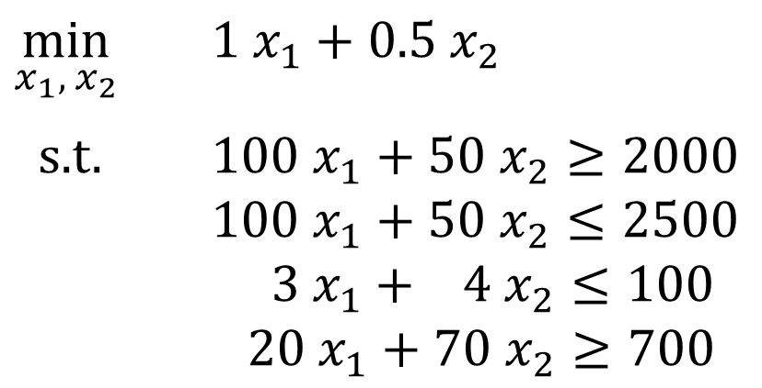
Optimization Formulation
Diet Problem
$\min_{x_{1}, { x}_{2}}{ {1 x}_{1}+0.5 x_{2}}$
s.t. $100 x_{1}+50 x_{2}≥2000$
$100 x_{1}+50 x_{2}≤2500$
$3 x_{1}+ 4 x_{2}≤100$
$20 x_{1}+70 x_{2}≥700$
Healthy Squad Goals
2000 $≤$ Calories $≤$ 2500
Sugar $≤$ 100 g
Calcium $≥$ 700 mg
Food | Cost | Calories | Sugar | Calcium
Stir-fry (per oz) | 1 | 100 | 3 | 20
Boba (per fl oz) | 0.5 | 50 | 4 | 70

Slide 19
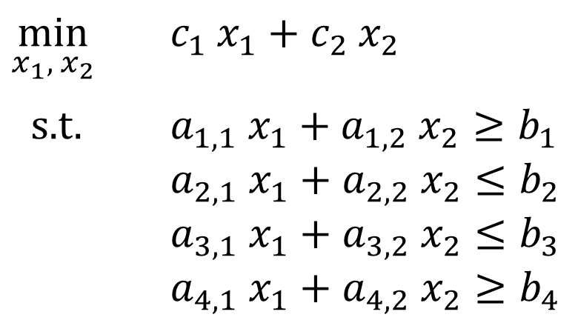
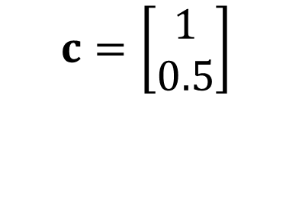
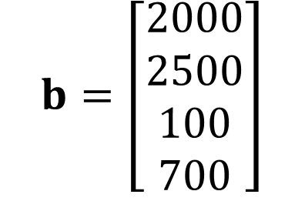
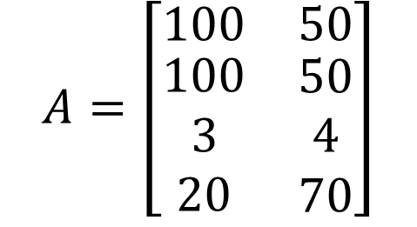
Optimization Formulation
Diet Problem
$\min_{x_{1}, { x}_{2}}{ {c_{1} x}_{1}+c_{2} x_{2}}$
s.t. $a_{1,1} x_{1}+a_{1,2} x_{2}≥b_{1}$
$a_{2,1} x_{1}+a_{2,2} x_{2}≤b_{2}$
$a_{3,1} x_{1}+a_{3,2} x_{2}≤b_{3}$
$a_{4,1} x_{1}+a_{4,2} x_{2}≥b_{4}$
Cost
$$c=\left[\begin{aligned}1 \\ 0.5\end{aligned}\right]$$
Stir-fry
Boba
Limit
$$A=\left[\begin{matrix}100 & 50 \\ \begin{aligned}100 \\ 3 \\ 20\end{aligned} & \begin{aligned}50 \\ 4 \\ 70\end{aligned}\end{matrix}\right]$$
$$b=\left[\begin{aligned}2000 \\ 2500 \\ 100 \\ 700\end{aligned}\right]$$
Calorie min
Calorie max
Sugar
Calcium

Slide 20
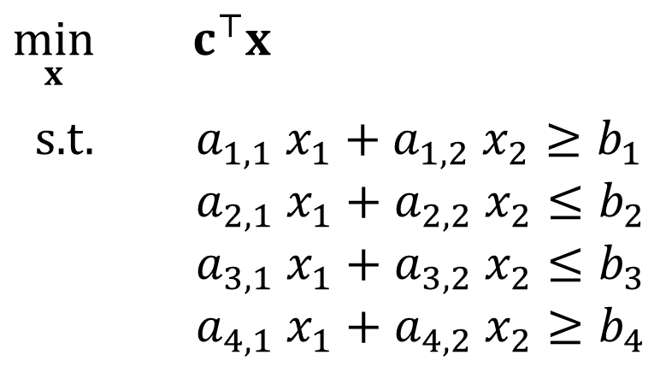
Optimization Formulation
Diet Problem
$\min_{x}{ c^{⊤}x}$
s.t. $a_{1,1} x_{1}+a_{1,2} x_{2}≥b_{1}$
$a_{2,1} x_{1}+a_{2,2} x_{2}≤b_{2}$
$a_{3,1} x_{1}+a_{3,2} x_{2}≤b_{3}$
$a_{4,1} x_{1}+a_{4,2} x_{2}≥b_{4}$
Cost
$$c=\left[\begin{aligned}1 \\ 0.5\end{aligned}\right]$$
Stir-fry
Boba
Limit
$$A=\left[\begin{matrix}100 & 50 \\ \begin{aligned}100 \\ 3 \\ 20\end{aligned} & \begin{aligned}50 \\ 4 \\ 70\end{aligned}\end{matrix}\right]$$
$$b=\left[\begin{aligned}2000 \\ 2500 \\ 100 \\ 700\end{aligned}\right]$$
Calorie min
Calorie max
Sugar
Calcium

Slide 21
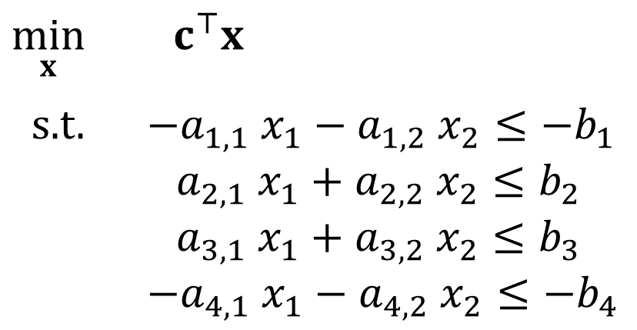
Optimization Formulation
Diet Problem
$\min_{x}{ c^{⊤}x}$
s.t. $−a_{1,1} x_{1}−a_{1,2} x_{2}≤−b_{1}$
$a_{2,1} x_{1}+a_{2,2} x_{2}≤b_{2}$
$a_{3,1} x_{1}+a_{3,2} x_{2}≤b_{3}$
$−a_{4,1} x_{1}−a_{4,2} x_{2}≤−b_{4}$
Cost
$$c=\left[\begin{aligned}1 \\ 0.5\end{aligned}\right]$$
Stir-fry
Boba
Limit
$$A=\left[\begin{matrix}100 & 50 \\ \begin{aligned}100 \\ 3 \\ 20\end{aligned} & \begin{aligned}50 \\ 4 \\ 70\end{aligned}\end{matrix}\right]$$
$$b=\left[\begin{aligned}2000 \\ 2500 \\ 100 \\ 700\end{aligned}\right]$$
Calorie min
Calorie max
Sugar
Calcium

Slide 22
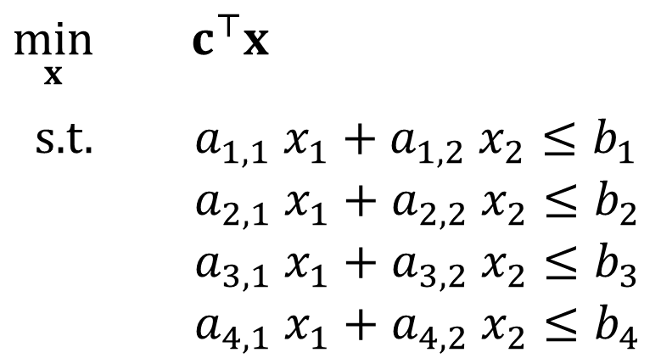
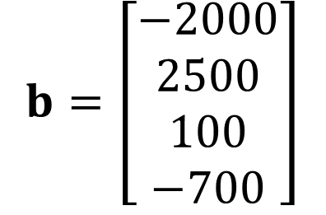
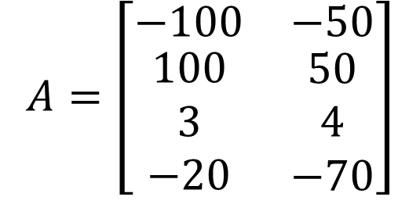
Optimization Formulation
Diet Problem
$\min_{x}{ c^{⊤}x}$
s.t. $a_{1,1} x_{1}+a_{1,2} x_{2}≤b_{1}$
$a_{2,1} x_{1}+a_{2,2} x_{2}≤b_{2}$
$a_{3,1} x_{1}+a_{3,2} x_{2}≤b_{3}$
$a_{4,1} x_{1}+a_{4,2} x_{2}≤b_{4}$
Cost
$$c=\left[\begin{aligned}1 \\ 0.5\end{aligned}\right]$$
Stir-fry
Boba
Limit
$$A=\left[\begin{matrix}−100 & −50 \\ \begin{aligned}100 \\ 3 \\ −20\end{aligned} & \begin{aligned}50 \\ 4 \\ −70\end{aligned}\end{matrix}\right]$$
$$b=\left[\begin{aligned}−2000 \\ 2500 \\ 100 \\ −700\end{aligned}\right]$$
Calorie min
Calorie max
Sugar
Calcium

Slide 23
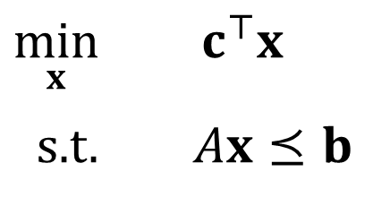
Optimization Formulation
Diet Problem
$\min_{x}{ c^{⊤}x}$
s.t. $Ax⪯b$
Cost
$$c=\left[\begin{aligned}1 \\ 0.5\end{aligned}\right]$$
Stir-fry
Boba
Limit
$$A=\left[\begin{matrix}−100 & −50 \\ \begin{aligned}100 \\ 3 \\ −20\end{aligned} & \begin{aligned}50 \\ 4 \\ −70\end{aligned}\end{matrix}\right]$$
$$b=\left[\begin{aligned}−2000 \\ 2500 \\ 100 \\ −700\end{aligned}\right]$$
Calorie min
Calorie max
Sugar
Calcium

Slide 24
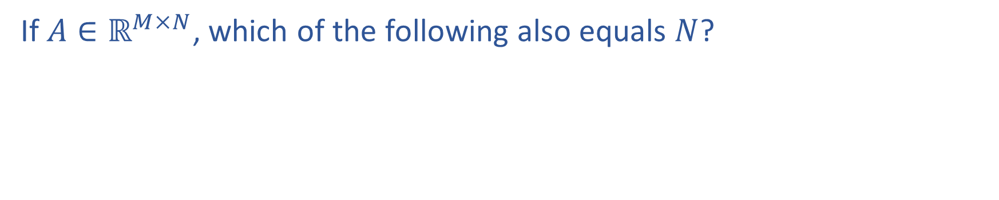
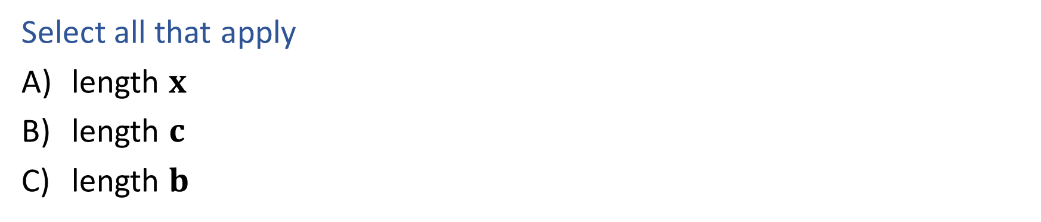
Question
If $A∈ℝ^{M×N}$, which of the following also equals $N$?
$\min_{x}{ c^{⊤}x}$
s.t. $Ax⪯b$
Select all that apply
length $x$
length $c$
length $b$

Slide 25

Plan
Pre-reading (with some polls today)
Linear programming (LP) formulation
    Problem description
    Optimization representation
    Graphical representation
Today
LP: Continue graphical representation
Solving linear programs
Higher dimensions than just 2
Today
Integer programming (IP)

Slide 26
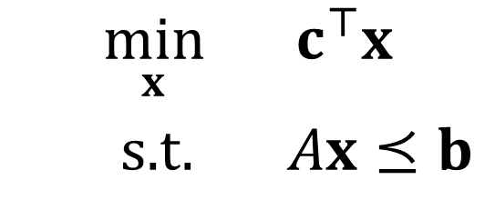
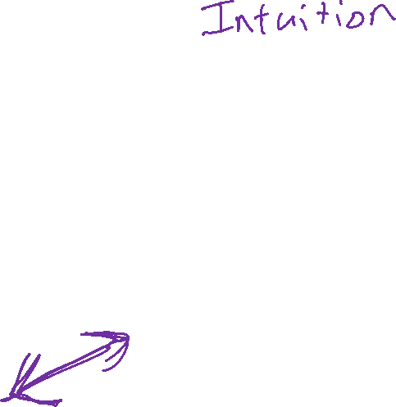
Optimization
Graphical Representation
Problem Description
Optimization Representation
$$\min_{x}{ c^{⊤}x}$$
s.t. $Ax⪯b$

Slide 27
Pre-reading
Graphical Representation (2-D)

Slide 28

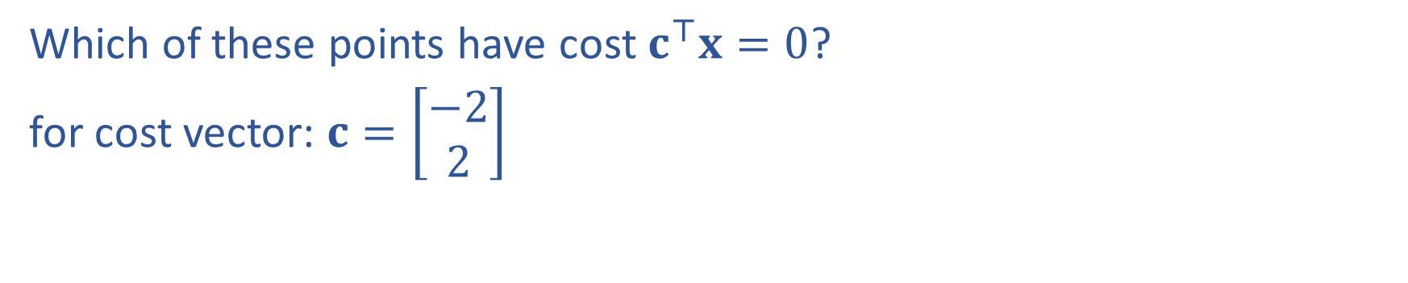
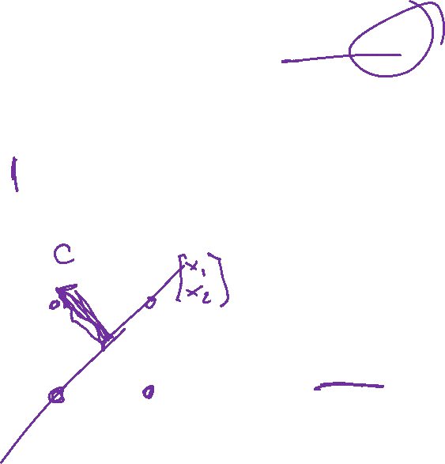

Poll 3
Which of these points have cost $c^{⊤}x=0$?
for cost vector: $c=\left[\begin{matrix}−2 \\ 2\end{matrix}\right]$
$$x_{2}$$
II
I
$$x_{1}$$
III
IV

Slide 29

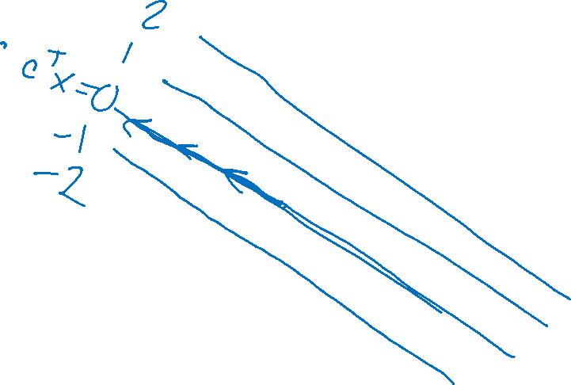
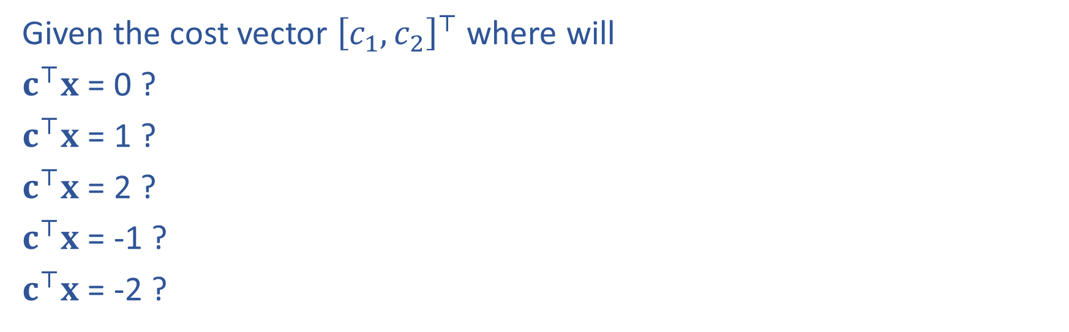


Question
Given the cost vector ${\left[c_{1}, c_{2}\right]}^{⊤}$ where will
$c^{⊤}x$ = 0 ?
$c^{⊤}x$ = 1 ?
$c^{⊤}x$ = 2 ?
$c^{⊤}x$ = -1 ?
$c^{⊤}x$ = -2 ?
$$x_{2}$$
$$c$$
$$x_{1}$$

Slide 30
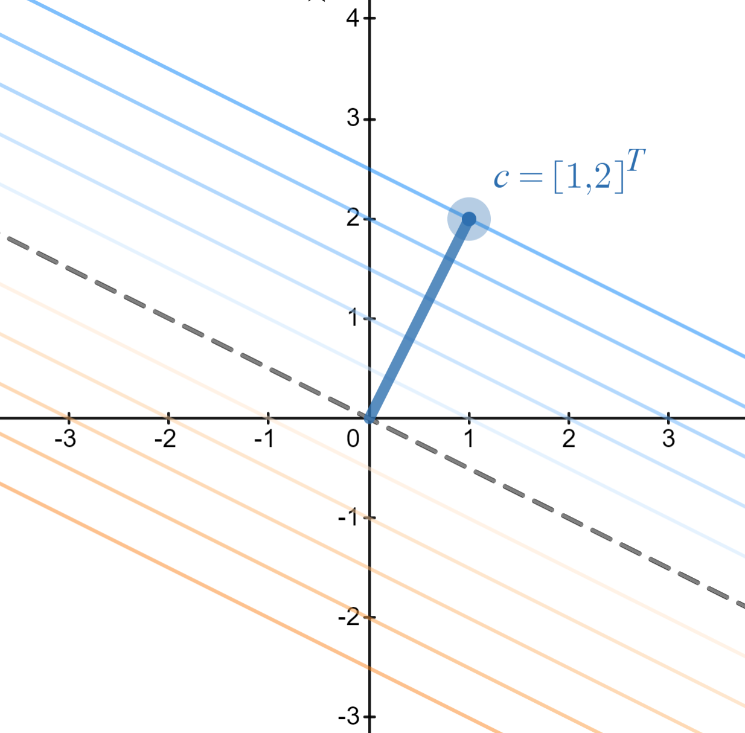
Cost Contours
Given the cost vector ${\left[c_{1}, c_{2}\right]}^{⊤}$ where will
$c^{⊤}x$ = 0 ?
$c^{⊤}x$ = 1 ?
$c^{⊤}x$ = 2 ?
$c^{⊤}x$ = -1 ?
$c^{⊤}x$ = -2 ?
https://www.desmos.com/calculator/8d9kxbdq9u

Slide 31


Question
As the magnitude of $c$ increases, the distance between
the contours lines of the objective $c^{⊤}x$:
Increases
Decreases
https://www.desmos.com/calculator/8d9kxbdq9u

Slide 32
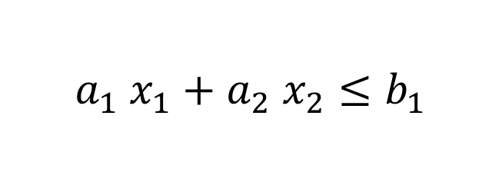
Graphics Representation
Geometry / Algebra I Quiz
What shape does this inequality represent?
$$a_{1} x_{1}+a_{2} x_{2}≤b_{1}$$

Slide 33
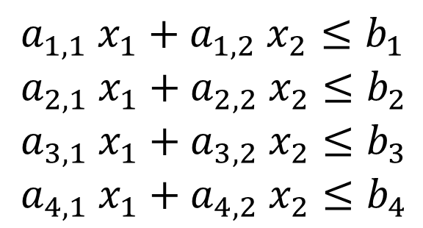



Graphics Representation
Geometry / Algebra I Quiz
What shape do these represent?
$$a_{1} x_{1}+a_{2} x_{2}=b_{1}$$
$$a_{1} x_{1}+a_{2} x_{2}≤b_{1}$$
$a_{1,1} x_{1}+a_{1,2} x_{2}≤b_{1}$
$a_{2,1} x_{1}+a_{2,2} x_{2}≤b_{2}$
$a_{3,1} x_{1}+a_{3,2} x_{2}≤b_{3}$
$a_{4,1} x_{1}+a_{4,2} x_{2}≤b_{4}$
Feasible region:
All points x that satisfy the constraints

Slide 34

Graphics Representation
Geometry / Algebra I Quiz
What shape do these represent?
$$a_{1} x_{1}+a_{2} x_{2}=b_{1}$$
$$a_{1} x_{1}+a_{2} x_{2}≤b_{1}$$
$a_{1,1} x_{1}+a_{1,2} x_{2}≤b_{1}$
$a_{2,1} x_{1}+a_{2,2} x_{2}≤b_{2}$
$a_{3,1} x_{1}+a_{3,2} x_{2}≤b_{3}$
$a_{4,1} x_{1}+a_{4,2} x_{2}≤b_{4}$
Feasible region:
All points x that satisfy the constraints

Slide 35


Graphics Representation
Geometry / Algebra I Quiz
What shape do these represent?
$$a_{1} x_{1}+a_{2} x_{2}=b_{1}$$
$$a_{1} x_{1}+a_{2} x_{2}≤b_{1}$$
https://www.desmos.com/calculator/lp0rqsb1w6

Slide 36


Graphics Representation
Geometry / Algebra I Quiz
What shape do these represent?
$$a_{1} x_{1}+a_{2} x_{2}=b_{1}$$
$$a_{1} x_{1}+a_{2} x_{2}≤b_{1}$$
$a_{1,1} x_{1}+a_{1,2} x_{2}≤b_{1}$
$a_{2,1} x_{1}+a_{2,2} x_{2}≤b_{2}$
$a_{3,1} x_{1}+a_{3,2} x_{2}≤b_{3}$
$a_{4,1} x_{1}+a_{4,2} x_{2}≤b_{4}$
https://www.desmos.com/calculator/plp1thgsbh

Slide 37
Reminder: Cost Contours
Given the cost vector ${\left[c_{1}, c_{2}\right]}^{⊤}$ where will
$c^{⊤}x$ = 0 ?
$c^{⊤}x$ = 1 ?
$c^{⊤}x$ = 2 ?
$c^{⊤}x$ = -1 ?
$c^{⊤}x$ = -2 ?
https://www.desmos.com/calculator/8d9kxbdq9u

Slide 38
Finding LP Solutions
Intuition

Slide 39


Poll 4
What is the solution to this LP?
https://www.desmos.com/calculator/tnlo7p5plp

Slide 40






Solving a Linear Program
Inequality form, with constraints
$\min_{x}.{ c^{⊤}x}$

Slide 41



Solving a Linear Program
Inequality form, with two constraints
$\min_{x}.{ c^{⊤}x}$

Slide 42

Solving a Linear Program
Inequality form, with one constraint
$\min_{x}.{ c^{⊤}x}$
s.t. $a_{1}x_{1}+a_{2}x_{2}≤b$
Desmos demo: LP with one constraint
https://www.desmos.com/calculator/ufrnzjgyvb

Slide 43




Poll 5
True or False: A minimizing LP with exactly on constraint, will always have a minimum objective at $−∞$.
$\min_{x}.{ c^{⊤}x}$
s.t. $a_{1}x_{1}+a_{2}x_{2}≤b$

Slide 44
Finding LP Solutions
Algorithms

Slide 45



Solving an LP
Solutions are at feasible intersections
of constraint boundaries!!
Algorithms
Check objective at all feasible intersections
In more detail:
Enumerate all intersections
Keep only those that are feasible (satisfy all inequalities)
Return feasible intersection with the lowest objective value

Slide 46




Solving an LP
But, how do we find the intersection between boundaries?
$$A=\left[\begin{matrix}−100 & −50 \\ \begin{aligned}100 \\ 3 \\ −20\end{aligned} & \begin{aligned}50 \\ 4 \\ −70\end{aligned}\end{matrix}\right]$$
$$b=\left[\begin{aligned}−2000 \\ 2500 \\ 100 \\ −700\end{aligned}\right]$$
Calorie min
$\min_{x}{ c^{⊤}x}$
s.t. $Ax⪯b$
Calorie max
Sugar
Calcium

Slide 47

Solving an LP
Solutions are at feasible intersections
of constraint boundaries!!
Algorithms
Check objective at all feasible intersections
Simplex

Slide 48

Solving an LP
Simplex algorithm
Start at a feasible intersection (if not trivial, can solve another LP to find one)
Define successors as “neighbors” of current intersection
  i.e., remove one row from our square subset of A, and add another row not in the subset; then check feasibility
Move to any successor with lower objective than current intersection
  If no such successors, we are done
Greedy local hill-climbing search! … but always finds optimal solution

Slide 49


Solving an LP
Simplex algorithm
Start at a feasible intersection (if not trivial, can solve another LP to find one)
Define successors as “neighbors” of current intersection
  i.e., remove one row from our square subset of A, and add another row not in the subset; then check feasibility
Move to any successor with lower objective than current intersection
  If no such successors, we are done
Greedy local hill-climbing search! … but always finds optimal solution

Slide 50


Solving an LP
Solutions are at feasible intersections
of constraint boundaries!!
Algorithms
Check objective at all feasible intersections
Simplex (intuition)
Interior Point (out of scope)
Figure 11.2 from Boyd and Vandenberghe, Convex Optimization

Slide 51
LPs in Higher Dimensions

Slide 52

What about higher dimensions?
Problem Description
Graphical Representation
Optimization Representation
$$\min_{x}{ c^{⊤}x}$$
s.t. $Ax⪯b$

Slide 53

“Marty, you’re not thinking fourth-dimensionally”
https://youtu.be/pTxW4n58eao?si=b5CdpwsJrpyVVNHv&t=39

Slide 54




Shapes in higher dimensions
How do these linear shapes extend to 3-D, N-D?
$$a_{1} x_{1}+a_{2} x_{2}=b_{1}$$
$$a_{1} x_{1}+a_{2} x_{2}≤b_{1}$$
$a_{1,1} x_{1}+a_{1,2} x_{2}≤b_{1}$
$a_{2,1} x_{1}+a_{2,2} x_{2}≤b_{2}$
$a_{3,1} x_{1}+a_{3,2} x_{2}≤b_{3}$
$a_{4,1} x_{1}+a_{4,2} x_{2}≤b_{4}$

Slide 55



What are intersections in higher dimensions?
How do these linear shapes extend to 3-D, N-D?
$$A=\left[\begin{matrix}−100 & −50 \\ \begin{aligned}100 \\ 3 \\ −20\end{aligned} & \begin{aligned}50 \\ 4 \\ −70\end{aligned} \end{matrix}\right]$$
$$b=\left[\begin{aligned}−2000 \\ 2500 \\ 100 \\ −700\end{aligned}\right]$$
Calorie min
$\min_{x}{ c^{⊤}x}$
s.t. $Ax⪯b$
Calorie max
Sugar
Calcium

Slide 56


How do we find intersections in higher dimensions?
Still looking at subsets of $A$ matrix
$$A=\left[\begin{matrix}−100 & −50 \\ \begin{aligned}100 \\ 3 \\ −20\end{aligned} & \begin{aligned}50 \\ 4 \\ −70\end{aligned} \end{matrix}\right]$$
$$b=\left[\begin{aligned}−2000 \\ 2500 \\ 100 \\ −700\end{aligned}\right]$$
Calorie min
$\min_{x}{ c^{⊤}x}$
s.t. $Ax⪯b$
Calorie max
Sugar
Calcium

