Slide 1

07-380 AI & ML II
Classical Planning II
and Motion Planning
Instructors: Pat Virtue & Mohammad Salameh
Slide credits: CMU AI

Slide 2

Today
Solving Planning Problems:
State Space Search
Planning Graphs and GraphPlan
Planning Heuristics
State Space Search (yes, back here)
Planning in Continuous State Space
Motion Planning and Configuration Space
RRT (Rapidly-Exploring Random Trees)
RRT*

Slide 3
Solivng Planning Problems
State-space Search

Slide 4

Search with a State Space Graph
Start
Goal

Slide 5
Size of the State-Space Tree
A state-space tree’s size is exponential in the number of predicates
Can we reduce the size of the graph we use for planning?

Slide 6

Solivng Planning Problems
Planning Graphs & Graph Plan

Slide 7
Planning Graph
Allow actions to be simultaneous
Always add predicates (don't delete)
GraphPlan is a relaxation of other classical planning search techniques
The GraphPlan search graph space is linear in the number of predicates
State space search
sockL()
bareR()
putShoeL
putSockL
putSockR
bareL()
bareR()
bareL()
sockR()
putSockL
putSockR
putShoeR

Slide 8





GraphPlan
Allow actions to be simultaneous
Always add predicates (don't delete)
GraphPlan is a relaxation of other classical planning search techniques
The planning graph is linear in the number of predicates
State space search
Planning graph
sockL()
bareR()
putShoeL
bareL()
bareR()
sockL()
bareL()
bareR()
sockR()
putShoeL
putSockL
putSockL
putSockL
putSockR
bareL()
bareR()
bareL()
bareR()
noop
noop
noop
bareL()
sockR()
putSockL
putSockR
putSockR
putSockR
putShoeR
putShoeR
$$S_{0}$$
$$A_{0}$$
$$S_{1}$$
$$A_{1}$$

Slide 9
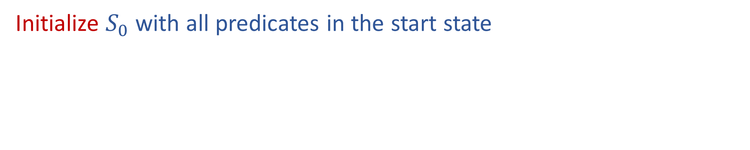



Building a Planning Graph
Initialize $S_{0}$ with all predicates in the start state
bareL()
bareR()
$$S_{0}$$
$$A_{0}$$
$$S_{1}$$

Slide 10

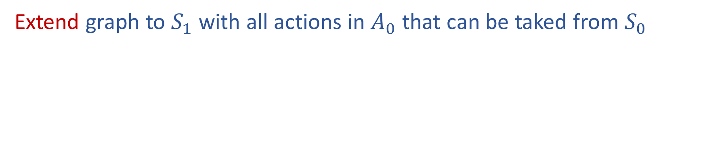
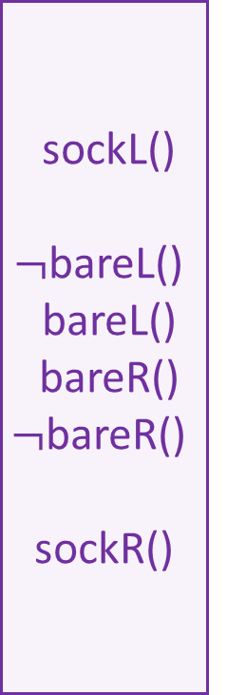
Building a Planning Graph
Extend graph to $S_{1}$ with all actions in $A_{0}$ that can be taked from $S_{0}$
bareL()
bareR()
sockL()
$¬$bareL()
bareL()
bareR()
$¬$bareR()
sockR()
For now, we are just assuming that any actions (including no-ops) can be taken individually in any order to get us to the next state
This certainly isn't always true
E.g., we can't put our socks
on and then take the no-ops that require bare feet
(More on these exclusion checks later)
putSockL
noop
putSockR
$$S_{0}$$
$$A_{0}$$
$$S_{1}$$

Slide 11
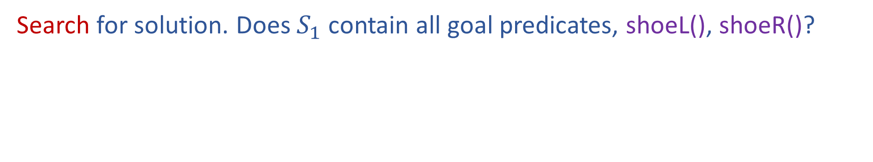
Building a Planning Graph
Search for solution. Does $S_{1}$ contain all goal predicates, shoeL(), shoeR()?
bareL()
bareR()
sockL()
$¬$bareL()
bareL()
bareR()
$¬$bareR()
sockR()
Nope, not yet
putSockL
noop
putSockR
$$S_{0}$$
$$A_{0}$$
$$S_{1}$$

Slide 12

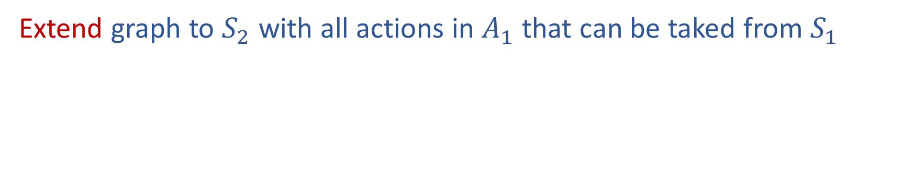


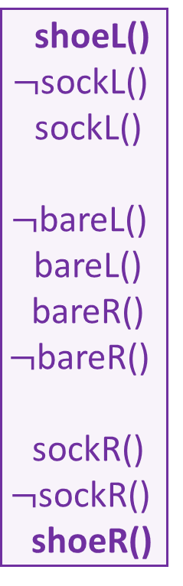
Building a Planning Graph
Extend graph to $S_{2}$ with all actions in $A_{1}$ that can be taked from $S_{1}$
bareL()
bareR()
sockL()
$¬$bareL()
bareL()
bareR()
$¬$bareR()
sockR()
shoeL()
$¬$sockL()
sockL()
$¬$bareL()
bareL()
bareR()
$¬$bareR()
sockR()
$¬$sockR()
shoeR()
putShoeL
putSockL
putSockL
noop
noop
putSockR
putSockR
putShoeR
$$S_{0}$$
$$A_{0}$$
$$S_{1}$$
$$A_{1}$$
$$S_{2}$$

Slide 13
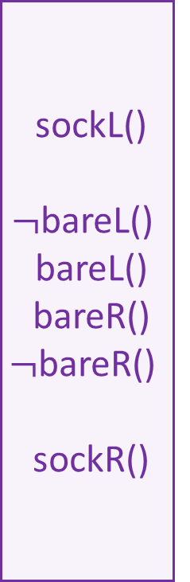
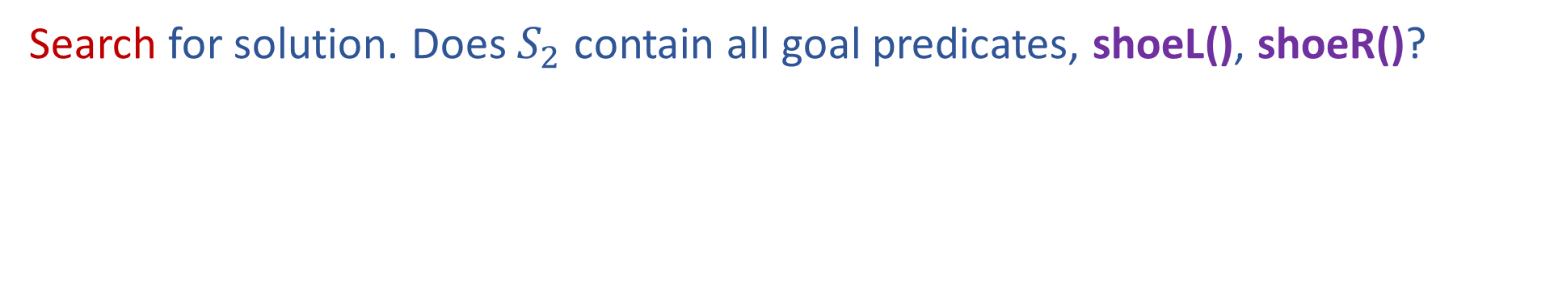
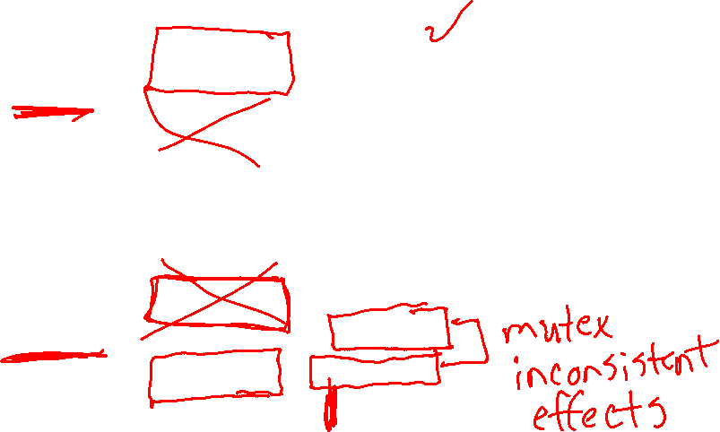
Building a Planning Graph
Search for solution. Does $S_{2}$ contain all goal predicates, shoeL(), shoeR()?
bareL()
bareR()
sockL()
$¬$bareL()
bareL()
bareR()
$¬$bareR()
sockR()
shoeL()
$¬$sockL()
sockL()
$¬$bareL()
bareL()
bareR()
$¬$bareR()
sockR()
$¬$sockR()
shoeR()
Yes, but
....is this ok??
Maybe ☺
We need to check that we can actually take the subset of actions that lead us the goal predicates
putShoeL
putSockL
putSockL
noop
noop
putSockR
putSockR
putShoeR
$$S_{0}$$
$$A_{0}$$
$$S_{1}$$
$$A_{1}$$
$$S_{2}$$

Slide 14

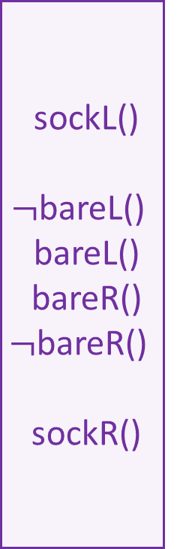





Building a Planning Graph
Search for solution. Does $S_{2}$ contain all goal predicates, shoeL(), shoeR()?
bareL()
bareR()
sockL()
$¬$bareL()
bareL()
bareR()
$¬$bareR()
sockR()
shoeL()
$¬$sockL()
sockL()
$¬$bareL()
bareL()
bareR()
$¬$bareR()
sockR()
$¬$sockR()
shoeR()
Are the goal predicates ok?
Do they directly contradict each other (negation)?
Are the actions that produced them ok (consistent support)?
  We'll need to check putShoeL and putShoeR
  Can we really do both of these actions in either order?
putShoeL
putSockL
putSockL
noop
noop
putSockR
putSockR
putShoeR
$$S_{0}$$
$$A_{0}$$
$$S_{1}$$
$$A_{1}$$
$$S_{2}$$

Slide 15
Building a Planning Graph
Search for solution. Does $S_{2}$ contain all goal predicates, shoeL(), shoeR()?
bareL()
bareR()
sockL()
$¬$bareL()
bareL()
bareR()
$¬$bareR()
sockR()
shoeL()
$¬$sockL()
sockL()
$¬$bareL()
bareL()
bareR()
$¬$bareR()
sockR()
$¬$sockR()
shoeR()
Are the actions leading to the goals okay (not exclusive)?
putShoeL
putSockL
putSockL
Actions A and B are exclusive (mutex) at action-level i, if:
  Interference: one action effect deletes or negates a precondition of the other
  Inconsistency: one action effect deletes or negates the effect of the other
  Competing Needs: the actions have preconditions that are mutex in prev. predicate-level
noop
noop
putSockR
putSockR
putShoeR
$$S_{0}$$
$$A_{0}$$
$$S_{1}$$
$$A_{1}$$
$$S_{2}$$

Slide 16
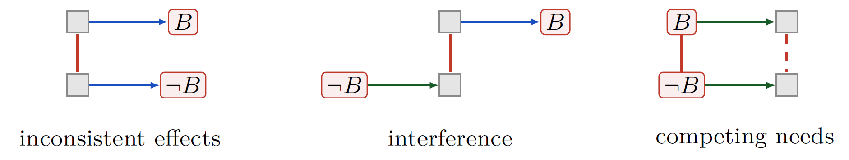
Planning Graph Mutexes
  Inconsistency: one action effect deletes or negates the effect of the other
  Interference: one action effect deletes or negates a precondition of the other
  Competing Needs: the actions have preconditions that are mutex in prev. predicate-level

Slide 17
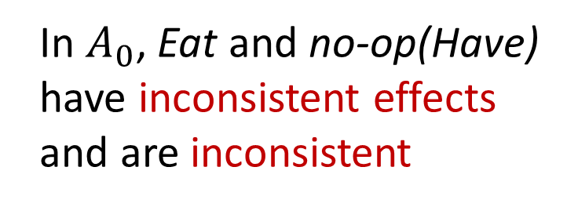





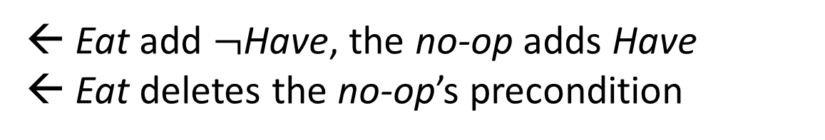
Planning Graph Mutexes
Can you have your cake and eat it too?
Have
Eat
$¬$Have
Have
Eaten
no-op
$$S_{0}$$
$$A_{0}$$
$$S_{1}$$
In $A_{0}$, Eat and no-op(Have)
have inconsistent effects
and are inconsistent
← Eat add $¬$Have, the no-op adds Have
← Eat deletes the no-op’s precondition

Slide 18

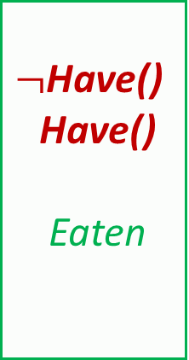
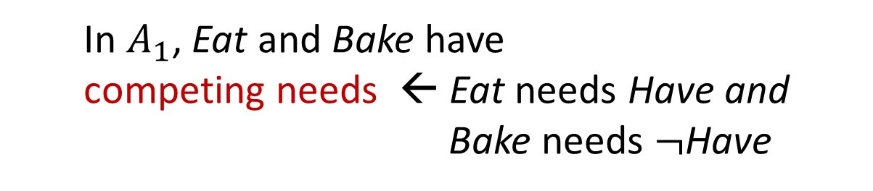


Planning Graph Mutexes
Can you have your cake and eat it too?
Have
Eat
$¬$Have()
Have()
Eaten
Eat
$¬$Have
Have
Eaten
$¬$Eaten
no-op
no-op
Bake
$$S_{0}$$
$$A_{0}$$
$$S_{1}$$
$$A_{1}$$
$$S_{2}$$
In $A_{1}$, Eat and Bake have
competing needs ← Eat needs Have and
Bake needs $¬$Have

Slide 19
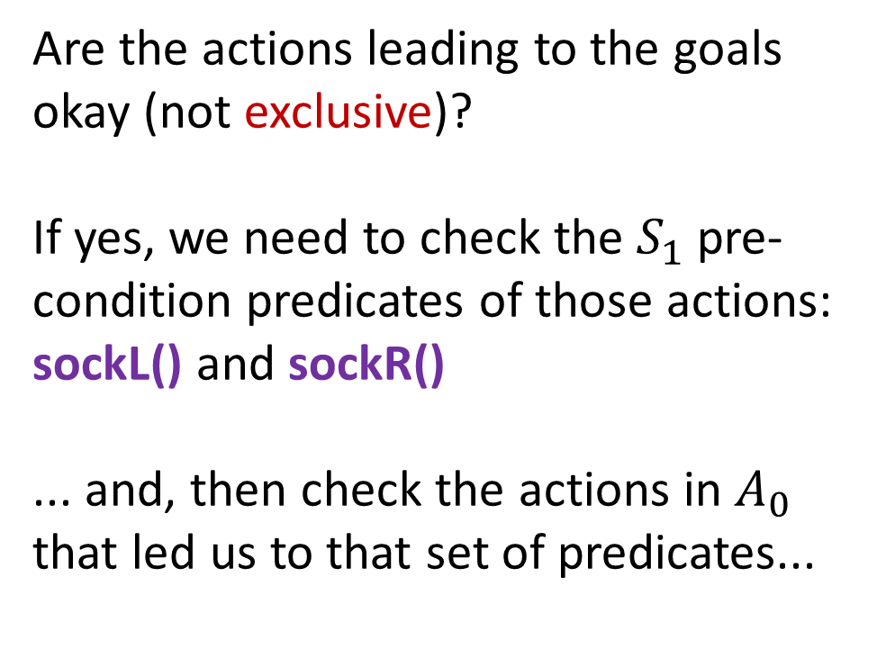
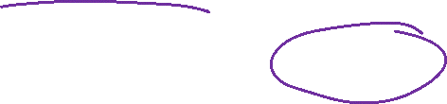
Building a Planning Graph
Search for solution. Does $S_{2}$ contain all goal predicates, shoeL(), shoeR()?
bareL()
bareR()
sockL()
$¬$bareL()
bareL()
bareR()
$¬$bareR()
sockR()
shoeL()
$¬$sockL()
sockL()
$¬$bareL()
bareL()
bareR()
$¬$bareR()
sockR()
$¬$sockR()
shoeR()
Are the actions leading to the goals okay (not exclusive)?
If yes, we need to check the $S_{1}$ pre-condition predicates of those actions: sockL() and sockR()
... and, then check the actions in $A_{0}$ that led us to that set of predicates...
putShoeL
putSockL
putSockL
noop
noop
putSockR
putSockR
putShoeR
$$S_{0}$$
$$A_{0}$$
$$S_{1}$$
$$A_{1}$$
$$S_{2}$$

Slide 20
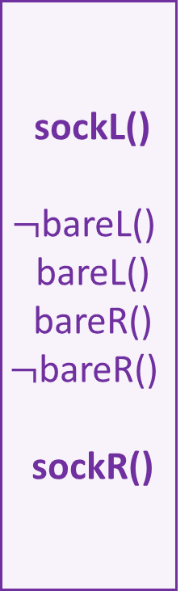

Building a Planning Graph
Search backwards for solution of non-exclusive predicates and actions
bareL()
bareR()
sockL()
$¬$bareL()
bareL()
bareR()
$¬$bareR()
sockR()
shoeL()
$¬$sockL()
sockL()
$¬$bareL()
bareL()
bareR()
$¬$bareR()
sockR()
$¬$sockR()
shoeR()
Solution found!
We can do putSockL and putSockR
in any order, then
We can do putShoeL and putShoeR
in any order
putShoeL
putSockL
putSockL
noop
noop
putSockR
putSockR
putShoeR
$$S_{0}$$
$$A_{0}$$
$$S_{1}$$
$$A_{1}$$
$$S_{2}$$

Slide 21

GraphPlan High Level Algorithm
Initialize first predicate layer with predicates from initial state
Loop
Extend the GraphPlan graph by adding an action level and
then a predicate level
If graph has leveled off (no new predicates added from previous level):
Return NO SOLUTION
If all predicates in the goal are present in the added predicate level: Search for a possible plan in the planning graph
(see solution algorithm)
If plan found, return with that plan

Slide 22
GraphPlan and Planning Graph Representation
Planning graphs contain two types of layers
  Predicate layers – all reachable predicates
  Action layers – actions that could be taken
  Both layers represent one time step
  GraphPlan algorithm includes two subtasks
  Extend: One time step (two layers) in the planning graph
  Search: Find a valid plan in the graphplan graph
GraphPlan finds a plan or proves that no plan has fewer time steps
  Each time step can contain multiple actions
  Bad News... GraphPlan backward search is exponential

Slide 23
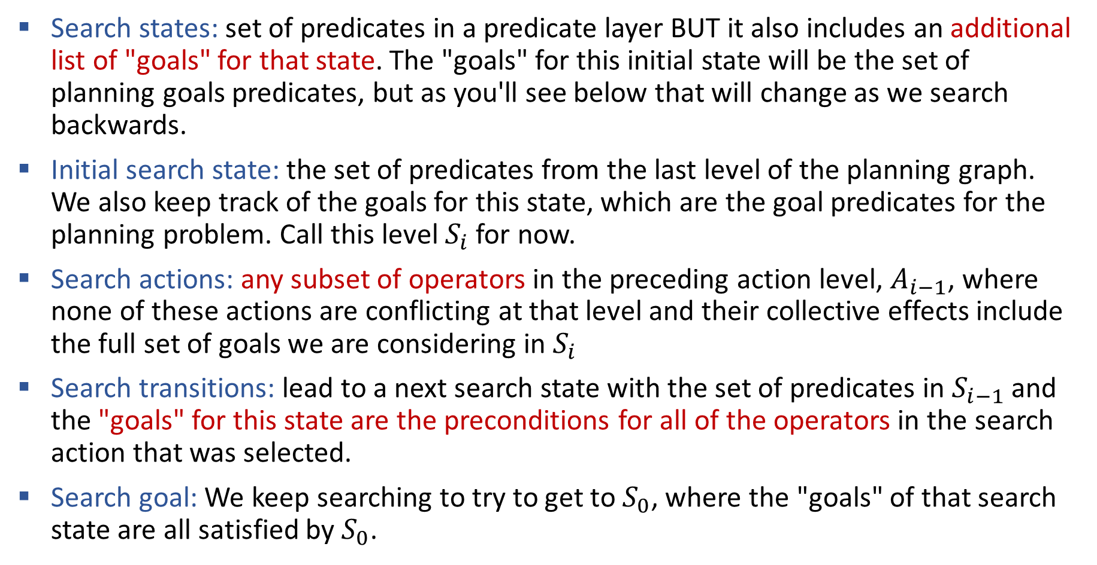
GraphPlan Details: Searching the Planning Graph
Search states: set of predicates in a predicate layer BUT it also includes an additional list of "goals" for that state. The "goals" for this initial state will be the set of planning goals predicates, but as you'll see below that will change as we search backwards.
Initial search state: the set of predicates from the last level of the planning graph. We also keep track of the goals for this state, which are the goal predicates for the planning problem. Call this level $S_{i}$ for now.
Search actions: any subset of operators in the preceding action level, $A_{i−1}$, where none of these actions are conflicting at that level and their collective effects include the full set of goals we are considering in $S_{i}$
Search transitions: lead to a next search state with the set of predicates in $S_{i−1}$ and the "goals" for this state are the preconditions for all of the operators in the search action that was selected.
Search goal: We keep searching to try to get to $S_{0}$, where the "goals" of that search state are all satisfied by $S_{0}$.

Slide 24
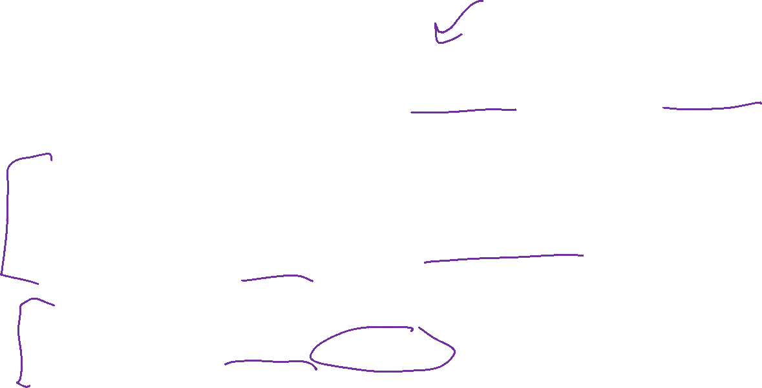
GraphPlan Big Picture
Construct a planning graph as an approximation of the state space graph
Num layers limited by num possible predicates and num possible actions
Polynomial space and construction time
  The approximation
  We do not delete any predicates that were EVER true since the start of the search. The planning graph computes the possibly reachable states although they aren’t necessarily feasible
  The Bad News
  GraphPlan backward search is exponential. We may have to try all the combinations of actions at each action layer
  But... the planning graph is still super useful for more modern techniques

Slide 25

Today
Solving Planning Problems:
State Space Search
Planning Graphs and GraphPlan
Planning Heuristics
State Space Search (yes, back here)
Planning in Continuous State Space
Motion Planning and Configuration Space
RRT (Rapidly-Exploring Random Trees)
RRT*

Slide 26
Solivng Planning Problems
Planning Heuristics

Slide 27

Delete-Relaxed Planning Graph
Key idea: Don't add the delete effects
bareL()
bareR()
sockL()
$¬$bareL()
bareL()
bareR()
$¬$bareR()
sockR()
shoeL()
$¬$sockL()
sockL()
$¬$bareL()
bareL()
bareR()
$¬$bareR()
sockR()
$¬$sockR()
shoeR()
putShoeL
putSockL
putSockL
noop
noop
putSockR
putSockR
putShoeR
$$S_{0}$$
$$A_{0}$$
$$S_{1}$$
$$A_{1}$$
$$S_{2}$$

Slide 28
(Delete-)Relaxed Planning Graph
Key idea: Don't add the delete effects (cheating even more than GraphPlan!)
bareL()
bareR()
sockL()
bareL()
bareR()
sockR()
shoeL()
sockL()
bareL()
bareR()
sockR()
shoeR()
putShoeL
Resulting mutexes go away too!!
Super fast to find a solution to this relaxed problem
Not great for an actual plan, but
Gives us a really good heuristic!
putSockL
putSockL
noop
noop
putSockR
putSockR
putShoeR

Slide 29
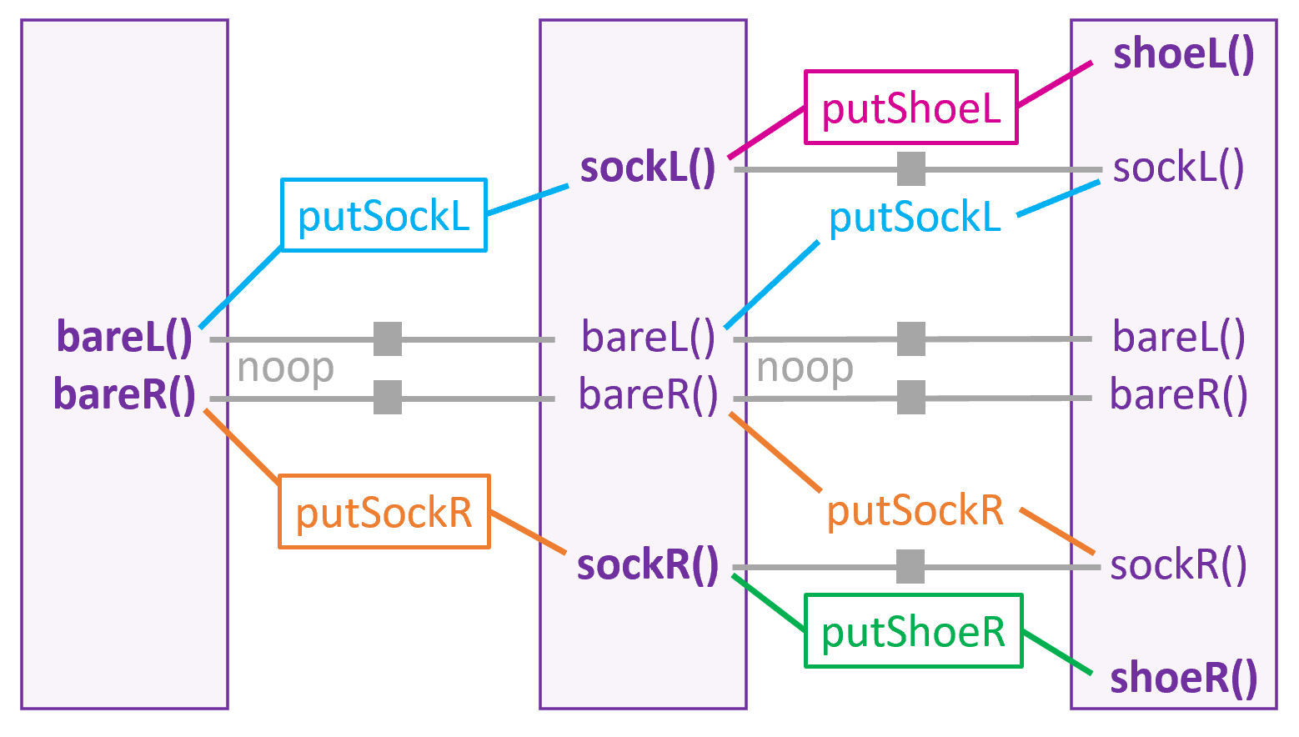
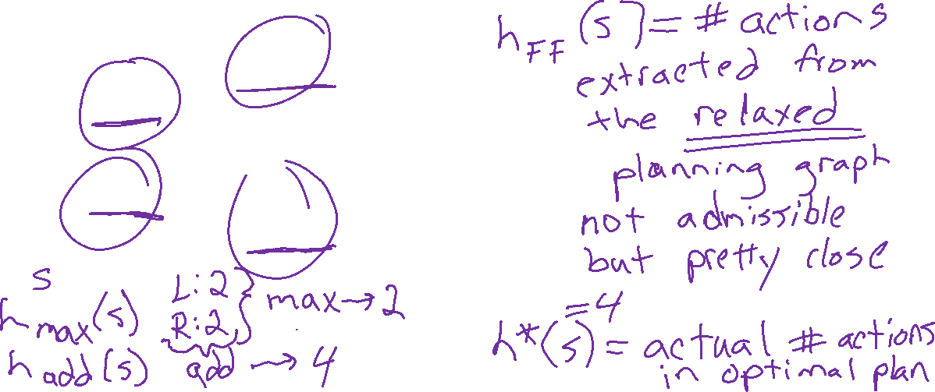
Planning Graph Heuristics
The Fast Forward planning technique used planning graph heuristics to speed up planning search in state space graphs!

Slide 30

Solivng Planning Problems
Fast Downward

Slide 31
Back to Searching with a State Space Graph
Start
Goal

Slide 32
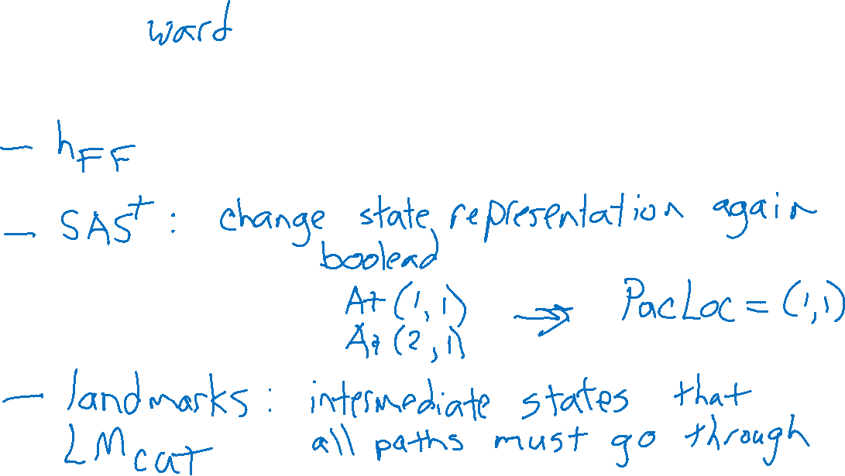
Modern Planning Workhorse: Fast Downward
The Fast Downward planning technique uses planning graph heuristics to speed up as well as a few other tricks while searching in state space graphs!

Slide 33
Today
Solving Planning Problems:
State Space Search
Planning Graphs and GraphPlan
Planning Heuristics
State Space Search (yes, back here)
Planning in Continuous State Space
Motion Planning and Configuration Space
RRT (Rapidly-Exploring Random Trees)
RRT*

Slide 34
Planning in Continuous State Space
Motion Planning

Slide 35
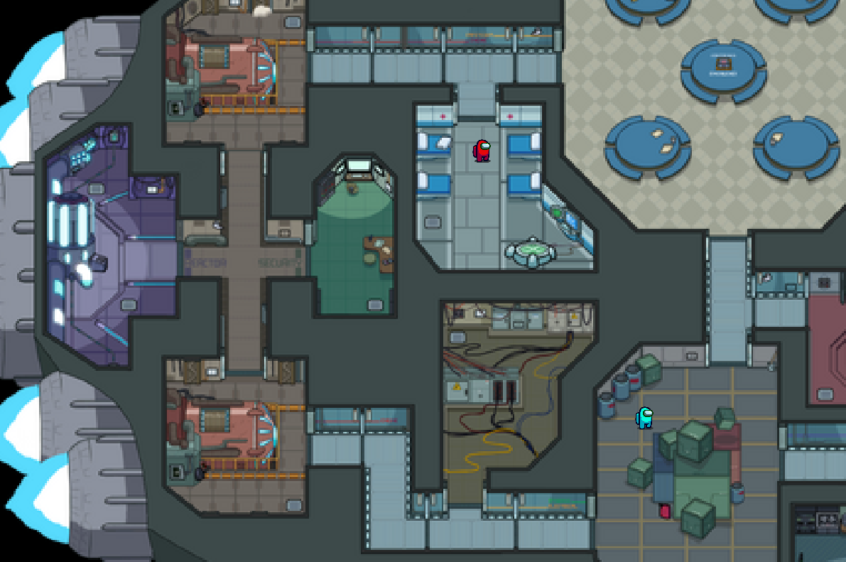
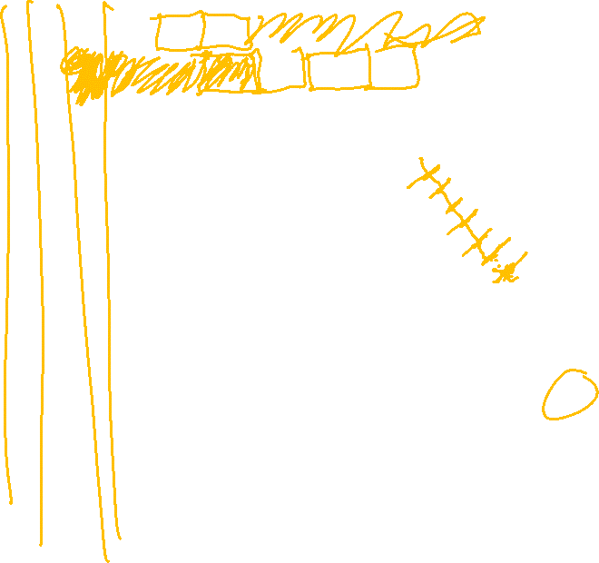
Among Us
How do we write an Among Us agent to move from one location to another?

Slide 36
Among Us
How do we write an Among Us agent to move from one location to another?

Slide 37
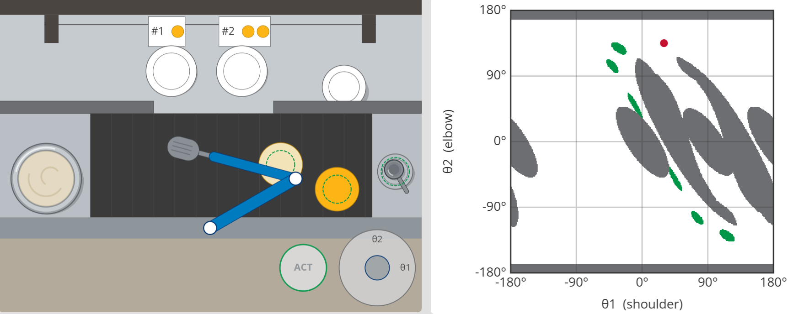

Robot Cook Environment
Demo: Robot Cook

Slide 38
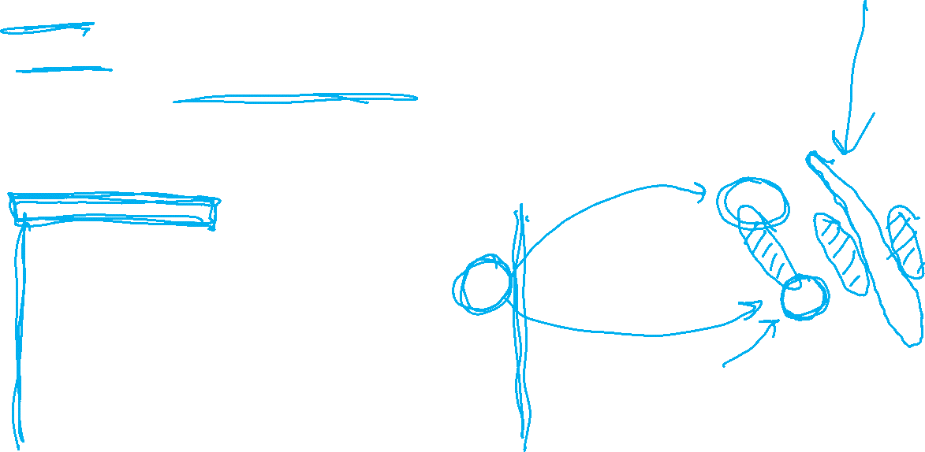
Poll 1 & 2
Demo: Robot Cook
Poll 1: What is this particular gray thing?
Poll 2: What action is available at this particular green thing?

Slide 39
Question
Demo: Robot Cook
How many target are available?

Slide 40

Configuration Space
Physical space vs configuration space (C-space)
Physical state, $s$, vs a configuration, $q$

Slide 41
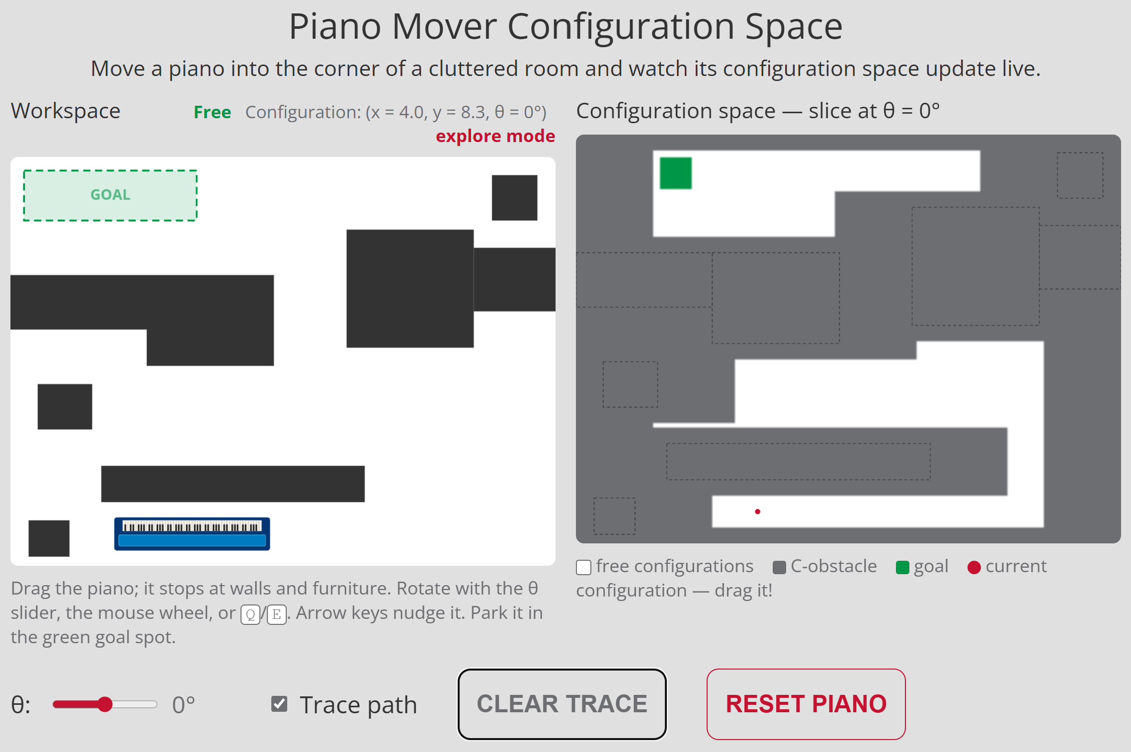
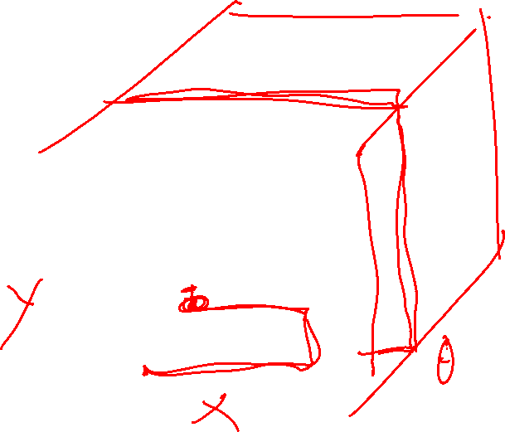
Poll 3
Demo: Piano Mover
How many dimensions is the C-space in the Piano Mover environment

Slide 42
Motion Planning
RRT

Slide 43

RRT (Rapidly-Exploring Random Trees)
🎵
Catch a falling star, and
put it in your pocket;
never let it fade away
🎵

Slide 44
RRT (Rapidly-Exploring Random Trees)
🎵
Pick a random point, and
find its nearest neighbor;
never let it get-too-far away
🎵

Slide 45
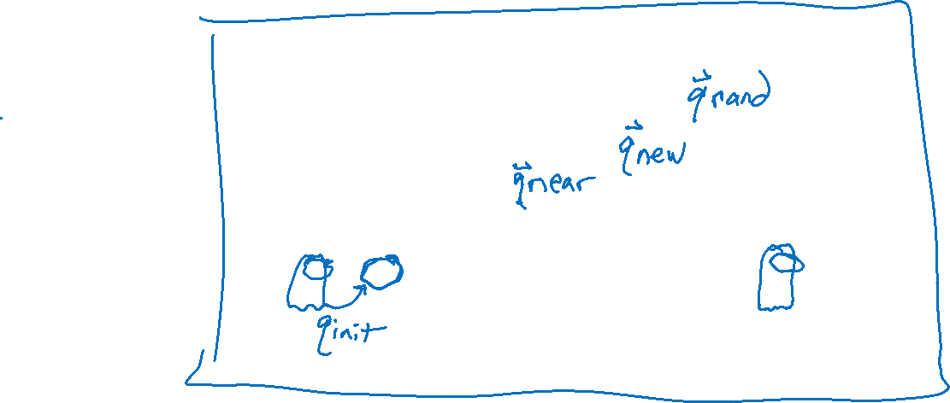

RRT (Rapidly-Exploring Random Trees)
🎵
Pick a random point, and
find its nearest neighbor;
never let it get-too-far away
🎵
max_edge

Slide 46




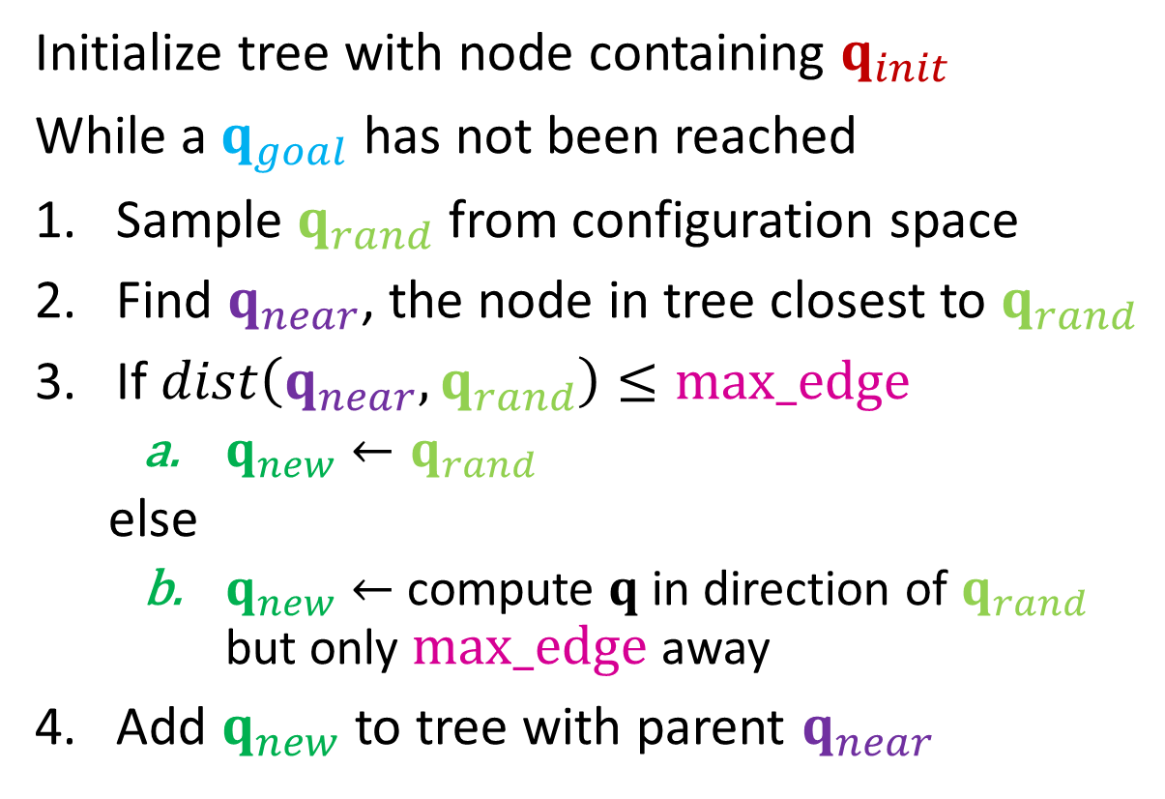



RRT (Rapidly-Exploring Random Trees)
Initialize tree with node containing $q_{init}$
While a $q_{goal}$ has not been reached
Sample $q_{rand}$ from configuration space
Find $q_{near}$, the node in tree closest to $q_{rand}$
If $dist\left(q_{near},q_{rand}\right)≤max_edge$
      $q_{new}←q_{rand}$
    else
      $q_{new}←$ compute $q$ in direction of $q_{rand}$ but only $max_edge$ away
Add $q_{new}$ to tree with parent $q_{near}$
$$q_{rand}$$
max_edge
$$q_{near}$$
$$q_{new}$$
$$q_{init}$$
$$q_{goal}$$

Slide 47
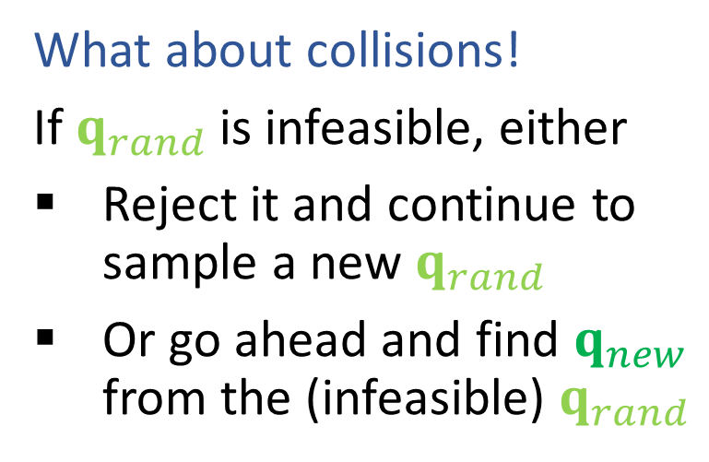
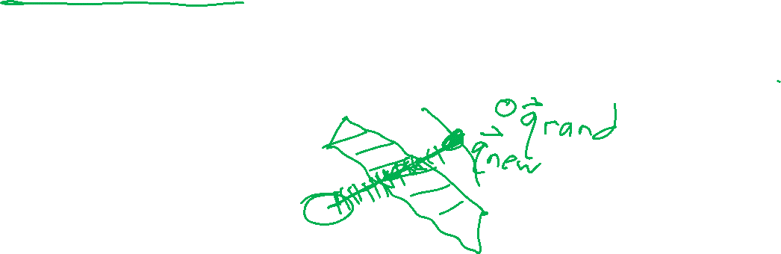
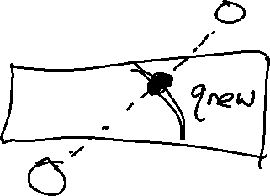
RRT (Rapidly-Exploring Random Trees)
What about collisions!
If $q_{rand}$ is infeasible, either
Reject it and continue to sample a new $q_{rand}$
Or go ahead and find $q_{new}$ from the (infeasible) $q_{rand}$

Slide 48
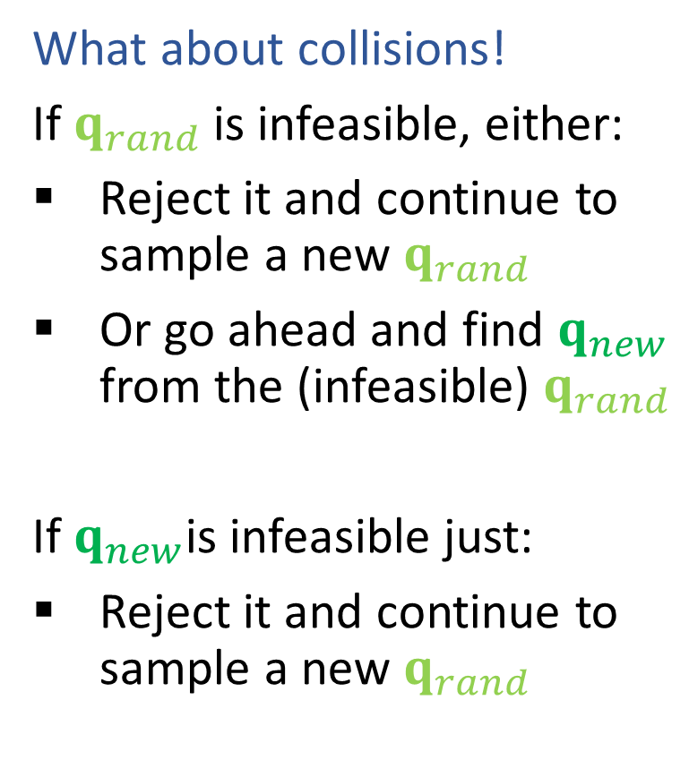
RRT (Rapidly-Exploring Random Trees)
What about collisions!
If $q_{rand}$ is infeasible, either:
Reject it and continue to sample a new $q_{rand}$
Or go ahead and find $q_{new}$ from the (infeasible) $q_{rand}$
If $q_{new}$is infeasible just:
Reject it and continue to sample a new $q_{rand}$

Slide 49
RRT (Rapidly-Exploring Random Trees)
Check the whole line segment before adding a new config to the tree!

Slide 50
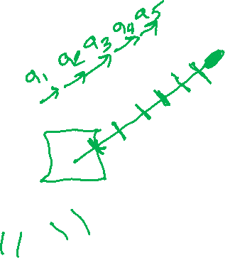
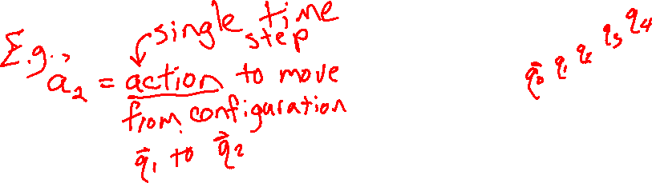
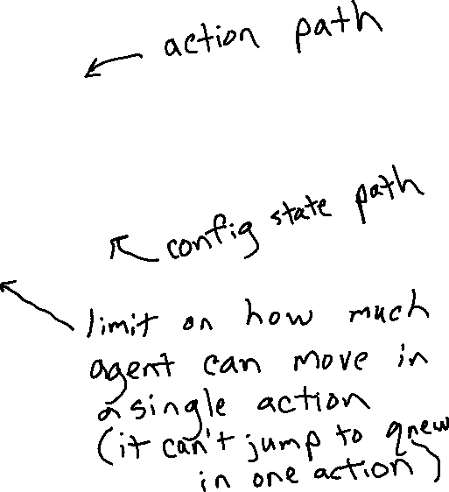
RRT (Rapidly-Exploring Random Trees)
Don't forget about limits of agent movement per step
We'll need to convert the RRT path to actions
May need to chop up segment and
Convert config pairs to actions

Slide 51
RRT Properties

Slide 52
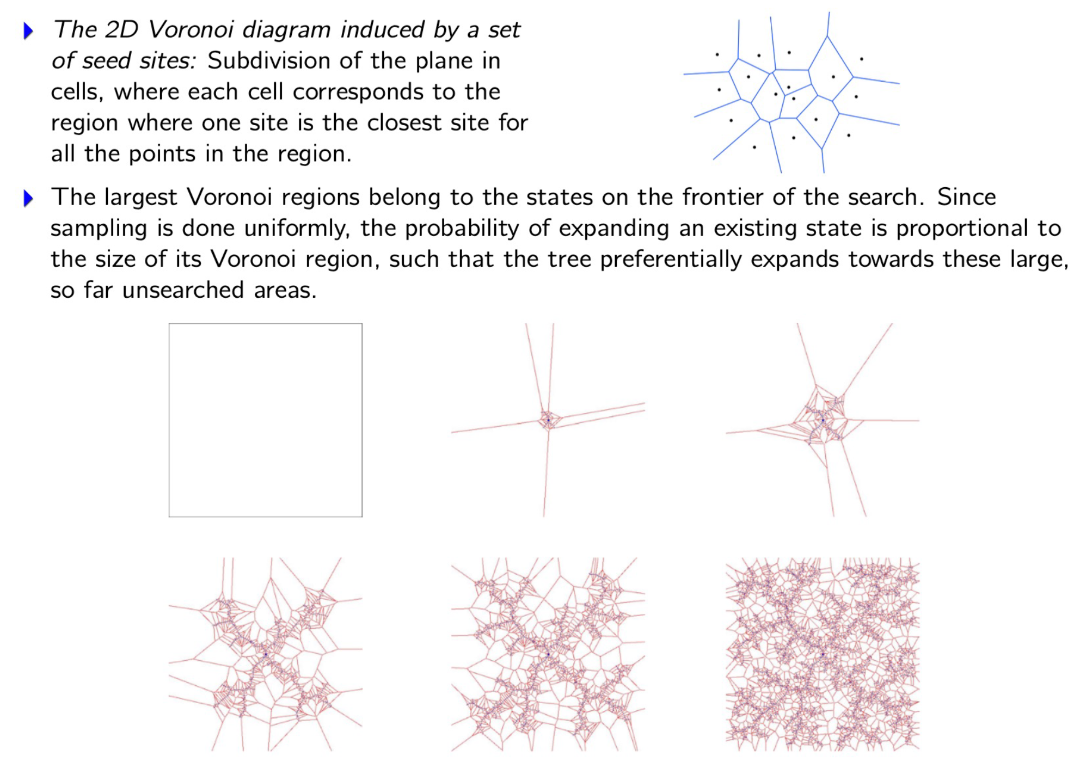
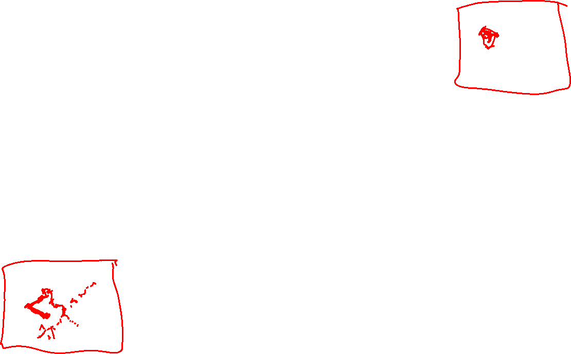
Exploring the Frontier!

Slide 53
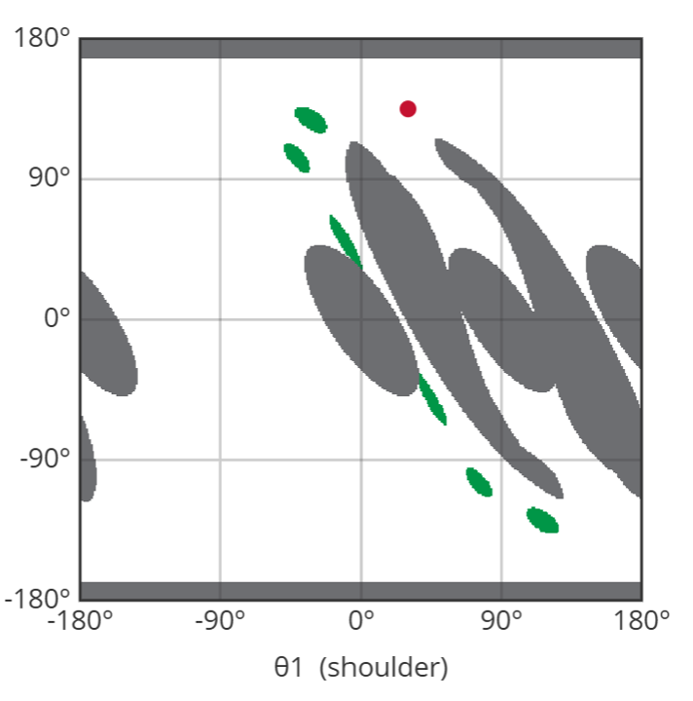
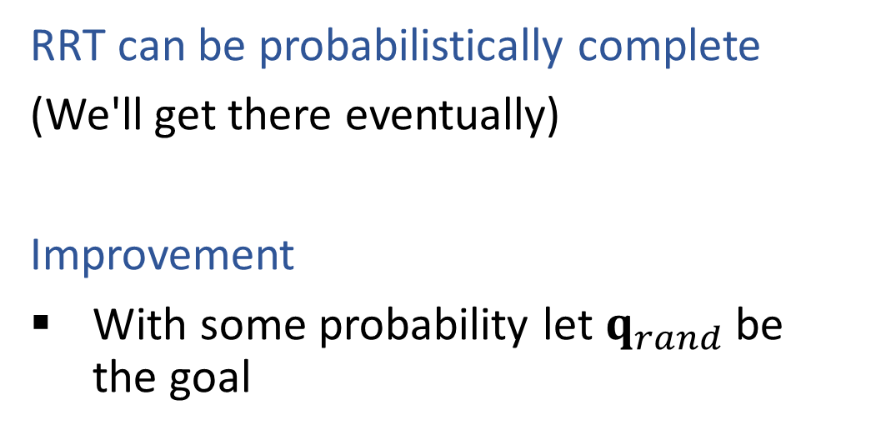

RRT Limitations: Completeness
RRT can be probabilistically complete
(We'll get there eventually)
Improvement
With some probability let $q_{rand}$ be the goal

Slide 54
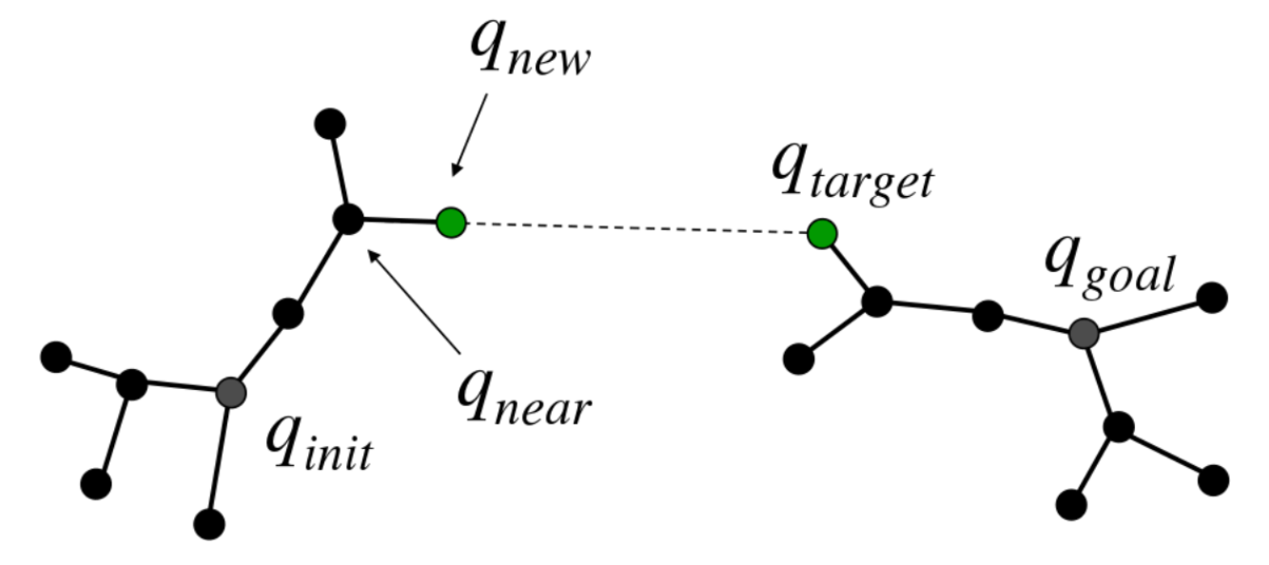
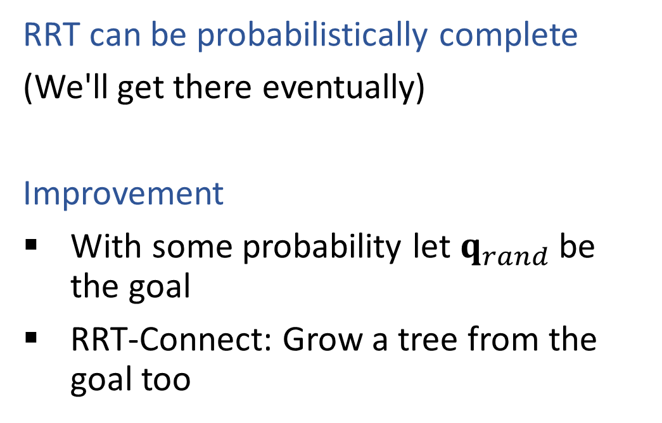
RRT Limitations: Completeness
RRT can be probabilistically complete
(We'll get there eventually)
Improvement
With some probability let $q_{rand}$ be the goal
RRT-Connect: Grow a tree from the goal too

Slide 55

RRT Limitations: Optimality
A node's parent is fixed the moment the node is created, and it is never reconsidered.
New samples can extend the tree, but they cannot repair a detour taken 500 iterations ago
So the solution is determined by the early, sparse phase of the tree, when the samples were least informative.
Karaman and Frazzoli, 2011: RRT converges to a suboptimal solution with probability 1
The fix is not more samples. It is to allow the tree to be rewritten
→ RRT *

Slide 56
Motion Planning
RRT*

Slide 57
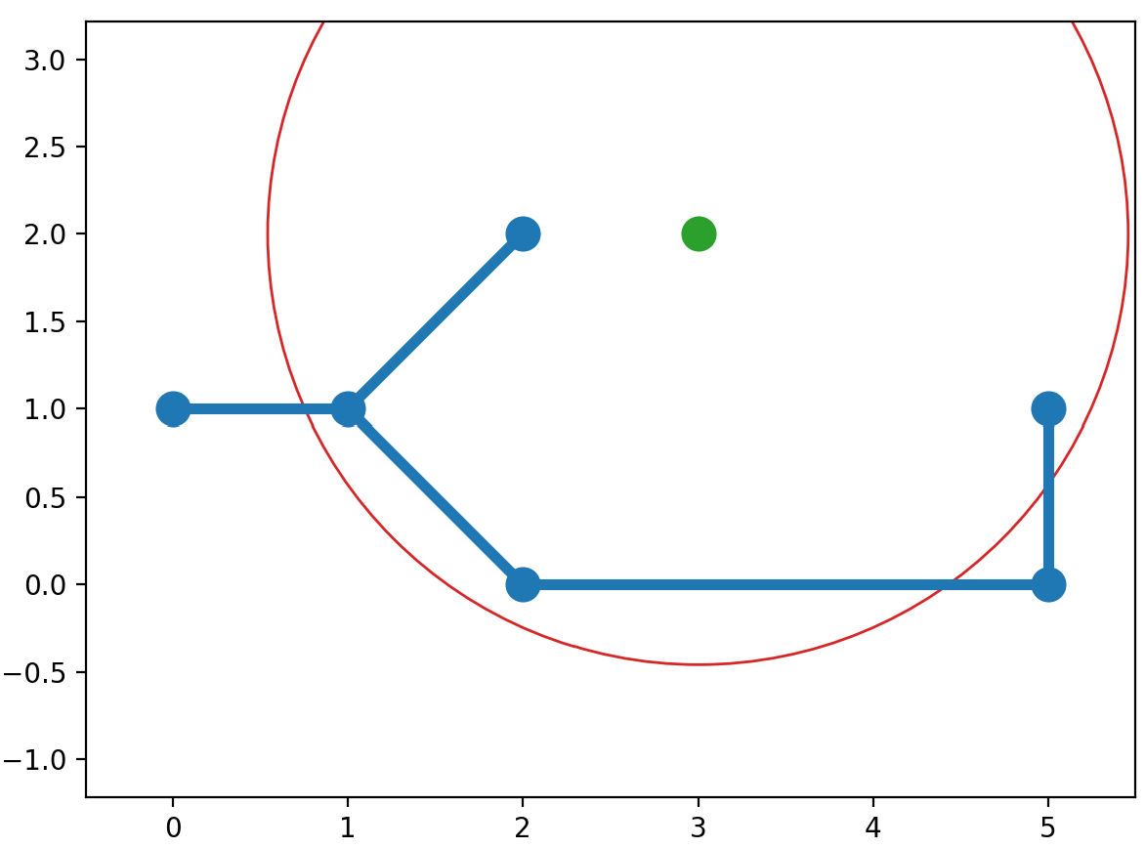
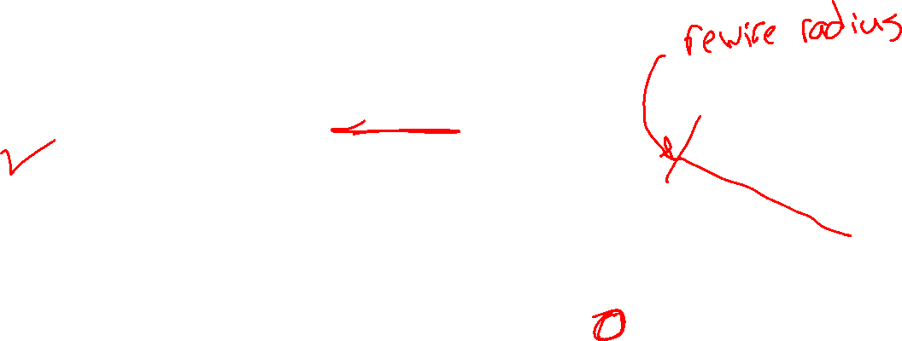
RRT*
Two tricks using the tree path cost:
Find a better parent
Rewire neighborhodd

Slide 58
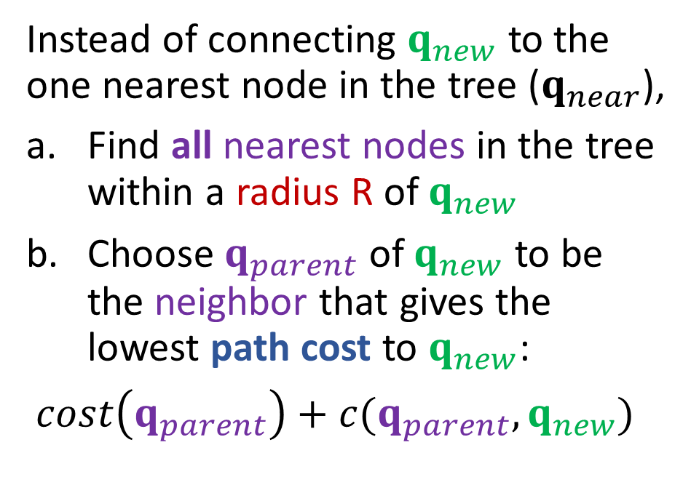
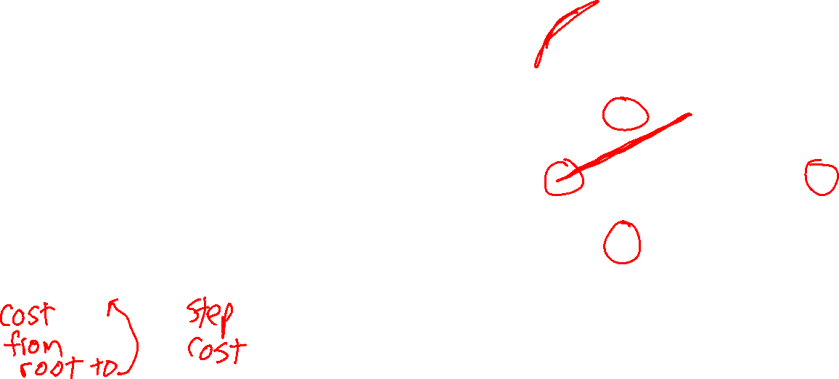
RRT*
Two tricks using the tree path cost: 1) Find a better parent
Instead of connecting $q_{new}$ to the one nearest node in the tree ($q_{near}$),
Find all nearest nodes in the tree within a radius R of $q_{new}$
Choose $q_{parent}$ of $q_{new}$ to be the neighbor that gives the lowest path cost to $q_{new}$:
$cost\left(q_{parent}\right)+c(q_{parent},q_{new})$

Slide 59
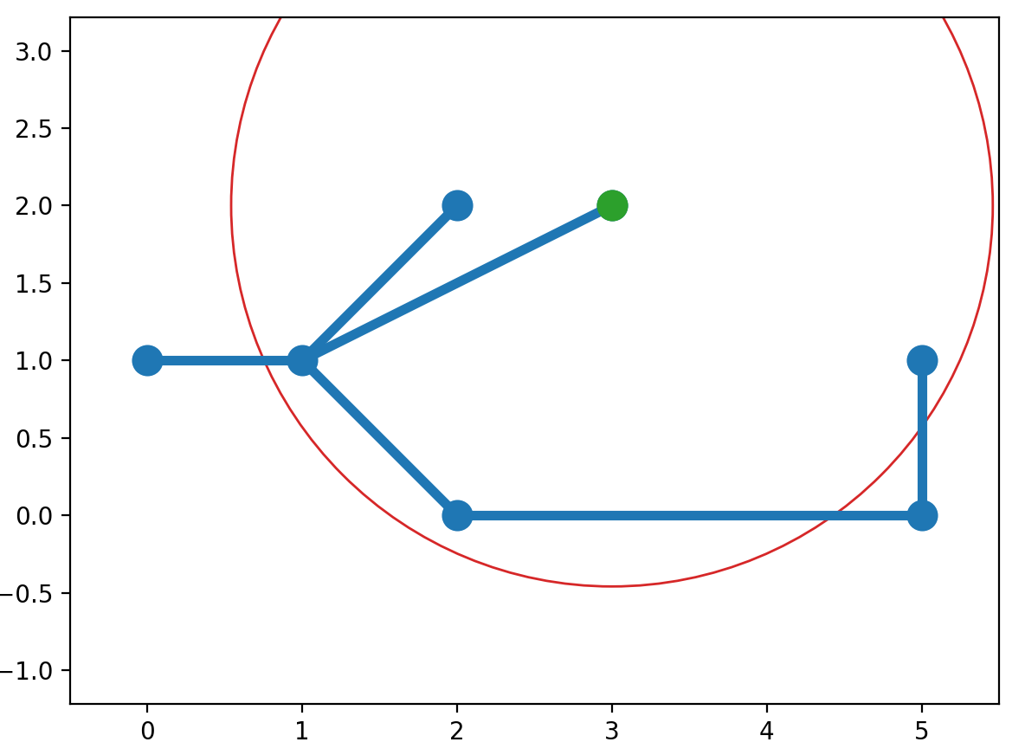
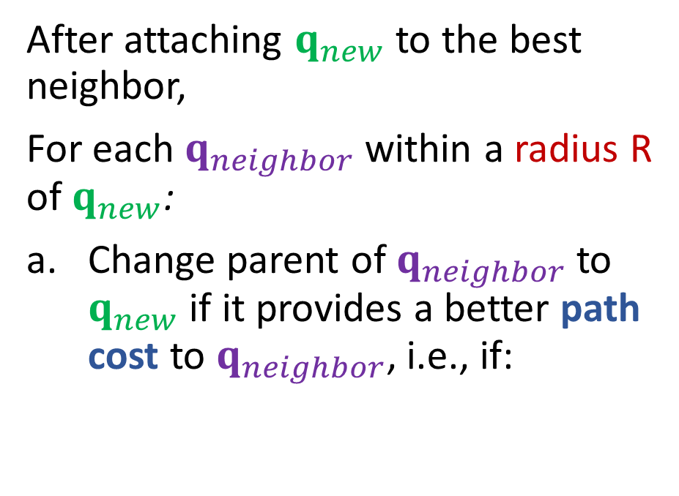


RRT*
Two tricks using the tree path cost: 2) Rewire the neighborhood to see if the new node is a better parent
After attaching $q_{new}$ to the best neighbor,
For each $q_{neighbor}$ within a radius R of $q_{new}$:
Change parent of $q_{neighbor}$ to $q_{new}$ if it provides a better path cost to $q_{neighbor}$, i.e., if:
$$cost\left(q_{new}\right)+c\left(q_{new},q_{neighbor}\right)<cost\left(q_{neighbor}\right)$$

Slide 60
RRT*
Two tricks using the tree path cost: 2) Rewire the neighborhood to see if the new node is a better parent
After attaching $q_{new}$ to the best neighbor,
For each $q_{neighbor}$ within a radius R of $q_{new}$:
Change parent of $q_{neighbor}$ to $q_{new}$ if it provides a better path cost to $q_{neighbor}$, i.e., if:
??
$$cost\left(q_{new}\right)+c\left(q_{new},q_{neighbor}\right)<cost\left(q_{neighbor}\right)$$

Slide 61
RRT*
Two tricks using the tree path cost: 2) Rewire the neighborhood to see if the new node is a better parent
After attaching $q_{new}$ to the best neighbor,
For each $q_{neighbor}$ within a radius R of $q_{new}$:
Change parent of $q_{neighbor}$ to $q_{new}$ if it provides a better path cost to $q_{neighbor}$, i.e., if:
???
$$cost\left(q_{new}\right)+c\left(q_{new},q_{neighbor}\right)<cost\left(q_{neighbor}\right)$$

Slide 62
RRT*
Two tricks using the tree path cost: 2) Rewire the neighborhood to see if the new node is a better parent
After attaching $q_{new}$ to the best neighbor,
For each $q_{neighbor}$ within a radius R of $q_{new}$:
Change parent of $q_{neighbor}$ to $q_{new}$ if it provides a better path cost to $q_{neighbor}$, i.e., if:
??
$$cost\left(q_{new}\right)+c\left(q_{new},q_{neighbor}\right)<cost\left(q_{neighbor}\right)$$

Slide 63

RRT*
Two tricks using the tree path cost: 2) Rewire the neighborhood to see if the new node is a better parent
After attaching $q_{new}$ to the best neighbor,
For each $q_{neighbor}$ within a radius R of $q_{new}$:
Change parent of $q_{neighbor}$ to $q_{new}$ if it provides a better path cost to $q_{neighbor}$, i.e., if:
?
$$cost\left(q_{new}\right)+c\left(q_{new},q_{neighbor}\right)<cost\left(q_{neighbor}\right)$$

Slide 64

Beyond RRT
Lots of extensions!
Wikipedia list →

Slide 65

Summary: Motion Planning
Dealing with continuous configuration space
1) Chop into discrete configuration space or 2) sample the configuration space (e.g., RRT)
RRT
Grow a tree by randomly sample points from configuration space and adding short, feasible segments from the existing tree toward the sampled config. Stop when you've connected $q_{init}$ with $q_{goal}$.
Not optimal
RRT*
Consider minimal path cost as samples are added to the RRT, rewiring parents as needed
Converges to optimal path (path to goal keeps getting better until optimal)

Slide 66
Additional Slides

Slide 67
Poll
What kind of mutex are actions to each other? (select all that apply)
Pickup-pickup are interference
Pickup-pickup are inconsistent
Pickup-pickup are competing needs
Pickup-put are interference
Pickup-put are inconsistent
Pickup-put are competing needs
HandEmpty
On-Table(O)
On-Table(G)
On(B,O)
Clear(B)
Clear(G)
Clear(O)
In-Hand(B)
In-Hand(G)
HandEmpty
On-Table(O)
On-Table(B)
On-Table(G)
On(G,B)
On(B,O)
On(B,G)
Clear(B)
Clear(G)
Clear(O)
In-Hand(B)
In-Hand(G)
Pickup(B)
Put(B,O)
Put(B,G)
Actions A and B are exclusive (mutex) at action-level i, if:
  Interference: one action effect deletes or negates a precondition of the other
  Inconsistency: one action effect deletes or negates the effect of the other
  Competing Needs: the actions have preconditions that are mutex in previous predicate-level
Put-Table(B)
Pickup(G)
Put-Table(G)
Put(G,B)
Pickup(O)

Slide 68
Poll
What kind of mutex are actions to each other? (select all that apply)
Pickup-pickup are interference
Pickup-pickup are inconsistent
Pickup-pickup are competing needs
Pickup-put are interference
Pickup-put are inconsistent
Pickup-put are competing needs
HandEmpty
On-Table(O)
On-Table(G)
On(B,O)
Clear(B)
Clear(G)
Clear(O)
In-Hand(B)
In-Hand(G)
HandEmpty
On-Table(O)
On-Table(B)
On-Table(G)
On(G,B)
On(B,O)
On(B,G)
Clear(B)
Clear(G)
Clear(O)
In-Hand(B)
In-Hand(G)
Pickup(B)
Put(B,O)
Put(B,G)
Actions A and B are exclusive (mutex) at action-level i, if:
  Interference: one action effect deletes or negates a precondition of the other
  Inconsistency: one action effect deletes or negates the effect of the other
  Competing Needs: the actions have preconditions that are mutex in previous predicate-level
Put-Table(B)
Pickup(G)
Put-Table(G)
Put(G,B)
Pickup(O)

Slide 69
We provide the GraphPlan implementation
In the programming assignment, you will create the representation, which will be passed into our GraphPlan implementation
In written assignments, you’ll be asked to build graph plan graphs and assess the graph plan graph for mutexes, goals, leveling off, and solutions.

Slide 70
Implementation

Slide 71
Implementing Symbolic Representations
Literals: Each thing/object in our model
i = Instance(“name”,TYPE)
Variables: Can take on any TYPE thing
v = Variable(“v_name”,TYPE)
Block World Example:
Pickup_from_Table(b):
Pre: HandEmpty(), Clear(b), On-Table(b)
Add: In-Hand(b)
Delete: HandEmpty(), On-Table(b)
Instances: “A”, “B”, “C” of type BLOCK
Variable: “b” of type BLOCK
In this operator, b can take on the value of any block instance

Slide 72
Implementing Symbolic Representations
Literals: Each thing/object in our model
i_a = Instance(“A”,BLOCK), i_b = Instance(“B”,BLOCK)
Variables: Can take on any TYPE thing
v_block = Variable(“b”,BLOCK)
Block World Example:
Pickup_from_Table(b):
Pre: HandEmpty(), Clear(b), On-Table(b)
Add: In-Hand(b)
Delete: HandEmpty(), On-Table(b)
ALERT: no two literals nor variables can have the same string name!!

Slide 73
Implementing Symbolic Representations
Literals: Each thing/object in our model
i_a = Instance(“A”,BLOCK), i_b = Instance(“B”,BLOCK)
Variables: Can take on any TYPE thing
v_block = Variable(“b”,BLOCK)
Propositions: Predicate Relationships
p1 = Proposition(“relation”, v_a, i, …)
Block World Example:
HandEmpty(), Clear(b), On-Table(b), On-Block(b1,b2)
Proposition(“handempty”), Proposition(“clear”,v_block), Proposition(“on-table”,v_block), Proposition(“on-block”,v_block, i_a)
NOTE: variables and instances do not have to start with i_ and v_

Slide 74
Initial State and Goal State
Create lists of Propositions as the initial state and goal state
initial = [ Proposition(“handempty”), Proposition(“on-table”, i_c), Proposition(“on-table”, i_b), Proposition(“on-block”, i_a, i_b), Proposition(“clear”, i_a), Proposition(“clear”, i_c)]
Goal = [Proposition(“on-table”,i_b), Proposition(“on-table”,i_c), Proposition(“on-block”,i_a, i_c), Proposition(“clear”,i_a), Proposition(“clear”,”c”)]

Slide 75
Implementing Symbolic Representations
Operators: the actions we take change state
pickup_table = Operator(“pick_table”, #name
[ Proposition(“handempty”,), #preconditions
Proposition(“clear”, v_block),
Proposition(“on-table”, v_block) ],
[ Proposition(“in-hand”, v_block) ], #add effects
[ Proposition(“handempty”), #delete effects
Proposition(“on-table”, v_block ]
)
Lists are conjunctions!
All propositions with a variable must take on the same instance!
Variables that don’t match name don’t have to be the same but can be unless otherwise specified!

Slide 76
We provide the GraphPlan implementation
You will create the representation, which will be passed into our GraphPlan implementation

Slide 77
Another Example - Rocket Ship
Suppose we have a rocket ship that can only be used once.
It has to carry two payloads.

Slide 78
Another Example - Rocket Ship
Suppose we have a rocket ship that can only be used once.
It has to carry two payloads.
Literals?

Slide 79
Another Example - Rocket Ship
Suppose we have a rocket ship that can only be used once.
It has to carry two payloads.
Literals: Rocket, G, O, LocA, LocB

Slide 80
Another Example - Rocket Ship
Suppose we have a rocket ship that can only be used once. It has to carry two payloads.
Literals: Rocket, G, O, LocA, LocB
Start state:
At(Rocket, LocA), Has-Fuel(),
Unloaded(G,LocA), Unloaded(O,LocA)
Goal state:
At(Rocket, LocB), Unloaded(G,LocB), Unloaded(O,LocB)
I create literals and variables as I go through the problem. In order to create the start state and the goal state, I need the literals defined.

Slide 81
Another Example - Rocket Ship
Literals: Rocket, G, O, LocA, LocB
Start state:
At(Rocket, LocA), Has-Fuel(),
Unloaded(G,LocA), Unloaded(O,LocA)
Goal state:
At(Rocket, LocB), Unloaded(G,LocB), Unloaded(O,LocB)
Move: Load: Unload:
As I create my operators, I will add variables.

Slide 82
Another Example - Rocket Ship
Literals: Rocket, G, O, LocA, LocB
Start state:
At(Rocket, LocA), Has-Fuel(),
Unloaded(G,LocA), Unloaded(O,LocA)
Goal state:
At(Rocket, LocB), Unloaded(G,LocB), Unloaded(O,LocB)
Move:
P:
A:
D:

Slide 83
Another Example - Rocket Ship
Literals: Rocket, G, O, LocA, LocB
Start state:
At(Rocket, LocA), Has-Fuel(),
Unloaded(G,LocA), Unloaded(O,LocA)
Goal state:
At(Rocket, LocB), Unloaded(G,LocB), Unloaded(O,LocB)
Variables: L
Move:
P: At(Rocket,L)
A:
D:
The rocket starts at a location, and it could be either location. I need to add a location variable

Slide 84
Another Example - Rocket Ship
Literals: Rocket, G, O, LocA, LocB
Start state:
At(Rocket, LocA), Has-Fuel(),
Unloaded(G,LocA), Unloaded(O,LocA)
Goal state:
At(Rocket, LocB), Unloaded(G,LocB), Unloaded(O,LocB)
Variables: L
Move:
P: At(Rocket,L), Has-Fuel()
A:
D:

Slide 85
Another Example - Rocket Ship
Literals: Rocket, G, O, LocA, LocB
Start state:
At(Rocket, LocA), Has-Fuel(),
Unloaded(G,LocA), Unloaded(O,LocA)
Goal state:
At(Rocket, LocB), Unloaded(G,LocB), Unloaded(O,LocB)
Variables: L, Dest
Move:
P: At(Rocket,L), Has-Fuel(), L!=Dest
A: At(Rocket,Dest)
D:
The rocket needs to go to a destination, which needs to be different from the start location. We need to define a dest variable.

Slide 86
Another Example - Rocket Ship
Literals: Rocket, G, O, LocA, LocB
Start state:
At(Rocket, LocA), Has-Fuel(),
Unloaded(G,LocA), Unloaded(O,LocA)
Goal state:
At(Rocket, LocB), Unloaded(G,LocB), Unloaded(O,LocB)
Variables: L, Dest
Move:
P: At(Rocket,L), Has-Fuel(), L!=Dest
A: At(Rocket,Dest)
D: Has-Fuel(),At(Rocket,L)

Slide 87
Another Example - Rocket Ship
Literals: Rocket, G, O, LocA, LocB
Start state:
At(Rocket, LocA), Has-Fuel(),
Unloaded(G,LocA), Unloaded(O,LocA)
Goal state:
At(Rocket, LocB), Unloaded(G,LocB), Unloaded(O,LocB)
Variables: L, Dest
Load:
P:
A:
D:

Slide 88
Another Example - Rocket Ship
Literals: Rocket, G, O, LocA, LocB
Start state:
At(Rocket, LocA), Has-Fuel(),
Unloaded(G,LocA), Unloaded(O,LocA)
Goal state:
At(Rocket, LocB), Unloaded(G,LocB), Unloaded(O,LocB)
Variables: L, Dest, Pkg
Load:
P: At(Rocket,L), Unloaded(Pkg,L)
A:
D:
The rocket needs to load a specific package G or O. The load action doesn’t care which package it is. We need a variable pkg to use.

Slide 89
Another Example - Rocket Ship
Literals: Rocket, G, O, LocA, LocB
Start state:
At(Rocket, LocA), Has-Fuel(),
Unloaded(G,LocA), Unloaded(O,LocA)
Goal state:
At(Rocket, LocB), Unloaded(G,LocB), Unloaded(O,LocB)
Variables: L, Dest, Pkg
Load:
P: At(Rocket,L), Unloaded(Pkg,L)
A: Loaded(Pkg,Rocket)
D: Unloaded(Pkg,L)

Slide 90
Another Example - Rocket Ship
Literals: Rocket, G, O, LocA, LocB
Start state:
At(Rocket, LocA), Has-Fuel(),
Unloaded(G,LocA), Unloaded(O,LocA)
Goal state:
At(Rocket, LocB), Unloaded(G,LocB), Unloaded(O,LocB)
Variables: L, Dest, Pkg
Unload:
P: At(Rocket,Dest), Loaded(Pkg,Rocket)
A: Unloaded(Pkg,Dest)
D: Loaded(Pkg,Rocket)
No new variables needed for unload.

Slide 91
Rocket Ship GraphPlan Graph
Start state
Action Layer 1
Predicate Layer 1
At(Rocket,LocA)
Has-Fuel()
Unloaded(G,LocA)
Unloaded(O,LocA)
At(Rocket,LocB)
At(Rocket,LocA)
Has-Fuel()
Unloaded(G,LocA)
Unloaded(O,LocA)
Loaded(G,Rocket)
Loaded(O,Rocket)
Move
Load(G)
Load(O)

Slide 92
Rocket Ship GraphPlan Graph
At(Rocket,LocA)
Has-Fuel()
Unloaded(G,LocA)
Unloaded(O,LocA)
At(Rocket,LocB)
At(Rocket,LocA)
Has-Fuel()
Unloaded(G,LocA)
Unloaded(O,LocA)
Loaded(G,Rocket)
Loaded(O,Rocket)
Move
Load(G)
Load(O)
Mutex Actions
Interference:
Move deletes At which is a precondition of Load
Inconsistent:
Move deletes At but noop adds it
Move deletes Has-Fuel but noop adds it
Mutex Predicates:
- At(Rocket,LocB) and
At(Rocket,LocA) because
Move and noop are mutex actions
- What else?
Notes:
Both Loaded conflict with At(B)
Both Loaded conflict with Unloaded

Slide 93
Rocket Ship GraphPlan Graph
Start state
Action Layer 1
Predicate Layer 1
Action Layer 2
Predicate Layer 2
At(Rocket,LocA)
Has-Fuel()
Unloaded(G,LocA)
Unloaded(O,LocA)
At(Rocket,LocB)
At(Rocket,LocA)
Has-Fuel()
Unloaded(G,LocA)
Unloaded(O,LocA)
Loaded(G,Rocket)
Loaded(O,Rocket)
At(Rocket,LocB)
At(Rocket,LocA)
Has-Fuel()
Unloaded(G,LocA)
Unloaded(O,LocA)
Loaded(G,Rocket)
Loaded(O,Rocket)
Move
Move
Load(G)
Load(G)
Load(O)
Load(O)

Slide 94
Rocket Ship GraphPlan Graph
At(Rocket,LocA)
Has-Fuel()
Unloaded(G,LocA)
Unloaded(O,LocA)
At(Rocket,LocB)
At(Rocket,LocA)
Has-Fuel()
Unloaded(G,LocA)
Unloaded(O,LocA)
Loaded(G,Rocket)
Loaded(O,Rocket)
At(Rocket,LocB)
At(Rocket,LocA)
Has-Fuel()
Unloaded(G,LocA)
Unloaded(O,LocA)
Loaded(G,Rocket)
Loaded(O,Rocket)
Move
Move
Load(G)
Load(G)
Load(O)
Load(O)
At time 1: Move can be performed OR both Load actions
At time 2: Possible plans include:
Load(G), Load(O), Move(LocB) ← reachable goal in two steps but feasible in three
Load(G), Move(LocB)
Load(O), Move(LocB)

