Slide 1
07-380 AI & ML II
Classical Planning
or Symbolic Planning
Instructors: Pat Virtue & Mohammad Salameh
Slide credits: CMU AI

Slide 2

Today
Polls covering Pre-reading
Planning with Propositional Logic
From Propositional Logic to Classical Planning
Classical Planning Representation
Solving Planning Problems: State space search
New
Solving Planning Problems: Planning Graphs and GraphPlan
Next time
From GraphPlan to Modern Planning
Planning with Continuous States

Slide 3
Pre-reading
Planning with Propositional Logic

Slide 4




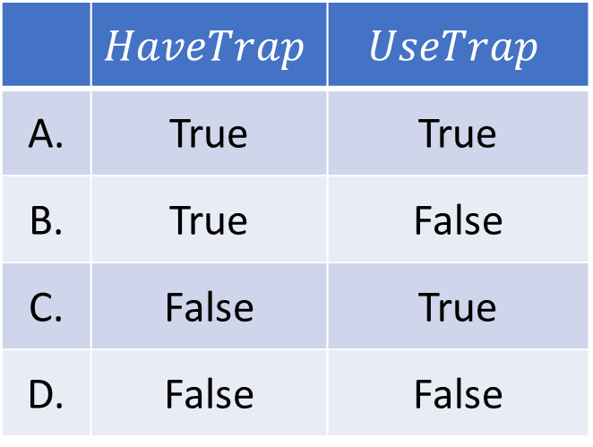


Poll 1
$$UseTrap$$
Which models satisfy the following sentence?
$$α: HaveTrap∧ UseTrap⇒¬HaveTrap$$
 | $$HaveTrap$$ | $$UseTrap$$
A. | True | True
B. | True | False
C. | False | True
D. | False | False

Slide 5
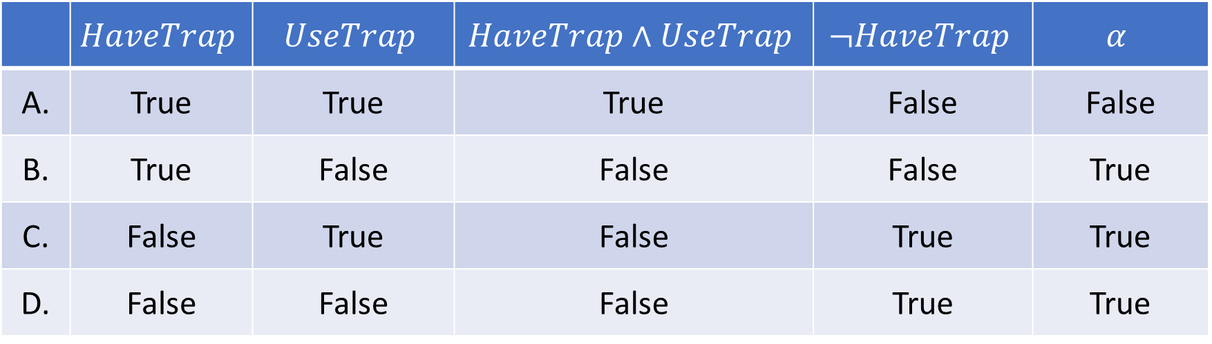
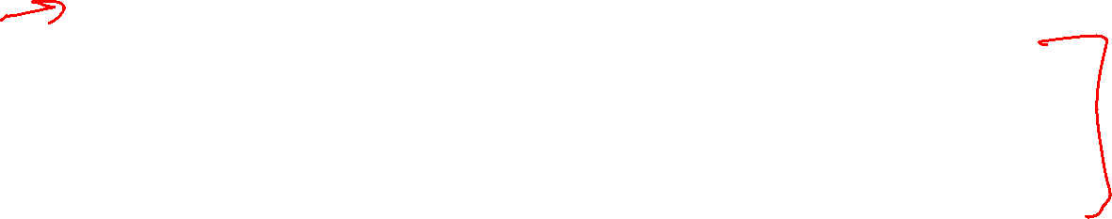
Poll 1
$$UseTrap$$
Which models satisfy the following sentence?
$$α: HaveTrap∧ UseTrap⇒¬HaveTrap$$
 | $$HaveTrap$$ | $$UseTrap$$ | $$HaveTrap∧UseTrap$$ | $$¬HaveTrap$$ | $$α$$
A. | True | True | True | False | False
B. | True | False | False | False | True
C. | False | True | False | True | True
D. | False | False | False | True | True

Slide 6
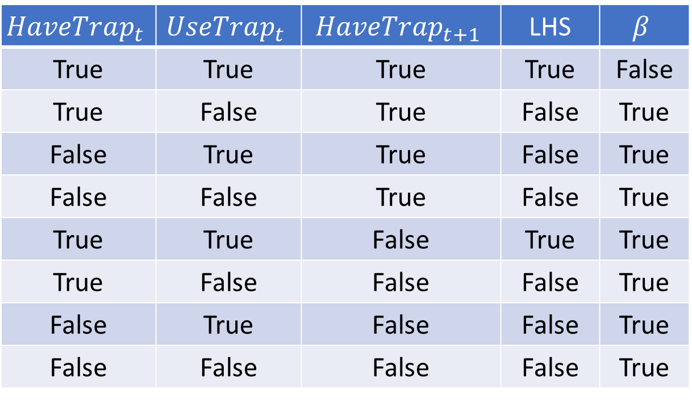
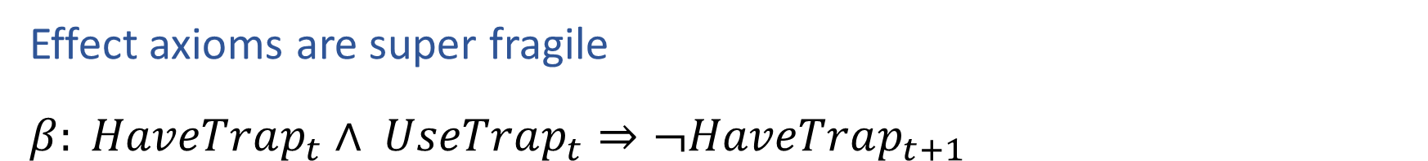
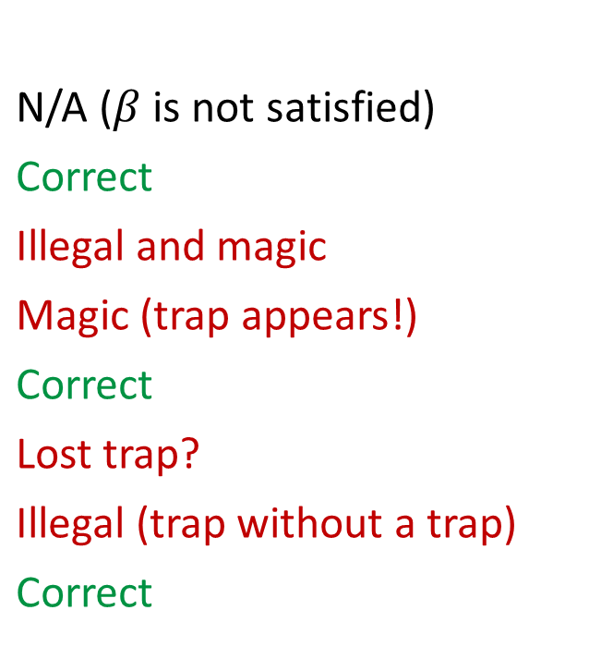
Fluents & Effect Axioms
$$UseTrap$$
Effect axioms are super fragile
$β: HaveTrap_{t}∧ UseTrap_{t}⇒¬HaveTrap_{t+1}$
$$HaveTrap_{t}$$ | $$UseTrap_{t}$$ | $$HaveTrap_{t+1}$$ | LHS | $$β$$
True | True | True | True | False
True | False | True | False | True
False | True | True | False | True
False | False | True | False | True
True | True | False | True | True
True | False | False | False | True
False | True | False | False | True
False | False | False | False | True
N/A ($β$ is not satisfied)
Correct
Illegal and magic
Magic (trap appears!)
Correct
Lost trap?
Illegal (trap without a trap)
Correct

Slide 7
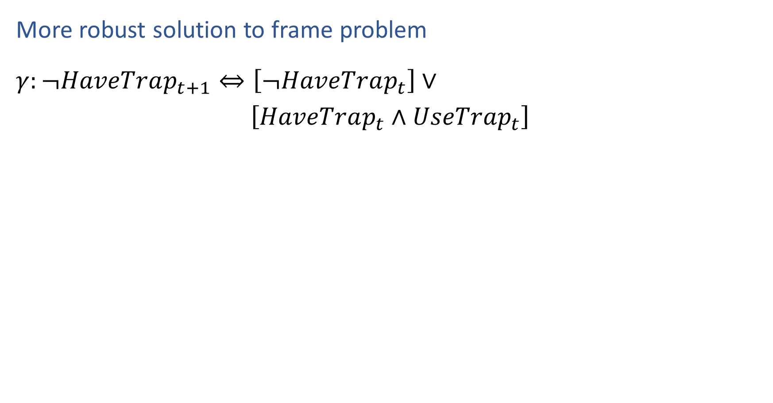
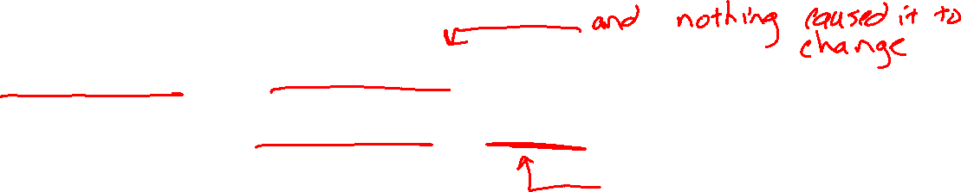
Successor State Axioms
$$UseTrap$$
More robust solution to frame problem
$γ:¬HaveTrap_{t+1}⇔\left[¬HaveTrap_{t}\right]∨$
$\left[HaveTrap_{t}∧UseTrap_{t}\right]$

Slide 8
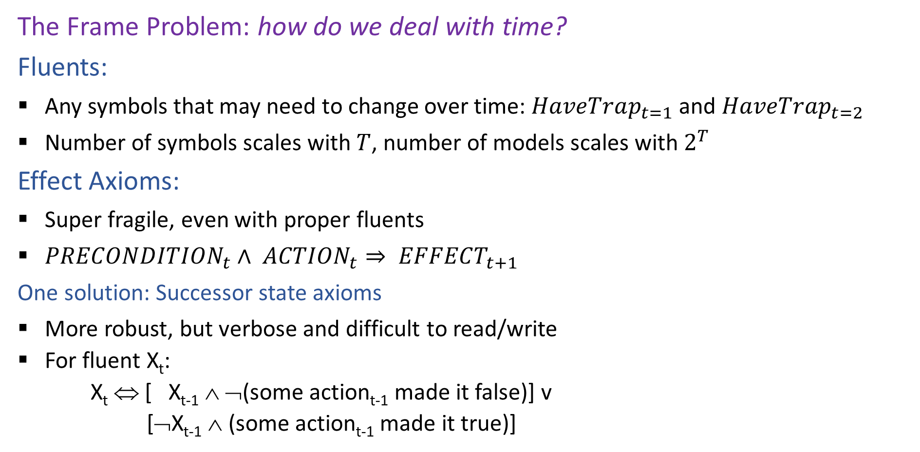
Planning with Propositional Logic
The Frame Problem: how do we deal with time?
Fluents:
Any symbols that may need to change over time: $HaveTrap_{t=1}$ and $HaveTrap_{t=2}$
Number of symbols scales with $T$, number of models scales with $2^{T}$
Effect Axioms:
Super fragile, even with proper fluents
$PRECONDITION_{t}∧ ACTION_{t}⇒ EFFECT_{t+1}$
One solution: Successor state axioms
More robust, but verbose and difficult to read/write
  For fluent X_{t}:
  X_{t} ⇔ [ X_{t-1} ∧ ¬(some action_{t-1} made it false)] v
  [¬X_{t-1} ∧ (some action_{t-1} made it true)]

Slide 9

Planning as Satisfiability: SATPlan
Given a hyper-efficient SAT solver, can we use it to make plans?
Yes, for fully observable, deterministic case: planning problem is solvable iff there is some satisfying assignment for actions etc.
For T = 1 to infinity, set up the KB as follows and run SAT solver:
  Initial state, domain constraints
  For t=1 to T
      Successor state axioms for time t
      Precondition axioms: At_1,1_0 ∧ N_0 ⇒ ¬Wall_1,2 etc.
      Action exclusion axioms: ¬(N_0 ∧ W_0) ∧ ¬(N_0 ∧ S_0) ∧ .. etc.
  Goal is true at time T

Slide 10
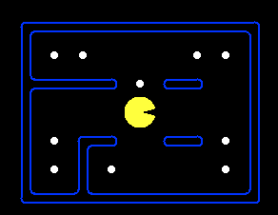
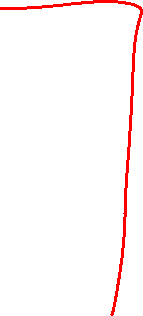
Planning as Satisfiability: SATPlan
(P[4,3,0] & (~P[1,1,0] | ~P[1,2,0]) & (~P[1,1,0] | ~P[1,3,0]) & (~P[1,1,0] | ~P[1,5,0]) & (~P[1,1,0] | ~P[2,3,0]) & (~P[1,1,0] | ~P[2,5,0]) & (~P[1,1,0] | ~P[3,1,0]) & (~P[1,1,0] | ~P[3,3,0]) & (~P[1,1,0] | ~P[3,5,0]) & (~P[1,1,0] | ~P[4,1,0]) & (~P[1,1,0] | ~P[4,2,0]) & (~P[1,1,0] | ~P[4,3,0]) & (~P[1,1,0] | ~P[4,4,0]) & (~P[1,1,0] | ~P[4,5,0]) & (~P[1,1,0] | ~P[5,1,0]) & (~P[1,1,0] | ~P[5,3,0]) & (~P[1,1,0] | ~P[5,5,0]) & (~P[1,1,0] | ~P[6,1,0]) & (~P[1,1,0] | ~P[6,3,0]) & (~P[1,1,0] | ~P[6,5,0]) & (~P[1,1,0] | ~P[7,1,0]) & (~P[1,1,0] | ~P[7,2,0]) & (~P[1,1,0] | ~P[7,3,0]) & (~P[1,1,0] | ~P[7,4,0]) & (~P[1,1,0] | ~P[7,5,0]) & (~P[1,2,0] | ~P[1,3,0]) & (~P[1,2,0] | ~P[1,5,0]) & (~P[1,2,0] | ~P[2,3,0]) & (~P[1,2,0] | ~P[2,5,0]) & (~P[1,2,0] | ~P[3,1,0]) & (~P[1,2,0] | ~P[3,3,0]) & (~P[1,2,0] | ~P[3,5,0]) & (~P[1,2,0] | ~P[4,1,0]) & (~P[1,2,0] | ~P[4,2,0]) & (~P[1,2,0] | ~P[4,3,0]) & (~P[1,2,0] | ~P[4,4,0]) & (~P[1,2,0] | ~P[4,5,0]) & (~P[1,2,0] | ~P[5,1,0]) & (~P[1,2,0] | ~P[5,3,0]) & (~P[1,2,0] | ~P[5,5,0]) & (~P[1,2,0] | ~P[6,1,0]) & (~P[1,2,0] | ~P[6,3,0]) & (~P[1,2,0] | ~P[6,5,0]) & (~P[1,2,0] | ~P[7,1,0]) & (~P[1,2,0] | ~P[7,2,0]) & (~P[1,2,0] | ~P[7,3,0]) & (~P[1,2,0] | ~P[7,4,0]) & (~P[1,2,0] | ~P[7,5,0]) & (~P[1,3,0] | ~P[1,5,0]) & (~P[1,3,0] | ~P[2,3,0]) & (~P[1,3,0] | ~P[2,5,0]) & (~P[1,3,0] | ~P[3,1,0]) & (~P[1,3,0] | ~P[3,3,0]) & (~P[1,3,0] | ~P[3,5,0]) & (~P[1,3,0] | ~P[4,1,0]) & (~P[1,3,0] | ~P[4,2,0]) & (~P[1,3,0] | ~P[4,3,0]) & (~P[1,3,0] | ~P[4,4,0]) & (~P[1,3,0] | ~P[4,5,0]) & (~P[1,3,0] | ~P[5,1,0]) & (~P[1,3,0] | ~P[5,3,0]) & (~P[1,3,0] | ~P[5,5,0]) & (~P[1,3,0] | ~P[6,1,0]) & (~P[1,3,0] | ~P[6,3,0]) & (~P[1,3,0] | ~P[6,5,0]) & (~P[1,3,0] | ~P[7,1,0]) & (~P[1,3,0] | ~P[7,2,0]) & (~P[1,3,0] | ~P[7,3,0]) & (~P[1,3,0] | ~P[7,4,0]) & (~P[1,3,0] | ~P[7,5,0]) & (~P[1,5,0] | ~P[2,3,0]) & (~P[1,5,0] | ~P[2,5,0]) & (~P[1,5,0] | ~P[3,1,0]) & (~P[1,5,0] | ~P[3,3,0]) & (~P[1,5,0] | ~P[3,5,0]) & (~P[1,5,0] | ~P[4,1,0]) & (~P[1,5,0] | ~P[4,2,0]) & (~P[1,5,0] | ~P[4,3,0]) & (~P[1,5,0] | ~P[4,4,0]) & (~P[1,5,0] | ~P[4,5,0]) & (~P[1,5,0] | ~P[5,1,0]) & (~P[1,5,0] | ~P[5,3,0]) & (~P[1,5,0] | ~P[5,5,0]) & (~P[1,5,0] | ~P[6,1,0]) & (~P[1,5,0] | ~P[6,3,0]) & (~P[1,5,0] | ~P[6,5,0]) & (~P[1,5,0] | ~P[7,1,0]) & (~P[1,5,0] | ~P[7,2,0]) & (~P[1,5,0] | ~P[7,3,0]) & (~P[1,5,0] | ~P[7,4,0]) & (~P[1,5,0] | ~P[7,5,0]) & (~P[2,3,0] | ~P[2,5,0]) & (~P[2,3,0] | ~P[3,1,0]) & (~P[2,3,0] | ~P[3,3,0]) & (~P[2,3,0] | ~P[3,5,0]) & (~P[2,3,0] | ~P[4,1,0]) & (~P[2,3,0] | ~P[4,2,0]) & (~P[2,3,0] | ~P[4,3,0]) & (~P[2,3,0] | ~P[4,4,0]) & (~P[2,3,0] | ~P[4,5,0]) & (~P[2,3,0] | ~P[5,1,0]) & (~P[2,3,0] | ~P[5,3,0]) & (~P[2,3,0] | ~P[5,5,0]) & (~P[2,3,0] | ~P[6,1,0]) & (~P[2,3,0] | ~P[6,3,0]) & (~P[2,3,0] | ~P[6,5,0]) & (~P[2,3,0] | ~P[7,1,0]) & (~P[2,3,0] | ~P[7,2,0]) & (~P[2,3,0] | ~P[7,3,0]) & (~P[2,3,0] | ~P[7,4,0]) & (~P[2,3,0] | ~P[7,5,0]) & (~P[2,5,0] | ~P[3,1,0]) & (~P[2,5,0] | ~P[3,3,0]) & (~P[2,5,0] | ~P[3,5,0]) & (~P[2,5,0] | ~P[4,1,0]) & (~P[2,5,0] | ~P[4,2,0]) & (~P[2,5,0] | ~P[4,3,0]) & (~P[2,5,0] | ~P[4,4,0]) & (~P[2,5,0] | ~P[4,5,0]) & (~P[2,5,0] | ~P[5,1,0]) & (~P[2,5,0] | ~P[5,3,0]) & (~P[2,5,0] | ~P[5,5,0]) & (~P[2,5,0] | ~P[6,1,0]) & (~P[2,5,0] | ~P[6,3,0]) & (~P[2,5,0] | ~P[6,5,0]) & (~P[2,5,0] | ~P[7,1,0]) & (~P[2,5,0] | ~P[7,2,0]) & (~P[2,5,0] | ~P[7,3,0]) & (~P[2,5,0] | ~P[7,4,0]) & (~P[2,5,0] | ~P[7,5,0]) & (~P[3,1,0] | ~P[3,3,0]) & (~P[3,1,0] | ~P[3,5,0]) & (~P[3,1,0] | ~P[4,1,0]) & (~P[3,1,0] | ~P[4,2,0]) & (~P[3,1,0] | ~P[4,3,0]) & (~P[3,1,0] | ~P[4,4,0]) & (~P[3,1,0] | ~P[4,5,0]) & (~P[3,1,0] | ~P[5,1,0]) & (~P[3,1,0] | ~P[5,3,0]) & (~P[3,1,0] | ~P[5,5,0]) & (~P[3,1,0] | ~P[6,1,0]) & (~P[3,1,0] | ~P[6,3,0]) & (~P[3,1,0] | ~P[6,5,0]) & (~P[3,1,0] | ~P[7,1,0]) & (~P[3,1,0] | ~P[7,2,0]) & (~P[3,1,0] | ~P[7,3,0]) & (~P[3,1,0] | ~P[7,4,0]) & (~P[3,1,0] | ~P[7,5,0]) & (~P[3,3,0] | ~P[3,5,0]) & (~P[3,3,0] | ~P[4,1,0]) & (~P[3,3,0] | ~P[4,2,0]) & (~P[3,3,0] | ~P[4,3,0]) & (~P[3,3,0] | ~P[4,4,0]) & (~P[3,3,0] | ~P[4,5,0]) & (~P[3,3,0] | ~P[5,1,0]) & (~P[3,3,0] | ~P[5,3,0]) & (~P[3,3,0] | ~P[5,5,0]) & (~P[3,3,0] | ~P[6,1,0]) & (~P[3,3,0] | ~P[6,3,0]) & (~P[3,3,0] | ~P[6,5,0]) & (~P[3,3,0] | ~P[7,1,0]) & (~P[3,3,0] | ~P[7,2,0]) & (~P[3,3,0] | ~P[7,3,0]) & (~P[3,3,0] | ~P[7,4,0]) & (~P[3,3,0] | ~P[7,5,0]) & (~P[3,5,0] | ~P[4,1,0]) & (~P[3,5,0] | ~P[4,2,0]) & (~P[3,5,0] | ~P[4,3,0]) & (~P[3,5,0] | ~P[4,4,0]) & (~P[3,5,0] | ~P[4,5,0]) & (~P[3,5,0] | ~P[5,1,0]) & (~P[3,5,0] | ~P[5,3,0]) & (~P[3,5,0] | ~P[5,5,0]) & (~P[3,5,0] | ~P[6,1,0]) & (~P[3,5,0] | ~P[6,3,0]) & (~P[3,5,0] | ~P[6,5,0]) & (~P[3,5,0] | ~P[7,1,0]) & (~P[3,5,0] | ~P[7,2,0]) & (~P[3,5,0] | ~P[7,3,0]) & (~P[3,5,0] | ~P[7,4,0]) & (~P[3,5,0] | ~P[7,5,0]) & (~P[4,1,0] | ~P[4,2,0]) & (~P[4,1,0] | ~P[4,3,0]) & (~P[4,1,0] | ~P[4,4,0]) & (~P[4,1,0] | ~P[4,5,0]) & (~P[4,1,0] | ~P[5,1,0]) & (~P[4,1,0] | ~P[5,3,0]) & (~P[4,1,0] | ~P[5,5,0]) & (~P[4,1,0] | ~P[6,1,0]) & (~P[4,1,0] | ~P[6,3,0]) & (~P[4,1,0] | ~P[6,5,0]) & (~P[4,1,0] | ~P[7,1,0]) & (~P[4,1,0] | ~P[7,2,0]) & (~P[4,1,0] | ~P[7,3,0]) & (~P[4,1,0] | ~P[7,4,0]) & (~P[4,1,0] | ~P[7,5,0]) & (~P[4,2,0] | ~P[4,3,0]) & (~P[4,2,0] | ~P[4,4,0]) & (~P[4,2,0] | ~P[4,5,0]) & (~P[4,2,0] | ~P[5,1,0]) & (~P[4,2,0] | ~P[5,3,0]) & (~P[4,2,0] | ~P[5,5,0]) & (~P[4,2,0] | ~P[6,1,0]) & (~P[4,2,0] | ~P[6,3,0]) & (~P[4,2,0] | ~P[6,5,0]) & (~P[4,2,0] | ~P[7,1,0]) & (~P[4,2,0] | ~P[7,2,0]) & (~P[4,2,0] | ~P[7,3,0]) & (~P[4,2,0] | ~P[7,4,0]) & (~P[4,2,0] | ~P[7,5,0]) & (~P[4,3,0] | ~P[4,4,0]) & (~P[4,3,0] | ~P[4,5,0]) & (~P[4,3,0] | ~P[5,1,0]) & (~P[4,3,0] | ~P[5,3,0]) & (~P[4,3,0] | ~P[5,5,0]) & (~P[4,3,0] | ~P[6,1,0]) & (~P[4,3,0] | ~P[6,3,0]) & (~P[4,3,0] | ~P[6,5,0]) & (~P[4,3,0] | ~P[7,1,0]) & (~P[4,3,0] | ~P[7,2,0]) & (~P[4,3,0] | ~P[7,3,0]) & (~P[4,3,0] | ~P[7,4,0]) & (~P[4,3,0] | ~P[7,5,0]) & (~P[4,4,0] | ~P[4,5,0]) & (~P[4,4,0] | ~P[5,1,0]) & (~P[4,4,0] | ~P[5,3,0]) & (~P[4,4,0] | ~P[5,5,0]) & (~P[4,4,0] | ~P[6,1,0]) & (~P[4,4,0] | ~P[6,3,0]) & (~P[4,4,0] | ~P[6,5,0]) & (~P[4,4,0] | ~P[7,1,0]) & (~P[4,4,0] | ~P[7,2,0]) & (~P[4,4,0] | ~P[7,3,0]) & (~P[4,4,0] | ~P[7,4,0]) & (~P[4,4,0] | ~P[7,5,0]) & (~P[4,5,0] | ~P[5,1,0]) & (~P[4,5,0] | ~P[5,3,0]) & (~P[4,5,0] | ~P[5,5,0]) & (~P[4,5,0] | ~P[6,1,0]) & (~P[4,5,0] | ~P[6,3,0]) & (~P[4,5,0] | ~P[6,5,0]) & (~P[4,5,0] | ~P[7,1,0]) & (~P[4,5,0] | ~P[7,2,0]) & (~P[4,5,0] | ~P[7,3,0]) & (~P[4,5,0] | ~P[7,4,0]) & (~P[4,5,0] | ~P[7,5,0]) & (~P[5,1,0] | ~P[5,3,0]) & (~P[5,1,0] | ~P[5,5,0]) & (~P[5,1,0] | ~P[6,1,0]) & (~P[5,1,0] | ~P[6,3,0]) & (~P[5,1,0] | ~P[6,5,0]) & (~P[5,1,0] | ~P[7,1,0]) & (~P[5,1,0] | ~P[7,2,0]) & (~P[5,1,0] | ~P[7,3,0]) & (~P[5,1,0] | ~P[7,4,0]) & (~P[5,1,0] | ~P[7,5,0]) & (~P[5,3,0] | ~P[5,5,0]) & (~P[5,3,0] | ~P[6,1,0]) & (~P[5,3,0] | ~P[6,3,0]) & (~P[5,3,0] | ~P[6,5,0]) & (~P[5,3,0] | ~P[7,1,0]) & (~P[5,3,0] | ~P[7,2,0]) & (~P[5,3,0] | ~P[7,3,0]) & (~P[5,3,0] | ~P[7,4,0]) & (~P[5,3,0] | ~P[7,5,0]) & (~P[5,5,0] | ~P[6,1,0]) & (~P[5,5,0] | ~P[6,3,0]) & (~P[5,5,0] | ~P[6,5,0]) & (~P[5,5,0] | ~P[7,1,0]) & (~P[5,5,0] | ~P[7,2,0]) & (~P[5,5,0] | ~P[7,3,0]) & (~P[5,5,0] | ~P[7,4,0]) & (~P[5,5,0] | ~P[7,5,0]) & (~P[6,1,0] | ~P[6,3,0]) & (~P[6,1,0] | ~P[6,5,0]) & (~P[6,1,0] | ~P[7,1,0]) & (~P[6,1,0] | ~P[7,2,0]) & (~P[6,1,0] | ~P[7,3,0]) & (~P[6,1,0] | ~P[7,4,0]) & (~P[6,1,0] | ~P[7,5,0]) & (~P[6,3,0] | ~P[6,5,0]) & (~P[6,3,0] | ~P[7,1,0]) & (~P[6,3,0] | ~P[7,2,0]) & (~P[6,3,0] | ~P[7,3,0]) & (~P[6,3,0] | ~P[7,4,0]) & (~P[6,3,0] | ~P[7,5,0]) & (~P[6,5,0] | ~P[7,1,0]) & (~P[6,5,0] | ~P[7,2,0]) & (~P[6,5,0] | ~P[7,3,0]) & (~P[6,5,0] | ~P[7,4,0]) & (~P[6,5,0] | ~P[7,5,0]) & (~P[7,1,0] | ~P[7,2,0]) & (~P[7,1,0] | ~P[7,3,0]) & (~P[7,1,0] | ~P[7,4,0]) & (~P[7,1,0] | ~P[7,5,0]) & (~P[7,2,0] | ~P[7,3,0]) & (~P[7,2,0] | ~P[7,4,0]) & (~P[7,2,0] | ~P[7,5,0]) & (~P[7,3,0] | ~P[7,4,0]) & (~P[7,3,0] | ~P[7,5,0]) & (~P[7,4,0] | ~P[7,5,0]) & (North[0] | South[0] | East[0] | West[0]) & (~North[0] | ~South[0]) & (~North[0] | ~East[0]) & (~North[0] | ~West[0]) & (~South[0] | ~East[0]) & (~South[0] | ~West[0]) & (~East[0] | ~West[0]) & (P[1,1,1] <=> (P[1,2,0] & South[0])) & (P[1,2,1] <=> ((P[1,3,0] & South[0]) | (P[1,1,0] & North[0]))) & (P[1,3,1] <=> ((P[1,2,0] & North[0]) | (P[2,3,0] & West[0]))) & (P[1,5,1] <=> (P[2,5,0] & West[0])) & (P[2,3,1] <=> ((P[3,3,0] & West[0]) | (P[1,3,0] & East[0]))) & (P[2,5,1] <=> ((P[3,5,0] & West[0]) | (P[1,5,0] & East[0]))) & (P[3,1,1] <=> (P[4,1,0] & West[0])) & (P[3,3,1] <=> ((P[4,3,0] & West[0]) | (P[2,3,0] & East[0]))) & (P[3,5,1] <=> ((P[4,5,0] & West[0]) | (P[2,5,0] & East[0]))) & (P[4,1,1] <=> ((P[4,2,0] & South[0]) | (P[5,1,0] & West[0]) | (P[3,1,0] & East[0]))) & (P[4,2,1] <=> ((P[4,3,0] & South[0]) | (P[4,1,0] & North[0]))) & (P[4,3,1] <=> ((P[4,4,0] & South[0]) | (P[4,2,0] & North[0]) | (P[5,3,0] & West[0]) | (P[3,3,0] & East[0]))) & (P[4,4,1] <=> ((P[4,5,0] & South[0]) | (P[4,3,0] & North[0]))) & (P[4,5,1] <=> ((P[4,4,0] & North[0]) | (P[5,5,0] & West[0]) | (P[3,5,0] & East[0]))) & (P[5,1,1] <=> ((P[6,1,0] & West[0]) | (P[4,1,0] & East[0]))) & (P[5,3,1] <=> ((P[6,3,0] & West[0]) | (P[4,3,0] & East[0]))) & (P[5,5,1] <=> ((P[6,5,0] & West[0]) | (P[4,5,0] & East[0]))) & (P[6,1,1] <=> ((P[7,1,0] & West[0]) | (P[5,1,0] & East[0]))) & (P[6,3,1] <=> ((P[7,3,0] & West[0]) | (P[5,3,0] & East[0]))) & (P[6,5,1] <=> ((P[7,5,0] & West[0]) | (P[5,5,0] & East[0]))) & (P[7,1,1] <=> ((P[7,2,0] & South[0]) | (P[6,1,0] & East[0]))) & (P[7,2,1] <=> ((P[7,3,0] & South[0]) | (P[7,1,0] & North[0]))) & (P[7,3,1] <=> ((P[7,4,0] & South[0]) | (P[7,2,0] & North[0]) | (P[6,3,0] & East[0]))) & (P[7,4,1] <=> ((P[7,5,0] & South[0]) | (P[7,3,0] & North[0]))) & (P[7,5,1] <=> ((P[7,4,0] & North[0]) | (P[6,5,0] & East[0]))) & (North[1] | South[1] | East[1] | West[1]) & (~North[1] | ~South[1]) & (~North[1] | ~East[1]) & (~North[1] | ~West[1]) & (~South[1] | ~East[1]) & (~South[1] | ~West[1]) & (~East[1] | ~West[1]) & (P[1,1,2] <=> (P[1,2,1] & South[1])) & (P[1,2,2] <=> ((P[1,3,1] & South[1]) | (P[1,1,1] & North[1]))) & (P[1,3,2] <=> ((P[1,2,1] & North[1]) | (P[2,3,1] & West[1]))) & (P[1,5,2] <=> (P[2,5,1] & West[1])) & (P[2,3,2] <=> ((P[3,3,1] & West[1]) | (P[1,3,1] & East[1]))) & (P[2,5,2] <=> ((P[3,5,1] & West[1]) | (P[1,5,1] & East[1]))) & (P[3,1,2] <=> (P[4,1,1] & West[1])) & (P[3,3,2] <=> ((P[4,3,1] & West[1]) | (P[2,3,1] & East[1]))) & (P[3,5,2] <=> ((P[4,5,1] & West[1]) | (P[2,5,1] & East[1]))) & (P[4,1,2] <=> ((P[4,2,1] & South[1]) | (P[5,1,1] & West[1]) | (P[3,1,1] & East[1]))) & (P[4,2,2] <=> ((P[4,3,1] & South[1]) | (P[4,1,1] & North[1]))) & (P[4,3,2] <=> ((P[4,4,1] & South[1]) | (P[4,2,1] & North[1]) | (P[5,3,1] & West[1]) | (P[3,3,1] & East[1]))) & (P[4,4,2] <=> ((P[4,5,1] & South[1]) | (P[4,3,1] & North[1]))) & (P[4,5,2] <=> ((P[4,4,1] & North[1]) | (P[5,5,1] & West[1]) | (P[3,5,1] & East[1]))) & (P[5,1,2] <=> ((P[6,1,1] & West[1]) | (P[4,1,1] & East[1]))) & (P[5,3,2] <=> ((P[6,3,1] & West[1]) | (P[4,3,1] & East[1]))) & (P[5,5,2] <=> ((P[6,5,1] & West[1]) | (P[4,5,1] & East[1]))) & (P[6,1,2] <=> ((P[7,1,1] & West[1]) | (P[5,1,1] & East[1]))) & (P[6,3,2] <=> ((P[7,3,1] & West[1]) | (P[5,3,1] & East[1]))) & (P[6,5,2] <=> ((P[7,5,1] & West[1]) | (P[5,5,1] & East[1]))) & (P[7,1,2] <=> ((P[7,2,1] & South[1]) | (P[6,1,1] & East[1]))) & (P[7,2,2] <=> ((P[7,3,1] & South[1]) | (P[7,1,1] & North[1]))) & (P[7,3,2] <=> ((P[7,4,1] & South[1]) | (P[7,2,1] & North[1]) | (P[6,3,1] & East[1]))) & (P[7,4,2] <=> ((P[7,5,1] & South[1]) | (P[7,3,1] & North[1]))) & (P[7,5,2] <=> ((P[7,4,1] & North[1]) | (P[6,5,1] & East[1]))) & (North[2] | South[2] | East[2] | West[2]) & (~North[2] | ~South[2]) & (~North[2] | ~East[2]) & (~North[2] | ~West[2]) & (~South[2] | ~East[2]) & (~South[2] | ~West[2]) & (~East[2] | ~West[2]) & (P[1,1,3] <=> (P[1,2,2] & South[2])) & (P[1,2,3] <=> ((P[1,3,2] & South[2]) | (P[1,1,2] & North[2]))) & (P[1,3,3] <=> ((P[1,2,2] & North[2]) | (P[2,3,2] & West[2]))) & (P[1,5,3] <=> (P[2,5,2] & West[2])) & (P[2,3,3] <=> ((P[3,3,2] & West[2]) | (P[1,3,2] & East[2]))) & (P[2,5,3] <=> ((P[3,5,2] & West[2]) | (P[1,5,2] & East[2]))) & (P[3,1,3] <=> (P[4,1,2] & West[2])) & (P[3,3,3] <=> ((P[4,3,2] & West[2]) | (P[2,3,2] & East[2]))) & (P[3,5,3] <=> ((P[4,5,2] & West[2]) | (P[2,5,2] & East[2]))) & (P[4,1,3] <=> ((P[4,2,2] & South[2]) | (P[5,1,2] & West[2]) | (P[3,1,2] & East[2]))) & (P[4,2,3] <=> ((P[4,3,2] & South[2]) | (P[4,1,2] & North[2]))) & (P[4,3,3] <=> ((P[4,4,2] & South[2]) | (P[4,2,2] & North[2]) | (P[5,3,2] & West[2]) | (P[3,3,2] & East[2]))) & (P[4,4,3] <=> ((P[4,5,2] & South[2]) | (P[4,3,2] & North[2]))) & (P[4,5,3] <=> ((P[4,4,2] & North[2]) | (P[5,5,2] & West[2]) | (P[3,5,2] & East[2]))) & (P[5,1,3] <=> ((P[6,1,2] & West[2]) | (P[4,1,2] & East[2]))) & (P[5,3,3] <=> ((P[6,3,2] & West[2]) | (P[4,3,2] & East[2]))) & (P[5,5,3] <=> ((P[6,5,2] & West[2]) | (P[4,5,2] & East[2]))) & (P[6,1,3] <=> ((P[7,1,2] & West[2]) | (P[5,1,2] & East[2]))) & (P[6,3,3] <=> ((P[7,3,2] & West[2]) | (P[5,3,2] & East[2]))) & (P[6,5,3] <=> ((P[7,5,2] & West[2]) | (P[5,5,2] & East[2]))) & (P[7,1,3] <=> ((P[7,2,2] & South[2]) | (P[6,1,2] & East[2]))) & (P[7,2,3] <=> ((P[7,3,2] & South[2]) | (P[7,1,2] & North[2]))) & (P[7,3,3] <=> ((P[7,4,2] & South[2]) | (P[7,2,2] & North[2]) | (P[6,3,2] & East[2]))) & (P[7,4,3] <=> ((P[7,5,2] & South[2]) | (P[7,3,2] & North[2]))) & (P[7,5,3] <=> ((P[7,4,2] & North[2]) | (P[6,5,2] & East[2]))) & (North[3] | South[3] | East[3] | West[3]) & (~North[3] | ~South[3]) & (~North[3] | ~East[3]) & (~North[3] | ~West[3]) & (~South[3] | ~East[3]) & (~South[3] | ~West[3]) & (~East[3] | ~West[3]) & (P[1,1,4] <=> (P[1,2,3] & South[3])) & (P[1,2,4] <=> ((P[1,3,3] & South[3]) | (P[1,1,3] & North[3]))) & (P[1,3,4] <=> ((P[1,2,3] & North[3]) | (P[2,3,3] & West[3]))) & (P[1,5,4] <=> (P[2,5,3] & West[3])) & (P[2,3,4] <=> ((P[3,3,3] & West[3]) | (P[1,3,3] & East[3]))) & (P[2,5,4] <=> ((P[3,5,3] & West[3]) | (P[1,5,3] & East[3]))) & (P[3,1,4] <=> (P[4,1,3] & West[3])) & (P[3,3,4] <=> ((P[4,3,3] & West[3]) | (P[2,3,3] & East[3]))) & (P[3,5,4] <=> ((P[4,5,3] & West[3]) | (P[2,5,3] & East[3]))) & (P[4,1,4] <=> ((P[4,2,3] & South[3]) | (P[5,1,3] & West[3]) | (P[3,1,3] & East[3]))) & (P[4,2,4] <=> ((P[4,3,3] & South[3]) | (P[4,1,3] & North[3]))) & (P[4,3,4] <=> ((P[4,4,3] & South[3]) | (P[4,2,3] & North[3]) | (P[5,3,3] & West[3]) | (P[3,3,3] & East[3]))) & (P[4,4,4] <=> ((P[4,5,3] & South[3]) | (P[4,3,3] & North[3]))) & (P[4,5,4] <=> ((P[4,4,3] & North[3]) | (P[5,5,3] & West[3]) | (P[3,5,3] & East[3]))) & (P[5,1,4] <=> ((P[6,1,3] & West[3]) | (P[4,1,3] & East[3]))) & (P[5,3,4] <=> ((P[6,3,3] & West[3]) | (P[4,3,3] & East[3]))) & (P[5,5,4] <=> ((P[6,5,3] & West[3]) | (P[4,5,3] & East[3]))) & (P[6,1,4] <=> ((P[7,1,3] & West[3]) | (P[5,1,3] & East[3]))) & (P[6,3,4] <=> ((P[7,3,3] & West[3]) | (P[5,3,3] & East[3]))) & (P[6,5,4] <=> ((P[7,5,3] & West[3]) | (P[5,5,3] & East[3]))) & (P[7,1,4] <=> ((P[7,2,3] & South[3]) | (P[6,1,3] & East[3]))) & (P[7,2,4] <=> ((P[7,3,3] & South[3]) | (P[7,1,3] & North[3]))) & (P[7,3,4] <=> ((P[7,4,3] & South[3]) | (P[7,2,3] & North[3]) | (P[6,3,3] & East[3]))) & (P[7,4,4] <=> ((P[7,5,3] & South[3]) | (P[7,3,3] & North[3]))) & (P[7,5,4] <=> ((P[7,4,3] & North[3]) | (P[6,5,3] & East[3]))) & (North[4] | South[4] | East[4] | West[4]) & (~North[4] | ~South[4]) & (~North[4] | ~East[4]) & (~North[4] | ~West[4]) & (~South[4] | ~East[4]) & (~South[4] | ~West[4]) & (~East[4] | ~West[4]) & (P[1,1,5] <=> (P[1,2,4] & South[4])) & (P[1,2,5] <=> ((P[1,3,4] & South[4]) | (P[1,1,4] & North[4]))) & (P[1,3,5] <=> ((P[1,2,4] & North[4]) | (P[2,3,4] & West[4]))) & (P[1,5,5] <=> (P[2,5,4] & West[4])) & (P[2,3,5] <=> ((P[3,3,4] & West[4]) | (P[1,3,4] & East[4]))) & (P[2,5,5] <=> ((P[3,5,4] & West[4]) | (P[1,5,4] & East[4]))) & (P[3,1,5] <=> (P[4,1,4] & West[4])) & (P[3,3,5] <=> ((P[4,3,4] & West[4]) | (P[2,3,4] & East[4]))) & (P[3,5,5] <=> ((P[4,5,4] & West[4]) | (P[2,5,4] & East[4]))) & (P[4,1,5] <=> ((P[4,2,4] & South[4]) | (P[5,1,4] & West[4]) | (P[3,1,4] & East[4]))) & (P[4,2,5] <=> ((P[4,3,4] & South[4]) | (P[4,1,4] & North[4]))) & (P[4,3,5] <=> ((P[4,4,4] & South[4]) | (P[4,2,4] & North[4]) | (P[5,3,4] & West[4]) | (P[3,3,4] & East[4]))) & (P[4,4,5] <=> ((P[4,5,4] & South[4]) | (P[4,3,4] & North[4]))) & (P[4,5,5] <=> ((P[4,4,4] & North[4]) | (P[5,5,4] & West[4]) | (P[3,5,4] & East[4]))) & (P[5,1,5] <=> ((P[6,1,4] & West[4]) | (P[4,1,4] & East[4]))) & (P[5,3,5] <=> ((P[6,3,4] & West[4]) | (P[4,3,4] & East[4]))) & (P[5,5,5] <=> ((P[6,5,4] & West[4]) | (P[4,5,4] & East[4]))) & (P[6,1,5] <=> ((P[7,1,4] & West[4]) | (P[5,1,4] & East[4]))) & (P[6,3,5] <=> ((P[7,3,4] & West[4]) | (P[5,3,4] & East[4]))) & (P[6,5,5] <=> ((P[7,5,4] & West[4]) | (P[5,5,4] & East[4]))) & (P[7,1,5] <=> ((P[7,2,4] & South[4]) | (P[6,1,4] & East[4]))) & (P[7,2,5] <=> ((P[7,3,4] & South[4]) | (P[7,1,4] & North[4]))) & (P[7,3,5] <=> ((P[7,4,4] & South[4]) | (P[7,2,4] & North[4]) | (P[6,3,4] & East[4]))) & (P[7,4,5] <=> ((P[7,5,4] & South[4]) | (P[7,3,4] & North[4]))) & (P[7,5,5] <=> ((P[7,4,4] & North[4]) | (P[6,5,4] & East[4]))) & (North[5] | South[5] | East[5] | West[5]) & (~North[5] | ~South[5]) & (~North[5] | ~East[5]) & (~North[5] | ~West[5]) & (~South[5] | ~East[5]) & (~South[5] | ~West[5]) & (~East[5] | ~West[5]) & (P[1,1,6] <=> (P[1,2,5] & South[5])) & (P[1,2,6] <=> ((P[1,3,5] & South[5]) | (P[1,1,5] & North[5]))) & (P[1,3,6] <=> ((P[1,2,5] & North[5]) | (P[2,3,5] & West[5]))) & (P[1,5,6] <=> (P[2,5,5] & West[5])) & (P[2,3,6] <=> ((P[3,3,5] & West[5]) | (P[1,3,5] & East[5]))) & (P[2,5,6] <=> ((P[3,5,5] & West[5]) | (P[1,5,5] & East[5]))) & (P[3,1,6] <=> (P[4,1,5] & West[5])) & (P[3,3,6] <=> ((P[4,3,5] & West[5]) | (P[2,3,5] & East[5]))) & (P[3,5,6] <=> ((P[4,5,5] & West[5]) | (P[2,5,5] & East[5]))) & (P[4,1,6] <=> ((P[4,2,5] & South[5]) | (P[5,1,5] & West[5]) | (P[3,1,5] & East[5]))) & (P[4,2,6] <=> ((P[4,3,5] & South[5]) | (P[4,1,5] & North[5]))) & (P[4,3,6] <=> ((P[4,4,5] & South[5]) | (P[4,2,5] & North[5]) | (P[5,3,5] & West[5]) | (P[3,3,5] & East[5]))) & (P[4,4,6] <=> ((P[4,5,5] & South[5]) | (P[4,3,5] & North[5]))) & (P[4,5,6] <=> ((P[4,4,5] & North[5]) | (P[5,5,5] & West[5]) | (P[3,5,5] & East[5]))) & (P[5,1,6] <=> ((P[6,1,5] & West[5]) | (P[4,1,5] & East[5]))) & (P[5,3,6] <=> ((P[6,3,5] & West[5]) | (P[4,3,5] & East[5]))) & (P[5,5,6] <=> ((P[6,5,5] & West[5]) | (P[4,5,5] & East[5]))) & (P[6,1,6] <=> ((P[7,1,5] & West[5]) | (P[5,1,5] & East[5]))) & (P[6,3,6] <=> ((P[7,3,5] & West[5]) | (P[5,3,5] & East[5]))) & (P[6,5,6] <=> ((P[7,5,5] & West[5]) | (P[5,5,5] & East[5]))) & (P[7,1,6] <=> ((P[7,2,5] & South[5]) | (P[6,1,5] & East[5]))) & (P[7,2,6] <=> ((P[7,3,5] & South[5]) | (P[7,1,5] & North[5]))) & (P[7,3,6] <=> ((P[7,4,5] & South[5]) | (P[7,2,5] & North[5]) | (P[6,3,5] & East[5]))) & (P[7,4,6] <=> ((P[7,5,5] & South[5]) | (P[7,3,5] & North[5]))) & (P[7,5,6] <=> ((P[7,4,5] & North[5]) | (P[6,5,5] & East[5]))) & (North[6] | South[6] | East[6] | West[6]) & (~North[6] | ~South[6]) & (~North[6] | ~East[6]) & (~North[6] | ~West[6]) & (~South[6] | ~East[6]) & (~South[6] | ~West[6]) & (~East[6] | ~West[6]) & (P[1,1,7] <=> (P[1,2,6] & South[6])) & (P[1,2,7] <=> ((P[1,3,6] & South[6]) | (P[1,1,6] & North[6]))) & (P[1,3,7] <=> ((P[1,2,6] & North[6]) | (P[2,3,6] & West[6]))) & (P[1,5,7] <=> (P[2,5,6] & West[6])) & (P[2,3,7] <=> ((P[3,3,6] & West[6]) | (P[1,3,6] & East[6]))) & (P[2,5,7] <=> ((P[3,5,6] & West[6]) | (P[1,5,6] & East[6]))) & (P[3,1,7] <=> (P[4,1,6] & West[6])) & (P[3,3,7] <=> ((P[4,3,6] & West[6]) | (P[2,3,6] & East[6]))) & (P[3,5,7] <=> ((P[4,5,6] & West[6]) | (P[2,5,6] & East[6]))) & (P[4,1,7] <=> ((P[4,2,6] & South[6]) | (P[5,1,6] & West[6]) | (P[3,1,6] & East[6]))) & (P[4,2,7] <=> ((P[4,3,6] & South[6]) | (P[4,1,6] & North[6]))) & (P[4,3,7] <=> ((P[4,4,6] & South[6]) | (P[4,2,6] & North[6]) | (P[5,3,6] & West[6]) | (P[3,3,6] & East[6]))) & (P[4,4,7] <=> ((P[4,5,6] & South[6]) | (P[4,3,6] & North[6]))) & (P[4,5,7] <=> ((P[4,4,6] & North[6]) | (P[5,5,6] & West[6]) | (P[3,5,6] & East[6]))) & (P[5,1,7] <=> ((P[6,1,6] & West[6]) | (P[4,1,6] & East[6]))) & (P[5,3,7] <=> ((P[6,3,6] & West[6]) | (P[4,3,6] & East[6]))) & (P[5,5,7] <=> ((P[6,5,6] & West[6]) | (P[4,5,6] & East[6]))) & (P[6,1,7] <=> ((P[7,1,6] & West[6]) | (P[5,1,6] & East[6]))) & (P[6,3,7] <=> ((P[7,3,6] & West[6]) | (P[5,3,6] & East[6]))) & (P[6,5,7] <=> ((P[7,5,6] & West[6]) | (P[5,5,6] & East[6]))) & (P[7,1,7] <=> ((P[7,2,6] & South[6]) | (P[6,1,6] & East[6]))) & (P[7,2,7] <=> ((P[7,3,6] & South[6]) | (P[7,1,6] & North[6]))) & (P[7,3,7] <=> ((P[7,4,6] & South[6]) | (P[7,2,6] & North[6]) | (P[6,3,6] & East[6]))) & (P[7,4,7] <=> ((P[7,5,6] & South[6]) | (P[7,3,6] & North[6]))) & (P[7,5,7] <=> ((P[7,4,6] & North[6]) | (P[6,5,6] & East[6]))) & (North[7] | South[7] | East[7] | West[7]) & (~North[7] | ~South[7]) & (~North[7] | ~East[7]) & (~North[7] | ~West[7]) & (~South[7] | ~East[7]) & (~South[7] | ~West[7]) & (~East[7] | ~West[7]) & (P[1,1,8] <=> (P[1,2,7] & South[7])) & (P[1,2,8] <=> ((P[1,3,7] & South[7]) | (P[1,1,7] & North[7]))) & (P[1,3,8] <=> ((P[1,2,7] & North[7]) | (P[2,3,7] & West[7]))) & (P[1,5,8] <=> (P[2,5,7] & West[7])) & (P[2,3,8] <=> ((P[3,3,7] & West[7]) | (P[1,3,7] & East[7]))) & (P[2,5,8] <=> ((P[3,5,7] & West[7]) | (P[1,5,7] & East[7]))) & (P[3,1,8] <=> (P[4,1,7] & West[7])) & (P[3,3,8] <=> ((P[4,3,7] & West[7]) | (P[2,3,7] & East[7]))) & (P[3,5,8] <=> ((P[4,5,7] & West[7]) | (P[2,5,7] & East[7]))) & (P[4,1,8] <=> ((P[4,2,7] & South[7]) | (P[5,1,7] & West[7]) | (P[3,1,7] & East[7]))) & (P[4,2,8] <=> ((P[4,3,7] & South[7]) | (P[4,1,7] & North[7]))) & (P[4,3,8] <=> ((P[4,4,7] & South[7]) | (P[4,2,7] & North[7]) | (P[5,3,7] & West[7]) | (P[3,3,7] & East[7]))) & (P[4,4,8] <=> ((P[4,5,7] & South[7]) | (P[4,3,7] & North[7]))) & (P[4,5,8] <=> ((P[4,4,7] & North[7]) | (P[5,5,7] & West[7]) | (P[3,5,7] & East[7]))) & (P[5,1,8] <=> ((P[6,1,7] & West[7]) | (P[4,1,7] & East[7]))) & (P[5,3,8] <=> ((P[6,3,7] & West[7]) | (P[4,3,7] & East[7]))) & (P[5,5,8] <=> ((P[6,5,7] & West[7]) | (P[4,5,7] & East[7]))) & (P[6,1,8] <=> ((P[7,1,7] & West[7]) | (P[5,1,7] & East[7]))) & (P[6,3,8] <=> ((P[7,3,7] & West[7]) | (P[5,3,7] & East[7]))) & (P[6,5,8] <=> ((P[7,5,7] & West[7]) | (P[5,5,7] & East[7]))) & (P[7,1,8] <=> ((P[7,2,7] & South[7]) | (P[6,1,7] & East[7]))) & (P[7,2,8] <=> ((P[7,3,7] & South[7]) | (P[7,1,7] & North[7]))) & (P[7,3,8] <=> ((P[7,4,7] & South[7]) | (P[7,2,7] & North[7]) | (P[6,3,7] & East[7]))) & (P[7,4,8] <=> ((P[7,5,7] & South[7]) | (P[7,3,7] & North[7]))) & (P[7,5,8] <=> ((P[7,4,7] & North[7]) | (P[6,5,7] & East[7]))) & (North[8] | South[8] | East[8] | West[8]) & (~North[8] | ~South[8]) & (~North[8] | ~East[8]) & (~North[8] | ~West[8]) & (~South[8] | ~East[8]) & (~South[8] | ~West[8]) & (~East[8] | ~West[8]) & (P[1,1,9] <=> (P[1,2,8] & South[8])) & (P[1,2,9] <=> ((P[1,3,8] & South[8]) | (P[1,1,8] & North[8]))) & (P[1,3,9] <=> ((P[1,2,8] & North[8]) | (P[2,3,8] & West[8]))) & (P[1,5,9] <=> (P[2,5,8] & West[8])) & (P[2,3,9] <=> ((P[3,3,8] & West[8]) | (P[1,3,8] & East[8]))) & (P[2,5,9] <=> ((P[3,5,8] & West[8]) | (P[1,5,8] & East[8]))) & (P[3,1,9] <=> (P[4,1,8] & West[8])) & (P[3,3,9] <=> ((P[4,3,8] & West[8]) | (P[2,3,8] & East[8]))) & (P[3,5,9] <=> ((P[4,5,8] & West[8]) | (P[2,5,8] & East[8]))) & (P[4,1,9] <=> ((P[4,2,8] & South[8]) | (P[5,1,8] & West[8]) | (P[3,1,8] & East[8]))) & (P[4,2,9] <=> ((P[4,3,8] & South[8]) | (P[4,1,8] & North[8]))) & (P[4,3,9] <=> ((P[4,4,8] & South[8]) | (P[4,2,8] & North[8]) | (P[5,3,8] & West[8]) | (P[3,3,8] & East[8]))) & (P[4,4,9] <=> ((P[4,5,8] & South[8]) | (P[4,3,8] & North[8]))) & (P[4,5,9] <=> ((P[4,4,8] & North[8]) | (P[5,5,8] & West[8]) | (P[3,5,8] & East[8]))) & (P[5,1,9] <=> ((P[6,1,8] & West[8]) | (P[4,1,8] & East[8]))) & (P[5,3,9] <=> ((P[6,3,8] & West[8]) | (P[4,3,8] & East[8]))) & (P[5,5,9] <=> ((P[6,5,8] & West[8]) | (P[4,5,8] & East[8]))) & (P[6,1,9] <=> ((P[7,1,8] & West[8]) | (P[5,1,8] & East[8]))) & (P[6,3,9] <=> ((P[7,3,8] & West[8]) | (P[5,3,8] & East[8]))) & (P[6,5,9] <=> ((P[7,5,8] & West[8]) | (P[5,5,8] & East[8]))) & (P[7,1,9] <=> ((P[7,2,8] & South[8]) | (P[6,1,8] & East[8]))) & (P[7,2,9] <=> ((P[7,3,8] & South[8]) | (P[7,1,8] & North[8]))) & (P[7,3,9] <=> ((P[7,4,8] & South[8]) | (P[7,2,8] & North[8]) | (P[6,3,8] & East[8]))) & (P[7,4,9] <=> ((P[7,5,8] & South[8]) | (P[7,3,8] & North[8]))) & (P[7,5,9] <=> ((P[7,4,8] & North[8]) | (P[6,5,8] & East[8]))) & (North[9] | South[9] | East[9] | West[9]) & (~North[9] | ~South[9]) & (~North[9] | ~East[9]) & (~North[9] | ~West[9]) & (~South[9] | ~East[9]) & (~South[9] | ~West[9]) & (~East[9] | ~West[9]) & (P[1,1,10] <=> (P[1,2,9] & South[9])) & (P[1,2,10] <=> ((P[1,3,9] & South[9]) | (P[1,1,9] & North[9]))) & (P[1,3,10] <=> ((P[1,2,9] & North[9]) | (P[2,3,9] & West[9]))) & (P[1,5,10] <=> (P[2,5,9] & West[9])) & (P[2,3,10] <=> ((P[3,3,9] & West[9]) | (P[1,3,9] & East[9]))) & (P[2,5,10] <=> ((P[3,5,9] & West[9]) | (P[1,5,9] & East[9]))) & (P[3,1,10] <=> (P[4,1,9] & West[9])) & (P[3,3,10] <=> ((P[4,3,9] & West[9]) | (P[2,3,9] & East[9]))) & (P[3,5,10] <=> ((P[4,5,9] & West[9]) | (P[2,5,9] & East[9]))) & (P[4,1,10] <=> ((P[4,2,9] & South[9]) | (P[5,1,9] & West[9]) | (P[3,1,9] & East[9]))) & (P[4,2,10] <=> ((P[4,3,9] & South[9]) | (P[4,1,9] & North[9]))) & (P[4,3,10] <=> ((P[4,4,9] & South[9]) | (P[4,2,9] & North[9]) | (P[5,3,9] & West[9]) | (P[3,3,9] & East[9]))) & (P[4,4,10] <=> ((P[4,5,9] & South[9]) | (P[4,3,9] & North[9]))) & (P[4,5,10] <=> ((P[4,4,9] & North[9]) | (P[5,5,9] & West[9]) | (P[3,5,9] & East[9]))) & (P[5,1,10] <=> ((P[6,1,9] & West[9]) | (P[4,1,9] & East[9]))) & (P[5,3,10] <=> ((P[6,3,9] & West[9]) | (P[4,3,9] & East[9]))) & (P[5,5,10] <=> ((P[6,5,9] & West[9]) | (P[4,5,9] & East[9]))) & (P[6,1,10] <=> ((P[7,1,9] & West[9]) | (P[5,1,9] & East[9]))) & (P[6,3,10] <=> ((P[7,3,9] & West[9]) | (P[5,3,9] & East[9]))) & (P[6,5,10] <=> ((P[7,5,9] & West[9]) | (P[5,5,9] & East[9]))) & (P[7,1,10] <=> ((P[7,2,9] & South[9]) | (P[6,1,9] & East[9]))) & (P[7,2,10] <=> ((P[7,3,9] & South[9]) | (P[7,1,9] & North[9]))) & (P[7,3,10] <=> ((P[7,4,9] & South[9]) | (P[7,2,9] & North[9]) | (P[6,3,9] & East[9]))) & (P[7,4,10] <=> ((P[7,5,9] & South[9]) | (P[7,3,9] & North[9]))) & (P[7,5,10] <=> ((P[7,4,9] & North[9]) | (P[6,5,9] & East[9]))) & (North[10] | South[10] | East[10] | West[10]) & (~North[10] | ~South[10]) & (~North[10] | ~East[10]) & (~North[10] | ~West[10]) & (~South[10] | ~East[10]) & (~South[10] | ~West[10]) & (~East[10] | ~West[10]) & (P[1,1,11] <=> (P[1,2,10] & South[10])) & (P[1,2,11] <=> ((P[1,3,10] & South[10]) | (P[1,1,10] & North[10]))) & (P[1,3,11] <=> ((P[1,2,10] & North[10]) | (P[2,3,10] & West[10]))) & (P[1,5,11] <=> (P[2,5,10] & West[10])) & (P[2,3,11] <=> ((P[3,3,10] & West[10]) | (P[1,3,10] & East[10]))) & (P[2,5,11] <=> ((P[3,5,10] & West[10]) | (P[1,5,10] & East[10]))) & (P[3,1,11] <=> (P[4,1,10] & West[10])) & (P[3,3,11] <=> ((P[4,3,10] & West[10]) | (P[2,3,10] & East[10]))) & (P[3,5,11] <=> ((P[4,5,10] & West[10]) | (P[2,5,10] & East[10]))) & (P[4,1,11] <=> ((P[4,2,10] & South[10]) | (P[5,1,10] & West[10]) | (P[3,1,10] & East[10]))) & (P[4,2,11] <=> ((P[4,3,10] & South[10]) | (P[4,1,10] & North[10]))) & (P[4,3,11] <=> ((P[4,4,10] & South[10]) | (P[4,2,10] & North[10]) | (P[5,3,10] & West[10]) | (P[3,3,10] & East[10]))) & (P[4,4,11] <=> ((P[4,5,10] & South[10]) | (P[4,3,10] & North[10]))) & (P[4,5,11] <=> ((P[4,4,10] & North[10]) | (P[5,5,10] & West[10]) | (P[3,5,10] & East[10]))) & (P[5,1,11] <=> ((P[6,1,10] & West[10]) | (P[4,1,10] & East[10]))) & (P[5,3,11] <=> ((P[6,3,10] & West[10]) | (P[4,3,10] & East[10]))) & (P[5,5,11] <=> ((P[6,5,10] & West[10]) | (P[4,5,10] & East[10]))) & (P[6,1,11] <=> ((P[7,1,10] & West[10]) | (P[5,1,10] & East[10]))) & (P[6,3,11] <=> ((P[7,3,10] & West[10]) | (P[5,3,10] & East[10]))) & (P[6,5,11] <=> ((P[7,5,10] & West[10]) | (P[5,5,10] & East[10]))) & (P[7,1,11] <=> ((P[7,2,10] & South[10]) | (P[6,1,10] & East[10]))) & (P[7,2,11] <=> ((P[7,3,10] & South[10]) | (P[7,1,10] & North[10]))) & (P[7,3,11] <=> ((P[7,4,10] & South[10]) | (P[7,2,10] & North[10]) | (P[6,3,10] & East[10]))) & (P[7,4,11] <=> ((P[7,5,10] & South[10]) | (P[7,3,10] & North[10]))) & (P[7,5,11] <=> ((P[7,4,10] & North[10]) | (P[6,5,10] & East[10]))) & (North[11] | South[11] | East[11] | West[11]) & (~North[11] | ~South[11]) & (~North[11] | ~East[11]) & (~North[11] | ~West[11]) & (~South[11] | ~East[11]) & (~South[11] | ~West[11]) & (~East[11] | ~West[11]) & (P[1,1,12] <=> (P[1,2,11] & South[11])) & (P[1,2,12] <=> ((P[1,3,11] & South[11]) | (P[1,1,11] & North[11]))) & (P[1,3,12] <=> ((P[1,2,11] & North[11]) | (P[2,3,11] & West[11]))) & (P[1,5,12] <=> (P[2,5,11] & West[11])) & (P[2,3,12] <=> ((P[3,3,11] & West[11]) | (P[1,3,11] & East[11]))) & (P[2,5,12] <=> ((P[3,5,11] & West[11]) | (P[1,5,11] & East[11]))) & (P[3,1,12] <=> (P[4,1,11] & West[11])) & (P[3,3,12] <=> ((P[4,3,11] & West[11]) | (P[2,3,11] & East[11]))) & (P[3,5,12] <=> ((P[4,5,11] & West[11]) | (P[2,5,11] & East[11]))) & (P[4,1,12] <=> ((P[4,2,11] & South[11]) | (P[5,1,11] & West[11]) | (P[3,1,11] & East[11]))) & (P[4,2,12] <=> ((P[4,3,11] & South[11]) | (P[4,1,11] & North[11]))) & (P[4,3,12] <=> ((P[4,4,11] & South[11]) | (P[4,2,11] & North[11]) | (P[5,3,11] & West[11]) | (P[3,3,11] & East[11]))) & (P[4,4,12] <=> ((P[4,5,11] & South[11]) | (P[4,3,11] & North[11]))) & (P[4,5,12] <=> ((P[4,4,11] & North[11]) | (P[5,5,11] & West[11]) | (P[3,5,11] & East[11]))) & (P[5,1,12] <=> ((P[6,1,11] & West[11]) | (P[4,1,11] & East[11]))) & (P[5,3,12] <=> ((P[6,3,11] & West[11]) | (P[4,3,11] & East[11]))) & (P[5,5,12] <=> ((P[6,5,11] & West[11]) | (P[4,5,11] & East[11]))) & (P[6,1,12] <=> ((P[7,1,11] & West[11]) | (P[5,1,11] & East[11]))) & (P[6,3,12] <=> ((P[7,3,11] & West[11]) | (P[5,3,11] & East[11]))) & (P[6,5,12] <=> ((P[7,5,11] & West[11]) | (P[5,5,11] & East[11]))) & (P[7,1,12] <=> ((P[7,2,11] & South[11]) | (P[6,1,11] & East[11]))) & (P[7,2,12] <=> ((P[7,3,11] & South[11]) | (P[7,1,11] & North[11]))) & (P[7,3,12] <=> ((P[7,4,11] & South[11]) | (P[7,2,11] & North[11]) | (P[6,3,11] & East[11]))) & (P[7,4,12] <=> ((P[7,5,11] & South[11]) | (P[7,3,11] & North[11]))) & (P[7,5,12] <=> ((P[7,4,11] & North[11]) | (P[6,5,11] & East[11]))) & (North[12] | South[12] | East[12] | West[12]) & (~North[12] | ~South[12]) & (~North[12] | ~East[12]) & (~North[12] | ~West[12]) & (~South[12] | ~East[12]) & (~South[12] | ~West[12]) & (~East[12] | ~West[12]) & (P[1,1,13] <=> (P[1,2,12] & South[12])) & (P[1,2,13] <=> ((P[1,3,12] & South[12]) | (P[1,1,12] & North[12]))) & (P[1,3,13] <=> ((P[1,2,12] & North[12]) | (P[2,3,12] & West[12]))) & (P[1,5,13] <=> (P[2,5,12] & West[12])) & (P[2,3,13] <=> ((P[3,3,12] & West[12]) | (P[1,3,12] & East[12]))) & (P[2,5,13] <=> ((P[3,5,12] & West[12]) | (P[1,5,12] & East[12]))) & (P[3,1,13] <=> (P[4,1,12] & West[12])) & (P[3,3,13] <=> ((P[4,3,12] & West[12]) | (P[2,3,12] & East[12]))) & (P[3,5,13] <=> ((P[4,5,12] & West[12]) | (P[2,5,12] & East[12]))) & (P[4,1,13] <=> ((P[4,2,12] & South[12]) | (P[5,1,12] & West[12]) | (P[3,1,12] & East[12]))) & (P[4,2,13] <=> ((P[4,3,12] & South[12]) | (P[4,1,12] & North[12]))) & (P[4,3,13] <=> ((P[4,4,12] & South[12]) | (P[4,2,12] & North[12]) | (P[5,3,12] & West[12]) | (P[3,3,12] & East[12]))) & (P[4,4,13] <=> ((P[4,5,12] & South[12]) | (P[4,3,12] & North[12]))) & (P[4,5,13] <=> ((P[4,4,12] & North[12]) | (P[5,5,12] & West[12]) | (P[3,5,12] & East[12]))) & (P[5,1,13] <=> ((P[6,1,12] & West[12]) | (P[4,1,12] & East[12]))) & (P[5,3,13] <=> ((P[6,3,12] & West[12]) | (P[4,3,12] & East[12]))) & (P[5,5,13] <=> ((P[6,5,12] & West[12]) | (P[4,5,12] & East[12]))) & (P[6,1,13] <=> ((P[7,1,12] & West[12]) | (P[5,1,12] & East[12]))) & (P[6,3,13] <=> ((P[7,3,12] & West[12]) | (P[5,3,12] & East[12]))) & (P[6,5,13] <=> ((P[7,5,12] & West[12]) | (P[5,5,12] & East[12]))) & (P[7,1,13] <=> ((P[7,2,12] & South[12]) | (P[6,1,12] & East[12]))) & (P[7,2,13] <=> ((P[7,3,12] & South[12]) | (P[7,1,12] & North[12]))) & (P[7,3,13] <=> ((P[7,4,12] & South[12]) | (P[7,2,12] & North[12]) | (P[6,3,12] & East[12]))) & (P[7,4,13] <=> ((P[7,5,12] & South[12]) | (P[7,3,12] & North[12]))) & (P[7,5,13] <=> ((P[7,4,12] & North[12]) | (P[6,5,12] & East[12]))) & (North[13] | South[13] | East[13] | West[13]) & (~North[13] | ~South[13]) & (~North[13] | ~East[13]) & (~North[13] | ~West[13]) & (~South[13] | ~East[13]) & (~South[13] | ~West[13]) & (~East[13] | ~West[13]) & (P[1,1,14] <=> (P[1,2,13] & South[13])) & (P[1,2,14] <=> ((P[1,3,13] & South[13]) | (P[1,1,13] & North[13]))) & (P[1,3,14] <=> ((P[1,2,13] & North[13]) | (P[2,3,13] & West[13]))) & (P[1,5,14] <=> (P[2,5,13] & West[13])) & (P[2,3,14] <=> ((P[3,3,13] & West[13]) | (P[1,3,13] & East[13]))) & (P[2,5,14] <=> ((P[3,5,13] & West[13]) | (P[1,5,13] & East[13]))) & (P[3,1,14] <=> (P[4,1,13] & West[13])) & (P[3,3,14] <=> ((P[4,3,13] & West[13]) | (P[2,3,13] & East[13]))) & (P[3,5,14] <=> ((P[4,5,13] & West[13]) | (P[2,5,13] & East[13]))) & (P[4,1,14] <=> ((P[4,2,13] & South[13]) | (P[5,1,13] & West[13]) | (P[3,1,13] & East[13]))) & (P[4,2,14] <=> ((P[4,3,13] & South[13]) | (P[4,1,13] & North[13]))) & (P[4,3,14] <=> ((P[4,4,13] & South[13]) | (P[4,2,13] & North[13]) | (P[5,3,13] & West[13]) | (P[3,3,13] & East[13]))) & (P[4,4,14] <=> ((P[4,5,13] & South[13]) | (P[4,3,13] & North[13]))) & (P[4,5,14] <=> ((P[4,4,13] & North[13]) | (P[5,5,13] & West[13]) | (P[3,5,13] & East[13]))) & (P[5,1,14] <=> ((P[6,1,13] & West[13]) | (P[4,1,13] & East[13]))) & (P[5,3,14] <=> ((P[6,3,13] & West[13]) | (P[4,3,13] & East[13]))) & (P[5,5,14] <=> ((P[6,5,13] & West[13]) | (P[4,5,13] & East[13]))) & (P[6,1,14] <=> ((P[7,1,13] & West[13]) | (P[5,1,13] & East[13]))) & (P[6,3,14] <=> ((P[7,3,13] & West[13]) | (P[5,3,13] & East[13]))) & (P[6,5,14] <=> ((P[7,5,13] & West[13]) | (P[5,5,13] & East[13]))) & (P[7,1,14] <=> ((P[7,2,13] & South[13]) | (P[6,1,13] & East[13]))) & (P[7,2,14] <=> ((P[7,3,13] & South[13]) | (P[7,1,13] & North[13]))) & (P[7,3,14] <=> ((P[7,4,13] & South[13]) | (P[7,2,13] & North[13]) | (P[6,3,13] & East[13]))) & (P[7,4,14] <=> ((P[7,5,13] & South[13]) | (P[7,3,13] & North[13]))) & (P[7,5,14] <=> ((P[7,4,13] & North[13]) | (P[6,5,13] & East[13]))) & (North[14] | South[14] | East[14] | West[14]) & (~North[14] | ~South[14]) & (~North[14] | ~East[14]) & (~North[14] | ~West[14]) & (~South[14] | ~East[14]) & (~South[14] | ~West[14]) & (~East[14] | ~West[14]) & (P[1,1,15] <=> (P[1,2,14] & South[14])) & (P[1,2,15] <=> ((P[1,3,14] & South[14]) | (P[1,1,14] & North[14]))) & (P[1,3,15] <=> ((P[1,2,14] & North[14]) | (P[2,3,14] & West[14]))) & (P[1,5,15] <=> (P[2,5,14] & West[14])) & (P[2,3,15] <=> ((P[3,3,14] & West[14]) | (P[1,3,14] & East[14]))) & (P[2,5,15] <=> ((P[3,5,14] & West[14]) | (P[1,5,14] & East[14]))) & (P[3,1,15] <=> (P[4,1,14] & West[14])) & (P[3,3,15] <=> ((P[4,3,14] & West[14]) | (P[2,3,14] & East[14]))) & (P[3,5,15] <=> ((P[4,5,14] & West[14]) | (P[2,5,14] & East[14]))) & (P[4,1,15] <=> ((P[4,2,14] & South[14]) | (P[5,1,14] & West[14]) | (P[3,1,14] & East[14]))) & (P[4,2,15] <=> ((P[4,3,14] & South[14]) | (P[4,1,14] & North[14]))) & (P[4,3,15] <=> ((P[4,4,14] & South[14]) | (P[4,2,14] & North[14]) | (P[5,3,14] & West[14]) | (P[3,3,14] & East[14]))) & (P[4,4,15] <=> ((P[4,5,14] & South[14]) | (P[4,3,14] & North[14]))) & (P[4,5,15] <=> ((P[4,4,14] & North[14]) | (P[5,5,14] & West[14]) | (P[3,5,14] & East[14]))) & (P[5,1,15] <=> ((P[6,1,14] & West[14]) | (P[4,1,14] & East[14]))) & (P[5,3,15] <=> ((P[6,3,14] & West[14]) | (P[4,3,14] & East[14]))) & (P[5,5,15] <=> ((P[6,5,14] & West[14]) | (P[4,5,14] & East[14]))) & (P[6,1,15] <=> ((P[7,1,14] & West[14]) | (P[5,1,14] & East[14]))) & (P[6,3,15] <=> ((P[7,3,14] & West[14]) | (P[5,3,14] & East[14]))) & (P[6,5,15] <=> ((P[7,5,14] & West[14]) | (P[5,5,14] & East[14]))) & (P[7,1,15] <=> ((P[7,2,14] & South[14]) | (P[6,1,14] & East[14]))) & (P[7,2,15] <=> ((P[7,3,14] & South[14]) | (P[7,1,14] & North[14]))) & (P[7,3,15] <=> ((P[7,4,14] & South[14]) | (P[7,2,14] & North[14]) | (P[6,3,14] & East[14]))) & (P[7,4,15] <=> ((P[7,5,14] & South[14]) | (P[7,3,14] & North[14]))) & (P[7,5,15] <=> ((P[7,4,14] & North[14]) | (P[6,5,14] & East[14]))) & (North[15] | South[15] | East[15] | West[15]) & (~North[15] | ~South[15]) & (~North[15] | ~East[15]) & (~North[15] | ~West[15]) & (~South[15] | ~East[15]) & (~South[15] | ~West[15]) & (~East[15] | ~West[15]) & (P[1,1,16] <=> (P[1,2,15] & South[15])) & (P[1,2,16] <=> ((P[1,3,15] & South[15]) | (P[1,1,15] & North[15]))) & (P[1,3,16] <=> ((P[1,2,15] & North[15]) | (P[2,3,15] & West[15]))) & (P[1,5,16] <=> (P[2,5,15] & West[15])) & (P[2,3,16] <=> ((P[3,3,15] & West[15]) | (P[1,3,15] & East[15]))) & (P[2,5,16] <=> ((P[3,5,15] & West[15]) | (P[1,5,15] & East[15]))) & (P[3,1,16] <=> (P[4,1,15] & West[15])) & (P[3,3,16] <=> ((P[4,3,15] & West[15]) | (P[2,3,15] & East[15]))) & (P[3,5,16] <=> ((P[4,5,15] & West[15]) | (P[2,5,15] & East[15]))) & (P[4,1,16] <=> ((P[4,2,15] & South[15]) | (P[5,1,15] & West[15]) | (P[3,1,15] & East[15]))) & (P[4,2,16] <=> ((P[4,3,15] & South[15]) | (P[4,1,15] & North[15]))) & (P[4,3,16] <=> ((P[4,4,15] & South[15]) | (P[4,2,15] & North[15]) | (P[5,3,15] & West[15]) | (P[3,3,15] & East[15]))) & (P[4,4,16] <=> ((P[4,5,15] & South[15]) | (P[4,3,15] & North[15]))) & (P[4,5,16] <=> ((P[4,4,15] & North[15]) | (P[5,5,15] & West[15]) | (P[3,5,15] & East[15]))) & (P[5,1,16] <=> ((P[6,1,15] & West[15]) | (P[4,1,15] & East[15]))) & (P[5,3,16] <=> ((P[6,3,15] & West[15]) | (P[4,3,15] & East[15]))) & (P[5,5,16] <=> ((P[6,5,15] & West[15]) | (P[4,5,15] & East[15]))) & (P[6,1,16] <=> ((P[7,1,15] & West[15]) | (P[5,1,15] & East[15]))) & (P[6,3,16] <=> ((P[7,3,15] & West[15]) | (P[5,3,15] & East[15]))) & (P[6,5,16] <=> ((P[7,5,15] & West[15]) | (P[5,5,15] & East[15]))) & (P[7,1,16] <=> ((P[7,2,15] & South[15]) | (P[6,1,15] & East[15]))) & (P[7,2,16] <=> ((P[7,3,15] & South[15]) | (P[7,1,15] & North[15]))) & (P[7,3,16] <=> ((P[7,4,15] & South[15]) | (P[7,2,15] & North[15]) | (P[6,3,15] & East[15]))) & (P[7,4,16] <=> ((P[7,5,15] & South[15]) | (P[7,3,15] & North[15]))) & (P[7,5,16] <=> ((P[7,4,15] & North[15]) | (P[6,5,15] & East[15]))) & (North[16] | South[16] | East[16] | West[16]) & (~North[16] | ~South[16]) & (~North[16] | ~East[16]) & (~North[16] | ~West[16]) & (~South[16] | ~East[16]) & (~South[16] | ~West[16]) & (~East[16] | ~West[16]) & (P[1,1,17] <=> (P[1,2,16] & South[16])) & (P[1,2,17] <=> ((P[1,3,16] & South[16]) | (P[1,1,16] & North[16]))) & (P[1,3,17] <=> ((P[1,2,16] & North[16]) | (P[2,3,16] & West[16]))) & (P[1,5,17] <=> (P[2,5,16] & West[16])) & (P[2,3,17] <=> ((P[3,3,16] & West[16]) | (P[1,3,16] & East[16]))) & (P[2,5,17] <=> ((P[3,5,16] & West[16]) | (P[1,5,16] & East[16]))) & (P[3,1,17] <=> (P[4,1,16] & West[16])) & (P[3,3,17] <=> ((P[4,3,16] & West[16]) | (P[2,3,16] & East[16]))) & (P[3,5,17] <=> ((P[4,5,16] & West[16]) | (P[2,5,16] & East[16]))) & (P[4,1,17] <=> ((P[4,2,16] & South[16]) | (P[5,1,16] & West[16]) | (P[3,1,16] & East[16]))) & (P[4,2,17] <=> ((P[4,3,16] & South[16]) | (P[4,1,16] & North[16]))) & (P[4,3,17] <=> ((P[4,4,16] & South[16]) | (P[4,2,16] & North[16]) | (P[5,3,16] & West[16]) | (P[3,3,16] & East[16]))) & (P[4,4,17] <=> ((P[4,5,16] & South[16]) | (P[4,3,16] & North[16]))) & (P[4,5,17] <=> ((P[4,4,16] & North[16]) | (P[5,5,16] & West[16]) | (P[3,5,16] & East[16]))) & (P[5,1,17] <=> ((P[6,1,16] & West[16]) | (P[4,1,16] & East[16]))) & (P[5,3,17] <=> ((P[6,3,16] & West[16]) | (P[4,3,16] & East[16]))) & (P[5,5,17] <=> ((P[6,5,16] & West[16]) | (P[4,5,16] & East[16]))) & (P[6,1,17] <=> ((P[7,1,16] & West[16]) | (P[5,1,16] & East[16]))) & (P[6,3,17] <=> ((P[7,3,16] & West[16]) | (P[5,3,16] & East[16]))) & (P[6,5,17] <=> ((P[7,5,16] & West[16]) | (P[5,5,16] & East[16]))) & (P[7,1,17] <=> ((P[7,2,16] & South[16]) | (P[6,1,16] & East[16]))) & (P[7,2,17] <=> ((P[7,3,16] & South[16]) | (P[7,1,16] & North[16]))) & (P[7,3,17] <=> ((P[7,4,16] & South[16]) | (P[7,2,16] & North[16]) | (P[6,3,16] & East[16]))) & (P[7,4,17] <=> ((P[7,5,16] & South[16]) | (P[7,3,16] & North[16]))) & (P[7,5,17] <=> ((P[7,4,16] & North[16]) | (P[6,5,16] & East[16]))) & (North[17] | South[17] | East[17] | West[17]) & (~North[17] | ~South[17]) & (~North[17] | ~East[17]) & (~North[17] | ~West[17]) & (~South[17] | ~East[17]) & (~South[17] | ~West[17]) & (~East[17] | ~West[17]) & (P[1,1,18] <=> (P[1,2,17] & South[17])) & (P[1,2,18] <=> ((P[1,3,17] & South[17]) | (P[1,1,17] & North[17]))) & (P[1,3,18] <=> ((P[1,2,17] & North[17]) | (P[2,3,17] & West[17]))) & (P[1,5,18] <=> (P[2,5,17] & West[17])) & (P[2,3,18] <=> ((P[3,3,17] & West[17]) | (P[1,3,17] & East[17]))) & (P[2,5,18] <=> ((P[3,5,17] & West[17]) | (P[1,5,17] & East[17]))) & (P[3,1,18] <=> (P[4,1,17] & West[17])) & (P[3,3,18] <=> ((P[4,3,17] & West[17]) | (P[2,3,17] & East[17]))) & (P[3,5,18] <=> ((P[4,5,17] & West[17]) | (P[2,5,17] & East[17]))) & (P[4,1,18] <=> ((P[4,2,17] & South[17]) | (P[5,1,17] & West[17]) | (P[3,1,17] & East[17]))) & (P[4,2,18] <=> ((P[4,3,17] & South[17]) | (P[4,1,17] & North[17]))) & (P[4,3,18] <=> ((P[4,4,17] & South[17]) | (P[4,2,17] & North[17]) | (P[5,3,17] & West[17]) | (P[3,3,17] & East[17]))) & (P[4,4,18] <=> ((P[4,5,17] & South[17]) | (P[4,3,17] & North[17]))) & (P[4,5,18] <=> ((P[4,4,17] & North[17]) | (P[5,5,17] & West[17]) | (P[3,5,17] & East[17]))) & (P[5,1,18] <=> ((P[6,1,17] & West[17]) | (P[4,1,17] & East[17]))) & (P[5,3,18] <=> ((P[6,3,17] & West[17]) | (P[4,3,17] & East[17]))) & (P[5,5,18] <=> ((P[6,5,17] & West[17]) | (P[4,5,17] & East[17]))) & (P[6,1,18] <=> ((P[7,1,17] & West[17]) | (P[5,1,17] & East[17]))) & (P[6,3,18] <=> ((P[7,3,17] & West[17]) | (P[5,3,17] & East[17]))) & (P[6,5,18] <=> ((P[7,5,17] & West[17]) | (P[5,5,17] & East[17]))) & (P[7,1,18] <=> ((P[7,2,17] & South[17]) | (P[6,1,17] & East[17]))) & (P[7,2,18] <=> ((P[7,3,17] & South[17]) | (P[7,1,17] & North[17]))) & (P[7,3,18] <=> ((P[7,4,17] & South[17]) | (P[7,2,17] & North[17]) | (P[6,3,17] & East[17]))) & (P[7,4,18] <=> ((P[7,5,17] & South[17]) | (P[7,3,17] & North[17]))) & (P[7,5,18] <=> ((P[7,4,17] & North[17]) | (P[6,5,17] & East[17]))) & (North[18] | South[18] | East[18] | West[18]) & (~North[18] | ~South[18]) & (~North[18] | ~East[18]) & (~North[18] | ~West[18]) & (~South[18] | ~East[18]) & (~South[18] | ~West[18]) & (~East[18] | ~West[18]) & (P[1,1,19] <=> (P[1,2,18] & South[18])) & (P[1,2,19] <=> ((P[1,3,18] & South[18]) | (P[1,1,18] & North[18]))) & (P[1,3,19] <=> ((P[1,2,18] & North[18]) | (P[2,3,18] & West[18]))) & (P[1,5,19] <=> (P[2,5,18] & West[18])) & (P[2,3,19] <=> ((P[3,3,18] & West[18]) | (P[1,3,18] & East[18]))) & (P[2,5,19] <=> ((P[3,5,18] & West[18]) | (P[1,5,18] & East[18]))) & (P[3,1,19] <=> (P[4,1,18] & West[18])) & (P[3,3,19] <=> ((P[4,3,18] & West[18]) | (P[2,3,18] & East[18]))) & (P[3,5,19] <=> ((P[4,5,18] & West[18]) | (P[2,5,18] & East[18]))) & (P[4,1,19] <=> ((P[4,2,18] & South[18]) | (P[5,1,18] & West[18]) | (P[3,1,18] & East[18]))) & (P[4,2,19] <=> ((P[4,3,18] & South[18]) | (P[4,1,18] & North[18]))) & (P[4,3,19] <=> ((P[4,4,18] & South[18]) | (P[4,2,18] & North[18]) | (P[5,3,18] & West[18]) | (P[3,3,18] & East[18]))) & (P[4,4,19] <=> ((P[4,5,18] & South[18]) | (P[4,3,18] & North[18]))) & (P[4,5,19] <=> ((P[4,4,18] & North[18]) | (P[5,5,18] & West[18]) | (P[3,5,18] & East[18]))) & (P[5,1,19] <=> ((P[6,1,18] & West[18]) | (P[4,1,18] & East[18]))) & (P[5,3,19] <=> ((P[6,3,18] & West[18]) | (P[4,3,18] & East[18]))) & (P[5,5,19] <=> ((P[6,5,18] & West[18]) | (P[4,5,18] & East[18]))) & (P[6,1,19] <=> ((P[7,1,18] & West[18]) | (P[5,1,18] & East[18]))) & (P[6,3,19] <=> ((P[7,3,18] & West[18]) | (P[5,3,18] & East[18]))) & (P[6,5,19] <=> ((P[7,5,18] & West[18]) | (P[5,5,18] & East[18]))) & (P[7,1,19] <=> ((P[7,2,18] & South[18]) | (P[6,1,18] & East[18]))) & (P[7,2,19] <=> ((P[7,3,18] & South[18]) | (P[7,1,18] & North[18]))) & (P[7,3,19] <=> ((P[7,4,18] & South[18]) | (P[7,2,18] & North[18]) | (P[6,3,18] & East[18]))) & (P[7,4,19] <=> ((P[7,5,18] & South[18]) | (P[7,3,18] & North[18]))) & (P[7,5,19] <=> ((P[7,4,18] & North[18]) | (P[6,5,18] & East[18]))) & (North[19] | South[19] | East[19] | West[19]) & (~North[19] | ~South[19]) & (~North[19] | ~East[19]) & (~North[19] | ~West[19]) & (~South[19] | ~East[19]) & (~South[19] | ~West[19]) & (~East[19] | ~West[19]) & (P[1,1,20] <=> (P[1,2,19] & South[19])) & (P[1,2,20] <=> ((P[1,3,19] & South[19]) | (P[1,1,19] & North[19]))) & (P[1,3,20] <=> ((P[1,2,19] & North[19]) | (P[2,3,19] & West[19]))) & (P[1,5,20] <=> (P[2,5,19] & West[19])) & (P[2,3,20] <=> ((P[3,3,19] & West[19]) | (P[1,3,19] & East[19]))) & (P[2,5,20] <=> ((P[3,5,19] & West[19]) | (P[1,5,19] & East[19]))) & (P[3,1,20] <=> (P[4,1,19] & West[19])) & (P[3,3,20] <=> ((P[4,3,19] & West[19]) | (P[2,3,19] & East[19]))) & (P[3,5,20] <=> ((P[4,5,19] & West[19]) | (P[2,5,19] & East[19]))) & (P[4,1,20] <=> ((P[4,2,19] & South[19]) | (P[5,1,19] & West[19]) | (P[3,1,19] & East[19]))) & (P[4,2,20] <=> ((P[4,3,19] & South[19]) | (P[4,1,19] & North[19]))) & (P[4,3,20] <=> ((P[4,4,19] & South[19]) | (P[4,2,19] & North[19]) | (P[5,3,19] & West[19]) | (P[3,3,19] & East[19]))) & (P[4,4,20] <=> ((P[4,5,19] & South[19]) | (P[4,3,19] & North[19]))) & (P[4,5,20] <=> ((P[4,4,19] & North[19]) | (P[5,5,19] & West[19]) | (P[3,5,19] & East[19]))) & (P[5,1,20] <=> ((P[6,1,19] & West[19]) | (P[4,1,19] & East[19]))) & (P[5,3,20] <=> ((P[6,3,19] & West[19]) | (P[4,3,19] & East[19]))) & (P[5,5,20] <=> ((P[6,5,19] & West[19]) | (P[4,5,19] & East[19]))) & (P[6,1,20] <=> ((P[7,1,19] & West[19]) | (P[5,1,19] & East[19]))) & (P[6,3,20] <=> ((P[7,3,19] & West[19]) | (P[5,3,19] & East[19]))) & (P[6,5,20] <=> ((P[7,5,19] & West[19]) | (P[5,5,19] & East[19]))) & (P[7,1,20] <=> ((P[7,2,19] & South[19]) | (P[6,1,19] & East[19]))) & (P[7,2,20] <=> ((P[7,3,19] & South[19]) | (P[7,1,19] & North[19]))) & (P[7,3,20] <=> ((P[7,4,19] & South[19]) | (P[7,2,19] & North[19]) | (P[6,3,19] & East[19]))) & (P[7,4,20] <=> ((P[7,5,19] & South[19]) | (P[7,3,19] & North[19]))) & (P[7,5,20] <=> ((P[7,4,19] & North[19]) | (P[6,5,19] & East[19]))) & (North[20] | South[20] | East[20] | West[20]) & (~North[20] | ~South[20]) & (~North[20] | ~East[20]) & (~North[20] | ~West[20]) & (~South[20] | ~East[20]) & (~South[20] | ~West[20]) & (~East[20] | ~West[20]) & (P[1,1,21] <=> (P[1,2,20] & South[20])) & (P[1,2,21] <=> ((P[1,3,20] & South[20]) | (P[1,1,20] & North[20]))) & (P[1,3,21] <=> ((P[1,2,20] & North[20]) | (P[2,3,20] & West[20]))) & (P[1,5,21] <=> (P[2,5,20] & West[20])) & (P[2,3,21] <=> ((P[3,3,20] & West[20]) | (P[1,3,20] & East[20]))) & (P[2,5,21] <=> ((P[3,5,20] & West[20]) | (P[1,5,20] & East[20]))) & (P[3,1,21] <=> (P[4,1,20] & West[20])) & (P[3,3,21] <=> ((P[4,3,20] & West[20]) | (P[2,3,20] & East[20]))) & (P[3,5,21] <=> ((P[4,5,20] & West[20]) | (P[2,5,20] & East[20]))) & (P[4,1,21] <=> ((P[4,2,20] & South[20]) | (P[5,1,20] & West[20]) | (P[3,1,20] & East[20]))) & (P[4,2,21] <=> ((P[4,3,20] & South[20]) | (P[4,1,20] & North[20]))) & (P[4,3,21] <=> ((P[4,4,20] & South[20]) | (P[4,2,20] & North[20]) | (P[5,3,20] & West[20]) | (P[3,3,20] & East[20]))) & (P[4,4,21] <=> ((P[4,5,20] & South[20]) | (P[4,3,20] & North[20]))) & (P[4,5,21] <=> ((P[4,4,20] & North[20]) | (P[5,5,20] & West[20]) | (P[3,5,20] & East[20]))) & (P[5,1,21] <=> ((P[6,1,20] & West[20]) | (P[4,1,20] & East[20]))) & (P[5,3,21] <=> ((P[6,3,20] & West[20]) | (P[4,3,20] & East[20]))) & (P[5,5,21] <=> ((P[6,5,20] & West[20]) | (P[4,5,20] & East[20]))) & (P[6,1,21] <=> ((P[7,1,20] & West[20]) | (P[5,1,20] & East[20]))) & (P[6,3,21] <=> ((P[7,3,20] & West[20]) | (P[5,3,20] & East[20]))) & (P[6,5,21] <=> ((P[7,5,20] & West[20]) | (P[5,5,20] & East[20]))) & (P[7,1,21] <=> ((P[7,2,20] & South[20]) | (P[6,1,20] & East[20]))) & (P[7,2,21] <=> ((P[7,3,20] & South[20]) | (P[7,1,20] & North[20]))) & (P[7,3,21] <=> ((P[7,4,20] & South[20]) | (P[7,2,20] & North[20]) | (P[6,3,20] & East[20]))) & (P[7,4,21] <=> ((P[7,5,20] & South[20]) | (P[7,3,20] & North[20]))) & (P[7,5,21] <=> ((P[7,4,20] & North[20]) | (P[6,5,20] & East[20]))) & (North[21] | South[21] | East[21] | West[21]) & (~North[21] | ~South[21]) & (~North[21] | ~East[21]) & (~North[21] | ~West[21]) & (~South[21] | ~East[21]) & (~South[21] | ~West[21]) & (~East[21] | ~West[21]) & (P[1,1,22] <=> (P[1,2,21] & South[21])) & (P[1,2,22] <=> ((P[1,3,21] & South[21]) | (P[1,1,21] & North[21]))) & (P[1,3,22] <=> ((P[1,2,21] & North[21]) | (P[2,3,21] & West[21]))) & (P[1,5,22] <=> (P[2,5,21] & West[21])) & (P[2,3,22] <=> ((P[3,3,21] & West[21]) | (P[1,3,21] & East[21]))) & (P[2,5,22] <=> ((P[3,5,21] & West[21]) | (P[1,5,21] & East[21]))) & (P[3,1,22] <=> (P[4,1,21] & West[21])) & (P[3,3,22] <=> ((P[4,3,21] & West[21]) | (P[2,3,21] & East[21]))) & (P[3,5,22] <=> ((P[4,5,21] & West[21]) | (P[2,5,21] & East[21]))) & (P[4,1,22] <=> ((P[4,2,21] & South[21]) | (P[5,1,21] & West[21]) | (P[3,1,21] & East[21]))) & (P[4,2,22] <=> ((P[4,3,21] & South[21]) | (P[4,1,21] & North[21]))) & (P[4,3,22] <=> ((P[4,4,21] & South[21]) | (P[4,2,21] & North[21]) | (P[5,3,21] & West[21]) | (P[3,3,21] & East[21]))) & (P[4,4,22] <=> ((P[4,5,21] & South[21]) | (P[4,3,21] & North[21]))) & (P[4,5,22] <=> ((P[4,4,21] & North[21]) | (P[5,5,21] & West[21]) | (P[3,5,21] & East[21]))) & (P[5,1,22] <=> ((P[6,1,21] & West[21]) | (P[4,1,21] & East[21]))) & (P[5,3,22] <=> ((P[6,3,21] & West[21]) | (P[4,3,21] & East[21]))) & (P[5,5,22] <=> ((P[6,5,21] & West[21]) | (P[4,5,21] & East[21]))) & (P[6,1,22] <=> ((P[7,1,21] & West[21]) | (P[5,1,21] & East[21]))) & (P[6,3,22] <=> ((P[7,3,21] & West[21]) | (P[5,3,21] & East[21]))) & (P[6,5,22] <=> ((P[7,5,21] & West[21]) | (P[5,5,21] & East[21]))) & (P[7,1,22] <=> ((P[7,2,21] & South[21]) | (P[6,1,21] & East[21]))) & (P[7,2,22] <=> ((P[7,3,21] & South[21]) | (P[7,1,21] & North[21]))) & (P[7,3,22] <=> ((P[7,4,21] & South[21]) | (P[7,2,21] & North[21]) | (P[6,3,21] & East[21]))) & (P[7,4,22] <=> ((P[7,5,21] & South[21]) | (P[7,3,21] & North[21]))) & (P[7,5,22] <=> ((P[7,4,21] & North[21]) | (P[6,5,21] & East[21]))) & (North[22] | South[22] | East[22] | West[22]) & (~North[22] | ~South[22]) & (~North[22] | ~East[22]) & (~North[22] | ~West[22]) & (~South[22] | ~East[22]) & (~South[22] | ~West[22]) & (

Slide 11
Pre-reading
From Propositional Logic to Classical Planning

Slide 12

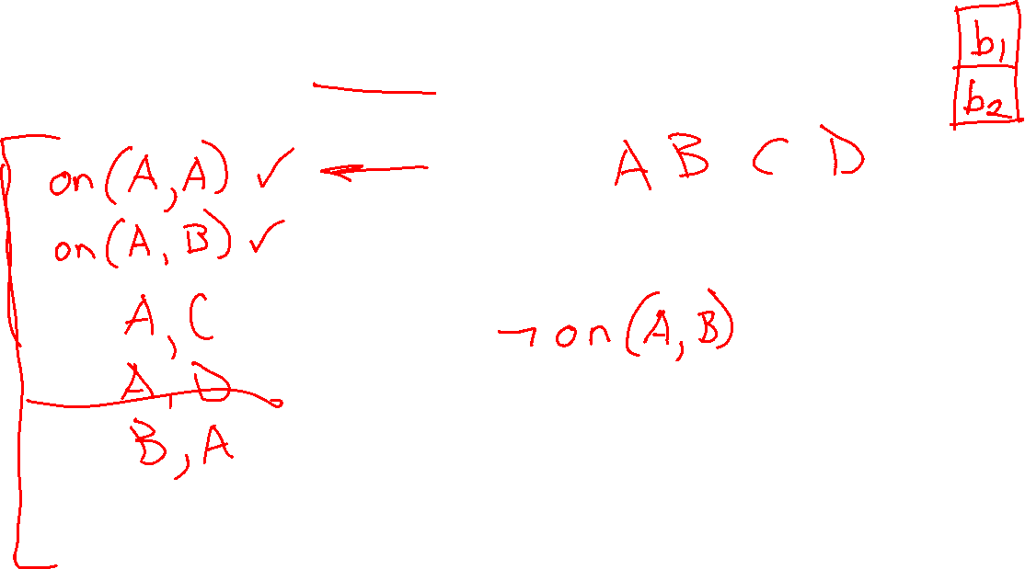
Poll 2
For the blocks world predicate $on(block1, block2)$ how many grounded atoms (facts), do we have with 4 block objects?

Slide 13
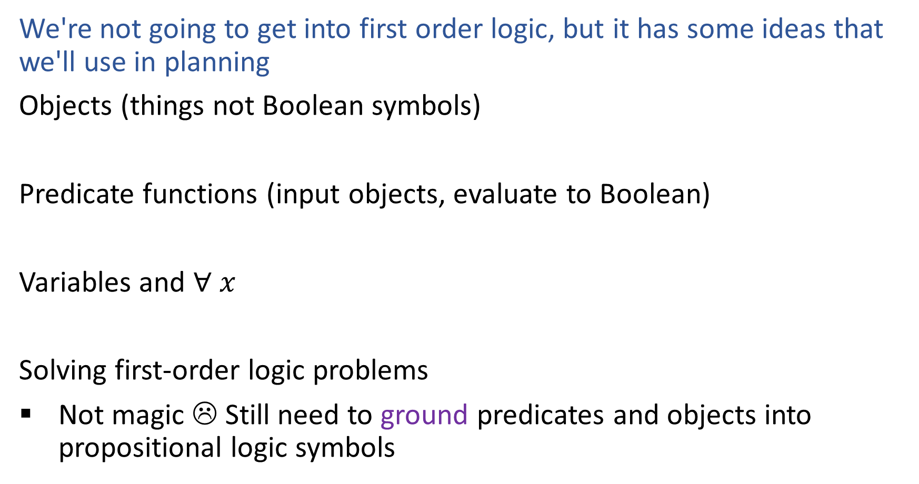
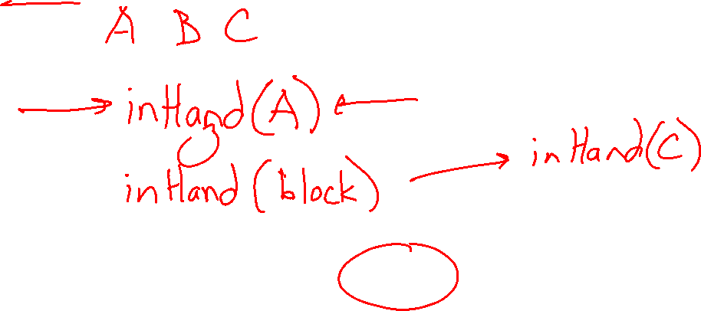
First-Order Logic and Grounding
We're not going to get into first order logic, but it has some ideas that we'll use in planning
Objects (things not Boolean symbols)
Predicate functions (input objects, evaluate to Boolean)
Variables and $∀ x$
Solving first-order logic problems
Not magic ☹ Still need to ground predicates and objects into propositional logic symbols

Slide 14

Search, Logic, and Classical Planning
State-space Search Planning
Assumes actions and transitions are provided for you, s’ = result(s, a)
State changes as you take actions
Propositional Logic Planning
Can reason about what actions are possible and their effects
Represent world with only Boolean symbols
Different symbols for different time points
Classical Planning
Can reason about what actions are possible and their effects
State changes as you take actions

Slide 15
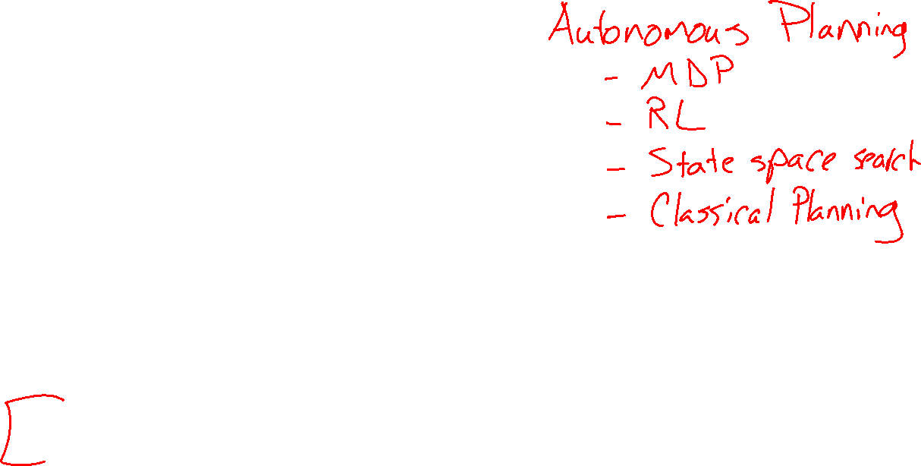
Pre-reading
Classical Planning (or Symbolic Planning)
Representation

Slide 16
Idea of Classical Planning
Represent objects/values separately from the state (instances)
Define predicates as true/false functions over the objects (propositions)
States are conjunctions of predicates
Goals are conjunctions of predicates
Operators (actions)
Robot Arm
A
B
C

Slide 17
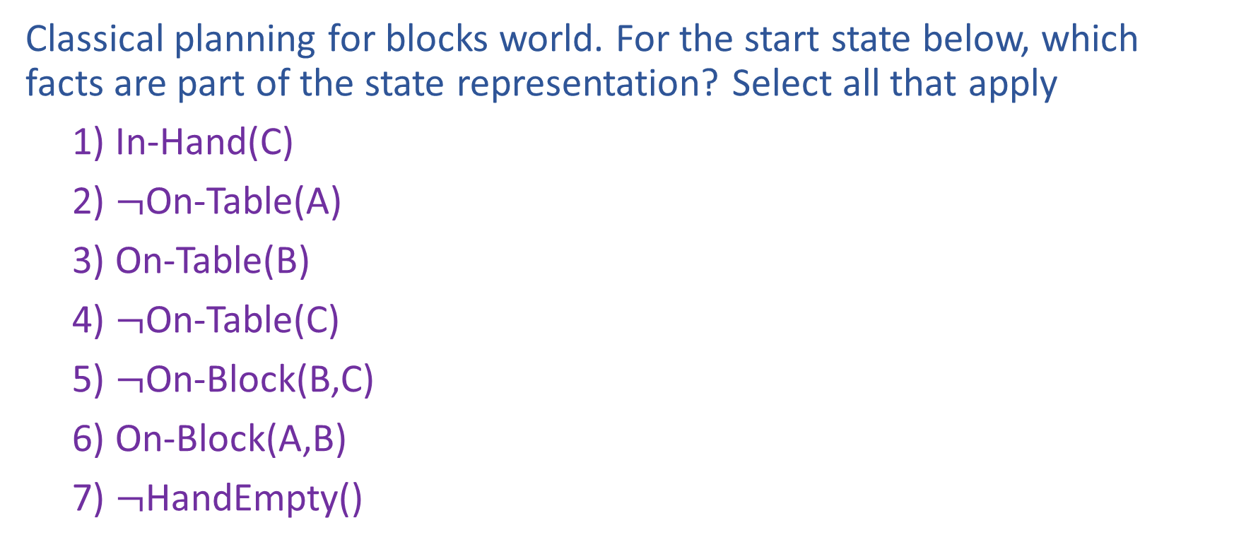

Poll 3
Classical planning for blocks world. For the start state below, which facts are part of the state representation? Select all that apply
1) In-Hand(C)
2) $¬$On-Table(A)
3) On-Table(B)
4) $¬$On-Table(C)
5) $¬$On-Block(B,C)
6) On-Block(A,B)
7) $¬$HandEmpty()
A
C
B

Slide 18
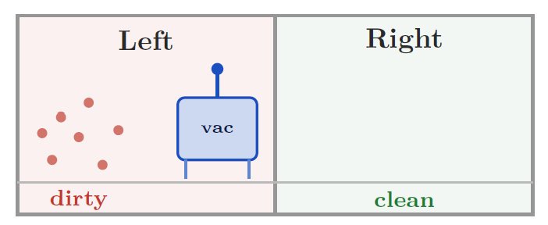
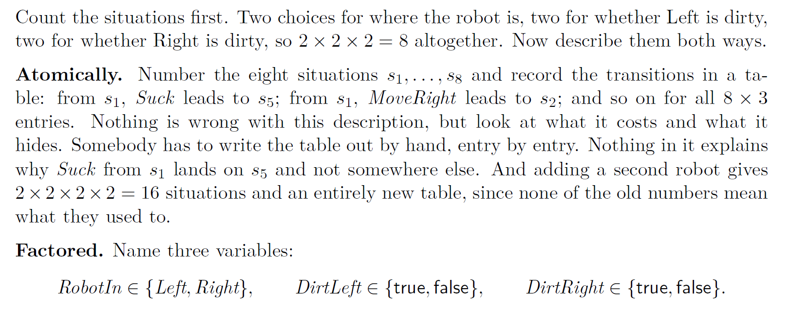
Factored State Representation
From pre-reading

Slide 19

Closed World Assumption (CWA)
Closed world assumption (CWA):
Any fact not listed in a state is false in that state
(Factored) State representation:
In-Hand(C)
On-Table(B)
On-Block(A,B)
Clear(A)
Clear(C)
Not explicitly included:
~HandEmpty(), ~On-Table(C), ~On-Table(A), ~On-Block(B,A), ~On-Block(C,A), ~On-Block(B,C), ~On-Block(C,B), ~On-Block(A,C), ~Clear(B), ~In-Hand(A), ~In-Hand(B)
A
C
B

Slide 20
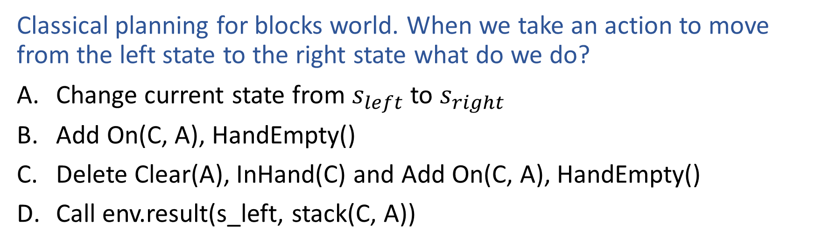
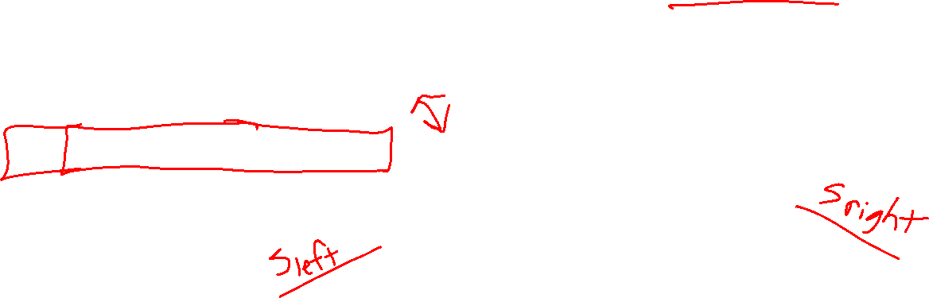
Poll 4
Classical planning for blocks world. When we take an action to move from the left state to the right state what do we do?
Change current state from $s_{left}$ to $s_{right}$
Add On(C, A), HandEmpty()
Delete Clear(A), InHand(C) and Add On(C, A), HandEmpty()
Call env.result(s_left, stack(C, A))
C
A
C
A
B
B

Slide 21
STRIPS Representation
STRIPS = Stanford Research Institute Problem Solver (1970s system)
Actions defined by:
Preconditions (only positive facts)
Add effects
Delete effects
Convention: all other facts remain unchanged → avoids frame axioms

Slide 22

Actions
Actions change the state by adding/deleting predicates
Preconditions:
Actions can be applied only if all precondition predicates are true in the current state
Effects:
New state is a copy of the current predicates with the addition or deletion of specified predicates
Unlike the successor-state axioms, we do not explicitly represent time

Slide 23
The Frame Problem
Frame problem: how to specify what remains unchanged after actions
Frame axioms (logic): one per unaffected predicate
Successor-State Axiom: combines persistence + change
STRIPS convention: actions only list what changes (preconditions, add, delete)

Slide 24
Pre-reading
Blocks World Predicates and Operators

Slide 25
Rules of Blocks World
Blocks are picked up and put down by the hand
Blocks can be picked up only if they are clear
Hand can pick up a block only if the hand is empty
Hand can pick up and put down blocks on blocks or on the table

Slide 26
Pickup Block C from Table (State Transition)
Instances:
Blocks A, B, C
Possible Predicates:
HandEmpty()
On-Table(block)
On-Block(b1,b2)
Clear(block)
In-Hand(block)
A
B
C
State:
HandEmpty()
On-Table(B)
On-Table(C)
On-Block(A,B)
Clear(A)
Clear(C)
State:
In-Hand(C)
On-Table(B)
On-Block(A,B)
Clear(A)
Clear(C)

Slide 27
Pickup Block C from Table (Preconditions, Effects)
Instances:
Blocks A, B, C
Possible Predicates:
HandEmpty()
On-Table(block)
On-Block(b1,b2)
Clear(block)
In-Hand(block)
A
B
C
State:
HandEmpty()
On-Table(B)
On-Table(C)
On-Block(A,B)
Clear(A)
Clear(C)
State:
HandEmpty()
On-Table(B)
On-Table(C)
On-Block(A,B)
Clear(A)
Clear(C)
State:
In-Hand(C)
On-Table(B)
On-Block(A,B)
Clear(A)
Clear(C)
State:
In-Hand(C)
On-Table(B)
On-Block(A,B)
Clear(A)
Clear(C)
Delete HandEmpty()
Delete On-Table(C)

Slide 28
Operator: Pickup-Block-C from Table
Preconditions Effects
HandEmpty() Add In-Hand(C)
Clear(C) Delete HandEmpty()
On-Table(C) On-Table(C)
A
B
C

Slide 29
Operator: Pickup-Block from Table
Preconditions Effects
HandEmpty() Add In-Hand(block)
Clear(block) Delete HandEmpty()
On-Table(block) On-Table(block)
Create a variable that takes on the value of a particular instance for all times it appears in an operator.

Slide 30
Operator: PutDown-Block on Table
Preconditions Effects
In-Hand(block) Add HandEmpty()
On-Table(block)
Delete In-Hand(block)
Why don’t we need to check if ~HandEmpty() is true?

Slide 31
Operators for Block Stacking
Pickup_Table(b):
Pre: HandEmpty(), Clear(b), On-Table(b)
Add: In-Hand(b)
Delete: HandEmpty(), On-Table(b)
Putdown_Table(b):
Pre: In-Hand(b)
Add: HandEmpty(), On-Table(b)
Delete: In-Hand(b)
Pickup_Block(b,c):
Pre: HandEmpty(), On-Block(b,c), b!=c
Add: In-Hand(b), Clear(c)
Delete: HandEmpty(), On-Block(b,c)
Putdown_Block(b,c):
Pre: In-Hand(b), Clear(c)
Add: HandEmpty(), On-Block(b,c)
Delete: Clear(c), In-Hand(b)
Why do we need separate operators for table vs on a block?

Slide 32
Example Matching Operators
HandEmpty() & On-Table(O) & On-Block(B,O) & Clear(B) & On-Table(G) & Clear(G)

Slide 33
Example Matching Operators
HandEmpty() & On-Table(O) & On-Block(B,O) & Clear(B) & On-Table(G) & Clear(G)
Pickup_Block(b,c):
Pre: HandEmpty(), On-Block(b,c), b!=c
Add: In-Hand(b), Clear(c)
Delete: HandEmpty(), On(b,c)
Pickup_Table(b):
Pre: HandEmpty, Clear(b), On-Table(b)
Add: In-Hand(b)
Delete: HandEmpty(), On-Table(b)

Slide 34
State Space Graph (also called Reachability Graph)
Start
Goal

Slide 35
Example Matching Operators
HandEmpty() & On-Table(O) & On-Block(B,O) & Clear(B) & On-Table(G) & Clear(G)
Pickup_Block(B,O)
On-Table(O) & Clear(B) & On-Table(G) & Clear(G) & In-Hand(B) & Clear(O)
Putdown_Table(B)
On-Table(O) & Clear(O) & On-Table(G) & Clear(G) & Clear(B) & On-Table(B) & HandEmpty()
Pickup_Table(G)
On-Table(O) & Clear(B) & Clear(G) & Clear(O) & On-Table(B) & In-Hand(G)
Putdown_Block(G,O)
On-Table(O) & Clear(B) & Clear(G) & On-Table(B) & On-Block(G,O) & HandEmpty()

Slide 36
Pre-reading
Classical Planning Representation
PDDL

Slide 37



Poll 5
Which of the following go into the PDDL problem file (rather than the domain file)?
Objects
Start state
Predicates
Actions
Goal
None of the above

Slide 38
PDDL
Domain file
Problem file
(define (domain blocksworld)
(:requirements :strips)
(:predicates (on ?x ?y) (onTable ?x) (clear ?x) (holding ?x) (handEmpty))
(:action stack
:parameters (?x ?y)
:precondition (and (holding ?x) (clear ?y))
:effect (and (on ?x ?y) (clear ?x) (handEmpty)
(not (holding ?x)) (not (clear ?y)))))
(define (problem bw-3blocks)
(:domain blocksworld)
(:objects a b c)
(:init (on c a) (onTable a) (onTable b) (clear c) (clear b) (handEmpty))
(:goal (and (on a b) (on b c))))

Slide 39
Solivng Planning Problems
State-space Search

Slide 40

Search with a State Space Graph
Start
Goal

Slide 41
Finding Plans with Symbolic Representations
Breadth-First Search
Sound?
Complete?
Optimal?
Yes
Yes
Yes
Soundness - all solutions found are legal plans
Completeness - a solution can be found whenever one actually exists
Optimality - the order in which solutions are found is consistent with some measure of plan quality

Slide 42
Size of the State-Space Tree
A state-space tree’s size is exponential in the number of predicates
Can we reduce the size of the graph we use for planning?

Slide 43

Today
Polls covering Pre-reading
Planning with Propositional Logic
From Propositional Logic to Classical Planning
Classical Planning Representation
Solving Planning Problems: State space search
New
Solving Planning Problems: Planning Graphs and GraphPlan
Next time
From GraphPlan to Modern Planning
Planning with Continuous States

Slide 44
Solivng Planning Problems
Planning Graphs & Graph Plan

Slide 45
GraphPlan
Allow actions to be simultaneous
Always add predicates (don't delete)
GraphPlan is a relaxation of other classical planning search techniques
The GraphPlan search graph space is linear in the number of predicates
State space search
sockL()
bareR()
putShoeL
putSockL
putSockR
bareL()
bareR()
bareL()
sockR()
putSockL
putSockR
putShoeR

Slide 46




GraphPlan
Allow actions to be simultaneous
Always add predicates (don't delete)
GraphPlan is a relaxation of other classical planning search techniques
The planning graph is linear in the number of predicates
State space search
Planning graph
sockL()
bareR()
putShoeL
bareL()
bareR()
sockL()
bareL()
bareR()
sockR()
putShoeL
putSockL
putSockL
putSockL
putSockR
bareL()
bareR()
bareL()
bareR()
noop
noop
noop
bareL()
sockR()
putSockL
putSockR
putSockR
putSockR
putShoeR
putShoeR
$$S_{0}$$
$$A_{0}$$
$$S_{1}$$
$$A_{1}$$

Slide 47
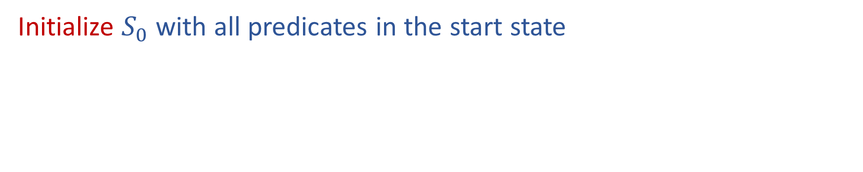



Building a Planning Graph
Initialize $S_{0}$ with all predicates in the start state
bareL()
bareR()
$$S_{0}$$
$$A_{0}$$
$$S_{1}$$

Slide 48
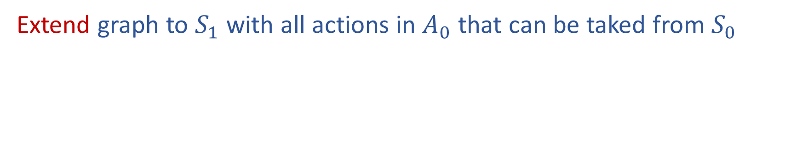

Building a Planning Graph
Extend graph to $S_{1}$ with all actions in $A_{0}$ that can be taked from $S_{0}$
bareL()
bareR()
sockL()
$¬$bareL()
bareL()
bareR()
$¬$bareR()
sockR()
For now, we are just assuming that any actions (including no-ops) can be taken individually in any order to get us to the next state
This certainly isn't always true
E.g., we can't put our socks
on and then take the no-ops that require bare feet
(More on these exclusion checks later)
putSockL
noop
putSockR
$$S_{0}$$
$$A_{0}$$
$$S_{1}$$

Slide 49
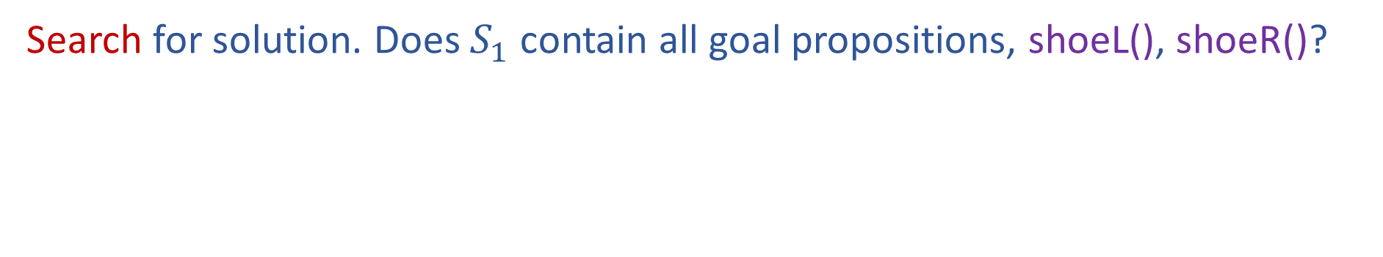
Building a Planning Graph
Search for solution. Does $S_{1}$ contain all goal propositions, shoeL(), shoeR()?
bareL()
bareR()
sockL()
$¬$bareL()
bareL()
bareR()
$¬$bareR()
sockR()
Nope, not yet
putSockL
noop
putSockR
$$S_{0}$$
$$A_{0}$$
$$S_{1}$$

Slide 50

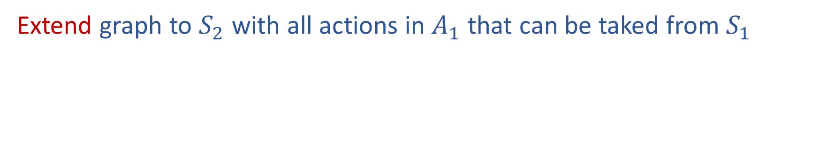

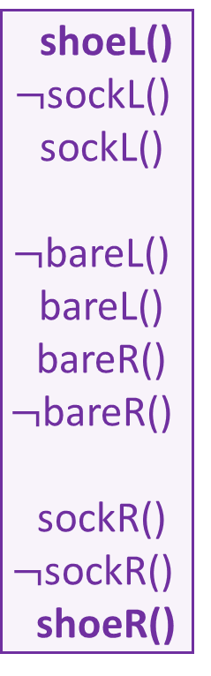
Building a Planning Graph
Extend graph to $S_{2}$ with all actions in $A_{1}$ that can be taked from $S_{1}$
bareL()
bareR()
sockL()
$¬$bareL()
bareL()
bareR()
$¬$bareR()
sockR()
shoeL()
$¬$sockL()
sockL()
$¬$bareL()
bareL()
bareR()
$¬$bareR()
sockR()
$¬$sockR()
shoeR()
putShoeL
putSockL
putSockL
noop
noop
putSockR
putSockR
putShoeR
$$S_{0}$$
$$A_{0}$$
$$S_{1}$$
$$A_{1}$$
$$S_{2}$$

Slide 51

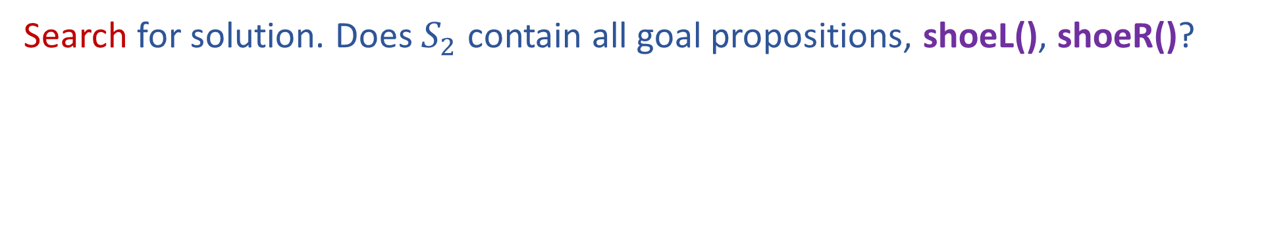
Building a Planning Graph
Search for solution. Does $S_{2}$ contain all goal propositions, shoeL(), shoeR()?
bareL()
bareR()
sockL()
$¬$bareL()
bareL()
bareR()
$¬$bareR()
sockR()
shoeL()
$¬$sockL()
sockL()
$¬$bareL()
bareL()
bareR()
$¬$bareR()
sockR()
$¬$sockR()
shoeR()
Yes, but
....is this ok??
Maybe ☺
We need to check that we can actually take the subset of actions that lead us the goal proposition
putShoeL
putSockL
putSockL
noop
noop
putSockR
putSockR
putShoeR
$$S_{0}$$
$$A_{0}$$
$$S_{1}$$
$$A_{1}$$
$$S_{2}$$

