Slide 1
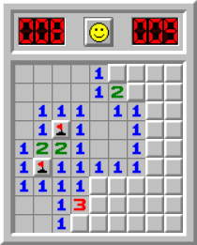
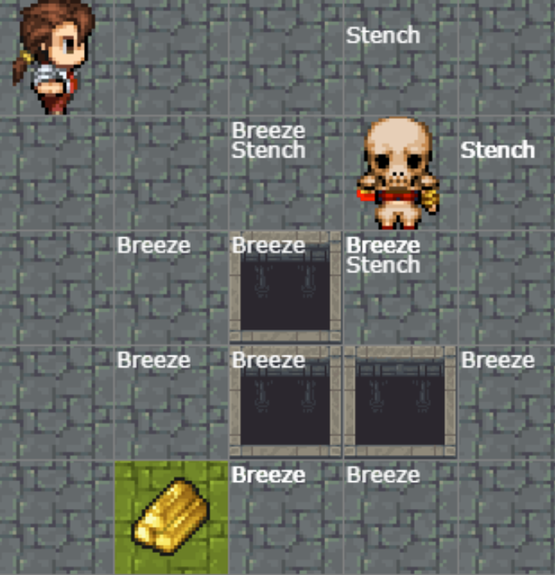
Warm-up:
Play Minesweeper or Wumpus World!
Notes:
0=7, R=4, W=6, U=2, T=8, F=1; 867 + 867 = 1734

Slide 2
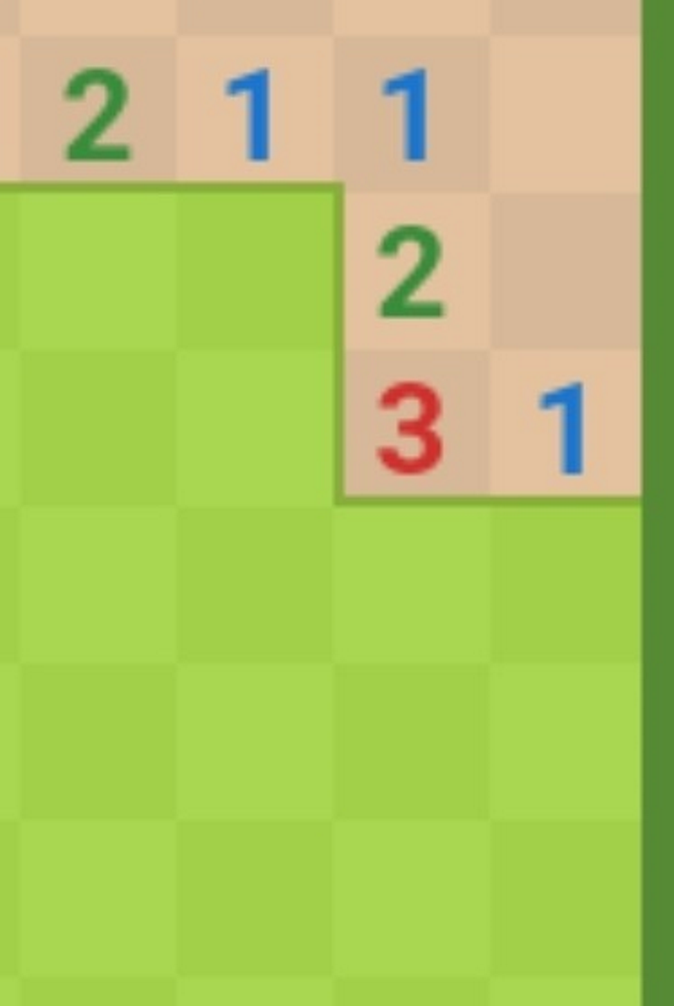

Warm-up
Play Minesweeper (link on website/piazza)
then fill in the green squares with:
if SAFE or
X if UNSAFE or
? if UNSURE
Numbers indicate how many mines are in the 8 adjacent cells
 | 1
 | 2
Notes:
0=7, R=4, W=6, U=2, T=8, F=1; 867 + 867 = 1734

Slide 3
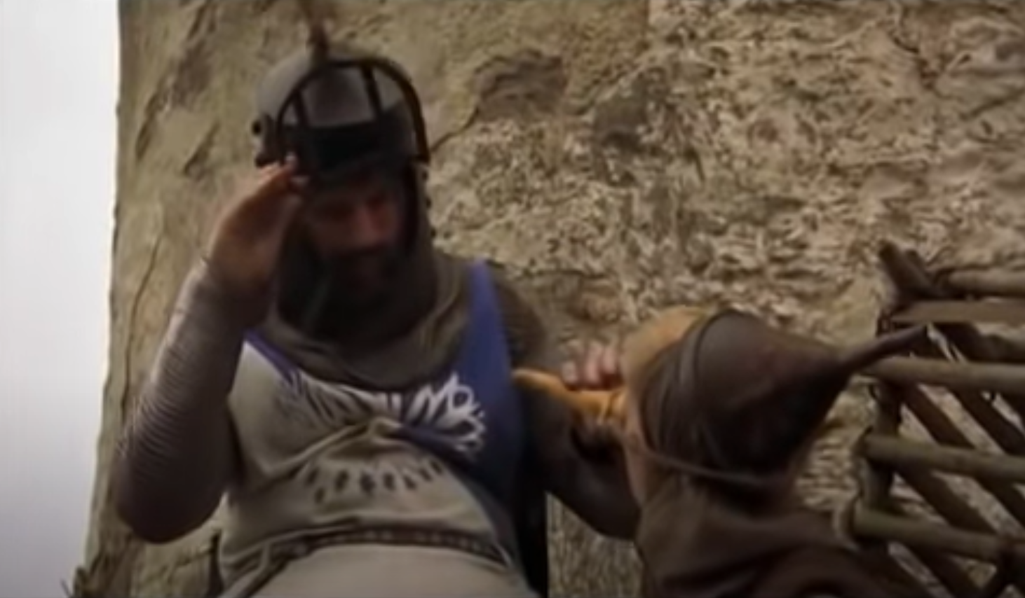
Monty Python Inference
There are ways of telling whether she is a witch
https://www.youtube.com/watch?v=rf71YotfykQ&t=52

Slide 4
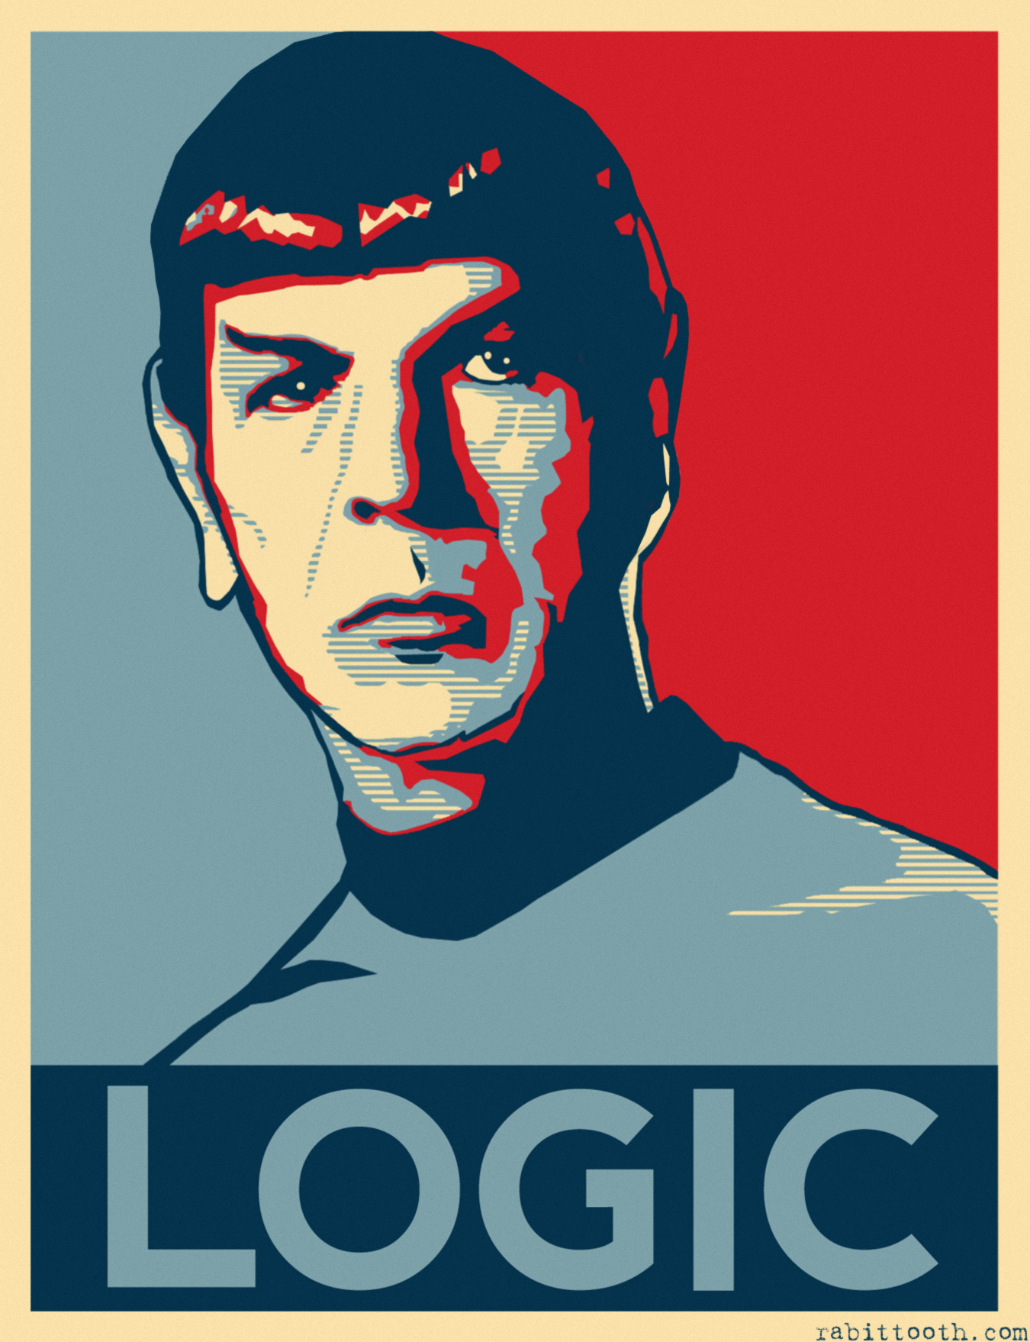
07-380 AI & ML II
Logical Agents
Instructors: Pat Virtue & Mohammad Salameh
Slide credits: CMU AI, http://ai.berkeley.edu

Slide 5
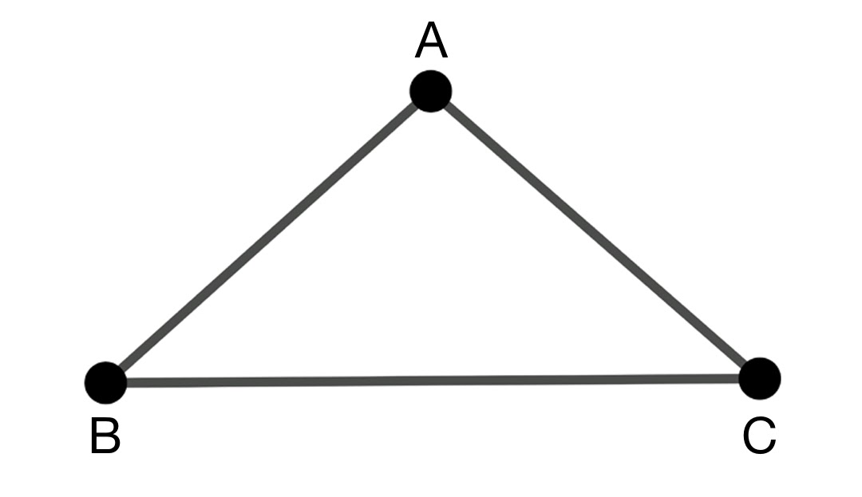
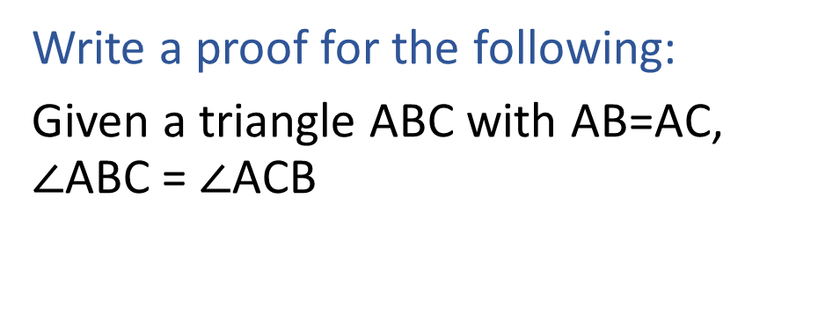
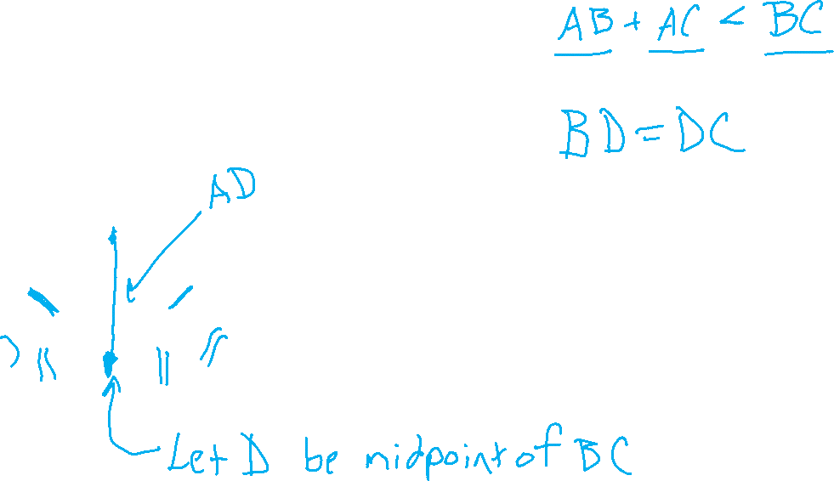
Warm-up
Write a proof for the following:
Given a triangle ABC with AB=AC, $∠$ABC = $∠$ACB
Notes:
0=7, R=4, W=6, U=2, T=8, F=1; 867 + 867 = 1734

Slide 6
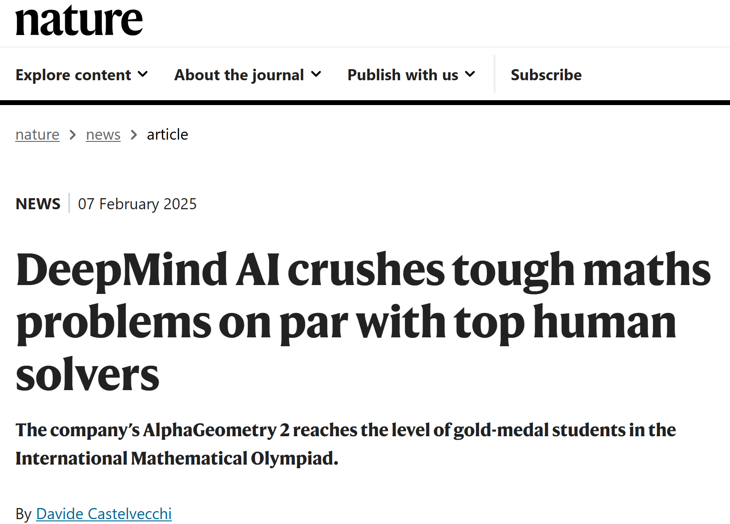
AlphaGeometry
https://www.nature.com/articles/d41586-025-00406-7
https://www.nature.com/articles/s41586-023-06747-5

Slide 7
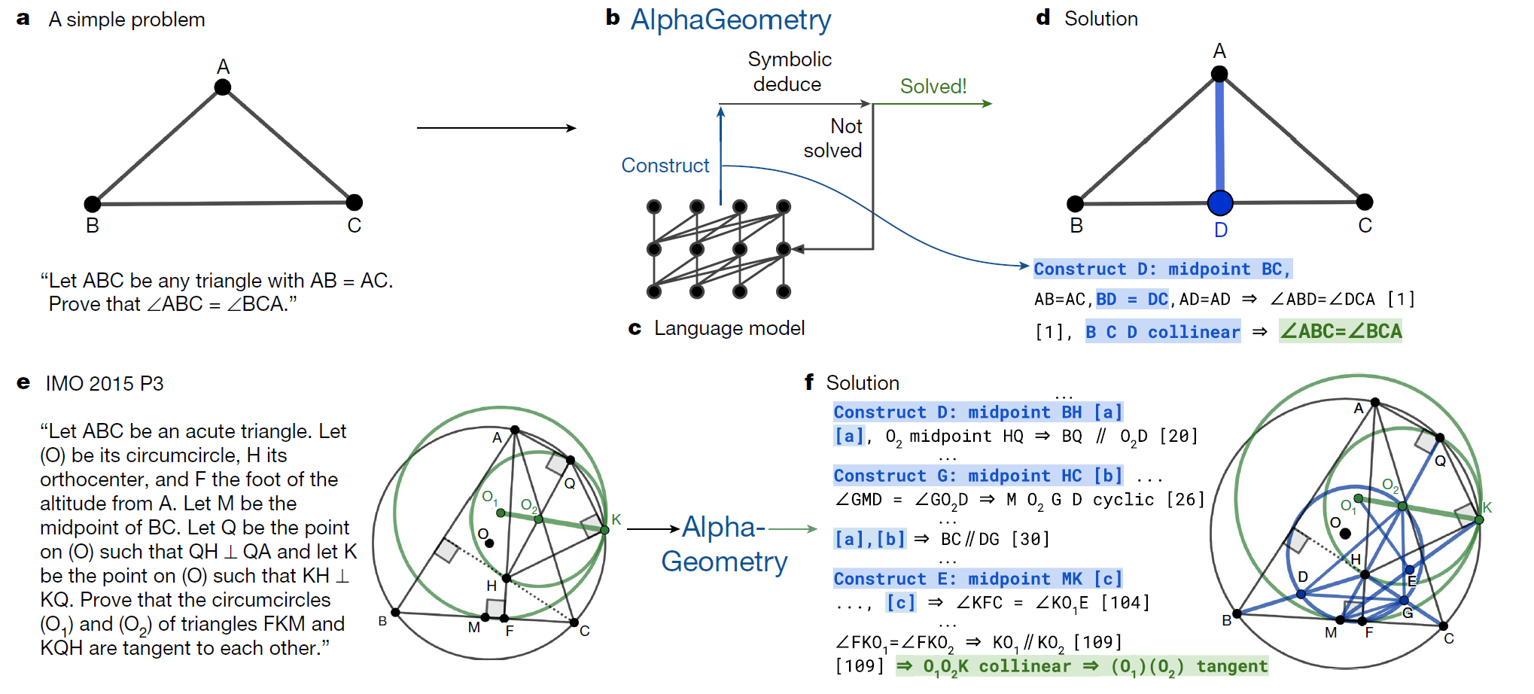
AlphaGeometry
https://www.nature.com/articles/d41586-025-00406-7
https://www.nature.com/articles/s41586-023-06747-5

Slide 8
How do we solve Sudoku?
1
2
1
3
4

Slide 9
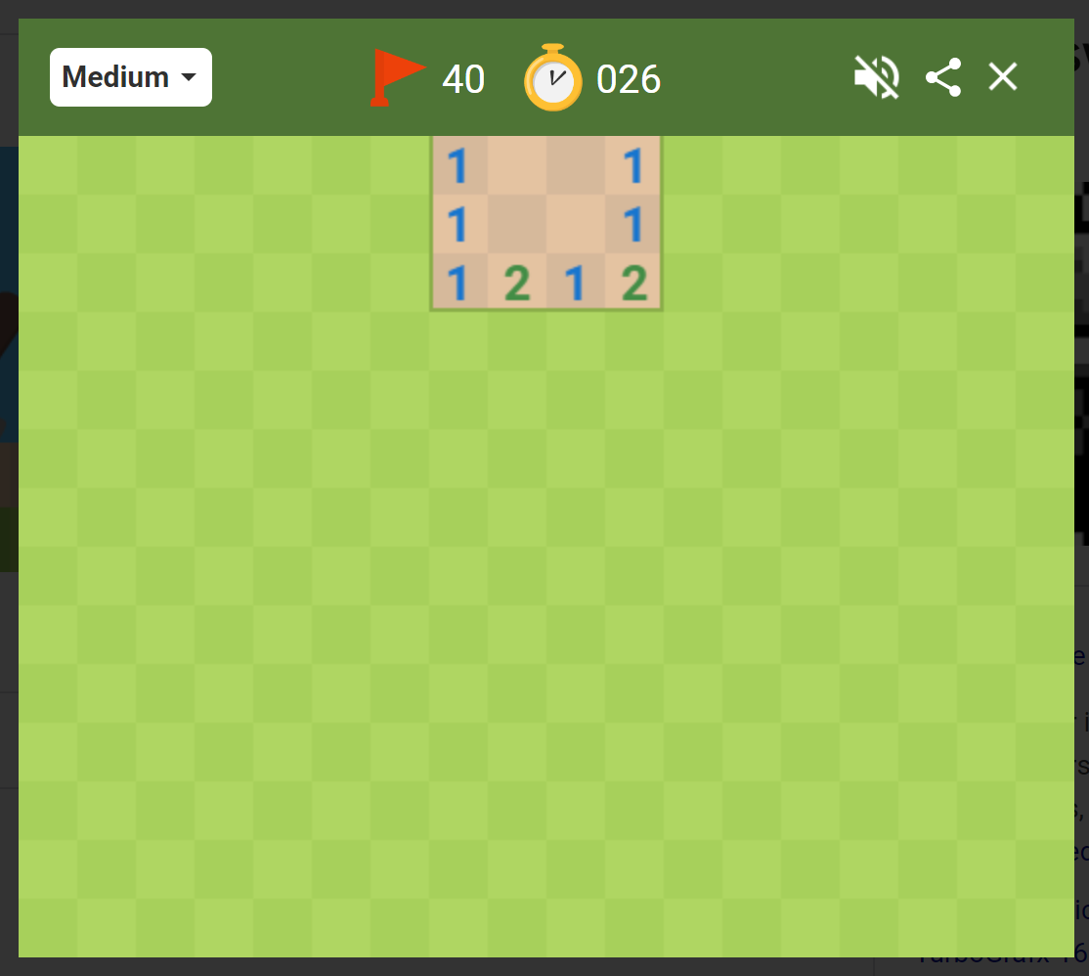
How do we play Minesweeper?
Numbers indicate how many mines are in the 8 adjacent cells
What are we trying to figure out?
A path (a sequence of actions)?
A complete solution?
 | 1
 | 2
Image: Google Minesweeper game

Slide 10
Minesweeper
Numbers indicate how many mines are in the 8 adjacent cells
 | 1
 | 2
We're trying to figure out what to do next
Which unvisited spaces that are definitely safe?
Which unvisited spaces that are definitely dangerous?
(What about the other spaces?)

Slide 11
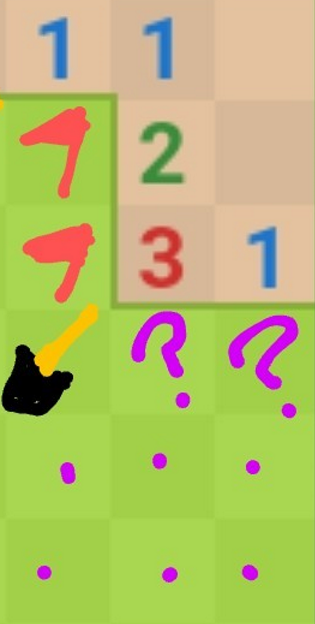
Minesweeper
Numbers indicate how many mines are in the 8 adjacent cells
 | 1
 | 2
We're trying to figure out what to do next
Which unvisited spaces that are definitely safe?
Which unvisited spaces that are definitely dangerous?
(What about the other spaces?)

Slide 12
Minesweeper
It may take a few logical steps to reason about:
What is possible
What is impossible
What is still unknown
Example human inference steps:
?

Slide 13
Minesweeper
It may take a few logical steps to reason about:
What is possible
What is impossible
What is still unknown
Example human inference steps:
?

Slide 14
High-level View: Logical Agents

Slide 15
Logical Agents
Logical agents and environments
Agent
Environment
Sensors
Percepts
Knowledge Base
Inference
?
Actuators
Actions

Slide 16

Logical Agents
So what do we TELL our knowledge base (KB)?
  Facts (sentences)
      The grass is green
      The sky is blue
  Rules (sentences)
      Eating too much candy makes you sick
      When you’re sick you don’t go to school
  Percepts and Actions (sentences)
      Pat ate too much candy today
What happens when we ASK the agent?
  Inference – new sentences created from old
      Pat is not going to school today

Slide 17
A Knowledge-based Agent
function KB-AGENT(percept) returns an action
persistent: KB, a knowledge base
persistent: t, an integer, initially 0
TELL(KB, PROCESS-PERCEPT(percept, t))
action ← ASK(KB, PROCESS-QUERY(t))
TELL(KB, PROCESS-RESULT(action, t))
t←t+1
return action

Slide 18
Pre-reading

Slide 19
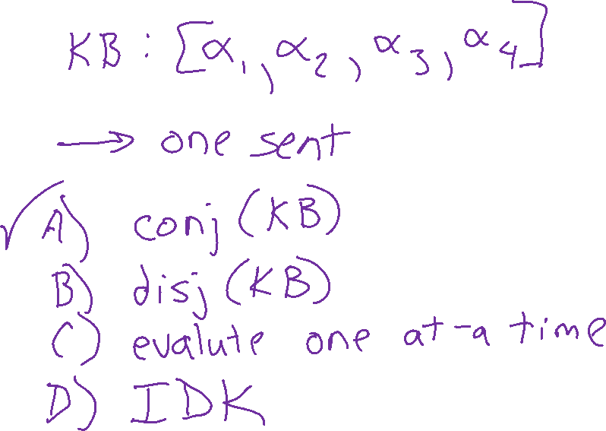
Poll 1

Slide 20
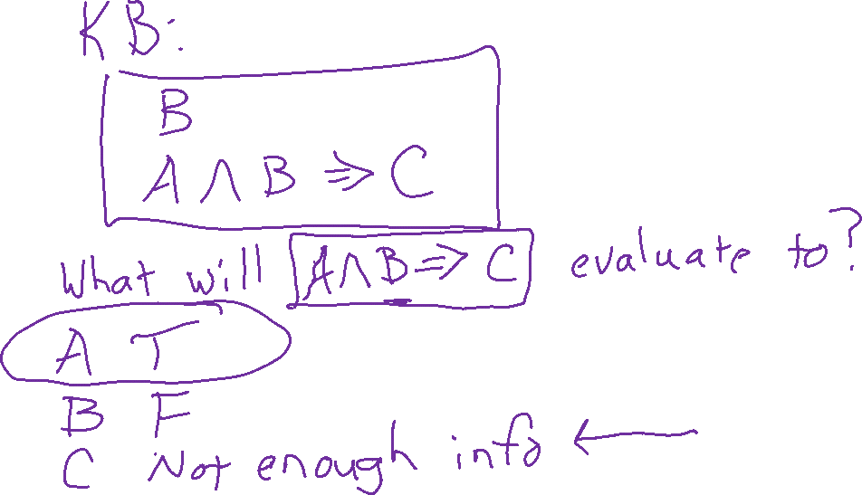
Poll 2

Slide 21
Models and Knowledge Bases
Entailment and Satisifiability

Slide 22
Logical Agent Vocab
Model
  An specific assignment of all symbols to True/False
Sentence
  Logical statement
  Composition of logic symbols and operators
KB
  Collection of sentences representing facts and rules we know about the world
Query
  Sentence we want to know if it is provably True, provably False, or unsure.

Slide 23
Models and Knowledge Bases
Example: Sudoku
Model
Assignment of values to all variables
Knowledge Base
Collection of things we know to be true
Rules of the world
Observations
Things we have figured out
1
2
1
3
4

Slide 24
Models and Knowledge Bases
Example: Minesweeper
Model
Assignment of values to all variables
Knowledge Base
Collection of things we know to be true
Rules of the world
Observations
Things we have figured out
Numbers indicate how many mines
 | 1
 | 2

Slide 25

Entailment and Satisfiability
More formally
Symbol (variable)
Models (all symbols assigned a value)
Satisfiable: there exists (at least one) model that meets the constraints
Entailment: statement is true for all models that meet the constraints
How do we get a computer to do this?

Slide 26
Entailment and Satisfiability
What reasoning are we doing?
Can I click here? / Is this definitely safe?
    Yes: For all possible configurations (models), none of them have a mine in that location
    No: There exists (at least) one possible configuration with a mine in that location
Is it possibly safe?
    Yes: There exists (at least) one possible configuration with a mine in that location
    No: For all possible configurations (models), all of them have a mine in that location → It's definitely dangerous
Entailment: definitely safe
Satisfiability: possibly not safe
Satisfiability: possibly safe
Entailment: definitely not safe

Slide 27
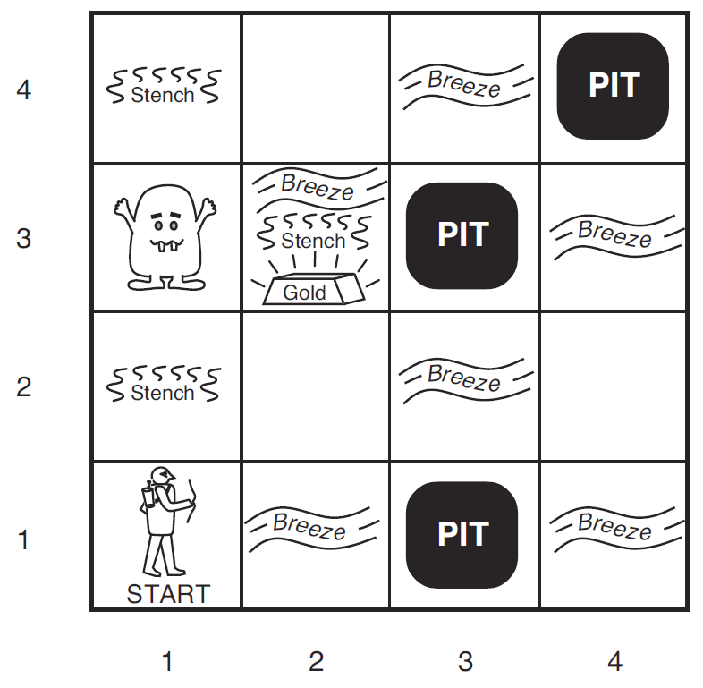
Wumpus World
We collect information as we move to a new grid in the world
Breeze: if next to a Pit
Stench: if next to a Wumpus
Both
Nothing
Oh, and there's gold
We're trying to figure out what to do next
Which unvisited spaces that are definitely safe?
Which unvisited spaces that are definitely dangerous?
(What about the other spaces?)

Slide 28
Wumpus World
Symbols for Wumpus World
B_{ij} = breeze felt
S_{ij} = stench smelt
P_{ij} = pit here
W_{ij} = wumpus here
G = gold
http://thiagodnf.github.io/wumpus-world-simulator/

Slide 29
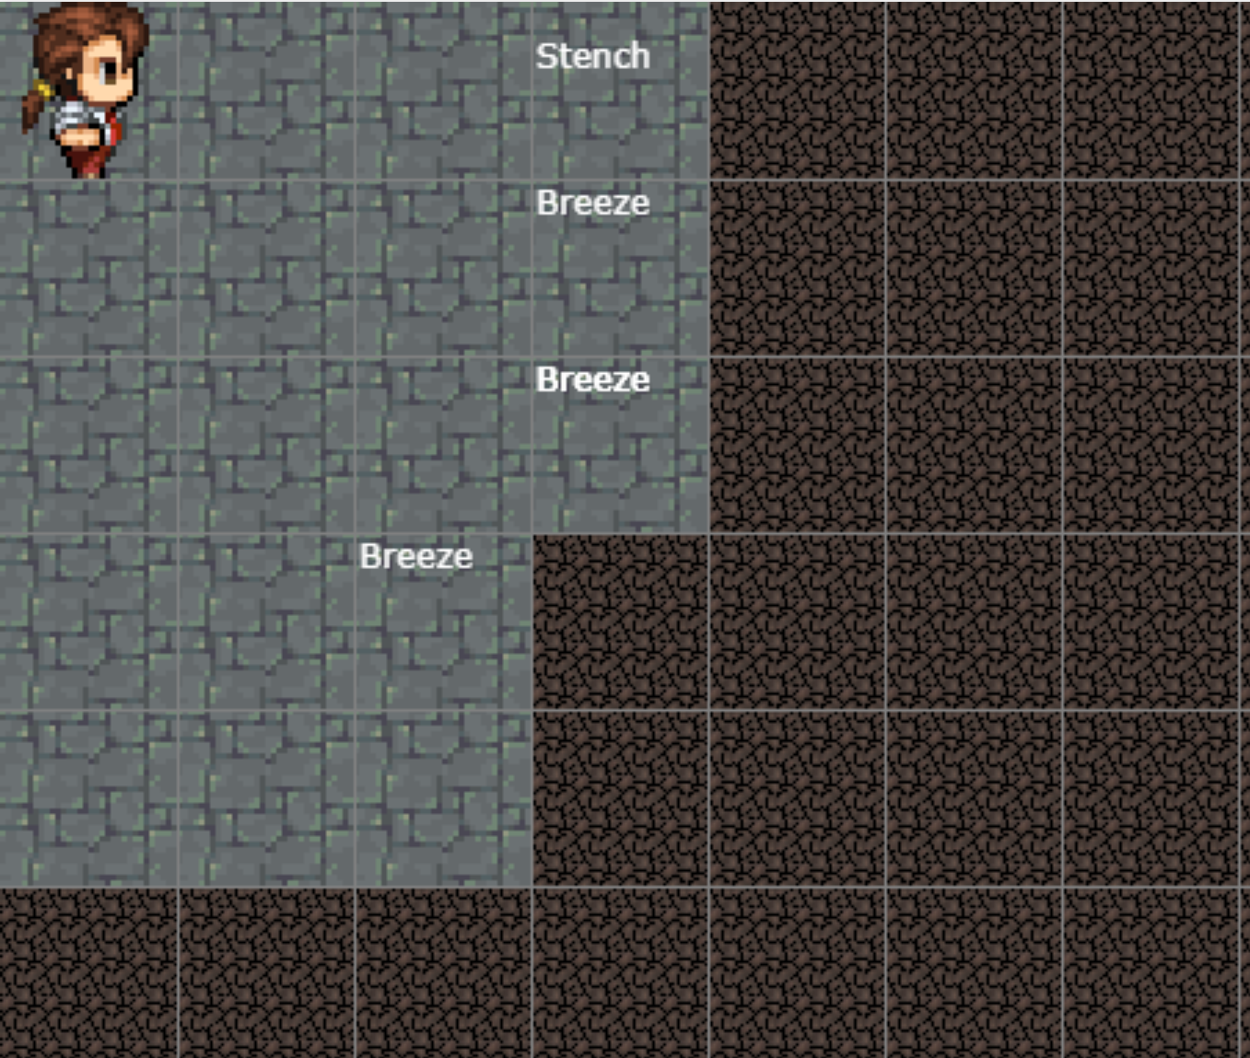
Wumpus World
Reasoning about how to get safely get more information!
http://thiagodnf.github.io/wumpus-world-simulator/

Slide 30
Propositional Logic

Slide 31
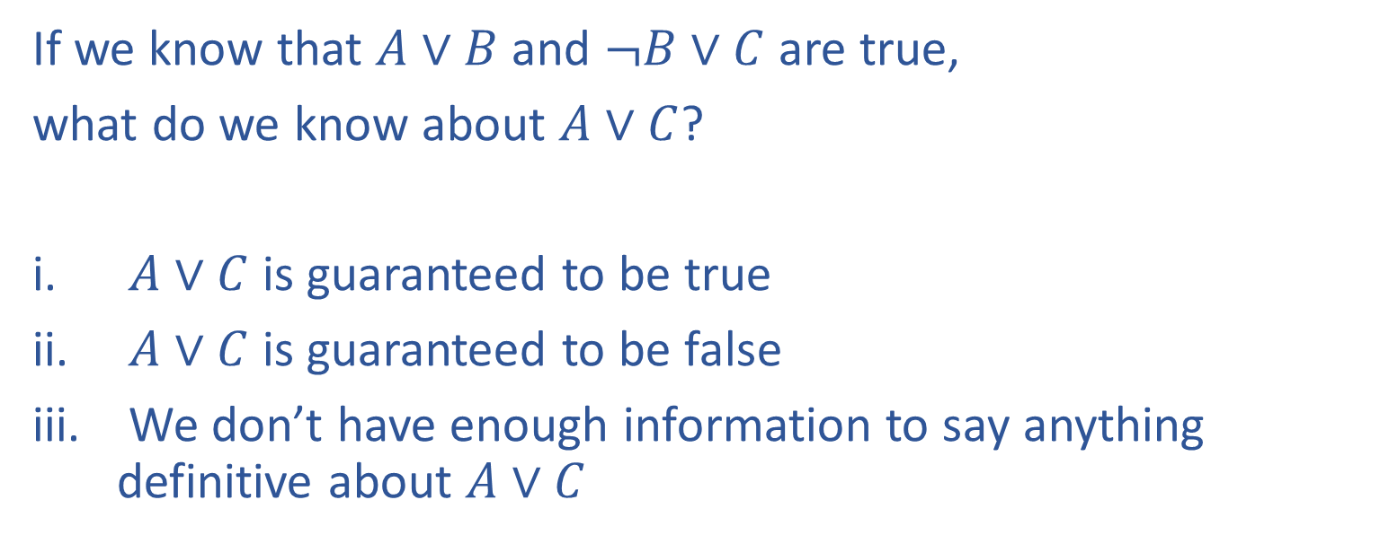
Poll 1
If we know that $A∨B$ and $¬B∨C$ are true,
what do we know about $A∨C$?
$A∨C$ is guaranteed to be true
$A∨C$ is guaranteed to be false
We don’t have enough information to say anything definitive about $A∨C$

Slide 32
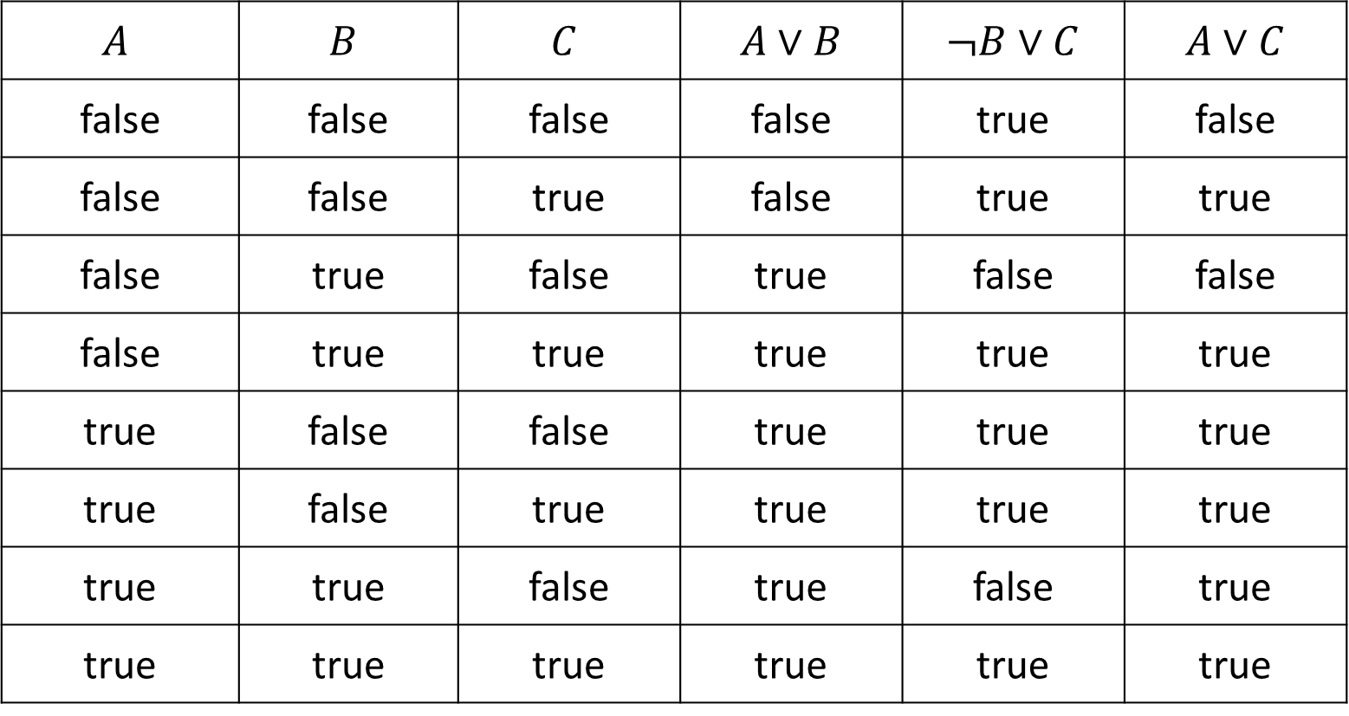
Poll 1
If we know that $A∨B$ and $¬B∨C$ are true, what do we know about $A∨C$?
$$A$$ | $$B$$ | $$C$$ | $A∨B$ | $¬B∨C$ | $A∨C$
false | false | false | false | true | false
false | false | true | false | true | true
false | true | false | true | false | false
false | true | true | true | true | true
true | false | false | true | true | true
true | false | true | true | true | true
true | true | false | true | false | true
true | true | true | true | true | true

Slide 33
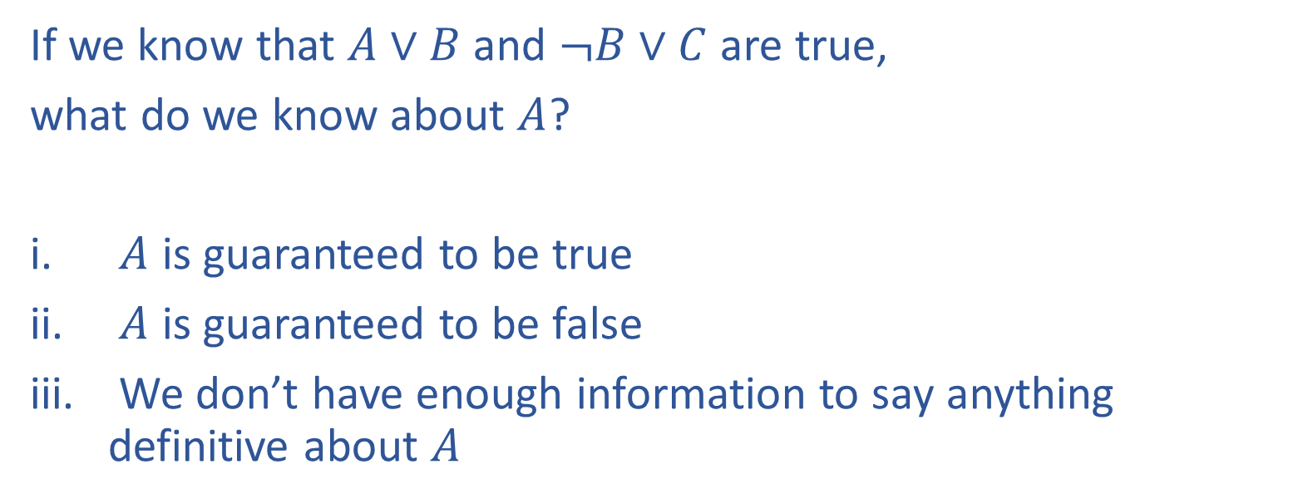
Poll 2
If we know that $A∨B$ and $¬B∨C$ are true,
what do we know about $A$?
$A$ is guaranteed to be true
$A$ is guaranteed to be false
We don’t have enough information to say anything definitive about $A$

Slide 34
Propositional Logic
Symbol:
Variable that can be true or false
We’ll try to use capital letters, e.g. A, B, P_{1,2}
Often include True and False
Operators:
¬ A: not A
A ∧ B: A and B (conjunction)
A ∨ B: A or B (disjunction) Note: this is not an “exclusive or”
A ⇒ B: A implies B (implication). If A then B
A ⇔ B: A if and only if B (biconditional)
Sentences

Slide 35
Propositional Logic Syntax
Given: a set of proposition symbols {X₁, X₂, …, X_{n}}
    (we often add True and False for convenience)
X_{i} is a sentence
If α is a sentence then ¬α is a sentence
If α and β are sentences then α ∧ β is a sentence
If α and β are sentences then α ∨ β is a sentence
If α and β are sentences then α ⇒ β is a sentence
If α and β are sentences then α ⇔ β is a sentence
And p.s. there are no other sentences!

Slide 36
Notes on Operators
𝛂 ∨ 𝛃 is inclusive or, not exclusive

Slide 37
Truth Tables
𝛂 ∨ 𝛃 is inclusive or, not exclusive
𝛂 | 𝛃 | 𝛂 ∧ 𝛃
F | F | F
F | T | F
T | F | F
T | T | T
𝛂 | 𝛃 | 𝛂 ∨ 𝛃
F | F | F
F | T | T
T | F | T
T | T | T

Slide 38
Notes on Operators
𝛂 ∨ 𝛃 is inclusive or, not exclusive
𝛂 ⇒ 𝛃 is equivalent to ¬𝛂 ∨ 𝛃
Says who?

Slide 39
Truth Tables
𝛂 ⇒ 𝛃 is equivalent to ¬𝛂 ∨ 𝛃
𝛂 | 𝛃 | 𝛂 ⇒ 𝛃 | ¬𝛂 | ¬𝛂 ∨ 𝛃
F | F | T | T | T
F | T | T | T | T
T | F | F | F | F
T | T | T | F | T

Slide 40
Notes on Operators
𝛂 ∨ 𝛃 is inclusive or, not exclusive
𝛂 ⇒ 𝛃 is equivalent to ¬𝛂 ∨ 𝛃
Says who?
𝛂 ⇔ 𝛃 is equivalent to (𝛂 ⇒ 𝛃) ∧ (𝛃 ⇒ 𝛂)
Prove it!

Slide 41
Truth Tables
𝛂 ⇔ 𝛃 is equivalent to (𝛂 ⇒ 𝛃) ∧ (𝛃 ⇒ 𝛂)
𝛂 | 𝛃 | 𝛂 ⇔ 𝛃 | 𝛂 ⇒ 𝛃 | 𝛃 ⇒ 𝛂 | (𝛂⇒𝛃) ∧ (𝛃⇒𝛂)
F | F | T | T | T | T
F | T | F | T | F | F
T | F | F | F | T | F
T | T | T | T | T | T
Equivalence: it’s true in all models. Expressed as a logical sentence:
(𝛂 ⇔ 𝛃) ⇔ [(𝛂 ⇒ 𝛃) ∧ (𝛃 ⇒ 𝛂)]

Slide 42
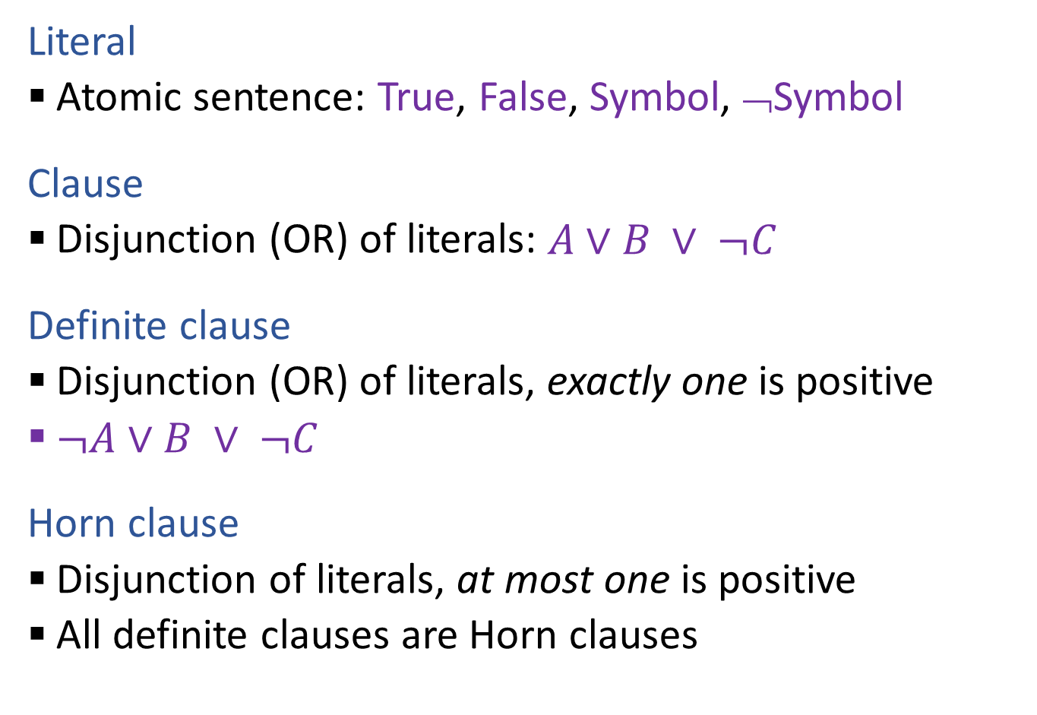
Propositional Logic Vocab
Literal
  Atomic sentence: True, False, Symbol, ¬Symbol
Clause
  Disjunction (OR) of literals: $A∨B ∨ ¬C$
Definite clause
  Disjunction (OR) of literals, exactly one is positive
  $¬A∨B ∨ ¬C$
Horn clause
  Disjunction of literals, at most one is positive
  All definite clauses are Horn clauses

Slide 43
PL: Conjunctive Normal Form (CNF)
Every sentence can be expressed as a conjunction (AND) of clauses
Each clause is a disjunction (OR) of literals
Each literal is a symbol or a negated symbol
  Example: (¬A v ¬C v B) ∧ (¬A v ¬B v C)

Slide 44
PL: Conjunctive Normal Form (CNF)
Every sentence can be expressed as a conjunction of clauses
Each clause is a disjunction of literals
Each literal is a symbol or a negated symbol
Conversion to CNF by a sequence of standard transformations:
  At_1,1_0 ⇒ (Wall_0,1 ⇔ Blocked_W_0)
  At_1,1_0 ⇒ ((Wall_0,1 ⇒ Blocked_W_0) ∧ (Blocked_W_0 ⇒Wall_0,1))
  ¬At_1,1_0 v ((¬Wall_0,1 v Blocked_W_0) ∧ (¬Blocked_W_0 v Wall_0,1))
  (¬At_1,1_0 v ¬Wall_0,1 v Blocked_W_0) ∧ (¬At_1,1_0 v ¬Blocked_W_0 v Wall_0,1)

Slide 45
PL: Conjunctive Normal Form (CNF)
Replace biconditional by two implications
Every sentence can be expressed as a conjunction of clauses
Each clause is a disjunction of literals
Each literal is a symbol or a negated symbol
Conversion to CNF by a sequence of standard transformations:
  At_1,1_0 ⇒ (Wall_0,1 ⇔ Blocked_W_0)
  At_1,1_0 ⇒ ((Wall_0,1 ⇒ Blocked_W_0) ∧ (Blocked_W_0 ⇒Wall_0,1))
  ¬At_1,1_0 v ((¬Wall_0,1 v Blocked_W_0) ∧ (¬Blocked_W_0 v Wall_0,1))
  (¬At_1,1_0 v ¬Wall_0,1 v Blocked_W_0) ∧ (¬At_1,1_0 v ¬Blocked_W_0 v Wall_0,1)
Replace α ⇒ β by ¬α v β
Distribute v over ∧

Slide 46
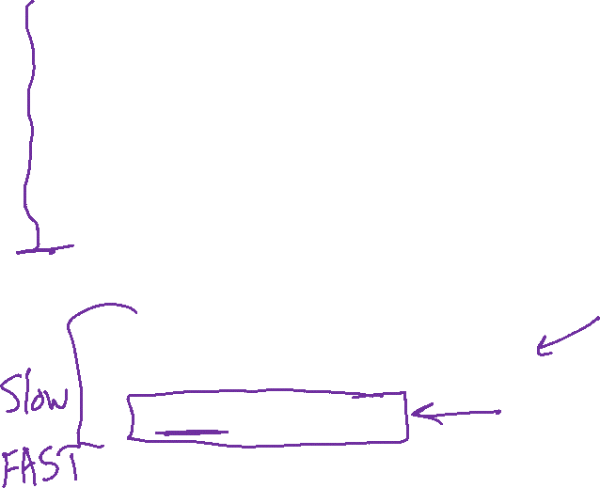
Plan
Pre-reading:
Propositional logic
Models and Knowledge Bases
Satisifiability and Entailment
Model checking: Truth table entailment/SAT
Today: Logical Agent Algorithms
Model checking
    Truth table entailment/SAT
    Faster SAT: DPLL
Theorem proving: Forward chaining
Planning with logic

Slide 47
Logical Agent Vocab
Model
  Complete assignment of symbols to True/False
Sentence
  Logical statement
  Composition of logic symbols and operators
KB
  Collection of sentences representing facts and rules we know about the world
Query
  Sentence we want to know if it is provably True, provably False, or unsure.

Slide 48

Provably True, Provably False, or Unsure
http://thiagodnf.github.io/wumpus-world-simulator/

Slide 49
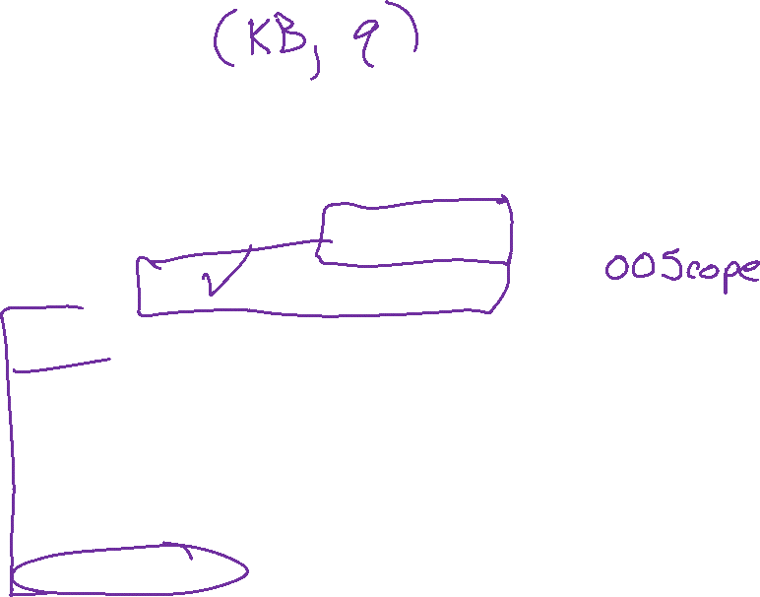
Logical Agent Vocab
Entailment
  Input: sentence1, sentence2
  Each model that satisfies sentence1 must also satisfy sentence2
  "If I know 1 holds, then I know 2 holds"
  (ASK), TT-ENTAILS, FC-ENTAILS, RESOLUTION-ENTAILS
Satisfy
  Input: model, sentence
  Is this sentence true in this model?
  Does this model satisfy this sentence
  "Does this particular state of the world work?’
  PL-TRUE

Slide 50
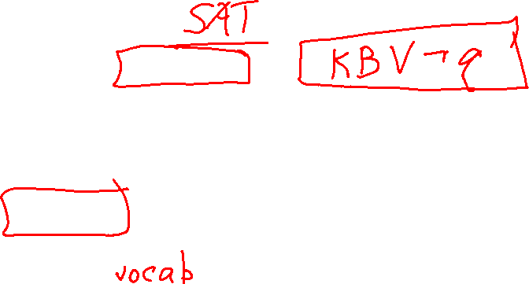
Logical Agent Vocab
Satisfiable
  Input: sentence
  Can find at least one model that satisfies this sentence
      (We often want to know what that model is)
  "Is it possible to make this sentence true?"
  DPLL
Valid
  Input: sentence
  sentence is true in all possible models

Slide 51
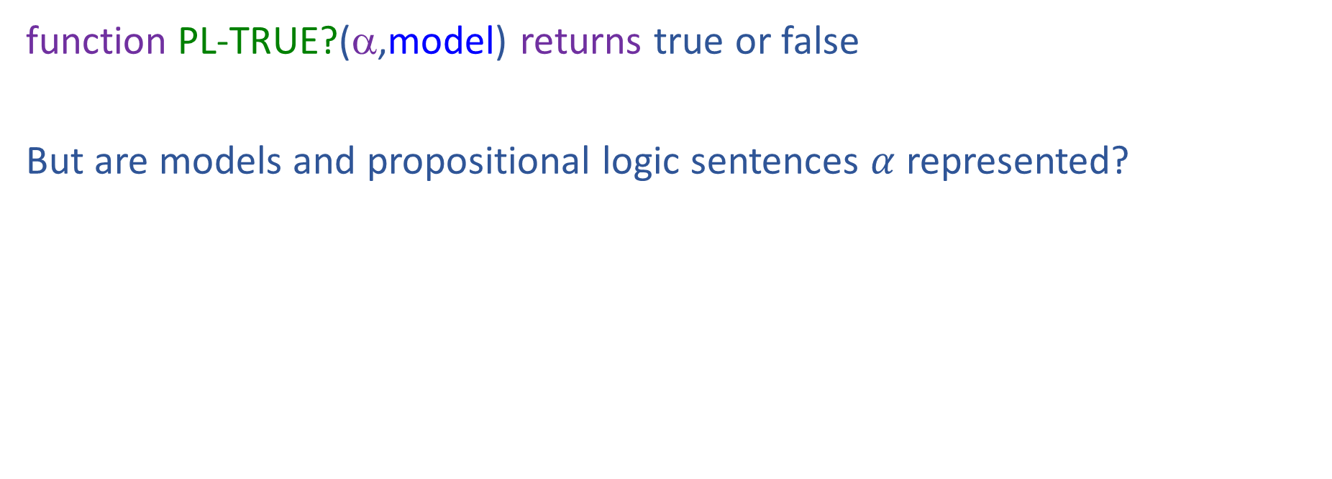
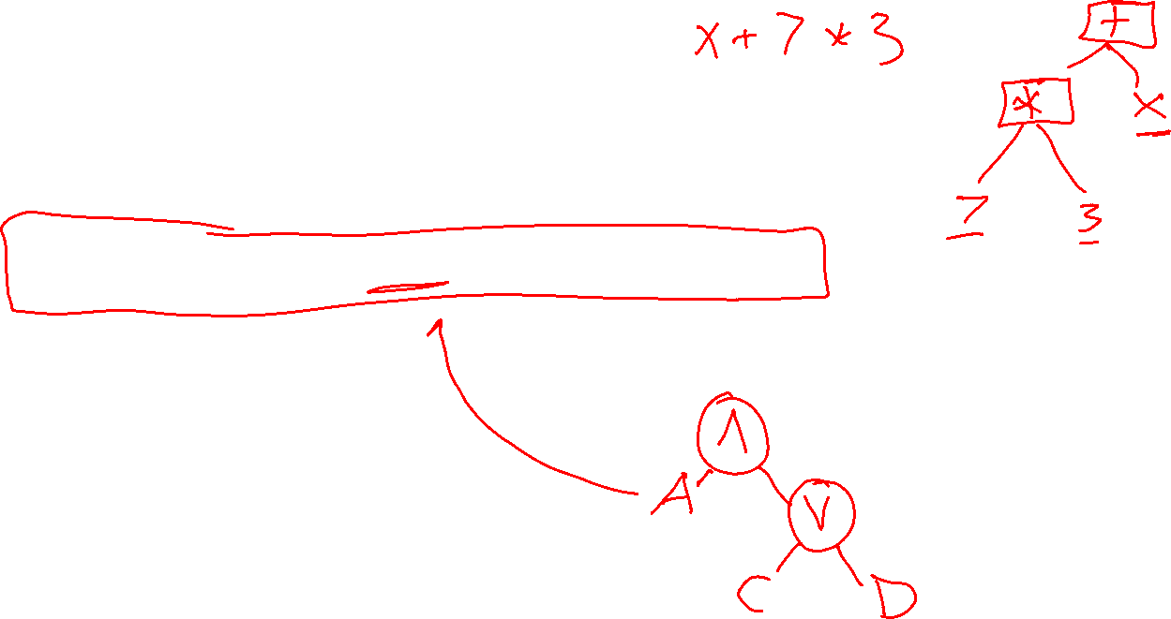
Propositional Logic
Check if sentence is true in given model
In other words, does the model satisfy the sentence?
function PL-TRUE?(α,model) returns true or false
But are models and propositional logic sentences $α$ represented?

Slide 52

Propositional Logic
Check if sentence is true in given model
In other words, does the model satisfy the sentence?
function PL-TRUE?(α,model) returns true or false
if α is a symbol then return Lookup(α, model)
if Op(α) = ¬ then return not(PL-TRUE?(Arg1(α),model))
if Op(α) = ∧ then return and(PL-TRUE?(Arg1(α),model),
PL-TRUE?(Arg2(α),model))
etc.
(Sometimes called “recursion over syntax”)

Slide 53

Plan
Pre-reading:
Propositional logic
Models and Knowledge Bases
Satisifiability and Entailment
Model checking: Truth table entailment/SAT
Today: Logical Agent Algorithms
Model checking
    Truth table entailment/SAT
    Faster SAT: DPLL
Theorem proving: Forward chaining
Planning with logic

Slide 54
Inference: Proofs
A proof is a demonstration of entailment between α and β
Method 1: model-checking
  For every possible world, if α is true make sure that is β true too
  OK for propositional logic (finitely many worlds); not easy for first-order logic

Slide 55
Simple Model Checking
function TT-ENTAILS?(KB, α) Returns true or false

Slide 56
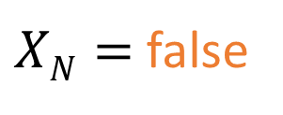
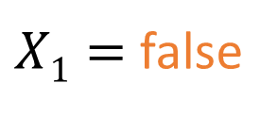
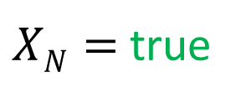
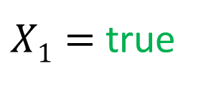

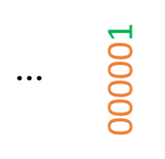

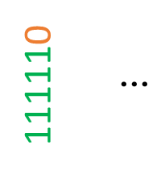
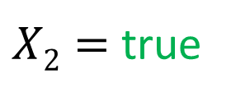
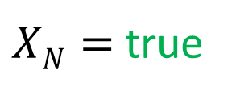
Simple Model Checking
function TT-ENTAILS?(KB, α)
Same recursion as backtracking
$X1=$true
$X1=$false
$X2=$true
$X2=$ false
$XN=$true
$XN=$ false
$XN=$true
$XN=$ false
KB?
α?
111110
$$⋮$$
$$⋮$$
000001
111111
101001
000000

Slide 57
Simple Model Checking
function TT-ENTAILS?(KB, α) Returns true or false
return TT-CHECK-ALL(KB, α, symbols(KB) ∪ symbols(α), {})
function TT-CHECK-ALL(KB, α, symbols, model) Returns true or false
Recursively check to make sure all models
that satisfy the KB also satisfy α

Slide 58
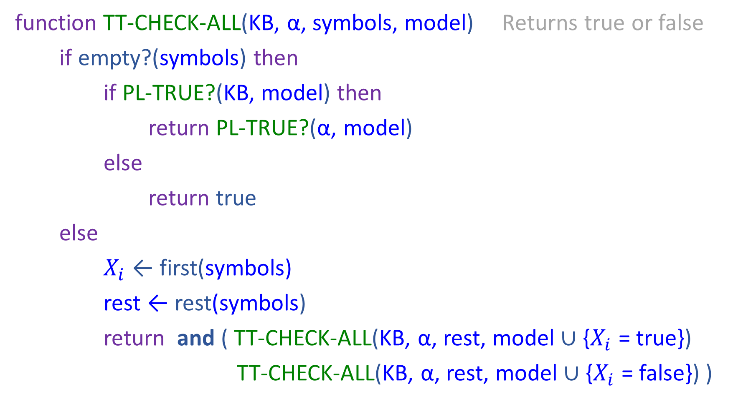
Simple Model Checking
function TT-CHECK-ALL(KB, α, symbols, model) Returns true or false
if empty?(symbols) then
if PL-TRUE?(KB, model) then
return PL-TRUE?(α, model)
else
return true
else
$X_{i}$ ← first(symbols)
rest ← rest(symbols)
return and ( TT-CHECK-ALL(KB, α, rest, model ∪ {$X_{i}$ = true})
TT-CHECK-ALL(KB, α, rest, model ∪ {$X_{i}$ = false}) )

Slide 59
Simple Model Checking
Same recursion as backtracking
O(2^{N}) time, linear space
Can we do better?
$X1=$true
$X1=$false
$X2=$true
$X2=$ false
$XN=$true
$XN=$ false
$XN=$true
$XN=$ false
KB?
α?
111110
$$⋮$$
$$⋮$$
000001
111111
101001
000000

Slide 60
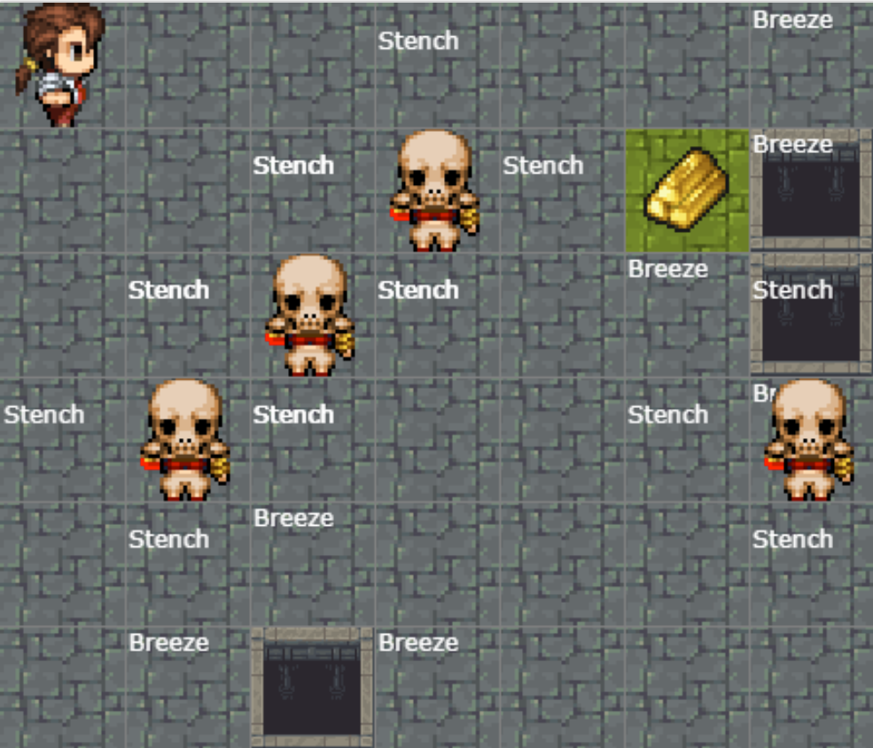
Satisfiability and Entailment
A sentence is satisfiable if it is true in at least one world (e.g. CSPs!)
http://thiagodnf.github.io/wumpus-world-simulator/

Slide 61
Satisfiability and Entailment
A sentence is satisfiable if it is true in at least one world (cf CSPs!)
Suppose we have a hyper-efficient SAT solver; how can we use it to test entailment?
  Suppose α |= β
  Then α ⇒ β is true in all worlds
  Hence ¬(α ⇒ β) is false in all worlds
  Hence α ∧ ¬β is false in all worlds, i.e., unsatisfiable
So, add the negated conclusion to what you know, test for (un)satisfiability; also known as reductio ad absurdum
Efficient SAT solvers operate on conjunctive normal form

Slide 62
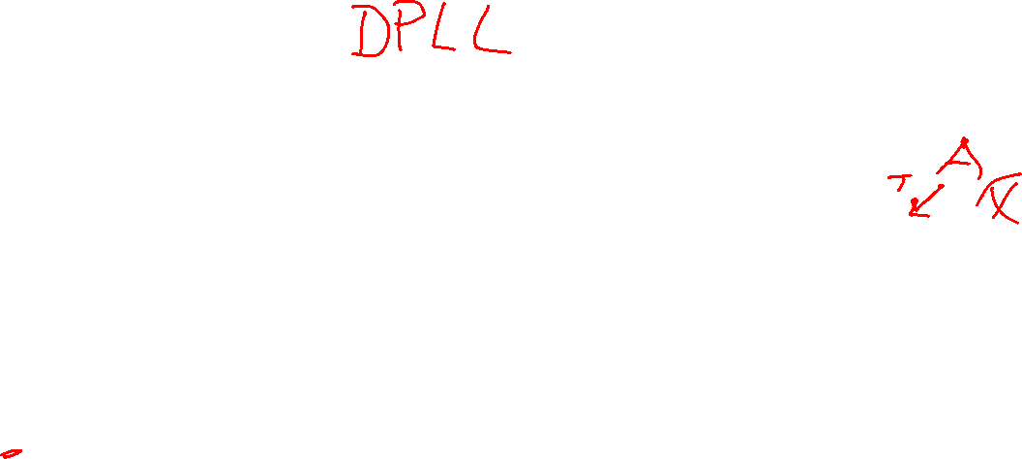

Efficient SAT solvers
DPLL (Davis-Putnam-Logemann-Loveland) is the core of modern solvers
Essentially a backtracking search over models with some extras:
  Early termination: stop if
    all clauses are satisfied; e.g., (A ∨ B) ∧ (A ∨ ¬C) is satisfied by {A=true}
    any clause is falsified; e.g., (A ∨ B) ∧ (A ∨ ¬C) is satisfied by {A=false, B=false}
  Pure literals: if all occurrences of a symbol in as-yet-unsatisfied clauses have the same sign, then give the symbol that value
    E.g., A is pure and positive in (A ∨ B) ∧ (A ∨ ¬C) ∧ (C ∨ ¬B) so set it to true
  Unit clauses: if a clause is left with a single literal, set symbol to satisfy clause
    E.g., if A=false, (A ∨ B) ∧ (A ∨ ¬C) becomes (false ∨ B) ∧ (false ∨ ¬C), i.e. (B) ∧ (¬C)
    Satisfying the unit clauses often leads to further propagation, new unit clauses, etc.

Slide 63
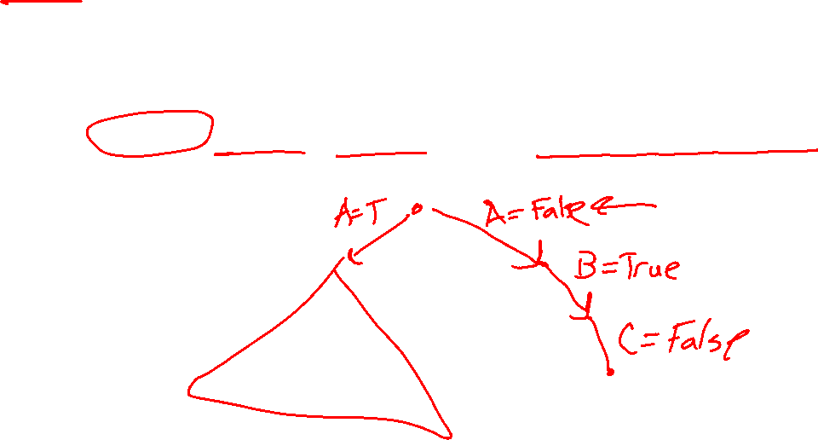
Efficient SAT solvers
DPLL (Davis-Putnam-Logemann-Loveland) is the core of modern solvers
Essentially a backtracking search over models with some extras:
  Unit clauses: if a clause is left with a single literal, set symbol to satisfy clause
    E.g., if A=false, (A ∨ B) ∧ (A ∨ ¬C) becomes (false ∨ B) ∧ (false ∨ ¬C), i.e. (B) ∧ (¬C)
    Satisfying the unit clauses often leads to further propagation, new unit clauses, etc.

Slide 64

DPLL algorithm
function DPLL(clauses, symbols, model) returns true or false
if every clause in clauses is true in model then return true
if some clause in clauses is false in model then return false
P, value ←FIND-PURE-SYMBOL(symbols, clauses, model)
if P is non-null then return DPLL(clauses, symbols–P, model∪{P=value})
P, value ←FIND-UNIT-CLAUSE(clauses, model)
if P is non-null then return DPLL(clauses, symbols–P, model∪{P=value})
P ← First(symbols)
rest ← Rest(symbols)
return or(DPLL(clauses, rest, model∪{P=true}),
DPLL(clauses, rest, model∪{P=false}))

Slide 65
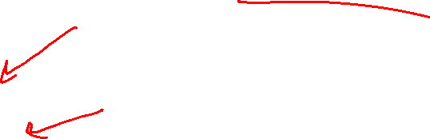
Inference: Proofs
A proof is a demonstration of entailment between α and β
Method 1: model-checking
  For every possible world, if α is true make sure that is β true too
  OK for propositional logic (finitely many worlds); not easy for first-order logic
Method 2: theorem-proving
  Search for a sequence of proof steps (applications of inference rules) leading from α to β
  E.g., from P ∧ (P ⇒ Q), infer Q by Modus Ponens
Properties
Sound algorithm: everything it claims to prove is in fact entailed
Complete algorithm: every sentence that is entailed can be proved

Slide 66
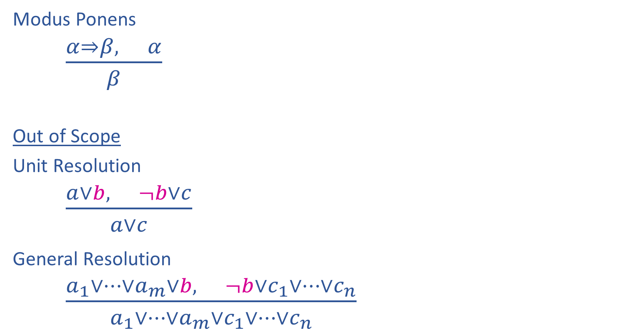
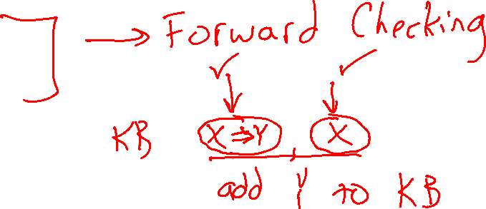
Inference Rules
Notation Alert!
Modus Ponens
$\frac{α⇒β, α}{β}$
Out of Scope
Unit Resolution
$\frac{a∨b, ¬b∨c}{a∨c}$
General Resolution
$\frac{a_{1}∨…∨a_{m}∨b, ¬b∨c_{1}∨…∨c_{n}}{a_{1}∨…∨a_{m}∨c_{1}∨…∨c_{n}}$

Slide 67
Simple Theorem Proving: Forward Chaining
Forward chaining applies Modus Ponens to generate new facts:
  Given X₁ ∧ X₂ ∧ … X_{n} ⇒ Y and X₁, X₂, …, X_{n}
  Infer Y
Forward chaining keeps applying this rule, adding new facts, until nothing more can be added
Requires KB to contain only definite clauses:
  (Conjunction of symbols) ⇒ symbol; or
  A single symbol (note that X is equivalent to True ⇒ X)

Slide 68
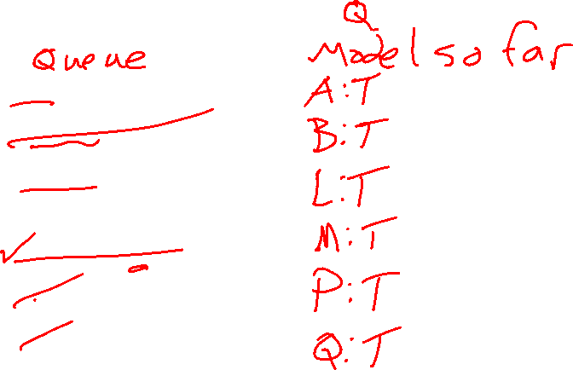
Forward Chaining Algorithm
function PL-FC-ENTAILS?(KB, q) Returns true or false
KB Clauses
P ⇒ Q
L ∧ M ⇒ P
B ∧ L ⇒ M
A ∧ P ⇒ L
A ∧ B ⇒ L
A
B

Slide 69
Forward Chaining Algorithm
function PL-FC-ENTAILS?(KB, q) returns true or false
count ← a table, where count[c] is the number of symbols in c’s premise
inferred ← a table, where inferred[s] is initially false for all s
agenda ← a queue of symbols, initially symbols known to be true in KB
Clauses
Count
Inferred
Agenda
P ⇒ Q
L ∧ M ⇒ P
B ∧ L ⇒ M
A ∧ P ⇒ L
A ∧ B ⇒ L
A
B
1
2
2
2
2
0
0
A false
B false
L false
M false
P false
Q false

Slide 70
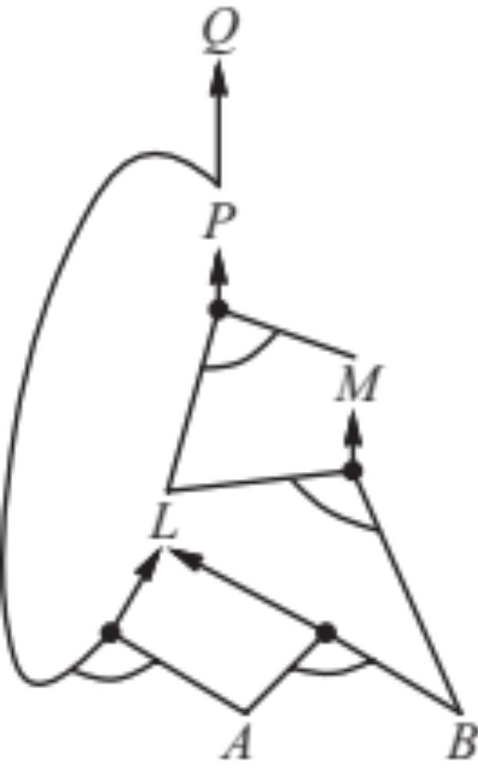
Forward Chaining Example: Proving Q
Clauses
Count
Inferred
1
2
2
2
2
0
0
A false
B false
L false
M false
P false
Q false
P ⇒ Q
L ∧ M ⇒ P
B ∧ L ⇒ M
A ∧ P ⇒ L
A ∧ B ⇒ L
A
B
// 0
xxxx true
// 1
xxxx true
// 0
// 0
xxxx true
// 1
// 0
xxxx true
// 1
xxxx true
// 0
// 1
xxxx true
Agenda
x
x
Q
x
L
x
x
x
M
P
A B
x
L

Slide 71
Forward Chaining Algorithm
function PL-FC-ENTAILS?(KB, q) returns true or false
count ← a table, where count[c] is the number of symbols in c’s premise
inferred ← a table, where inferred[s] is initially false for all s
agenda ← a queue of symbols, initially symbols known to be true in KB
while agenda is not empty do
p ← Pop(agenda)
if p = q then return true
if inferred[p] = false then
inferred[p]←true
for each clause c in KB where p is in c.premise do
decrement count[c]
if count[c] = 0 then add c.conclusion to agenda
return false

Slide 72
Properties of forward chaining
Theorem: FC is sound and complete for definite-clause KBs
Soundness: follows from soundness of Modus Ponens (easy to check)
Completeness proof:
1. FC reaches a fixed point where no new atomic sentences are derived
2. Consider the final inferred table as a model m, assigning true/false to symbols
3. Every clause in the original KB is true for m
Proof: Suppose a clause a₁∧... ∧a_{k} ⇒ b is false for m
Then a₁∧... ∧a_{k} is true in m and b is false for m
Therefore the algorithm has not reached a fixed point!
4. Hence m is a model of KB
5. If KB |= q, q is true in every model of KB, including m
A false
B false
L false
M false
P false
Q false
xxxx true
xxxx true
xxxx true
xxxx true
xxxx true
xxxx true

Slide 73
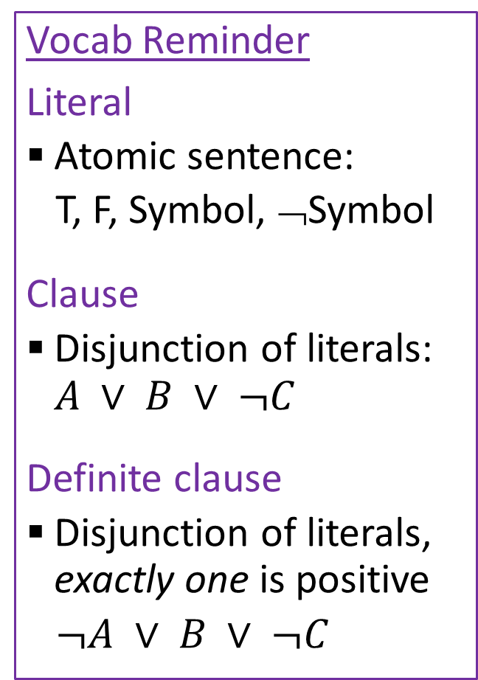
Properties
Vocab Reminder
Literal
  Atomic sentence:
  T, F, Symbol, ¬Symbol
Clause
  Disjunction of literals: $A ∨ B ∨ ¬C$
Definite clause
  Disjunction of literals, exactly one is positive
  $¬A ∨ B ∨ ¬C$
Forward Chaining is:
Sound and complete for definite-clause KBs
Complexity: linear time ☺
Resolution is another theorem-proving algorithm that is:
Sound and complete for any PL KBs!
Complexity: exponential time ☹

Slide 74
Next Time
Planning with PL and SAT

Slide 75
Additional Slides
Theorem Proving: Resolution (out of scope)

Slide 76
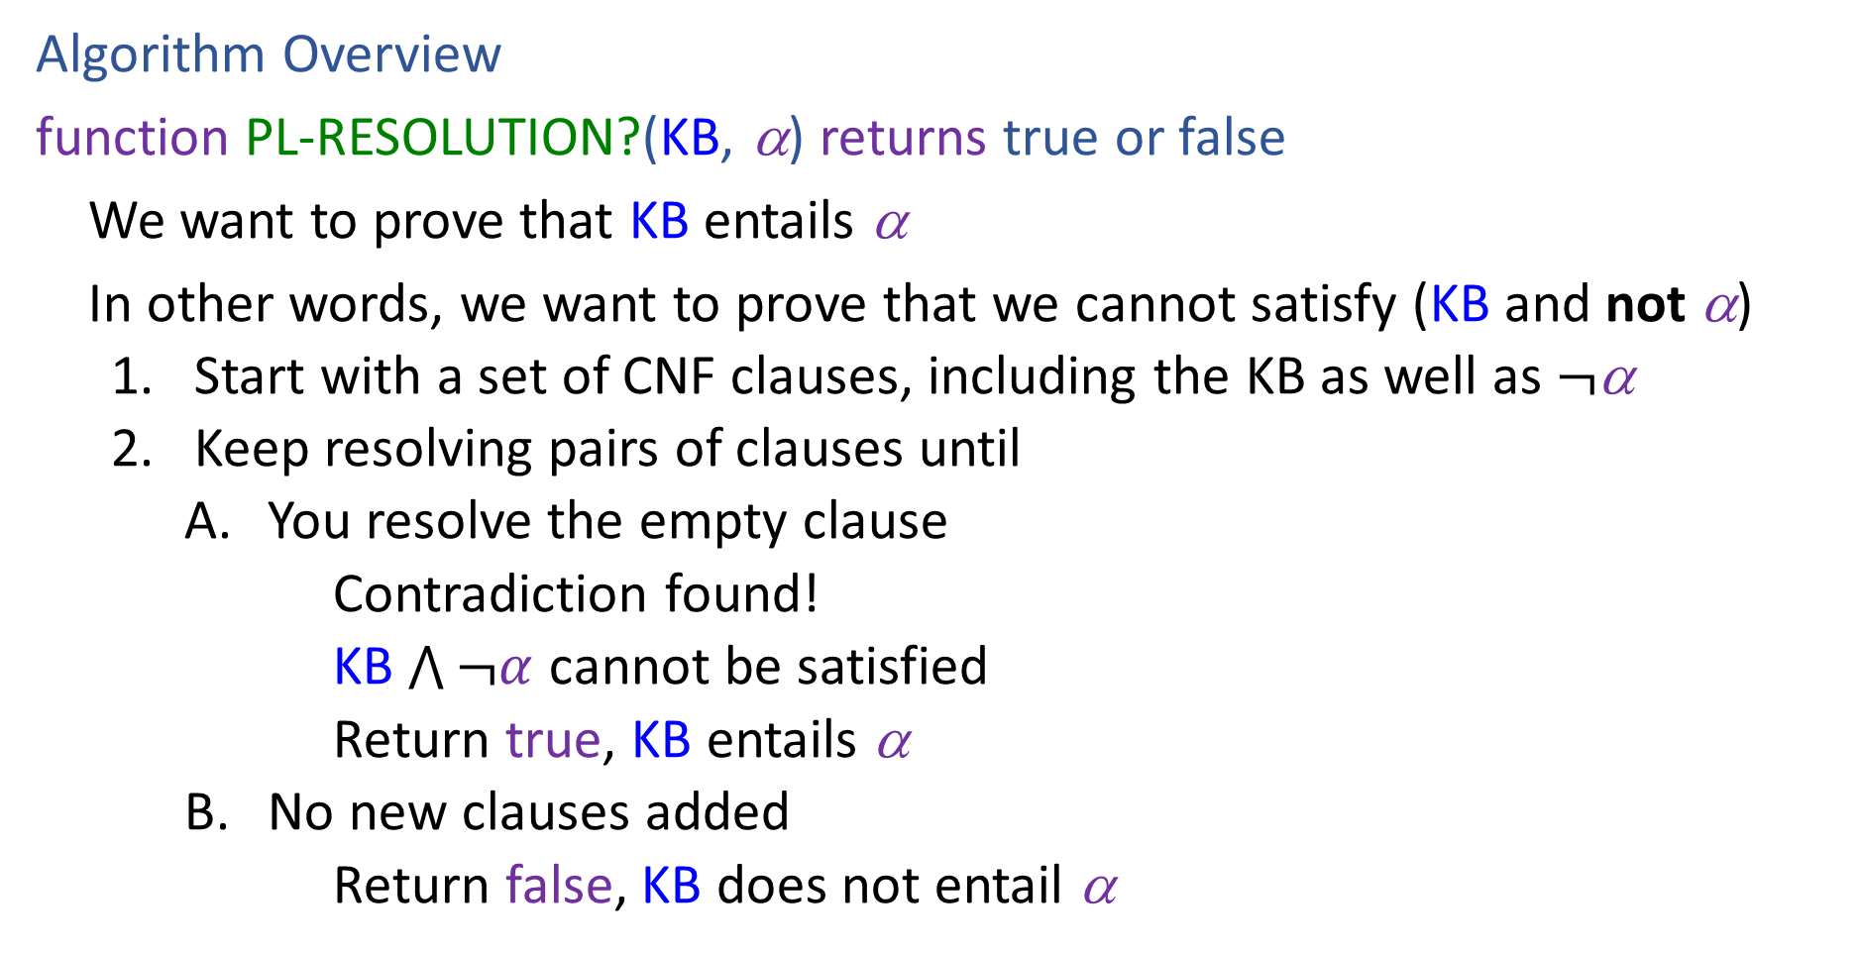
Resolution
Algorithm Overview
function PL-RESOLUTION?(KB, α) returns true or false
We want to prove that KB entails α
In other words, we want to prove that we cannot satisfy (KB and not α)
    Start with a set of CNF clauses, including the KB as well as $¬$α
    Keep resolving pairs of clauses until
        You resolve the empty clause
        Contradiction found!
        KB $\bigwedge{¬α}$ cannot be satisfied
        Return true, KB entails α
        No new clauses added
        Return false, KB does not entail α

Slide 77
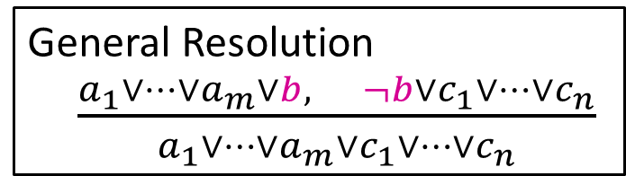






Resolution
General Resolution
$\frac{a_{1}∨…∨a_{m}∨b, ¬b∨c_{1}∨…∨c_{n}}{a_{1}∨…∨a_{m}∨c_{1}∨…∨c_{n}}$
Example trying to prove $¬P_{1,2}$
Knowledge Base
$$¬P_{2,1}∨B_{1,1}$$
$$¬B_{1,1}∨P_{1,2}∨P_{2,1}$$
$$¬P_{1,2}∨B_{1,1}$$
$$¬B_{1,1}$$
$$¬¬P_{1,2}$$

Slide 78







Resolution
General Resolution
$\frac{a_{1}∨…∨a_{m}∨b, ¬b∨c_{1}∨…∨c_{n}}{a_{1}∨…∨a_{m}∨c_{1}∨…∨c_{n}}$
Example trying to prove $¬P_{1,2}$
Knowledge Base
$$¬P_{2,1}∨B_{1,1}$$
$$¬B_{1,1}∨P_{1,2}∨P_{2,1}$$
$$¬P_{1,2}∨B_{1,1}$$
$$¬B_{1,1}$$
$$P_{1,2}$$
$$¬B_{1,1}∨P_{1,2}∨B_{1,1}$$
$$P_{1,2}∨P_{2,1}∨¬P_{2,1}$$
$$¬B_{1,1}∨P_{2,1}∨B_{1,1}$$
$$P_{1,2}∨P_{2,1}∨¬P_{1,2}$$
$$¬P_{2,1}$$
$$¬P_{1,2}$$

Slide 79
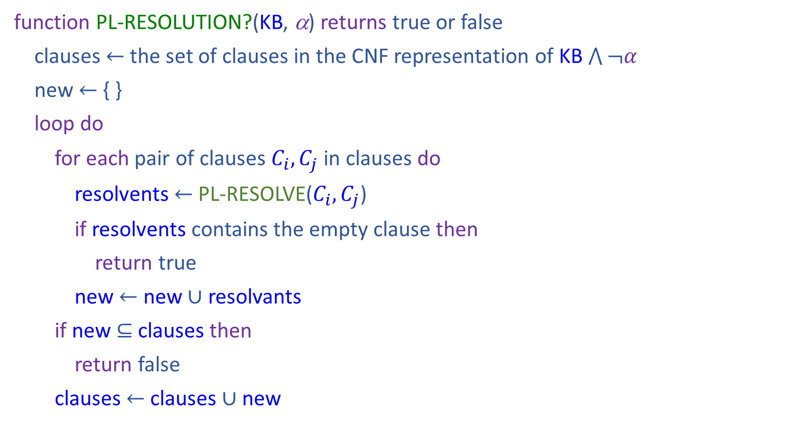
Resolution
function PL-RESOLUTION?(KB, α) returns true or false
clauses $←$ the set of clauses in the CNF representation of KB $\bigwedge{¬α}$
new $←${ }
loop do
for each pair of clauses $C_{i}, C_{j}$ in clauses do
resolvents $←$ PL-RESOLVE($C_{i}, C_{j}$)
if resolvents contains the empty clause then
return true
new $←$ new $∪$ resolvants
if new $⊆$ clauses then
return false
clauses $←$ clauses $∪$ new

