Slide 1

07-380
AI & ML II
Introduction
Instructors:
Pat Virtue &
Mohammad Salameh

Slide 2
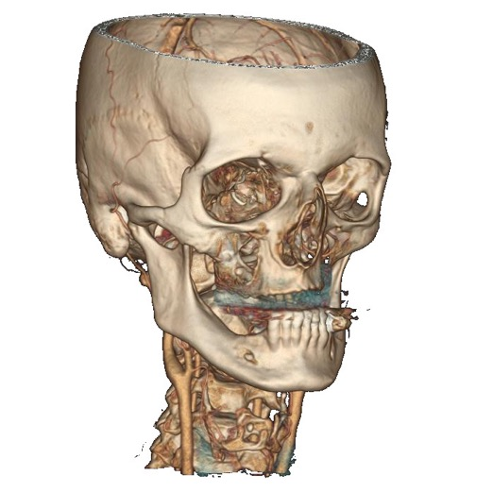
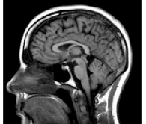




Pat Virtue
From Medical Imaging background to AI Education Outreach
GE Healthcare
UC Berkeley
Carnegie Mellon University

Slide 3




Mohammad Salameh
Visiting AI Faculty from CMU Qatar!
Assistant Teaching Professor at Carnegie Mellon University in Qatar (CMU-Q).
Previously, Principal Researcher and Team Lead at Huawei Technologies Canada
Ph.D. in Computing Science from the University of Alberta, Canada, in 2016.
BS and MS from the Lebanese American University, Lebanon

Slide 4

Mohammad Salameh
Visiting AI Faculty from CMU Qatar!
Assistant Teaching Professor at Carnegie Mellon University in Qatar (CMU-Q).
Previously, Principal Researcher and Team Lead at Huawei Technologies Canada
Ph.D. in Computing Science from the University of Alberta, Canada, in 2016.
BS and MS from the Lebanese American University, Lebanon
Research Interests
Optimizing deep learning models for devices with limited computing resources
Software-hardware co-design
Neural architecture search
Computer vision
Natural language processing (NLP)
Autonomous driving

Slide 5

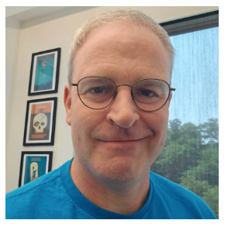

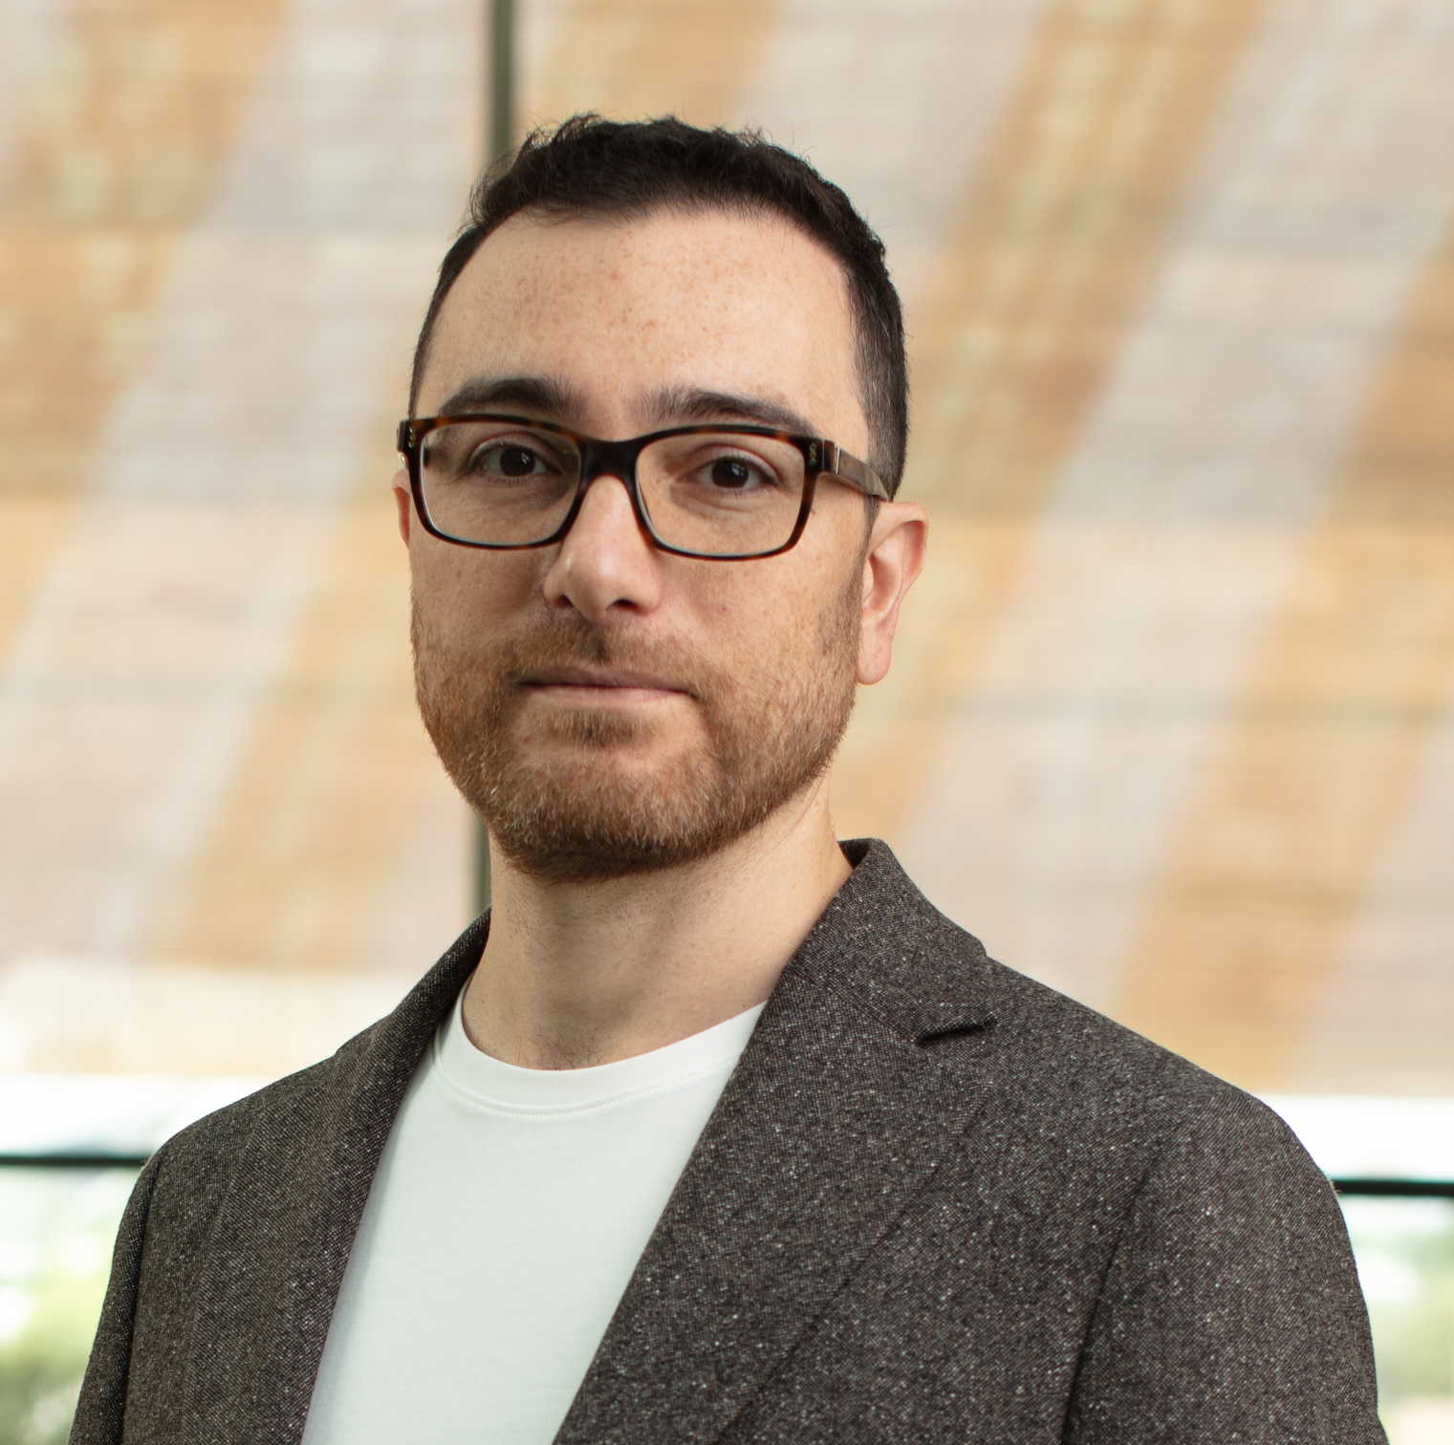

Course Team
Teaching Assistants
Ellyse
Lai
Instructors
Pat
Virtue
Steven
Yang
Mohammad
Salameh
Arnav
Pallem

Slide 6

Why are we here? – CMU version
Good Will Hunting
https://youtu.be/hIdsjNGCGz4?si=ggWBp-NE5u-I3lA6&t=78

Slide 7
Question: Why are we here?
Why CMU and not just a $1.50 in late charges at the public library?
(or $20 on Claude?)

Slide 8
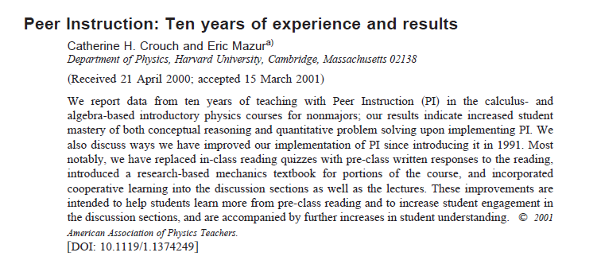
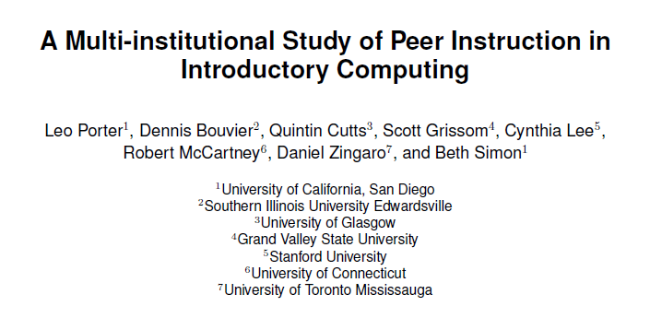
Course Team
We're here for the people
Yeah, instructors and TAs, but mostly other students
07-380
Peer Instruction
Programming partners (pairs)
Group project (teams of 3)
https://www.researchgate.net/publication/216743159_Peer_Instruction_Engaging_students_one-on-one_all_at_once
https://dl.acm.org/doi/10.1145/2839509.2844642

Slide 9

Course Information
Website: https://www.cs.cmu.edu/~07380
Communication:
https://piazza.com/
Piazza for all communication
Important posts!
Course Infrastructure
Pre-reading (due Tue)
Lec Preview & Poll Links
Coming soon
HW1 (out Fri)

Slide 10
Poll 1
When is the first pre-reading checkpoint due?
Tonight
Tomorrow
Sunday night
Before class next Monday

Slide 11
Poll 2
Home many OH appointment slots does Pat have available this week?

Slide 12


Today
Why are we here? CMU-version
Course team
Quick course info
(Another) Discussion of Intelligence
Why are we here? 07-380-version
07-380 design considerations
Runthrough of 380 topics (as time permits)

Slide 13
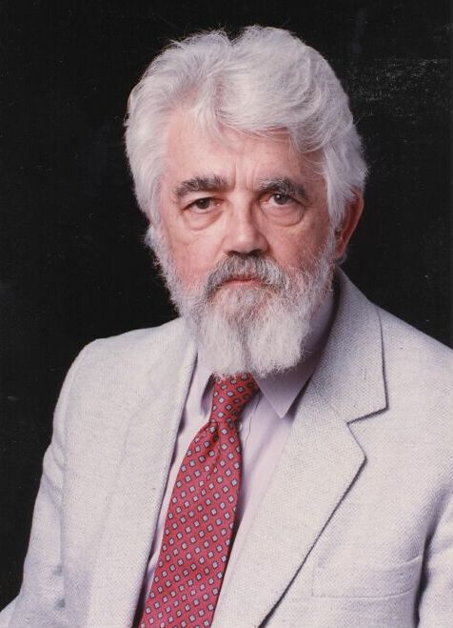
Reminder: AI Definition by John McCarthy
What is artificial intelligence
  It is the science and engineering of making intelligent machines, especially intelligent computer programs
What is intelligence
  Intelligence is the computational part of the ability to achieve goals in the world
http://www-formal.stanford.edu/jmc/whatisai/whatisai.html

Slide 14
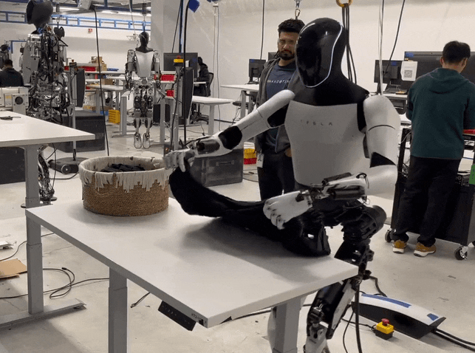
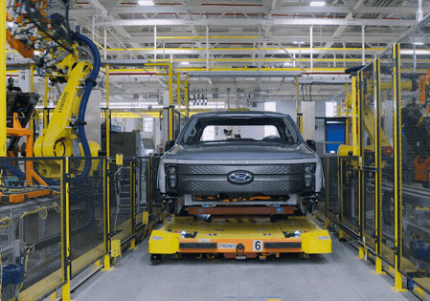
Reminder: What is artificial Intelligence?
Why is folding clothes a research problem while robots are actively being used to assemble cars in factories?

Slide 15


Reminder: AI Definition (Pat's Version)
What is intelligence
  Intelligence is the ability to perform well on a task that involves uncertainty
Intelligence is not binary
  How well an agent performs and how much uncertainty is involved will determine how intelligent we consider the agent to be

Slide 16
Intelligence and Uncertainty
Another way to think about intelligence is to consider how much uncertainty is involved
Uncertainty comes into play whenever it is not feasible to determine exact information
Uncertainty requires decisions to be made

Slide 17
Intelligence and Uncertainty
Uncertainty can have lots of sources, including anything we attribute to random chance
Hidden information
    Cards in another player’s hand
Noise
    Sensor noise
Way to complicated to model
    Leaves blowing in the wind
Infinite number of possible configurations
More possibilities than any computer can compute in a reasonable time
    Tic-tac-toe → Checkers → Chess

Slide 18
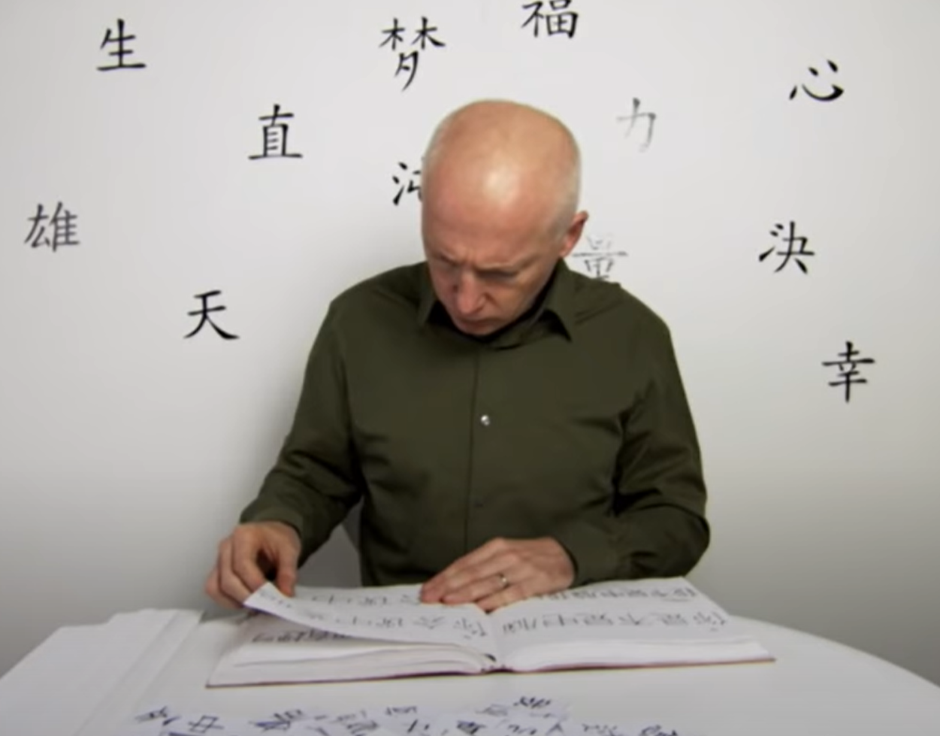
What is Intelligence?
Chinese room experiment
John Searle
https://www.youtube.com/watch?v=D0MD4sRHj1M

Slide 19
Poll 3
Is the "Chinese room" intelligent?
---
Yes
No
---

Slide 20
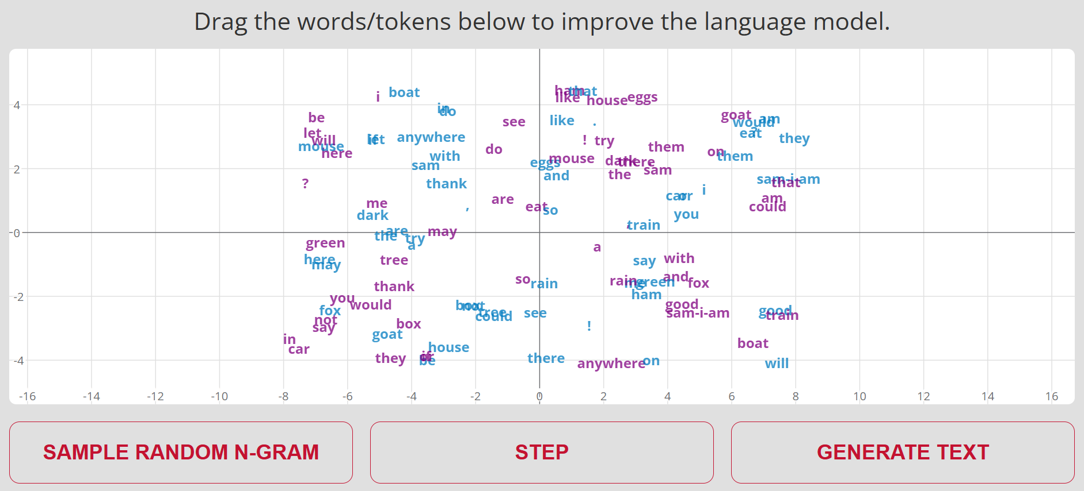
LLM Embeddings
https://www.cs.cmu.edu/~pvirtue/AIS/word-embeddings/word-embeddings.html

Slide 21
Weak AI vs AGI
Singularity
Weak AI
Strong AI
Narrow AI
Limited number of applications
Artificial General Intelligence (AGI)
Recursive self-improvement
Beyond human control

Slide 22

Poll 4
Are AI tools already AGI?

Slide 23
Why are we here? – 07-380 version
What were we considering when designing 07-380?
Building breadth and depth of AI and ML
What do we want to make sure all AI majors/minors learn, regardless of which electives they choose?
Which components are the building blocks?
    Giving students the language to learn more
Which components are more difficult to learn outside of university?
    (Math)
Learn more about the state-of-the-art
Prepare students for critical AI/ML challenges in practice

Slide 24
Artificial Intelligence vs Machine Learning?
Artificial Intelligence
Machine Learning
Deep Learning
Generative AI

Slide 25
Artificial Intelligence vs Machine Learning?
Artificial Intelligence
AI/ML Ethics
Heuristic Search
Machine Learning
CSPs
Games
Deep Learning
Generative AI
LLM
MLE
Markov Chains
RL
MDP
MCTS

Slide 26
Artificial Intelligence vs Machine Learning?
Artificial Intelligence
AI/ML Ethics
Heuristic Search
Machine Learning
CSPs
Games
ML Theory
Deep Learning
Game Theory
Graphical
Models
Logic
Generative AI
LLM
Parallel
Planning
PCA
VLM
Optim:
LP, IP
MLE
MAP
VAE
Scaling
Diffusion
Markov Chains
RL
Policy Grad.
MDP
MCTS

Slide 27

Why are we here? – 07-380 version
What were we considering when designing 07-380?
Building breadth and depth of AI and ML
What do we want to make sure all AI majors/minors learn, regardless of which electives they choose?

Slide 28
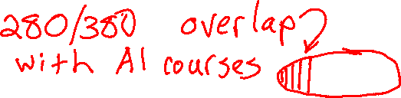

Courses in AI Major & AI Minor
AI Ethics, Cognitive Studies, Humanities, Sci/Eng, SCS Electives
Math core, CS core
AI Core
ML Cluster
Dec. & Rob.
Human AI Int.
Perc. & Lang.
280
380
16-385
11-411
403
405
414
DL
422
423
708
725
11-441
36-402
15-482
16-350

Slide 29
Why are we here? – 07-380 version
What were we considering when designing 07-380?
Building breadth and depth of AI and ML
What do we want to make sure all AI majors/minors learn, regardless of which electives they choose?
Which components are the building blocks?
    Giving students the language to learn more
Which components are more difficult to learn outside of university?
    (Math)
Learn more about the state-of-the-art
Prepare students for critical AI/ML challenges in practice

Slide 30

Today
Why are we here? CMU-version
Course team
Quick course info
(Another) Discussion of Intelligence
Why are we here? 07-380-version
07-380 design considerations
Runthrough of 380 topics (as time permits)

