Slide 1
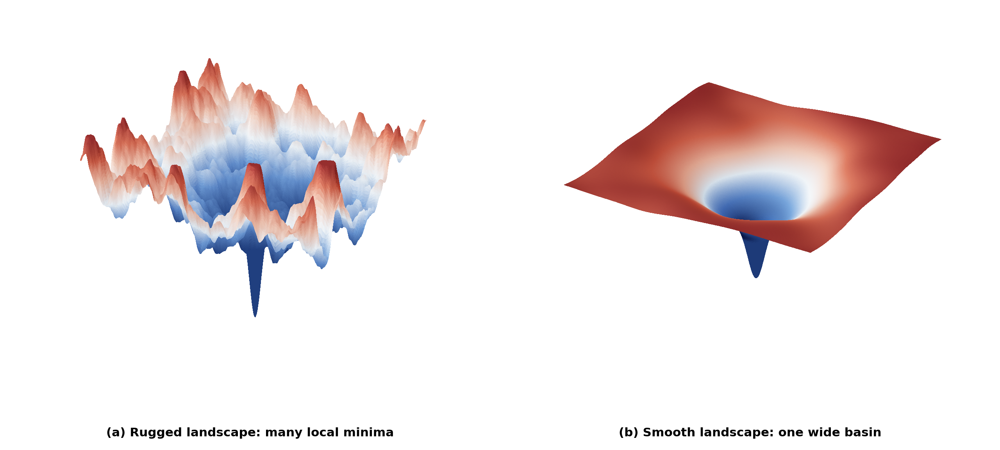
Deep Learning Optimization
Mohammad Salameh and Pat Virtue

Slide 2
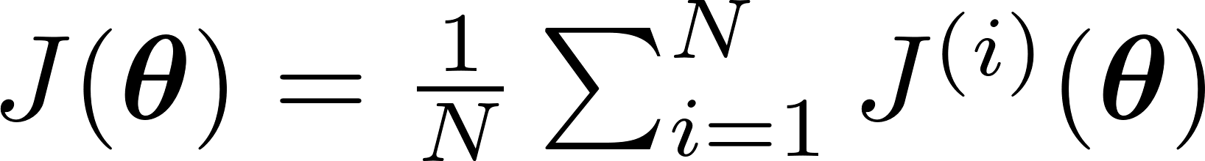
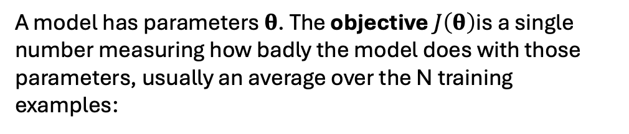
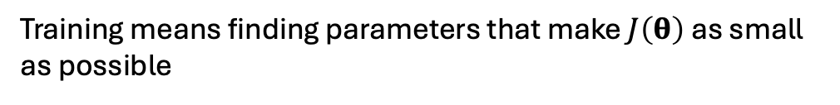
Functions and the Objective
A model has parameters 𝛉. The objective $J\left(θ\right)$is a single number measuring how badly the model does with those parameters, usually an average over the N training examples:
Training means finding parameters that make $J\left(θ\right)$ as small as possible

Slide 3
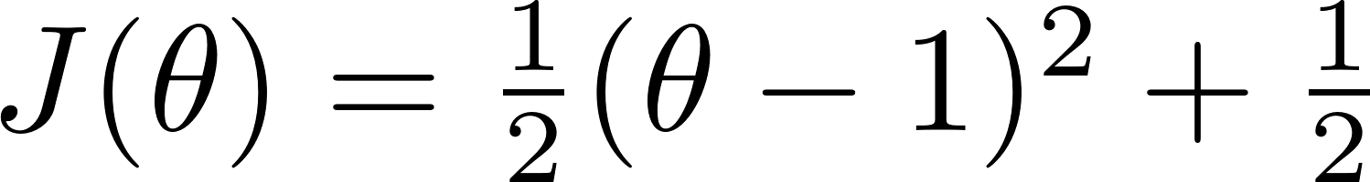
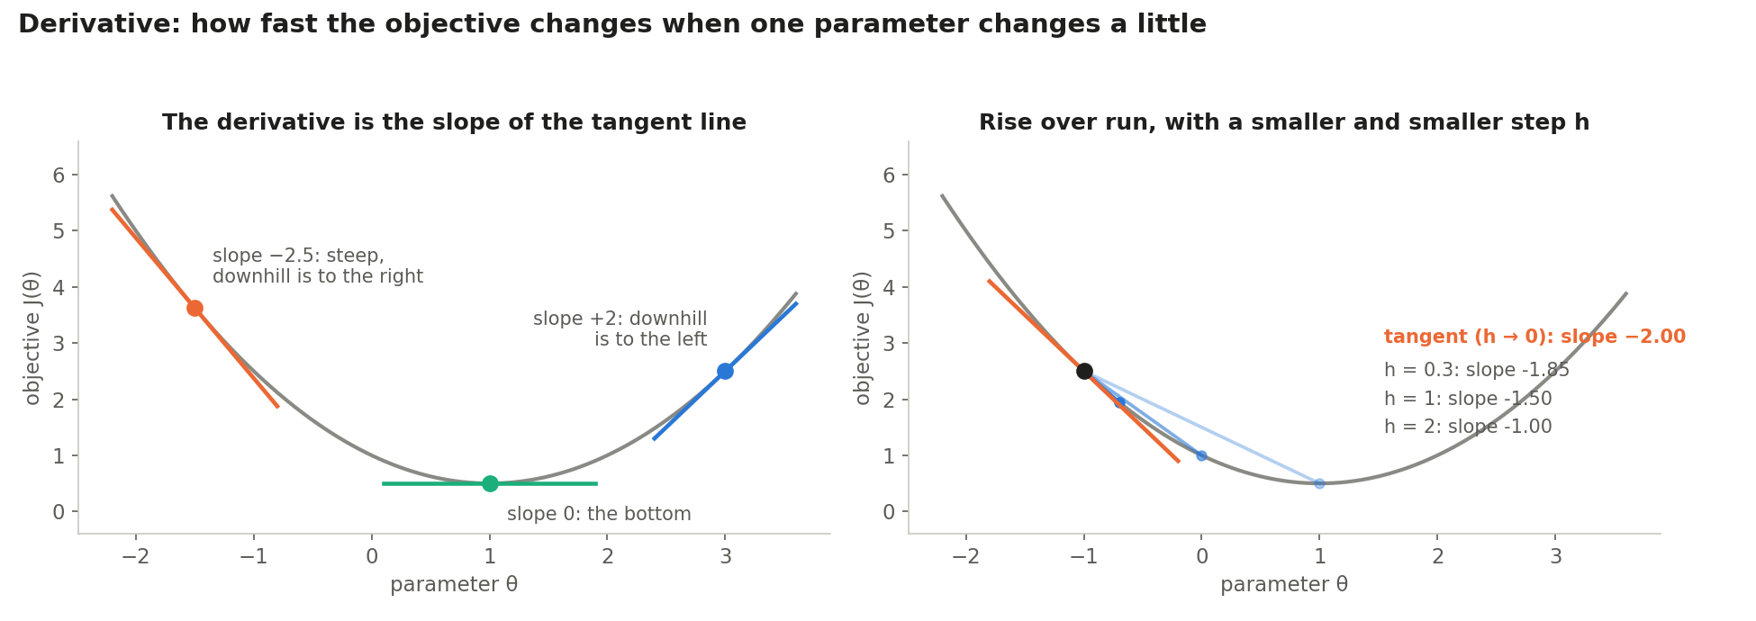
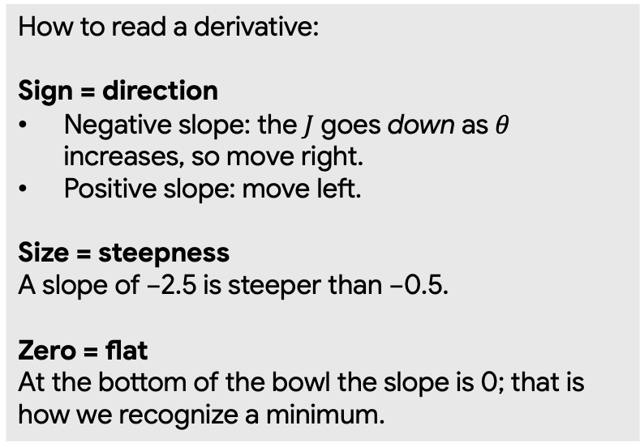
The derivative: slope with one parameter
How to read a derivative:
Sign = direction
Negative slope: the $J$ goes down as $θ$ increases, so move right.
Positive slope: move left.
Size = steepness
A slope of −2.5 is steeper than −0.5.
Zero = flat
At the bottom of the bowl the slope is 0; that is how we recognize a minimum.

Slide 4
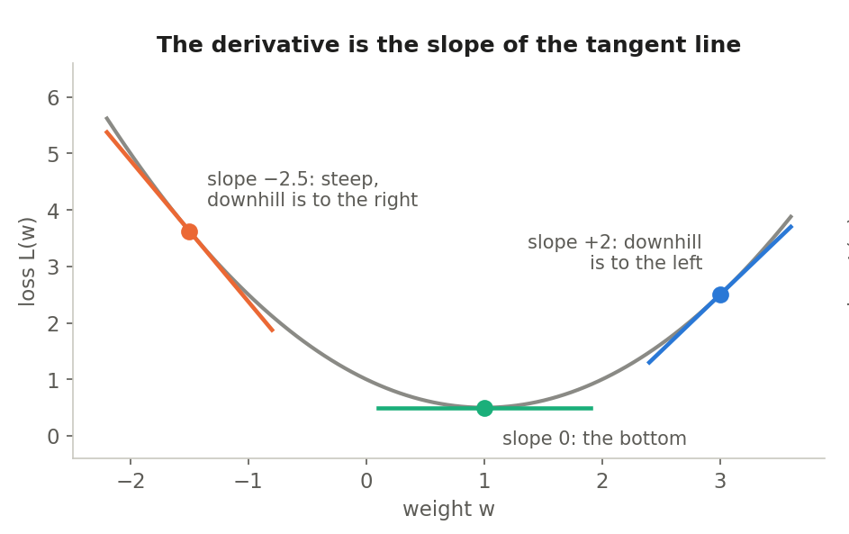
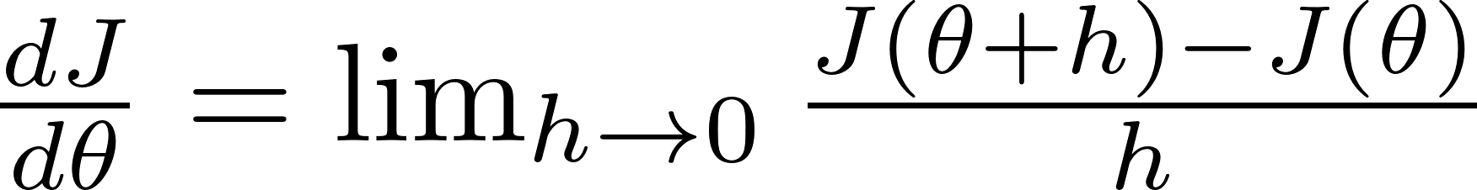
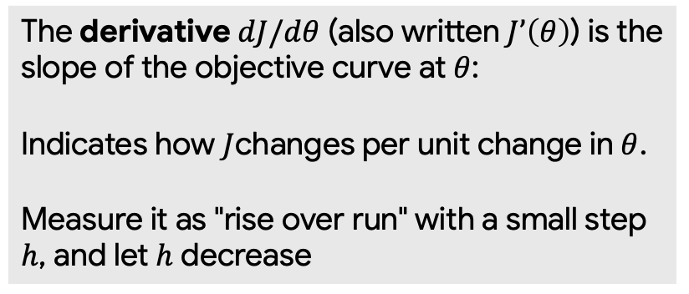
The derivative: slope with one parameter
The derivative $dJ/dθ$ (also written $J’\left(θ\right)$) is the slope of the objective curve at $θ$:
Indicates how $J$changes per unit change in $θ$.
Measure it as "rise over run" with a small step $h$, and let $h$ decrease

Slide 5
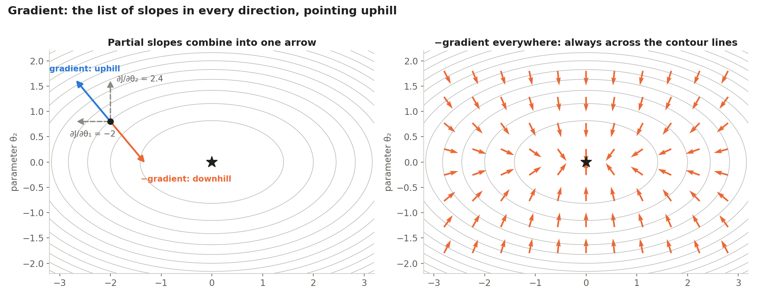
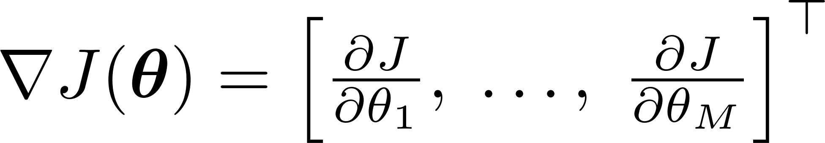

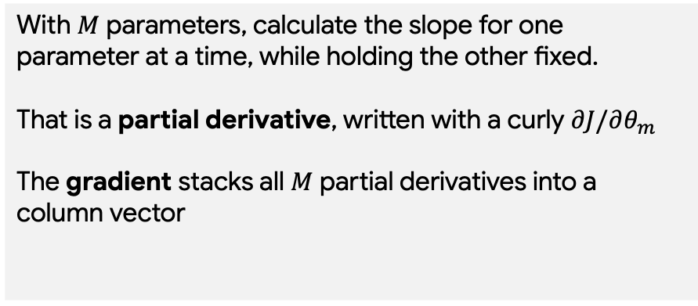
Partial derivatives: slopes of objective for each parameter
With $M$ parameters, calculate the slope for one parameter at a time, while holding the other fixed.
That is a partial derivative, written with a curly $∂J/∂θ_{m}$
The gradient stacks all $M$ partial derivatives into a column vector
Example with M = 2
At $θ=\left[−2,0.8\right]ᵀ$, the gradient is $\left[−2,2.4\right]ᵀ$

Slide 6
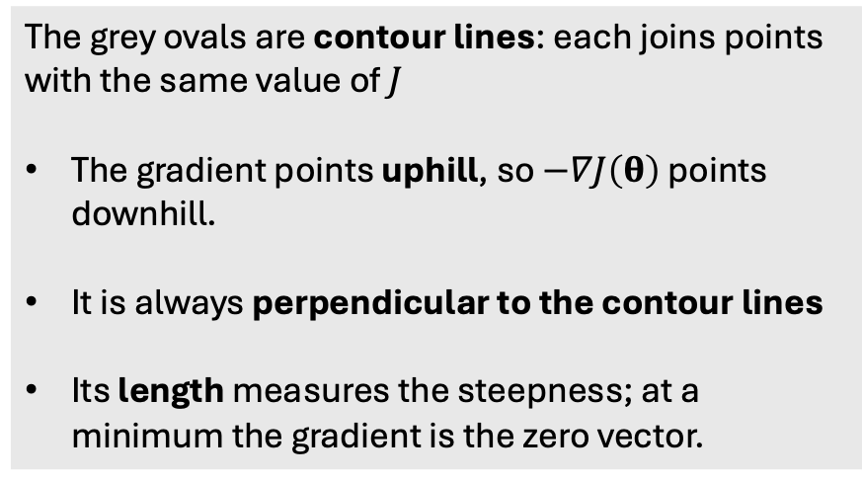
The gradient: all the slopes in one arrow
The grey ovals are contour lines: each joins points with the same value of $J$
The gradient points uphill, so $−∇J\left(θ\right)$ points downhill.
It is always perpendicular to the contour lines
Its length measures the steepness; at a minimum the gradient is the zero vector.

Slide 7
The gradient: all the slopes in one arrow
The grey ovals are contour lines: each joins points with the same value of $J$
The gradient points uphill, so $−∇J\left(θ\right)$ points downhill.
It is always perpendicular to the contour lines
Its length measures the steepness; at a minimum the gradient is the zero vector.

Slide 8
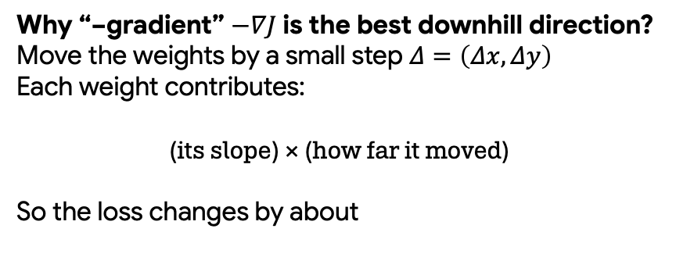
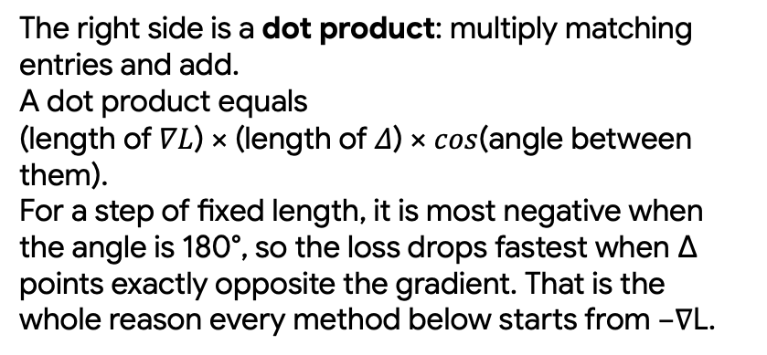
The gradient: all the slopes in one arrow
Why “−gradient” $−∇J$ is the best downhill direction?
Move the weights by a small step $Δ=\left(Δx,Δy\right)$
Each weight contributes:
(its slope) × (how far it moved)
So the loss changes by about
The right side is a dot product: multiply matching entries and add.
A dot product equals
(length of $∇L$) × (length of $Δ$) × $cos$(angle between them).
For a step of fixed length, it is most negative when the angle is 180°, so the loss drops fastest when Δ points exactly opposite the gradient. That is the whole reason every method below starts from −∇L.

Slide 9
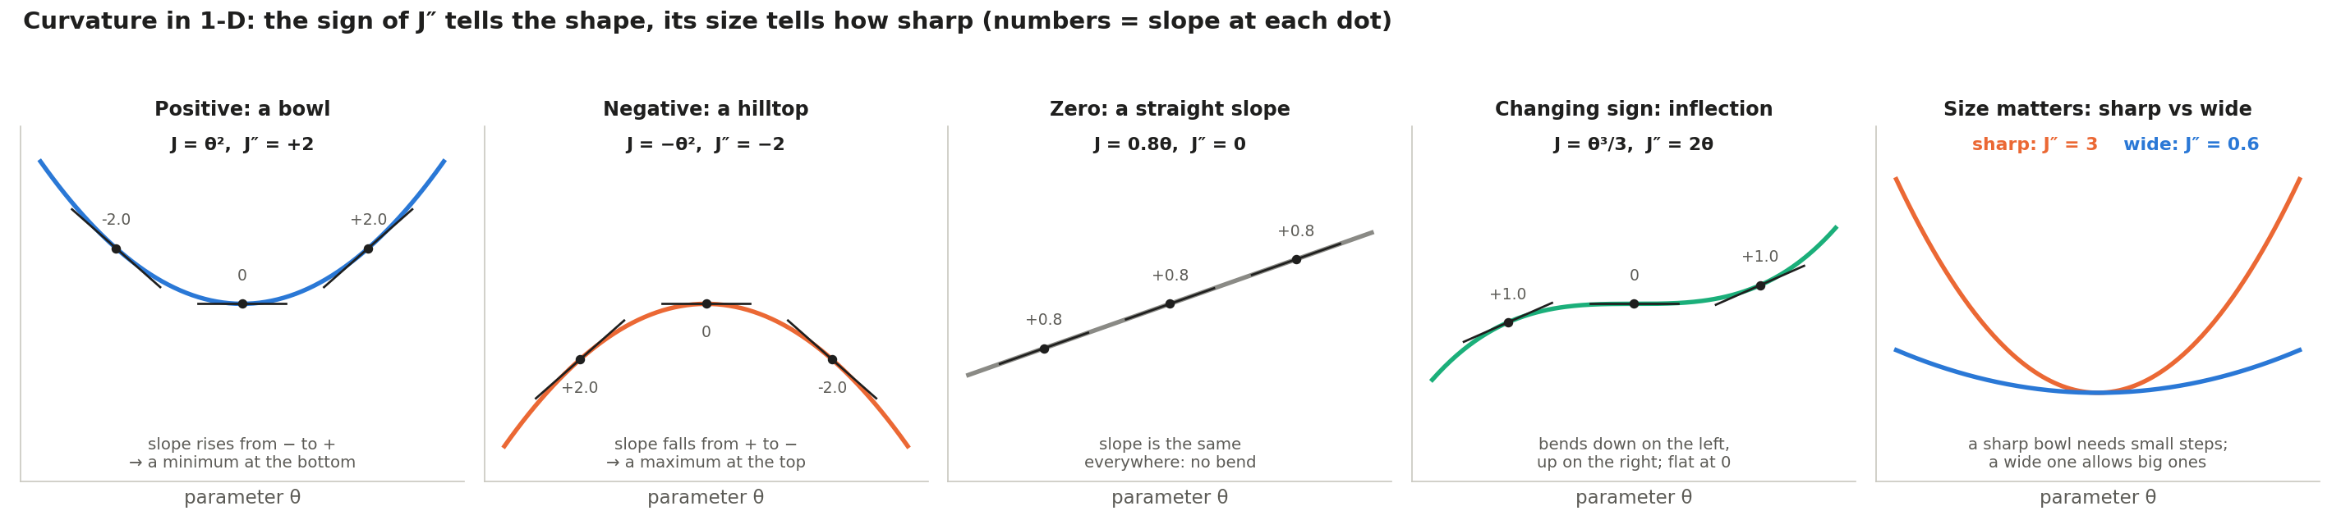
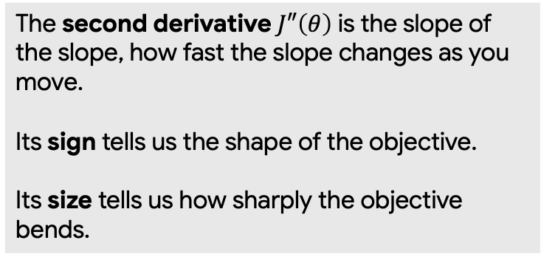
Curvature
Slope tells us which way is downhill.
Curvature tells us how quickly that slope changes and that decides how large a step you can safely take.
The second derivative $J″\left(θ\right)$ is the slope of the slope, how fast the slope changes as you move.
Its sign tells us the shape of the objective.
Its size tells us how sharply the objective bends.
Notes:
Compute it by differentiating twice. For L(w) = ½(w − 1)² + ½ we get L′ = w − 1, and then L″ = 1.

Slide 10
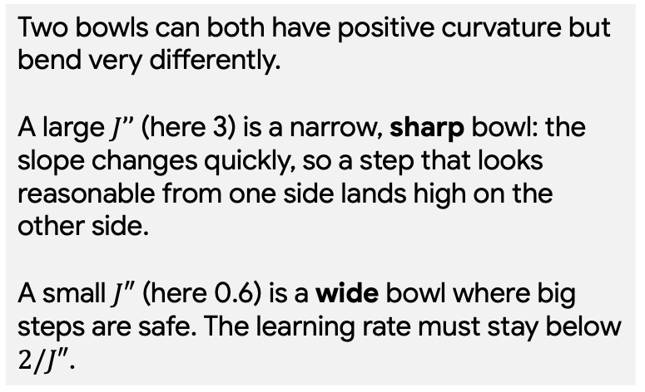
Curvature
Most of the trouble in optimization comes from curvature varying widely across directions.
Two bowls can both have positive curvature but bend very differently.
A large $J’’$ (here 3) is a narrow, sharp bowl: the slope changes quickly, so a step that looks reasonable from one side lands high on the other side.
A small $J″$ (here 0.6) is a wide bowl where big steps are safe. The learning rate must stay below $2/J″$.

Slide 11
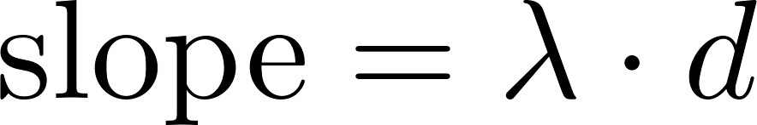
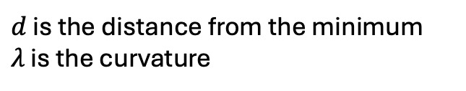
Curvature
$d$ is the distance from the minimum
$λ$ is the curvature
In a sharp direction, even a small distance produces a big slope.

Slide 12
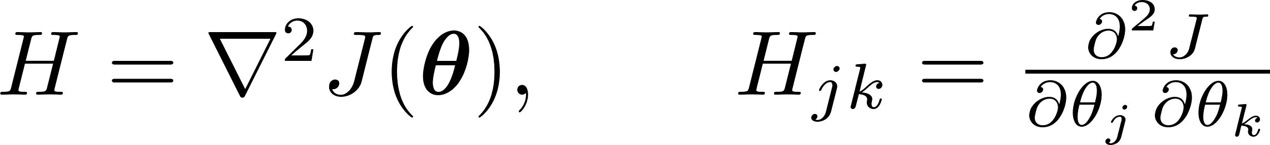
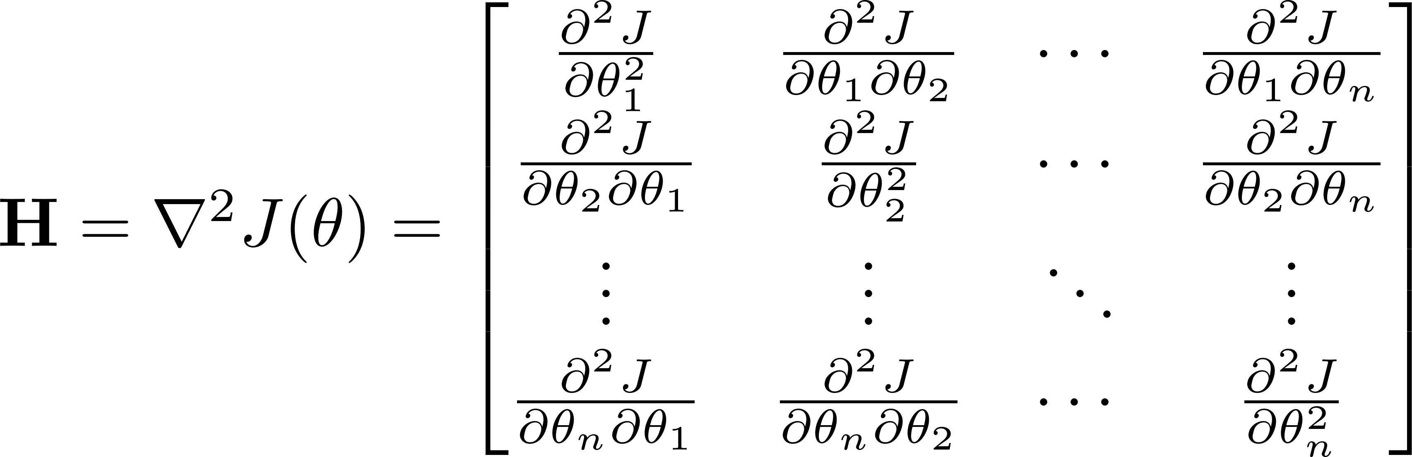
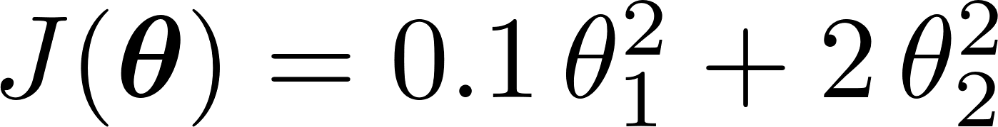
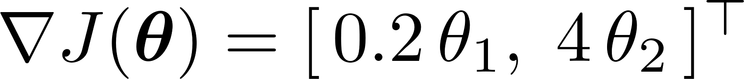
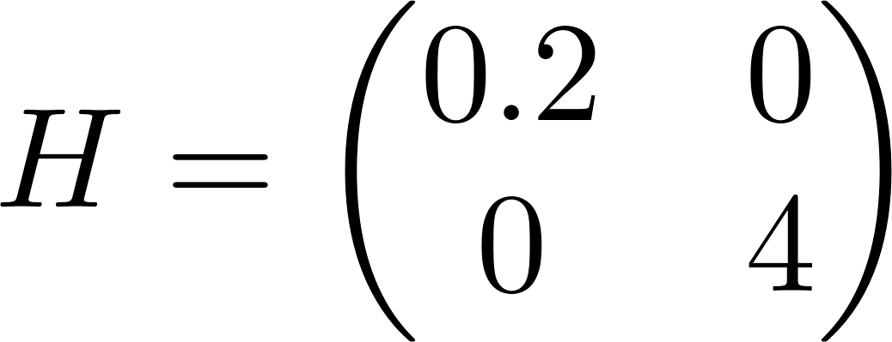
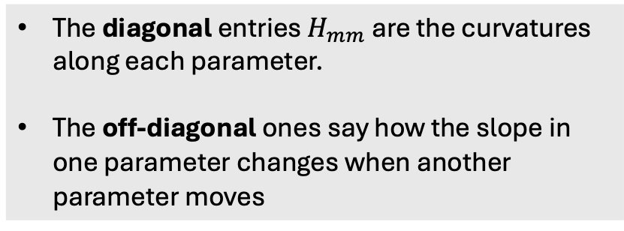
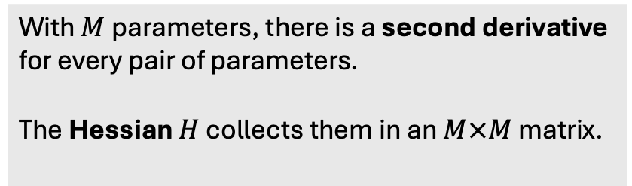
The Hessian: all the curvatures in one matrix
With $M$ parameters, there is a second derivative for every pair of parameters.
The Hessian $H$ collects them in an $M×M$ matrix.
The diagonal entries $H_{mm}$ are the curvatures along each parameter.
The off-diagonal ones say how the slope in one parameter changes when another parameter moves
For the ravine used in our example,

Slide 13
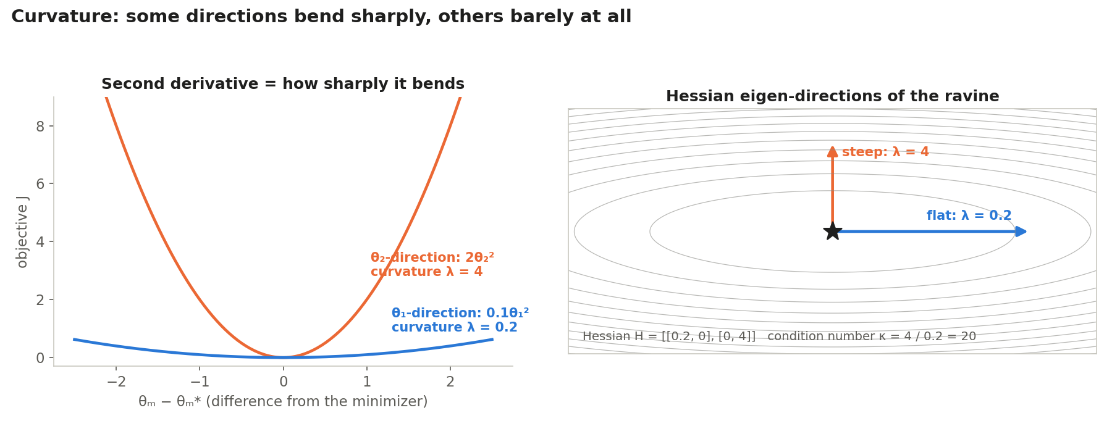
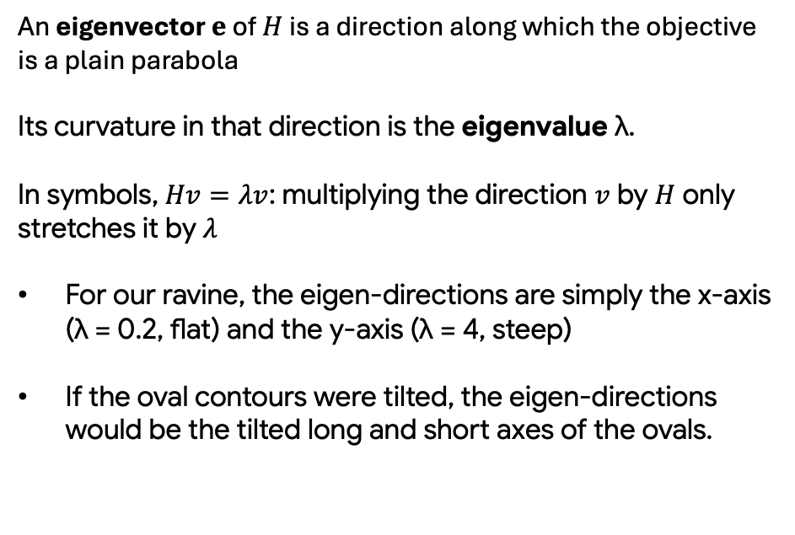
Eigenvector, eigenvalues and the condition number
An eigenvector $e$ of $H$ is a direction along which the objective is a plain parabola
Its curvature in that direction is the eigenvalue λ.
In symbols, $Hv=λv$: multiplying the direction $v$ by $H$ only stretches it by $λ$
For our ravine, the eigen-directions are simply the x-axis (λ = 0.2, flat) and the y-axis (λ = 4, steep)
If the oval contours were tilted, the eigen-directions would be the tilted long and short axes of the ovals.

Slide 14
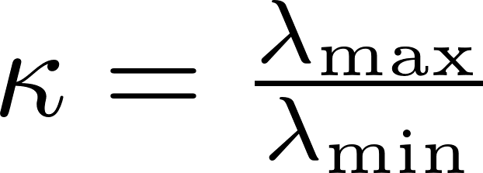
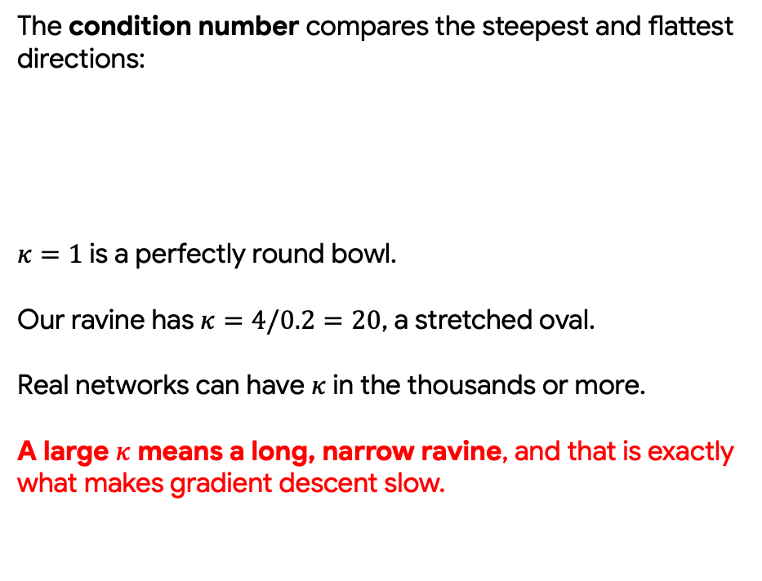
Eigenvector, eigenvalues and the condition number
The condition number compares the steepest and flattest directions:
$κ=1$ is a perfectly round bowl.
Our ravine has $κ=4/0.2=20$, a stretched oval.
Real networks can have $κ$ in the thousands or more.
A large $κ$ means a long, narrow ravine, and that is exactly what makes gradient descent slow.

Slide 15
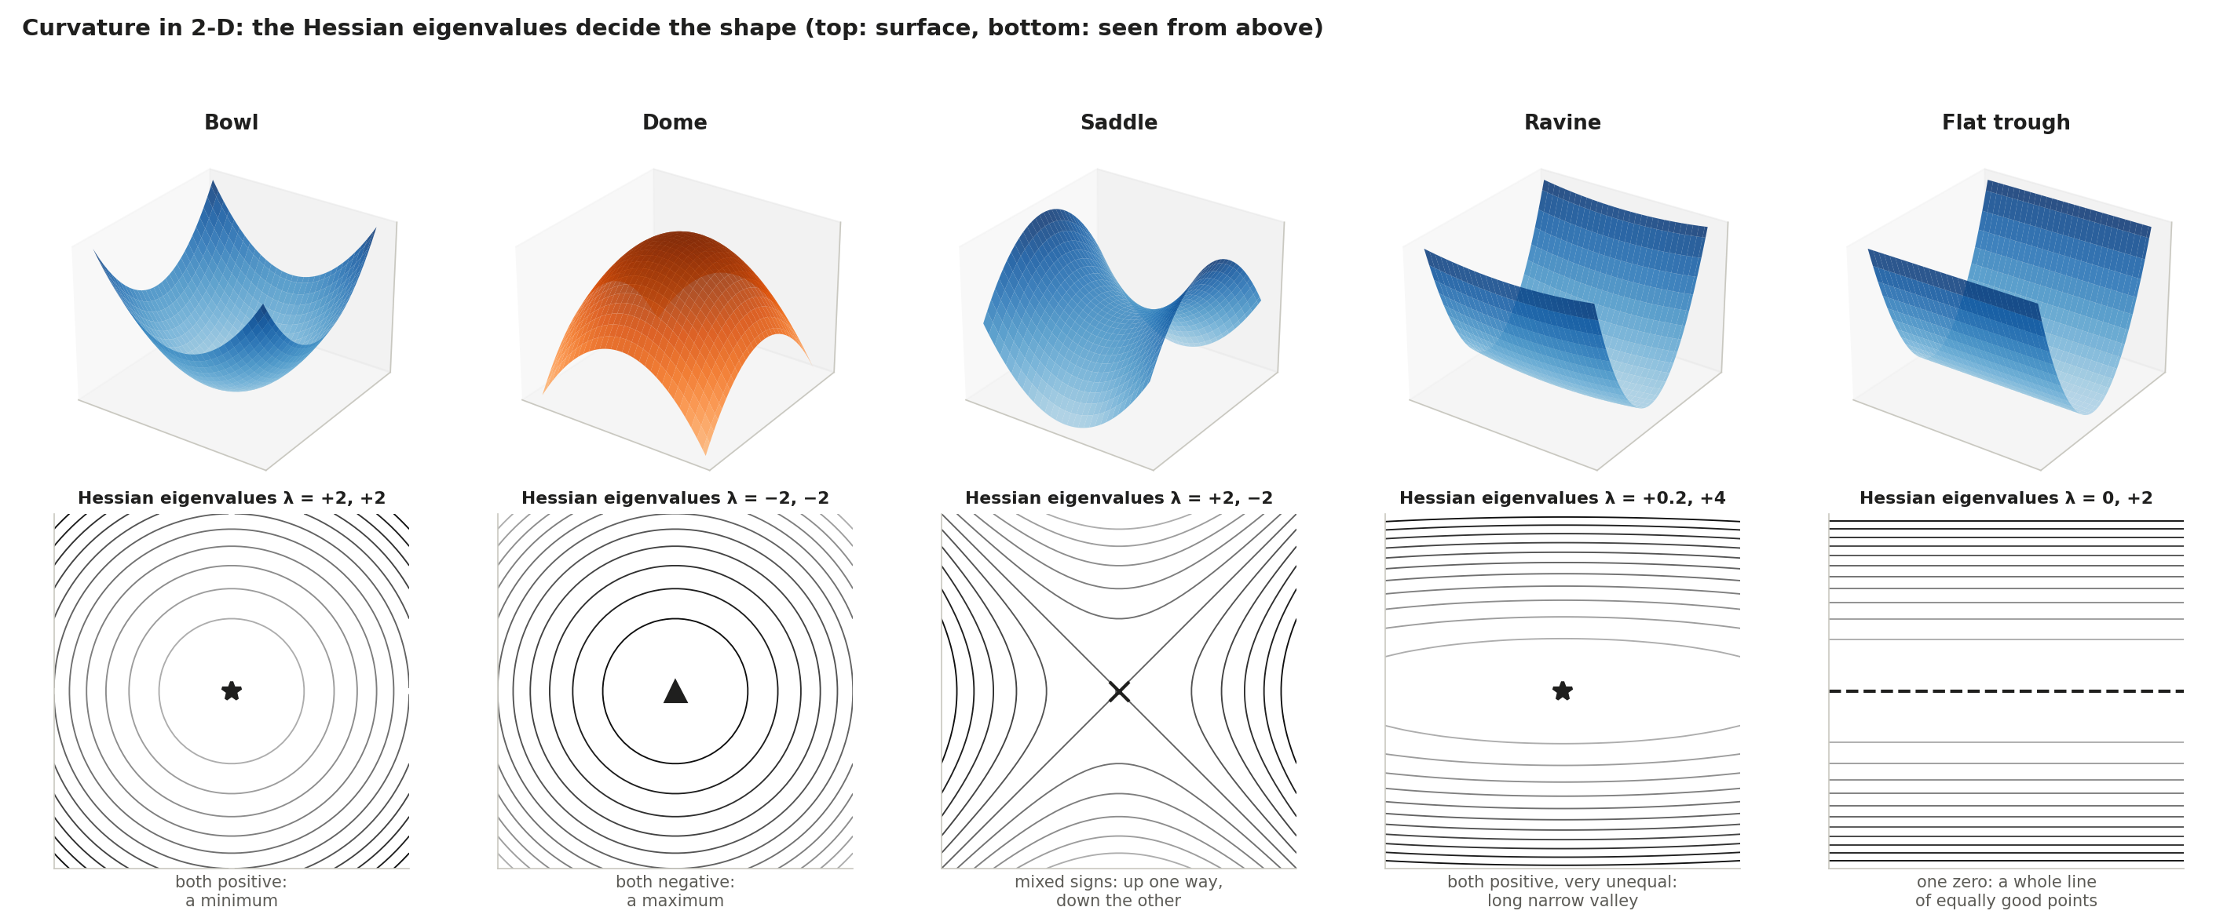
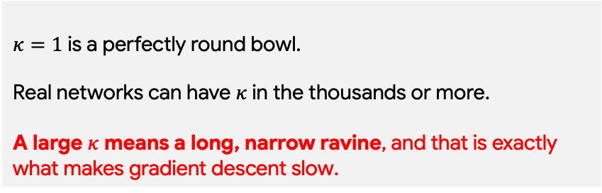
Eigenvector, eigenvalues and the condition number
$κ=1$ is a perfectly round bowl.
Real networks can have $κ$ in the thousands or more.
A large $κ$ means a long, narrow ravine, and that is exactly what makes gradient descent slow.
With two parameters, there are two eigenvalues, and their signs and sizes name the shape:
What gradient descent does
Heads straight in
Rolls away in every direction
Slows near the middle, then escapes downhill
Zig-zags across, crawls along
Drops to the floor, then feels no push along it
Notes:
Flat through has a whole line of minimizers

Slide 16
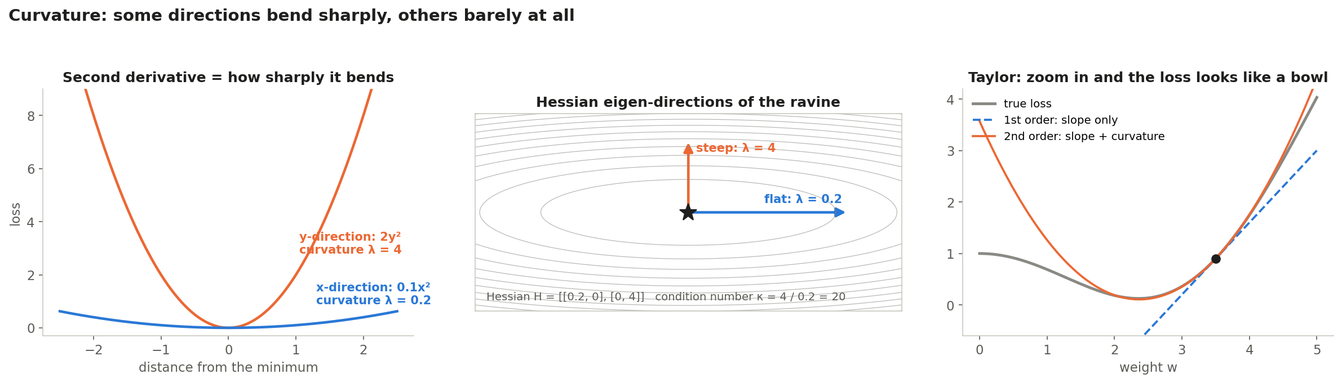
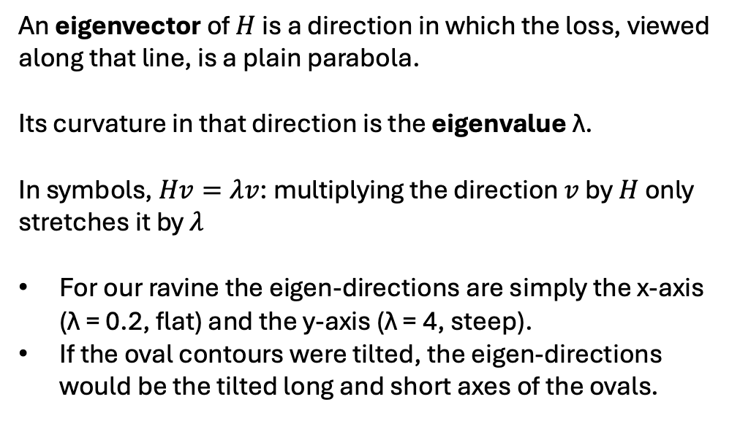
Eigenvector, eigenvalues
and the condition number
An eigenvector of $H$ is a direction in which the loss, viewed along that line, is a plain parabola.
Its curvature in that direction is the eigenvalue λ.
In symbols, $Hv=λv$: multiplying the direction $v$ by $H$ only stretches it by $λ$
For our ravine the eigen-directions are simply the x-axis (λ = 0.2, flat) and the y-axis (λ = 4, steep).
If the oval contours were tilted, the eigen-directions would be the tilted long and short axes of the ovals.

Slide 17
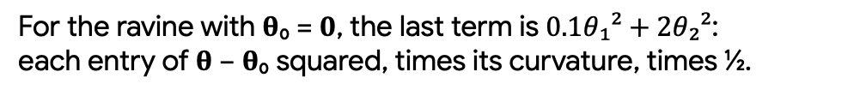
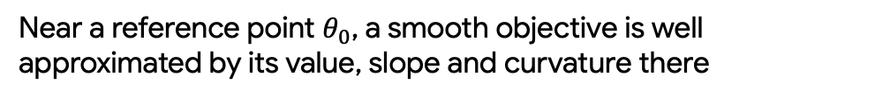
The Taylor approximation: up close, every loss looks like a bowl
Near a reference point $θ_{0}$, a smooth objective is well approximated by its value, slope and curvature there
With $M$ parameters and a small move $θ−θ_{0}$, the same idea reads
For the ravine with 𝛉₀ = 𝟎, the last term is $0.1θ₁²+2θ₂²$:
each entry of 𝛉 − 𝛉₀ squared, times its curvature, times ½.
The straight line (slope only) is good just next to the point; the parabola (slope + curvature) hugs the true objective much longer.
Near a minimum, every smooth loss looks like a bowl. So watching optimizers on simple bowls, as we do below, tells us how they behave close to a real minimum.

Slide 18
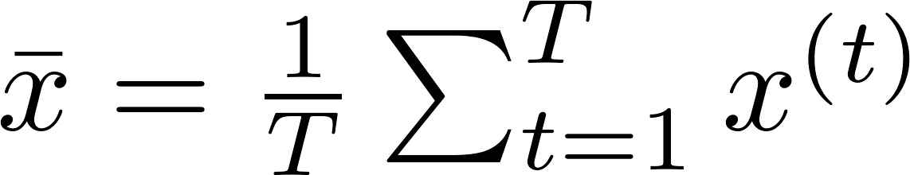
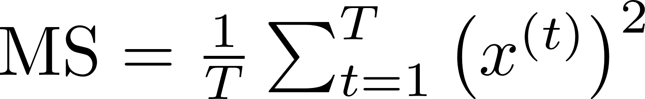
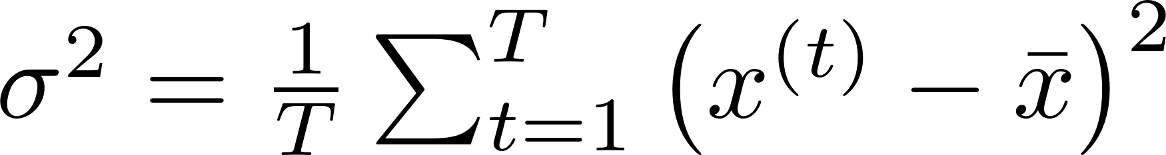

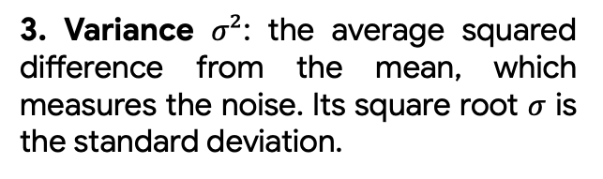
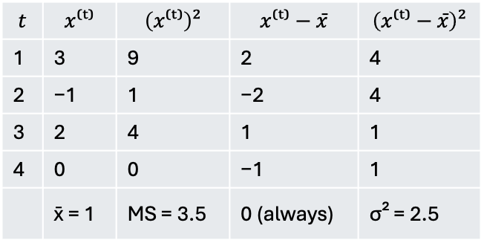
Mean, variance and root mean square
1. Mean: the typical direction.
$$t$$ | $$x⁽ᵗ⁾$$ | $$\left(x⁽ᵗ⁾\right)²$$ | $$x⁽ᵗ⁾−x̄$$ | $$\left(x⁽ᵗ⁾−x̄\right)²$$
1 | 3 | 9 | 2 | 4
2 | −1 | 1 | −2 | 4
3 | 2 | 4 | 1 | 1
4 | 0 | 0 | −1 | 1
 | x̄ = 1 | MS = 3.5 | 0 (always) | σ² = 2.5
2. Mean square (MS): square first, then average. It measures size and ignores sign.
3. Variance $σ²$: the average squared difference from the mean, which measures the noise. Its square root $σ$ is the standard deviation.
So $RMS=√3.5≈1.87$and $σ=√2.5≈1.58$
4. Root mean square (RMS): the typical size, in the same units as x.

Slide 19
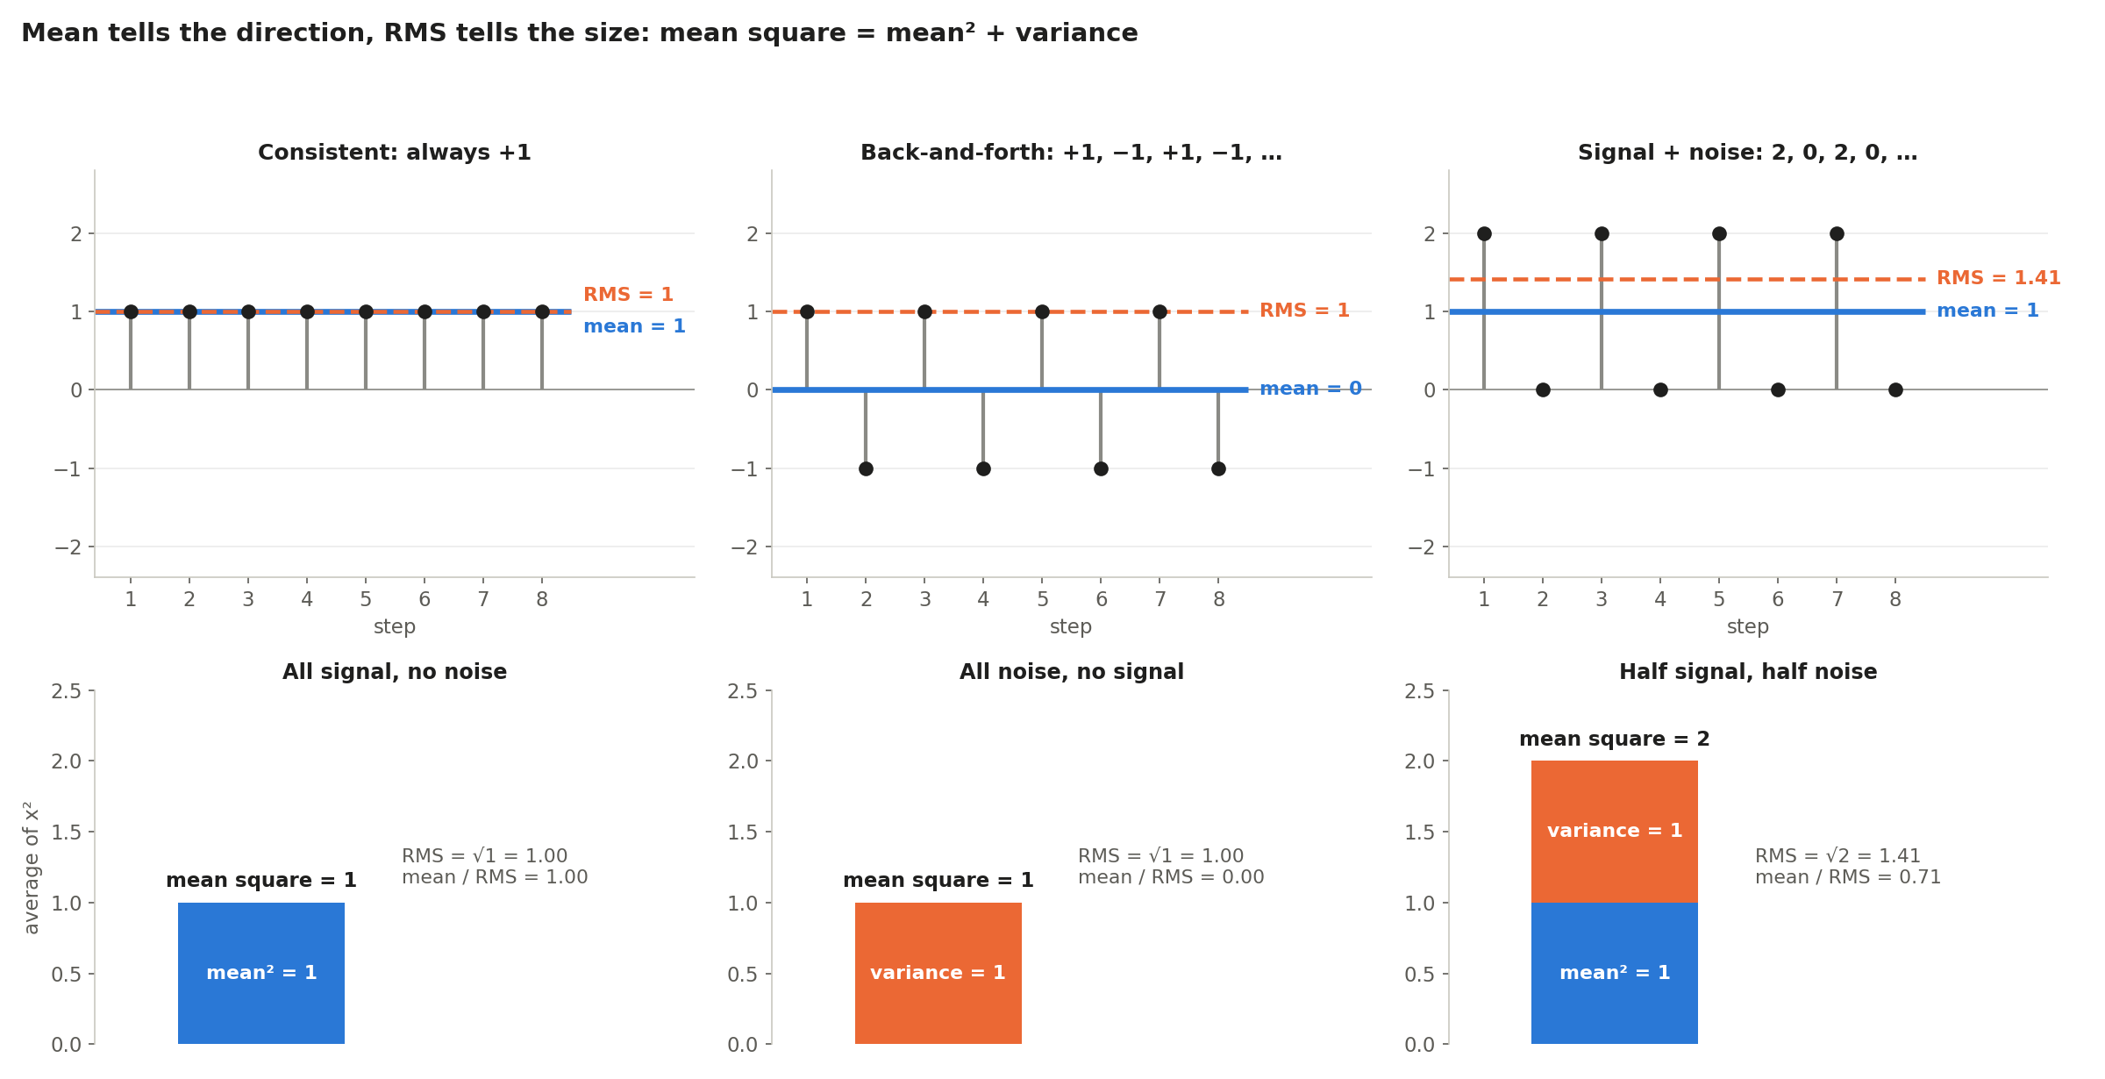
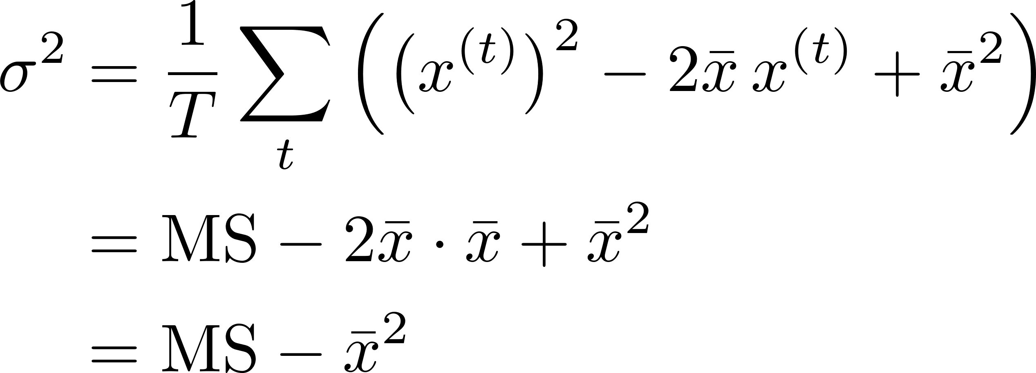
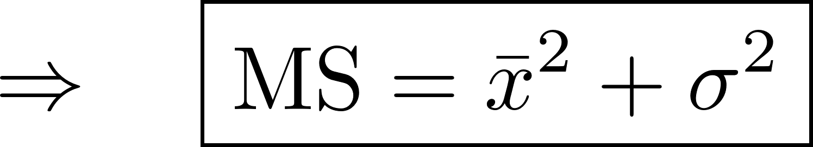
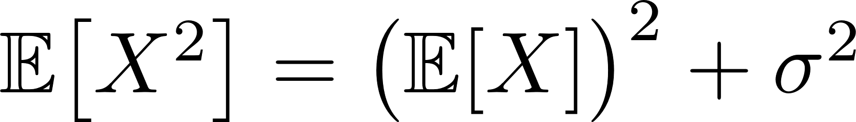
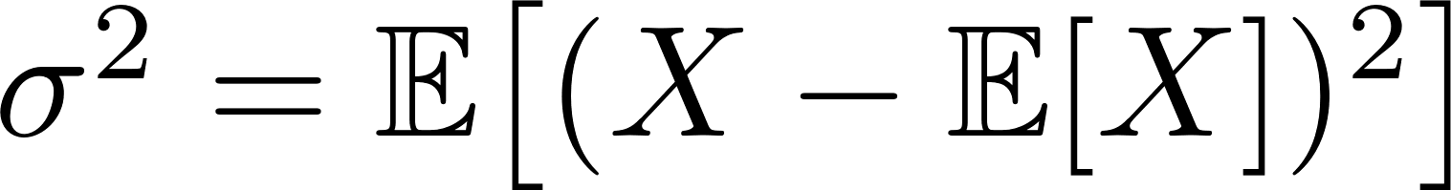
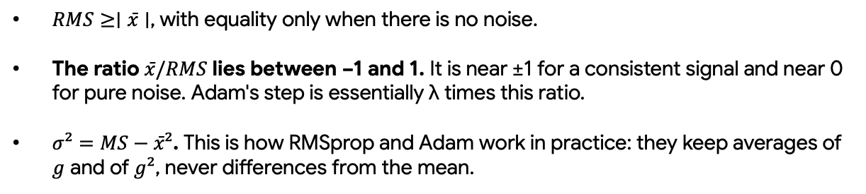
averages and noise
mean square = mean² + variance
$RMS≥∣x̄∣$, with equality only when there is no noise.
The ratio $x̄/RMS$ lies between −1 and 1. It is near ±1 for a consistent signal and near 0 for pure noise. Adam's step is essentially λ times this ratio.
$σ²=MS−x̄²$. This is how RMSprop and Adam work in practice: they keep averages of $g$ and of $g²$, never differences from the mean.

Slide 20
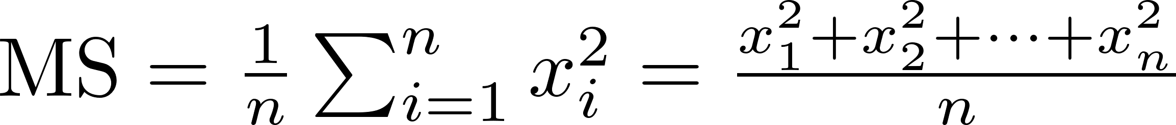

averages and noise

Slide 21
Exponential Moving
Average (EMA)
At every step, the optimizer receives a new, noisy gradient.
We do not want to store the whole history of gradients for every step
We want a running estimate of what the gradients have typically been lately, updated cheaply at each step
Notes:
A running average that and mixes in a fraction 1 − β of the new value, starting from s₀ = 0

Slide 22



Exponential Moving
Average (EMA)
start the average at $s₀=0$
At every step, the optimizer receives a new, noisy gradient.
We do not want to store the whole history of gradients for every step
We want a running estimate of what the gradients have typically been lately, updated cheaply at each step
keeps a fraction $β$ of the old average
mixes in a fraction $1−β$ of the new value
new average $=β×$ old average $+\left(1−β\right)×$ new value.
Notes:
A running average that and mixes in a fraction 1 − β of the new value, starting from s₀ = 0

Slide 23

Exponential Moving
Average (EMA)
start the average at $s₀=0$
At every step, the optimizer receives a new, noisy gradient.
We do not want to store the whole history of gradients for every step
We want a running estimate of what the gradients have typically been lately, updated cheaply at each step
keeps a fraction $β$ of the old average
mixes in a fraction $1−β$ of the new value
new average $=β×$ old average $+\left(1−β\right)×$ new value.
$β$ is a number between 0 and 1, indicating how much of the past to keep.
EMA effectively remembers about the last $1/\left(1−β\right)$ values:
$2$ steps for $β=0.5$
$10$ for $β=0.9$
$100$ for $β=0.99$
$1,000$ for $β=0.999$
Larger $β$ means smoother but slower to react
Notes:
A running average that and mixes in a fraction 1 − β of the new value, starting from s₀ = 0

Slide 24



Exponential Moving
Average (EMA)
start the average at $s₀=0$
At every step, the optimizer receives a new, noisy gradient.
We do not want to store the whole history of gradients for every step
We want a running estimate of what the gradients have typically been lately, updated cheaply at each step
keeps a fraction $β$ of the old average
mixes in a fraction $1−β$ of the new value
new average $=β×$ old average $+\left(1−β\right)×$ new value.
$β$ is a number between 0 and 1, indicating how much of the past to keep.
EMA effectively remembers about the last $1/\left(1−β\right)$ values:
2 steps for $β=0.5$
$10$ for $β=0.9$
100 for $β=0.99$
$1,000$ for $β=0.999$
Larger $β$ means smoother but slower to react
Rolling:
$$⋮$$
$β$ sets how far back it remembers. Because each older value counts $β$ times less, only the last $1/\left(1−β\right)$ or so values really matter
Notes:
A running average that and mixes in a fraction 1 − β of the new value, starting from s₀ = 0

Slide 25


Exponential Moving
Average (EMA)
new average $=β×$ old average $+\left(1−β\right)×$ new value
Step $t$ | New value $x$ | Calculation ($β=0.5$): $$0.5×s_{t−1}+0.5×x_{t}$$ | New average $s$
1 | 4 | $0.5×2+0.5×6$ | 2
2 | 6 | $0.5×4+0.5×5$ | 4
3 | 5 | $0.5×4.5+0.5×3$ | 4.5
4 | 3 | $0.5×3.75+0.5×7$ | 3.75
5 | 7 | $0.5×0+0.5×4$ | 5.375
6 | 5 | $0.5×0+0.5×4$ | 5.1875
Notes:
A running average that and mixes in a fraction 1 − β of the new value, starting from s₀ = 0

Slide 26


Exponential Moving
Average (EMA)
new average $=β×$ old average $+\left(1−β\right)×$ new value
Step $t$ | New value $x$ | Calculation ($β=0.5$): $$0.5×s_{t−1}+0.5×x_{t}$$ | New average $s$
1 | 4 | $0.5×2+0.5×6$ | 2
2 | 6 | $0.5×4+0.5×5$ | 4
3 | 5 | $0.5×4.5+0.5×3$ | 4.5
4 | 3 | $0.5×3.75+0.5×7$ | 3.75
5 | 7 | $0.5×0+0.5×4$ | 5.375
6 | 5 | $0.5×0+0.5×4$ | 5.1875
Notice that $s₃$'s shares do not add up to 1
$0.5+0.25+0.125=0.875$
Notes:
A running average that and mixes in a fraction 1 − β of the new value, starting from s₀ = 0

Slide 27

Exponential Moving
Average (EMA)
new average $=β×$ old average $+\left(1−β\right)×$ new value
Step $t$ | New value $x$ | Calculation ($β=0.5$): $$0.5×s_{t−1}+0.5×x_{t}$$ | New average $s$
1 | 4 | $0.5×2+0.5×6$ | 2
2 | 6 | $0.5×4+0.5×5$ | 4
3 | 5 | $0.5×4.5+0.5×3$ | 4.5
4 | 3 | $0.5×3.75+0.5×7$ | 3.75
5 | 7 | $0.5×0+0.5×4$ | 5.375
6 | 5 | $0.5×0+0.5×4$ | 5.1875
Notice that $s₃$'s shares do not add up to 1
$0.5+0.25+0.125=0.875$
Notes:
A running average that and mixes in a fraction 1 − β of the new value, starting from s₀ = 0

Slide 28
Exponential Moving
Average (EMA)
new average $=β×$ old average $+\left(1−β\right)×$ new value
Step $t$ | New value $x$ | Calculation ($β=0.5$): $$0.5×s_{t−1}+0.5×x_{t}$$ | New average $s$
1 | 4 | $0.5×2+0.5×6$ | 2
2 | 6 | $0.5×4+0.5×5$ | 4
3 | 5 | $0.5×4.5+0.5×3$ | 4.5
4 | 3 | $0.5×3.75+0.5×7$ | 3.75
5 | 7 | $0.5×0+0.5×4$ | 5.375
6 | 5 | $0.5×0+0.5×4$ | 5.1875
Notes:
A running average that and mixes in a fraction 1 − β of the new value, starting from s₀ = 0

Slide 29


Exponential Moving
Average (EMA)
$β$ sets the memory
Small β (quick to react): the average forgets the old level fast, so it follows the jump within a few steps.
Large β (slow to react): the old values keep most of the weight, so the average lags behind the change for a long time.
Notes:
A running average that and mixes in a fraction 1 − β of the new value, starting from s₀ = 0

Slide 30



Exponential Moving
Average (EMA)
Bias with the zero start
Because the shares add up to only $1−βᵗ$, an EMA that starts at 0 is too small at first.
If every value equals $x$, the average after $t$ steps is exactly $\left(1−βᵗ\right)·x$.
The fix is to divide that factor out:
Fixing the start matters a lot (for Adam):
with $β=0.9$ the plain EMA needs about 20 steps to catch up
with $β=0.999$ it would need thousands.
$$ŝ₁=2/\left(1−0.5\right)=4$$
$$ŝ₃=4.5/0.875≈5.14$$
After many steps, $βᵗ$ is almost $0$ and the correction stops mattering
Notes:
A running average that and mixes in a fraction 1 − β of the new value, starting from s₀ = 0

Slide 32





Gradient Descent
new weights
$$=$$
old
weights
learning
rate
$$−$$
$$×$$
gradient
Each parameter moves against its own slope, by an amount proportional to how steep that slope

Slide 33





Gradient Descent
Each step multiplies $θ$ by the same factor, 0.4.
Near a minimizer with curvature λ, the slope is
$$J′\left(θ\right)=λ\left(θ−θ∗\right)$$
So subtracting θ* from both sides of the update gives:
Let $J\left(θ\right)=θ²$
Step | $$θ⁽ᵗ⁾$$ | Slope $$J′\left(θ⁽ᵗ⁾\right)=2θ⁽ᵗ⁾$$ | Update $$θ⁽ᵗ⁺¹⁾=θ⁽ᵗ⁾−0.3·J′\left(θ⁽ᵗ⁾\right)$$
0 | −4.00 | −8.00 | −4 + 2.4 = −1.60
1 | −1.60 | −3.20 | −1.6 + 0.96 = −0.64
2 | −0.64 | −1.28 | −0.64 + 0.384 = −0.256
How big the learning rate can be depends on this
The safe range is
Notes:
With many weights there is one such limit per direction, and the steepest direction (the largest λ) sets the limit for everyone: η < 2/λ_max. Keep that in mind; it is the root of the problems

Slide 34


Gradient Descent
Each step multiplies $θ$ by the same factor, 0.4.
Near a minimizer with curvature λ, the slope is
$$J′\left(θ\right)=λ\left(θ−θ∗\right)$$
So subtracting θ* from both sides of the update gives:
$$ηλ$$ | Factor | What happens
0.1 | 0.9 | Shrinks 10% per step: slow but steady
0.6 | 0.4 | Shrinks fast: a good choice
1 | 0 | Lands exactly on the minimum in one step
1.9 | −0.9 | Sign flips every step: bounces across the valley, slowly settling
above 2 | below −1 | Each bounce is bigger than the last: diverges
How big the learning rate can be depends on this
The safe range is
Notes:
With many weights there is one such limit per direction, and the steepest direction (the largest λ) sets the limit for everyone: η < 2/λ_max. Keep that in mind; it is the root of the problems

Slide 35


Gradient Descent
Let $J\left(θ\right)=θ²$
How big the learning rate can be depends on this
Step | $$θ⁽ᵗ⁾$$ | Slope $$J′\left(θ⁽ᵗ⁾\right)=2θ⁽ᵗ⁾$$ | Update $$θ⁽ᵗ⁺¹⁾=θ⁽ᵗ⁾−0.3·J′\left(θ⁽ᵗ⁾\right)$$
0 | −4.00 | −8.00 | −4 + 2.4 = −1.60
1 | −1.60 | −3.20 | −1.6 + 0.96 = −0.64
2 | −0.64 | −1.28 | −0.64 + 0.384 = −0.256
Notice that each step multiplies $w$ by the same factor $0.$
On a bowl with curvature $λ$ the slope is $λ·w$
the safe range is
Notes:
With many weights there is one such limit per direction, and the steepest direction (the largest λ) sets the limit for everyone: η < 2/λ_max. Keep that in mind; it is the root of the problems

Slide 36



Stochastic Gradient Descent
Gradient Descent:
Calculating the slope with Gradient Descent requires every training example, which is expensive
The loss is an average over all $N$ training examples, each with its own loss $ℓᵢ$, so the gradient is an average too
Stochastic Gradient Descent:
SGD picks a random minibatch $B$ of $b$ examples and averages only those
MNIST has N = 60,000 training images. Full-batch gradient descent makes 1 update per pass over the data; SGD with b = 128 makes about 470, each one 470 times cheaper
Notes:
Why it still works. Because the minibatch is random, g_t is right on average: E[g_t] = ∇L (Part 3: the expected value is the long-run average). Each step has some noise, but the noise points in random directions and largely cancels over many steps. Averaging b examples shrinks the noise's standard deviation by a factor of √b.
Near the minimum the true gradient becomes tiny, but the noise does not, so SGD keeps jittering around the bottom . That is why learning rates are usually lowered later in training. From here on, "the gradient g" means this minibatch estimate.

Slide 37

Problems with SGD
The direction problem. Real loss landscapes often look like long, narrow ravines: steep walls on the sides, a gentle slope along the floor. The steepest direction points mostly across the ravine, not along it. So SGD bounces from wall to wall, zig-zagging, while making slow progress along the floor.
The step-size problem. SGD uses one learning rate for every weight. Some weights sit in steep directions and need tiny steps, others in flat directions and need big ones. Any single learning rate is too big for some and too small for others.
Real loss landscapes are often shaped like long, narrow ravines.

Slide 38



The Overall Picture
Every method is a choice of
$m$ (what direction to move) and
$v$ (how to rescale each coordinate)

Slide 39
The Overall Picture
Every method is a choice of
$m$ (what direction to move) and
$v$ (how to rescale each coordinate)
SGD: m = g, v = 1
Momentum: m = EMA-style sum of past gradients, v = 1.
Nesterov evaluates the gradient at a look-ahead point)
Adagrad: m = g, v = sum of squared gradients.
RMSprop: m = g, v = EMA of squared gradients.
Adam: m = EMA of gradients, v = EMA of squared gradients, both bias-corrected.

Slide 40

Momentum
Let us replace the hiker with a ball
A ball doesn't change direction at every bump; it carries speed from before.
Pushes that keep coming from the same side build up speed, and
pushes that alternate left and right cancel out.

Slide 41




Momentum
Keep a velocity $m$ (one number per parameter, starting at 0)
At each step:
keep a fraction$γ$ of the old velocity

Slide 42

Momentum
Keep a velocity $m$ (one number per parameter, starting at 0)
At each step:
keep a fraction$γ$ of the old velocity
add the new gradient, and

Slide 43

Momentum
Keep a velocity $m$ (one number per weight, starting at 0)
At each step:
keep a fraction$γ$ of the old velocity
add the new gradient, and
move along the velocity

Slide 44

Momentum
Keep a velocity $m$ (one number per weight, starting at 0)
At each step:
keep a fraction$γ$ of the old velocity
add the new gradient, and
move along the velocity
$γ=0$ is plain SGD
$γ$ close to 1 means very little friction
$γ$ is set to 0.9

Slide 45
Momentum
Keep a velocity $m$ (one number per weight, starting at 0)
At each step:
keep a fraction$γ$ of the old velocity
add the new gradient, and
move along the velocity
$γ=0$ is plain SGD
$γ$ close to 1 means very little friction
$γ$ is set to 0.9
The velocity It is a sum of all past gradients, with older ones counting less

Slide 46



Momentum
The velocity It is a sum of all past gradients, older ones counting less
Case 1: the gradient keeps pointing the same way (along the ravine floor). Take $g=1$ every step and $γ=0.9$:
Step | 1 | 2 | 3 | 4 | … | long run
b | 1 | 1.9 | 2.71 | 3.44 | … | 10
Consistent directions get amplified
Case 2: the gradient flips sign every step (bouncing between the walls). Take g$=+1,−1,+1,…:$ $b=1,−0.1,0.91,−0.18,…$
The signs alternate inside the sum, so it settles at a size of only
Back-and-forth directions get damped

Slide 47


Momentum
New problem: overshoot
A heavy ball builds up speed and rolls past the bottom before friction stops it. With large $γ$ it can circle the minimizer for a long time

Slide 48

Momentum
New problem: overshoot
A heavy ball builds up speed and rolls past the bottom before friction stops it. With large $γ$ it can circle the minimizer for a long time
Solution: Nesterov

Slide 49

Nesterov
Momentum vs Nesterov
Every momentum step is really two moves:
a momentum step along the accumulated velocity
the gradient corrects it.
Classical momentum computes that correction from the gradient at the current parameters (where it started).
Nesterov computes it at the look-ahead point, where the momentum step lands.
That is the only difference

Slide 50

Nesterov
Momentum vs Nesterov
Every momentum step is really two moves:
a momentum step along the accumulated velocity
the gradient corrects it.
Classical momentum computes that correction from the gradient at the current parameters (where it started).
Nesterov computes it at the look-ahead point, where the momentum step lands.
That is the only difference
1. Look ahead: to where the momentum step would land
look-ahead point
step size
momentum coefficient
velocity

Slide 51


Nesterov
Momentum vs Nesterov
Every momentum step is really two moves:
a momentum step along the accumulated velocity
the gradient corrects it.
Classical momentum computes that correction from the gradient at the current parameters (where it started).
Nesterov computes it at the look-ahead point, where the momentum step lands.
That is the only difference
1. Look ahead: to where the momentum step would land
2. Measure the gradient there (one gradient computation, at $\overset{˜}{θ}$ instead of $θ_{t}$)
Gradient at the look-ahead point

Slide 52


Nesterov
Momentum vs Nesterov
Every momentum step is really two moves:
a momentum step along the accumulated velocity
the gradient corrects it.
Classical momentum computes that correction from the gradient at the current parameters (where it started).
Nesterov computes it at the look-ahead point, where the momentum step lands.
That is the only difference
1. Look ahead: to where the momentum step would land
2. Measure the gradient there (one gradient computation, at $\overset{˜}{θ}$ instead of $θ_{t}$)
3. Update the velocity: keep $γ$ of the old velocity and add the look-ahead slope

Slide 53
Nesterov
Momentum vs Nesterov
Every momentum step is really two moves:
a momentum step along the accumulated velocity
the gradient corrects it.
Classical momentum computes that correction from the gradient at the current parameters (where it started).
Nesterov computes it at the look-ahead point, where the momentum step lands.
That is the only difference
1. Look ahead: to where the momentum step would land
2. Measure the gradient there (one gradient computation, at $\overset{˜}{θ}$ instead of $θ_{t}$)
3. Update the velocity: keep $γ$ of the old velocity and add the look-ahead slope
4. Update the parameters: move along the new velocity

Slide 54

Nesterov
Momentum vs Nesterov
Every momentum step is really two moves:
a momentum step along the accumulated velocity
the gradient corrects it.
Substitute step 3 into step 4 and the update splits into the two moves:
1. Look ahead: to where the momentum step would land
2. Measure the gradient there (one gradient computation, at $\overset{˜}{θ}$ instead of $θ_{t}$)
3. Update the velocity: keep $γ$ of the old velocity and add the look-ahead slope
4. Update the parameters: move along the new velocity
Notes:
So Nesterov = a momentum step to the look-ahead point, then an ordinary gradient step from there.
Momentum makes the same momentum step but corrects with ∇J(𝛉⁽ᵗ⁾), the gradient back at the starting point, which may be out of date by the time the parameters have moved.

Slide 55





Nesterov
$$J\left(θ\right)=½θ²$$
$$η=1$$
$γ=0.9$
$$θ⁽ᵗ⁾=0.5$$
$$m⁽ᵗ⁻¹⁾=0.9$$
$$J′\left(θ\right)=θ$$
$$θ^{∗}=0$$

Slide 56


Nesterov
With $γ=0.9$ and the same learning rate, momentum swings past the minimum and circles it, while Nesterov settles smoothly
Why it brakes where it should?
Near a minimizer with curvature λ, the look-ahead gradient is
In flat directions (small $λ$) the braking term is tiny and Nesterov keeps its speed.
In steep directions (large $λ$) it cancels much of the momentum step.
Each direction effectively gets a momentum coefficient of $γ\left(1−ηλ\right)$

Slide 57
Nesterov
With $γ=0.9$ and the same learning rate, momentum swings past the minimum and circles it, while Nesterov settles smoothly
Why it brakes where it should?
Near a minimizer with curvature λ, the look-ahead gradient is
Both momentum methods use one step size for every parameter.
In flat directions (small $λ$) the braking term is tiny and Nesterov keeps its speed.
In steep directions (large $λ$) it cancels much of the momentum step.
Each direction effectively gets a momentum coefficient of $γ\left(1−ηλ\right)$

Slide 58


Adagrad
In the ravine, one step size $η$ has to serve two very different directions:
the steep one (large curvature λ) needs small steps,
the flat one (small λ) needs big steps
Momentum only softens this.
Adagrad gives each parameter $θ_{m}$ its own step size, set by how large its gradients have been so far(based on its own history).
a parameter whose gradients have been large (a steep direction) gets smaller steps
a parameter whose gradients have been small gets bigger step.
Notes:
SGD moves y eight times further than x, which is the zig-zag. Adagrad divides each slope by its own size, so both weights move by the same amount and the path heads much more directly toward the minimum.

Slide 59



Adagrad
For every parameter, keep a running sum of squared gradients $\left(s⁽⁰⁾=0\right)$:
𝐠⁽ᵗ⁾ is the minibatch gradient at iteration t
Element-wise product results with squaring the gradient, entry by entry, where the sign is dropped and only the size is kept.
Notes:
SGD moves y eight times further than x, which is the zig-zag. Adagrad divides each slope by its own size, so both weights move by the same amount and the path heads much more directly toward the minimum.

Slide 60



Adagrad
For every parameter, keep a running sum of squared gradients $\left(s⁽⁰⁾=0\right)$:
The small constant $ε$ (e.g. 10⁻¹⁰) only prevents division by zero
Then divide each entry of the gradient by the square root of its sum:
global step size
$\sqrt{s_{m}^{\left(t\right)}}$ measures how large the gradients of $θ_{m}$have been so far.
Notes:
SGD moves y eight times further than x, which is the zig-zag. Adagrad divides each slope by its own size, so both weights move by the same amount and the path heads much more directly toward the minimum.

Slide 61



Adagrad
For every parameter, keep a running sum of squared gradients $\left(s⁽⁰⁾=0\right)$:
Then divide each entry of the gradient by the square root of its sum:
For one parameter the division becomes a step size of its own. Parameter $θ_{m}$ has its own effective step size
$$\frac{η}{\sqrt{s_{m}^{\left(t\right)}}+ ε}$$
Notes:
SGD moves y eight times further than x, which is the zig-zag. Adagrad divides each slope by its own size, so both weights move by the same amount and the path heads much more directly toward the minimum.

Slide 62


Adagrad
For one parameter the division becomes a step size of its own. Parameter $θ_{m}$ has its own
effective step size
$$η/\left(√sₘ⁽ᵗ⁾+ε\right)$$
For every parameter, keep a running sum of squared gradients $\left(s⁽⁰⁾=0\right)$:
Then divide each entry of the gradient by the square root of its sum:
The square root and the division act entry by entry.
The second factor is the strength. The gradient is divided by its own typical size, so its scale cancels: a parameter with gradients around 0.1 and one with gradients around 100 take steps of the same size.
The first factor is the weakness. Because Adagrad sums instead of averaging, an extra 1/√t appears, and the step keeps shrinking whether or not training is finished.
Notes:
SGD moves y eight times further than x, which is the zig-zag. Adagrad divides each slope by its own size, so both weights move by the same amount and the path heads much more directly toward the minimum.

Slide 63






Adagrad
Example with two parameters (Ignore $ε$)
$θ₁$sits in a flat direction and always sees gradient 0.1
$θ₂$ sits in a steep direction and always sees gradient 2.
Step t | $$s₁⁽ᵗ⁾$$ | Step taken by $θ₁$ | $$s₂⁽ᵗ⁾$$ | Step taken by $θ₂$
1 | 0.01 | η · 0.1 / 0.1 = 1.00η | 4 | η · 2 / 2 = 1.00η
2 | 0.02 | η · 0.1 / 0.141 = 0.71η | 8 | η · 2 / 2.83 = 0.71η
3 | 0.03 | 0.58η | 12 | 0.58η
4 | 0.04 | 0.50η | 16 | 0.50η
Big and small gradients get the same step.
Adagrad divides each gradient by its own past size, so both parameters move the same amount, $η/√t$. The flat direction is no longer neglected, and the steep one no longer overshoots.
Three consequences of dividing by $\sqrt{s_{m}}$:
The gradient's size cancels. Plain gradient descent would move $θ₂$ twenty times farther than $θ₁$. Adagrad moves them the same amount, so the flat direction is no longer neglected.
The step keeps shrinking. With a constant gradient $g$, $s⁽ᵗ⁾=tg²$, so the step is
After 100 steps it is $0.1η$; after 10,000 steps, $0.01η$.
Gradient scale doesn't matter. Multiply every gradient of a weight by 1,000: G grows by 1,000,000, $√G$ by 1,000, and the step is unchanged. Weights with naturally tiny or huge gradients are put on the same footing.
Notes:
Scale doesn't matter. Multiply every gradient of a weight by 1,000: G grows by 1,000,000, $√G$ by 1,000, and the step is unchanged. Weights with naturally tiny or huge gradients are put on the same footing.
Rare features learn fast. If a weight gets a gradient of typical size $σ$ in only $n$ of the steps, then $√G≈σ√n$, and each update moves it by about $η/√n$.
In NLP, a word seen 10,000 times moves $η/100$ per occurrence; a word seen 100 times moves $η/10$, ten times more. That is why Adagrad suited word embeddings in NLP.

Slide 64

RMSProp
Adagrad divides each slope by a running total that keeps growing and never forgets.
RMSprop divides by the size of recent gradients only, using an exponential moving average, so each parameter's step size can go down and back up and never wears out.
The step size then reflects how big the gradients have been recently.

Slide 65

RMSProp
Start with 𝐯⁽⁰⁾ = 𝟎. At every iteration t = 1, 2, …:
1. Square the gradient, entry by entry. 𝐠⁽ᵗ⁾ ⊙ 𝐠⁽ᵗ⁾ has entries (gₘ⁽ᵗ⁾)². Squaring drops the sign and keeps the size.
Adagrad divides each slope by a running total that keeps growing and never forgets.
RMSprop divides by the size of recent gradients only, using an exponential moving average, so each parameter's step size can go down and back up and never wears out.
The step size then reflects how big the gradients have been recently.
2. Update the moving average of the squares:
decay rate: the fraction of the old average kept each step.
For $β=0.9$, $v$ keeps 90% of what it knew and adds 10% of the newest squared slope
EMA of squared gradients; vₘ⁽ᵗ⁾ estimates the mean square 𝔼[gₘ²], starts at 0

Slide 66

RMSProp
Start with 𝐯⁽⁰⁾ = 𝟎. At every iteration t = 1, 2, …:
1. Square the gradient, entry by entry. 𝐠⁽ᵗ⁾ ⊙ 𝐠⁽ᵗ⁾ has entries (gₘ⁽ᵗ⁾)². Squaring drops the sign and keeps the size.
Adagrad divides each slope by a running total that keeps growing and never forgets.
RMSprop divides by the size of recent gradients only, using an exponential moving average, so each parameter's step size can go down and back up and never wears out.
The step size then reflects how big the gradients have been recently.
2. Update the moving average of the squares:
3. Take the square root. √vₘ⁽ᵗ⁾ is the root mean square (RMS) of the recent gradients of $θ_{m}$: their typical size, in the same units as the gradient.

Slide 67


RMSProp
Start with 𝐯⁽⁰⁾ = 𝟎. At every iteration t = 1, 2, …:
1. Square the gradient, entry by entry. 𝐠⁽ᵗ⁾ ⊙ 𝐠⁽ᵗ⁾ has entries (gₘ⁽ᵗ⁾)². Squaring drops the sign and keeps the size.
Adagrad divides each slope by a running total that keeps growing and never forgets.
RMSprop divides by the size of recent gradients only, using an exponential moving average, so each parameter's step size can go down and back up and never wears out.
The step size then reflects how big the gradients have been recently.
2. Update the moving average of the squares:
3. Take the square root. √vₘ⁽ᵗ⁾ is the root mean square (RMS) of the recent gradients of $θ_{m}$: their typical size, in the same units as the gradient.
4. Divide and step:
RMS of the recent gradients of $θ_{m}$

Slide 68

RMSProp
Start with 𝐯⁽⁰⁾ = 𝟎. At every iteration t = 1, 2, …:
1. Square the gradient, entry by entry. 𝐠⁽ᵗ⁾ ⊙ 𝐠⁽ᵗ⁾ has entries (gₘ⁽ᵗ⁾)². Squaring drops the sign and keeps the size.
Adagrad divides each slope by a running total that keeps growing and never forgets.
RMSprop divides by the size of recent gradients only, using an exponential moving average, so each parameter's step size can go down and back up and never wears out.
The step size then reflects how big the gradients have been recently.
2. Update the moving average of the squares:
3. Take the square root. √vₘ⁽ᵗ⁾ is the root mean square (RMS) of the recent gradients of $θ_{m}$: their typical size, in the same units as the gradient.
4. Divide and step:
Written for one parameter, the division becomes a step size of its own:

Slide 69




RMSProp
Adagrad vs RMSProp
$β=0.9$, one parameter, $ε$ ignored
Step | Slope | RMS props √v | RMS prop step | Adagrad step
1 | 1 | 0.32 | 3.16 | 1.00
3 | 1 | 0.52 | 1.92 | 0.58
20 | 1 | 0.94 | 1.07 | 0.22
300 | 1 | 1.00 | 1.00 | 0.06
301 | 0.1 | 0.95 | 0.105 | 0.006
310 | 0.1 | 0.60 | 0.17 | 0.006
330 | 0.1 | 0.23 | 0.44 | 0.006
350 | 0.1 | 0.12 | 0.81 | 0.006
360 | 0.1 | 0.11 | 0.92 | 0.006
$0.01+0.99×{0.9}^{300}$ $≈0.01$
$$0.1/√300≈0.006$$
Why the steps no longer die out?
The step no longer depends on the scale of the gradient. If the gradients of $θ_{m}$ are steady at some value g, then $vₘ→g²$and
Multiply the objective by 100: every gradient grows 100×, √v grows 100×, and the step does not change. Plain SGD's step would grow 100×.
While in Adagrad it is $\frac{η}{\sqrt{t}}$
(slope drops)
Notes:
Start, steps 1–20 (the spike). v starts at 0, so after the first step it holds only 10% of a squared slope: v = 0.1 and √v ≈ 0.32. Dividing by that too-small number makes the first step 3 times too big. It settles within about 20 steps. This “startup jolt” is what Adam’s bias correction fixes.
Steady, steps 20–300 (the flat green line). With the same slope every step, v settles at 1, so every step is exactly 1 × the learning rate. RMSprop does not get tired. Adagrad’s step keeps sinking over the same steps.
The drop, step 300 onward (the dip and recovery). Right after the slope falls to 0.1, v still remembers the old big slopes (√v ≈ 0.95), so the step briefly shrinks to about 0.1. But the old memory fades by 10% each step, so √v drops toward 0.1 and the step climbs back to about 1 within roughly 60 steps. Adagrad’s total still contains all 300 big slopes (√G ≈ 17), so its step falls to 0.006 and can never recover.

Slide 70
RMSProp
Adagrad vs RMSProp
$β=0.9$, one parameter, $ε$ ignored
Step | Slope | RMS props √v | RMS prop step | Adagrad step
1 | 1 | 0.32 | 3.16 | 1.00
3 | 1 | 0.52 | 1.92 | 0.58
20 | 1 | 0.94 | 1.07 | 0.22
300 | 1 | 1.00 | 1.00 | 0.06
301 | 0.1 | 0.95 | 0.105 | 0.006
310 | 0.1 | 0.60 | 0.17 | 0.006
330 | 0.1 | 0.23 | 0.44 | 0.006
350 | 0.1 | 0.12 | 0.81 | 0.006
360 | 0.1 | 0.11 | 0.92 | 0.006
$0.01+0.99×{0.9}^{300}$ $≈0.01$
$$0.1/√300≈0.006$$
(slope drops)
Notes:
Start, steps 1–20 (the spike). v starts at 0, so after the first step it holds only 10% of a squared slope: v = 0.1 and √v ≈ 0.32. Dividing by that too-small number makes the first step 3 times too big. It settles within about 20 steps. This “startup jolt” is what Adam’s bias correction fixes.
Steady, steps 20–300 (the flat green line). With the same slope every step, v settles at 1, so every step is exactly 1 × the learning rate. RMSprop does not get tired. Adagrad’s step keeps sinking over the same steps.
The drop, step 300 onward (the dip and recovery). Right after the slope falls to 0.1, v still remembers the old big slopes (√v ≈ 0.95), so the step briefly shrinks to about 0.1. But the old memory fades by 10% each step, so √v drops toward 0.1 and the step climbs back to about 1 within roughly 60 steps. Adagrad’s total still contains all 300 big slopes (√G ≈ 17), so its step falls to 0.006 and can never recover.

Slide 71
RMSProp
Adagrad vs RMSProp
$β=0.9$, one parameter, $ε$ ignored
Step | Slope | RMS props √v | RMS prop step | Adagrad step
1 | 1 | 0.32 | 3.16 | 1.00
3 | 1 | 0.52 | 1.92 | 0.58
20 | 1 | 0.94 | 1.07 | 0.22
300 | 1 | 1.00 | 1.00 | 0.06
301 | 0.1 | 0.95 | 0.105 | 0.006
310 | 0.1 | 0.60 | 0.17 | 0.006
330 | 0.1 | 0.23 | 0.44 | 0.006
350 | 0.1 | 0.12 | 0.81 | 0.006
360 | 0.1 | 0.11 | 0.92 | 0.006
$0.01+0.99×{0.9}^{300}$ $≈0.01$
$$0.1/√300≈0.006$$
(slope drops)
RMSprop has no momentum. Each step points along the current gradient only, so in a ravine it still zig-zags somewhat between the walls, and its first steps are inflated by the zero start.
Notes:
Start, steps 1–20 (the spike). v starts at 0, so after the first step it holds only 10% of a squared slope: v = 0.1 and √v ≈ 0.32. Dividing by that too-small number makes the first step 3 times too big. It settles within about 20 steps. This “startup jolt” is what Adam’s bias correction fixes.
Steady, steps 20–300 (the flat green line). With the same slope every step, v settles at 1, so every step is exactly 1 × the learning rate. RMSprop does not get tired. Adagrad’s step keeps sinking over the same steps.
The drop, step 300 onward (the dip and recovery). Right after the slope falls to 0.1, v still remembers the old big slopes (√v ≈ 0.95), so the step briefly shrinks to about 0.1. But the old memory fades by 10% each step, so √v drops toward 0.1 and the step climbs back to about 1 within roughly 60 steps. Adagrad’s total still contains all 300 big slopes (√G ≈ 17), so its step falls to 0.006 and can never recover.

Slide 72



Adadelta
Adadelta was invented at the same time as RMSprop and uses the same moving average of squared gradients.
It adds one more question: do the steps have the right units? Its answer removes the learning rate altogether

Slide 73
Adadelta
Adadelta was invented at the same time as RMSprop and uses the same moving average of squared gradients. It adds one more question: do the steps have the right units? Its answer removes the learning rate altogether

Slide 74
Adam
By now there are two good ideas:
momentum: average recent gradients for a steady direction
RMSprop : divide by the recent gradient size for a sensible step size per weight
Adam ("adaptive moment estimation") uses both, and fixes the zero-start bias that RMSprop left open.
For each parameter, it keeps
a running average of the gradient (the direction) and
a running average of the squared gradient (the size),
and steps by direction divided by size, with a fix for the first few steps

Slide 75

Adam
The update
Start with 𝐦⁽⁰⁾ = 𝐯⁽⁰⁾ = 𝟎. At every iteration t = 1, 2, …:
By now there are two good ideas:
momentum: average recent gradients for a steady direction
RMSprop : divide by the recent gradient size for a sensible step size per weight
Adam ("adaptive moment estimation") uses both, and fixes the zero-start bias that RMSprop left open.
1. Average the gradients (the direction). This is the first moment:
Adam's 𝐦 is an average and not a plain sum.
The factor $\left(1−β₁\right)$ keeps it on the scale of one gradient instead of $1/\left(1−γ\right)$ gradients.
Both point in the same direction.

Slide 76
Adam
The update
Start with 𝐦⁽⁰⁾ = 𝐯⁽⁰⁾ = 𝟎. At every iteration t = 1, 2, …:
By now there are two good ideas:
momentum: average recent gradients for a steady direction
RMSprop : divide by the recent gradient size for a sensible step size per weight
Adam ("adaptive moment estimation") uses both, and fixes the zero-start bias that RMSprop left open.
1. Average the gradients (the direction). This is the first moment:
2. Average the squared gradients (the size). This is the second moment, exactly RMSprop's 𝐯 with decay β₂:
Why "moments". In statistics the first moment of X is its mean 𝔼[X] and the second moment is its mean square 𝔼[X²]
Adam keeps EMA estimates of both for every gradient entry.

Slide 77


Adam
The update
Start with 𝐦⁽⁰⁾ = 𝐯⁽⁰⁾ = 𝟎. At every iteration t = 1, 2, …:
By now there are two good ideas:
momentum: average recent gradients for a steady direction
RMSprop : divide by the recent gradient size for a sensible step size per weight
Adam ("adaptive moment estimation") uses both, and fixes the zero-start bias that RMSprop left open.
1. Average the gradients (the direction). This is the first moment:
2. Average the squared gradients (the size). This is the second moment, exactly RMSprop's 𝐯 with decay β₂:
3. Bias Correction for the zero start:
Why does bias correction matter?
Without it, the first steps are several times too large. With it, the step is the right size from step 1.
$β₁ᵗ$and $β₂ᵗ$ are powers ($β₁$ raised to the power $t$), not iteration indices.

Slide 78


Adam
The update
Start with 𝐦⁽⁰⁾ = 𝐯⁽⁰⁾ = 𝟎. At every iteration t = 1, 2, …:
By now there are two good ideas:
momentum: average recent gradients for a steady direction
RMSprop : divide by the recent gradient size for a sensible step size per weight
Adam ("adaptive moment estimation") uses both, and fixes the zero-start bias that RMSprop left open.
1. Average the gradients (the direction). This is the first moment:
2. Average the squared gradients (the size). This is the second moment, exactly RMSprop's 𝐯 with decay β₂:
3. Bias Correction for the zero start:
The step is about η times a “confidence” ratio.
$m̂/√v̂≈mean/RMS$ of the gradient, which always lies between −1 and 1:
consistent gradients give a full step of about $η$;
noisy gradients that flip sign give tiny steps;
so no parameter moves much more than $η$ per step, whatever the scale of the objective.
4. Step: the averaged direction divided by the RMS:

Slide 79

Adam
The update
Start with 𝐦⁽⁰⁾ = 𝐯⁽⁰⁾ = 𝟎. At every iteration t = 1, 2, …:
By now there are two good ideas:
momentum: average recent gradients for a steady direction
RMSprop : divide by the recent gradient size for a sensible step size per weight
Adam ("adaptive moment estimation") uses both, and fixes the zero-start bias that RMSprop left open.
1. Average the gradients (the direction). This is the first moment:
2. Average the squared gradients (the size). This is the second moment, exactly RMSprop's 𝐯 with decay β₂:
3. Bias Correction for the zero start:
For one parameter:
4. Step: the averaged direction divided by the RMS:

Slide 80


Adam
Consider two parameters on very different scales
$θ₁$ always sees gradient 0.01 and $θ₂$ always sees gradient 100.
With bias correction, $m̂=g$ and $v̂=g²$, so both steps are $η·g/∣g∣=η$. Plain SGD would move $θ₂$ ten thousand times farther than $θ₁$.
Why Adam is the default. It inherits momentum's smoothing and RMSprop's per-parameter scaling, works out of the box with η = 10⁻³ on most problems, and its step size is roughly bounded by η, which makes η easy to reason about. In practice many models use AdamW, which adds decoupled weight decay on top of this update

