Slide 1
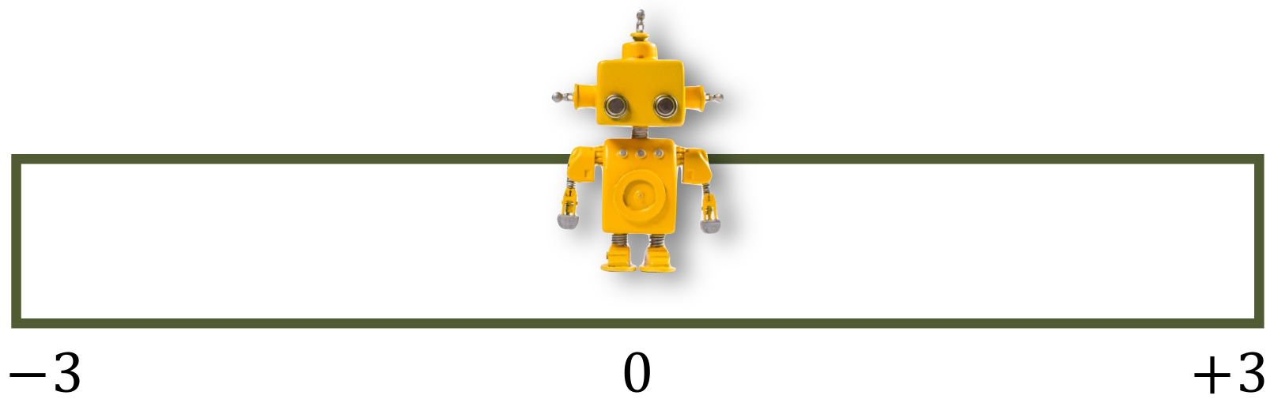
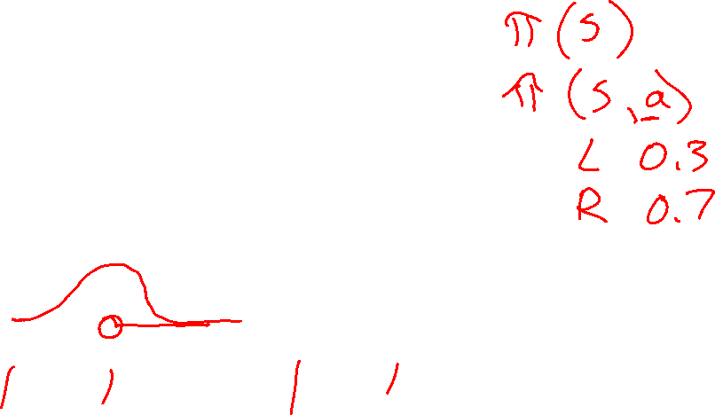
07-380 AI & ML II
Policy Gradient Methods for
Deep Reinforcement Learning
Instructors: Pat Virtue & Mohammad Salameh
Slide credits: Matt Gormley (10-301/10-601) and Geoff Gordon
Notes:
Translated from Matt Gormley's 10-301/10-601 lecture "Policy Gradient + Deep Reinforcement Learning", page 1.

Slide 2
Deep Reinforcement Learning
Notes:
Source: Matt Gormley, 10-301/10-601 policy gradient lecture, PDF page 2.

Slide 3
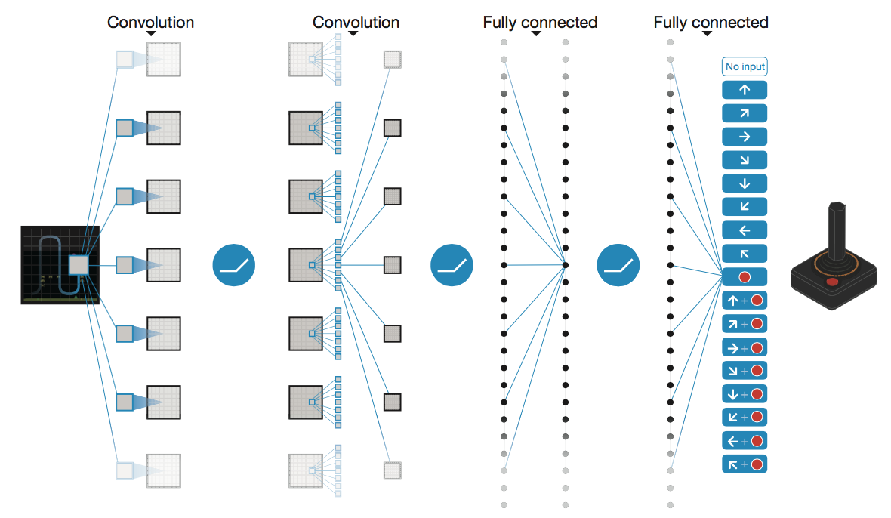
Deep Q-Networks (DQN)
Approximate Q-learning: Linear → Network
Image: Deep Mind

Slide 4
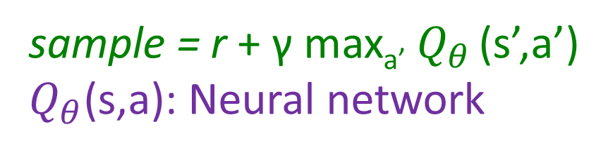
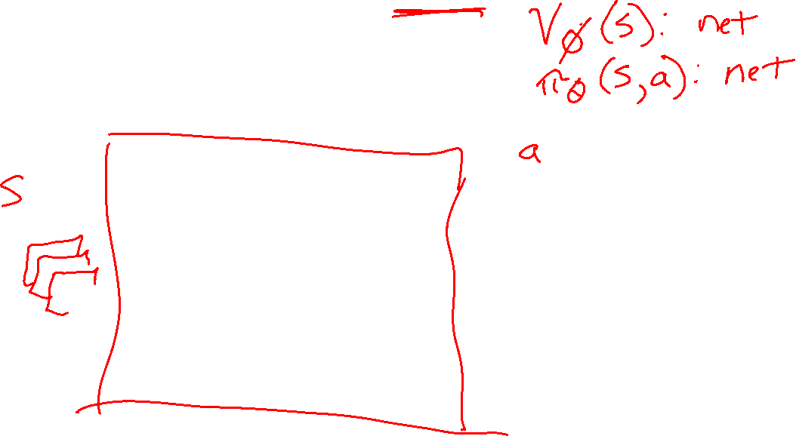

Deep Q-Networks
sample = r + γ max_{a’} $Q_{θ}$ (s’,a’)
$Q_{θ}$(s,a): Neural network
Deep Mind, 2015
Used a deep learning network to represent Q:
  Input is last 4 images (84x84 pixel values) plus score
49 Atari games, incl. Breakout, Space Invaders, Seaquest, Enduro
Image: Deep Mind

Slide 5
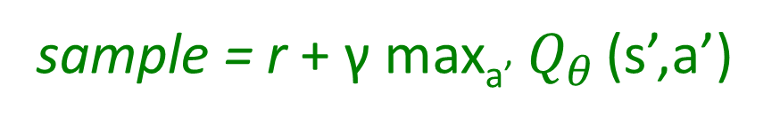
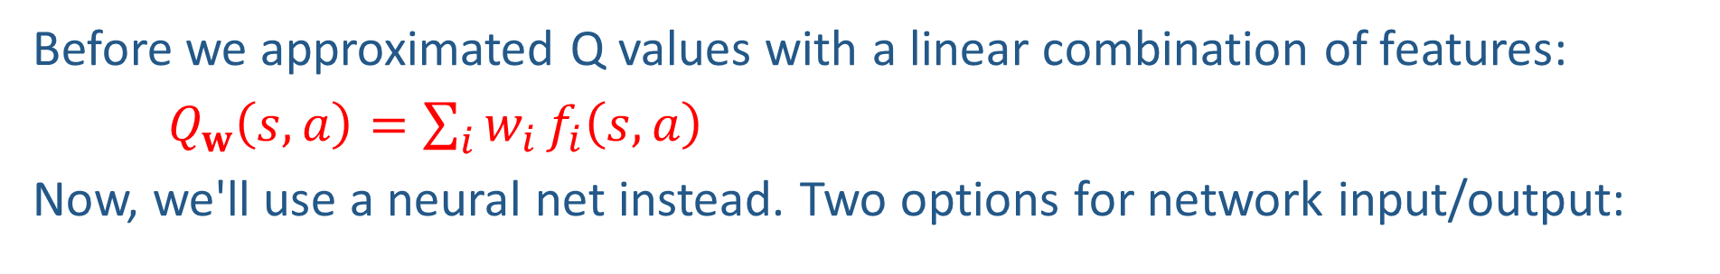
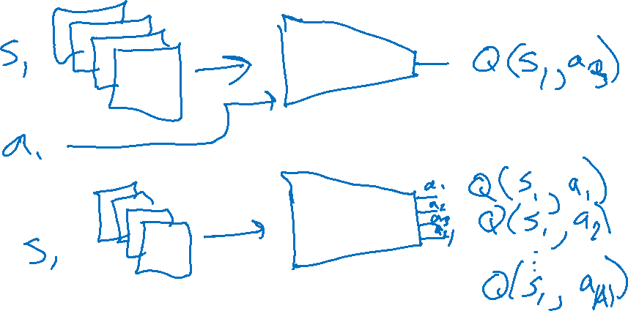
Deep Q-Networks
sample = r + γ max_{a’} $Q_{θ}$ (s’,a’)
Before we approximated Q values with a linear combination of features:
$Q_{w}\left(s, a\right)=\sum_{i}{w_{i}}f_{i}\left(s, a\right)$
Now, we'll use a neural net instead. Two options for network input/output:

Slide 6
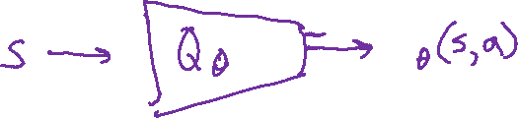
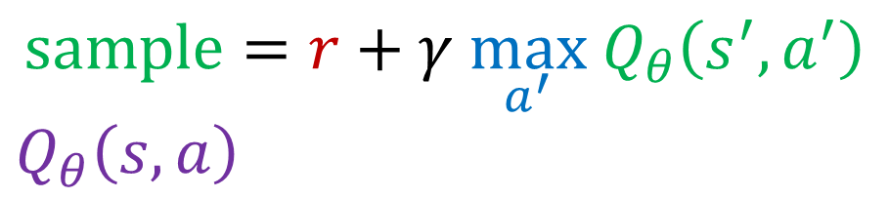
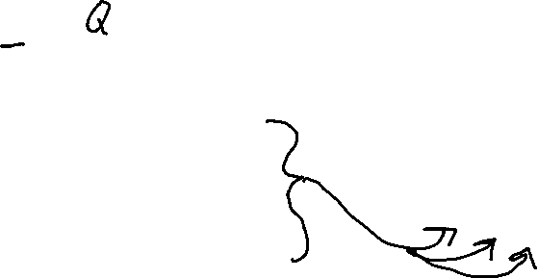

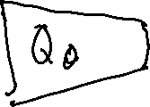
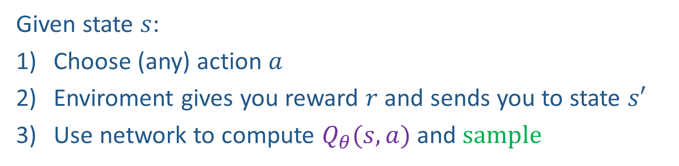
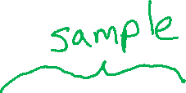
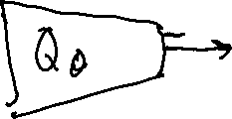
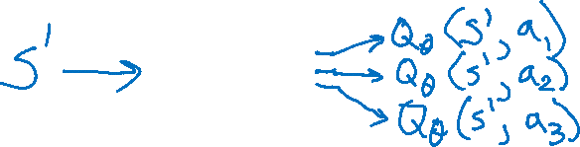
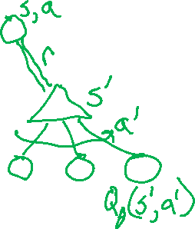
Deep Q-Networks
$$sample=r+γ \max_{a^{′}} Q_{θ}\left(s^{′},a^{′}\right)$$
$Q_{θ}\left(s, a\right)$
Given state $s$:
Choose (any) action $a$
Enviroment gives you reward $r$ and sends you to state $s′$
Use network to compute $Q_{θ}(s,a)$ and $sample$

Slide 7
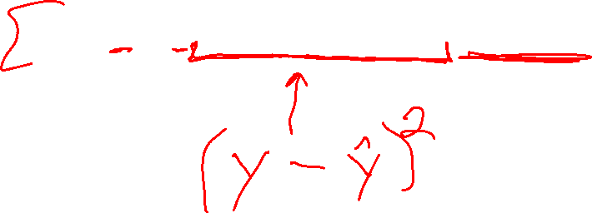
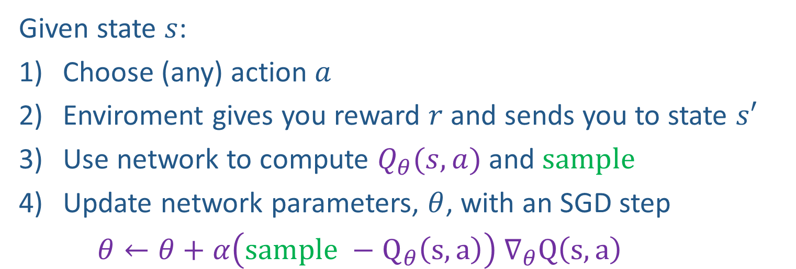
Deep Q-Networks
$$sample=r+γ \max_{a^{′}} Q_{θ}\left(s^{′},a^{′}\right)$$
$Q_{θ}\left(s, a\right)$
Given state $s$:
Choose (any) action $a$
Enviroment gives you reward $r$ and sends you to state $s′$
Use network to compute $Q_{θ}(s,a)$ and $sample$
Update network parameters, $θ$, with an SGD step
$θ←θ+α\left(sample −Q_{θ}\left(s, a\right)\right) ∇_{θ}Q\left(s, a\right)$

Slide 8
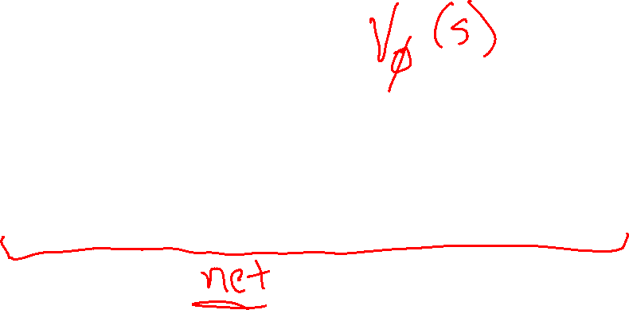
Learning a Value Function with Function Approximation
Slides: CMU MLD, Matt Gormley
Notes:
Source: Matt Gormley, 10-301/10-601 policy gradient lecture, PDF page 18.

Slide 9
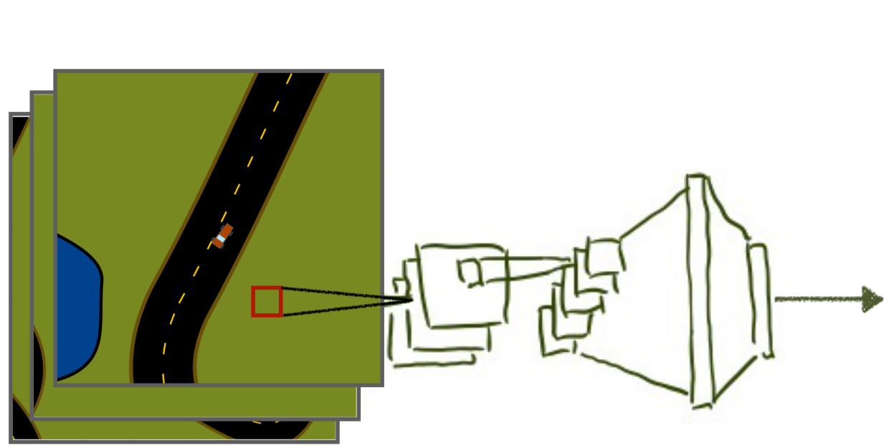
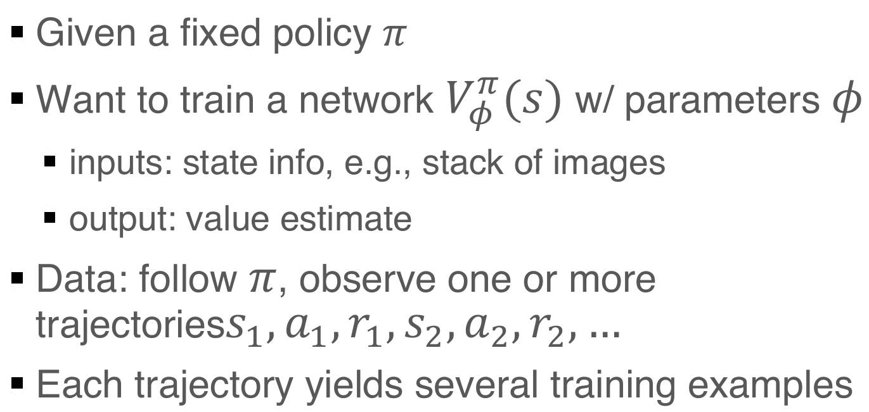
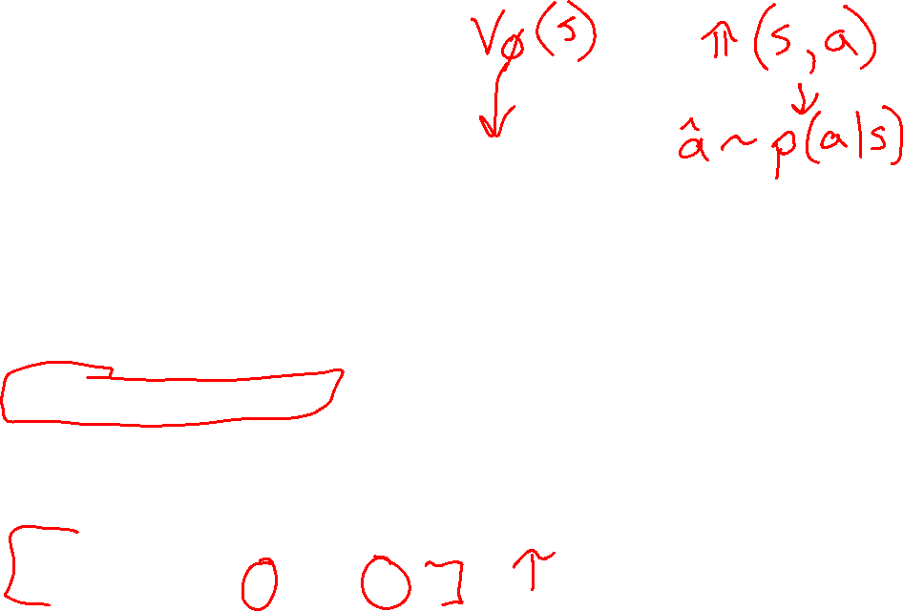
Learning V^{π}
Slides: CMU MLD, Geoff Gordon
Notes:
Source: Matt Gormley, 10-301/10-601 policy gradient lecture, PDF page 19.

Slide 10
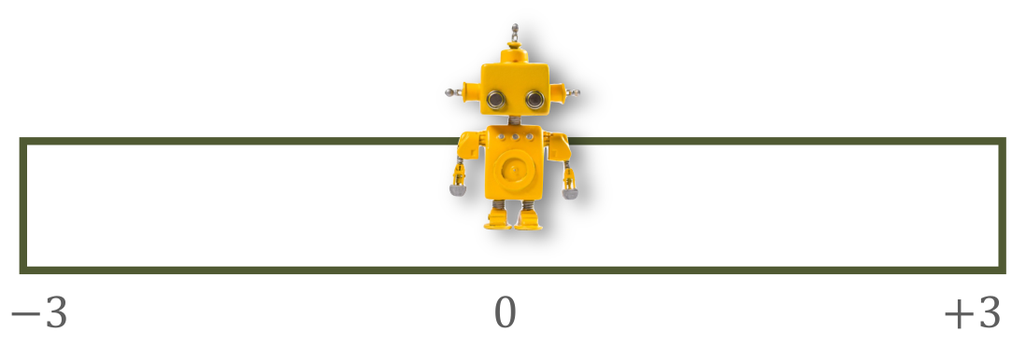
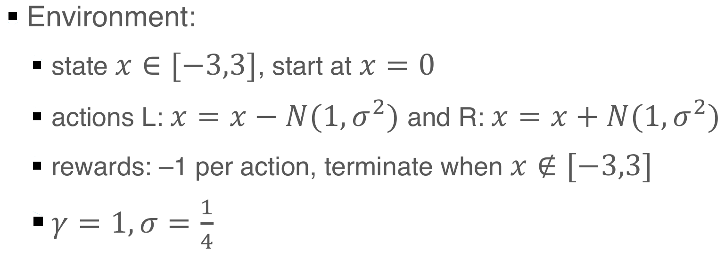
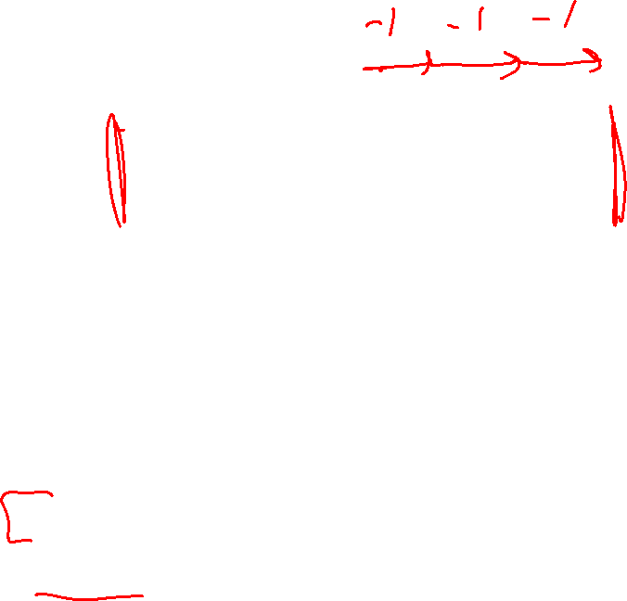
Learning V^{π}: example
Slides: CMU MLD, Geoff Gordon
Notes:
Source: Matt Gormley, 10-301/10-601 policy gradient lecture, PDF page 20.

Slide 11
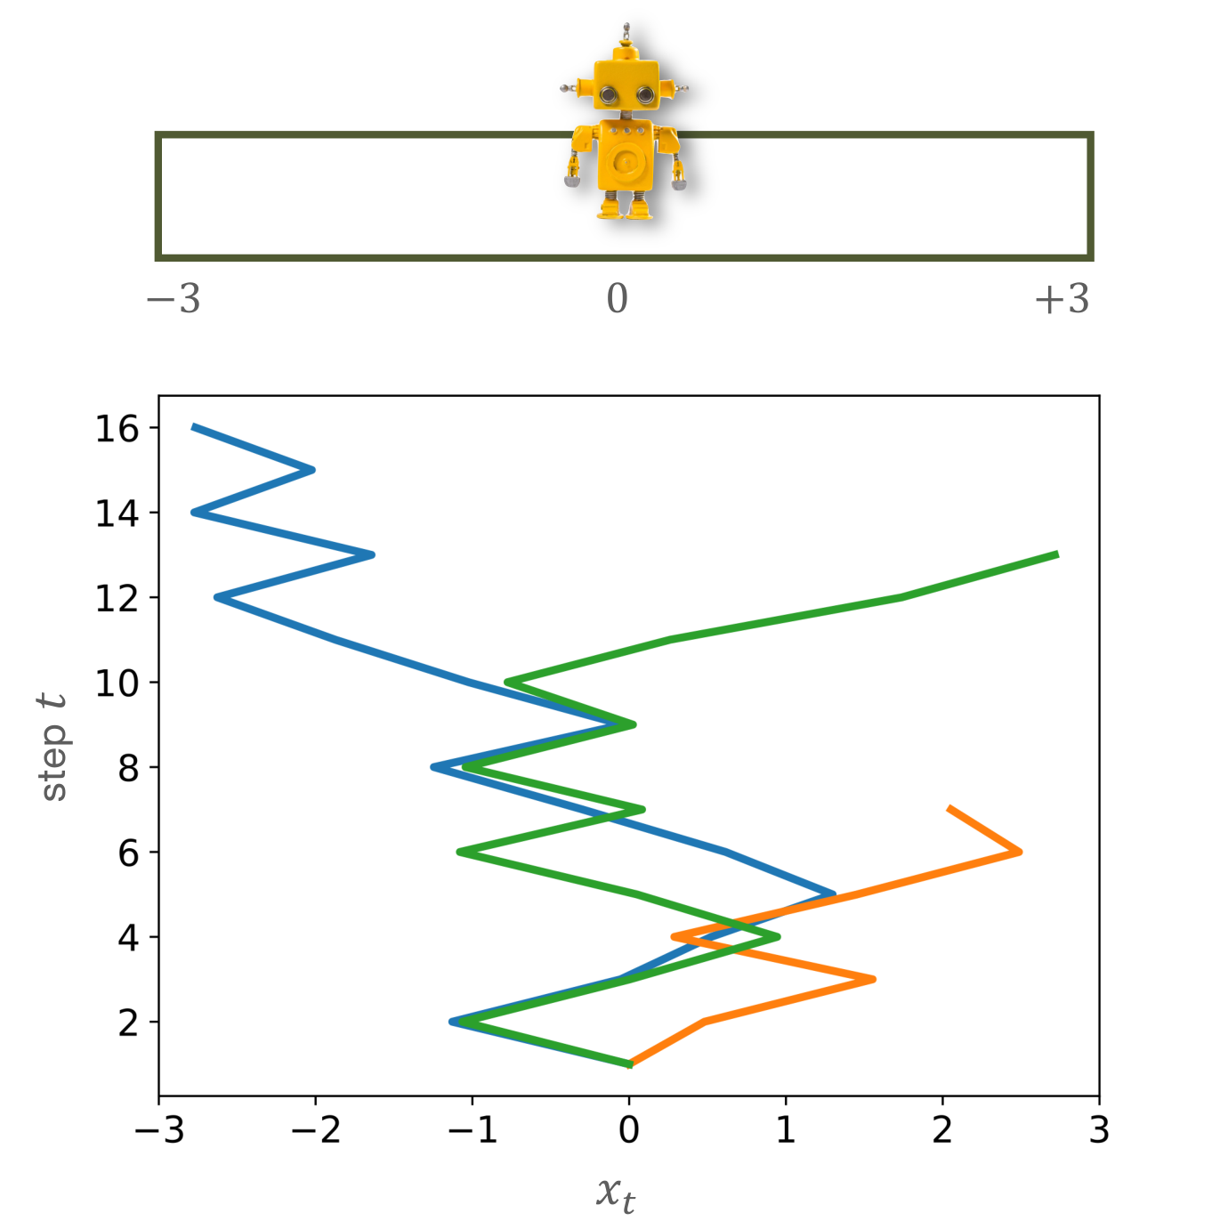
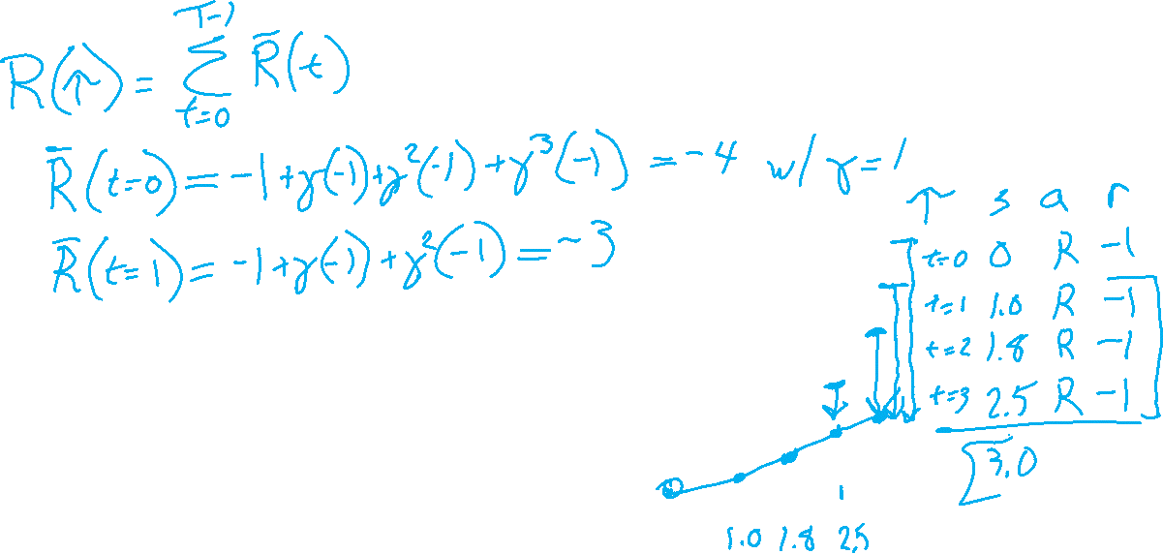
Some sample trajectories
(x, V(x))
(0, –13)
(-1, –15)
(+2, 2)
(-2, -1)
…
(-3, –20)
Each trajectory
yields several
training examples
Slides: CMU MLD, Geoff Gordon
Notes:
Source: Matt Gormley, 10-301/10-601 policy gradient lecture, PDF page 21.

Slide 12
Some sample trajectories
(x, V(x))
(0, –13)
(-1, –15)
(+2, -2)
(-2, -1)
…
(-3, –20)
Each trajectory
yields several
training examples
Slides: CMU MLD, Geoff Gordon
Notes:
Source: Matt Gormley, 10-301/10-601 policy gradient lecture, PDF page 21.

Slide 13
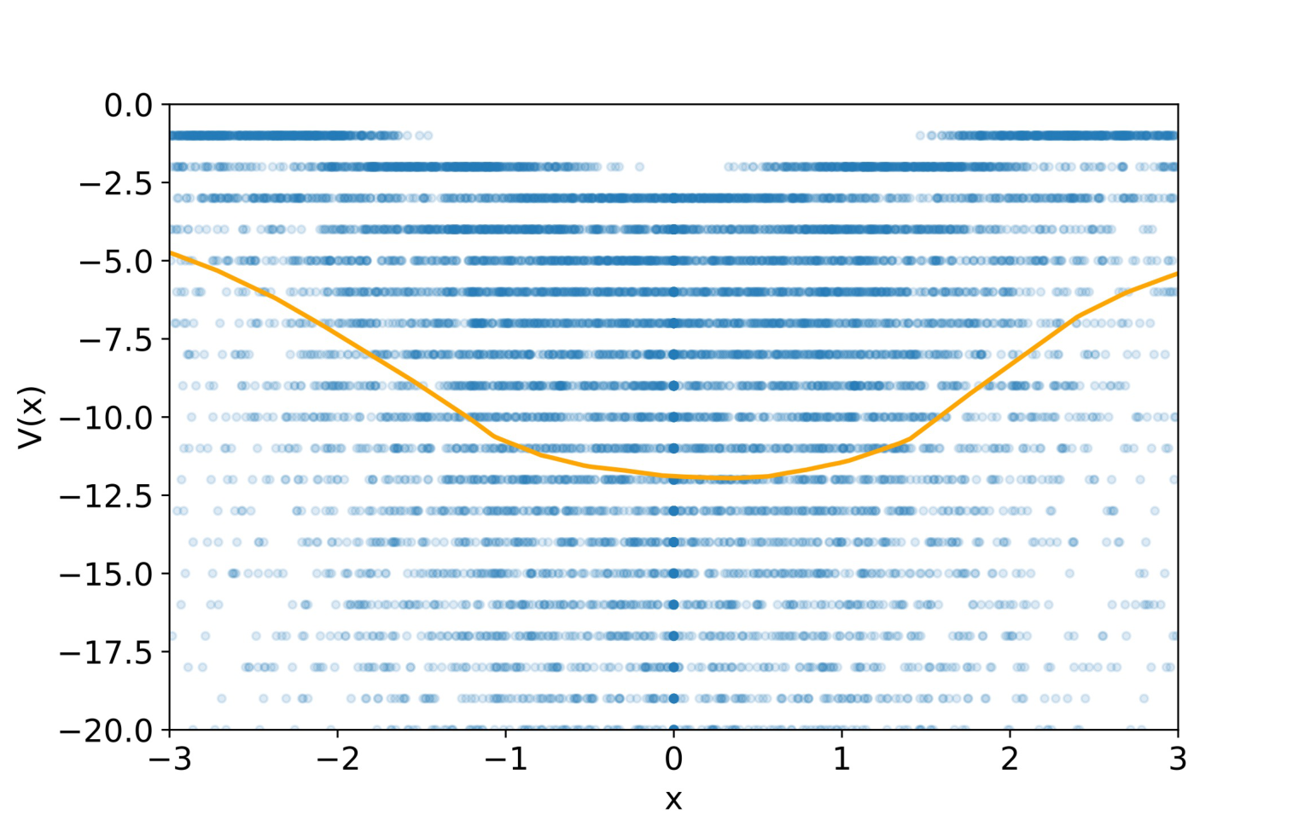
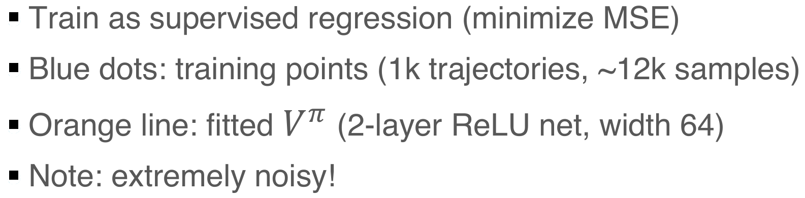
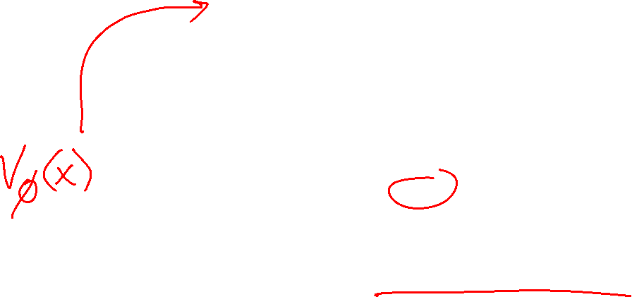
Learned V^{π}
Slides: CMU MLD, Geoff Gordon
Notes:
Source: Matt Gormley, 10-301/10-601 policy gradient lecture, PDF page 22.

Slide 14
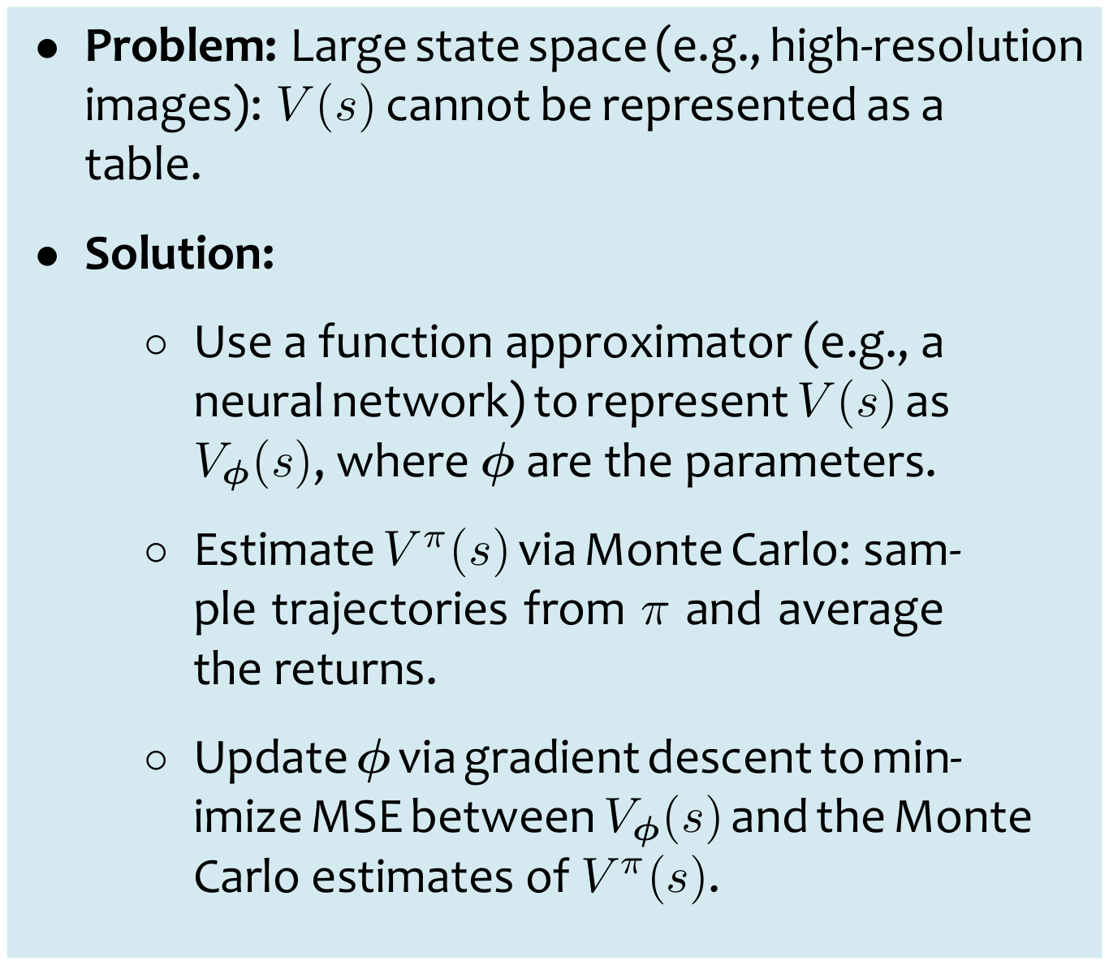
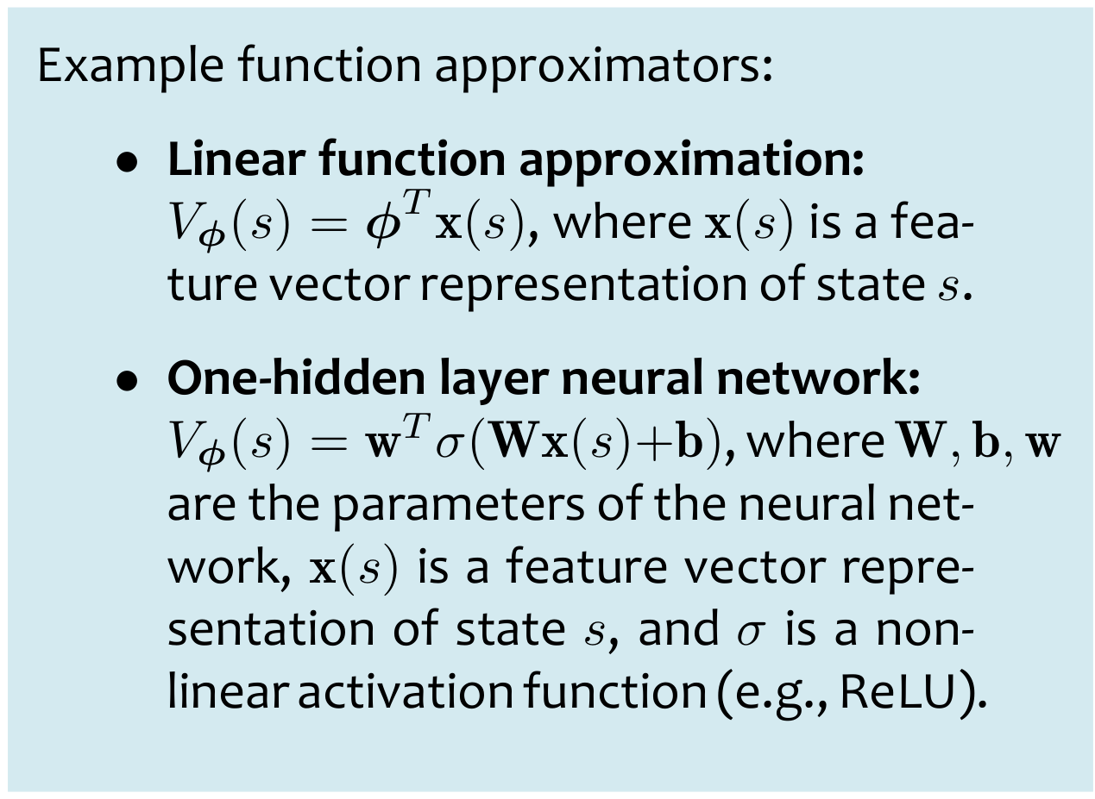
How to Learn V^{π} given π?
Slides: CMU MLD, Matt Gormley
Notes:
Source: Matt Gormley, 10-301/10-601 policy gradient lecture, PDF page 23.

Slide 15
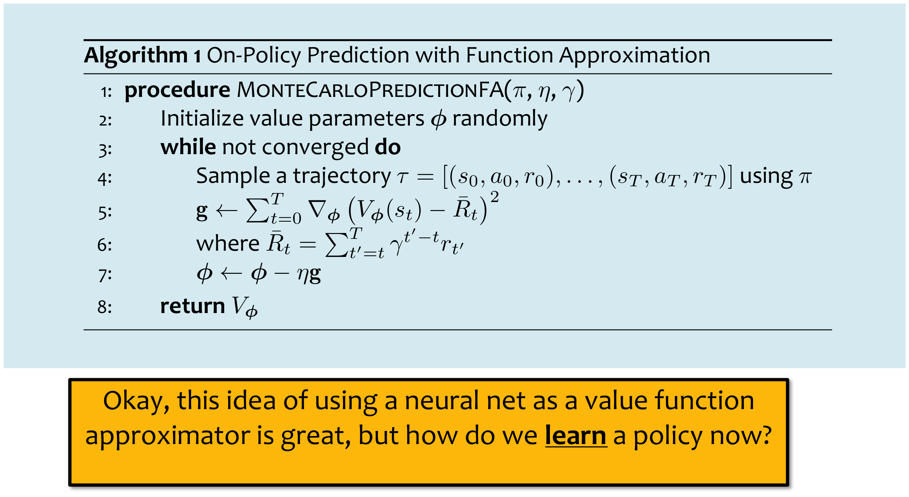
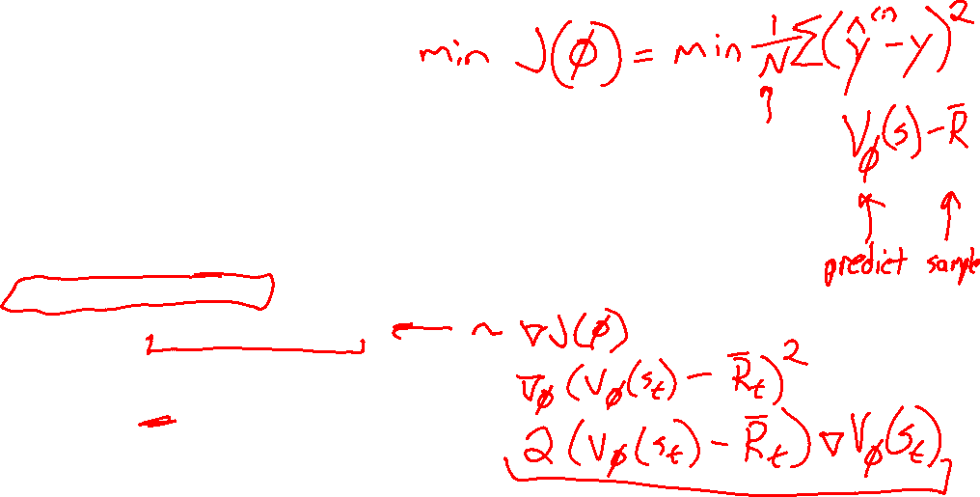
How to Learn V^{π} given π?
Slides: CMU MLD, Matt Gormley
Notes:
Source: Matt Gormley, 10-301/10-601 policy gradient lecture, PDF page 24.

Slide 16
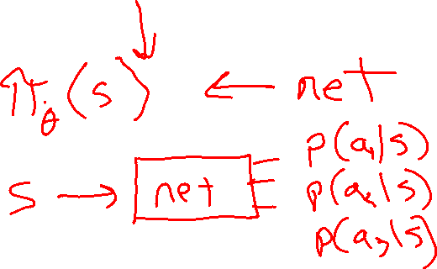
Policy Gradient Algorithms
Notes:
Source: Matt Gormley, 10-301/10-601 policy gradient lecture, PDF page 25.

Slide 17
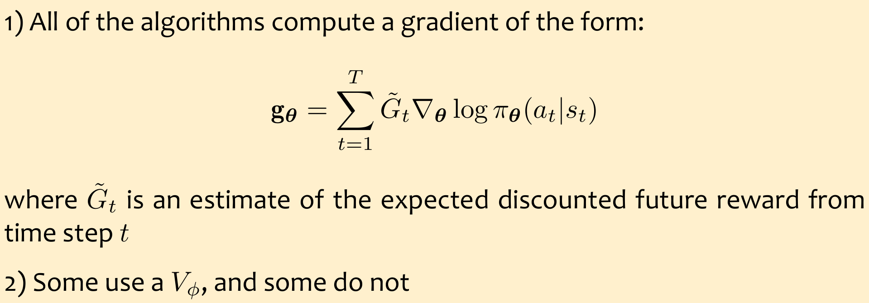
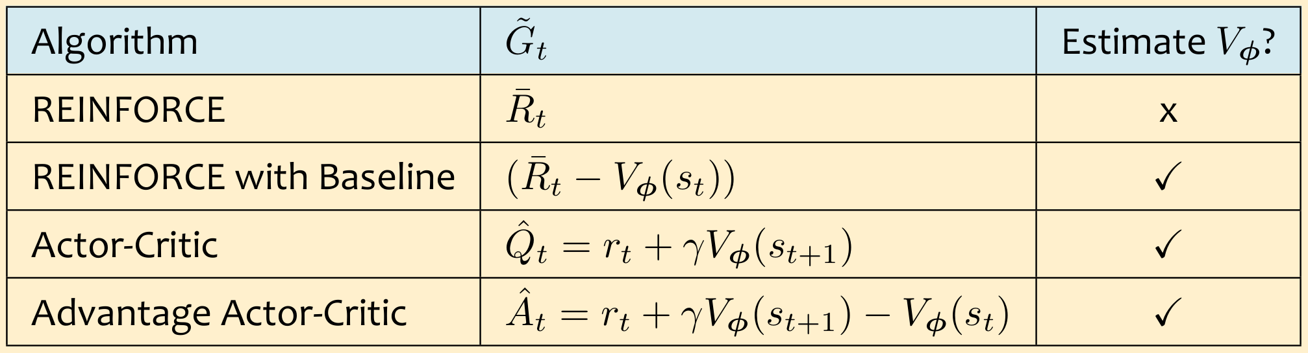
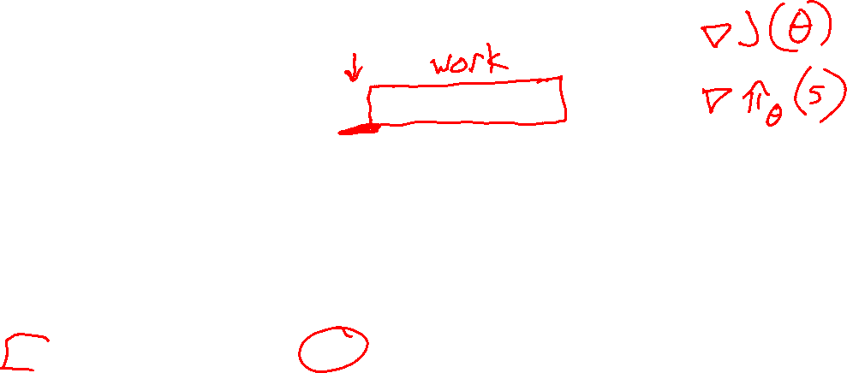
Comparison of Policy Gradient Methods
Slides: CMU MLD, Matt Gormley
Notes:
Source: Matt Gormley, 10-301/10-601 policy gradient lecture, PDF page 47.

Slide 18
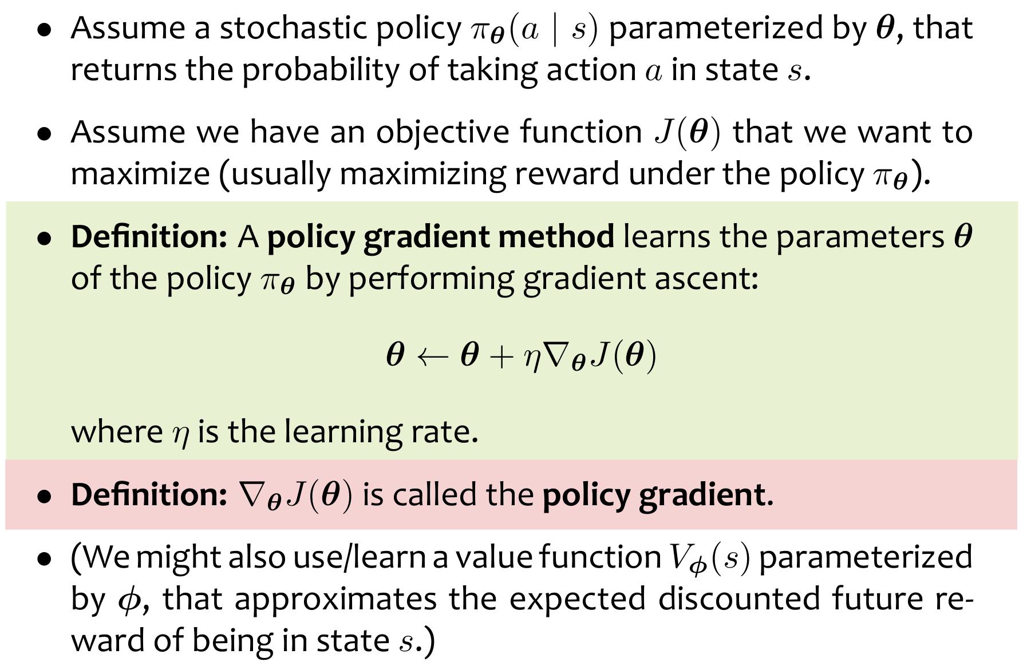
Policy Gradient Methods (generally)
Slides: CMU MLD, Matt Gormley
Notes:
Source: Matt Gormley, 10-301/10-601 policy gradient lecture, PDF page 26.

Slide 19
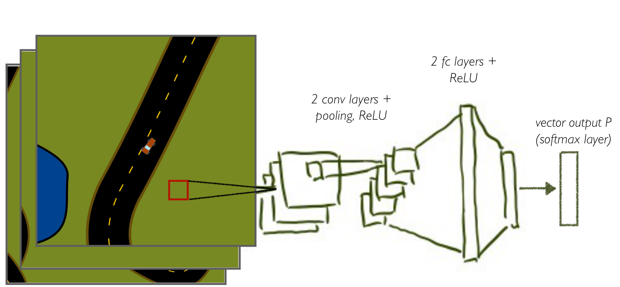
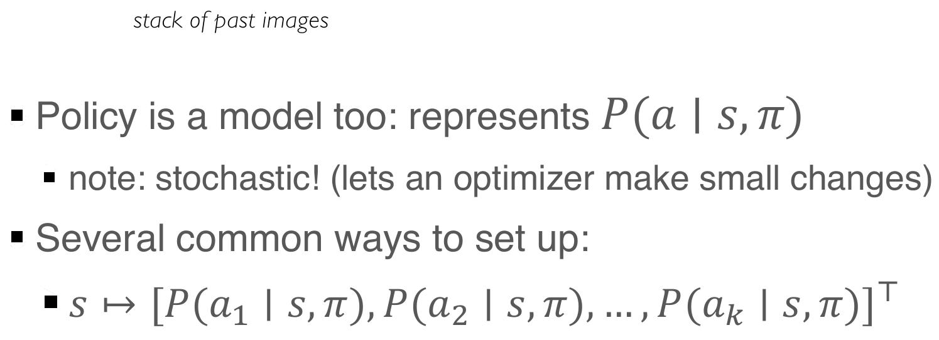
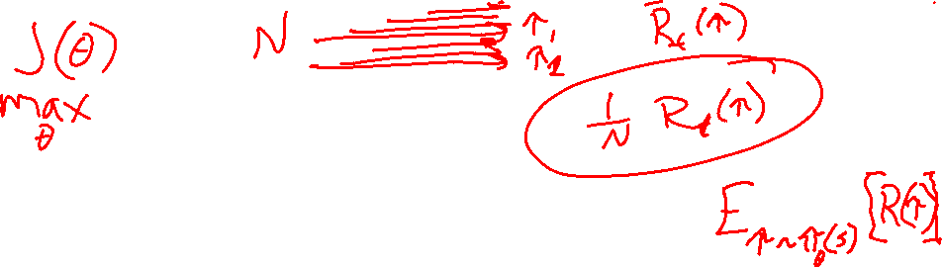
Policy
Slides: CMU MLD, Geoff Gordon
Notes:
Source: Matt Gormley, 10-301/10-601 policy gradient lecture, PDF page 27.

Slide 20
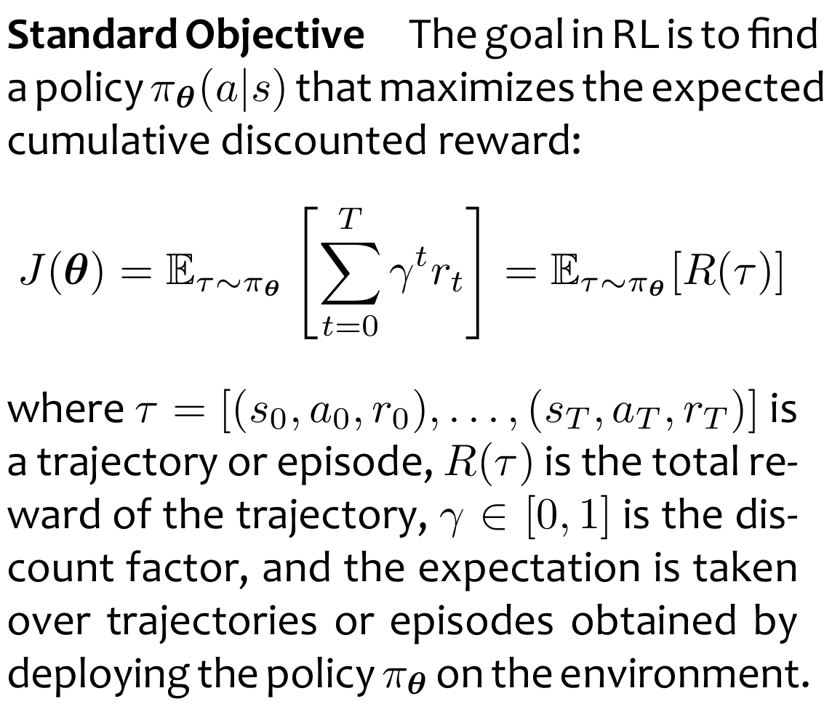
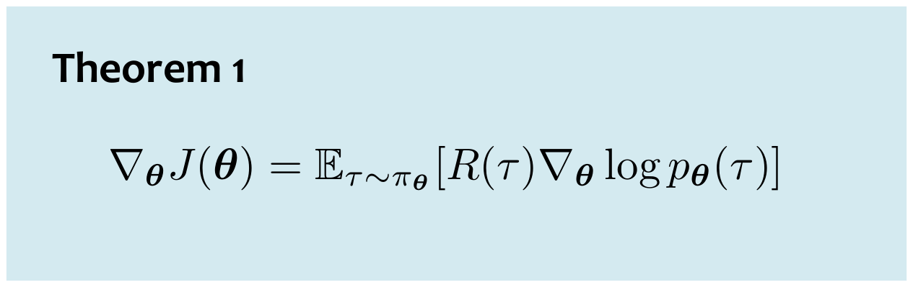
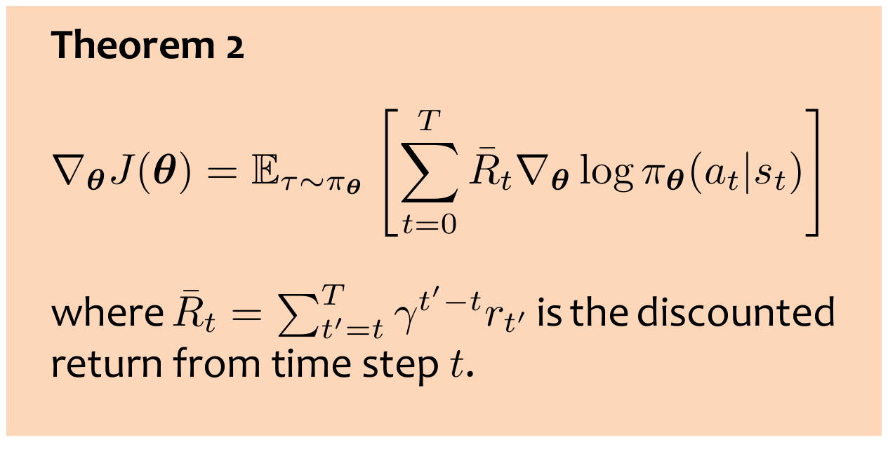
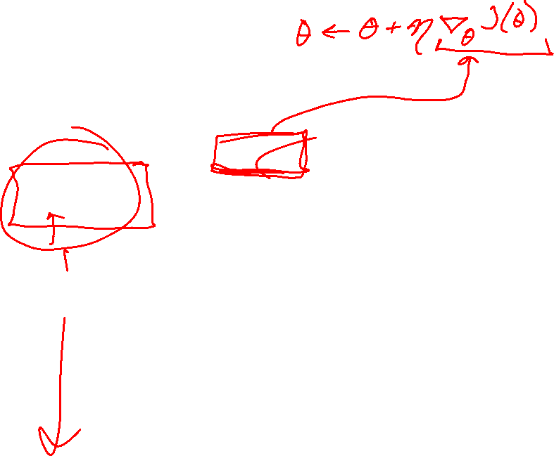
Policy Gradient Theorem
Slides: CMU MLD, Matt Gormley
Notes:
Source: Matt Gormley, 10-301/10-601 policy gradient lecture, PDF page 28.

Slide 21
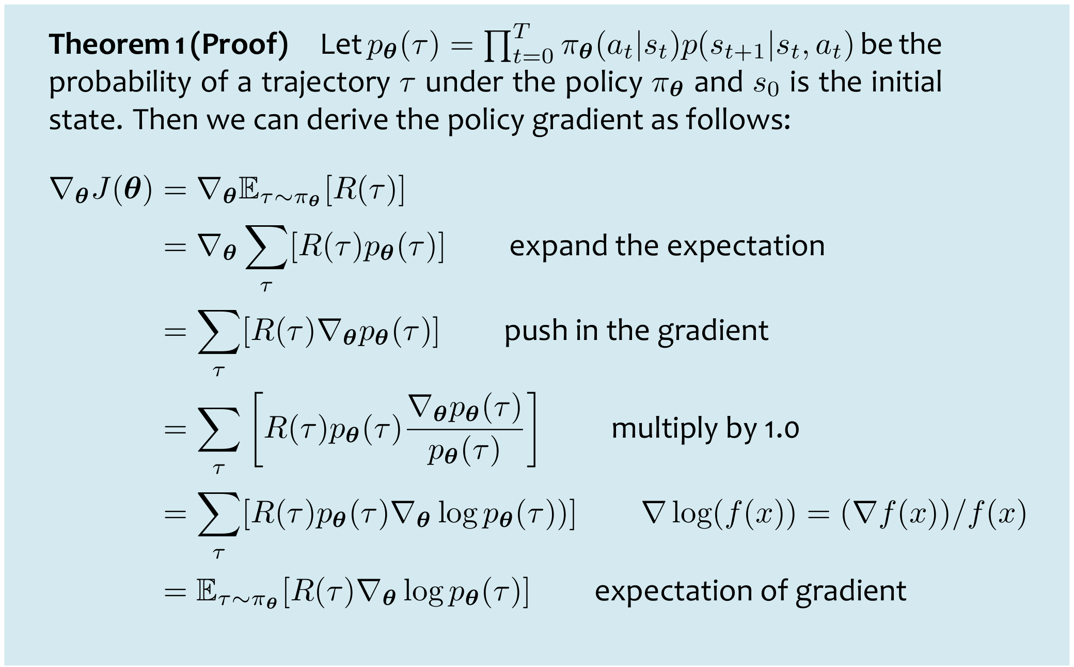
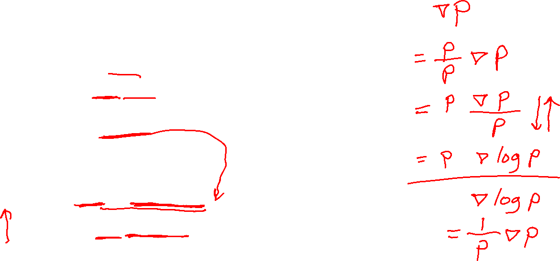
Policy Gradient Theorem
Slides: CMU MLD, Matt Gormley
Notes:
Source: Matt Gormley, 10-301/10-601 policy gradient lecture, PDF page 29.

Slide 22
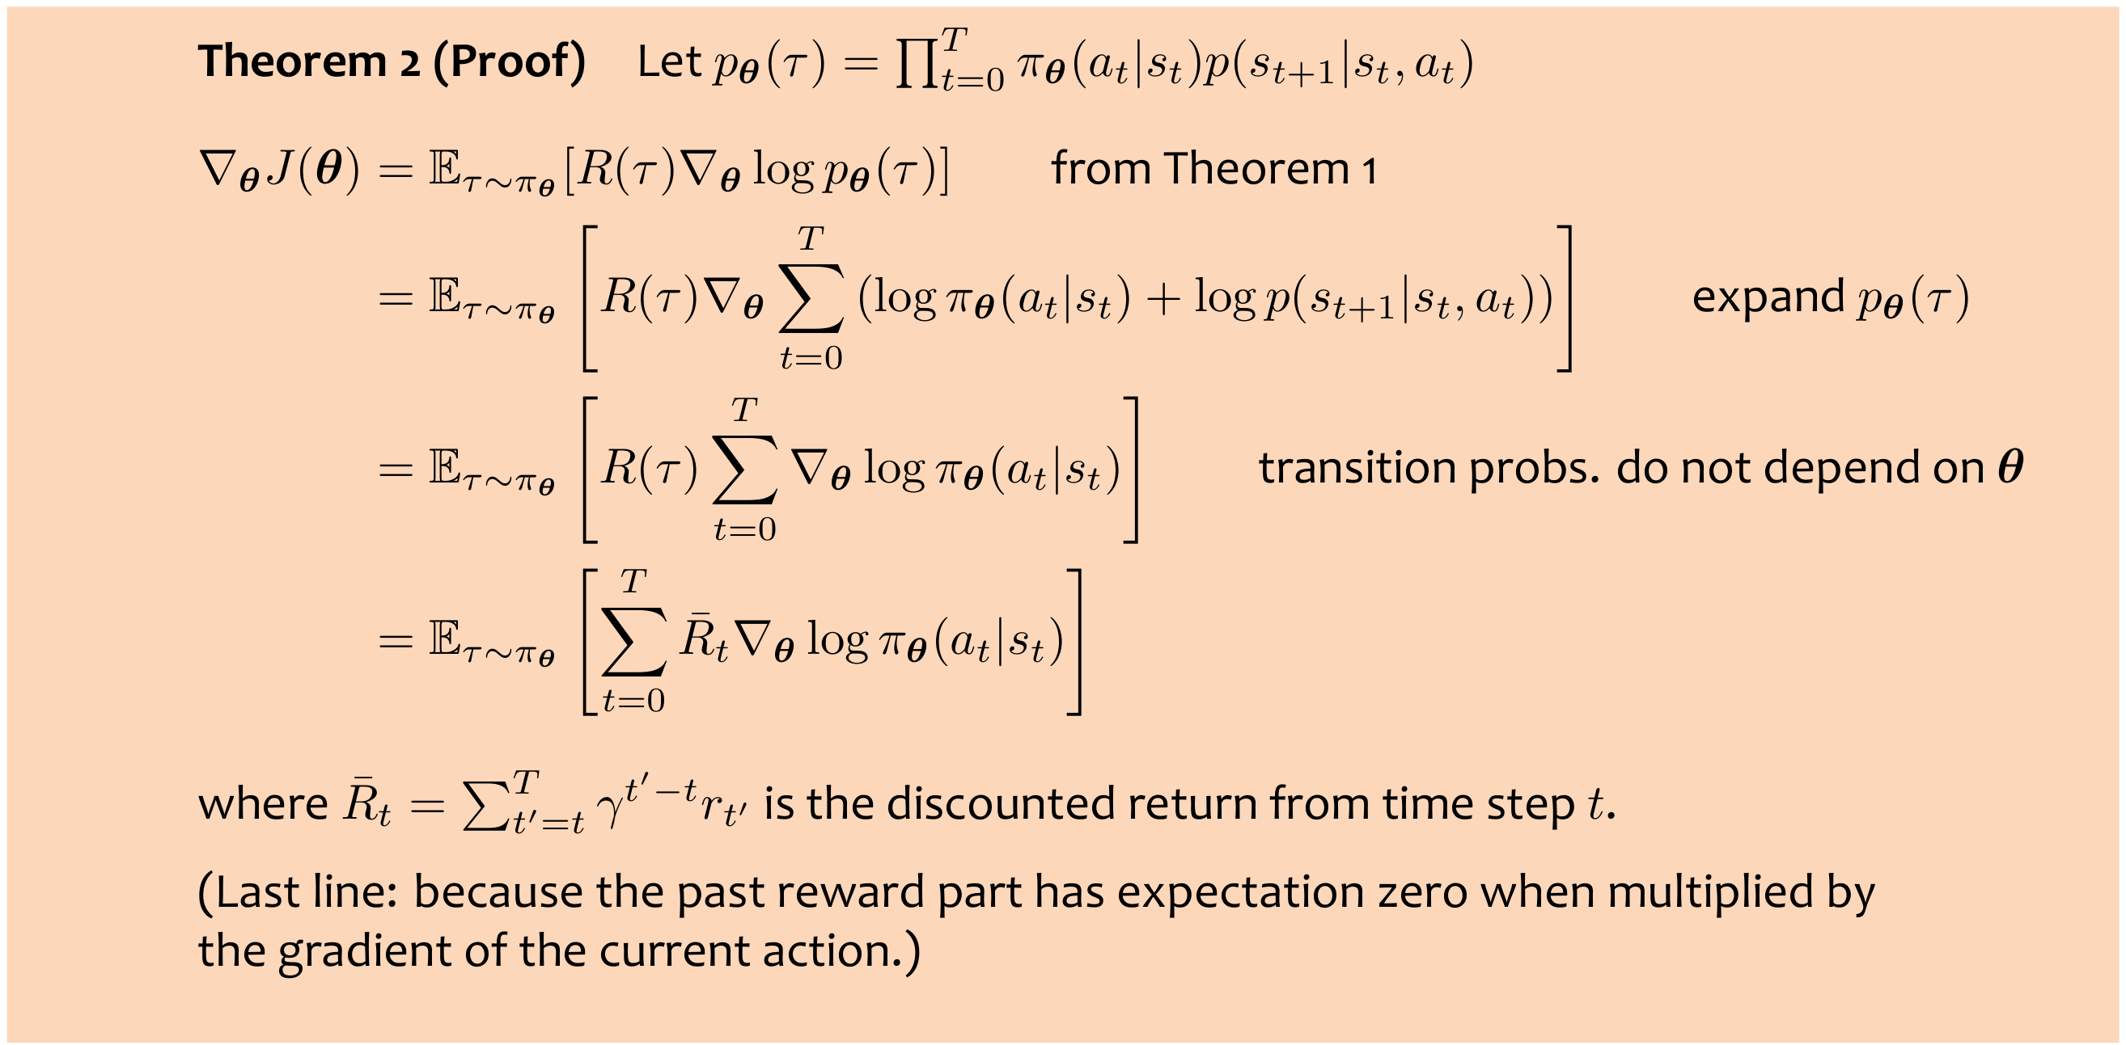

Policy Gradient Theorem
Slides: CMU MLD, Matt Gormley
Notes:
Source: Matt Gormley, 10-301/10-601 policy gradient lecture, PDF page 30.

Slide 23


Policy Gradient Theorem
Slides: CMU MLD, Matt Gormley
Notes:
Source: Matt Gormley, 10-301/10-601 policy gradient lecture, PDF page 31.

Slide 24




Policy gradient intuition
Slides: CMU MLD, Geoff Gordon
Notes:
Source: Matt Gormley, 10-301/10-601 policy gradient lecture, PDF page 32.

Slide 25



Algorithm 1: REINFORCE
Slides: CMU MLD, Matt Gormley
Notes:
Source: Matt Gormley, 10-301/10-601 policy gradient lecture, PDF page 33.

Slide 26






REINFORCE Example
Slides: CMU MLD, Matt Gormley, Geoff Gordon
Notes:
Source: Matt Gormley, 10-301/10-601 policy gradient lecture, PDF page 34.

Slide 27



REINFORCE Example
Action
logits
Slides: CMU MLD, Geoff Gordon
Notes:
Source: Matt Gormley, 10-301/10-601 policy gradient lecture, PDF page 35.

Slide 28

REINFORCE Example
Slides: CMU MLD, Matt Gormley, Geoff Gordon
Notes:
Source: Matt Gormley, 10-301/10-601 policy gradient lecture, PDF page 36.

Slide 29



REINFORCE Example
Calculate gradient estimate
Slides: CMU MLD, Geoff Gordon
Notes:
Source: Matt Gormley, 10-301/10-601 policy gradient lecture, PDF page 37.

Slide 30


REINFORCE Example
Slides: CMU MLD, Matt Gormley, Geoff Gordon
Notes:
Source: Matt Gormley, 10-301/10-601 policy gradient lecture, PDF page 38.

Slide 31


Failure modes of REINFORCE
Slides: CMU MLD, Geoff Gordon
Notes:
Source: Matt Gormley, 10-301/10-601 policy gradient lecture, PDF page 40.

Slide 32
Algorithm 1: REINFORCE
Slides: CMU MLD, Matt Gormley
Notes:
Source: Matt Gormley, 10-301/10-601 policy gradient lecture, PDF page 41.

Slide 33


Algorithm 2: REINFORCE with Baseline
Slides: CMU MLD, Matt Gormley, Geoff Gordon
Notes:
Source: Matt Gormley, 10-301/10-601 policy gradient lecture, PDF page 42.

Slide 34

Actor-critic
REINFORCE
Slides: CMU MLD, Geoff Gordon
Notes:
Source: Matt Gormley, 10-301/10-601 policy gradient lecture, PDF page 43.

Slide 35





Algorithm 3: Actor-Critic
Slides: CMU MLD, Matt Gormley, Geoff Gordon
Notes:
Source: Matt Gormley, 10-301/10-601 policy gradient lecture, PDF page 44.

Slide 36




Algorithm 4: Advantage Actor-Critic (A2C)
Slides: CMU MLD, Matt Gormley, Geoff Gordon
Notes:
Source: Matt Gormley, 10-301/10-601 policy gradient lecture, PDF page 45.

Slide 37



Algorithm 5: A2C with n-Step Returns
The advantage actor-critic algorithm uses a one-step return to estimate the advantage function, which can lead to high bias in the policy gradient estimate.
To reduce bias, we can use an n-step return to estimate the advantage function
Closely connected to temporal difference learning, specifically TD(lambda)
Slides: CMU MLD, Matt Gormley, Geoff Gordon
Notes:
Source: Matt Gormley, 10-301/10-601 policy gradient lecture, PDF page 46.

Slide 38
Comparison of Policy Gradient Methods
Slides: CMU MLD, Matt Gormley
Notes:
Source: Matt Gormley, 10-301/10-601 policy gradient lecture, PDF page 47.

Slide 39


Example: AlphaGo
Slides: CMU MLD, Geoff Gordon
Notes:
Source: Matt Gormley, 10-301/10-601 policy gradient lecture, PDF page 48.

Slide 40
Example: AlphaGo
Training and play ran on a cluster of 50 GPUs
Training:
  supervised policy: minibatches of 16 positions, 340,000,000 iterations of async SGD via parameter server, ~1k GPU-days
  REINFORCE: minibatches of 128 games, embarrassingly parallel; 10,000 iterations of synchronous policy gradient, 50 GPU-days
  self-play data: generated 30,000,000 positions, each from a separate game, embarrassingly parallel
  Value network: minibatches of 32 positions, 50,000,000 iterations of async SGD, parameter server, 350 GPU-days
Play: custom parallel variant of MCTS
Slides: CMU MLD, Geoff Gordon
Notes:
Source: Matt Gormley, 10-301/10-601 policy gradient lecture, PDF page 49.

Slide 41


Example: generative language model
Generative language model: produce text by repeatedly choosing next word to fill in (actually subword token)
Sequential decision problem: state = words so far, action = next word
Train base model as a classifier on a giant corpus: e.g., internet crawl, Wikipedia, public Github repos
The result is not what we want: it predicts what a random internet user would say next (bigoted, NSFW, cruel)
Slides: CMU MLD, Geoff Gordon
Notes:
Source: Matt Gormley, 10-301/10-601 policy gradient lecture, PDF page 50.

Slide 42
Reinforcement learning from human feedback (RLHF)
Make it better: train as an RL problem, where humans provide feedback signal
  learn to generate what we actually want, instead of the worst of the internet
Many ways to set up feedback (human’s rating problem)
  e.g., give two complete generations, ask which is preferred
  train regression to predict score that determines P(preferred)
  use learned score as delayed reward for RL, improve generation policy (next-word picker)
Can use a much smaller dataset to train reward model (feasible to create with paid human raters)
Often RL method is a variant of policy gradient, scaled by running simulations in parallel across many workers (share reward model (once), policy parameters (once each batch))
Slides: CMU MLD, Geoff Gordon
Notes:
Source: Matt Gormley, 10-301/10-601 policy gradient lecture, PDF page 51.

Slide 43

Another fun example
Slides: CMU MLD, Geoff Gordon
Notes:
Source: Matt Gormley, 10-301/10-601 policy gradient lecture, PDF page 52.

