Slide 1
07-380 AI & ML II
Latent Factors:
Clustering and k-means
GMM (Gaussian Mixture Models)
EM (Expectation-Maximization)
Instructors: Pat Virtue & Mohammad Salameh
Slide credits: CMU AI with drawings from http://ai.berkeley.edu

Slide 2
Clustering &
Unsupervised Learning

Slide 3
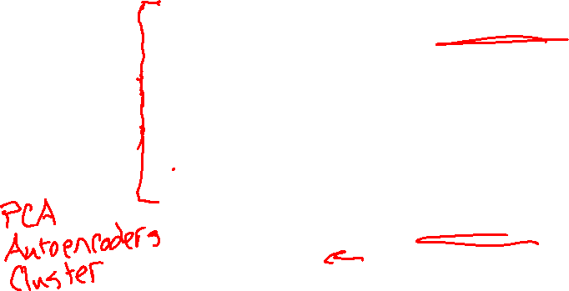
Learning Paradigms
Slide credit: CMU MLD, Matt Gormley

Slide 4
Clustering, Informal Goals
Goal: Automatically partition unlabeled data into groups of similar datapoints.
Question: When and why would we want to do this?
Useful for:
• Automatically organizing data.
• Understanding hidden structure in data.
• Preprocessing for further analysis.
• Representing high-dimensional data in a low-dimensional space (e.g., for visualization purposes).
Slide credit: CMU MLD Nina Balcan

Slide 5
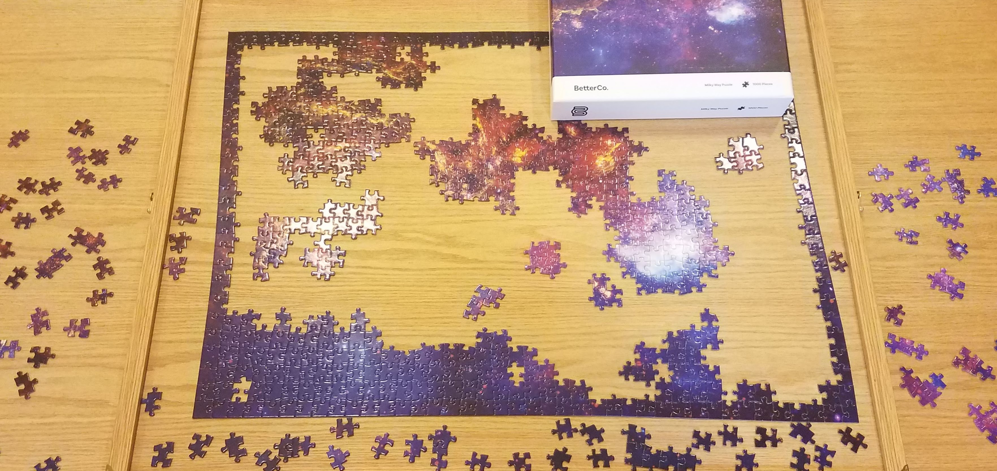
Clustering Applications
Jigsaw puzzles!

Slide 6
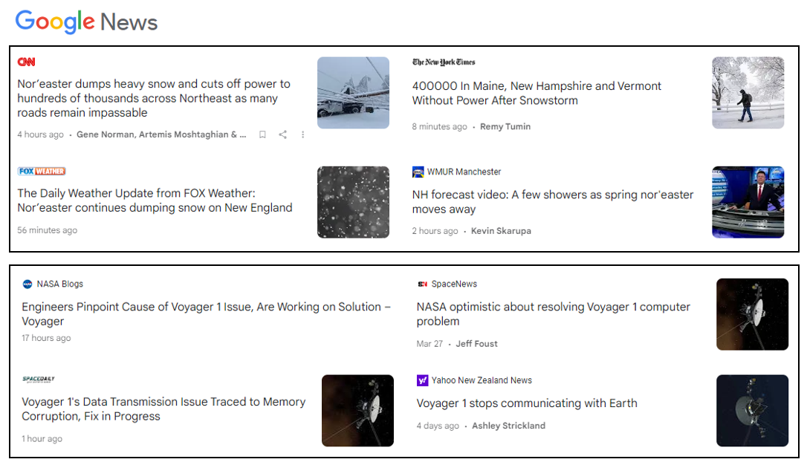
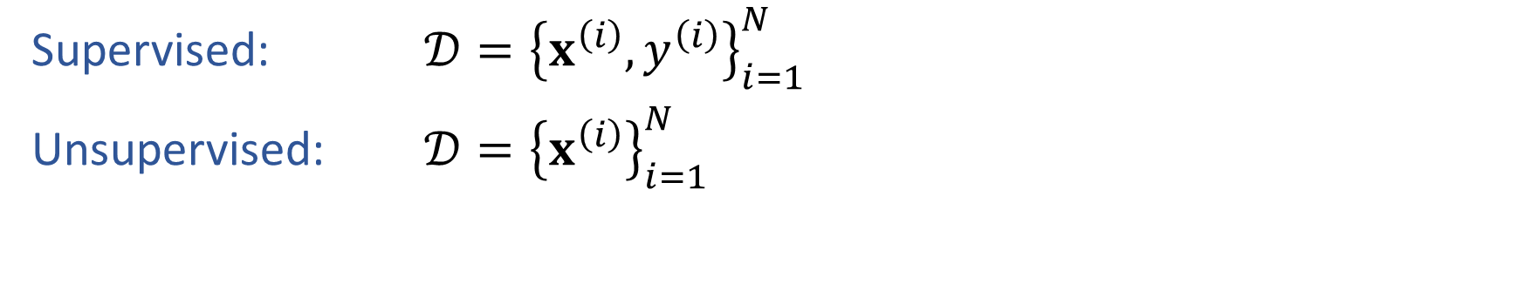
Semi-supervised Learning
Supervised: $𝒟={\left\{x^{\left(i\right)}, y^{\left(i\right)}\right\}}_{i=1}^{N}$
Unsupervised: $𝒟={\left\{x^{\left(i\right)}\right\}}_{i=1}^{N}$

Slide 7

Semi-supervised Learning
Supervised: $𝒟={\left\{x^{\left(i\right)}, y^{\left(i\right)}\right\}}_{i=1}^{N}$
Unsupervised: $𝒟={\left\{x^{\left(i\right)}\right\}}_{i=1}^{N}$

Slide 8

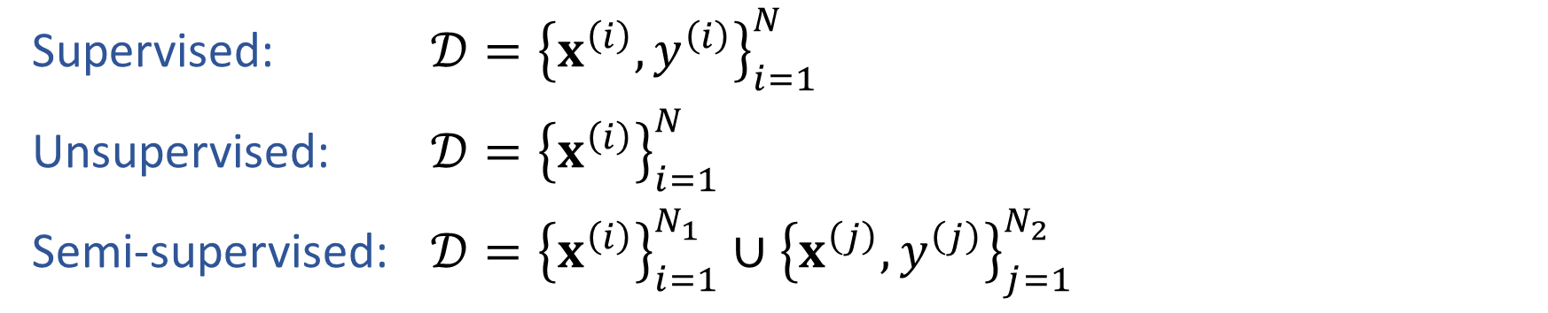

Semi-supervised Learning
Supervised: $𝒟={\left\{x^{\left(i\right)}, y^{\left(i\right)}\right\}}_{i=1}^{N}$
Unsupervised: $𝒟={\left\{x^{\left(i\right)}\right\}}_{i=1}^{N}$
Semi-supervised: $𝒟={\left\{x^{\left(i\right)}\right\}}_{i=1}^{N_{1}}∪{\left\{x^{\left(j\right)}, y^{\left(j\right)}\right\}}_{j=1}^{N_{2}}$

Slide 9
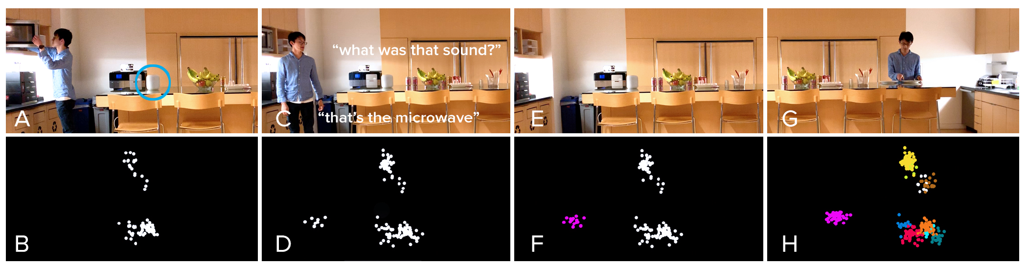

Semi-supervised Learning
Supervised: $𝒟={\left\{x^{\left(i\right)}, y^{\left(i\right)}\right\}}_{i=1}^{N}$
Unsupervised: $𝒟={\left\{x^{\left(i\right)}\right\}}_{i=1}^{N}$
Semi-supervised: $𝒟={\left\{x^{\left(i\right)}\right\}}_{i=1}^{N_{1}}∪{\left\{x^{\left(j\right)}, y^{\left(j\right)}\right\}}_{j=1}^{N_{2}}$
https://chrisharrison.net/index.php/Research/ListenLearner

Slide 10
Partitioning Algorithms
Partitioning method: Construct a partition of N objects into a set of K clusters
Given: a set of objects and the number K
Find: a partition of K clusters that optimizes the chosen partitioning criterion
  Globally optimal: exhaustively enumerate all partitions
  Effective heuristic method: K-means algorithm
Slide credit: CMU MLD Aarti Singh

Slide 11
Clustering
k-means algorithm

Slide 12
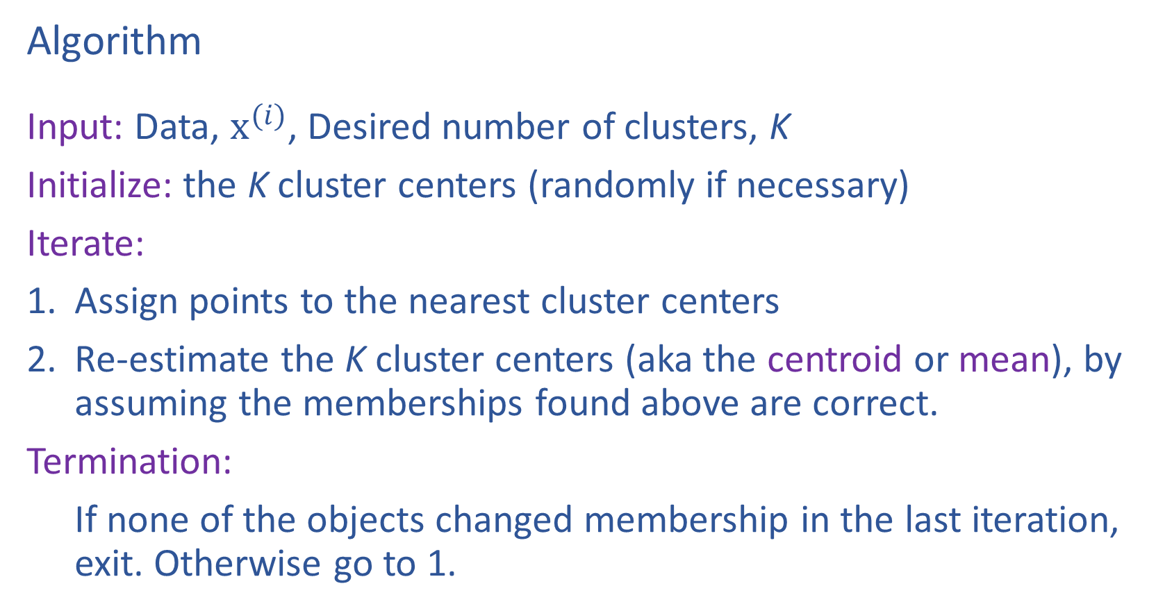
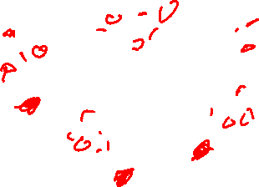
K-Means
Algorithm
Input: Data, $x^{(i)}$, Desired number of clusters, K
Initialize: the K cluster centers (randomly if necessary)
Iterate:
Assign points to the nearest cluster centers
Re-estimate the K cluster centers (aka the centroid or mean), by assuming the memberships found above are correct.
Termination:
If none of the objects changed membership in the last iteration, exit. Otherwise go to 1.
Slide credit: CMU MLD Aarti Singh

Slide 13
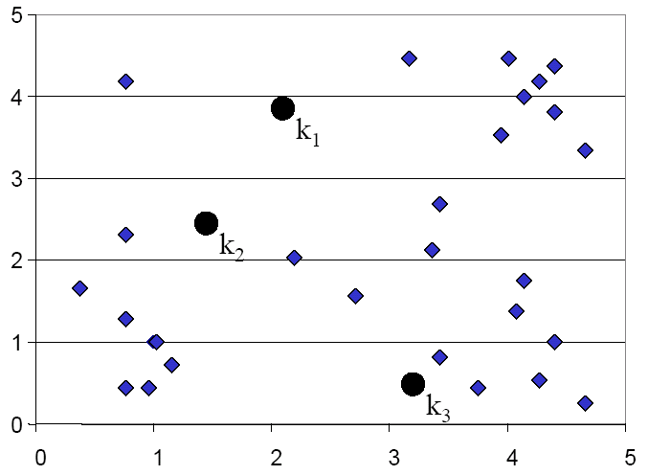
K-means Clustering: Assign points
Slide credit: CMU MLD Eric Xing

Slide 14
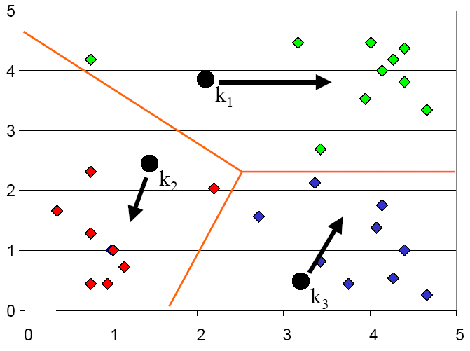
K-means Clustering: Update centers
Slide credit: CMU MLD Eric Xing

Slide 15
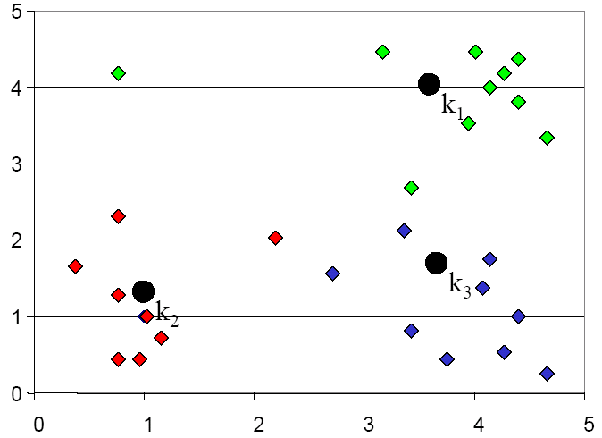
K-means Clustering: Assign points
Slide credit: CMU MLD Eric Xing

Slide 16
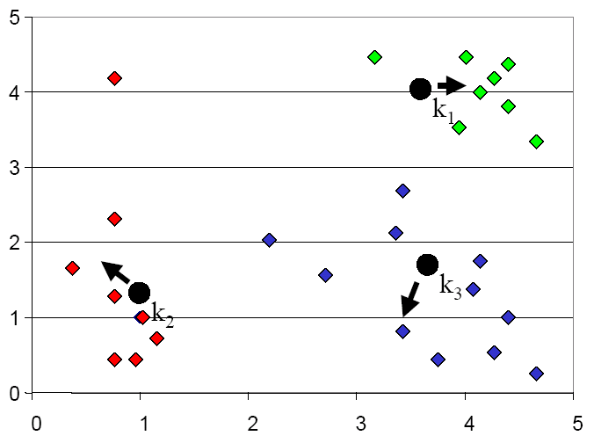
K-means Clustering: Update centers
Slide credit: CMU MLD Eric Xing

Slide 17
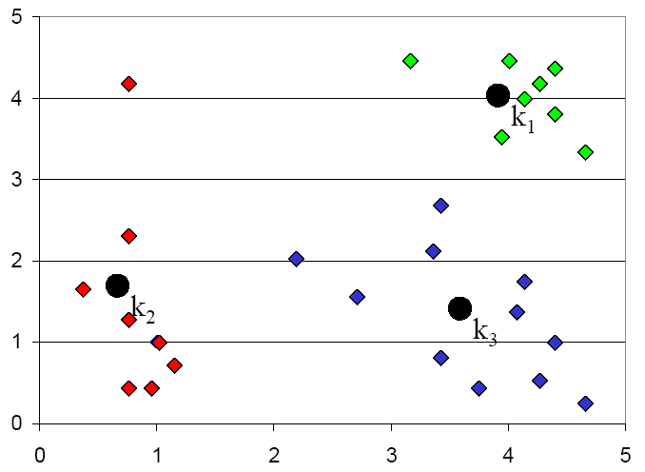
K-means Clustering: Assign points
Slide credit: CMU MLD Eric Xing

Slide 18
K-means Optimization
Optimization recipe
Formulate objective
Minimize objective
Slide credit: CMU MLD Matt Gormley

Slide 19
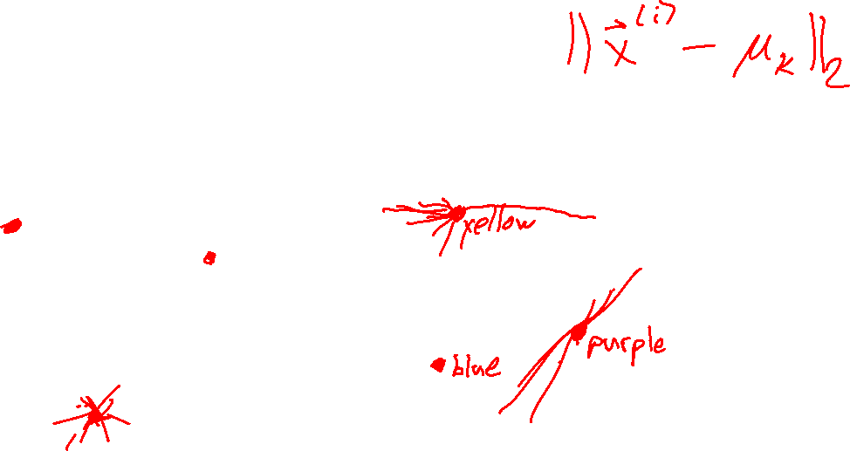
K-means Optimization
Question: Which of these clusterings is “better”?
Slide credit: CMU MLD Matt Gormley

Slide 20
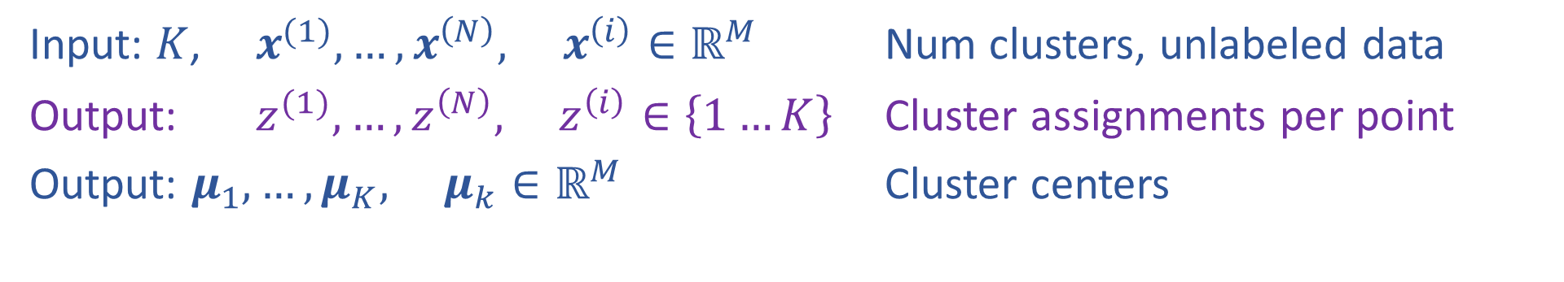
K-means Optimization
Input: $K$, $x^{(1)}, …, x^{\left(N\right)}, x^{\left(i\right)}∈ℝ^{M}$ Num clusters, unlabeled data
Output: $z^{(1)}, …,z^{\left(N\right)}, z^{\left(i\right)}∈\left\{1…K\right\}$ Cluster assignments per point
Output: $μ_{1}, …, μ_{K}, μ_{k}∈ℝ^{M}$ Cluster centers
Slide credit: CMU MLD Matt Gormley

Slide 21
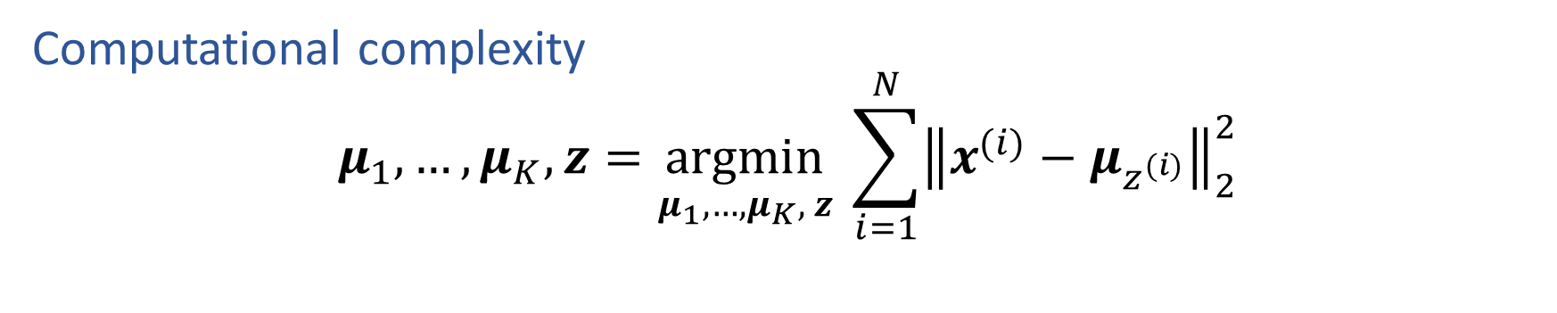
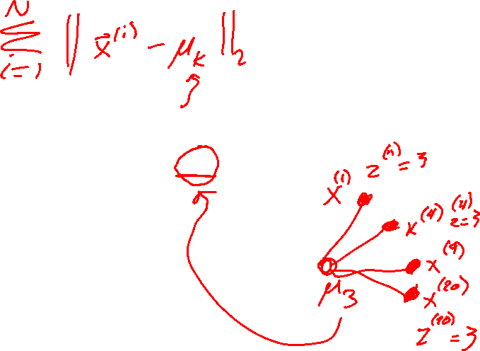
K-means Optimization
Computational complexity
$$μ_{1}, …, μ_{K},z=\underset{μ_{1}, …, μ_{K}, z}{argmin} \sum_{i=1}^{N}{{\left\|x^{(i)}−μ_{z^{(i)}}\right\|}_{2}^{2}}$$
Slide credit: CMU MLD Matt Gormley

Slide 22
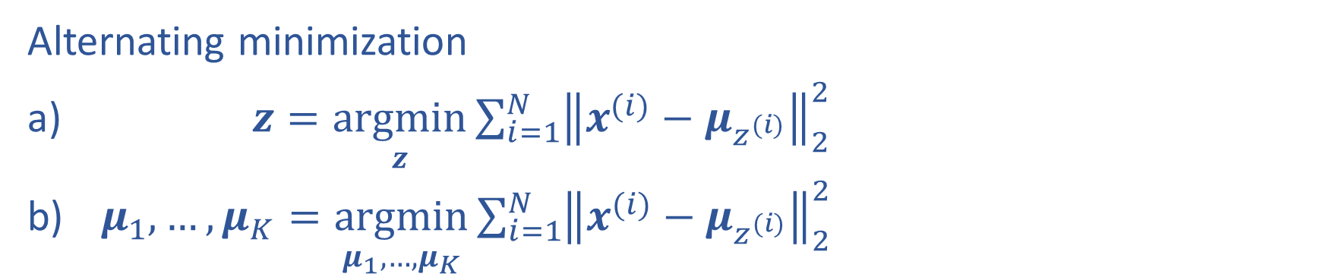
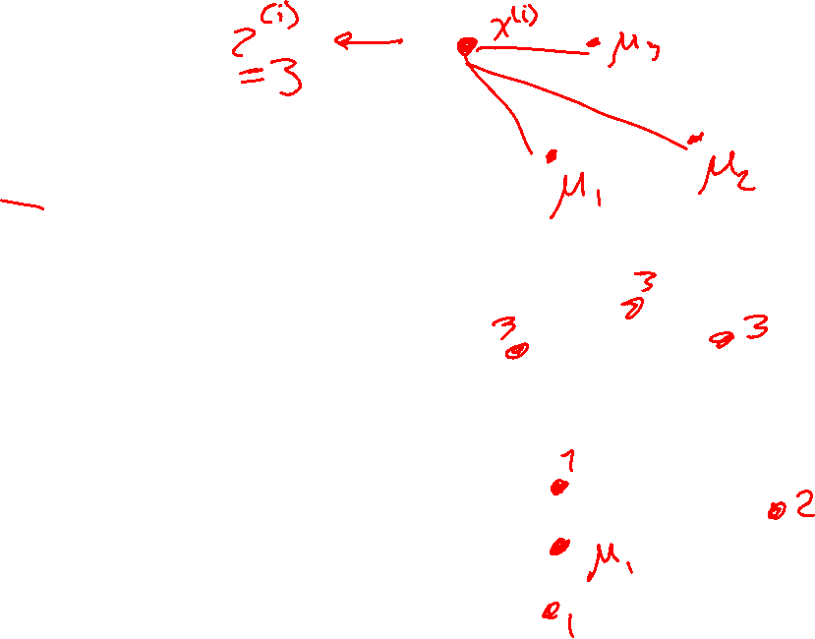
K-means Optimization
Alternating minimization
$z=\underset{z}{argmin}\sum_{i=1}^{N}{{\left\|x^{(i)}−μ_{z^{(i)}}\right\|}_{2}^{2}}$
$μ_{1}, …, μ_{K}=\underset{μ_{1}, …, μ_{K}}{argmin}\sum_{i=1}^{N}{{\left\|x^{(i)}−μ_{z^{(i)}}\right\|}_{2}^{2}}$

Slide 23
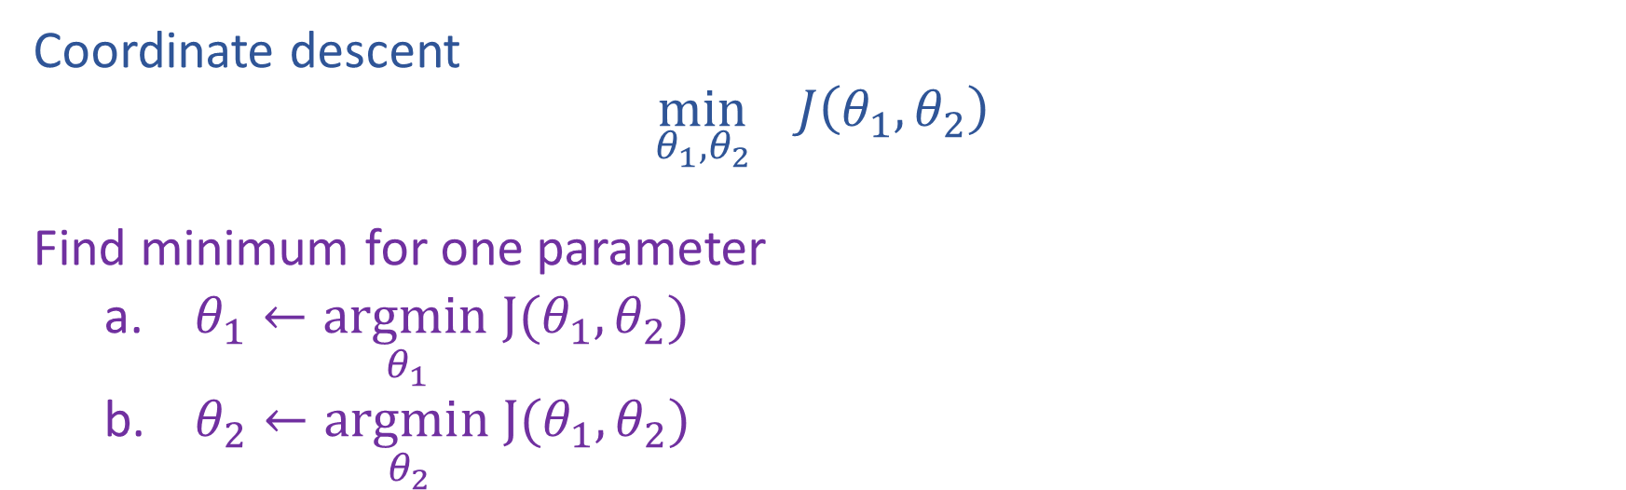
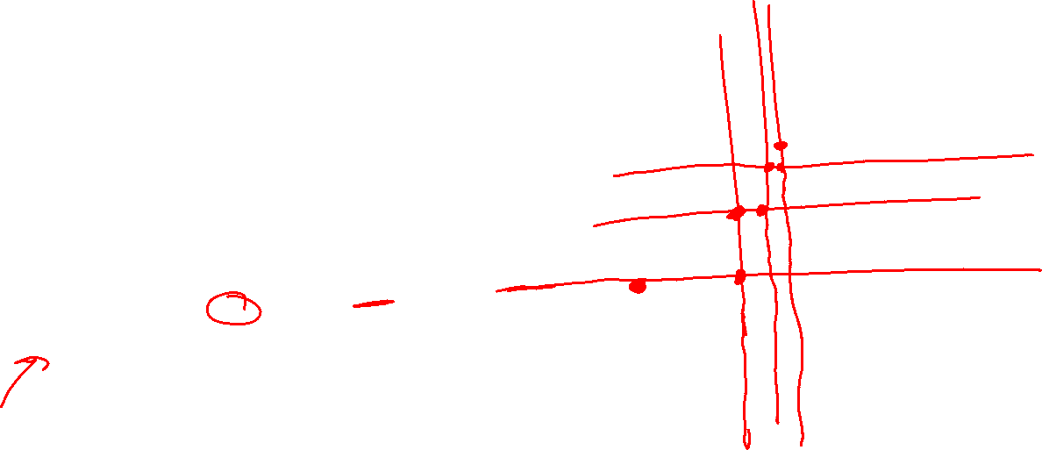
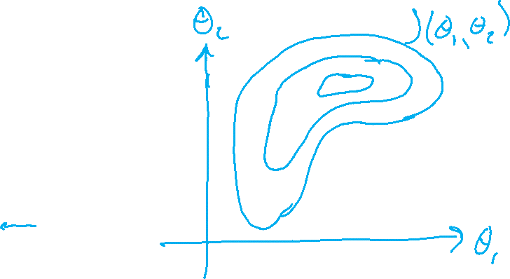
Alternating minimization
Coordinate descent
$$\min_{θ_{1},θ_{2}}{ J\left(θ_{1},θ_{2}\right)}$$
Find minimum for one parameter
    $θ_{1}←\underset{θ_{1} }{argmin}J(θ_{1},θ_{2})$
    $θ_{2}←\underset{θ_{2} }{argmin}J(θ_{1},θ_{2})$

Slide 24
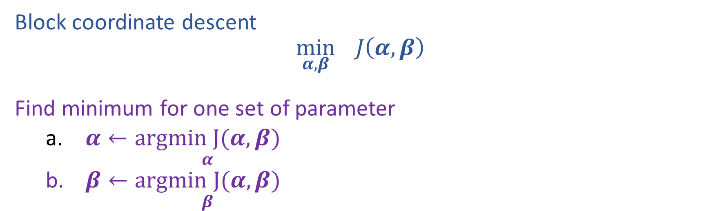
Alternating minimization
Block coordinate descent
$$\min_{α,β}{ J\left(α,β\right)}$$
Find minimum for one set of parameter
    $α←\underset{α}{argmin J(α, β)}$
    $β←\underset{β}{argmin J(α, β)}$

Slide 25
Gaussian Mixture Models

Slide 26
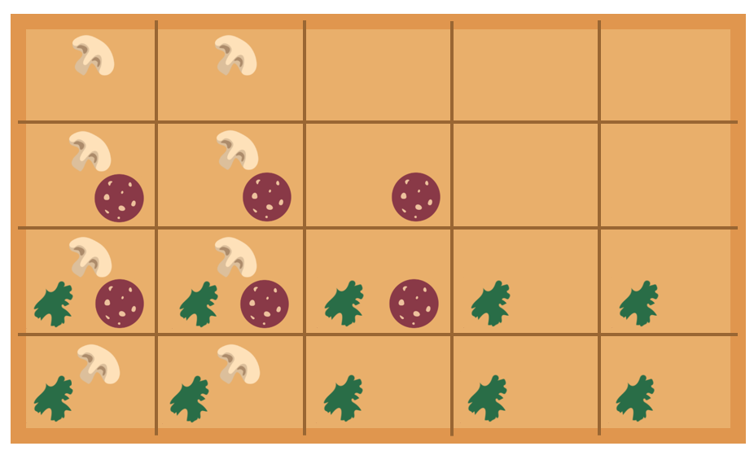
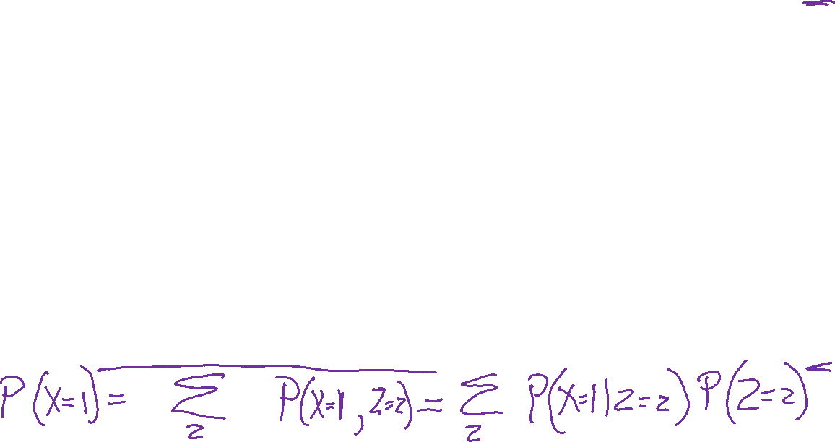
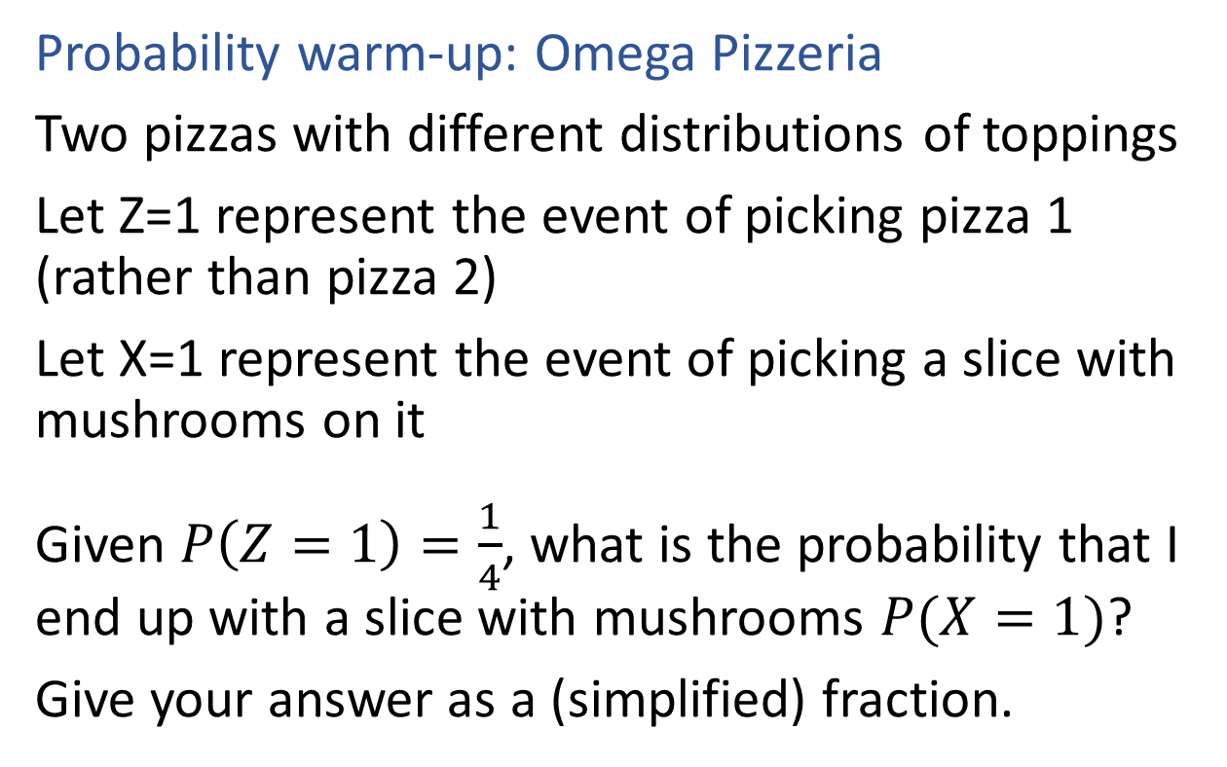
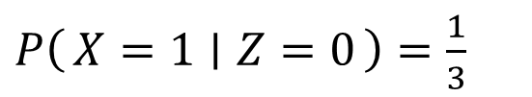
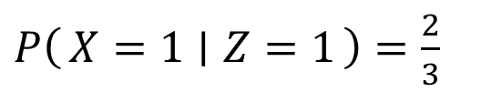
Poll 1
$P\left(X=1 ∣ Z=1\right)=\frac{2}{3}$
Probability warm-up: Omega Pizzeria
Two pizzas with different distributions of toppings
Let Z=1 represent the event of picking pizza 1 (rather than pizza 2)
Let X=1 represent the event of picking a slice with mushrooms on it
Given $P\left(Z=1\right)=\frac{1}{4}$, what is the probability that I end up with a slice with mushrooms $P(X=1)$?
Give your answer as a (simplified) fraction.
$P\left(X=1 ∣ Z=0\right)=\frac{1}{3}$

Slide 27
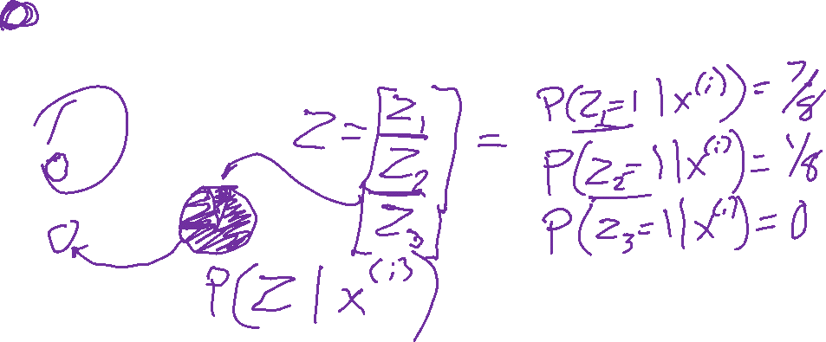
(One) bad case for K-means
Clusters may overlap
Some clusters may be “wider” than others
Clusters may not be linearly separable
Slide credit: CMU MLD Aarti Singh
TexPoint fonts used in EMF.
Read the TexPoint manual before you delete this box.: AAAAAAAAA

Slide 28
Partitioning Algorithms
K-means
  hard assignment: each object belongs to only one cluster
Mixture modeling
  soft assignment: probability that an object belongs to a cluster
  Generative approach
Slide credit: CMU MLD Aarti Singh

Slide 29



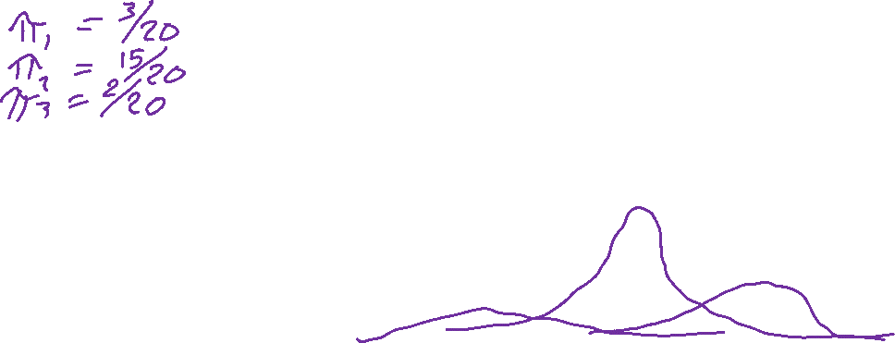
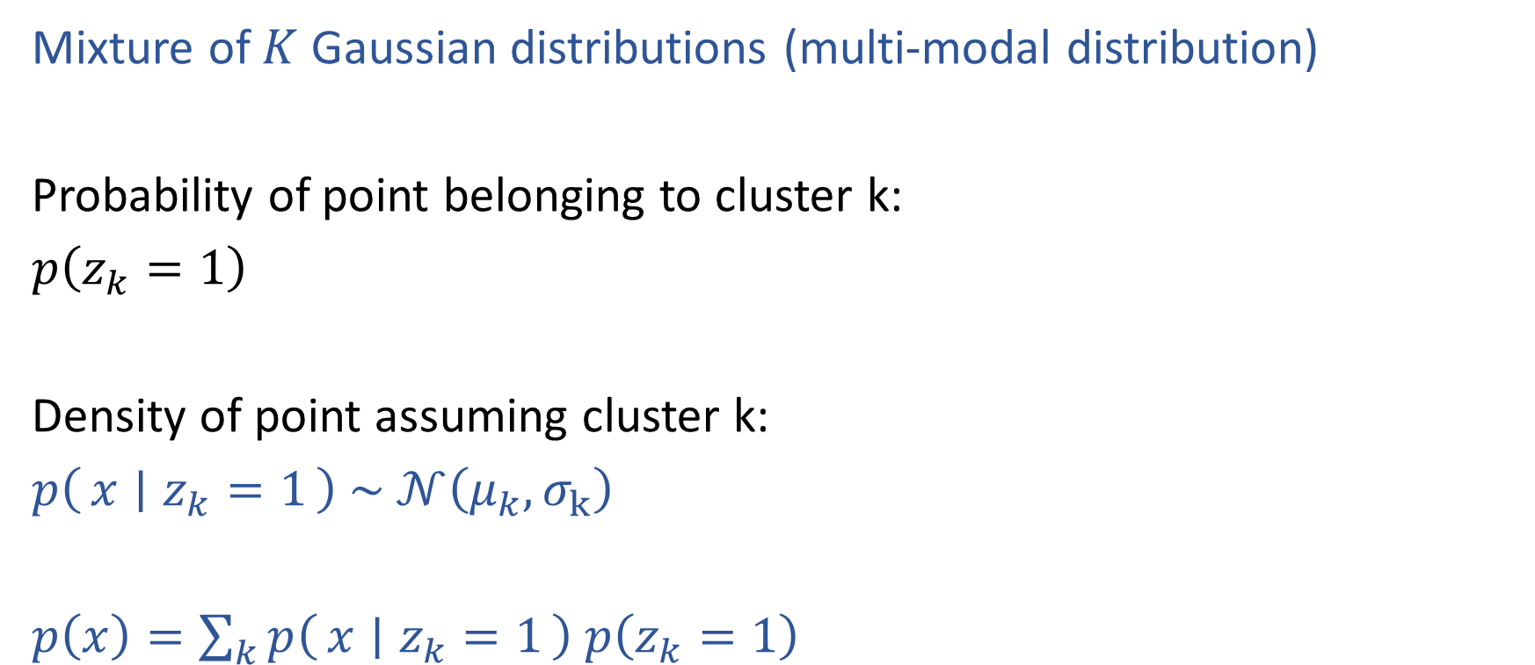


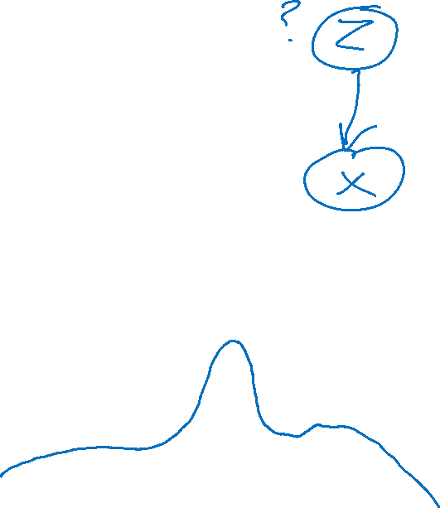

Gaussian Mixture Model
Mixture of $K$ Gaussian distributions (multi-modal distribution)
Probability of point belonging to cluster k:
$p\left(z_{k}=1\right)$
Density of point assuming cluster k:
$p\left(x ∣ z_{k}=1\right) \sim 𝒩\left(μ_{k}, σ_{k}\right)$
$p\left(x\right)=\sum_{k}{p\left(x ∣ z_{k}=1\right) p\left(z_{k}=1\right)}$
$$σ_{2}$$
$$σ_{1}$$
$$σ_{3}$$
Mixture
component
Mixture
proportion
$$μ_{1}$$
$$μ_{2}$$
$$μ_{3}$$

Slide 30





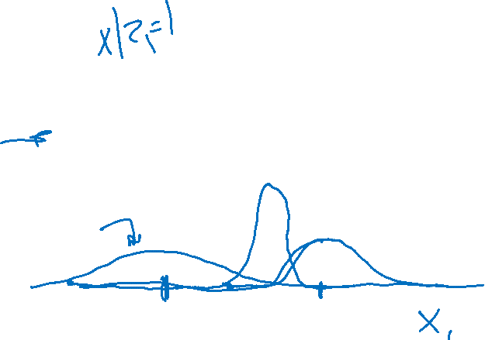

Gaussian Mixture Model
Mixture of $K$ Gaussian distributions (multi-modal distribution)
Probability of point belonging to cluster k:
$p\left(z_{k}=1\right)$
Density of point assuming cluster k:
$p\left(x ∣ z_{k}=1\right) \sim 𝒩\left(μ_{k}, σ_{k}\right)$
$p\left(x\right)=\sum_{k}{p\left(x ∣ z_{k}=1\right) p\left(z_{k}=1\right)}$
$$σ_{2}$$
$$σ_{1}$$
$$σ_{3}$$
Mixture
component
Mixture
proportion
$$μ_{1}$$
$$μ_{2}$$
$$μ_{3}$$

Slide 31



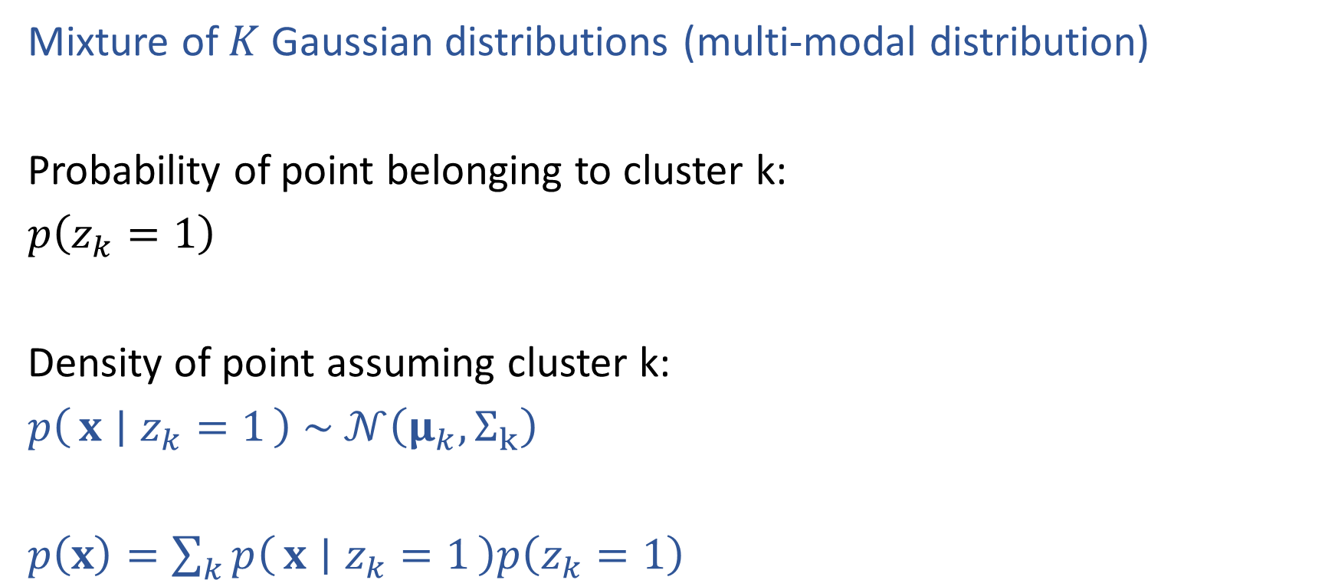


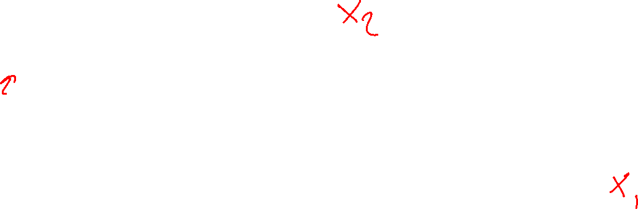

Gaussian Mixture Model
Mixture of $K$ Gaussian distributions (multi-modal distribution)
Probability of point belonging to cluster k:
$p\left(z_{k}=1\right)$
Density of point assuming cluster k:
$p\left(x ∣ z_{k}=1\right) \sim 𝒩\left(μ_{k}, Σ_{k}\right)$
$p\left(x\right)=\sum_{k}{p\left(x ∣ z_{k}=1\right)p\left(z_{k}=1\right)}$
$$Σ_{2}$$
$$Σ_{1}$$
$$μ_{2}$$
$$μ_{1}$$
$$μ_{3}$$
$$Σ_{3}$$
Mixture
component
Mixture
proportion

Slide 32
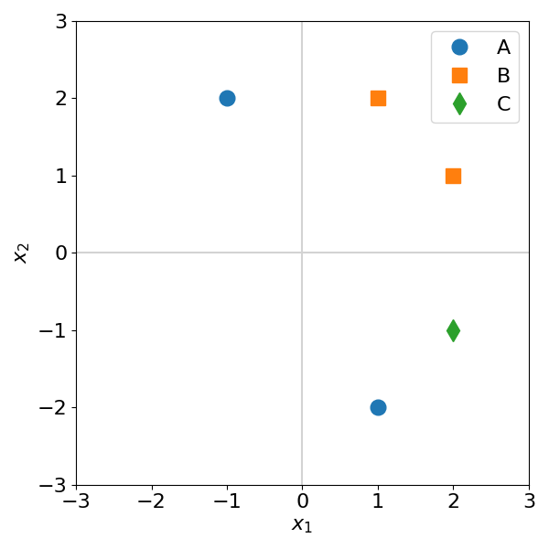
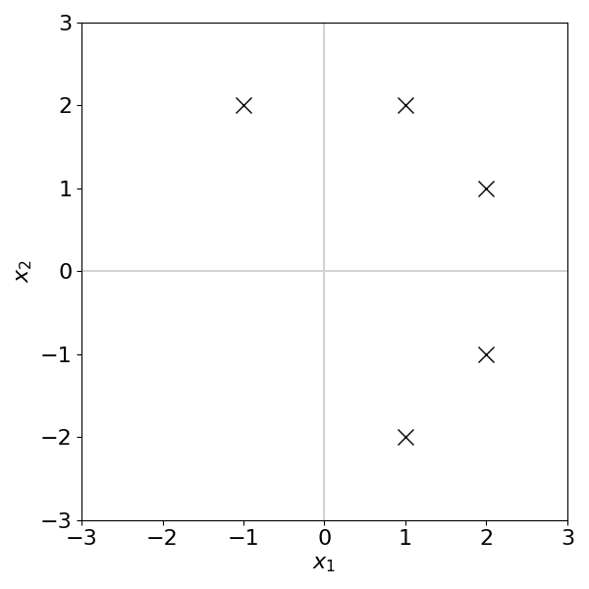
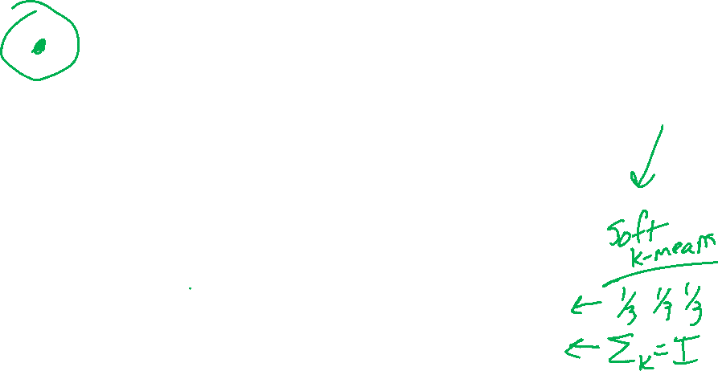
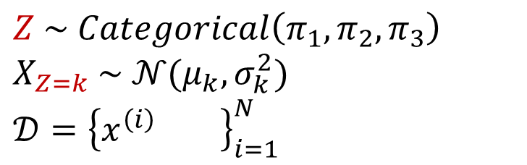
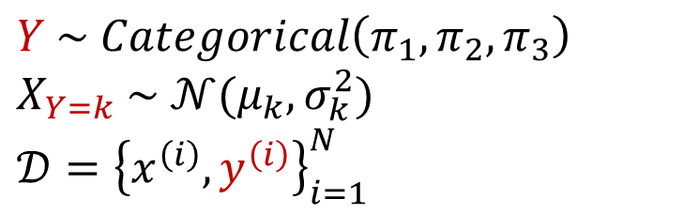
Generative Models: Supervised vs Unsupervised
Gaussian discriminant analysis vs Gaussian mixture models
$Y \sim Categorical\left(π_{1},π_{2},π_{3}\right)$
$X_{Y=k} \sim 𝒩(μ_{k},σ_{k}^{2})$
$𝒟={\left\{x^{\left(i\right)}, y^{\left(i\right)}\right\}}_{i=1}^{N}$
$Z \sim Categorical\left(π_{1},π_{2},π_{3}\right)$
$X_{Z=k} \sim 𝒩(μ_{k},σ_{k}^{2})$
$𝒟={\left\{x^{\left(i\right)} \right\}}_{i=1}^{N}$

Slide 33
Soft K-means
Working our way up to GMMs

Slide 34
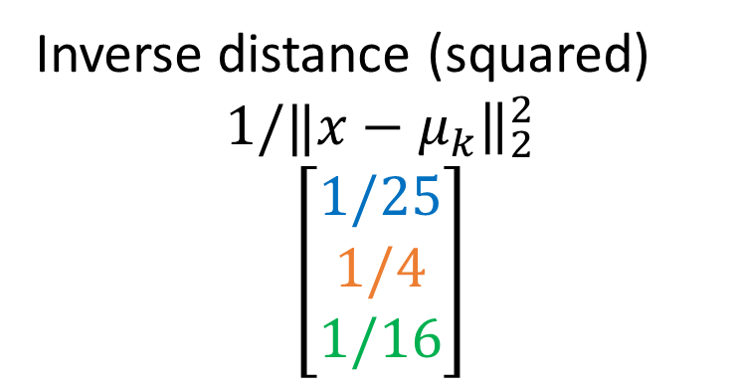

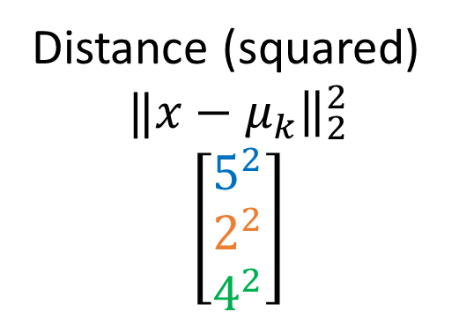
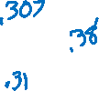
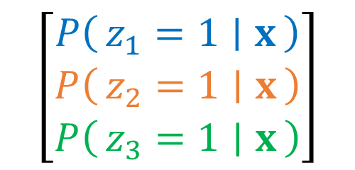



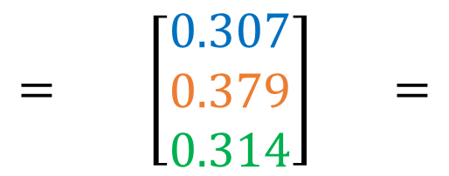

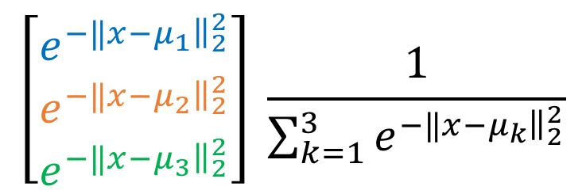
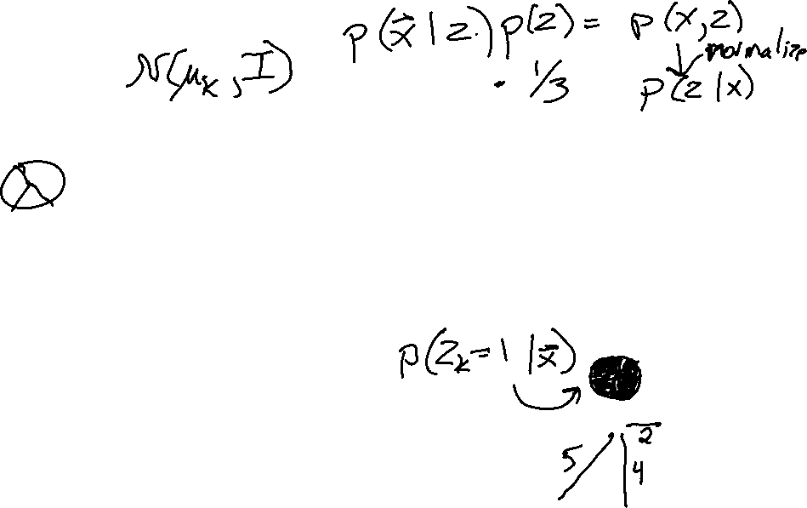
Soft K-means
Assume we have means, how could we estimate the probability a point belongs to each cluster?
Softmax of inverse squared distance
$$\left[\begin{matrix}P\left(z_{1}=1 ∣ x\right) \\ P\left(z_{2}=1 ∣ x\right) \\ P\left(z_{3}=1 ∣ x\right)\end{matrix}\right]$$
$$\left[\begin{matrix}e^{−‖x−μ_{1}{\left.​\right\|}_{2}^{2}} \\ e^{−‖x−μ_{2}{\left.​\right\|}_{2}^{2}} \\ e^{−‖x−μ_{3}{\left.​\right\|}_{2}^{2}}\end{matrix}\right] \frac{1}{\sum_{k=1}^{3}{e^{−‖x−μ_{k}{\left.​\right\|}_{2}^{2}}}}$$
$$= \left[\begin{matrix}0.307 \\ 0.379 \\ 0.314\end{matrix}\right] =$$
Inverse distance (squared)
$$1/‖x−μ_{k}{\left.​\right\|}_{2}^{2}$$
$$\left[\begin{matrix}1/25 \\ 1/4 \\ 1/16\end{matrix}\right]$$
Distance (squared)
$$‖x−μ_{k}{\left.​\right\|}_{2}^{2}$$
$$\left[\begin{matrix}5^{2} \\ 2^{2} \\ 4^{2}\end{matrix}\right]$$
$$x$$
$$μ_{2}$$
$$μ_{1}$$
$$μ_{3}$$

Slide 35
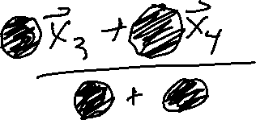
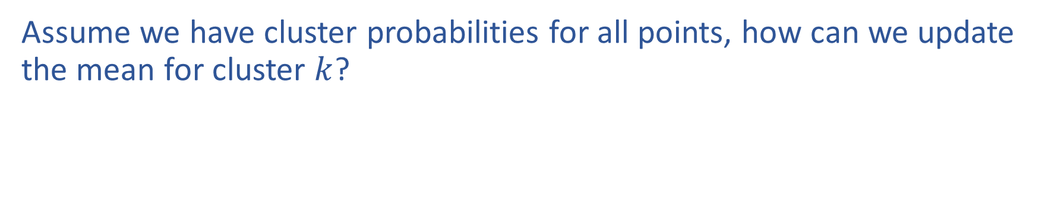
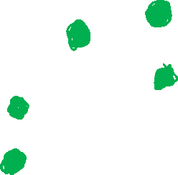

Soft K-means
Assume we have cluster probabilities for all points, how can we update the mean for cluster $k$?

Slide 36



Soft K-means
Assume we have cluster probabilities for all points, how can we update the mean for cluster $k$?

Slide 37



Soft K-means
Assume we have cluster probabilities for all points, how can we update the mean for cluster $k$?

Slide 38


Soft K-means
0) Initialize clusters
Repeat until convergence
Update cluster probabilities
Update cluster means

Slide 39
Back to (full) GMMs

Slide 40







Gaussian Mixture Model
Mixture of $K$ Gaussian distributions (multi-modal distribution)
There are $K$ components
Component $k$ generates data from a Gaussian with mean vector $μ_{k}$ and covariance matrix $Σ_{k}$
Each data point is generated according to the follow recipe:
Pick a component at random: Choose component $k$ with probability $p(z_{k}=1)$
Data point $x \sim 𝒩\left(μ_{k}, Σ_{k}\right)$
$$Σ_{2}$$
$$Σ_{1}$$
$$μ_{2}$$
$$μ_{1}$$
$$μ_{3}$$
$$Σ_{3}$$

Slide 41








Learning General GMM
Mixture of $K$ Gaussian distributions (multi-modal distribution)
$$x_{1},…, x_{M} \sim p\left(x\right)=\sum_{k=1}^{K}{p\left(x ∣ z_{k}=1\right)p(z_{k}=1)}$$
$$Σ_{2}$$
Mixture: $π_{k}≝p\left(z_{k}=1\right)$
Gaussian components:
$p\left(x ∣ z_{k}=1\right) \sim 𝒩\left(μ_{k}, Σ_{k}\right)$
Parameters:
$θ≝{\left\{π_{k}, μ_{k}, Σ_{k}\right\}}_{k=1}^{K}$
$$Σ_{1}$$
$$μ_{2}$$
$$μ_{1}$$
$$μ_{3}$$
$$Σ_{3}$$
How to estimate parameters? Can we do MLE even without labels $z$?

Slide 42




Learning General GMM
Maximize marginal likelihood:
$$\underset{θ}{argmax}{ \prod_{i}^{N}{p\left(x^{(i)}∣θ \right)}}$$
$$=\underset{θ}{argmax}{ \prod_{i}^{N}{\sum_{k=1}^{K}{p\left(x^{\left(i\right)},z_{k}^{(i)}=1∣θ \right)}}}$$
$$=\underset{θ}{argmax}{ \prod_{i}^{N}{\sum_{k=1}^{K}{p\left(z_{k}^{(i)}=1\right) p\left(x^{\left(i\right)}∣z_{k}^{(i)}=1\right)}}}$$
$$=\underset{θ}{argmax}{ \prod_{i}^{N}{\sum_{k=1}^{K}{ π_{k} {\left|Σ_{k}\right|}^{−\frac{1}{2}} e^{−\frac{1}{2}{\left(x^{(i)}−μ_{k}\right)}^{T}Σ_{k}^{−1}\left(x^{(i)}−μ_{k}\right)}}}}$$

Slide 43


Learning General GMM
Maximize marginal likelihood:
$$\underset{θ}{argmax}{ \prod_{i}^{N}{p\left(x^{(i)}∣θ \right)}}$$
$$=\underset{θ}{argmax}{ \prod_{i}^{N}{\sum_{k=1}^{K}{ π_{k} {\left|Σ_{k}\right|}^{−\frac{1}{2}} e^{−\frac{1}{2}{\left(x^{(i)}−μ_{k}\right)}^{T}Σ_{k}^{−1}\left(x^{(i)}−μ_{k}\right)}}}}$$
How do we find the $π_{k}, μ_{k}, Σ_{k}$ which give the max. marginal likelihood?
Set $\frac{∂}{∂μ_{k}}ℓ(θ;𝒟)=0$ and solve for $μ_{k}$, etc. ? No closed-form solution
Use gradient descent? Doable, but complicated, often slow, and need to consider constraints on parameters

Slide 44

Log (Marginal) Likelihood for Missing Data
Marginalize over missing data, $z^{(i)}$
$$ℓ\left(θ ∣ 𝒟\right)= log{ \prod_{i}^{N}{p\left(x^{(i)}∣θ \right)}}$$

Slide 45



Log (Marginal) Likelihood for Missing Data
Marginalize over missing data, $z^{(i)}$
$$ℓ\left(θ ∣ 𝒟\right)= log{ \prod_{i}^{N}{p\left(x^{(i)}∣θ \right)}}$$

Slide 46


GMM vs K-means
Maximize marginal likelihood:
$\underset{θ}{argmax}{ \prod_{i=1}^{N}{p\left(x^{(i)}∣θ \right)}}$
$=\underset{θ}{argmax}{ \prod_{i=1}^{N}{\sum_{k=1}^{K}{p\left(z^{\left(i\right)}=k\right) p\left(x^{\left(i\right)}∣z^{\left(i\right)}=k \right)}}}$
What happens if we assume a hard-assignment?
$p\left(z^{\left(i\right)}=k\right)=1$ if point $i$ belongs to the $k$-th cluster
(and assume variances are all the same)
$\underset{θ}{argmax}{ \prod_{i=1}^{N}{\sum_{k=1}^{K}{p\left(z^{\left(i\right)}=k\right) p\left(x^{\left(i\right)}∣z^{\left(i\right)}=k \right)}}}$
$=\underset{θ}{argmax}{ \prod_{i=1}^{N}{e^{−\frac{1}{2}{\left\|x^{\left(i\right)}−μ_{z^{\left(i\right)}}\right\|}_{2}^{2}}}}$
$=\underset{θ}{argmin}{ \sum_{i=1}^{N}{{\left\|x^{\left(i\right)}−μ_{z^{\left(i\right)}}\right\|}_{2}^{2}}}$ Same as K-means!

Slide 47

K-means Optimization
Alternating minimization
$z=\underset{z}{argmin}\sum_{i=1}^{N}{{\left\|x^{(i)}−μ_{z^{(i)}}\right\|}_{2}^{2}}$
$μ_{1}, …, μ_{K}=\underset{μ_{1}, …, μ_{K}}{argmin}\sum_{i=1}^{N}{{\left\|x^{(i)}−μ_{z^{(i)}}\right\|}_{2}^{2}}$
We're going to use alternating minimization to solve GMMs as well!

Slide 48
EM Algorithm for GMMs
We'll get to what EM means later

Slide 49


Learning General GMM
Mixture of $K$ Gaussian distributions (multi-modal distribution)
$$x_{1},…, x_{M} \sim p\left(x\right)=\sum_{k=1}^{K}{p\left(x ∣ Z_{k}=1\right)p(Z_{k}=1)}$$
$$Σ_{2}$$
Mixture: $π_{k}≝p\left(Z_{k}=1\right)$
Gaussian components:
$p\left(x ∣ Z_{k}=1\right) \sim 𝒩\left(μ_{k}, Σ_{k}\right)$
Parameters:
$θ≝{\left\{π_{k}, μ_{k}, Σ_{k}\right\}}_{k=1}^{K}$
$$Σ_{1}$$
$$μ_{2}$$
$$μ_{1}$$
$$μ_{3}$$
$$Σ_{3}$$
How to estimate parameters? Can we do MLE even without labels $z$?

Slide 50



EM for GMMS
Initialize parameters
For $t=0$, $π_{k}^{(0)}, μ_{k}^{(0)}, Σ_{k}^{(0)}$
E-step
For a fixed set of Gaussian mixture model parameters, $θ^{(t)}$, update the probability that each point, $x^{(i)}$, belongs to cluster $k$, $p\left(Z_{k}^{\left(i\right)}=1 ∣ x^{\left(i\right)}, θ^{\left(t\right)}\right)$
M-step
For a fixed $p\left(Z_{k}^{\left(i\right)}=1 ∣ x^{\left(i\right)}, θ^{\left(t\right)}\right)$, update the estimate for each parameter, $π_{k}^{(t+1)}, μ_{k}^{(t+1)}, Σ_{k}^{(t+1)}$
Iterate between E and M steps

Slide 51


EM for GMMs: Example
Σ₂
Σ₃
μ₂
μ₁
μ₃
Σ₁
P($z_{2}$ = 1 |x_{j},μ₁,μ₂,μ₃,Σ₁,Σ₂,Σ₃,$π$₁, $π$₂, $π$₃)

Slide 52

After 1st iteration

Slide 53

After 2nd iteration

Slide 54

After 3rd iteration

Slide 55

After 4th iteration

Slide 56

After 5th iteration

Slide 57

After 6th iteration

Slide 58

After 20th iteration

Slide 59



EM for GMMS
Complete Log likelihood $𝒟=\left\{x^{\left(i\right)},z^{(i)}\right\}$
$$ℓ_{c}\left(θ ∣ 𝒟_{c}\right)= log{ \prod_{i}^{N}{p\left(x^{\left(i\right)},z^{(i)}∣θ \right)}}$$
E-step
Estimated probabilistic cluster assignments $p\left(Z_{k}^{\left(i\right)}=1 ∣ x^{\left(i\right)}, θ^{\left(t\right)}\right)$
Formulate expected value over Z of complete log likelihood
M-step
$π_{k}^{(t+1)}$
$μ_{k}^{(t+1)} ={argmax}_{θ} E_{Z∣X, θ^{(t)}}\left[ℓ_{c}\left(θ ∣ 𝒟_{c}\right)\right]$
$Σ_{k}^{(t+1)}$

Slide 60





EM for GMMS
E-step
M-step

Slide 61
Optimization formulation
Supervised vs Unsupervised
Gaussian discriminant anaylasis vs Gaussian Mixuture Models

Slide 62



Generative Models: Supervised vs Unsupervised
Gaussian discriminant analysis vs Gaussian mixture models
$Y \sim Categorical\left(π_{1},π_{2},π_{3}\right)$
$X_{Y=k} \sim 𝒩(μ_{k},σ_{k}^{2})$
$𝒟={\left\{x^{\left(i\right)}, y^{\left(i\right)}\right\}}_{i=1}^{N}$
$Z \sim Categorical\left(π_{1},π_{2},π_{3}\right)$
$X_{Z=k} \sim 𝒩(μ_{k},σ_{k}^{2})$
$𝒟={\left\{x^{\left(i\right)} \right\}}_{i=1}^{N}$

Slide 63







Generative Model: Supervised
MLE: Gaussian discriminant analysis
$Y \sim Categorical\left(π_{1},π_{2},π_{3}\right)$
$X_{Y=k} \sim 𝒩(μ_{k},σ_{k}^{2})$.
$𝒟={\left\{x^{\left(i\right)}, y^{\left(i\right)}\right\}}_{i=1}^{N}$
$$\underset{θ}{argmax}{ \prod_{i}^{N}{p\left(x^{\left(i\right)},y^{(i)} \right)}}$$

Slide 64




Generative Model: Supervised
MLE: Gaussian discriminant analysis
$Y \sim Categorical\left(π_{1},π_{2},π_{3}\right)$
$X_{Y=k} \sim 𝒩(μ_{k},σ_{k}^{2})$.
$𝒟={\left\{x^{\left(i\right)}, y^{\left(i\right)}\right\}}_{i=1}^{N}$
$$\underset{θ}{argmax}{ \prod_{i}^{N}{p\left(x^{\left(i\right)},y^{(i)} \right)}}$$
$$=\underset{θ}{argmax}{ \prod_{i}^{N}{\prod_{k}^{K}{p{\left(x^{\left(i\right)},Y_{k}^{\left(i\right)}=1 \right)}^{y_{k}^{(i)}}}}}$$
$$=\underset{θ}{argmax}{ \prod_{i}^{N}{\prod_{k}^{K}{{\left(p\left(Y_{k}^{\left(i\right)}=1\right) p\left(x^{\left(i\right)}∣Y_{k}^{\left(i\right)}=1\right)\right)}^{y_{k}^{(i)}}}}}$$
$$=\underset{θ}{argmax}{ \prod_{i}^{N}{\prod_{k}^{K}{{\left(π_{k} {\left|Σ_{k}\right|}^{−\frac{1}{2}} e^{−\frac{1}{2}{\left(x^{\left(i\right)}−μ_{k}\right)}^{T}Σ_{k}^{−1}\left(x^{\left(i\right)}−μ_{k}\right)}\right)}^{y_{k}^{(i)}}}}}$$
$$=\underset{θ}{argmax}{ log\prod_{i}^{N}{\prod_{k}^{K}{{\left(π_{k} {\left|Σ_{k}\right|}^{−\frac{1}{2}} e^{−\frac{1}{2}{\left(x^{\left(i\right)}−μ_{k}\right)}^{T}Σ_{k}^{−1}\left(x^{\left(i\right)}−μ_{k}\right)}\right)}^{y_{k}^{(i)}}}}}$$
$$=\underset{θ}{argmax}{ \sum_{i}^{N}{\sum_{k}^{k}{y_{k}^{(i)} log }}\left(π_{k} {\left|Σ_{k}\right|}^{−\frac{1}{2}} e^{−\frac{1}{2}{\left(x^{\left(i\right)}−μ_{k}\right)}^{T}Σ_{k}^{−1}\left(x^{\left(i\right)}−μ_{k}\right)}\right)}$$

Slide 65






Generative Models: Supervised vs Unsupervised
Discriminant analysis vs Gaussian mixture models
$$\underset{θ}{argmax}{ \prod_{i}^{N}{p\left(x^{\left(i\right)},y^{(i)} \right)}}$$
$$\underset{θ}{argmax}{ \prod_{i}^{N}{p\left(x^{(i)}\right)}}$$
$$=\underset{θ}{argmax}{ \prod_{i}^{N}{\prod_{k}^{K}{p{\left(x^{\left(i\right)},Y_{k}^{\left(i\right)}=1 \right)}^{y_{k}^{(i)}}}}}$$
$$=\underset{θ}{argmax}{ \prod_{i}^{N}{ }}$$
$$=\underset{θ}{argmax}{ \prod_{i}^{N}{\prod_{k}^{K}{{\left(p\left(Y_{k}^{\left(i\right)}=1\right) p\left(x^{\left(i\right)}∣Y_{k}^{\left(i\right)}=1\right)\right)}^{y_{k}^{(i)}}}}}$$

Slide 66




Generative Models: Supervised vs Unsupervised
Discriminant analysis vs Gaussian mixture models
$$\underset{θ}{argmax}{ \prod_{i}^{N}{p\left(x^{\left(i\right)},y^{(i)} \right)}}$$
$$\underset{θ}{argmax}{ \prod_{i}^{N}{p\left(x^{(i)} \right)}}$$
$$=\underset{θ}{argmax}{ \prod_{i}^{N}{\prod_{k}^{K}{p{\left(x^{\left(i\right)},Y_{k}^{\left(i\right)}=1 \right)}^{y_{k}^{(i)}}}}}$$
$$=\underset{θ}{argmax}{ \prod_{i}^{N}{\sum_{k=1}^{K}{p\left(x^{\left(i\right)},Z_{k}^{(i)}=1 \right)}}}$$
$$=\underset{θ}{argmax}{ \prod_{i}^{N}{\prod_{k}^{K}{{\left(p\left(Y_{k}^{\left(i\right)}=1\right) p\left(x^{\left(i\right)}∣Y_{k}^{\left(i\right)}=1\right)\right)}^{y_{k}^{(i)}}}}}$$
$$=\underset{θ}{argmax}{ \prod_{i}^{N}{\sum_{k=1}^{K}{p\left(Z_{k}^{(i)}=1\right) p\left(x^{\left(i\right)}∣Z_{k}^{(i)}=1\right)}}}$$

Slide 67








Generative Models: Supervised vs Unsupervised
Discriminant analysis vs Gaussian mixture models
$$\underset{θ}{argmax}{ \prod_{i}^{N}{p\left(x^{\left(i\right)},y^{(i)}∣θ \right)}}$$
$$\underset{θ}{argmax}{ \prod_{i}^{N}{p\left(x^{(i)}∣θ \right)}}$$
$$=\underset{θ}{argmax}{ \prod_{i}^{N}{\prod_{k}^{K}{p{\left(x^{\left(i\right)},Y_{k}^{\left(i\right)}=1∣θ \right)}^{y_{k}^{(i)}}}}}$$
$$=\underset{θ}{argmax}{ \prod_{i}^{N}{\sum_{k=1}^{K}{p\left(x^{\left(i\right)},Z_{k}^{(i)}=1∣θ \right)}}}$$
$$=\underset{θ}{argmax}{ \prod_{i}^{N}{\prod_{k}^{K}{{\left(p\left(Y_{k}^{\left(i\right)}=1\right) p\left(x^{\left(i\right)}∣Y_{k}^{\left(i\right)}=1\right)\right)}^{y_{k}^{(i)}}}}}$$
$$=\underset{θ}{argmax}{ \prod_{i}^{N}{\sum_{k=1}^{K}{p\left(Z_{k}^{(i)}=1\right) p\left(x^{\left(i\right)}∣Z_{k}^{(i)}=1\right)}}}$$
$$=\underset{θ}{argmax}{ \prod_{i}^{N}{\prod_{k}^{K}{{\left(π_{k} {\left|Σ_{k}\right|}^{−\frac{1}{2}} e^{−\frac{1}{2}{\left(x^{\left(i\right)}−μ_{k}\right)}^{T}Σ_{k}^{−1}\left(x^{\left(i\right)}−μ_{k}\right)}\right)}^{y_{k}^{(i)}}}}}$$
$$=\underset{θ}{argmax}{ \prod_{i}^{N}{\sum_{k=1}^{K}{ π_{k} {\left|Σ_{k}\right|}^{−\frac{1}{2}} e^{−\frac{1}{2}{\left(x^{(i)}−μ_{k}\right)}^{T}Σ_{k}^{−1}\left(x^{(i)}−μ_{k}\right)}}}}$$
$$=\underset{θ}{argmax}{ log\prod_{i}^{N}{\prod_{k}^{K}{{\left(π_{k} {\left|Σ_{k}\right|}^{−\frac{1}{2}} e^{−\frac{1}{2}{\left(x^{\left(i\right)}−μ_{k}\right)}^{T}Σ_{k}^{−1}\left(x^{\left(i\right)}−μ_{k}\right)}\right)}^{y_{k}^{(i)}}}}}$$
$$=\underset{θ}{argmax}{ log\prod_{i}^{N}{\sum_{k=1}^{K}{ π_{k} {\left|Σ_{k}\right|}^{−\frac{1}{2}} e^{−\frac{1}{2}{\left(x^{(i)}−μ_{k}\right)}^{T}Σ_{k}^{−1}\left(x^{(i)}−μ_{k}\right)}}}}$$
$$=\underset{θ}{argmax}{ \sum_{i}^{N}{\sum_{k}^{k}{y_{k}^{(i)} log }}\left(π_{k} {\left|Σ_{k}\right|}^{−\frac{1}{2}} e^{−\frac{1}{2}{\left(x^{\left(i\right)}−μ_{k}\right)}^{T}Σ_{k}^{−1}\left(x^{\left(i\right)}−μ_{k}\right)}\right)}$$
$$=\underset{θ}{argmax}{ \sum_{i}^{N}{log}\sum_{k=1}^{K}{ π_{k} {\left|Σ_{k}\right|}^{−\frac{1}{2}} e^{−\frac{1}{2}{\left(x^{(i)}−μ_{k}\right)}^{T}Σ_{k}^{−1}\left(x^{(i)}−μ_{k}\right)}}}$$

Slide 68
Expectation-Maximization for GMM

Slide 69












Supervised vs Unsupervised Log Likelihood
Supervised $𝒟_{supervised}=\left\{x^{\left(i\right)},y^{(i)}\right\}$
Log likelihood $𝒟=\left\{x^{(i)}\right\}$
$$ℓ\left(θ ∣ 𝒟_{supervised}\right)$$
$$ℓ\left(θ ∣ 𝒟\right)$$
$$=log\prod_{i}^{N}{p\left(x^{\left(i\right)},y^{(i)}\right)}$$
$$=\log{ \prod_{i}^{N}{p\left(x^{(i)}\right)}}$$
$$=log\prod_{i}^{N}{\prod_{k}^{K}{{p\left(x^{\left(i\right)},Y_{k}^{\left(i\right)}=1\right)}^{y_{k}^{(i)}}}}$$
$$=\log{ \prod_{i}^{N}{\sum_{k}^{K}{p\left(x^{\left(i\right)},Z_{k}^{(i)}=1\right)}}}$$
$$=log\prod_{i}^{N}{\prod_{k}^{K}{{\left(p\left(Y_{k}^{\left(i\right)}=1\right) p\left(x^{\left(i\right)}∣Y_{k}^{\left(i\right)}=1\right)\right)}^{y_{k}^{(i)}}}}$$
$$=\log{ \prod_{i}^{N}{\sum_{k}^{K}{p\left(Z_{k}^{(i)}=1\right) p\left(x^{\left(i\right)}∣Z_{k}^{(i)}=1\right)}}}$$
$$=\sum_{i}^{N}{\sum_{k}^{K}{y_{k}^{(i)}\log\left(p\left(Y_{k}^{\left(i\right)}=1\right) p\left(x^{\left(i\right)}∣Y_{k}^{\left(i\right)}=1\right)\right)}}$$
$$=\sum_{i}^{N}{\log{\sum_{k}^{K}{p\left(Z_{k}^{(i)}=1\right) p\left(x^{\left(i\right)}∣Z_{k}^{(i)}=1\right)}}}{ }$$

Slide 70






Unsupervised vs Supervised
Log is stuck outside of the summation over z ☹
$$DATASET$$
$$ℓ\left(θ ∣ DATASET\right)$$
Unsupervised
$𝒟=\left\{x^{\left(i\right)}\right\}$
$$\sum_{i}^{N}{\log{ \sum_{k=1}^{K}{ p\left(Z_{k}^{(i)}=1\right) p\left(x^{\left(i\right)}∣Z_{k}^{(i)}=1\right)}}}{ }$$
Supervised
$𝒟_{supervised}=\left\{x^{\left(i\right)},y^{(i)}\right\}$
$$\sum_{i}^{N}{\sum_{k}^{K}{ y_{k}^{(i)} \log\left(p\left(Y_{k}^{\left(i\right)}=1\right) p\left(x^{\left(i\right)}∣Y_{k}^{\left(i\right)}=1\right)\right)}}$$

Slide 71



Unsupervised vs Supervised vs Complete Log Likelihood
Complete log likelihood: Pretend that we have the cluster labels in the dataset
$$DATASET$$
$$ℓ\left(θ ∣ DATASET\right)$$
Unsupervised
$𝒟=\left\{x^{\left(i\right)}\right\}$
$$\sum_{i}^{N}{\log{ \sum_{k=1}^{K}{ p\left(Z_{k}^{(i)}=1\right) p\left(x^{\left(i\right)}∣Z_{k}^{(i)}=1\right)}}}{ }$$
Supervised
$𝒟_{supervised}=\left\{x^{\left(i\right)},y^{(i)}\right\}$
$$\sum_{i}^{N}{\sum_{k}^{K}{ y_{k}^{(i)} \log\left(p\left(Y_{k}^{\left(i\right)}=1\right) p\left(x^{\left(i\right)}∣Y_{k}^{\left(i\right)}=1\right)\right)}}$$
Complete
$𝒟_{complete}=\left\{x^{\left(i\right)},z^{(i)}\right\}$
$$\sum_{i}^{N}{\sum_{k}^{K}{z_{k}^{(i)}\log\left(p\left(Z_{k}^{\left(i\right)}=1\right) p\left(x^{\left(i\right)}∣Z_{k}^{\left(i\right)}=1\right)\right)}}$$

Slide 72








Expected Value of Complete Log Likelihood
Supervised $𝒟_{supervised}=\left\{x^{\left(i\right)},y^{(i)}\right\}$
Complete Log likelihood $𝒟_{c}=\left\{x^{\left(i\right)},z^{(i)}\right\}$
$$ℓ\left(θ ∣ 𝒟_{supervised}\right)$$
$$𝔼_{Z∣X,θ}\left[ℓ_{c}\left(θ ∣ 𝒟_{c}\right)\right]$$
$$=log\prod_{i}^{N}{p\left(x^{\left(i\right)},y^{(i)}\right)}$$
$$=𝔼_{Z∣X,θ}\left[log\prod_{i}^{N}{p\left(x^{\left(i\right)},Z^{(i)}\right)}\right]$$
$$=\sum_{i}^{N}{\sum_{k}^{K}{y_{k}^{(i)}\log\left(p\left(Y_{k}^{\left(i\right)}=1\right) p\left(x^{\left(i\right)}∣Y_{k}^{\left(i\right)}=1\right)\right)}}$$
$$=\sum_{i}^{N}{\sum_{k}^{K}{p\left(Z_{k}^{(i)}=1∣x^{(i)}\right)\log\left(p\left(Z_{k}^{\left(i\right)}=1\right) p\left(x^{\left(i\right)}∣Z_{k}^{\left(i\right)}=1\right)\right)}}$$

Slide 73












Details: Expected Value of Complete Log Likelihood
Supervised $𝒟_{supervised}=\left\{x^{\left(i\right)},y^{(i)}\right\}$
Complete Log likelihood $𝒟_{c}=\left\{x^{\left(i\right)},z^{(i)}\right\}$
$$ℓ\left(θ ∣ 𝒟_{supervised}\right)$$
$$𝔼_{Z∣X,θ}\left[ℓ_{c}\left(θ ∣ 𝒟_{c}\right)\right]$$
$$=log\prod_{i}^{N}{p\left(x^{\left(i\right)},y^{(i)}\right)}$$
$$=𝔼_{Z∣X,θ}\left[log\prod_{i}^{N}{p\left(x^{\left(i\right)},Z^{(i)}\right)}\right]$$
$$=log\prod_{i}^{N}{\prod_{k}^{K}{{p\left(x^{\left(i\right)},Y_{k}^{\left(i\right)}=1\right)}^{y_{k}^{(i)}}}}$$
$$=𝔼_{Z∣X,θ}\left[log\prod_{i}^{N}{\prod_{k}^{K}{p{\left(x^{\left(i\right)},Z_{k}^{\left(i\right)}=1\right)}^{Z_{k}^{(i)}}}}\right]$$
$$=log\prod_{i}^{N}{\prod_{k}^{K}{{\left(p\left(Y_{k}^{\left(i\right)}=1\right) p\left(x^{\left(i\right)}∣Y_{k}^{\left(i\right)}=1\right)\right)}^{y_{k}^{(i)}}}}$$
$$=𝔼_{Z∣X,θ}\left[log\prod_{i}^{N}{\prod_{k}^{K}{{\left(p\left(Z_{k}^{\left(i\right)}=1\right) p\left(x^{\left(i\right)}∣Z_{k}^{\left(i\right)}=1\right)\right)}^{Z_{k}^{(i)}}}}\right]$$
$$=\sum_{i}^{N}{\sum_{k}^{K}{y_{k}^{(i)}\log\left(p\left(Y_{k}^{\left(i\right)}=1\right) p\left(x^{\left(i\right)}∣Y_{k}^{\left(i\right)}=1\right)\right)}}$$
$$=𝔼_{Z∣X,θ}\left[\sum_{i}^{N}{\sum_{k}^{K}{Z_{k}^{(i)}\log\left(p\left(Z_{k}^{\left(i\right)}=1\right) p\left(x^{\left(i\right)}∣Z_{k}^{\left(i\right)}=1\right)\right)}}\right]$$
$$=\sum_{i}^{N}{\sum_{k}^{K}{𝔼_{Z∣X,θ}\left[Z_{k}^{(i)}\right]\log\left(p\left(Z_{k}^{\left(i\right)}=1\right) p\left(x^{\left(i\right)}∣Z_{k}^{\left(i\right)}=1\right)\right)}}$$
$$=\sum_{i}^{N}{\sum_{k}^{K}{p\left(Z_{k}^{(i)}=1∣x^{(i)}\right)\log\left(p\left(Z_{k}^{\left(i\right)}=1\right) p\left(x^{\left(i\right)}∣Z_{k}^{\left(i\right)}=1\right)\right)}}$$

Slide 74


Details: Expected Value of Complete Log Likelihood
Complete Log likelihood $𝒟_{c}=\left\{x^{\left(i\right)},z^{(i)}\right\}$
$$𝔼_{Z∣X,θ}\left[ℓ_{c}\left(θ ∣ 𝒟_{c}\right)\right]$$
$$=𝔼_{Z∣X,θ}\left[log\prod_{i}^{N}{p\left(x^{\left(i\right)},Z^{(i)}\right)}\right]$$
$$=𝔼_{Z∣X,θ}\left[log\prod_{i}^{N}{\prod_{k}^{K}{p{\left(x^{\left(i\right)},Z_{k}^{\left(i\right)}=1\right)}^{Z_{k}^{(i)}}}}\right]$$
Even more details
$$=𝔼_{Z∣X,θ}\left[log\prod_{i}^{N}{\prod_{k}^{K}{{\left(p\left(Z_{k}^{\left(i\right)}=1\right) p\left(x^{\left(i\right)}∣Z_{k}^{\left(i\right)}=1\right)\right)}^{Z_{k}^{(i)}}}}\right]$$
$𝔼_{Z∣X,θ}\left[Z_{k}^{(i)}\right]$
$$=\sum_{z_{k}∈\{0,1\}}{z_{k}}p\left({Z_{k}^{\left(i\right)}=z}_{k}∣x^{(i)}\right)$$
$$= 0 + 1⋅p\left({Z_{k}^{\left(i\right)}=z}_{k}∣x^{\left(i\right)}\right)$$
$$=p\left({Z_{k}^{\left(i\right)}=z}_{k}∣x^{\left(i\right)}\right)$$
$$=𝔼_{Z∣X,θ}\left[\sum_{i}^{N}{\sum_{k}^{K}{Z_{k}^{(i)}\log\left(p\left(Z_{k}^{\left(i\right)}=1\right) p\left(x^{\left(i\right)}∣Z_{k}^{\left(i\right)}=1\right)\right)}}\right]$$
$$=\sum_{i}^{N}{\sum_{k}^{K}{𝔼_{Z∣X,θ}\left[Z_{k}^{(i)}\right]\log\left(p\left(Z_{k}^{\left(i\right)}=1\right) p\left(x^{\left(i\right)}∣Z_{k}^{\left(i\right)}=1\right)\right)}}$$
$$=\sum_{i}^{N}{\sum_{k}^{K}{p\left(Z_{k}^{(i)}=1∣x^{(i)}\right)\log\left(p\left(Z_{k}^{\left(i\right)}=1\right) p\left(x^{\left(i\right)}∣Z_{k}^{\left(i\right)}=1\right)\right)}}$$

Slide 75
Notes on EM
EM is an optimization strategy for objective functions that can be interpreted as likelihoods in the presence of missing data.
It is much simpler than gradient methods:
  No need to choose step size.
  Enforces constraints.
  Calls inference and fully observed learning as subroutines.
EM is an Iterative algorithm with two linked steps:
  E-step: fill-in hidden values using inference, p(z|x, θ^{t}).
  M-step: update parameters t+1 using standard MLE/MAP method applied to completed data
This procedure monotonically improves (or leaves it unchanged). Thus, it always converges to a local optimum of the likelihood.

Slide 76

EM for GMMS
Complete Log likelihood $𝒟=\left\{x^{\left(i\right)},z^{(i)}\right\}$
$$ℓ_{c}\left(θ ∣ 𝒟_{c}\right)= log{ \prod_{i}^{N}{p\left(x^{\left(i\right)},z^{(i)}∣θ \right)}}$$
E-step
Estimated probabilistic cluster assignments $p\left(Z_{k}^{\left(i\right)}=1 ∣ x^{\left(i\right)}, θ^{\left(t\right)}\right)$
Formulate expected value over Z of complete log likelihood
M-step
$π_{k}^{(t+1)}$
$μ_{k}^{(t+1)} ={argmax}_{θ} E_{Z∣X, θ^{(t)}}\left[ℓ_{c}\left(θ ∣ 𝒟_{c}\right)\right]$
$Σ_{k}^{(t+1)}$

Slide 77


EM for GMMS
Initialize parameters
For $t=0$, $π_{k}^{(0)}, μ_{k}^{(0)}, Σ_{k}^{(0)}$
E-step
For a fixed set of Gaussian mixture model parameters, $θ^{(t)}$, update the probability that each point, $x^{(i)}$, belongs to cluster $k$, $p\left(Z_{k}^{\left(i\right)}=1 ∣ x^{\left(i\right)}, θ^{\left(t\right)}\right)$
M-step
For a fixed $p\left(Z_{k}^{\left(i\right)}=1 ∣ x^{\left(i\right)}, θ^{\left(t\right)}\right)$, update the estimate for each parameter, $π_{k}^{(t+1)}, μ_{k}^{(t+1)}, Σ_{k}^{(t+1)}$
Iterate between E and M steps

Slide 78
EM for GMMS
E-step
M-step

Slide 79
General EM Algorithm

Slide 80

Theory underlying EM
What are we doing?
Recall that according to MLE, we intend to learn the model parameter that would have maximize the likelihood of the data.
But we do not observe z, so computing
is difficult!
What shall we do?

Slide 81


Complete & Incomplete Log Likelihoods
Complete log likelihood
  Let X denote the observable variable(s), and Z denote the latent variable(s).
  If Z could be observed, then
  Usually, optimizing l_{c}() given both z and x is straightforward (c.f. MLE for fully observed models).
  Recalled that in this case the objective for, e.g., MLE, decomposes into a sum of factors, the parameter for each factor can be estimated separately.
  But given that Z is not observed, l_{c}() is a random quantity, cannot be maximized directly.
Incomplete log likelihood
  With z unobserved, our objective becomes the log of a marginal probability:
  This objective won't decouple

Slide 82





Expected Complete Log Likelihood
For any distribution q(z), define expected complete log likelihood:
    A deterministic function of θ
    Linear in l_{c}() --- inherit its factorizabiility
    Does maximizing this surrogate yield a maximizer of the likelihood?
Jensen’s inequality

Slide 83





Lower Bounds and Free Energy
For fixed data x, define a functional called the free energy:
The EM algorithm is coordinate-ascent on F :
  E-step:
  M-step:

Slide 84



E-step: maximization of expected l_{c} w.r.t. q
Claim:
  This is the posterior distribution over the latent variables given the data and the parameters. Often we need this at test time anyway (e.g. to perform classification).
Proof (easy): this setting attains the bound l(θ;x)≥F(q,θ )
Can also show this result using variational calculus or the fact that

Slide 85





E-step ≡ plug in posterior expectation of latent variables
Without loss of generality: assume that p(x,z|θ) is a generalized exponential family distribution:
  Special cases: if p(X|Z) are GLIMs, then
The expected complete log likelihood under is

Slide 86


M-step: maximization of expected l_{c} w.r.t. θ
Note that the free energy breaks into two terms:
  The first term is the expected complete log likelihood (energy) and the second term, which does not depend on θ, is the entropy.
Thus, in the M-step, maximizing with respect to θ for fixed q we only need to consider the first term:
  Under optimal q^{t+1}, this is equivalent to solving a standard MLE of fully observed model p(x,z|θ), with the sufficient statistics involving z replaced by their expectations w.r.t. p(z|x,θ).

Slide 87




Convergence of EM
Marginal
Likelihood function
F($q^{t+1}$, $θ^{t+1}$)
Sequence of EM lower bound F-functions
EM monotonically converges to a local maximum of likelihood !
TexPoint fonts used in EMF.
Read the TexPoint manual before you delete this box.: AAAAAAAAA

Slide 88
EM & Local Maxima
Typical likelihood function
Different sequence of EM lower bound
F-functions depending on initialization
Use multiple, randomized initializations in practice
TexPoint fonts used in EMF.
Read the TexPoint manual before you delete this box.: AAAAAAAAA

Slide 89
Summary: EM Algorithm
A way of maximizing likelihood function for latent variable models. Finds MLE of parameters when the original (hard) problem can be broken up into two (easy) pieces:
  Estimate some “missing” or “unobserved” data from observed data and current parameters.
  Using this “complete” data, find the maximum likelihood parameter estimates.
Alternate between filling in the latent variables using the best guess (posterior) and updating the parameters based on this guess:
  E-step:
  M-step:
In the M-step we optimize a lower bound on the likelihood. In the E-step we close the gap, making bound=likelihood.

Slide 90
A Report Card for EM
Some good things about EM:
  no learning rate (step-size) parameter
  enforces parameter constraints
  very fast for low dimensions
  each iteration guaranteed to improve likelihood
Some bad things about EM:
  can get stuck in local minima
  can be slower than conjugate gradient (especially near convergence)
  requires expensive inference step
  is a maximum likelihood/MAP method

