Slide 1
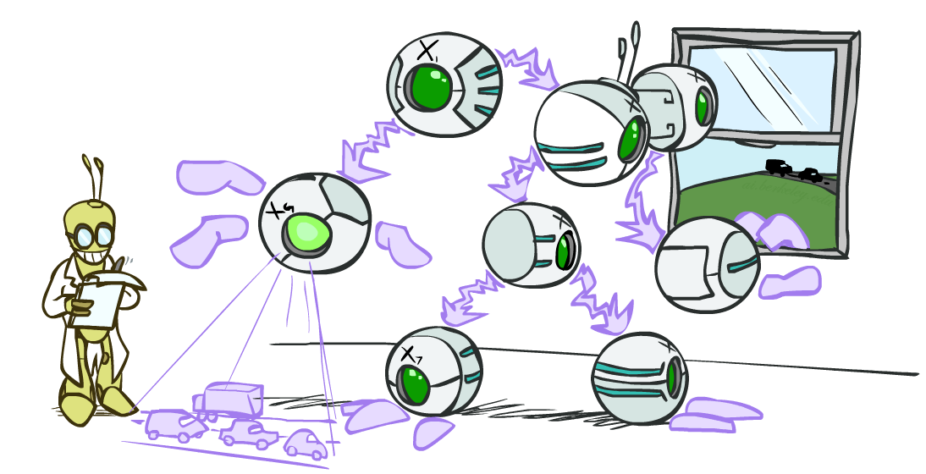
07-380 AI & ML II
Bayes Nets
Instructors: Pat Virtue & Mohammad Salameh
Slide credits: CMU AI and http://ai.berkeley.edu

Slide 2
Machine Learning
Select Model → Train Model → Use Model (Inference)

Slide 3
Bayes Nets
Representation and Independence
(Training?)
Exact Inference
  Enumeration (always exponential complexity)
  Some shortcuts (worst-case exponential complexity, often better)
  Inference is NP-hard in general
Approximate Inference
Prior sampling
Rejection sampling
Likelihood-weighted sampling
Gibbs sampling

Slide 4

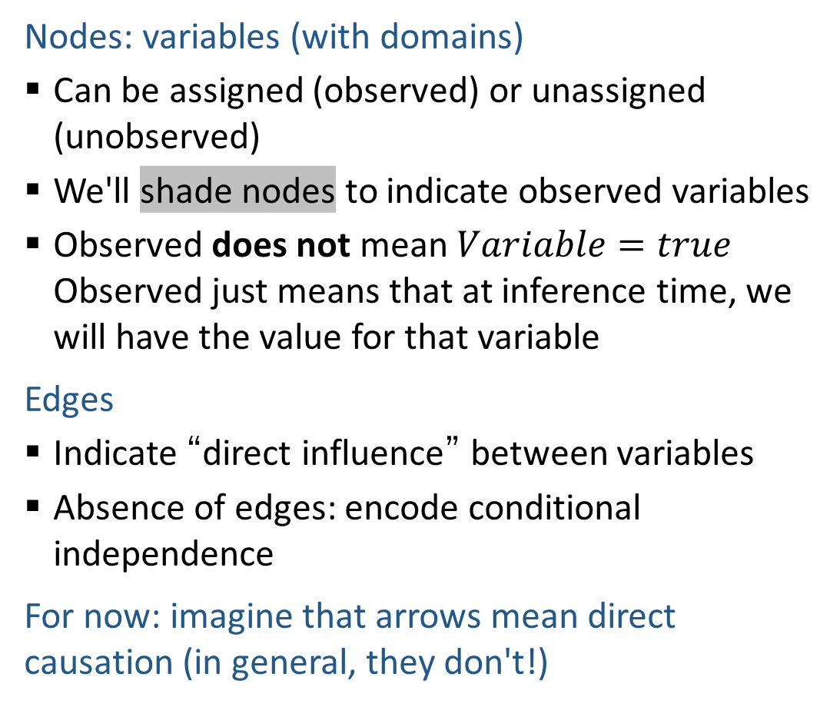
Graphical Model Notation
Nodes: variables (with domains)
  Can be assigned (observed) or unassigned (unobserved)
  We'll shade nodes to indicate observed variables
  Observed does not mean $Variable=true$ Observed just means that at inference time, we will have the value for that variable
Edges
  Indicate “direct influence” between variables
  Absence of edges: encode conditional independence
For now: imagine that arrows mean direct causation (in general, they don't!)
Weather
HeartDisease
BloodPressure
ChestPain

Slide 5

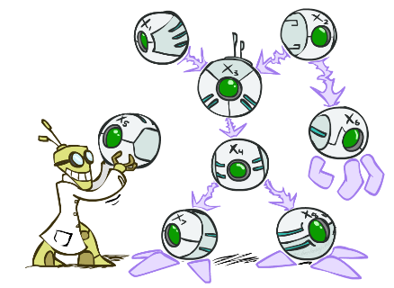
Bayes’ Nets: Big Picture
Two problems with using full joint distribution tables as our probabilistic models:
  Usually, the joint is WAY too big to represent explicitly
  Hard to learn (estimate) anything empirically about more than a few variables at a time
Bayes nets: a technique for describing complex joint distributions (models) using simple, local distributions (conditional probabilities)
  A type of probabilistic graphical models
  We describe how variables locally interact
  Local interactions chain together to give global, indirect interactions

Slide 6

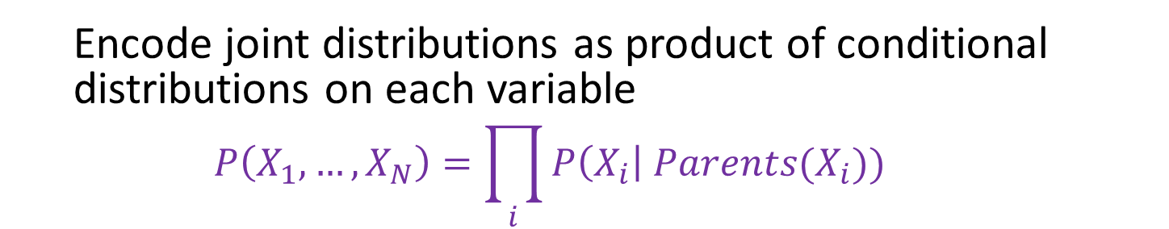



Bayesian Networks
Bayes net
Example of full chain rule Bayes net
$$A$$
$$B$$
$$C$$
$$D$$
$$P\left(A, B, C, D\right)=P\left(A\right) P\left(B | A\right) P\left(C | A,B\right) P\left(D | A,B,C\right)$$
  Encode joint distributions as product of conditional distributions on each variable
  $$P\left(X_{1},…,X_{N}\right)=\prod_{i}{P\left(X_{i}\right| Parents(X_{i})) }$$

Slide 7
Bayesian Networks
Bayes net
Missing edges (compared to full chain rule)
encode our independence assumptions
$$A$$
$$B$$
$$C$$
$$D$$
$P\left(A, B, C, D\right)=P\left(A\right) P\left(B | A\right) P\left(C | A,B\right) P\left(D | C\right)$
  Encode joint distributions as product of conditional distributions on each variable
  $$P\left(X_{1},…,X_{N}\right)=\prod_{i}{P\left(X_{i}\right| Parents(X_{i})) }$$

Slide 8
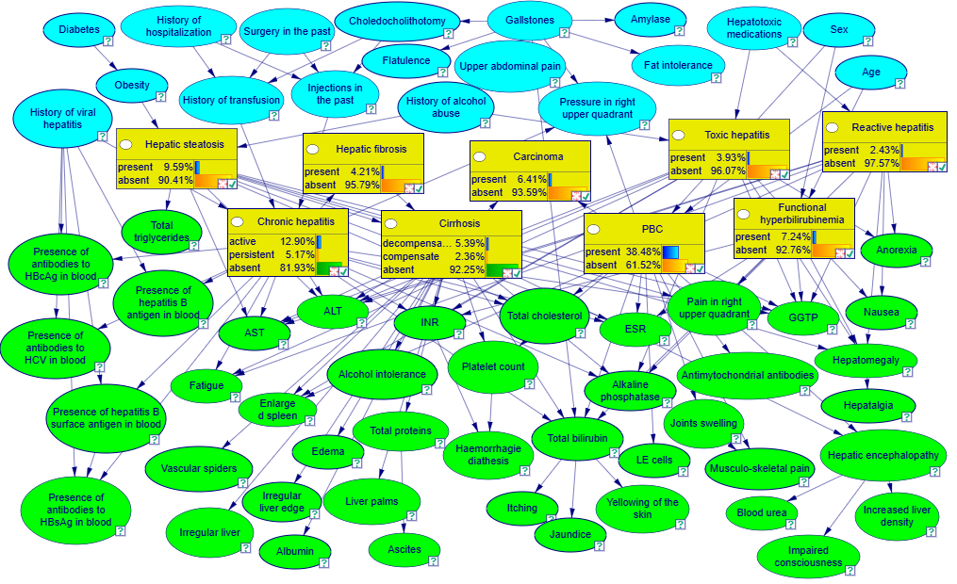
Example: Liver Disorders
https://demo.bayesfusion.com/bayesbox.html

Slide 9


Maggie Makar, University of Michigan
Assistant Professor
Computer Science and Engineering
University of Michigan
https://mymakar.github.io/
Causally-motivated shortcut removal using auxiliary labels
M. Makar, B. Packer, D. Moldovan, D. Blalock, Y. Halpern, A. D'Amour
AIStats 2022 [paper]

Slide 10
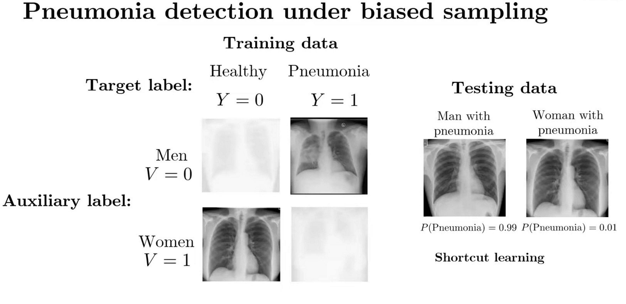
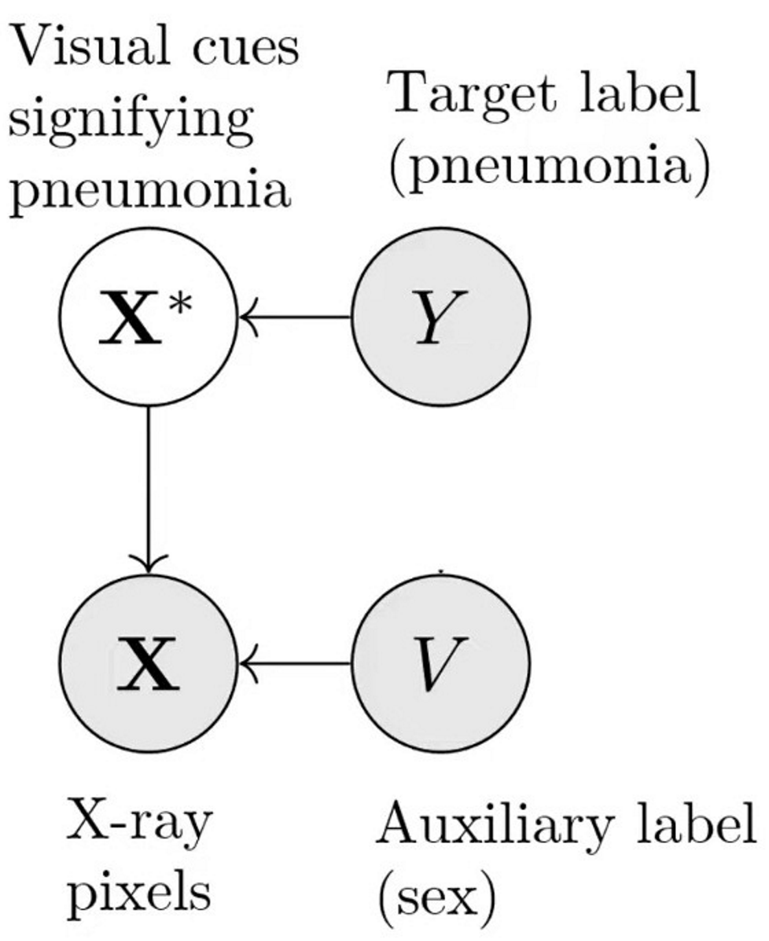
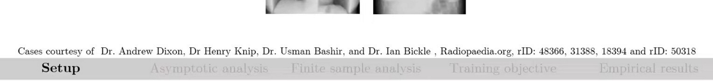
Causally-motivated shortcut removal using auxiliary labels
M. Makar, B. Packer, D. Moldovan, D. Blalock, Y. Halpern, A. D'Amour
AIStats 2022 [paper]

Slide 11



Danielle Belgrave, Microsoft Research
Vice President
AI/ML
GSK
https://www.daniellebelgrave.com
Developmental Profiles of Eczema, Wheeze, and Rhinitis:
Two Population-Based Birth Cohort Studies
Danielle Belgrave, et al. PLOS Medicine, 2014
https://journals.plos.org/plosmedicine/article?id=10.1371/journal.pmed.1001748

Slide 12
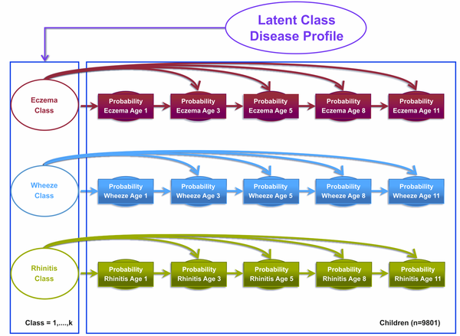
Danielle Belgrave, et al. PLOS Medicine, 2014
https://journals.plos.org/plosmedicine/article?id=10.1371/journal.pmed.1001748

Slide 13
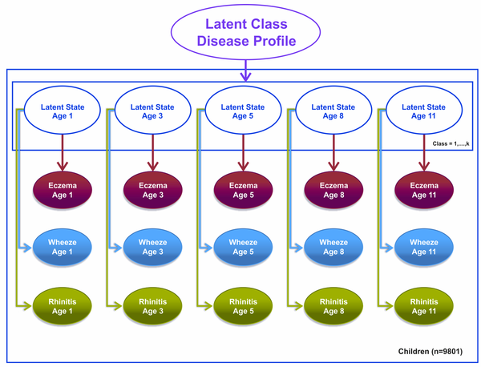
Danielle Belgrave, et al. PLOS Medicine, 2014
https://journals.plos.org/plosmedicine/article?id=10.1371/journal.pmed.1001748

Slide 14
Bayes Nets Independence

Slide 15

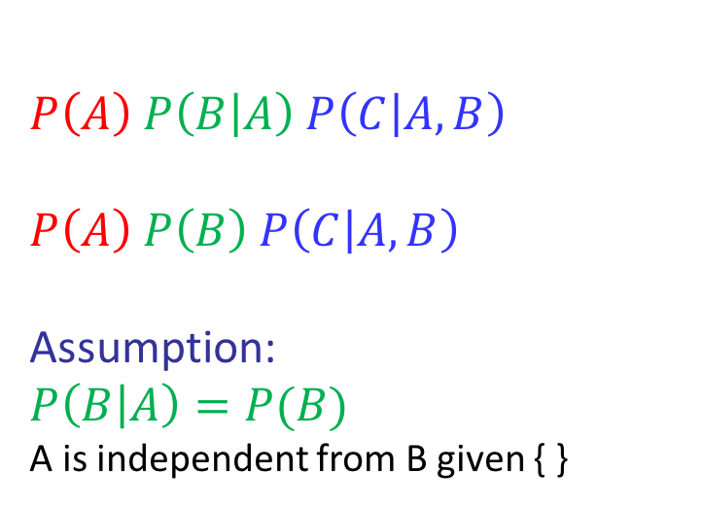


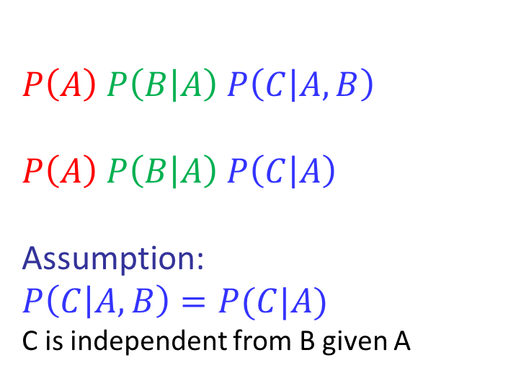
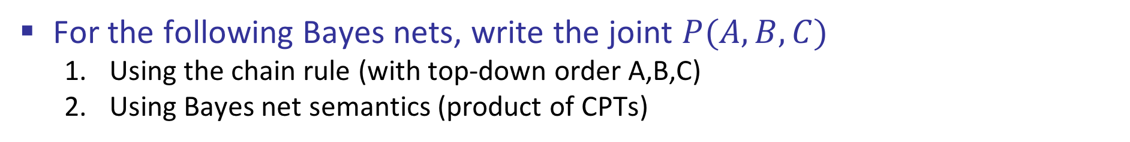

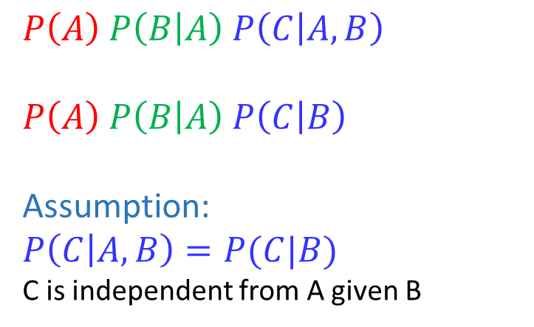




Conditional Independence Semantics
For the following Bayes nets, write the joint $P(A,B,C)$
  Using the chain rule (with top-down order A,B,C)
  Using Bayes net semantics (product of CPTs)
$$A$$
$$A$$
$$B$$
$$A$$
$$B$$
$$C$$
$$B$$
$$C$$
$$C$$
  $$P\left(A\right) P\left(B | A\right) P\left(C | A,B\right)$$
  $$P\left(A\right) P\left(B | A\right) P\left(C | B\right)$$
  Assumption:
  $$P\left(C | A,B\right)=P(C|B)$$
  C is independent from A given B
  $$P\left(A\right) P\left(B | A\right) P\left(C | A,B\right)$$
  $$P\left(A\right) P\left(B | A\right) P\left(C | A\right)$$
  Assumption:
  $$P\left(C | A,B\right)=P(C|A)$$
  C is independent from B given A
  $$P\left(A\right) P\left(B | A\right) P\left(C | A,B\right)$$
  $$P\left(A\right) P\left(B\right) P\left(C | A, B\right)$$
  Assumption:
  $$P\left(B | A\right)=P(B)$$
  A is independent from B given { }

Slide 16















Answering Independence Questions
Is A independent from E?
Is A independent from E given C?
Is A independent from C given E?
$$A$$
$$B$$
$$C$$
$$D$$
$$E$$
$$A$$
$$B$$
$$C$$
$$D$$
$$E$$
$$A$$
$$B$$
$$C$$
$$D$$
$$E$$

Slide 17
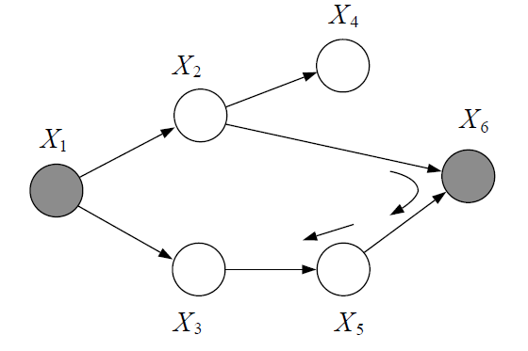
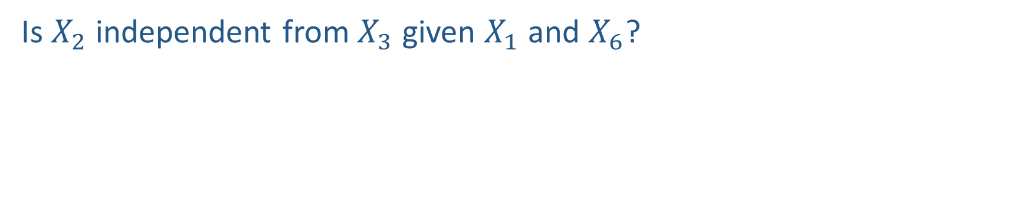
Leveraging Independence from a Bayes Net
Is $X_{2}$ independent from $X_{3}$ given $X_{1}$ and $X_{6}$?

Slide 18
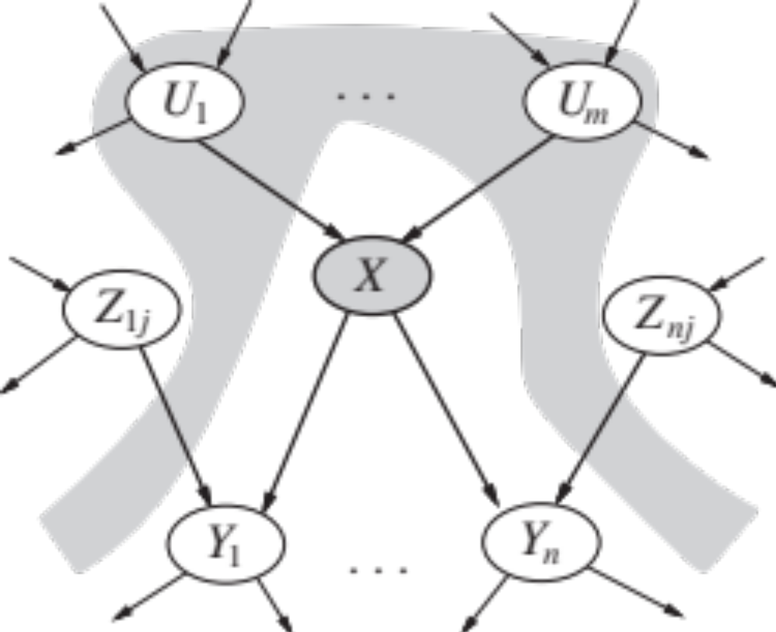



Conditional Independence Semantics
Every variable is conditionally independent of its non-descendants given its parents
$$U_{1}$$
$$U_{m}$$
$$X$$

Slide 19
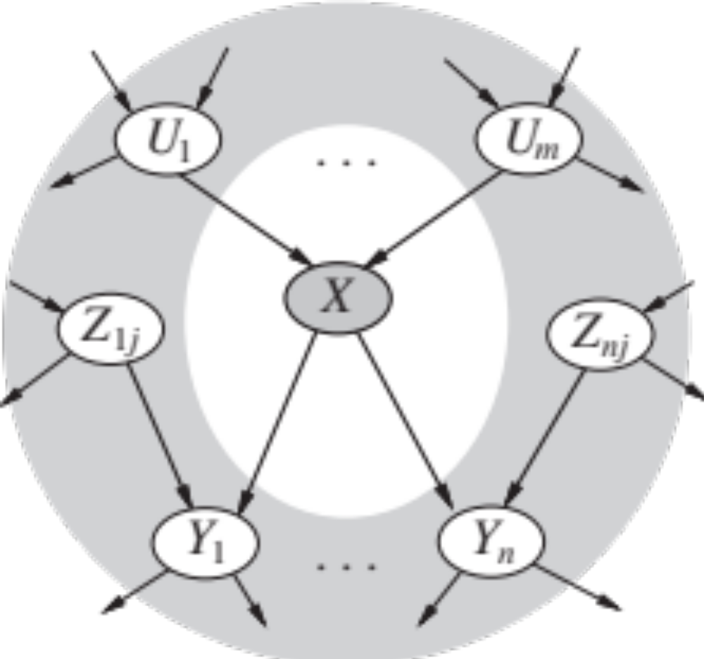







Markov blanket
A variable’s Markov blanket consists of parents, children, children’s other parents
Every variable is conditionally independent of all other variables given its Markov blanket
$$U_{1}$$
$$U_{m}$$
$$X$$
$$Z_{1j}$$
$$Z_{nj}$$
$$Y_{1}$$
$$Y_{n}$$

Slide 20
Machine Learning
Select Model → Train Model → Use Model (Inference)

Slide 21
Bayes Nets Training

Slide 22
Bayes Nets Training
Where do all these probabilities come from?
Danielle Belgrave, et al. PLOS Medicine, 2014
https://journals.plos.org/plosmedicine/article?id=10.1371/journal.pmed.1001748

Slide 23
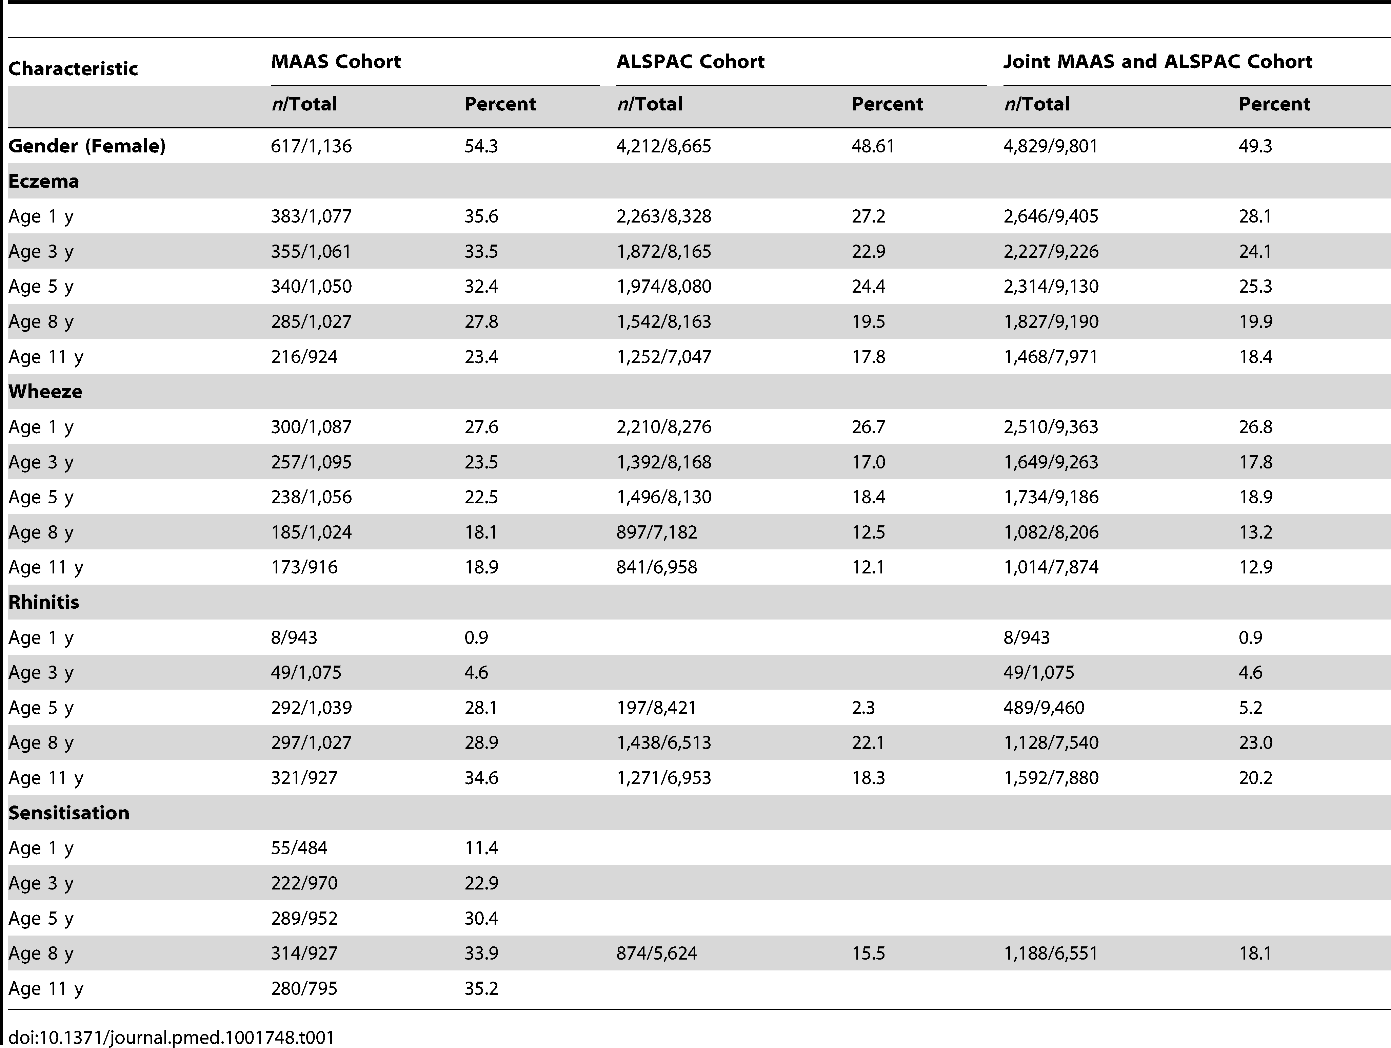
Danielle Belgrave, et al. PLOS Medicine, 2014
https://journals.plos.org/plosmedicine/article?id=10.1371/journal.pmed.1001748

Slide 24
Bayes Nets
Representation and Independence
(Training?)
Exact Inference
  Enumeration (always exponential complexity)
  Some shortcuts (worst-case exponential complexity, often better)
  Inference is NP-hard in general
Approximate Inference
Prior sampling
Rejection sampling
Likelihood-weighted sampling
Gibbs sampling

Slide 25
Bayes Nets Inference
Exact Inference

Slide 26
Answer Any Query from Joint Distribution
P(Weather)?
P(Weather | winter)?
P(Weather | winter, hot)?
Season | Temp | Weather | P(S, T, W)
summer | hot | sun | 0.30
summer | hot | rain | 0.05
summer | cold | sun | 0.10
summer | cold | rain | 0.05
winter | hot | sun | 0.10
winter | hot | rain | 0.05
winter | cold | sun | 0.15
winter | cold | rain | 0.20

Slide 27
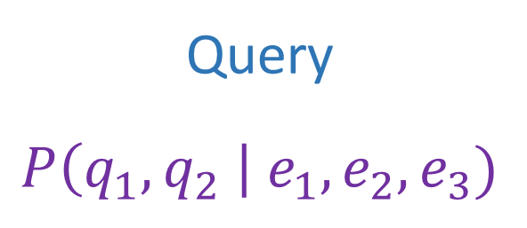
Answer Any Query from Joint Distribution
Joint distributions are the best!
Joint
Query
$$P\left(q_{1},q_{2} \right| e_{1}, e_{2},e_{3})$$

Slide 28
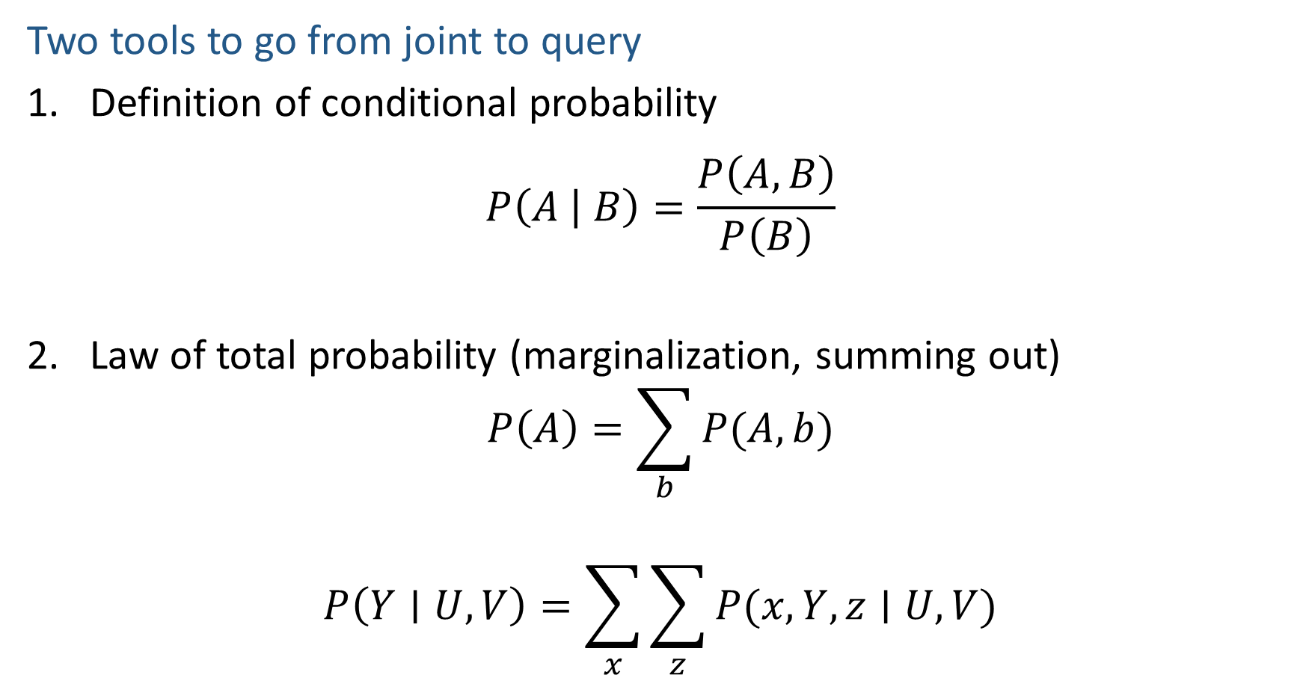
Answer Any Query from Joint Distribution
Two tools to go from joint to query
Definition of conditional probability
$$P\left(A | B\right)=\frac{P\left(A,B\right)}{P\left(B\right)}$$
Law of total probability (marginalization, summing out)
$$P\left(A\right)=\sum_{b}{P(A,b)}$$
$$P\left(Y∣U, V\right)=\sum_{x}{\sum_{z}{P(x, Y, z∣U, V)}}$$

Slide 29
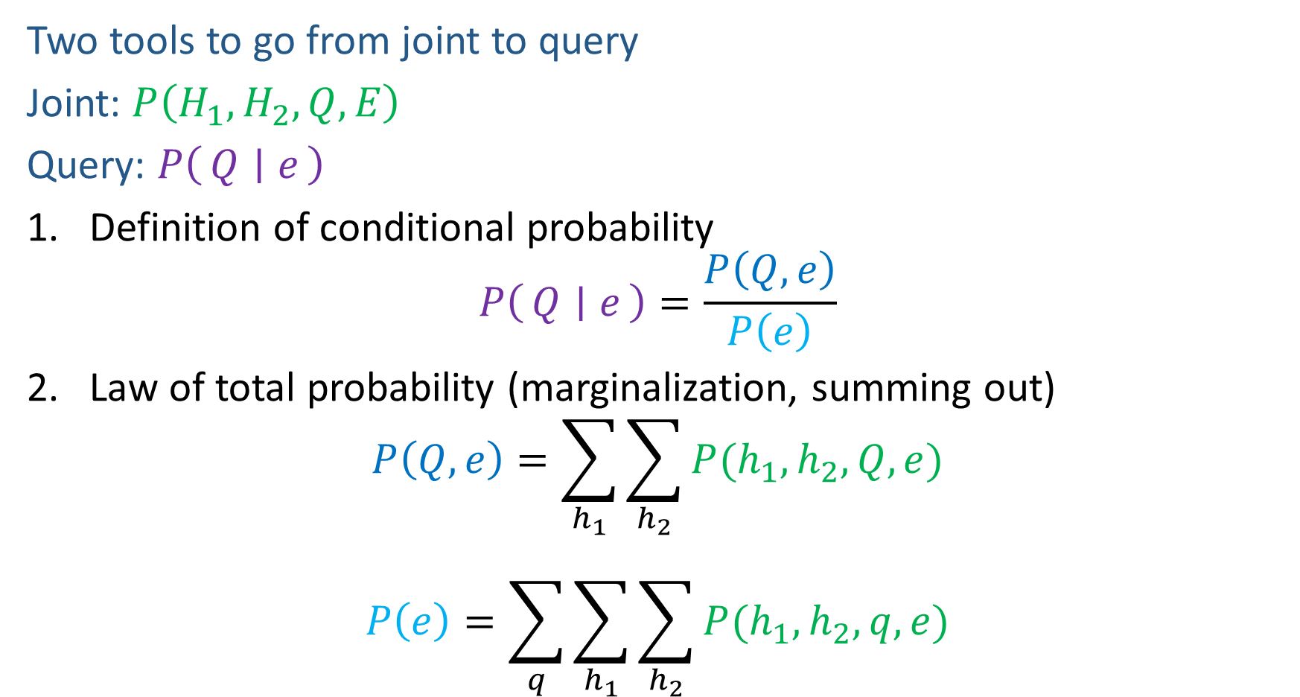
Answer Any Query from Joint Distribution
Two tools to go from joint to query
Joint: $P\left(H_{1}, H_{2}, Q, E\right)$
Query: $P\left(Q ∣ e\right)$
Definition of conditional probability
$$P\left(Q ∣ e\right)=\frac{P\left(Q,e\right)}{P\left(e\right)}$$
Law of total probability (marginalization, summing out)
$$P\left(Q,e\right)=\sum_{h_{1}}{\sum_{h_{2}}{P(h_{1},h_{2},Q, e)}}$$
$$P\left(e\right)=\sum_{q}{\sum_{h_{1}}{\sum_{h_{2}}{P(h_{1},h_{2}, q,e)}}}$$

Slide 30
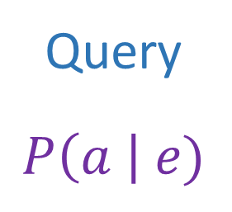
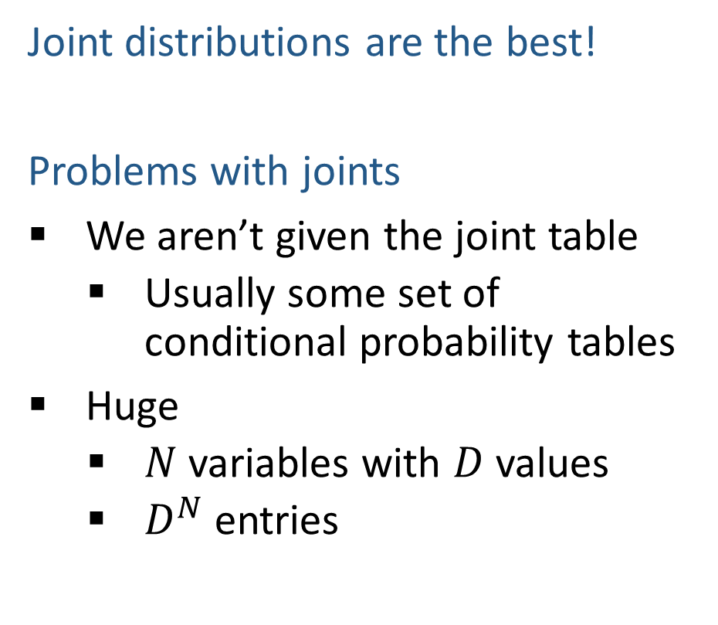
Answer Any Query from Joint Distribution
Joint distributions are the best!
Problems with joints
We aren’t given the joint table
    Usually some set of conditional probability tables
Huge
    $N$ variables with $D$ values
    $D^{N}$ entries
Joint
Query
$$P\left(a \right| e)$$

Slide 31
Answer Any Query from Bayes Net
Bayes Net
Joint
Query
$$P\left(a \right| e)$$
$$P\left(A\right) P\left(B | A\right) P\left(C | A\right) P\left(D | C\right) P(E|C)$$

Slide 32

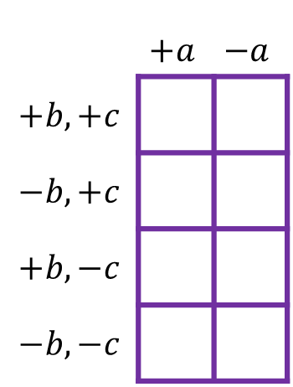

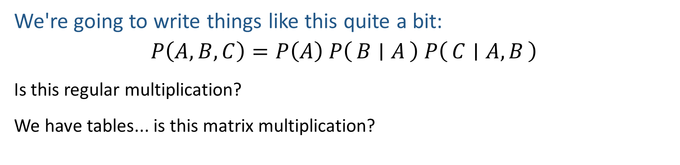

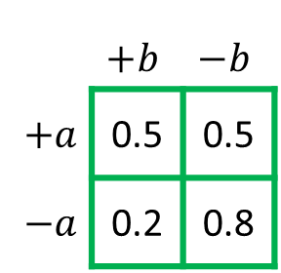
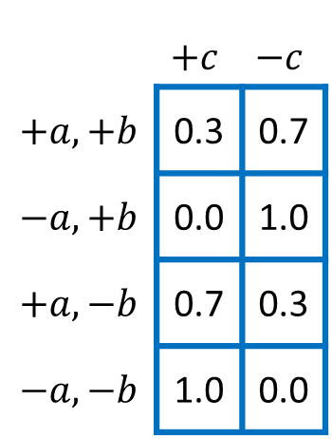
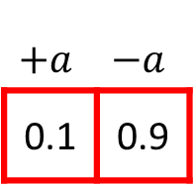

CAUTION: Multipling Probability Tables!
We're going to write things like this quite a bit:
$$P\left(A,B,C\right)=P\left(A\right) P\left(B ∣ A\right) P\left(C ∣ A, B\right)$$
Is this regular multiplication?
We have tables... is this matrix multiplication?
$$P\left(A,B,C\right)$$
$$P\left(A\right)$$
$$P\left(B ∣ A\right)$$
$$P\left(C ∣ A, B\right)$$
 | $$+a$$ | $$−a$$
$$+b,+c$$
$$−b,+c$$
$$+b,−c$$
$$−b,−c$$
$$+a$$ | $$−a$$
0.1 | 0.9
 | $$+b$$ | $$−b$$
$+a$ | 0.5 | 0.5
$−a$ | 0.2 | 0.8
 | $$+c$$ | $$−c$$
$$+a,+b$$ | 0.3 | 0.7
$$−a,+b$$ | 0.0 | 1.0
$$+a,−b$$ | 0.7 | 0.3
$$−a,−b$$ | 1.0 | 0.0

Slide 33
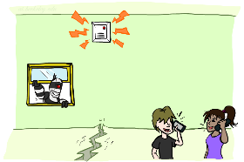

Example: Alarm Network
$P\left(+b, −e, −a, −j,−m\right)=$
B | P(B)
+b | 0.001
-b | 0.999
E | P(E)
+e | 0.002
-e | 0.998
Burglary
Earthqk
Alarm
B | E | A | P(A|B,E)
+b | +e | +a | 0.95
+b | +e | -a | 0.05
+b | -e | +a | 0.94
+b | -e | -a | 0.06
-b | +e | +a | 0.29
-b | +e | -a | 0.71
-b | -e | +a | 0.001
-b | -e | -a | 0.999
John calls
Mary calls
A | J | P(J|A)
+a | +j | 0.9
+a | -j | 0.1
-a | +j | 0.05
-a | -j | 0.95
A | M | P(M|A)
+a | +m | 0.7
+a | -m | 0.3
-a | +m | 0.01
-a | -m | 0.99
Notes:
demo

Slide 34
Example: Alarm Network
$$P\left(+b, −e, −a, −j,−m\right)=P\left(+b\right) ∗ P\left(−e\right) ∗ P\left(−a | +b, −e\right) ∗ P\left(−j | −a\right) ∗ P\left(−m | −a\right)$$
$=0.001 ∗ 0.998 ∗ 0.06 ∗ 0.95 ∗ 0.99$
$$P\left(+b, −e, −a, −j,−m\right)=P\left(−e\right) ∗ P\left(−a | +b, −e\right) ∗P\left(+b\right) ∗P\left(−j | −a\right) ∗ P\left(−m | −a\right)$$
$=0.998 ∗ 0.06 ∗ 0.001 ∗ 0.95 ∗ 0.99$
$$P\left(+b, −e, −a, −j,−m\right)=P\left(−e\right) ∗ P\left(−a | +b, −e\right) ∗P\left(+b\right) P\left(−j | −a\right) ∗ P\left(−m | −a\right)$$
$=0.998 ∗ 0.06 ∗ 0.0095 ∗ 0.99$
Multiplication order can change (commutativity)
Multiplication pairs don’t have to make sense (associativity)
Notes:
demo

Slide 35
Inference by Enumeration in Bayes Net
Reminder of inference by enumeration:
  Any probability of interest can be computed by summing entries from the joint distribution
  Entries from the joint distribution can be obtained from a BN by multiplying the corresponding conditional probabilities
  P(B | j, m) = α P(B, j, m)
  = α ∑_{e,a} P(B, e, a, j, m)
  = α ∑_{e,a} P(B) P(e) P(a|B,e) P(j|a) P(m|a)
So inference in Bayes nets means computing sums of products of numbers: sounds easy!!
Problem: sums of exponentially many products!
B
E
A
J
M

Slide 36
Bayes Net Inference
Exact inference shortcuts: Variable elimination

Slide 37
Answer Any Query from Bayes Net
Bayes Net
Joint
Query
$$P\left(a \right| e)$$
$$P\left(A\right) P\left(B | A\right) P\left(C | A\right) P\left(D | C\right) P(E|C)$$

Slide 38
Next: Answer Any Query from Bayes Net
Bayes Net
Query
$$P\left(a \right| e)$$
$$P\left(A\right) P\left(B | A\right) P\left(C | A\right) P\left(D | C\right) P(E|C)$$

Slide 39
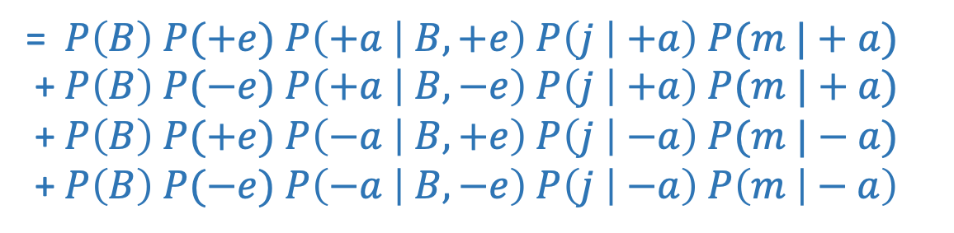
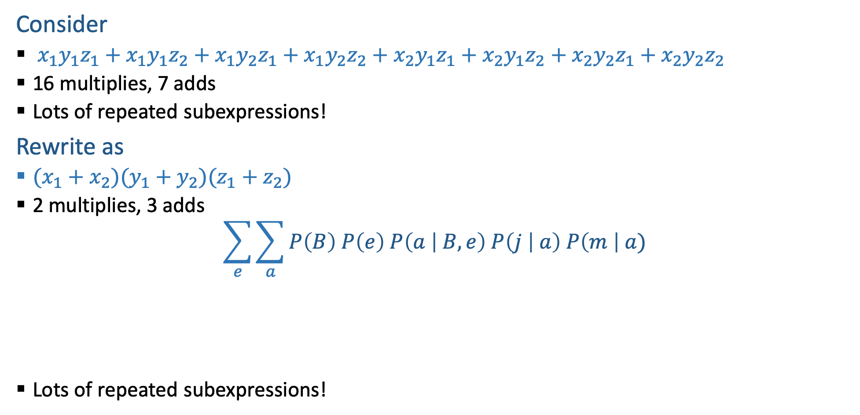
Can we do better?
Consider
  $x_{1}y_{1}z_{1}+x_{1}y_{1}z_{2}+x_{1}y_{2}z_{1}+x_{1}y_{2}z_{2}+x_{2}y_{1}z_{1}+x_{2}y_{1}z_{2}+x_{2}y_{2}z_{1}+x_{2}y_{2}z_{2}$
  16 multiplies, 7 adds
  Lots of repeated subexpressions!
Rewrite as
  $(x_{1}+x_{2})(y_{1}+y_{2})(z_{1}+z_{2})$
  2 multiplies, 3 adds
$$\sum_{e}{\sum_{a}{P\left(B\right) P\left(e\right) P\left(a | B,e\right) P\left(j | a\right) P\left(m \right| a)}}$$
  Lots of repeated subexpressions!
= $P\left(B\right) P(+e)$ $P\left(+a | B,+e\right) P\left(j | +a\right) P(m |+a)$
+ $P\left(B\right) P(−e)$ $P\left(+a | B,−e\right) P\left(j | +a\right) P(m |+a)$
+ $P\left(B\right) P(+e)$ $P\left(−a | B,+e\right) P\left(j | −a\right) P(m |−a)$
+ $P\left(B\right) P(−e)$ $P\left(−a | B,−e\right) P\left(j | −a\right) P\left(m | − a\right)$

Slide 40



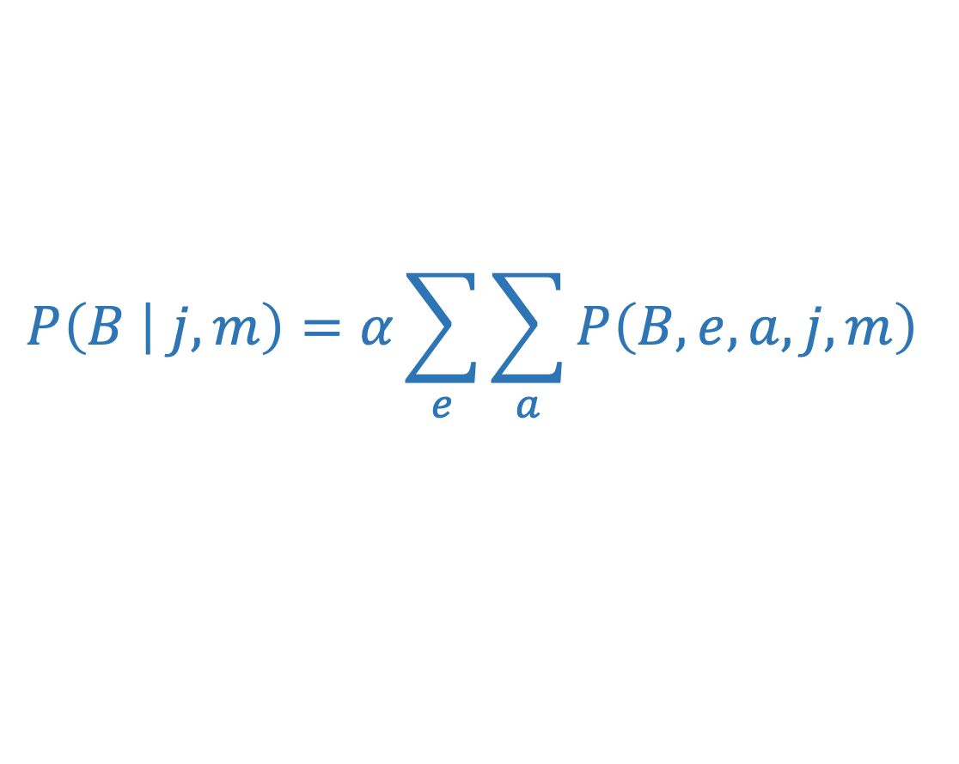



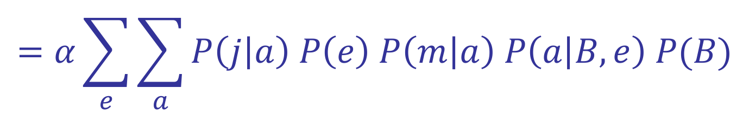










Variable elimination: The basic ideas
Move summations inwards as far as possible
$$P\left(B | j,m\right)=α\sum_{e}{\sum_{a}{P\left(B,e,a,j,m\right) }}$$
$$=α\sum_{e}{\sum_{a}{P\left(j | a\right) P\left(e\right) P\left(m | a\right) P\left(a | B,e\right) P(B)}}$$
$$\sum_{e}{ }$$
$$\sum_{a}{ }$$
$$=α$$
$$P\left(e\right)$$
$$P\left(B\right)$$
$$P\left(j | a\right)$$
$$P(m|a)$$
$$P\left(a | B,e\right)$$
$$\sum_{e}{ }$$
$$\sum_{a}{ }$$
$$=α$$
$$P\left(B\right)$$
$$P\left(e\right)$$
$$P\left(j | a\right)$$
$$P(m|a)$$
$$P\left(a | B,e\right)$$

Slide 41

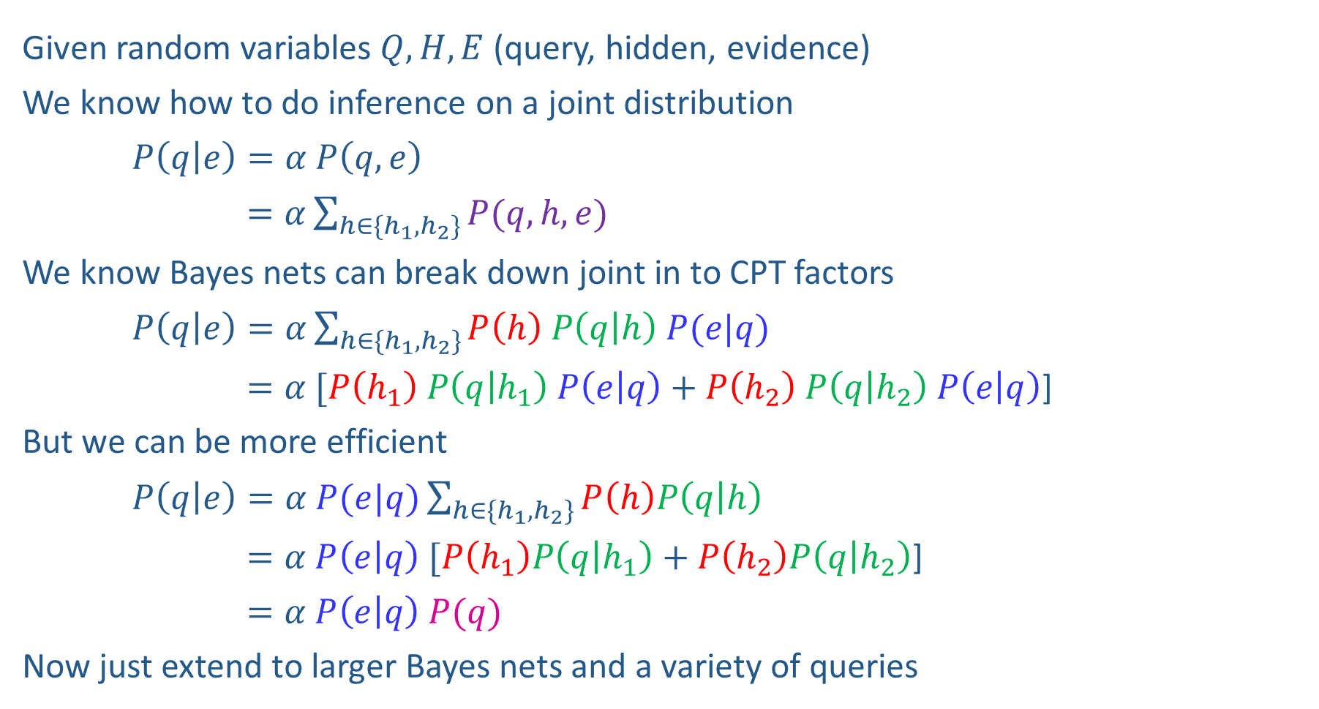


Inference Overview
Given random variables$Q, H, E$ (query, hidden, evidence)
We know how to do inference on a joint distribution
$P\left(q | e\right)=α P\left(q,e\right)$
$=α\sum_{h∈\{h_{1},h_{2}\}}{P(q,h,e)}$
We know Bayes nets can break down joint in to CPT factors
$P\left(q | e\right)=α\sum_{h∈\{h_{1},h_{2}\}}{P\left(h\right) P\left(q | h\right) P(e|q)}$
$=α [P\left(h_{1}\right) P\left(q | h_{1}\right) P\left(e | q\right)+P\left(h_{2}\right) P\left(q | h_{2}\right) P\left(e | q\right)$]
But we can be more efficient
$P\left(q | e\right)=α P(e|q)\sum_{h∈\{h_{1},h_{2}\}}{P\left(h\right)P\left(q | h\right) }$
$=α P\left(e | q\right) [P\left(h_{1}\right)P\left(q | h_{1}\right)+P\left(h_{2}\right)P\left(q | h_{2}\right)$]
$=α P\left(e | q\right) P(q)$
Now just extend to larger Bayes nets and a variety of queries
Enumeration
$$H$$
$$Q$$
$$E$$
Variable
Elimination

Slide 42
Order matters
  Elimination Order: C, B, A, Z
    P(D) = α ∑_{z,a,b,c} P(D|z) P(z) P(a|z) P(b|z) P(c|z)
    = α ∑_{z} P(D|z) P(z) ∑_{a} P(a|z) ∑_{b} P(b|z) ∑_{c} P(c|z)
    Largest factor has 2 variables (D,Z)
  Elimination Order: Z, C, B, A
    P(D) = α ∑_{a,b,c,z} P(a|z) P(b|z) P(c|z) P(D|z) P(z)
    = α ∑_{a} ∑_{b} ∑_{c} ∑_{z} P(a|z) P(b|z) P(c|z) P(D|z) P(z)
    Largest factor has 4 variables (A,B,C,D) (or 5 if you count pre-summation over Z)
Z
A
B
C
D

Slide 43
Variable Elimination: Complexity
The computational and space complexity of variable elimination is determined by the largest factor (and it’s space that kills you)
The elimination ordering can greatly affect the size of the largest factor.
  E.g., previous slide’s example 2^{N} vs. 2
Does there always exist an ordering that only results in small factors?
  No!

Slide 44





















VE: Computational and Space Complexity
Inference in Bayes’ nets is NP-hard.
No known efficient probabilistic inference in general.

Slide 45
Bayes Nets
Representation and Independence
(Training?)
Exact Inference
  Enumeration (always exponential complexity)
  Some shortcuts (worst-case exponential complexity, often better)
  Inference is NP-hard in general
Approximate Inference
Prior sampling
Rejection sampling
Likelihood-weighted sampling
Gibbs sampling

Slide 46

Bayes Nets Inference
Approximate Inference (Sampling)

Slide 47
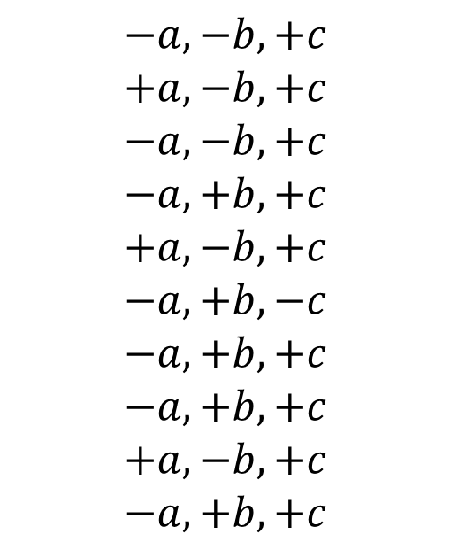
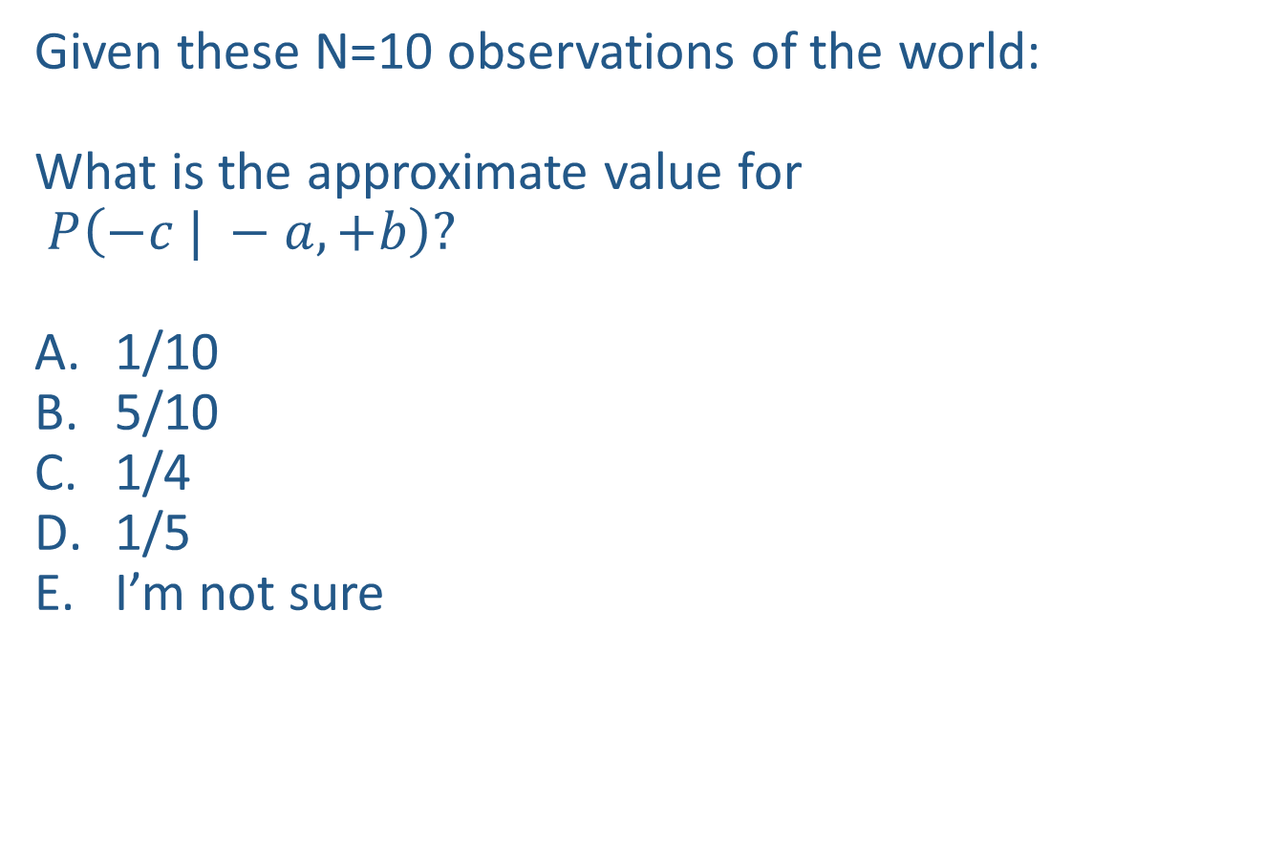
Poll 1
Given these N=10 observations of the world:
What is the approximate value for
$P\left(−c | −a, +b\right)?$
1/10
5/10
1/4
1/5
I’m not sure
Counts
$$−a, −b, +c$$
$$+a,−b, +c$$
$$−a, −b,+c$$
$$−a, +b, +c$$
$$+a, −b, +c$$
$$−a, +b, −c$$
$$−a, +b, +c$$
$$−a, +b, +c$$
$$+a, −b, +c$$
$$−a, +b, +c$$
+a | +b | +c | 0
+a | +b | -c | 0
+a | -b | +c | 3
+a | -b | -c | 0
-a | +b | +c | 4
-a | +b | -c | 1
-a | -b | +c | 2
-a | -b | -c | 0

Slide 48

Approximate Inference: Sampling

Slide 49
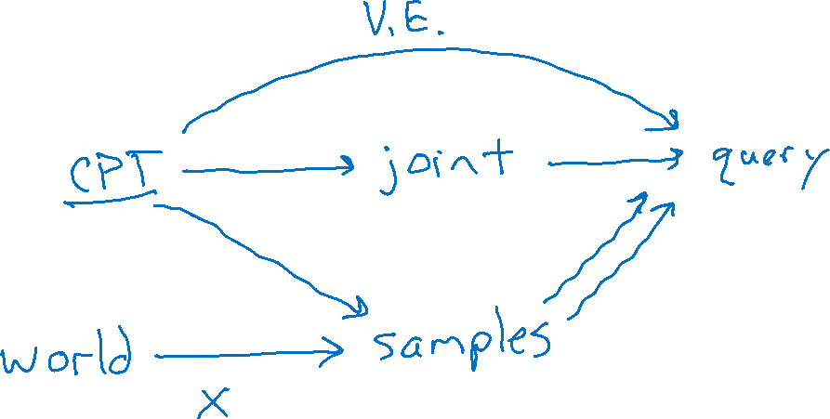
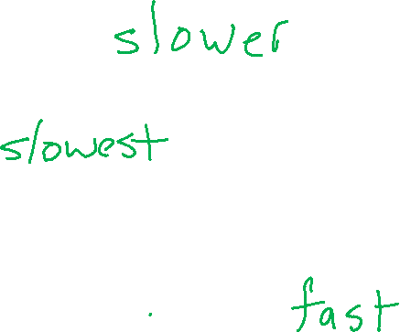
Exact Inference vs Sampling

Slide 50
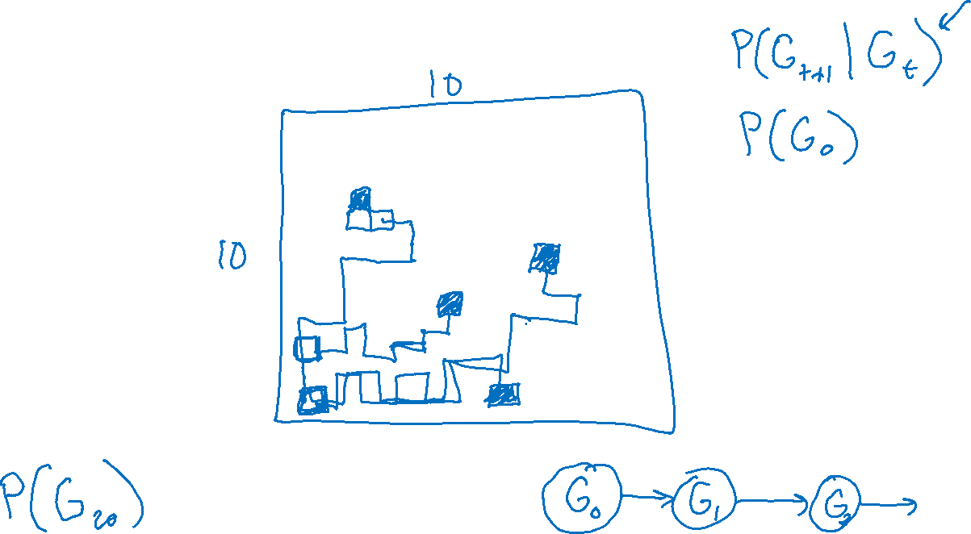
Motivation for Approximate Inference

Slide 51

Sampling
Sampling is a lot like repeated simulation
  Predicting the weather, basketball games, …
Basic idea
  Draw N samples from a sampling distribution S
  Compute an approximate posterior probability
  Show this converges to the true probability P
Why sample?
Learning: get samples from a distribution you don’t know
Inference: getting a sample is faster than computing the right answer (e.g. with variable elimination)

Slide 52
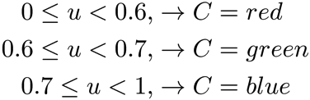

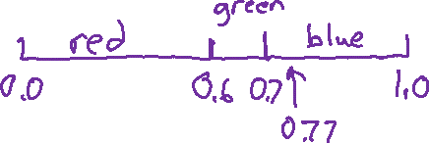
Sampling
Sampling from given distribution
  Step 1: Get sample u from uniform distribution over [0, 1)
    e.g. random() in python
  Step 2: Convert this sample u into an outcome for the given distribution by having each outcome associated with a sub-interval of [0,1) with sub-interval size equal to probability of the outcome
Example
  If random() returns u = 0.83, then our sample is C = blue
  E.g, after sampling 8 times:
C | P(C)
red | 0.6
green | 0.1
blue | 0.3

Slide 53




Sampling
How would you sample from a conditional distribution?
+a | 1/2
-a | 1/2
$$P(A)$$
$$A$$
+a | +b | 1/10
 | -b | 9/10
-a | +b | 1/2
 | -b | 1/2
$$P(B|A)$$
$$B$$

Slide 54
Sampling in Bayes’ Nets
Prior Sampling
Rejection Sampling
Likelihood Weighting
Gibbs Sampling

Slide 55
Handout
No evidence:
Prior Sampling
Some evidence:
Likelihood Weighted Sampling
All evidence:
Likelihood Weighted
Input: no evidence
for i=1, 2, …, m
    Sample x_{i} from P(X_{i} | Parents(X_{i}))
return (x₁, x₂, …, x_{m})
Input: evidence instantiation
w = 1.0
for i=1, 2, …, m
if X_{i} is an evidence variable
    X_{i} = observation x_{i} for X_{i}
    Set w = w * P(x_{i} | Parents(X_{i}))
else
    Sample x_{i} from P(X_{i} | Parents(X_{i}))
return (x₁, x₂, …, x_{m}), w
Input: evidence instantiation
w = 1.0
for i=1, 2, …, m
    Set w = w * P(x_{i} | Parents(X_{i}))
return w

Slide 56

Prior Sampling

Slide 57




Prior Sampling Demo
+c | 0.5
-c | 0.5
Cloudy
Cloudy
+c | +s | 0.1
 | -s | 0.9
-c | +s | 0.5
 | -s | 0.5
+c | +r | 0.8
 | -r | 0.2
-c | +r | 0.2
 | -r | 0.8
Sprinkler
Sprinkler
Rain
Rain
WetGrass
WetGrass
Samples:
+s | +r | +w | 0.99
 |  | -w | 0.01
 | -r | +w | 0.90
 |  | -w | 0.10
-s | +r | +w | 0.90
 |  | -w | 0.10
 | -r | +w | 0.01
 |  | -w | 0.99
+c, -s, +r, +w
-c, +s, -r, +w
…

Slide 58
Prior Sampling
For i = 1, 2, …, m
    Sample x_{i} from P(X_{i} | Parents(X_{i}))
Return (x₁, x₂, …, x_{m})

Slide 59
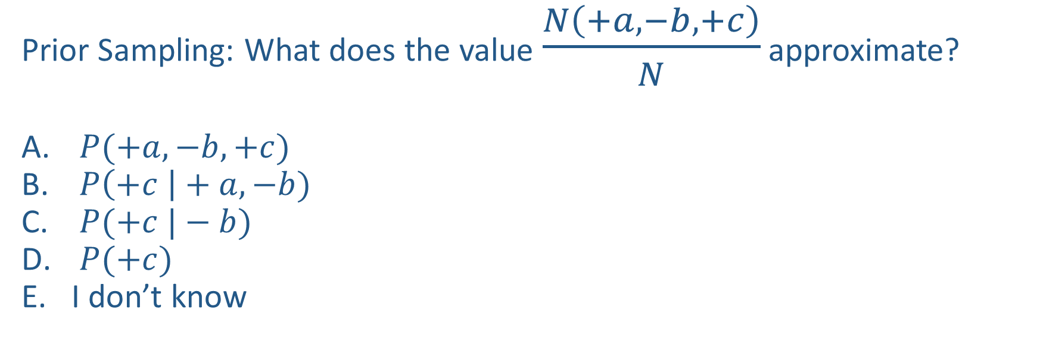
Poll 2
$$A$$
Prior Sampling: What does the value $\frac{N\left(+a, −b, +c\right)}{N}$ approximate?
$P(+a, −b, +c)$
$P\left(+c \right|+a, −b)$
$P(+c |−b)$
$P(+c)$
I don’t know
$$B$$
$$C$$

Slide 60
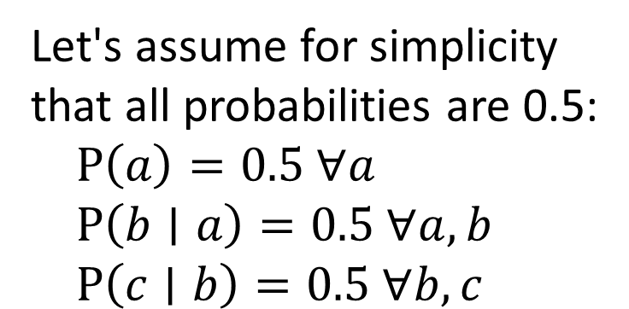
Poll 2
$$A$$
Prior Sampling: What does the value $\frac{N\left(+a, −b, +c\right)}{N}$ approximate?
$P(+a, −b, +c)$
$P\left(+c \right|+a, −b)$
$P(+c |−b)$
$P(+c)$
I don’t know
$$B$$
$$C$$
Let's assume for simplicity that all probabilities are 0.5:
$P\left(a\right)=0.5 ∀a$
$P\left(b∣a\right)=0.5 ∀a, b$
$P\left(c∣b\right)=0.5 ∀b,c$
Let's take 1000 samples:

Slide 61

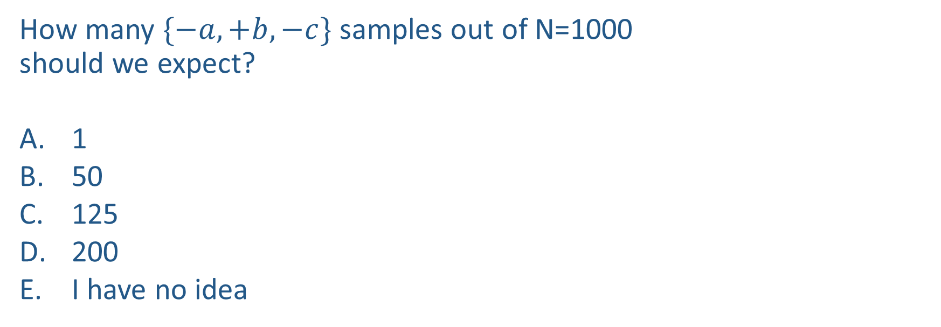
Poll 3
How many $\{−a,+b,−c\}$ samples out of N=1000
should we expect?
1
50
125
200
I have no idea
+a | 1/2
-a | 1/2
$$P(A)$$
$$A$$
+a | +b | 1/10
 | -b | 9/10
-a | +b | 1/2
 | -b | 1/2
$$P(B|A)$$
$$B$$
+b | +c | 4/5
 | -c | 1/5
-b | +c | 1
 | -c | 0
$$C$$
$$P(C|B)$$

Slide 62
Poll 3
How many $\{−a,+b,−c\}$ samples out of N=1000
should we expect?
1
50
125
200
I have no idea
+a | 1/2
-a | 1/2
$$P(A)$$
$$A$$
+a | +b | 1/10
 | -b | 9/10
-a | +b | 1/2
 | -b | 1/2
$$P(B|A)$$
$$B$$
+b | +c | 4/5
 | -c | 1/5
-b | +c | 1
 | -c | 0
$$C$$
$$P(C|B)$$

Slide 63
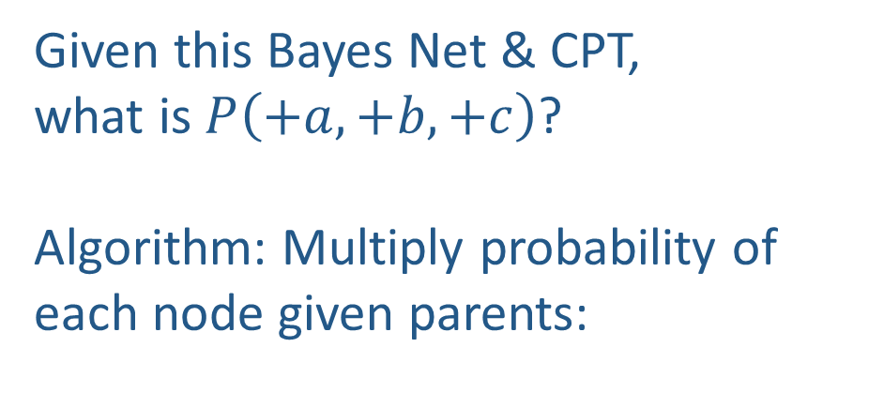
Probability of a sample
Given this Bayes Net & CPT,
what is $P\left(+a,+b,+c\right)$?
Algorithm: Multiply probability of each node given parents:
+a | 1/2
-a | 1/2
$$P(A)$$
$$A$$
+a | +b | 1/10
 | -b | 9/10
-a | +b | 1/2
 | -b | 1/2
$$P(B|A)$$
w = 1.0
for i=1, 2, …, m
  Set w = w * P(x_{i} | Parents(X_{i}))
return w
$$B$$
+b | +c | 4/5
 | -c | 1/5
-b | +c | 1
 | -c | 0
$$C$$
$$P(C|B)$$

Slide 64
Example
We’ll get a bunch of samples from the BN:
  +c, -s, +r, +w
  +c, +s, +r, +w
  -c, +s, +r, -w
  +c, -s, +r, +w
  -c, -s, -r, +w
If we want to know P(W)
  We have counts <+w:4, -w:1>
  Normalize to get P(W) = <+w:0.8, -w:0.2>
  This will get closer to the true distribution with more samples
  Can estimate anything else, too
  What about P(C| +w)? P(C| +r, +w)? P(C| -r, -w)?
  Fast: can use fewer samples if less time (what’s the drawback?)
C
S
R
W

Slide 65
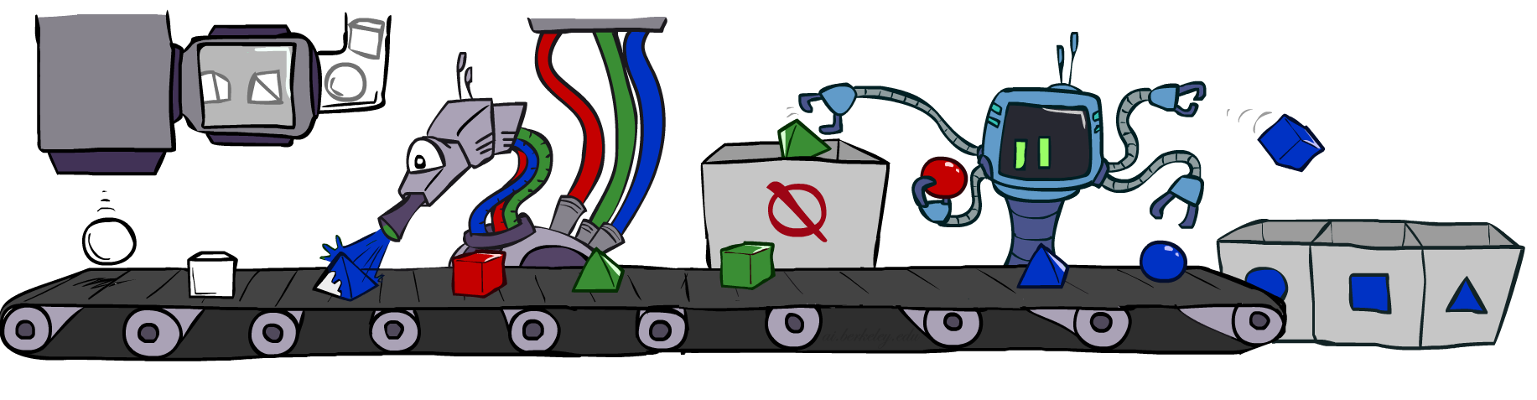
Rejection Sampling

Slide 66
Rejection Sampling
Let's say we want P(C| +s)
  Tally C outcomes, but ignore (reject) samples which don’t have S=+s
  This is called rejection sampling
  It is also consistent for conditional probabilities (i.e., correct in the limit)
C
S
R
W
  +c, -s, +r, +w
  +c, +s, +r, +w
  -c, +s, +r, -w
  +c, -s, +r, +w
  -c, -s, -r, +w

Slide 67
Rejection Sampling
IN: evidence instantiation
For i=1, 2, …, m
  Sample x_{i} from P(X_{i} | Parents(X_{i}))
  If x_{i} not consistent with evidence
    Reject: Return, and no sample is generated in this cycle
Return (x₁, x₂, …, x_{m})

Slide 68
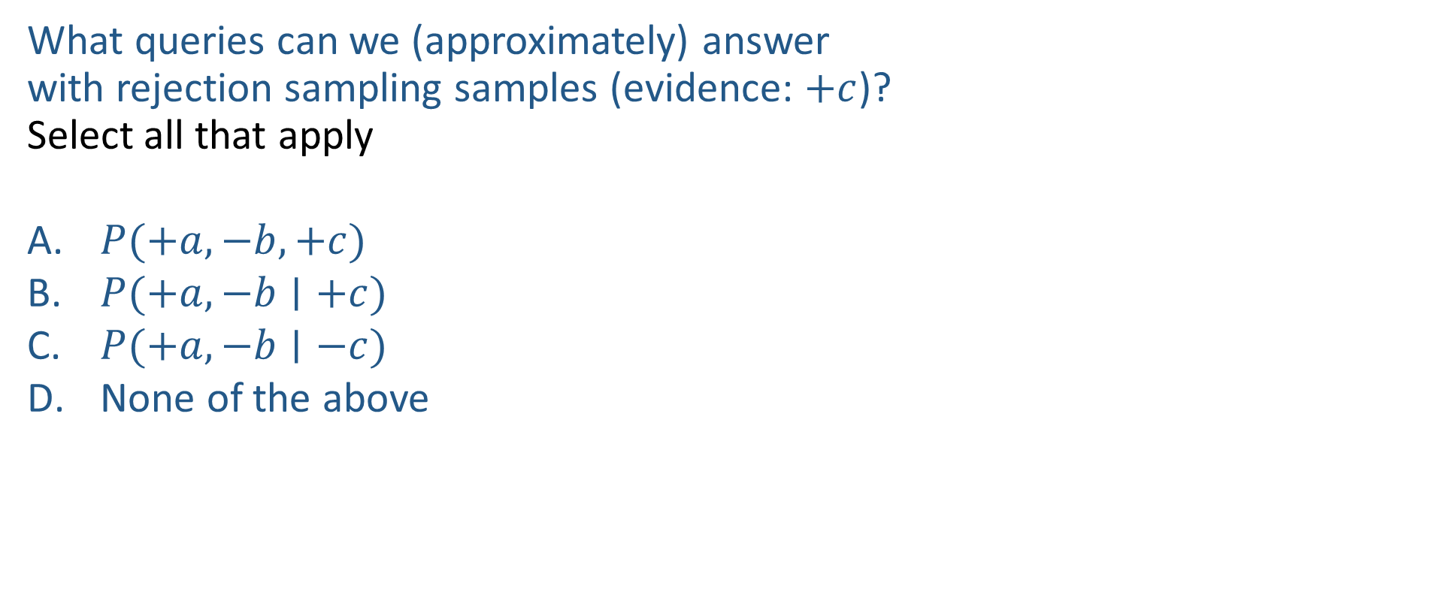
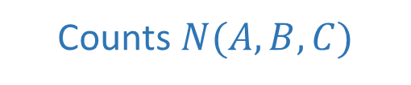
Poll 3
$$A$$
What queries can we (approximately) answer
with rejection sampling samples (evidence: $+c$)?
Select all that apply
$P(+a, −b, +c)$
$P(+a, −b∣+c)$
$P(+a, −b∣−c)$
None of the above
$$B$$
Counts $N(A,B,C)$
+a | +b | +c | 4
+a | +b | -c
+a | -b | +c | 3
+a | -b | -c
-a | +b | +c | 2
-a | +b | -c
-a | -b | +c | 1
-a | -b | -c
$$C$$

Slide 69
Poll 3
$$A$$
What queries can we (approximately) answer
with rejection sampling samples (evidence: $+c$)?
Select all that apply
$P(+a, −b, +c)$
$P(+a, −b∣+c)$
$P(+a, −b∣−c)$
None of the above
$$B$$
Counts $N(A,B,C)$
+a | +b | +c | 4
+a | +b | -c
+a | -b | +c | 3
+a | -b | -c
-a | +b | +c | 2
-a | +b | -c
-a | -b | +c | 1
-a | -b | -c
$$C$$
A: only if we also have total number of attempts

Slide 70
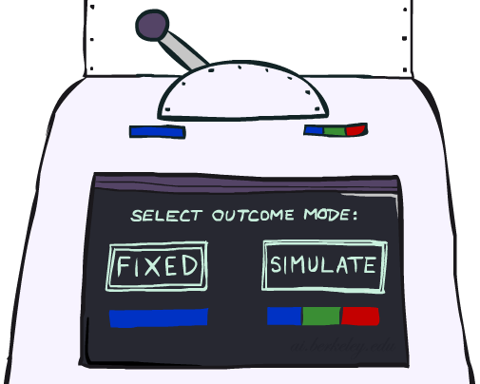

Likelihood Weighting

Slide 71



Likelihood Weighting
Problem with rejection sampling:
  If evidence is unlikely, rejects lots of samples
  Evidence not exploited as you sample
  Consider P(Shape|blue)
Idea: fix evidence variables and sample the rest
  Problem: sample distribution not consistent!
  Solution: weight by probability of evidence given parents
  pyramid, green
  pyramid, red
  sphere, blue
  cube, red
  sphere, green
  pyramid, blue
  pyramid, blue
  sphere, blue
  cube, blue
  sphere, blue
Shape
Color
Shape
Color

Slide 72



Likelihood Weighting
+c | 0.5
-c | 0.5
Cloudy
Cloudy
+c | +s | 0.1
 | -s | 0.9
-c | +s | 0.5
 | -s | 0.5
+c | +r | 0.8
 | -r | 0.2
-c | +r | 0.2
 | -r | 0.8
Sprinkler
Sprinkler
Rain
Rain
WetGrass
Samples:
WetGrass
+s | +r | +w | 0.99
 |  | -w | 0.01
 | -r | +w | 0.90
 |  | -w | 0.10
-s | +r | +w | 0.90
 |  | -w | 0.10
 | -r | +w | 0.01
 |  | -w | 0.99
+c, +s, +r, +w
…

Slide 73

Likelihood Weighting
IN: evidence instantiation
w = 1.0
for i=1, 2, …, m
  if X_{i} is an evidence variable
    X_{i} = observation x_{i} for X_{i}
    Set w = w * P(x_{i} | Parents(X_{i}))
  else
    Sample x_{i} from P(X_{i} | Parents(X_{i}))
return (x₁, x₂, …, x_{m}), w

Slide 74


Likelihood Weighting
No evidence:
Prior Sampling
Some evidence:
Likelihood Weighted Sampling
All evidence:
Likelihood Weighted
Input: no evidence
for i=1, 2, …, m
    Sample x_{i} from P(X_{i} | Parents(X_{i}))
return (x₁, x₂, …, x_{m})
Input: evidence instantiation
w = 1.0
for i=1, 2, …, m
if X_{i} is an evidence variable
    X_{i} = observation x_{i} for X_{i}
    Set w = w * P(x_{i} | Parents(X_{i}))
else
    Sample x_{i} from P(X_{i} | Parents(X_{i}))
return (x₁, x₂, …, x_{m}), w
Input: evidence instantiation
w = 1.0
for i=1, 2, …, m
    Set w = w * P(x_{i} | Parents(X_{i}))
return w
$$P\left(x1, x2, …,xm\right)≈\frac{N\left(x1, x2, …,xm\right)}{N}$$
$$P\left(x1, x2, …,xm\right)≈w⋅\frac{N\left(x1, x2, …,xm\right)}{N}$$
$$P\left(x1, x2, …,xm\right)=w$$

Slide 75
Remember Poll 3
How many $\{−a,+b,−c\}$ samples out of N=1000
should we expect?
1
50
125
200
I have no idea
+a | 1/2
-a | 1/2
$$P(A)$$
$$A$$
+a | +b | 1/10
 | -b | 9/10
-a | +b | 1/2
 | -b | 1/2
$$P(B|A)$$
$$B$$
+b | +c | 4/5
 | -c | 1/5
-b | +c | 1
 | -c | 0
$$C$$
$$P(C|B)$$

Slide 76




Likelihood Weighting
+a | 1/2
-a | 1/2
$$P(A)$$
$$A$$
+a | +b | 1/10
 | -b | 9/10
-a | +b | 1/2
 | -b | 1/2
$$P(B|A)$$
$$B$$
+b | +c | 4/5
 | -c | 1/5
-b | +c | 1
 | -c | 0
$$C$$
$$P(C|B)$$

Slide 77



Likelihood Weighting Distribution
$$A$$
Consistency of likelihood weighted sampling distribution
Evidence: $+a$, $+b$, $−c$, $−d$, $+e$
Joint from Bayes nets
$$P\left(A,B,C,D,E\right)=P\left(+a\right) P\left(+b | +a\right) P\left(−c | +a\right) P\left(−d | −c\right) P(+e|−c)$$
$$B$$
$$C$$
$$D$$
$$E$$

Slide 78


Likelihood Weighting Distribution
$$A$$
Consistency of likelihood weighted sampling distribution
Evidence: None
Joint from Bayes nets
$$P\left(A,B,C,D,E\right)=P\left(A\right) P\left(B | A\right) P\left(C | A\right) P\left(D | C\right) P(E|C)$$
$$B$$
$$C$$
$$D$$
$$E$$

Slide 79

Likelihood Weighting Distribution
$$A$$
Consistency of likelihood weighted sampling distribution
Evidence: $+a$, $−d$
Joint from Bayes nets
$$P\left(A,B,C,D,E\right)=P\left(+a\right) P\left(B | +a\right) P\left(C | +a\right) P\left(−d | C\right) P(E|C)$$
$$B$$
$$C$$
$$D$$
$$E$$

Slide 80
Poll 5
Given a fixed query, two identical samples from likelihood weighted sampling will have the same exact weights.
True
False
It depends
I don’t know

Slide 81







Poll 5
Given a fixed query, two identical samples from likelihood weighted sampling will have the same exact weights.
True
False
It depends
I don’t know
Example:
$$P(A, C∣+b, −d)$$
$$+b$$
$$−d$$
$$A$$
$$B$$
$$C$$
$$D$$

Slide 82

Poll 6
Assuming an observed value +c, what does the following likelihood weighted value approximate?
${weight}_{(+a,−b,+c)}⋅$ $\frac{N\left(+a, −b, +c\right)}{N}$
$P(+a, −b, +c)$
$P\left(+a, −b \right|+c)$
I’m not sure

Slide 83

Poll 6
Assuming an observed value +c, what does the following likelihood weighted value approximate?
${weight}_{(+a,−b,+c)}⋅$ $\frac{N\left(+a, −b, +c\right)}{N}$
$P(+a, −b, +c)$
$P\left(+a, −b \right|+c)$
I’m not sure
$$weight_{\left(x_{1},x_{2}, x_{3},e_{1},e_{2},e_{3}\right)}=\prod_{i}{P\left(e_{i} ∣ Parents\left(e_{i}\right)\right)}$$
$$\frac{N\left(x_{1},x_{2}, x_{3},e_{1},e_{2},e_{3}\right)}{N}≈\prod_{j}{P\left(x_{j} ∣ Parents\left(x_{j}\right)\right)}$$
$$weight_{\left(x_{1},x_{2}, x_{3},e_{1},e_{2},e_{3}\right)}⋅\frac{N\left(x_{1},x_{2}, x_{3},e_{1},e_{2},e_{3}\right)}{N}≈P\left(x_{1},x_{2}, x_{3},e_{1},e_{2},e_{3}\right)$$

Slide 84




Likelihood Weighting
Sampling distribution if z sampled and e fixed evidence
Now, samples have weights
Together, weighted sampling distribution is consistent
Cloudy
C
S
R
W

Slide 85

Likelihood Weighting
Likelihood weighting is good
  We have taken evidence into account as we generate the sample
  E.g. here, W's value will get picked based on the evidence values of S, R
  More of our samples will reflect the state of the world suggested by the evidence
Likelihood weighting doesn’t solve all our problems
  Evidence influences the choice of downstream variables, but not upstream ones (C isn’t more likely to get a value matching the evidence)
We would like to consider evidence when we sample every variable

Slide 86
Likelihood Weighting
Likelihood weighting doesn’t solve all our problems
  Evidence influences the choice of downstream variables, but not upstream ones (C isn’t more likely to get a value matching the evidence)
We would like to consider evidence when we sample every variable
→ Gibbs sampling

Slide 87

Gibbs Sampling

Slide 88
Gibbs Sampling
Procedure: keep track of a full instantiation x₁, x₂, …, x_{m}.
Start with an arbitrary instantiation consistent with the evidence.
Sample one variable at a time, conditioned on all the rest, but keep evidence fixed.
Keep repeating this for a long time.

Slide 89
Gibbs Sampling Example: P( S | +r)
Step 1: Fix evidence
  R = +r
Steps 3: Repeat
  Choose a non-evidence variable X
  Resample X from P( X | all other variables)
Step 2: Initialize other variables
  Randomly
C
C
S
+r
S
+r
W
W
C
C
C
C
C
C
S
+r
S
+r
S
+r
S
+r
S
+r
S
+r
W
W
W
W
W
W

Slide 90
Gibbs Sampling Example: P( S | +r)
Keep only the last sample from each iteration:
C
C
C
C
C
S
+r
S
+r
S
+r
S
+r
S
+r
W
W
W
W
W
C
C
C
C
C
S
+r
S
+r
S
+r
S
+r
S
+r
W
W
W
W
W
C
C
C
C
C
S
+r
S
+r
S
+r
S
+r
S
+r
W
W
W
W
W

Slide 91

Efficient Resampling of One Variable
Sample from P(S | +c, +r, -w)
Many things cancel out – only CPTs with S remain!
More generally: only CPTs that have resampled variable need to be considered, and joined together
C
S
+r
W

Slide 92
Gibbs Sampling
Procedure: keep track of a full instantiation x₁, x₂, …, x_{m}.
Start with an arbitrary instantiation consistent with the evidence.
Sample one variable at a time, conditioned on all the rest, but keep evidence fixed.
Keep repeating this for a long time.
Property: in the limit of repeating this infinitely many times the resulting sample is coming from the correct distribution
Rationale: both upstream and downstream variables condition on evidence.
In contrast: likelihood weighting only conditions on upstream evidence, and hence weights obtained in likelihood weighting can sometimes be very small. Sum of weights over all samples is indicative of how many “effective” samples were obtained, so want high weight.

Slide 93
Out of scope: Further Reading on Gibbs Sampling
Gibbs sampling produces sample from the query distribution P( Q | e ) in limit of re-sampling infinitely often
Gibbs sampling is a special case of more general methods called Markov chain Monte Carlo (MCMC) methods
  Metropolis-Hastings is one of the more famous MCMC methods (in fact, Gibbs sampling is a special case of Metropolis-Hastings)
You may read about Monte Carlo methods – they’re just sampling

Slide 94
Markov Chain Monte Carlo*
Idea: instead of sampling from scratch, create samples that are each like the last one.
Procedure: resample one variable at a time, conditioned on all the rest, but keep evidence fixed. E.g., for P(b|c):
Properties: Now samples are not independent (in fact they’re nearly identical), but sample averages are still consistent estimators!
What’s the point: both upstream and downstream variables condition on evidence.
+b
+a
+c
-b
+a
+c
-b
-a
+c

Slide 95





Bayes Net Sampling Summary
Prior Sampling P(Q, E)
Likelihood Weighting P( Q , e)
Rejection Sampling P( Q | e )
Gibbs Sampling P( Q | e )

