Slide 1


NumPy Overview
Courses: Machine Learning in Nutshell (15-288), AI & ML I (07-280)
By: Mohammed Yusuf Ansari, PhD

Slide 2
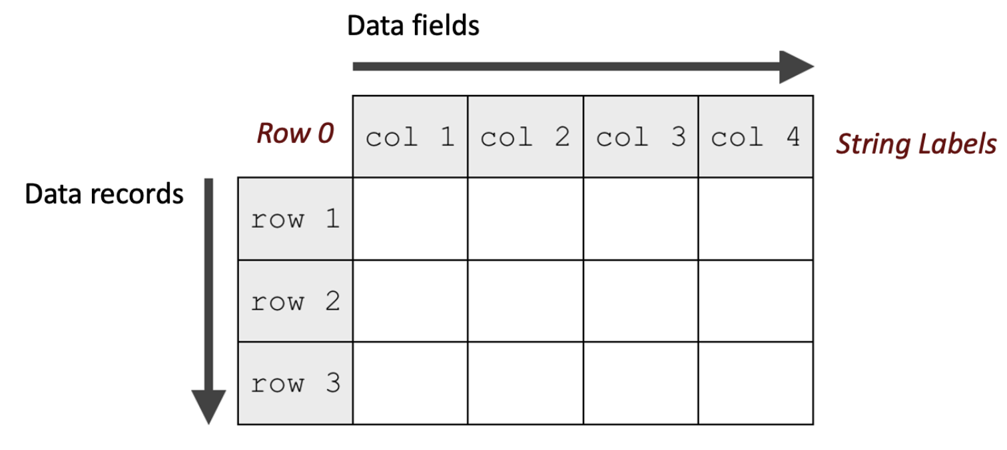
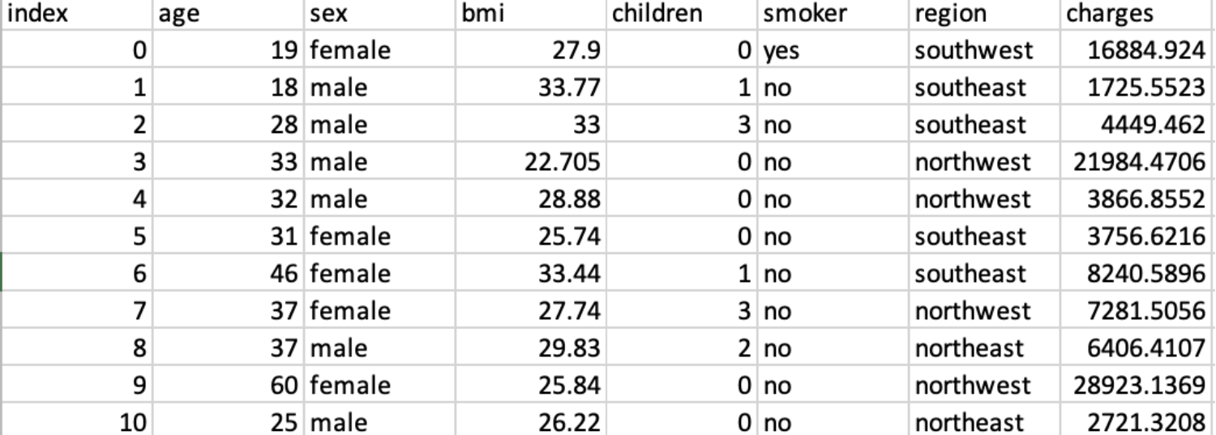
Machine Learning Data
Nature of Machine Learning Data:
Data is typically stored and processed in tabular form
Tabular data is naturally represented as a matrix of values
Each row corresponds to a single data example
Each column corresponds to a specific property/attribute/feature of the data
Insurance Charges Dataset

Slide 3

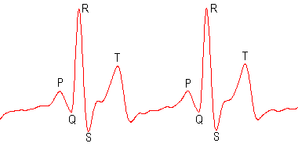

Deep Learning Data
Nature of Deep Learning Data:
Deep learning models operate on raw or minimally processed data
Unlike Machine Learning, features are often not handcrafted/engineered.
Models learn representations directly from dats
Ultrasound image (2D Matrix)
ECG Signal. (1D vector)
Computed Tomography (3D Matrix)

Slide 4
Why NumPy?
Why Python Lists Are Not Enough?
Machine learning requires operations on large vectors, matrices, and tensors
Typical operations include:
Element-wise arithmetic
Vector and matrix multiplication
Reductions such as sum, mean, and norms
These operations must be expressive and efficient.
List often require explicit loops for these operations (verbose, error-prone)
Lists stores pointers to objects, incurring significant compute and memory overhead
NumPy provides numerical computational functionality with operations in
mathematical form, offering performance, clarity!

Slide 5

NumPy Overview Roadmap
NumPy arrays for numerical computing
Creation and initialization of an array
Indexing and slicing
Indexing and slicing with arrays of indices
Iterating in arrays
Arithmetic operations
Multiplication, matrix multiplication, and dot product
Aggregate measures
Relational operators
Logical (bitwise) operators
Indices of elements that satisfy a condition & Sorting

Slide 6
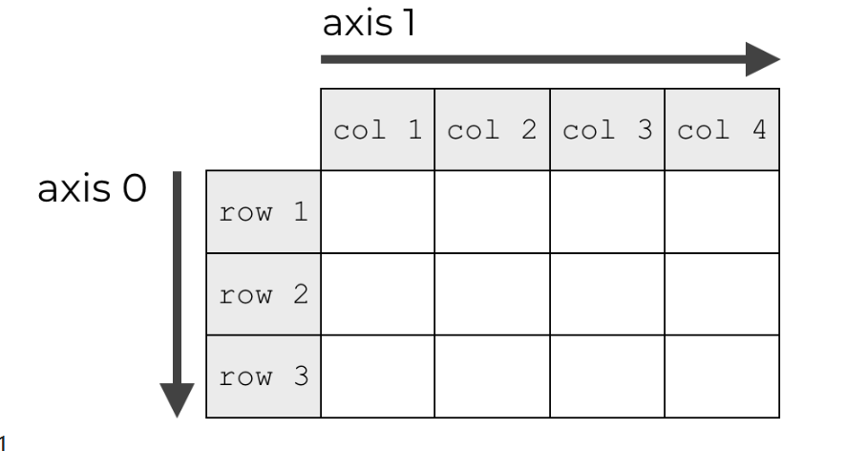
1. NumPy arrays for numerical computing
The ndarray implements a multi-dimensional array object and serves as the core data container for all NumPy operations.
Universal functions (ufuncs) operate automatically on ndarray in an element-by-element manner, without requiring explicit loops.
Structure and Properties of a NumPy array (ndarray)
A ndarray represents data arranged along one or more dimensions (ndim)
Each dimension has a length, forming the array shape (shape)
The total number of elements in the array is given by (size)
All elements in a NumPy array share the same data type (dtype)
Array values are stored in a contiguous memory buffer (data)
NumPy supports multiple numerical data types
Common integer types include: int8, int16, int32, int64
Common floating-point types include: float32, float64
Ndim and Axes

Slide 7
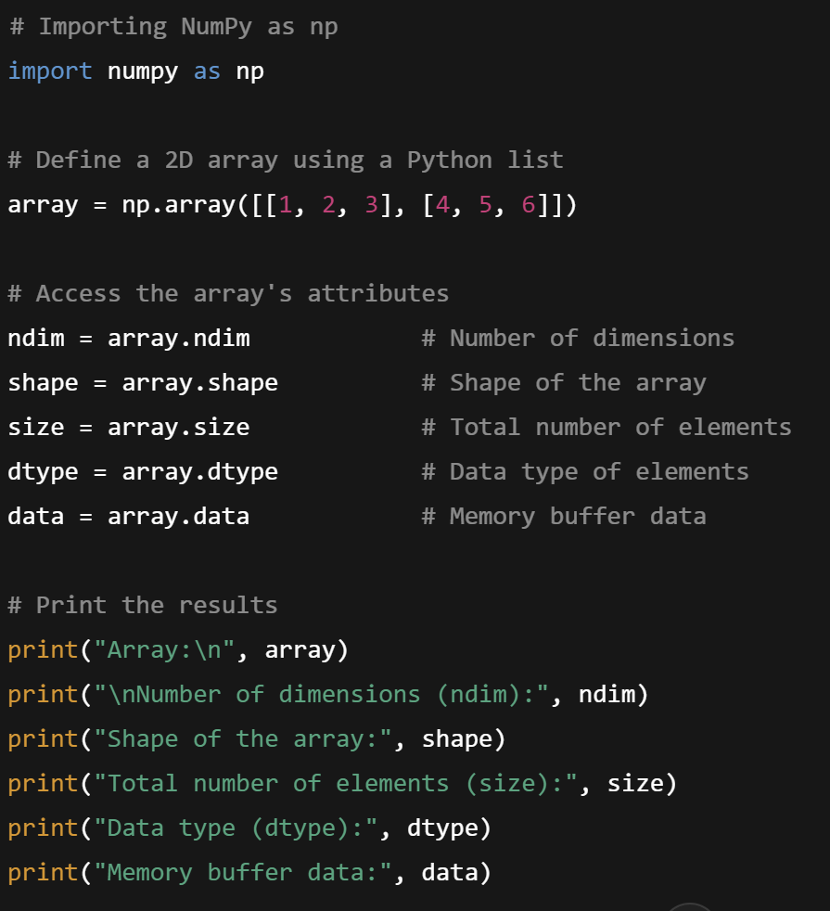
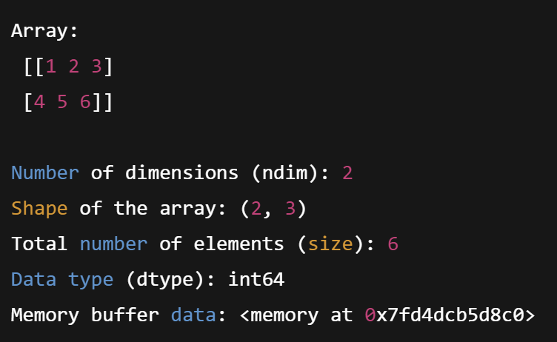
1. NumPy arrays for numerical computing
Output
Sample Code

Slide 8

2. Creation and initialization of ndarray
From Python List or Tuple: Create an array using np.array() with a list or tuple.
Zero-filled Array: Use np.zeros() to create an array filled with zeros, with a defined shape.
One-filled Array: Use np.ones() to create an array filled with ones, with a defined shape.
Constant-filled Array: Use np.full() to create an array filled with a constant value.
Identity Matrix: Use np.eye() to create an identity matrix of a specified size.
Arbitrarily-filled Array: Use np.empty() to create an uninitialized array with arbitrary values.
Range of Values: Use np.arange() to create an array with a specified range of values.
Linearly spaced values: Use np.linspace() to create an array of linearly spaced values between a start and stop point.
Array Reshaping: Use np.reshape() to change the shape of an array without changing its data.
Random Array Creation: Use np.random to create arrays filled with random numbers from various distributions.

Slide 9
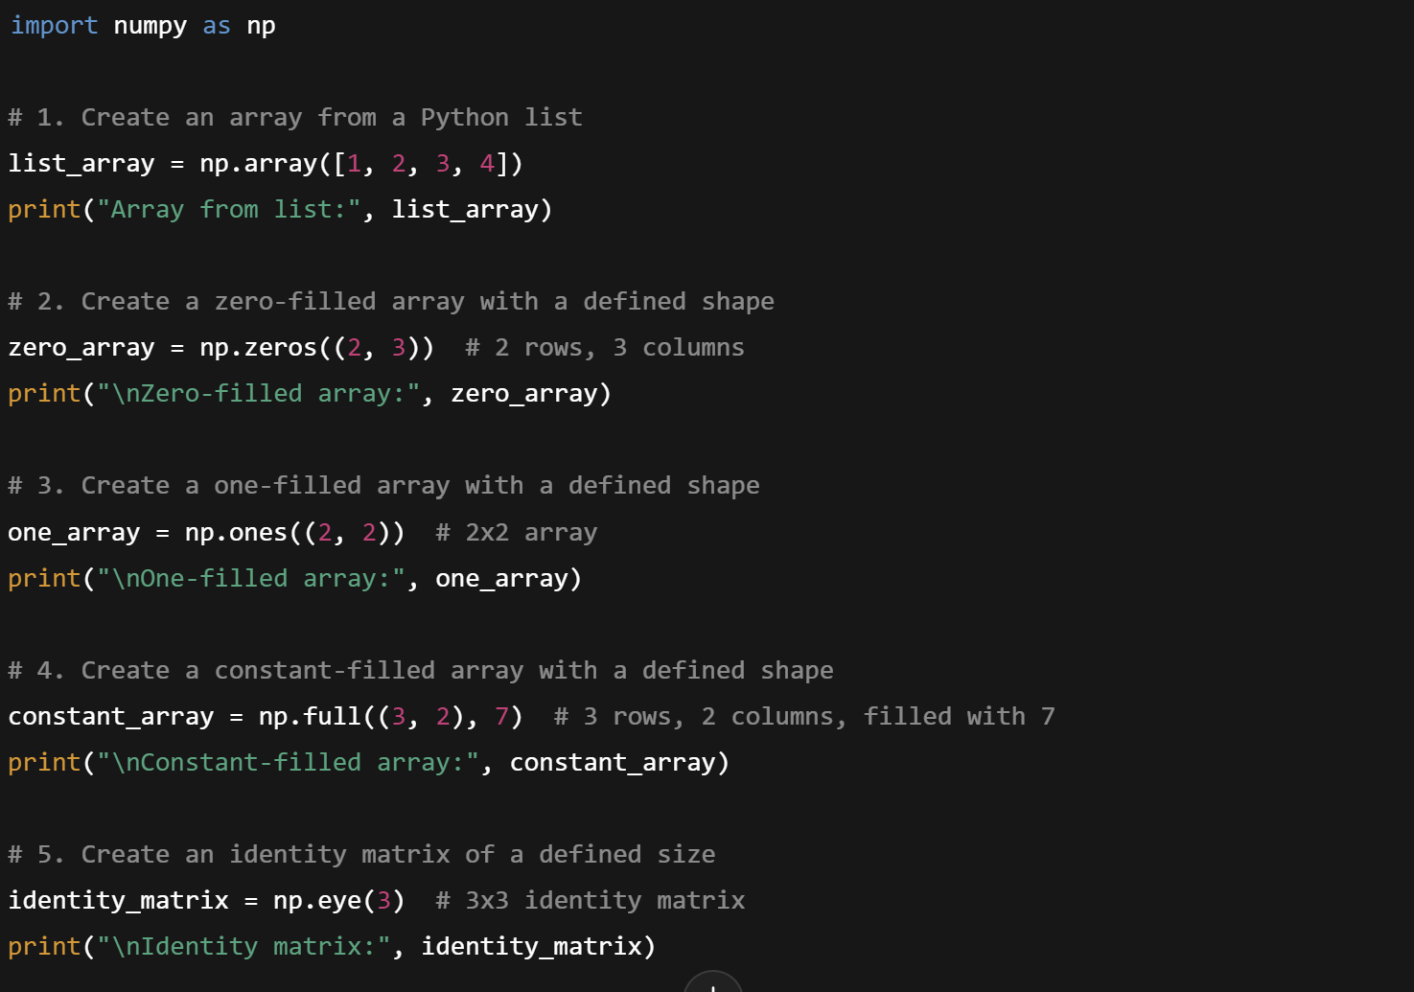
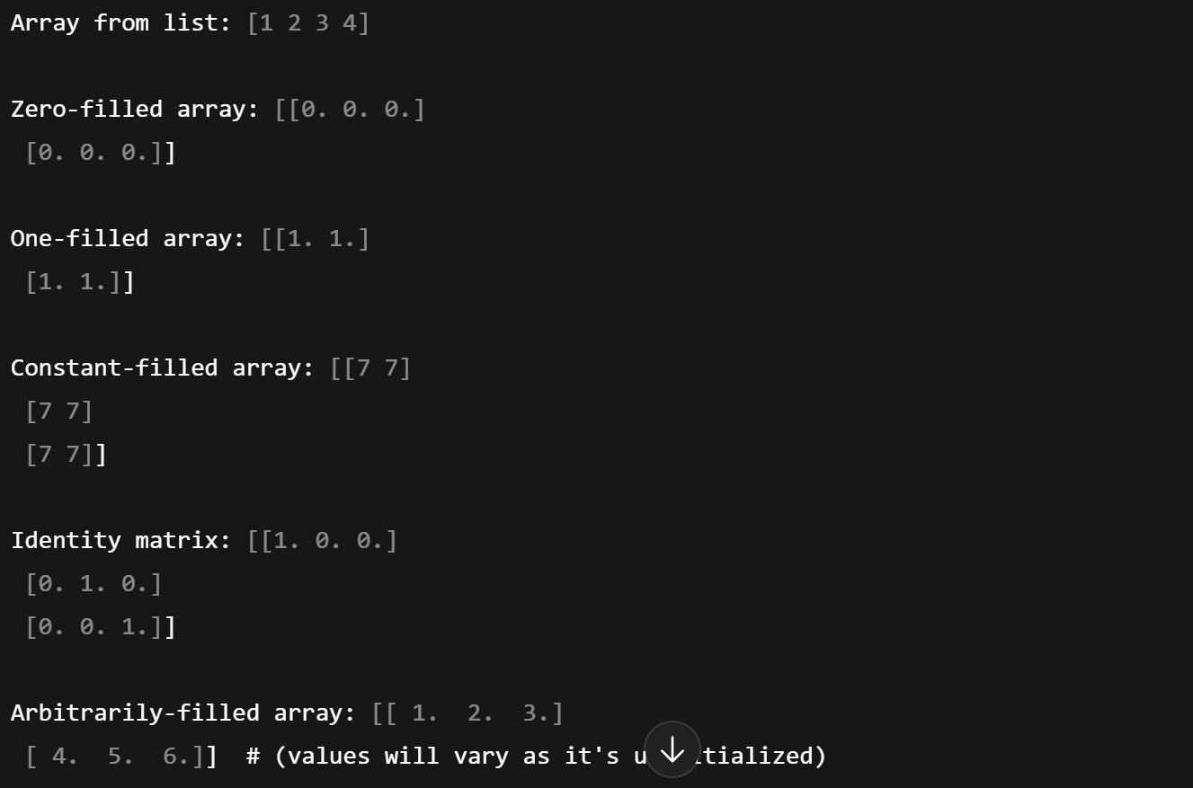
2. Creation and initialization of ndarray
Output
Sample Code

Slide 10
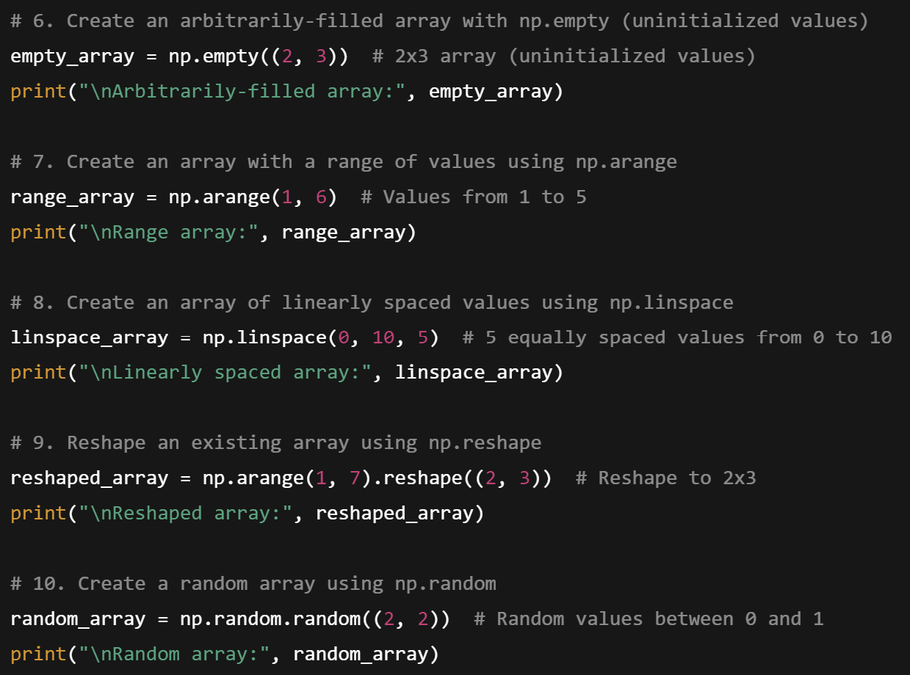
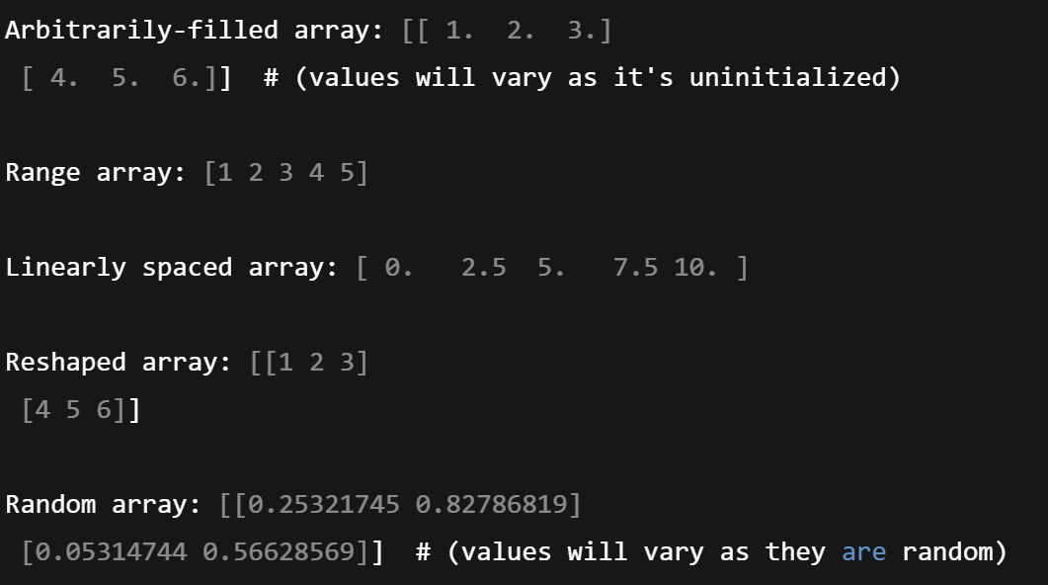
2. Creation and initialization of ndarray obj
Output
Sample Code

Slide 11
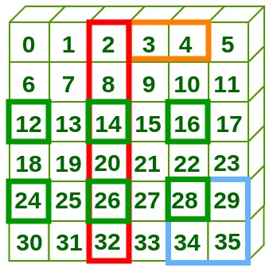
3. Indexing and slicing
Indexing: Accessing a specific element in a NumPy array, using row/column indices
Indexing syntax differs from lists (i.e., array[i, j] for ndarray vs array[i][j] for lists).
Slicing: Extracting a subset of an array, by specifying start, stop, and step values for each axis.
Multi-dimensional ndarrays: Both indexing and slicing can be applied to arrays with multiple dimensions (e.g., 2D, 3D).

Slide 12
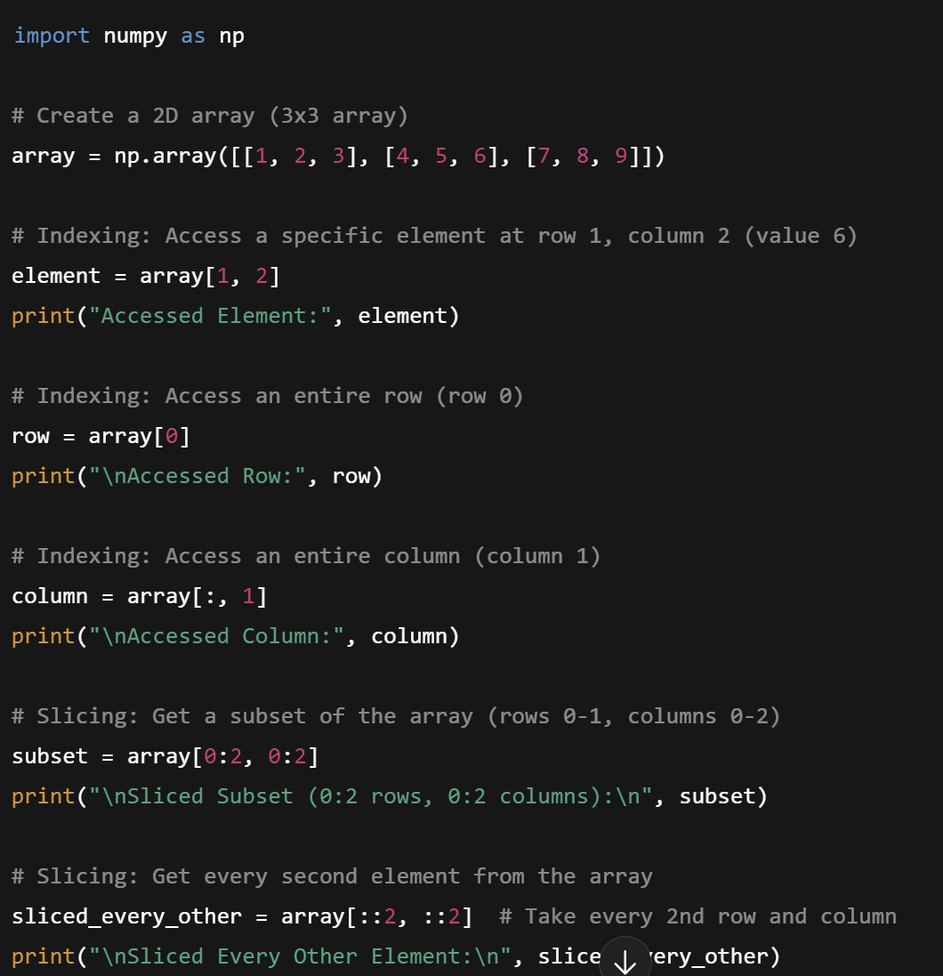
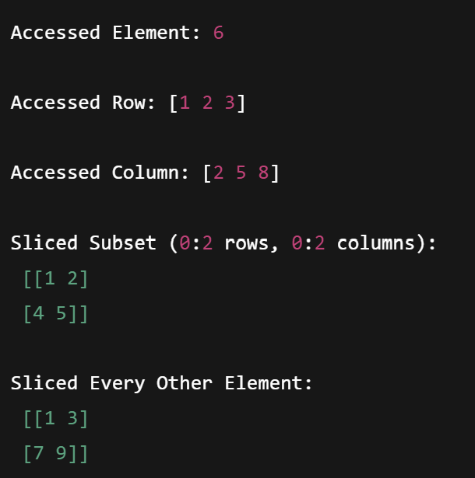
3. Indexing and slicing
Output
Sample Code

Slide 13
4. Indexing and slicing with arrays of indices
Index Arrays: Instead of using a single index, we can use an array of indices to access multiple elements or rows/columns simultaneously in multi-dimensional arrays.
Boolean Masks: Boolean indexing allows you to filter or select elements in an array based on a condition, where True values correspond to selected elements.

Slide 14
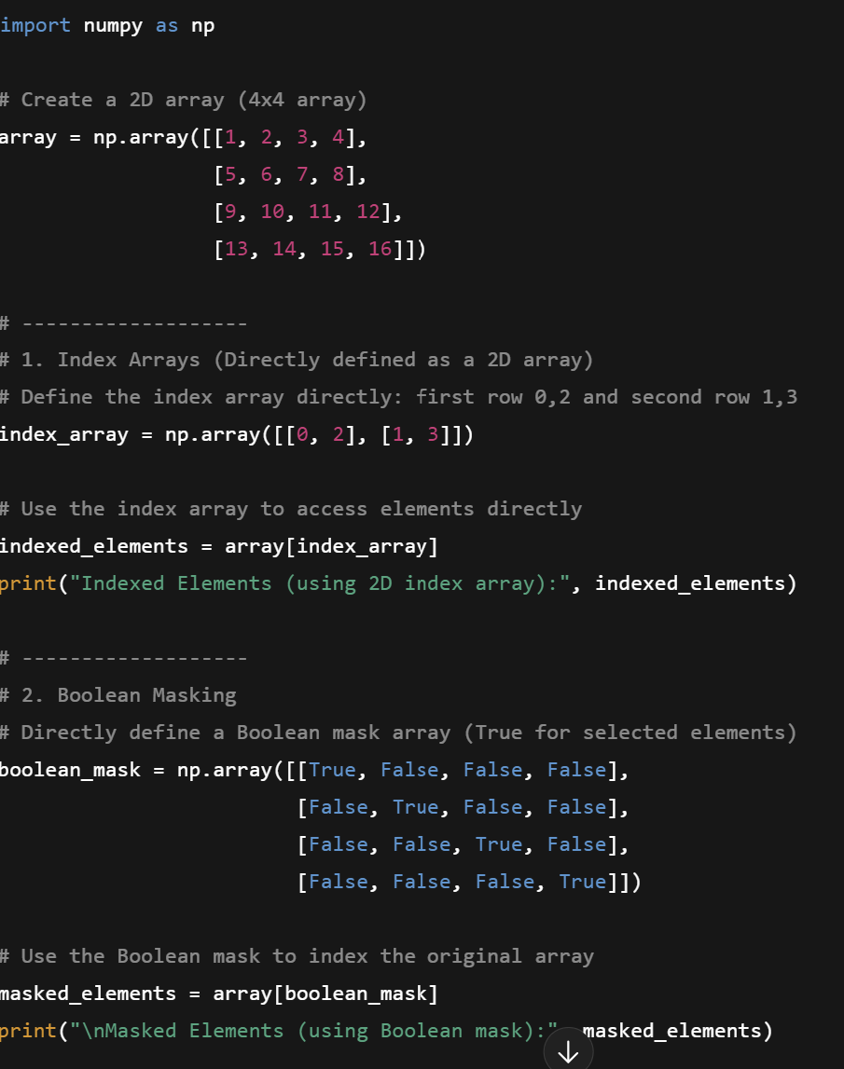
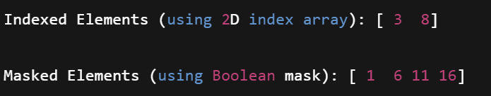
4. Indexing and slicing with arrays of indices
Output
Sample Code

Slide 15
5. Iterating in arrays
.flat:
Returns a flat iterator over the array.
It provides a one-dimensional view of the array, but it's not a copy
Useful for accessing or iterating over all elements in the array without altering the original structure.
.ravel():
Returns a flattened array (1D) from the original array, but unlike .flat(), ravel() creates a view whenever possible (i.e., no memory copy).
It is more efficient for operations where you want a flattened view of the array and will modify the result.
A view in NumPy is a lightweight reference to the original array, sharing its data, where modifications affect both the view and the original array.

Slide 16
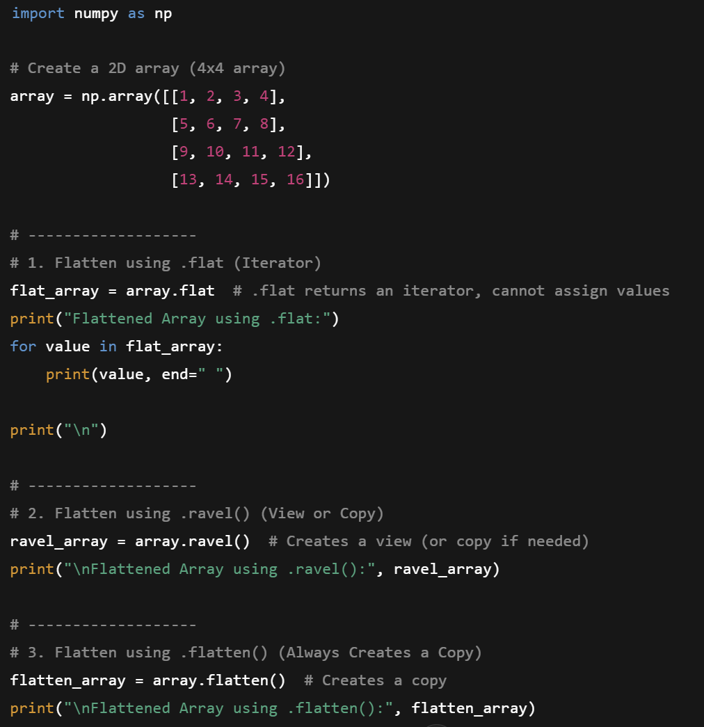
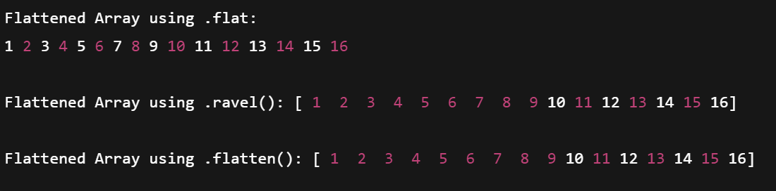
5. Iterating in arrays
Output
Sample Code

Slide 17
6. Arithmetic operations
Perform operations on each element of the array individually. These operations are applied element by element and return a new array.
Addition: +
Subtraction: -
Multiplication: *
Division: /
Exponentiation: **
In-place Operations: Modify the array in-place, meaning the original array is updated directly without creating a new one.
In-place Addition: +=
In-place Subtraction: -=
In-place Multiplication: *=
In-place Division: /=

Slide 18
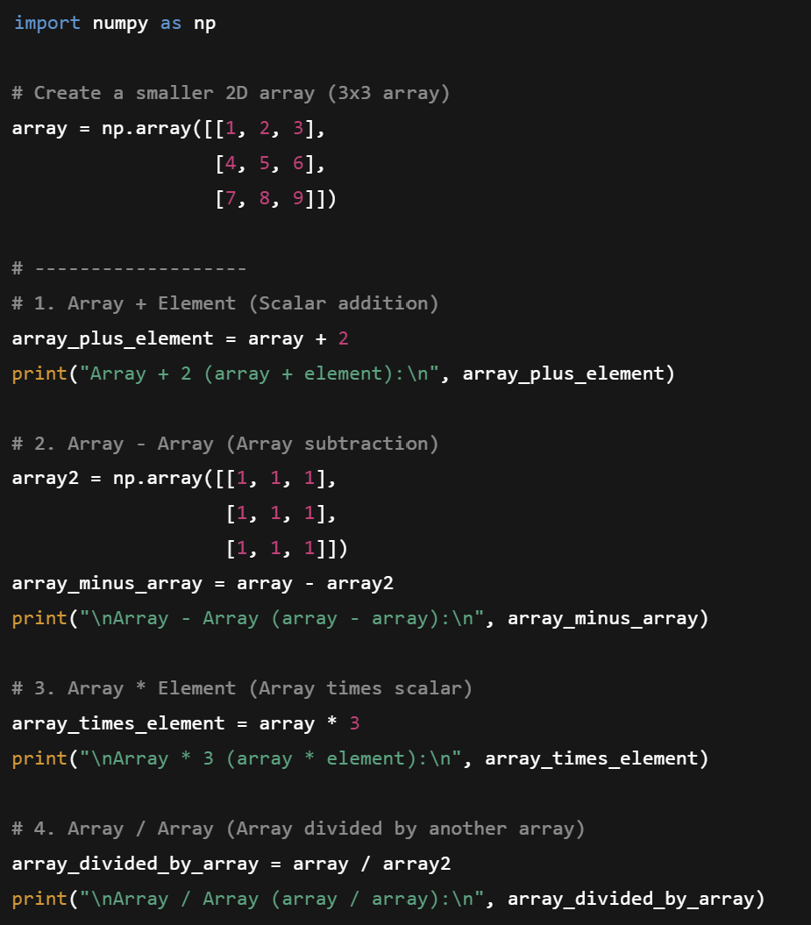
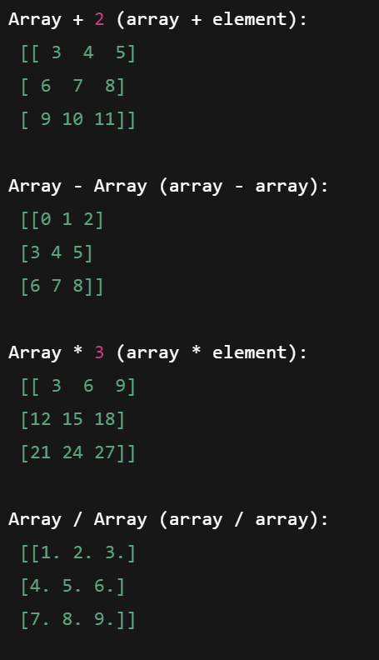
6. Arithmetic operations (not in-place)
Output
Sample Code

Slide 19
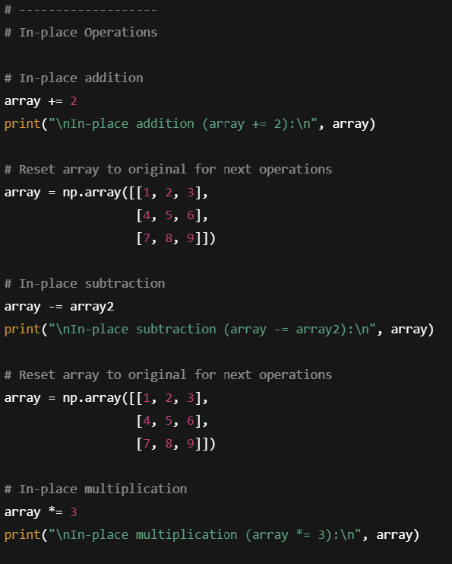
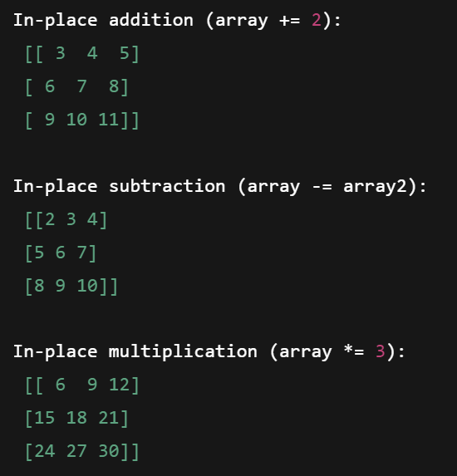
6. Arithmetic operations (in-place)
Output
Sample Code

Slide 20
7. Multiplication, matrix multiplication, & dot product
Element-wise Multiplication: Each element in one array is multiplied by the corresponding element in another array using the * operator.
Dot Product: Computes the sum of the product of two vectors. It’s used for vector dot products and can be done with np.dot().
Matrix Multiplication: Follows linear algebra rules for matrix multiplication, where the number of columns in the first matrix must equal the number of rows in the second. This can be done using np.matmul() or the @ operator.

Slide 21
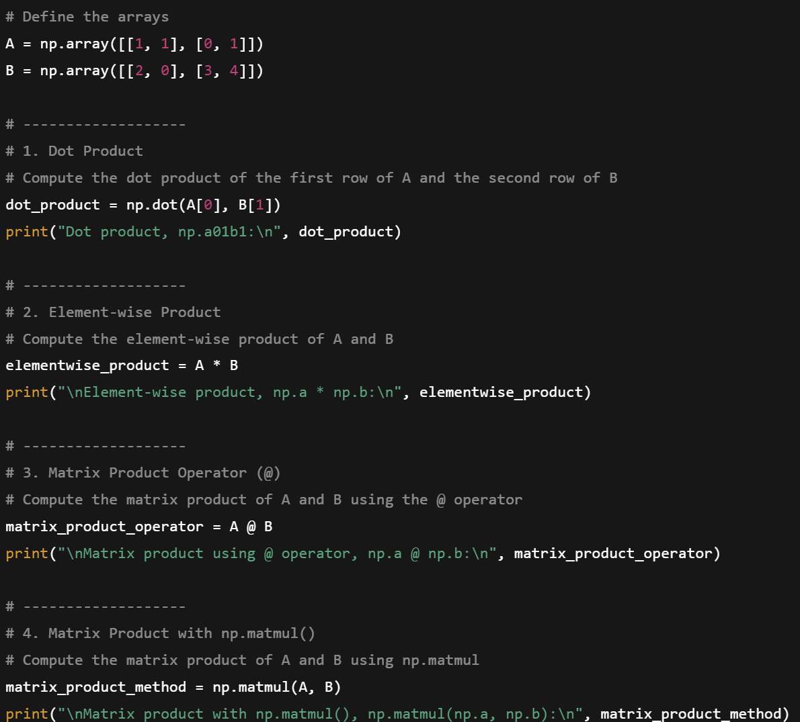
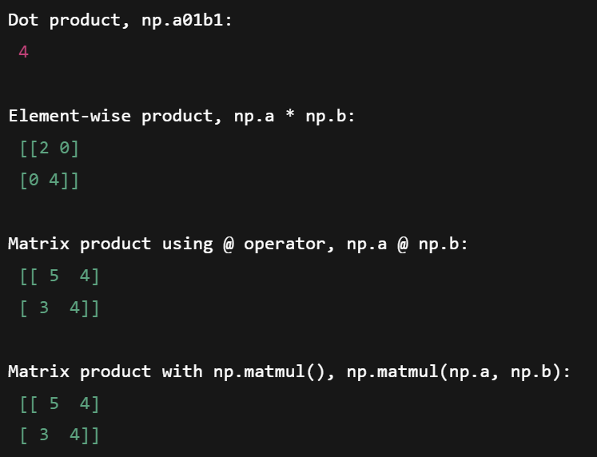
7. Multiplication, matrix multiplication, & dot product
Output
Sample Code

Slide 22
8. Aggregate measures
Operate element-wise across NumPy arrays (and, when applicable, along specified axes), enabling efficient aggregation over large datasets.
Aggregator Functions:
sum(): Computes the sum of all elements in an array (or along a specified axis).
min(): Computes the minimum value of an array (or along a specified axis).
max(): Computes the maximum value of an array (or along a specified axis).
argmin(): Returns the index of the minimum value in the array (or along a specified axis).
argmax(): Returns the index of the maximum value in the array (or along a specified axis).
average(): Computes the weighted average of an array.
median(): Computes the median of an array, a robust statistic against outliers.

Slide 23
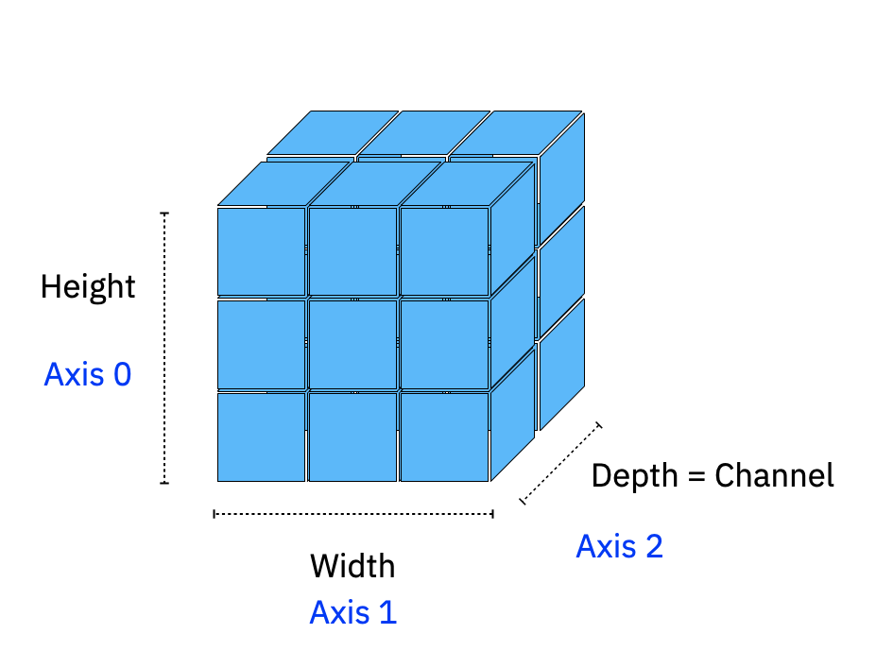

8. Aggregate measures
Shape = (3,3,2)
Aggregate Across Axes:
Axes 0: (3,2)
Axes 1: (3,2)
Axes 2: (3,3)
Shape = (H,W,C)

Slide 24
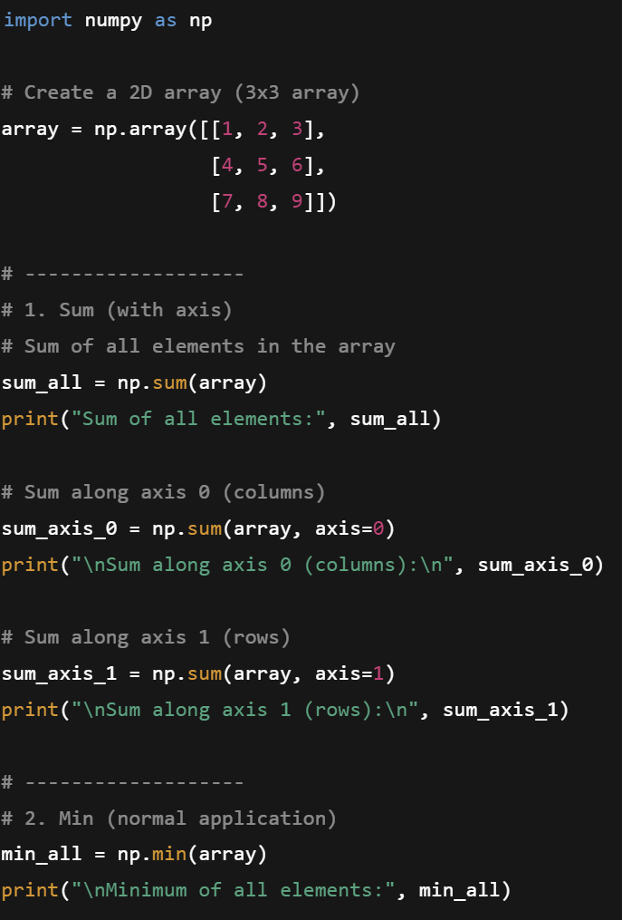
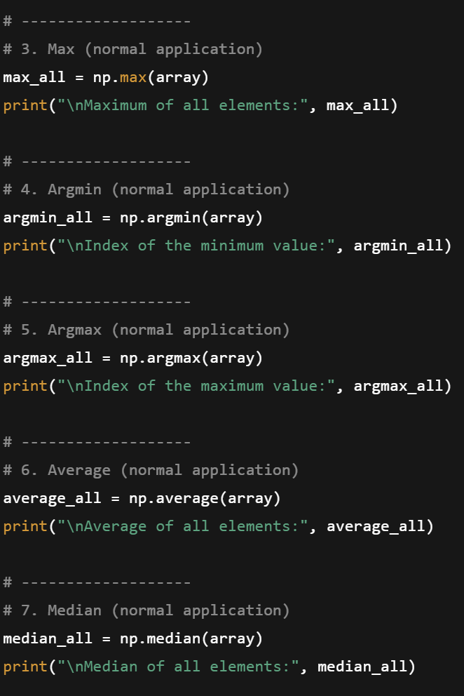
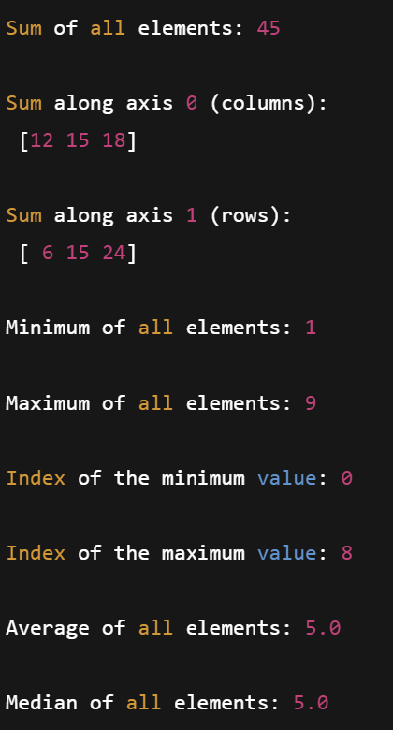
8. Aggregate measures
Sample Code
Output

Slide 25
9. Relational Operators
Element-wise Comparison: Compare an array to a single element (scalar), producing a Boolean array as the result.
Array-to-Array Comparison: Operators can also be applied between two arrays, performing element-wise comparisons and returning a Boolean array indicating the result of each comparison.
Common Relational Operators:
Greater than or equal to (>=)
Less than or equal to (<=)
Equal to (==)
Not equal to (!=)

Slide 26
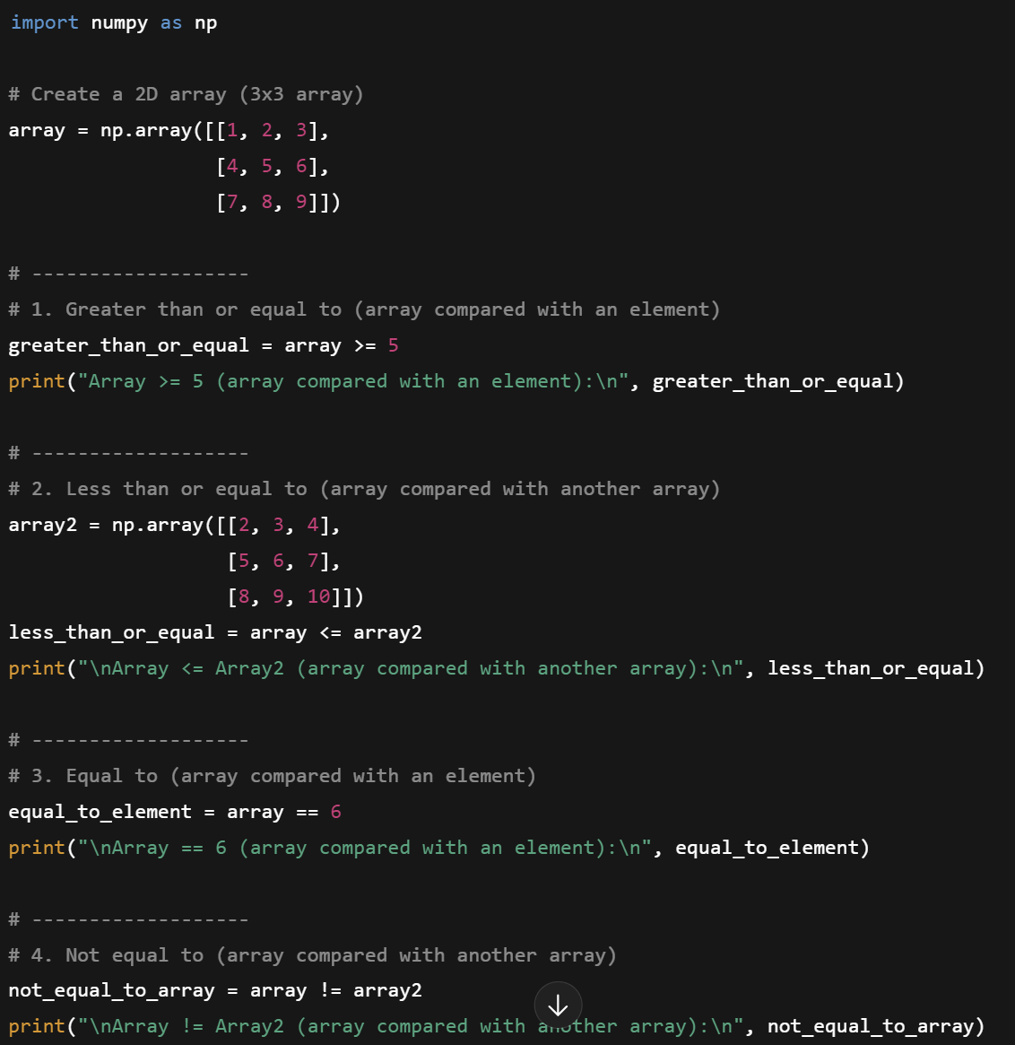
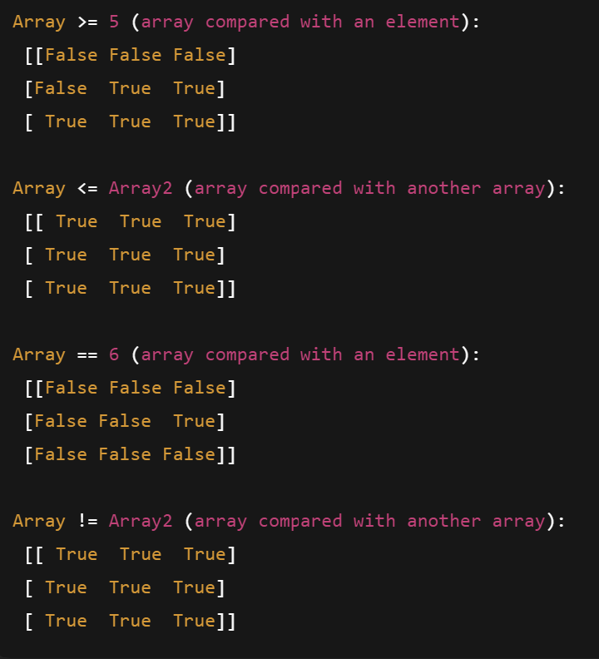
9. Relational Operators
Output
Sample Code

Slide 27
10. Logical (bitwise) Operators
Bitwise logical operators work on boolean arrays that result from relational comparisons and allow efficient operations on these arrays.
Common Operators:
& (and): Performs AND operation on boolean
| (or): Performs OR operation on boolean arrays
~ (not): Performs NOT operation, flipping the bits of a boolean array.
^ (xor): Performs XOR operation, which returns True only when the inputs differ.

Slide 28
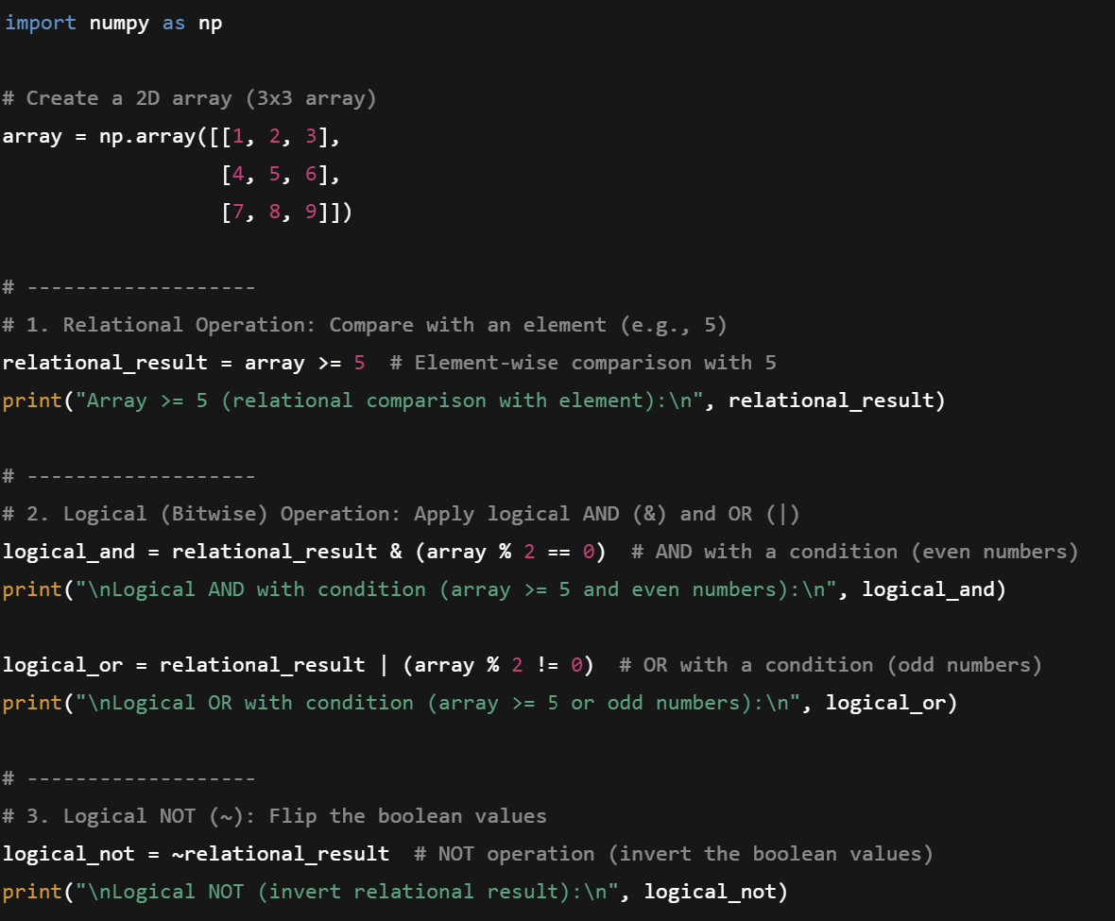
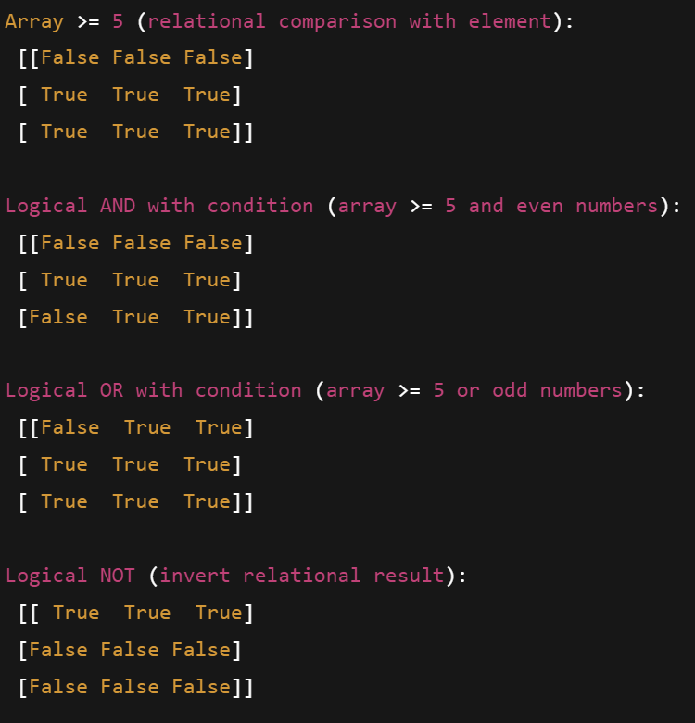
10. Logical (bitwise) Operators
Output
Sample Code

Slide 29
11. Indices of elements that satisfy a condition & Sorting
Finding Indices with np.where: Returns the indices of the elements in an array that satisfy a given condition. It can be used in two forms:
np.where(condition): Returns the indices where the condition is True.
np.where(condition, x, y): Selects values from x where the condition is True, and from y otherwise.
Sorting an Array:
In-place Sorting: Use a.sort() to sort the array in place, meaning the original array is modified and no new array is returned.
Not in-place Sorting: Use np.sort(a) to return a new sorted array, leaving the original array unchanged

Slide 30
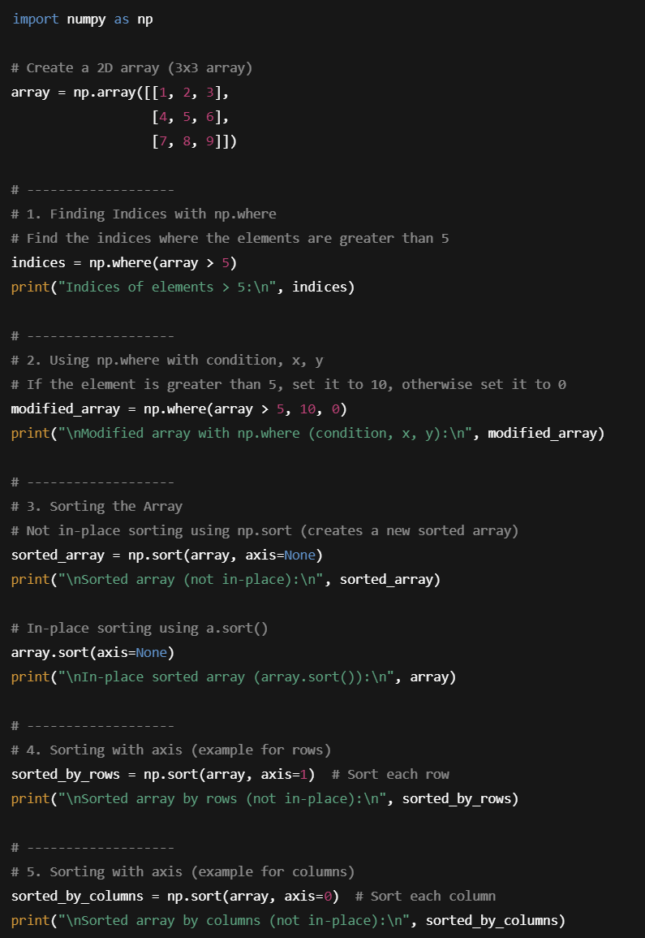
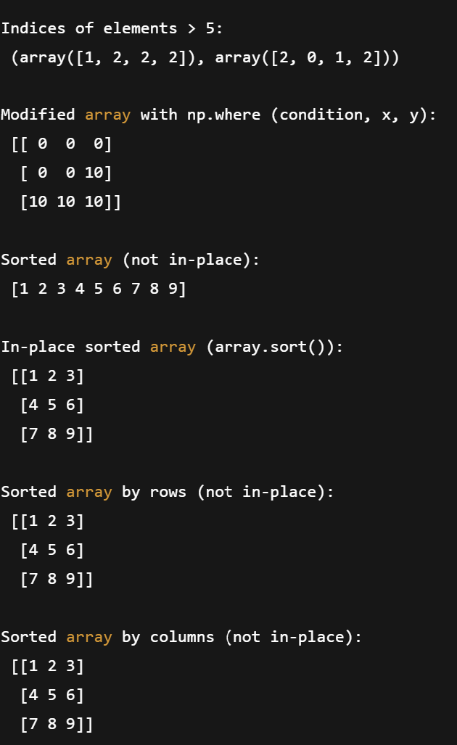
11. Indices of elements that satisfy a condition & Sorting
Output
Sample Code

Slide 31
I hope you found this session useful. Keep exploring NumPy!

