Slide 1
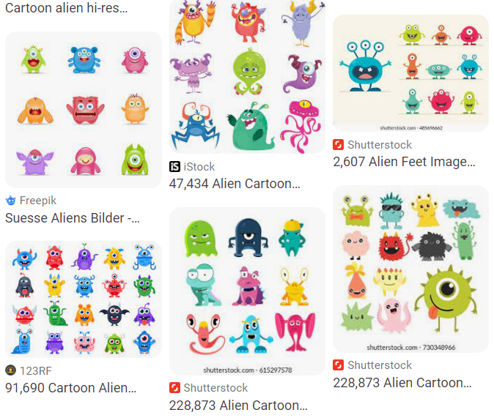
As you walk in
Welcome!
Help draw some aliens for our dataset today!
Grab a sharpie and some sticky notes
Just stick figures, nothing quite this fancy →

Slide 2

07-280 AI & ML I
Instructors:
Nihar Shah & Pat Virtue

Slide 3
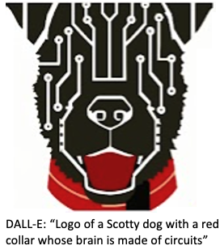
Today
Course team
Quick course info
Alien Autoencoders!
What is AI and ML?
Seasons of AI
Example Applications

Slide 4
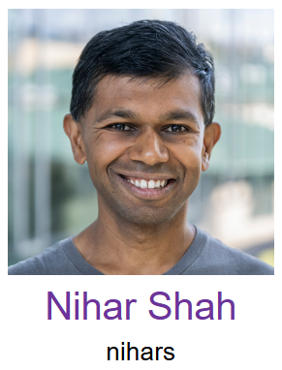
Course Team
Instructors
Education Associate

Slide 5



Nihar Shah Research on
the Evaluation of Science and the Science of Evaluation
Is it correct?
Is it good?
Is it even real?
Should it be funded?
Our research
Humans + Algorithms
Empirical performance + mathematical guarantees
Deployed in evaluation of
Over 100,000 papers
1000s of research proposals
Competitions
Admissions

Slide 6
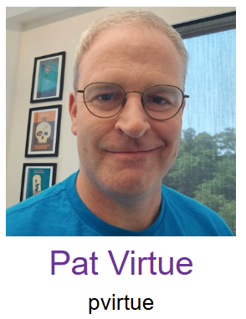
Course Team
Instructors
Education Associate

Slide 7
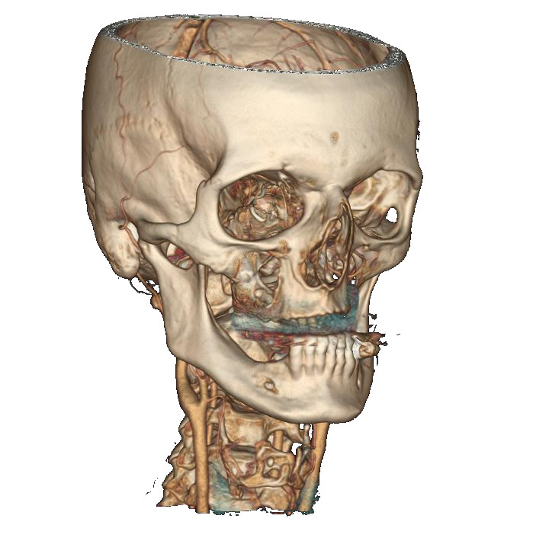
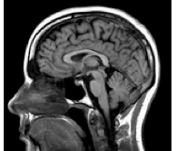




Pat Virtue
From Medical Imaging background to AI Education Outreach
GE Healthcare
UC Berkeley
Carnegie Mellon University

Slide 8

Course Team
Instructors
Education Associate
Email Brynn, bedmunds@andrew.cmu.edu:
Exceptions, extensions, etc
(may replace with exceptions form)
Any course logistics

Slide 9
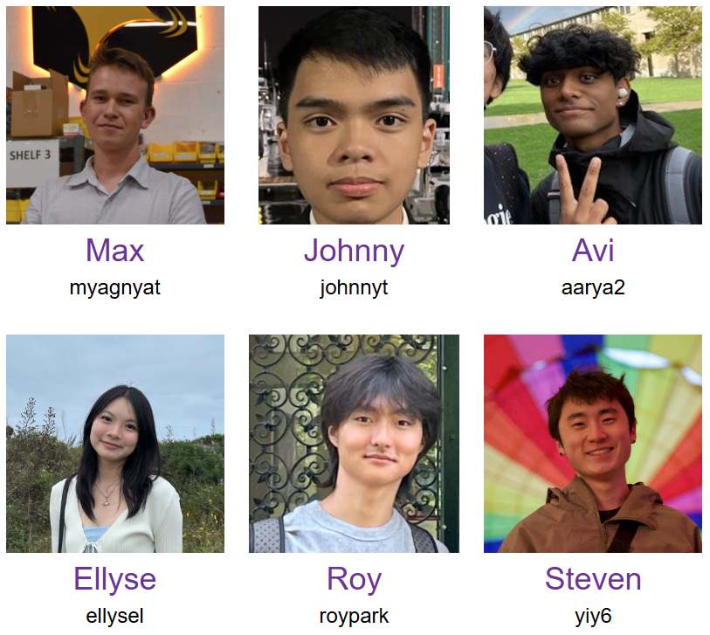
Course Team
Teaching Assistants

Slide 10
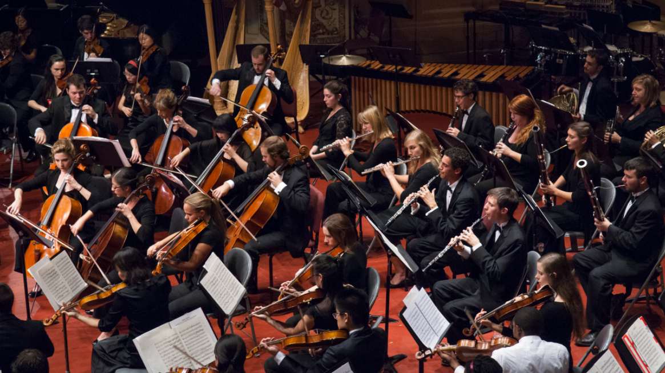
Course Team
Students!!

Slide 11

Course Information
Website: https://www.cs.cmu.edu/~10315
Communication:
https://piazza.com/
E-mail Brynn if Piazza doesn't work:
bedmunds@andrew.cmu.edu
Important posts!
Course Infrastructure
Numpy Tutorial
Pre-reading (due Wed)
HW0 (due Thu)
Lec Preview & Poll Links
Coming soon
Recitation1 (Fri)
HW1 (out Fri)

Slide 12
Poll 1
How many 07-280 assignments are due this week?

Slide 13
Today
Course team
Quick course info
Alien Autoencoders!
What is AI and ML?
Seasons of AI
Example Applications

Slide 14
Alien Autoencoders Game

Slide 15
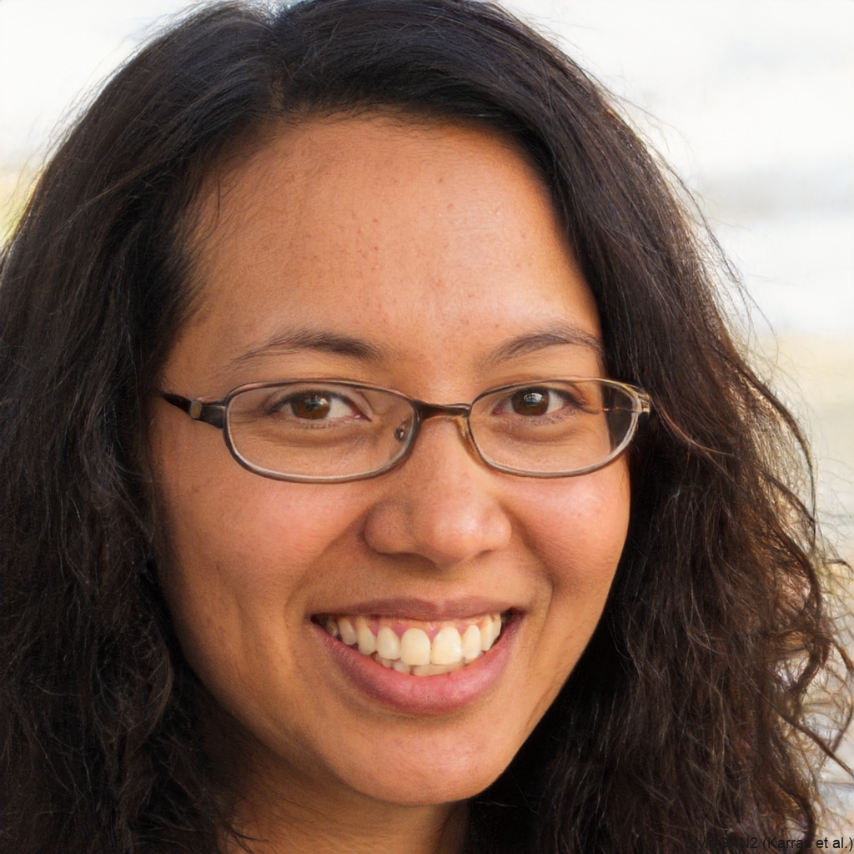
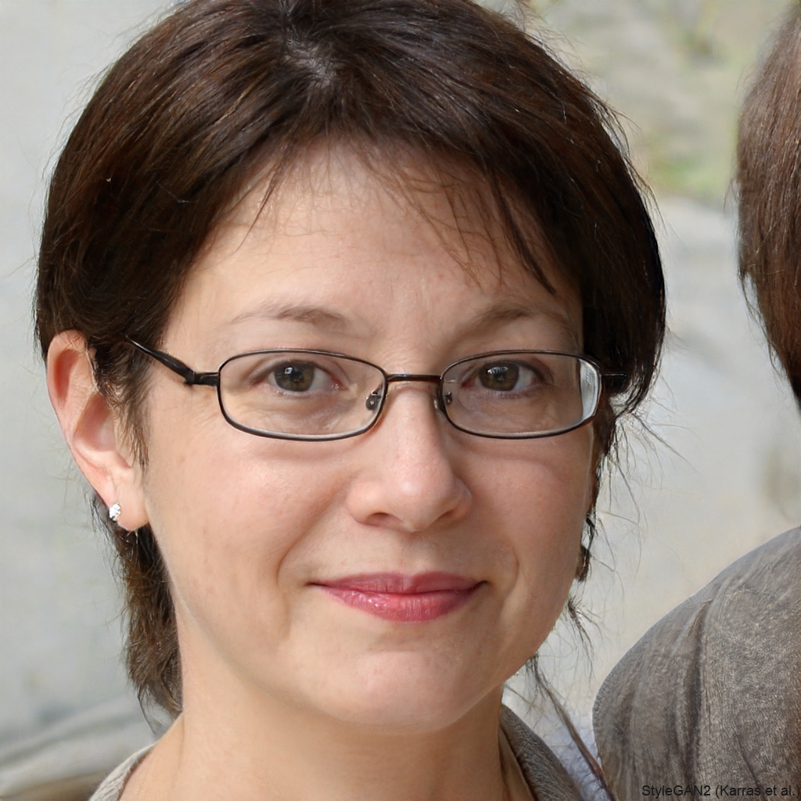
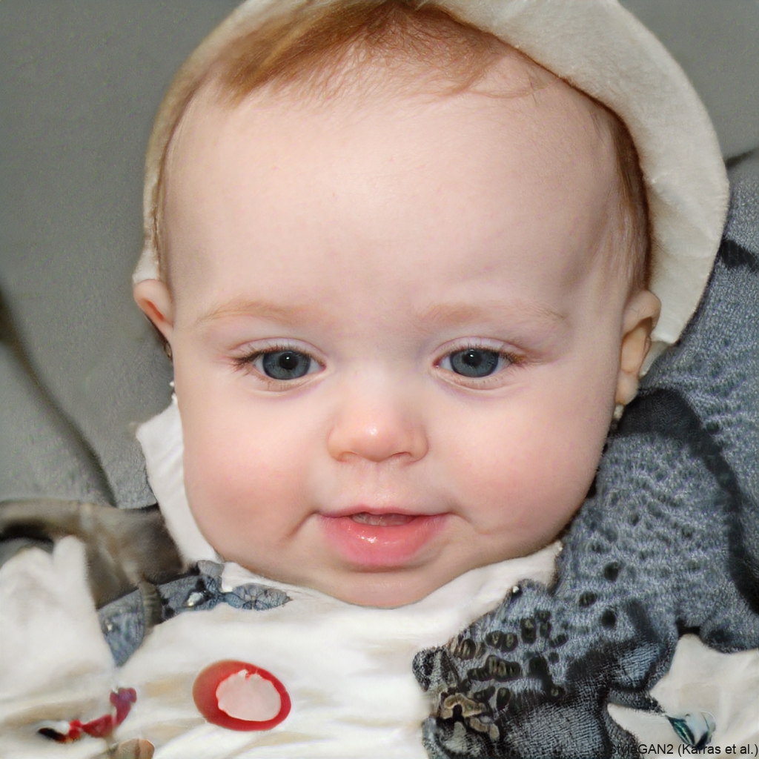
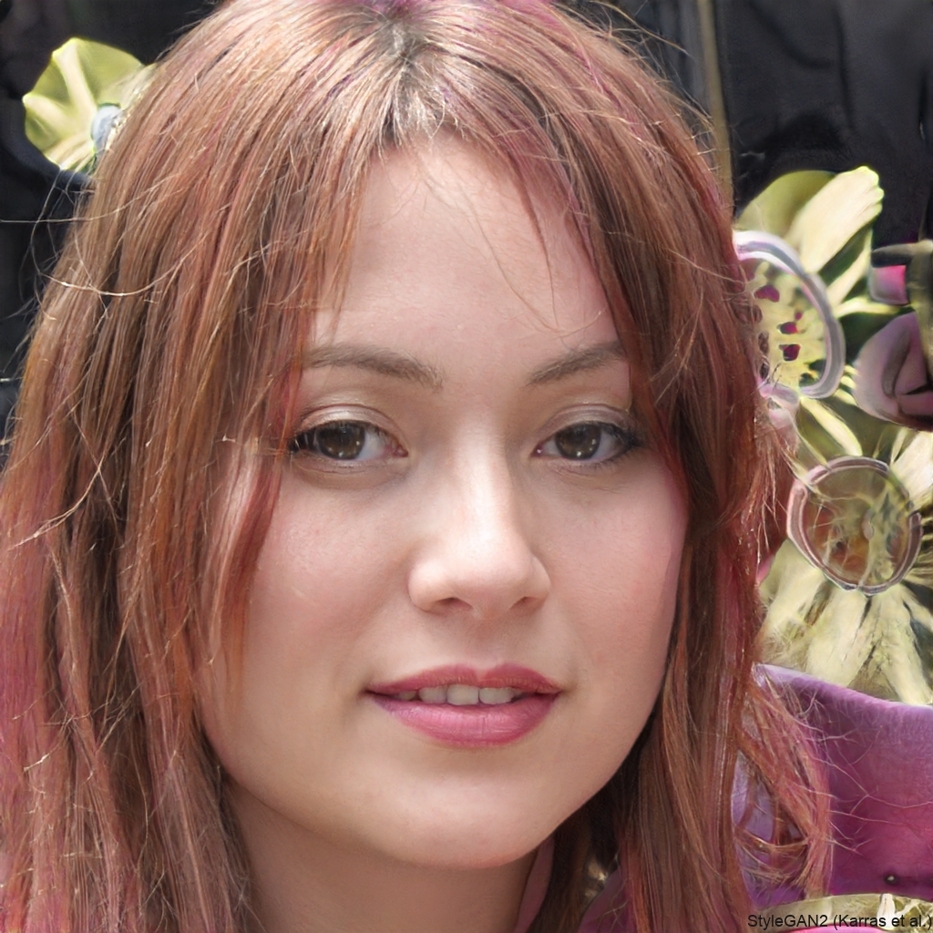

Task: Face Generation
https://thispersondoesnotexist.com/

Slide 16
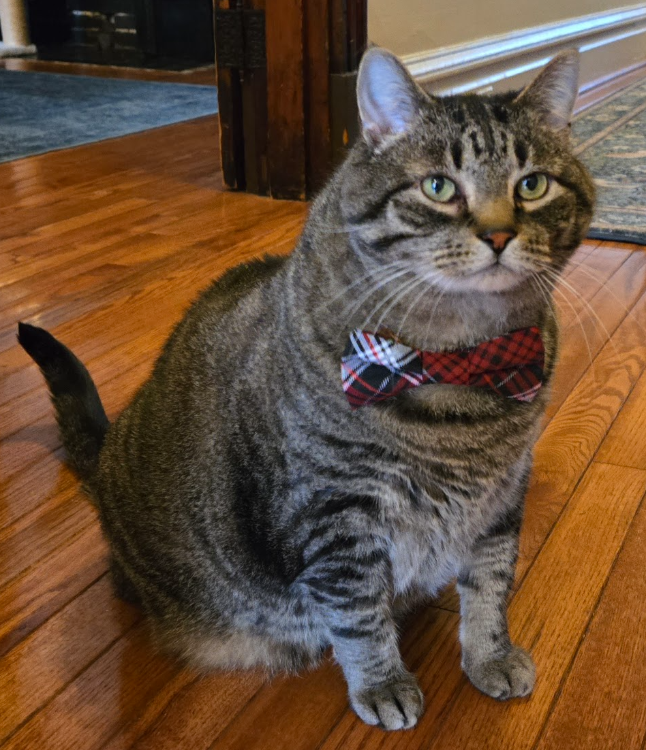
Task: Classification from Features
What is this?
Input:
Image
Predicted Output: Category

Slide 17


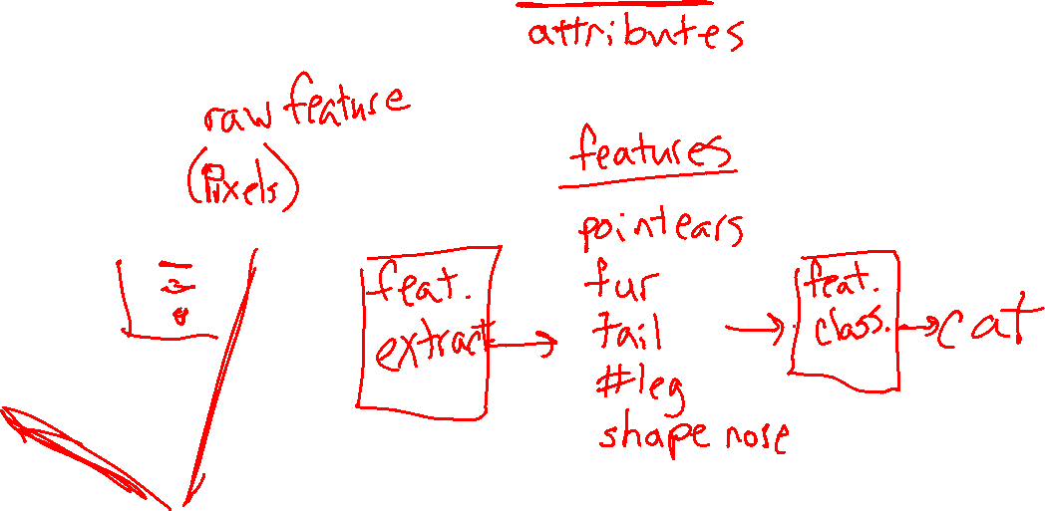
Task: Classification from Features
What is this?
Input:
Image
Predicted Output: Category

Slide 18
As you walk in
Welcome!
Help draw some aliens for our dataset today!
See table up front
Just stick figures, nothing quite this fancy →

Slide 19
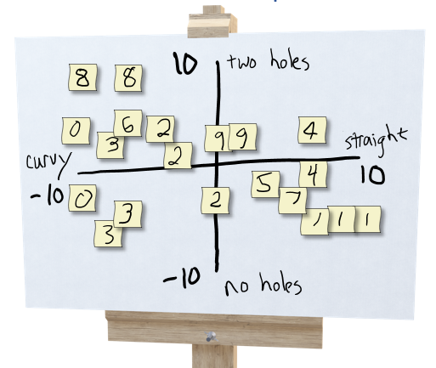
Exercise: Human-defined Feature Space
Try to organize data on a 2-D coordinate plot
to win the following game:
Select three students: A, B, C
Student A draws a new alien and hands it to student B
Student B thinks about where to plot it and comes up with a 2-D coordinate (horizonal, vertical)
Student C draws a second alien based on coordinate and plot of aliens (don't peak at drawing from A!)

Slide 20
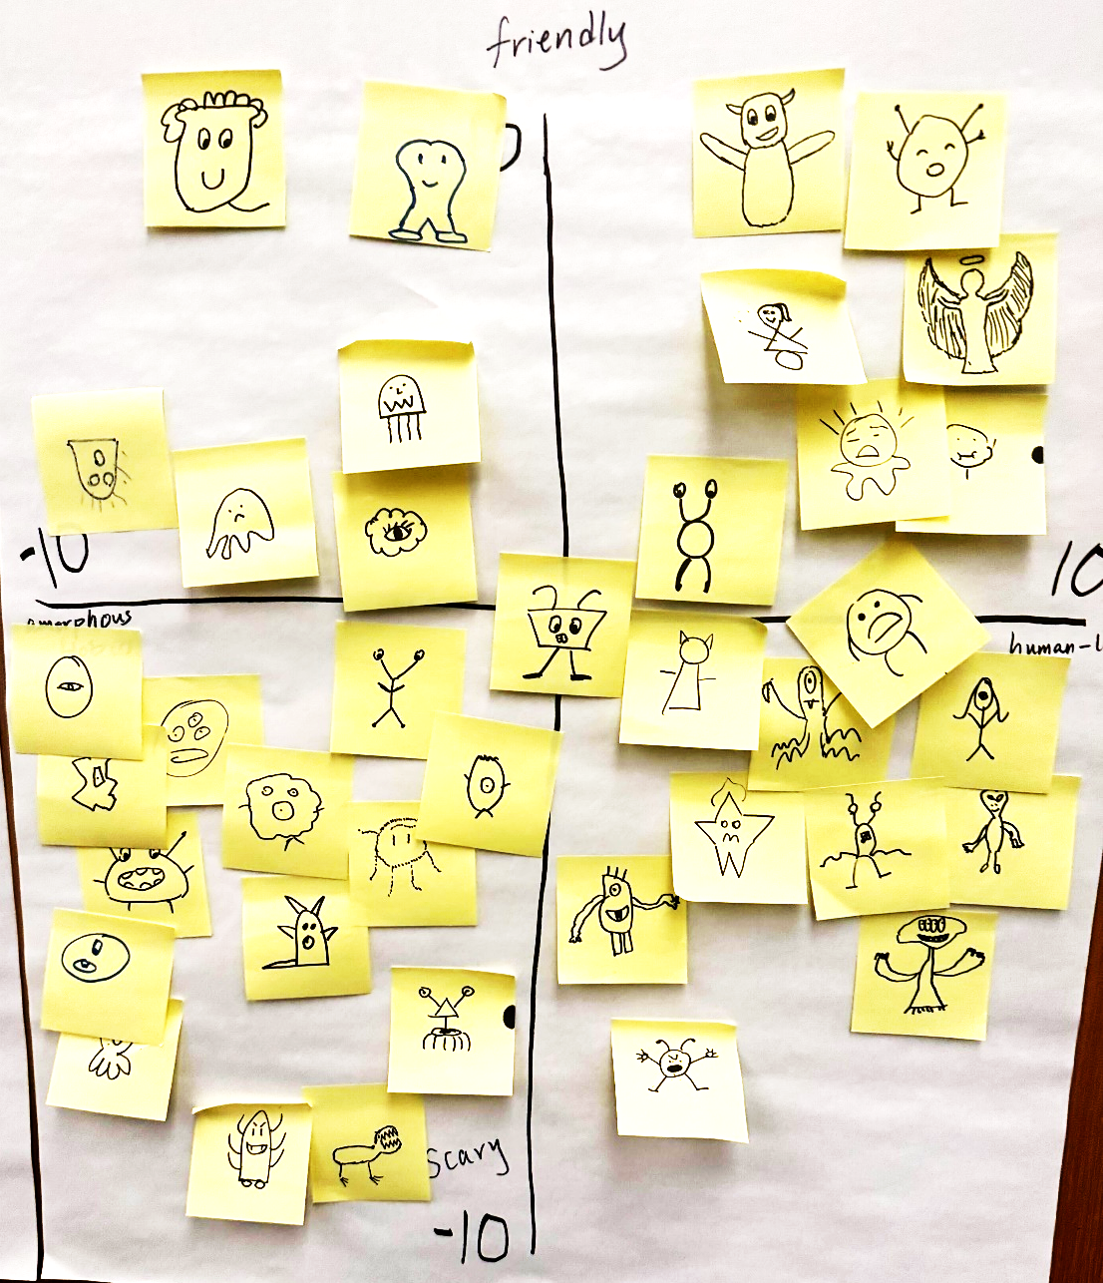

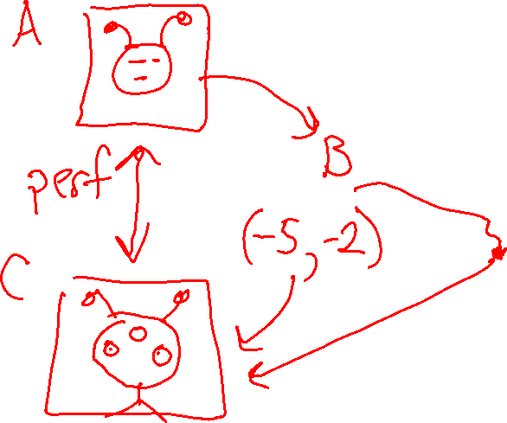
Exercise: Human-defined Feature Space

Slide 21
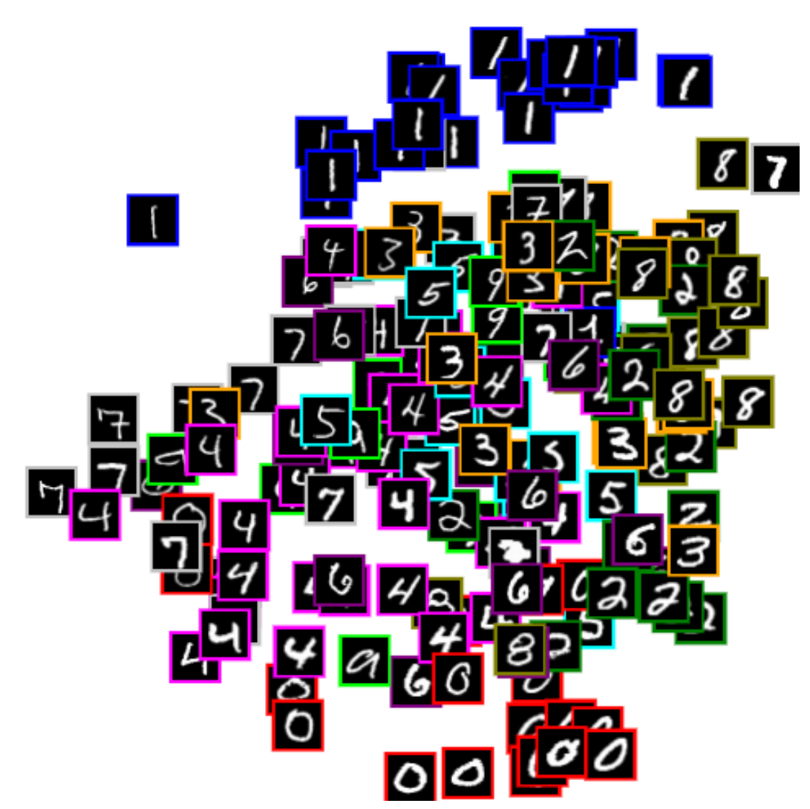



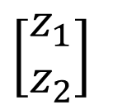


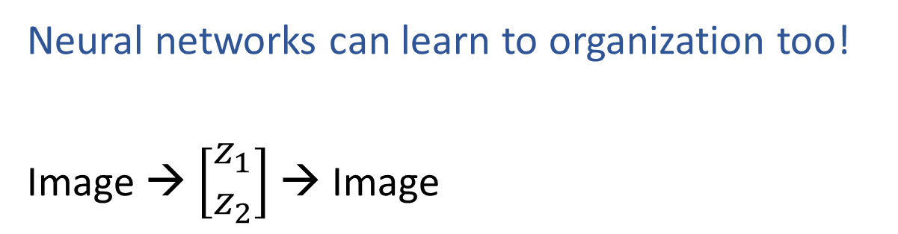
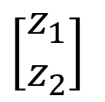
Learning to Organize Data
Neural networks can learn to organization too!
Image → $\left[\begin{aligned}z_{1} \\ z_{2}\end{aligned}\right]$ → Image
$$z_{2}$$
Net
$$\left[\begin{aligned}z_{1} \\ z_{2}\end{aligned}\right]$$
Net
$$\left[\begin{aligned}z_{1} \\ z_{2}\end{aligned}\right]$$
$$z_{1}$$
https://cs.stanford.edu/people/karpathy/convnetjs/demo/autoencoder.html

Slide 22


Digit Autoencoder
https://cs.stanford.edu/people/karpathy/convnetjs/demo/autoencoder.html
Layer 1
Layer 2
Layer 4
Layer 5
Layer 6
Input
28x28 = 784 pixels
Layer 3
50 neurons
50 neurons
784 neurons
50 neurons
50 neurons
2 neurons
Autoencoder network

Slide 23

Digit Autoencoder
Demo: Using a learned feature space

Slide 24
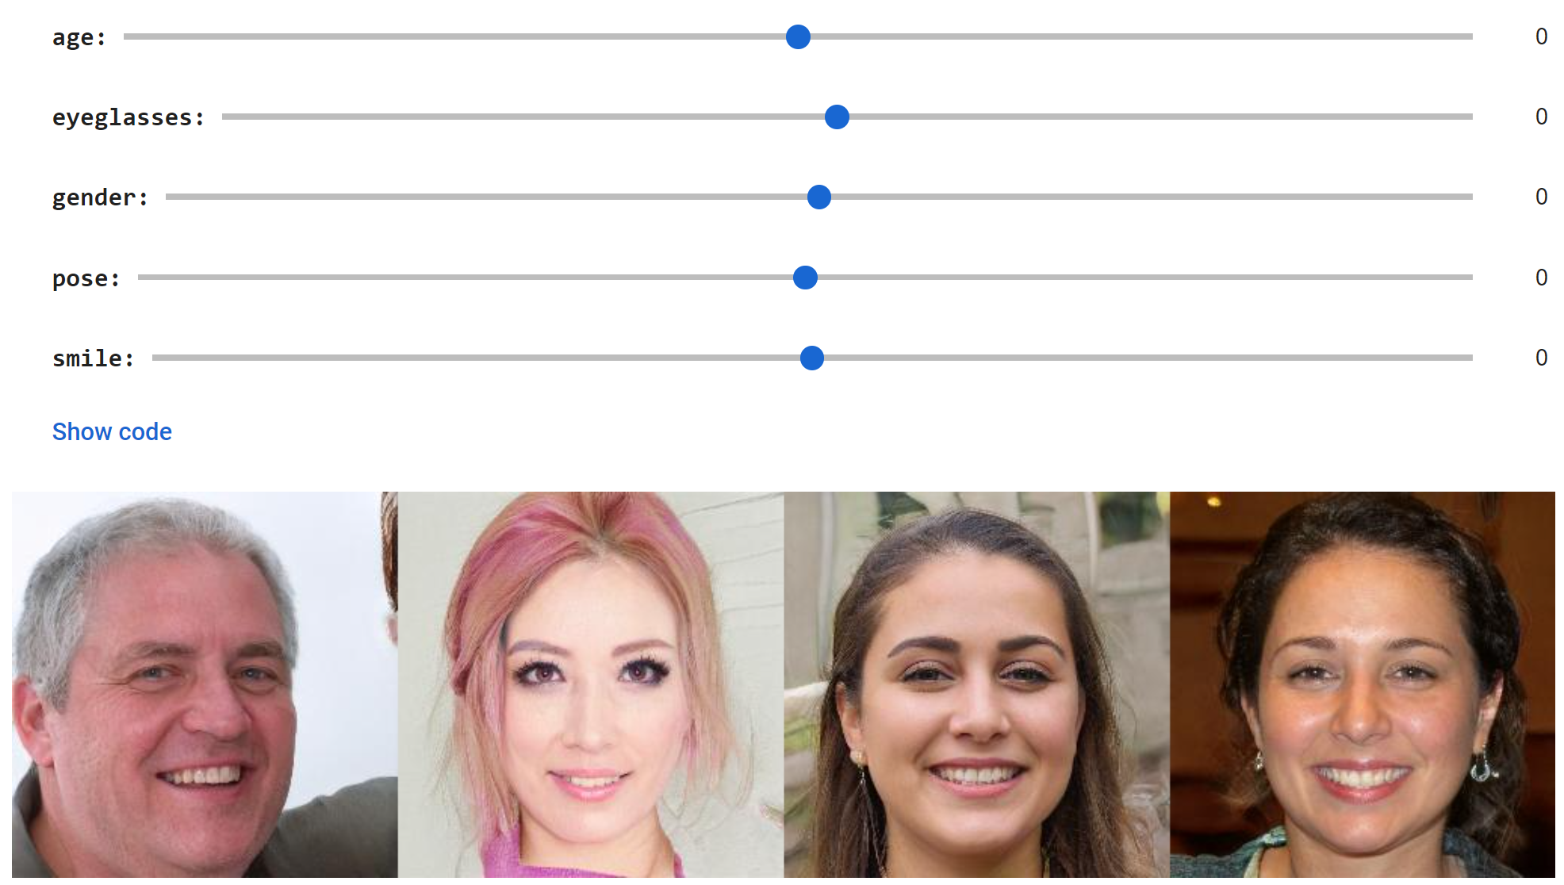
Face GAN Slider Demo
https://github.com/genforce/interfacegan
https://colab.research.google.com/github/genforce/interfacegan/blob/master/docs/InterFaceGAN.ipynb

Slide 25
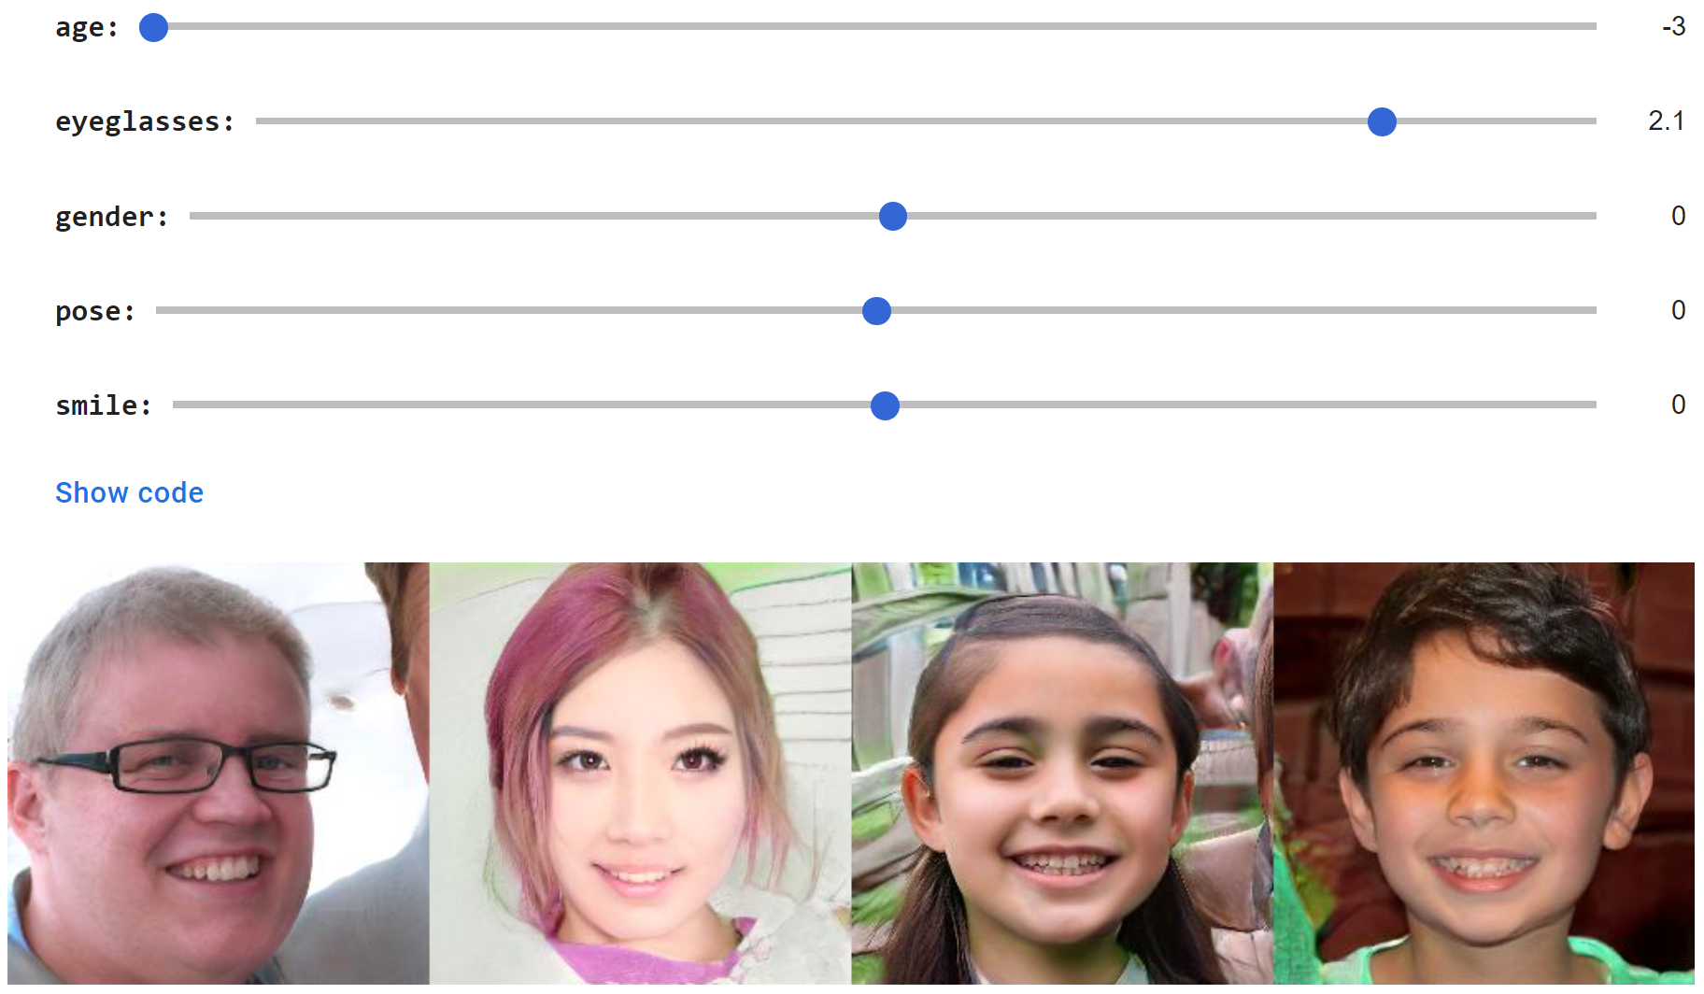
Face GAN Slider Demo
https://github.com/genforce/interfacegan
https://colab.research.google.com/github/genforce/interfacegan/blob/master/docs/InterFaceGAN.ipynb

Slide 26
Today
Course team
Quick course info
Alien Autoencoders!
What is AI and ML?
Seasons of AI
Example Applications

Slide 27
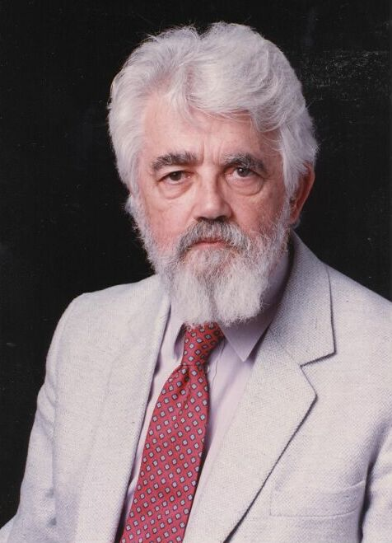
AI Definition by John McCarthy
What is artificial intelligence
It is the science and engineering of making intelligent machines, especially intelligent computer programs
What is intelligence
Intelligence is the computational part of the ability to achieve goals in the world
http://www-formal.stanford.edu/jmc/whatisai/whatisai.html

Slide 28
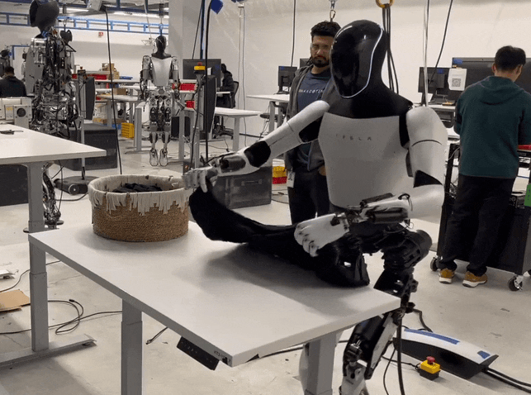
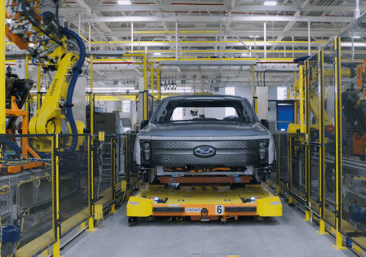
What is artificial Intelligence?
Why is folding clothes a research problem while robots are actively being used to assemble cars in factories?

Slide 29


AI Definition (Pat's Version)
What is intelligence
Intelligence is the ability to perform well on a task that involves uncertainty
Intelligence is not binary
How well an agent performs and how much uncertainty is involved will determine how intelligent we consider the agent to be

Slide 30
Artificial Intelligence vs Machine Learning?
Artificial Intelligence
Machine Learning
Machine Learning
Deep Learning

Slide 31
Artificial Intelligence vs Machine Learning?
Artificial Intelligence
Search
Machine Learning
CSPs
Machine Learning
Planning
Logic
PGM
Linear/Int. Programming
Deep Learning
RL
Game Theory
MDPs

Slide 32

Artificial Intelligence vs Machine Learning?
Artificial Intelligence
Machine Learning
Machine Learning
Deep Learning
Deep Learning

Slide 33

Artificial Intelligence vs Machine Learning?
Artificial Intelligence
Machine Learning
Machine Learning
Deep Learning
Deep Learning

Slide 34
Artificial Intelligence vs Machine Learning?
Artificial Intelligence
Search
Machine Learning
AI/ML Ethics
CSPs
Planning
Deep Learning
Logic
Linear/Int. Programming
Probabilistic Graphical Models
Generative
AI
Game Theory
Reinforcement Learning
MDPs

Slide 35
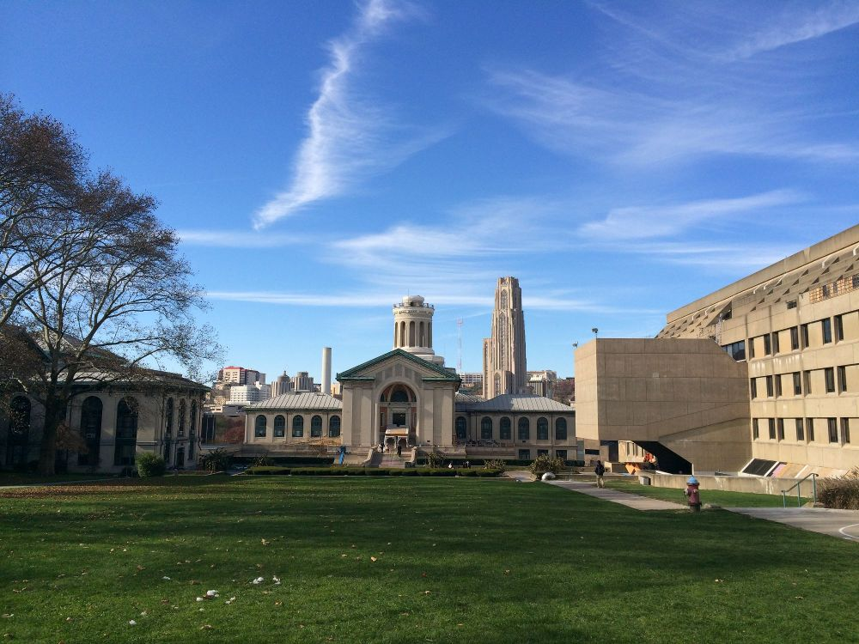
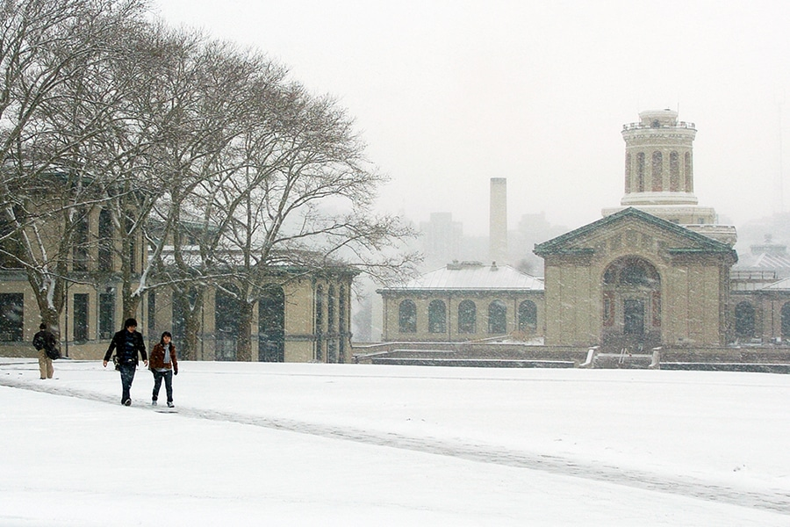
Seasons of AI…

Slide 36
Summer: 1940s, 50s, early 60s
First mathematical model of neurons: Pitts & McCulloch (1943)
Beginning of artificial neural networks
Perceptron, Rosenblatt (1958)

Slide 37
Winter: Late 1960s, 70s
Collapse of early promises
Perceptron can’t even learn the XOR function
Don’t know how to train multi-layer perceptrons (aka deep neural nets)
1960s Backpropagation algorithm for training
but not much attention

Slide 38
Summer: 1980s
Expert (rule based) systems
1986 Backpropagation reinvented / popularized
“Learning representations by back-propagating errors,” Rumelhart, Hinton, Williams, Nature, 323, 533—536, 1986
Successful applications: Character recognition, autonomous cars,…

Slide 39
Winter 1990s
Vapnik and collaborators develop SVM (1993)
Shallow architecture
SVM almost kills the ANN research
Training deeper networks consistently yields poor results.
Exception: deep convolutional neural networks, LeCun 1998.

Slide 40




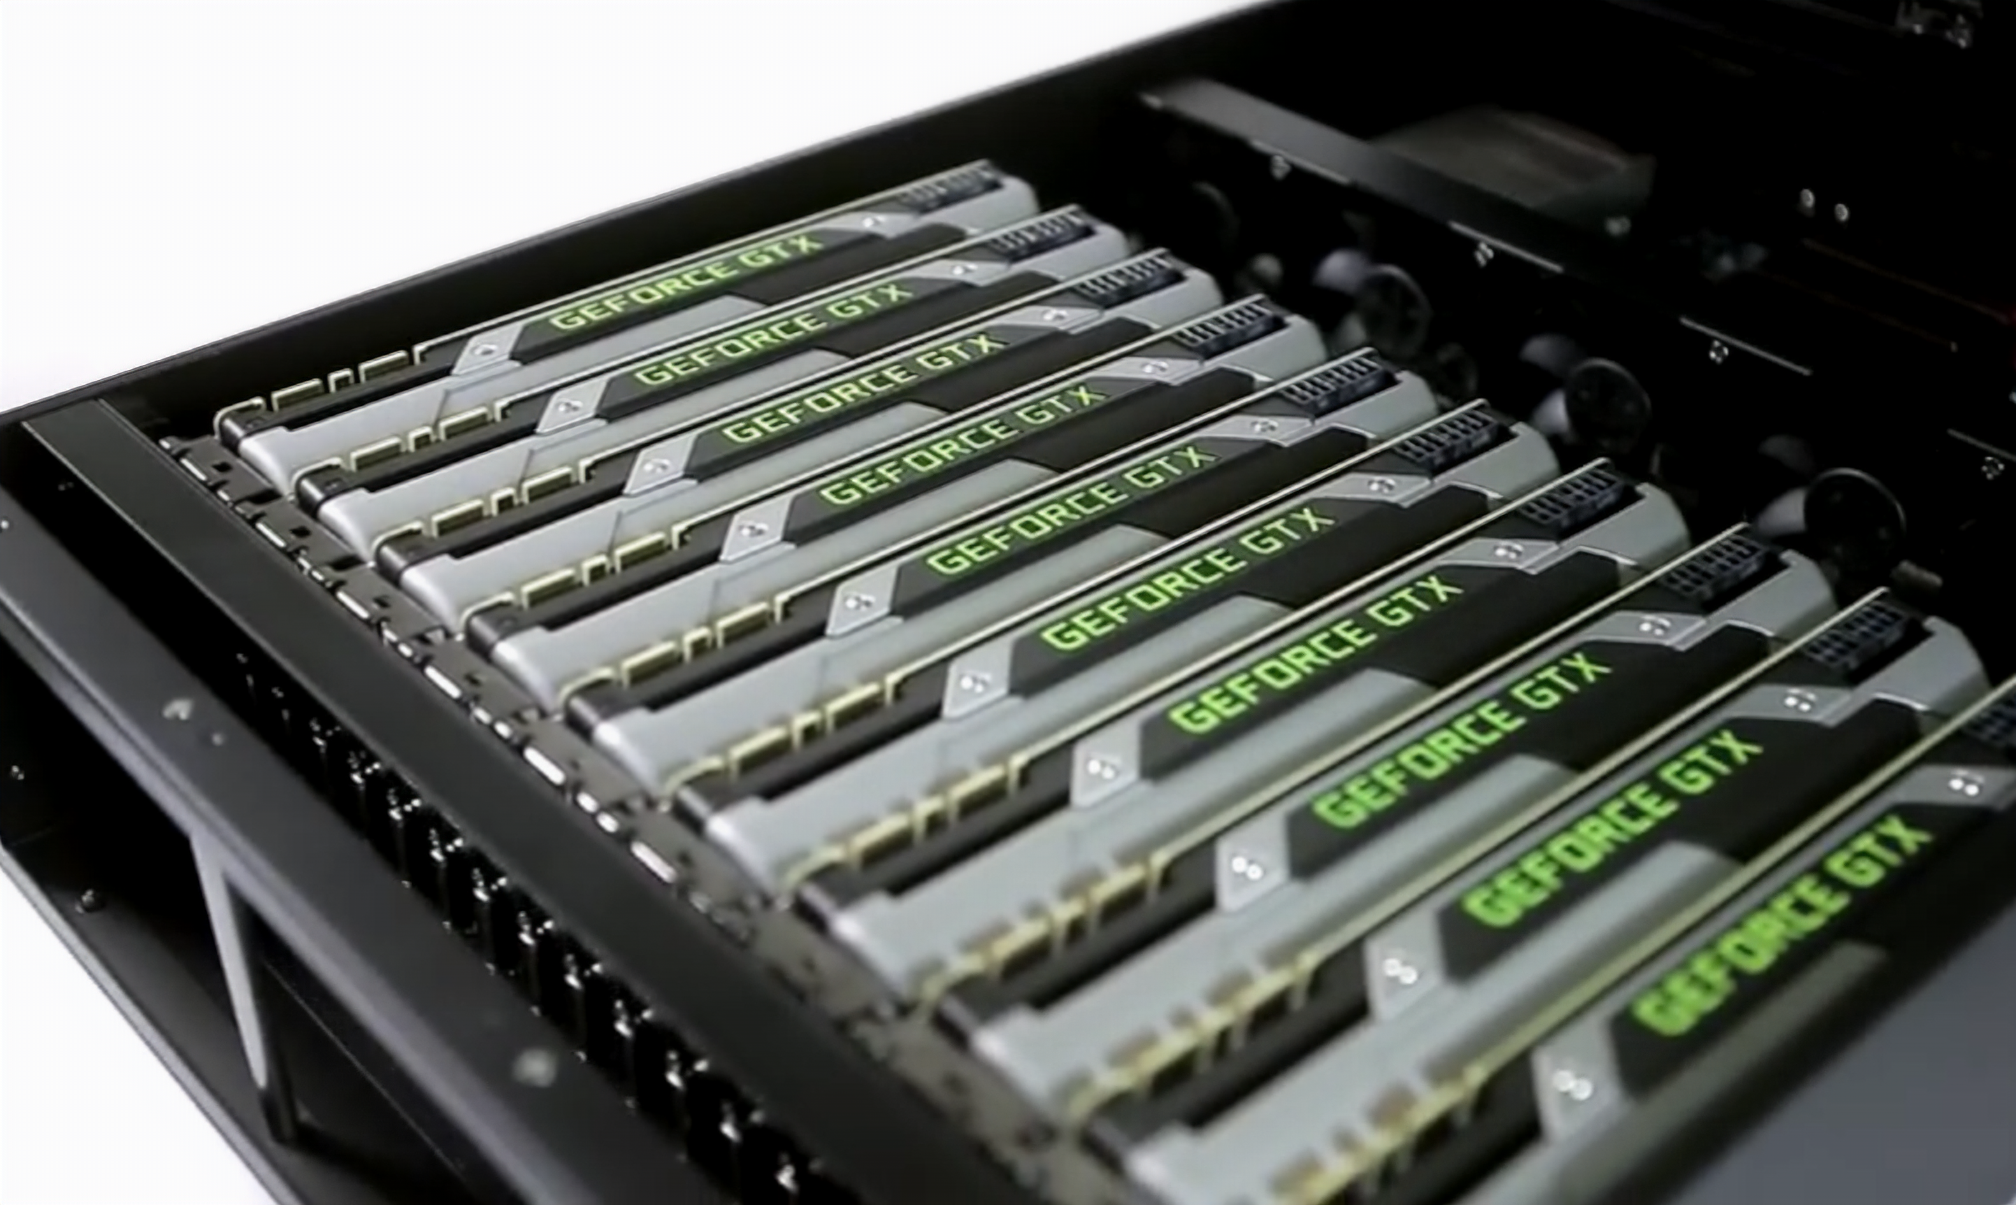
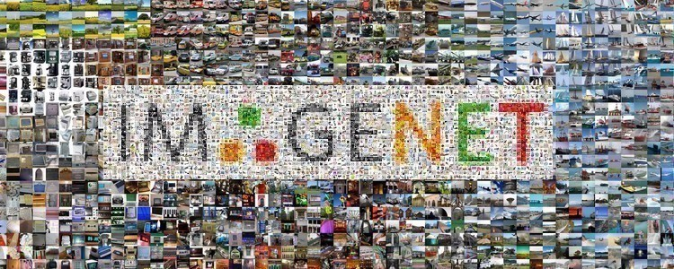






2010s onwards
Processing
Data
Research
Engineering
Academia
Industry
“ImageNet Classification with Deep Convolutional Neural Networks,” Krizhevsky, Sutskever, Hinton, Imagenet competition winner 2012.

Slide 41

Late 2010s onwards
Scaling
Attention mechanisms, Transformers
2022: ChatGPT released
Diffusion models
Generative AI

Slide 42
Some applications…

Slide 43
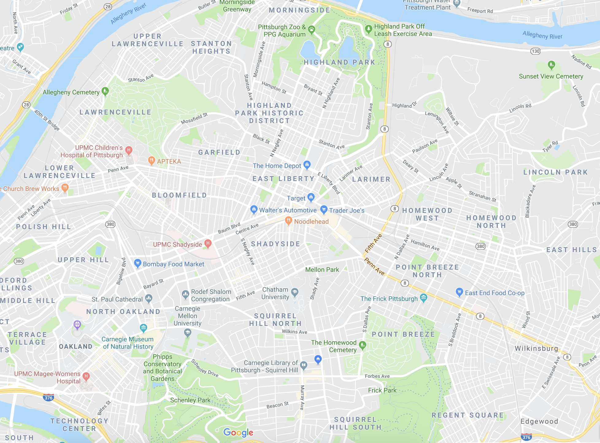
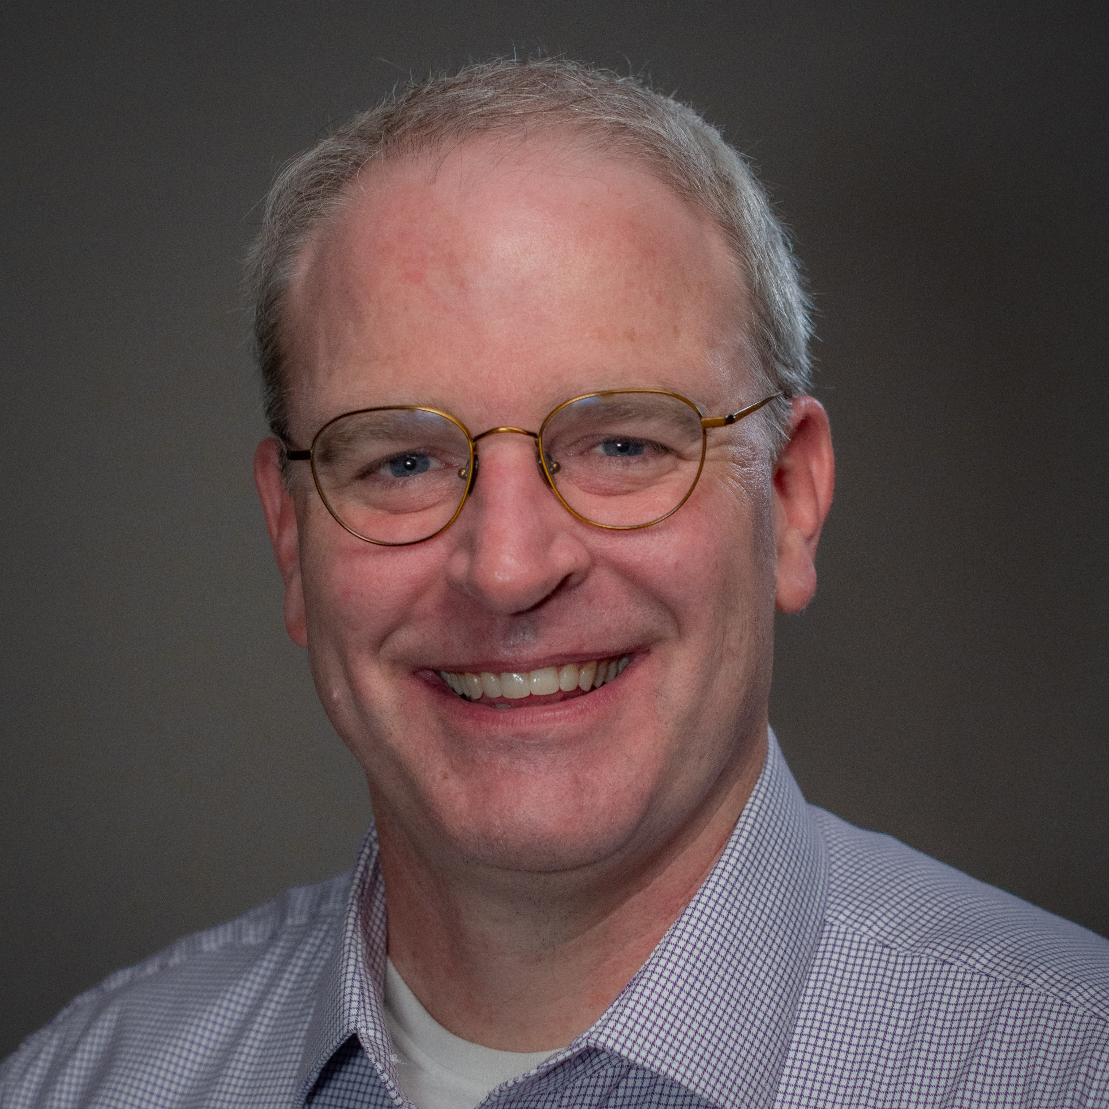
SEARCH
Find best path from initial to goal state under uncertainty
I feel like going to the zoo today!
Best route?

Slide 44
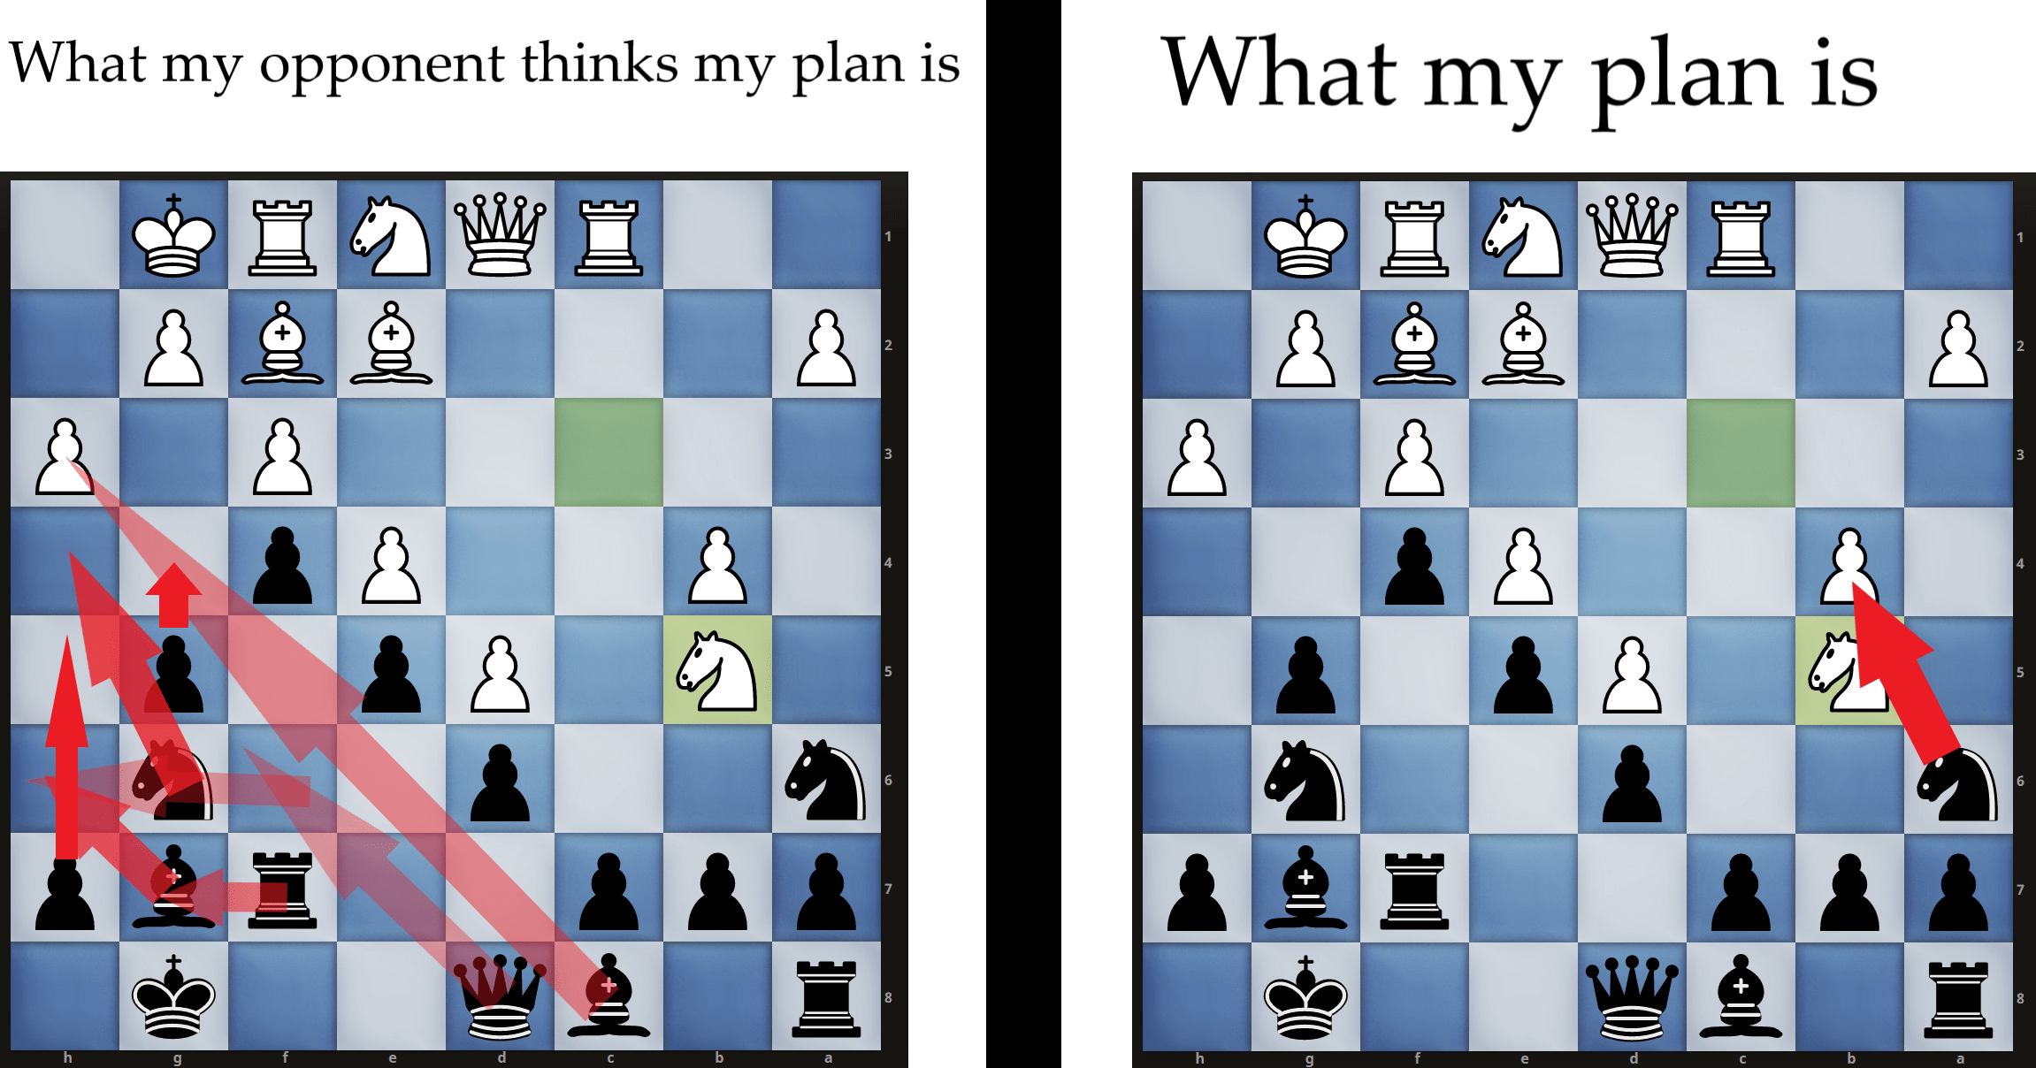
SEARCH
https://www.chess.com/forum/view/fun-with-chess/funny-chess-pictures-1

Slide 45
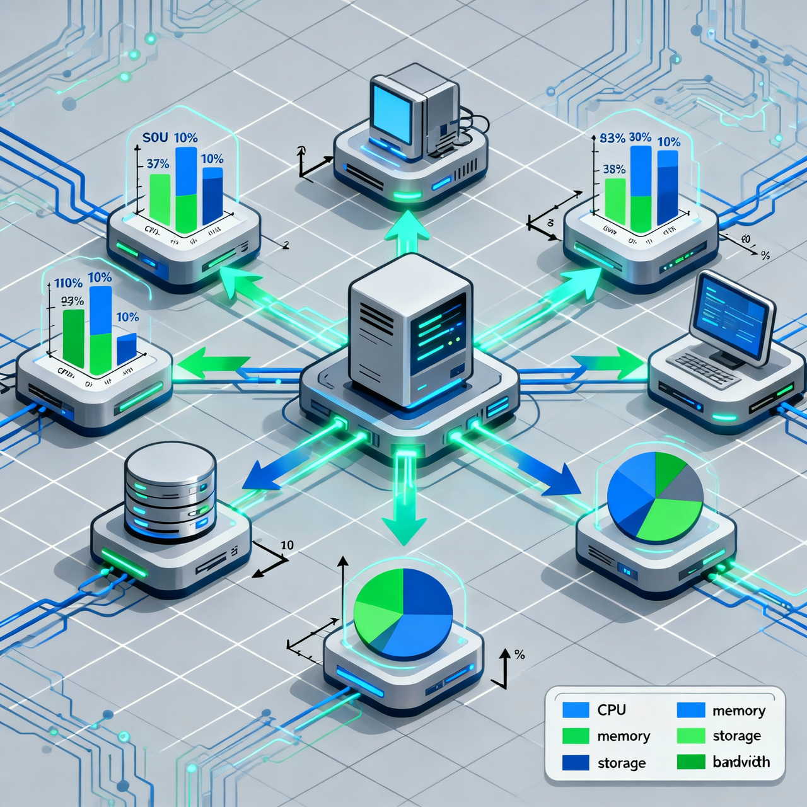
OPTIMIZATION
Find maximum or minimum subject to constraints

Slide 46
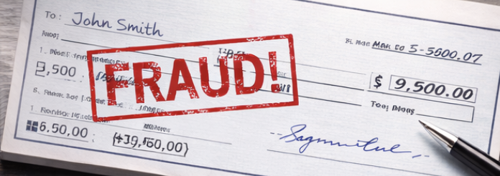
MACHINE LEARNING
Learn from examples, identify patterns

Slide 47

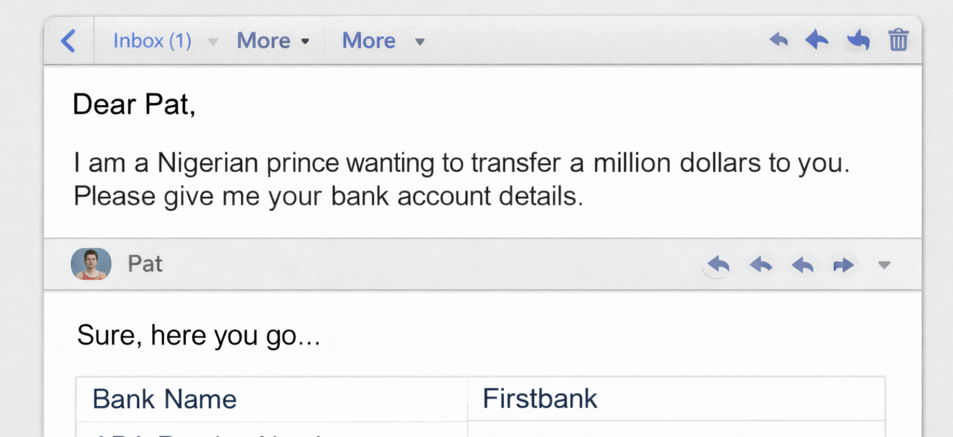

king on deathbed. I want
.and password.

Slide 48
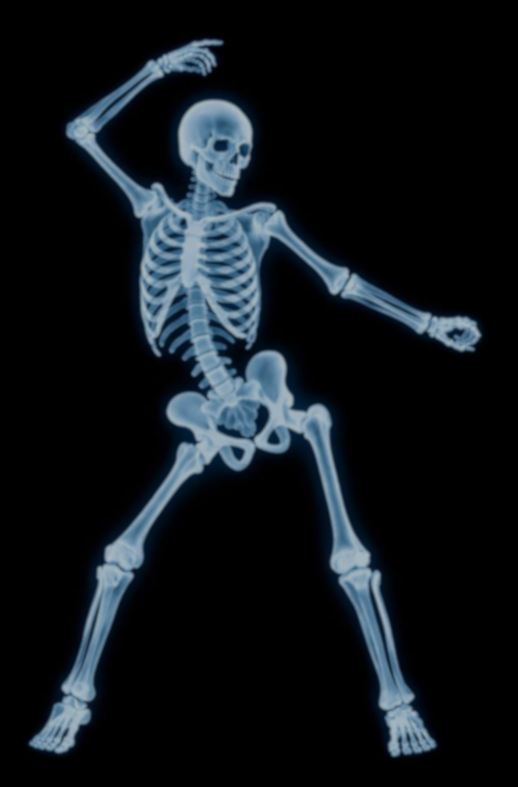
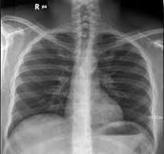

Slide 49

LANGUAGE MODELS
Predicting and generating text from patterns in text data.
Where can I find a king who’ll give me a million $$?

Slide 50
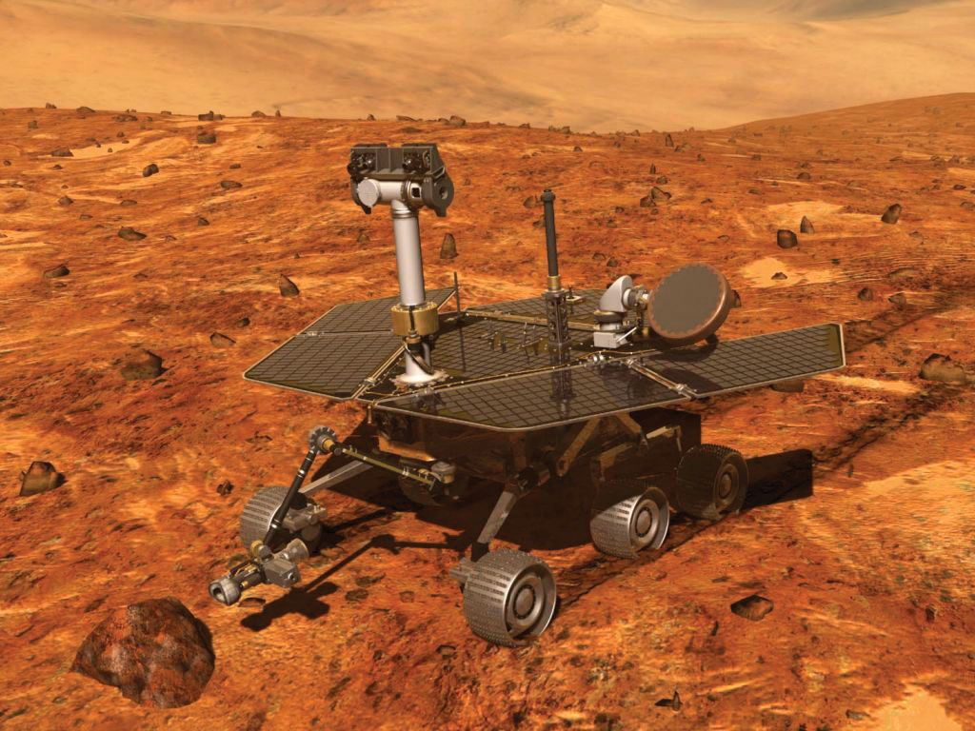
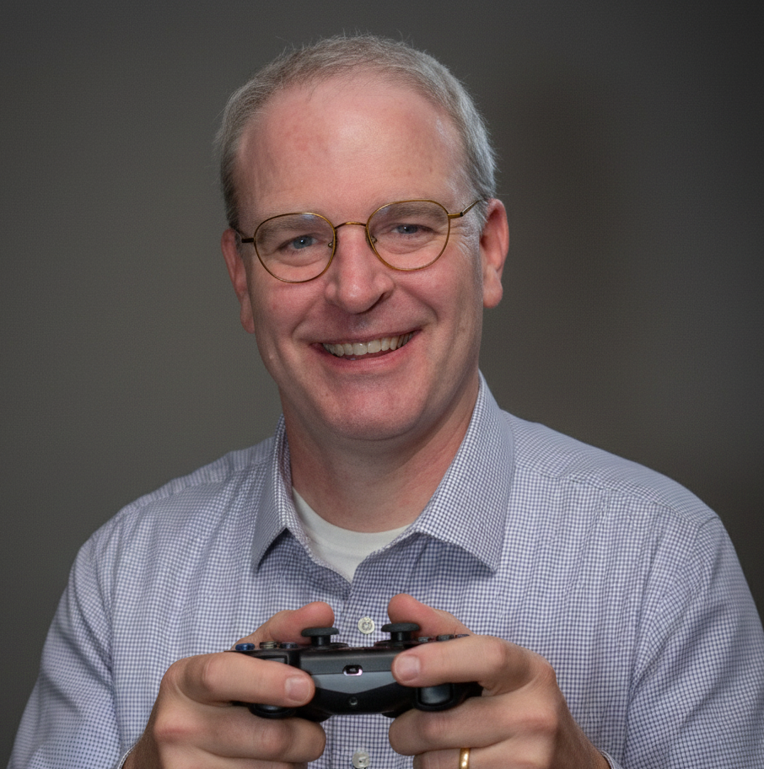
REINFORCEMENT LEARNING
Learning to take appropriate actions by rewarding desired behaviors and penalizing undesired ones.
Wheeee!!

Slide 51
(More next semester in 07-380)

