Slide 1

07-280 AI & ML I
Constraint Satisfaction Problems (CSPs)
Instructors:
Pat Virtue & Nihar Shah

Slide 2


What is Search For?
Planning: sequences of actions
  The path to the goal is the important thing
  Paths have various costs, depths
  Heuristics give problem-specific guidance
Identification: assignments to variables
  The goal itself is important, not the path
  All paths at the same depth (for some formulations)
Are the warm-up assignments planning or identification problems?
Slide/Image credit: Ketrina Yim, UCB CS 188

Slide 3
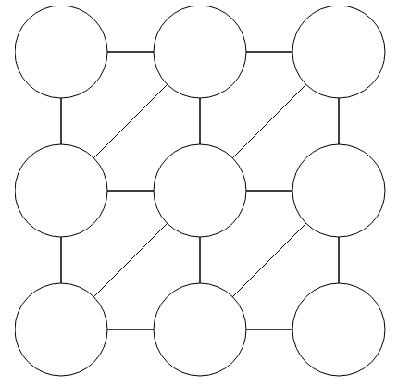

Warm-up as You Walk In
Assign Red, Green, or Blue
Neighbors must be different
Sudoku
1
2
1
3
4
Notes:
Demo:
CS188 javascript demos -> source -> exercises -> csps -> CSPs demos -> CSPs demos.html
Settings:
Graph = Complex
Algorithm = Backtracking
Ordering = MRV
Filtering = Forward Checking
Solves already without any need for backtracking
Note: need a bigger problem to illustrate relevance of backtracking+AC+MRV+MCV

Slide 4



Constraint Satisfaction Problems
CSP is a special class of search problems
  Mostly identification problems
  Have specialized algorithms for them
Standard search problems:
  State is an arbitrary data structure
  Goal test can be any function over states
Constraint satisfaction problems (CSPs):
  State is defined by variables X_{i} with values from a domain D (sometimes D depends on i)
  Goal test is a set of constraints specifying allowable combinations of values for subsets of variables
Slide/Image credit: Ketrina Yim, UCB CS 188
Notes:
Goal test has structure, it ‘s more like a manual describing a set of constraints that have to hold true

Slide 5
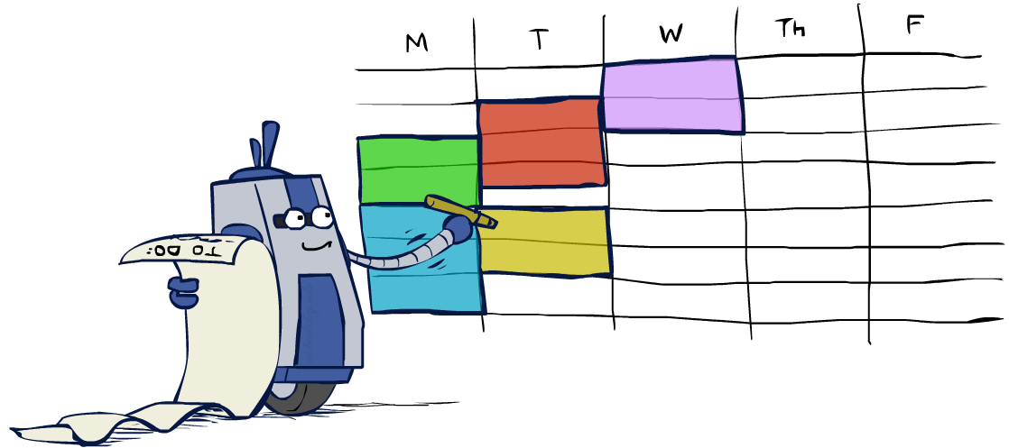



Why study CSPs?
Many real-world problems can be formulated as CSPs
Assignment problems: e.g., who teaches what class
Timetabling problems: e.g., which class is offered when and where?
Hardware configuration
Transportation scheduling
Factory scheduling
Circuit layout
Fault diagnosis
… lots more!
Sometimes involve real-valued variables…
Slide/Image credit: Ketrina Yim, UCB CS 188

Slide 6
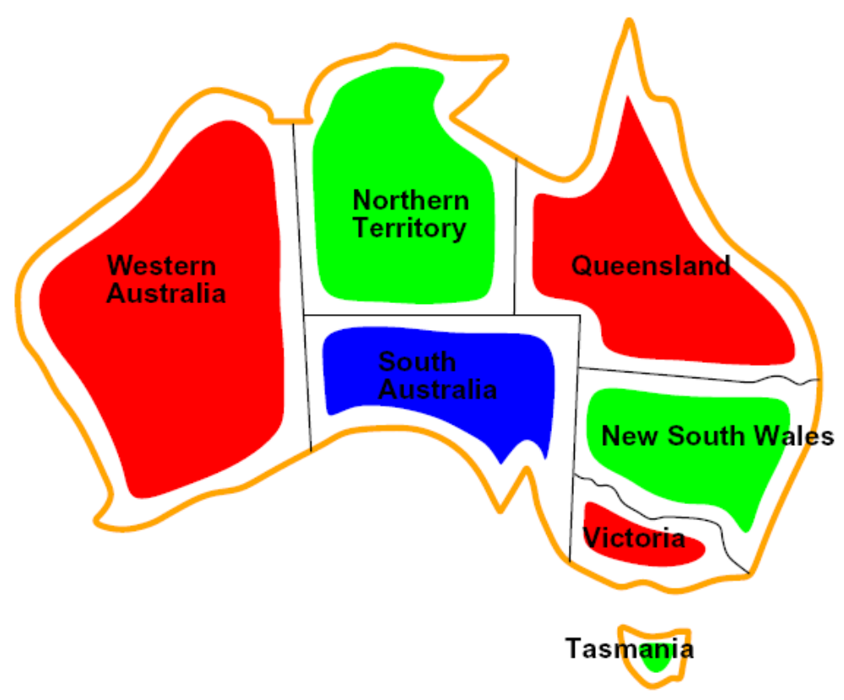

CSP Examples
Slide/Image credit: Ketrina Yim, UCB CS 188

Slide 7


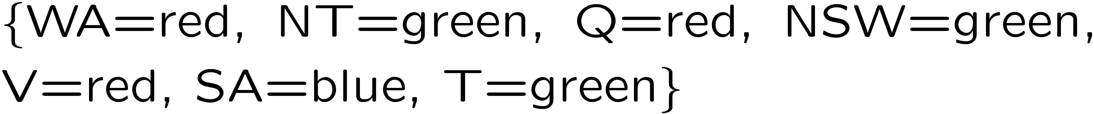

Example: Map Coloring
Variables:
Domains:
Constraints: adjacent regions must have different colors
Solutions are assignments satisfying all constraints, e.g.:
Slide/Image credit: Ketrina Yim, UCB CS 188

Slide 8

Example: Map Coloring
Google OR Tools
# Edges (related to binary constraints)
constraints = [
("WA", "NT"),
("WA", "SA"),
("NT", "SA"),
("NT", "Q"),
("SA", "Q"),
("SA", "NSW"),
("SA", "V"),
("Q", "NSW"),
("NSW", "V"),
]
# Add binary inequality constraints:
# adjacent regions must differ in color
for v1, v2 in constraints:
model.Add(variables[v1] != variables[v2])
# Solve
solver = cp_model.CpSolver()
status = solver.Solve(model)
from ortools.sat.python import cp_model
model = cp_model.CpModel()
# All CSP variables:
# Domain: {0,1,2} representing three colors
variables = {
"WA": model.NewIntVar(0, 2, "WA"),
"NT": model.NewIntVar(0, 2, "NT"),
"SA": model.NewIntVar(0, 2, "SA"),
"Q": model.NewIntVar(0, 2, "Q"),
"NSW": model.NewIntVar(0, 2, "NSW"),
"V": model.NewIntVar(0, 2, "V"),
"T": model.NewIntVar(0, 2, "T"),
}

Slide 9
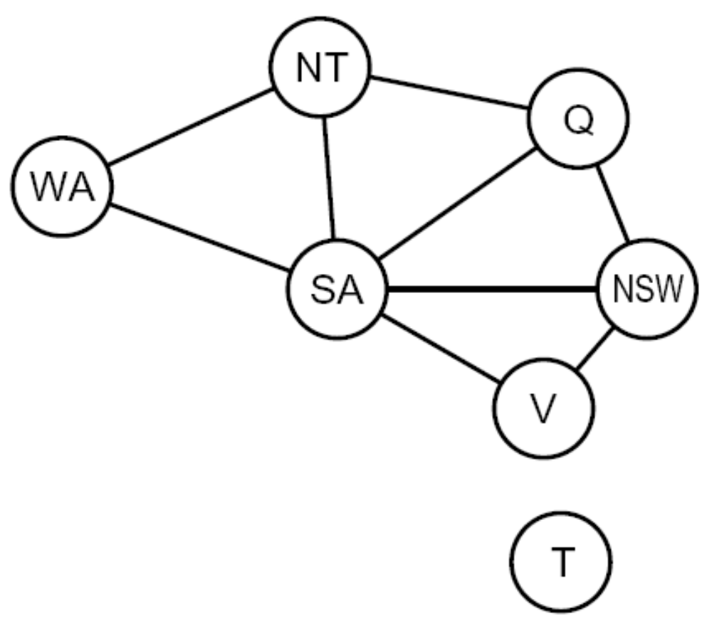
Constraint Graphs
Slide/Image credit: Ketrina Yim, UCB CS 188

Slide 10

Constraint Graphs
Binary CSP: each constraint relates (at most) two variables
Binary constraint graph: nodes are variables, arcs show constraints
General-purpose CSP algorithms use the graph structure to speed up search. E.g., Tasmania is an independent subproblem!
Slide credit: UCB CS 188
Notes:
Demo:
Run constraint.jar or constraint.exe, load the 5 queens problem.
Demo is just showing the n-queens applet as illustration of constraint graph, but later in lecture we’ll interact with the applet.
aispace.org will have the latest version

Slide 11

Varieties of CSPs and Constraints
Slide/Image credit: Ketrina Yim, UCB CS 188

Slide 12
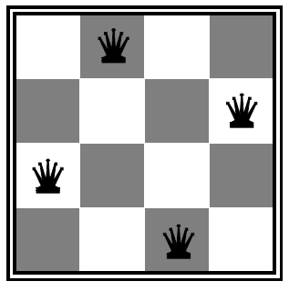

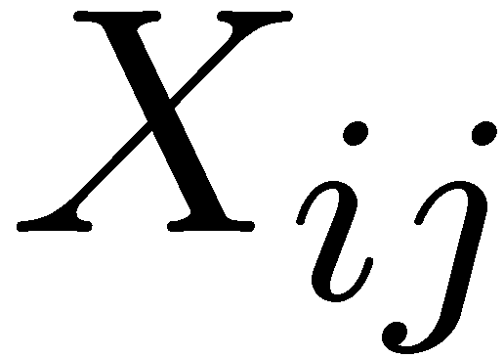

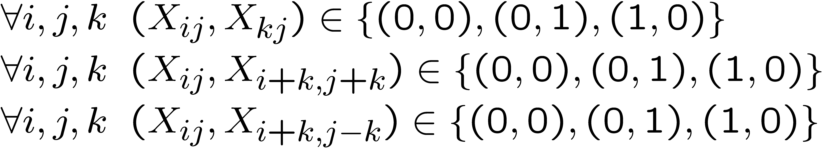
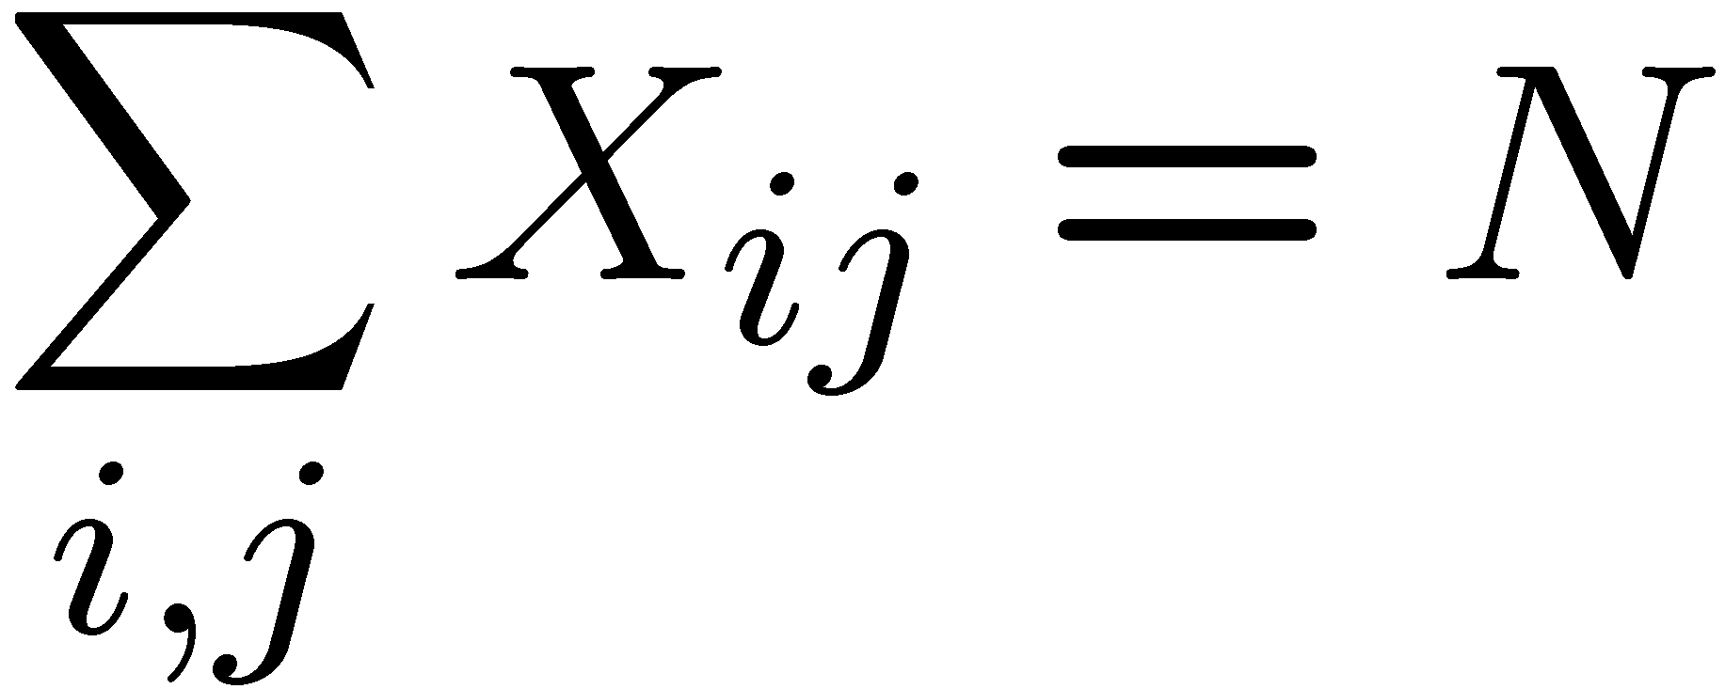

Example: N-Queens
Formulation 1:
  Variables:
  Domains:
  Constraints
Slide/Image credit: Ketrina Yim, UCB CS 188

Slide 13







Example: N-Queens
Formulation 2:
  Variables:
  Domains:
  Constraints:
Implicit:
Explicit:
Slide credit: UCB CS 188

Slide 14
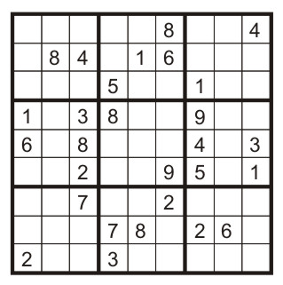
Example: Sudoku
Variables: Each (open) square
Domains: {1,2,…,9}
Constraints:
9-way alldiff for each column
9-way alldiff for each row
9-way alldiff for each region
(or can have a bunch of pairwise inequality constraints)
Slide: UCB CS 188

Slide 15



Varieties of CSPs
We will cover today
Discrete Variables
  Finite domains
    Size d means O(d^{n}) complete assignments
    E.g., Boolean CSPs, including Boolean satisfiability (NP-complete)
  Infinite domains (integers, strings, etc.)
    E.g., job scheduling, variables are start/end times for each job
    Linear constraints solvable, nonlinear undecidable
Continuous variables
  E.g., start/end times for Hubble Telescope observations
  Linear constraints solvable in polynomial time
We will cover in a 07-380
Slide/Image credit: Ketrina Yim, UCB CS 188

Slide 16



Varieties of Constraints
Varieties of Constraints
  Unary constraints involve a single variable (equivalent to reducing domains), e.g.:
  Binary constraints involve pairs of variables, e.g.:
  Higher-order constraints involve 3 or more variables:
  e.g., sudoku constraints
Focus of today
Preferences (soft constraints):
  E.g., red is better than green
  Often representable by a cost for each variable assignment
  Gives constrained optimization problems
Slide/Image credit: Ketrina Yim, UCB CS 188

Slide 17

Solving CSPs
Slide/Image credit: Ketrina Yim, UCB CS 188

Slide 18


Standard Search Formulation
Standard search formulation of CSPs
States defined by the values assigned so far (partial assignments)
  Initial state: the empty assignment, {}
  Successor function: assign a value to an unassigned variable
  Goal test: the current assignment is complete and satisfies all constraints
We’ll start with the straightforward, naïve approach, then improve it
$→$Can be any unassigned variable
Slide/Image credit: Ketrina Yim, UCB CS 188

Slide 19
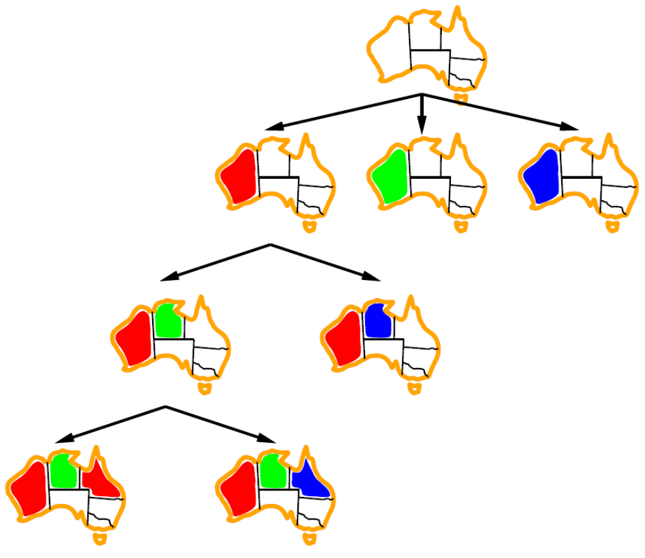
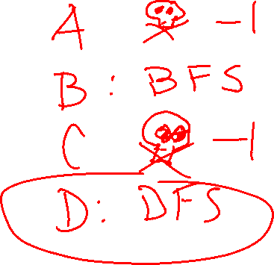
Poll 1: Search for CSPs
Should we use BFS or DFS?
Image credit: Ketrina Yim, UCB CS 188

Slide 20
Depth First Search
At each node, assign a value from the domain to the variable
Check feasibility (constraints) when the assignment is complete
Slide/Image credit: Ketrina Yim, UCB CS 188

Slide 21
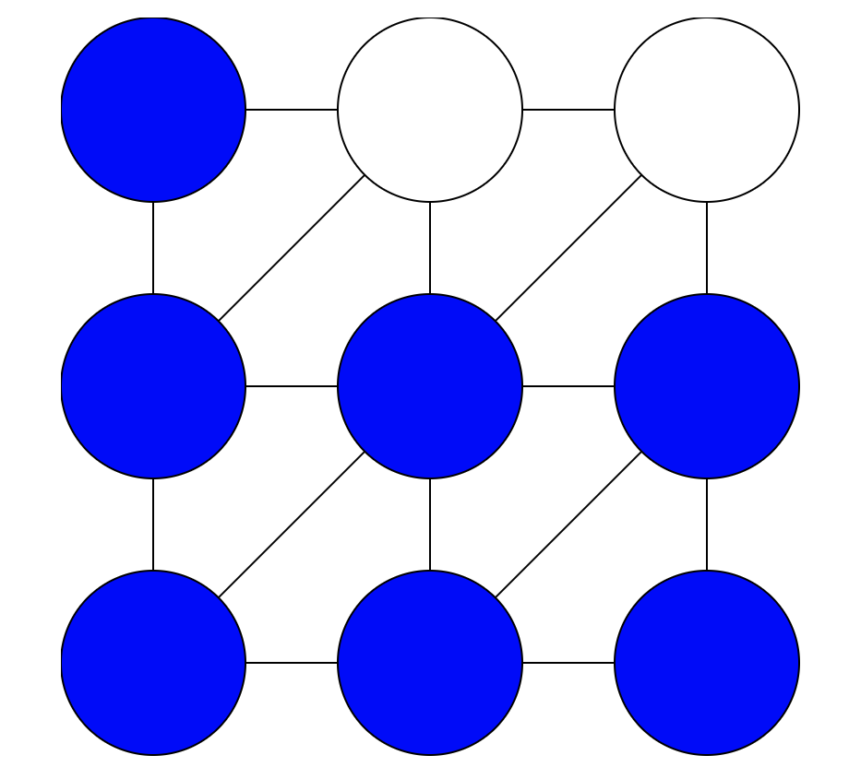

Demo – Naïve Search
Demo credit: UCB CS 188

Slide 22

Backtracking Search
Slide/Image credit: Ketrina Yim, UCB CS 188

Slide 23

Backtracking Search
Backtracking search is the basic uninformed algorithm for solving CSPs
Backtracking search = DFS + two improvements
Idea 1: One variable at a time
  Variable assignments are commutative
    [WA = red then NT = green] same as [NT = green then WA = red]
  Only need to consider assign value to a single variable at each step
Idea 2: Check constraints as you go
  Consider only values which do not conflict previous assignments
  May need some computation to check the constraints
  “Incremental goal test”
Can solve n-queens for n ≈ 25
Slide/Image credit: Ketrina Yim, UCB CS 188

Slide 24

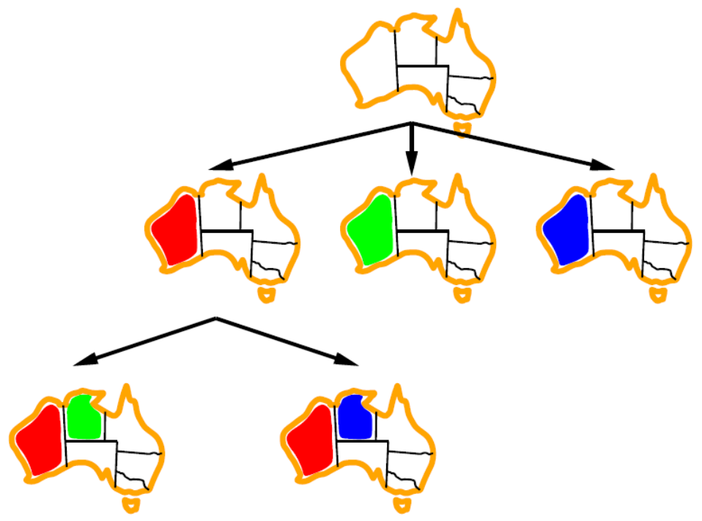
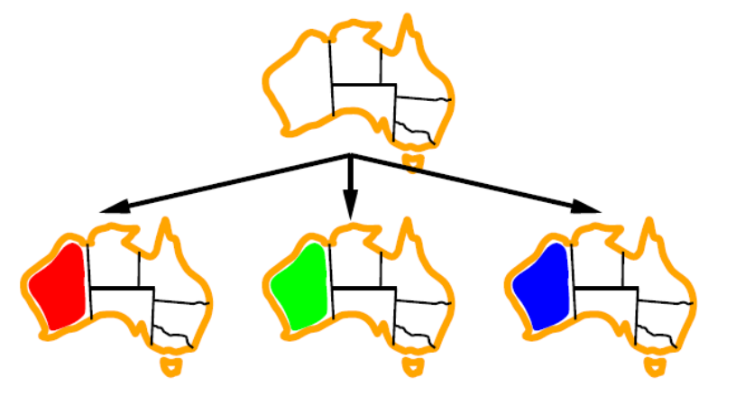

Backtracking Example
Slide/Image credit: Ketrina Yim, UCB CS 188

Slide 25
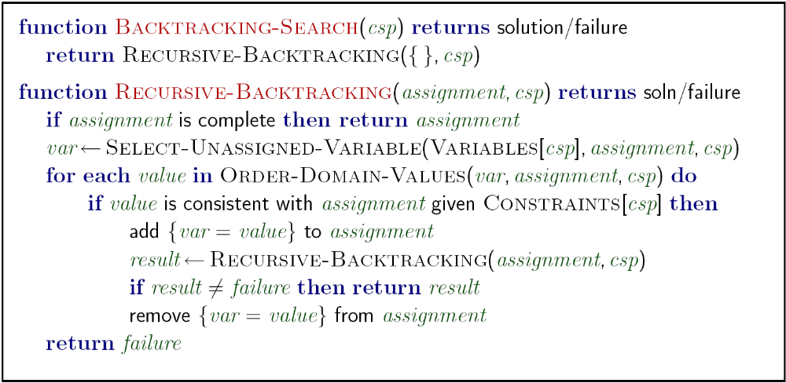

Backtracking Search
Image credit: aima.cs.berkeley.edu
Notes:
Demo:
CS188 javascript demos -> source -> exercises -> csps -> CSPs demos -> CSPs demos.html
Settings:
Graph = Simple
Algorithm = Backtracking
Ordering = None
Filtering = None

Slide 26
Backtracking Search
Image credit: aima.cs.berkeley.edu
Notes:
Demo:
CS188 javascript demos -> source -> exercises -> csps -> CSPs demos -> CSPs demos.html
Settings:
Graph = Simple
Algorithm = Backtracking
Ordering = None
Filtering = None

Slide 27
Backtracking Search
Image credit: aima.cs.berkeley.edu
Notes:
Demo:
CS188 javascript demos -> source -> exercises -> csps -> CSPs demos -> CSPs demos.html
Settings:
Graph = Simple
Algorithm = Backtracking
Ordering = None
Filtering = None

Slide 28
Backtracking Search
No need to check constraints for a complete assignment
Image credit: aima.cs.berkeley.edu
Notes:
Demo:
CS188 javascript demos -> source -> exercises -> csps -> CSPs demos -> CSPs demos.html
Settings:
Graph = Simple
Algorithm = Backtracking
Ordering = None
Filtering = None

Slide 29
Backtracking Search
Checks consistency at each assignment
Image credit: aima.cs.berkeley.edu
Notes:
Demo:
CS188 javascript demos -> source -> exercises -> csps -> CSPs demos -> CSPs demos.html
Settings:
Graph = Simple
Algorithm = Backtracking
Ordering = None
Filtering = None

Slide 30
Backtracking Search
Backtracking = DFS + variable-ordering + fail-on-violation
What are the decision points?
Image credit: aima.cs.berkeley.edu
Notes:
Demo:
CS188 javascript demos -> source -> exercises -> csps -> CSPs demos -> CSPs demos.html
Settings:
Graph = Simple
Algorithm = Backtracking
Ordering = None
Filtering = None

Slide 31
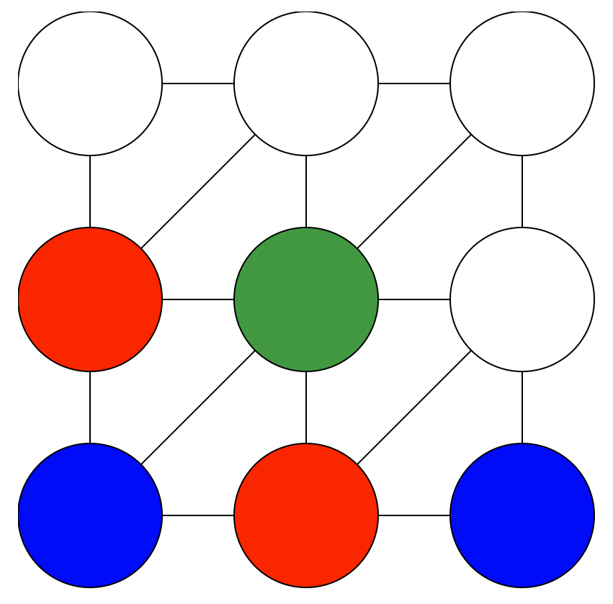
Demo – Backtracking
https://www.cs.cmu.edu/~15281/demos/csp_backtracking
Demo credit: UCB CS 188

Slide 32


Improving Backtracking
General-purpose ideas give huge gains in speed
Filtering: Can we detect inevitable failure early?
Ordering:
  Which variable should be assigned next?
  In what order should its values be tried?
Structure: Can we exploit the problem structure?
Slide/Image credit: Ketrina Yim, UCB CS 188

Slide 33


Filtering
Slide/Image credit: Ketrina Yim, UCB CS 188

Slide 34

Filtering: Forward Checking
Filtering: Keep track of domains for unassigned variables and cross off bad options
Forward checking: A simple way for filtering
  After a variable is assigned a value, check related constraints and cross off values of unassigned variables which violate the constraints
  Failure detected if some variables have no values remaining
Slide credit: UCB CS 188
Notes:
Demo:
CS188 javascript demos -> source -> exercises -> csps -> CSPs demos -> CSPs demos.html
Settings:
Graph = Simple
Algorithm = Backtracking
Ordering = None
Filtering = Forward Checking

Slide 35
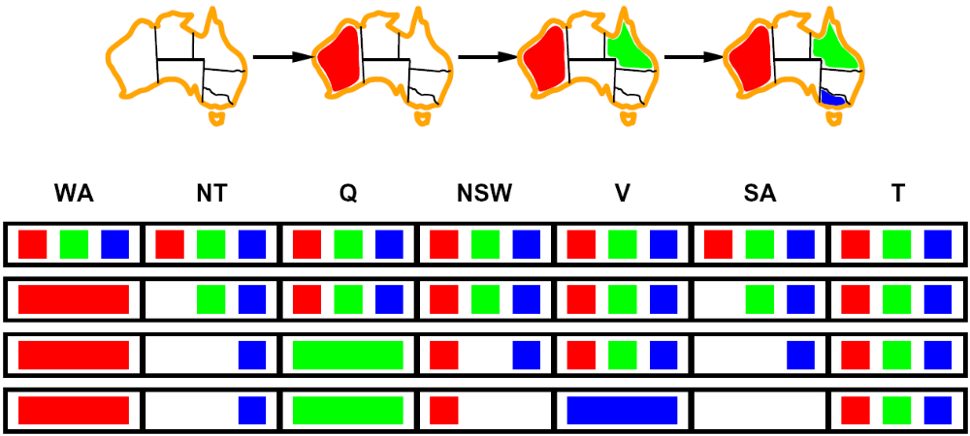

Filtering: Forward Checking
Filtering: Keep track of domains for unassigned variables and cross off bad options
Forward checking: A simple way for filtering
  After a variable is assigned a value, check related constraints and cross off values of unassigned variables which violate the constraints
  Failure detected if some variables have no values remaining
NT
Q
WA
SA
NSW
V
T
Slide/Image credit: Ketrina Yim, UCB CS 188
Notes:
Demo:
CS188 javascript demos -> source -> exercises -> csps -> CSPs demos -> CSPs demos.html
Settings:
Graph = Simple
Algorithm = Backtracking
Ordering = None
Filtering = Forward Checking

Slide 36
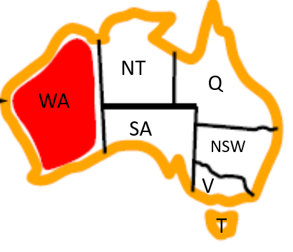


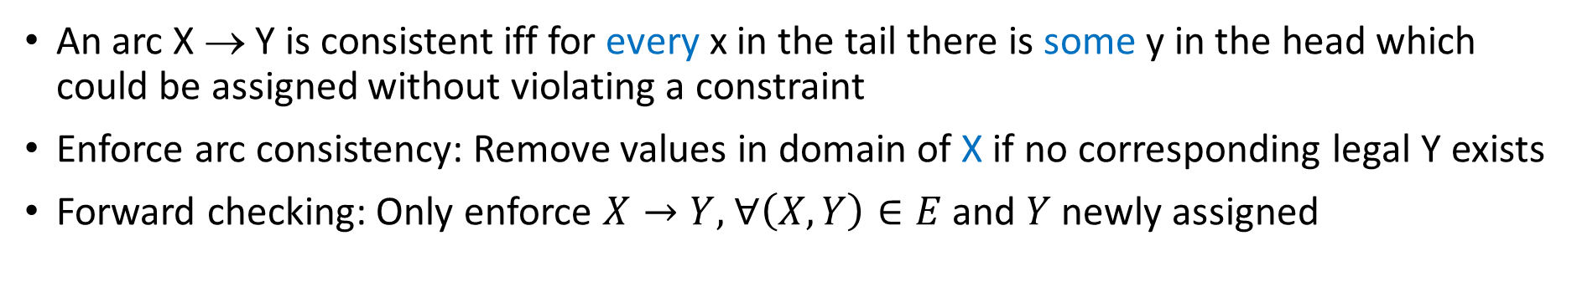
Consistency of A Single Arc
An arc X → Y is consistent iff for every x in the tail there is some y in the head which could be assigned without violating a constraint
Enforce arc consistency: Remove values in domain of X if no corresponding legal Y exists
Forward checking: Only enforce $X→Y,$ $∀\left(X,Y\right)∈E$ and $Y$ newly assigned
(Remove values from the tail!)
Recall: Binary constraint graph for a binary CSP (i.e., each constraint has most two variables): nodes are variables, edges show constraints
Slide/Image credit: Ketrina Yim, UCB CS 188

Slide 37
Consistency of A Single Arc
An arc X → Y is consistent iff for every x in the tail there is some y in the head which could be assigned without violating a constraint
Enforce arc consistency: Remove values in domain of X if no corresponding legal Y exists
Forward checking: Only enforce $X→Y,$ $∀\left(X,Y\right)∈E$ and $Y$ newly assigned
Slide/Image credit: Ketrina Yim, UCB CS 188

Slide 38

Filtering: Forward Checking
Filtering: Keep track of domains for unassigned variables and cross off bad options
Forward checking: A simple way for filtering
  After a variable is assigned a value, check related constraints and cross off values of unassigned variables which violate the constraints
  Failure detected if some variables have no values remaining
Recall: Binary constraint graph for a binary CSP (i.e., each constraint has most two variables): nodes are variables, edges show constraints
Slide/Image credit: Ketrina Yim, UCB CS 188
Notes:
Demo:
CS188 javascript demos -> source -> exercises -> csps -> CSPs demos -> CSPs demos.html
Settings:
Graph = Simple
Algorithm = Backtracking
Ordering = None
Filtering = Forward Checking

Slide 39
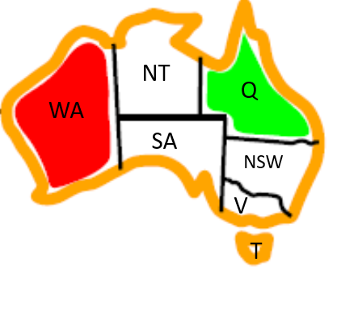

Filtering: Forward Checking
Filtering: Keep track of domains for unassigned variables and cross off bad options
Forward checking: A simple way for filtering
  After a variable is assigned a value, check related constraints and cross off values of unassigned variables which violate the constraints
  Failure detected if some variables have no values remaining
Slide/Image credit: Ketrina Yim, UCB CS 188
Notes:
Demo:
CS188 javascript demos -> source -> exercises -> csps -> CSPs demos -> CSPs demos.html
Settings:
Graph = Simple
Algorithm = Backtracking
Ordering = None
Filtering = Forward Checking

Slide 40
Filtering: Forward Checking
Filtering: Keep track of domains for unassigned variables and cross off bad options
Forward checking: A simple way for filtering
  After a variable is assigned a value, check related constraints and cross off values of unassigned variables which violate the constraints
  Failure detected if some variables have no values remaining
FAIL – variable with no possible values
Slide/Image credit: Ketrina Yim, UCB CS 188
Notes:
Demo:
CS188 javascript demos -> source -> exercises -> csps -> CSPs demos -> CSPs demos.html
Settings:
Graph = Simple
Algorithm = Backtracking
Ordering = None
Filtering = Forward Checking

Slide 41
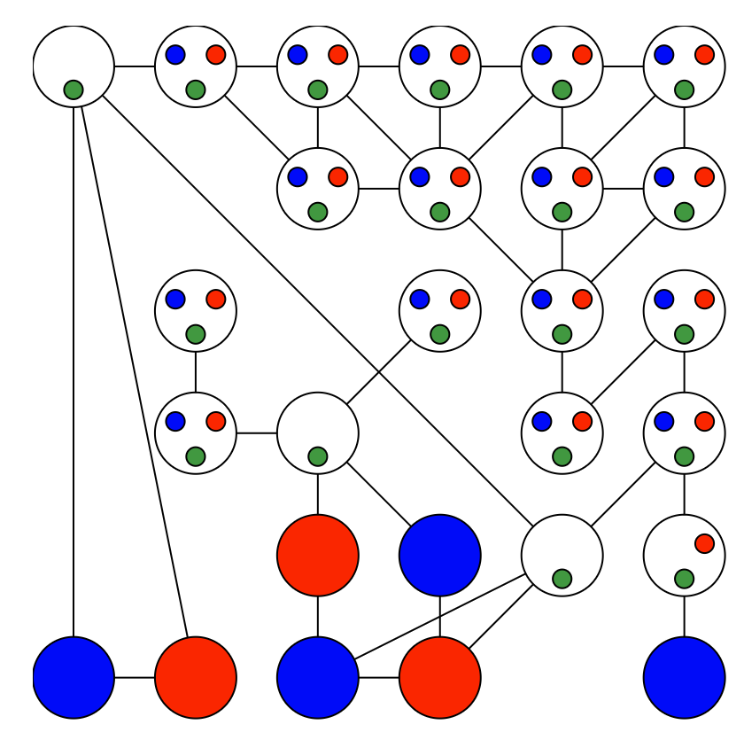
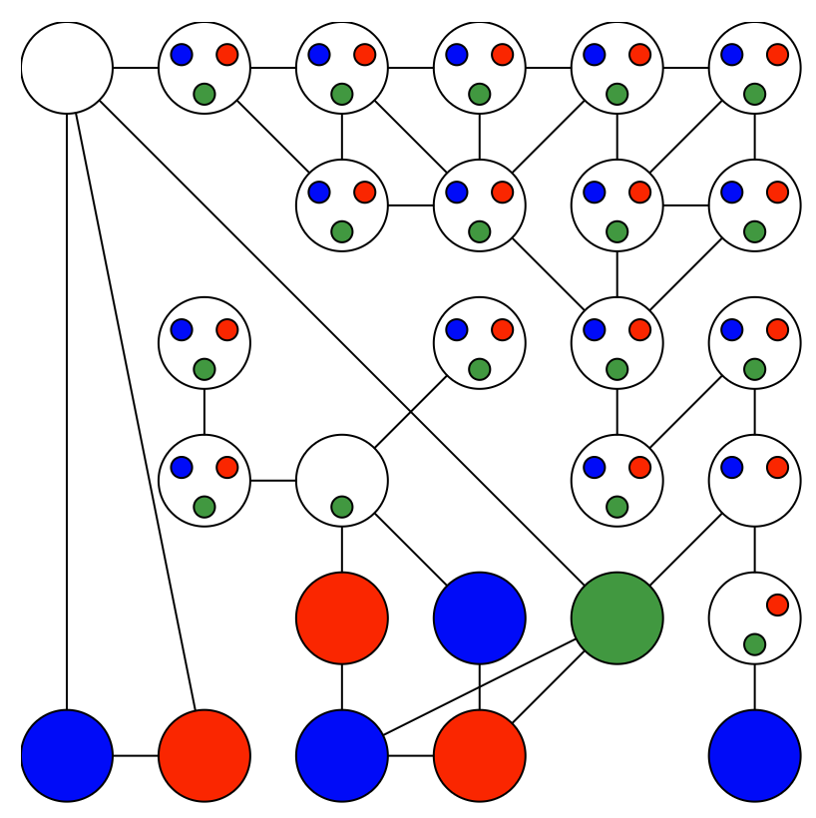

Demo – Backtracking with Forward Checking
https://www.cs.cmu.edu/~15281/demos/csp_backtracking
Demo credit: UCB CS 188

Slide 42
Filtering: Constraint Propagation
Limitations of simple forward checking: propagates information from assigned to unassigned variables, but doesn't provide early detection for all failures
  NT and SA cannot both be blue! Why didn’t we detect this yet?
Constraint propagation: reason from constraint to constraint
Slide/Image credit: Ketrina Yim, UCB CS 188
Notes:
Demo:
CS188 javascript demos -> source -> exercises -> csps -> CSPs demos -> CSPs demos.html
Settings:
Graph = Simple
Algorithm = Backtracking
Ordering = None
Filtering = Forward Checking

Slide 43
How to Enforce Arc Consistency of Entire CSP
A simplistic algorithm: Cycle over the pairs of variables, enforcing arc-consistency, repeating the cycle until no domains change for a whole cycle
AC-3 (short for Arc Consistency Algorithm #3): A more efficient algorithm ignoring constraints that have not been modified since they were last analyzed
NT
Q
WA
SA
NSW
V
T
Slide/Image credit: Ketrina Yim, UCB CS 188

Slide 44
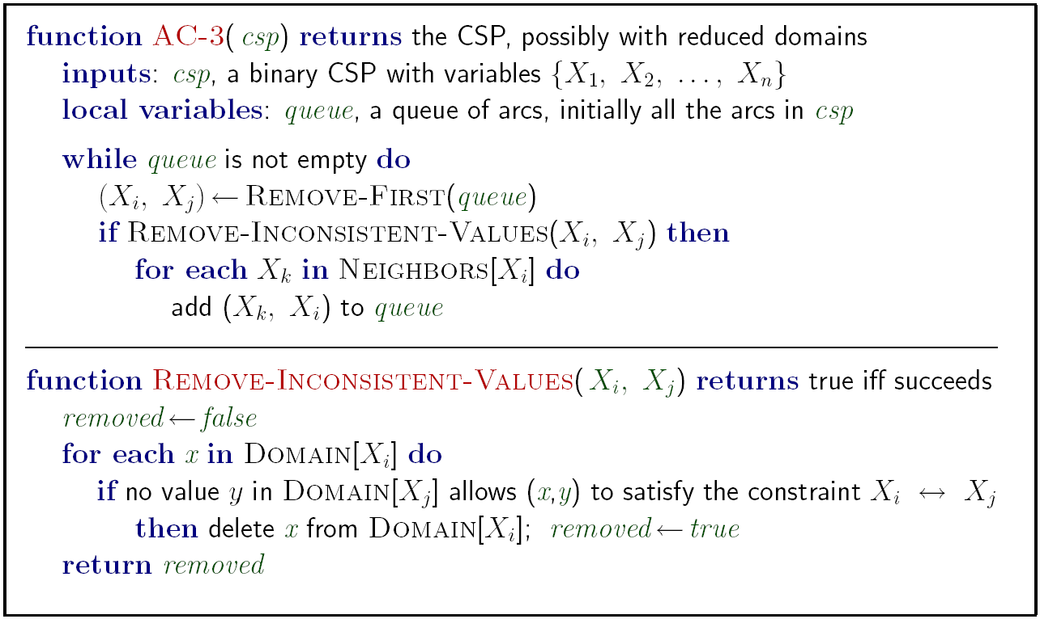
AC-3: Enforce Arc Consistency of Entire CSP
Constraint Propagation!
Image credit: aima.cs.berkeley.edu
Notes:
Auto-consistency (note initially nothing gets deleted/pruned since there are consistent options for all constraints for initial variable domains)
Flashes whenever something needs to be re-checked

Slide 45

AC-3: Enforce Arc Consistency of Entire CSP
Queue:
SA->WA
NT->WA
NT
Q
WA
SA
NSW
V
T
Remember: Delete from the tail!
Image credit: Ketrina Yim, UCB CS 188

Slide 46

AC-3: Enforce Arc Consistency of Entire CSP
Queue:
NT->WA
WA->SA
NT->SA
Q->SA
NSW->SA
V->SA
NT
Q
WA
SA
NSW
V
T
Remember: Delete from the tail!
Image credit: Ketrina Yim, UCB CS 188

Slide 47

AC-3: Enforce Arc Consistency of Entire CSP
Queue:
WA->SA
NT->SA
Q->SA
NSW->SA
V->SA
WA->NT
SA->NT
Q->NT
NT
Q
WA
SA
NSW
V
T
Remember: Delete from the tail!
Image credit: Ketrina Yim, UCB CS 188

Slide 48
AC-3: Enforce Arc Consistency of Entire CSP
Queue:
WA->SA
NT->SA
Q->SA
NSW->SA
V->SA
WA->NT
SA->NT
Q->NT
NT
Q
WA
SA
NSW
V
T
Remember: Delete from the tail!
Image credit: Ketrina Yim, UCB CS 188

Slide 49
AC-3: Enforce Arc Consistency of Entire CSP
Queue:
NT->SA
Q->SA
NSW->SA
V->SA
WA->NT
SA->NT
Q->NT
NT
Q
WA
SA
NSW
V
T
Remember: Delete from the tail!
Image credit: Ketrina Yim, UCB CS 188

Slide 50
AC-3: Enforce Arc Consistency of Entire CSP
Queue:
Q->SA
NSW->SA
V->SA
WA->NT
SA->NT
Q->NT
NT
Q
WA
SA
NSW
V
T
Remember: Delete from the tail!
Image credit: Ketrina Yim, UCB CS 188

Slide 51

AC-3: Enforce Arc Consistency of Entire CSP
Queue:
NSW->SA
V->SA
WA->NT
SA->NT
Q->NT
NT
Q
WA
SA
NSW
V
T
Remember: Delete from the tail!
Image credit: Ketrina Yim, UCB CS 188

Slide 52

AC-3: Enforce Arc Consistency of Entire CSP
Queue:
NT
Q
WA
SA
NSW
V
T
Remember: Delete from the tail!
Image credit: Ketrina Yim, UCB CS 188

Slide 53
Poll 2: After assigning Q to Green, what gets added to the Queue?
Queue:
NT
Q
WA
SA
NSW
V
T
A: NSW->Q, SA->Q, NT->Q
B: Q->NSW, Q->SA, Q->NT
Image credit: Ketrina Yim, UCB CS 188

Slide 54
AC-3: Enforce Arc Consistency of Entire CSP
Queue:
NT->Q
SA->Q
NSW->Q
NT
Q
WA
SA
NSW
V
T
Remember: Delete from the tail!
Image credit: Ketrina Yim, UCB CS 188

Slide 55
AC-3: Enforce Arc Consistency of Entire CSP
Queue:
SA->Q
NSW->Q
WA->NT
SA->NT
Q->NT
NT
Q
WA
SA
NSW
V
T
Remember: Delete from the tail!
Image credit: Ketrina Yim, UCB CS 188

Slide 56
AC-3: Enforce Arc Consistency of Entire CSP
Queue:
NSW->Q
WA->NT
SA->NT
Q->NT
WA->SA
NT->SA
Q->SA
NSW->SA
V->SA
NT
Q
WA
SA
NSW
V
T
Remember: Delete from the tail!
Image credit: Ketrina Yim, UCB CS 188

Slide 57
AC-3: Enforce Arc Consistency of Entire CSP
Queue:
WA->NT
SA->NT
Q->NT
WA->SA
NT->SA
Q->SA
NSW->SA
V->SA
V->NSW
Q->NSW
SA->NSW
NT
Q
WA
SA
NSW
V
T
Remember: Delete from the tail!
Image credit: Ketrina Yim, UCB CS 188

Slide 58
AC-3: Enforce Arc Consistency of Entire CSP
Queue:
WA->NT
SA->NT
Q->NT
WA->SA
NT->SA
Q->SA
NSW->SA
V->SA
V->NSW
Q->NSW
SA->NSW
NT
Q
WA
SA
NSW
V
T
Remember: Delete from the tail!
Image credit: Ketrina Yim, UCB CS 188

Slide 59
AC-3: Enforce Arc Consistency of Entire CSP
Queue:
SA->NT
Q->NT
WA->SA
NT->SA
Q->SA
NSW->SA
V->SA
V->NSW
Q->NSW
SA->NSW
NT
Q
WA
SA
NSW
V
T
!!!
Remember: Delete from the tail!
Image credit: Ketrina Yim, UCB CS 188

Slide 60
AC-3: Enforce Arc Consistency of Entire CSP
Queue:
SA->NT
Q->NT
WA->SA
NT->SA
Q->SA
NSW->SA
V->SA
V->NSW
Q->NSW
SA->NSW
Backtrack on the assignment of Q
Arc consistency detects failure earlier than forward checking
Can be run as a preprocessor or after each assignment
What’s the downside of enforcing arc consistency?
NT
Q
WA
SA
NSW
V
T
!!!
Remember: Delete from the tail!
Image credit: Ketrina Yim, UCB CS 188

Slide 61
Limitations of Arc Consistency
After enforcing arc consistency:
  Can have one solution left
  Can have multiple solutions left
  Can have no solutions left (and not know it)
Arc consistency only checks local consistency conditions
Arc consistency still runs inside a backtracking search!
What went wrong here?
Slide credit: UCB CS 188
Notes:
Demo:
CS188 javascript demos -> source -> exercises -> csps -> CSPs demos -> CSPs demos.html
Settings:
Graph = Complex
Algorithm = Backtracking
Ordering = None
Filtering = Forward Checking (first) / Arc Consistency (second)

Slide 62
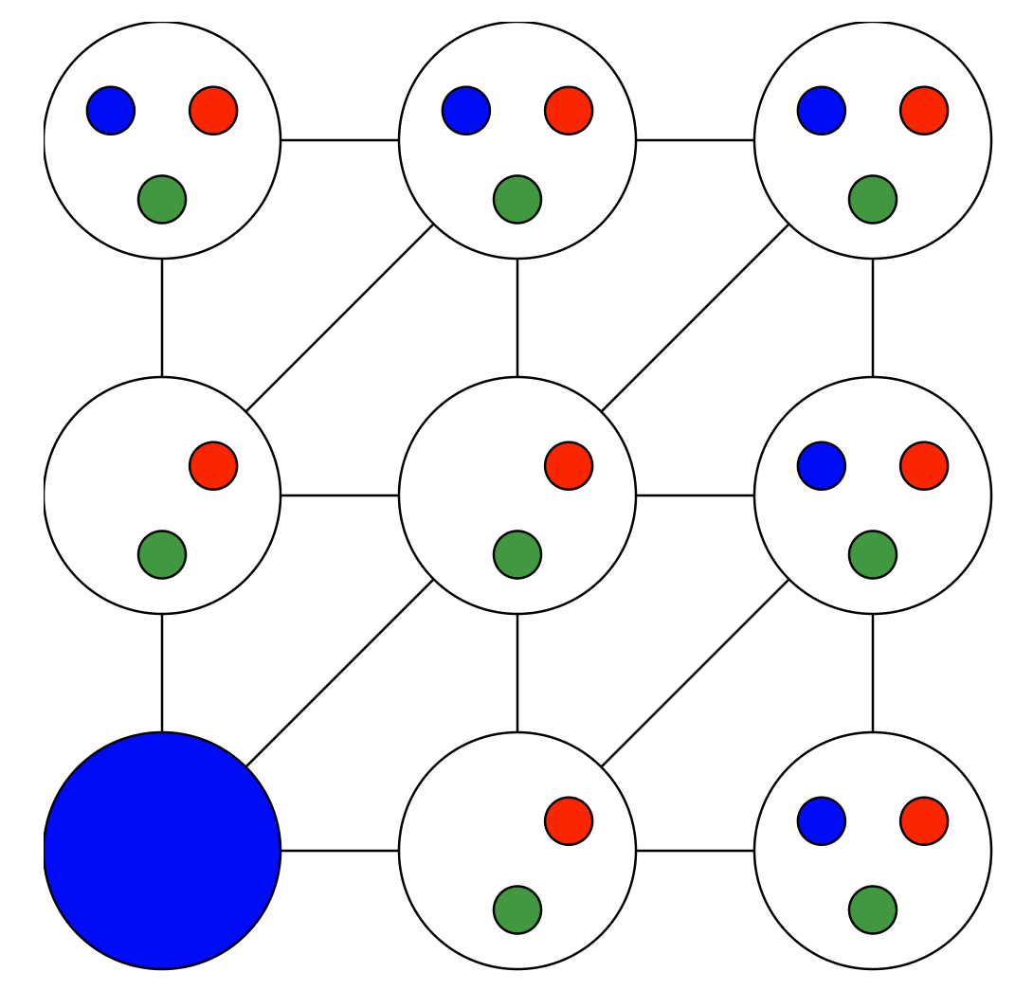

Demo – Backtracking with AC-3
Forward checking only check arcs connecting variables a variable that we just assigned.
With AC-3, we make sure all arcs are consistent
Compare
Backtracking with Forward Checking
Backtracking with AC-3
Demo credit: UCB CS 188

Slide 63
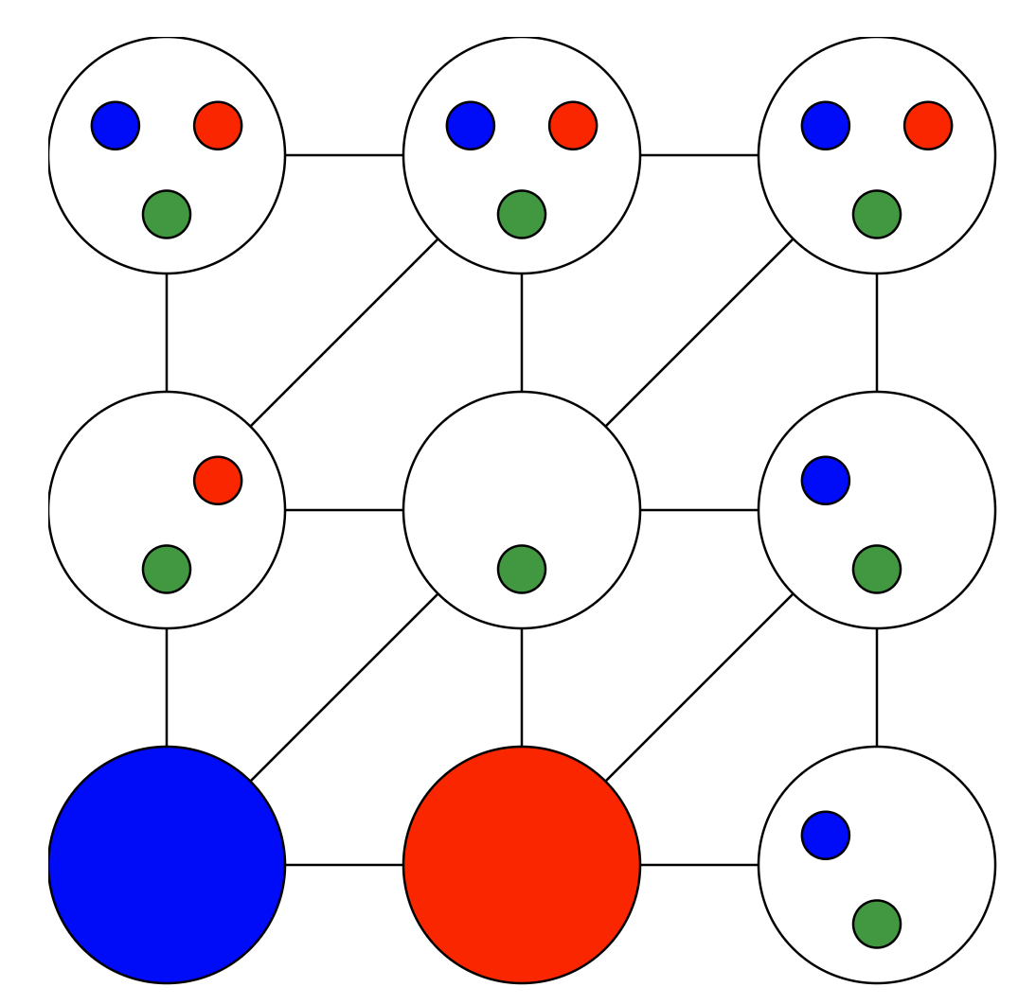
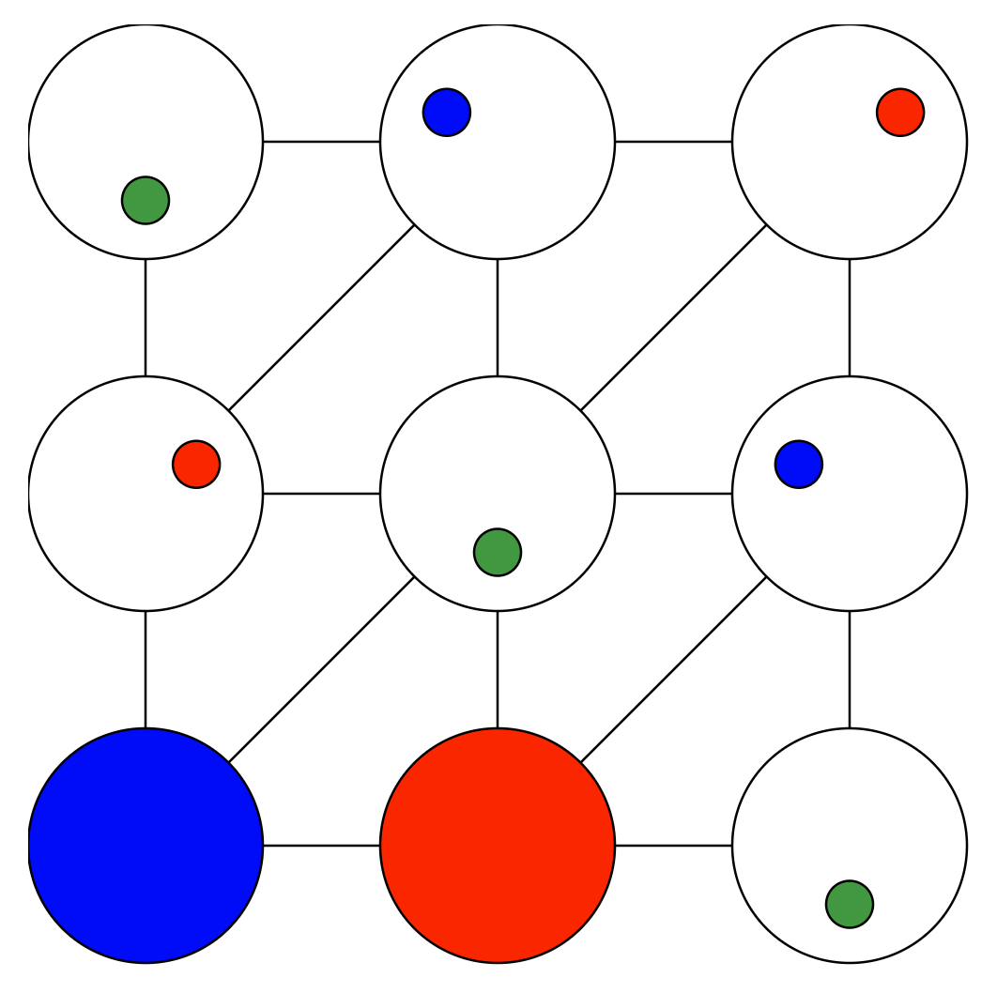


Demo – Backtracking with AC-3
Forward checking only check arcs connecting variables a variable that we just assigned.
With AC-3, we make sure all arcs are consistent
Compare
Backtracking with Forward Checking
Backtracking with AC-3
Demo credit: UCB CS 188

Slide 64
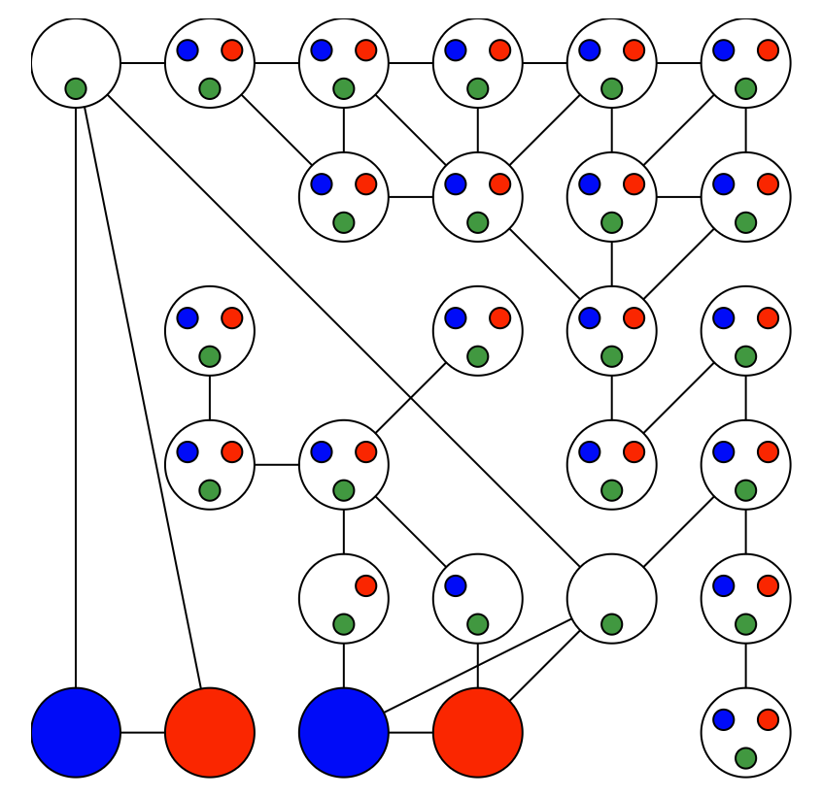
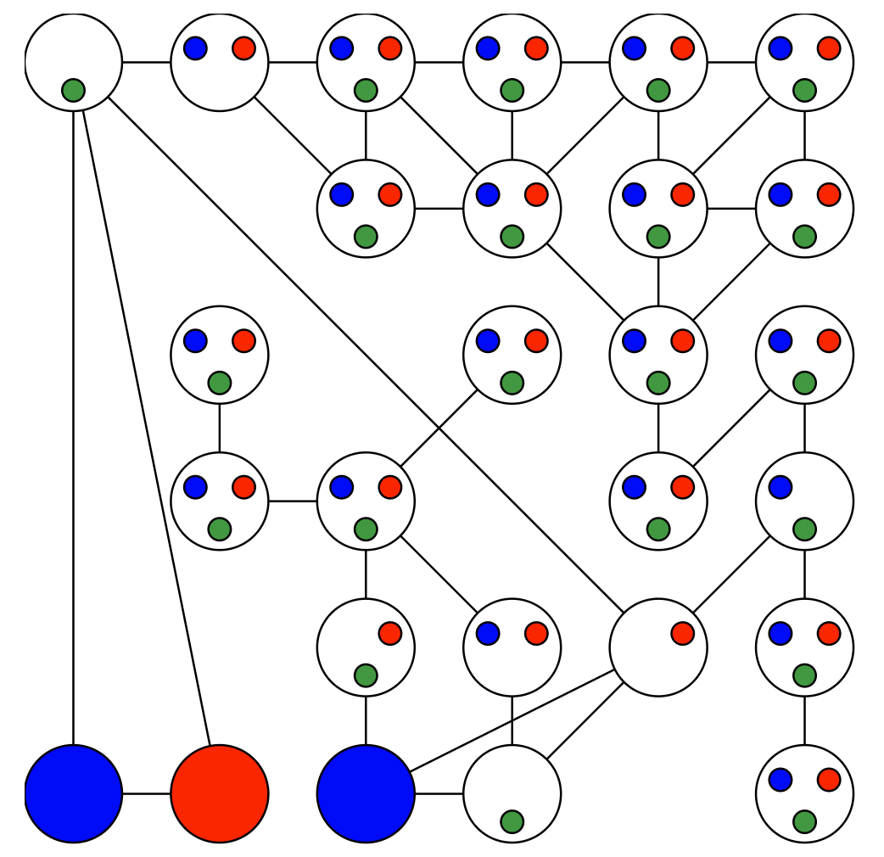
Demo – Backtracking with AC-3
Forward checking only check arcs connecting variables a variable that we just assigned.
With AC-3, we can find existing problems, such as the arc between these two variables with only green left.
Compare
Backtracking with Forward Checking
Backtracking with AC-3
Slide/Image credit: Ketrina Yim, UCB CS 188

Slide 65
Complexity of a single run of AC-3
Recall that the whole backtracking algorithm with AC-3 will call AC-3 many times
Image credit: aima.cs.berkeley.edu
Notes:
Auto-consistency (note initially nothing gets deleted/pruned since there are consistent options for all constraints for initial variable domains)
Flashes whenever something needs to be re-checked

Slide 66
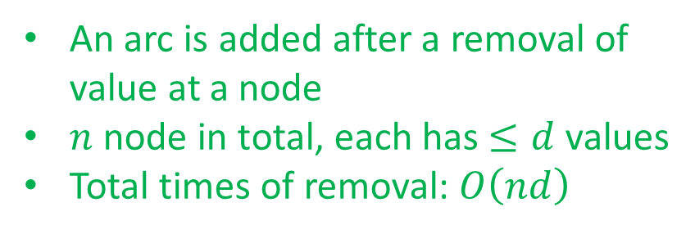
Complexity of a single run of AC-3
An arc is added after a removal of value at a node
$n$ node in total, each has $≤d$ values
Total times of removal: $O\left(nd\right)$
Image credit: aima.cs.berkeley.edu
Notes:
Auto-consistency (note initially nothing gets deleted/pruned since there are consistent options for all constraints for initial variable domains)
Flashes whenever something needs to be re-checked

Slide 67
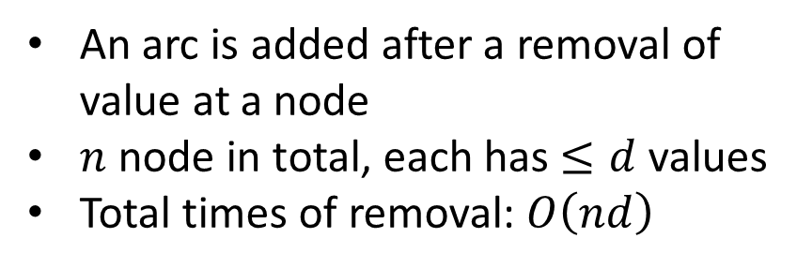
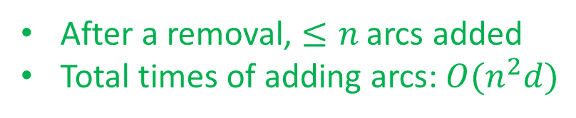
Complexity of a single run of AC-3
An arc is added after a removal of value at a node
$n$ node in total, each has $≤d$ values
Total times of removal: $O\left(nd\right)$
After a removal, $≤n$ arcs added
Total times of adding arcs: $O(n^{2}d)$
Image credit: aima.cs.berkeley.edu
Notes:
Auto-consistency (note initially nothing gets deleted/pruned since there are consistent options for all constraints for initial variable domains)
Flashes whenever something needs to be re-checked

Slide 68
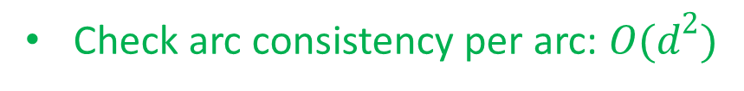
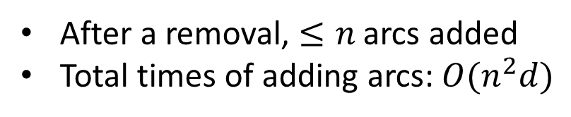
Complexity of a single run of AC-3
An arc is added after a removal of value at a node
$n$ node in total, each has $≤d$ values
Total times of removal: $O\left(nd\right)$
After a removal, $≤n$ arcs added
Total times of adding arcs: $O(n^{2}d)$
Check arc consistency per arc: $O(d^{2})$
Complexity of a single run of AC-3 is at most $O(n^{2}d^{3})$
(Not required) Zhang&Yap (2001) show that its complexity is $O(n^{2}d^{2})$
Image credit: aima.cs.berkeley.edu
Notes:
Auto-consistency (note initially nothing gets deleted/pruned since there are consistent options for all constraints for initial variable domains)
Flashes whenever something needs to be re-checked

Slide 69


Backtracking Search with AC-3
AC-3($csp$)
Where do you run AC-3?
Image credit: aima.cs.berkeley.edu
Notes:
Demo:
CS188 javascript demos -> source -> exercises -> csps -> CSPs demos -> CSPs demos.html
Settings:
Graph = Simple
Algorithm = Backtracking
Ordering = None
Filtering = None

Slide 70

Ordering
Slide/Image credit: Ketrina Yim, UCB CS 188

Slide 71



Ordering: Minimum Remaining Values
Variable Ordering: Minimum remaining values (MRV):
  Choose the variable with the fewest legal left values in its domain
Why min rather than max?
Also called “most constrained variable”
“Fail-fast” ordering
Slide/Image credit: Ketrina Yim, UCB CS 188

Slide 72
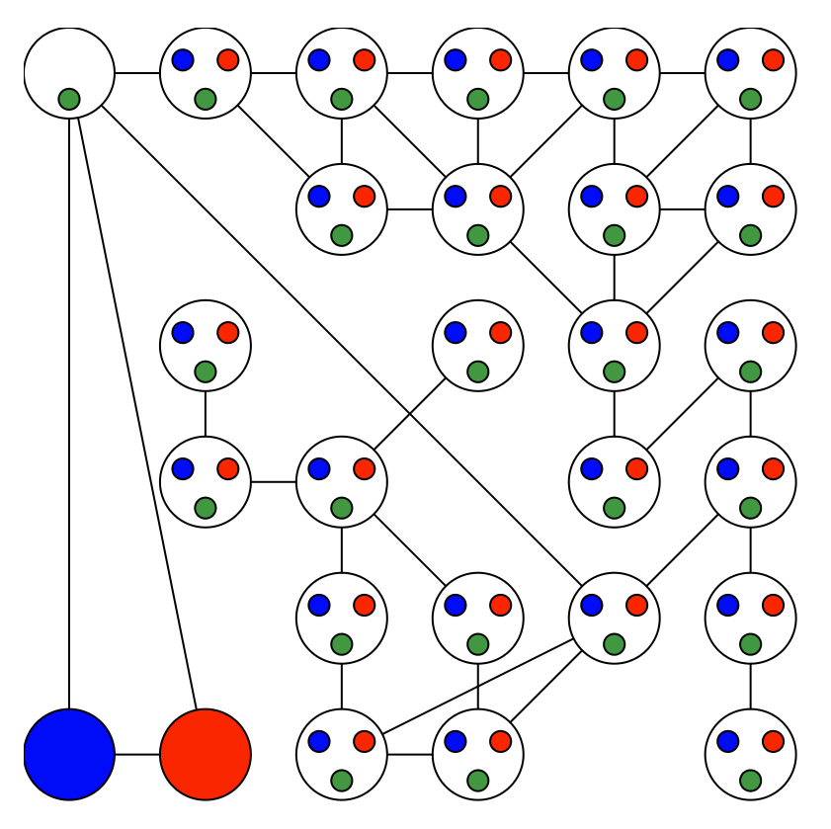
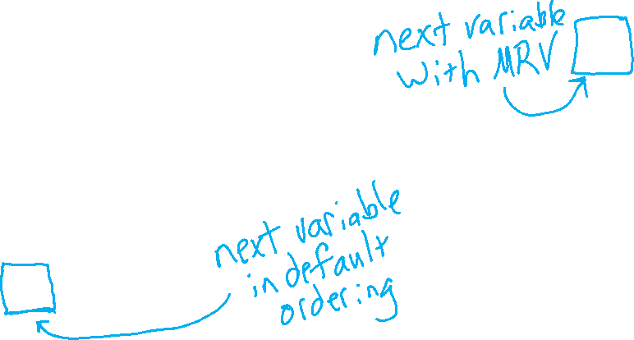
Demo – Coloring with a Complex Graph
Compare
Backtracking with Forward Checking
Backtracking with AC-3
Backtracking + Forward Checking + Minimum Remaining Values (MRV)
Demo credit: UCB CS 188

Slide 73
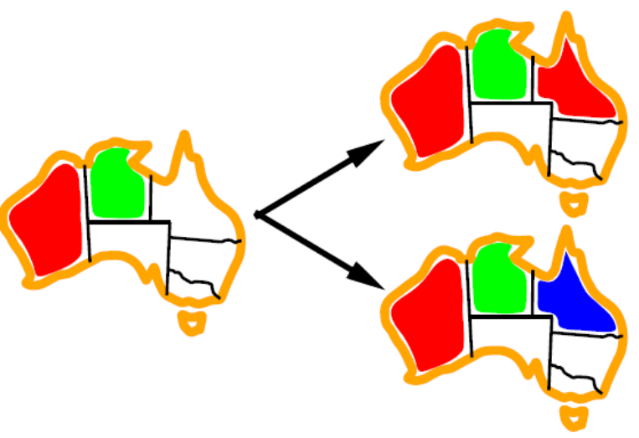
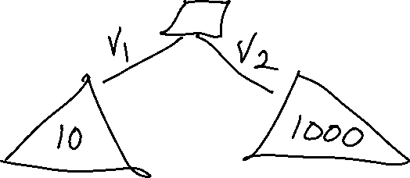
Ordering: Least Constraining Value
Value Ordering: Least Constraining Value
  Given a choice of variable, choose the least constraining value
  i.e., the one that rules out the fewest values in the remaining variables
  Note that it may take some computation to determine this! (E.g., rerunning filtering)
Slide/Image credit: Ketrina Yim, UCB CS 188

Slide 74
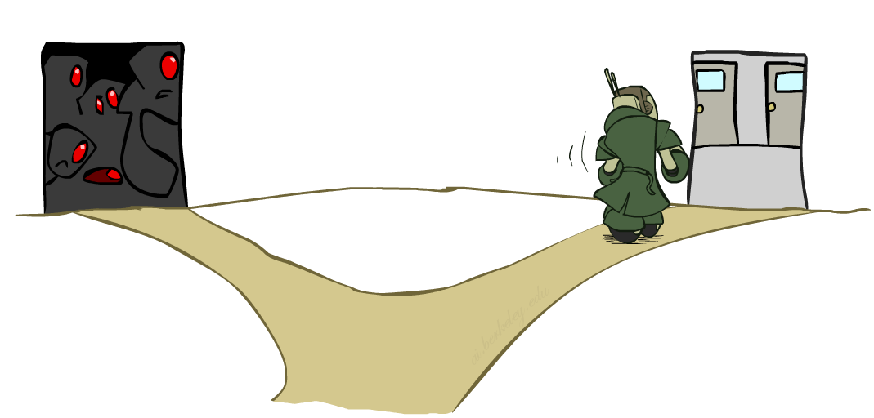
Ordering: Least Constraining Value
Value Ordering: Least Constraining Value
  Given a choice of variable, choose the least constraining value
  i.e., the one that rules out the fewest values in the remaining variables
  Note that it may take some computation to determine this! (E.g., rerunning filtering)
Why least rather than most?
Combining these ordering ideas makes
1000 queens feasible
Slide/Image credit: Ketrina Yim, UCB CS 188

Slide 75
Demo – Coloring with a Complex Graph
Compare
Backtracking with Forward Checking
Backtracking with AC-3
Backtracking + Forward Checking + Minimum Remaining Values (MRV)
Backtracking + AC-3 + MRV + LCV

Slide 76
Summary: CSPs
CSPs are a special kind of search problem:
  States are partial assignments
  Goal test defined by constraints
Basic solution: backtracking search
Speed-ups:
  Ordering
  Filtering
  (Structure)
Slide/Image credit: Ketrina Yim, UCB CS 188

