Slide 1

07-280 AI & ML I
Adversarial Search
Instructors:
Pat Virtue & Nihar Shah

Slide 2

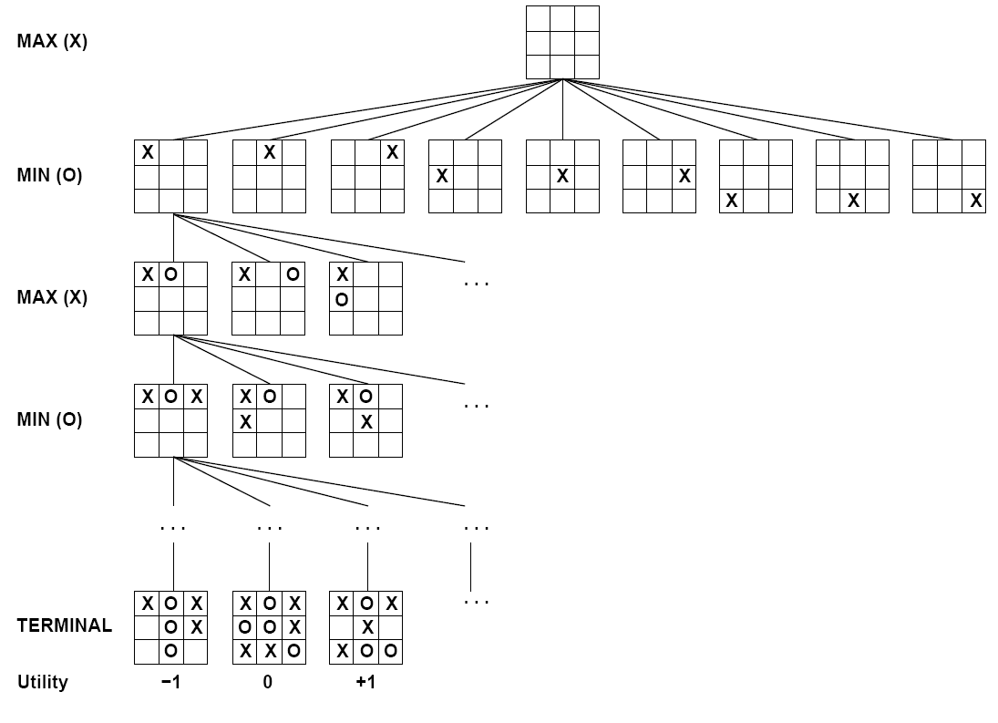

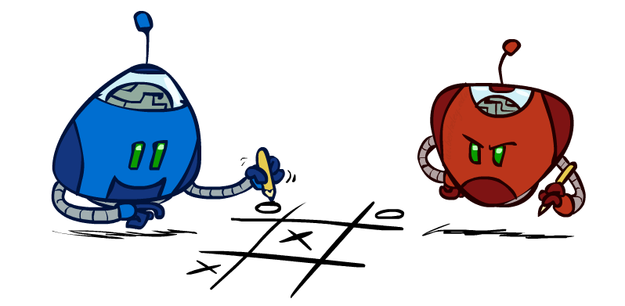

Minimax
Why not use A* search?
Why the focus on games?
States
Actions
Values
Image credit: Ketrina Yim, UCB CS 188

Slide 3
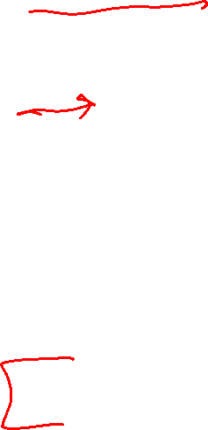
Intelligence and Uncertainty
Uncertainty can have lots of sources, including anything we attribute to random chance
Hidden information
    Cards in another player’s hand
Noise
    Sensor noise
Way to complicated to model
    Leaves blowing in the wind
Infinite number of possible configurations
More possibilities than any computer can compute in a reasonable time
    Tic-tac-toe → Checkers → Chess

Slide 4
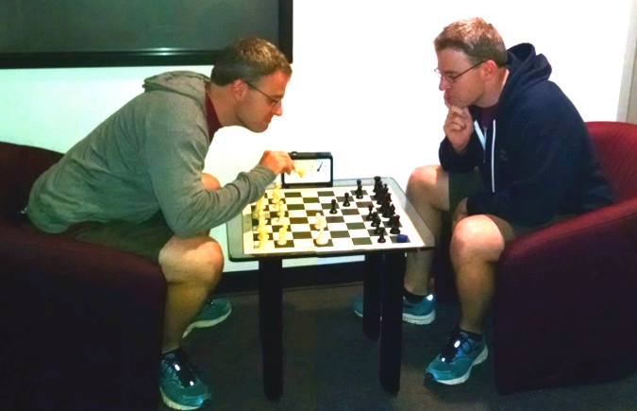

Outline
Pre-reading
History
Standard/Zero-Sum Games
Minimax
Expected Value
Expectimax
Evaluation Functions
Pruning
Modeling Assumptions
Image credit: Ketrina Yim, UCB CS 188 and well, Pat Virtue

Slide 5
Pre-reading

Slide 6
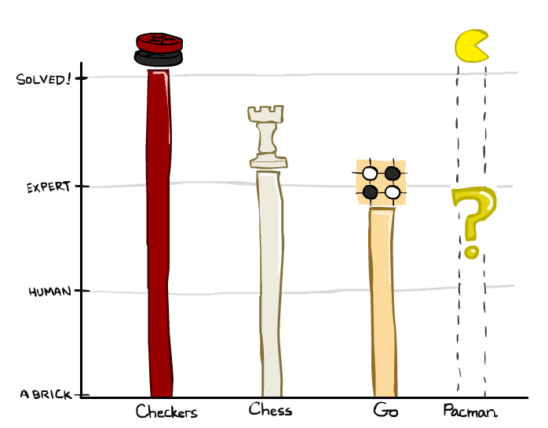
Game Playing State-of-the-Art
Checkers:
  1950: First computer player.
  1959: Samuel’s self-taught program.
  1994: First computer world champion: Chinook ended 40-year-reign of human champion Marion Tinsley using complete 8-piece endgame.
  2007: Checkers solved! Endgame database of 39 trillion states
Chess:
  1945-1960: Zuse, Wiener, Shannon, Turing, Newell & Simon, McCarthy.
  1960s onward: gradual improvement under “standard model”
  1997: special-purpose chess machine Deep Blue defeats human champion Gary Kasparov in a six-game match. Deep Blue examined 200M positions per second and extended some lines of search up to 40 ply. Current programs running on a PC rate > 3200 (vs 2870 for Magnus Carlsen).
Go:
  1968: Zobrist’s program plays legal Go, barely (b>300!)
  2005-2014: Monte Carlo tree search enables rapid advances: current programs beat strong amateurs, and professionals with a 3-4 stone handicap.
Slide/Image credit: Ketrina Yim, UCB CS 188
Notes:
Tinsley lost only 5 games to humans in 42 years; has been known to solve 60-ply problems

Slide 7
Game Playing State-of-the-Art
Checkers:
  1950: First computer player.
  1959: Samuel’s self-taught program.
  1994: First computer world champion: Chinook ended 40-year-reign of human champion Marion Tinsley using complete 8-piece endgame.
  2007: Checkers solved! Endgame database of 39 trillion states
Chess:
  1945-1960: Zuse, Wiener, Shannon, Turing, Newell & Simon, McCarthy.
  1960s onward: gradual improvement under “standard model”
  1997: special-purpose chess machine Deep Blue defeats human champion Gary Kasparov in a six-game match. Deep Blue examined 200M positions per second and extended some lines of search up to 40 ply. Current programs running on a PC rate > 3200 (vs 2870 for Magnus Carlsen).
Go:
  1968: Zobrist’s program plays legal Go, barely (b>300!)
  2005-2014: Monte Carlo tree search enables rapid advances: current programs beat strong amateurs, and professionals with a 3-4 stone handicap.
Slide/Image credit: Ketrina Yim, UCB CS 188
Notes:
Tinsley lost only 5 games to humans in 42 years; has been known to solve 60-ply problems

Slide 8
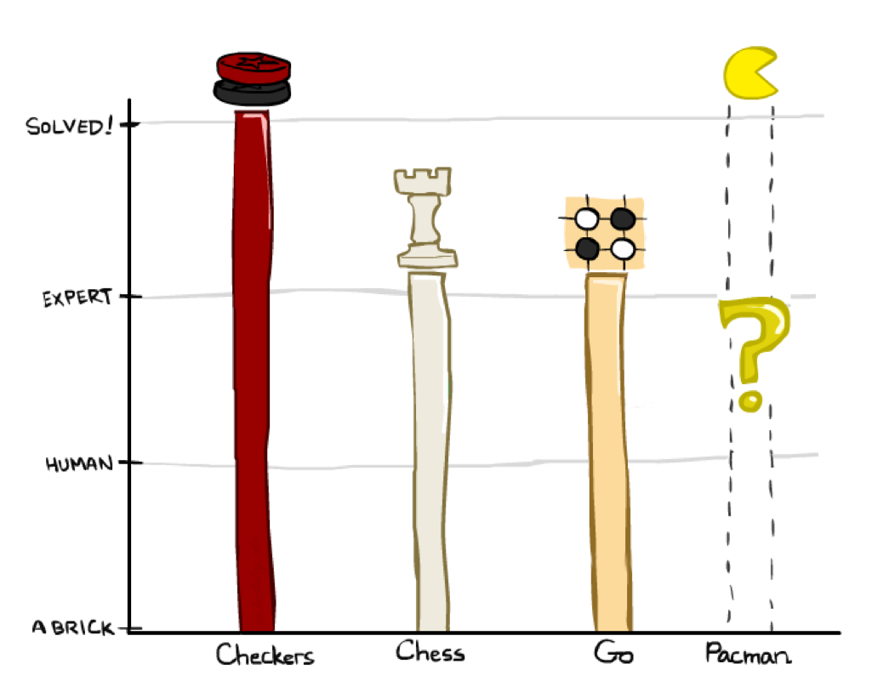

Game Playing State-of-the-Art
Checkers:
  1950: First computer player.
  1959: Samuel’s self-taught program.
  1994: First computer world champion: Chinook ended 40-year-reign of human champion Marion Tinsley using complete 8-piece endgame.
  2007: Checkers solved! Endgame database of 39 trillion states
Chess:
  1945-1960: Zuse, Wiener, Shannon, Turing, Newell & Simon, McCarthy.
  1960s onward: gradual improvement under “standard model”
  1997: special-purpose chess machine Deep Blue defeats human champion Gary Kasparov in a six-game match. Deep Blue examined 200M positions per second and extended some lines of search up to 40 ply. Current programs running on a PC rate > 3200 (vs 2870 for Magnus Carlsen).
Go:
  1968: Zobrist’s program plays legal Go, barely (b>300!)
  2005-2014: Monte Carlo tree search enables rapid advances: current programs beat strong amateurs, and professionals with a 3-4 stone handicap.
  2015: AlphaGo from DeepMind beats Lee Sedol
Slide/Image credit: Ketrina Yim, UCB CS 188
Notes:
Tinsley lost only 5 games to humans in 42 years; has been known to solve 60-ply problems

Slide 9
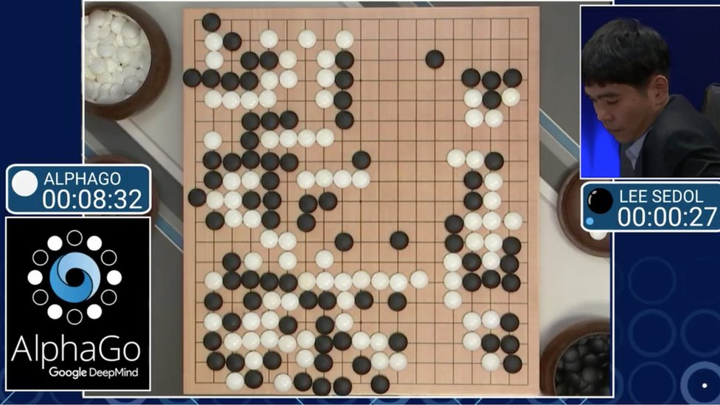
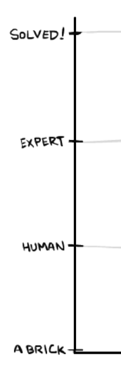
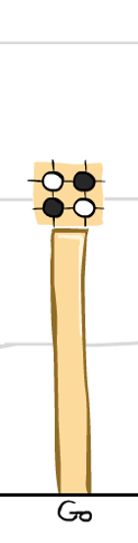
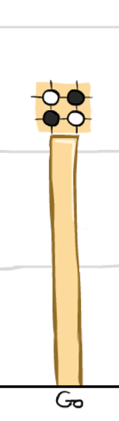
AlphaGo
2015: AlphaGo from DeepMind beats Lee Sedol
Slide/Image credit: Ketrina Yim, UCB CS 188

Slide 10
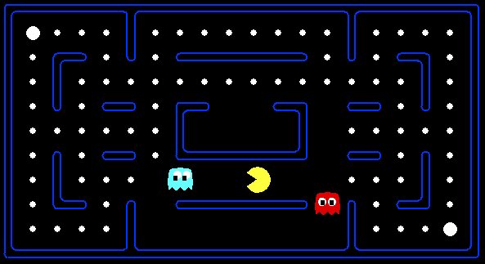
Behavior from Computation
Slide/Image credit: UCB CS 188
[Demo: mystery pacman (L6D1)]

Slide 11
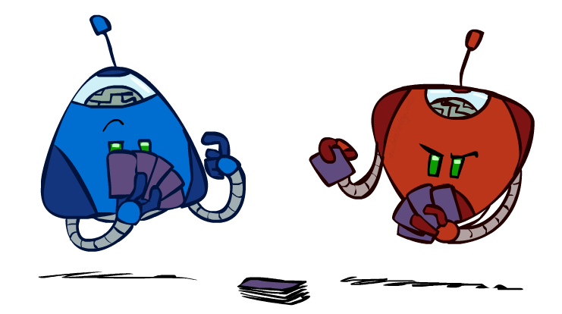
Types of Games
Many different kinds of games!
Axes:
  Deterministic or stochastic?
  Perfect information (fully observable)?
  One, two, or more players?
  Turn-taking or simultaneous?
  Zero sum?
Want algorithms for calculating a contingent plan (a.k.a. strategy or policy) which recommends a move for every possible eventuality
Image/slide credit: Ketrina Yim, UCB CS 188

Slide 12
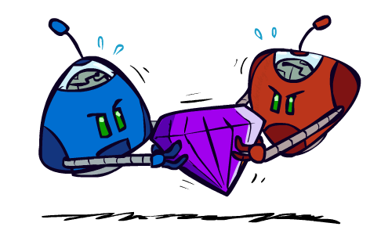
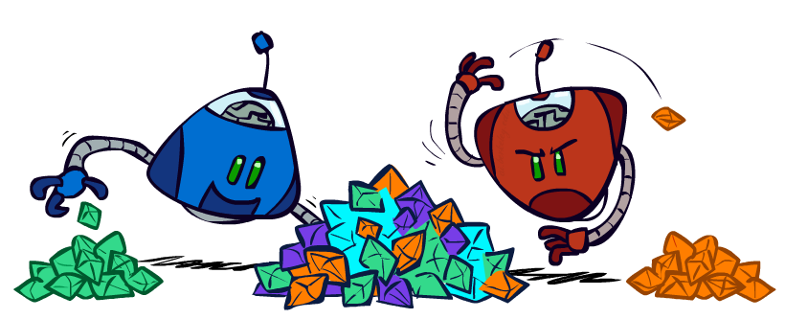
Zero-Sum Games
Zero-Sum Games
  Agents have opposite utilities
  Pure competition:
    One maximizes, the other minimizes
General Games
  Agents have independent utilities
  Cooperation, indifference, competition, shifting alliances, and more are all possible
Image/slide credit: Ketrina Yim, UCB CS 188

Slide 13
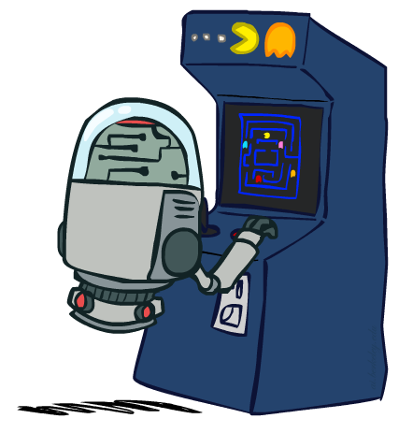
“Standard” Games
Standard games are deterministic, observable, two-player, turn-taking, zero-sum
Game formulation:
  Initial state: s₀
  Players: Player(s) indicates whose move it is
  Actions: Actions(s) for player on move
  Transition model: Result(s,a)
  Terminal test: Terminal-Test(s)
  Terminal values: Utility(s,p) for player p
    Or just Utility(s) for player making the decision at root
Image/slide credit: Ketrina Yim, UCB CS 188

Slide 14
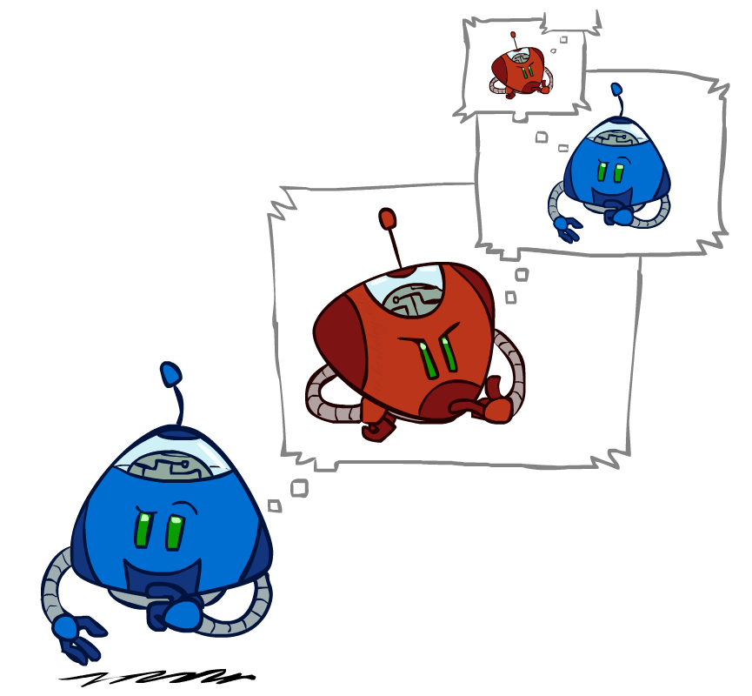
Pre-reading
Minimax Search
Image credit: Ketrina Yim, UCB CS 188

Slide 15
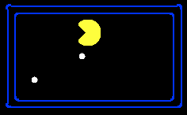
Single-Agent Trees
8
2
0
…
2
6
…
4
6
Slide credit: UCB CS 188
Notes:
10 points for eating dot; -1 for each time step

Slide 16
Minimax
States
Actions
Values
Image/slide credit: Ketrina Yim, UCB CS 188

Slide 17
Minimax Example
Left
Right
Center
Jump
Hide
Jump
Run
Hide
Run
3
12
2
6
5
2
Notes:
Add values by hand if on tablet, or add by animation steps

Slide 18
Generic Game Tree Pseudocode
function minimax_decision( state )
return argmax _{a in state.actions} value( state.result(a) )
function value( state )
  if state.is_leaf
  return state.value
  if state.player is MAX
  return max _{a in state.actions} value( state.result(a) )
  if state.player is MIN
  return min _{a in state.actions} value( state.result(a) )
Slide credit: UCB CS 188

Slide 19
Minimax Efficiency
How efficient is minimax?
  Just like (exhaustive) DFS
  Time: O(b^{m})
  Space: O(bm)
Example: For chess, b ≈ 35, m ≈ 100
  Exact solution is completely infeasible
  Humans can’t do this either, so how do we play chess?
  Bounded rationality – Herbert Simon
Image/slide credit: Ketrina Yim, UCB CS 188

Slide 20
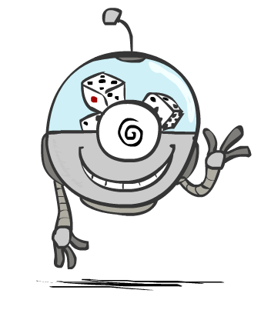
Pre-reading
Probability and Expected Value
Image credit: Ketrina Yim, UCB CS 188

Slide 21
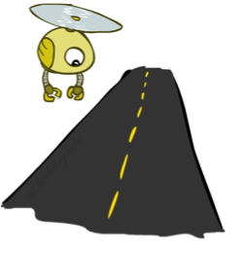
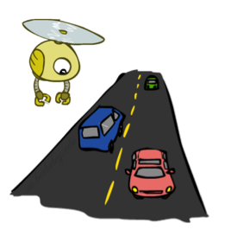
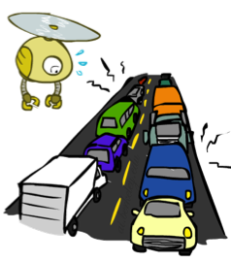
Probabilities
A random variable represents an event whose outcome is unknown
A probability distribution is an assignment of weights to outcomes
Example: Traffic on freeway
  Random variable: T = whether there’s traffic
  Outcomes: T in {none, light, heavy}
  Distribution:
  P(T=none) = 0.25, P(T=light) = 0.50, P(T=heavy) = 0.25
Probabilities over all possible outcomes sum to one
0.25
0.50
0.25
Image/slide credit: Ketrina Yim, UCB CS 188

Slide 22
Expected Value
Expected value of a function of a random variable:
  Average the values of each outcome,
  weighted by the probability of that outcome
Example: How long to get to the airport?
Time:
20 min
30 min
60 min
+
+
35 min
x
x
x
Probability:
0.25
0.50
0.25
Image/slide credit: Ketrina Yim, UCB CS 188

Slide 23
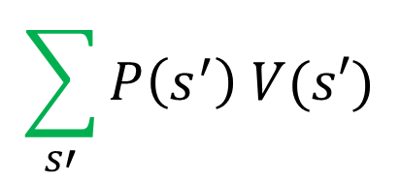

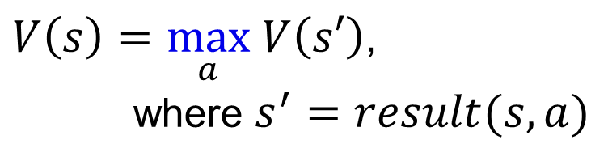
Expected Value
Time:
20 min
30 min
60 min
+
+
x
x
x
Probability:
0.25
0.50
0.25
0.25
0.25
0.5
20
30
60
Max node notation
Chance node notation
$$\sum_{s′}{P\left(s^{′}\right) V(s′)}$$
$V\left(s\right)=\max_{a} V\left(s′\right)$,
where $s^{′}=result(s, a)$
$$V\left(s\right)=$$
Image credit: Ketrina Yim, UCB CS 188

Slide 24
Example
Expectimax tree search
Left
Right
Center
1/4
1/2
1/2
1/2
1/3
2/3
1/4
12
8
4
8
6
12
6
Slide credit: UCB CS 188

Slide 25
Updated: Generic Game Tree Pseudocode
function value( state )
  if state.is_leaf
  return state.value
  if state.player is MAX
  return max _{a in state.actions} value( state.result(a) )
  if state.player is MIN
  return min _{a in state.actions} value( state.result(a) )
  if state.player is CHANCE
  return sum _{s in state.next_states} P( s ) * value( s )
Slide credit: UCB CS 188

Slide 26
Adversarial Search
Image credit: Ketrina Yim, UCB CS 188

Slide 27
Minimax Code and Notation

Slide 28
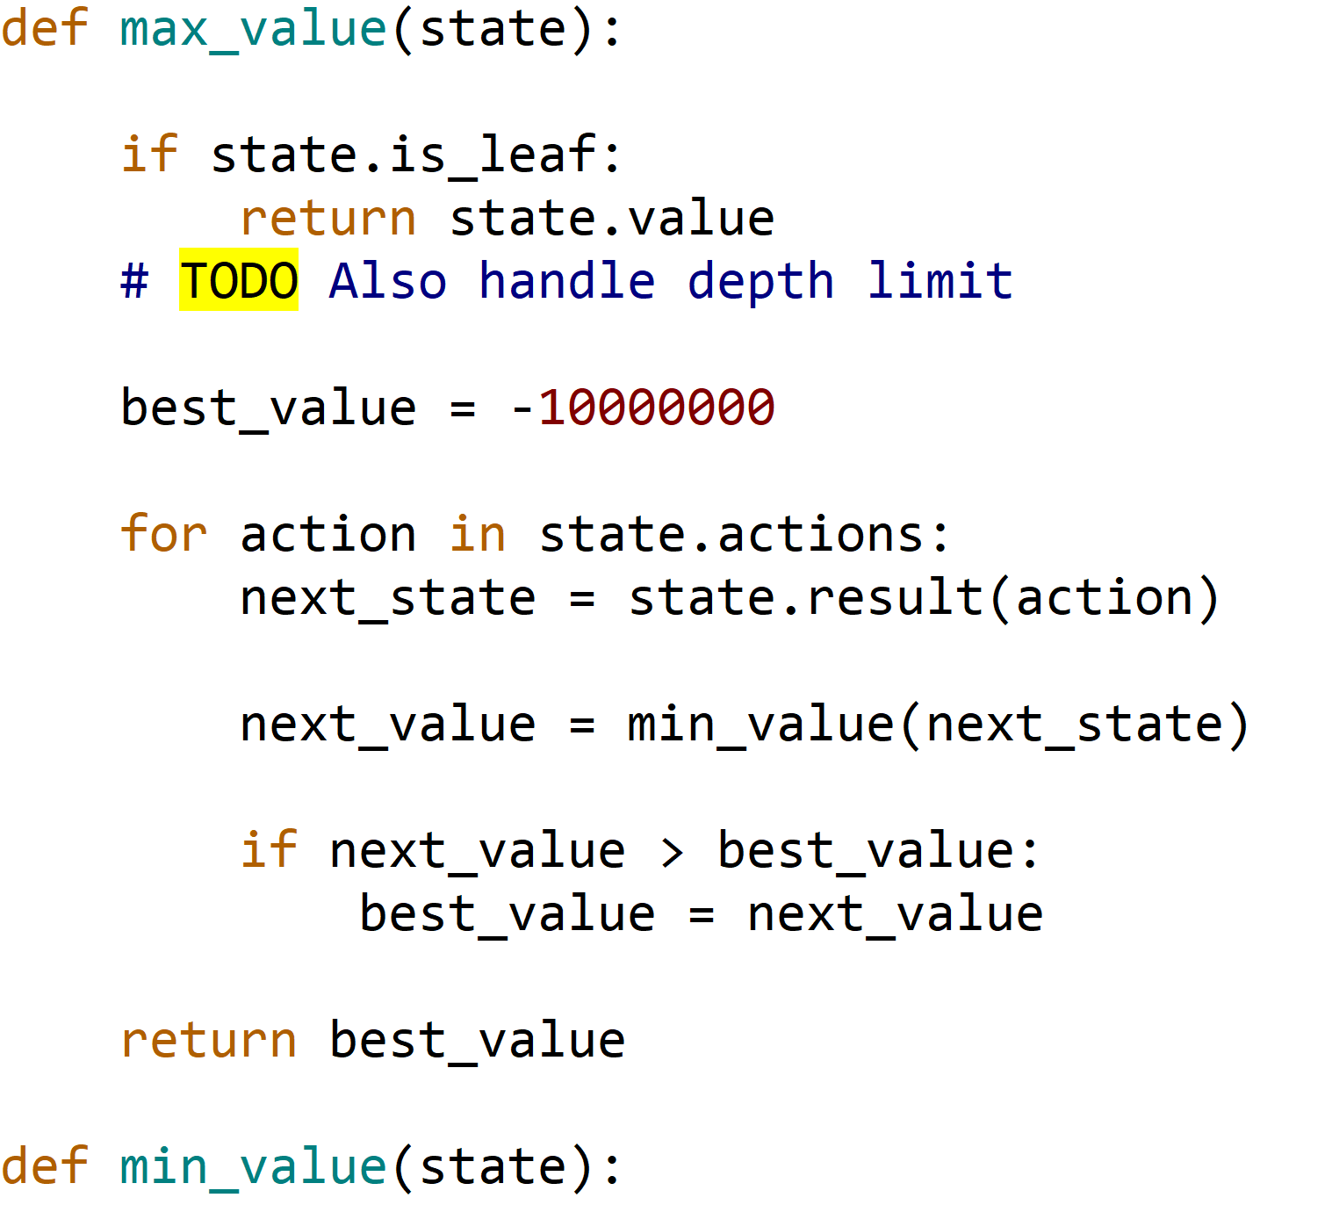
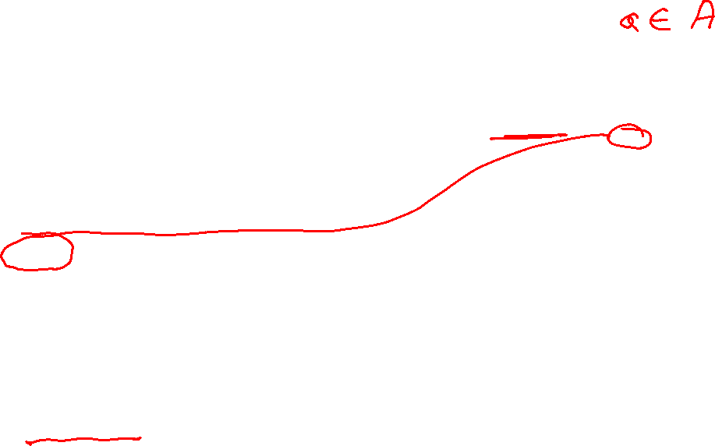
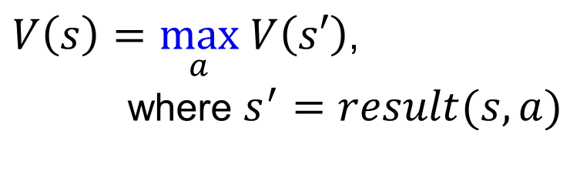
Minimax Notation
$V\left(s\right)=\max_{a} V\left(s′\right)$,
where $s^{′}=result(s, a)$

Slide 29
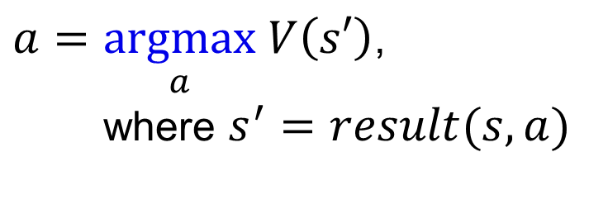
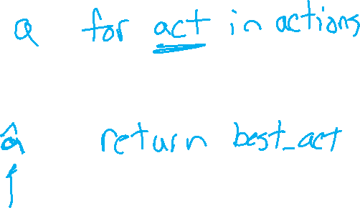

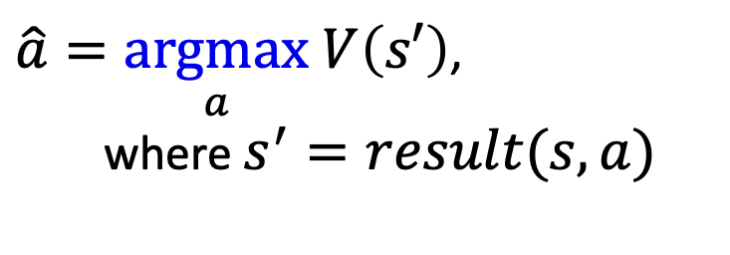
Minimax Notation
$V\left(s\right)=\max_{a} V\left(s′\right)$,
where $s^{′}=result(s, a)$
$a=\underset{a}{argmax} V\left(s′\right)$,
where $s^{′}=result(s, a)$
$\hat{a}=\underset{a}{argmax} V\left(s′\right)$,
where $s^{′}=result(s, a)$

Slide 30
Minimax Efficiency
How efficient is minimax?
  Just like (exhaustive) DFS
  Time: O(b^{m})
  Space: O(bm)
Example: For chess, b ≈ 35, m ≈ 100
  Exact solution is completely infeasible
  Humans can’t do this either, so how do we play chess?
  Bounded rationality – Herbert Simon
Image/slide credit: Ketrina Yim, UCB CS 188

Slide 31

Resource Limits
Image/slide credit: Ketrina Yim, UCB CS 188

Slide 32
Resource Limits
Problem: In realistic games, cannot search to leaves!
Solution 1: Bounded lookahead
  Search only to a preset depth limit or horizon
  Use an evaluation function for non-terminal positions
Guarantee of optimal play is gone
More plies make a BIG difference
Example:
  Suppose we have 100 seconds, can explore 10K nodes / sec
  So can check 1M nodes per move
  For chess, b=~35 so reaches about depth 4 – not so good
max
4
-2
4
min
-1
-2
4
9
?
?
?
?
Slide credit: UCB CS 188

Slide 33


Depth Matters
Evaluation functions are always imperfect
Deeper search => better play (usually)
Or, deeper search gives same quality of play with a less accurate evaluation function
An important example of the tradeoff between complexity of features and complexity of computation
Image/slide credit: Ketrina Yim, UCB CS 188
[Demo: depth limited (L6D4, L6D5)]

Slide 34
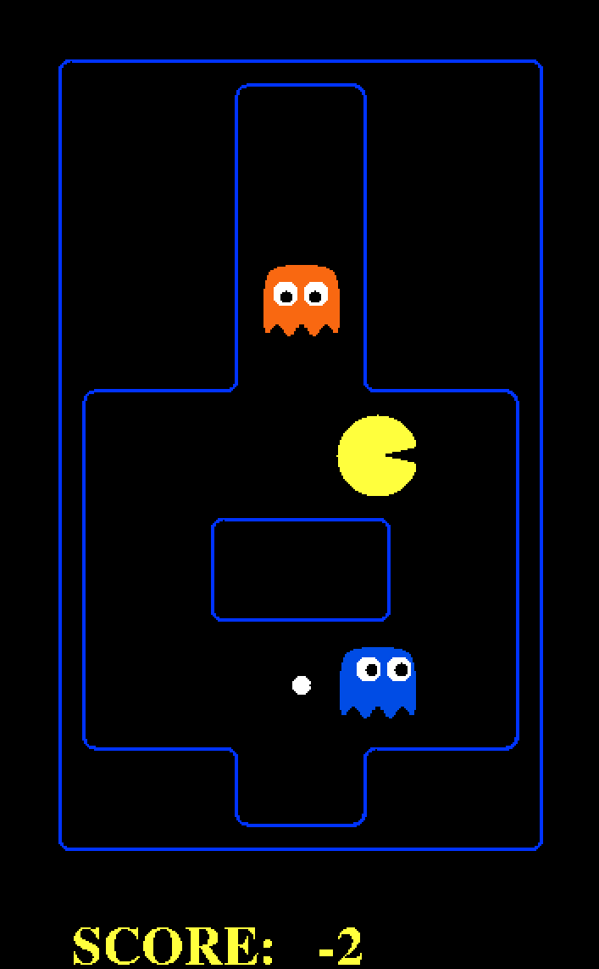

Demo Limited Depth (2 vs 10)
Slide credit: UCB CS 188
[Demo: depth limited (L6D4, L6D5)]
Notes:
Depth 2, one dot and two ghosts; dot is about 8 steps away – cannot see actual eating, so need to include distance to dots in eval; but limited depth means it goes into a dead end and cannot escape even a simple ghost strategy;

Slide 35
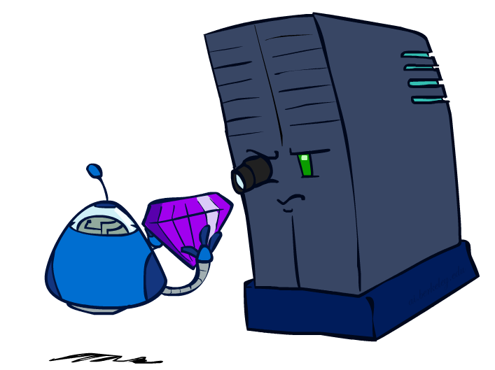
Evaluation Functions
Image/slide credit: Ketrina Yim, UCB CS 188

Slide 36
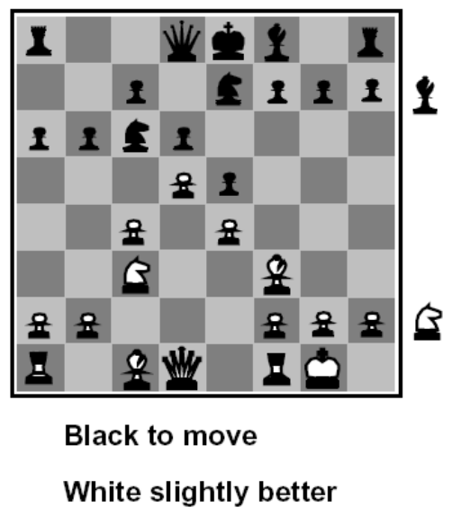
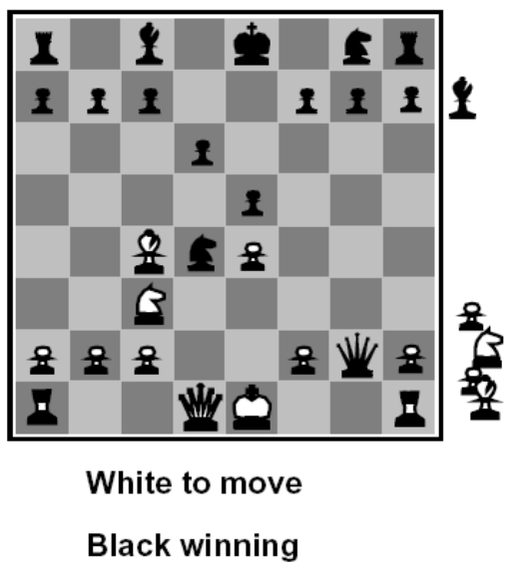
Evaluation Functions
Evaluation functions score non-terminals in depth-limited search
Ideal function: returns the actual minimax value of the position
In practice: typically weighted linear sum of features:
  EVAL(s) = w₁ f₁(s) + w₂ f₂(s) + …. + w_{n} f_{n}(s)
  E.g., w₁ = 9, f₁(s) = (num white queens – num black queens), etc.
Slide credit: UCB CS 188

Slide 37




Evaluation for Pacman
Slide credit: UCB CS 188

Slide 38
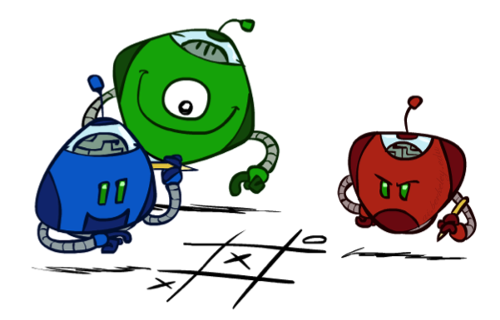
Generalized minimax
What if the game is not zero-sum, or has multiple players?
Generalization of minimax:
  Terminals have utility tuples
  Node values are also utility tuples
  Each player maximizes its own component
  Can give rise to cooperation and
  competition dynamically…
8,8,1
8,8,1
7,7,2
0,0,7
8,8,1
7,7,2
0,0,8
1,1,6
0,0,7
9,9,0
8,8,1
9,9,0
7,7,2
0,0,8
0,0,7
Image/slide credit: Ketrina Yim, UCB CS 188
Notes:
If both ghosts go the same way, pacman wins; if they go different ways, pacman loses

Slide 39
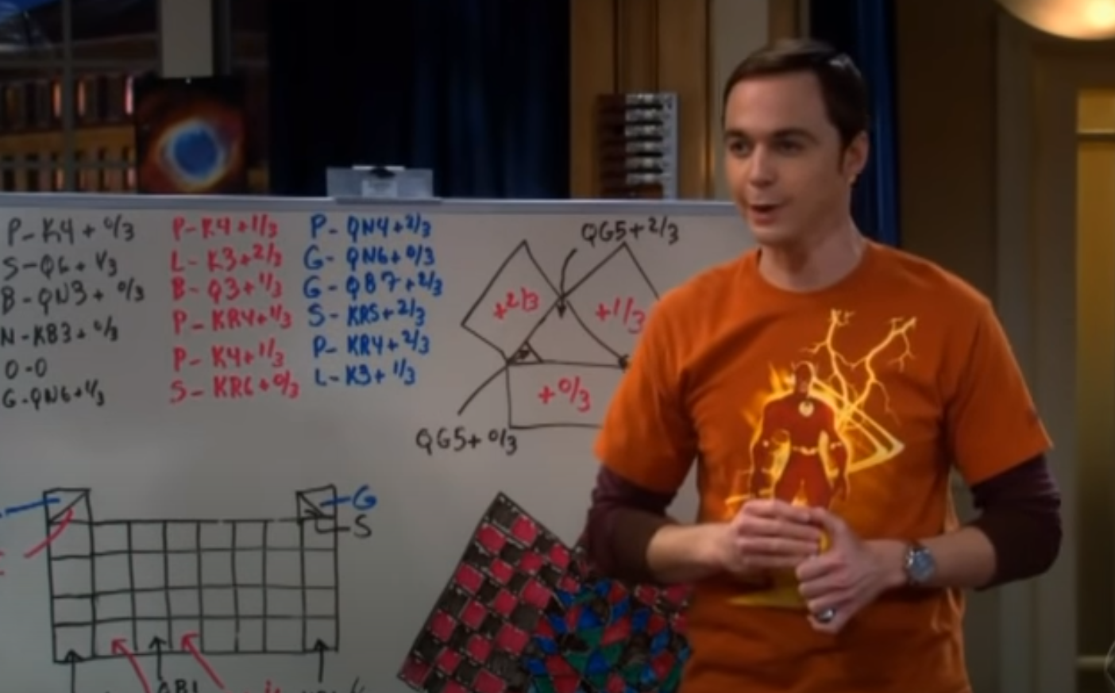
Generalized minimax
Three Person Chess
https://www.youtube.com/watch?v=HHVPutfveVs

Slide 40
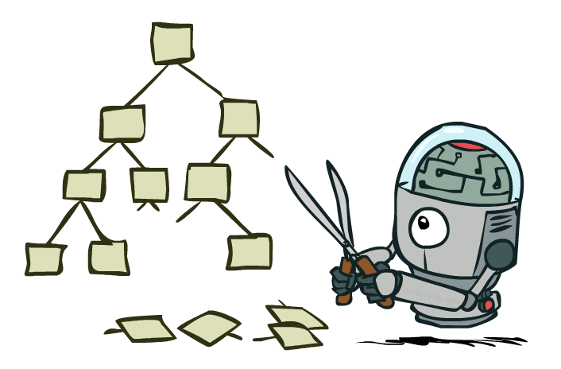
Game Tree Pruning
Image/slide credit: Ketrina Yim, UCB CS 188

Slide 41

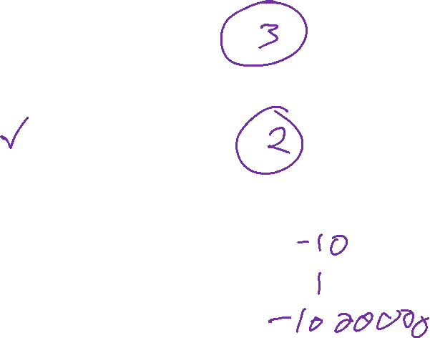
Alpha-Beta Example
α = best option so far from any
MAX node on this path
3
α =3
α =3
3
3
12
8
2
14
5
2
The order of generation matters: more pruning
is possible if good moves come first
Slide credit: UCB CS 188
Notes:
Add values by hand if on tablet, or add by animation steps

Slide 42
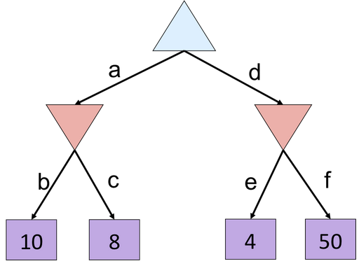

Poll 1
Which branches are pruned?
(Left to right traversal)
Select all that apply
Slide credit: UCB CS 188
Notes:
f is not evaluated

Slide 43
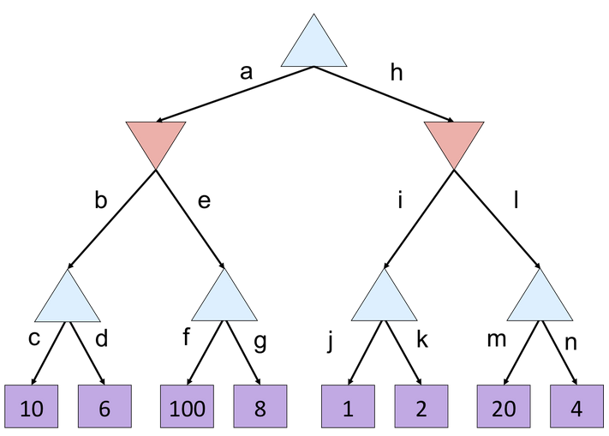
Example
Which branches are pruned?
(Left to right traversal)
Slide credit: UCB CS 188

Slide 44
Poll 2
Which branches are pruned?
(Left to right traversal)
Select all that apply
Slide credit: UCB CS 188

Slide 45
Alpha-Beta Implementation
  α: MAX’s best option on path to root
  β: MIN’s best option on path to root
def max-value(state, α, β):
  initialize v = -∞
  for each successor of state:
    v = max(v, value(successor, α, β))
    if v ≥ β
    return v
    α = max(α, v)
  return v
def min-value(state , α, β):
  initialize v = +∞
  for each successor of state:
    v = min(v, value(successor, α, β))
    if v ≤ α
    return v
    β = min(β, v)
  return v
Slide credit: UCB CS 188
Notes:
Pick an order for two reasons: sequential processor and pruning

Slide 46

Alpha-Beta version of Poll 1
  α: MAX’s best option on path to root
  β: MIN’s best option on path to root
def max-value(state, α, β):
  initialize v = -∞
  for each successor of state:
    v = max(v, value(successor, α, β))
    if v ≥ β
    return v
    α = max(α, v)
  return v
β = 10
10
v=100
Slide credit: UCB CS 188

Slide 47
Alpha-Beta version of Poll 1
  α: MAX’s best option on path to root
  β: MIN’s best option on path to root
α = 10
def min-value(state , α, β):
  initialize v = +∞
  for each successor of state:
    v = min(v, value(successor, α, β))
    if v ≤ α
    return v
    β = min(β, v)
  return v
10
v = 2
10
100
2
Slide credit: UCB CS 188

Slide 48

Alpha-Beta Pruning Properties
Theorem: This pruning has no effect on minimax value computed for the root!
Good child ordering improves effectiveness of pruning
  Iterative deepening helps with this
With “perfect ordering”:
  Time complexity drops to O(b^{m/2})
  Doubles solvable depth!
  1M nodes/move => depth=8, respectable
This is a simple example of metareasoning (computing about what to compute)
max
min
10
10
0
Slide credit: UCB CS 188

Slide 49
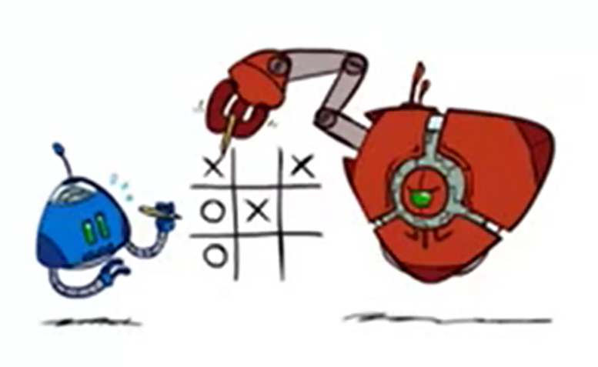
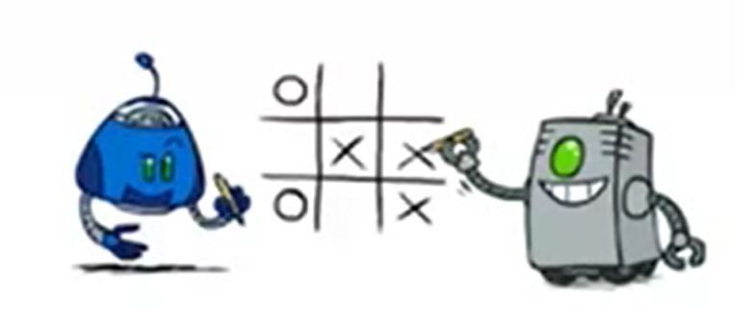
Modeling Assumptions
Image/slide credit: Ketrina Yim, UCB CS 188

Slide 50
Modeling Assumptions
Know your opponent
10
10
9
100
Image/slide credit: Ketrina Yim, UCB CS 188

Slide 51
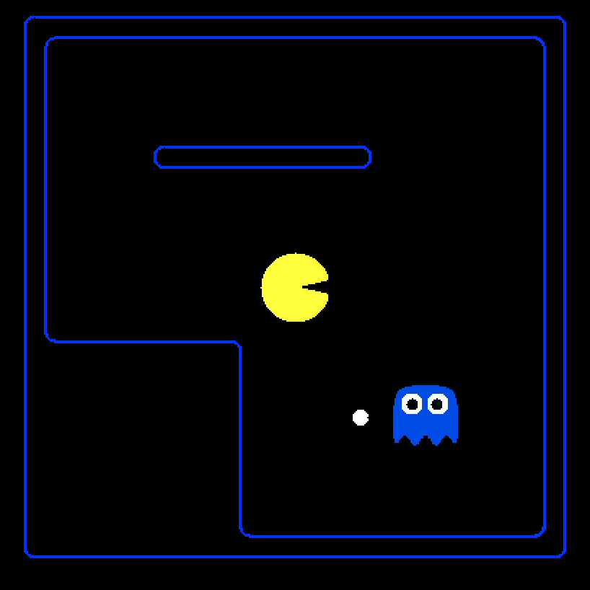
Minimax Demo
Points
+500 win
-500 lose
-1 each move
Fine print
Pacman: uses depth 4 minimax
Ghost: uses depth 2 minimax
Slide credit: UCB CS 188
[Demo: minimax, minimax L7D4)]

Slide 52
Poll 3
How well would a minimax Pacman perform against a
ghost that moves randomly?
  Better than against a minimax ghost
  Worse than against a minimax ghost
  Same as against a minimax ghost
Fine print
Points: +500 win, -500 lose, -1 each move
Pacman: uses depth 4 minimax as before
Ghost: moves randomly
Slide credit: UCB CS 188

Slide 53
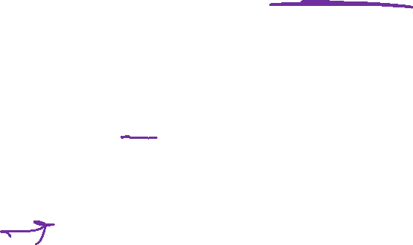
Assumptions vs. Reality
Which pair performs the worst (for Pacman)?
Which is the best?
 | Minimax Ghost | Random Ghost
Minimax Pacman | Won 5/5 Avg. Score: 493 | Won 5/5 Avg. Score: 464
Expectimax Pacman | Won 1/5 Avg. Score: -303 | Won 5/5 Avg. Score: 503
Results from playing 5 games
Slide credit: UCB CS 188
[Demo: random, minimax L7D6)]

Slide 54
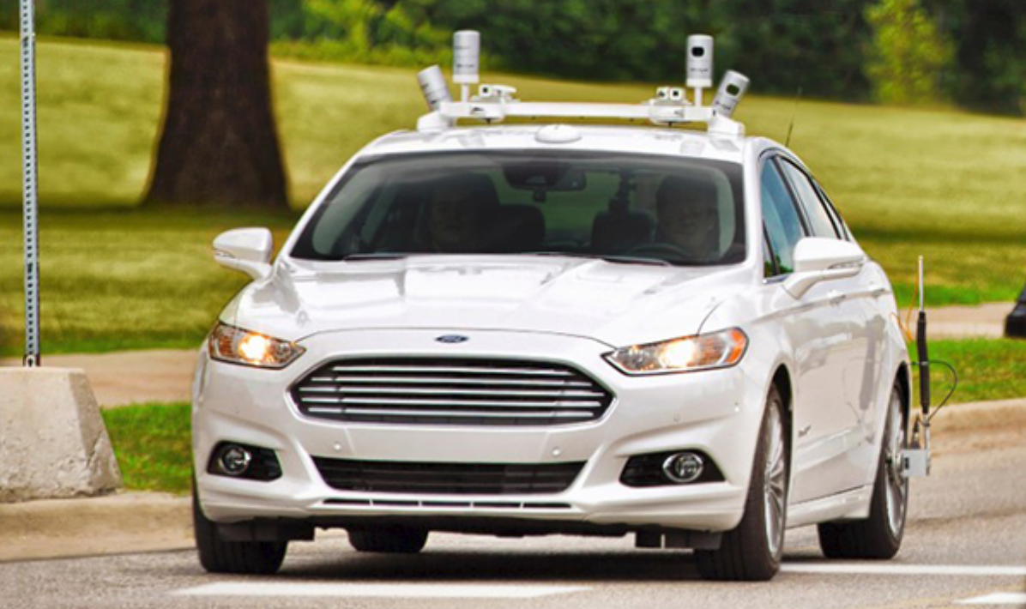
Modeling Assumptions
Minimax autonomous vehicle?
Image: https://corporate.ford.com/innovation/autonomous-2021.html

Slide 55
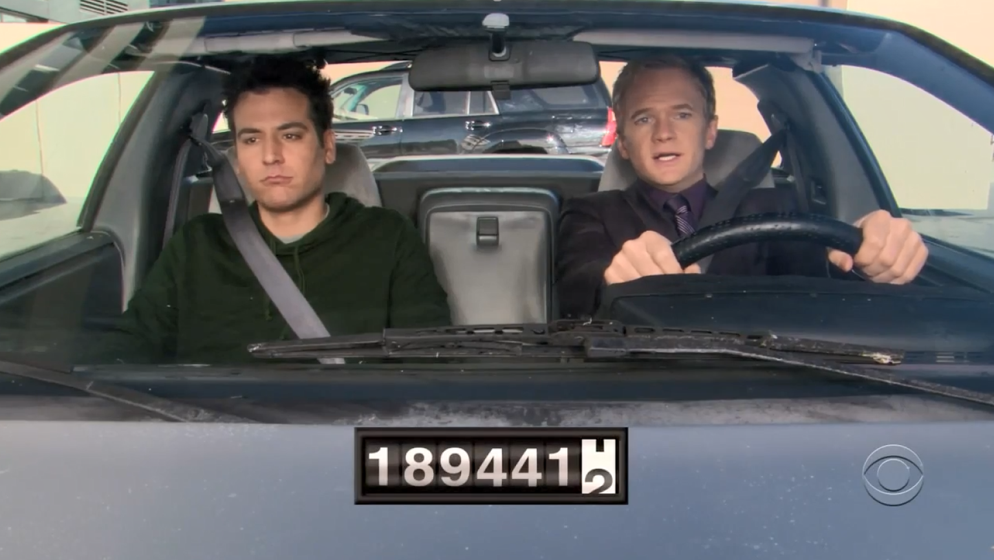
Minimax Driver?
https://youtu.be/tzjgkMvTk5E?si=4twYU7UhYCkZqF73&t=89
Clip: How I Met Your Mother, CBS

Slide 56
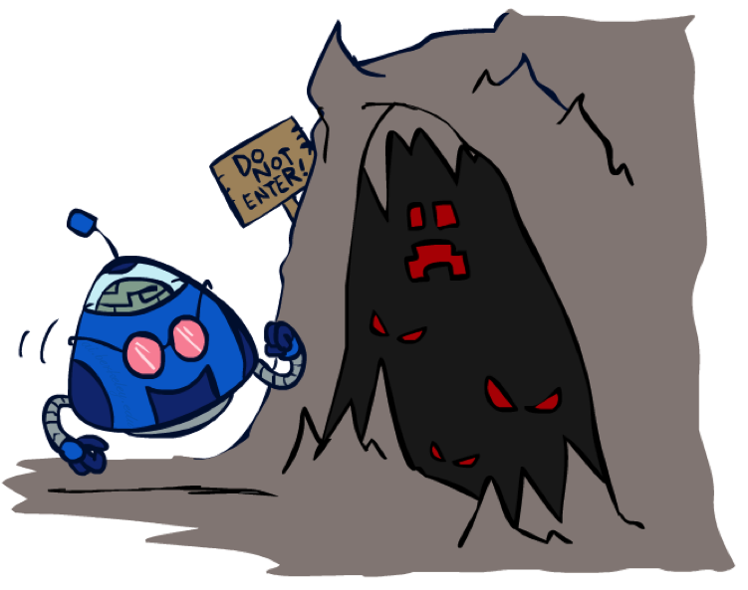
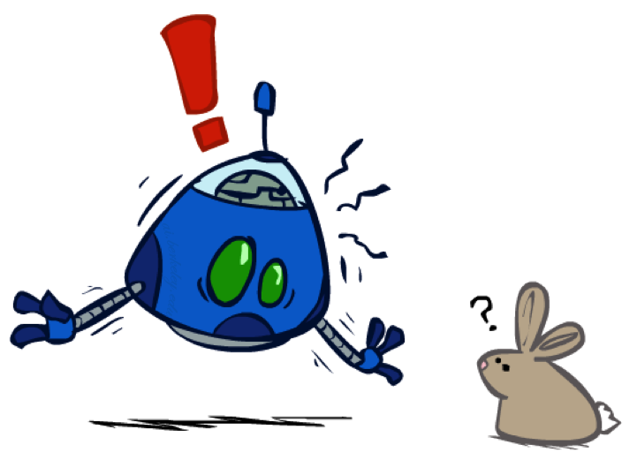
Modeling Assumptions
Dangerous Pessimism
Assuming the worst case when it’s not likely
Dangerous Optimism
Assuming chance when the world is adversarial
Image/slide credit: Ketrina Yim, UCB CS 188

Slide 57
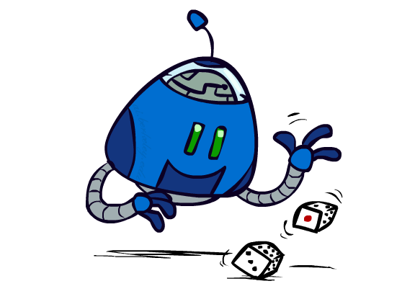
Modeling Assumptions
Chance nodes: Expectimax
10
10
9
100
Image/slide credit: Ketrina Yim, UCB CS 188

Slide 58
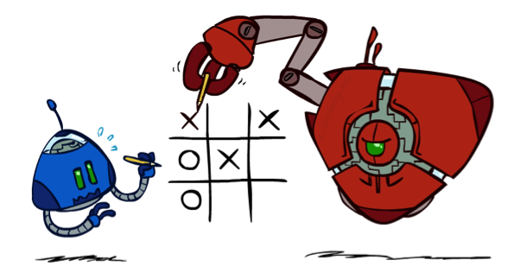
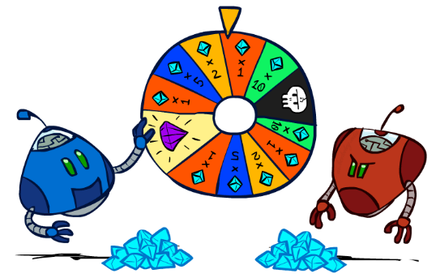
Chance outcomes in trees
10
10
9
100
10
10
9
100
Tictactoe, chess
Minimax
Tetris, investing
Expectimax
10
9
10
9
10
100
Backgammon, Monopoly
Expectiminimax
Image/slide credit: Ketrina Yim, UCB CS 188
Notes:
At least 10, or otherwise just rather dead; or just 100, or otherwise rather dead; that’s yet something different than minimax or expectimax

Slide 59


Expectimax Pruning?
3
12
9
2
Image/slide credit: Ketrina Yim, UCB CS 188

Slide 60
Expectimax Code
function value( state )
  if state.is_leaf
  return state.value
  if state.player is MAX
  return max _{a in state.actions} value( state.result(a) )
  if state.player is MIN
  return min _{a in state.actions} value( state.result(a) )
  if state.player is CHANCE
  return sum _{s in state.next_states} P( s ) * value( s )
Slide credit: UCB CS 188

Slide 61


Preview: MDP/Reinforcement Learning Notation
$$V\left(s\right)=\max_{a}{\sum_{s′}{P(s^{′}) V(s^{′})}}$$

Slide 62

Preview: MDP/Reinforcement Learning Notation
$$V\left(s\right)=\max_{a}{\sum_{s′}{P\left(s^{′}\right|s,a)V(s^{′})}}$$
$$V\left(s\right)=\max_{a}{\sum_{s′}{P\left(s^{′} | s,a\right)\left[R\left(s,a,s^{′}\right)+γV\left(s^{′}\right)\right]}}$$
$$V_{k+1}\left(s\right)=\max_{a}{\sum_{s′}{P\left(s^{′} | s,a\right)\left[R\left(s,a,s^{′}\right)+γV_{k}\left(s^{′}\right)\right]}}, ∀ s$$
$$Q_{k+1}\left(s,a\right)=\sum_{s′}{P\left(s^{′} | s,a\right)[R\left(s,a,s^{′}\right)+γ\max_{a^{′}}{Q_{k}(s^{′},a^{′})]}, } ∀ s,a$$
$$π_{V}\left(s\right)=\underset{a}{argmax}{\sum_{s′}{P\left(s^{′} | s,a\right)[R\left(s,a,s^{′}\right)+γV\left(s^{′}\right)]}}, ∀ s$$
$$V_{k+1}^{π}\left(s\right)=\sum_{s′}{P\left(s^{′} | s,π\left(s\right)\right)[R\left(s,π\left(s\right),s^{′}\right)+γV_{k}^{π}\left(s^{′}\right)]}, ∀ s$$
$$π_{new}\left(s\right)=\underset{a}{argmax}{\sum_{s′}{P\left(s^{′} | s,a\right)\left[R\left(s,a,s^{′}\right)+γV^{π_{old}}\left(s^{′}\right)\right]}}, ∀ s$$
Standard expectimax:
Bellman equations:
Value iteration:
Q-iteration:
Policy extraction:
Policy evaluation:
Policy improvement:

Slide 63

Preview: MDP/Reinforcement Learning Notation
$$V\left(s\right)=\max_{a}{\sum_{s′}{P\left(s^{′}\right|s,a)V(s^{′})}}$$
$$V\left(s\right)=\max_{a}{\sum_{s′}{P\left(s^{′} | s,a\right)\left[R\left(s,a,s^{′}\right)+γV\left(s^{′}\right)\right]}}$$
$$V_{k+1}\left(s\right)=\max_{a}{\sum_{s′}{P\left(s^{′} | s,a\right)\left[R\left(s,a,s^{′}\right)+γV_{k}\left(s^{′}\right)\right]}}, ∀ s$$
$$Q_{k+1}\left(s,a\right)=\sum_{s′}{P\left(s^{′} | s,a\right)[R\left(s,a,s^{′}\right)+γ\max_{a^{′}}{Q_{k}(s^{′},a^{′})]}, } ∀ s,a$$
$$π_{V}\left(s\right)=\underset{a}{argmax}{\sum_{s′}{P\left(s^{′} | s,a\right)[R\left(s,a,s^{′}\right)+γV\left(s^{′}\right)]}}, ∀ s$$
$$V_{k+1}^{π}\left(s\right)=\sum_{s′}{P\left(s^{′} | s,π\left(s\right)\right)[R\left(s,π\left(s\right),s^{′}\right)+γV_{k}^{π}\left(s^{′}\right)]}, ∀ s$$
$$π_{new}\left(s\right)=\underset{a}{argmax}{\sum_{s′}{P\left(s^{′} | s,a\right)\left[R\left(s,a,s^{′}\right)+γV^{π_{old}}\left(s^{′}\right)\right]}}, ∀ s$$
Standard expectimax:
Bellman equations:
Value iteration:
Q-iteration:
Policy extraction:
Policy evaluation:
Policy improvement:

Slide 64
Why Expectimax?
Pretty great model for an agent in the world
Choose the action that has the: highest expected value
Slide credit: UCB CS 188

Slide 65
Bonus Question
Let’s say you know that your opponent is actually running a depth 1 minimax, using the result 80% of the time, and moving randomly otherwise
Question: What tree search should you use?
A: Minimax
B: Expectimax
C: Something completely different
Slide credit: UCB CS 188

Slide 66
Summary
Games require decisions when optimality is impossible
  Bounded-depth search and approximate evaluation functions
Games force efficient use of computation
  Alpha-beta pruning
Game playing has produced important research ideas
  Reinforcement learning (checkers)
  Iterative deepening (chess)
  Monte Carlo tree search (Go)
  Solution methods for partial-information games in economics (poker)
Video games present much greater challenges – lots to do!
  b = 10⁵⁰⁰, |S| = 10⁴⁰⁰⁰, m = 10,000
Slide credit: UCB CS 188

