Slide 1

07-280 AI & ML I
Heurisitc Search
Instructors:
Pat Virtue & Nihar Shah

Slide 2
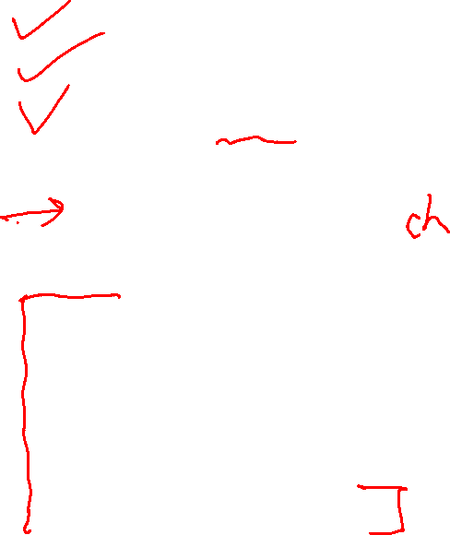
Plan
Pre-reading
Tree search vs graph search
BFS, DFS, UCS
Today
A few notes about sear
UCS – one important modification
Heuristics
Greedy search
A* search
    Optimality
[More on heuristics]

Slide 3


Search Problems
Image/slide credit: Ketrina Yim, UCB CS 188

Slide 4







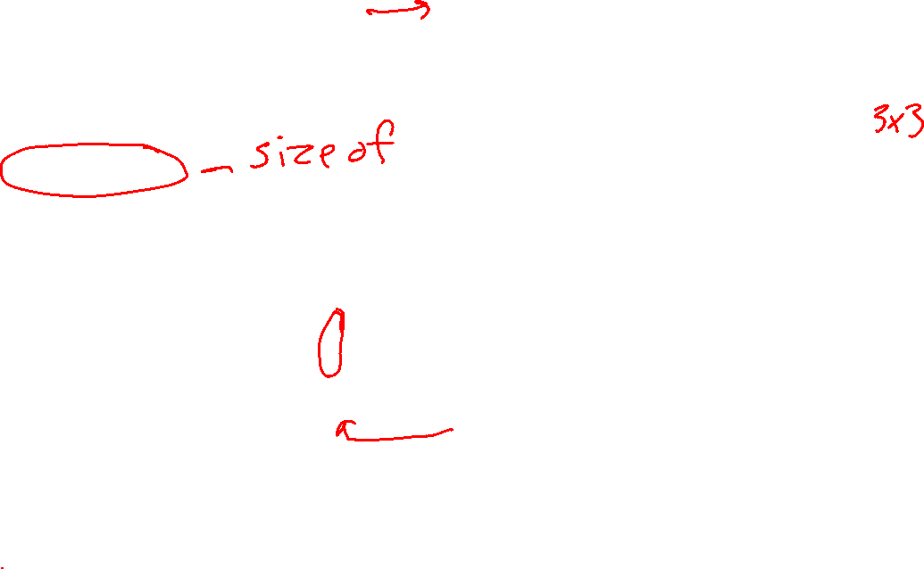
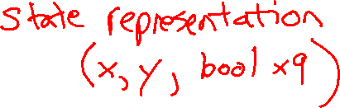
Search Problems
A search problem consists of:
  A state space
  For each state, a set
  Actions(s) of allowable actions
  A transition model Result(s,a)
  A step cost function c(s,a,s’)
  A start state and a goal test
A solution is a sequence of actions (a plan) which transforms the start state to a goal state
...
{N, E}
1
N
E
1
Slide credit: UCB CS 188
Notes:
Often comes back on exams
Goal test – sometimes more than one state that satisfies having achieved the goal, for example, “eat all the dots”
Abstraction

Slide 5
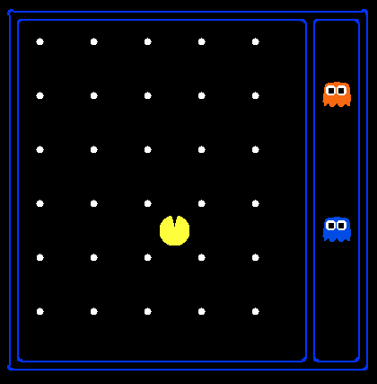
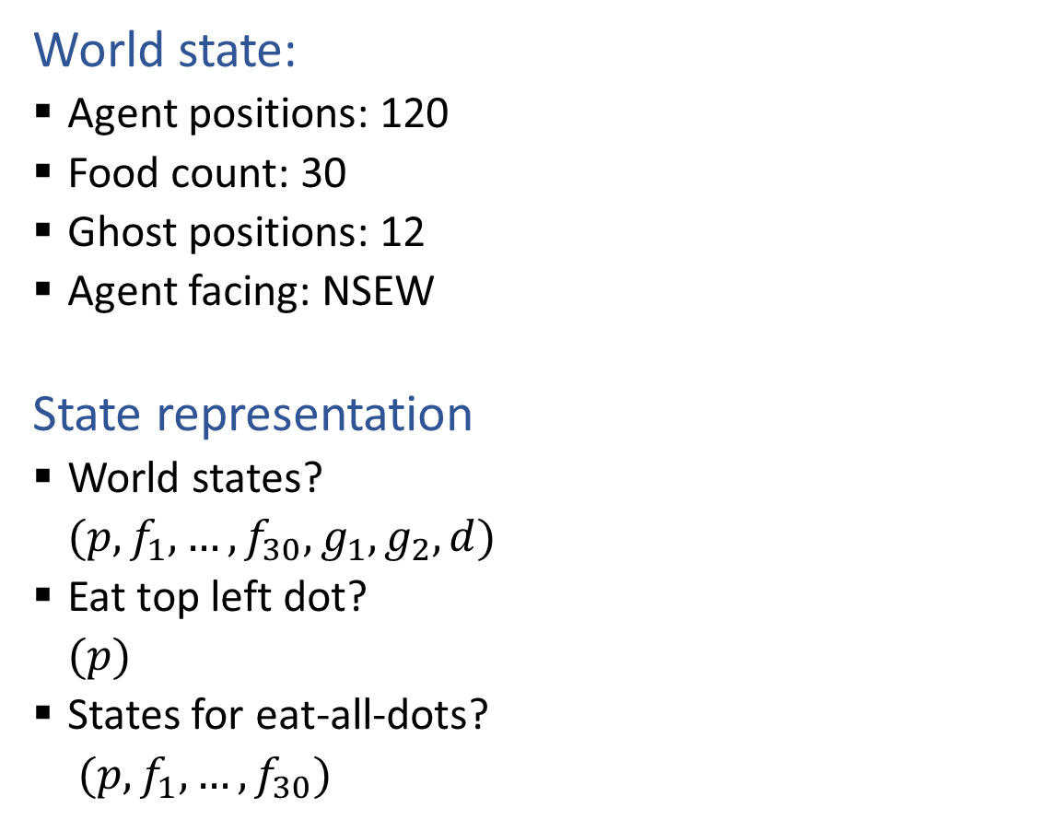

State Space Representation and Size?
World state:
  Agent positions: 120
  Food count: 30
  Ghost positions: 12
  Agent facing: NSEW
State representation
  World states?
  $(p, f_{1}, …, f_{30}, g_{1}, g_{2}, d)$
  Eat top left dot?
  $(p)$
  States for eat-all-dots?
  $(p, f_{1}, …, f_{30})$
State space size
  120x(2³⁰)x(12²)x4
  120
  120x(2³⁰)
Slide credit: UCB CS 188
Notes:
90 * (2^30-1) + 30 * 2^29 = 145 billion
2^29 = 536 870 912

Slide 6
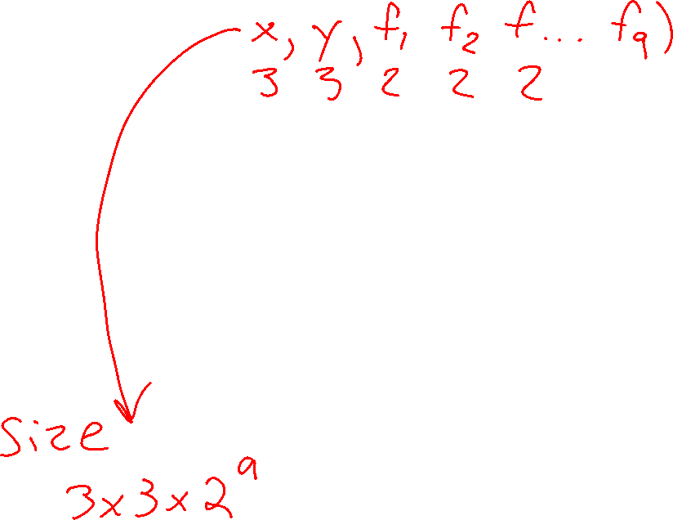
State Space Graphs
State space graph: A mathematical representation of a search problem
  Vertices are (abstracted) world configurations
  Edges represent transitions resulting from actions
  The goal test is a set of goal nodes (maybe only one)
In a state space graph, each state occurs only once!
We can rarely build this full graph in memory (it’s too big), but it’s a useful idea
Slide credit: UCB CS 188

Slide 7
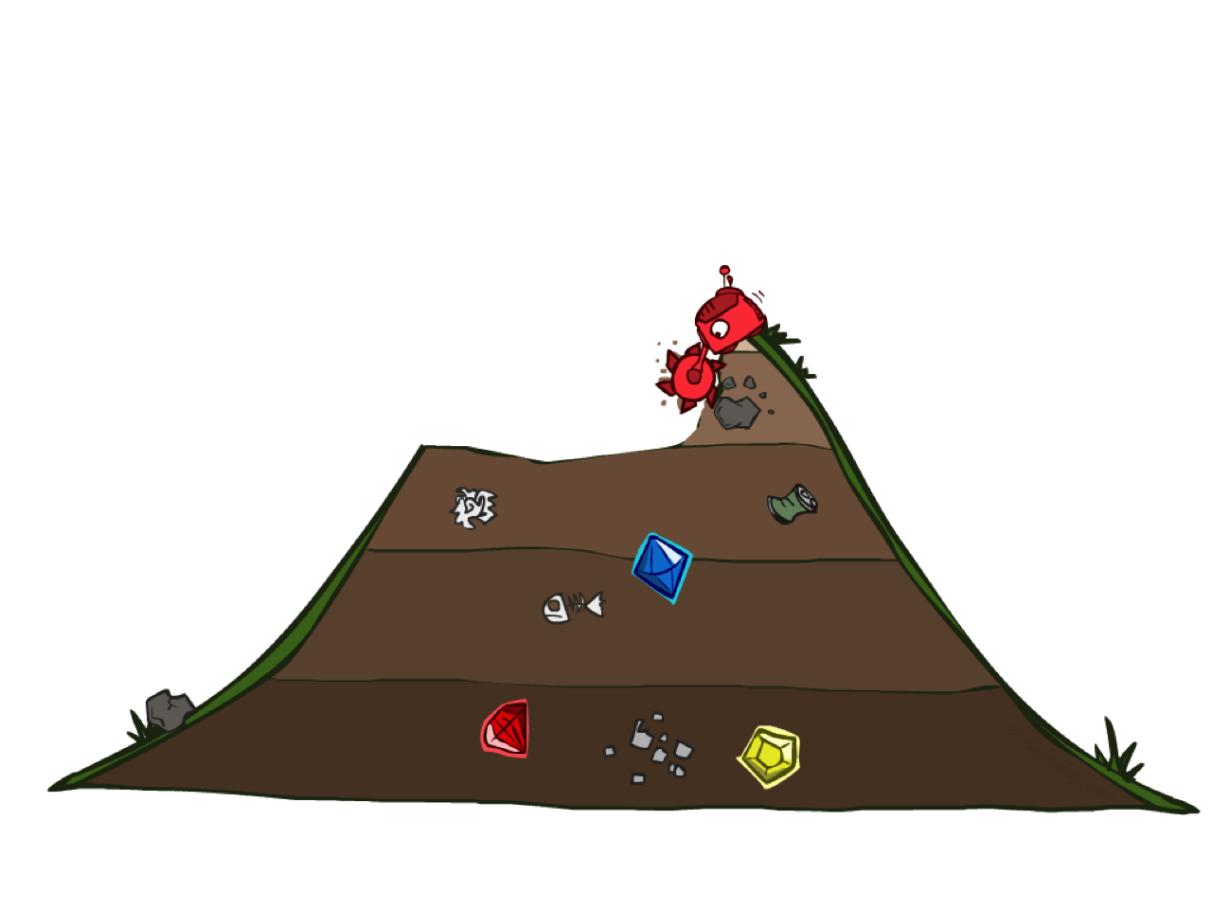
Uniform Cost Search
Image/slide credit: Ketrina Yim, UCB CS 188

Slide 8
Finding a Least-Cost Path
a
GOAL
2
2
b
c
3
2
1
8
2
e
d
f
3
9
8
2
START
h
1
4
2
p
4
r
15
q
Slide credit: UCB CS 188

Slide 9
Breadth-First (Tree) Search
Strategy: expand a shallowest node first
Implementation: Frontier is a FIFO queue
a
G
b
c
d
e
f
S
h
p
q
r
S
d
e
p
Search
Tiers
b
c
e
h
r
q
a
a
h
r
p
q
f
p
q
f
q
c
G
q
c
G
a
Slide credit: UCB CS 188
a

Slide 10
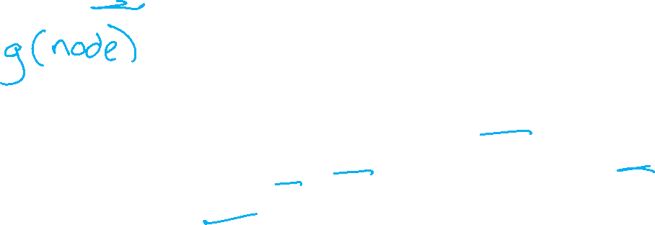
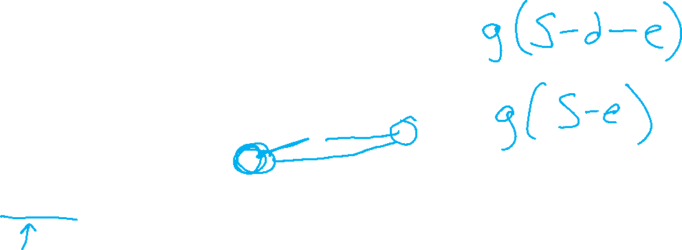
Uniform Cost (Tree) Search
2
G
a
Strategy: expand a cheapest node first:
Frontier is a priority queue (priority: cumulative cost)
b
c
1
8
2
2
e
3
d
f
9
8
2
S
h
1
1
p
q
r
15
0
S
d
3
e
9
p
1
b
4
e
5
h
17
r
11
q
16
c
11
Cost contours
a
6
a
h
13
r
7
p
q
f
p
q
f
8
q
c
G
q
c
a
11
G
10
Slide credit: UCB CS 188
a

Slide 11
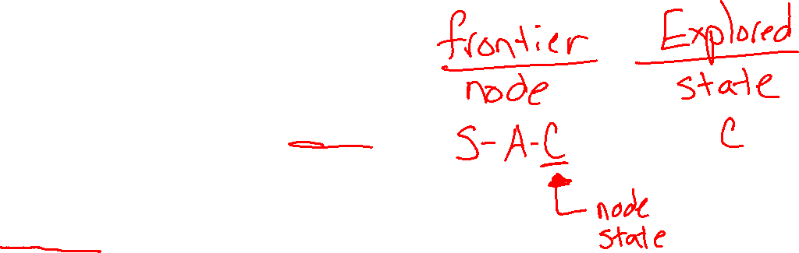
function GRAPH_SEARCH(problem) returns a solution, or failure
initialize the explored set to be empty
initialize the frontier as a specific work list (stack, queue, priority queue)
add initial state of problem to frontier
loop do
if the frontier is empty then
return failure
choose a node and remove it from the frontier
if the node contains a goal state then
return the corresponding solution
add the node state to the explored set
for each resulting child from node
if the child state is not already in the frontier or explored set then
add child to the frontier
Slide credit: UCB CS 188

Slide 12
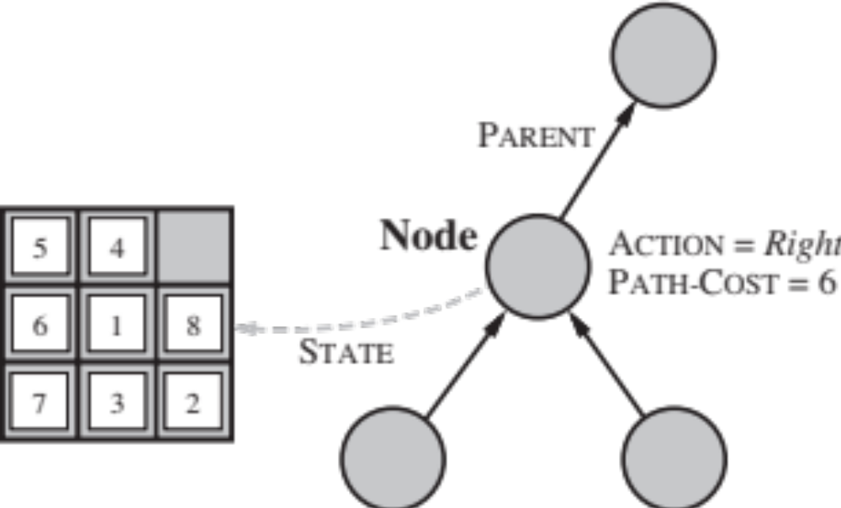

A Note on Implementation
Nodes have
state, parent, action, path-cost
A child of parent_node by action a has:
state = result(parent_node.state,a)
parent = parent_node
action = a
path-cost = parent_node.path_cost + step_cost(parent_ node.state, a, self.state)
Extract solution by tracing back parent pointers, collecting actions
Slide credit: UCB CS 188

Slide 13
Walk-through UCS
2
C
A
G
4
1
3
S
B
D
4
1

Slide 14

Walk-through UCS
C
C
2
C
Frontier
S: 0
S-A: 1
S-B: 4
S-A-C: 3
S-A-C-D: 7
S-B-D: 5 ??
Explored
S
A
C
B
A
G
A
A
4
1
3
S
B
D
B
S
B
D
S
4
1

Slide 15


Walk-through UCS
C
C
2
C
G
Frontier
S: 0
S-A: 1
S-B: 4
S-A-C: 3
S-A-C-D: 7
S-B-D: 5
S-B-D-G: 8
Explored
S
A
C
B
D
A
G
A
A
4
1
3
B
B
D
S
B
D
S
D
S
4
1
Replaced by better path to D!
Result: S-B-D-G (path cost 8)

Slide 16

function UNIFORM-COST-SEARCH(problem) returns a solution, or failure
initialize the explored set to be empty
initialize the frontier as a priority queue using node path_cost as the priority
add initial state of problem to frontier with path_cost = 0
loop do
if the frontier is empty then
return failure
choose a node and remove it from the frontier
if the node contains a goal state then
return the corresponding solution
add the node state to the explored set
for each resulting child from node
if the child state is not already in the frontier or explored set then
add child to the frontier
else if the child is already in the frontier with higher path_cost then
replace that frontier node with child
2
C
A
4
G
1
3
S
B
D
4
1
Slide credit: UCB CS 188

Slide 17
Uniform Cost Issues
Remember:
UCS explores increasing cost contours
The good:
UCS is complete and optimal!
The bad:
  Explores options in every “direction”
  No information about goal location
We’ll fix that!
…
c ≤ 1
c ≤ 2
c ≤ 3
Start
Goal
Slide credit: UCB CS 188

Slide 18
Informed Search

Slide 19
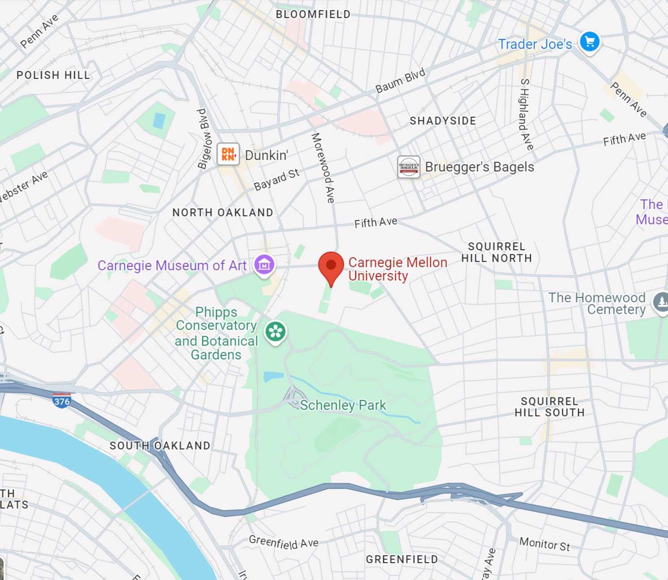
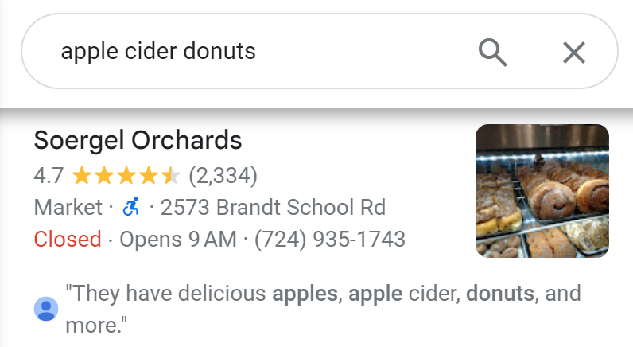
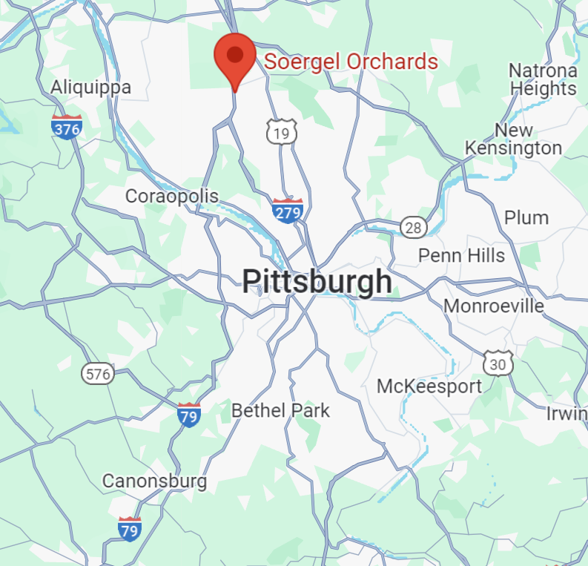
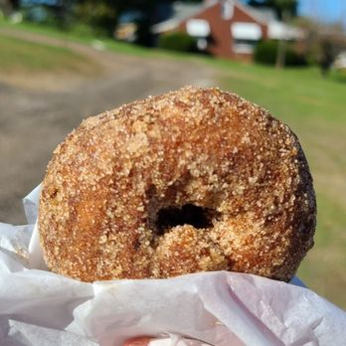
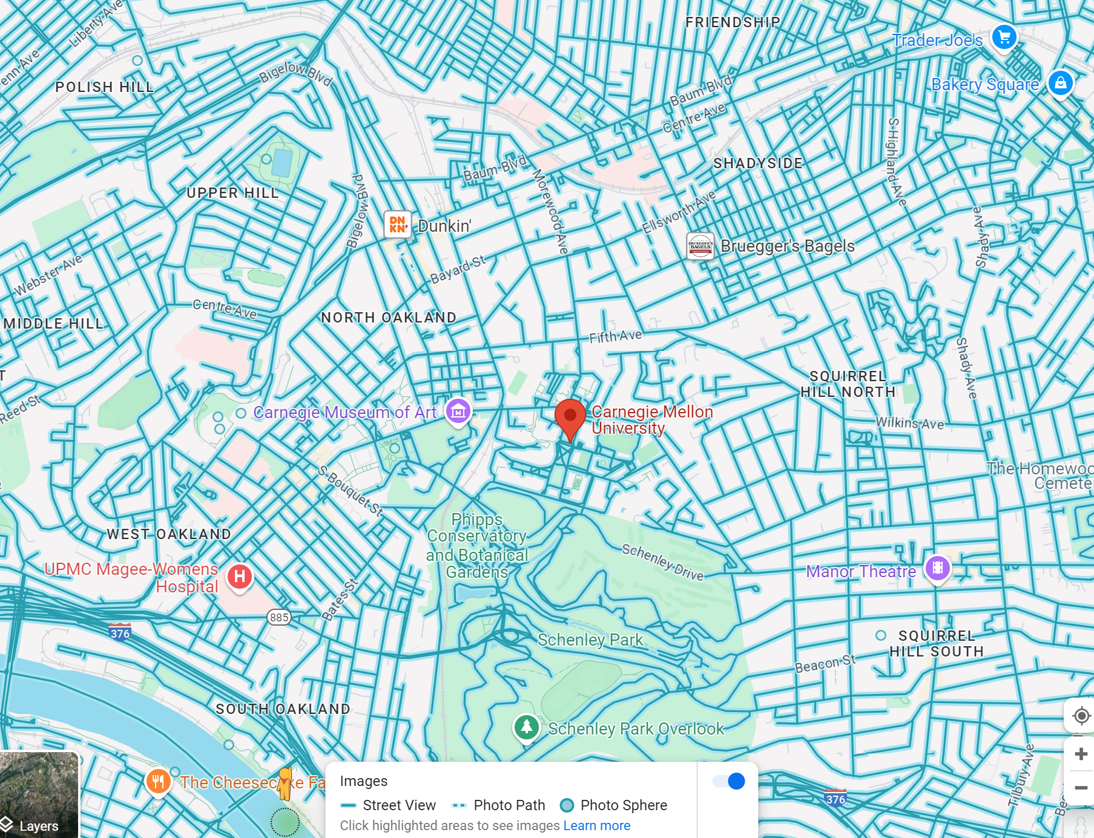
Donuts ASAP!
Images: Yelp "Soergel's", Google Maps

Slide 20

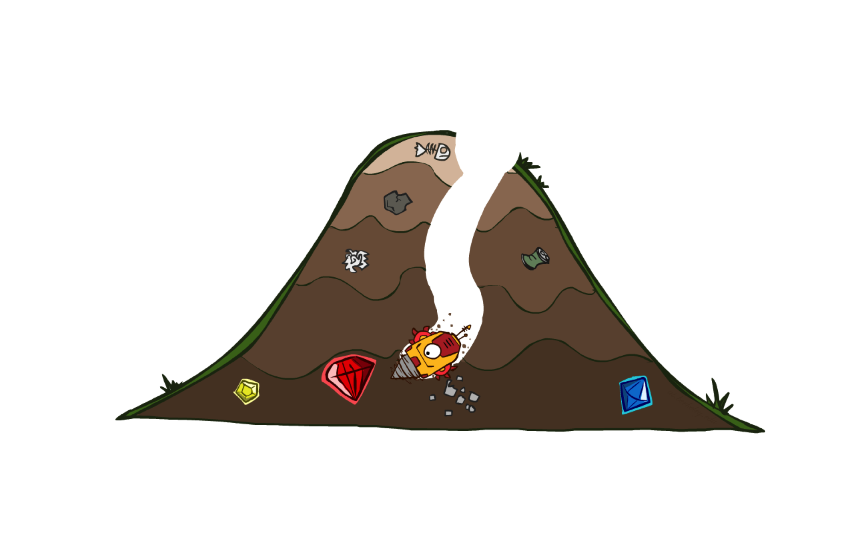

Uninformed vs Informed Search
Image/slide credit: Ketrina Yim, UCB CS 188

Slide 21

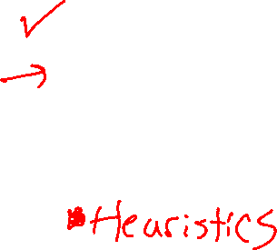
Today
Informed Search
  Heuristics
  Greedy Search
  A* Search
Image/slide credit: Ketrina Yim, UCB CS 188

Slide 22

Informed Search
Image/slide credit: Ketrina Yim, UCB CS 188

Slide 23
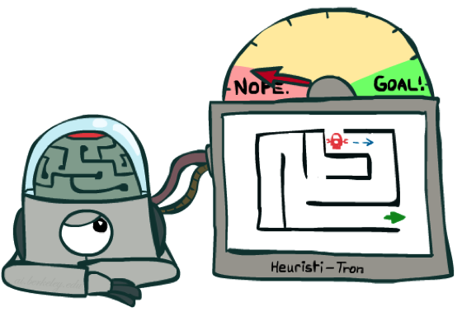
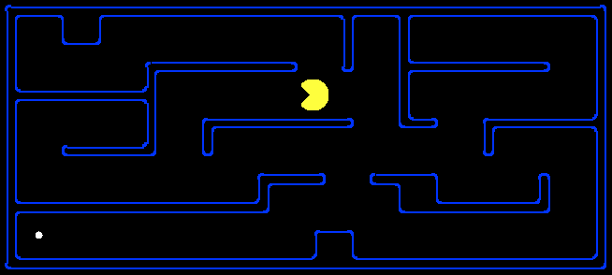
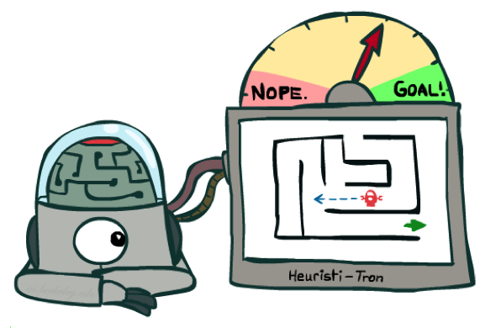

Search Heuristics
A heuristic is:
A function that estimates how close a state is to a goal
Designed for a particular search problem
Examples: Manhattan distance, Euclidean distance for pathing
10
5
11.2
Image/slide credit: Ketrina Yim, UCB CS 188

Slide 24
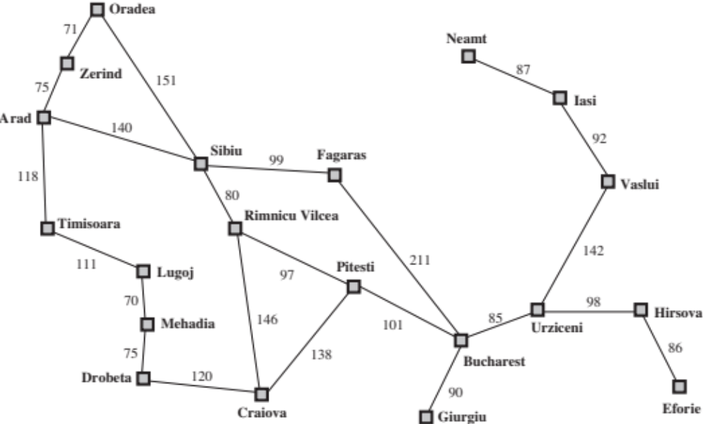
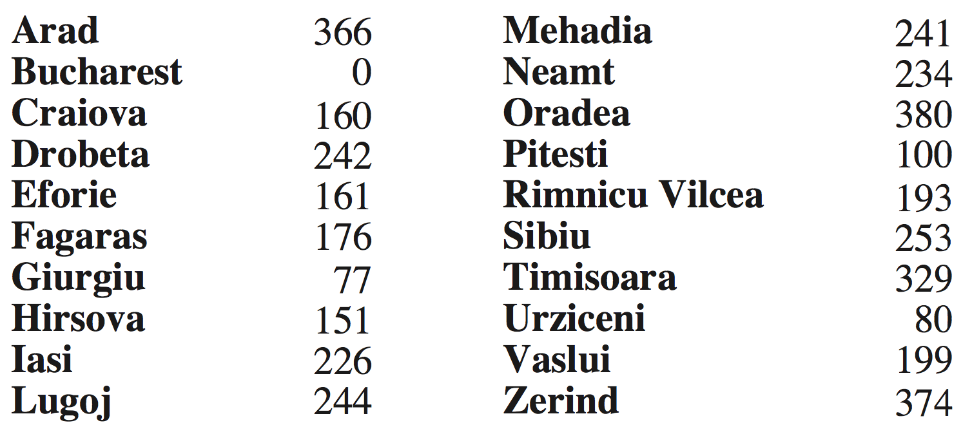

Example: Euclidean distance to Bucharest
h(state) → value
Slide credit: UCB CS 188

Slide 25
Effect of heuristics
Guide search towards the goal instead of all over the place
Start
Goal
Start
Goal
Informed
Uninformed
Slide credit: UCB CS 188

Slide 26
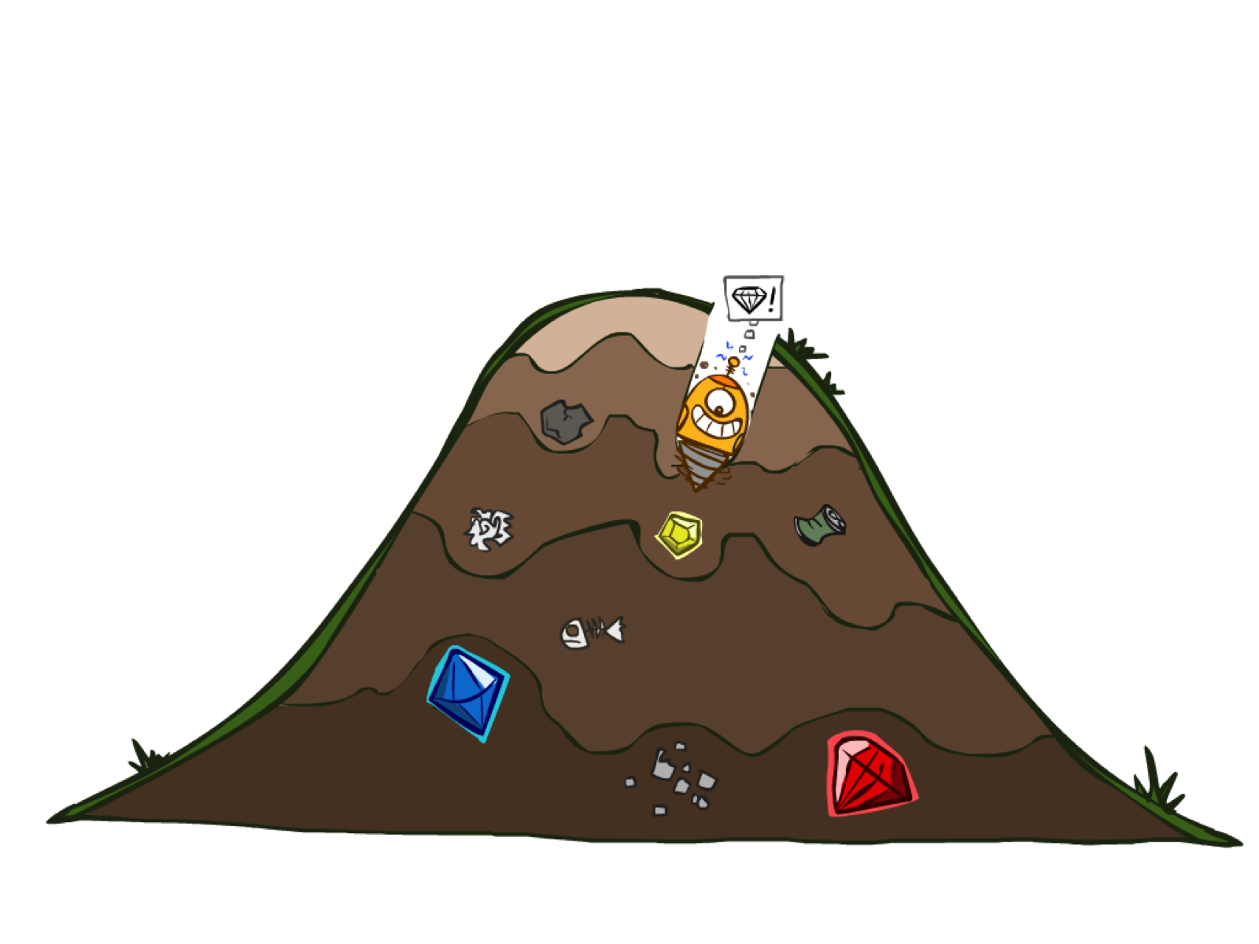
Greedy Search
Image/slide credit: Ketrina Yim, UCB CS 188

Slide 27

Donuts ASAP!

Slide 28
Greedy Search
b
Strategy: expand a node that seems closest to a goal state, according to h
Problem 1: it chooses a node even if it’s at the end of a very long and winding road
Problem 2: it takes h literally even if it’s completely wrong
…
Slide credit: UCB CS 188
Notes:
For any search problem, you know the goal. Now, you have an idea of how far away you are from the goal.

Slide 29
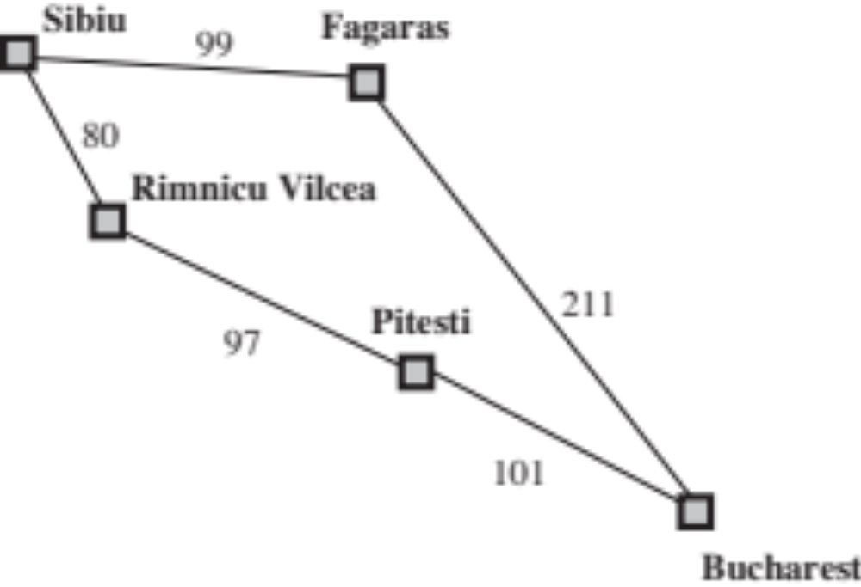

Greedy Search
Expand the node that seems closest…(order frontier by h)
What can possibly go wrong?
Sibiu-Fagaras-Bucharest =
99+211 = 310
Sibiu-Rimnicu Vilcea-Pitesti-Bucharest =
80+97+101 = 278
h= 253
h=176
h=193
1000000
h=100
h=0
Image/slide credit: Ketrina Yim, UCB CS 188

Slide 30
Demo Contours Greedy (Empty)

Slide 31
Demo Contours Greedy (Pacman Small Maze)

Slide 32
A* Search
Image/slide credit: Ketrina Yim, UCB CS 188

Slide 33

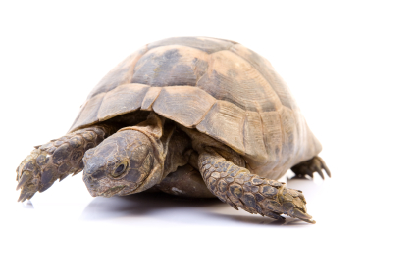

A* Search
UCS
Greedy
A*
Slide credit: UCB CS 188
Notes:
Notes: these images licensed from iStockphoto for UC Berkeley use.

Slide 34
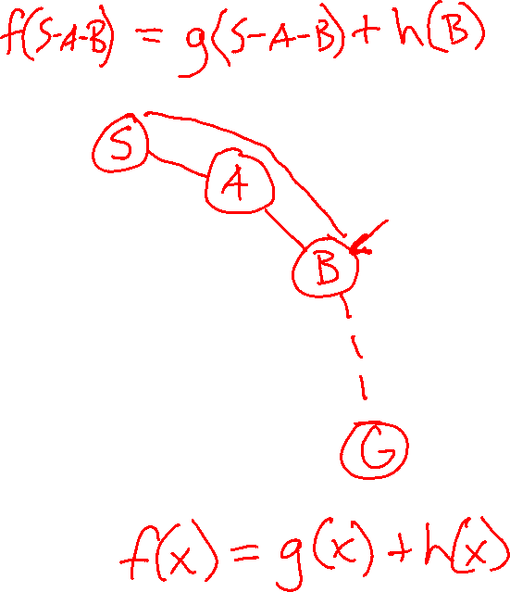
A* Search
UCS
Greedy
A*
Slide credit: UCB CS 188
Notes:
Notes: these images licensed from iStockphoto for UC Berkeley use.

Slide 35
Combining UCS and Greedy
Uniform-cost orders by path cost, or backward cost g(n)
8
g = 0 h=6
S
e
h=1
g = 1 h=5
a
1
1
3
2
g = 2 h=6
g = 9 h=1
S
a
d
G
b
d
g = 4 h=2
e
h=6
1
h=5
h=2
h=0
1
g = 3 h=7
g = 6 h=0
g = 10 h=2
c
b
c
G
d
h=7
h=6
g = 12 h=0
G
Example: Teg Grenager

Slide 36
Combining UCS and Greedy
Uniform-cost orders by path cost, or backward cost g(n)
Greedy orders by goal proximity, or forward cost h(n)
8
g = 0 h=6
S
e
h=1
g = 1 h=5
a
1
1
3
2
g = 2 h=6
g = 9 h=1
S
a
d
G
b
d
g = 4 h=2
e
h=6
1
h=5
h=2
h=0
1
g = 3 h=7
g = 6 h=0
g = 10 h=2
c
b
c
G
d
h=7
h=6
g = 12 h=0
G
Example: Teg Grenager

Slide 37
Combining UCS and Greedy
Uniform-cost orders by path cost, or backward cost g(n)
Greedy orders by goal proximity, or forward cost h(n)
A* Search orders by the sum: f(n) = g(n) + h(n)
8
g = 0 h=6
S
e
h=1
g = 1 h=5
a
1
1
3
2
g = 2 h=6
g = 9 h=1
S
a
d
G
b
d
g = 4 h=2
e
h=6
1
h=5
h=2
h=0
1
g = 3 h=7
g = 6 h=0
g = 10 h=2
c
b
c
G
d
h=7
h=6
g = 12 h=0
G
Example: Teg Grenager

Slide 38
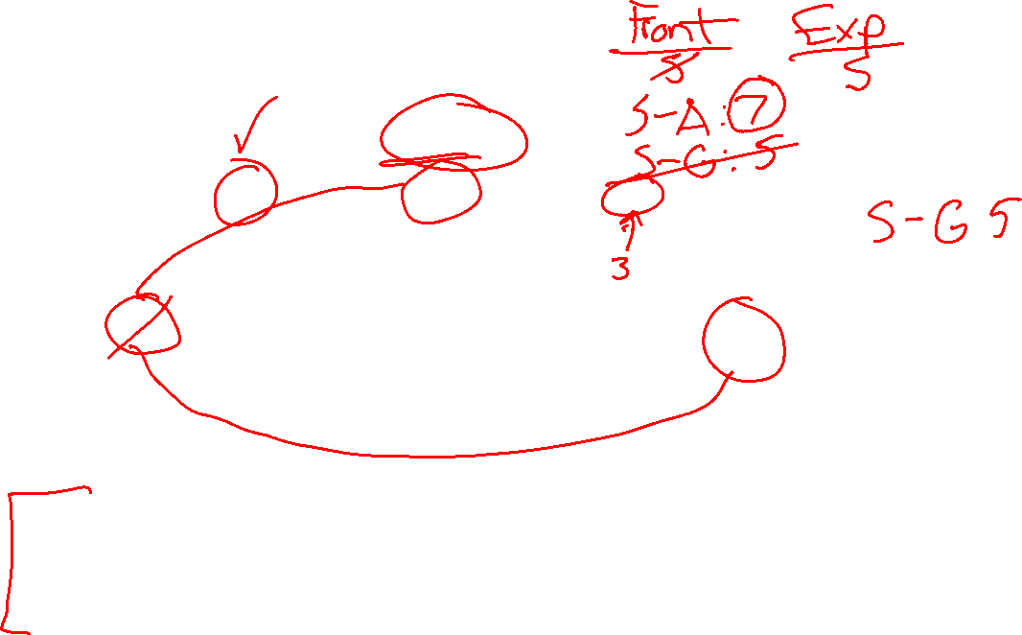
Is A* Optimal?
h = 6
1
A
3
S
h = 7
G
h = 0
5
What went wrong?
Estimated good goal cost > Actual future cost!
We need estimates to be less than actual costs!
Slide credit: UCB CS 188

Slide 39

The Price is Wrong…
Closest bid without going over…
https://www.youtube.com/watch?v=9B0ZKRurC5Y

Slide 40
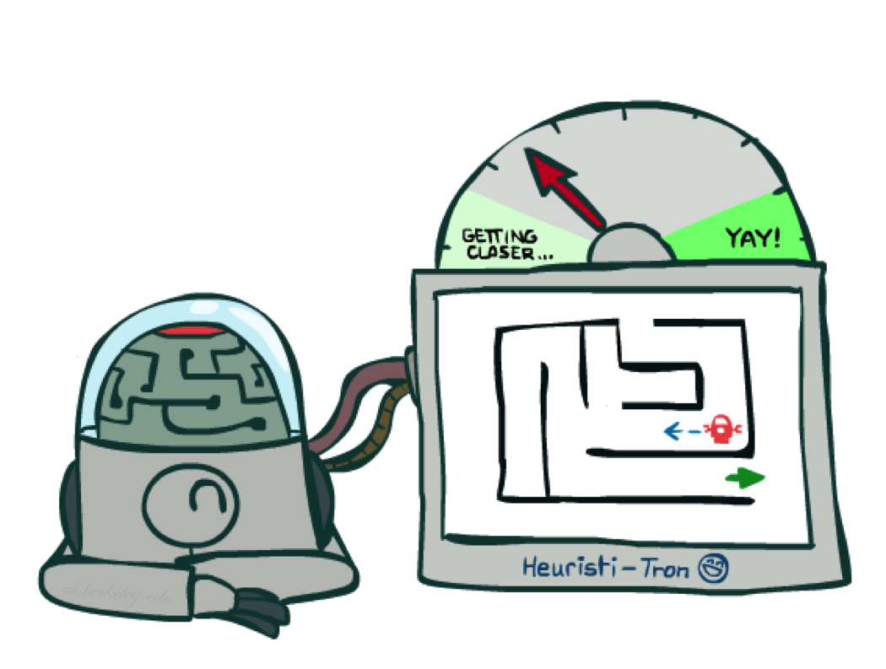
Admissible Heuristics
Image/slide credit: Ketrina Yim, UCB CS 188

Slide 41
Admissible Heuristics
A heuristic h is admissible (optimistic) if:
  0 ≤ h(n) ≤ h*(n)
where h*(n) is the true cost to a nearest goal
Example:
Coming up with admissible heuristics is most of what’s involved in using A* in practice.
15
Slide credit: UCB CS 188

Slide 42

Optimality of A* Tree Search
Image/slide credit: Ketrina Yim, UCB CS 188

Slide 43
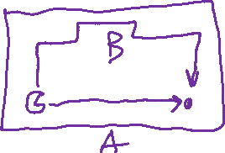
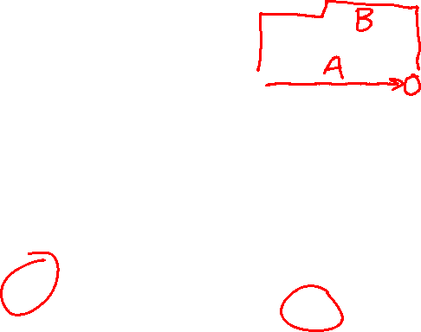
Optimality of A* Tree Search
Assume:
A is an optimal goal node
B is a suboptimal goal node
h is admissible
Claim:
A will be chosen for exploration (popped off the frontier) before B
…
A
B
Slide credit: UCB CS 188

Slide 44
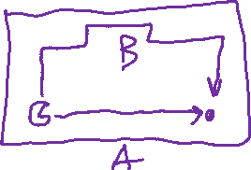

Optimality of A* Tree Search: Blocking
Proof:
Imagine B is on the frontier
Some ancestor n of A is on the frontier, too (Maybe the start state; maybe A itself!)
Claim: n will be explored before B
All ancestors of A are explored before B
A is explored before B
A* search is optimal
…
n
A
B
Slide credit: UCB CS 188

Slide 45

Optimality of A* Tree Search: Blocking
Proof:
Imagine B is on the frontier
Some ancestor n of A is on the frontier, too (Maybe the start state; maybe A itself!)
Claim: n will be explored before B
  f(n) ≤ f(A) ← TODO
  f(A) < f(B) ← TODO
  f(n) < f(B) then n is explored before B
All ancestors of A are explored before B
A is explored before B
A* search is optimal
…
n
A
B
Slide credit: UCB CS 188

Slide 46
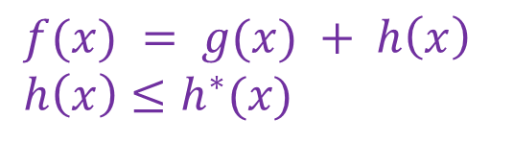

Optimality of A* Tree Search: Blocking
$f(x) = g(x) + h\left(x\right)$
$h\left(x\right)≤h^{∗}(x)$
Proof:
Imagine B is on the frontier
Some ancestor n of A is on the frontier, too (Maybe the start state; maybe A itself!)
Claim: n will be explored before B
  f(n) ≤ f(A)
  f(A) < f(B)
  f(n) < f(B) then n is explored before B
All ancestors of A are explored before B
A is explored before B
A* search is optimal
…
n
A
B
f(n) = g(n) + h(n) Definition of f-cost
f(n) ≤ g(n) + h*(n) Admissibility of h
f(n) ≤ g(A) n on optimal path to A
f(n) ≤ f(A) h = 0 at a goal

Slide 47
Optimality of A* Tree Search: Blocking
$f(x) = g(x) + h\left(x\right)$
$h\left(x\right)≤h^{∗}(x)$
Proof:
Imagine B is on the frontier
Some ancestor n of A is on the frontier, too (Maybe the start state; maybe A itself!)
Claim: n will be explored before B
  f(n) ≤ f(A)
  f(A) < f(B)
  f(n) < f(B) then n is explored before B
All ancestors of A are explored before B
A is explored before B
A* search is optimal
…
n
A
B
f(A) = g(A) + h(A) Def. of f(x)
= g(A) h = 0 at a goal
f(B) = g(B) Similarly for B
g(A) < g(B) Suboptimality of B
f(A) < f(B)

Slide 48
Optimality of A* Tree Search: Blocking
$f(x) = g(x) + h\left(x\right)$
$h\left(x\right)≤h^{∗}(x)$
Proof:
Imagine B is on the frontier
Some ancestor n of A is on the frontier, too (Maybe the start state; maybe A itself!)
Claim: n will be explored before B
  f(n) is less than or equal to f(A)
  f(A) is less than f(B)
  f(n) < f(B) then n is explored before B
All ancestors of A are explored before B
A is explored before B
A* search is optimal
…
n
A
B
Slide credit: UCB CS 188

Slide 49

UCS vs A* Contours
Uniform-Cost
A*
b
b
…
…

Slide 50
UCS vs A* Contours
Uniform-cost expands equally in all “directions”
A* expands mainly toward the goal, but does hedge its bets to ensure optimality
Start
Goal
Start
Goal
Slide credit: UCB CS 188

Slide 51
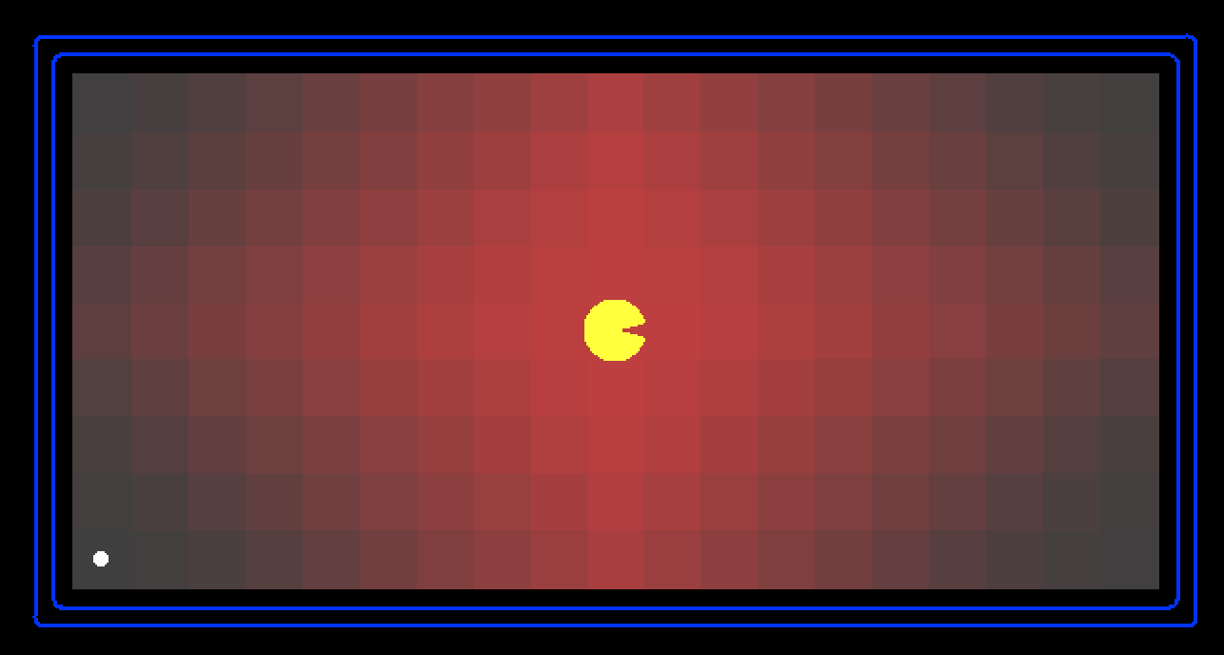

Demo Contours UCS Empty
Slide credit: UCB CS 188

Slide 52
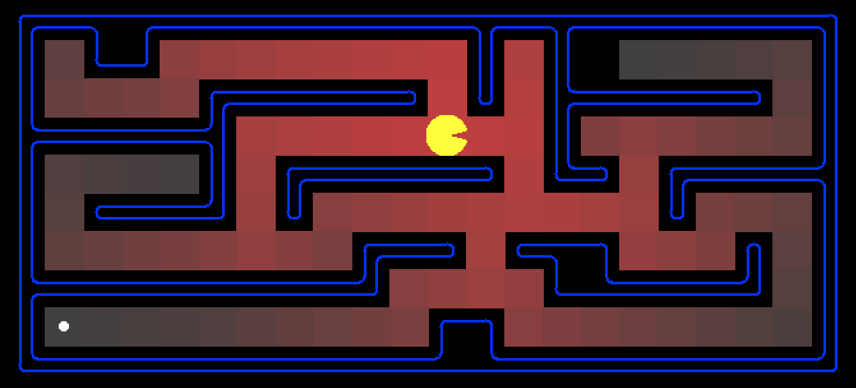

Demo Contours UCS Pacman Small Maze
Slide credit: UCB CS 188

Slide 53
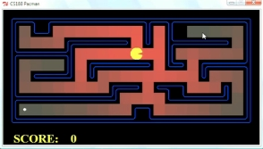
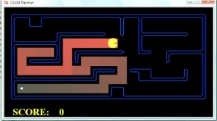
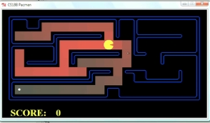
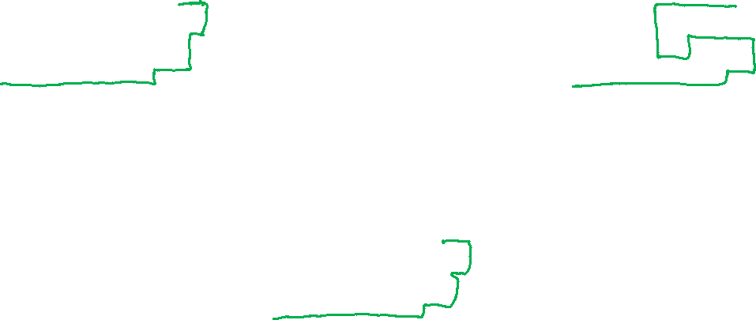
Comparison
A*
UCS
Greedy
Slide credit: UCB CS 188

Slide 54
Demo Empty Water Shallow/Deep – Guess Algorithm
Slide credit: UCB CS 188

Slide 55

A* Search Algorithms
A* Tree Search
Same tree search algorithm as before but with a frontier that is a priority queue using priority f(n) = g(n) + h(n)
A* Graph Search
Same UCS graph search algorithm but with a frontier that is a priority queue using priority f(n) = g(n) + h(n)
Slide credit: UCB CS 188

Slide 56
function UNIFORM-COST-SEARCH(problem) returns a solution, or failure
initialize the explored set to be empty
initialize the frontier as a priority queue using g(n) as the priority
add initial state of problem to frontier with priority g(S) = 0
loop do
if the frontier is empty then
return failure
choose a node and remove it from the frontier
if the node contains a goal state then
return the corresponding solution
add the node state to the explored set
for each resulting child from node
if the child state is not already in the frontier or explored set then
add child to the frontier
else if the child is already in the frontier with higher g(n) then
replace that frontier node with child
Slide credit: UCB CS 188

Slide 57
function A-STAR-SEARCH(problem) returns a solution, or failure
initialize the explored set to be empty
initialize the frontier as a priority queue using f(n) = g(n) + h(n) as the priority
add initial state of problem to frontier with priority f(S) = 0 + h(S)
loop do
if the frontier is empty then
return failure
choose a node and remove it from the frontier
if the node contains a goal state then
return the corresponding solution
add the node state to the explored set
for each resulting child from node
if the child state is not already in the frontier or explored set then
add child to the frontier
else if the child is already in the frontier with higher f(n) then
replace that frontier node with child
Slide credit: UCB CS 188

Slide 58
Optimality of A* Graph Search
Image/slide credit: Ketrina Yim, UCB CS 188

Slide 59
A* Tree Search
State space graph
Search tree
Frontier
S (0+2)
h=4
S (0+2)
A
S-A (1+4)
1
1
h=1
S-C (3+1)
S
C
A (1+4)
C (3+1)
S-C-G (6+0)
h=2
3
S-A-C (2+1)
3
C (2+1)
G (6+0)
S-A-C-G (5+0)
G (5+0)
G
Result: S-A-C-G cost 5
Correct!
h=0

Slide 60
Poll 1: A* Graph Search
What paths does A* graph search consider during its search?
(What does your work for the frontier look like?)
h=4
A) S, S-A, S-C, S-C-G
1
A
1
h=1
B) S, S-A, S-C, S-A-C, S-C-G
S
C
C) S, S-A, S-A-C, S-A-C-G
h=2
3
D) S, S-A, S-C, S-A-C, S-A-C-G
3
G
h=0

Slide 61
Poll 1: A* Graph Search
What paths does A* graph search consider during its search?
(What does your work for the frontier look like?)
h=4
A) S, S-A, S-C, S-C-G
1
A
1
h=1
B) S, S-A, S-C, S-A-C, S-C-G
S
C
C) S, S-A, S-A-C, S-A-C-G
h=2
3
D) S, S-A, S-C, S-A-C, S-A-C-G
3
G
h=0

Slide 62
A* Graph Search
A)
A
S
C
What does the resulting graph tree look like?
G
h=4
A
A
B)
1
1
S
C
h=1
S
C
h=2
3
G
3
C & D)
A
S
C
G
h=0
G

Slide 63
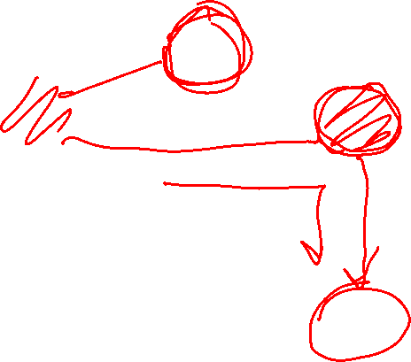
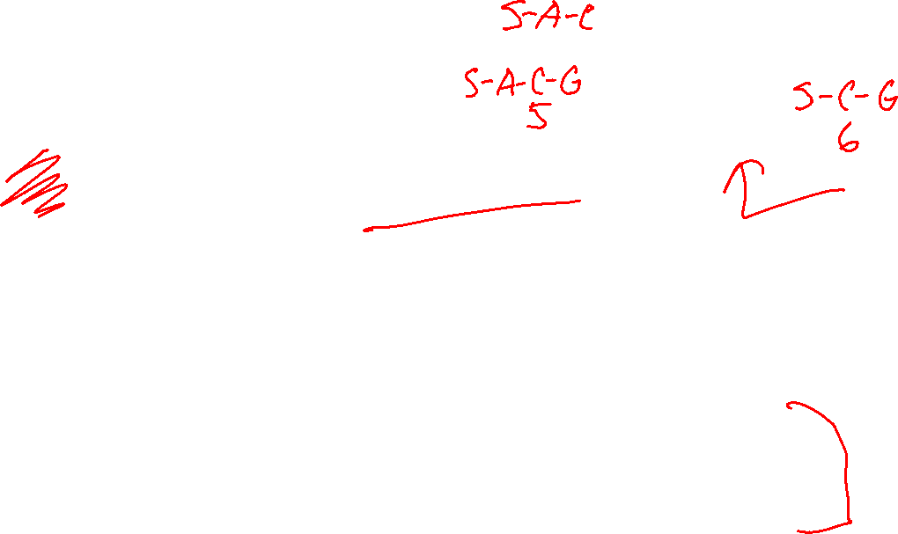
A* Graph Search Gone Wrong?
…
n
State space graph
h=4
A
S: 0+2 = 2
S-A: 1+4 = 5
S-C: 2+1 = 3
S-C-G: 6+0 = 6
1
1
h=1
S
C
h=2
3
3
C (specifically S-C) is no longer on the frontier, so it can't be replaced with the better S-A-C option
G
h=0

Slide 64

Admissibility of Heuristics
Main idea: Estimated heuristic values ≤ actual costs
  Admissibility:
  heuristic value ≤ actual cost to goal
  h(A) ≤ actual cost from A to G
A
1
C
h=4
3
G

Slide 65

Consistency of Heuristics
Main idea: Estimated heuristic costs ≤ actual costs
  Admissibility:
  heuristic cost ≤ actual cost to goal
  h(A) ≤ actual cost from A to G
  Consistency:
  “heuristic step cost” ≤ actual cost for each step
  h(A) – h(C) ≤ cost(A to C)
  triangle inequality (kind of)
  h(A) ≤ cost(A to C) + h(C)
Consequences of consistency:
  The f value along a path never decreases
  A* graph search is optimal
A
1
C
h=4
h=2
h=1
G
Slide credit: UCB CS 188

Slide 66
Optimality of A* Graph Search
Sketch: consider what A* does with a consistent heuristic:
  Fact 1: In tree search, A* expands nodes in increasing total f value (f-contours)
  Fact 2: For every state s, nodes that reach s optimally are explored before nodes that reach s suboptimally
  Result: A* graph search is optimal
…
f ≤ 1
f ≤ 2
f ≤ 3
Slide credit: UCB CS 188

Slide 67

Optimality
Tree search:
  A* is optimal if heuristic is admissible
  UCS is a special case (h = 0)
Graph search:
  A* optimal if heuristic is consistent
  UCS optimal (h = 0 is consistent)
Consistency implies admissibility
In general, most natural admissible heuristics tend to be consistent, especially if from relaxed problems
Image/slide credit: Ketrina Yim, UCB CS 188

Slide 68
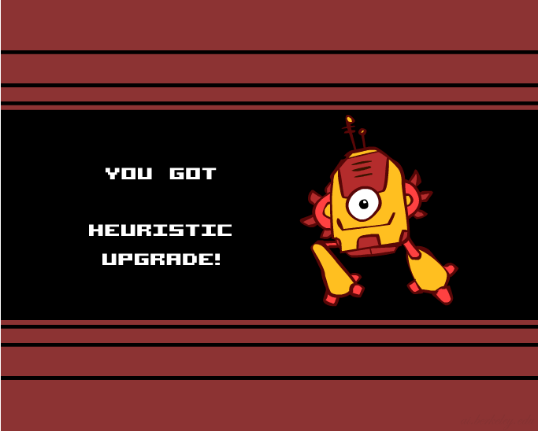
Creating Heuristics
Image/slide credit: Ketrina Yim, UCB CS 188

Slide 69
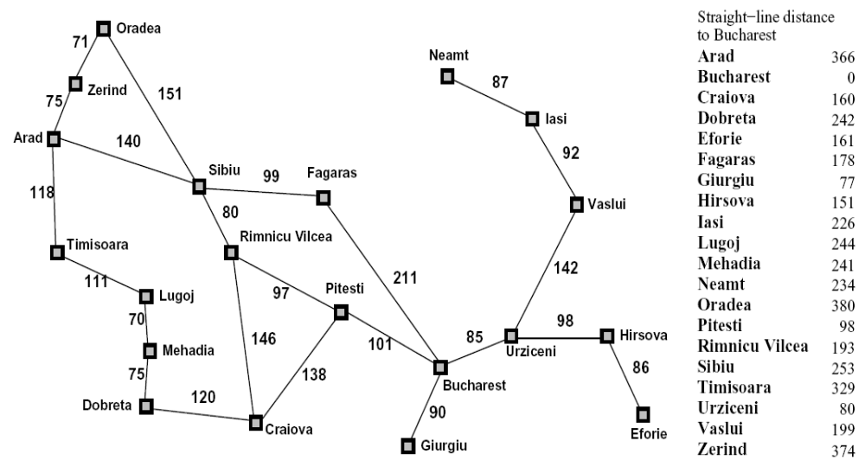

Creating Admissible Heuristics
Most of the work in solving hard search problems optimally is in coming up with admissible heuristics
Often, admissible heuristics are solutions to relaxed problems, where new actions are available
366
15
Slide credit: UCB CS 188

Slide 70
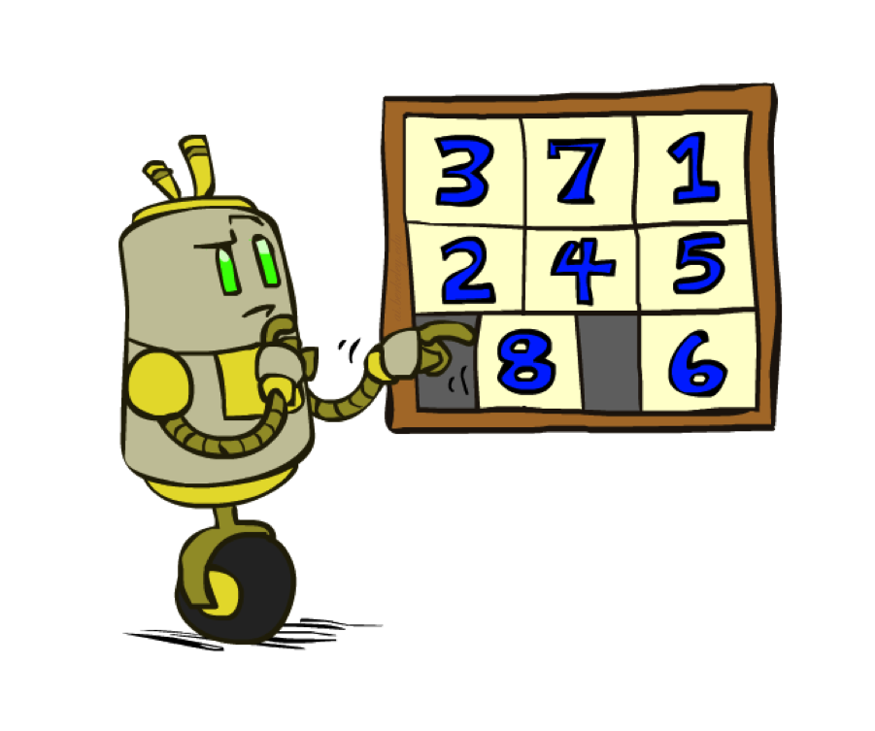
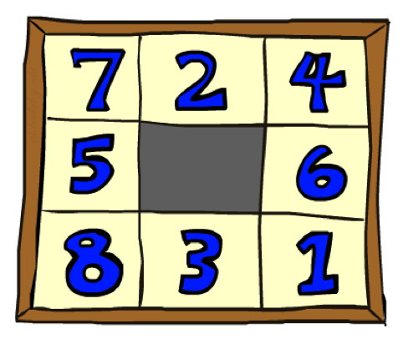
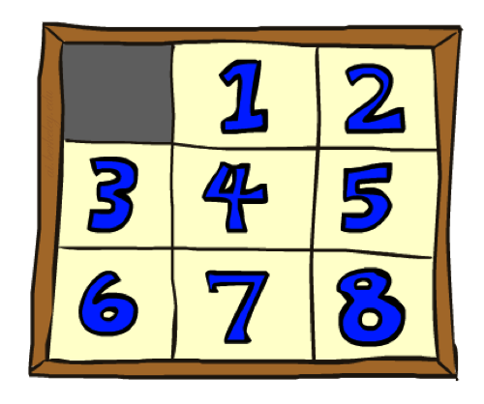

Example: 8 Puzzle
Start State
Actions
Goal State
What are the states?
How many states?
What are the actions?
How many actions from the start state?
What should the step costs be?
Image/slide credit: Ketrina Yim, UCB CS 188

Slide 71
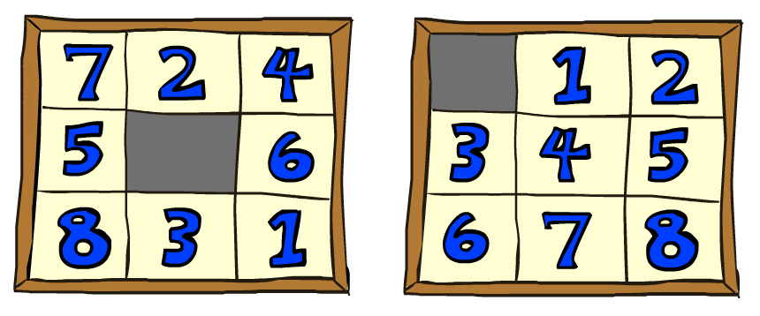

8 Puzzle I
Heuristic: Number of tiles misplaced
Why is it admissible?
h(start) =
This is a relaxed-problem heuristic
8
Start State
Goal State
 | Average nodes expanded when the optimal path has…
 | …4 steps | …8 steps | …12 steps
UCS | 112 | 6,300 | 3.6 x 10⁶
A*TILES | 13 | 39 | 227
Image/slide credit: Ketrina Yim, UCB CS 188
Statistics from Andrew Moore

Slide 72
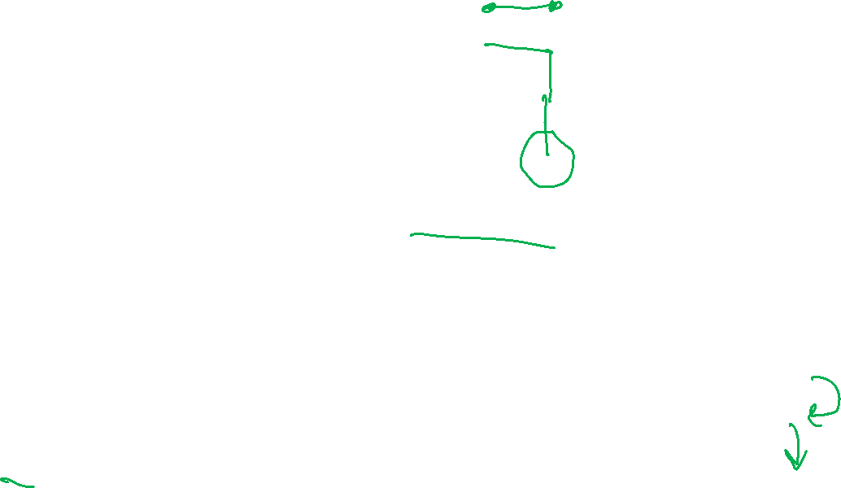
8 Puzzle II
What if we had an easier 8-puzzle where any tile could slide any direction at any time, ignoring other tiles?
Total Manhattan distance
Why is it admissible?
h(start) =
Start State
Goal State
 | Average nodes expanded when the optimal path has…
 | …4 steps | …8 steps | …12 steps
UCS | 112 | 6,300 | 3.6 x 10⁶
A*TILES | 13 | 39 | 227
A*MANHATTAN | 12 | 25 | 73
3 + 1 + 2 + … = 18
Image/slide credit: Ketrina Yim, UCB CS 188
Statistics from Andrew Moore

Slide 73

Combining heuristics
Dominance: h_{a} ≥ h_{c} if
∀n h_{a}(n) ≥ h_{c}(n)
  Roughly speaking, larger is better as long as both are admissible
  The zero heuristic is pretty bad (what does A* do with h=0?)
  The exact heuristic is pretty good, but usually too expensive!
What if we have two heuristics, neither dominates the other?
  Form a new heuristic by taking the max of both:
  h(n) = max( h_{a}(n), h_{b}(n) )
  Max of admissible heuristics is admissible and dominates both!
Slide credit: UCB CS 188
Notes:
Semi-lattice: x <= y <-> x = x ^ y

Slide 74

A*: Summary
Image/slide credit: Ketrina Yim, UCB CS 188

Slide 75

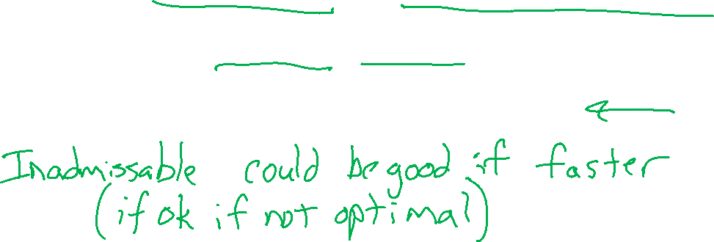
A*: Summary
A* uses both backward costs and (estimates of) forward costs
A* is optimal with admissible / consistent heuristics
Heuristic design is key: often use relaxed problems
Image/slide credit: Ketrina Yim, UCB CS 188

