Slide 1

07-280
AI & ML I
Reinforcement Learning
Instructors:
Pat Virtue & Nihar Shah

Slide 2
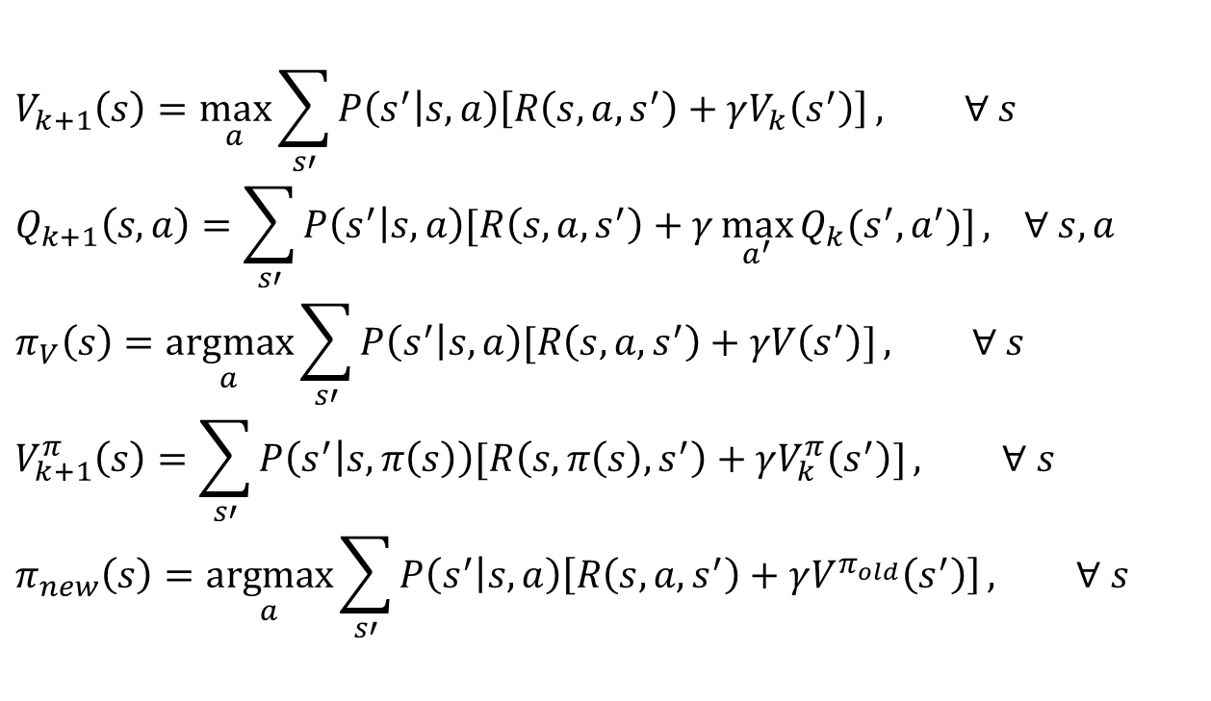

Reinforcement learning
What if we didn’t know $P(s’|s,a)$and $R(s,a,s’)$?
$$V_{k+1}\left(s\right)=\max_{a}{\sum_{s′}{P\left(s^{′} | s,a\right)\left[R\left(s,a,s^{′}\right)+γV_{k}\left(s^{′}\right)\right]}}, ∀ s$$
$$Q_{k+1}\left(s,a\right)=\sum_{s′}{P\left(s^{′} | s,a\right)[R\left(s,a,s^{′}\right)+γ\max_{a^{′}}{Q_{k}(s^{′},a^{′})]}, } ∀ s,a$$
$$π_{V}\left(s\right)=\underset{a}{argmax}{\sum_{s′}{P\left(s^{′} | s,a\right)[R\left(s,a,s^{′}\right)+γV\left(s^{′}\right)]}}, ∀ s$$
$$V_{k+1}^{π}\left(s\right)=\sum_{s′}{P\left(s^{′} | s,π\left(s\right)\right)[R\left(s,π\left(s\right),s^{′}\right)+γV_{k}^{π}\left(s^{′}\right)]}, ∀ s$$
$$π_{new}\left(s\right)=\underset{a}{argmax}{\sum_{s′}{P\left(s^{′} | s,a\right)\left[R\left(s,a,s^{′}\right)+γV^{π_{old}}\left(s^{′}\right)\right]}}, ∀ s$$
Value iteration:
Q-iteration:
Policy extraction:
Policy evaluation:
Policy improvement:

Slide 3
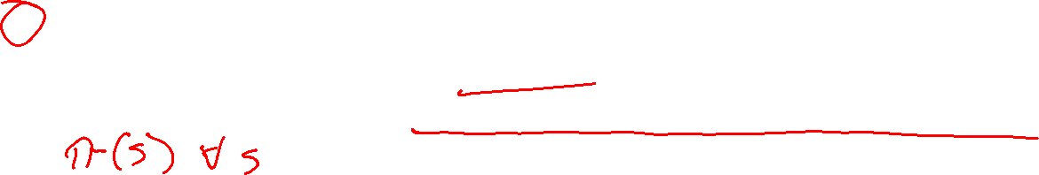
Reinforcement Learning
Agent
State: s
Reward: r
Actions: a
Environment
Basic idea:
  All learning is based on observed samples of rewards and next states!
  Receive feedback in the form of rewards
  Must (learn to) act so as to maximize expected sum of discounted rewards
Slide credit: UC Berkeley AI
Notes:
Show robot-soccer learning to walk videos (UT Austin):
? Show snake robot:

Slide 4
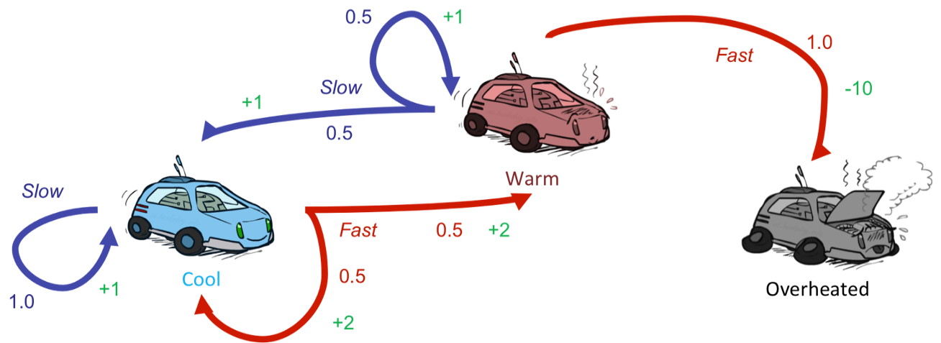
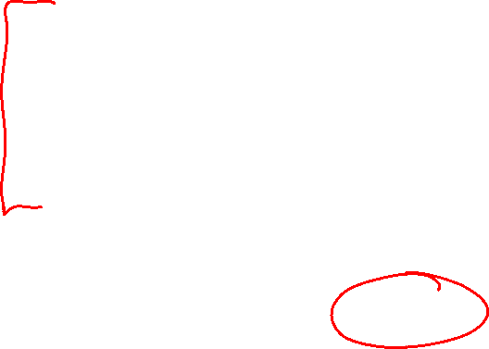
Reinforcement Learning
Still assume a Markov decision process (MDP):
  A set of states s ∈ S
  A set of actions (per state) A
  A model T(s,a,s’)
  A reward function R(s,a,s’)
Still looking for a policy π(s)
New twist: don’t know T or R
  I.e. we don’t know which states are good or what the actions do
  Must actually try actions and states out to learn
Slide credit: UC Berkeley AI

Slide 5
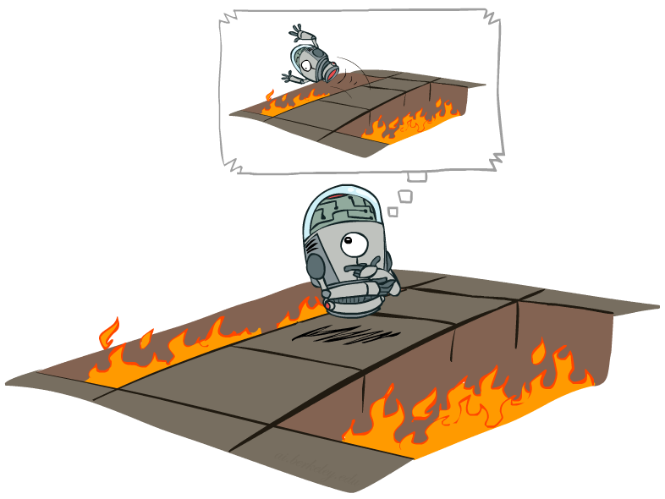
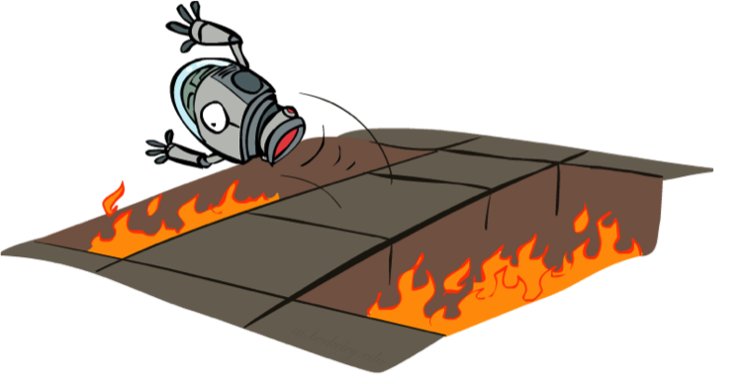
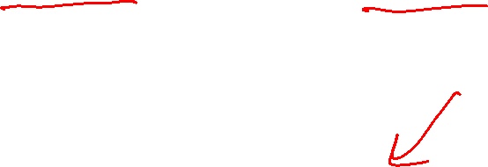
Offline (MDPs) vs. Online (RL)
Offline Solution
(Known MDP)
Online Learning
(Unknown MDP)
Slide credit: UC Berkeley AI

Slide 6
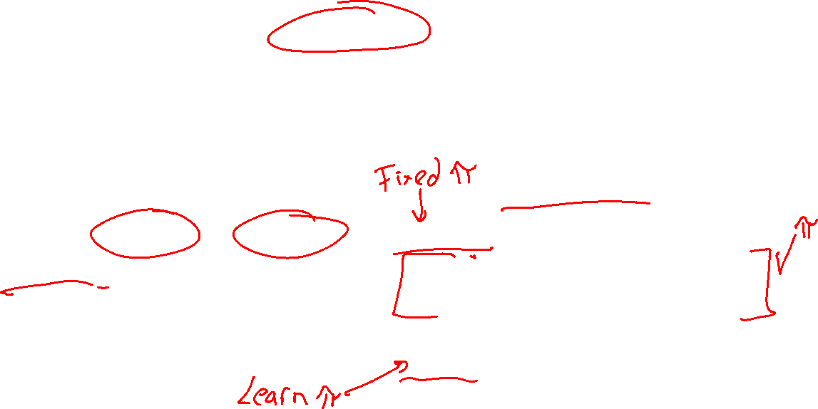
Overview: MDPs and Reinforcement Learning
Known MDP: Offline Solution
Value Iteration / Policy Iteration
Unknown MDP: Online Learning
Model-Based
Model-Free
Estimate MDP T(s,a,s') and R(s,a,s')
from samples of environment
Passive Reinforcement Learning
Monte Carlo Policy Evaluation
TD(0) Learning
Active Reinforcement Learning
Q-Learning

Slide 7

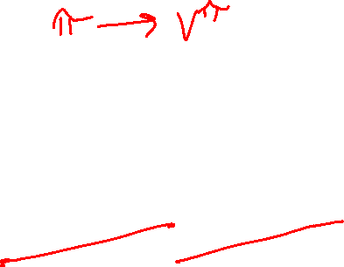
Why Not Use Policy Evaluation?
s
Simplified Bellman updates calculate V for a fixed policy:
  Each round, replace V with a one-step-look-ahead layer over V
  This approach fully exploited the connections between the states
  Unfortunately, we need T and R to do it!
Key question: How can we do this update to V without knowing T and R?
  In other words, how to we take a weighted average without knowing the weights?
π(s)
s, π(s)
s, π(s),s’
s’
Slide credit: UC Berkeley AI

Slide 8
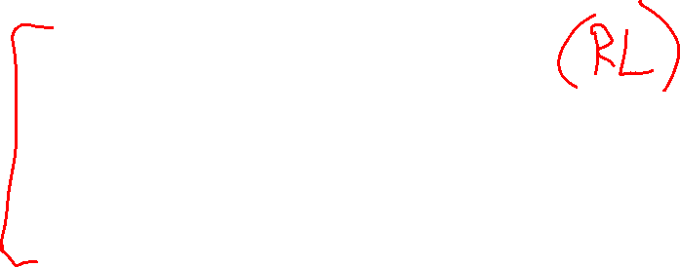
Online Learning
Passive Reinforcement Learning
Monte Carlo Policy Evaluation

Slide 9
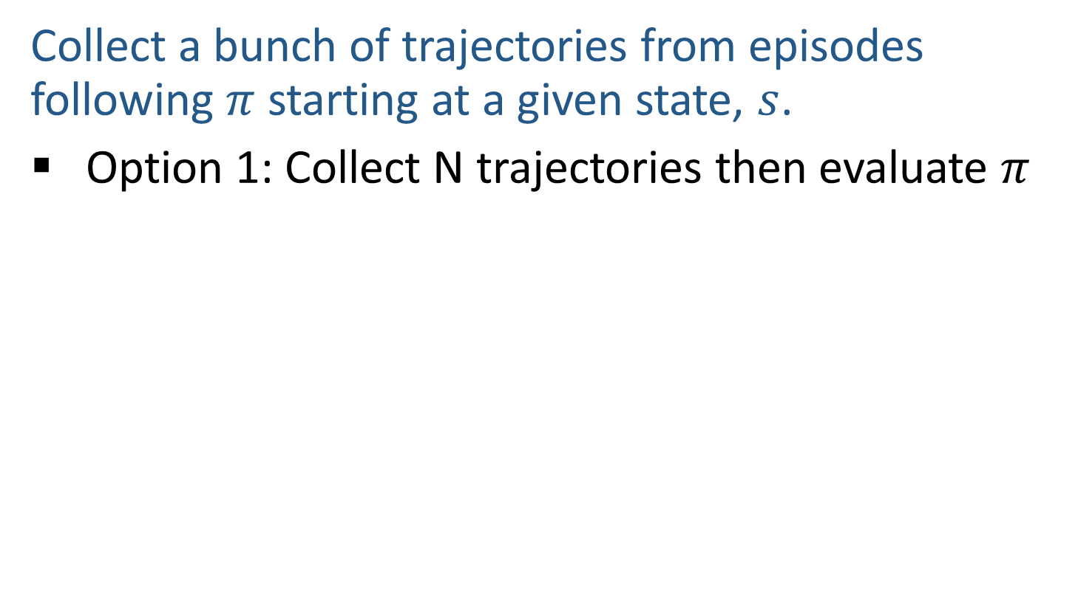

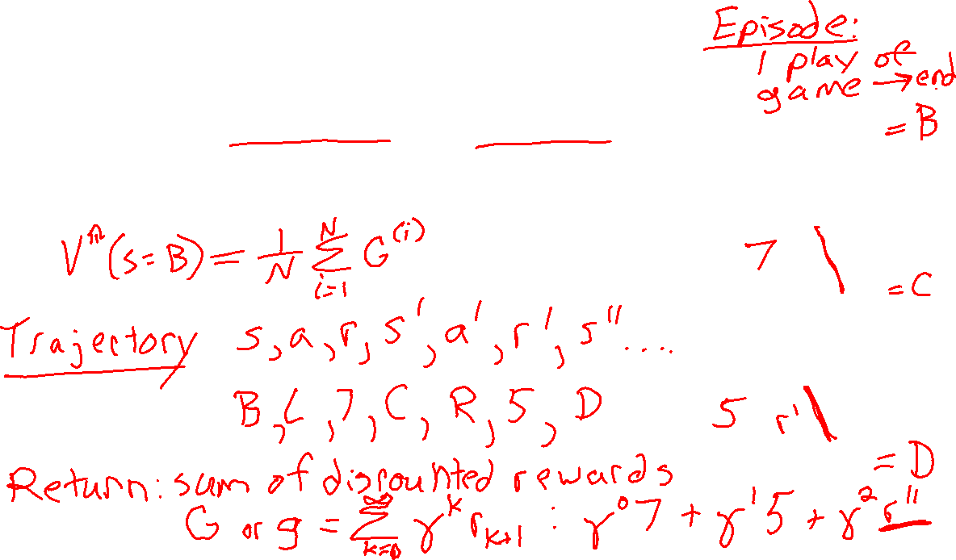
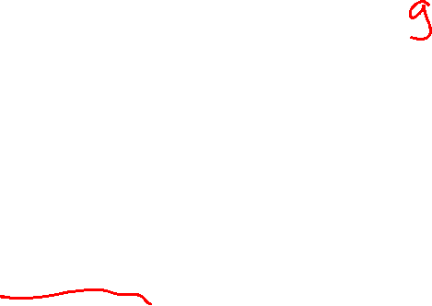
Monte Carlo (Sample-Based) Learning
Collect a bunch of trajectories from episodes following $π$ starting at a given state, $s$.
Option 1: Collect N trajectories then evaluate $π$
s
a
s, a
r
s’
a’
s’, a’
s’’

Slide 10

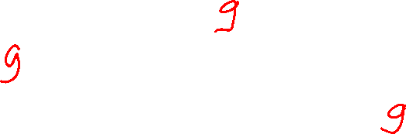
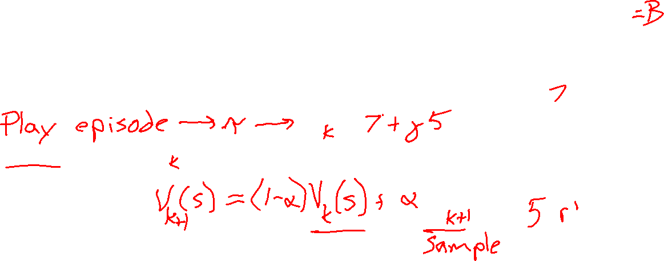
Monte Carlo (Sample-Based) Learning
Collect a bunch of trajectories from episodes following $π$ starting at a given state, $s$.
Option 1: Collect N trajectories then evaluate $π$
Option 2: Update $V^{π}\left(s\right)$ after each episode
s
a
s, a
r
s’
Sample of V(s):
a’
s’, a’
Update to V(s):
s’’

Slide 11

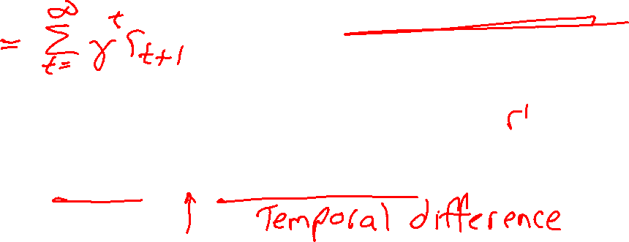
Monte Carlo (Sample-Based) Learning
Collect a bunch of trajectories from episodes following $π$ starting at a given state, $s$.
Option 1: Collect N trajectories then evaluate $π$
Option 2: Update $V^{π}\left(s\right)$ after each episode
s
a
s, a
r
s’
Sample of V(s):
a’
s’, a’
Update to V(s):
s’’
Same update:

Slide 12
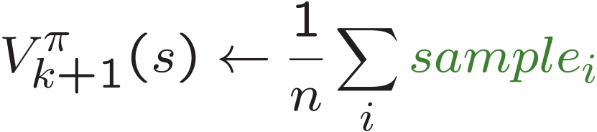
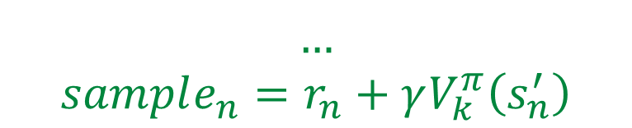


Sample-Based Policy Evaluation?
We want to improve our estimate of V by computing these averages:
Idea: Take samples of outcomes s’ (by doing the action!) and average
$$sample_{1}=r_{1}+γV_{k}^{π}\left(s_{1}^{′}\right)$$
s
$$sample_{2}=r_{2}+γV_{k}^{π}\left(s_{2}^{′}\right)$$
π(s)
$$…$$
$$sample_{n}=r_{n}+γV_{k}^{π}\left(s_{n}^{′}\right)$$
s, π(s)
s, π(s),s’
s₁'
s₂'
s'
s₃'
Almost! But we can’t rewind time to get sample after sample from state s.
Slide credit: UC Berkeley AI

Slide 13
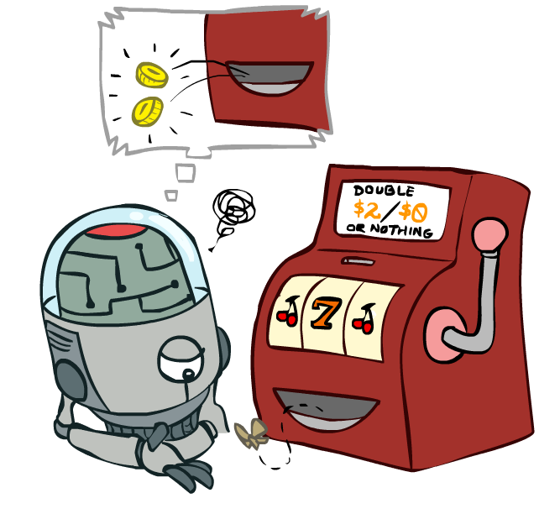
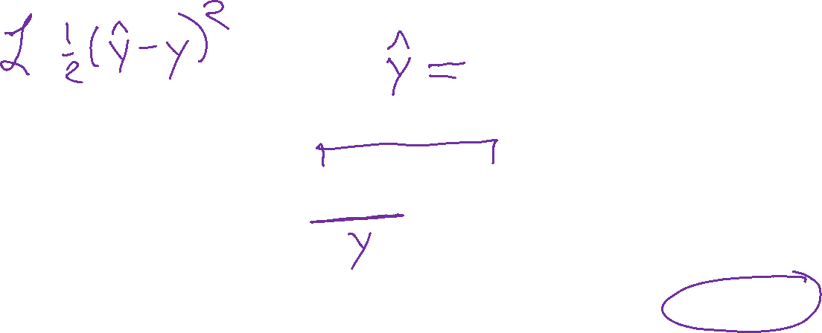

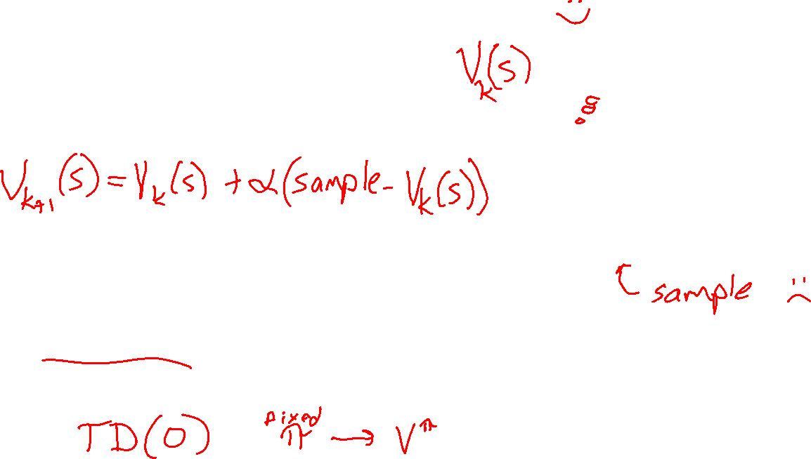
Online Learning
Passive Reinforcement Learning
Temporal Difference Learning
Image credit: Ketrina Yim, UC Berkeley

Slide 14

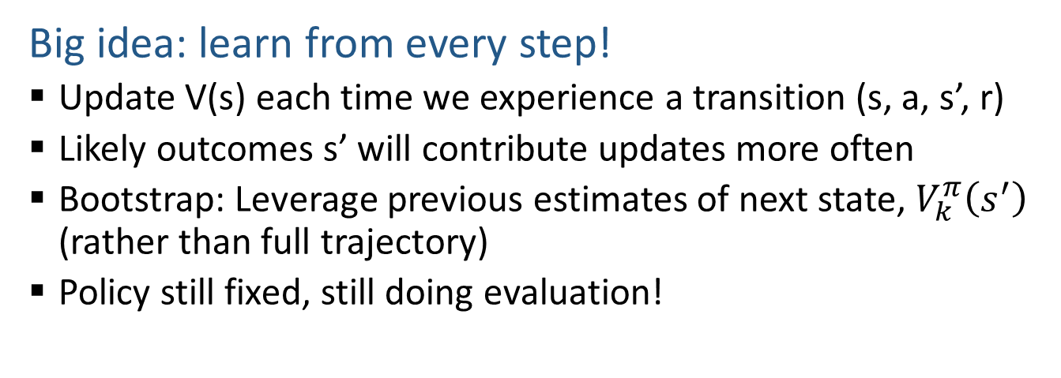
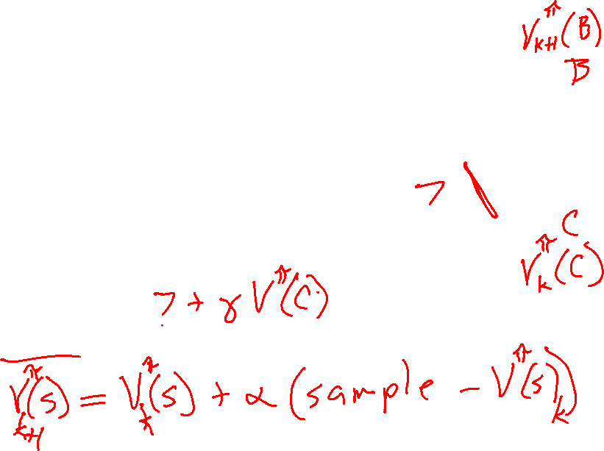
Temporal Difference Learning
s
Big idea: learn from every step!
  Update V(s) each time we experience a transition (s, a, s’, r)
  Likely outcomes s’ will contribute updates more often
  Bootstrap: Leverage previous estimates of next state, $V_{k}^{π}\left(s^{′}\right)$ (rather than full trajectory)
  Policy still fixed, still doing evaluation!
π(s)
s, π(s)
s’
Sample of V(s):
$$sample = r + γ V_{k}^{π}\left(s′\right)$$
Update to V(s):
Slide credit: UC Berkeley AI

Slide 15
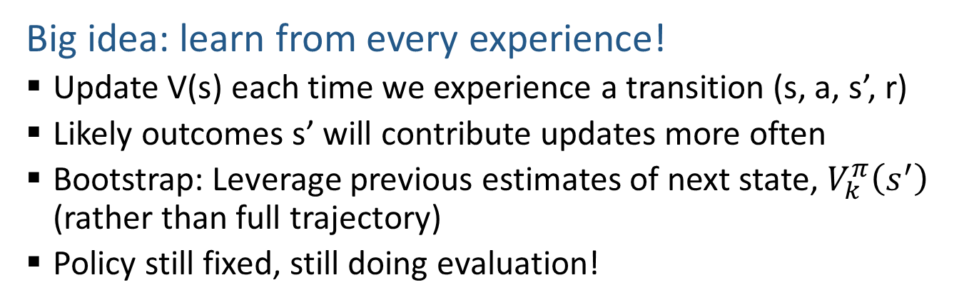
Temporal Difference Learning
s
Big idea: learn from every experience!
  Update V(s) each time we experience a transition (s, a, s’, r)
  Likely outcomes s’ will contribute updates more often
  Bootstrap: Leverage previous estimates of next state, $V_{k}^{π}\left(s^{′}\right)$ (rather than full trajectory)
  Policy still fixed, still doing evaluation!
π(s)
s, π(s)
s’
Sample of V(s):
$$sample = r + γ V_{k}^{π}\left(s′\right)$$
Update to V(s):
Slide credit: UC Berkeley AI

Slide 16
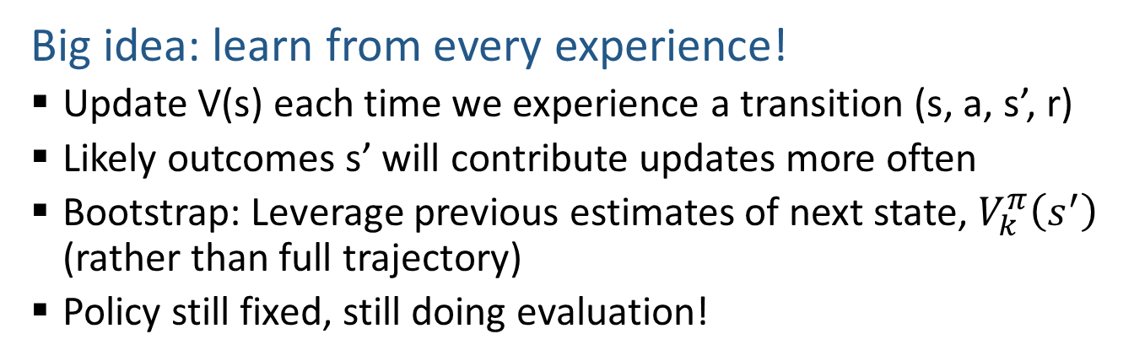
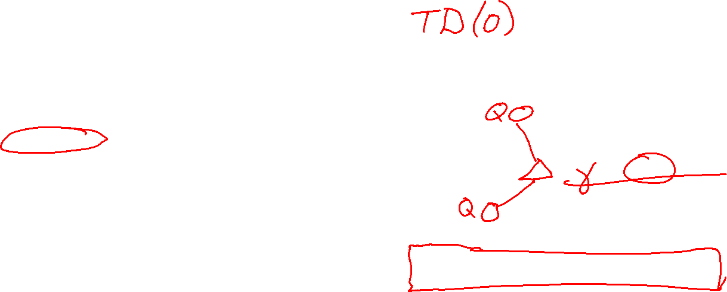
Temporal Difference Learning
s
Big idea: learn from every experience!
  Update V(s) each time we experience a transition (s, a, s’, r)
  Likely outcomes s’ will contribute updates more often
  Bootstrap: Leverage previous estimates of next state, $V_{k}^{π}\left(s^{′}\right)$ (rather than full trajectory)
  Policy still fixed, still doing evaluation!
π(s)
s, π(s)
s’
Sample of V(s):
$$sample = r + γ V_{k}^{π}\left(s′\right)$$
Update to V(s):
Same update:
Slide credit: UC Berkeley AI

Slide 17
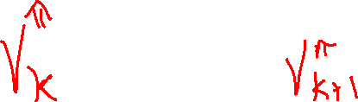
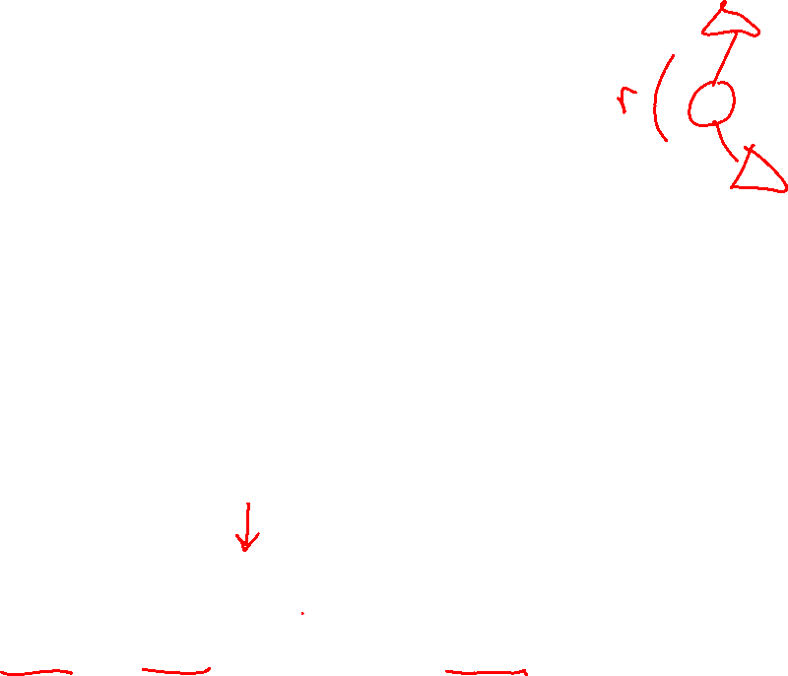
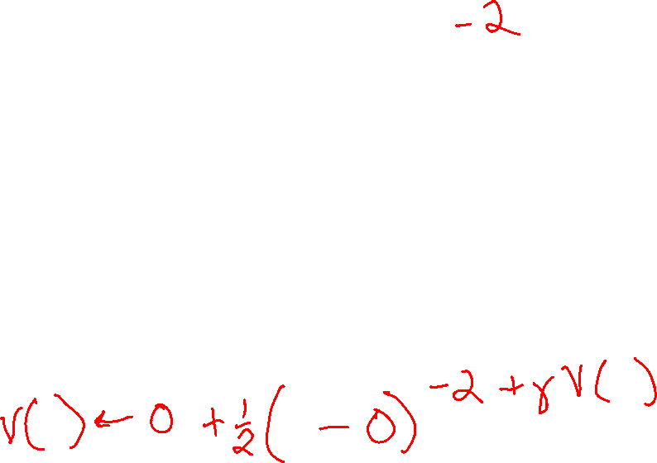
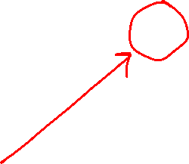

Example: Temporal Difference Learning
States
Observed Transitions
B, east, C, -2
 | A
B | C | D
 | E
 | 0
0 | 0 | 8
 | 0
 | 0
-1 | 0 | 8
 | 0
Assume: γ = 1, α = 1/2
Slide credit: UC Berkeley AI

Slide 18

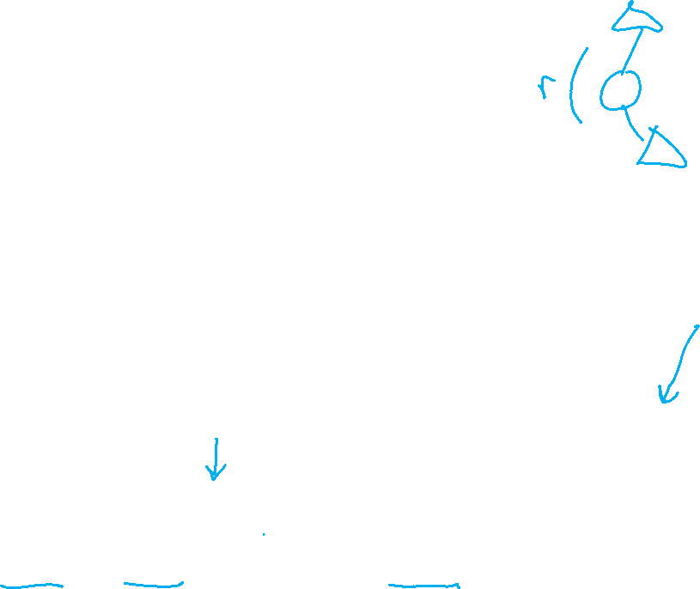
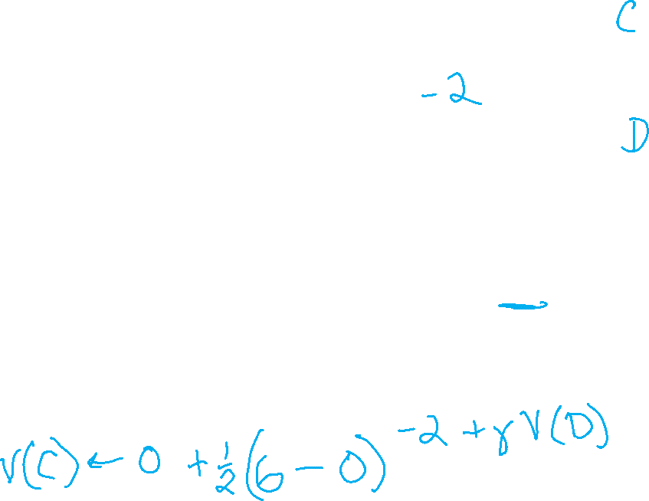
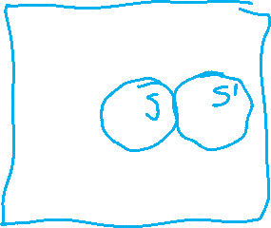
Example: Temporal Difference Learning
States
Observed Transitions
B, east, C, -2
C, east, D, -2
 | A
B | C | D
 | E
 | 0
0 | 0 | 8
 | 0
 | 0
-1 | 0 | 8
 | 0
 | 0
-1 | 3 | 8
 | 0
Assume: γ = 1, α = 1/2
Slide credit: UC Berkeley AI

Slide 19
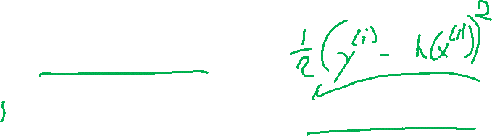

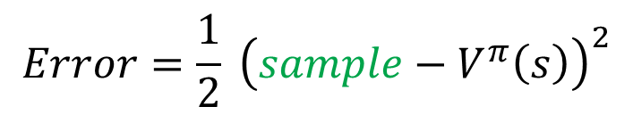


Temporal Difference Learning
Big idea: learn from every experience!
  Update V(s) each time we experience a transition (s, a, s’, r)
  Likely outcomes s’ will contribute updates more often
Temporal difference learning of values
  Policy still fixed, still doing evaluation!
  Move values toward value of whatever successor occurs: running average
s
π(s)
s, π(s)
s’
Sample of V(s):
$$sample= r+γ V^{π}\left(s^{′}\right)$$
Update to V(s):
$$V^{π}\left(s\right) ← {\left(1−α\right) V}^{π}\left(s\right)+(α) sample$$
Same update:
$$V^{π}\left(s\right) ← V^{π}(s) +α \left[sample− V^{π}\left(s\right)\right]$$
$$Error=\frac{1}{2} {\left(sample−V^{π}\left(s\right)\right)}^{2}$$
Same update:
$$V^{π}\left(s\right) ← V^{π}\left(s\right)−α∇Error$$
Slide credit: UC Berkeley AI

Slide 20
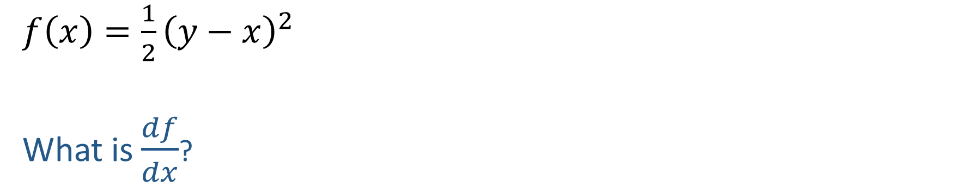
ML detour: Quick Calculus Quiz
$f\left(x\right)=\frac{1}{2}{\left(y−x\right)}^{2}$
What is $\frac{df}{dx}$?

Slide 21
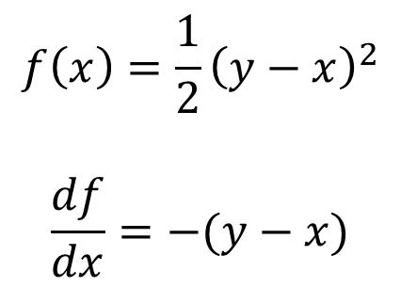
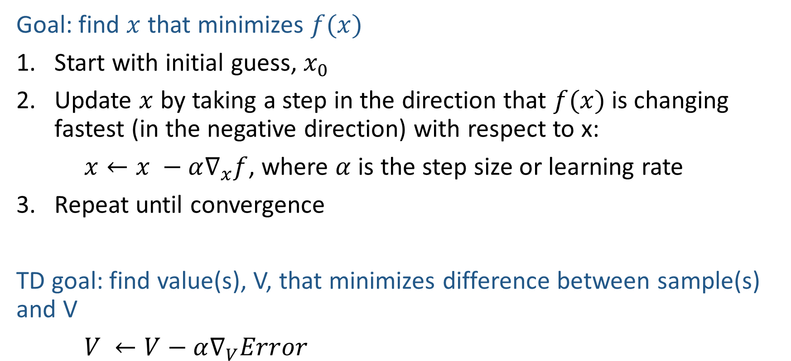
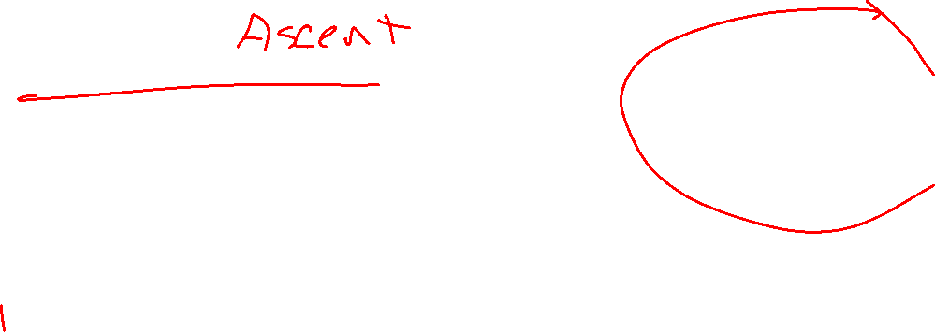
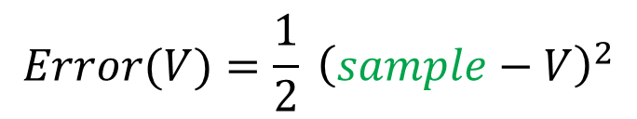
ML detour: Gradient Descent
$$f\left(x\right)=\frac{1}{2}{\left(y−x\right)}^{2}$$
$$\frac{df}{dx}=−(y−x)$$
Goal: find $x$ that minimizes $f(x)$
Start with initial guess, $x_{0}$
Update $x$ by taking a step in the direction that $f(x)$ is changing fastest (in the negative direction) with respect to x:
$x←x −α∇_{x}f$, where $α$ is the step size or learning rate
Repeat until convergence
TD goal: find value(s), V, that minimizes difference between sample(s) and V
$V ←V−α∇_{V}Error$
$$Error(V)=\frac{1}{2} {\left(sample−V\right)}^{2}$$

Slide 22
Temporal Difference Learning
Big idea: learn from every experience!
  Update V(s) each time we experience a transition (s, a, s’, r)
  Likely outcomes s’ will contribute updates more often
Temporal difference learning of values
  Policy still fixed, still doing evaluation!
  Move values toward value of whatever successor occurs: running average
s
π(s)
s, π(s)
s’
Sample of V(s):
$$sample= r+γ V^{π}\left(s^{′}\right)$$
Update to V(s):
$$V^{π}\left(s\right) ← {\left(1−α\right) V}^{π}\left(s\right)+(α) sample$$
Same update:
$$V^{π}\left(s\right) ← V^{π}(s) +α \left[sample− V^{π}\left(s\right)\right]$$
$$Error=\frac{1}{2} {\left(sample−V^{π}\left(s\right)\right)}^{2}$$
Same update:
$$V^{π}\left(s\right) ← V^{π}\left(s\right)−α∇Error$$
Slide credit: UC Berkeley AI

Slide 23
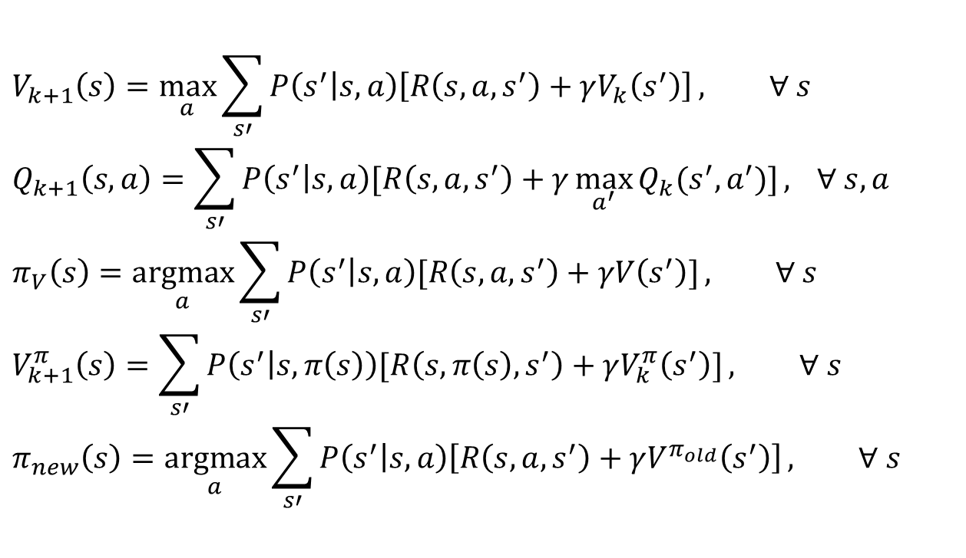
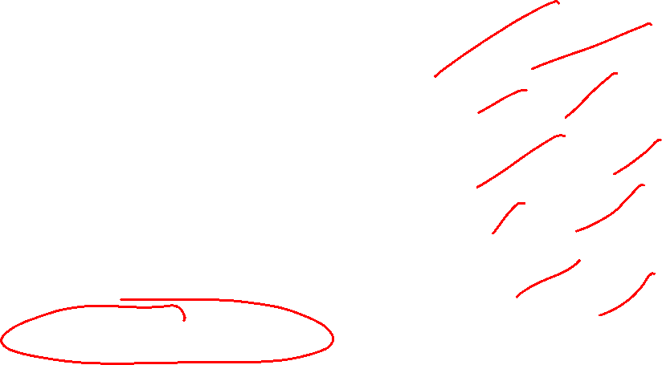
Poll 1
TD update:
$$V^{π}\left(s\right) = V^{π}(s) +α \left[r+γ V^{π}\left(s^{′}\right)− V^{π}\left(s\right)\right]$$
Which converts TD values into a policy?
$$V_{k+1}\left(s\right)=\max_{a}{\sum_{s′}{P\left(s^{′} | s,a\right)\left[R\left(s,a,s^{′}\right)+γV_{k}\left(s^{′}\right)\right]}}, ∀ s$$
$$Q_{k+1}\left(s,a\right)=\sum_{s′}{P\left(s^{′} | s,a\right)[R\left(s,a,s^{′}\right)+γ\max_{a^{′}}{Q_{k}(s^{′},a^{′})]}, } ∀ s,a$$
$$π_{V}\left(s\right)=\underset{a}{argmax}{\sum_{s′}{P\left(s^{′} | s,a\right)[R\left(s,a,s^{′}\right)+γV\left(s^{′}\right)]}}, ∀ s$$
$$V_{k+1}^{π}\left(s\right)=\sum_{s′}{P\left(s^{′} | s,π\left(s\right)\right)[R\left(s,π\left(s\right),s^{′}\right)+γV_{k}^{π}\left(s^{′}\right)]}, ∀ s$$
$$π_{new}\left(s\right)=\underset{a}{argmax}{\sum_{s′}{P\left(s^{′} | s,a\right)\left[R\left(s,a,s^{′}\right)+γV^{π_{old}}\left(s^{′}\right)\right]}}, ∀ s$$
A) Value iteration:
B) Q-iteration:
C) Policy extraction:
D) Policy evaluation:
E) Policy improvement:
F) None of the above

Slide 24
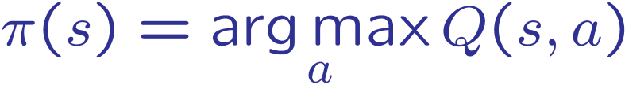
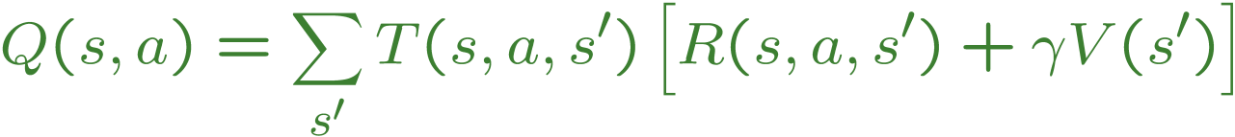

Problems with TD Value Learning
TD value leaning is a model-free way to do policy evaluation, mimicking Bellman updates with running sample averages
However, if we want to turn values into a (new) policy, we’re sunk:
Idea: learn Q-values, not values
Makes action selection model-free too!
s
a
s, a
s,a,s’
s’
Slide credit: UC Berkeley AI

Slide 25
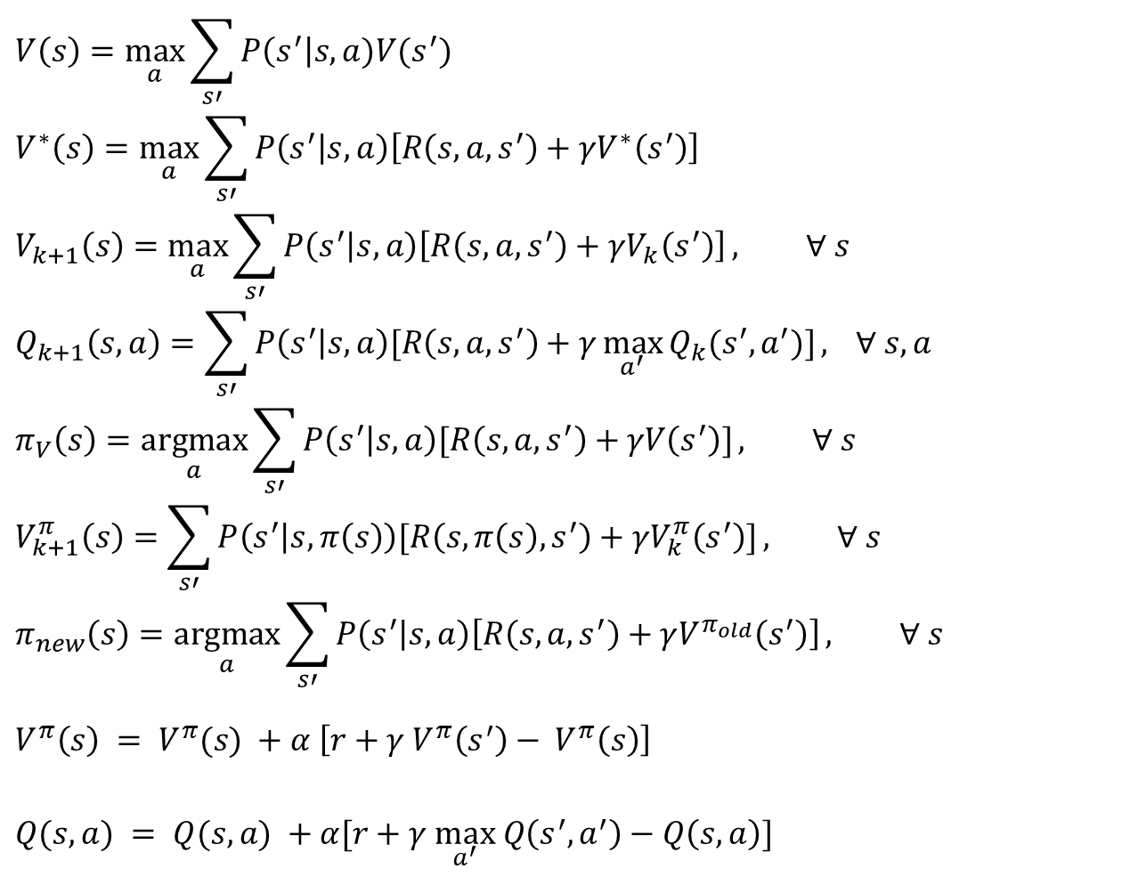
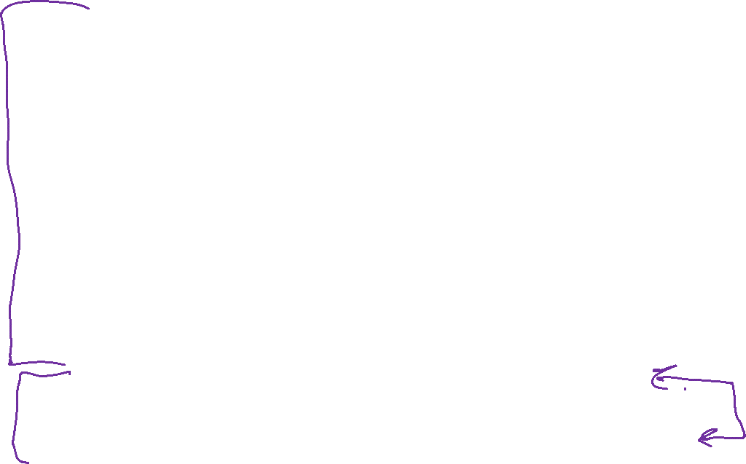

MDP/RL Notation
Standard expectimax:
$$V\left(s\right)=\max_{a}{\sum_{s′}{P\left(s^{′}\right|s,a)V(s^{′})}}$$
$$V^{∗}\left(s\right)=\max_{a}{\sum_{s′}{P\left(s^{′} | s,a\right)\left[R\left(s,a,s^{′}\right)+γV^{∗}\left(s^{′}\right)\right]}}$$
$$V_{k+1}\left(s\right)=\max_{a}{\sum_{s′}{P\left(s^{′} | s,a\right)\left[R\left(s,a,s^{′}\right)+γV_{k}\left(s^{′}\right)\right]}}, ∀ s$$
$$Q_{k+1}\left(s,a\right)=\sum_{s′}{P\left(s^{′} | s,a\right)[R\left(s,a,s^{′}\right)+γ\max_{a^{′}}{Q_{k}(s^{′},a^{′})]}, } ∀ s,a$$
$$π_{V}\left(s\right)=\underset{a}{argmax}{\sum_{s′}{P\left(s^{′} | s,a\right)[R\left(s,a,s^{′}\right)+γV\left(s^{′}\right)]}}, ∀ s$$
$$V_{k+1}^{π}\left(s\right)=\sum_{s′}{P\left(s^{′} | s,π\left(s\right)\right)[R\left(s,π\left(s\right),s^{′}\right)+γV_{k}^{π}\left(s^{′}\right)]}, ∀ s$$
$$π_{new}\left(s\right)=\underset{a}{argmax}{\sum_{s′}{P\left(s^{′} | s,a\right)\left[R\left(s,a,s^{′}\right)+γV^{π_{old}}\left(s^{′}\right)\right]}}, ∀ s$$
$$V^{π}\left(s\right) = V^{π}(s) +α \left[r+γ V^{π}\left(s^{′}\right)− V^{π}\left(s\right)\right]$$
$Q(s,a) = Q(s,a) +α[r+γ \max_{a^{′}} Q\left(s^{′},a^{′}\right)−Q\left(s, a\right)]$
Bellman equations:
Value iteration:
Q-iteration:
Policy extraction:
Policy evaluation:
Policy improvement:
Value (TD) learning:
Q-learning:

Slide 26
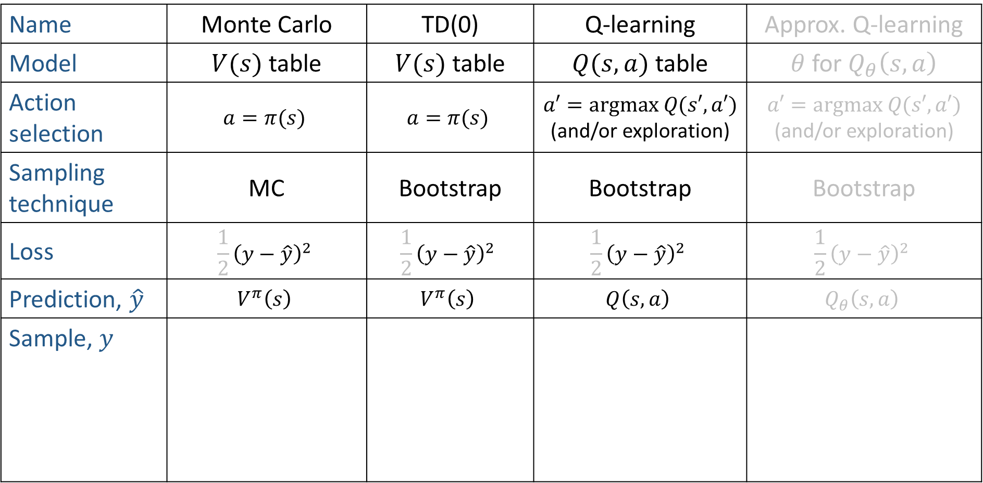
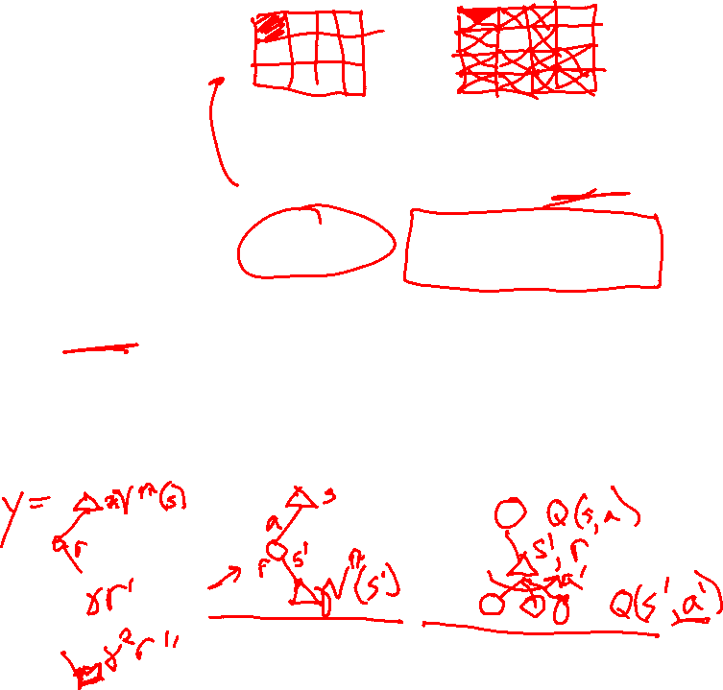

RL Summary
Name | Monte Carlo | TD(0) | Q-learning | Approx. Q-learning
Model | $V(s)$ table | $V(s)$ table | $Q(s,a)$ table | $θ$ for $Q_{θ}\left(s, a\right)$
Action selection | $$a=π(s)$$ | $$a=π(s)$$ | $$a′=argmax Q(s′,a′)$$ (and/or exploration) | $$a′=argmax Q(s′,a′)$$ (and/or exploration)
Sampling technique | MC | Bootstrap | Bootstrap | Bootstrap
Loss | $${\frac{1}{2}\left(y−\hat{y}\right)}^{2}$$ | $${\frac{1}{2}\left(y−\hat{y}\right)}^{2}$$ | $${\frac{1}{2}\left(y−\hat{y}\right)}^{2}$$ | $${\frac{1}{2}\left(y−\hat{y}\right)}^{2}$$
Prediction, $\hat{y}$ | $$V^{π}\left(s\right)$$ | $$V^{π}\left(s\right)$$ | $$Q\left(s, a\right)$$ | $$Q_{θ}\left(s, a\right)$$
Sample, $y$

Slide 27
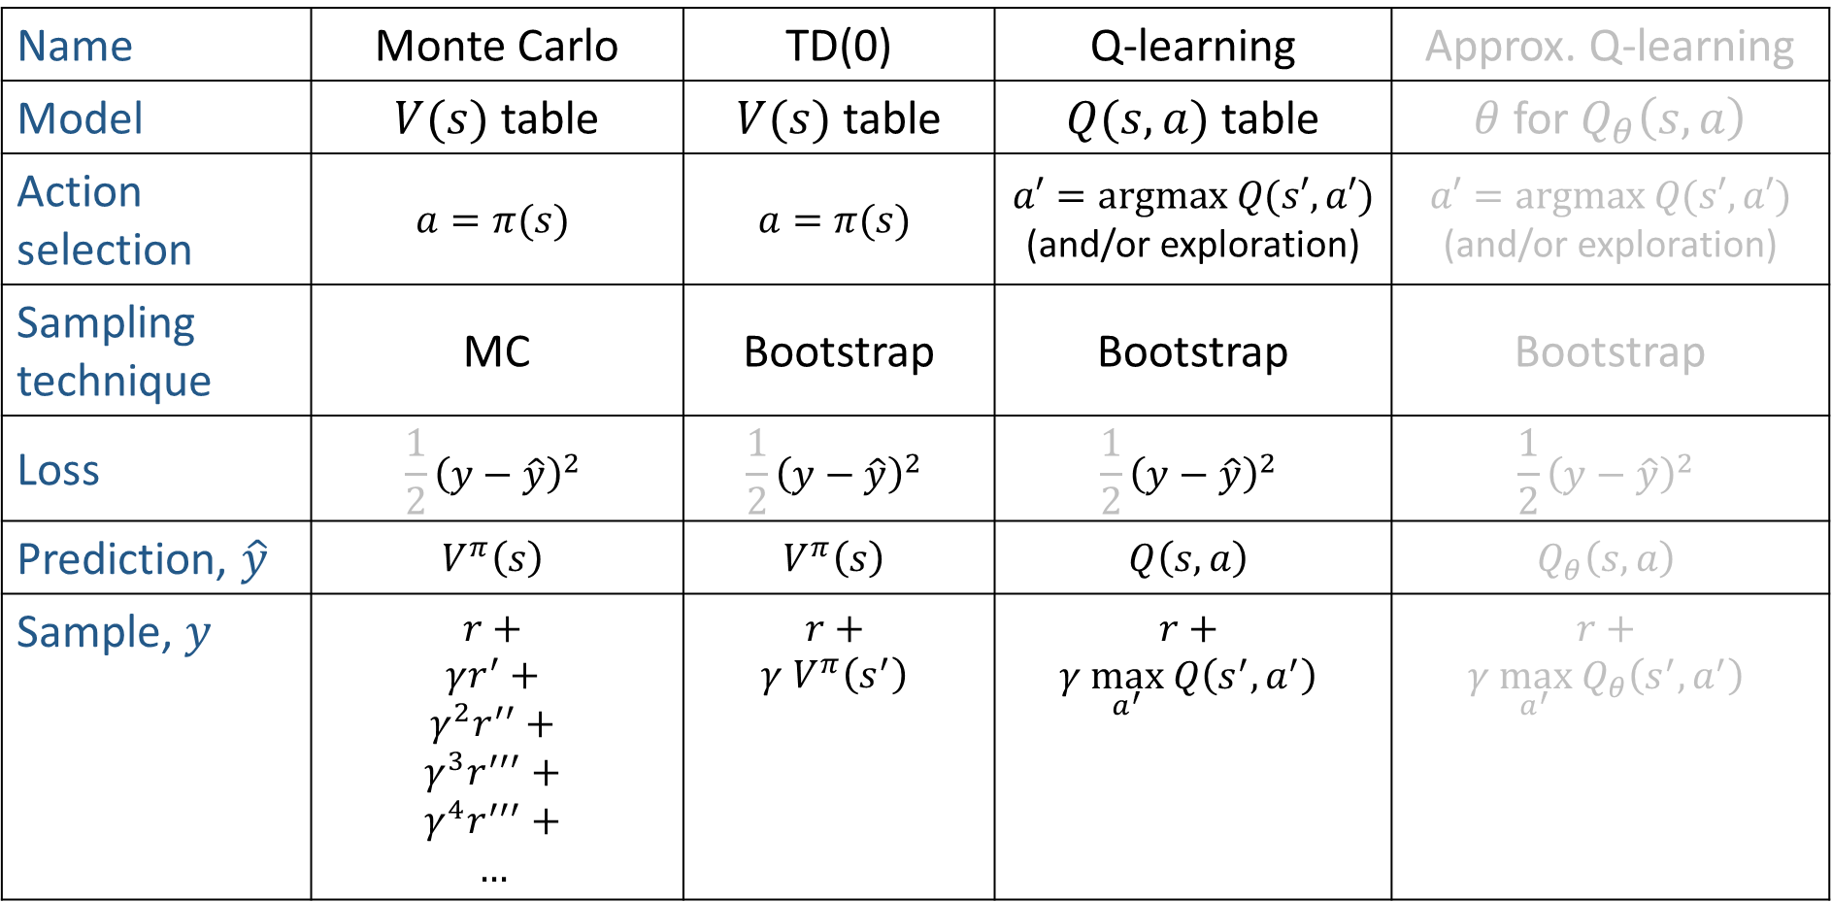
RL Summary
Name | Monte Carlo | TD(0) | Q-learning | Approx. Q-learning
Model | $V(s)$ table | $V(s)$ table | $Q(s,a)$ table | $θ$ for $Q_{θ}\left(s, a\right)$
Action selection | $$a=π(s)$$ | $$a=π(s)$$ | $$a′=argmax Q(s′,a′)$$ (and/or exploration) | $$a′=argmax Q(s′,a′)$$ (and/or exploration)
Sampling technique | MC | Bootstrap | Bootstrap | Bootstrap
Loss | $${\frac{1}{2}\left(y−\hat{y}\right)}^{2}$$ | $${\frac{1}{2}\left(y−\hat{y}\right)}^{2}$$ | $${\frac{1}{2}\left(y−\hat{y}\right)}^{2}$$ | $${\frac{1}{2}\left(y−\hat{y}\right)}^{2}$$
Prediction, $\hat{y}$ | $$V^{π}\left(s\right)$$ | $$V^{π}\left(s\right)$$ | $$Q\left(s, a\right)$$ | $$Q_{θ}\left(s, a\right)$$
Sample, $y$ | $$r+$$ $$γr^{′}+$$ $$γ^{2}r^{′′}+$$ $$γ^{3}r^{′′′}+$$ $$γ^{4}r^{′′′}+$$ $$…$$ | $$r+$$ $$γ V^{π}\left(s^{′}\right)$$ | $$r+$$ $$γ \max_{a^{′}} Q\left(s^{′},a^{′}\right)$$ | $$r+$$ $$γ \max_{a^{′}} Q_{θ}\left(s^{′},a^{′}\right)$$

Slide 28

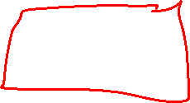
Online Learning
Model-free Learning
Active Reinforcement Learning
Q-Learning
Image credit: Ketrina Yim, UC Berkeley

Slide 29



Q-Learning
We’d like to do Q-value updates to each Q-state:
  But can’t compute this update without knowing T, R
Instead, compute average as we go
  Receive a sample transition (s,a,r,s’)
  The sample value is then:
  But we want to average over results from (s,a) (Why?)
  So keep a running average
$$sample=$$
Slide credit: UC Berkeley AI

Slide 30

Q-Learning Properties
Amazing result: Q-learning converges to optimal policy -- even if you’re acting suboptimally!
This is called off-policy learning
Caveats:
  You have to explore enough
  You have to eventually make the learning rate
  small enough
  … but not decrease it too quickly
  Basically, in the limit, it doesn’t matter how you select actions (!)
Slide credit: UC Berkeley AI

Slide 31
Overview: MDPs and Reinforcement Learning
Known MDP: Offline Solution
Value Iteration / Policy Iteration
Unknown MDP: Online Learning
Model-Based
Model-Free
Estimate MDP T(s,a,s') and R(s,a,s')
from samples of environment
Passive Reinforcement Learning
Monte Carlo Policy Evaluation
TD Learning
Active Reinforcement Learning
Q-Learning

Slide 32

Demo Q-Learning Auto Cliff Grid
Slide credit: UC Berkeley AI
[Demo: Q-learning – auto – cliff grid (L11D1)]

Slide 33




Double Bandits
Slide credit: UC Berkeley AI

Slide 34
Double-Bandit MDP
Actions: Blue, Red
States: Win, Lose
0.25 $0
0.75
$2
W
L
0.25
$0
$1
1.0
$1
1.0
0.75 $2
Slide credit: UC Berkeley AI

Slide 35

Offline Planning
No discount
100 time steps
Solving MDPs is offline planning
  You determine all quantities through computation
  You need to know the details of the MDP
  You do not actually play the game!
0.25 $0
Value
0.75
$2
0.25
$0
Play Red
150
W
L
$1
1.0
$1
1.0
0.75 $2
Play Blue
100
Slide credit: UC Berkeley AI

Slide 36
Let’s Play!
$2
$2
$0
$2
$2
$2
$2
$0
$0
$0
Slide credit: UC Berkeley AI

Slide 37
Online Planning
Rules changed! Red’s win chance is different.
?? $0
??
$2
W
L
??
$0
$1
1.0
$1
1.0
?? $2
Slide credit: UC Berkeley AI

Slide 38
Let’s Play!
$0
$0
$0
$2
$0
$2
$0
$0
$0
$0
Slide credit: UC Berkeley AI

Slide 39

What Just Happened?
That wasn’t planning, it was learning!
  Specifically, reinforcement learning
  There was an MDP, but you couldn’t solve it with just computation
  You needed to actually act to figure it out
Important ideas in reinforcement learning that came up
  Exploration: you have to try unknown actions to get information
  Exploitation: eventually, you have to use what you know
  Regret: even if you learn intelligently, you make mistakes
  Sampling: because of chance, you have to try things repeatedly
  Difficulty: learning can be much harder than solving a known MDP
Slide credit: UC Berkeley AI

Slide 40

Exploration vs. Exploitation
Slide credit: UC Berkeley AI

Slide 41


How to Explore?
Several schemes for forcing exploration
  Simplest: random actions (ε-greedy)
    Every time step, flip a coin
    With (small) probability ε, act randomly
    With (large) probability 1-ε, act on current policy
  Problems with random actions?
    You do eventually explore the space, but keep thrashing around once learning is done
    One solution: lower ε over time
    Another solution: exploration functions
[Demo: Q-learning – manual exploration – bridge grid (L11D2)] [Demo: Q-learning – epsilon-greedy -- crawler (L11D3)]
Slide credit: UC Berkeley AI

Slide 42

Demo Q-learning – Manual Exploration – Bridge Grid
Slide credit: UC Berkeley AI

Slide 43



Exploration Functions
When to explore?
  Random actions: explore a fixed amount
  Better idea: explore areas whose badness is not
  (yet) established, eventually stop exploring
Exploration function
  Takes a value estimate u and a visit count n, and
  returns an optimistic utility, e.g.
  Note: this propagates the “bonus” back to states that lead to unknown states as well!
Regular Q-Update:
Modified Q-Update:
Slide credit: UC Berkeley AI
[Demo: exploration – Q-learning – crawler – exploration function (L11D4)]

Slide 44


Exploration Functions
When to explore?
  Random actions: explore a fixed amount
  Better idea: explore areas whose badness is not
  (yet) established, eventually stop exploring
Exploration function
  Takes a value estimate u and a visit count n, and
  returns an optimistic utility, e.g.
  Note: this propagates the “bonus” back to states that lead to unknown states as well!
Regular Q-Update:
Modified Q-Update:
Slide credit: UC Berkeley AI
[Demo: exploration – Q-learning – crawler – exploration function (L11D4)]

Slide 45


Demo Q-learning – Epsilon-Greedy – Crawler
Slide credit: UC Berkeley AI

Slide 46

Exploration Functions
When to explore?
  Random actions: explore a fixed amount
  Better idea: explore areas whose badness is not
  (yet) established, eventually stop exploring
Exploration function
  Takes a value estimate u and a visit count n, and
  returns an optimistic utility, e.g.
  $$f\left(u, n\right)=u+k/(n+1)$$
  Note: this propagates the “bonus” back to states that lead to unknown states as well!
Regular Q-Update: $Q\left(s, a\right)=Q\left(s,a\right)+α [r+γ\max_{a^{′}} Q\left(s^{′}, a^{′}\right) −Q\left(s, a\right)]$
Modified Q-Update: $Q\left(s, a\right)=Q\left(s,a\right)+α [r+γ\max_{a^{′}} f(Q\left(s^{′}, a^{′}\right), N\left(s^{′}, a^{′}\right)) −Q\left(s, a\right)]$
Slide credit: UC Berkeley AI
[Demo: exploration – Q-learning – crawler – exploration function (L11D4)]

Slide 47

Regret
Even if you learn the optimal policy, you still make mistakes along the way!
Regret is a measure of your total mistake cost: the difference between your (expected) rewards, including youthful suboptimality, and optimal (expected) rewards
Minimizing regret goes beyond learning to be optimal – it requires optimally learning to be optimal
Example: random exploration and exploration functions both end up optimal, but random exploration has higher regret
Slide credit: UC Berkeley AI

Slide 48

RL Summary
Name | Monte Carlo | TD(0) | Q-learning | Approx. Q-learning
Model | $V(s)$ table | $V(s)$ table | $Q(s,a)$ table | $θ$ for $Q_{θ}\left(s, a\right)$
Action selection | $$a=π(s)$$ | $$a=π(s)$$ | $$a′=argmax Q(s′,a′)$$ (and/or exploration) | $$a′=argmax Q(s′,a′)$$ (and/or exploration)
Sampling technique | MC | Bootstrap | Bootstrap | Bootstrap
Loss | $${\frac{1}{2}\left(\hat{y}−y\right)}^{2}$$ | $${\frac{1}{2}\left(\hat{y}−y\right)}^{2}$$ | $${\frac{1}{2}\left(\hat{y}−y\right)}^{2}$$ | $${\frac{1}{2}\left(\hat{y}−y\right)}^{2}$$
Prediction, $\hat{y}$ | $$V^{π}\left(s\right)$$ | $$V^{π}\left(s\right)$$ | $$Q\left(s, a\right)$$ | $$Q_{θ}\left(s, a\right)$$
Sample, $y$ | $$r+$$ $$γr^{′}+$$ $$γ^{2}r^{′′}+$$ $$γ^{3}r^{′′′}+$$ $$γ^{4}r^{′′′}+$$ $$…$$ | $$r+$$ $$γ V^{π}\left(s^{′}\right)$$ | $$r+$$ $$γ \max_{a^{′}} Q\left(s^{′},a^{′}\right)$$ | $$r+$$ $$γ \max_{a^{′}} Q_{θ}\left(s^{′},a^{′}\right)$$

