Slide 1

07-280
AI & ML I
Markov Decision Processes
Instructors:
Pat Virtue & Nihar Shah

Slide 2
Pre-reading

Slide 3
Question
Expectimax tree search:
Which action do we choose?
A) Left
B) Center
C) Right
D) Eight
Left
Right
Center
1/4
1/2
1/2
1/2
1/3
2/3
1/4
12
8
4
8
6
12
6

Slide 4
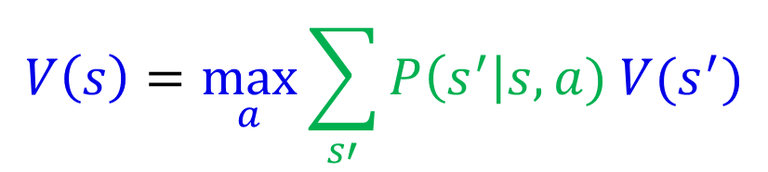
Expectimax Notation
$$V\left(s\right)=\max_{a}{\sum_{s′}{P\left(s^{′}\right|s,a) V(s^{′})}}$$

Slide 5
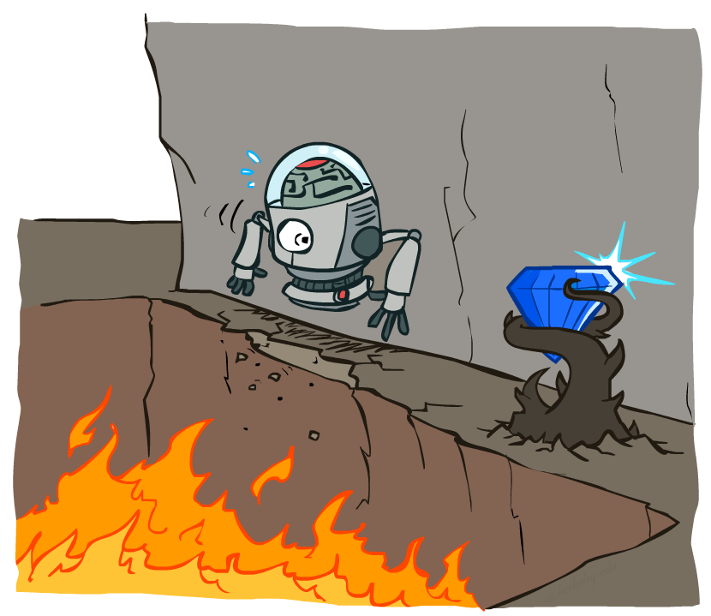
Non-Deterministic Search
Image credit: Ketrina Yim, UC Berkeley

Slide 6
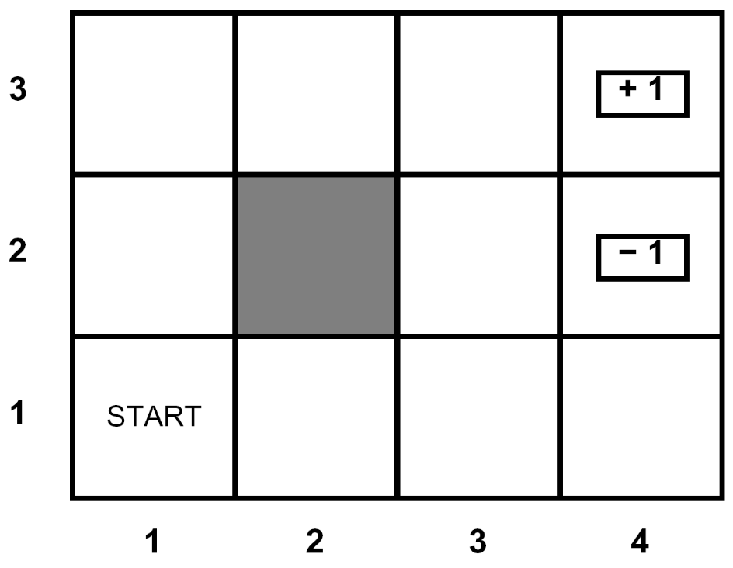
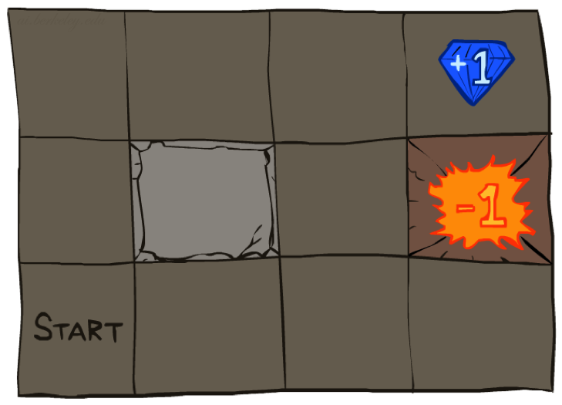




Example: Grid World
A maze-like problem
  The agent lives in a grid
  Walls block the agent’s path
Noisy movement: actions do not always go as planned
  80% of the time, the action North takes the agent North
  (if there is no wall there)
  10% of the time, North takes the agent West; 10% East
  If there is a wall in the direction the agent would have been taken, the agent stays put
The agent receives rewards each time step
  Small “living” reward each step (can be negative)
  Big rewards come at the end (good or bad)
Goal: maximize sum of rewards
Slide credit: UC Berkeley AI
Notes:
[cut demo of moving around in grid world program]

Slide 7
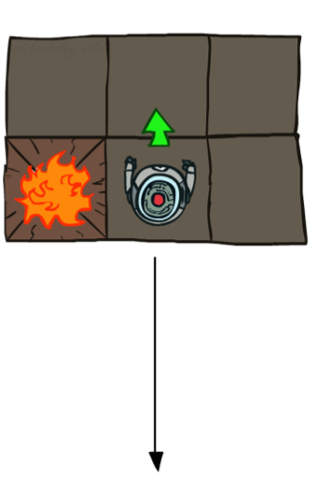
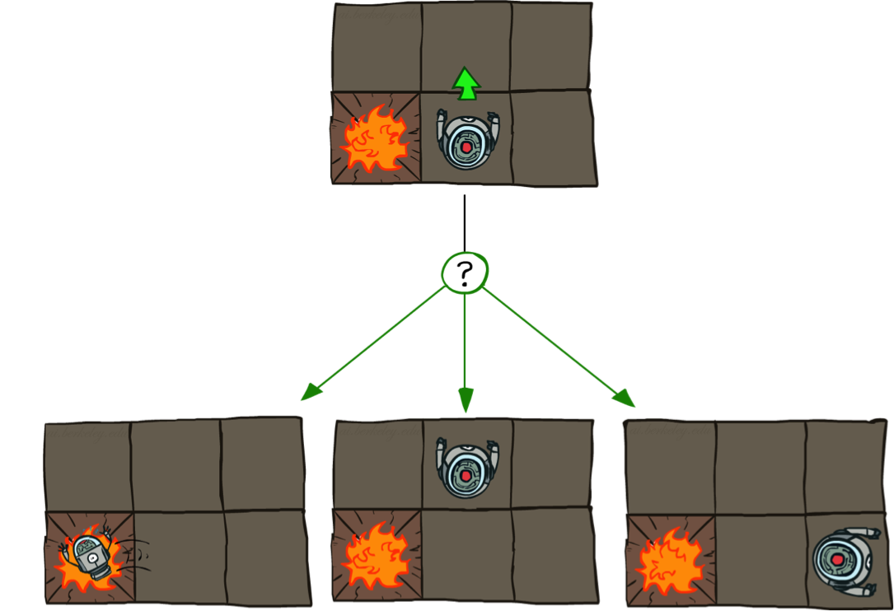
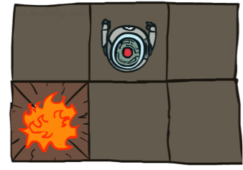
Grid World Actions
Deterministic Grid World
Stochastic Grid World
Slide credit: UC Berkeley AI

Slide 8
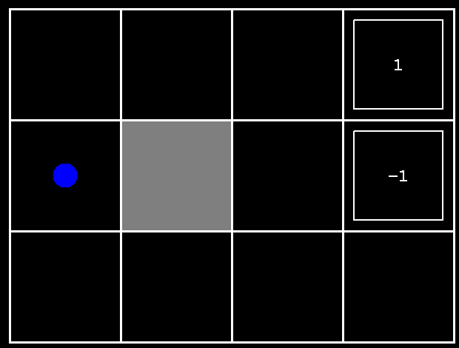
Grid World Demo
Slide credit: UC Berkeley AI
[Demo – gridworld manul intro (L8D1)]

Slide 9
Markov Decision Processes
An MDP is defined by:
  A set of states s ∈ S
  A set of actions a ∈ A
  A transition function P(s’| s, a)
    Probability that a from s leads to s’, i.e., P(s’| s, a)
    Also called the model or the dynamics
  A reward function R(s, a, s’)
    Sometimes just R(s) or R(s’) (negative if it is a penalty)
  Maybe a terminal state
MDPs are non-deterministic search problems
  One way to solve them is with expectimax search
  We’ll have a new tool soon
Slide credit: UC Berkeley AI
Notes:
In search problems: did not talk about actions, but about successor functions --- now the information inside the successor function is unpacked into actions, transitions and reward
Write out S, A, example entry in T, entry in R
Reward function different from the book : R(s,a,s’)
In book simpler for equations, but not useful for the projects.
Need to modify expectimax a tiny little bit to account for rewards along the way, but that’s something you should be able to do, and so you can already solve MDP’s (not in most efficient way)

Slide 10
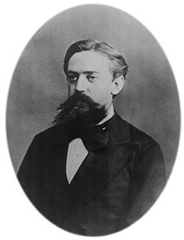

What is Markov about MDPs?
“Markov” generally means that given the present state, the future and the past are independent
For Markov decision processes, “Markov” means action outcomes depend only on the current state
This is just like search, where the successor function could only depend on the current state (not the history)
Andrey Markov (1856-1922)
Slide credit: UC Berkeley AI
Notes:
Like search: successor function only depended on current state
Can make this happen by stuffing more into the state;
Very similar to search problems: when solving a maze with food pellets, we stored which food pellets were eaten

Slide 11
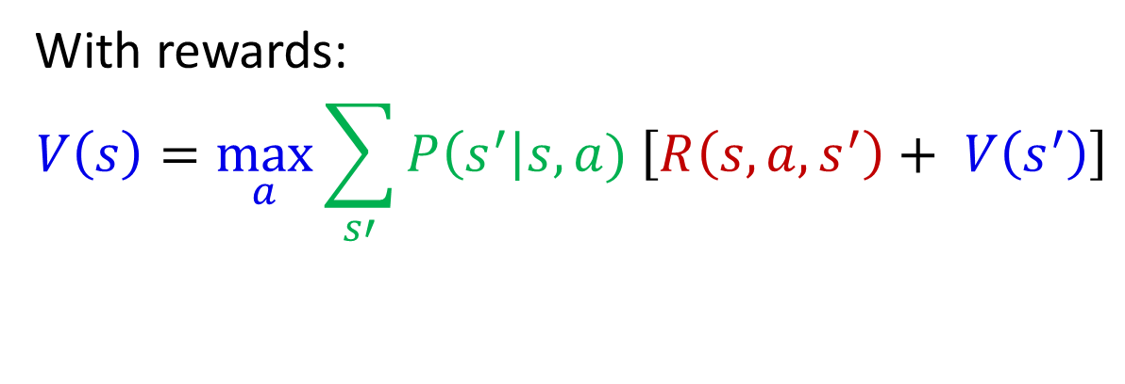
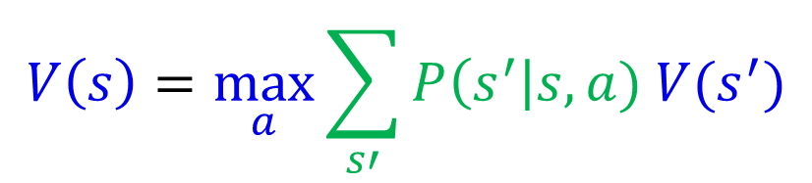
Recursive Expectimax (with rewards!)
s
$$V\left(s\right)=\max_{a}{\sum_{s′}{P\left(s^{′}\right|s,a) V(s^{′})}}$$
a
With rewards:
$$V\left(s\right)=\max_{a}{\sum_{s′}{P\left(s^{′}\right|s,a) \left[R\left(s, a, s^{′}\right)+ V\left(s^{′}\right)\right]}}$$
s, a
s,a,s’
s’

Slide 12

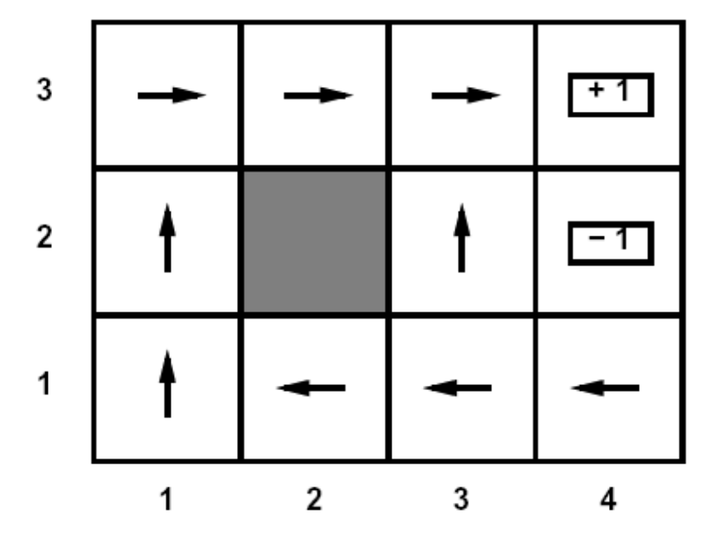
Policies
For MDPs, we want an optimal policy π*: S → A
  A policy π gives an action for each state
  An optimal policy is one that maximizes expected utility if followed
Example policy
(a map of states to actions)
Slide credit: UC Berkeley AI
Notes:
Dan has a DEMO for this.

Slide 13
Value Iteration (no discount yet)

Slide 14
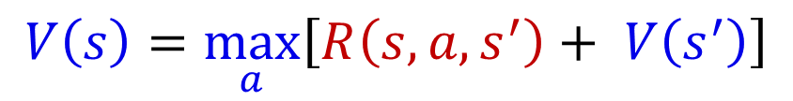
Simple Deterministic Example
T (Terminal)
R(A, Exit, T) = 10
R(A, Exit, T) = 1
  Actions: B, C, D: East, West
  Actions: A, E: Exit
  Transitions: deterministic
  Rewards only for transitioning to terminal state
A | B | C | D | E
$$V\left(s\right)=\max_{a}\left[R\left(s, a, s^{′}\right)+ V\left(s^{′}\right)\right]$$

Slide 15
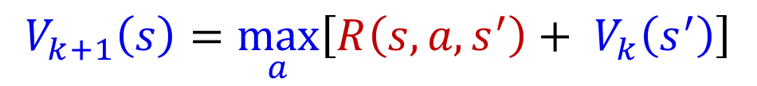
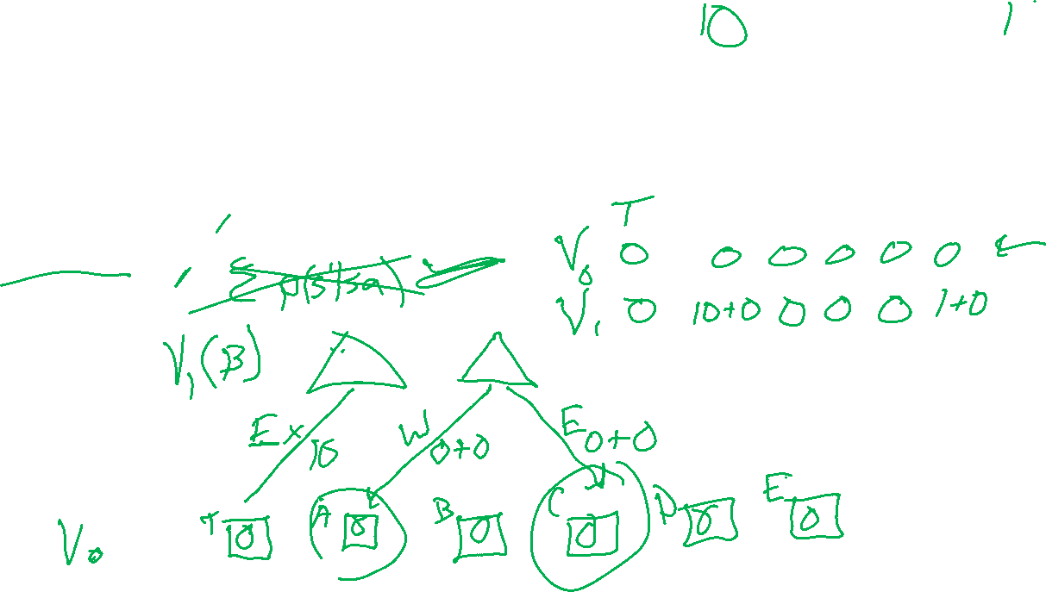
Simple Deterministic Example
T (Terminal)
R(A, Exit, T) = 10
R(A, Exit, T) = 1
  Actions: B, C, D: East, West
  Actions: A, E: Exit
  Transitions: deterministic
  Rewards only for transitioning to terminal state
A | B | C | D | E
$$V_{k+1}\left(s\right)=\max_{a}\left[R\left(s, a, s^{′}\right)+ V_{k}\left(s^{′}\right)\right]$$

Slide 16
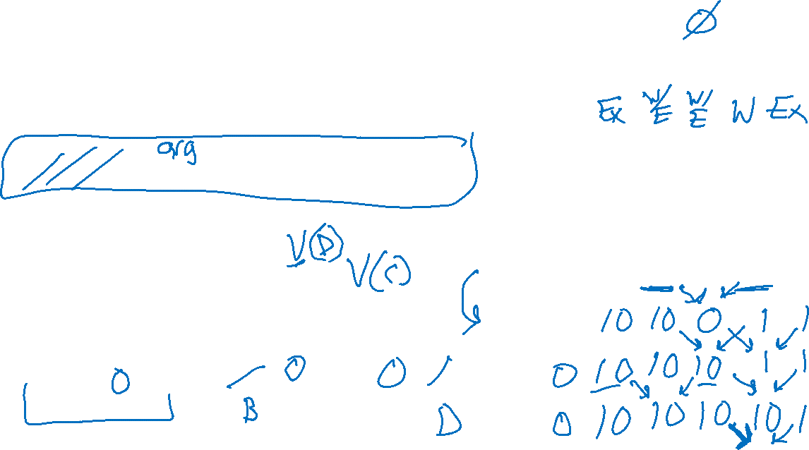
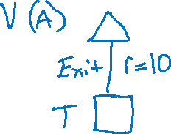
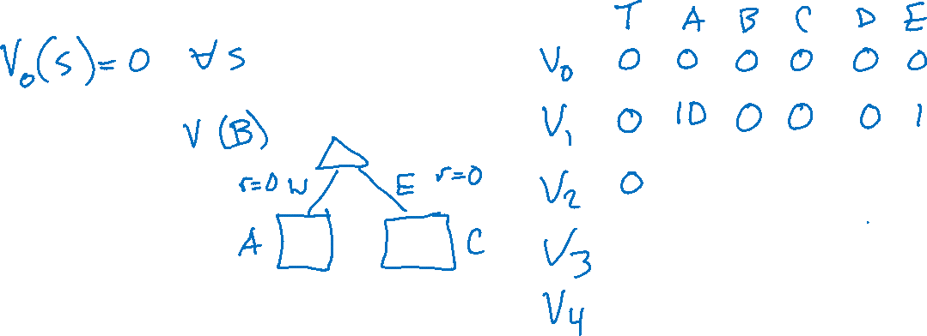
Simple Deterministic Example
T (Terminal)
R(A, Exit, T) = 10
R(E, Exit, T) = 1
  Actions: B, C, D: East, West
  Actions: A, E: Exit
  Transitions: deterministic
  Rewards only for transitioning to terminal state
A | B | C | D | E
$$V_{k+1}\left(s\right)=\max_{a}\left[R\left(s, a, s^{′}\right)+ V_{k}\left(s^{′}\right)\right]$$

Slide 17
[End Pre-reading]

Slide 18
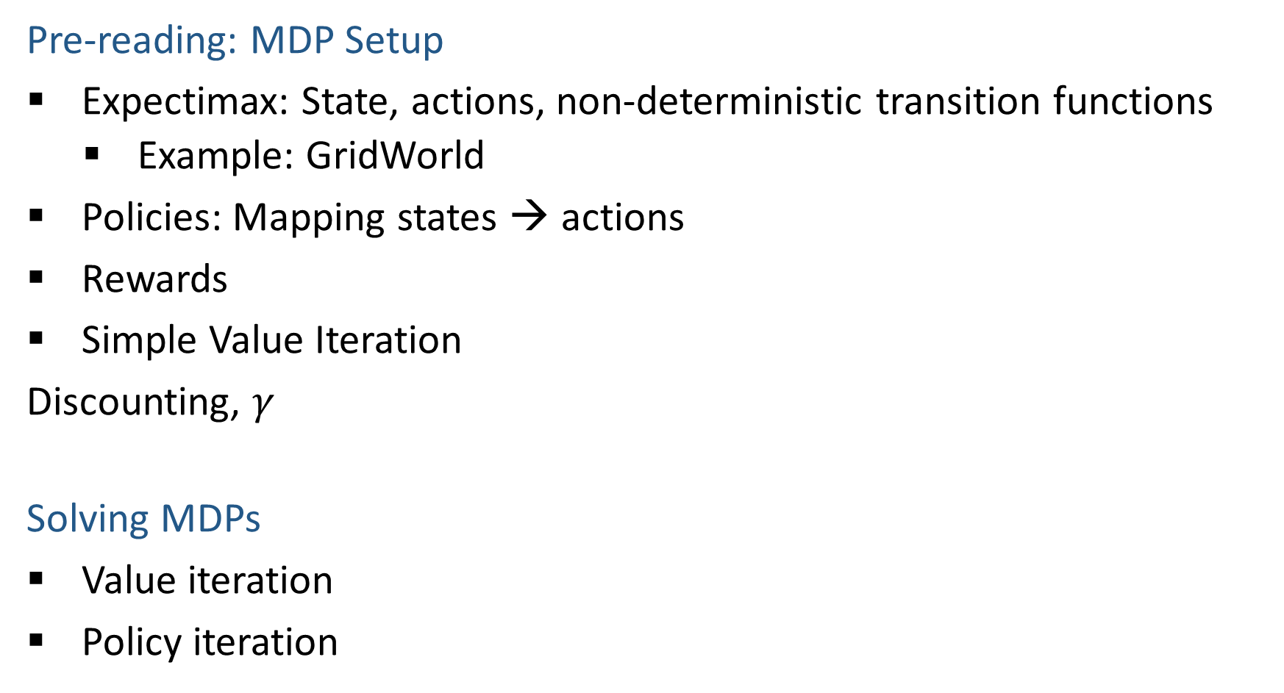
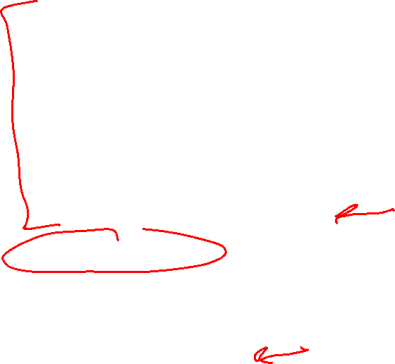
MDP Outline
Pre-reading: MDP Setup
Expectimax: State, actions, non-deterministic transition functions
    Example: GridWorld
Policies: Mapping states → actions
Rewards
Simple Value Iteration
Discounting, $γ$
Solving MDPs
Value iteration
Policy iteration
Image credit: Ketrina Yim, UC Berkeley

Slide 19
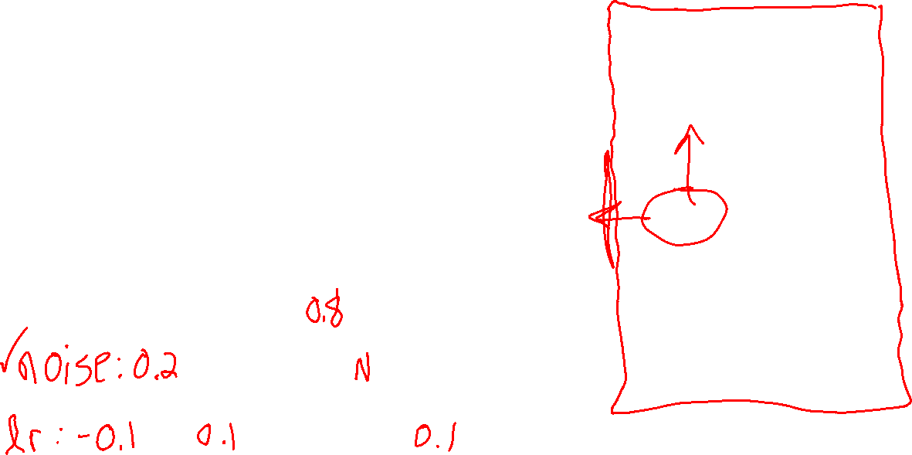
Question
Which is the best move?
  A. North
  B. East
  C. South
  D. West
Image credit: Ketrina Yim, UC Berkeley
Notes:
R(s) = the “living reward”

Slide 20
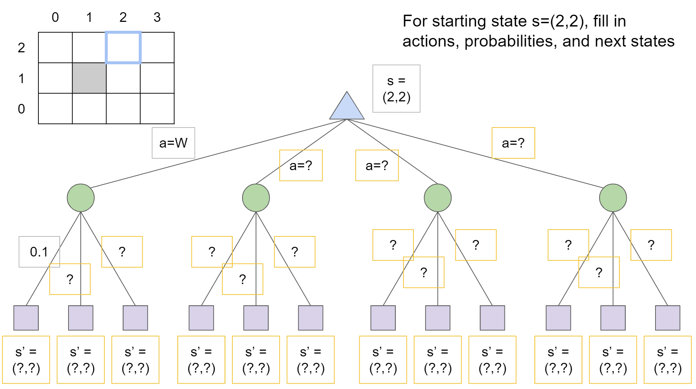
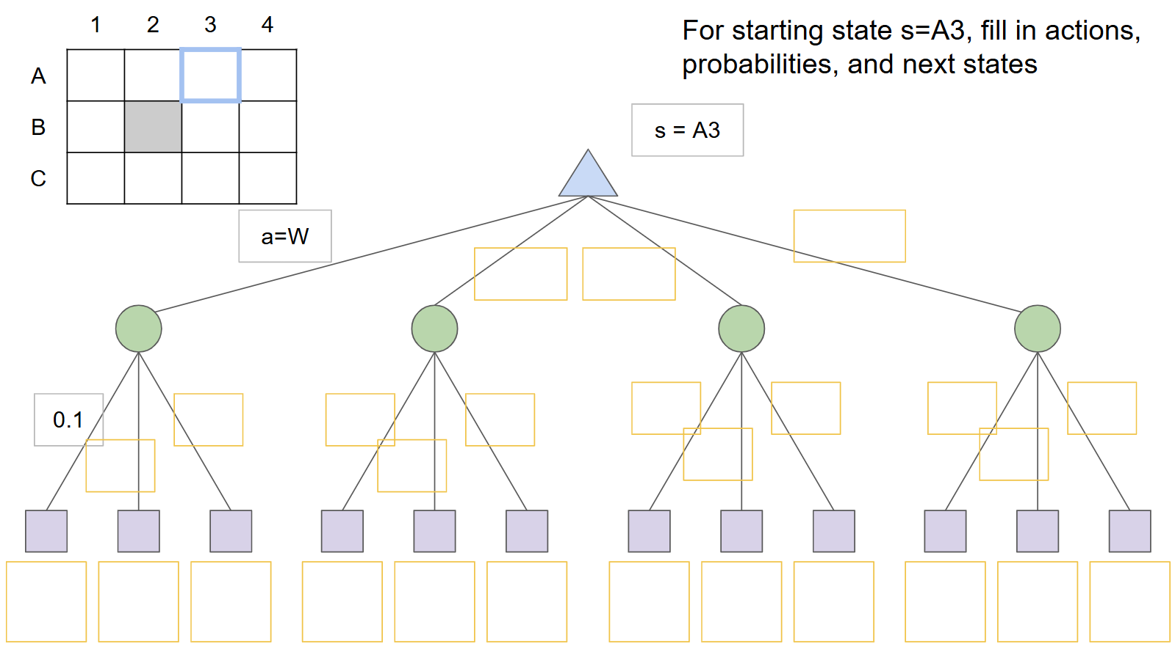
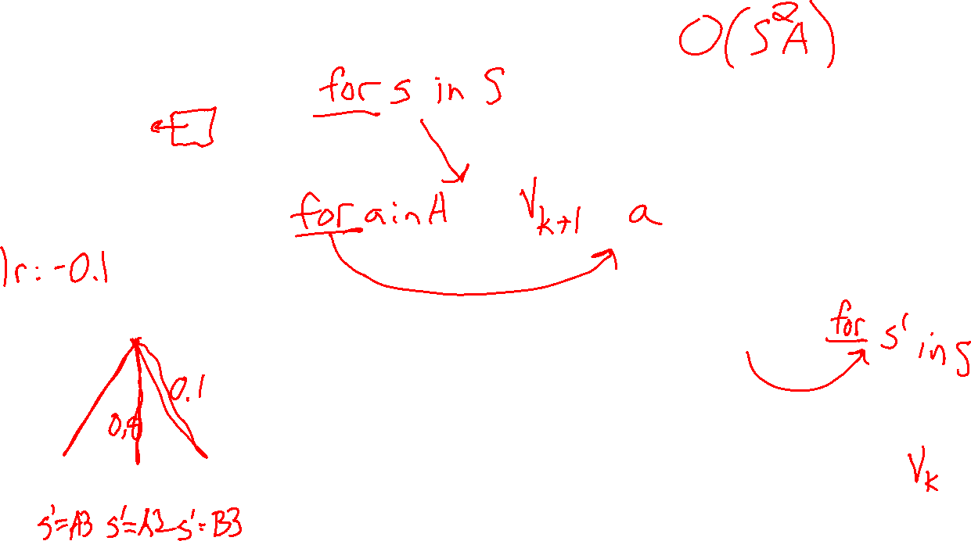
Grid World: Expectimax tree

Slide 21

MDP Outline
Pre-reading: MDP Setup
Expectimax: State, actions, non-deterministic transition functions
    Example: GridWorld
Policies: Mapping states → actions
Rewards
Simple Value Iteration
Discounting, $γ$
Solving MDPs
Value iteration
Policy iteration
Image credit: Ketrina Yim, UC Berkeley

Slide 22
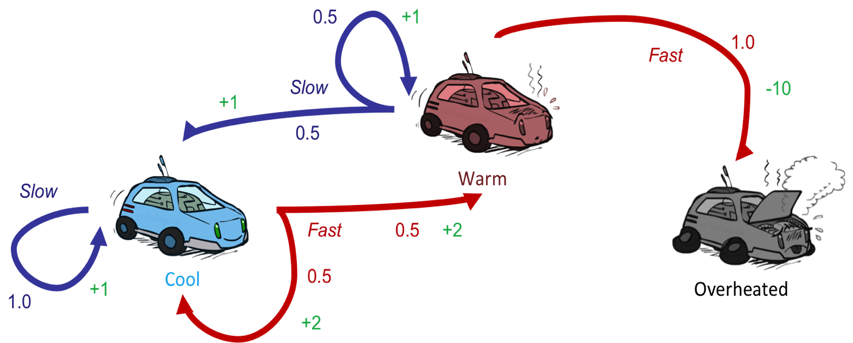

Example MDP: Racing
0.5
1.0
Fast
(R=-10)
Slow (R=1)
0.5
Slow (R=1)
Fast
(R=2)
0.5
1.0
0.5
Assume no discount!
Slide credit: UC Berkeley AI

Slide 23

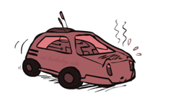

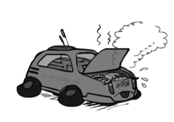
Racing Search Tree
Slide credit: UC Berkeley AI

Slide 24


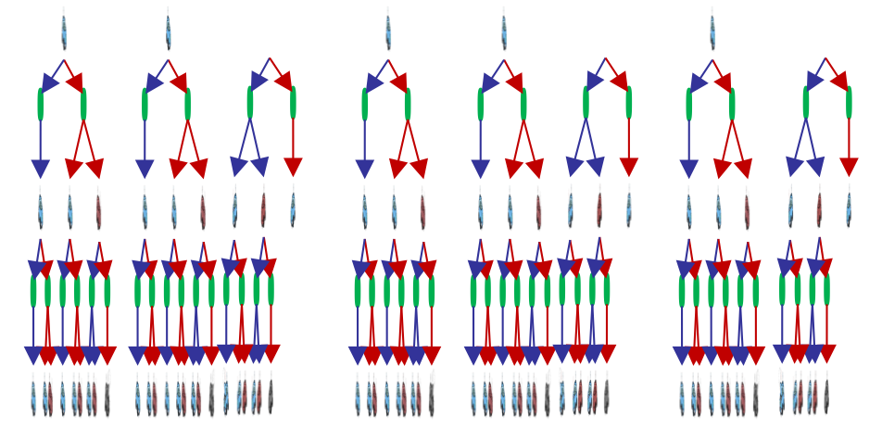

Racing Search Tree
We’re doing way too much work with expectimax!
Problem: States are repeated
  Idea: Only compute needed quantities once
Problem: Tree goes on forever
  Idea: Do a depth-limited computation, but with increasing depths until change is small
  Note: deep parts of the tree eventually don’t matter if γ < 1
Slide credit: UC Berkeley AI

Slide 25
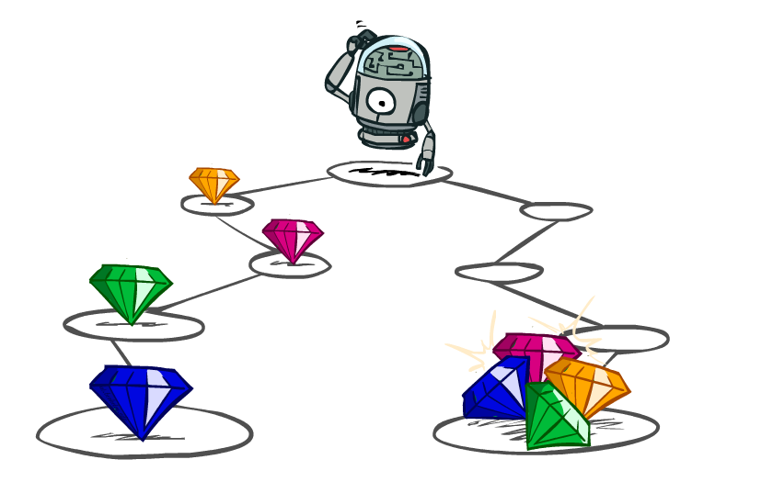
Utilities of Sequences
Image credit: Ketrina Yim, UC Berkeley

Slide 26
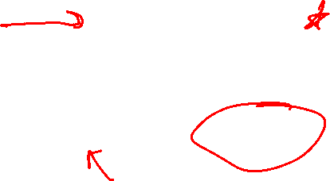
Utilities of Sequences
What preferences should an agent have over reward sequences?
More or less?
Now or later?
[1, 2, 2]
or
[2, 3, 4]
[0, 0, 1]
or
[1, 0, 0]
Slide credit: UC Berkeley AI

Slide 27

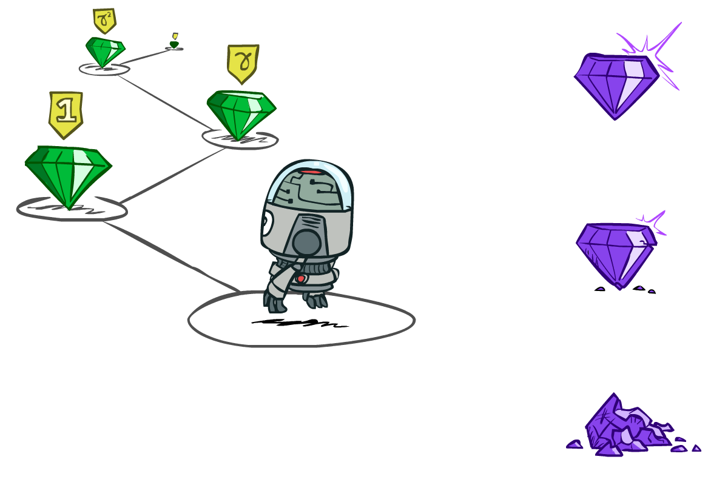

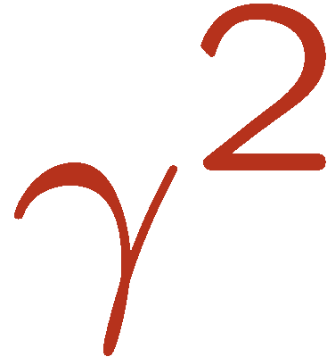

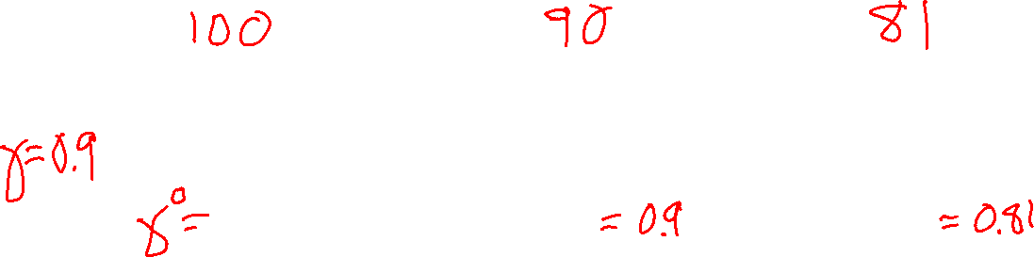
Discounting
It’s reasonable to maximize the sum of rewards
It’s also reasonable to prefer rewards now to rewards later
One solution: values of rewards decay exponentially
Worth Now
Worth Next Step
Worth In Two Steps
Slide credit: UC Berkeley AI

Slide 28

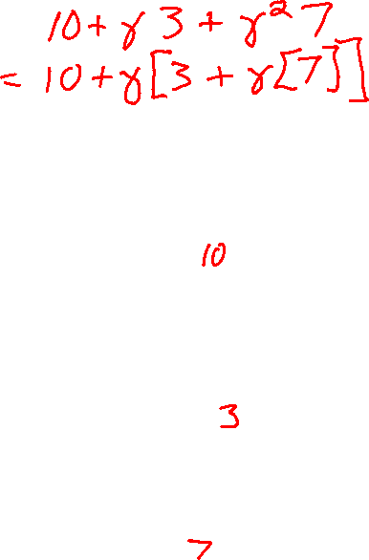
Discounting
How to discount?
  Each time we descend a level, we multiply in the discount once
Why discount?
  Sooner rewards probably do have higher utility than later rewards
  Also helps our algorithms converge
  Important: use 0 < γ < 1
Slide credit: UC Berkeley AI
Notes:
Rewards in the future (deeper in the tree) matter less
Interesting: running expectimax, if having to truncate the search, then not losing much; e.g., less then \gamma^d / (1-\gamma)

Slide 29

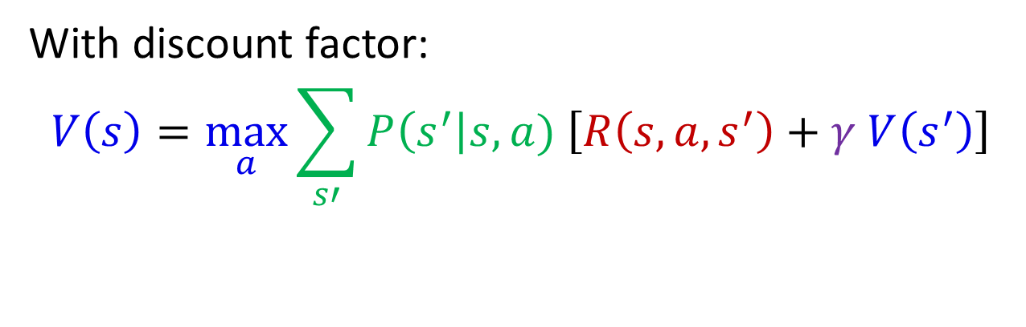
Recursive Expectimax
s
$$V\left(s\right)=\max_{a}{\sum_{s′}{P\left(s^{′}\right|s,a) V(s^{′})}}$$
a
With rewards:
$$V\left(s\right)=\max_{a}{\sum_{s′}{P\left(s^{′}\right|s,a) \left[R\left(s, a, s^{′}\right)+ V\left(s^{′}\right)\right]}}$$
s, a
With discount factor:
$$V\left(s\right)=\max_{a}{\sum_{s′}{P\left(s^{′}\right|s,a) \left[R\left(s, a, s^{′}\right)+γ V\left(s^{′}\right)\right]}}$$
s,a,s’
$$γ$$
s’

Slide 30



Recursive Expectimax
s
a
$$V\left(s\right)=\max_{a}{\sum_{s′}{P\left(s^{′}\right|s,a) V(s^{′})}}$$
s, a
With rewards:
$$V\left(s\right)=\max_{a}{\sum_{s′}{P\left(s^{′}\right|s,a) \left[R\left(s, a, s^{′}\right)+ V\left(s^{′}\right)\right]}}$$
s,a,s’
$$γ$$
s’
With discount factor:
$$V\left(s\right)=\max_{a}{\sum_{s′}{P\left(s^{′}\right|s,a) \left[R\left(s, a, s^{′}\right)+γ V\left(s^{′}\right)\right]}}$$
a'
s', a'
s',a',s''
$$γ$$
s''

Slide 31
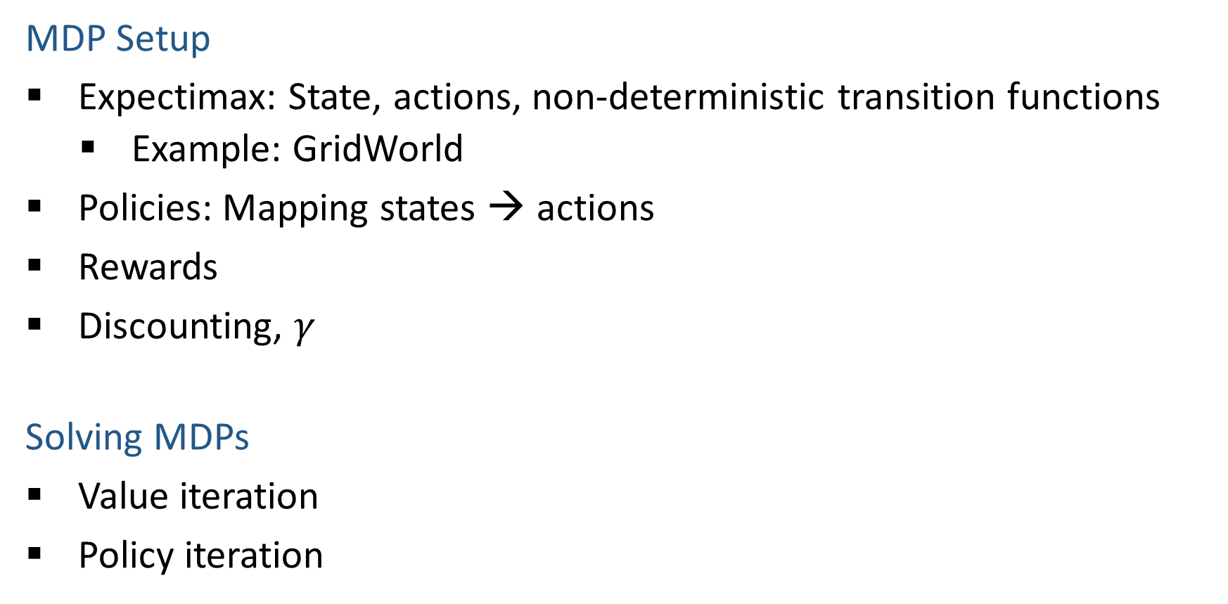
MDP Outline
MDP Setup
Expectimax: State, actions, non-deterministic transition functions
    Example: GridWorld
Policies: Mapping states → actions
Rewards
Discounting, $γ$
Solving MDPs
Value iteration
Policy iteration
Image credit: Ketrina Yim, UC Berkeley

Slide 32
Solving MDPs
Image credit: Ketrina Yim, UC Berkeley

Slide 33

Value Iteration
Image credit: Ketrina Yim, UC Berkeley

Slide 34
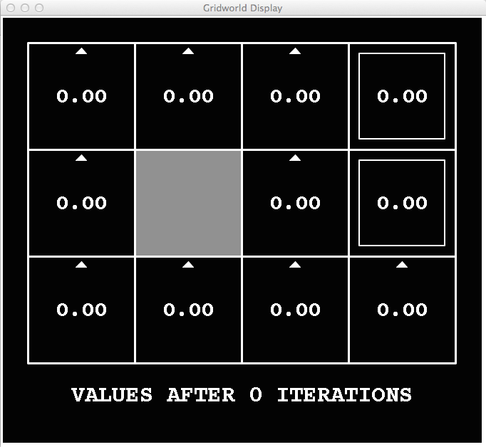
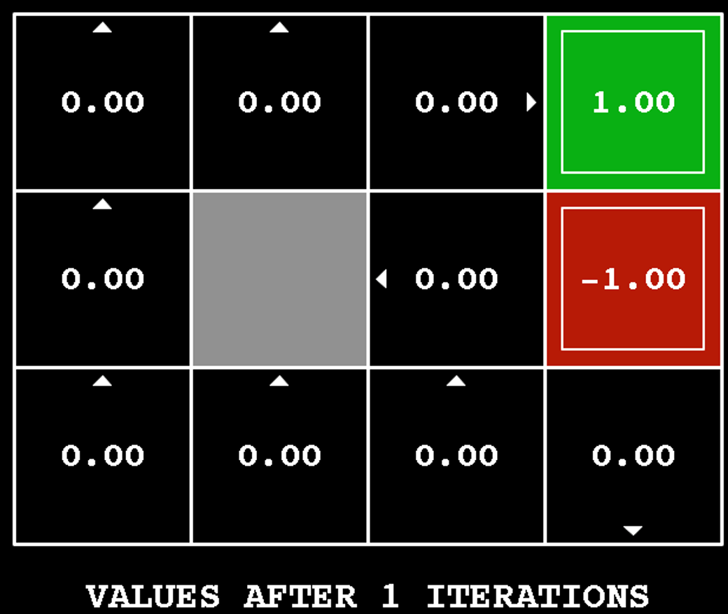
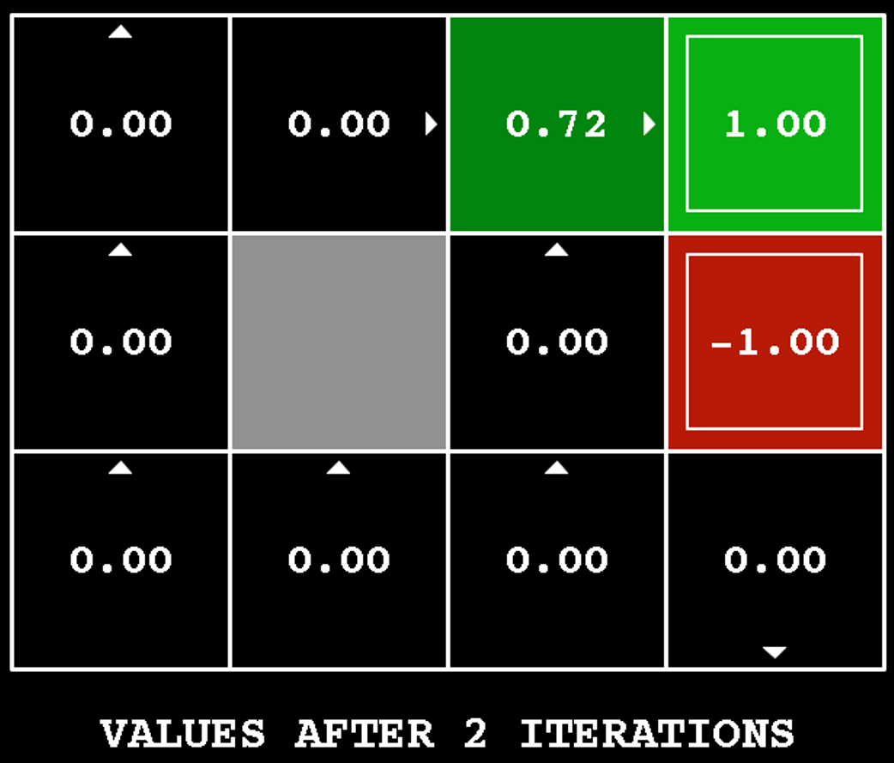
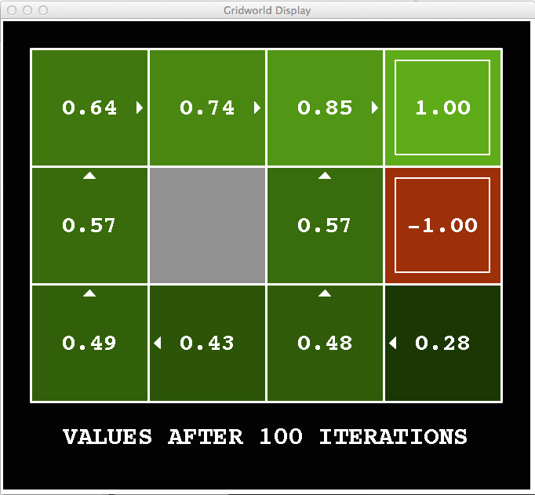
Value Iteration
Start with V₀(s) = 0: no time steps left means an expected reward sum of zero
Given vector of V_{k}(s) values, do one ply of expectimax from each state:
Repeat until convergence
V_{k+1}(s)
a
s, a
s,a,s’
V_{k}(s’)
...
Slide credit: UC Berkeley AI
Notes:
Discuss computational complexity: S * A * S times number of iterations
Note: updates not in place [if in place, it means something else and not even clear what it means]

Slide 35
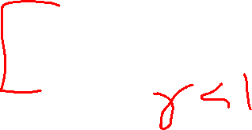
Value Iteration
Start with V₀(s) = 0: no time steps left means an expected reward sum of zero
Given vector of V_{k}(s) values, do one ply of expectimax from each state:
Repeat until convergence
Theorem: will converge to unique optimal values
  Basic idea: approximations get refined towards optimal values
V_{k+1}(s)
a
s, a
s,a,s’
V_{k}(s’)
Slide credit: UC Berkeley AI
Notes:
Discuss computational complexity: S * A * S times number of iterations
Note: updates not in place [if in place, it means something else and not even clear what it means]

Slide 36
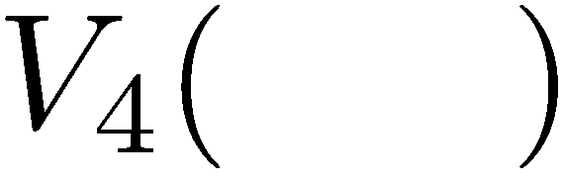



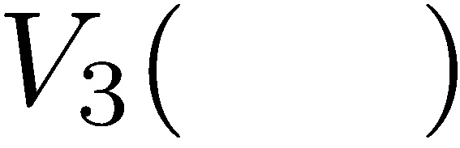

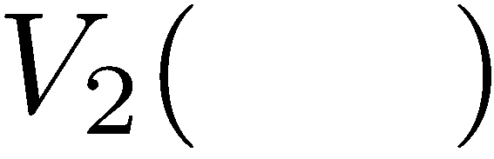
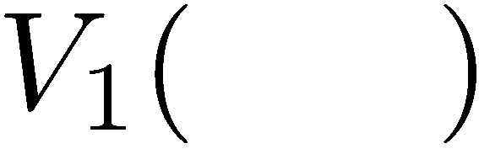
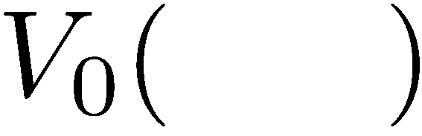

Computing Time-Limited Values
Slide credit: UC Berkeley AI

Slide 37


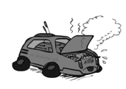
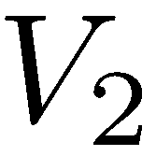
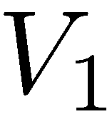
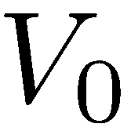
Example: Value Iteration
0.5
1.0
Fast
(R=-10)
Slow (R=1)
0.5
3.5 2.5 0
Slow (R=1)
Fast
(R=2)
0.5
2 1 0
1.0
0.5
Assume no discount!
0 0 0
Slide credit: UC Berkeley AI

Slide 38
GridWorld Value Iteration

Slide 39
Grid World: Expectimax tree

Slide 40

k=0
Noise = 0.2
Discount = 0.9
Living reward = 0
Slide credit: UC Berkeley AI
Notes:
Assuming zero living reward

Slide 41


k=1
Noise = 0.2
Discount = 0.9
Living reward = 0
Slide credit: UC Berkeley AI
Notes:
Assuming zero living reward

Slide 42


k=2
Noise = 0.2
Discount = 0.9
Living reward = 0
Slide credit: UC Berkeley AI
Notes:
Assuming zero living reward

Slide 43


k=3
Noise = 0.2
Discount = 0.9
Living reward = 0
Slide credit: UC Berkeley AI
Notes:
Assuming zero living reward

Slide 44

k=4
Noise = 0.2
Discount = 0.9
Living reward = 0
Slide credit: UC Berkeley AI
Notes:
Assuming zero living reward

Slide 45

k=5
Noise = 0.2
Discount = 0.9
Living reward = 0
Slide credit: UC Berkeley AI
Notes:
Assuming zero living reward

Slide 46

k=6
Noise = 0.2
Discount = 0.9
Living reward = 0
Slide credit: UC Berkeley AI
Notes:
Assuming zero living reward

Slide 47

k=7
Noise = 0.2
Discount = 0.9
Living reward = 0
Slide credit: UC Berkeley AI
Notes:
Assuming zero living reward

Slide 48

k=8
Noise = 0.2
Discount = 0.9
Living reward = 0
Slide credit: UC Berkeley AI
Notes:
Assuming zero living reward

Slide 49

k=9
Noise = 0.2
Discount = 0.9
Living reward = 0
Slide credit: UC Berkeley AI
Notes:
Assuming zero living reward

Slide 50

k=10
Noise = 0.2
Discount = 0.9
Living reward = 0
Slide credit: UC Berkeley AI
Notes:
Assuming zero living reward

Slide 51

k=11
Noise = 0.2
Discount = 0.9
Living reward = 0
Slide credit: UC Berkeley AI
Notes:
Assuming zero living reward

Slide 52

k=12
Noise = 0.2
Discount = 0.9
Living reward = 0
Slide credit: UC Berkeley AI
Notes:
Assuming zero living reward

Slide 53
k=100
Noise = 0.2
Discount = 0.9
Living reward = 0
Slide credit: UC Berkeley AI
Notes:
Assuming zero living reward

Slide 54

Optimal Values & Bellman Equations
How to be optimal:
Step 1: Take correct first action
Step 2: Keep being optimal
Image credit: Ketrina Yim, UC Berkeley

Slide 55
Optimal Quantities
s
The value (utility) of a state s:
  V*(s) = expected utility starting in s and acting optimally
a
s, a
s,a,s’
s’
Slide credit: UC Berkeley AI
[Demo: gridworld values (L9D1)]
Notes:
Demo just shows V and Q values, snapshots on next slides.

Slide 56
Optimal Quantities
s
The value (utility) of a state s:
  V*(s) = expected utility starting in s and acting optimally
The value (utility) of a q-state (s,a):
  Q*(s,a) = expected utility starting out having taken action a from state s and (thereafter) acting optimally
a
s, a
s,a,s’
s’
Slide credit: UC Berkeley AI
[Demo: gridworld values (L9D1)]
Notes:
Demo just shows V and Q values, snapshots on next slides.

Slide 57

Optimal Quantities
s
The value (utility) of a state s:
  V*(s) = expected utility starting in s and acting optimally
The value (utility) of a q-state (s,a):
  Q*(s,a) = expected utility starting out having taken action a from state s and (thereafter) acting optimally
The optimal policy:
  π*(s) = optimal action from state s
a
s, a
s,a,s’
s’
Slide credit: UC Berkeley AI
[Demo: gridworld values (L9D1)]
Notes:
Demo just shows V and Q values, snapshots on next slides.

Slide 58

Gridworld Values V*
Slide credit: UC Berkeley AI

Slide 59


Gridworld: Q*
Slide credit: UC Berkeley AI

Slide 60



The Bellman Equations
s
Definition of “optimal utility” via expectimax recurrence gives a simple one-step lookahead relationship amongst optimal utility values
These are the Bellman equations, and they characterize optimal values in a way we’ll use over and over
a
s, a
s,a,s’
s’
Slide credit: UC Berkeley AI
Notes:
Let’s start by equations that characterize these quantities through mutual recursions. [step through this by writing on slide, one step at a time]
Recursive characterization of V* in terms of V*; not necessarily helpful; but it is a characterization.
Note: this is a set of equations that needs to be satisfied; but it could have multiple solutions (it does not, but at this stage of our knowledge it could).

Slide 61

Summary: Bellman Equations vs Value Iteration
s
Bellman equations characterize the optimal values:
Value iteration computes them:
Value iteration is just a fixed point solution method
a
s, a
s,a,s’
Slide credit: UC Berkeley AI
Notes:
Discuss computational complexity: S * A * S times number of iterations
Note: updates not in place [if in place, it means something else and not even clear what it means]

Slide 62

MDP Notation
$$V\left(s\right)=\max_{a}{\sum_{s′}{P\left(s^{′}\right|s,a)V(s^{′})}}$$
$$V^{∗}\left(s\right)=\max_{a}{\sum_{s′}{P\left(s^{′} | s,a\right)\left[R\left(s,a,s^{′}\right)+γV^{∗}\left(s^{′}\right)\right]}}$$
$$V_{k+1}\left(s\right)=\max_{a}{\sum_{s′}{P\left(s^{′} | s,a\right)\left[R\left(s,a,s^{′}\right)+γV_{k}\left(s^{′}\right)\right]}}, ∀ s$$
Standard expectimax:
Bellman equations:
Value iteration:

Slide 63

Outline
MDP Setup
Expectimax: State, actions, non-deterministic transition functions
Rewards
    Walk-through of super-simple value iteration
Discounting, $γ$
Solving MDPs
Method 1) Value iteration
    Value iteration convergence
Optimal values & Bellman equations
Policy Extraction
Method 2) Policy Iteration
A | B | C | D | E
Image credit: Ketrina Yim, UC Berkeley

Slide 64


Solved MDP! Now what?
What are we going to do with these values??
$$V^{∗}\left(s\right)$$
$$Q^{∗}\left(s,a\right)$$
Slide credit: UC Berkeley AI

Slide 65

Poll 1
If you need to extract a policy, would you rather have
A) Values, B) Q-values?

Slide 66
Poll 1
If you need to extract a policy, would you rather have
A) Values, B) Q-values ?

Slide 67

Policy Extraction
Image credit: Ketrina Yim, UC Berkeley

Slide 68



Computing Actions from Values
Let’s imagine we have the optimal values V*(s)
How should we act?
  It’s not obvious!
We need to do a mini-expectimax (one step)
This is called policy extraction, since it gets the policy implied by the values
Slide credit: UC Berkeley AI

Slide 69


Computing Actions from Q-Values
Let’s imagine we have the optimal q-values:
How should we act?
  Completely trivial to decide!
Important lesson: actions are easier to select from q-values than values!
Slide credit: UC Berkeley AI

Slide 70

Value Iteration Notes
Value iteration repeats the Bellman updates:
Things to notice when running value iteration:
It’s slow – O(S²A) per iteration
The “max” at each state rarely changes
The optimal policy appears before the values converge (but we don’t know that the policy is optimal until the values converge)
s
a
s, a
s,a,s’
s’
Slide credit: UC Berkeley AI
[Demo: value iteration (L9D2)]
Notes:
Demo steps through value iteration; snapshots of values shown on next slides.

Slide 71

k=0
Noise = 0.2
Discount = 0.9
Living reward = 0
Slide credit: UC Berkeley AI
Notes:
Assuming zero living reward

Slide 72
k=1
Noise = 0.2
Discount = 0.9
Living reward = 0
Slide credit: UC Berkeley AI
Notes:
Assuming zero living reward

Slide 73
k=2
Noise = 0.2
Discount = 0.9
Living reward = 0
Slide credit: UC Berkeley AI
Notes:
Assuming zero living reward

Slide 74
k=3
Noise = 0.2
Discount = 0.9
Living reward = 0
Slide credit: UC Berkeley AI
Notes:
Assuming zero living reward

Slide 75
k=4
Noise = 0.2
Discount = 0.9
Living reward = 0
Slide credit: UC Berkeley AI
Notes:
Assuming zero living reward

Slide 76
k=5
Noise = 0.2
Discount = 0.9
Living reward = 0
Slide credit: UC Berkeley AI
Notes:
Assuming zero living reward

Slide 77
k=6
Noise = 0.2
Discount = 0.9
Living reward = 0
Slide credit: UC Berkeley AI
Notes:
Assuming zero living reward

Slide 78

k=7
Noise = 0.2
Discount = 0.9
Living reward = 0
Slide credit: UC Berkeley AI
Notes:
Assuming zero living reward

Slide 79
k=8
Noise = 0.2
Discount = 0.9
Living reward = 0
Slide credit: UC Berkeley AI
Notes:
Assuming zero living reward

Slide 80

k=9
Noise = 0.2
Discount = 0.9
Living reward = 0
Slide credit: UC Berkeley AI
Notes:
Assuming zero living reward

Slide 81

k=10
Noise = 0.2
Discount = 0.9
Living reward = 0
Slide credit: UC Berkeley AI
Notes:
Assuming zero living reward

Slide 82
k=11
Noise = 0.2
Discount = 0.9
Living reward = 0
Slide credit: UC Berkeley AI
Notes:
Assuming zero living reward

Slide 83
k=12
Noise = 0.2
Discount = 0.9
Living reward = 0
Slide credit: UC Berkeley AI
Notes:
Assuming zero living reward

Slide 84

k=100
Noise = 0.2
Discount = 0.9
Living reward = 0
Slide credit: UC Berkeley AI
Notes:
Assuming zero living reward

Slide 85


Outline
Pre-reading: MDP Setup
Expectimax: State, actions, non-deterministic transition functions
Rewards
    Walk-through of super-simple value iteration
Discounting, $γ$
Solving MDPs
Method 1) Value iteration
    Value iteration convergence
Bellman equations
Policy Extraction
Method 2) Policy Iteration
A | B | C | D | E
Image credit: Ketrina Yim, UC Berkeley

Slide 86


Policy Iteration
Image credit: Ketrina Yim, UC Berkeley

Slide 87

Two Methods for Solving MDPs
Value iteration + policy extraction
  Step 1: Value iteration: calculate values for all states by running one ply of the Bellman equations using values from previous iteration until convergence
  Step 2: Policy extraction: compute policy by running one ply of the Bellman equations using values from value iteration
Policy iteration
  Step 1: Policy evaluation: calculate values for some fixed policy (not optimal values!) until convergence
  Step 2: Policy improvement: update policy by running one ply of the Bellman equations using values from policy evaluation
  Repeat steps until policy converges

Slide 88

Policy Evaluation
Image credit: Ketrina Yim, UC Berkeley

Slide 89



Example: Policy Evaluation
Always Go Right
Always Go Forward
Slide credit: UC Berkeley AI

Slide 90


Example: Policy Evaluation
Always Go Right
Always Go Forward
Slide credit: UC Berkeley AI

Slide 91

Policy Evaluation: Fixed Policies
Normally: Do the optimal action
Fixed policy: Do what π says to do
s
s
a
π(s)
s, a
s, π(s)
s,a,s’
s, π(s),s’
s’
s’
Expectimax trees max over all actions to compute the optimal values
If we fixed some policy π(s), then the tree would be simpler – only one action per state
  … though the tree’s value would depend on which policy we fixed
Slide credit: UC Berkeley AI

Slide 92
Policy Evaluation: Utilities for a Fixed Policy
Another basic operation: compute the utility value of a state s under a fixed (generally non-optimal) policy
Define the utility of a state s, under a fixed policy π:
  V^{π}(s) = expected sum of discounted rewards starting in s and following π
Recursive relation (one-step look-ahead / Bellman equation):
s
π(s)
s, π(s)
s, π(s),s’
s’
Slide credit: UC Berkeley AI

Slide 93


Policy Evaluation
How do we calculate the V’s for a fixed policy π?
Idea 1: Turn recursive Bellman equations into updates
(like value iteration)
Efficiency: O(S²) per iteration
Idea 2: Without the maxes, the Bellman equations are just a linear system
  Solve with your favorite linear system solver
s
π(s)
s, π(s)
s, π(s),s’
s’
Slide credit: UC Berkeley AI

Slide 94

Policy Improvement
Image credit: Ketrina Yim, UC Berkeley

Slide 95

Policy Iteration:
Evaluation: For fixed current policy π, find values with policy evaluation:
  Iterate until values converge:
Improvement: For fixed values, get a better policy using policy extraction
  One-step look-ahead:
Policy iteration
  It’s still optimal!
  Can converge faster under some conditions
Slide credit: UC Berkeley AI

Slide 96


Two Methods for Solving MDPs
Value iteration + policy extraction
  Step 1: Value iteration:
  $V_{k+1}\left(s\right)=\max_{a}{\sum_{s′}{P\left(s^{′} | s,a\right)\left[R\left(s,a,s^{′}\right)+γV_{k}\left(s^{′}\right)\right]}}, ∀ s$ until convergence
  Step 2: Policy extraction:
  $π_{V}\left(s\right)=\underset{a}{argmax}{\sum_{s′}{P\left(s^{′} | s,a\right)[R\left(s,a,s^{′}\right)+γV\left(s^{′}\right)]}}, ∀ s$
Policy iteration
  Step 1: Policy evaluation:
  $V_{k+1}^{π}\left(s\right)=\sum_{s′}{P\left(s^{′} | s,π\left(s\right)\right)[R\left(s,π\left(s\right),s^{′}\right)+γV_{k}^{π}\left(s^{′}\right)]}, ∀ s$ until convergence
  Step 2: Policy improvement:
  $π_{new}\left(s\right)=\underset{a}{argmax}{\sum_{s′}{P\left(s^{′} | s,a\right)\left[R\left(s,a,s^{′}\right)+γV^{π_{old}}\left(s^{′}\right)\right]}}, ∀ s$
  Repeat steps until policy converges

Slide 97
Comparison
Both value iteration and policy iteration compute the same thing (all optimal values)
In value iteration:
  Every iteration updates both the values and (implicitly) the policy
  We don’t track the policy, but taking the max over actions implicitly recomputes it
In policy iteration:
  We do several passes that update values with fixed policy (each pass is fast because we consider only one action, not all of them; however we do many passes)
  After the policy is evaluated, a new policy is chosen (with (arg)max like value iteration)
  The new policy will be better (or we’re done)
(Both are dynamic programs for solving MDPs)

Slide 98
Summary: MDP Algorithms
So you want to….
  Compute optimal values: use value iteration or policy iteration
  Compute values for a particular policy: use policy evaluation
  Turn your values into a policy: use policy extraction (one-step lookahead)
These all look the same!
  They basically are – they are all variations of Bellman updates
  They all use one-step lookahead expectimax fragments
  They differ only in whether we plug in a fixed policy or max over actions

Slide 99


MDP Notation
$$V\left(s\right)=\max_{a}{\sum_{s′}{P\left(s^{′}\right|s,a)V(s^{′})}}$$
$$V^{∗}\left(s\right)=\max_{a}{\sum_{s′}{P\left(s^{′} | s,a\right)\left[R\left(s,a,s^{′}\right)+γV^{∗}\left(s^{′}\right)\right]}}$$
$$V_{k+1}\left(s\right)=\max_{a}{\sum_{s′}{P\left(s^{′} | s,a\right)\left[R\left(s,a,s^{′}\right)+γV_{k}\left(s^{′}\right)\right]}}, ∀ s$$
$$Q_{k+1}\left(s,a\right)=\sum_{s′}{P\left(s^{′} | s,a\right)[R\left(s,a,s^{′}\right)+γ\max_{a^{′}}{Q_{k}(s^{′},a^{′})]}, } ∀ s,a$$
$$π_{V}\left(s\right)=\underset{a}{argmax}{\sum_{s′}{P\left(s^{′} | s,a\right)[R\left(s,a,s^{′}\right)+γV\left(s^{′}\right)]}}, ∀ s$$
$$V_{k+1}^{π}\left(s\right)=\sum_{s′}{P\left(s^{′} | s,π\left(s\right)\right)[R\left(s,π\left(s\right),s^{′}\right)+γV_{k}^{π}\left(s^{′}\right)]}, ∀ s$$
$$π_{new}\left(s\right)=\underset{a}{argmax}{\sum_{s′}{P\left(s^{′} | s,a\right)\left[R\left(s,a,s^{′}\right)+γV^{π_{old}}\left(s^{′}\right)\right]}}, ∀ s$$
Standard expectimax:
Bellman equations:
Value iteration:
Q-iteration:
Policy extraction:
Policy evaluation:
Policy improvement:

Slide 100


MDP Notation
$$V\left(s\right)=\max_{a}{\sum_{s′}{P\left(s^{′}\right|s,a)V(s^{′})}}$$
$$V^{∗}\left(s\right)=\max_{a}{\sum_{s′}{P\left(s^{′} | s,a\right)\left[R\left(s,a,s^{′}\right)+γV^{∗}\left(s^{′}\right)\right]}}$$
$$V_{k+1}\left(s\right)=\max_{a}{\sum_{s′}{P\left(s^{′} | s,a\right)\left[R\left(s,a,s^{′}\right)+γV_{k}\left(s^{′}\right)\right]}}, ∀ s$$
$$Q_{k+1}\left(s,a\right)=\sum_{s′}{P\left(s^{′} | s,a\right)[R\left(s,a,s^{′}\right)+γ\max_{a^{′}}{Q_{k}(s^{′},a^{′})]}, } ∀ s,a$$
$$π_{V}\left(s\right)=\underset{a}{argmax}{\sum_{s′}{P\left(s^{′} | s,a\right)[R\left(s,a,s^{′}\right)+γV\left(s^{′}\right)]}}, ∀ s$$
$$V_{k+1}^{π}\left(s\right)=\sum_{s′}{P\left(s^{′} | s,π\left(s\right)\right)[R\left(s,π\left(s\right),s^{′}\right)+γV_{k}^{π}\left(s^{′}\right)]}, ∀ s$$
$$π_{new}\left(s\right)=\underset{a}{argmax}{\sum_{s′}{P\left(s^{′} | s,a\right)\left[R\left(s,a,s^{′}\right)+γV^{π_{old}}\left(s^{′}\right)\right]}}, ∀ s$$
Standard expectimax:
Bellman equations:
Value iteration:
Q-iteration:
Policy extraction:
Policy evaluation:
Policy improvement:

Slide 101
MDP Notation
$$V\left(s\right)=\max_{a}{\sum_{s′}{P\left(s^{′}\right|s,a)V(s^{′})}}$$
$$V^{∗}\left(s\right)=\max_{a}{\sum_{s′}{P\left(s^{′} | s,a\right)\left[R\left(s,a,s^{′}\right)+γV^{∗}\left(s^{′}\right)\right]}}$$
$$V_{k+1}\left(s\right)=\max_{a}{\sum_{s′}{P\left(s^{′} | s,a\right)\left[R\left(s,a,s^{′}\right)+γV_{k}\left(s^{′}\right)\right]}}, ∀ s$$
$$Q_{k+1}\left(s,a\right)=\sum_{s′}{P\left(s^{′} | s,a\right)[R\left(s,a,s^{′}\right)+γ\max_{a^{′}}{Q_{k}(s^{′},a^{′})]}, } ∀ s,a$$
$$π_{V}\left(s\right)=\underset{a}{argmax}{\sum_{s′}{P\left(s^{′} | s,a\right)[R\left(s,a,s^{′}\right)+γV\left(s^{′}\right)]}}, ∀ s$$
$$V_{k+1}^{π}\left(s\right)=\sum_{s′}{P\left(s^{′} | s,π\left(s\right)\right)[R\left(s,π\left(s\right),s^{′}\right)+γV_{k}^{π}\left(s^{′}\right)]}, ∀ s$$
$$π_{new}\left(s\right)=\underset{a}{argmax}{\sum_{s′}{P\left(s^{′} | s,a\right)\left[R\left(s,a,s^{′}\right)+γV^{π_{old}}\left(s^{′}\right)\right]}}, ∀ s$$
Standard expectimax:
Bellman equations:
Value iteration:
Q-iteration:
Policy extraction:
Policy evaluation:
Policy improvement:

Slide 102


MDP Notation
$$V\left(s\right)=\max_{a}{\sum_{s′}{P\left(s^{′}\right|s,a)V(s^{′})}}$$
$$V^{∗}\left(s\right)=\max_{a}{\sum_{s′}{P\left(s^{′} | s,a\right)\left[R\left(s,a,s^{′}\right)+γV^{∗}\left(s^{′}\right)\right]}}$$
$$V_{k+1}\left(s\right)=\max_{a}{\sum_{s′}{P\left(s^{′} | s,a\right)\left[R\left(s,a,s^{′}\right)+γV_{k}\left(s^{′}\right)\right]}}, ∀ s$$
$$Q_{k+1}\left(s,a\right)=\sum_{s′}{P\left(s^{′} | s,a\right)[R\left(s,a,s^{′}\right)+γ\max_{a^{′}}{Q_{k}(s^{′},a^{′})]}, } ∀ s,a$$
$$π_{V}\left(s\right)=\underset{a}{argmax}{\sum_{s′}{P\left(s^{′} | s,a\right)[R\left(s,a,s^{′}\right)+γV\left(s^{′}\right)]}}, ∀ s$$
$$V_{k+1}^{π}\left(s\right)=\sum_{s′}{P\left(s^{′} | s,π\left(s\right)\right)[R\left(s,π\left(s\right),s^{′}\right)+γV_{k}^{π}\left(s^{′}\right)]}, ∀ s$$
$$π_{new}\left(s\right)=\underset{a}{argmax}{\sum_{s′}{P\left(s^{′} | s,a\right)\left[R\left(s,a,s^{′}\right)+γV^{π_{old}}\left(s^{′}\right)\right]}}, ∀ s$$
Standard expectimax:
Bellman equations:
Value iteration:
Q-iteration:
Policy extraction:
Policy evaluation:
Policy improvement:

