Slide 1

07-280
AI & ML I
Attention & Transformers
Instructors:
Pat Virtue & Nihar Shah

Slide 2
Simple Word Embedding LM
Building a language model with just word embedding layers ☺
Current text
Really Small Language Model
Next text
Tokenizer
Tokenizer
Sampling
Input tokens
Next token
Probabilty
of each token
in vocab
Word Embedding
Output Embedding
Softmax
Embedded vector representation
Similarity scores
for each token
in vocab

Slide 3
Word (Token) Embeddings
The beginning and the end of LLM networks
Current text
Large Language Model
e.g GPT, Llama, etc
Next text
Tokenizer
Tokenizer
Sampling
Input tokens
Next token
Probabilty
of each token
in vocab
Word Embedding
Many layers of
transformer/attention blocks
Output Embedding
Softmax
Embedded vector representation
Embedded vector representation
Similarity scores
for each token
in vocab

Slide 4

Large Language Models!
Last time
Word Embeddings
Today
Increasing the conext size
Positional Encoding
Attention
Building GPT2!
Multiheaded attention
Transformers

Slide 5
Context size > 1

Slide 6
Transformer Language Models
Increasing context size
Uniform average of context vectors
Position encoding
Attention
Weighted average of context vectors
Query Keys Values
Expressive power of linear transforms
Building GPT2!

Slide 7
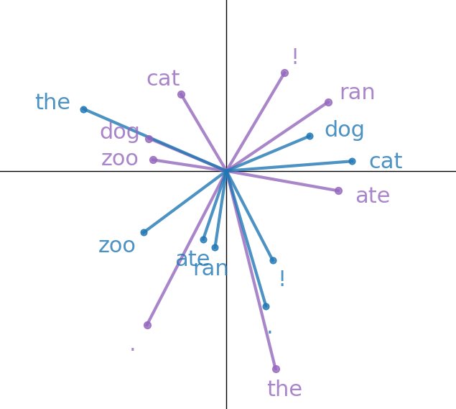
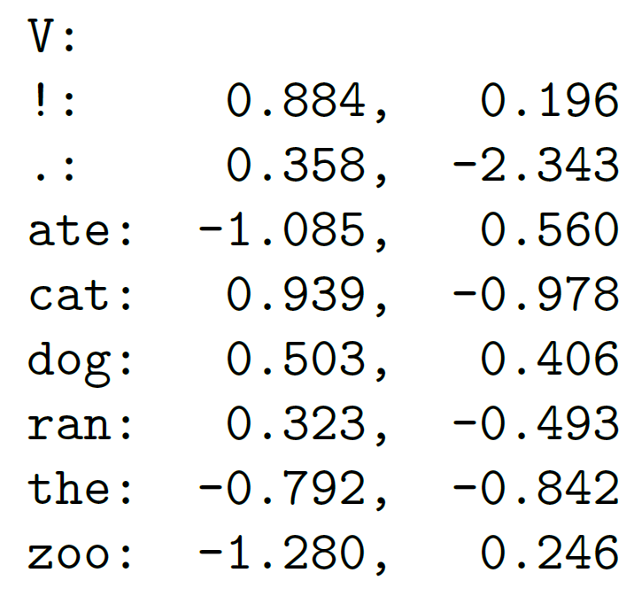
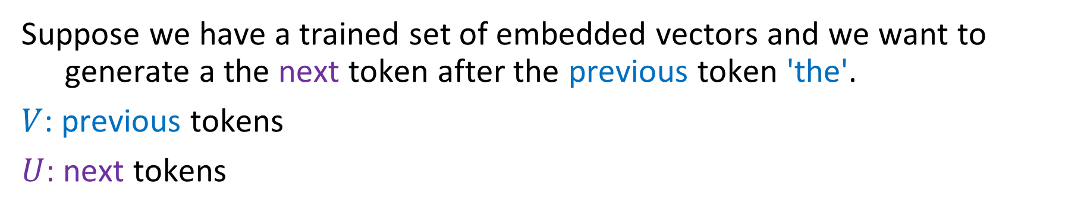
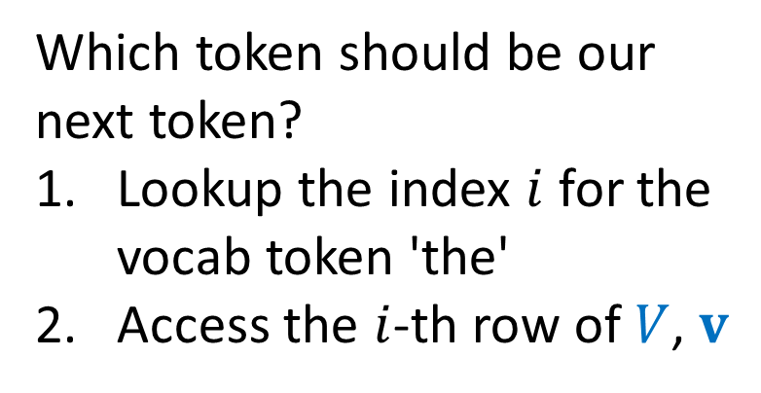
Sampling from Word Embeddings
Suppose we have a trained set of embedded vectors and we want to generate a the next token after the previous token 'the'.
$V$: previous tokens
$U$: next tokens
Which token should be our next token?
Lookup the index $i$ for the vocab token 'the'
Access the $i$-th row of $V$, $v$

Slide 8
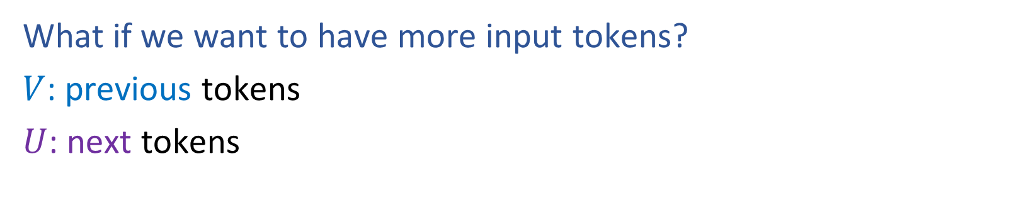
Increasing Context Size
What if we want to have more input tokens?
$V$: previous tokens
$U$: next tokens

Slide 9
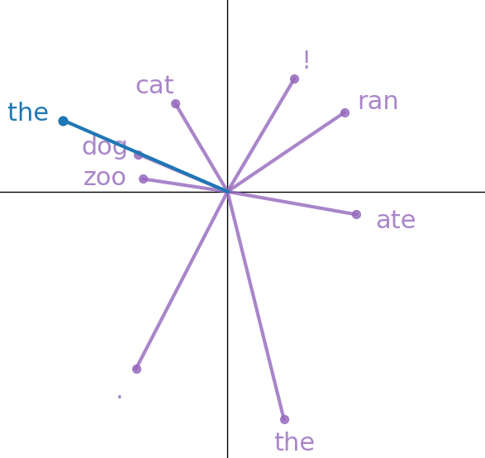
Increasing Context Size
What if we want to have more input tokens?
V: for context
U: for next token

Slide 10
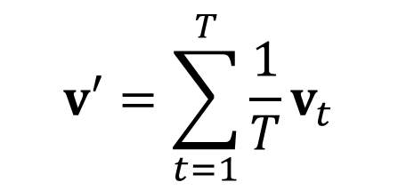
Increasing Context Size
What if we want to have more input tokens?
Uniform average over T input context tokens
context
$$v′=\sum_{t=1}^{T}{{\frac{1}{T}v}_{t}}$$
v₁
v₂
v₃
v₄
the
dog
ate
the

Slide 11
Position Encoding
What about position within the input context??
v₁
v₂
v₃
v₄
the
dog
ate
the

Slide 12
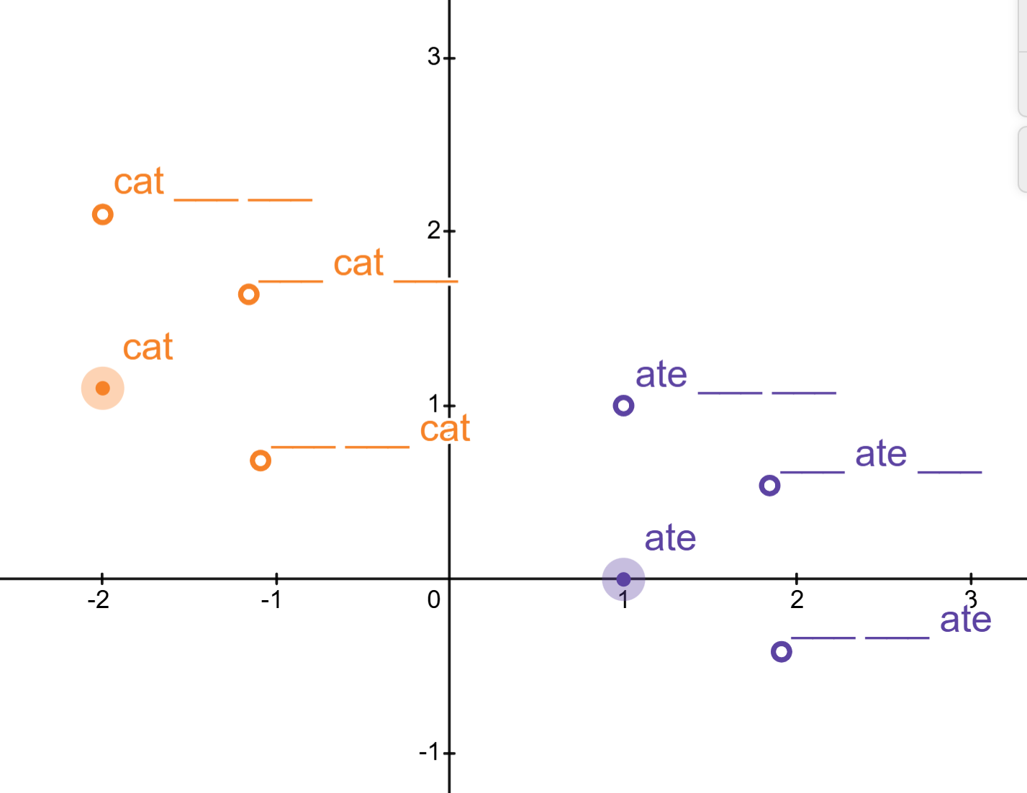
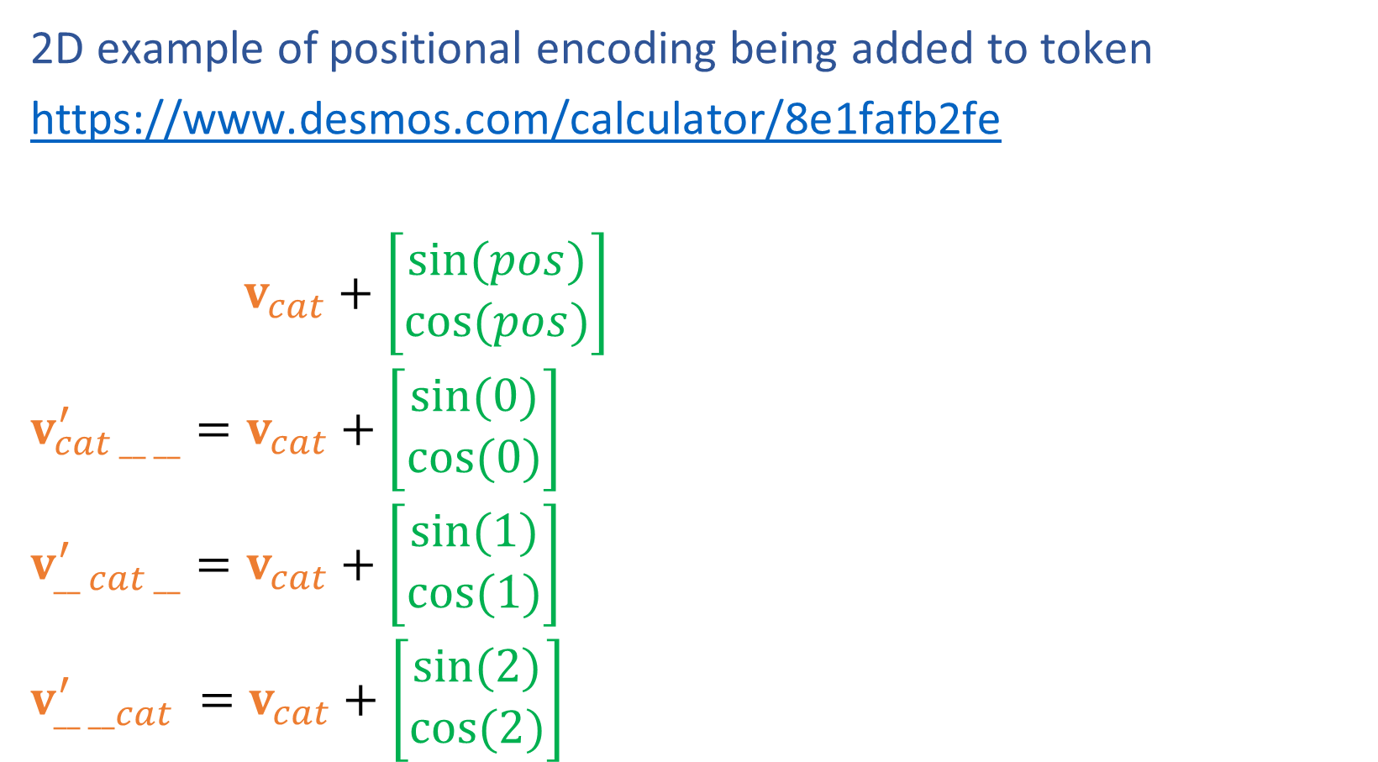
Positional Encoding
2D example of positional encoding being added to token
https://www.desmos.com/calculator/8e1fafb2fe
$v_{cat}+\left[\begin{aligned}sin⁡(pos) \\ cos⁡(pos)\end{aligned}\right]$
$v_{cat __ __}^{′}=v_{cat}+\left[\begin{aligned}sin⁡(0) \\ cos⁡(0)\end{aligned}\right]$
$v_{__ cat __}^{′}=v_{cat}+\left[\begin{aligned}sin⁡(1) \\ cos⁡(1)\end{aligned}\right]$
$v_{__ __cat}^{′} =v_{cat}+\left[\begin{aligned}sin⁡(2) \\ cos⁡(2)\end{aligned}\right]$

Slide 13
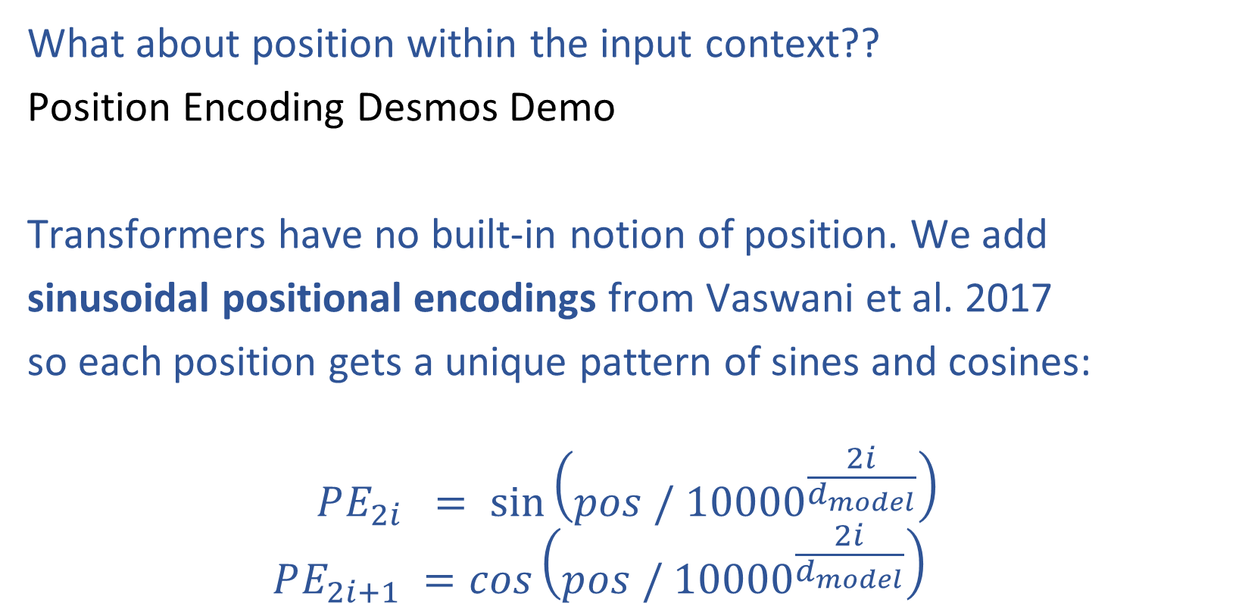
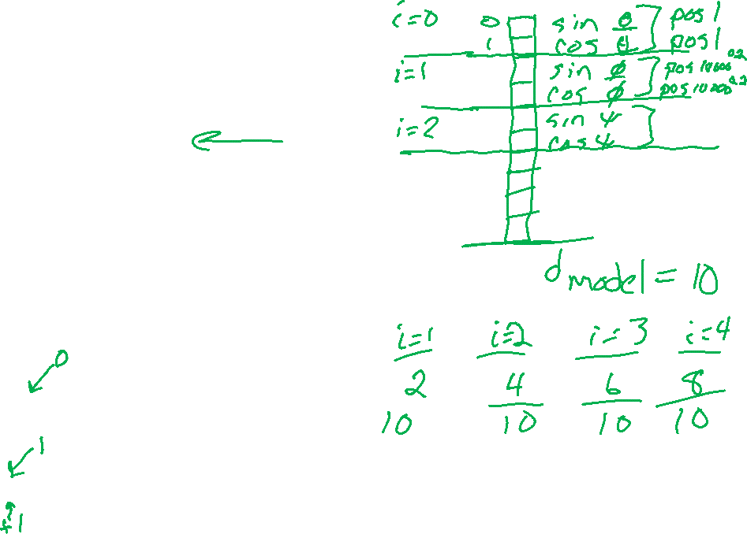
Positional Encoding
What about position within the input context??
Position Encoding Desmos Demo
Transformers have no built-in notion of position. We add
sinusoidal positional encodings from Vaswani et al. 2017
so each position gets a unique pattern of sines and cosines:
$$PE_{2i} = sin\left(pos / {10000}^{\frac{2i}{d_{model}}}\right)$$
$$PE_{2i+1} =cos\left(pos / {10000}^{\frac{2i}{d_{model}}}\right)$$

Slide 14
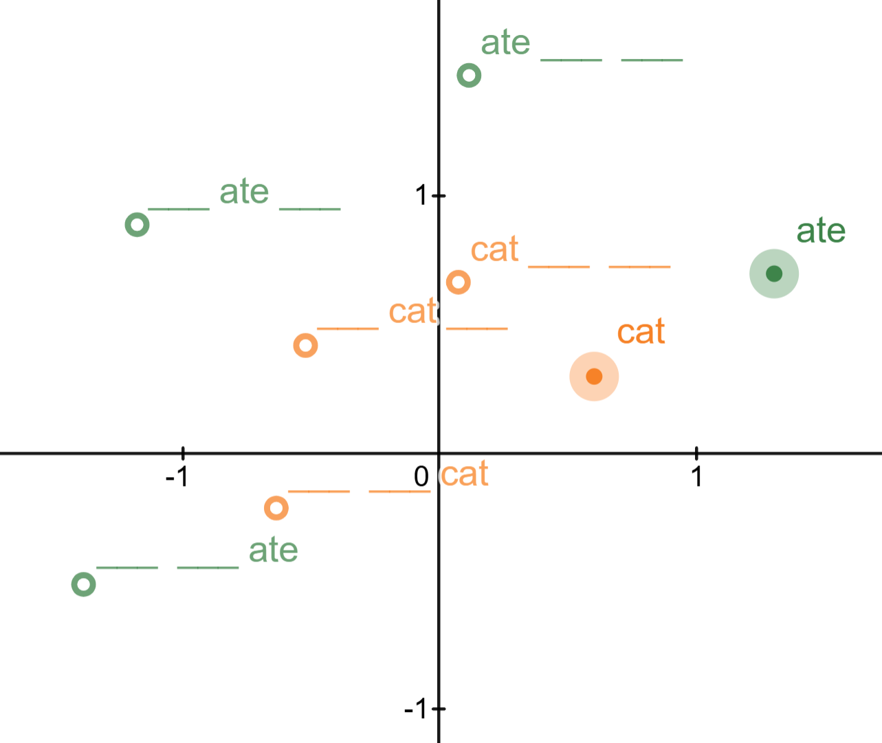
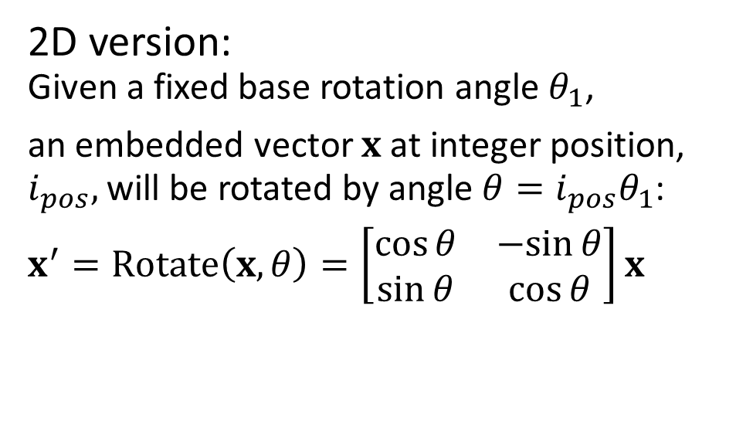
Rotary Position Encoding
What about position within the input context??
Rotary Position Encoding (RoPE) Desmos Demo
https://www.desmos.com/calculator/88combmfxv
2D version:
Given a fixed base rotation angle $θ_{1}$,
an embedded vector $x$ at integer position, $i_{pos},$ will be rotated by angle $θ=i_{pos}θ_{1}$:
$x^{′}=Rotate\left(x, θ\right)=\left[\begin{matrix}\cos{θ} & −sin{θ} \\ \sin{θ} & \cos{θ}\end{matrix}\right]x$

Slide 15
Attention

Slide 16
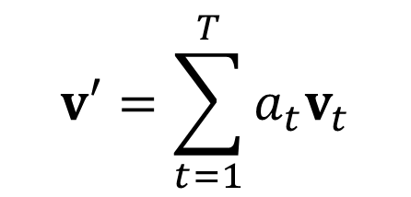
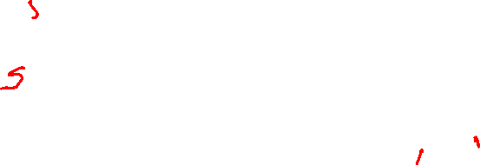
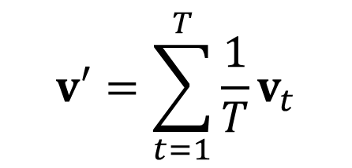
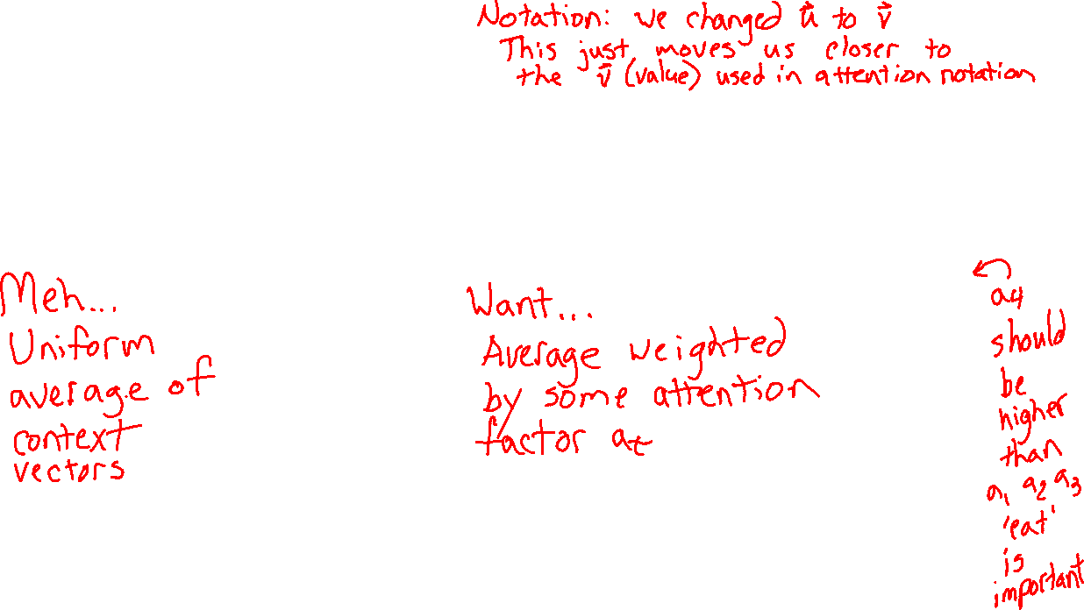
Learn to pay attention!
Context: v'
We can do better than uniform combination of input
$$v′=\sum_{t=1}^{T}{{\frac{1}{T}v}_{t}}$$
$$v′=\sum_{t=1}^{T}{{a_{t}v}_{t}}$$
a₁
a₂
a₃
a₄
Context: v'
v₁
v₂
v₃
v₄
v₁
v₂
v₃
v₄
I
will
not
eat
I
will
not
eat

Slide 17
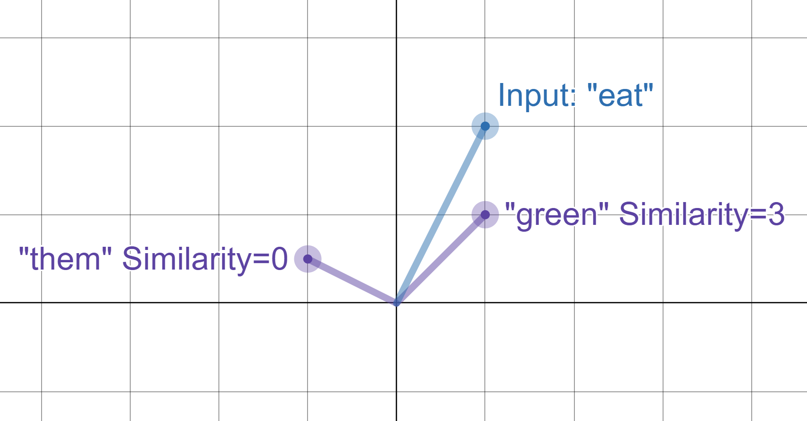
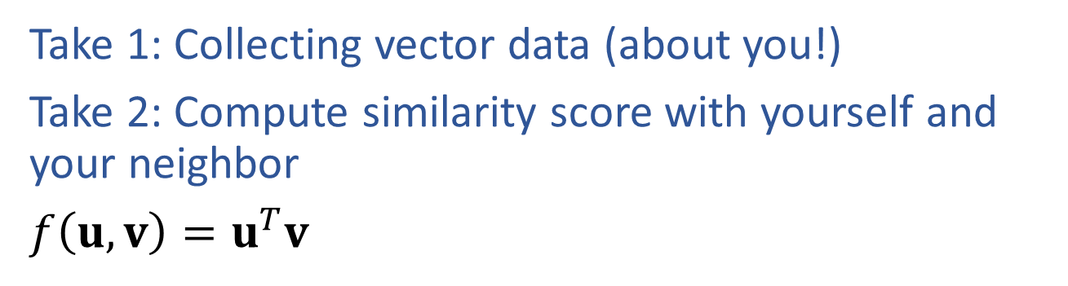
Reminder: Poll 1
Take 1: Collecting vector data (about you!)
Take 2: Compute similarity score with yourself and your neighbor
$f\left(u, v\right)=u^{T}v$

Slide 18
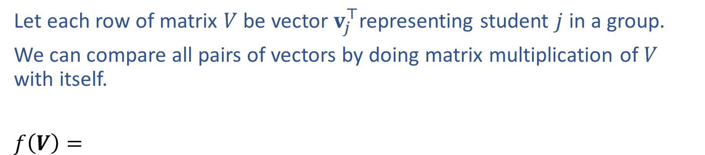
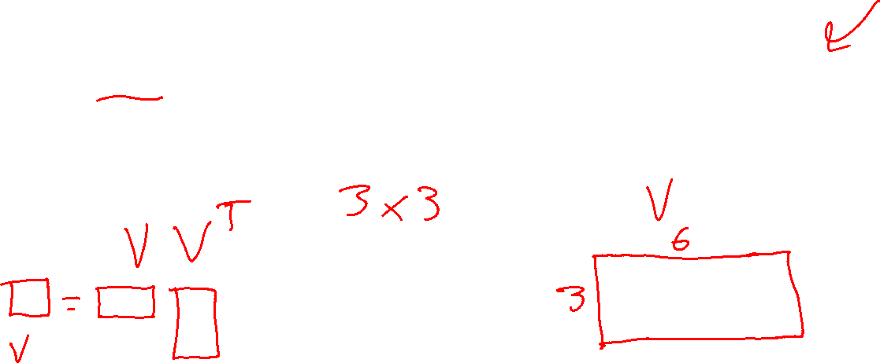
Reminder: Similarity Matrix
Let each row of matrix $V$ be vector $v_{j}^{⊤}$representing student $j$ in a group.
We can compare all pairs of vectors by doing matrix multiplication of $V$ with itself.
$f\left(V\right)=$

Slide 19
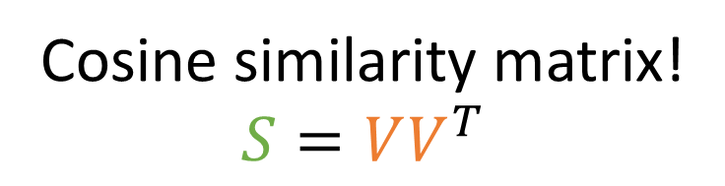
Learn to pay attention!
context
If only we had a way to measure vector similarity
$$v′=\sum_{t=1}^{T}{{a_{t}v}_{t}}$$
Cosine similarity matrix!
$$S=VV^{T}$$
a₁
a₂
a₃
a₄
I
will
not
eat
1
2
3
4
Je
1
s_{4,1}
s_{4,2}
s_{4,3}
s_{4,4}
na
2
mange
3
v₁
v₂
v₃
v₄
pas
4
I
will
not
eat

Slide 20
Learn to pay attention!
context
If only we had a way to measure vector similarity
$$v′=\sum_{t=1}^{T}{{a_{t}v}_{t}}$$
Cosine similarity matrix!
$$S=VV^{T}$$
a₁
a₂
a₃
a₄
I
will
not
eat
1
2
3
4
softmax
1
s_{4,1}
s_{4,2}
s_{4,3}
s_{4,4}
2
3
v₁
v₂
v₃
v₄
4
I
will
not
eat

Slide 21
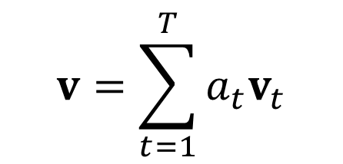
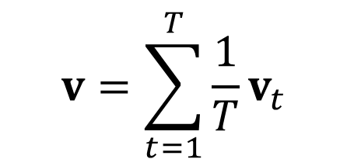
Learn to pay attention!
context
We can do better than uniform combination of input
$$v=\sum_{t=1}^{T}{{\frac{1}{T}v}_{t}}$$
$$v=\sum_{t=1}^{T}{{a_{t}v}_{t}}$$
a₁
a₂
a₃
a₄
context
softmax
s_{4,1}
s_{4,2}
s_{4,3}
s_{4,4}
v₁
v₂
v₃
v₄
v₁
v₂
v₃
v₄
I
will
not
eat
I
will
not
eat

Slide 22
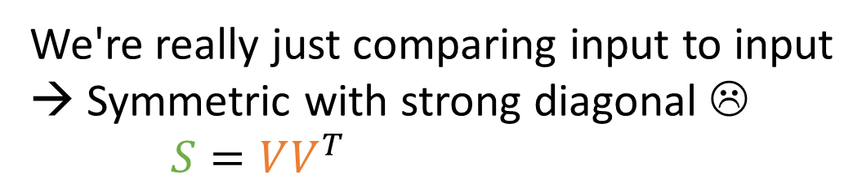
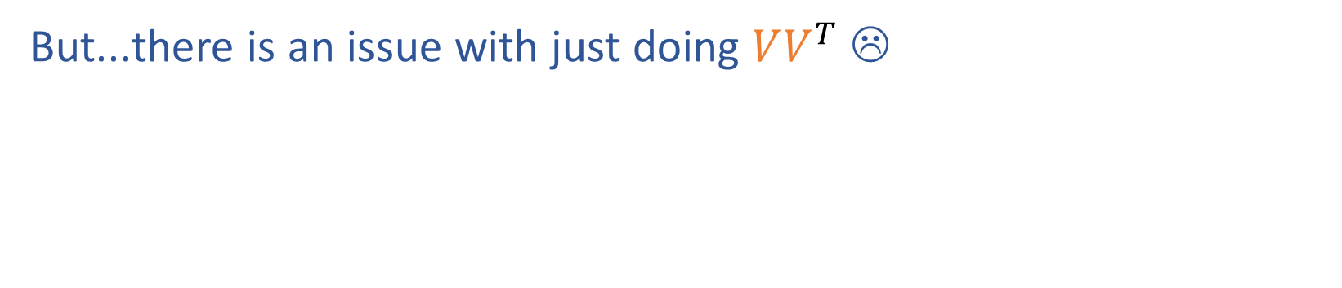
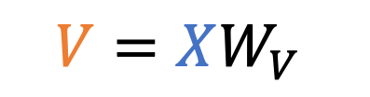
Learn to pay attention!
context
But...there is an issue with just doing $VV^{T}$ ☹
a₁
a₂
a₃
a₄
We're really just comparing input to input
→ Symmetric with strong diagonal ☹
$S=VV^{T}$
softmax
s_{4,1}
s_{4,2}
s_{4,3}
s_{4,4}
I
will
not
eat
1
2
3
4
1
eat
v₁
v₂
v₃
v₄
4
2
3
$$V=XW_{V}$$
4
x₁
x₂
x₃
x₄
I
will
not
eat

Slide 23
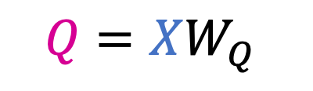
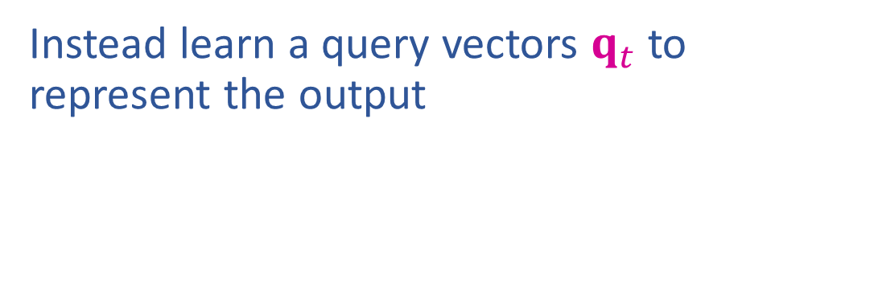
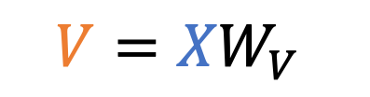

Learn to pay attention!
context
Instead learn a query vectors $q_{t}$ to represent the output
a₁
a₂
a₃
a₄
I
will
not
eat
1
2
3
4
softmax
1
eat
4
s_{4,1}
s_{4,2}
s_{4,3}
s_{4,4}
$S=QV^{T}$
2
3
v₁
v₂
v₃
v₄
4
$$Q=XW_{Q}$$
$$V={XW}_{V}$$
x₁
x₂
x₃
x₄
I
will
not
eat

Slide 24
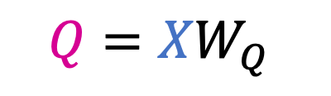
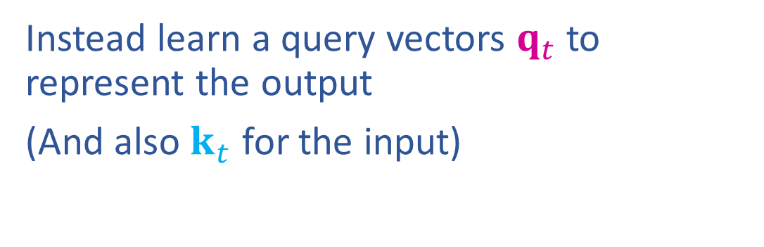
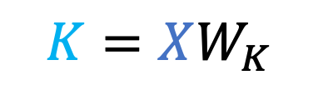
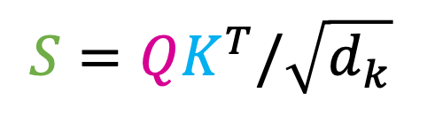
Learn to pay attention!
context
Instead learn a query vectors $q_{t}$ to represent the output
(And also $k_{t}$ for the input)
a₁
a₂
a₃
a₄
I
will
not
eat
1
2
3
4
softmax
1
eat
4
s_{4,1}
s_{4,2}
s_{4,3}
s_{4,4}
$$S=QK^{T}/\sqrt{d_{k}}$$
2
3
v₁
v₂
v₃
v₄
4
$$Q={XW}_{Q}$$
$$K=XW_{K}$$
$$V=XW_{V}$$
x₁
x₂
x₃
x₄
I
will
not
eat

Slide 25
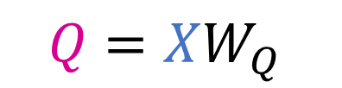
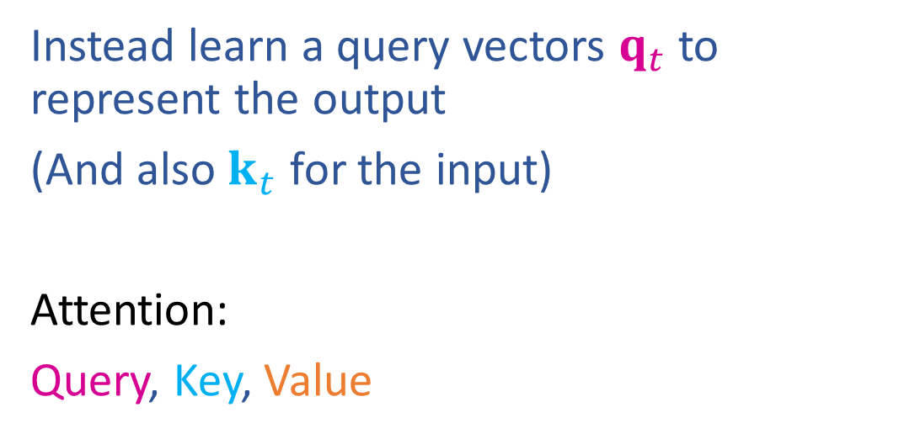


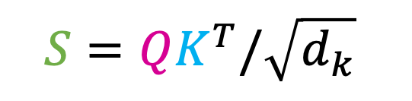
Learn to pay attention!
Instead learn a query vectors $q_{t}$ to represent the output
(And also $k_{t}$ for the input)
Attention:
Query, Key, Value
$$Q=XW_{Q}$$
$$S=QK^{T}/\sqrt{d_{k}}$$
$$K=XW_{K}$$
$$V=XW_{V}$$

Slide 26
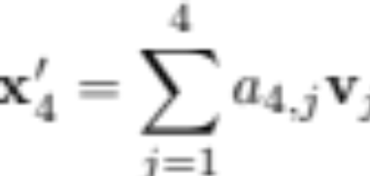





Scaled Dot-Product Attention
attention
a_{4,1}
a_{4,2}
a_{4,3}
a_{4,4}
attention weights
softmax
W_{q}
s_{4,1}
s_{4,2}
s_{4,3}
s_{4,4}
scores
q₁
q₂
q₃
q₄
queries
W_{k}
k₁
k₂
k₃
k₄
keys
W_{v}
v₁
v₂
v₃
v₄
values
x₁
x₂
x₃
x₄

Slide 27






















Attention
$$o_{4}$$
Vector representation
$$W_{O}$$
$$z_{4}$$
$o_{t}=W_{O}^{⊤}$ $z_{t}$
$$z_{t}=V^{⊤}a_{t}$$
$$a_{4}=softmax\left(s_{t}\right)$$
$$s_{4,j}=k_{j}^{⊤}q_{4}/\sqrt{d_{k}}$$
$$a_{t}=\operatorname{softmax}\left(s_{t}\right)$$
$$a_{4,1}$$
$$q_{4}^{⊤}$$
$$s_{t}=Kq_{t}/\sqrt{d_{k}}$$
$$v_{1}$$
$$v_{4}$$
$$K^{⊤}$$
$$q_{t}=W_{Q}^{⊤}x_{t}$$
$$W_{V}$$
$$k_{t}=W_{K}^{⊤}x_{t}$$
$$W_{K}$$
$$v_{t}=W_{V}^{⊤}x_{t}$$
$$x_{1}$$
$$x_{4}$$
$$W_{Q}$$

Slide 28












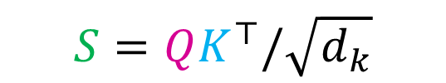








(Full) Attention
$${X′}^{⊤}$$
Matrix representation
$$+$$
$$O^{⊤}$$
$$X^{′}=X⊕O$$
$$O={ZW}_{O}$$
$$W_{O}$$
$$Z^{⊤}$$
$$Z=AV$$
$$A=softmax\left(S\right)$$
$$S=QK^{⊤}/\sqrt{d_{k}}$$
$$A={\operatorname{softmax}\left(S\right)}_{row−wise}$$
$S=QK^{⊤}/\sqrt{d_{k}}$
$$A$$
$$Q$$
$$Q=XW_{Q}$$
$$V^{⊤}$$
$$K^{⊤}$$
$$K=XW_{K}$$
$$V=XW_{V}$$
$$X^{⊤}$$
$W_{V}, W_{K},$ $W_{Q }$

Slide 29
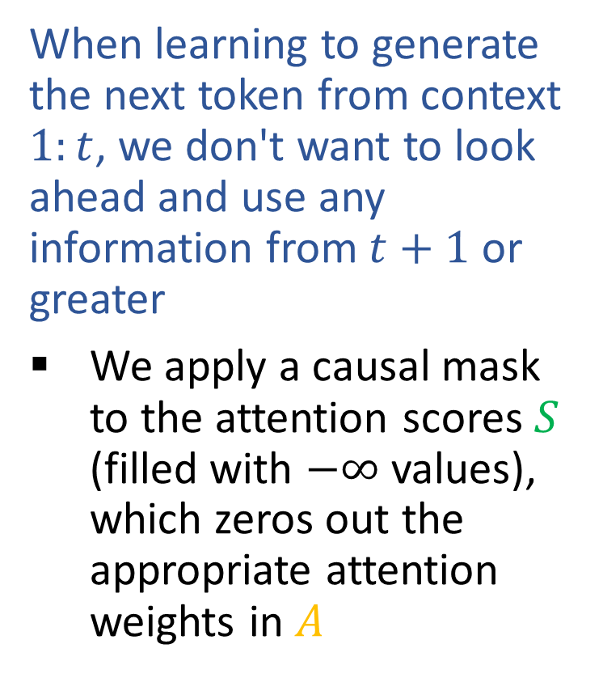
Causal Attention
$${X′}^{⊤}$$
When learning to generate the next token from context $1:t$, we don't want to look ahead and use any information from $t+1$ or greater
We apply a causal mask to the attention scores $S$ (filled with $−∞$ values), which zeros out the appropriate attention weights in $A$
$$+$$
$$O^{⊤}$$
$$W_{O}$$
$$Z^{⊤}$$
$$A=softmax\left(S\right)$$
$$S=QK^{⊤}/\sqrt{d_{k}}$$
$$A$$
$$Q$$
$$V^{⊤}$$
$$K^{⊤}$$
$$X^{⊤}$$
$W_{V}, W_{K},$ $W_{Q }$

Slide 30


Causal Attention
$${X′}^{⊤}$$
When learning to generate the next token from context $1:t$, we don't want to look ahead and use any information from $t+1$ or greater
We apply a causal mask to the attention scores $S$ (filled with $−∞$ values), which zeros out the appropriate attention weights in $A$
$$+$$
$$O^{⊤}$$
$$W_{O}$$
$$Z^{⊤}$$
$$A=softmax\left(S\right)$$
$$S=QK^{⊤}/\sqrt{d_{k}}$$
$$A$$
$$Q$$
$$V^{⊤}$$
$$K^{⊤}$$
$$X^{⊤}$$
$W_{V}, W_{K},$ $W_{Q }$

Slide 31
Causal Attention
$${X′}^{⊤}$$
When learning to generate the next token from context $1:t$, we don't want to look ahead and use any information from $t+1$ or greater
We apply a causal mask to the attention scores $S$ (filled with $−∞$ values), which zeros out the appropriate attention weights in $A$
$$+$$
$$O^{⊤}$$
$$W_{O}$$
$$Z^{⊤}$$
$$A=softmax\left(S\right)$$
$$S=QK^{⊤}/\sqrt{d_{k}}$$
$$A$$
$$Q$$
$$V^{⊤}$$
$$K^{⊤}$$
$$X^{⊤}$$
$W_{V}, W_{K},$ $W_{Q }$

Slide 32
Causal Attention
$${X′}^{⊤}$$
When learning to generate the next token from context $1:t$, we don't want to look ahead and use any information from $t+1$ or greater
We apply a causal mask to the attention scores $S$ (filled with $−∞$ values), which zeros out the appropriate attention weights in $A$
$$+$$
$$O^{⊤}$$
$$W_{O}$$
$$Z^{⊤}$$
$$A=softmax\left(S\right)$$
$$S=QK^{⊤}/\sqrt{d_{k}}$$
$$A$$
$$Q$$
$$V^{⊤}$$
$$K^{⊤}$$
$$X^{⊤}$$
$W_{V}, W_{K},$ $W_{Q }$

Slide 33
Causal Attention
$${X′}^{⊤}$$
When learning to generate the next token from context $1:t$, we don't want to look ahead and use any information from $t+1$ or greater
We apply a causal mask to the attention scores $S$ (filled with $−∞$ values), which zeros out the appropriate attention weights in $A$
$$+$$
$$O^{⊤}$$
$$W_{O}$$
$$Z^{⊤}$$
$$A=softmax\left(S\right)$$
$$S=QK^{⊤}/\sqrt{d_{k}}$$
$$A$$
$$Q$$
$$V^{⊤}$$
$$K^{⊤}$$
$$X^{⊤}$$
$W_{V}, W_{K},$ $W_{Q }$

Slide 34




Causal Attention
$${X′}^{⊤}$$
Inference time
Done training. Watch this attention block as the context size increases as we generate more and more tokens
Note how different components build up as the context grows
But the size of the parameters don't change!
$$+$$
$$O^{⊤}$$
$$W_{O}∈ℝ^{{d_{k}×d}_{model}}$$
$$Z^{⊤}$$
$$A=softmax\left(S\right)$$
$$S=QK^{⊤}/\sqrt{d_{k}}$$
$$A$$
$$Q$$
$$V^{⊤}$$
$$K^{⊤}$$
$$X^{⊤}$$
$W_{V}, W_{K},$ $W_{Q }$ are all $∈ℝ^{d_{model}×d_{k}}$

Slide 35



Causal Attention
$${X′}^{⊤}$$
Inference time
Done training. Watch this attention block as the context size increases as we generate more and more tokens
Note how different components build up as the context grows
But the size of the parameters don't change!
$$+$$
$$O^{⊤}$$
$$W_{O}$$
$$Z^{⊤}$$
$$A=softmax\left(S\right)$$
$$S=QK^{⊤}/\sqrt{d_{k}}$$
$$A$$
$$Q$$
$$V^{⊤}$$
$$K^{⊤}$$
$$X^{⊤}$$
$W_{V}, W_{K},$ $W_{Q }$

Slide 36

Causal Attention
$${X′}^{⊤}$$
Inference time
Done training. Watch this attention block as the context size increases as we generate more and more tokens
Note how different components build up as the context grows
But the size of the parameters don't change!
$$+$$
$$O^{⊤}$$
$$W_{O}$$
$$Z^{⊤}$$
$$A=softmax\left(S\right)$$
$$S=QK^{⊤}/\sqrt{d_{k}}$$
$$A$$
$$Q$$
$$V^{⊤}$$
$$K^{⊤}$$
$$X^{⊤}$$
$W_{V}, W_{K},$ $W_{Q }$

Slide 37
Causal Attention
$${X′}^{⊤}$$
Inference time
Done training. Watch this attention block as the context size increases as we generate more and more tokens
Note how different components build up as the context grows
But the size of the parameters don't change!
$$+$$
$$O^{⊤}$$
$$W_{O}$$
$$Z^{⊤}$$
$$A=softmax\left(S\right)$$
$$S=QK^{⊤}/\sqrt{d_{k}}$$
$$A$$
$$Q$$
$$V^{⊤}$$
$$K^{⊤}$$
$$X^{⊤}$$
$W_{V}, W_{K},$ $W_{Q }$

Slide 38

Causal Attention
$${X′}^{⊤}$$
Inference time
(Repeated without red arrows showing attention combination)
$$+$$
$$O^{⊤}$$
$$W_{O}$$
$$Z^{⊤}$$
$$A=softmax\left(S\right)$$
$$S=QK^{⊤}/\sqrt{d_{k}}$$
$$A$$
$$Q$$
$$V^{⊤}$$
$$K^{⊤}$$
$$X^{⊤}$$
$W_{V}, W_{K},$ $W_{Q }$

Slide 39
Causal Attention
$${X′}^{⊤}$$
Inference time
(Repeated without red arrows showing attention combination)
$$+$$
$$O^{⊤}$$
$$W_{O}$$
$$Z^{⊤}$$
$$A=softmax\left(S\right)$$
$$S=QK^{⊤}/\sqrt{d_{k}}$$
$$A$$
$$Q$$
$$V^{⊤}$$
$$K^{⊤}$$
$$X^{⊤}$$
$W_{V}, W_{K},$ $W_{Q }$

Slide 40
Causal Attention
$${X′}^{⊤}$$
Inference time
(Repeated without red arrows showing attention combination)
$$+$$
$$O^{⊤}$$
$$W_{O}$$
$$Z^{⊤}$$
$$A=softmax\left(S\right)$$
$$S=QK^{⊤}/\sqrt{d_{k}}$$
$$A$$
$$Q$$
$$V^{⊤}$$
$$K^{⊤}$$
$$X^{⊤}$$
$W_{V}, W_{K},$ $W_{Q }$

Slide 41
Causal Attention
$${X′}^{⊤}$$
Inference time
(Repeated without red arrows showing attention combination)
$$+$$
$$O^{⊤}$$
$$W_{O}$$
$$Z^{⊤}$$
$$A=softmax\left(S\right)$$
$$S=QK^{⊤}/\sqrt{d_{k}}$$
$$A$$
$$Q$$
$$V^{⊤}$$
$$K^{⊤}$$
$$X^{⊤}$$
$W_{V}, W_{K},$ $W_{Q }$

Slide 42
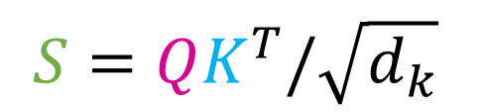
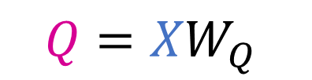


Full Attention
context
What if we want to translate an input context to another language?
a₁
a₂
a₃
a₄
I
will
not
eat
1
2
3
4
softmax
1
eat
4
s_{4,1}
s_{4,2}
s_{4,3}
s_{4,4}
2
3
v₁
v₂
v₃
v₄
4
$$S=QK^{T}/\sqrt{d_{k}}$$
$$Q={XW}_{Q}$$
$$K=XW_{K}$$
$$V=XW_{V}$$
x₁
x₂
x₃
x₄
I
will
not
eat

Slide 43
(Full) Attention
$${X′}^{⊤}$$
Matrix representation
$$+$$
$$O^{⊤}$$
$$X^{′}=X⊕O$$
$$O={ZW}_{O}$$
$$W_{O}$$
$$Z^{⊤}$$
$$Z=AV$$
$$A=softmax\left(S\right)$$
$$S=QK^{⊤}/\sqrt{d_{k}}$$
$$A={\operatorname{softmax}\left(S\right)}_{row−wise}$$
$S=QK^{⊤}/\sqrt{d_{k}}$
$$A$$
$$Q$$
$$Q=XW_{Q}$$
$$V^{⊤}$$
$$K^{⊤}$$
$$K=XW_{K}$$
$$V=XW_{V}$$
$$X^{⊤}$$
$W_{V}, W_{K},$ $W_{Q }$

Slide 44
(Full) Attention
$${X′}^{⊤}$$
Matrix representation
$$+$$
$$O^{⊤}$$
$$X^{′}=X⊕O$$
$$O={ZW}_{O}$$
$$W_{O}$$
$$Z^{⊤}$$
$$Z=AV$$
$$A=softmax\left(S\right)$$
$$S=QK^{⊤}/\sqrt{d_{k}}$$
$$A={\operatorname{softmax}\left(S\right)}_{row−wise}$$
$S=QK^{⊤}/\sqrt{d_{k}}$
$$A$$
$$Q$$
$$Q=XW_{Q}$$
$$V^{⊤}$$
$$K^{⊤}$$
$$K=XW_{K}$$
$$V=XW_{V}$$
$$X^{⊤}$$
$W_{V}, W_{K},$ $W_{Q }$

Slide 45
(Full) Attention
$${X′}^{⊤}$$
Matrix representation
$$+$$
$$O^{⊤}$$
$$X^{′}=X⊕O$$
$$O={ZW}_{O}$$
$$W_{O}$$
$$Z^{⊤}$$
$$Z=AV$$
$$A=softmax\left(S\right)$$
$$S=QK^{⊤}/\sqrt{d_{k}}$$
$$A={\operatorname{softmax}\left(S\right)}_{row−wise}$$
$S=QK^{⊤}/\sqrt{d_{k}}$
$$A$$
$$Q$$
$$Q=XW_{Q}$$
$$V^{⊤}$$
$$K^{⊤}$$
$$K=XW_{K}$$
$$V=XW_{V}$$
$$X^{⊤}$$
$W_{V}, W_{K},$ $W_{Q }$

Slide 46
(Full) Attention
$${X′}^{⊤}$$
Matrix representation
$$+$$
$$O^{⊤}$$
$$X^{′}=X⊕O$$
$$O={ZW}_{O}$$
$$W_{O}$$
$$Z^{⊤}$$
$$Z=AV$$
$$A=softmax\left(S\right)$$
$$S=QK^{⊤}/\sqrt{d_{k}}$$
$$A={\operatorname{softmax}\left(S\right)}_{row−wise}$$
$S=QK^{⊤}/\sqrt{d_{k}}$
$$A$$
$$Q$$
$$Q=XW_{Q}$$
$$V^{⊤}$$
$$K^{⊤}$$
$$K=XW_{K}$$
$$V=XW_{V}$$
$$X^{⊤}$$
$W_{V}, W_{K},$ $W_{Q }$

Slide 47
(Full) Attention
$${X′}^{⊤}$$
Matrix representation
$$+$$
$$O^{⊤}$$
$$X^{′}=X⊕O$$
$$O={ZW}_{O}$$
$$W_{O}$$
$$Z^{⊤}$$
$$Z=AV$$
$$A=softmax\left(S\right)$$
$$S=QK^{⊤}/\sqrt{d_{k}}$$
$$A={\operatorname{softmax}\left(S\right)}_{row−wise}$$
$S=QK^{⊤}/\sqrt{d_{k}}$
$$A$$
$$Q$$
$$Q=XW_{Q}$$
$$V^{⊤}$$
$$K^{⊤}$$
$$K=XW_{K}$$
$$V=XW_{V}$$
$$X^{⊤}$$
$W_{V}, W_{K},$ $W_{Q }$

Slide 48
Attention Takeaways
Size of weights doesn't change when the context size changes!
Weights have to learn a good way to convert input tokens to q, k, v regardless of context length
Better than having different copies of weights for every context size
Similarity matrix in attention is calcuated (not a parameter matrix)!
S does change side based on context but it is generated from two generated matrices Q and K
Attention is learned from Q and K via W_Q and W_K
Linear operations!
GPUs already do this fast

Slide 49
Transformer Language Models
Increasing context size
Uniform average of context vectors
Position encoding
Attention
Weighted average of context vectors
Query Keys Values
Expressive power of linear transforms
Building GPT2!

Slide 50
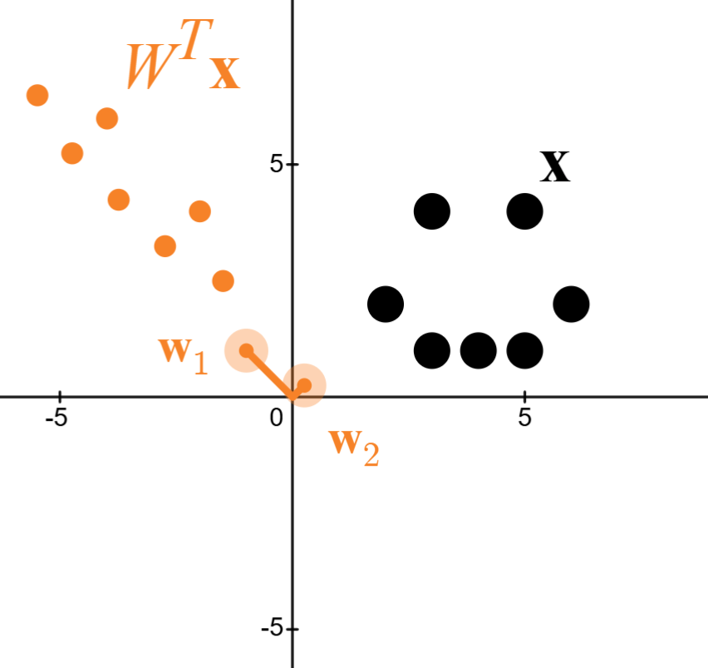
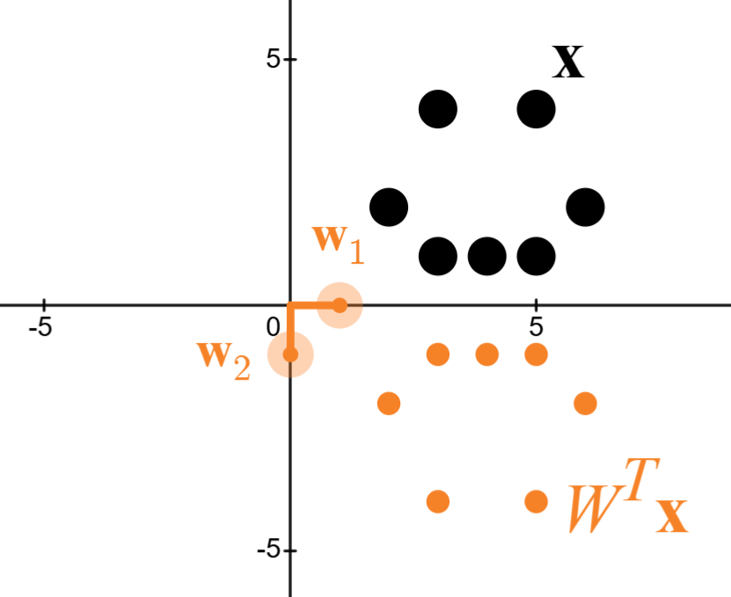
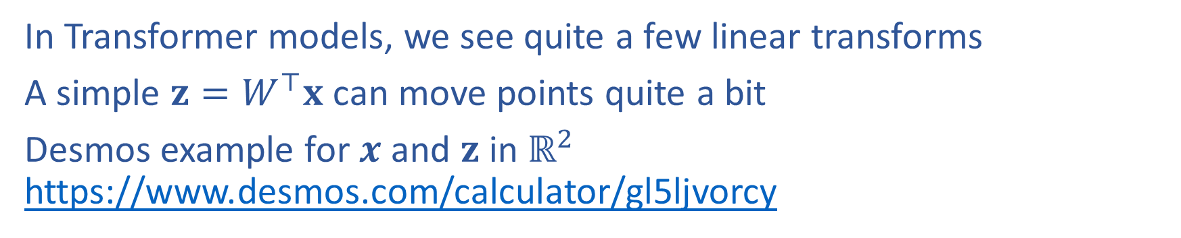
Linear Transforms: Graphical Intuition
In Transformer models, we see quite a few linear transforms
A simple $z=W^{⊤}x$ can move points quite a bit
Desmos example for $x$ and $z$ in $ℝ^{2}$ https://www.desmos.com/calculator/gl5ljvorcy

Slide 51
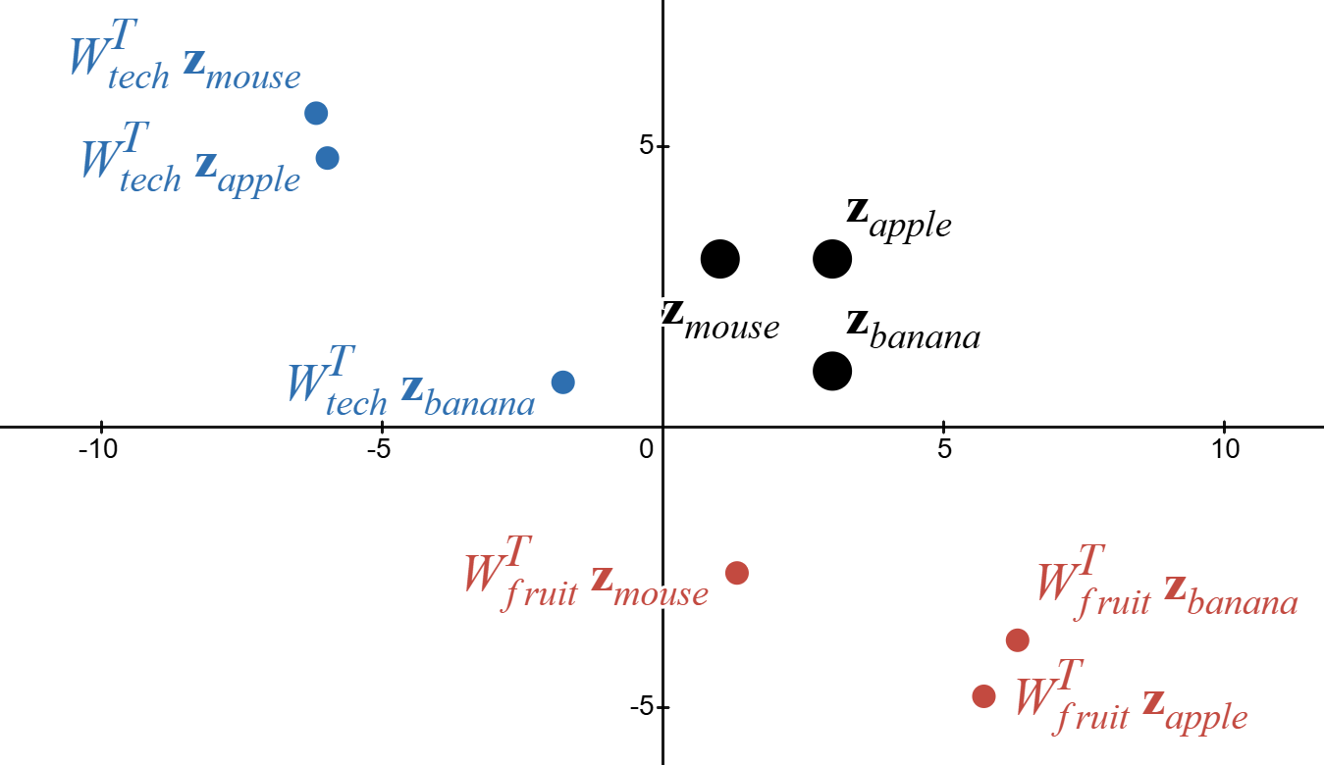
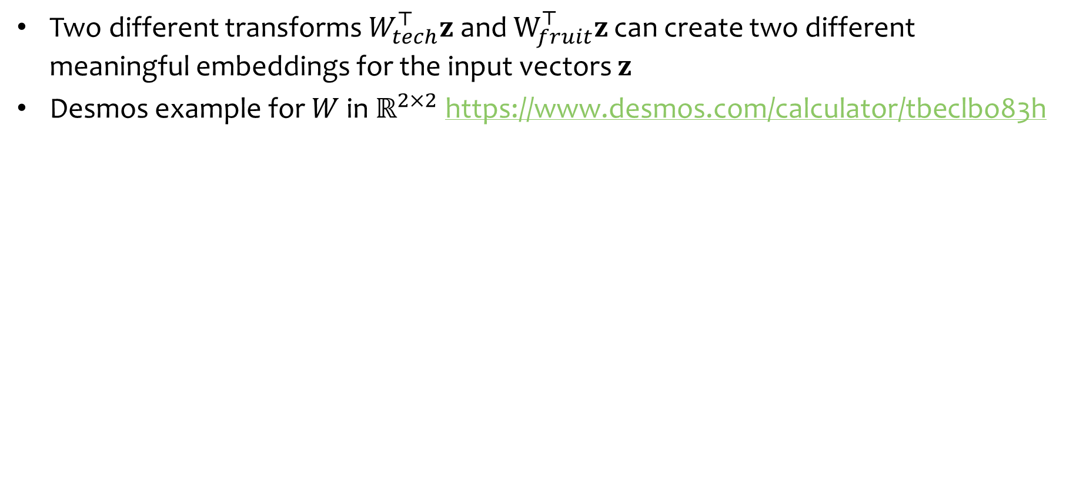
Linear Transforms: Graphical Intuition
Two different transforms $W_{tech}^{⊤}z$ and $W_{fruit}^{⊤}z$ can create two different meaningful embeddings for the input vectors $z$
Desmos example for $W$ in $ℝ^{2×2}$ https://www.desmos.com/calculator/tbeclbo83h

Slide 52
Building GPT2!

Slide 53

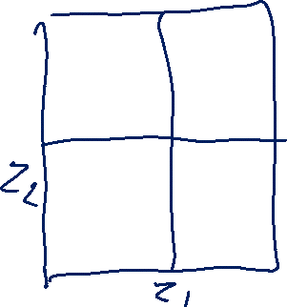

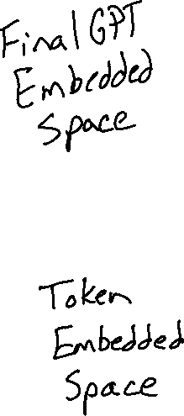
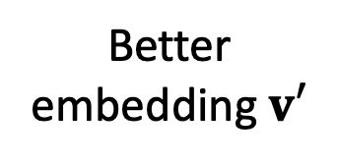


GPT Skeleton
Better embedding $v′$
GPT
(Layers of Attention Blocks)
v₁
v₂
v₃
v₄
Embedded context tokens

Slide 54






GPT Skeleton
Combined Context: $v′$
GPT
(Layers of Attention Blocks)
$$\hat{y}= g_{softmax}(Uv′)$$
v₁
v₂
v₃
v₄
$$next_idx= \underset{j}{argmax} \hat{y}$$
Embedded context tokens

Slide 55




MinGPT Femto
2-D embedded space
1 attention layer
1 attention head (think channel)
Combined Context: $v′$
$$\hat{y}= g_{softmax}(Uv′)$$
GPT
$$next_idx= \underset{j}{argmax} \hat{y}$$
v₁
v₂
v₃
v₄

Slide 56


MinGPT Femto
2-D embedded space
1 attention layer
1 attention head (think channel)
Combined Context: $v′$
GPT
v₁
v₂
v₃
v₄

Slide 57



MinGPT Pico
2-D embedded space
3 attention layer
3 attention heads (think channels)
Combined Context: $v′$
GPT
v₁
v₂
v₃
v₄

Slide 58
Multi-headed Attention

Slide 59
Multi-headed Attention
x₁’
x₂’
x₃’
x₄’
Just as we can have multiple channels in a convolution layer, we can use multiple heads in an attention layer
Each head gets its own parameters
We can concatenate all the outputs to get a single vector for each time step
1st
head
2nd head
W_{q}
3rd head
W_{k}
multi-headed attention
W_{v}
x₁
x₂
x₃
x₄

Slide 60
Multi-headed Attention
To ensure the dimension of the input embedding x_{t} is the same as the output embedding x_{t}’, Transformers usually choose the embedding sizes and number of heads appropriately:
  d_{model} = dim. of inputs
  d_{k} = dim. of each output
  h = # of heads
  Choose d_{k} = d_{model} / h
Then concatenate the outputs
x₁’
x₂’
x₃’
x₄’
W_{q}
multi-headed attention
W_{k}
W_{v}
x₁
x₂
x₃
x₄

Slide 61
Multi-headed Attention
To ensure the dimension of the input embedding x_{t} is the same as the output embedding x_{t}’, Transformers usually choose the embedding sizes and number of heads appropriately:
  d_{model} = dim. of inputs
  d_{k} = dim. of each output
  h = # of heads
  Choose d_{k} = d_{model} / h
Then concatenate the outputs
x₁’
x₂’
x₃’
x₄’
W_{q}
multi-headed attention
W_{k}
W_{v}
x₁
x₂
x₃
x₄

Slide 62
MinGPT Pico
2-D embedded space
3 attention layer
3 attention heads (think channels)
Combined Context: $v′$
GPT
v₁
v₂
v₃
v₄

Slide 63

MinGPT Pico: Output embedded space - 3 heads

Slide 64

MinGPT Pico: Attention Weights – 3 layers, 3 heads

Slide 65
Transformer Layer

Slide 66
Transformer Layer
x₁’
x₂’
x₃’
x₄’
Each layer of a Transformer LM consists of several sublayers:
attention
feed-forward neural network
layer normalization
residual connections
layer normalization
residual connections
feed forward neural network
layer normalization
residual connections
W_{q}
multi-headed attention
W_{k}
W_{v}
x₁
x₂
x₃
x₄

Slide 67
Layer Normalization
The Problem: internal covariate shift occurs during training of a deep network when a small change in the low layers amplifies into a large change in the high layers
One Solution: Layer normalization normalizes each layer and learns elementwise gain/bias
Such normalization allows for higher learning rates (for faster convergence) without issues of diverging gradients
Figure from https://arxiv.org/pdf/1607.06450.pdf
Notes:
There are a variety of normalization methods to address this: BatchNorm, LayerNorm, InstanceNorm, GroupNorm,…

Slide 68


Layer Normalization
The Problem: internal covariate shift occurs during training of a deep network when a small change in the low layers amplifies into a large change in the high layers
One Solution: Layer normalization normalizes each layer and learns elementwise gain/bias
Such normalization allows for higher learning rates (for faster convergence) without issues of diverging gradients
Figure from https://arxiv.org/pdf/1607.06450.pdf
Notes:
There are a variety of normalization methods to address this: BatchNorm, LayerNorm, InstanceNorm, GroupNorm,…

Slide 69



Residual Connections
Residual Connection
The Problem: as network depth grows very large, a performance degradation occurs that is not explained by overfitting (i.e. train / test error both worsen)
One Solution: Residual connections pass a copy of the input alongside another function so that information can flow more directly
These residual connections allow for effective training of very deep networks that perform better than their shallower (though still deep) counterparts
Plain Connection
$$+$$
$$f(a)$$
Why are residual connections helpful?
Instead of f(a) having to learn a full transformation of a, f(a) only needs to learn an additive modification of a (i.e. the residual).
Figure from https://arxiv.org/pdf/1512.03385.pdf
Notes:
There are a variety of normalization methods to address this: BatchNorm, LayerNorm, InstanceNorm, GroupNorm,…

Slide 70



Residual Connections
Residual Connection
The Problem: as network depth grows very large, a performance degradation occurs that is not explained by overfitting (i.e. train / test error both worsen)
One Solution: Residual connections pass a copy of the input alongside another function so that information can flow more directly
These residual connections allow for effective training of very deep networks that perform better than their shallower (though still deep) counterparts
Plain Connection
Figure from https://arxiv.org/pdf/1512.03385.pdf
Notes:
There are a variety of normalization methods to address this: BatchNorm, LayerNorm, InstanceNorm, GroupNorm,…

Slide 71
Transformer Layer
x₁’
x₂’
x₃’
x₄’
Pre-LN Version:
However, subsequent work found that reordering such that the LayerNorm’s came at the beginning of each set of 3 layers, the multi-headed attention and feed-forward NN layers tend to be better behaved (i.e. tricks like warm-up are less important).
Each layer of a Transformer LM consists of several sublayers:
attention
feed-forward neural network
layer normalization
residual connections
residual connection (addition)
feed forward neural network
layer normalization
residual connection (addition)
W_{q}
multi-headed attention
W_{k}
W_{v}
layer normalization
x₁
x₂
x₃
x₄

Slide 72
Transformer Layer
x₁’
x₂’
x₃’
x₄’
Post-LN Version:
This is the version of the Transformer Layer that was introduced in the original paper in 2017.
The LayerNorm modules occur at the end of each set of 3 layers.
Each layer of a Transformer LM consists of several sublayers:
attention
feed-forward neural network
layer normalization
residual connections
layer normalization
residual connection (addition)
feed forward neural network
layer normalization
residual connection (addition)
W_{q}
multi-headed attention
W_{k}
W_{v}
x₁
x₂
x₃
x₄

Slide 73
Transformer Layer
x₁’
x₂’
x₃’
x₄’
Transformer
Layer
Each layer of a Transformer LM consists of several sublayers:
attention
feed-forward neural network
layer normalization
residual connections
residual connection (addition)
feed forward neural network
layer normalization
residual connection (addition)
W_{q}
multi-headed attention
W_{k}
W_{v}
layer normalization
x₁
x₂
x₃
x₄

Slide 74
Transformer Layer
x₁’
x₂’
x₃’
x₄’
Transformer
Layer
Each layer of a Transformer LM consists of several sublayers:
attention
feed-forward neural network
layer normalization
residual connections
layer normalization
residual connections
feed forward neural network
layer normalization
residual connections
W_{q}
multi-headed attention
W_{k}
W_{v}
x₁
x₂
x₃
x₄

Slide 75
Transformer Layer
Each layer of a Transformer LM consists of several sublayers:
attention
feed-forward neural network
layer normalization
residual connections
x₁’
x₂’
x₃’
x₄’
Transformer layer
x₁
x₂
x₃
x₄

Slide 76
Transformer Language Model
The
bat
made
noise
Each layer of a Transformer LM consists of several sublayers:
attention
feed-forward neural network
layer normalization
residual connections
Each hidden vector looks back at the hidden vectors of the current and previous timesteps in the previous layer.
The language model part is just like an RNN-LM!
p(w₁|h₁)
p(w₂|h₂)
p(w₃|h₃)
p(w₄|h₄)
h₁
h₂
h₃
h₄
Transformer layer
Transformer layer
Transformer layer
x₁
x₂
x₃
x₄
…
START
The
bat
made

Slide 77
Vision Transformers

Slide 78


Vision Transformer (ViT)
Instead of words as input, the inputs are $P×P$ pixel patches
Each patch is embedded linearly into a vector of size 1024
Uses 1D positional embeddings
Pre-trained on a large, supervised dataset (e.g., ImageNet 21K, JFT-300M)
Source: https://arxiv.org/pdf/2010.11929

Slide 79
From LM to Chat

Slide 80
We trained a GPT LM!
But all it can do is auto-complete sentences ☹
How can we get it to do more?

Slide 81
In-Context Learning

Slide 82

Few-shot Learning
Definition: in few-shot learning we assume that training data contains a handful (maybe two, three, or four) examples of each label
Figure from https://dl.acm.org/doi/10.1145/3386252

Slide 83
Few-shot Learning with LLMs
Suppose you have…
a dataset D = {(x_{i}, y_{i})}_{i=1}^{N} and N is rather small (i.e. few-shot setting)
a very large (billions of parameters) pre-trained language model
There are two ways to “learn”
This section!
Option A: Supervised fine-tuning
Option B: In-context learning
Definition: fine-tune the LLM on the training data using…
  a standard supervised objective
  backpropagation to compute gradients
  your favorite optimizer (e.g. Adam)
Pro: fits into the standard ML recipe
Pro: still works if N is large
Con: backpropagation requires ~3x the memory and computation time as the forward computation
Con: you might not have access to the model weights at all (e.g. because the model is proprietary)
Definition:
  feed training examples to the LLM as a prompt
  allow the LLM to infer patterns in the training examples during inference (i.e. decoding)
  take the output of the LLM following the prompt as its prediction
Con: the prompt may be very long and Transformer LMs require O(N²) time/space where N = length of context
Pro: no backpropagation required and only one pass through the training data
Pro: does not require model weights, only API access

Slide 84

Few-shot
In-context Learning
Few-shot learning can be done via in-context learning
Typically, a task description is presented first
Then a sequence of input/output pairs from a training dataset are presented in sequence
Figure from https://arxiv.org/pdf/2310.09881.pdf

Slide 85

Few-shot
In-context Learning
Few-shot learning can be done via in-context learning
Typically, a task description is presented first
Then a sequence of input/output pairs from a training dataset are presented in sequence
Figure from http://arxiv.org/abs/2005.14165

