Slide 1
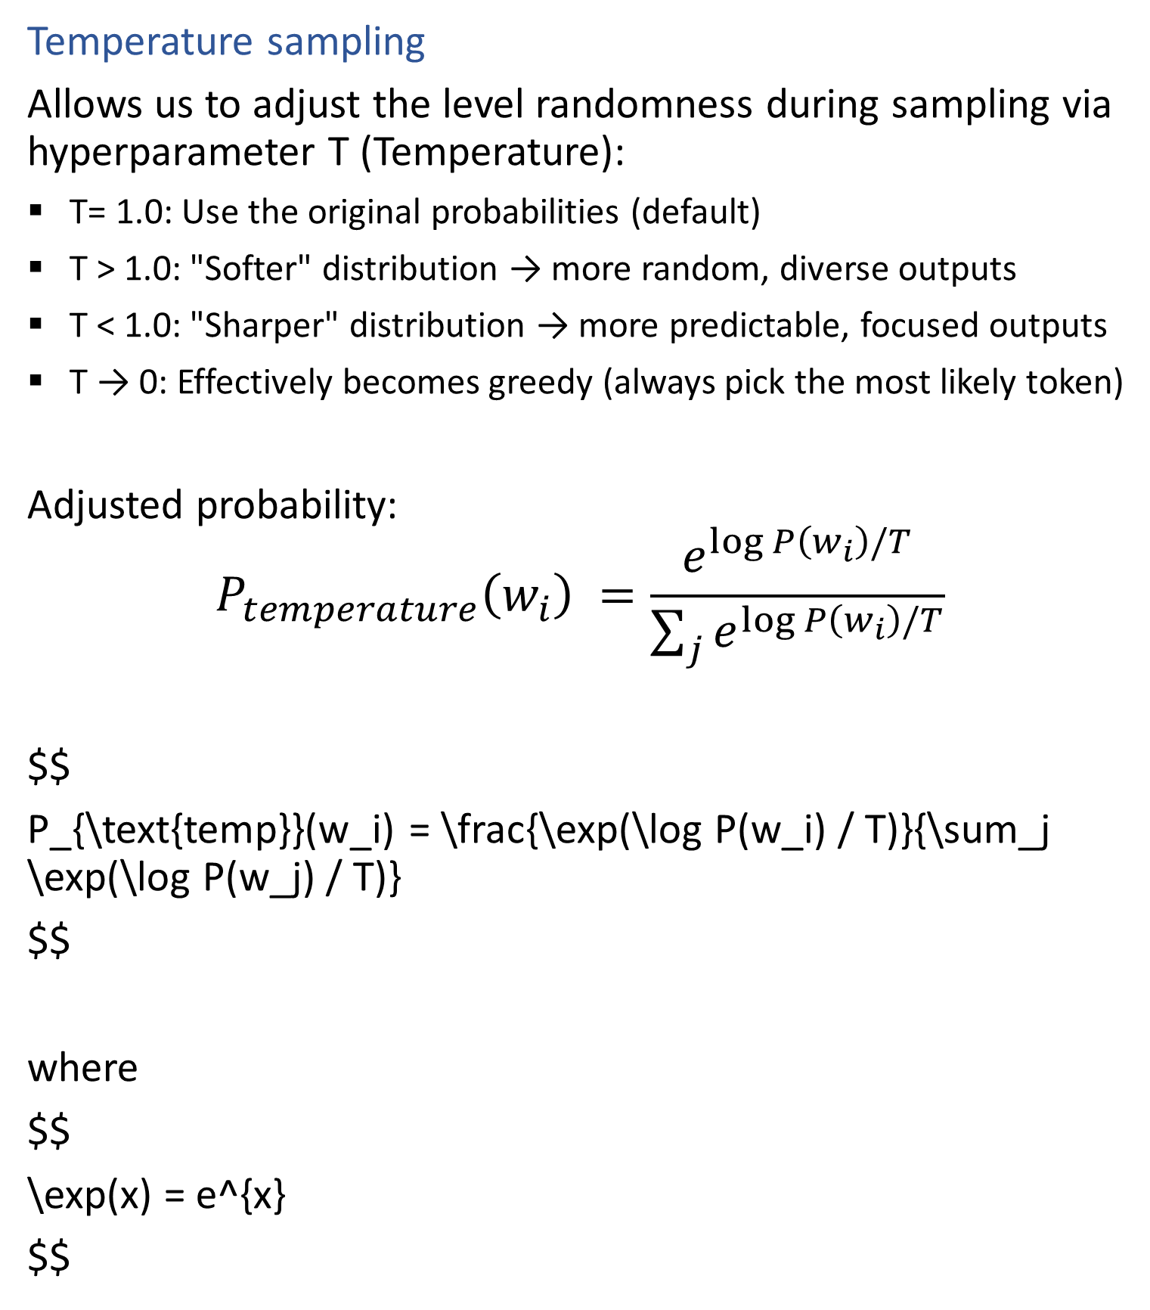
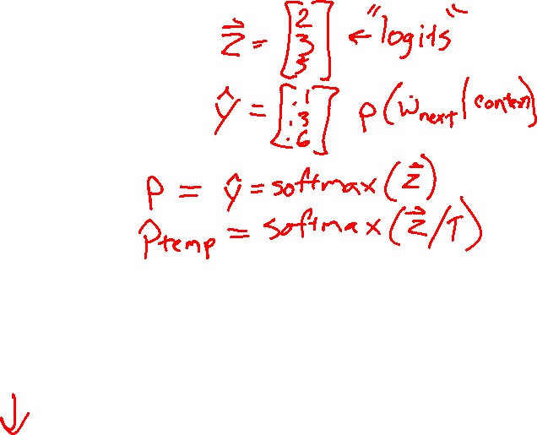
Sampling from a Language Model
Temperature sampling
Allows us to adjust the level randomness during sampling via hyperparameter T (Temperature):
T= 1.0: Use the original probabilities (default)
T > 1.0: "Softer" distribution → more random, diverse outputs
T < 1.0: "Sharper" distribution → more predictable, focused outputs
T → 0: Effectively becomes greedy (always pick the most likely token)
Adjusted probability:
$$P_{temperature}\left(w_{i}\right) =\frac{e^{\log{P\left(w_{i}\right)}/T}}{\sum_{j}{e^{\log{P\left(w_{i}\right)}/T}}}$$
$$
P_{\text{temp}}(w_i) = \frac{\exp(\log P(w_i) / T)}{\sum_j \exp(\log P(w_j) / T)}
$$
where
$$
\exp(x) = e^{x}
$$

Slide 2

07-280
AI & ML I
NLP: Word Embeddings
Attention
Instructors:
Pat Virtue & Nihar Shah

Slide 3
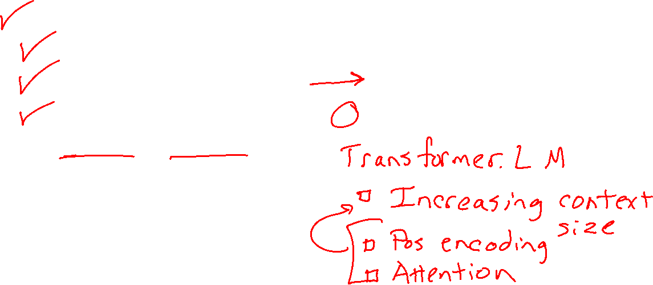
Natural Language Processing (NLP)
Last time
Language Models
N-gram LMs
Training Data
Sampling (Decoding) (Generation) (Inference)
Today
Feature Engineering for NLP
Feature Learning
Word Embeddings
Image and Audio Embeddings

Slide 4
Feature Engineering for Text

Slide 5
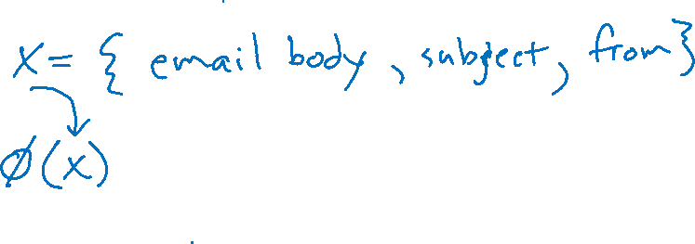
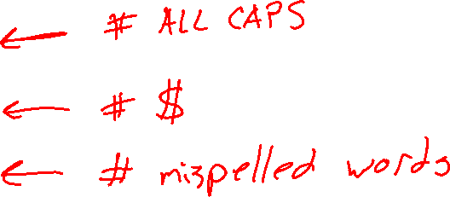
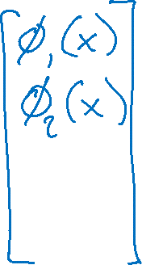
Text Features
SPAM Classification

Slide 6
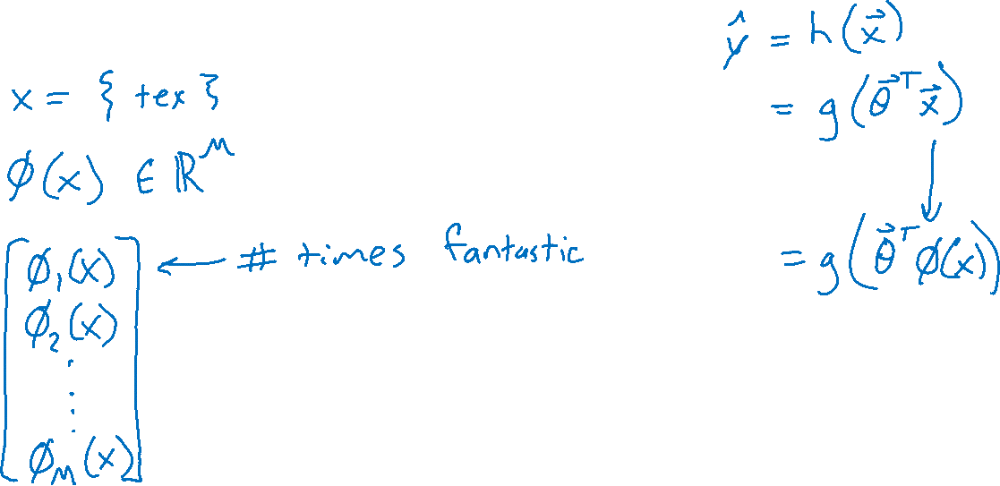
Text Features
Predicting Rating from Written Movie Review

Slide 7
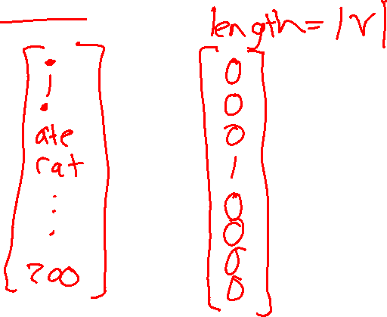
Text Features
One-hot vector for each token

Slide 8
Text Features
Bag of words: Vector of length the size of the vocabulary
Two options
Word occurrence: Binary: does the word exist (at least once) or not
Word histogram: Integer: count of how many times the word appears

Slide 9
Word Embedding LMs

Slide 10
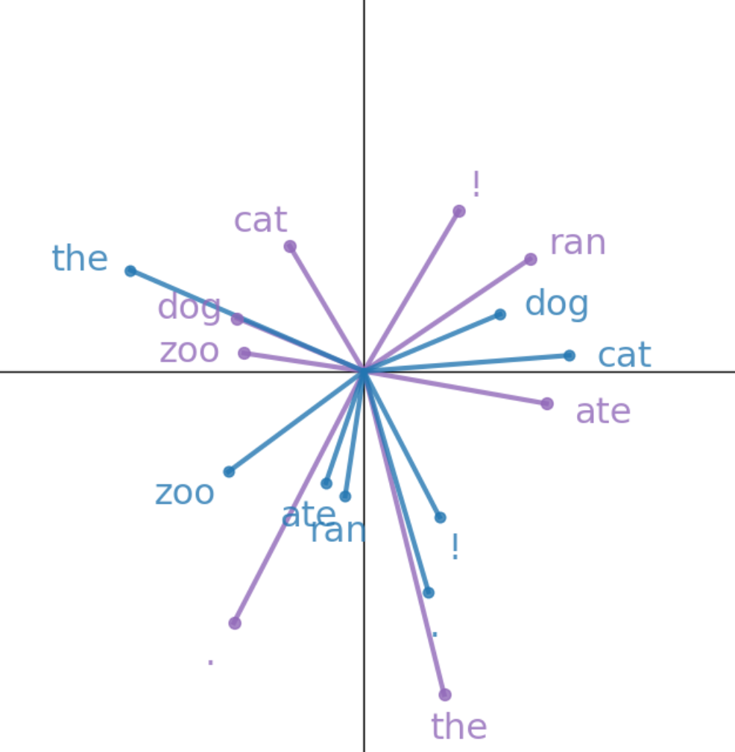
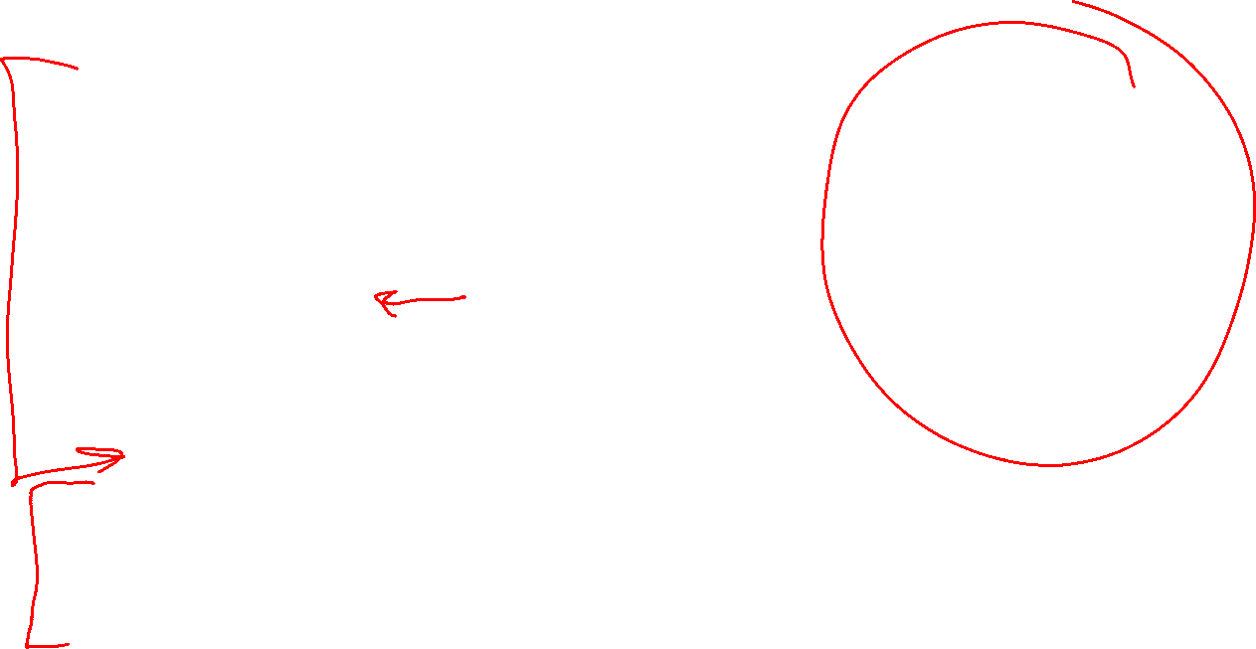
Word Embedding Language Models
Vector representation of vocab tokens
Set of vectors for both previous and next token
Sampling next token
Cosine similarity
Softmax
Sample from categorical distribution
Learning better vectors
Cross-entropy loss
SGD: looping through pairs of tokens in our corpus

Slide 11
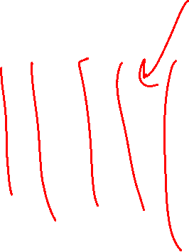
Word (Token) Embeddings
The beginning and the end of LLM networks
Current text
Large Language Model
e.g GPT, Llama, etc
Next text
Tokenizer
Tokenizer
Sampling
Input tokens
Next token
Probabilty
of each token
in vocab
Word Embedding
Many layers of
transformer/attention blocks
Output Embedding
Softmax
Embedded vector representation
Embedded vector representation
Similarity scores
for each token
in vocab

Slide 12
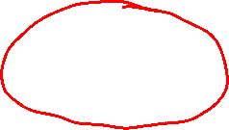
Simple Word Embedding LM
Building a language model with just word embedding layers ☺
Current text
Really Small Language Model
Next text
Tokenizer
Tokenizer
Sampling
Input tokens
Next token
Probabilty
of each token
in vocab
Word Embedding
Output Embedding
Softmax
Embedded vector representation
Similarity scores
for each token
in vocab

Slide 13
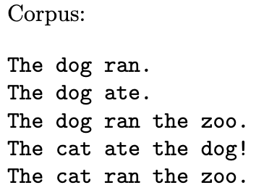
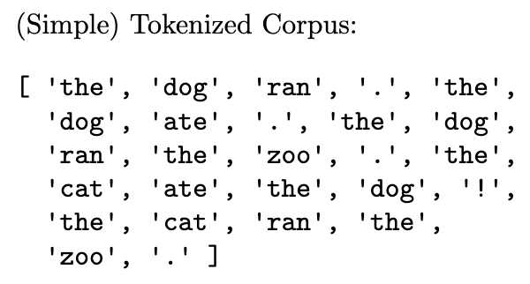
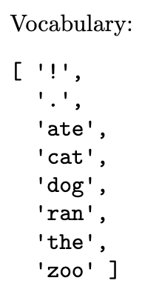
Simple Word Embedding LM
Setup
Tokenizer

Slide 14
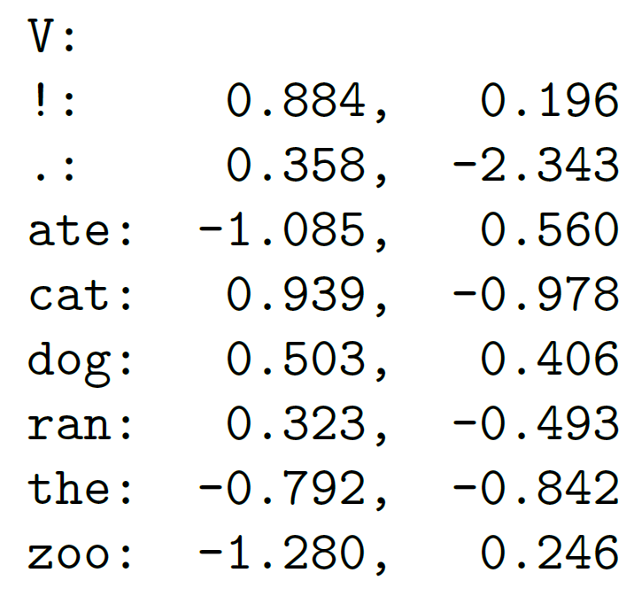
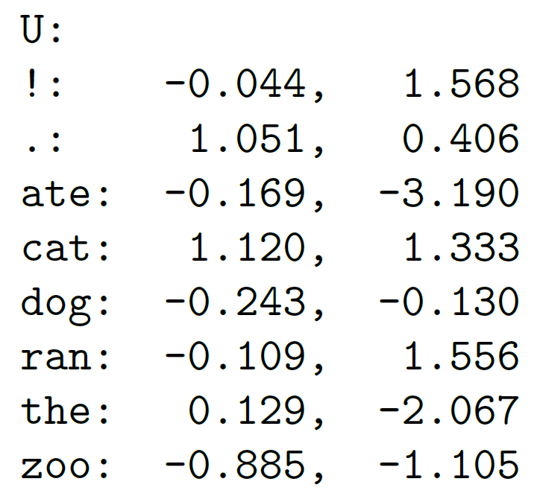
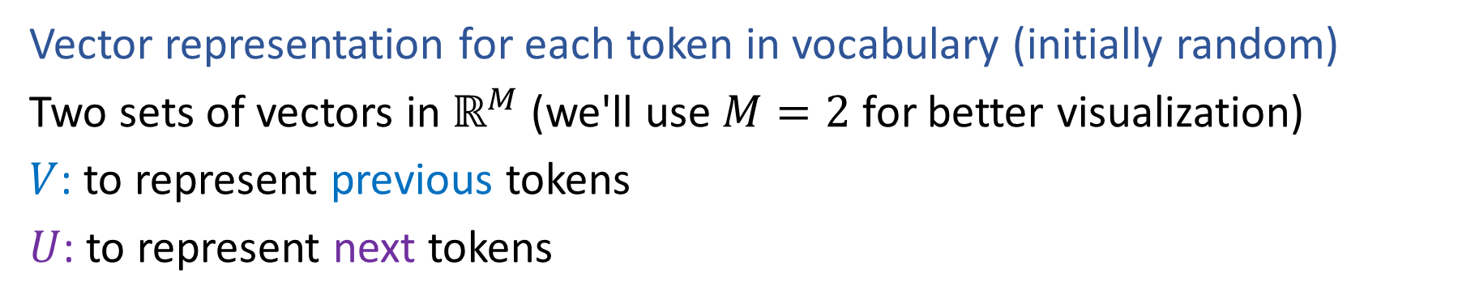
Simple Word Embedding LM
Vector representation for each token in vocabulary (initially random)
Two sets of vectors in $ℝ^{M}$ (we'll use $M=2$ for better visualization)
$V$: to represent previous tokens
$U$: to represent next tokens

Slide 15
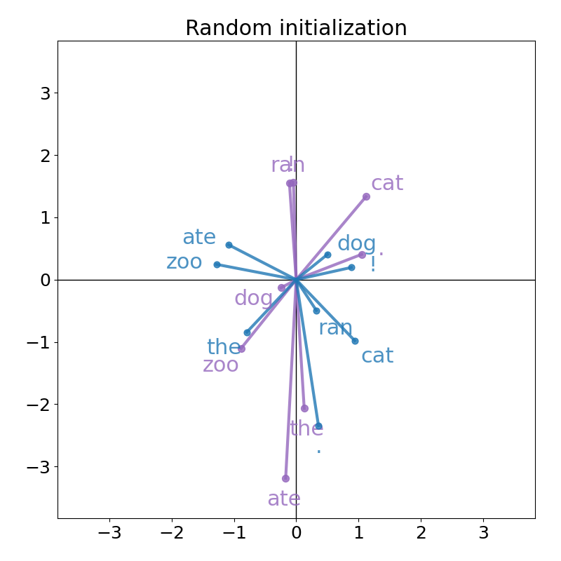

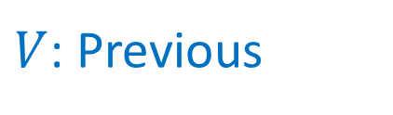
Simple Word Embedding LM
Vector representation for each token in vocabulary (initially random)
$V$: Previous
$U$: Next

Slide 16
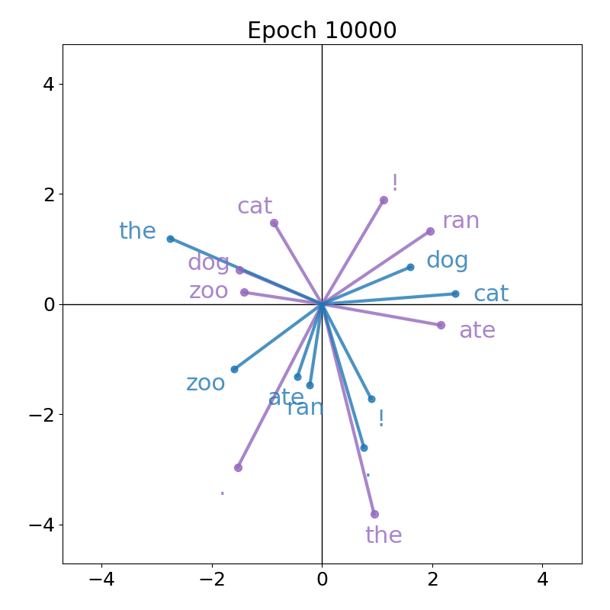
Simple Word Embedding LM
After training our LM, we'll learn more organized vectors (details later)

Slide 17
Simple Word Embedding LM
We can use either of these models to generate text, staring with "the dog"
Random vectors
Trained vectors
Generated tokens from random and trained models
the dog cat ate ran zoo zoo zoo dog dog cat cat ate ran . ate . ate ate ! the ate
the dog ate . the dog ! the zoo . the dog ran the zoo . the dog ate the dog !

Slide 18

Outline: Word Embedding LM
Vector representation of vocab tokens
Set of vectors for both previous and next token
Sampling next token
Cosine similarity
Softmax
Sample from categorical distribution
Learning better vectors
Cross-entropy loss
SGD: looping through pairs of tokens in our corpus

Slide 19
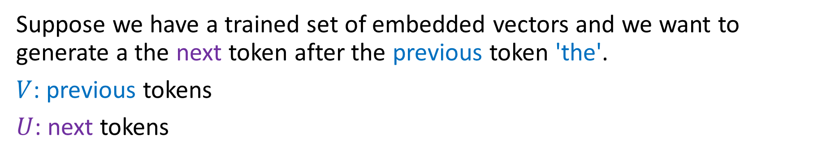
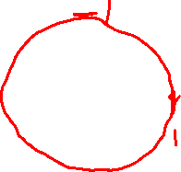
Sampling from Word Embeddings
Suppose we have a trained set of embedded vectors and we want to generate a the next token after the previous token 'the'.
$V$: previous tokens
$U$: next tokens
Which token should be our next token?

Slide 20
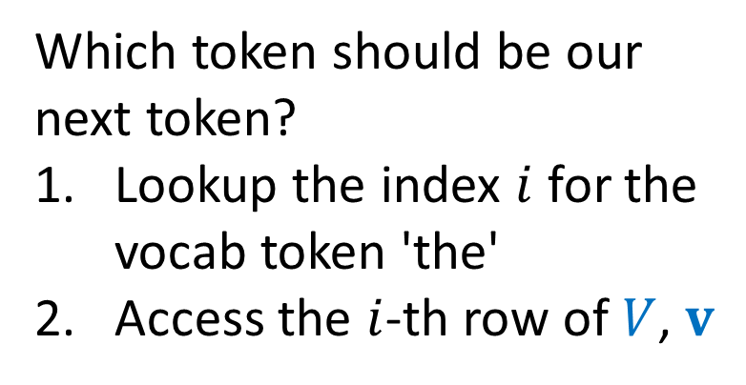
Sampling from Word Embeddings
Suppose we have a trained set of embedded vectors and we want to generate a the next token after the previous token 'the'.
$V$: previous tokens
$U$: next tokens
Which token should be our next token?
Lookup the index $i$ for the vocab token 'the'
Access the $i$-th row of $V$, $v$

Slide 21
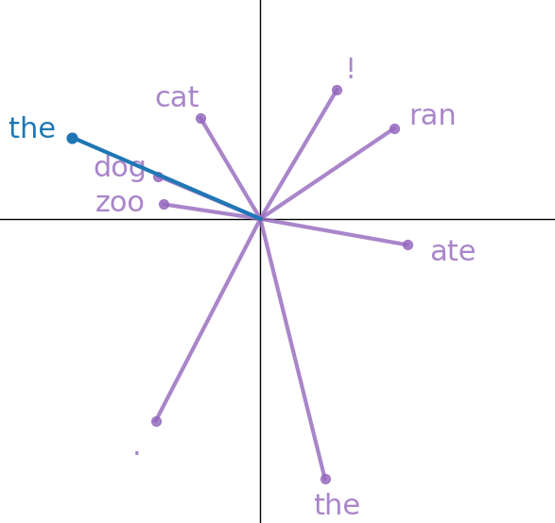
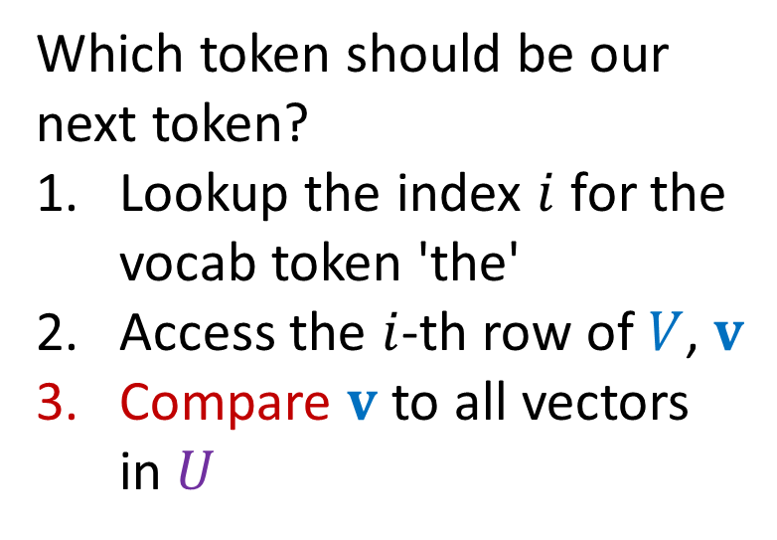
Sampling from Word Embeddings
Suppose we have a trained set of embedded vectors and we want to generate a the next token after the previous token 'the'.
$V$: previous tokens
$U$: next tokens
Which token should be our next token?
Lookup the index $i$ for the vocab token 'the'
Access the $i$-th row of $V$, $v$
Compare $v$ to all vectors in $U$

Slide 22
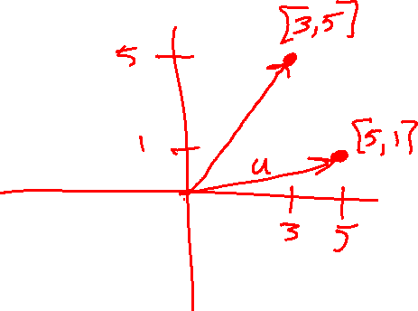

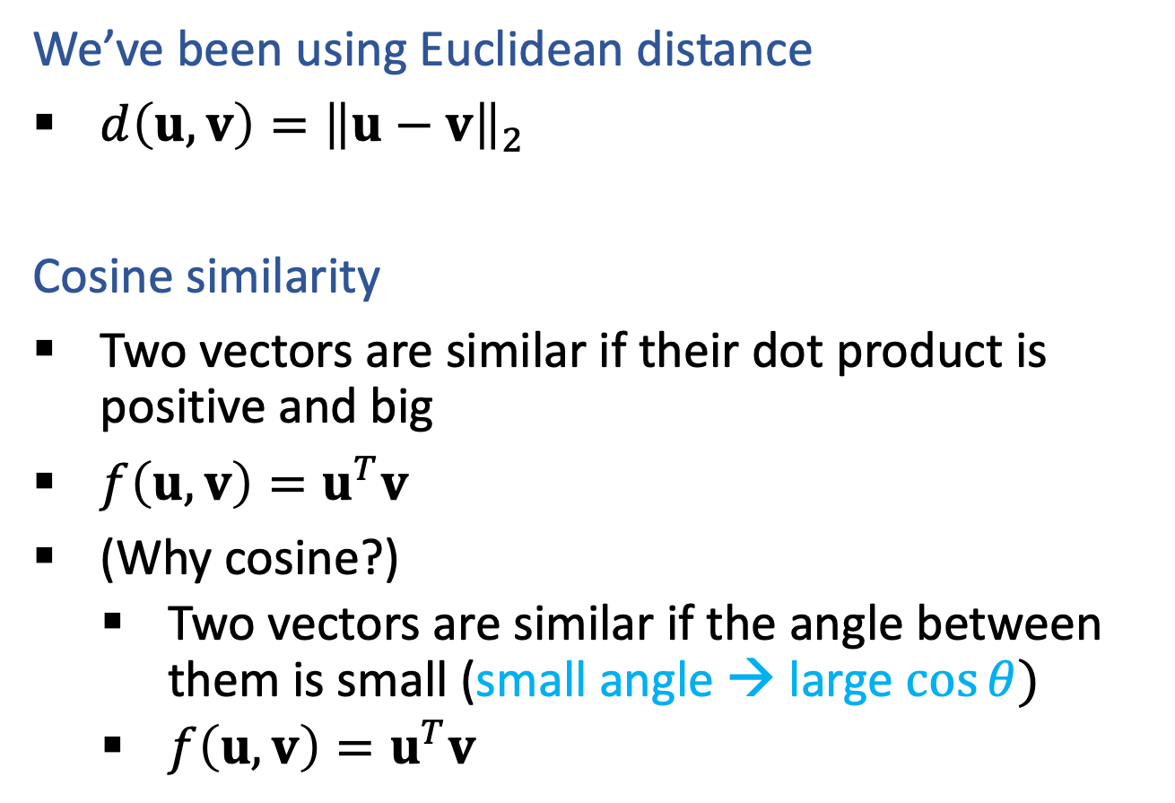

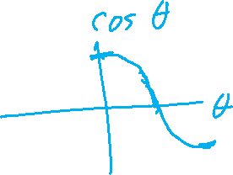
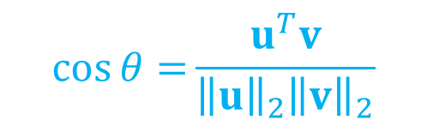
(Unnormalized) Cosine Similarity Metric
We’ve been using Euclidean distance
$d\left(u, v\right)={\left\|u−v\right\|}_{2}$
Cosine similarity
Two vectors are similar if their dot product is positive and big
$f\left(u, v\right)=u^{T}v$
(Why cosine?)
    Two vectors are similar if the angle between them is small (small angle → large $cos⁡θ)$
    $f\left(u, v\right)=u^{T}v$
$$\cos{θ=}\frac{u^{T}v}{{\left\|u\right\|}_{2}{\left\|v\right\|}_{2}}$$

Slide 23
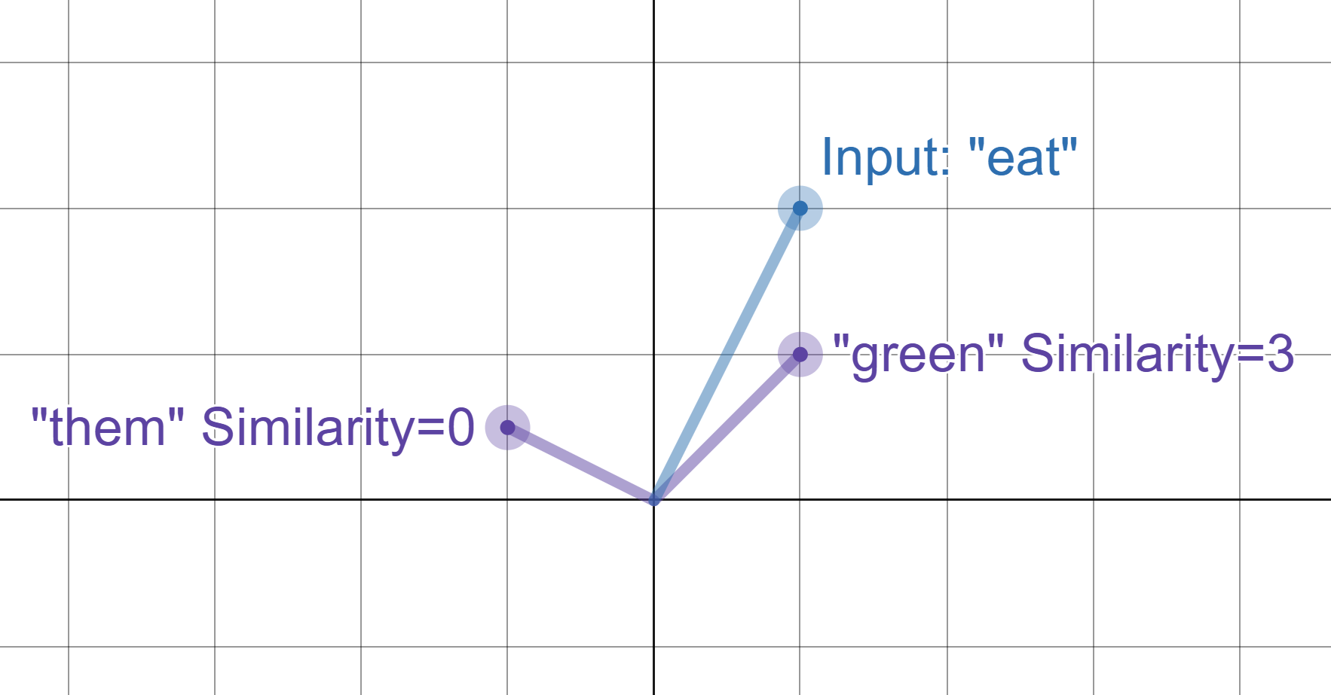
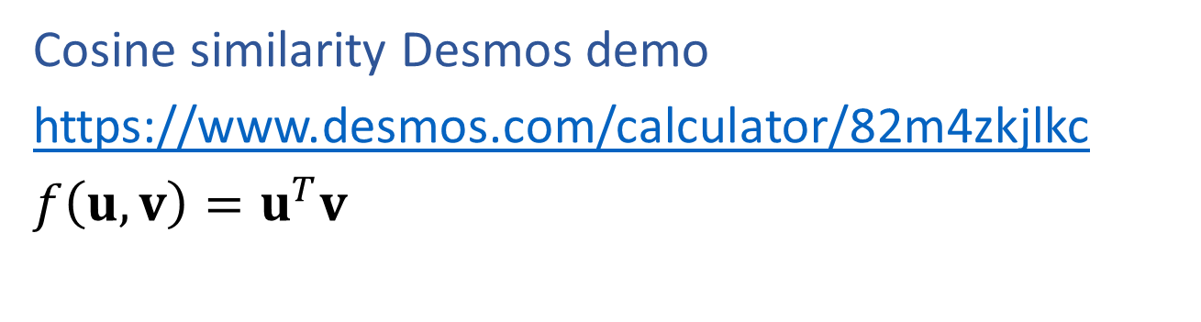
(Unnormalized) Cosine Similarity Metric
Cosine similarity Desmos demo
https://www.desmos.com/calculator/82m4zkjlkc
$f\left(u, v\right)=u^{T}v$

Slide 24
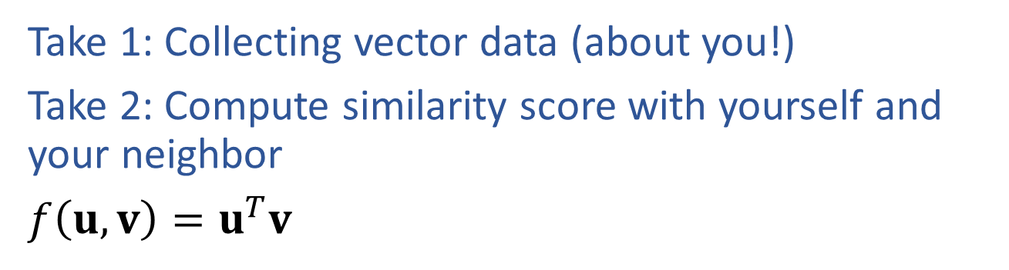

Poll 1
Take 1: Collecting vector data (about you!)
Take 2: Compute similarity score with yourself and your neighbor
$f\left(u, v\right)=u^{T}v$

Slide 25
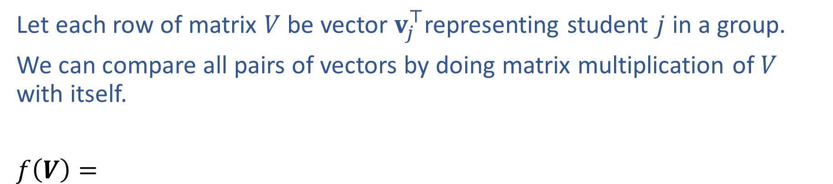
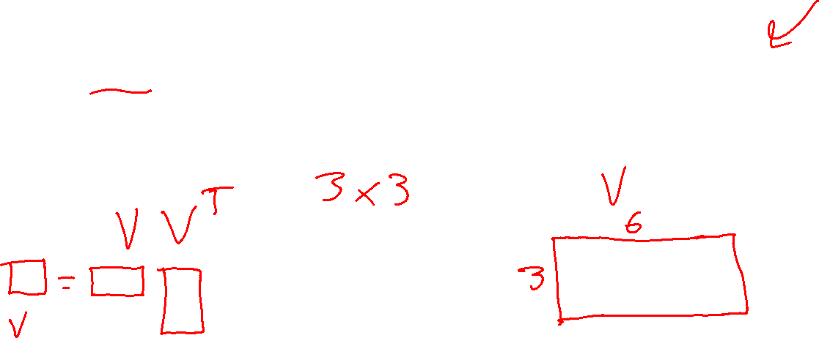
Similarity Matrix
Let each row of matrix $V$ be vector $v_{j}^{⊤}$representing student $j$ in a group.
We can compare all pairs of vectors by doing matrix multiplication of $V$ with itself.
$f\left(V\right)=$

Slide 26
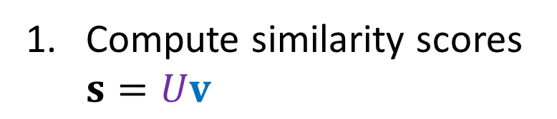
Sampling from Word Embeddings
Suppose we have a trained set of embedded vectors and we want to generate a the next token after the previous token 'the'.
$V$: previous tokens
$U$: next tokens
Compute similarity scores $s=Uv$

Slide 27
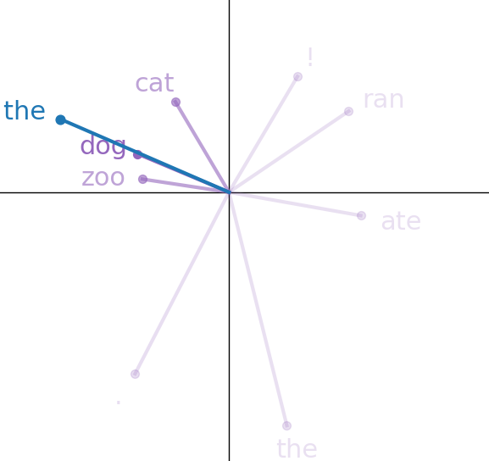
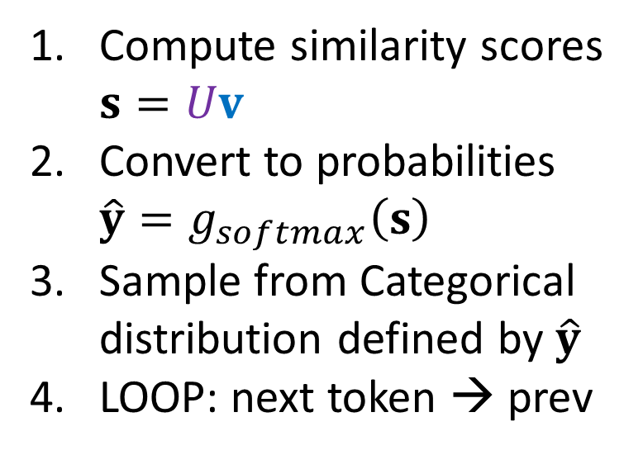
Sampling from Word Embeddings
Suppose we have a trained set of embedded vectors and we want to generate a the next token after the previous token 'the'.
$V$: previous tokens
$U$: next tokens
Compute similarity scores $s=Uv$
Convert to probabilities $\hat{y}=g_{softmax}\left(s\right)$
Sample from Categorical distribution defined by $\hat{y}$
LOOP: next token → prev

Slide 28
Simple Word Embedding LM
Building a language model with just word embedding layers ☺
Current text
Really Small Language Model
Next text
Tokenizer
Tokenizer
Sampling
Input tokens
Next token
Probabilty
of each token
in vocab
Word Embedding
Output Embedding
Softmax
Embedded vector representation
Similarity scores
for each token
in vocab

Slide 29
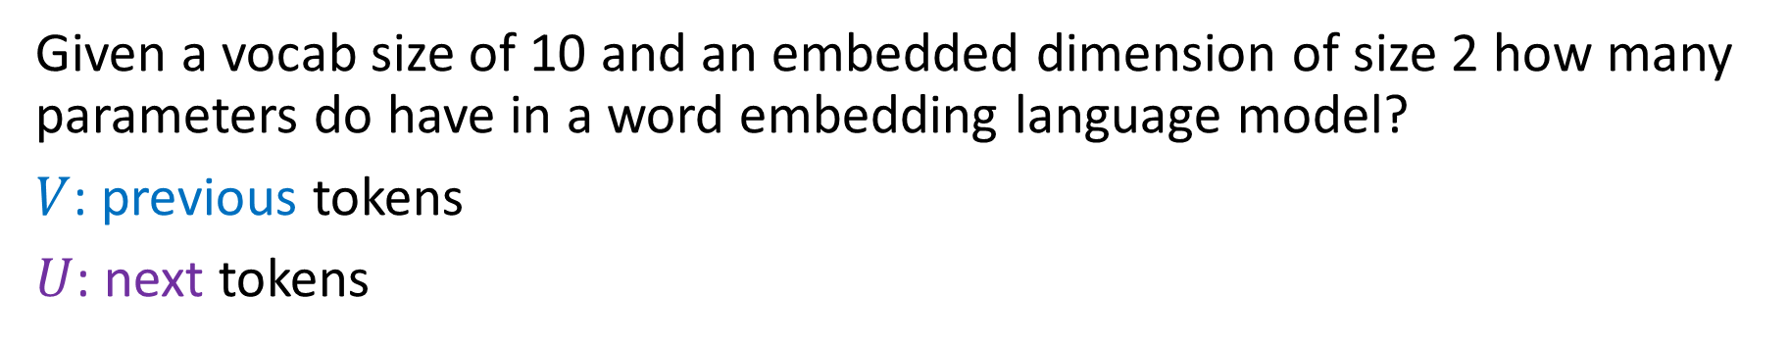
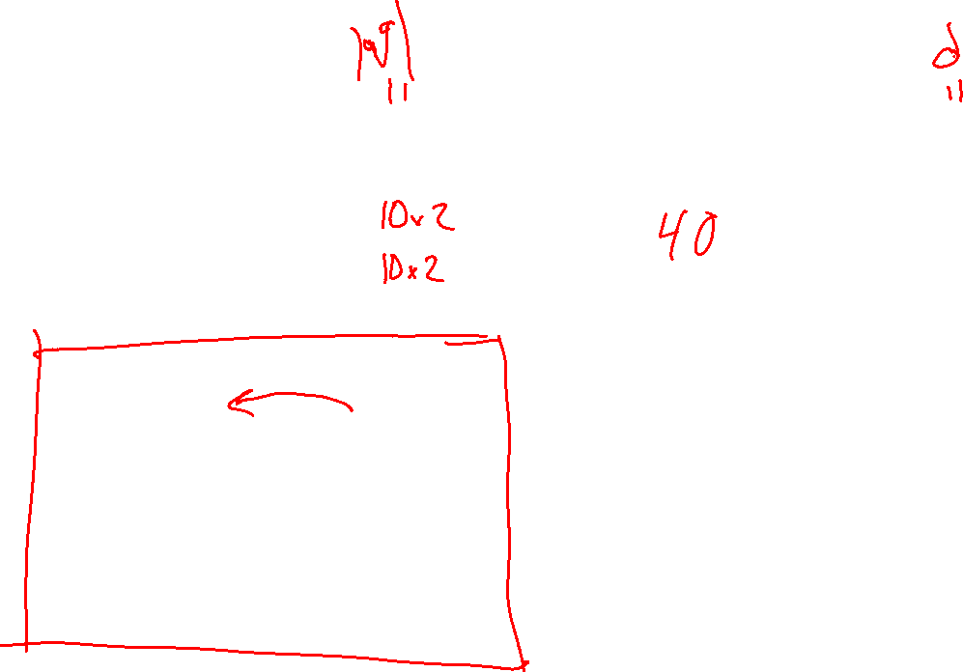
Poll 2
Given a vocab size of 10 and an embedded dimension of size 2 how many parameters do have in a word embedding language model?
$V$: previous tokens
$U$: next tokens
Compute similarity scores $s=Uv$
Convert to probabilities $\hat{y}=g_{softmax}\left(s\right)$
Sample from Categorical distribution defined by $\hat{y}$
LOOP: next token → prev

Slide 30
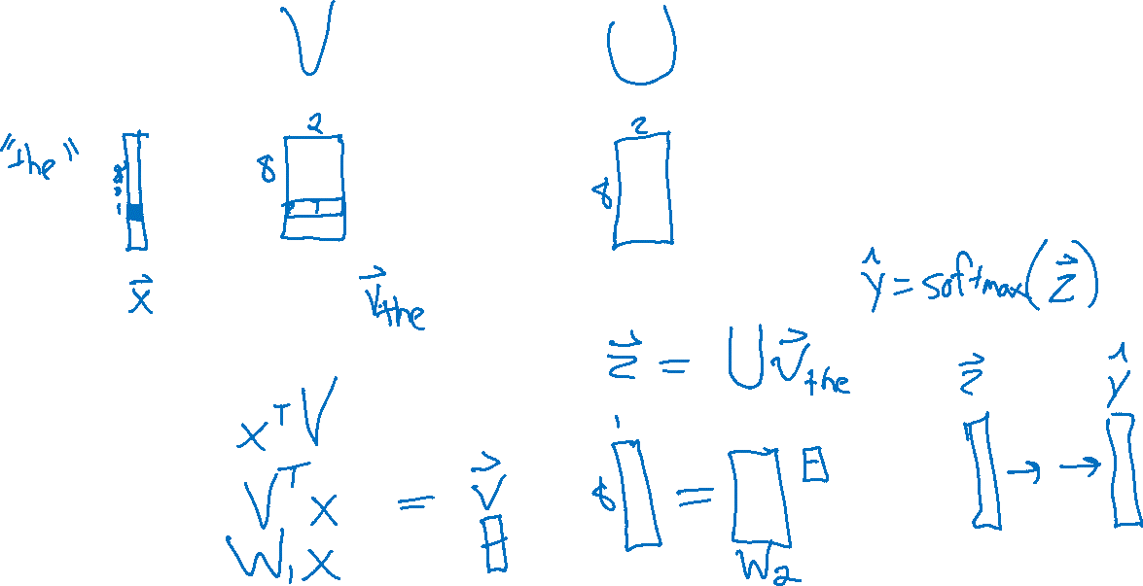
Linear Layer for Word Embeddings

Slide 31
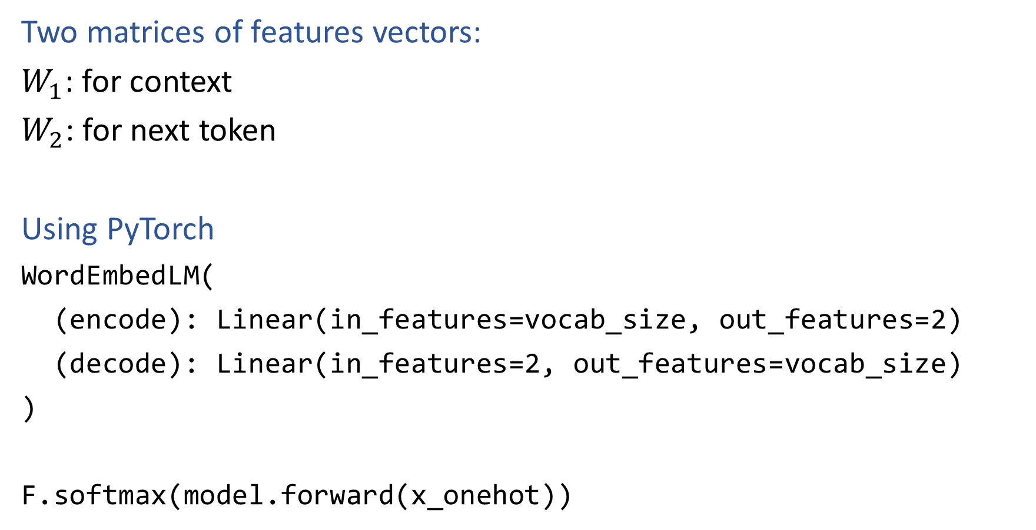
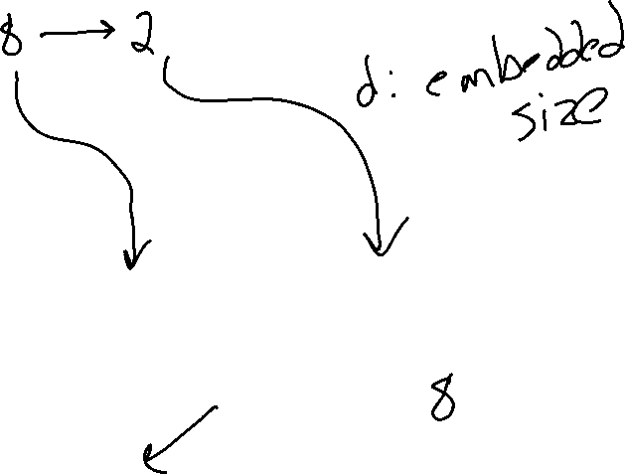
PyTorch for Word Embedding LM
Two matrices of features vectors:
$W_{1}$: for context
$W_{2}$: for next token
Using PyTorch
WordEmbedLM(
(encode): Linear(in_features=vocab_size, out_features=2)
(decode): Linear(in_features=2, out_features=vocab_size)
)
F.softmax(model.forward(x_onehot))

Slide 32
PyTorch for Word Embedding LM
Two matrices of features vectors:
$W_{1}$: for context
$W_{2}$: for next token
Using PyTorch
WordEmbedLM(
(encode): Linear(in_features=vocab_size, out_features=2)
(decode): Linear(in_features=2, out_features=vocab_size)
)
F.softmax(model.forward(x_onehot))
torch.nn.Embedding(num_embeddings, embedding_dim)
x_index

Slide 33
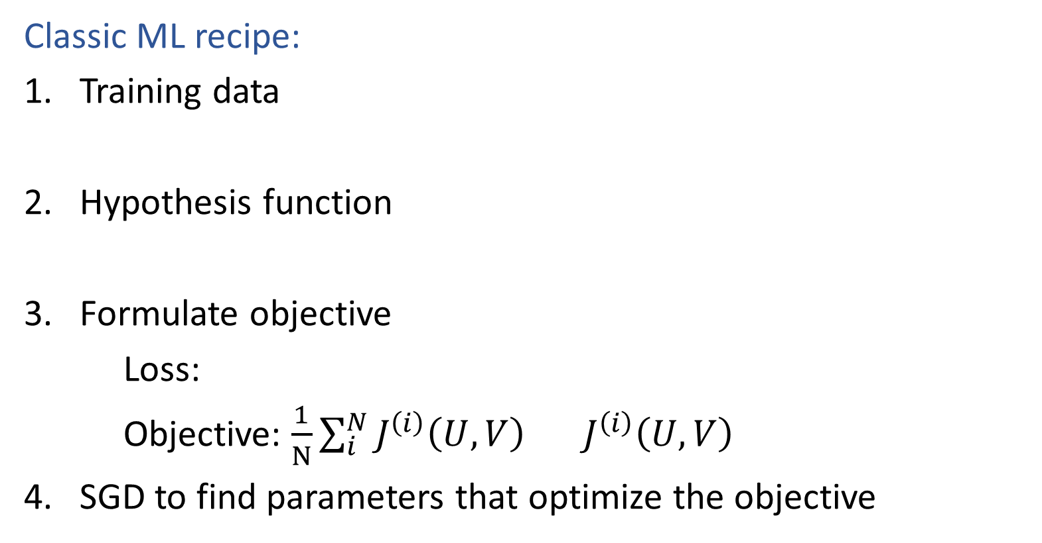

Learning Better Vectors
Classic ML recipe:
Training data
Hypothesis function
Formulate objective
Loss:
Objective: $\frac{1}{N}\sum_{i}^{N}{J^{\left(i\right)}\left(U, V\right)} J^{\left(i\right)}\left(U, V\right)$
SGD to find parameters that optimize the objective
$$\hat{y}= g_{softmax}(Uv)$$

Slide 34
Feature Learning
Image and Audio

Slide 35

Feature Learning
Learning a lower dimensional representation of our data rather than doing feature engineering to represent the data
Also called feature embedding
(embedding data in a lower/different dimensional space)

Slide 36
Word Embeddings
Vector representation for each token in vocabulary (initially random)
$V$: Previous
$U$: Next

Slide 37
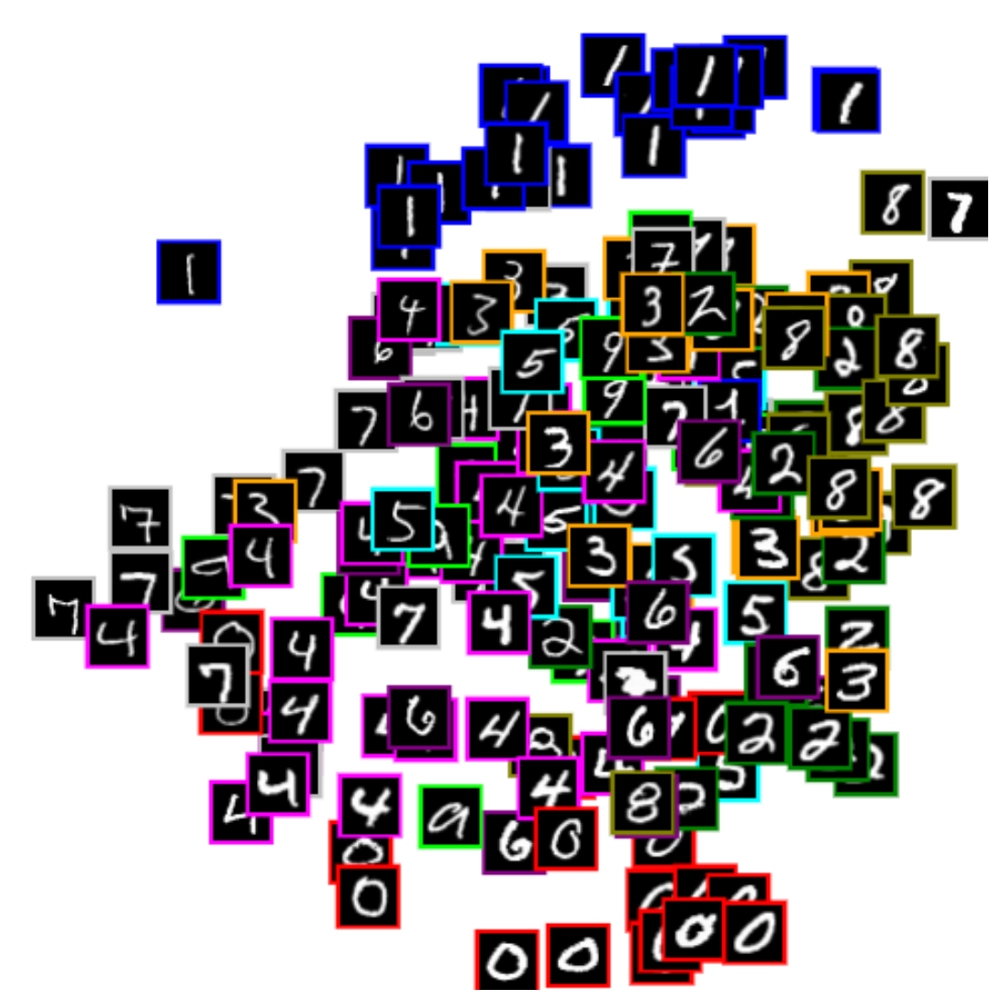
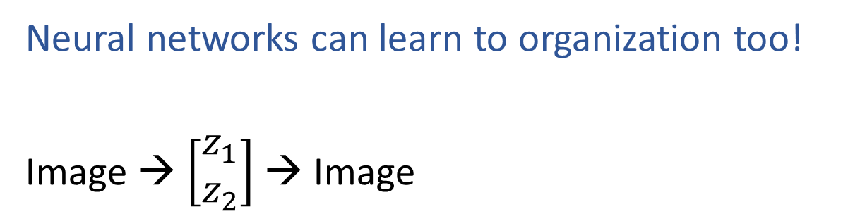


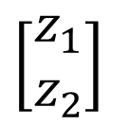

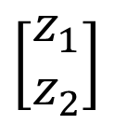
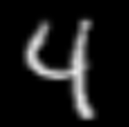

Learning to Organize Data
Net
Net
Net
Net
https://cs.stanford.edu/people/karpathy/convnetjs/demo/autoencoder.html

Slide 38

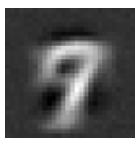
Digit Autoencoder
https://cs.stanford.edu/people/karpathy/convnetjs/demo/autoencoder.html
Layer 1
Layer 2
Layer 4
Layer 5
Layer 6
Input
28x28 = 784 pixels
Layer 3
50 neurons
50 neurons
784 neurons
50 neurons
50 neurons
2 neurons
Autoencoder network

Slide 39

Digit Autoencoder
Demo: Using a learned feature space

Slide 40

Variational Autoencoder Demo
Zhuoyue Lyu, Safinah Ali, and Cynthia Breazeal. EAAI 2022.
https://colab.research.google.com/gist/ZhuoyueLyu/5046225a9ae3675cf633c1df5f63be06/digits-interpolation-notebook-eaai.ipynb

Slide 41

Feature Learning
Listen Learner
https://chrisharrison.net/index.php/Research/ListenLearner

Slide 42

Exploring Feature Space
https://experiments.withgoogle.com/ai/melody-mixer/view/

Slide 43

Exploring Feature Space
https://experiments.withgoogle.com/ai/beat-blender/view/

Slide 44

Feature Learning
CLIP: Connecting text and images
https://openai.com/research/clip

Slide 45

Feature Learning
CLIP: Connecting text and images
https://openai.com/research/clip

