Slide 1

07-280
AI & ML I
NLP: N-gram LMs
Instructors:
Pat Virtue & Nihar Shah

Slide 2
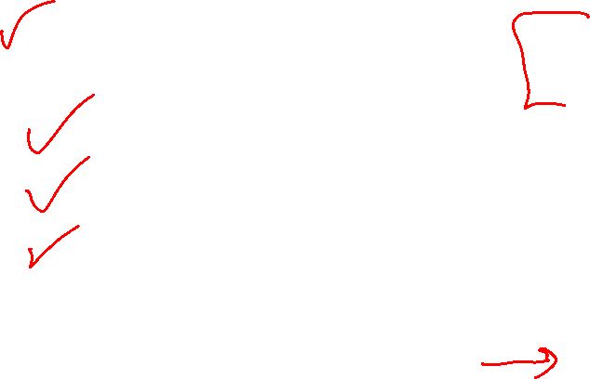
Natural Language Processing (NLP)
Last time
MLE
NLP
Tokenization
N-grams Worksheet
Language Models (LMs)
Today
Language Models
N-gram LMs
Training Data
Sampling (Decoding) (Generation)
Feature Engineering for NLP
Feature Learning
Word Embeddings
Image and Audio Embeddings

Slide 3
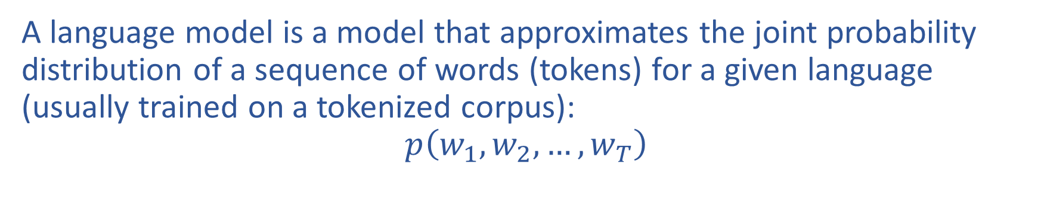

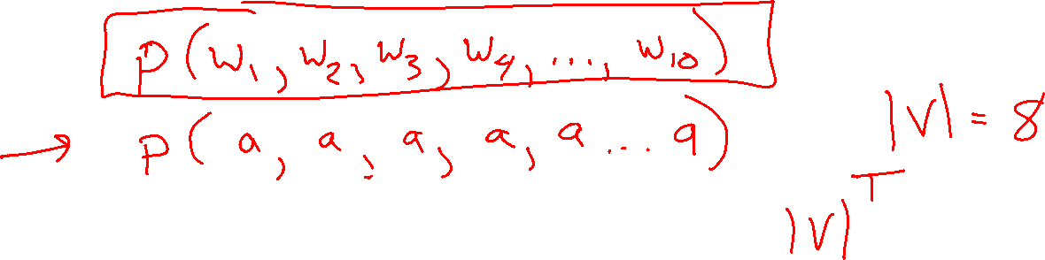
What is a language model (LM)?
A language model is a model that approximates the joint probability distribution of a sequence of words (tokens) for a given language (usually trained on a tokenized corpus):
$$p\left(w_{1}, w_{2}, …, w_{T}\right)$$

Slide 4
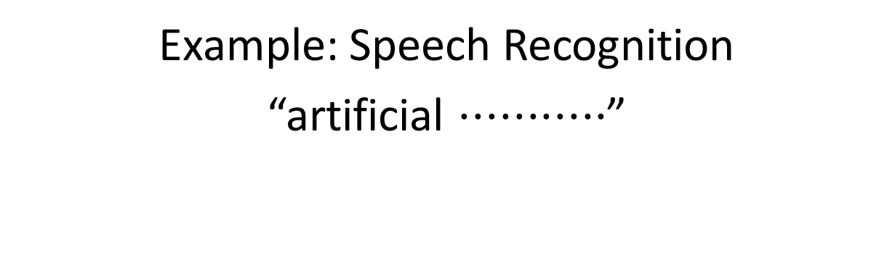
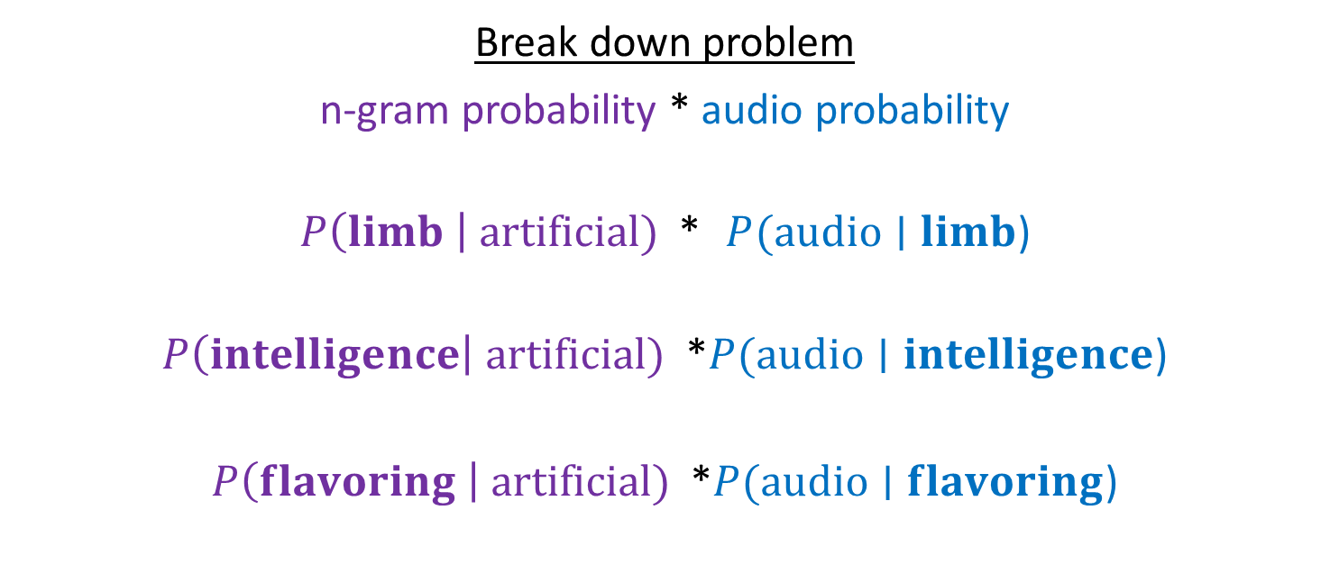
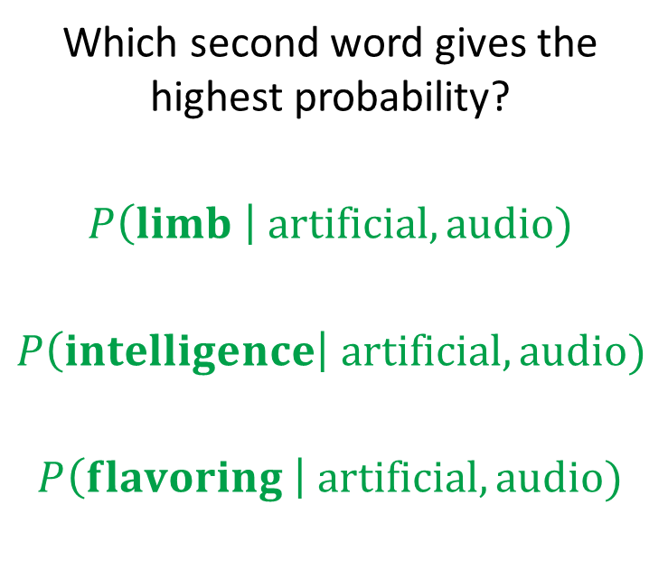

LM Applications: Speech Recognition
Example: Speech Recognition
“artificial $⋅⋅⋅⋅⋅⋅⋅⋅⋅⋅⋅$”
Find most probable next word given “artificial” and the audio for second word.
Which second word gives the highest probability?
$$P\left(limb \right| artificial, audio)$$
$$P\left(intelligence\right| artificial, audio)$$
$$P\left(flavoring \right| artificial, audio)$$
Break down problem
n-gram probability * audio probability
$P\left(limb \right| artificial)$ * $P(audio∣limb$)
$P\left(intelligence\right| artificial)$ *$P(audio∣intelligence$)
$P\left(flavoring \right| artificial)$ *$P(audio∣flavoring$)

Slide 5
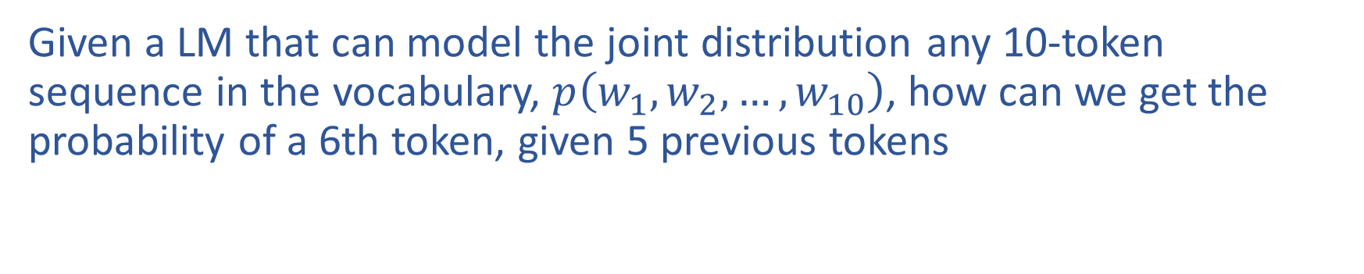
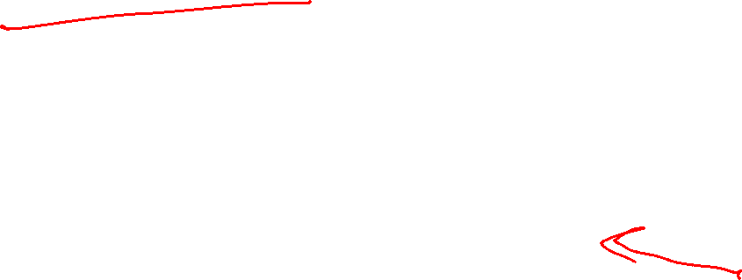
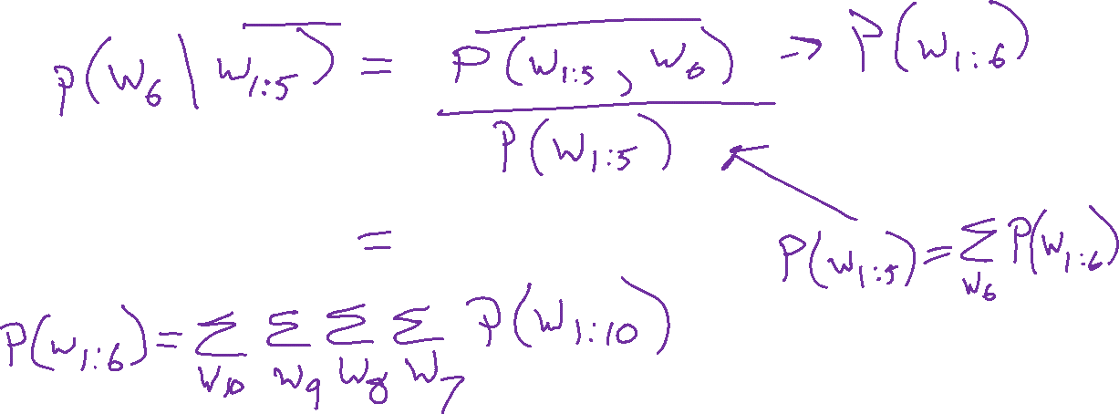
LM Applications: Text Generation
Given a LM that can model the joint distribution any 10-token sequence in the vocabulary, $p\left(w_{1}, w_{2}, …, w_{10}\right)$, how can we get the probability of a 6th token, given 5 previous tokens

Slide 6
Language Models
N-grams

Slide 7
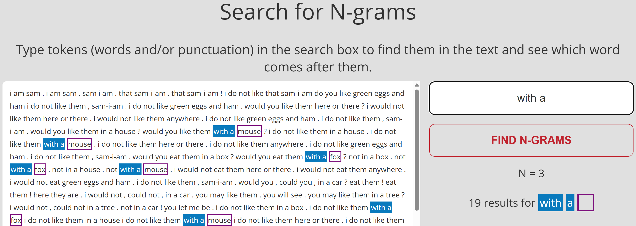
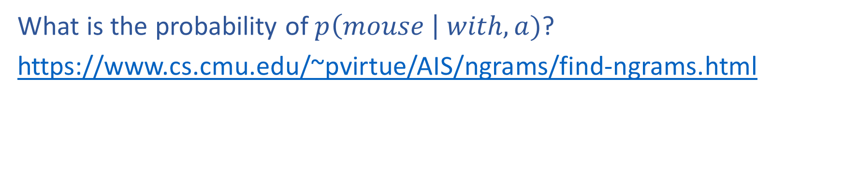
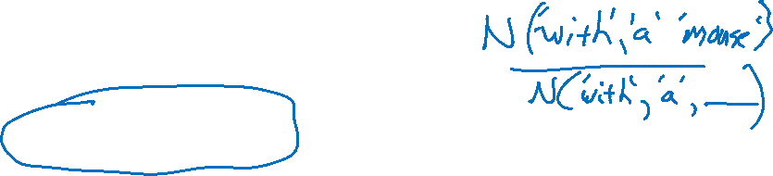
Poll 1
What is the probability of $p\left(mouse \right| with, a)$?
https://www.cs.cmu.edu/~pvirtue/AIS/ngrams/find-ngrams.html

Slide 8
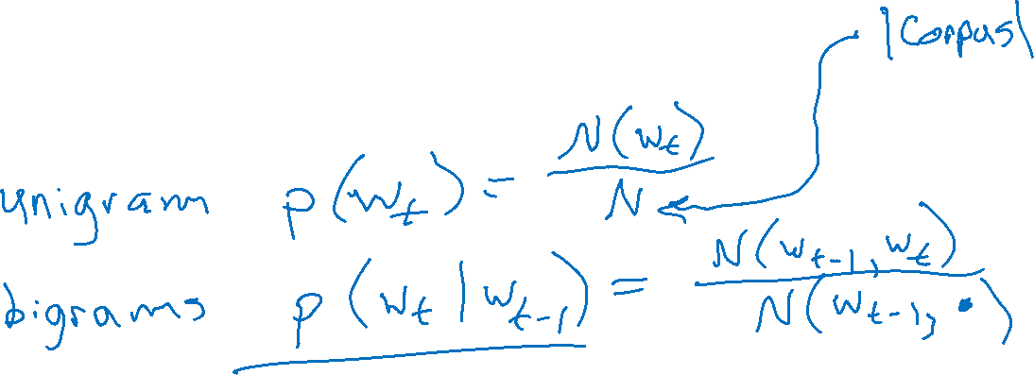
N-gram Worksheet
Computing N-grams

Slide 9
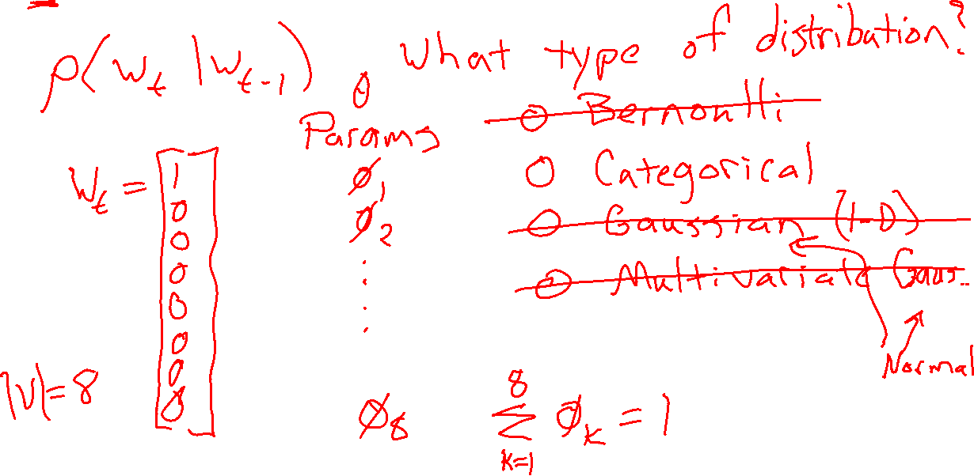

MLE to learn N-grams

Slide 10
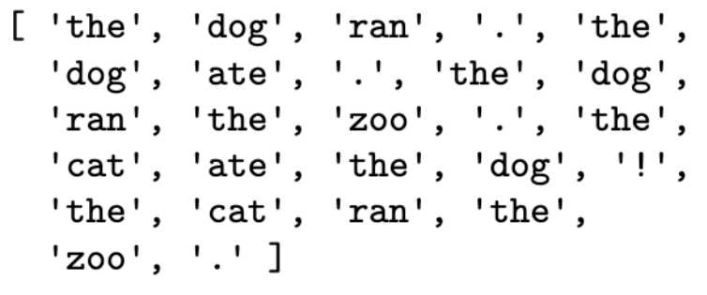
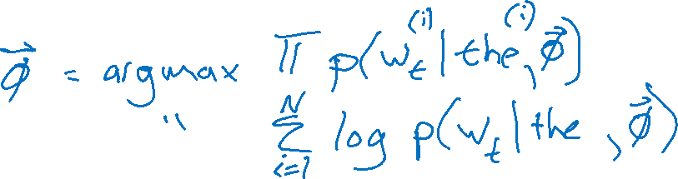
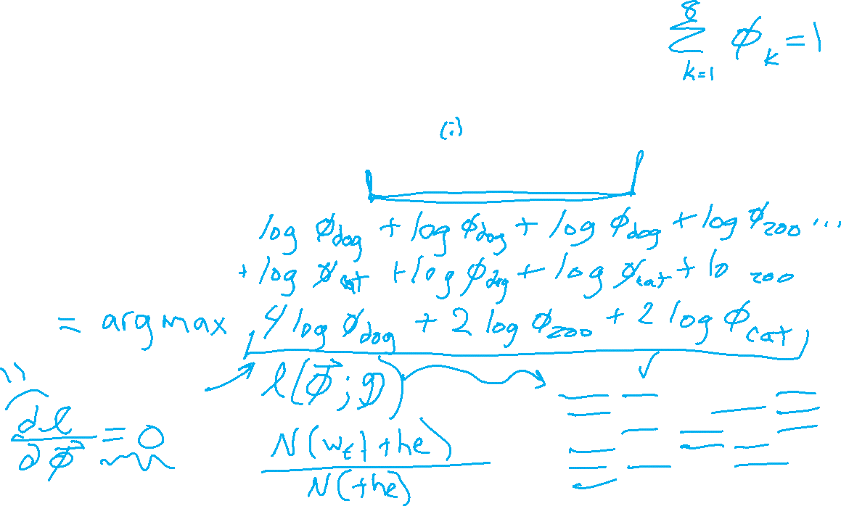
MLE to learn N-grams

Slide 11
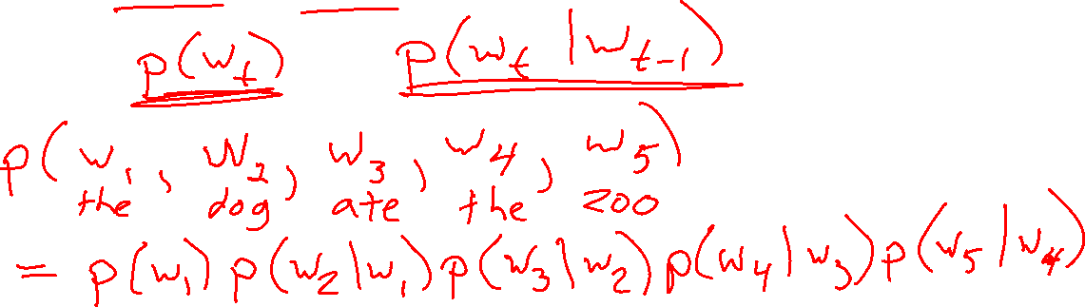
N-gram Language Model
If we have unigram and bigram probabilities, do we have a language model??

Slide 12
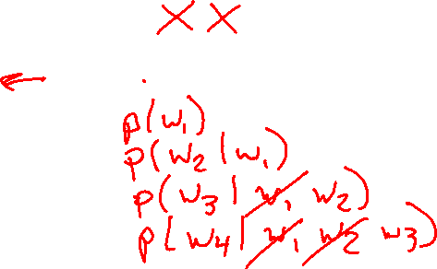
n-Gram Language Model
Question: How can we define a probability distribution over a sequence of length T?
The
bat
made
noise
at
night
w₁
w₂
w₃
w₄
w₅
w₆
n-Gram Model (n=2)
p(w₁, w₂, w₃, … , w₆) =
p(w₁)
p(w₂ | w₁)
p(w₃ | w₂)
p(w₄ | w₃)
p(w₅ | w₄)
p(w₆ | w₅)
The
The
bat
bat
made
made
noise
noise
at
at
night
Notes:
p(w_1, w_2, \ldots, w_T) = \prod_{t=1}^T p(w_t \mid w_{t-1})

Slide 13
n-Gram Language Model
Question: How can we define a probability distribution over a sequence of length T?
The
bat
made
noise
at
night
w₁
w₂
w₃
w₄
w₅
w₆
n-Gram Model (n=3)
p(w₁, w₂, w₃, … , w₆) =
p(w₁)
p(w₂ | w₁)
p(w₃ | w₂, w₁)
p(w₄ | w₃, w₂)
p(w₅ | w₄, w₃)
p(w₆ | w₅, w₄)
The
The
bat
The
bat
made
bat
made
noise
made
noise
at
noise
at
night
Notes:
p(w_1, w_2, \ldots, w_T) = \prod_{t=1}^T p(w_t \mid w_{t-1}, w_{t-2})

Slide 14

The Chain Rule of Probability
Question: How can we define a probability distribution over a sequence of length T?
The
bat
made
noise
at
night
w₁
w₂
w₃
w₄
w₅
w₆
p(w₁, w₂, w₃, … , w₆) =
p(w₁)
p(w₂ | w₁)
p(w₃ | w₂, w₁)
p(w₄ | w₃, w₂, w₁)
p(w₅ | w₄, w₃, w₂, w₁)
p(w₆ | w₅, w₄, w₃, w₂, w₁)
The
The
bat
The
bat
made
The
bat
made
noise
The
bat
made
noise
at
The
bat
made
noise
at
night
Notes:
p(w_1, w_2, \ldots, w_T) = \prod_{t=1}^T p(w_t \mid w_{t-1}, \ldots, w_{1})

Slide 15
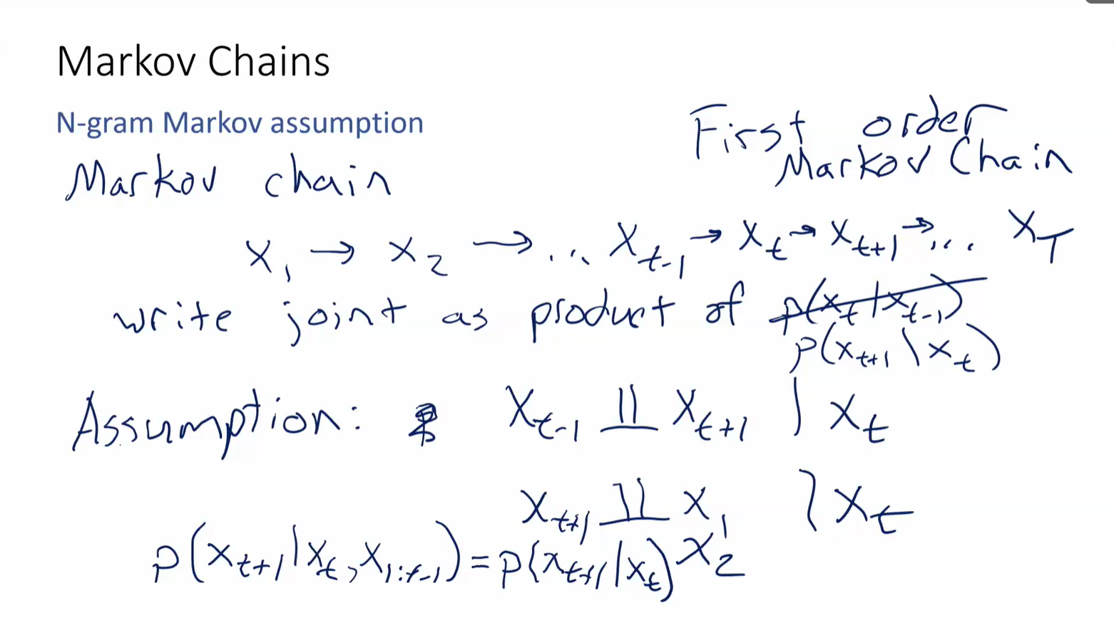
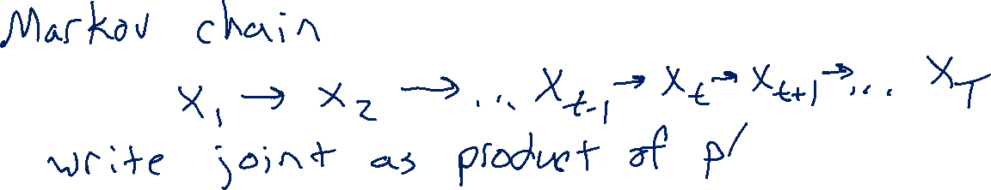
Markov Chains
N-gram Markov assumption

Slide 16
LM Training Data

Slide 17
N-gram Training
Where do the n-gram probabilities come from?
Google n-grams demo

Slide 18
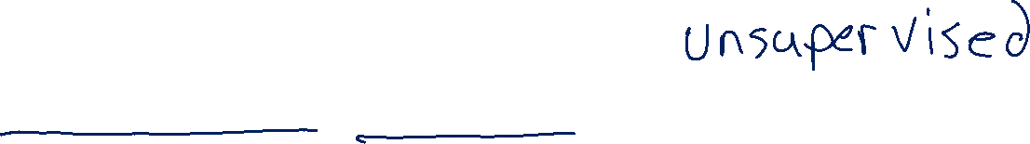
N-gram Training Data
Self-supervised learning (auto-regressive)
Example: Jane Austen, Pride and Prejudice
Vanity and pride are different things, though the words are often used synonymously. A person may be proud without being vain. Pride relates more to our opinion of ourselves, vanity to what we would have others think of us.

Slide 19
N-gram Training Data
Self-supervised learning (auto-regressive)
Example: Jane Austen, Pride and Prejudice
Vanity and pride are different things, though the words are often used synonymously. A person may be proud without being vain. Pride relates more to our opinion of ourselves, vanity to what we would have others think of us.

Slide 20
Sampling from a Language Model

Slide 21
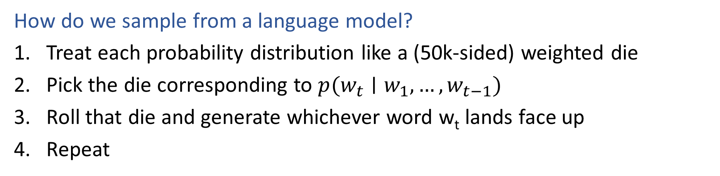
Sampling from a Language Model
How do we sample from a language model?
Treat each probability distribution like a (50k-sided) weighted die
Pick the die corresponding to $p(w_{t}∣w_{1}, …, w_{t−1})$
Roll that die and generate whichever word w_{t} lands face up
Repeat
p(· | The) #Bigram
p(· | noise, at)
p(· | made, noise)
p(· | bat, made)
p(·) #Unigram
p(· | The, bat)
The
bat
made
noise
at
night
Slide: CMU, Matt Gormley
Notes:
https://pixabay.com/vectors/dice-red-two-game-rolling-chance-25637/

Slide 22
N-gram Examples
Random samples from language model trained on Shakespeare:
n=1: “in as , stands gods revenge ! france pitch good in fair hoist an what fair shallow-rooted , . that with wherefore it what a as your . , powers course which thee dalliance all”
n=2: “look you may i have given them to the dank here to the jaws of tune of great difference of ladies . o that did contemn what of ear is shorter time ; yet seems to”
n=3: “believe , they all confess that you withhold his levied host , having brought the fatal bowels of the pope ! ' and that this distemper'd messenger of heaven , since thou deniest the gentle desdemona ,”
n=7: “so express'd : but what of that ? 'twere good you do so much for charity . i cannot find it ; 'tis not in the bond . you , merchant , have you any thing to say ? but little”
This is starting to look a lot like Shakespeare… because it is Shakespeare
Slide: CMU, Zico Kolter

Slide 23
N-gram LM Issues
What are the downsides of N-grams for language models?

Slide 24
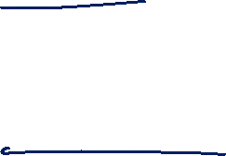
Sampling from a Language Model
Variations
Greedy (argmax) versus sampling
Top-K
Temperature

Slide 25
Sampling from a Language Model
Temperature sampling
Allows us to adjust the level randomness during sampling via hyperparameter T (Temperature):
T= 1.0: Use the original probabilities (default)
T > 1.0: "Softer" distribution → more random, diverse outputs
T < 1.0: "Sharper" distribution → more predictable, focused outputs
T → 0: Effectively becomes greedy (always pick the most likely token)
Adjusted probability:
$$P_{temperature}\left(w_{i}\right) =\frac{e^{\log{P\left(w_{i}\right)}/T}}{\sum_{j}{e^{\log{P\left(w_{i}\right)}/T}}}$$
$$
P_{\text{temp}}(w_i) = \frac{\exp(\log P(w_i) / T)}{\sum_j \exp(\log P(w_j) / T)}
$$
where
$$
\exp(x) = e^{x}
$$

