Slide 1


07-280
AI & ML I
Natural Language Processing (NLP):
N-gram Language Models
Instructors:
Pat Virtue & Nihar Shah

Slide 2

Natural Language Processing (NLP)
Quick NLP Intro
Tokenization
N-grams
Language Models (LMs)
LM Sampling

Slide 3
Natural Language Processing (NLP)

Slide 4
Language is Hard
Emphasis can drastically change meaning
I didn’t eat your dog

Slide 5
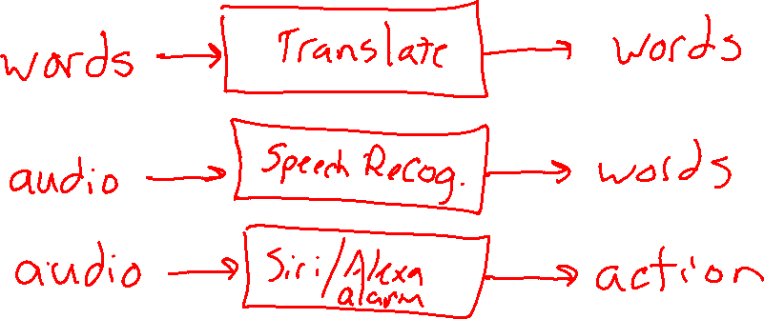
NLP Tasks Examples
How many different NLP Input/Output agents can you think of?
Task
Input
Output

Slide 6

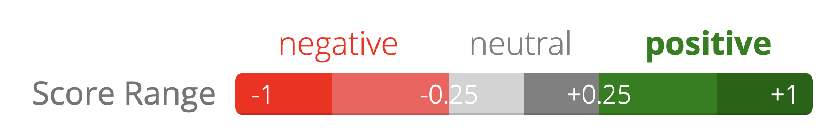
NLP Task: Sentiment Analysis
Sentiment analysis demo
https://text2data.com/Demo
“I recommend that you find something better to do with your time”

Slide 7
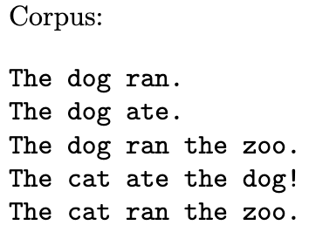
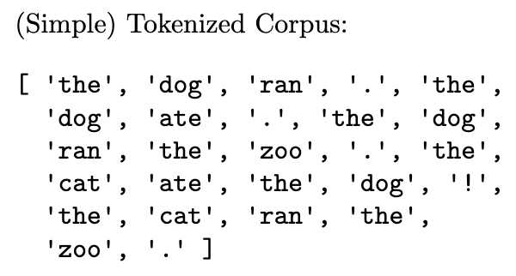
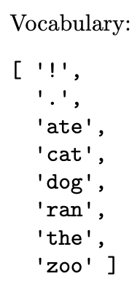
Vocab
Corpus
Tokenization/Tokens
Vocabulary
Context
Tokenizer

Slide 8

NLP Vocab
Corpus, Tokenizer
Tokenizer

Slide 9
Tokenization

Slide 10

Tokenization
Text encoding: token → index within vocabulary
What is our "vocabulary", i.e., what are our tokens?
Characters
Byte pair encoding
Words and punctuation
Corpus
I am Sam. I am Sam. Sam I am. That Sam-I-am. That Sam-I-am!

Slide 11
Tokenization
I am Sam. I am Sam. Sam I am. That Sam-I-am. That Sam-I-am!
Text encoding: token → index within vocabulary
What is our "vocabulary", i.e., what are our tokens?
Character token vocabulary
BPE token vocabulary
Word token vocabulary
0:
1:
2:
3:
4:
5:
6:
7:
8:
9:
10:
0:
1:
2:
3:
4:
5:
6:
7:
8:
9:
10:
11:
12:
13:
14:
15:
Sam
Th
am
_Sam
_am
0:
1:
2:
3:
4:
5:
6:
!
.
am
I
Sam
That
Sam-I-am
!
-
.
I
S
T
a
h
m
t
_ (space)
!
-
.
I
S
T
a
h
m
t
_(space)

Slide 12

Tokenization
I am Sam. I am Sam. Sam I am. That Sam-I-am. That Sam-I-am!
Text encoding: token → index within vocabulary
Byte pair encoding (BPE)
Current token vocabulary
(Initialize to characters in corpus)
Pair frequencies
Count frequencies of all pairs of current tokens appearting together in corpus
New tokens
Add most frequent pair to tokens
!
-
.
I
S
T
a
h
m
t
_ (space)
!
-
.
I
S
T
a
h
m
t
_ (space)
am
_a: 3 am: 10 _S: 4 Sa: 5 _I: 1 Th: 2 ha: 2 at: 2

Slide 13
Tokenization
I am Sam. I am Sam. Sam I am. That Sam-I-am. That Sam-I-am!
Text encoding: token → index within vocabulary
Byte pair encoding (BPE)
Current token vocabulary
(Initialize to characters in corpus)
Pair frequencies
Count frequencies of all pairs of current tokens appearting together in corpus
New tokens
Add most frequent pair to tokens
!
-
.
I
S
T
a
h
m
t
_ (space)
am
!
-
.
I
S
T
a
h
m
t
_ (space)
am
Sam
_S: 4 _I: 1 Th: 2 ha: 2 at: 2
_am: 3
Sam: 5

Slide 14
Tokenization
I am Sam. I am Sam. Sam I am. That Sam-I-am. That Sam-I-am!
Text encoding: token → index within vocabulary
What is our "vocabulary", i.e., what are our tokens?
Character token vocabulary
BPE token vocabulary
Word token vocabulary
0:
1:
2:
3:
4:
5:
6:
7:
8:
9:
10:
0:
1:
2:
3:
4:
5:
6:
7:
8:
9:
10:
11:
12:
13:
14:
15:
Sam
Th
am
_Sam
_am
0:
1:
2:
3:
4:
5:
6:
!
.
am
I
Sam
That
Sam-I-am
!
-
.
I
S
T
a
h
m
t
_ (space)
!
-
.
I
S
T
a
h
m
t
_(space)

Slide 15
Language Models

Slide 16
Human Language Model
Wheel of Fortune

Slide 17
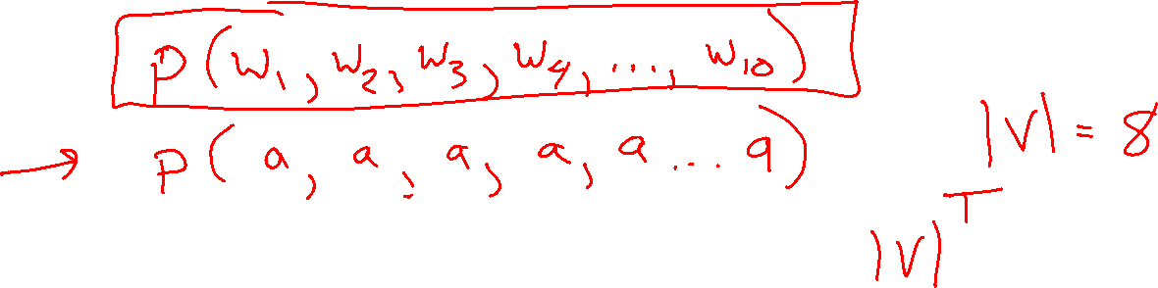
What is a language model (LM)?

Slide 18
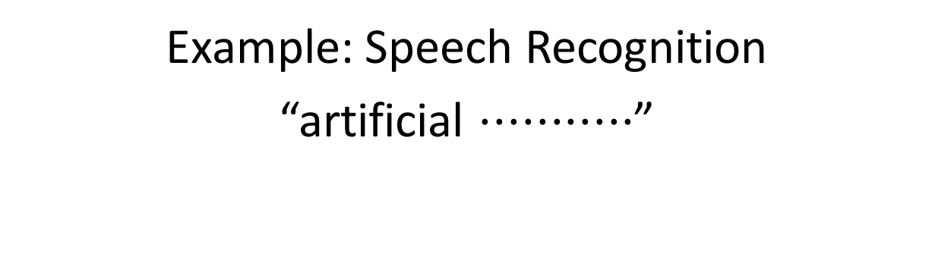
LM Applications: Speech Recognition
Example: Speech Recognition
“artificial $⋅⋅⋅⋅⋅⋅⋅⋅⋅⋅⋅$”
Find most probable next word given “artificial” and the audio for second word.

Slide 19
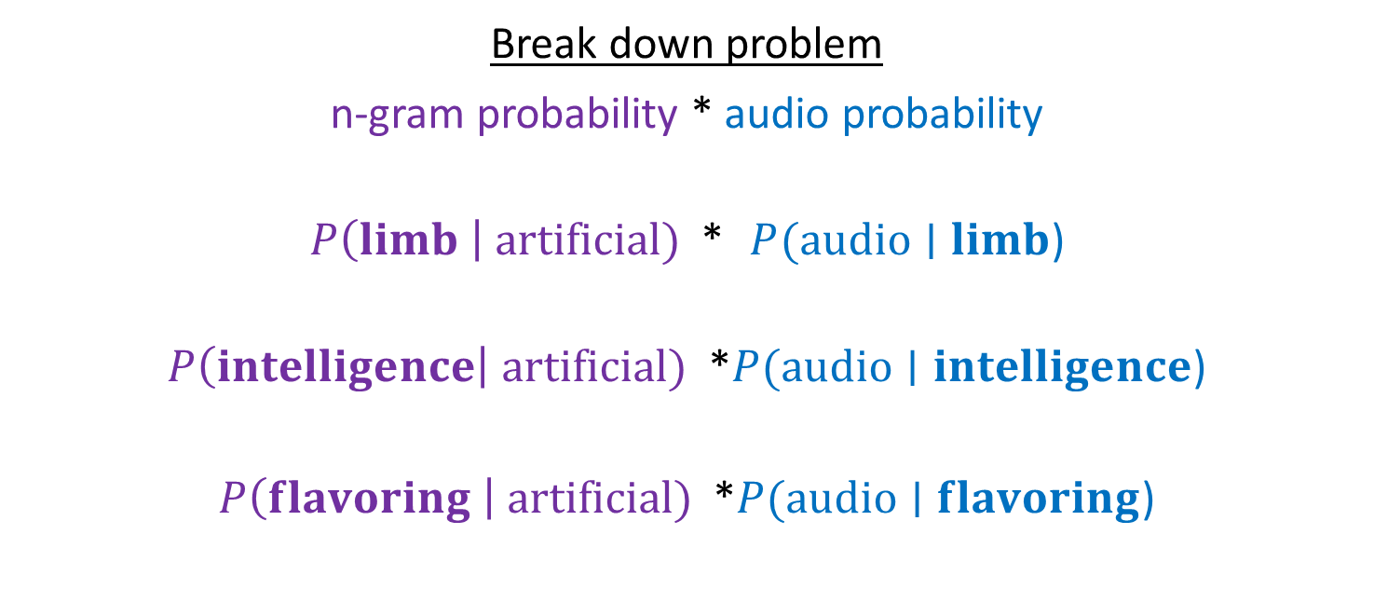
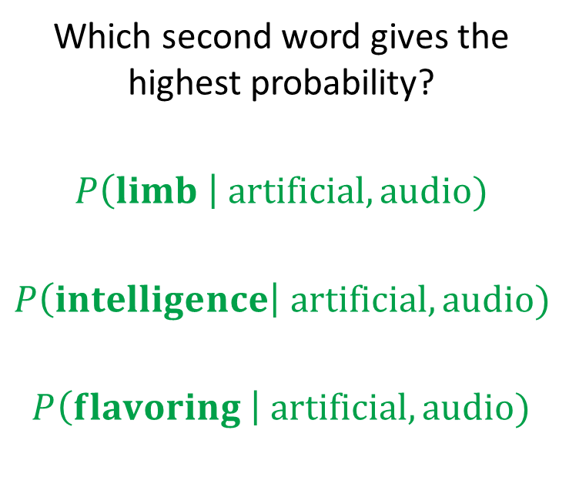
LM Applications: Speech Recognition
Example: Speech Recognition
“artificial $⋅⋅⋅⋅⋅⋅⋅⋅⋅⋅⋅$”
Find most probable next word given “artificial” and the audio for second word.
Which second word gives the highest probability?
$$P\left(limb \right| artificial, audio)$$
$$P\left(intelligence\right| artificial, audio)$$
$$P\left(flavoring \right| artificial, audio)$$
Break down problem
n-gram probability * audio probability
$P\left(limb \right| artificial)$ * $P(audio∣limb$)
$P\left(intelligence\right| artificial)$ *$P(audio∣intelligence$)
$P\left(flavoring \right| artificial)$ *$P(audio∣flavoring$)

Slide 20
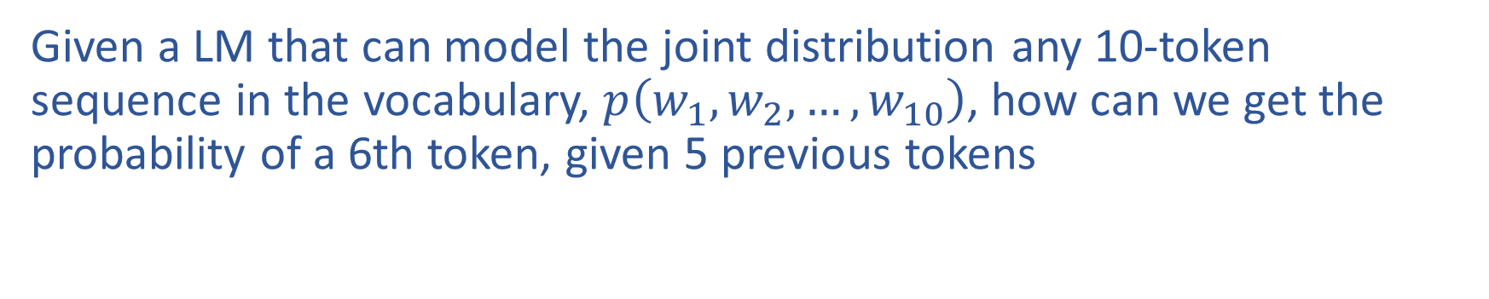
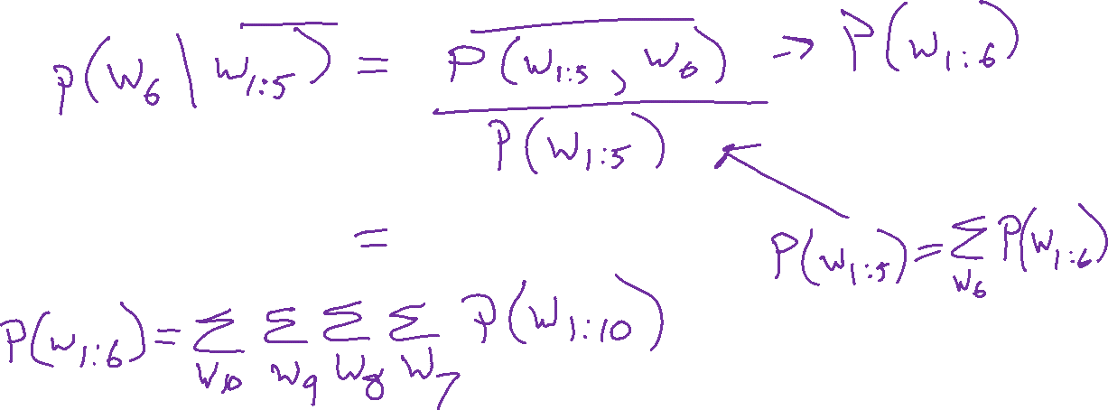
LM Applications: Text Generation
Given a LM that can model the joint distribution any 10-token sequence in the vocabulary, $p\left(w_{1}, w_{2}, …, w_{10}\right)$, how can we get the probability of a 6th token, given 5 previous tokens

Slide 21
Language Models
N-grams

Slide 22
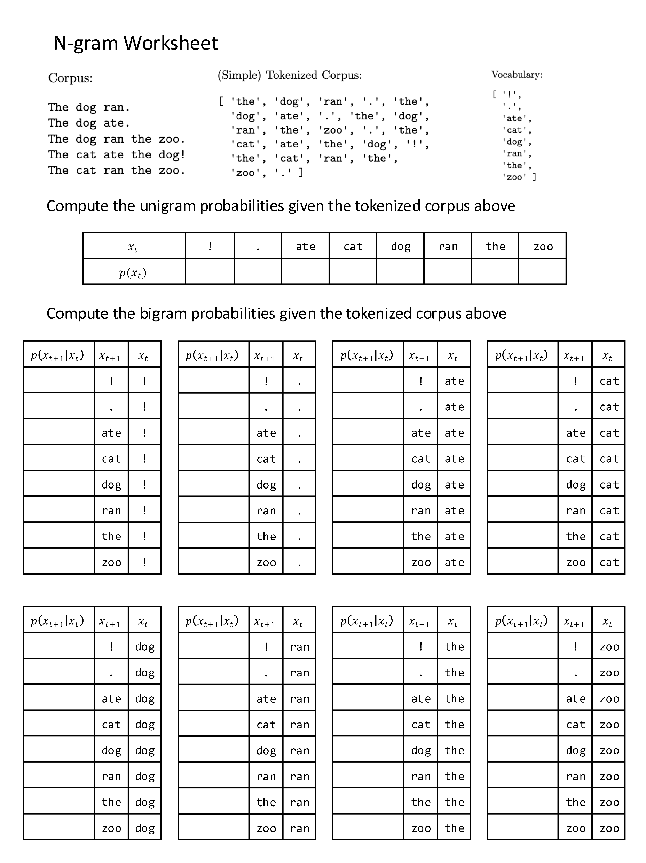
N-gram Worksheet
Worksheet linked on website

