Slide 1
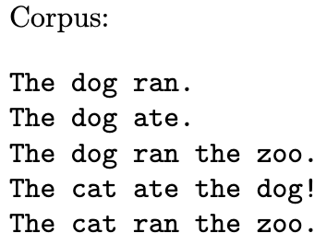
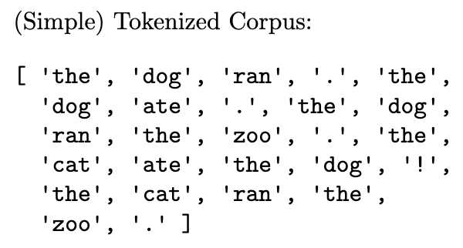
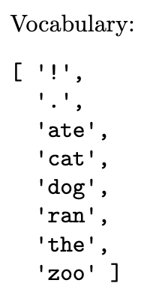
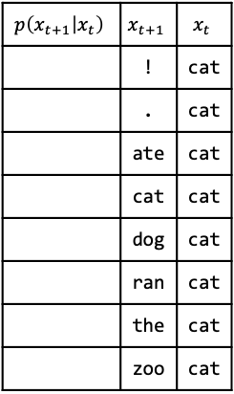

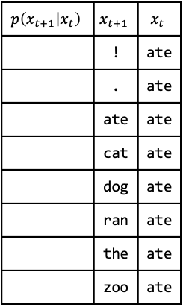
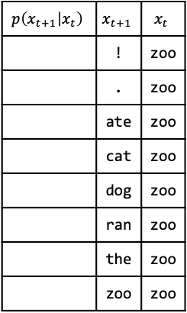
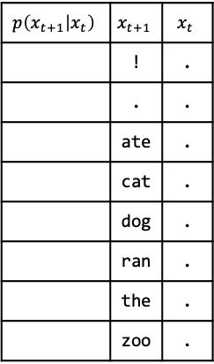
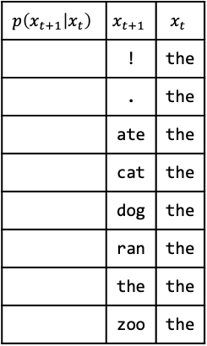
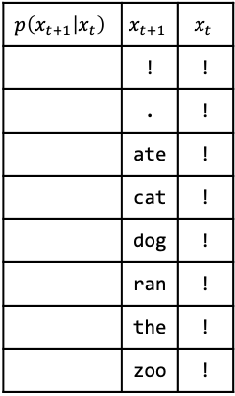
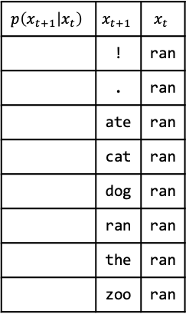
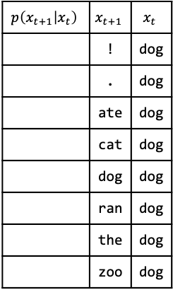
N-gram Worksheet
Compute the unigram probabilities given the tokenized corpus above
$$x_{t}$$ | ! | . | ate | cat | dog | ran | the | zoo
$$p(x_{t})$$
Compute the bigram probabilities given the tokenized corpus above
$$p\left(x_{t+1} | x_{t}\right)$$ | $$x_{t+1}$$ | $$x_{t}$$
 | ! | !
 | . | !
 | ate | !
 | cat | !
 | dog | !
 | ran | !
 | the | !
 | zoo | !
$$p\left(x_{t+1} | x_{t}\right)$$ | $$x_{t+1}$$ | $$x_{t}$$
 | ! | .
 | . | .
 | ate | .
 | cat | .
 | dog | .
 | ran | .
 | the | .
 | zoo | .
$$p\left(x_{t+1} | x_{t}\right)$$ | $$x_{t+1}$$ | $$x_{t}$$
 | ! | ate
 | . | ate
 | ate | ate
 | cat | ate
 | dog | ate
 | ran | ate
 | the | ate
 | zoo | ate
$$p\left(x_{t+1} | x_{t}\right)$$ | $$x_{t+1}$$ | $$x_{t}$$
 | ! | cat
 | . | cat
 | ate | cat
 | cat | cat
 | dog | cat
 | ran | cat
 | the | cat
 | zoo | cat
$$p\left(x_{t+1} | x_{t}\right)$$ | $$x_{t+1}$$ | $$x_{t}$$
 | ! | dog
 | . | dog
 | ate | dog
 | cat | dog
 | dog | dog
 | ran | dog
 | the | dog
 | zoo | dog
$$p\left(x_{t+1} | x_{t}\right)$$ | $$x_{t+1}$$ | $$x_{t}$$
 | ! | ran
 | . | ran
 | ate | ran
 | cat | ran
 | dog | ran
 | ran | ran
 | the | ran
 | zoo | ran
$$p\left(x_{t+1} | x_{t}\right)$$ | $$x_{t+1}$$ | $$x_{t}$$
 | ! | the
 | . | the
 | ate | the
 | cat | the
 | dog | the
 | ran | the
 | the | the
 | zoo | the
$$p\left(x_{t+1} | x_{t}\right)$$ | $$x_{t+1}$$ | $$x_{t}$$
 | ! | zoo
 | . | zoo
 | ate | zoo
 | cat | zoo
 | dog | zoo
 | ran | zoo
 | the | zoo
 | zoo | zoo

