Slide 1

07-280
AI & ML I
Neural Networks II
Instructor:
Pat Virtue & Nihar Shah

Slide 2
Outline
Last time: Neural Networks
Three-neuron Network
    Optimization
    Neural Network Intuition
Forward pass and Backward pass (scalar version)
Today: Neural Networks
Neural Network Properties and Intuition
Backpropagation (scalar version)
Calculus: multi-variate chain rule
Backpropagation (vector version)

Slide 3
Neural Net
Properties and Intuition

Slide 4
Neural Networks Questions
Can we fit any function?
Non-convex? What about local minima?
What if there are no non-linear activations?
How many neurons/layers should we add?
Please, tell me more about calculus

Slide 5
Neural Network Properties
Fitting complex functions (with 1-D input)

Slide 6
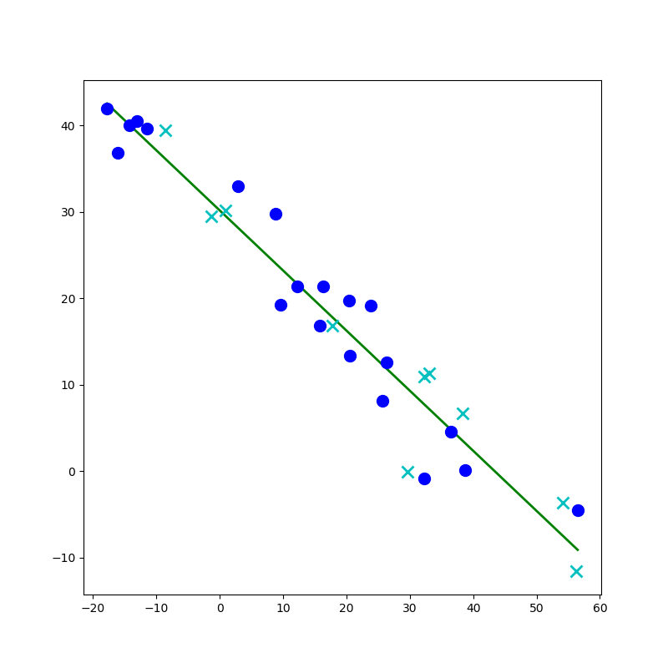
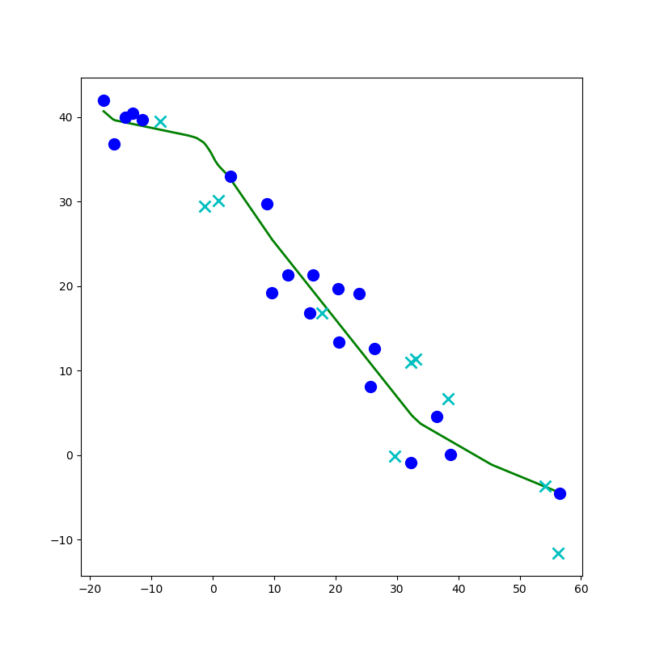
Network to Approximate a 1-D Function

Slide 7
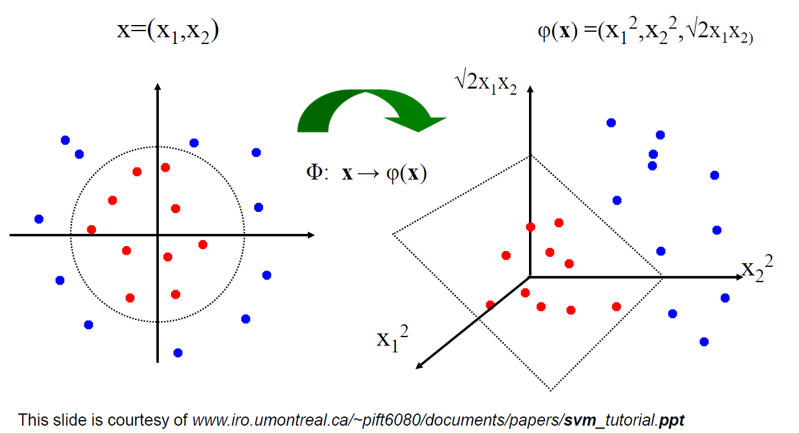
Linear Classifiers for Nonlinear Data
Linear classifiers have linear decision boundaries
Feature mapping can convert nonlinear data to higher dimensions
Today, instead of choosing a feature mapping function, we’ll use neural networks to learn nonlinear decision boundaries and regression functions

Slide 8
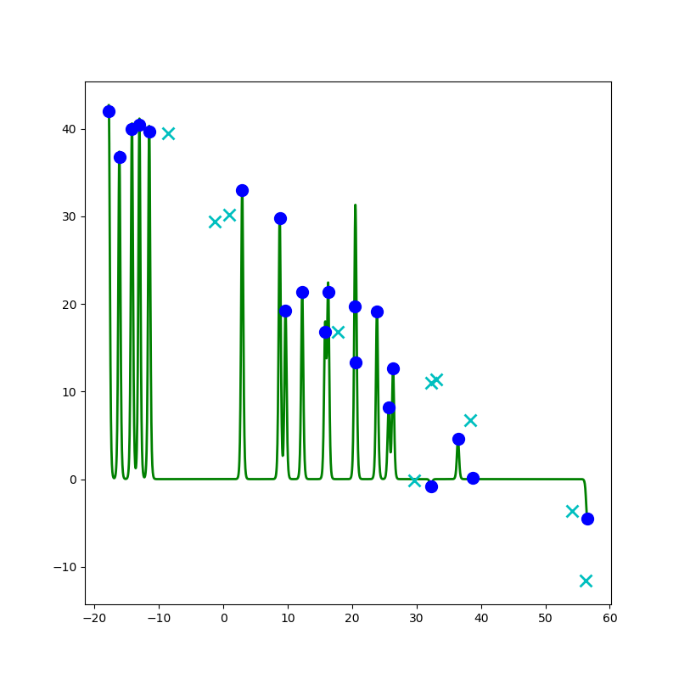
Network to Approximate a 1-D Function

Slide 9
Network to Approximate a 1-D Function
Design a network to approximate this function using:
Linear, Sigmoid, Step, or ReLU

Slide 10
Network to Approximate a 1-D Function

Slide 11
Neural Network Properties
Fitting complicated functions (with 2-D input)

Slide 12


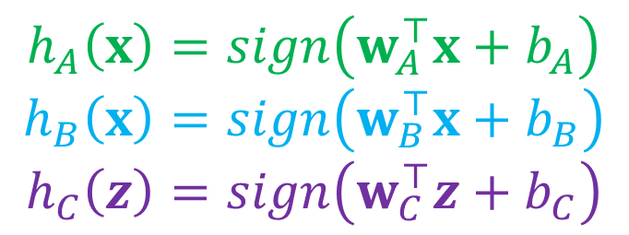
Classification Design Challenge
$$h_{A}\left(x\right)=sign\left(w_{A}^{⊤}x+b_{A}\right)$$
$$h_{B}\left(x\right)=sign\left(w_{B}^{⊤}x+b_{B}\right)$$
$$h_{C}\left(z\right)=sign\left(w_{C}^{⊤}z+b_{C}\right)$$
How could you configure three specific perceptrons to classify this data?
$$x2$$
$$x1$$

Slide 13
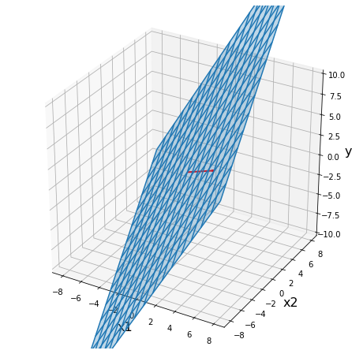
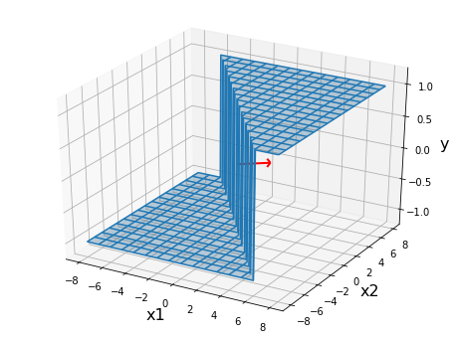
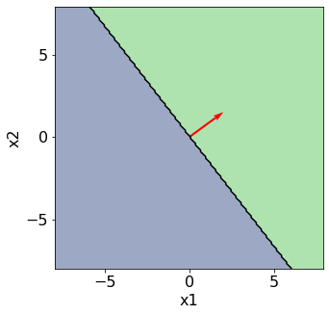
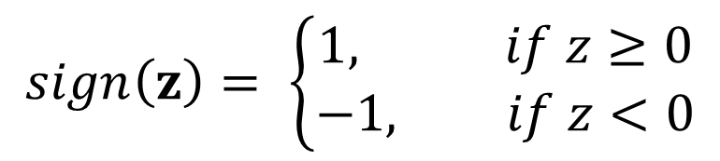

Perceptron
$$sign\left(z\right)= \left\{\begin{aligned}1, if z≥0 \\ −1, if z<0\end{aligned}\right.$$
Classification: Hard threshold on linear model
$$h\left(x\right)=sign\left(w^{⊤}x+b\right)$$

Slide 14
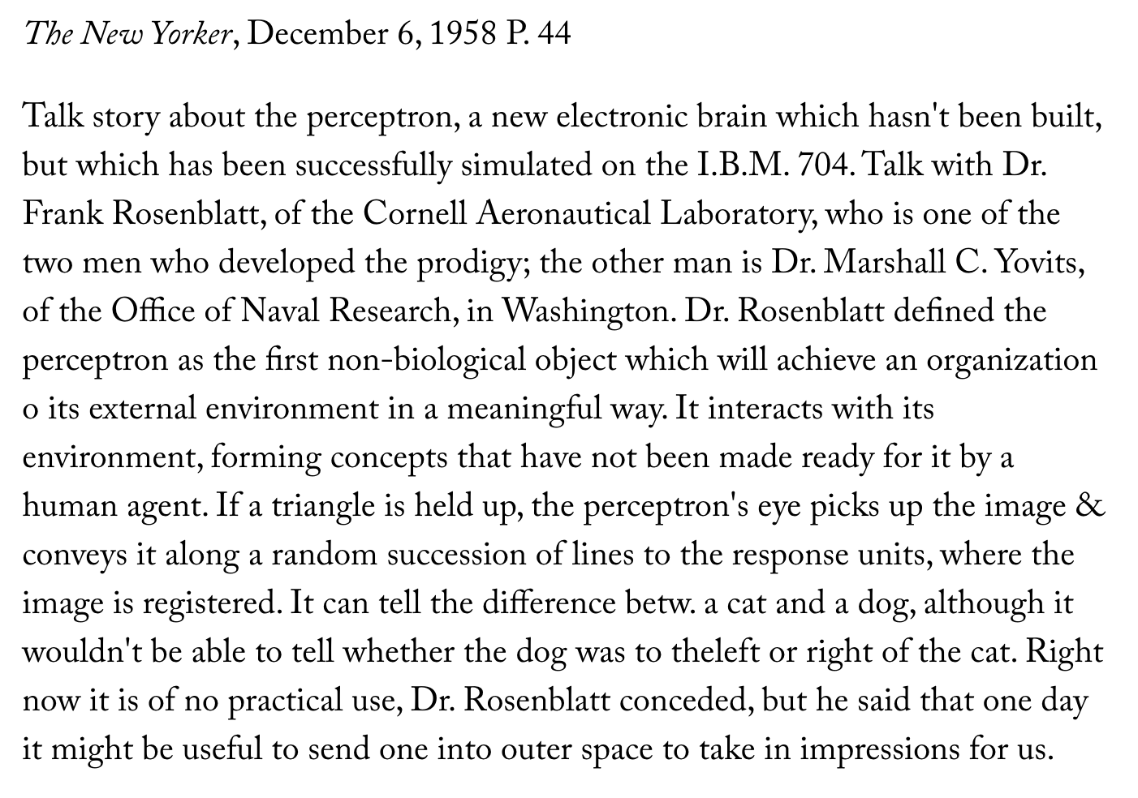
Perceptron History
Frank Rosenblatt, 1957

Slide 15

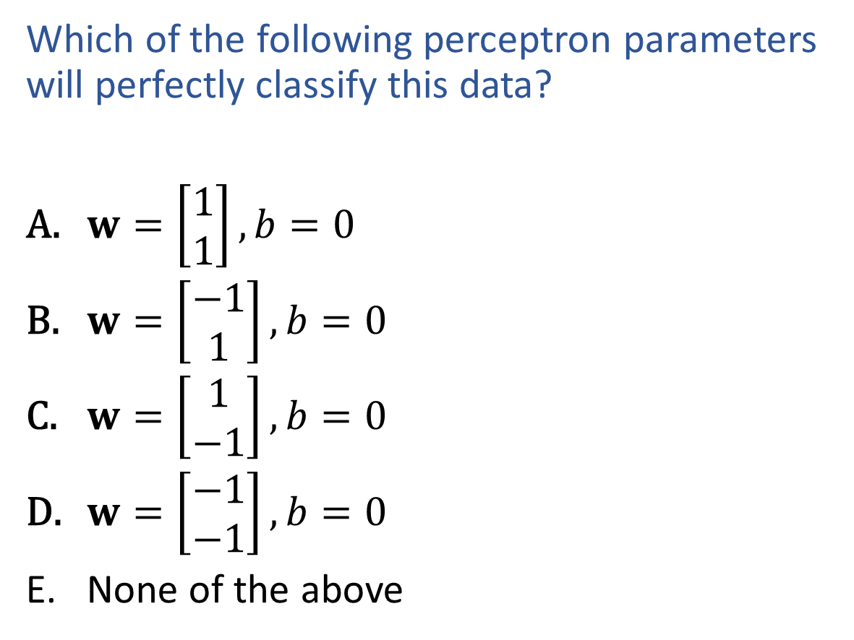
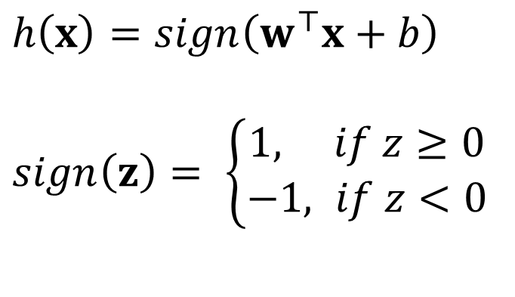

Exercise
$h\left(x\right)=sign\left(w^{⊤}x+b\right)$
$sign\left(z\right)= \left\{\begin{aligned}1, if z≥0 \\ −1, if z<0\end{aligned}\right.$
Which of the following perceptron parameters will perfectly classify this data?
$w=\left[\begin{aligned}1 \\ 1\end{aligned}\right], b=0$
$w=\left[\begin{aligned}−1 \\ 1\end{aligned}\right], b=0$
$w=\left[\begin{aligned}1 \\ −1\end{aligned}\right], b=0$
$w=\left[\begin{aligned}−1 \\ −1\end{aligned}\right], b=0$
None of the above
$$x2$$
$$x1$$

Slide 16
Poll
$h\left(x\right)=sign\left(w^{⊤}x+b\right)$
$sign\left(z\right)= \left\{\begin{aligned}1, if z≥0 \\ −1, if z<0\end{aligned}\right.$
Which of the following perceptron parameters will perfectly classify this data?
$w=\left[\begin{aligned}1 \\ 1\end{aligned}\right], b=0$
$w=\left[\begin{aligned}−1 \\ 1\end{aligned}\right], b=0$
$w=\left[\begin{aligned}1 \\ −1\end{aligned}\right], b=0$
$w=\left[\begin{aligned}−1 \\ −1\end{aligned}\right], b=0$
None of the above
$$x2$$
$$x1$$

Slide 17

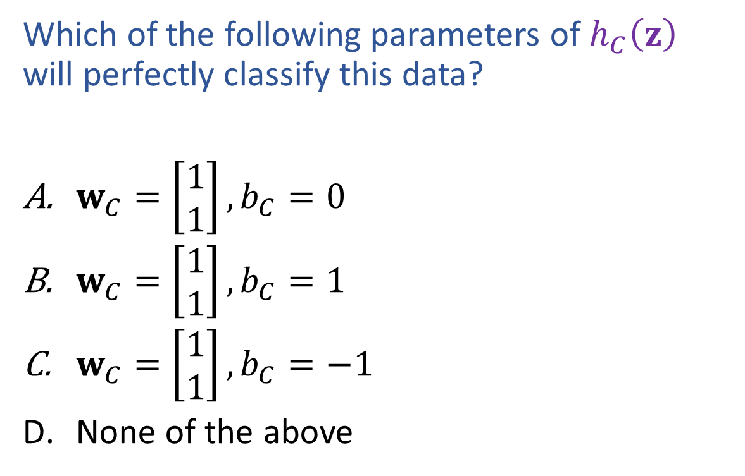
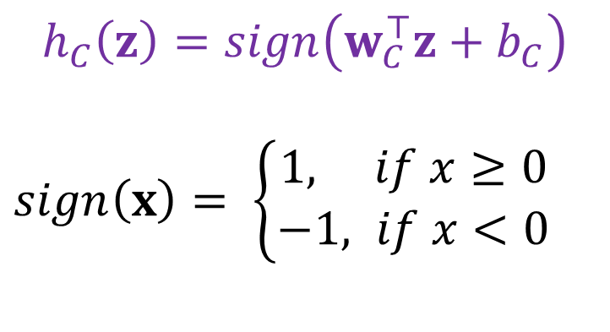

Poll
$$h_{C}\left(z\right)=sign\left(w_{C}^{⊤}z+b_{C}\right)$$
$sign\left(x\right)= \left\{\begin{aligned}1, if x≥0 \\ −1, if x<0\end{aligned}\right.$
Which of the following parameters of $h_{C}\left(z\right)$ will perfectly classify this data?
$w_{C}=\left[\begin{aligned}1 \\ 1\end{aligned}\right], b_{C}=0$
$w_{C}=\left[\begin{aligned}1 \\ 1\end{aligned}\right], b_{C}=1$
$w_{C}=\left[\begin{aligned}1 \\ 1\end{aligned}\right], b_{C}=−1$
None of the above
$$z2$$
$$z1$$

Slide 18
Classification Design Challenge
$$h_{A}\left(x\right)=sign\left(w_{A}^{⊤}x+b_{A}\right)$$
$$h_{B}\left(x\right)=sign\left(w_{B}^{⊤}x+b_{B}\right)$$
$$h_{C}\left(z\right)=sign\left(w_{C}^{⊤}z+b_{C}\right)$$
How could you configure three specific perceptrons to classify this data?
$$x2$$
$$x1$$

Slide 19
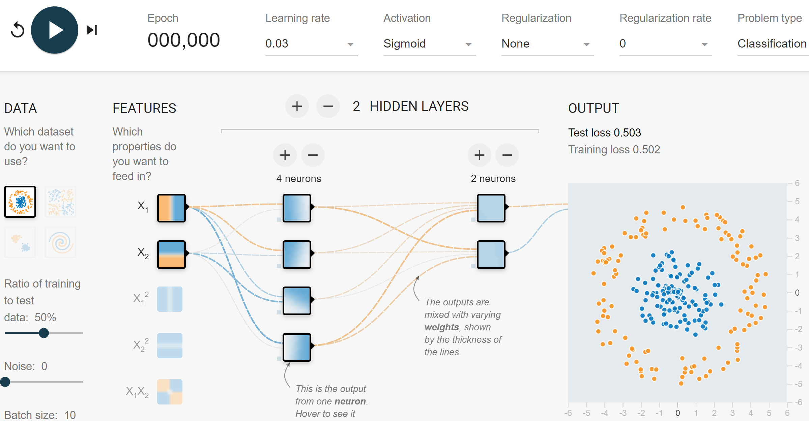
Network to Approximate Binary Classification
https://playground.tensorflow.org/#activation=sigmoid

Slide 20
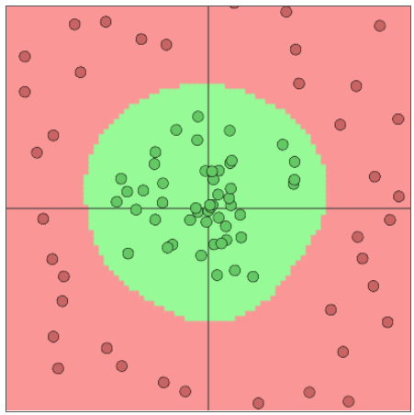
Network to Approximate Binary Classification
Approximate arbitrary decision boundary
https://cs.stanford.edu/people/karpathy/convnetjs/demo/classify2d.html

Slide 21
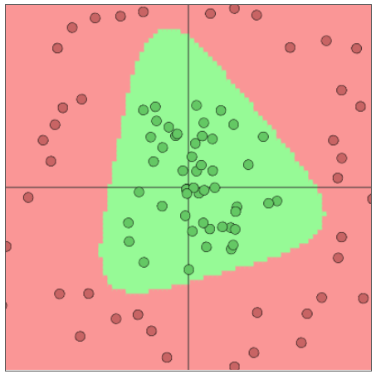
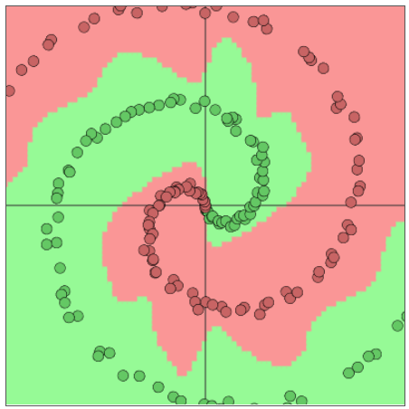
Network to Approximate Binary Classification
Approximate arbitrary decision boundary
https://cs.stanford.edu/people/karpathy/convnetjs/demo/classify2d.html

Slide 22
Network to Approximate Binary Classification
Approximate arbitrary decision boundary
https://cs.stanford.edu/people/karpathy/convnetjs/demo/classify2d.html

Slide 23
Neural Network Properties
(Over?) Fitting any function

Slide 24
Neural Networks Properties
Universal Approximation Theorem
A two-layer neural network with a sufficient number of neurons can approximate any continuous function to any desired accuracy
Reminder
Just because it can fit any function will it?
Objective function is non-convex
→ it will get stuck in local minima
Stochastic gradient decent take pseudorandom steps
→ Helps pop out of local minima
Is getting stuck at a local minima necessarily a bad thing??

Slide 25
Network to Approximate a 1-D Function

Slide 26
Debugging Overfitting and Underfitting
Underfitting (check this first!)
Evidence: poor training loss (and poor validation loss)
    Note: Compare with human performance as a baseline, i.e., make sure the task isn't impossible for a human (with unlimited resources)
Try: Adding more capacity to network (wider or deeper)
    But how do we choose a new network structure?
Overfitting
Evidence: good training loss, but poor validation loss
Evidence: really large parameter values
Try: Regularization (we'll learn about this soon!)
Try: Adding more data

Slide 27
Summary: Neural Networks Properties
Practical considerations
  Large number of neurons
      Danger for overfitting
  Modeling assumptions vs data assumptions trade-off
  Gradient descent can easily get stuck local optima
What if there are no non-linear activations?
A deep neural network with only linear layers can be reduced to an exactly equivalent single linear layer
Universal Approximation Theorem:
A two-layer neural network with a sufficient number of neurons can approximate any continuous function to any desired accuracy.

Slide 28
Forward Pass and Backpropagation
Scalar's version

Slide 29

























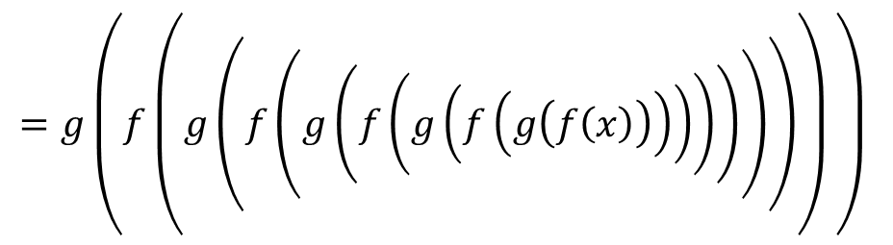






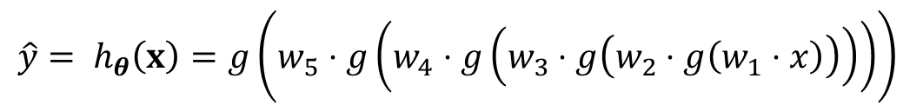
Forward Pass
Width 1 deep network (no bias) (dumb but will help with calculus)
$$y$$
$$x$$
$$z1$$
$$a1$$
$$z2$$
$$a2$$
$$z3$$
$$a3$$
$$z4$$
$$a4$$
$$z5$$
$$a5=\hat{y}$$
$$J$$
$$f$$
$$g$$
$$f$$
$$g$$
$$f$$
$$g$$
$$f$$
$$g$$
$$f$$
$$g$$
$$ℓ$$
$$w1$$
$$w2$$
$$w3$$
$$w4$$
$$w5$$
$$\hat{y}= h_{θ}\left(x\right)=g\left(w_{5}⋅g\left(w_{4}⋅g\left(w_{3}⋅g\left(w_{2}⋅g\left(w_{1}⋅x\right)\right)\right)\right)\right)$$
$$z_{ℓ}=f\left(w_{ℓ}, a_{ℓ−1}\right)=w_{ℓ}⋅a_{ℓ−1}$$
$$a_{ℓ}=g\left(z_{ℓ}\right)$$
$$=g\left(f\left(g\left(f\left(g\left(f\left(g\left(f\left(g\left(f\left(x\right)\right)\right)\right)\right)\right)\right)\right)\right) \right)$$

Slide 30
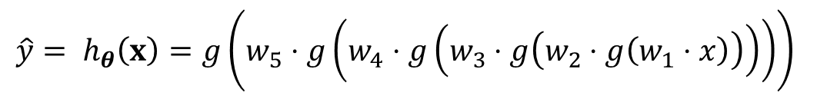
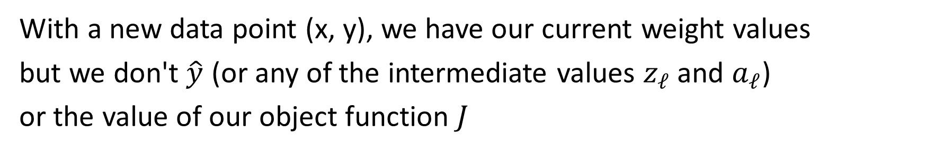
Forward Pass
$$\hat{y}= h_{θ}\left(x\right)=g\left(w_{5}⋅g\left(w_{4}⋅g\left(w_{3}⋅g\left(w_{2}⋅g\left(w_{1}⋅x\right)\right)\right)\right)\right)$$
Width 1 deep network (no bias) (dumb but will help with calculus)
$$y$$
$$x$$
$$z1$$
$$a1$$
$$z2$$
$$a2$$
$$z3$$
$$a3$$
$$z4$$
$$a4$$
$$z5$$
$$a5=\hat{y}$$
$$J$$
$$f$$
$$g$$
$$f$$
$$g$$
$$f$$
$$g$$
$$f$$
$$g$$
$$f$$
$$g$$
$$ℓ$$
$$w1$$
$$w2$$
$$w3$$
$$w4$$
$$w5$$
With a new data point (x, y), we have our current weight values
but we don't $\hat{y}$ (or any of the intermediate values $z_{ℓ}$ and $a_{ℓ}$)
or the value of our object function $J$

Slide 31
Forward Pass
$$\hat{y}= h_{θ}\left(x\right)=g\left(w_{5}⋅g\left(w_{4}⋅g\left(w_{3}⋅g\left(w_{2}⋅g\left(w_{1}⋅x\right)\right)\right)\right)\right)$$
Width 1 deep network (no bias) (dumb but will help with calculus)
$$y$$
$$x$$
$$f$$
$$g$$
$$f$$
$$g$$
$$f$$
$$g$$
$$f$$
$$g$$
$$f$$
$$g$$
$$ℓ$$
$$w1$$
$$w2$$
$$w3$$
$$w4$$
$$w5$$
With a new data point (x, y), we have our current weight values
but we don't $\hat{y}$ (or any of the intermediate values $z_{ℓ}$ and $a_{ℓ}$)
or the value of our object function $J$

Slide 32
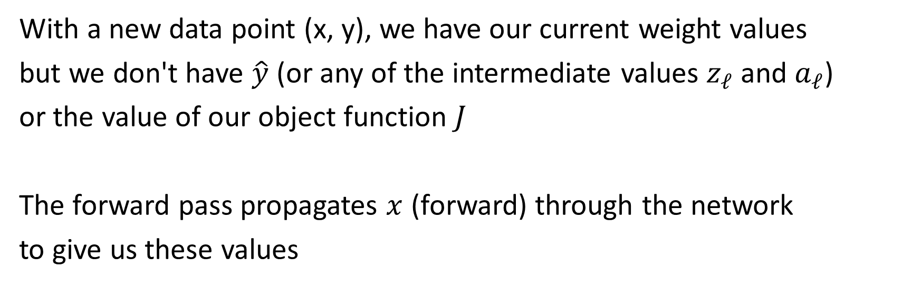
Forward Pass
$$\hat{y}= h_{θ}\left(x\right)=g\left(w_{5}⋅g\left(w_{4}⋅g\left(w_{3}⋅g\left(w_{2}⋅g\left(w_{1}⋅x\right)\right)\right)\right)\right)$$
Width 1 deep network (no bias) (dumb but will help with calculus)
$$y$$
$$x$$
$$z1$$
$$a1$$
$$z2$$
$$a2$$
$$z3$$
$$a3$$
$$z4$$
$$a4$$
$$z5$$
$$a5=\hat{y}$$
$$J$$
$$f$$
$$g$$
$$f$$
$$g$$
$$f$$
$$g$$
$$f$$
$$g$$
$$f$$
$$g$$
$$ℓ$$
$$w1$$
$$w2$$
$$w3$$
$$w4$$
$$w5$$
With a new data point (x, y), we have our current weight values
but we don't have $\hat{y}$ (or any of the intermediate values $z_{ℓ}$ and $a_{ℓ}$)
or the value of our object function $J$
The forward pass propagates $x$ (forward) through the network
to give us these values

Slide 33








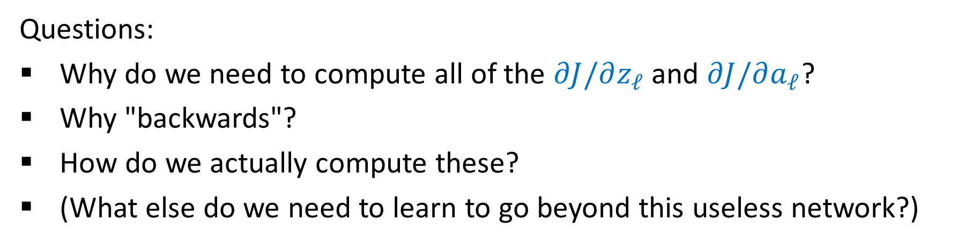







Backpropagation
$$\hat{y}= h_{θ}\left(x\right)=g\left(w_{5}⋅g\left(w_{4}⋅g\left(w_{3}⋅g\left(w_{2}⋅g\left(w_{1}⋅x\right)\right)\right)\right)\right)$$
Width 1 deep network (no bias) (dumb but will help with calculus)
$$\frac{∂J}{∂z_{1}}$$
$$\frac{∂J}{∂a_{1}}$$
$$\frac{∂J}{∂z_{2}}$$
$$\frac{∂J}{∂a_{2}}$$
$$\frac{∂J}{∂z_{3}}$$
$$\frac{∂J}{∂a_{3}}$$
$$\frac{∂J}{∂z_{4}}$$
$$\frac{∂J}{∂a_{4}}$$
$$\frac{∂J}{∂z_{5}}$$
$$\frac{∂J}{∂\hat{y}}$$
$$y$$
$$x$$
$$z1$$
$$a1$$
$$z2$$
$$a2$$
$$z3$$
$$a3$$
$$z4$$
$$a4$$
$$z5$$
$$a5=\hat{y}$$
$$J$$
$$f$$
$$g$$
$$f$$
$$g$$
$$f$$
$$g$$
$$f$$
$$g$$
$$f$$
$$g$$
$$ℓ$$
$$w1$$
$$w2$$
$$w3$$
$$w4$$
$$w5$$
$$\frac{∂J}{∂w_{1}}$$
$$\frac{∂J}{∂w_{2}}$$
$$\frac{∂J}{∂w_{3}}$$
$$\frac{∂J}{∂w_{4}}$$
$$\frac{∂J}{∂w_{5}}$$
Questions:
Why do we need to compute all of the $∂J/∂z_{ℓ}$ and $∂J/∂a_{ℓ}$?
Why "backwards"?
How do we actually compute these?
(What else do we need to learn to go beyond this useless network?)

Slide 34
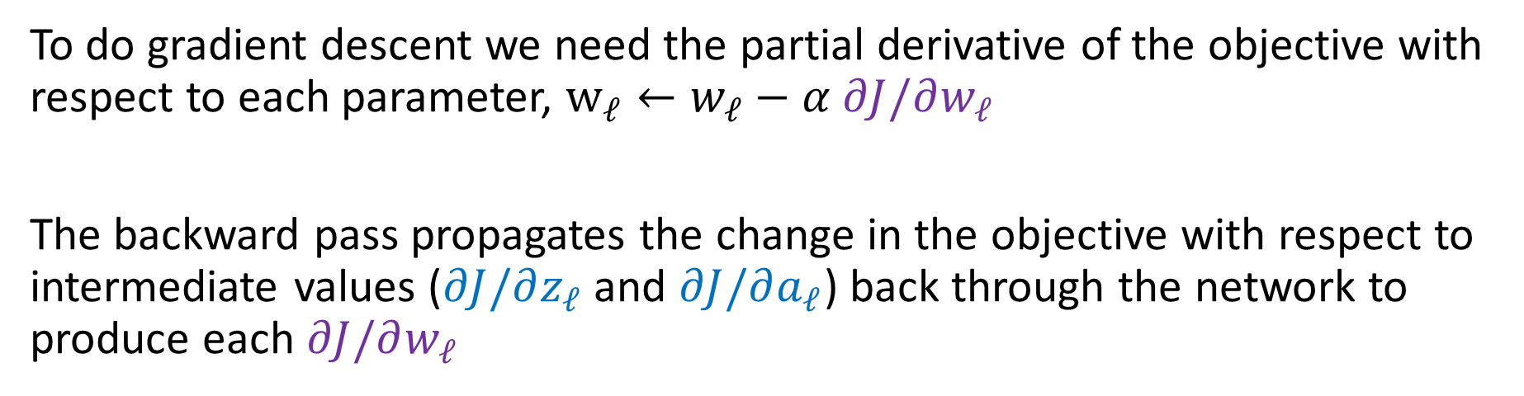
Backpropagation
$$\hat{y}= h_{θ}\left(x\right)=g\left(w_{5}⋅g\left(w_{4}⋅g\left(w_{3}⋅g\left(w_{2}⋅g\left(w_{1}⋅x\right)\right)\right)\right)\right)$$
Width 1 deep network (no bias) (dumb but will help with calculus)
$$\frac{∂J}{∂z_{1}}$$
$$\frac{∂J}{∂a_{1}}$$
$$\frac{∂J}{∂z_{2}}$$
$$\frac{∂J}{∂a_{2}}$$
$$\frac{∂J}{∂z_{3}}$$
$$\frac{∂J}{∂a_{3}}$$
$$\frac{∂J}{∂z_{4}}$$
$$\frac{∂J}{∂a_{4}}$$
$$\frac{∂J}{∂z_{5}}$$
$$\frac{∂J}{∂\hat{y}}$$
$$y$$
$$x$$
$$z1$$
$$a1$$
$$z2$$
$$a2$$
$$z3$$
$$a3$$
$$z4$$
$$a4$$
$$z5$$
$$a5=\hat{y}$$
$$J$$
$$f$$
$$g$$
$$f$$
$$g$$
$$f$$
$$g$$
$$f$$
$$g$$
$$f$$
$$g$$
$$ℓ$$
$$w1$$
$$w2$$
$$w3$$
$$w4$$
$$w5$$
$$\frac{∂J}{∂w_{1}}$$
$$\frac{∂J}{∂w_{2}}$$
$$\frac{∂J}{∂w_{3}}$$
$$\frac{∂J}{∂w_{4}}$$
$$\frac{∂J}{∂w_{5}}$$
To do gradient descent we need the partial derivative of the objective with respect to each parameter, $w_{ℓ}←w_{ℓ}−α ∂J/∂w_{ℓ}$
The backward pass propagates the change in the objective with respect to intermediate values ($∂J/∂z_{ℓ}$ and $∂J/∂a_{ℓ}$) back through the network to produce each $∂J/∂w_{ℓ}$

Slide 35
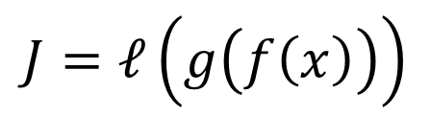
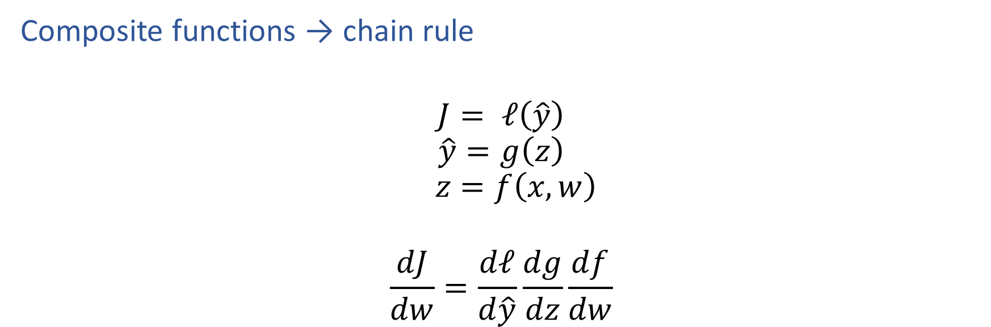
Reminder: Calculus Chain Rule (scalar version)
Composite functions → chain rule
$$J= ℓ\left(\hat{y}\right)$$
$$\hat{y}=g\left(z\right)$$
$$z=f\left(x, w\right)$$
$$\frac{dJ}{dw}=\frac{dℓ}{d\hat{y}}\frac{dg}{dz}\frac{df}{dw}$$
$$J=ℓ\left(g\left(f\left(x\right)\right)\right)$$

Slide 36
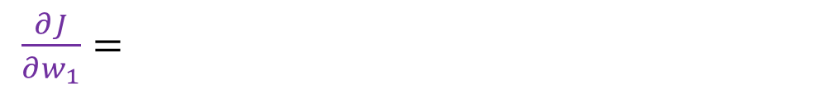
Why backwards?
$$\hat{y}= h_{θ}\left(x\right)=g\left(w_{5}⋅g\left(w_{4}⋅g\left(w_{3}⋅g\left(w_{2}⋅g\left(w_{1}⋅x\right)\right)\right)\right)\right)$$
Width 1 deep network (no bias) (dumb but will help with calculus)
$$\frac{∂J}{∂\hat{y}}$$
$$y$$
$$x$$
$$z1$$
$$a1$$
$$z2$$
$$a2$$
$$z3$$
$$a3$$
$$z4$$
$$a4$$
$$z5$$
$$a5=\hat{y}$$
$$J$$
$$f$$
$$g$$
$$f$$
$$g$$
$$f$$
$$g$$
$$f$$
$$g$$
$$f$$
$$g$$
$$ℓ$$
$$w1$$
$$w2$$
$$w3$$
$$w4$$
$$w5$$
$\frac{∂J}{∂w_{1}}=$

Slide 37
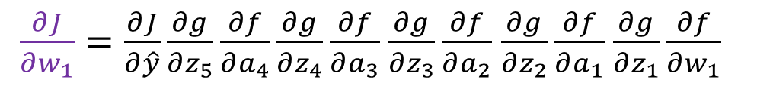
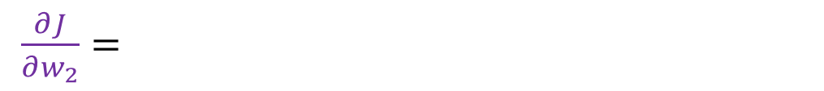
Why backwards?
$$\hat{y}= h_{θ}\left(x\right)=g\left(w_{5}⋅g\left(w_{4}⋅g\left(w_{3}⋅g\left(w_{2}⋅g\left(w_{1}⋅x\right)\right)\right)\right)\right)$$
Width 1 deep network (no bias) (dumb but will help with calculus)
$$\frac{∂J}{∂z_{1}}$$
$$\frac{∂J}{∂a_{1}}$$
$$\frac{∂J}{∂z_{2}}$$
$$\frac{∂J}{∂a_{2}}$$
$$\frac{∂J}{∂z_{3}}$$
$$\frac{∂J}{∂a_{3}}$$
$$\frac{∂J}{∂z_{4}}$$
$$\frac{∂J}{∂a_{4}}$$
$$\frac{∂J}{∂z_{5}}$$
$$\frac{∂J}{∂\hat{y}}$$
$$y$$
$$x$$
$$z1$$
$$a1$$
$$z2$$
$$a2$$
$$z3$$
$$a3$$
$$z4$$
$$a4$$
$$z5$$
$$a5=\hat{y}$$
$$J$$
$$f$$
$$g$$
$$f$$
$$g$$
$$f$$
$$g$$
$$f$$
$$g$$
$$f$$
$$g$$
$$ℓ$$
$$w1$$
$$w2$$
$$w3$$
$$w4$$
$$w5$$
$\frac{∂J}{∂w_{1}}=\frac{∂J}{∂\hat{y}}\frac{∂g}{∂z_{5}}\frac{∂f}{∂a_{4}}\frac{∂g}{∂z_{4}}\frac{∂f}{∂a_{3}}$ $\frac{∂g}{∂z_{3}}\frac{∂f}{∂a_{2}}$ $\frac{∂g}{∂z_{2}}\frac{∂f}{∂a_{1}}$ $\frac{∂g}{∂z_{1}}\frac{∂f}{∂w_{1}}$
$\frac{∂J}{∂w_{2}}=$

Slide 38

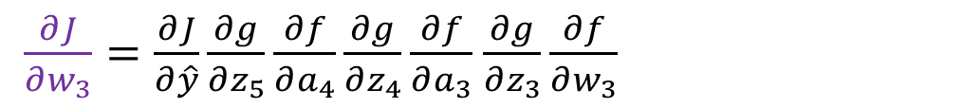
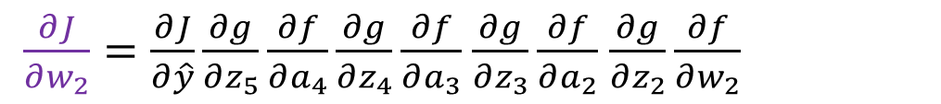
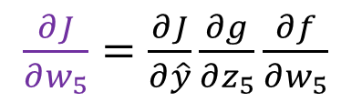
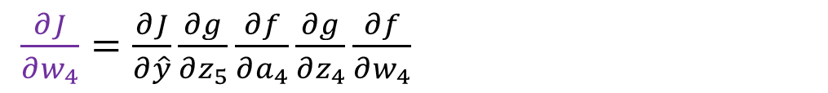
Why backwards?
$$\hat{y}= h_{θ}\left(x\right)=g\left(w_{5}⋅g\left(w_{4}⋅g\left(w_{3}⋅g\left(w_{2}⋅g\left(w_{1}⋅x\right)\right)\right)\right)\right)$$
Width 1 deep network (no bias) (dumb but will help with calculus)
$$\frac{∂J}{∂z_{1}}$$
$$\frac{∂J}{∂a_{1}}$$
$$\frac{∂J}{∂z_{2}}$$
$$\frac{∂J}{∂a_{2}}$$
$$\frac{∂J}{∂z_{3}}$$
$$\frac{∂J}{∂a_{3}}$$
$$\frac{∂J}{∂z_{4}}$$
$$\frac{∂J}{∂a_{4}}$$
$$\frac{∂J}{∂z_{5}}$$
$$\frac{∂J}{∂\hat{y}}$$
$$y$$
$$x$$
$$z1$$
$$a1$$
$$z2$$
$$a2$$
$$z3$$
$$a3$$
$$z4$$
$$a4$$
$$z5$$
$$a5=\hat{y}$$
$$J$$
$$f$$
$$g$$
$$f$$
$$g$$
$$f$$
$$g$$
$$f$$
$$g$$
$$f$$
$$g$$
$$ℓ$$
$$w1$$
$$w2$$
$$w3$$
$$w4$$
$$w5$$
$\frac{∂J}{∂w_{1}}=\frac{∂J}{∂\hat{y}}\frac{∂g}{∂z_{5}}\frac{∂f}{∂a_{4}}\frac{∂g}{∂z_{4}}\frac{∂f}{∂a_{3}}$ $\frac{∂g}{∂z_{3}}\frac{∂f}{∂a_{2}}$ $\frac{∂g}{∂z_{2}}\frac{∂f}{∂a_{1}}$ $\frac{∂g}{∂z_{1}}\frac{∂f}{∂w_{1}}$
$\frac{∂J}{∂w_{2}}=\frac{∂J}{∂\hat{y}}\frac{∂g}{∂z_{5}}\frac{∂f}{∂a_{4}}\frac{∂g}{∂z_{4}}\frac{∂f}{∂a_{3}}$ $\frac{∂g}{∂z_{3}}\frac{∂f}{∂a_{2}}$ $\frac{∂g}{∂z_{2}}\frac{∂f}{∂w_{2}}$
$\frac{∂J}{∂w_{3}}=\frac{∂J}{∂\hat{y}}\frac{∂g}{∂z_{5}}\frac{∂f}{∂a_{4}}\frac{∂g}{∂z_{4}}\frac{∂f}{∂a_{3}}$ $\frac{∂g}{∂z_{3}}\frac{∂f}{∂w_{3}}$
$\frac{∂J}{∂w_{4}}=\frac{∂J}{∂\hat{y}}\frac{∂g}{∂z_{5}}\frac{∂f}{∂a_{4}}\frac{∂g}{∂z_{4}}\frac{∂f}{∂w_{4}}$
$\frac{∂J}{∂w_{5}}=\frac{∂J}{∂\hat{y}}\frac{∂g}{∂z_{5}}\frac{∂f}{∂w_{5}}$

Slide 39
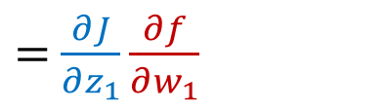
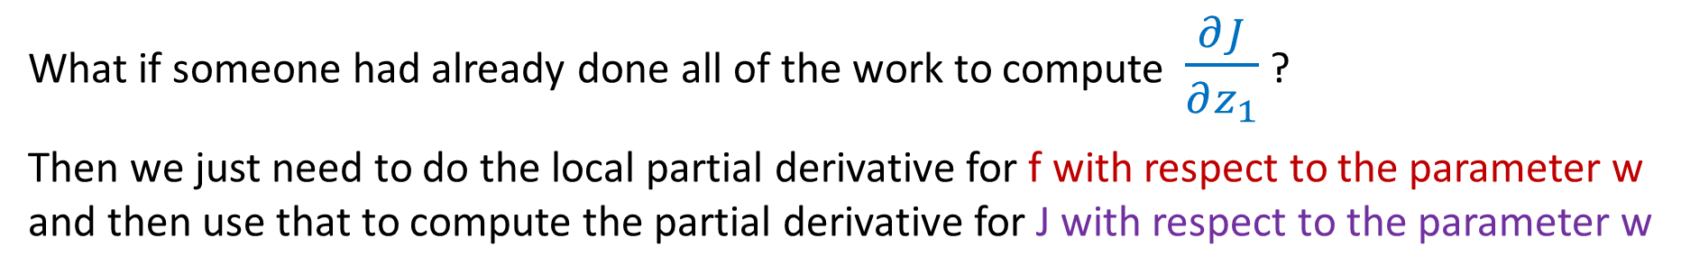
Why backwards?
$$\hat{y}= h_{θ}\left(x\right)=g\left(w_{5}⋅g\left(w_{4}⋅g\left(w_{3}⋅g\left(w_{2}⋅g\left(w_{1}⋅x\right)\right)\right)\right)\right)$$
Width 1 deep network (no bias) (dumb but will help with calculus)
$$\frac{∂J}{∂z_{1}}$$
$$y$$
$$x$$
$$z1$$
$$a1$$
$$z2$$
$$a2$$
$$z3$$
$$a3$$
$$z4$$
$$a4$$
$$z5$$
$$a5=\hat{y}$$
$$J$$
$$f$$
$$g$$
$$f$$
$$g$$
$$f$$
$$g$$
$$f$$
$$g$$
$$f$$
$$g$$
$$ℓ$$
$$w1$$
$$w2$$
$$w3$$
$$w4$$
$$w5$$
$\frac{∂J}{∂w_{1}}=\frac{∂J}{∂\hat{y}}\frac{∂g}{∂z_{5}}\frac{∂f}{∂a_{4}}\frac{∂g}{∂z_{4}}\frac{∂f}{∂a_{3}}\frac{∂g}{∂z_{3}}\frac{∂f}{∂a_{2}}\frac{∂g}{∂z_{2}}\frac{∂f}{∂a_{1}}\frac{∂g}{∂z_{1}}\frac{∂f}{∂w_{1}}$
$=$ $\frac{∂J}{∂z_{1}}\frac{∂f}{∂w_{1}}$
What if someone had already done all of the work to compute $\frac{∂J}{∂z_{1}}$ ?
Then we just need to do the local partial derivative for f with respect to the parameter w and then use that to compute the partial derivative for J with respect to the parameter w

Slide 40

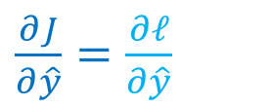

Backpropagation
$$\hat{y}= h_{θ}\left(x\right)=g\left(w_{5}⋅g\left(w_{4}⋅g\left(w_{3}⋅g\left(w_{2}⋅g\left(w_{1}⋅x\right)\right)\right)\right)\right)$$
More efficient to start at the end and reuse values!
$$y$$
$$x$$
$$z1$$
$$a1$$
$$z2$$
$$a2$$
$$z3$$
$$a3$$
$$z4$$
$$a4$$
$$z5$$
$$a5=\hat{y}$$
$$J$$
$$f$$
$$g$$
$$f$$
$$g$$
$$f$$
$$g$$
$$f$$
$$g$$
$$f$$
$$g$$
$$ℓ$$
$$w1$$
$$w2$$
$$w3$$
$$w4$$
$$w5$$
$\frac{∂J}{∂\hat{y}}=\frac{∂ℓ}{∂\hat{y}}$
$$\frac{∂J}{∂\hat{y}}$$

Slide 41

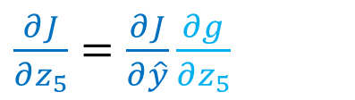

Backpropagation
$$\hat{y}= h_{θ}\left(x\right)=g\left(w_{5}⋅g\left(w_{4}⋅g\left(w_{3}⋅g\left(w_{2}⋅g\left(w_{1}⋅x\right)\right)\right)\right)\right)$$
More efficient to start at the end and reuse values!
$$\frac{∂J}{∂\hat{y}}$$
$$y$$
$$x$$
$$z1$$
$$a1$$
$$z2$$
$$a2$$
$$z3$$
$$a3$$
$$z4$$
$$a4$$
$$z5$$
$$a5=\hat{y}$$
$$J$$
$$f$$
$$g$$
$$f$$
$$g$$
$$f$$
$$g$$
$$f$$
$$g$$
$$f$$
$$g$$
$$ℓ$$
$$w1$$
$$w2$$
$$w3$$
$$w4$$
$$w5$$
$\frac{∂J}{∂z_{5}}=\frac{∂J}{∂\hat{y}}\frac{∂g}{∂z_{5}}$
$$\frac{∂J}{∂z_{5}}$$

Slide 42

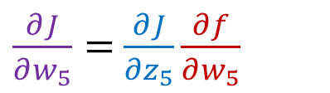

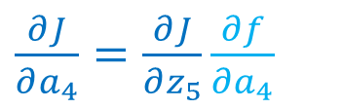
Backpropagation
$$\hat{y}= h_{θ}\left(x\right)=g\left(w_{5}⋅g\left(w_{4}⋅g\left(w_{3}⋅g\left(w_{2}⋅g\left(w_{1}⋅x\right)\right)\right)\right)\right)$$
More efficient to start at the end and reuse values!
$$\frac{∂J}{∂z_{5}}$$
$$\frac{∂J}{∂\hat{y}}$$
$$y$$
$$x$$
$$z1$$
$$a1$$
$$z2$$
$$a2$$
$$z3$$
$$a3$$
$$z4$$
$$a4$$
$$z5$$
$$a5=\hat{y}$$
$$J$$
$$f$$
$$g$$
$$f$$
$$g$$
$$f$$
$$g$$
$$f$$
$$g$$
$$f$$
$$g$$
$$ℓ$$
$$w1$$
$$w2$$
$$w3$$
$$w4$$
$$w5$$
$\frac{∂J}{∂a_{4}}=\frac{∂J}{∂z_{5}}\frac{∂f}{∂a_{4}}$
$$\frac{∂J}{∂a_{4}}$$
$\frac{∂J}{∂w_{5}}=$ $\frac{∂J}{∂z_{5}}\frac{∂f}{∂w_{5}}$

Slide 43
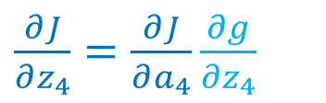


Backpropagation
$$\hat{y}= h_{θ}\left(x\right)=g\left(w_{5}⋅g\left(w_{4}⋅g\left(w_{3}⋅g\left(w_{2}⋅g\left(w_{1}⋅x\right)\right)\right)\right)\right)$$
More efficient to start at the end and reuse values!
$$\frac{∂J}{∂a_{4}}$$
$$\frac{∂J}{∂z_{5}}$$
$$\frac{∂J}{∂\hat{y}}$$
$$y$$
$$x$$
$$z1$$
$$a1$$
$$z2$$
$$a2$$
$$z3$$
$$a3$$
$$z4$$
$$a4$$
$$z5$$
$$a5=\hat{y}$$
$$J$$
$$f$$
$$g$$
$$f$$
$$g$$
$$f$$
$$g$$
$$f$$
$$g$$
$$f$$
$$g$$
$$ℓ$$
$$w1$$
$$w2$$
$$w3$$
$$w4$$
$$w5$$
$\frac{∂J}{∂z_{4}}=\frac{∂J}{∂a_{4}}\frac{∂g}{∂z_{4}}$
$$\frac{∂J}{∂z_{4}}$$

Slide 44

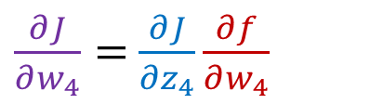

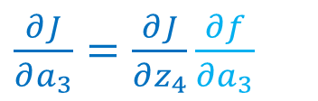
Backpropagation
$$\hat{y}= h_{θ}\left(x\right)=g\left(w_{5}⋅g\left(w_{4}⋅g\left(w_{3}⋅g\left(w_{2}⋅g\left(w_{1}⋅x\right)\right)\right)\right)\right)$$
More efficient to start at the end and reuse values!
$$\frac{∂J}{∂z_{4}}$$
$$\frac{∂J}{∂a_{4}}$$
$$\frac{∂J}{∂z_{5}}$$
$$\frac{∂J}{∂\hat{y}}$$
$$y$$
$$x$$
$$z1$$
$$a1$$
$$z2$$
$$a2$$
$$z3$$
$$a3$$
$$z4$$
$$a4$$
$$z5$$
$$a5=\hat{y}$$
$$J$$
$$f$$
$$g$$
$$f$$
$$g$$
$$f$$
$$g$$
$$f$$
$$g$$
$$f$$
$$g$$
$$ℓ$$
$$w1$$
$$w2$$
$$w3$$
$$w4$$
$$w5$$
$\frac{∂J}{∂a_{3}}=\frac{∂J}{∂z_{4}}\frac{∂f}{∂a_{3}}$
$$\frac{∂J}{∂a_{3}}$$
$\frac{∂J}{∂w_{4}}=$ $\frac{∂J}{∂z_{4}}\frac{∂f}{∂w_{4}}$

Slide 45

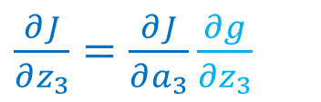

Backpropagation
$$\hat{y}= h_{θ}\left(x\right)=g\left(w_{5}⋅g\left(w_{4}⋅g\left(w_{3}⋅g\left(w_{2}⋅g\left(w_{1}⋅x\right)\right)\right)\right)\right)$$
More efficient to start at the end and reuse values!
$$\frac{∂J}{∂a_{3}}$$
$$\frac{∂J}{∂z_{4}}$$
$$\frac{∂J}{∂a_{4}}$$
$$\frac{∂J}{∂z_{5}}$$
$$\frac{∂J}{∂\hat{y}}$$
$$y$$
$$x$$
$$z1$$
$$a1$$
$$z2$$
$$a2$$
$$z3$$
$$a3$$
$$z4$$
$$a4$$
$$z5$$
$$a5=\hat{y}$$
$$J$$
$$f$$
$$g$$
$$f$$
$$g$$
$$f$$
$$g$$
$$f$$
$$g$$
$$f$$
$$g$$
$$ℓ$$
$$w1$$
$$w2$$
$$w3$$
$$w4$$
$$w5$$
$\frac{∂J}{∂z_{3}}=\frac{∂J}{∂a_{3}}\frac{∂g}{∂z_{3}}$
$$\frac{∂J}{∂z_{3}}$$

Slide 46
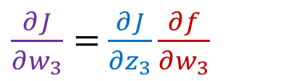


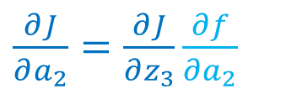
Backpropagation
$$\hat{y}= h_{θ}\left(x\right)=g\left(w_{5}⋅g\left(w_{4}⋅g\left(w_{3}⋅g\left(w_{2}⋅g\left(w_{1}⋅x\right)\right)\right)\right)\right)$$
More efficient to start at the end and reuse values!
$$\frac{∂J}{∂z_{3}}$$
$$\frac{∂J}{∂a_{3}}$$
$$\frac{∂J}{∂z_{4}}$$
$$\frac{∂J}{∂a_{4}}$$
$$\frac{∂J}{∂z_{5}}$$
$$\frac{∂J}{∂\hat{y}}$$
$$y$$
$$x$$
$$z1$$
$$a1$$
$$z2$$
$$a2$$
$$z3$$
$$a3$$
$$z4$$
$$a4$$
$$z5$$
$$a5=\hat{y}$$
$$J$$
$$f$$
$$g$$
$$f$$
$$g$$
$$f$$
$$g$$
$$f$$
$$g$$
$$f$$
$$g$$
$$ℓ$$
$$w1$$
$$w2$$
$$w3$$
$$w4$$
$$w5$$
$\frac{∂J}{∂a_{2}}=\frac{∂J}{∂z_{3}}\frac{∂f}{∂a_{2}}$
$$\frac{∂J}{∂a_{2}}$$
$\frac{∂J}{∂w_{3}}=$ $\frac{∂J}{∂z_{3}}\frac{∂f}{∂w_{3}}$

Slide 47


Backpropagation
$$\hat{y}= h_{θ}\left(x\right)=g\left(w_{5}⋅g\left(w_{4}⋅g\left(w_{3}⋅g\left(w_{2}⋅g\left(w_{1}⋅x\right)\right)\right)\right)\right)$$
More efficient to start at the end and reuse values!
$$\frac{∂J}{∂a_{2}}$$
$$\frac{∂J}{∂z_{3}}$$
$$\frac{∂J}{∂a_{3}}$$
$$\frac{∂J}{∂z_{4}}$$
$$\frac{∂J}{∂a_{4}}$$
$$\frac{∂J}{∂z_{5}}$$
$$\frac{∂J}{∂\hat{y}}$$
$$y$$
$$x$$
$$z1$$
$$a1$$
$$z2$$
$$a2$$
$$z3$$
$$a3$$
$$z4$$
$$a4$$
$$z5$$
$$a5=\hat{y}$$
$$J$$
$$f$$
$$g$$
$$f$$
$$g$$
$$f$$
$$g$$
$$f$$
$$g$$
$$f$$
$$g$$
$$ℓ$$
$$w1$$
$$w2$$
$$w3$$
$$w4$$
$$w5$$
$\frac{∂J}{∂z_{2}}=\frac{∂J}{∂a_{2}}\frac{∂g}{∂z_{2}}$

Slide 48


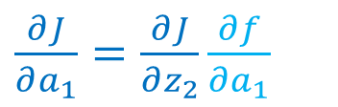
Backpropagation
$$\hat{y}= h_{θ}\left(x\right)=g\left(w_{5}⋅g\left(w_{4}⋅g\left(w_{3}⋅g\left(w_{2}⋅g\left(w_{1}⋅x\right)\right)\right)\right)\right)$$
More efficient to start at the end and reuse values!
$$\frac{∂J}{∂z_{2}}$$
$$\frac{∂J}{∂a_{2}}$$
$$\frac{∂J}{∂z_{3}}$$
$$\frac{∂J}{∂a_{3}}$$
$$\frac{∂J}{∂z_{4}}$$
$$\frac{∂J}{∂a_{4}}$$
$$\frac{∂J}{∂z_{5}}$$
$$\frac{∂J}{∂\hat{y}}$$
$$y$$
$$x$$
$$z1$$
$$a1$$
$$z2$$
$$a2$$
$$z3$$
$$a3$$
$$z4$$
$$a4$$
$$z5$$
$$a5=\hat{y}$$
$$J$$
$$f$$
$$g$$
$$f$$
$$g$$
$$f$$
$$g$$
$$f$$
$$g$$
$$f$$
$$g$$
$$ℓ$$
$$w1$$
$$w2$$
$$w3$$
$$w4$$
$$w5$$
$\frac{∂J}{∂a_{1}}=\frac{∂J}{∂z_{2}}\frac{∂f}{∂a_{1}}$
$\frac{∂J}{∂w_{2}}=$ $\frac{∂J}{∂z_{2}}\frac{∂f}{∂w_{2}}$

Slide 49
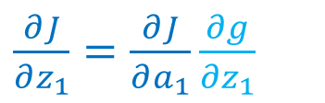

Backpropagation
$$\hat{y}= h_{θ}\left(x\right)=g\left(w_{5}⋅g\left(w_{4}⋅g\left(w_{3}⋅g\left(w_{2}⋅g\left(w_{1}⋅x\right)\right)\right)\right)\right)$$
More efficient to start at the end and reuse values!
$$\frac{∂J}{∂a_{1}}$$
$$\frac{∂J}{∂z_{2}}$$
$$\frac{∂J}{∂a_{2}}$$
$$\frac{∂J}{∂z_{3}}$$
$$\frac{∂J}{∂a_{3}}$$
$$\frac{∂J}{∂z_{4}}$$
$$\frac{∂J}{∂a_{4}}$$
$$\frac{∂J}{∂z_{5}}$$
$$\frac{∂J}{∂\hat{y}}$$
$$y$$
$$x$$
$$z1$$
$$a1$$
$$z2$$
$$a2$$
$$z3$$
$$a3$$
$$z4$$
$$a4$$
$$z5$$
$$a5=\hat{y}$$
$$J$$
$$f$$
$$g$$
$$f$$
$$g$$
$$f$$
$$g$$
$$f$$
$$g$$
$$f$$
$$g$$
$$ℓ$$
$$w1$$
$$w2$$
$$w3$$
$$w4$$
$$w5$$
$\frac{∂J}{∂z_{1}}=\frac{∂J}{∂a_{1}}\frac{∂g}{∂z_{1}}$

Slide 50
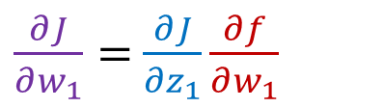

Backpropagation
$$\hat{y}= h_{θ}\left(x\right)=g\left(w_{5}⋅g\left(w_{4}⋅g\left(w_{3}⋅g\left(w_{2}⋅g\left(w_{1}⋅x\right)\right)\right)\right)\right)$$
More efficient to start at the end and reuse values!
$$\frac{∂J}{∂z_{1}}$$
$$\frac{∂J}{∂a_{1}}$$
$$\frac{∂J}{∂z_{2}}$$
$$\frac{∂J}{∂a_{2}}$$
$$\frac{∂J}{∂z_{3}}$$
$$\frac{∂J}{∂a_{3}}$$
$$\frac{∂J}{∂z_{4}}$$
$$\frac{∂J}{∂a_{4}}$$
$$\frac{∂J}{∂z_{5}}$$
$$\frac{∂J}{∂\hat{y}}$$
$$y$$
$$x$$
$$z1$$
$$a1$$
$$z2$$
$$a2$$
$$z3$$
$$a3$$
$$z4$$
$$a4$$
$$z5$$
$$a5=\hat{y}$$
$$J$$
$$f$$
$$g$$
$$f$$
$$g$$
$$f$$
$$g$$
$$f$$
$$g$$
$$f$$
$$g$$
$$ℓ$$
$$w1$$
$$w2$$
$$w3$$
$$w4$$
$$w5$$
$\frac{∂J}{∂w_{1}}=$ $\frac{∂J}{∂z_{1}}\frac{∂f}{∂w_{1}}$

Slide 51
Backpropagation
$$\hat{y}= h_{θ}\left(x\right)=g\left(w_{5}⋅g\left(w_{4}⋅g\left(w_{3}⋅g\left(w_{2}⋅g\left(w_{1}⋅x\right)\right)\right)\right)\right)$$
More efficient to start at the end and reuse values!
$$\frac{∂J}{∂z_{1}}$$
$$\frac{∂J}{∂a_{1}}$$
$$\frac{∂J}{∂z_{2}}$$
$$\frac{∂J}{∂a_{2}}$$
$$\frac{∂J}{∂z_{3}}$$
$$\frac{∂J}{∂a_{3}}$$
$$\frac{∂J}{∂z_{4}}$$
$$\frac{∂J}{∂a_{4}}$$
$$\frac{∂J}{∂z_{5}}$$
$$\frac{∂J}{∂\hat{y}}$$
$$y$$
$$x$$
$$z1$$
$$a1$$
$$z2$$
$$a2$$
$$z3$$
$$a3$$
$$z4$$
$$a4$$
$$z5$$
$$a5=\hat{y}$$
$$J$$
$$f$$
$$g$$
$$f$$
$$g$$
$$f$$
$$g$$
$$f$$
$$g$$
$$f$$
$$g$$
$$ℓ$$
$$w1$$
$$w2$$
$$w3$$
$$w4$$
$$w5$$
$$\frac{∂J}{∂w_{1}}$$
$$\frac{∂J}{∂w_{2}}$$
$$\frac{∂J}{∂w_{3}}$$
$$\frac{∂J}{∂w_{4}}$$
$$\frac{∂J}{∂w_{5}}$$
To do gradient descent we need the partial derivative of the objective with respect to each parameter, $w_{ℓ}←w_{ℓ}−α ∂J/∂w_{ℓ}$
The backward pass propagates the change in the objective with respect to intermediate values ($∂J/∂z_{ℓ}$ and $∂J/∂a_{ℓ}$) back through the network to produce each $∂J/∂w_{ℓ}$

Slide 52
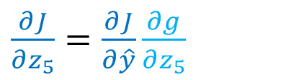













Backpropagation
$$\hat{y}= h_{θ}\left(x\right)=g\left(w_{5}⋅g\left(w_{4}⋅g\left(w_{3}⋅g\left(w_{2}⋅g\left(w_{1}⋅x\right)\right)\right)\right)\right)$$
More efficient to start at the end and reuse values!
$$\frac{∂J}{∂z_{1}}$$
$$\frac{∂J}{∂a_{1}}$$
$$\frac{∂J}{∂z_{2}}$$
$$\frac{∂J}{∂a_{2}}$$
$$\frac{∂J}{∂z_{3}}$$
$$\frac{∂J}{∂a_{3}}$$
$$\frac{∂J}{∂z_{4}}$$
$$\frac{∂J}{∂a_{4}}$$
$$\frac{∂J}{∂z_{5}}$$
$$\frac{∂J}{∂\hat{y}}$$
$$y$$
$$x$$
$$z1$$
$$a1$$
$$z2$$
$$a2$$
$$z3$$
$$a3$$
$$z4$$
$$a4$$
$$z5$$
$$a5=\hat{y}$$
$$J$$
$$f$$
$$g$$
$$f$$
$$g$$
$$f$$
$$g$$
$$f$$
$$g$$
$$f$$
$$g$$
$$ℓ$$
$$w1$$
$$w2$$
$$w3$$
$$w4$$
$$w5$$
$\frac{∂J}{∂a_{1}}=\frac{∂J}{∂z_{2}}\frac{∂f}{∂a_{1}}$
$\frac{∂J}{∂a_{2}}=\frac{∂J}{∂z_{3}}\frac{∂f}{∂a_{2}}$
$\frac{∂J}{∂a_{3}}=\frac{∂J}{∂z_{4}}\frac{∂f}{∂a_{3}}$
$\frac{∂J}{∂a_{4}}=\frac{∂J}{∂z_{5}}\frac{∂f}{∂a_{4}}$
$\frac{∂J}{∂\hat{y}}=\frac{∂ℓ}{∂\hat{y}}$
$\frac{∂J}{∂z_{1}}=\frac{∂J}{∂a_{1}}\frac{∂g}{∂z_{1}}$
$\frac{∂J}{∂z_{2}}=\frac{∂J}{∂a_{2}}\frac{∂g}{∂z_{2}}$
$\frac{∂J}{∂z_{3}}=\frac{∂J}{∂a_{3}}\frac{∂g}{∂z_{3}}$
$\frac{∂J}{∂z_{4}}=\frac{∂J}{∂a_{4}}\frac{∂g}{∂z_{4}}$
$\frac{∂J}{∂z_{5}}=\frac{∂J}{∂\hat{y}}\frac{∂g}{∂z_{5}}$
$\frac{∂J}{∂w_{1}}=$ $\frac{∂J}{∂z_{1}}\frac{∂f}{∂w_{1}}$
$\frac{∂J}{∂w_{2}}=$ $\frac{∂J}{∂z_{2}}\frac{∂f}{∂w_{2}}$
$\frac{∂J}{∂w_{3}}=$ $\frac{∂J}{∂z_{3}}\frac{∂f}{∂w_{3}}$
$\frac{∂J}{∂w_{4}}=$ $\frac{∂J}{∂z_{4}}\frac{∂f}{∂w_{4}}$
$\frac{∂J}{∂w_{5}}=$ $\frac{∂J}{∂z_{5}}\frac{∂f}{∂w_{5}}$

Slide 53
















Generic Layer Implementation (so-far)
Compute derivatives per layer, utilizing previous derivatives
Objective: $J\left(θ\right)$
Arbitrary layer: $z_{out}=f\left(z_{in}, θ\right)$
Need:
  $\frac{∂J}{∂z_{in}}=\frac{∂J}{∂z_{out}}\frac{∂f}{∂z_{in}}$
  $\frac{∂J}{∂θ} =\frac{∂J}{∂z_{out}}\frac{∂f}{∂θ}$
$$zin$$
$$zout$$
$$J$$
$$f$$
$$θ$$
$$z_{in}$$
Layer $z_{out}=f\left(z_{in}, θ\right)$
$\frac{∂f}{∂z_{in}}$
$\frac{∂f}{∂θ}$
$$z_{out}$$
$$\frac{∂J}{∂z_{in}}$$
$$\frac{∂J}{∂z_{out}}$$
$$θ$$
$$\frac{∂J}{∂θ}$$

Slide 54








































Optimization
$$\hat{y}= h_{θ}\left(x\right)=g\left(b_{3,1}+\sum_{k}{w_{3,1,k}} g\left(b_{2,k}+\sum_{i}{w_{2,k,i}} g\left(b_{1,i}+\sum_{j}{w_{1,i,j}} x_{j}\right)\right)\right)$$
Tons of repeated partial derivatives
$$z11$$
$$a11$$
$$x1$$
$$f$$
$$g$$
$$b11$$
$$z21$$
$$a21$$
$$f$$
$$g$$
$$z12$$
$$a12$$
$$b21$$
$$z31$$
$$\hat{y}$$
$$J$$
$$x2$$
$$f$$
$$g$$
$$f$$
$$g$$
$$ℓ$$
$$b12$$
$$z22$$
$$a22$$
$$b31$$
$$f$$
$$g$$
$$y$$
$$z13$$
$$a13$$
$$b22$$
$$\frac{∂J}{∂b_{3,1}}=\frac{∂ℓ}{∂\hat{y}} \frac{∂a_{3,1}}{∂z_{3,1}} \frac{∂z_{3,1}}{∂b_{3,1}}$$
$$x3$$
$$f$$
$$g$$
$$b13$$
$$\frac{∂J}{∂b_{2,i}}=\frac{∂ℓ}{∂\hat{y}} \frac{∂a_{3,1}}{∂z_{3,1}} \frac{∂z_{3,1}}{∂a_{2,i}} \frac{∂a_{2,i}}{∂z_{2,i}} \frac{∂z_{2,i}}{∂b_{2,i}}$$
$$\frac{∂J}{∂b_{1,i}}=\frac{∂ℓ}{∂\hat{y}} \frac{∂a_{3,1}}{∂z_{3,1}} \frac{∂z_{3,1}}{∂a_{2}} \frac{∂a_{2}}{∂z_{2}} \frac{∂z_{2}}{∂a_{1,i}} \frac{∂a_{1,i}}{∂z_{1,i}} \frac{∂z_{1,i}}{∂b_{1,i}}$$

Slide 55











Optimization
$$\hat{y}= h_{θ}\left(x\right)=g\left(b_{3,1}+\sum_{k}{w_{3,1,k}} g\left(b_{2,k}+\sum_{i}{w_{2,k,i}} g\left(b_{1,i}+\sum_{j}{w_{1,i,j}} x_{j}\right)\right)\right)$$
Tons of repeated partial derivatives
$$z11$$
$$a11$$
$$x1$$
$$f$$
$$g$$
$$b11$$
$$z21$$
$$a21$$
$$f$$
$$g$$
$$z12$$
$$a12$$
$$b21$$
$$z31$$
$$\hat{y}$$
$$J$$
$$x2$$
$$f$$
$$g$$
$$f$$
$$g$$
$$ℓ$$
$$b12$$
$$z22$$
$$a22$$
$$b31$$
$$f$$
$$g$$
$$y$$
$$z13$$
$$a13$$
$$b22$$
$$\frac{∂J}{∂b_{3,1}}=\frac{∂ℓ}{∂\hat{y}} \frac{∂a_{3,1}}{∂z_{3,1}} \frac{∂z_{3,1}}{∂b_{3,1}}$$
$$x3$$
$$f$$
$$g$$
$$b13$$
$$\frac{∂J}{∂b_{2,i}}=\frac{∂ℓ}{∂\hat{y}} \frac{∂a_{3,1}}{∂z_{3,1}} \frac{∂z_{3,1}}{∂a_{2,i}} \frac{∂a_{2,i}}{∂z_{2,i}} \frac{∂z_{2,i}}{∂b_{2,i}}$$
$$\frac{∂J}{∂b_{1,i}}=\frac{∂ℓ}{∂\hat{y}} \frac{∂a_{3,1}}{∂z_{3,1}} \frac{∂z_{3,1}}{∂a_{2}} \frac{∂a_{2}}{∂z_{2}} \frac{∂z_{2}}{∂a_{1,i}} \frac{∂a_{1,i}}{∂z_{1,i}} \frac{∂z_{1,i}}{∂b_{1,i}}$$

Slide 56
Calculus Time-out

Slide 57
Multivariate-chain rule

Slide 58

Multivariable Chain Rule
$g_{1}\left(x\right)=3x$
$g_{2}\left(x\right)=5x$
$f\left(z_{1}, z_{2}\right)={2z}_{1}+{7z}_{2}$
$y=f\left(g_{1}\left(x\right),g_{2}\left(x\right)\right)$

Slide 59


Exercise: Multivariable Chain Rule
$$\frac{df}{dx} = \frac{∂f}{∂g_{1}}\frac{∂g_{1}}{∂x} + \frac{∂f}{∂g_{2}}\frac{∂g_{2}}{∂x}$$
$z_{1}=g_{1}\left(x\right)=sin\left(x\right)$
$z_{2}=g_{2}\left(x\right)=x^{3}$
$y=f\left(z_{1}, z_{2}\right)=z_{1}^{4}e^{z_{2}}+5z_{1}+7z_{2}$

Slide 60











Exercise: Multivariable Chain Rule
$$\frac{df}{dx} = \frac{∂f}{∂g_{1}}\frac{∂g_{1}}{∂x} + \frac{∂f}{∂g_{2}}\frac{∂g_{2}}{∂x}$$
$z_{1}=g_{1}\left(x\right)=sin\left(x\right)$
$z_{2}=g_{2}\left(x\right)=x^{3}$
$y=f\left(z_{1}, z_{2}\right)=z_{1}^{4}e^{z_{2}}+5z_{1}+7z_{2}$
$dg_{1}/dx$ $=\cos\left(x\right)$
$dg_{2}/dx$ $=3x^{2}$
$∂f/∂z_{1}$ $=4z_{1}^{3}e^{z_{2}}+5$
$∂f/∂z_{2}$ $=z_{1}^{4}e^{z_{2}}+7$
$$\frac{df}{dx} = \frac{∂f}{∂g_{1}}\frac{∂g_{1}}{∂x} + \frac{∂f}{∂g_{2}}\frac{∂g_{2}}{∂x}$$
$=\left(4z_{1}^{3}e^{z_{2}}+5\right)\cos\left(x\right)$
$+ \left(z_{1}^{4}e^{z_{2}}+7\right) 3x^{2}$
$$z1$$
$$g_{1}$$
$$x$$
$$y$$
$$f$$
$$z_{2}$$
$$g_{2}$$

Slide 61
Calculus Chain Rule
Scalar:
$y=f\left(z\right)$
$z=g\left(x\right)$
$\frac{dy}{dx}=\frac{dy}{dz}\frac{dz}{dx}$
Multivariate:
$y=f\left(z\right)$
$z=g\left(x\right)$
$\frac{dy}{dx}=\sum_{j}{\frac{∂y}{∂z_{j}}\frac{∂z_{j}}{∂x}}$
Multivariate:
$y=f\left(z\right)$
$z=g\left(x\right)$
$\frac{dy_{i}}{dx_{k}}=\sum_{j}{\frac{∂y_{i}}{∂z_{j}}\frac{∂z_{j}}{∂x_{k}}}$

Slide 62
Calculus Chain Rule
Scalar:
$y=f\left(z\right)$
$z=g\left(x\right)$
$\frac{dy}{dx}=\frac{dy}{dz}\frac{dz}{dx}$
Multivariate:
$y=f\left(z\right)$
$z=g\left(x\right)$
$\frac{dy}{dx}=\sum_{j}{\frac{∂y}{∂z_{j}}\frac{∂z_{j}}{∂x}}$
Multivariate:
$y=f\left(z\right)$
$z=g\left(x\right)$
$\frac{dy_{i}}{dx_{k}}=\sum_{j}{\frac{∂y_{i}}{∂z_{j}}\frac{∂z_{j}}{∂x_{k}}}$

Slide 63

Multivariable Chain Rule

Slide 64
Backpropagation (vector version)

Slide 65








Generic Layer Implementation (updated)
Compute derivatives per layer, utilizing previous derivatives
Objective: $J\left(θ\right)$
Arbitrary layer: $z_{out}=f\left(z_{in}, θ\right)$
Need:
  $\frac{∂J}{∂z_{in}}+=\frac{∂J}{∂z_{out}}\frac{∂f}{∂z_{in}}$
  $\frac{∂J}{∂θ} +=\frac{∂J}{∂z_{out}}\frac{∂f}{∂θ}$
$$zout$$
$$zin$$
$$J$$
$$f$$
$$θ$$
$$z_{in}$$
Layer $z_{out}=f\left(z_{in}, θ\right)$
$\frac{∂f}{∂z_{in}}$
$\frac{∂f}{∂θ}$
$$z_{out}$$
$$\frac{∂J}{∂z_{in}}$$
$$\frac{∂J}{∂z_{out}}$$
$$θ$$
$$\frac{∂J}{∂θ}$$

Slide 66











Generic Layer Implementation (vector output version)
Compute derivatives per layer, utilizing previous derivatives
Objective: $J\left(θ\right)$
Arbitrary layer: $z_{out}=f\left(z_{in}, θ\right)$
Need:
  $\frac{∂J}{∂z_{in}}=$
  $\frac{∂J}{∂θ_{j}} =$
$$zin$$
$$zout∈ℝ^{K}$$
$$J$$
$$f$$
$$θ∈ℝ^{M}$$
$$z_{in}$$
Layer $z_{out}=f\left(z_{in}, θ\right)$
$\frac{∂f}{∂z_{in}}$
$\frac{∂f}{∂θ}$
$$z_{out}$$
$$\frac{∂J}{∂z_{in}}$$
$$\frac{∂J}{∂z_{out}}$$
$$θ$$
$$\frac{∂J}{∂θ}$$

Slide 67




Generic Layer Implementation (vector output version)
Compute derivatives per layer, utilizing previous derivatives
Objective: $J\left(θ\right)$
Arbitrary layer: $z_{out}=f\left(z_{in}, θ\right)$
Need:
  $\frac{∂J}{∂z_{in}}=\sum_{k}{\frac{∂J}{∂z_{out,k}}\frac{∂z_{out,k}}{∂z_{in}}}$
  $\frac{∂J}{∂θ_{j}} =\sum_{k}{\frac{∂J}{∂z_{out,k}}\frac{∂f}{∂θ_{j}}}$
$$z_{out,1}$$
$$zin$$
$$zout∈ℝ^{K}$$
$$z_{out,2}$$
$$J$$
$$f$$
$$z_{out,3}$$
$$θ∈ℝ^{M}$$
$$z_{in}$$
Layer $z_{out}=f\left(z_{in}, θ\right)$
$\frac{∂f}{∂z_{in}}$
$\frac{∂f}{∂θ}$
$$z_{out}$$
$$\frac{∂J}{∂z_{in}}$$
$$\frac{∂J}{∂z_{out}}$$
$$θ$$
$$\frac{∂J}{∂θ}$$

Slide 68
















Linear Layer Implementation
$$a∈ℝ^{M}$$
$$z∈ℝ^{K}$$
$$J$$
$$f$$
$$W∈ℝ^{K×M}, b∈ℝ^{K}$$
Compute derivatives per layer
Objective: $J\left(θ\right)$
Layer: $z=f\left(a, W,b\right)=Wa+b$
Scalar version (no formatting)
  $\frac{∂J}{∂a_{j}} =$
  $\frac{∂J}{∂W_{i,j}}=$
  $\frac{∂J}{∂b_{i}} =$
$$a$$
Layer $a=f\left(a, W,b\right)$
$\frac{∂f}{∂a}$
$\frac{∂f}{∂W}$ $\frac{∂f}{∂b}$
$$z$$
$$\frac{∂J}{∂a}$$
$$\frac{∂J}{∂z}$$
$$W b$$
$$\frac{∂J}{∂W}$$
$$\frac{∂J}{∂b}$$
$$z=Wa+b$$
$z_{k}=b_{k}+\sum_{j}{W_{k,j}a_{j}}$

Slide 69

Linear Layer Implementation
$$a∈ℝ^{M}$$
$$z∈ℝ^{K}$$
$$J$$
$$f$$
$$W∈ℝ^{K×M}, b∈ℝ^{K}$$
Compute derivatives per layer
Objective: $J\left(θ\right)$
Layer: $z=f\left(a, W,b\right)=Wa+b$
Scalar version (no formatting)
  $\frac{∂J}{∂a_{j}} =\sum_{k}{\frac{∂J}{∂z_{k}}}\frac{∂z_{k}}{∂a_{j}}$
  $\frac{∂J}{∂W_{i,j}}=\sum_{k}{\frac{∂J}{∂z_{k}}}\frac{∂z_{k}}{∂W_{i,j}}$
  $\frac{∂J}{∂b_{i}} =\sum_{k}{\frac{∂J}{∂z_{k}}}\frac{∂z_{k}}{∂b_{i}}$
$$a$$
Layer $a=f\left(a, W,b\right)$
$\frac{∂f}{∂a}$
$\frac{∂f}{∂W}$ $\frac{∂f}{∂b}$
$$z$$
$$\frac{∂J}{∂a}$$
$$\frac{∂J}{∂z}$$
$$W b$$
$$\frac{∂J}{∂W}$$
$$\frac{∂J}{∂b}$$
$$z=Wa+b$$
$z_{k}=b_{k}+\sum_{j}{W_{k,j}a_{j}}$

Slide 70



Linear Layer Implementation
$$a∈ℝ^{M}$$
$$z∈ℝ^{K}$$
$$J$$
$$f$$
$$W∈ℝ^{K×M}, b∈ℝ^{K}$$
Compute derivatives per layer
Objective: $J\left(θ\right)$
Layer: $z=f\left(a, W,b\right)=Wa+b$
(Denominator format)
  $\frac{∂J}{∂a}$
  $\frac{∂J}{∂W}$
  $\frac{∂J}{∂b}$
$$a$$
Layer $z=f\left(a, W,b\right)$
$\frac{∂f}{∂a}$
$\frac{∂f}{∂W}$ $\frac{∂f}{∂b}$
$$z$$
$$\frac{∂J}{∂a}$$
$$\frac{∂J}{∂z}$$
$$W b$$
$$\frac{∂J}{∂W}$$
$$\frac{∂J}{∂b}$$

Slide 71

Linear Layer Implementation
$$a∈ℝ^{M}$$
$$z∈ℝ^{K}$$
$$J$$
$$f$$
$$W∈ℝ^{K×M}, b∈ℝ^{K}$$
Compute derivatives per layer
Objective: $J\left(θ\right)$
Layer: $z=f\left(a, W,b\right)=Wa+b$
(Numerator format)
  $\frac{∂J}{∂a}$
  $\frac{∂J}{∂W}$
  $\frac{∂J}{∂b}$
$$a$$
Layer $z=f\left(a, W,b\right)$
$\frac{∂f}{∂a}$
$\frac{∂f}{∂W}$ $\frac{∂f}{∂b}$
$$z$$
$$\frac{∂J}{∂a}$$
$$\frac{∂J}{∂z}$$
$$W b$$
$$\frac{∂J}{∂W}$$
$$\frac{∂J}{∂b}$$

