Slide 1

07-280
Introduction to ML
Neural Networks
Instructors:
Pat Virtue & Nihar Shah

Slide 2
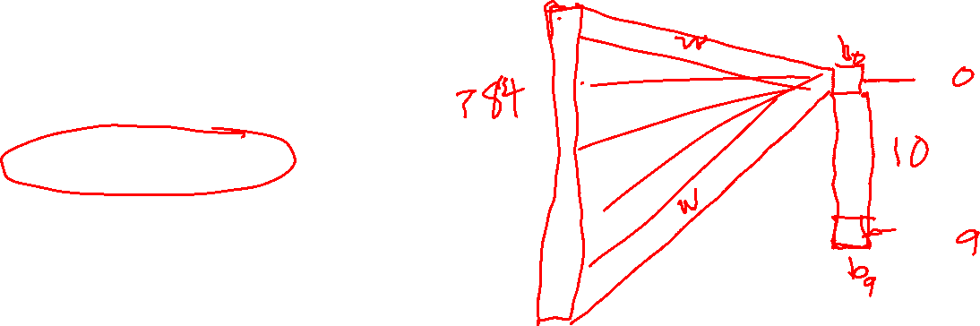
Poll 1
Logistic regression for 28x28=784 pixel hand-written digit images into 10 classes:
How many parameters (including bias terms)?
10
10+784
10*784
10*784 + 10
10*784 + 784
I have no idea

Slide 3
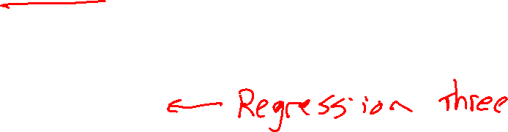
Outline
Pre-reading: Neural Networks
Network diagrams for linear and logistic regression
Neuron and activation functions
Three-neuron network
Neural network structure (adding more neurons)
Today: Neural Networks
Neural Network Regression
Scalar Optimization (Backpropogation)
Next time: Neural Network
Vector/Matrix Calculus Optimization (Backpropogation)
Properties and Intuition

Slide 4
Neuron
Pre-reading

Slide 5

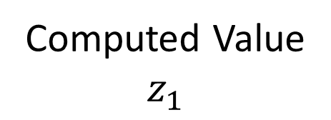

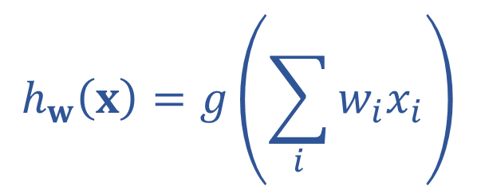
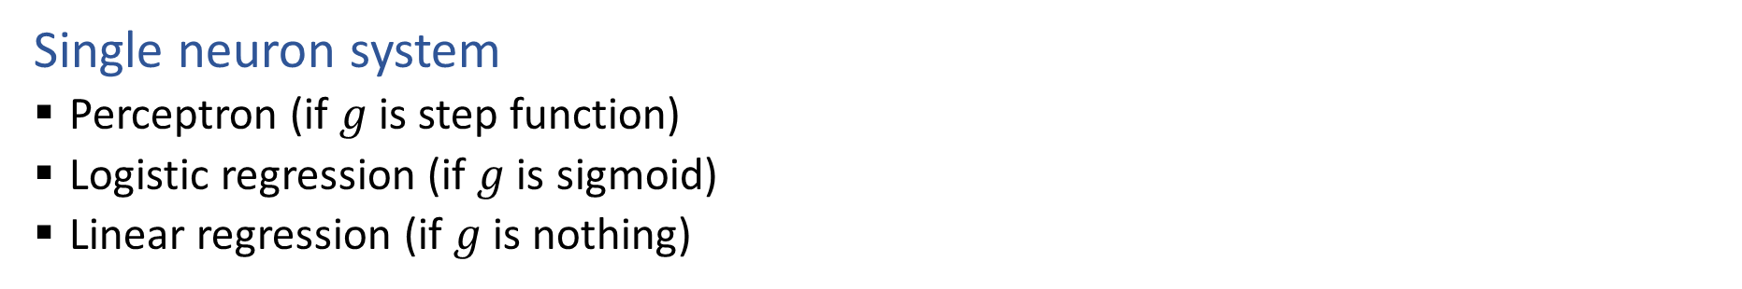






Single Neuron
Single neuron system
  Perceptron (if $g$ is step function)
  Logistic regression (if $g$ is sigmoid)
  Linear regression (if $g$ is nothing)
$$x1$$
$$w1$$
Computed Value
$$z_{1}$$
True Label
$$y$$
$$∑$$
$$g$$
$$x2$$
$$h_{w}\left(x\right)=z_{1}$$
$$w2$$
$$h_{w}\left(x\right)=g\left(\sum_{i}{w_{i}x_{i}}\right)$$

Slide 6
Activation Functions
Pre-reading

Slide 7

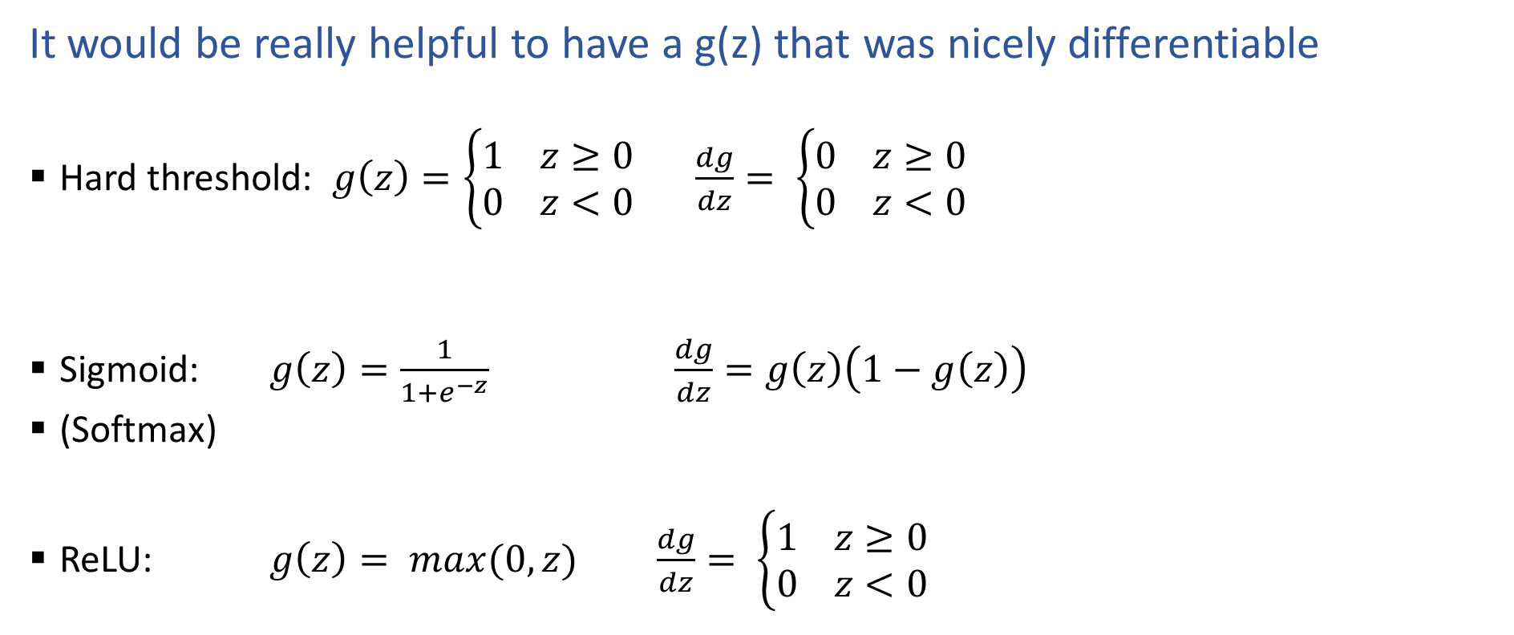


Activation Functions
It would be really helpful to have a g(z) that was nicely differentiable
  Hard threshold: $g\left(z\right)=\left\{\begin{aligned}1 z≥0 \\ 0 z<0\end{aligned}\right.$ $\frac{dg}{dz}= \left\{\begin{aligned}0 z≥0 \\ 0 z<0\end{aligned}\right.$
  Sigmoid: $g\left(z\right)=\frac{1}{1+e^{−z}}$ $\frac{dg}{dz}=g\left(z\right)\left(1−g\left(z\right)\right)$
  (Softmax)
  ReLU: $g\left(z\right)= max(0,z)$ $\frac{dg}{dz}= \left\{\begin{aligned}1 z≥0 \\ 0 z<0\end{aligned}\right.$
$$z$$
$$z$$
$$z$$

Slide 8
Three-neuron Network
Pre-reading

Slide 9



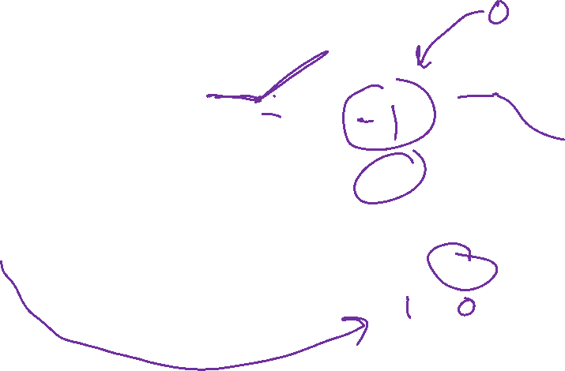




















Three-neuron Network
Network diagram
$$z_{1,1}$$
$$a_{1,1}$$
$$w_{1,1}$$
$$∑$$
$$g$$
$$w_{2,1}$$
$$x_{1}$$
$$b_{1,1}$$
$$\hat{y}$$
$$∑$$
$$z_{1,2}$$
$$b_{2,1}$$
$$ℓ$$
$$w_{1,2}$$
$$a_{1,2}$$
$$w_{2,2}$$
$$∑$$
$$g$$
$$y$$
$$b_{1,2}$$
$\hat{y}{=h}_{θ}\left(x\right)=$ $b_{2}+\sum_{j}{w_{2,j}{ a}_{1,j}}$
$$a_{1,j}=g_{ReLU}\left(b_{1,j}+w_{1,j} x_{1}\right)$$

Slide 10
Adding More Neurons
Pre-reading

Slide 11










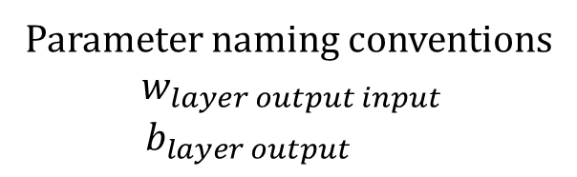


































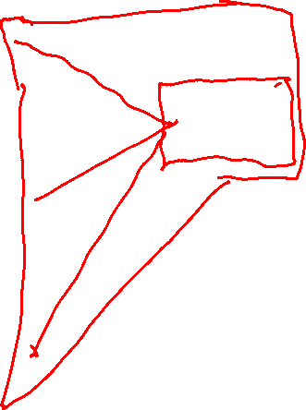






Three-layer Network
Parameter naming conventions
$$w_{layer output input}$$
$$b_{layer output}$$
Network diagram
$$w111$$
$$z11$$
$$a11$$
$$x1$$
$$∑$$
$$g$$
$$w112$$
$$b11$$
$$w211$$
$$w113$$
$$z21$$
$$a21$$
$$w212$$
$$∑$$
$$g$$
$$w121$$
$$w311$$
$$b21$$
$$w122$$
$$z12$$
$$a12$$
$$w213$$
$$z31$$
$$a31=\hat{y}$$
$$x2$$
$$∑$$
$$g$$
$$∑$$
$$g$$
$$b12$$
$$w221$$
$$w123$$
$$w312$$
$$b31$$
$$z22$$
$$a22$$
$$w222$$
$$∑$$
$$g$$
$$w131$$
$$w132$$
$$w223$$
$$b22$$
$$z13$$
$$a13$$
$$x3$$
$$∑$$
$$g$$
$$w133$$
$$b13$$

Slide 12
Three-layer Network
Different ways to define network layers: Layers of functions
$$x1$$
$$∑$$
$$g$$
$$∑$$
$$g$$
$$x2$$
$$∑$$
$$g$$
$$∑$$
$$g$$
$$∑$$
$$g$$
$$x3$$
$$∑$$
$$g$$

Slide 13
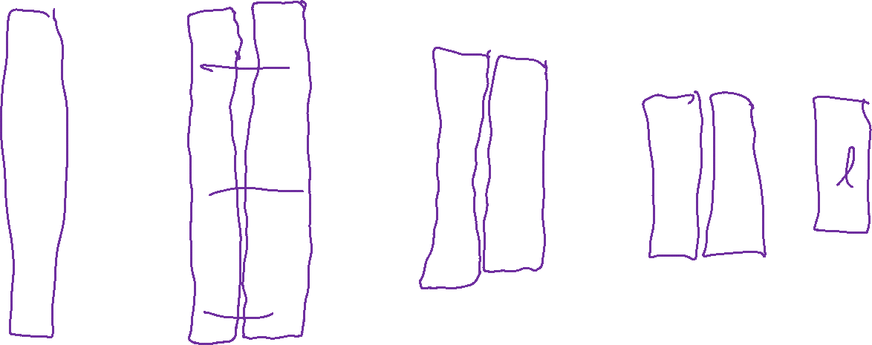
Three-layer Network
Different ways to define network layers: Layers of neurons
$$x1$$
$$∑$$
$$g$$
$$∑$$
$$g$$
$$x2$$
$$∑$$
$$g$$
$$∑$$
$$g$$
$$∑$$
$$g$$
$$x3$$
$$∑$$
$$g$$

Slide 14
Neural Network Regression

Slide 15



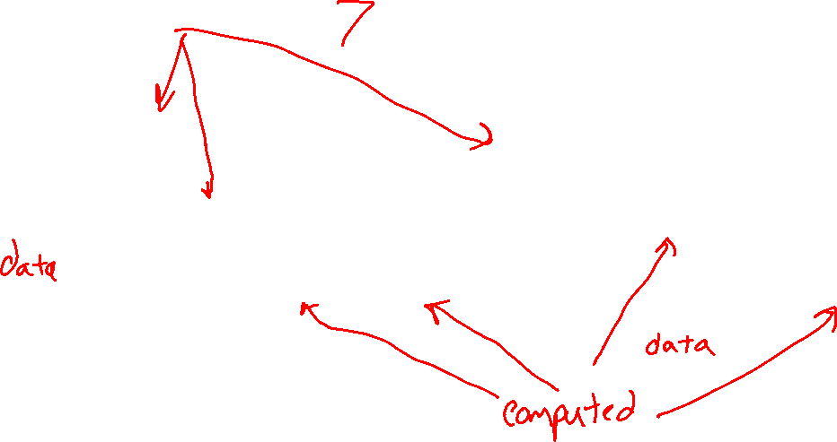










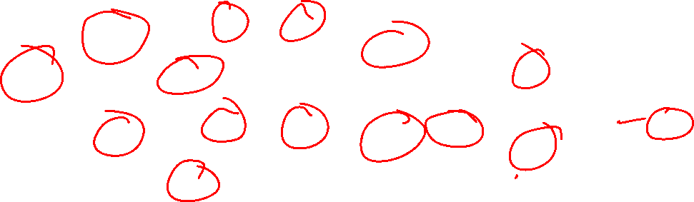








Poll 2
How many total parameters?
$$z_{1,1}$$
$$a_{1,1}$$
$$w_{1,1}$$
$$∑$$
$$g$$
$$w_{2,1}$$
$$x_{1}$$
$$b_{1,1}$$
$$\hat{y}$$
$$∑$$
$$z_{1,2}$$
$$b_{2,1}$$
$$ℓ$$
$$w_{1,2}$$
$$a_{1,2}$$
$$w_{2,2}$$
$$∑$$
$$g$$
$$y$$
$$b_{1,2}$$

Slide 16
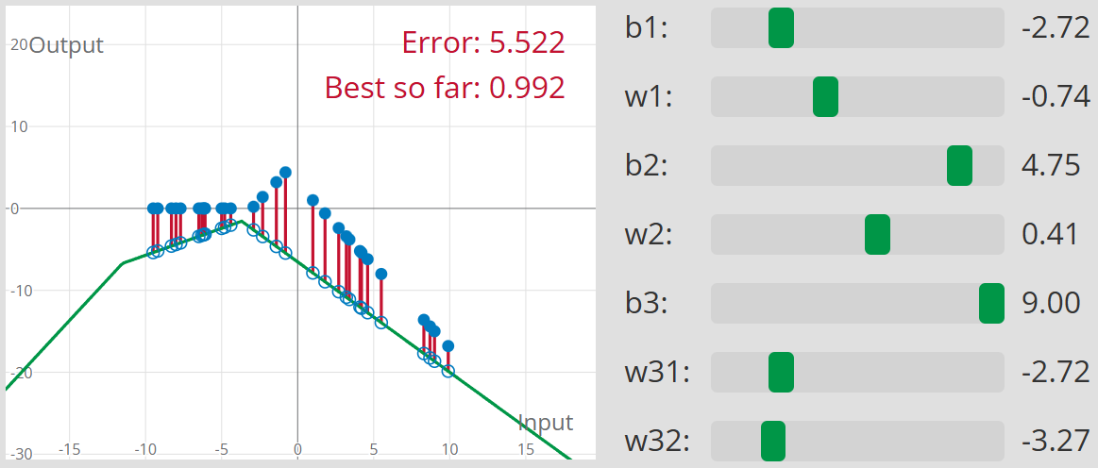
Three-neuron network
Interactive demo: https://www.cs.cmu.edu/~pvirtue/AIS/regression/

Slide 17
Poll 3
Interactive demo: https://www.cs.cmu.edu/~pvirtue/AIS/regression/
What's the smallest MSE that you can find?

Slide 18
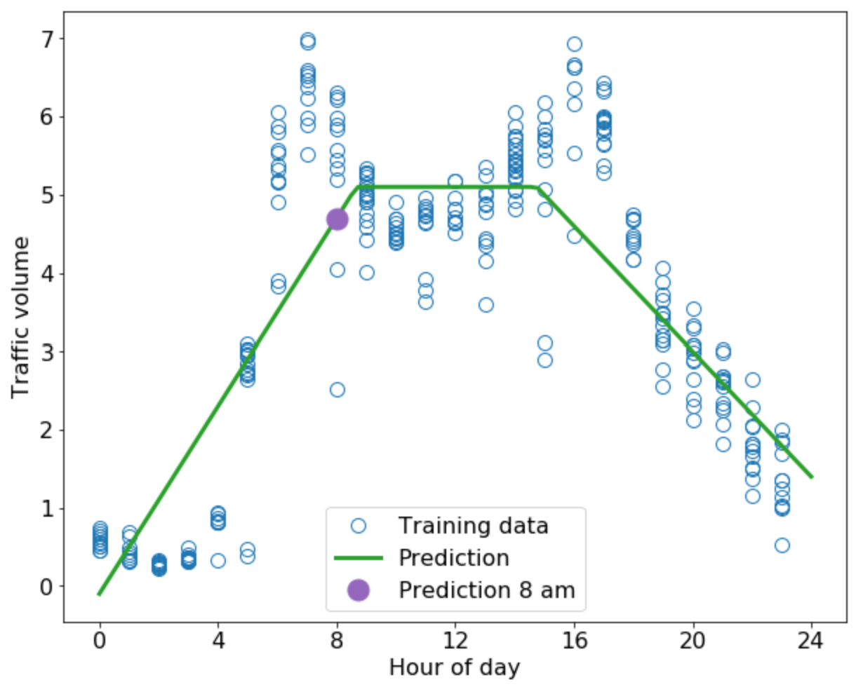






















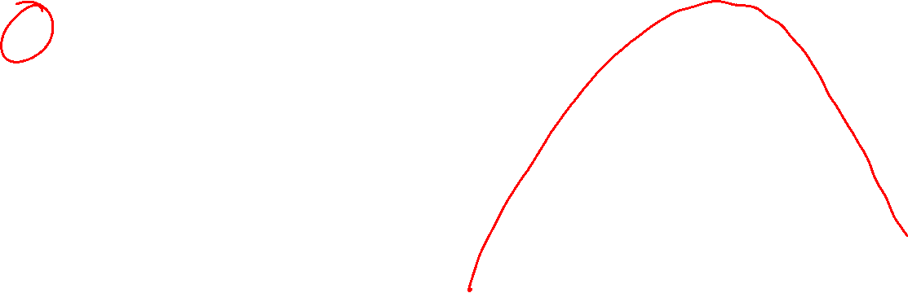





Traffic Data Example
Quadratic feature engineering vs three-neuron network
$$x1$$
$$w1$$
$$\hat{y}$$
$$∑$$
$${x_{1}^{2}→x}_{2}$$
$$w2$$
$$b$$
$$z_{1,1}$$
$$a_{1,1}$$
$$w_{1,1}$$
$$∑$$
$$g$$
$$w_{2,1}$$
$$x_{1}$$
$$b_{1,1}$$
$$\hat{y}$$
$$∑$$
$$w_{1,2}$$
$$z_{1,2}$$
$$a_{1,2}$$
$$w_{2,2}$$
$$b_{2,1}$$
$$∑$$
$$g$$
$$b_{1,2}$$

Slide 19


















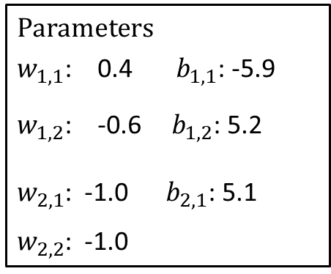



Traffic Data Example
Three-neuron Network
Three-neuron network
Parameters
$w_{1,1}$: 0.4 $b_{1,1}$: -5.9
$w_{1,2}$: -0.6 $b_{1,2}$: 5.2
$w_{2,1}$: -1.0 $b_{2,1}$: 5.1
$w_{2,2}$: -1.0
$$z_{1,1}$$
$$a_{1,1}$$
$$w_{1,1}$$
$$∑$$
$$g$$
$$w_{2,1}$$
$$x_{1}$$
$$b_{1,1}$$
$$\hat{y}$$
$$∑$$
$$z_{1,2}$$
$$b_{2,1}$$
$$ℓ$$
$$w_{1,2}$$
$$a_{1,2}$$
$$w_{2,2}$$
$$∑$$
$$g$$
$$y$$
$$b_{1,2}$$

Slide 20
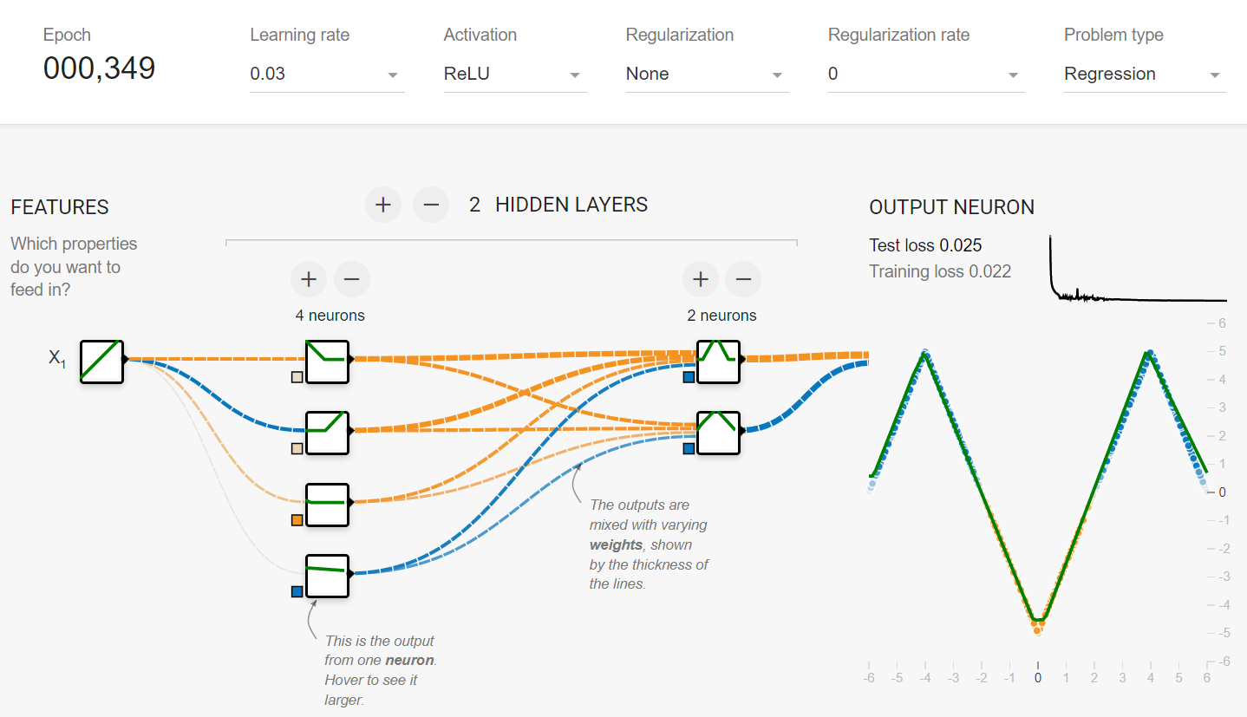
Exercise: Neural Net Regression: 1-D input
What is the smallest number of nodes you can use to perfectly fit the training data for the "M" dataset?
Tensor Flow Playground: 1-D Regression
https://playground.tensorflow.org/
https://www.cs.cmu.edu/~pvirtue/tfp

Slide 21
Neural Network Optimization

Slide 22
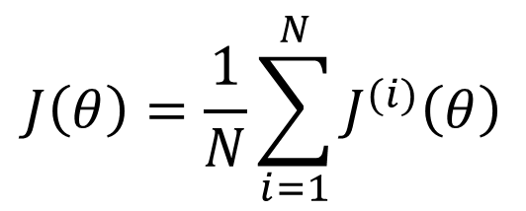
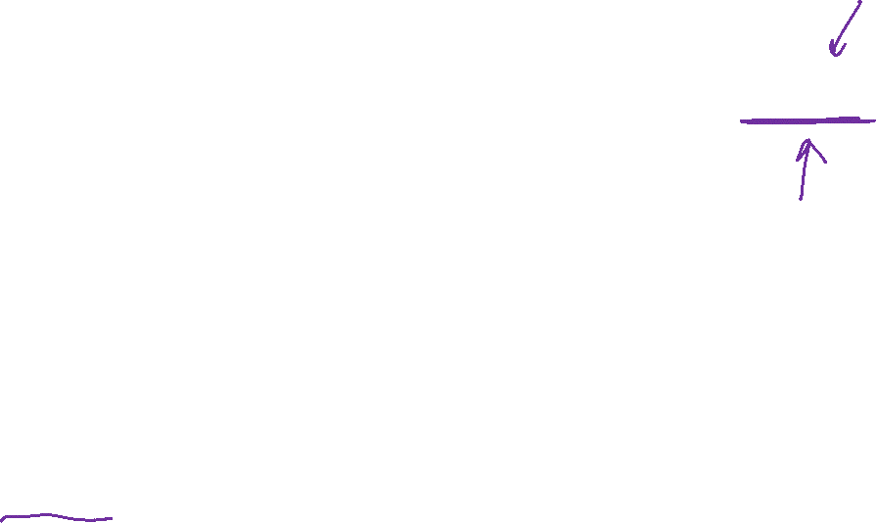
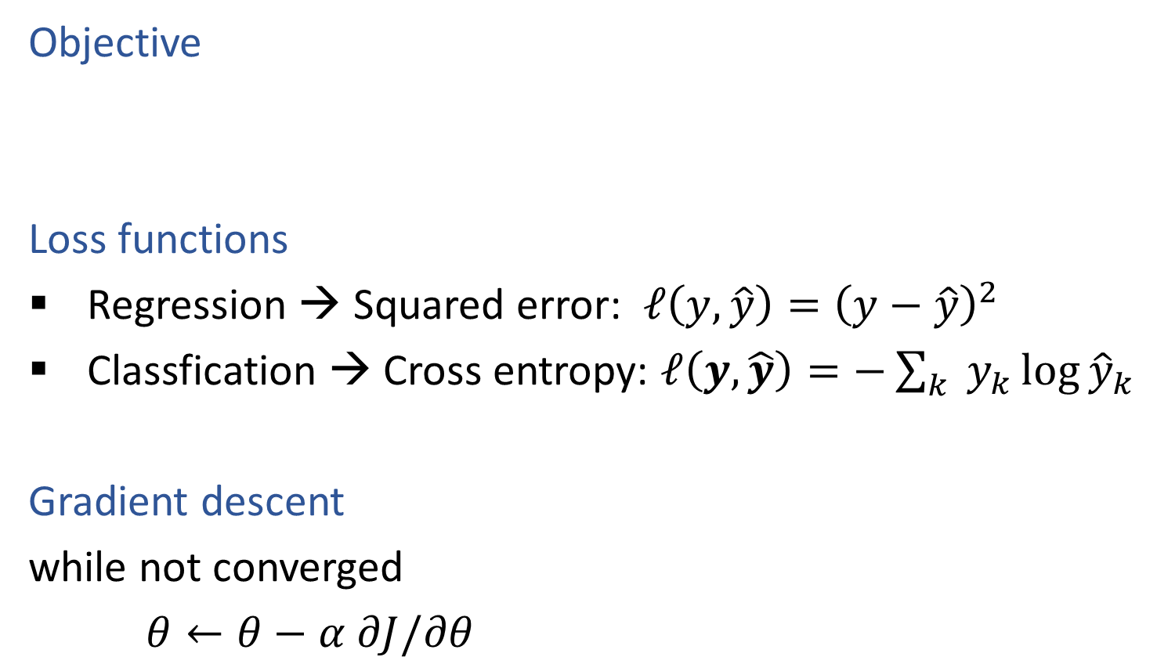


Objective, Loss Functions, Gradient Descent
Objective
Loss functions
Regression → Squared error: $ℓ\left(y, \hat{y}\right)={\left(y−\hat{y}\right)}^{2}$
Classfication → Cross entropy: $ℓ\left(y, \hat{y}\right)=−\sum_{k}{ y_{k}\log{{\hat{y}}_{k}}}$
Gradient descent
while not converged
$θ←θ−α ∂J/∂θ$
$$J\left(θ\right)=\frac{1}{N}\sum_{i=1}^{N}{J^{(i)}\left(θ\right)}$$
$$J^{(i)}\left(θ\right)=ℓ\left(y^{(i)}, {\hat{y}}^{(i)}\right)$$
$$\hat{y}=h(x;θ)$$

Slide 23
Reminder: Poll 2
How many total parameters?
$$z_{1,1}$$
$$a_{1,1}$$
$$w_{1,1}$$
$$∑$$
$$g$$
$$w_{2,1}$$
$$x_{1}$$
$$b_{1,1}$$
$$\hat{y}$$
$$∑$$
$$z_{1,2}$$
$$b_{2,1}$$
$$ℓ$$
$$w_{1,2}$$
$$a_{1,2}$$
$$w_{2,2}$$
$$∑$$
$$g$$
$$y$$
$$b_{1,2}$$

Slide 24









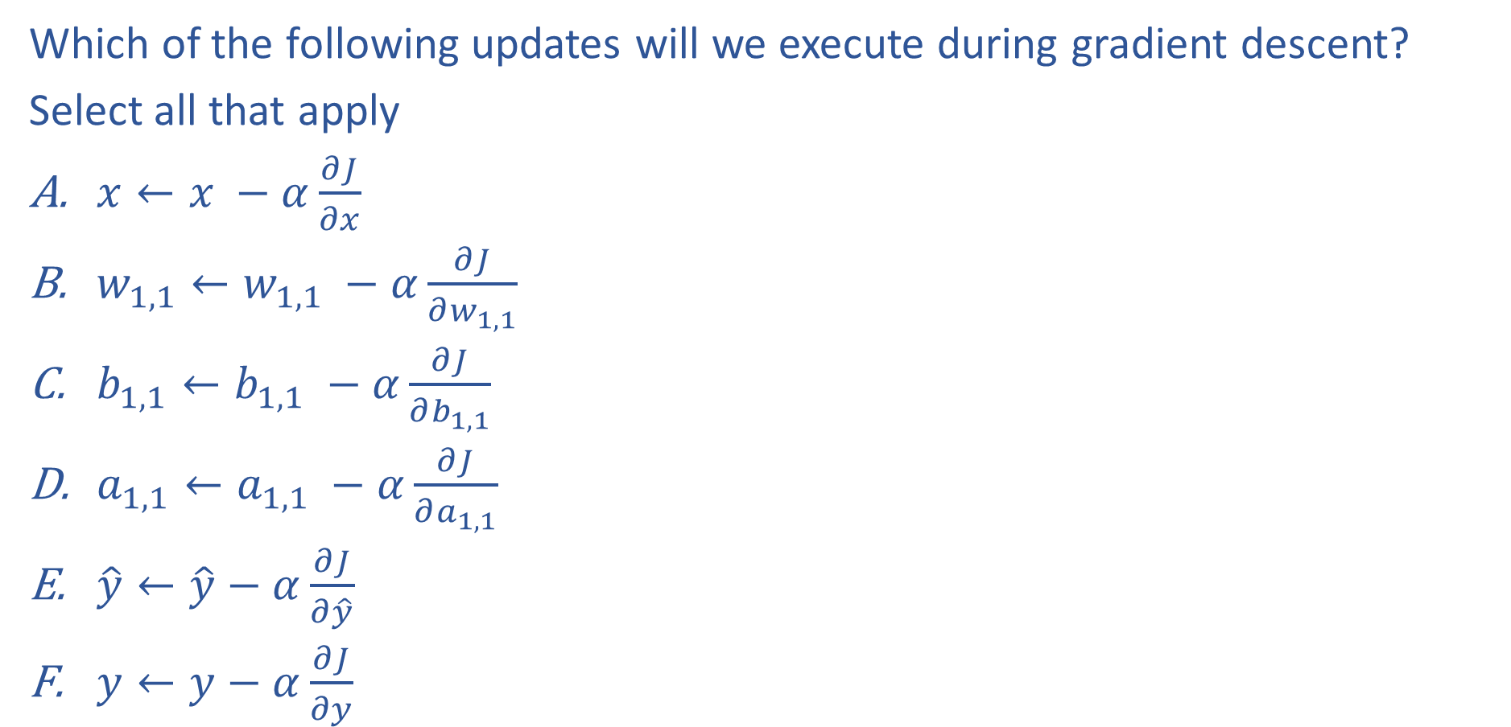













Poll 4
Which of the following updates will we execute during gradient descent?
Select all that apply
$x←x −α\frac{∂J}{∂x}$
$w_{1,1}←w_{1,1} −α\frac{∂J}{∂w_{1,1}}$
$b_{1,1}←b_{1,1} −α\frac{∂J}{∂b_{1,1}}$
$a_{1,1}←a_{1,1} −α\frac{∂J}{∂a_{1,1}}$
$\hat{y}←\hat{y}−α\frac{∂J}{∂\hat{y}}$
$y←y−α\frac{∂J}{∂y}$
$$z_{1,1}$$
$$a_{1,1}$$
$$w_{1,1}$$
$$∑$$
$$g$$
$$w_{2,1}$$
$$x_{1}$$
$$b_{1,1}$$
$$\hat{y}$$
$$∑$$
$$z_{1,2}$$
$$b_{2,1}$$
$$ℓ$$
$$w_{1,2}$$
$$a_{1,2}$$
$$w_{2,2}$$
$$∑$$
$$g$$
$$y$$
$$b_{1,2}$$

Slide 25


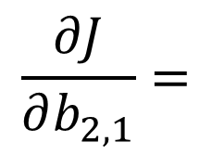





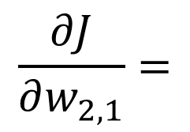









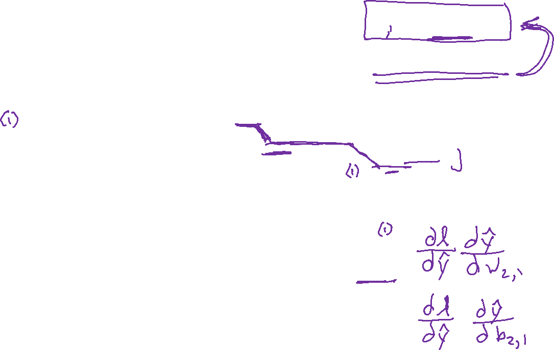






Optimization
$\hat{y}{=h}_{θ}\left(x\right)=$ $b_{2}+\sum_{j}{w_{2,j}{ a}_{1,j}}$
$$a_{1,j}=g\left(b_{1,j}+w_{1,j} x_{1}\right)$$
Three-neuron network
$$z_{1,1}$$
$$a_{1,1}$$
$$w_{1,1}$$
$$∑$$
$$g$$
$$w_{2,1}$$
$$x_{1}$$
$$b_{1,1}$$
$$\hat{y}$$
$$∑$$
$$z_{1,2}$$
$$b_{2,1}$$
$$ℓ$$
$$w_{1,2}$$
$$a_{1,2}$$
$$w_{2,2}$$
$$∑$$
$$g$$
$$y$$
$$b_{1,2}$$
$$\frac{∂J}{∂w_{2,1}}=$$
$$\frac{∂J}{∂b_{2,1}}=$$

Slide 26
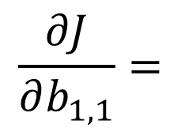
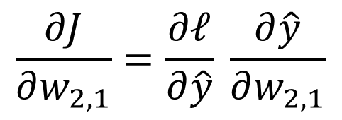

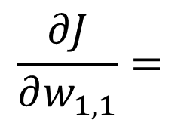
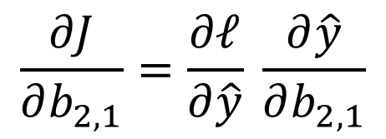
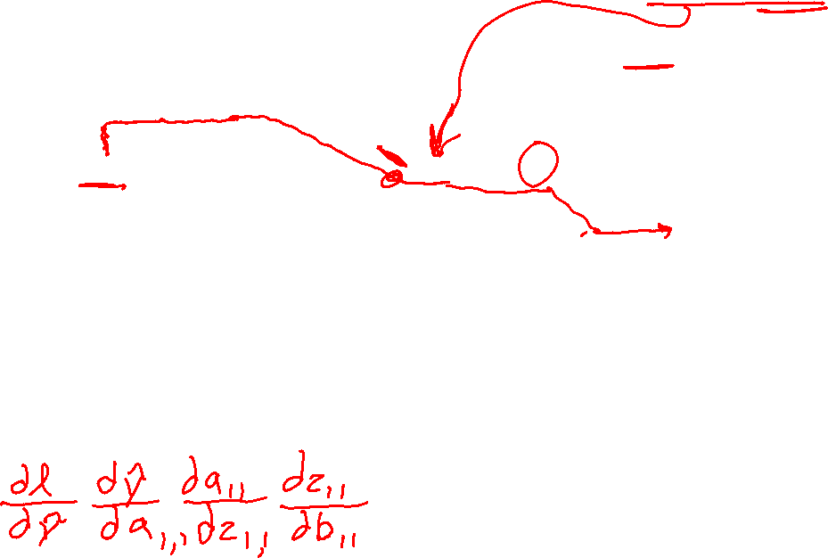
Optimization
$\hat{y}{=h}_{θ}\left(x\right)=$ $b_{2}+\sum_{j}{w_{2,j}{ a}_{1,j}}$
$$a_{1,j}=g\left(b_{1,j}+w_{1,j} x_{1}\right)$$
Three-neuron network
$$z_{1,1}$$
$$a_{1,1}$$
$$w_{1,1}$$
$$∑$$
$$g$$
$$w_{2,1}$$
$$x_{1}$$
$$b_{1,1}$$
$$\hat{y}$$
$$∑$$
$$z_{1,2}$$
$$b_{2,1}$$
$$ℓ$$
$$w_{1,2}$$
$$a_{1,2}$$
$$w_{2,2}$$
$$∑$$
$$g$$
$$y$$
$$b_{1,2}$$
$$\frac{∂J}{∂w_{1,1}}=$$
$$\frac{∂J}{∂w_{2,1}}=\frac{∂ℓ}{∂\hat{y}} \frac{∂\hat{y}}{∂w_{2,1}}$$
$$\frac{∂J}{∂b_{1,1}}=$$
$$\frac{∂J}{∂b_{2,1}}=\frac{∂ℓ}{∂\hat{y}} \frac{∂\hat{y}}{∂b_{2,1}}$$

Slide 27
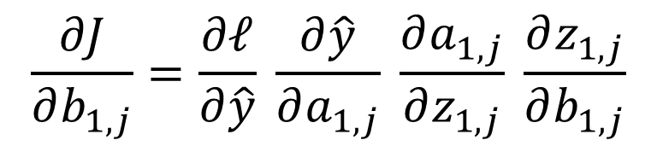
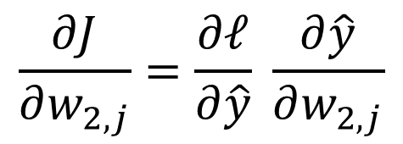
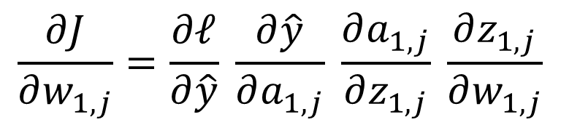

Optimization
$\hat{y}{=h}_{θ}\left(x\right)=$ $b_{2}+\sum_{j}{w_{2,j}{ a}_{1,j}}$
$$a_{1,j}=g\left(b_{1,j}+w_{1,j} x_{1}\right)$$
Three-neuron network
$$z_{1,1}$$
$$a_{1,1}$$
$$w_{1,1}$$
$$∑$$
$$g$$
$$w_{2,1}$$
$$x_{1}$$
$$b_{1,1}$$
$$\hat{y}$$
$$∑$$
$$z_{1,2}$$
$$b_{2,1}$$
$$ℓ$$
$$w_{1,2}$$
$$a_{1,2}$$
$$w_{2,2}$$
$$∑$$
$$g$$
$$y$$
$$b_{1,2}$$
$$\frac{∂J}{∂w_{1,j}}=\frac{∂ℓ}{∂\hat{y}} \frac{∂\hat{y}}{∂a_{1,j}} \frac{∂a_{1,j}}{∂z_{1,j}} \frac{∂z_{1,j}}{∂w_{1,j}}$$
$$\frac{∂J}{∂w_{2,j}}=\frac{∂ℓ}{∂\hat{y}} \frac{∂\hat{y}}{∂w_{2,j}}$$
$$\frac{∂J}{∂b_{1,j}}=\frac{∂ℓ}{∂\hat{y}} \frac{∂\hat{y}}{∂a_{1,j}} \frac{∂a_{1,j}}{∂z_{1,j}} \frac{∂z_{1,j}}{∂b_{1,j}}$$
$$\frac{∂J}{∂b_{2,1}}=\frac{∂ℓ}{∂\hat{y}} \frac{∂\hat{y}}{∂b_{2,1}}$$

Slide 28
Neural Net Forward Pass and
Backpropagation

Slide 29









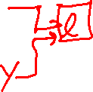









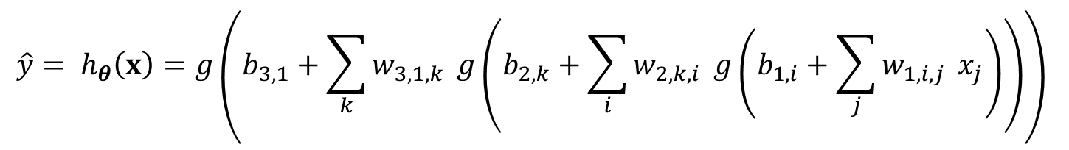
































Forward pass
Parameter naming conventions
$$w_{layer output input}$$
$$b_{layer output}$$
Predicting output from input
$$w111$$
$$z11$$
$$a11$$
$$x1$$
$$∑$$
$$g$$
$$w112$$
$$b11$$
$$w211$$
$$w113$$
$$z21$$
$$a21$$
$$w212$$
$$∑$$
$$g$$
$$w121$$
$$w311$$
$$b21$$
$$z31$$
$$w122$$
$$z12$$
$$a12$$
$$w213$$
$$a31=\hat{y}$$
$$x2$$
$$∑$$
$$g$$
$$∑$$
$$g$$
$$b12$$
$$w221$$
$$w123$$
$$w312$$
$$b31$$
$$z22$$
$$a22$$
$$w222$$
$$∑$$
$$g$$
$$w131$$
$$w132$$
$$w223$$
$$b22$$
$$z13$$
$$a13$$
$$x3$$
$$∑$$
$$g$$
$$w133$$
$$b13$$
$$\hat{y}= h_{θ}\left(x\right)=g\left(b_{3,1}+\sum_{k}{w_{3,1,k}} g\left(b_{2,k}+\sum_{i}{w_{2,k,i}} g\left(b_{1,i}+\sum_{j}{w_{1,i,j}} x_{j}\right)\right)\right)$$

Slide 30




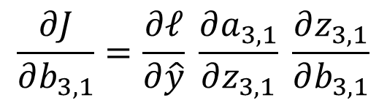





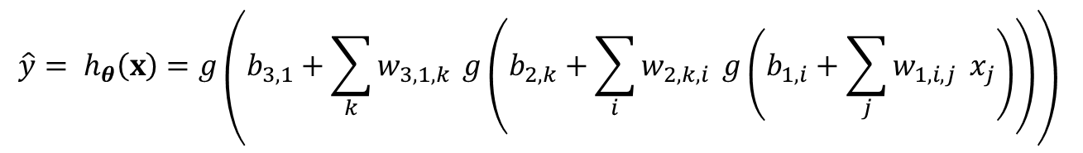





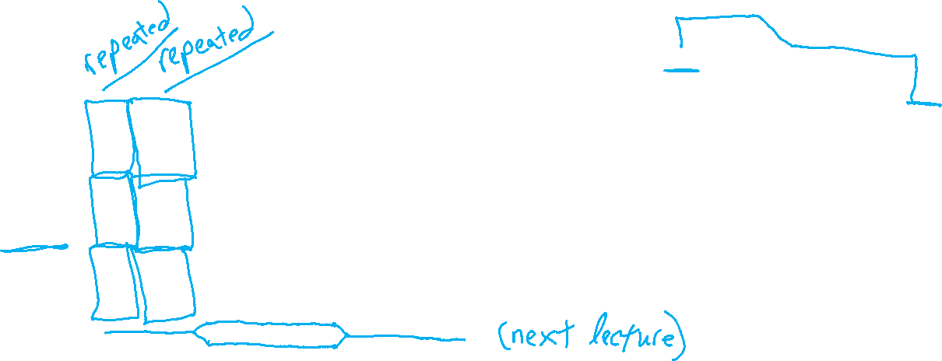
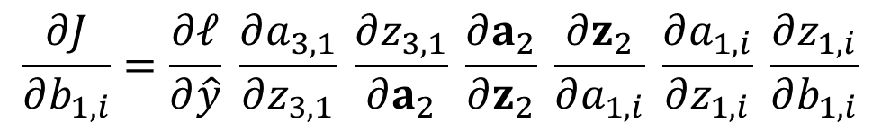


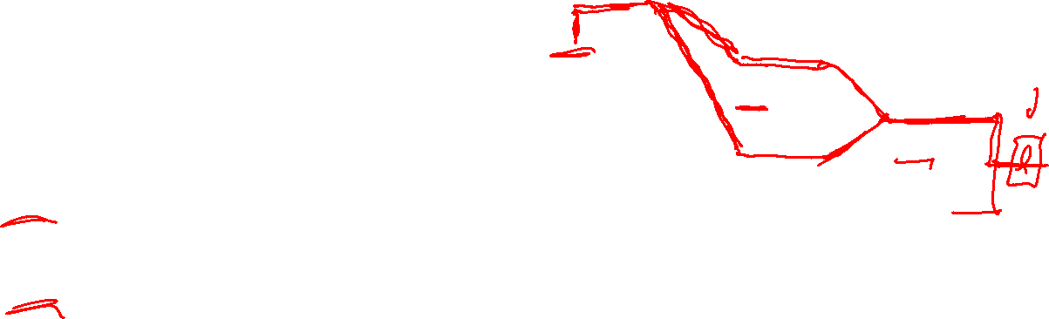


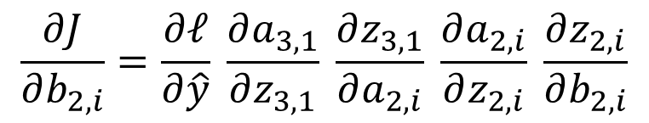




Optimization
$$\hat{y}= h_{θ}\left(x\right)=g\left(b_{3,1}+\sum_{k}{w_{3,1,k}} g\left(b_{2,k}+\sum_{i}{w_{2,k,i}} g\left(b_{1,i}+\sum_{j}{w_{1,i,j}} x_{j}\right)\right)\right)$$
Tons of repeated partial derivatives
$$x1$$
$$∑$$
$$g$$
$$b11$$
$$∑$$
$$g$$
$$b21$$
$$x2$$
$$∑$$
$$g$$
$$∑$$
$$g$$
$$b12$$
$$b31$$
$$\frac{∂J}{∂b_{3,1}}=\frac{∂ℓ}{∂\hat{y}} \frac{∂a_{3,1}}{∂z_{3,1}} \frac{∂z_{3,1}}{∂b_{3,1}}$$
$$∑$$
$$g$$
$$b22$$
$$x3$$
$$∑$$
$$g$$
$$\frac{∂J}{∂b_{2,i}}=\frac{∂ℓ}{∂\hat{y}} \frac{∂a_{3,1}}{∂z_{3,1}} \frac{∂z_{3,1}}{∂a_{2,i}} \frac{∂a_{2,i}}{∂z_{2,i}} \frac{∂z_{2,i}}{∂b_{2,i}}$$
$$b13$$
$$\frac{∂J}{∂b_{1,i}}=\frac{∂ℓ}{∂\hat{y}} \frac{∂a_{3,1}}{∂z_{3,1}} \frac{∂z_{3,1}}{∂a_{2}} \frac{∂a_{2}}{∂z_{2}} \frac{∂z_{2}}{∂a_{1,i}} \frac{∂a_{1,i}}{∂z_{1,i}} \frac{∂z_{1,i}}{∂b_{1,i}}$$

Slide 31
Forward Pass and Backpropagation
Scalar's version

Slide 32

























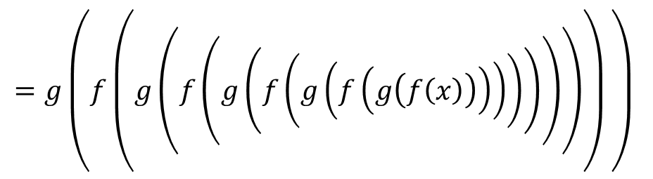






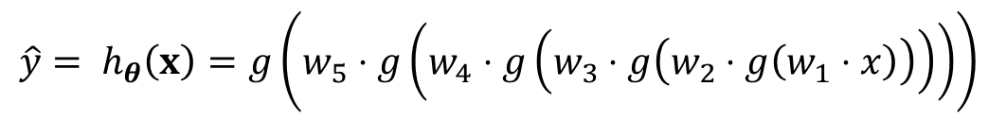
Forward Pass
Width 1 deep network (no bias) (dumb but will help with calculus)
$$y$$
$$x$$
$$z1$$
$$a1$$
$$z2$$
$$a2$$
$$z3$$
$$a3$$
$$z4$$
$$a4$$
$$z5$$
$$a5=\hat{y}$$
$$J$$
$$f$$
$$g$$
$$f$$
$$g$$
$$f$$
$$g$$
$$f$$
$$g$$
$$f$$
$$g$$
$$ℓ$$
$$w1$$
$$w2$$
$$w3$$
$$w4$$
$$w5$$
$$\hat{y}= h_{θ}\left(x\right)=g\left(w_{5}⋅g\left(w_{4}⋅g\left(w_{3}⋅g\left(w_{2}⋅g\left(w_{1}⋅x\right)\right)\right)\right)\right)$$
$$z_{ℓ}=f\left(w_{ℓ}, a_{ℓ−1}\right)=w_{ℓ}⋅a_{ℓ−1}$$
$$a_{ℓ}=g\left(z_{ℓ}\right)$$
$$=g\left(f\left(g\left(f\left(g\left(f\left(g\left(f\left(g\left(f\left(x\right)\right)\right)\right)\right)\right)\right)\right)\right) \right)$$

Slide 33
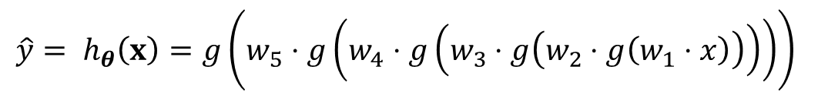
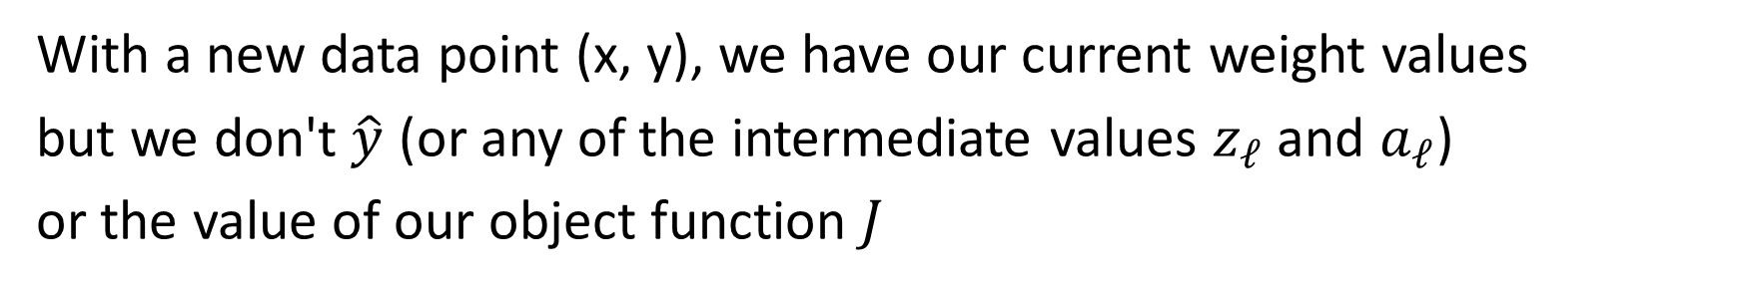
Forward Pass
$$\hat{y}= h_{θ}\left(x\right)=g\left(w_{5}⋅g\left(w_{4}⋅g\left(w_{3}⋅g\left(w_{2}⋅g\left(w_{1}⋅x\right)\right)\right)\right)\right)$$
Width 1 deep network (no bias) (dumb but will help with calculus)
$$y$$
$$x$$
$$z1$$
$$a1$$
$$z2$$
$$a2$$
$$z3$$
$$a3$$
$$z4$$
$$a4$$
$$z5$$
$$a5=\hat{y}$$
$$J$$
$$f$$
$$g$$
$$f$$
$$g$$
$$f$$
$$g$$
$$f$$
$$g$$
$$f$$
$$g$$
$$ℓ$$
$$w1$$
$$w2$$
$$w3$$
$$w4$$
$$w5$$
With a new data point (x, y), we have our current weight values
but we don't $\hat{y}$ (or any of the intermediate values $z_{ℓ}$ and $a_{ℓ}$)
or the value of our object function $J$

Slide 34
Forward Pass
$$\hat{y}= h_{θ}\left(x\right)=g\left(w_{5}⋅g\left(w_{4}⋅g\left(w_{3}⋅g\left(w_{2}⋅g\left(w_{1}⋅x\right)\right)\right)\right)\right)$$
Width 1 deep network (no bias) (dumb but will help with calculus)
$$y$$
$$x$$
$$f$$
$$g$$
$$f$$
$$g$$
$$f$$
$$g$$
$$f$$
$$g$$
$$f$$
$$g$$
$$ℓ$$
$$w1$$
$$w2$$
$$w3$$
$$w4$$
$$w5$$
With a new data point (x, y), we have our current weight values
but we don't $\hat{y}$ (or any of the intermediate values $z_{ℓ}$ and $a_{ℓ}$)
or the value of our object function $J$

Slide 35
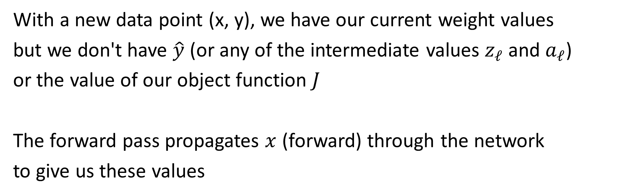
Forward Pass
$$\hat{y}= h_{θ}\left(x\right)=g\left(w_{5}⋅g\left(w_{4}⋅g\left(w_{3}⋅g\left(w_{2}⋅g\left(w_{1}⋅x\right)\right)\right)\right)\right)$$
Width 1 deep network (no bias) (dumb but will help with calculus)
$$y$$
$$x$$
$$z1$$
$$a1$$
$$z2$$
$$a2$$
$$z3$$
$$a3$$
$$z4$$
$$a4$$
$$z5$$
$$a5=\hat{y}$$
$$J$$
$$f$$
$$g$$
$$f$$
$$g$$
$$f$$
$$g$$
$$f$$
$$g$$
$$f$$
$$g$$
$$ℓ$$
$$w1$$
$$w2$$
$$w3$$
$$w4$$
$$w5$$
With a new data point (x, y), we have our current weight values
but we don't have $\hat{y}$ (or any of the intermediate values $z_{ℓ}$ and $a_{ℓ}$)
or the value of our object function $J$
The forward pass propagates $x$ (forward) through the network
to give us these values

Slide 36









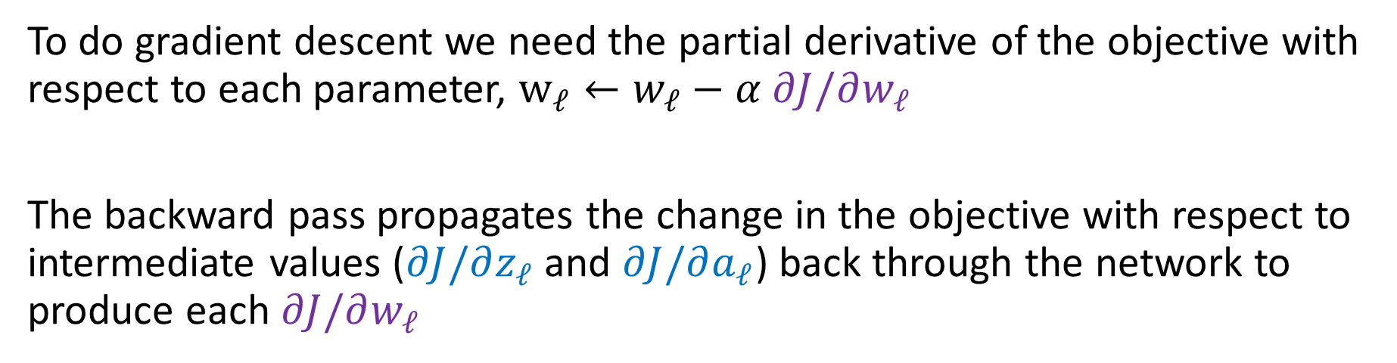







Backpropagation
$$\hat{y}= h_{θ}\left(x\right)=g\left(w_{5}⋅g\left(w_{4}⋅g\left(w_{3}⋅g\left(w_{2}⋅g\left(w_{1}⋅x\right)\right)\right)\right)\right)$$
Width 1 deep network (no bias) (dumb but will help with calculus)
$$\frac{∂J}{∂z_{1}}$$
$$\frac{∂J}{∂a_{1}}$$
$$\frac{∂J}{∂z_{2}}$$
$$\frac{∂J}{∂a_{2}}$$
$$\frac{∂J}{∂z_{3}}$$
$$\frac{∂J}{∂a_{3}}$$
$$\frac{∂J}{∂z_{4}}$$
$$\frac{∂J}{∂a_{4}}$$
$$\frac{∂J}{∂z_{5}}$$
$$\frac{∂J}{∂\hat{y}}$$
$$y$$
$$x$$
$$z1$$
$$a1$$
$$z2$$
$$a2$$
$$z3$$
$$a3$$
$$z4$$
$$a4$$
$$z5$$
$$a5=\hat{y}$$
$$J$$
$$f$$
$$g$$
$$f$$
$$g$$
$$f$$
$$g$$
$$f$$
$$g$$
$$f$$
$$g$$
$$ℓ$$
$$w1$$
$$w2$$
$$w3$$
$$w4$$
$$w5$$
$$\frac{∂J}{∂w_{1}}$$
$$\frac{∂J}{∂w_{2}}$$
$$\frac{∂J}{∂w_{3}}$$
$$\frac{∂J}{∂w_{4}}$$
$$\frac{∂J}{∂w_{5}}$$
To do gradient descent we need the partial derivative of the objective with respect to each parameter, $w_{ℓ}←w_{ℓ}−α ∂J/∂w_{ℓ}$
The backward pass propagates the change in the objective with respect to intermediate values ($∂J/∂z_{ℓ}$ and $∂J/∂a_{ℓ}$) back through the network to produce each $∂J/∂w_{ℓ}$

Slide 37
Additional Slides

Slide 38
Simple Network
What do the colors of the lines represent?
Weight
Value from previous neuron
https://playground.tensorflow.org/
https://www.cs.cmu.edu/~pvirtue/tfp

Slide 39
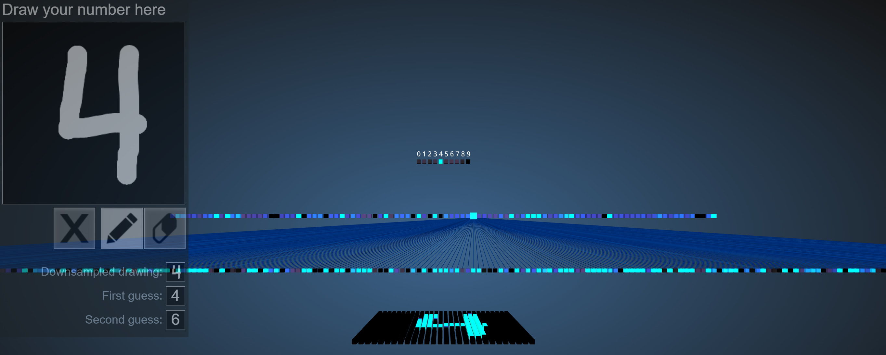
Image Classification
Demo of (Fully-connected) neural network to classify images of hand-written digits
https://adamharley.com/nn_vis/mlp/3d.html

Slide 40
Reminder: Image Classification
Demo of (Fully-connected) neural network to classify images of hand-written digits
https://adamharley.com/nn_vis/mlp/3d.html
Digit network
Output layer
10 neurons
Hidden layer 2
100 neurons
Hidden layer 1
300 neurons
Input
784 pixels

Slide 41
Image Classification
Demo of (Fully-connected) neural network to classify images of hand-written digits
https://adamharley.com/nn_vis/mlp/3d.html

Slide 42
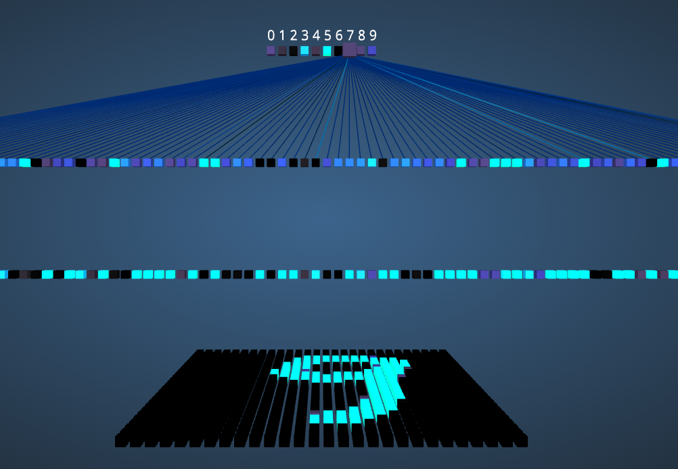
Poll
How many parameters does one neuron in the output layer have?
1
2
10
11
100
101
https://adamharley.com/nn_vis/mlp/3d.html

Slide 43
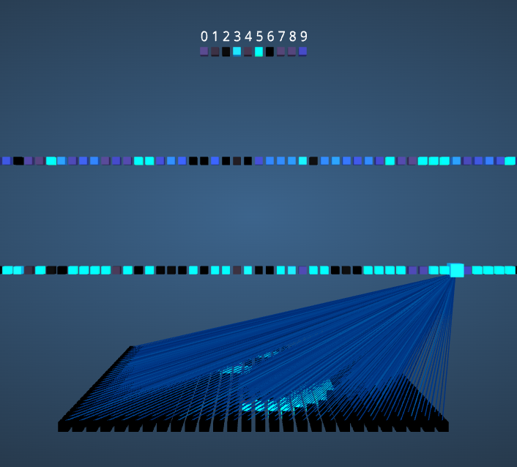
Poll
How many parameters does one neuron in the first hidden layer have?
1
2
300
301
784
785
https://adamharley.com/nn_vis/mlp/3d.html

Slide 44
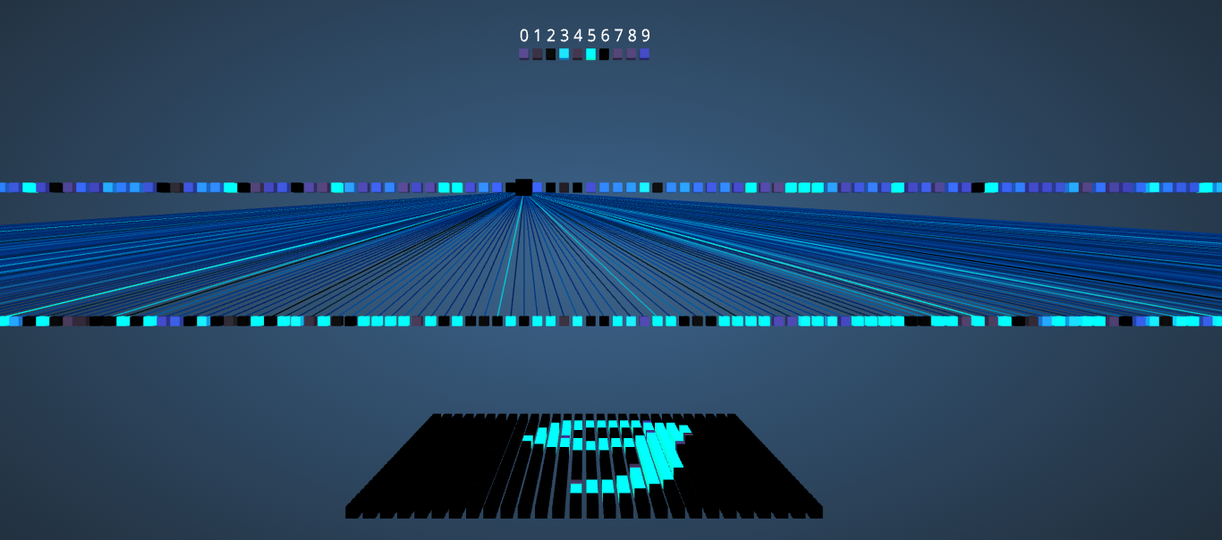
Poll
What do the colors of the lines represent?
Weight
Value from previous neuron
https://adamharley.com/nn_vis/mlp/3d.html

Slide 45
Poll
What do the colors of the neuron squares represent?
Weight
Output value of the neuron
Input value of the neuron
https://adamharley.com/nn_vis/mlp/3d.html

