Slide 1
Lecture 13:
UIMS Techniques:
Menu trees, Transition Networks, Grammars, Event Languages, HyperTalk, Production systems,
Declarative Languages
Brad Myers
05-830
Advanced User Interface Software

Slide 2
Announcements
Office hours
  Friday
  During Spring Break?
Homework 3 due date
  Postpone?
Homework 4 – constraints
  Now available
Pick topics
  Access the page?
  How decide which order?
  Some people haven’t picked yet

Slide 3
Overview
The term "User Interface Management System" associated with older systems that represent the dialog of the interface in a formal language.
Thus, most of the following UIMSs define a special (textual or graphical) language for programming the UI.
This is primarily only the input from the user to the computer, not the reverse.
  Human-human dialog is symmetric, but not computer-human dialogs
Original forms were: menu trees, transition networks, grammars, and events.
Issues: Formal range vs. effective range
  What can conceivably be represented vs. what is convenient and understandable.

Slide 4
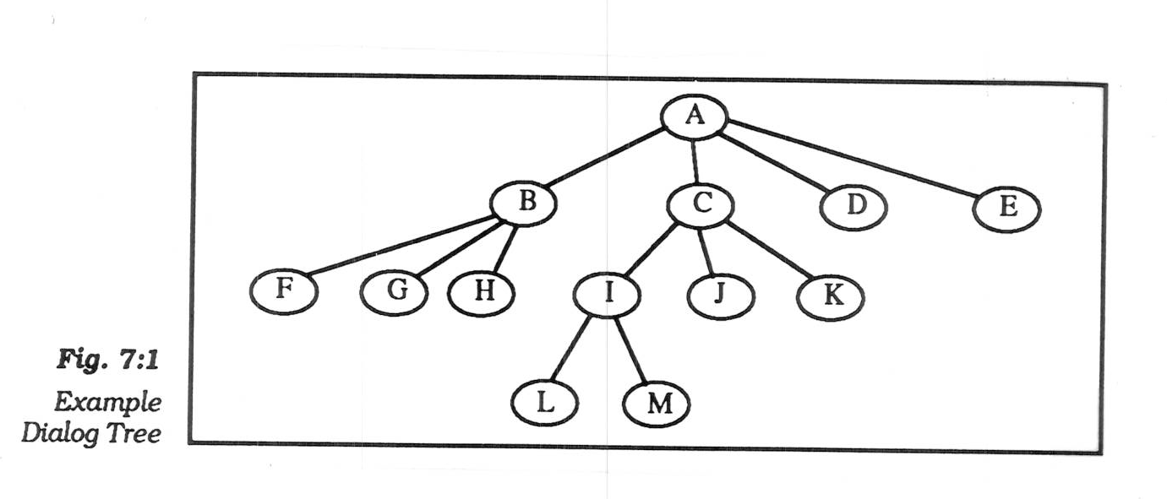
Menu Trees
Also called "Dialog Trees"
Hierarchy of menus
picture, Olsen UIMS book, p. 116 (Fig 7:1) (Dan R. Olsen, Jr., User Interface Management Systems: Models and Algorithms, Morgan Kaufmann, San Mateo, CA, 1992.)
Used in Kasik's "TIGER" UIMS, which was used for years to create Boeing's CAD tools (1982)
  Interface is "command-line style" with menus to choose the keywords
    Prefix
    Operator defines the parameters that will come
  Very large number of commands, e.g. 10 ways to draw a circle
  Special facilities for jumping around the tree, and doing the right semantic actions
  Aborting commands

Slide 5
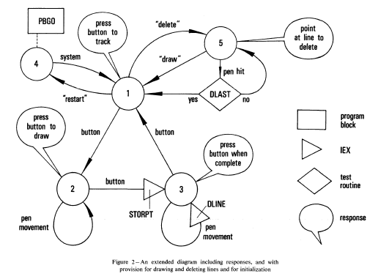
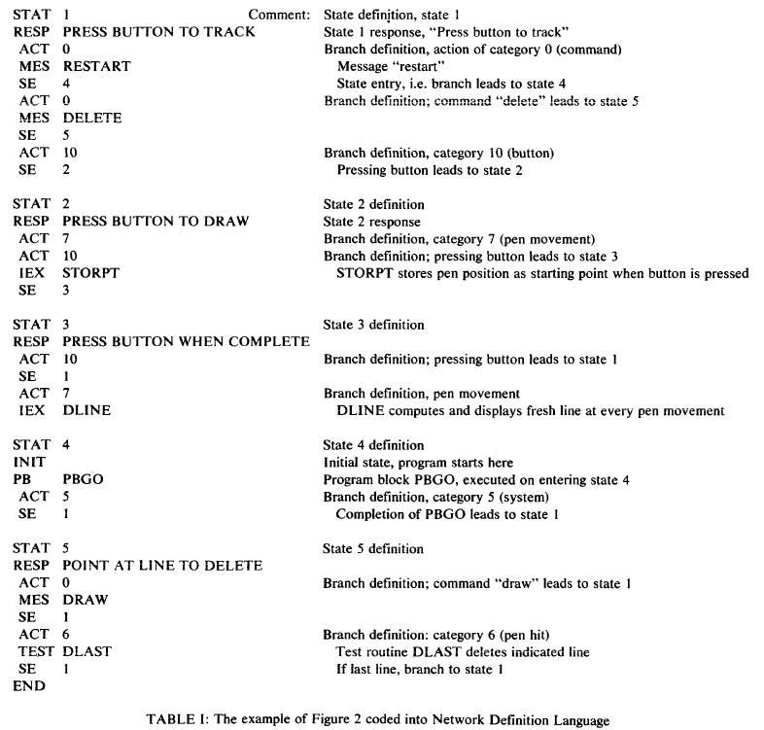
Transition Diagrams
Set of states and set of arcs.
Probably the earliest UIMS:
  William Newman's "Reaction Handler" in 1968 http://doi.acm.org/10.1145/1468075.1468083

Slide 6
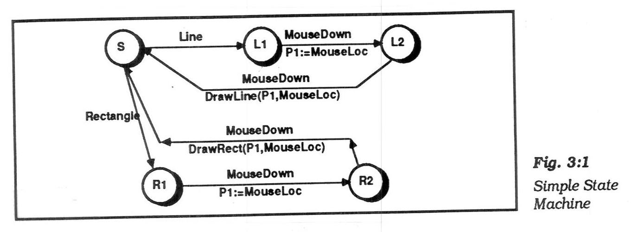
Transition Diagrams, cont.
Simplest form, arcs are user input events.
  arcs can be extended by listing feedback (output) and semantic actions on the arcs
  actions usually written in a conventional language (e.g. C)
  picture, Olsen, p. 37 (Fig 3:1)

Slide 7
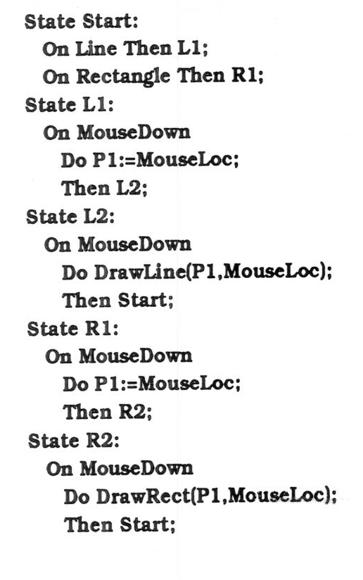
Transition Diagrams, cont.
Often, represented textually:
  picture, Olsen p. 38

Slide 8
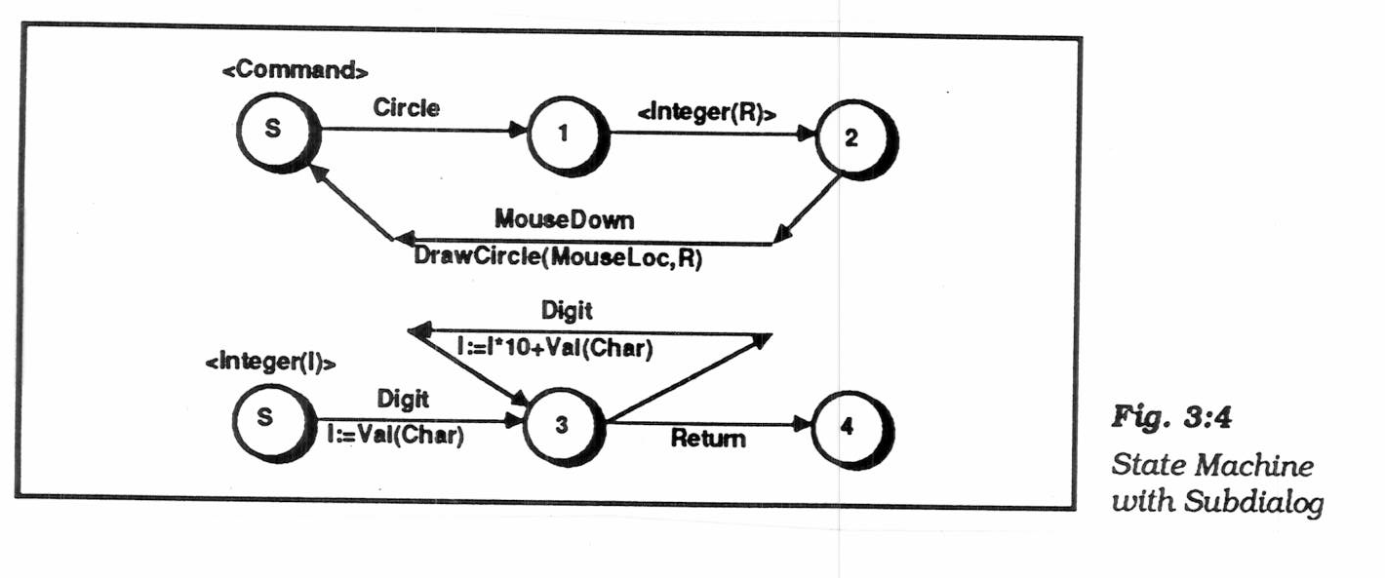
Transition Diagrams, cont.
Sub-diagrams
  To help modularize and simplify large networks
  if call themselves, then "recursive transition network"
    Picture Olsen, p. 41 (Fig 3:4)
  Problem: when to enter and leave the sub-dialog:
    don't want to use up a token

Slide 9
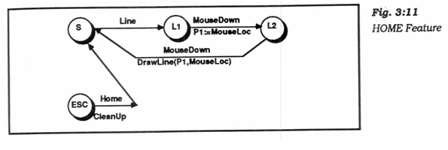
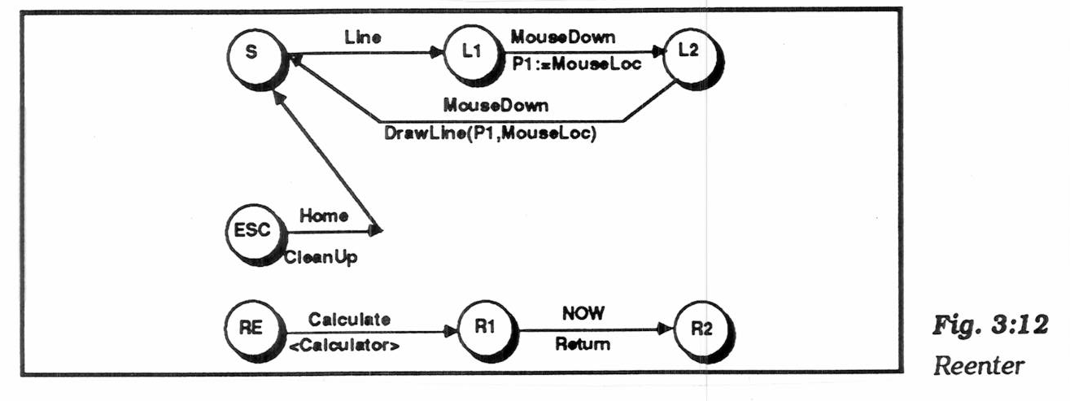
Transition Diagrams, cont.
"Pervasive states" to handle help, abort, undo, etc.
  "Escape" transitions to abort (permanently leave) a dialog
    picture, Olsen p. 53 (Fig 3:11)
  "Re-enter" sub-dialogs for temporary excursions that return to same place. E.g., help, use calculator, etc.
    picture, Olsen p. 55 (Fig 3:12)
  Transitions are taken if no specific arcs from node

Slide 10
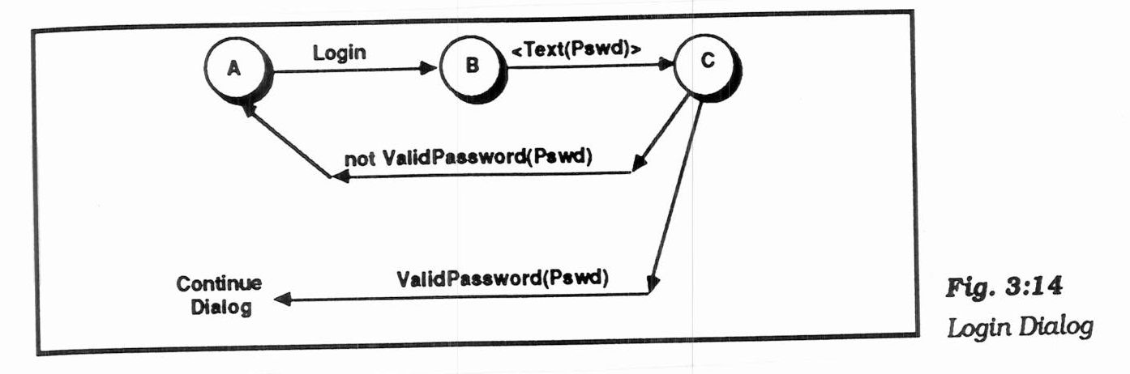
Transition Diagrams, cont.
"Augmented transition networks"
  local variables
  function on arcs can determine transitions
  "guards" determine whether transition is legal
  "conditional transitions" calculate where to go
    picture, Olsen p. 57 (Fig 3:14)
  upgrades the power to context-free-grammar

Slide 11
Transition Diagrams, cont.
Transition Networks, in general, used in various UIMSs:
  Research: Newman's "reaction handler", Jacob's RTN, Olsen's "Interactive Pushdown Automata", Stephen Oney’s Euclase, etc.
  Commercial: IDE's RAPID/USE,
  Virtual Prototypes's VAPS
  VAPS uses spreadsheet interface to the ATN
    Pictures

Slide 12
Transition Diagrams, evaluation
Good
  Make explicit the interpretation of all events in each state
  Emphasize the temporal sequence of user and system actions (unlike grammars)
  Natural and easily understood if small
    easy to teach, learn, and read
  Appropriate for some parts of GUIs: widget behaviors, dialog box transitions, etc.
  May be appropriate to model transitions around web sites

Slide 13
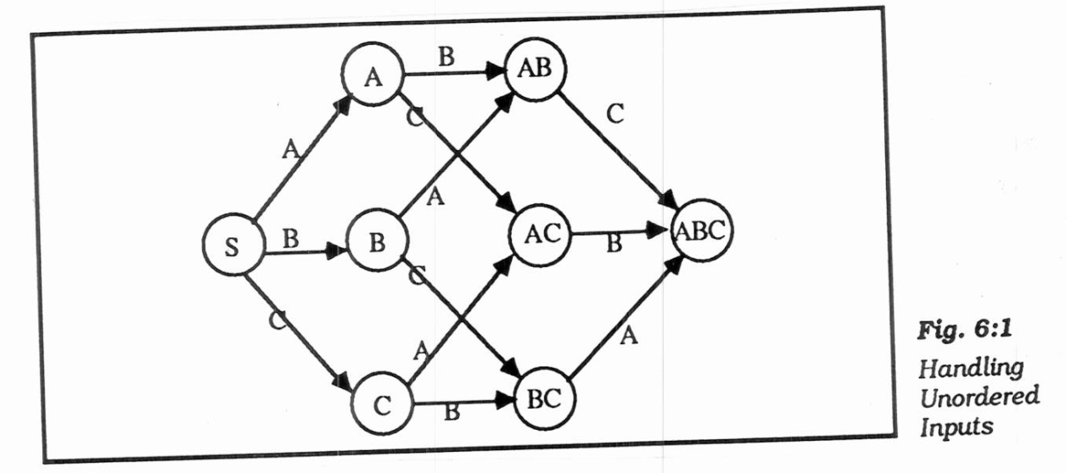
Transition Diagrams, evaluation
Bad
  Does not scale:
  150 commands with
  3 or 4 states each
    explosion of lines and
    states for normal interfaces: "maze of wires"
  unordered inputs
    picture, Olsen p. 91 (Fig 6:1)
  Textual form is like GOTO-based assembly language
  Communication through global variables
  Doesn't handle GUI mode-free style well
  What to do with un-specified input? crash, ignore input
  Doesn't address output

Slide 14
Grammars
Context-free grammars good for describing textual dialogs which have a formal syntax.
  “BNF” for languages (Backus–Naur Form)
  alphabet of symbols
  sentences - legal sequences of symbols
  language - set of all legal sentences
  grammar - set of terminals, set of non-terminals, set of productions, start symbol
  context-free-grammar: all productions of the form <a> ::= B where <a> is a single nontermimal, and B is a non-empty string of terminals and/or non-terminals
Notes:
Stopped here

Slide 15
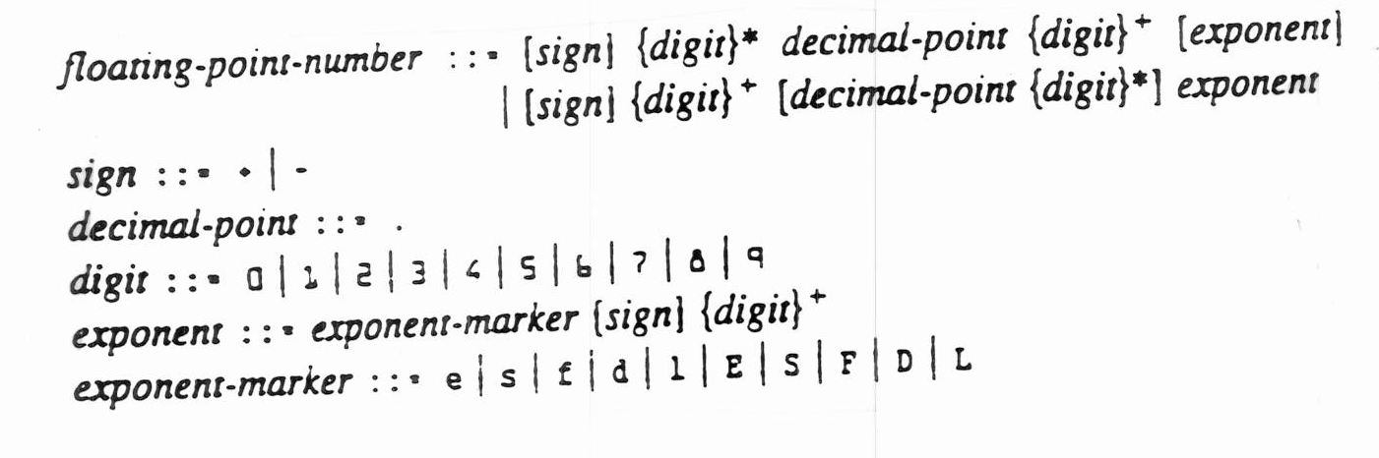
Grammars, cont.
Example: syntax of Lisp floating point numbers:
  picture, Lisp book, p 17
Non-terminals, terminals. Listed in order.
Iteration by recursion, unless support *, +
Essentially the same power as STNs, certainly ATNs.
Eliminates the need to specify a lot of states as in STN
Attach semantic actions to the parsing of non-terminals
  But not clear when processed: bottom-up or top-down
Used in only a few UIMSs:
  Olsen's "SYNGraph"
    special features for Undo and Cancel (Rubout)
  others using YACC+LEX

Slide 16
Grammars, evaluation
Good
  Handles complex dialogs
  Handles both lexical and syntactic levels
Bad
  Unintuitive for developer
  Hard to know where to attach semantic actions
  Bad error recovery: can't push forward looking for ";"
  Doesn't address output
  Doesn't handle GUI mode-free style well

Slide 17
Event Languages
Since get a stream of events from window manager, design a language where receiving events is the central paradigm.
Central theme: interface designed in terms of input events and visual objects, not internal states (modes) and syntax
Designed to handle multiple processes:
  Multiple input devices at the same time
  Multiple interaction techniques

Slide 18
Event Languages, cont.
Event Languages have
  Events: any action from the user or program
    input events: leftdown
    synthetic to control the program: modeDrawingLine
    usually have parameters, such as (X,Y) of event
  Event handlers: procedures to process events
    have an event that starts them and code that is executed.
    Code can compute, interface with the application, generate new events, change internal state, etc.
    Computation is arbitrary, so event languages have full power.

Slide 19
Event Languages, cont.
Sometimes called "production systems" since are similar to AI systems with "if -- then --" rules.
  Distinction: Where events are qualified with the object performed over.
Examples:
  Cardelli's Squeak (C)
    textual language for communicating with mice
  Flecchia & Bergeron's ALGAE (Pascal) 1987
  Hill's SASSAFRAS & ERL (lisp) 1986
  HyperCard's HyperTalk
  Martin Frank's EET

Slide 20
Event Response Language (ERL), in "Sassafras”
Hill RD. Supporting Concurrency, Communication and Synchronization in Human-Computer Interaction -- The Sassafras UIMS. ACM Transactions on Graphics. Jul, 1986 1986;5(3):179-210.
list of rules: condition -> action
conditions: name of an event + list of flags or just a list of flags.
action:
  flags to raise |
  events to send !
  assignments <-

Slide 21
Sassafras, example rules
1. MouseDown waitingForLine ->
StartLine.X <- MouseDown.X
StartLine.Y <- MouseDown.Y
StartLine!
lineDragging |
2. MouseDown waitingForCircle ->
CircleCenter.X <- MouseDown.X
CircleCenter.Y <- MouseDown.Y
CircleCenter!
circleDragging |
3. MouseUp circleDragging ->
EnterCircle.X <- MouseUp.X
EnterCircle.Y <- MouseUp.Y
EnterCircle!
waitingForCircle |

Slide 22
Sassafras, example rules
Note that CircleCenter! stores the center for EnterCenter
Another example (unordered inputs):
Command getCmd -> cmd |
Argument getArg -> arg |
- - - cmd arg -> Process!
waitProcessing |
DoneProcessing waitProcessing ->
getCmd |
getArg |
Note that more than one rule may fire

Slide 23
HyperTalk in HyperCard
(about 1988)
Define scripts to be executed on events
Attempts to be "English-like" but is a real programming language:
on mouseUp
global PreviousName
put field "Name" into PreviousName
PurgeName
end mouseUp
on PurgeName
put "???" into field "Name"
end PurgeName
"real" and synthetic events like Sassafras
Always interpreted, so was slow

Slide 24
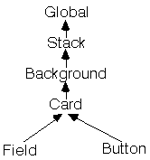
HyperTalk, cont.
Scripts can be associated with buttons, fields (text editing), cards, backgrounds, stacks, and global. Events given to the most specific first

Slide 25
Martin Frank's "Elements, Events & Transitions" (EET) Model
PhD, 1996, Georgia Tech
Define scripts to be executed on events
Per object, rather than global, handlers (like HyperTalk)

Slide 26
EET
"Transitions" happen on events:
Transition PropertiesButton.pressed()
{
PropertiesWindow.mapped := 1;
PropertiesButton.enabled := false;
}
Transition PropertiesCancelButton.pressed()
{
PropertiesWindow.mapped := 0;
PropertiesButton.enabled := true;
}

Slide 27
EET
Can be conditional on values of events:
Transition(*.isSelectable=="true").pressed()
{
self.color := "red";
}
  this transition invoked whenever a "press" event occurs on an element which has an "isSelectable" attribute with value equal "true"
  operates on all items of set that it applies to

Slide 28
EET
"Implicit" events generated for parameter values changing, lists change size, etc.
  for objects created, deleted or attributes changed
  Transition bb.changed(string attr == "selectedPins",
  int NewLength != 2)
  {
  connectButton.enabled := false;
  }
  Transition bb.changed(string attr == "selectedPins",
  int NewLength == 2)
  {
  connectButton.enabled := true;
  }
  button is enabled whenever the list in the bb element's selectedPins attribute is have length = 2
  like "active variables"
  can implement a form of constraints

Slide 29
EET
Programmer can "throw" events explicitly
Transition ((*.isAButton=="true") &&
(*.status =="enabled")).released()
{
throw self.invoke();
}
+ Advantage over ERL: events on objects, like HyperTalk
- Difficult to figure out meaning of the transitions (when they will fire)
- Flow of control hard to program and read

Slide 30
Event Languages, in General
Implementation: can be expensive if test every rule
  Can hash off input events
  Bit vector for flags so test if applicable is fast

Slide 31
Event Languages, Evaluation
+ Seems more natural for GUIs
+ Can handle multi-threaded dialogs
+ Greater descriptive power [Green86]
  Because conditions match any values for the unnamed states
+ More direct since deals with graphics and their events
- Difficult to write correct code since flow of control not local
- Hard to specify syntax: need to use synthetic events or flags
- Need to learn a new programming language
- Hard to understand code when it gets large
  Where is the handler for this message?
- Little (no?) separation UI code from application code
- Still communicating through global variables and semantics has to store temporary information
- Often no modularization: events and flags are global
- May not be good for recognition-based UIs of the future

Slide 32
Combined approach:
Jacob's event+ATN system
[Robert J.K. Jacob, "A Specification Language for Direct Manipulation Interfaces," ACM Transactions on Graphics, Oct, 1986, vol. 5, no. 4, pp. 283-317.]
Interfaces are highly moded, in that mouse button will have different actions in different places, and depending on global state
  but modes are highly visible and very quick
Conventional ATN for DM would be large, regular and uninformative
  also, remembered state in each widget, e.g. partial file name, item awaiting confirmation, etc.
  so "co-routines" are appropriate: suspended and resumed with remembered state
Define "interaction objects" that internally are programmed with state machines
"Events" are high level tokens, including location
All active interaction objects define event handlers and "executive" chooses the correct handler based on input event.
Evaluation: fundamentally, programmers generally prefer to program using textual languages.

Slide 33
Declarative Languages
For dialog boxes, forms and menus, just list the contents
But need to also list a lot of properties for each field
Used by
  CMU's COUSIN system (~1985), and
  Apollo's Domain/Dialog (later HP/Apollo's Open Dialog) ~1985-87.
  Html forms (to some extent)
Goals:
  less overall effort
  Better separation UI and application
  Multiple interfaces for same application
  Consistency since UI part uses same package

Slide 34
Declarative Languages, cont.
UI and application interface through "variables"
  Either can set or access
  Typed by the kind of data transmitted: string, integer, enumerated
"Domain Dialog" ("Open Dialog")
  Call-back attached to each variable
HTML is basically another example of this
  Also, Motif’s UIL, XUL, Microsoft’s XAML, Adobe’s MXML
  - Can be edited by users (in theory) for customization
Cousin (1985):
  Cousin supports push buttons, cycle buttons, text, table, windows
  Cousin sends to application a single event encoding the user's interaction, application must do dispatch
    different from callbacks on widgets

Slide 35
Cousin example
[
FormName: "File System Manager"
Purpose: "For browsing and managing files"
]
[
Name: "Sort by"
ValueType: String
DefaultValue: Name
InteractionMode: CycleButton
ChangeResponse: Active
EnumeratedValues: (Name, "Last Change Date", Size)
Purpose: "How the files should be sorted"
Location: 10, 40
]
[
Name: Files
ValueType: String
DefaultSource: NoDefault
MinNumber: 1
MaxNumber: 1000
InteractionMode: Table
NumColumns: 4
ChangeResponse: Passive
Purpose: "List of files found matching the spec"
Location: 10, 40
Size: 400, 100
]

Slide 36
Commercial Example
Apollo’s Open Dialog, 1987
  Pictures

Slide 37
Declarative, evaluation
+ Specify "what" not "how" = declarative
+ Good for "coarse grain" interaction (forms)
+ Programmer doesn't have to worry about time sequence of events
+ Separate UI from application -- communicate through variables
- Fixed interactions
- Can't deal with non-widgets: need to use "graphic areas" and program by hand
- Can't dynamically change interface based on application
- Can't express dependencies: this widget is enabled when that widget has specific value.
- Interactive tools are easier to use for widgets and their properties
  Motif's UIL or Microsoft Resource files designed to be written by such tools
  Visual Basic has an internal format like this: xxx.frm file
  XAML, MXML, html, etc. created by interactive tools
Next step: "Model-based" tools that take a specification of the contents and automatically decide on a layout, so fewer parameters have to be specified.

