Slide 1
Warm-up:
What is the relationship between number of constraints and number of possible solutions?
In other words, as the number of the constraints increases,
does the number of possible solutions:
Increase
Decrease
Stay the same

Slide 2
Announcements
Midterm 1 in one week!
Covering content through Monday Feb 17
Practice tests released, review Sunday 2-4pm in GHC 6115
HW4 Online and Written due tomorrow, Thursday Feb 13
HW5 Online out tomorrow Thursday Feb 13, due Feb 21
Programming 2 out now, due Feb 21

Slide 3

AI: Representation and Problem Solving
Propositional Logic and Logical Agents
Instructors: Tuomas Sandholm and Vincent Conitzer
Slide credits: CMU AI, http://ai.berkeley.edu

Slide 4
Logical Agents
Logical agents and environments
Agent
Environment
Percepts
Sensors
Knowledge Base
Inference
?
Actions
Actuators

Slide 5
Logical Agents
So what do we TELL our knowledge base (KB)?
Facts (sentences)
The grass is green
The sky is blue
Rules (sentences)
Eating too much candy makes you sick
When you’re sick you don’t go to school
Percepts and Actions (sentences)
Vince ate too much candy today
What happens when we ASK the agent?
Inference – new sentences created from old
Vince is not going to school today

Slide 6

Models
How do we represent possible worlds with models and knowledge bases?
How do we then do inference with these representations?

Slide 7
Logic Language
Natural language?
Propositional logic
Syntax: P ∨ (¬Q ∧ R); X₁ ⇔ (Raining ⇒ Sunny)
Possible world: {P=true, Q=true, R=false, S=true} or 1101
Semantics: α ∧ β is true in a world iff is α true and β is true (etc.)
First-order logic
Syntax: ∀x ∃y P(x,y) ∧ ¬Q(Joe,f(x)) ⇒ f(x)=f(y)
Possible world: Objects o₁, o₂, o₃; P holds for <o₁,o₂>; Q holds for <o₃>; f(o₁)=o₁; Joe=o₃; etc.
Semantics: φ(σ) is true in a world if σ=o_{j} and φ holds for o_{j}; etc.

Slide 8
Propositional Logic

Slide 9
Propositional Logic
Symbol:
Variables that can be true or false
We’ll try to use capital letters, e.g. A, B, P_{1,2}
Often include True and False
Operators:
¬ A: not A
A ∧ B: A and B (conjunction)
A ∨ B: A or B (disjunction) Note: this is not an “exclusive or”
A ⇒ B: A implies B (implication). If A then B
A ⇔ B: A if and only if B (biconditional)
Sentences

Slide 10
Propositional Logic Syntax
Given: a set of proposition symbols {X₁, X₂, …, X_{n}}
(we often add True and False for convenience)
X_{i} is a sentence
If α is a sentence then ¬α is a sentence
If α and β are sentences then α ∧ β is a sentence
If α and β are sentences then α ∨ β is a sentence
If α and β are sentences then α ⇒ β is a sentence
If α and β are sentences then α ⇔ β is a sentence
And p.s. there are no other sentences!

Slide 11
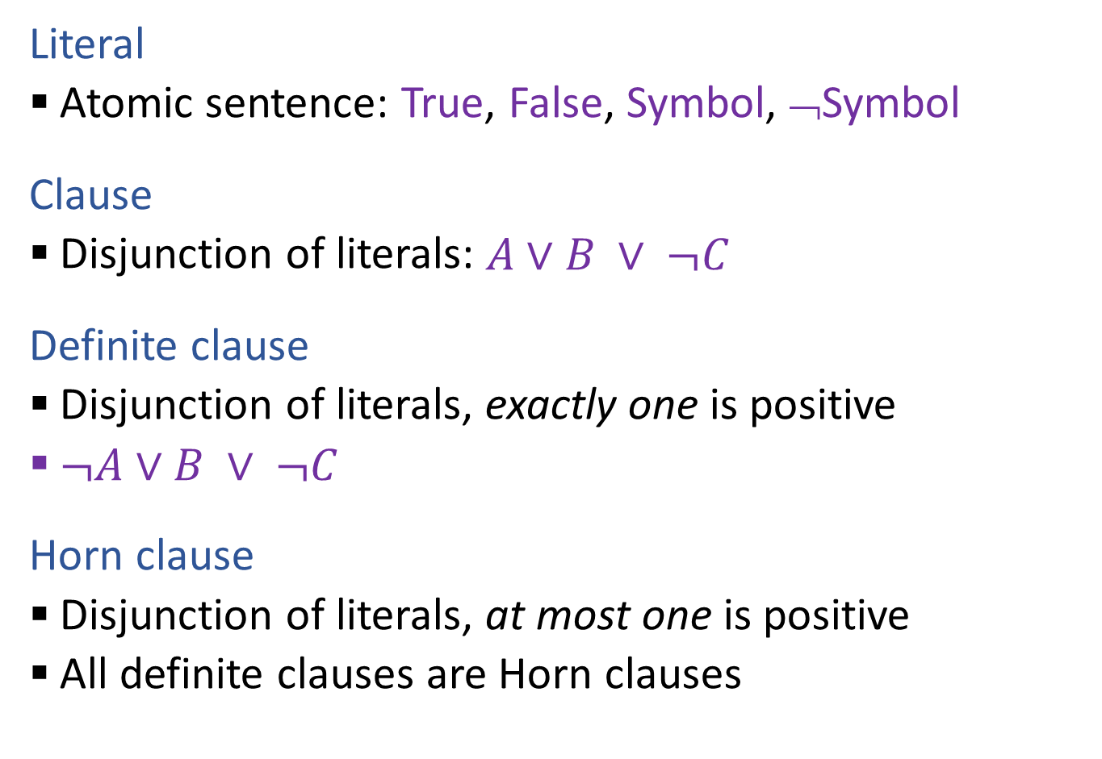
Propositional Logical Vocab
Literal
Atomic sentence: True, False, Symbol, ¬Symbol
Clause
Disjunction of literals: $A∨B ∨ ¬C$
Definite clause
Disjunction of literals, exactly one is positive
$¬A∨B ∨ ¬C$
Horn clause
Disjunction of literals, at most one is positive
All definite clauses are Horn clauses
Vocab Alert!

Slide 12
Notes on Operators
𝛂 ∨ 𝛃 is inclusive or, not exclusive

Slide 13
Truth Tables
𝛂 ∨ 𝛃 is inclusive or, not exclusive
𝛂 | 𝛃 | 𝛂 ∧ 𝛃
F | F | F
F | T | F
T | F | F
T | T | T
𝛂 | 𝛃 | 𝛂 ∨ 𝛃
F | F | F
F | T | T
T | F | T
T | T | T

Slide 14
Notes on Operators
𝛂 ∨ 𝛃 is inclusive or, not exclusive
𝛂 ⇒ 𝛃 is equivalent to ¬𝛂 ∨ 𝛃
Says who?

Slide 15
Truth Tables
𝛂 ⇒ 𝛃 is equivalent to ¬𝛂 ∨ 𝛃
𝛂 | 𝛃 | 𝛂 ⇒ 𝛃 | ¬𝛂 | ¬𝛂 ∨ 𝛃
F | F | T | T | T
F | T | T | T | T
T | F | F | F | F
T | T | T | F | T

Slide 16
Notes on Operators
𝛂 ∨ 𝛃 is inclusive or, not exclusive
𝛂 ⇒ 𝛃 is equivalent to ¬𝛂 ∨ 𝛃
Says who?
𝛂 ⇔ 𝛃 is equivalent to (𝛂 ⇒ 𝛃) ∧ (𝛃 ⇒ 𝛂)
Prove it!

Slide 17
Truth Tables
𝛂 ⇔ 𝛃 is equivalent to (𝛂 ⇒ 𝛃) ∧ (𝛃 ⇒ 𝛂)
𝛂 | 𝛃 | 𝛂 ⇔ 𝛃 | 𝛂 ⇒ 𝛃 | 𝛃 ⇒ 𝛂 | (𝛂⇒𝛃) ∧ (𝛃⇒𝛂)
F | F | T | T | T | T
F | T | F | T | F | F
T | F | F | F | T | F
T | T | T | T | T | T
Equivalence: it’s true in all models. Expressed as a logical sentence:
(𝛂 ⇔ 𝛃) ⇔ [(𝛂 ⇒ 𝛃) ∧ (𝛃 ⇒ 𝛂)]

Slide 18
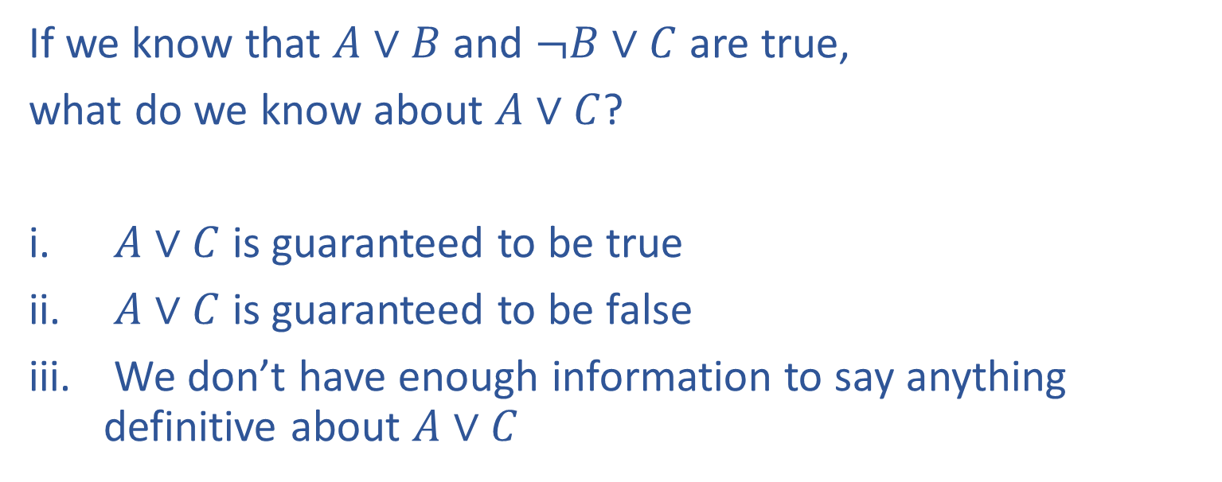
Poll 1
If we know that $A∨B$ and $¬B∨C$ are true,
what do we know about $A∨C$?
$A∨C$ is guaranteed to be true
$A∨C$ is guaranteed to be false
We don’t have enough information to say anything definitive about $A∨C$

Slide 19
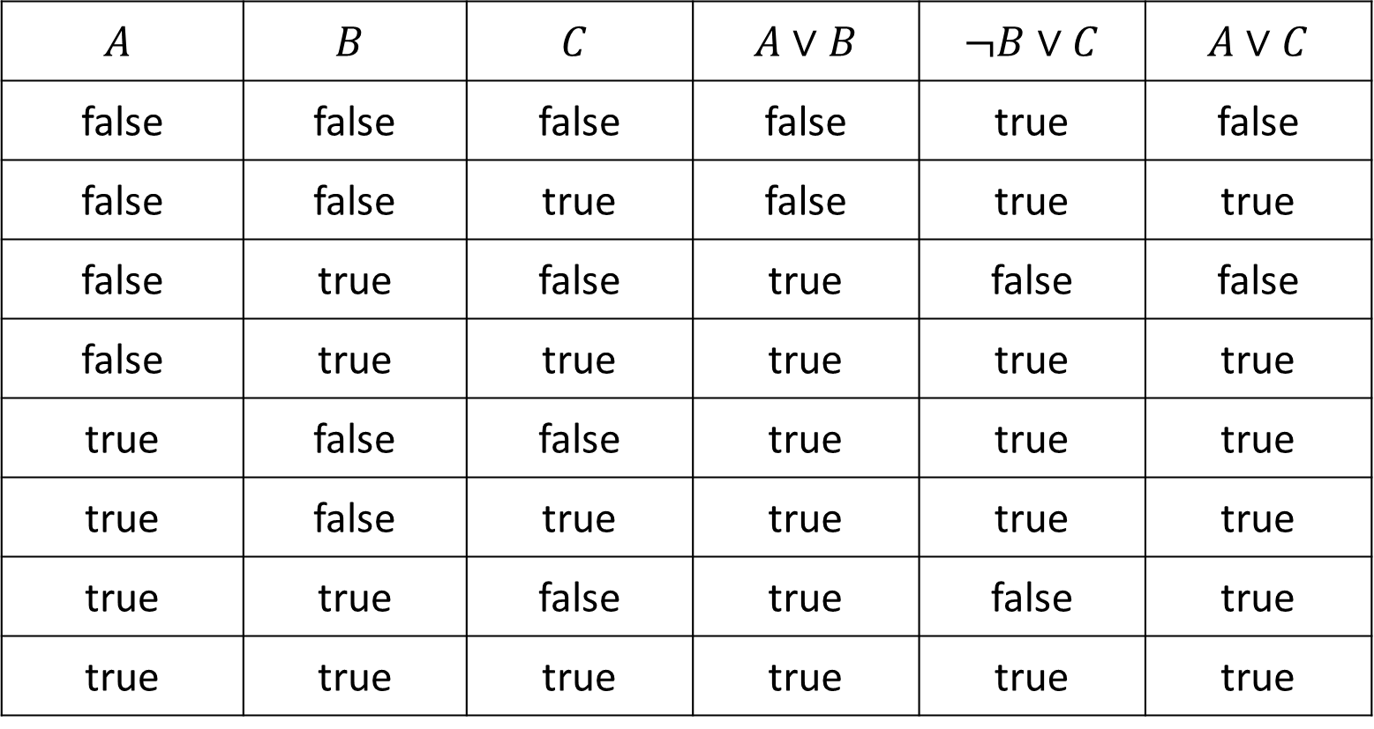
Poll 1
If we know that $A∨B$ and $¬B∨C$ are true, what do we know about $A∨C$?
$$A$$ | $$B$$ | $$C$$ | $A∨B$ | $¬B∨C$ | $A∨C$
false | false | false | false | true | false
false | false | true | false | true | true
false | true | false | true | false | false
false | true | true | true | true | true
true | false | false | true | true | true
true | false | true | true | true | true
true | true | false | true | false | true
true | true | true | true | true | true

Slide 20
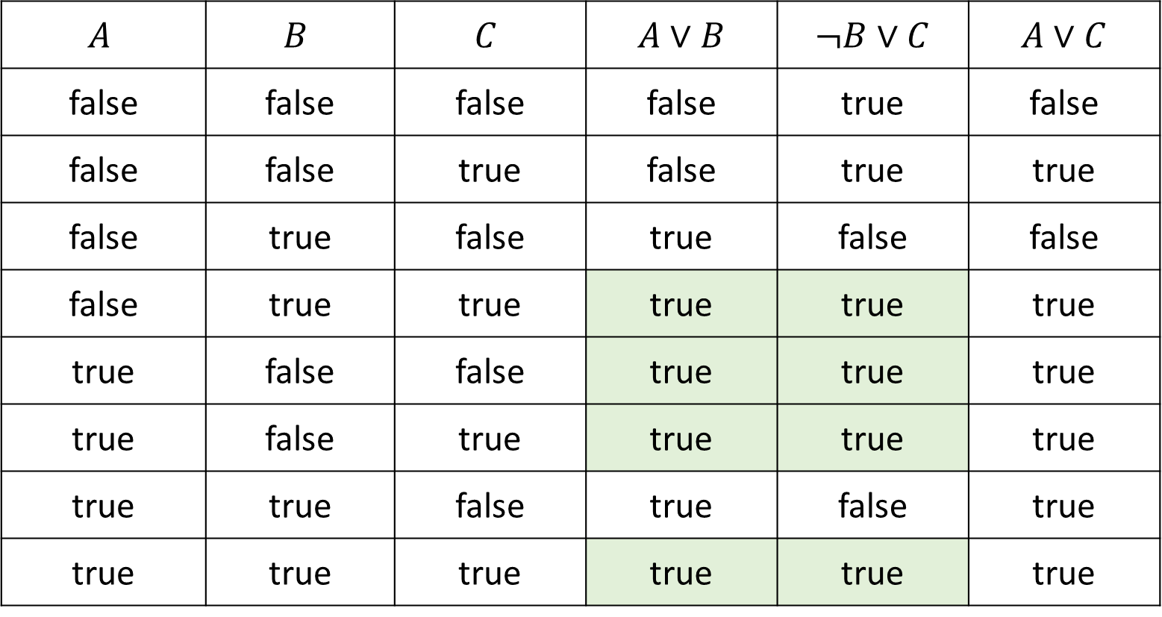
Poll 1
If we know that $A∨B$ and $¬B∨C$ are true, what do we know about $A∨C$?
$$A$$ | $$B$$ | $$C$$ | $A∨B$ | $¬B∨C$ | $A∨C$
false | false | false | false | true | false
false | false | true | false | true | true
false | true | false | true | false | false
false | true | true | true | true | true
true | false | false | true | true | true
true | false | true | true | true | true
true | true | false | true | false | true
true | true | true | true | true | true

Slide 21
Poll 1
If we know that $A∨B$ and $¬B∨C$ are true,
what do we know about $A∨C$?
$A∨C$ is guaranteed to be true
$A∨C$ is guaranteed to be false
We don’t have enough information to say anything definitive about $A∨C$

Slide 22
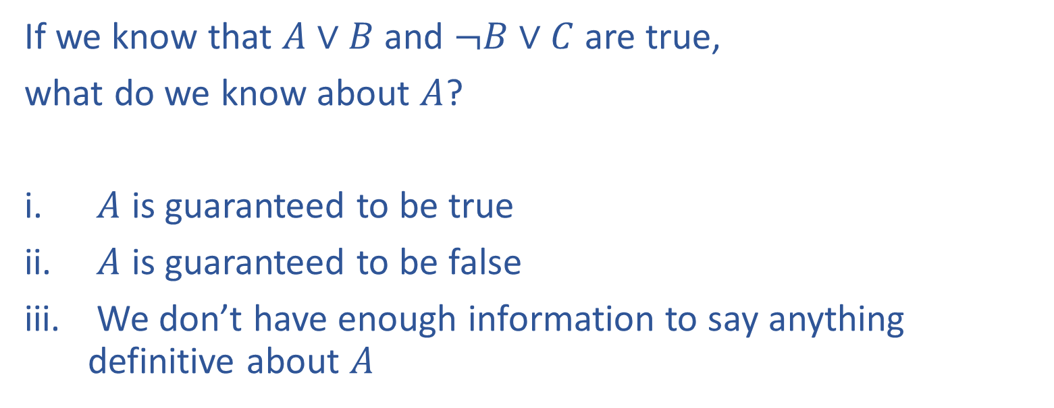
Poll 2
If we know that $A∨B$ and $¬B∨C$ are true,
what do we know about $A$?
$A$ is guaranteed to be true
$A$ is guaranteed to be false
We don’t have enough information to say anything definitive about $A$

Slide 23
Poll 2
If we know that $A∨B$ and $¬B∨C$ are true, what do we know about $A$?
$$A$$ | $$B$$ | $$C$$ | $A∨B$ | $¬B∨C$ | $A∨C$
false | false | false | false | true | false
false | false | true | false | true | true
false | true | false | true | false | false
false | true | true | true | true | true
true | false | false | true | true | true
true | false | true | true | true | true
true | true | false | true | false | true
true | true | true | true | true | true

Slide 24
Poll 2
If we know that $A∨B$ and $¬B∨C$ are true,
what do we know about $A$?
$A$ is guaranteed to be true
$A$ is guaranteed to be false
We don’t have enough information to say anything definitive about $A$

Slide 25
Logic Representation of World Models
Knowledge Base of things we know to be true (logical sentences):
P ∨ (¬Q ∧ R); X₁ ⇔ (Raining ⇒ Sunny)
Possible world model (assignment of variables to values):
{P=true, Q=true, R=false, S=true} or 1101
Semantics: α ∧ β is true in a world iff is α true and β is true (etc.)

Slide 26
Propositional Logic
Check if sentence is true in given model
In other words, does the model satisfy the sentence?
function PL-TRUE?(α,model) returns true or false
if α is a symbol then return Lookup(α, model)
if Op(α) = ¬ then return not(PL-TRUE?(Arg1(α),model))
if Op(α) = ∧ then return and(PL-TRUE?(Arg1(α),model),
PL-TRUE?(Arg2(α),model))
etc.
(Sometimes called “recursion over syntax”)

Slide 27
Warm-up:
What is the relationship between number of constraints and number of possible solutions?
In other words, as the number of the constraints increases,
does the number of possible solutions:
Increase
Decrease
Stay the same
Where is the knowledge in our CSPs?
Notes:
0=7, R=4, W=6, U=2, T=8, F=1; 867 + 867 = 1734

Slide 28
Question
What is the relationship between the size of the knowledge base and number of satisfiable models?
In other words, as the number of the knowledge base rules increases,
does the number of satisfiable models:
Increase
Decrease
Stay the same
Notes:
0=7, R=4, W=6, U=2, T=8, F=1; 867 + 867 = 1734

Slide 29
Sentences as Constraints
Adding a sentence to our knowledge base constrains the
number of possible models:
KB: Nothing
Possible
Models
P | Q | R
false | false | false
false | false | true
false | true | false
false | true | true
true | false | false
true | false | true
true | true | false
true | true | true

Slide 30
Sentences as Constraints
Adding a sentence to our knowledge base constrains the
number of possible models:
KB: Nothing
KB: [(P ∧ ¬Q) ∨ (Q ∧ ¬P)] ⇒ R
Possible
Models
P | Q | R
false | false | false
false | false | true
false | true | false
false | true | true
true | false | false
true | false | true
true | true | false
true | true | true

Slide 31
Sentences as Constraints
Adding a sentence to our knowledge base constrains the
number of possible models:
KB: Nothing
KB: [(P ∧ ¬Q) ∨ (Q ∧ ¬P)] ⇒ R
KB: R, [(P ∧ ¬Q) ∨ (Q ∧ ¬P)] ⇒ R
Possible
Models
P | Q | R
false | false | false
false | false | true
false | true | false
false | true | true
true | false | false
true | false | true
true | true | false
true | true | true

Slide 32
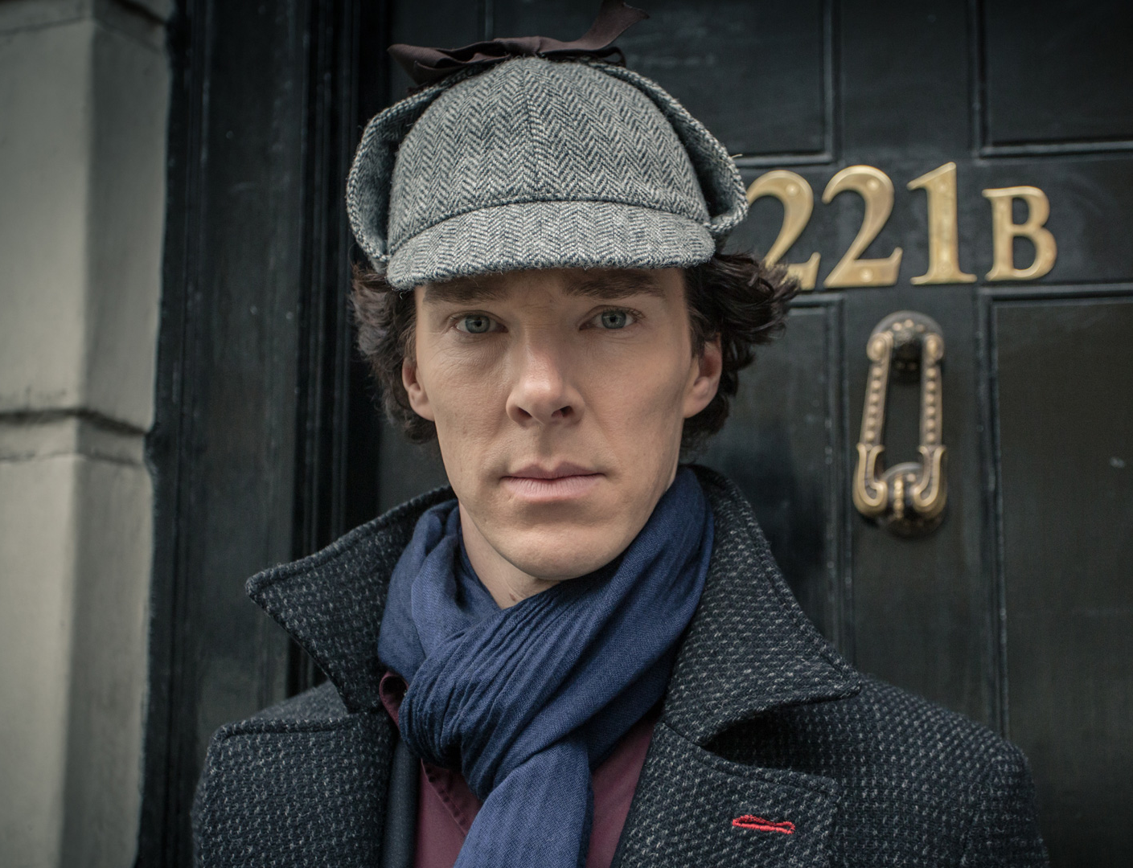
Sherlock Entailment
“When you have eliminated the impossible, whatever remains, however improbable, must be the truth” – Sherlock Holmes via Sir Arthur Conan Doyle
Knowledge base and inference allow us to remove impossible models, helping us to see what is true in all of the remaining models

Slide 33
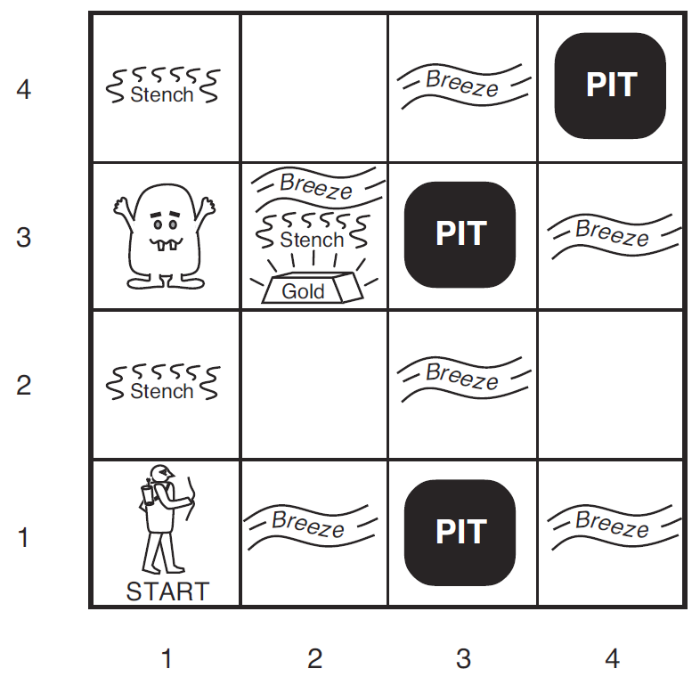
Wumpus World
Logical Reasoning as a CSP
B_{ij} = breeze felt
S_{ij} = stench smelt
P_{ij} = pit here
W_{ij} = wumpus here
G = gold
http://thiagodnf.github.io/wumpus-world-simulator/

Slide 34
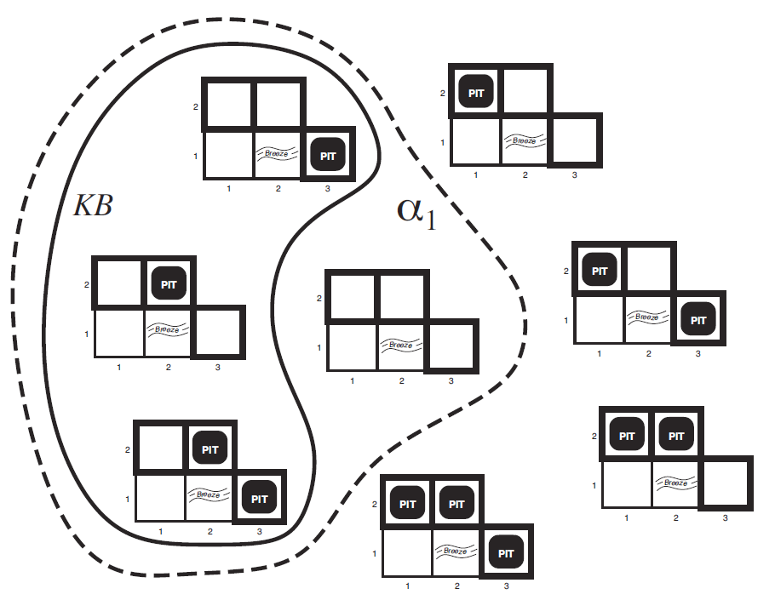
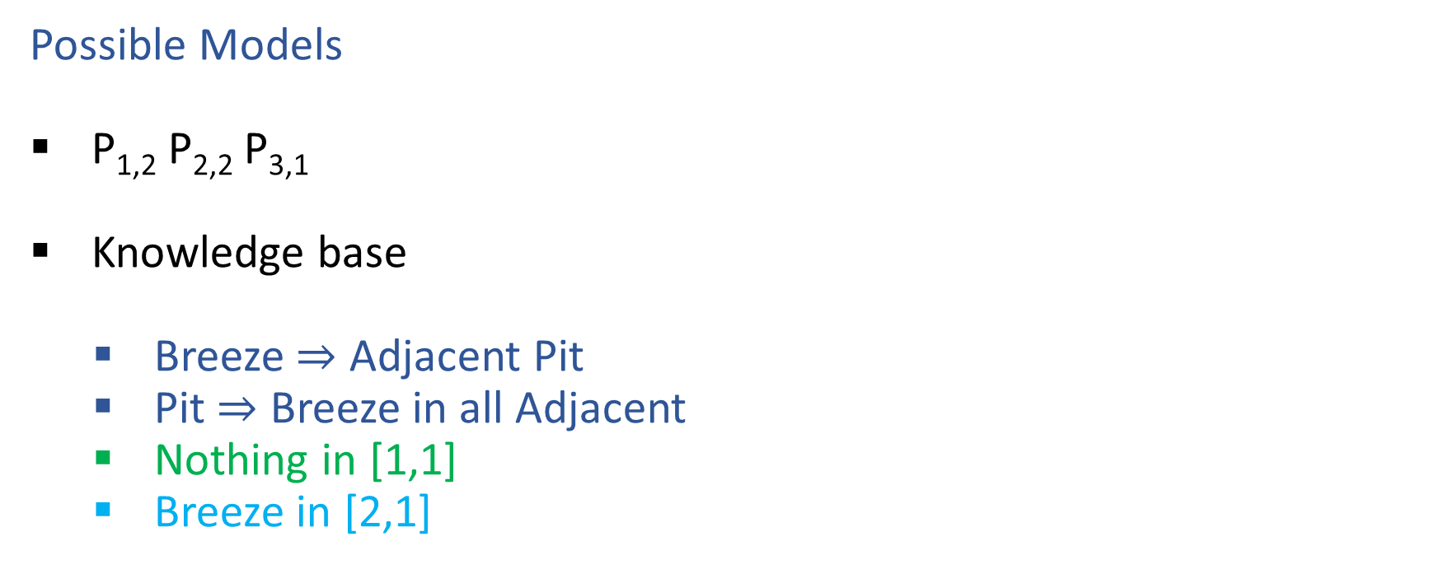

Wumpus World
Possible Models
P_{1,2} P_{2,2} P_{3,1}
Knowledge base
Breeze $⇒$ Adjacent Pit
Pit $⇒$ Breeze in all Adjacent
Nothing in [1,1]
Breeze in [2,1]

Slide 35
Entailment
Entailment: α |= β (“α entails β” or “β follows from α”) iff in every world where α is true, β is also true
I.e., the α-worlds are a subset of the β-worlds [models(α) ⊆ models(β)]
Usually, we want to know if KB |= query
models(KB) ⊆ models(query)
In other words
KB removes all impossible models (any model where KB is false)
If query is true in all of these remaining models, we conclude that query must be true
Entailment and implication are very much related
However, entailment relates two sentences, while an implication is itself a sentence (usually derived via inference to show entailment)

Slide 36
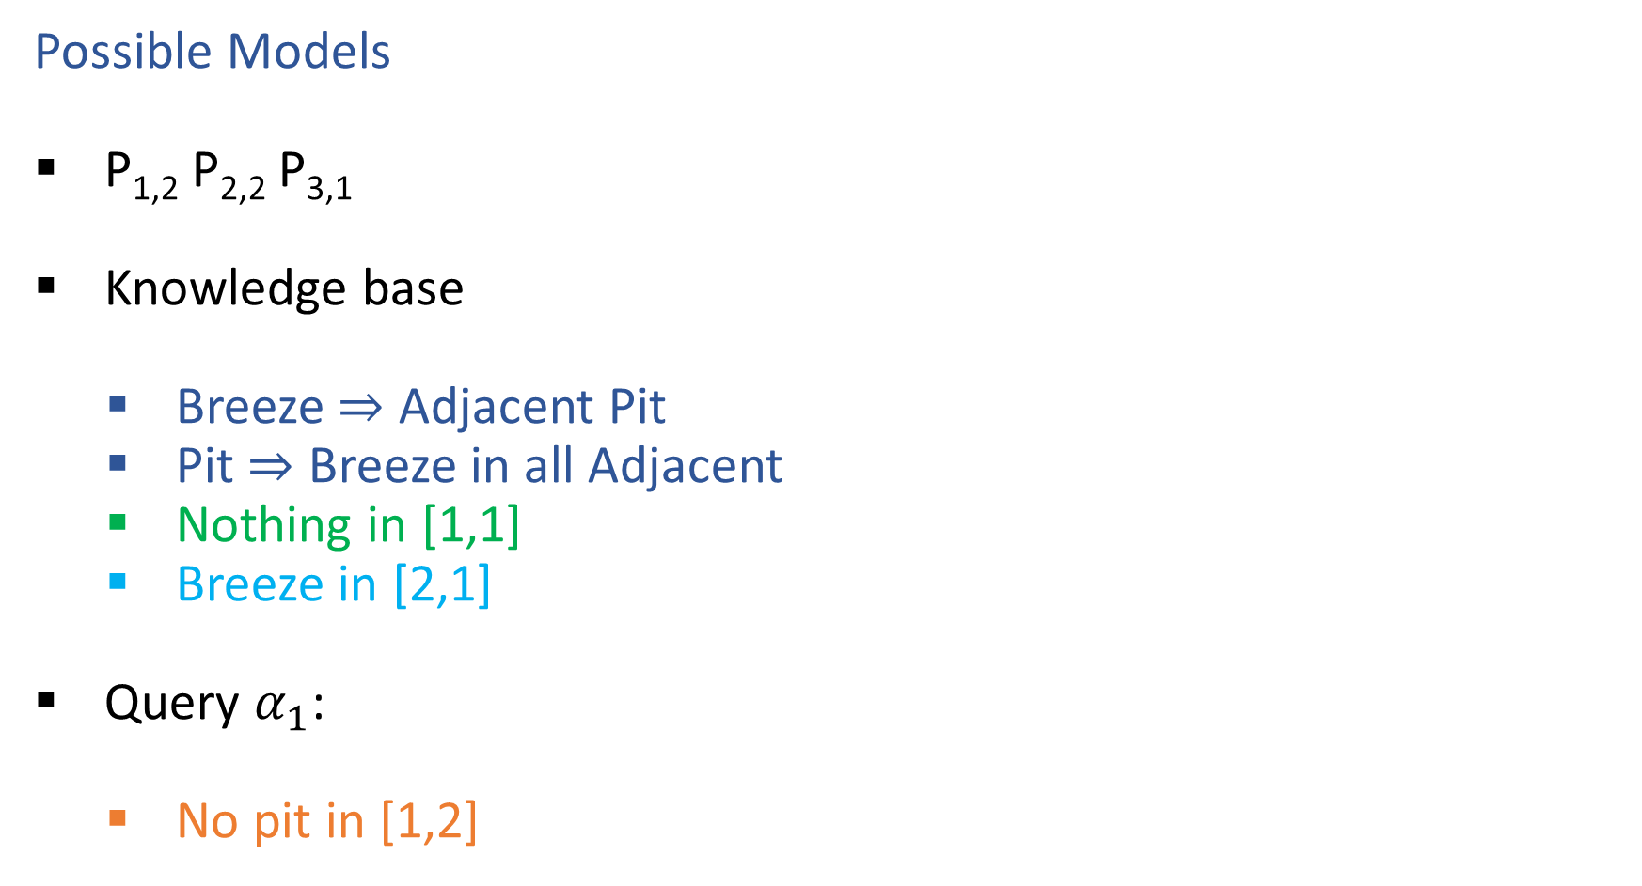
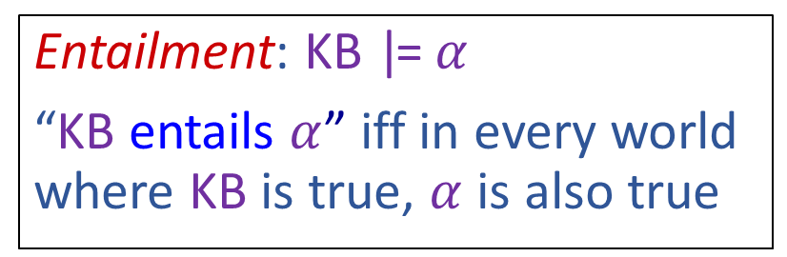
Wumpus World
Possible Models
P_{1,2} P_{2,2} P_{3,1}
Knowledge base
Breeze $⇒$ Adjacent Pit
Pit $⇒$ Breeze in all Adjacent
Nothing in [1,1]
Breeze in [2,1]
Query $α_{1}$:
No pit in [1,2]
Entailment: KB |= $α$
“KB entails $α$” iff in every world where KB is true, $α$ is also true

Slide 37
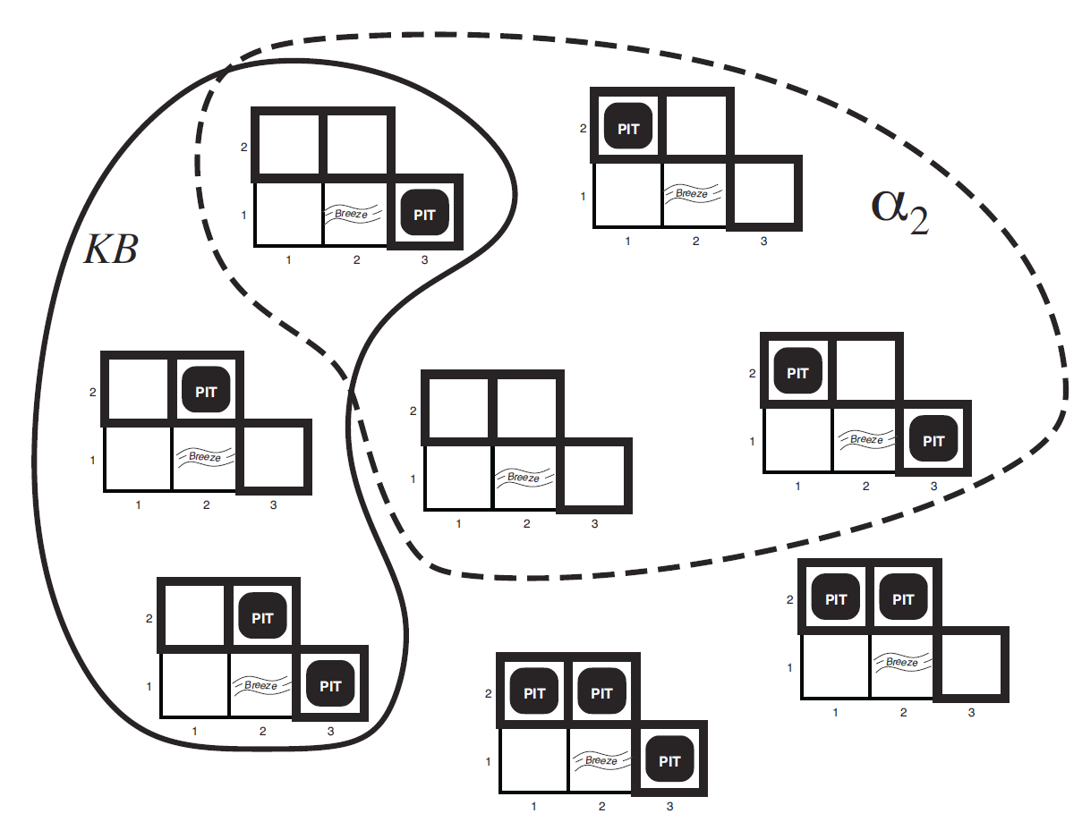
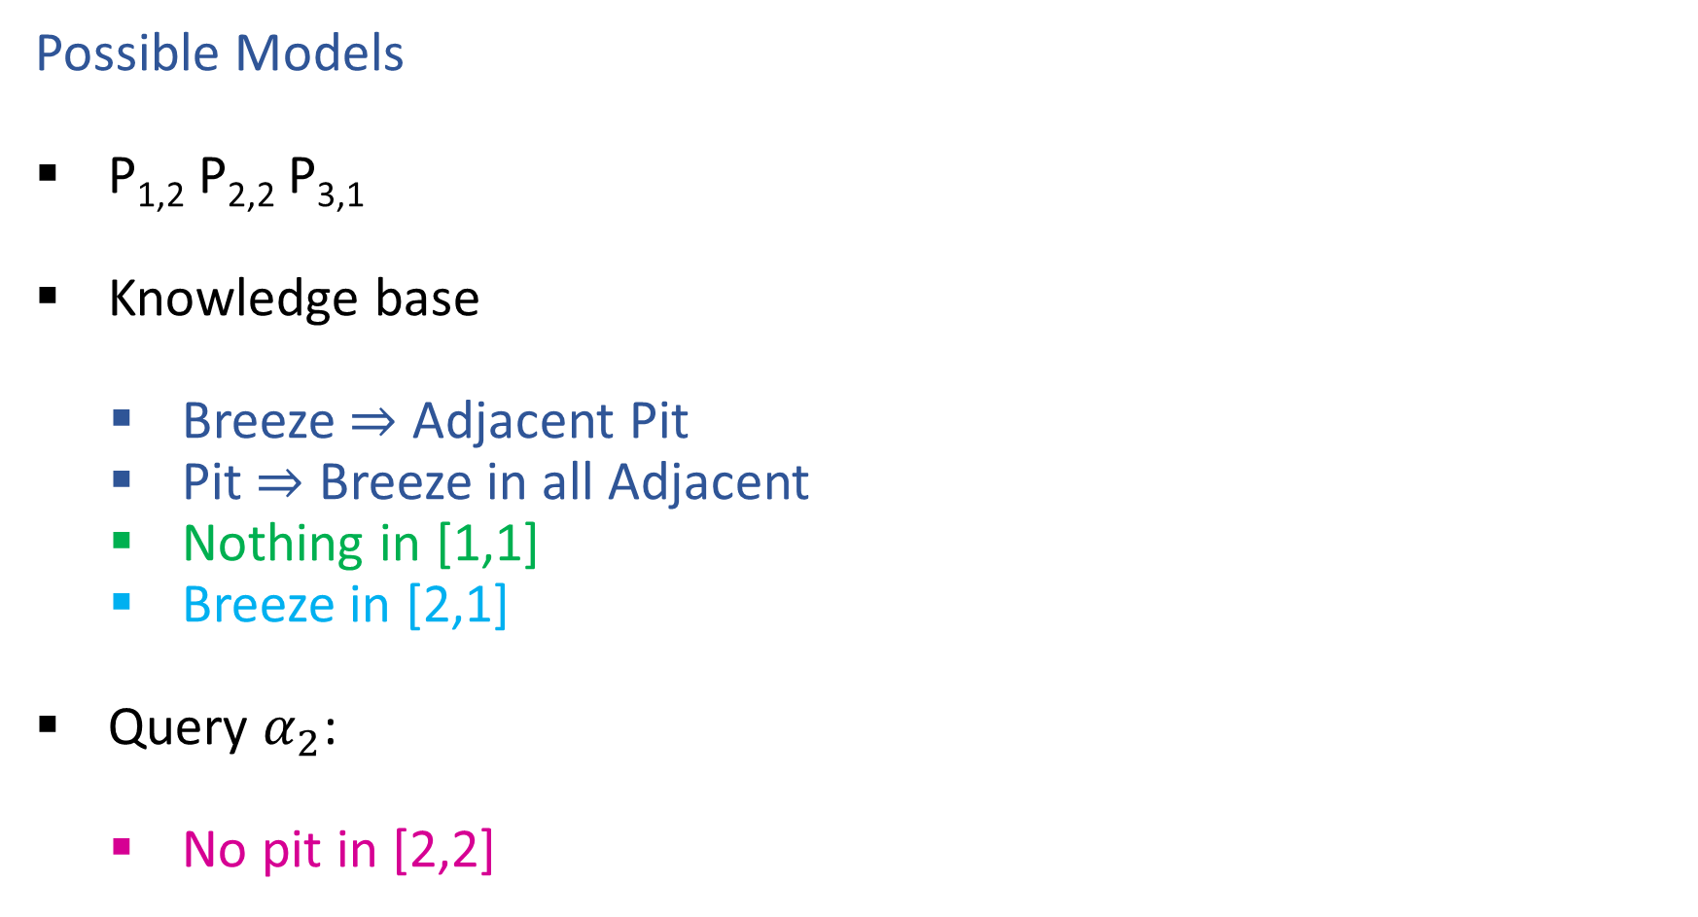
Wumpus World
Possible Models
P_{1,2} P_{2,2} P_{3,1}
Knowledge base
Breeze $⇒$ Adjacent Pit
Pit $⇒$ Breeze in all Adjacent
Nothing in [1,1]
Breeze in [2,1]
Query $α_{2}$:
No pit in [2,2]
Entailment: KB |= $α$
“KB entails $α$” iff in every world where KB is true, $α$ is also true

Slide 38
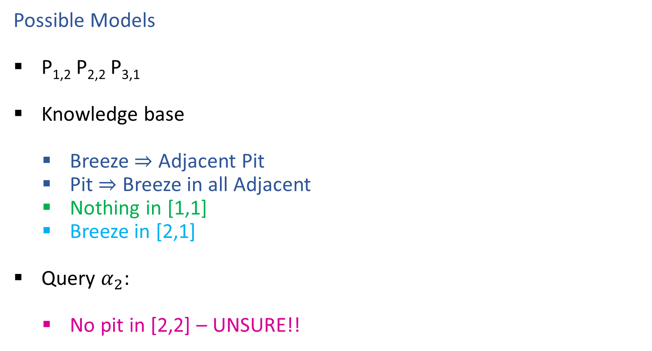
Wumpus World
Possible Models
P_{1,2} P_{2,2} P_{3,1}
Knowledge base
Breeze $⇒$ Adjacent Pit
Pit $⇒$ Breeze in all Adjacent
Nothing in [1,1]
Breeze in [2,1]
Query $α_{2}$:
No pit in [2,2] – UNSURE!!
Entailment: KB |= $α$
“KB entails $α$” iff in every world where KB is true, $α$ is also true

Slide 39
Propositional Logic Models
All Possible Models
A | 0 | 0 | 0 | 0 | 1 | 1 | 1 | 1
B | 0 | 0 | 1 | 1 | 0 | 0 | 1 | 1
C | 0 | 1 | 0 | 1 | 0 | 1 | 0 | 1
Model Symbols

Slide 40
Poll 3
Entailment: α |= β
“α entails β” iff in every world where α is true, β is also true
Does the KB entail query C?
All Possible Models
A | 0 | 0 | 0 | 0 | 1 | 1 | 1 | 1
B | 0 | 0 | 1 | 1 | 0 | 0 | 1 | 1
C | 0 | 1 | 0 | 1 | 0 | 1 | 0 | 1
A | 0 | 0 | 0 | 0 | 1 | 1 | 1 | 1
B⇒C | 1 | 1 | 0 | 1 | 1 | 1 | 0 | 1
A⇒B∨C | 1 | 1 | 1 | 1 | 0 | 1 | 1 | 1
C | 0 | 1 | 0 | 1 | 0 | 1 | 0 | 1
Model Symbols
Knowledge Base
Query

Slide 41
Poll 3
Entailment: α |= β
“α entails β” iff in every world where α is true, β is also true
Does the KB entail query C?
Yes!
All Possible Models
A | 0 | 0 | 0 | 0 | 1 | 1 | 1 | 1
B | 0 | 0 | 1 | 1 | 0 | 0 | 1 | 1
C | 0 | 1 | 0 | 1 | 0 | 1 | 0 | 1
A | 0 | 0 | 0 | 0 | 1 | 1 | 1 | 1
B⇒C | 1 | 1 | 0 | 1 | 1 | 1 | 0 | 1
A⇒B∨C | 1 | 1 | 1 | 1 | 0 | 1 | 1 | 1
KB | 0 | 0 | 0 | 0 | 0 | 1 | 0 | 1
C | 0 | 1 | 0 | 1 | 0 | 1 | 0 | 1
Model Symbols
Knowledge Base
Query

Slide 42
Entailment
How do we implement a logical agent that proves entailment?
Logic language
Propositional logic
First order logic
Knowledge Base
Add known logical rules and facts
Inference algorithms
Theorem proving
Model checking

Slide 43
Simple Model Checking
function TT-ENTAILS?(KB, α) returns true or false

Slide 44
Simple Model Checking, contd.
Same recursion as backtracking
P₁=true
P₁=false
P₂=true
P₂=false
P_{n}=true
P_{n}=false
KB?
α?
11111…1
0000…0

Slide 45
Simple Model Checking
function TT-ENTAILS?(KB, α) returns true or false return TT-CHECK-ALL(KB, α, symbols(KB) U symbols(α),{})
function TT-CHECK-ALL(KB, α, symbols,model) returns true or false
if empty?(symbols) then
if PL-TRUE?(KB, model) then return PL-TRUE?(α, model)
else return true
else
P ← first(symbols) rest ← rest(symbols) return and (TT-CHECK-ALL(KB, α, rest, model ∪ {P = true})
TT-CHECK-ALL(KB, α, rest, model ∪ {P = false}))

Slide 46
Simple Model Checking, contd.
Same recursion as backtracking
O(2^{n}) time, linear space
Can we do better?
P₁=true
P₁=false
P₂=true
P₂=false
P_{n}=true
P_{n}=false
KB?
α?
11111…1
0000…0

Slide 47
Inference: Proofs
A proof is a demonstration of entailment between α and β
Method 1: model-checking
For every possible world, if α is true make sure that is β true too
OK for propositional logic (finitely many worlds); not easy for first-order logic
Method 2: theorem-proving
Search for a sequence of proof steps (applications of inference rules) leading from α to β
E.g., from P ∧ (P ⇒ Q), infer Q by Modus Ponens
Properties
Sound algorithm: everything it claims to prove is in fact entailed
Complete algorithm: every sentence that is entailed can be proved

Slide 48
Simple Theorem Proving: Forward Chaining
Forward chaining applies Modus Ponens to generate new facts:
Given X₁ ∧ X₂ ∧ … X_{n} ⇒ Y and X₁, X₂, …, X_{n}
Infer Y
Forward chaining keeps applying this rule, adding new facts, until nothing more can be added
Requires KB to contain only definite clauses:
(Conjunction of symbols) ⇒ symbol; or
A single symbol (note that X is equivalent to True ⇒ X)

Slide 49
Forward Chaining Algorithm
function PL-FC-ENTAILS?(KB, q) returns true or false
Clauses
P ⇒ Q
L ∧ M ⇒ P
B ∧ L ⇒ M
A ∧ P ⇒ L
A ∧ B ⇒ L
A
B

Slide 50
Forward Chaining Algorithm
function PL-FC-ENTAILS?(KB, q) returns true or false count ← a table, where count[c] is the number of symbols in c’s premise
inferred ← a table, where inferred[s] is initially false for all s
agenda ← a queue of symbols, initially symbols known to be true in KB
Clauses
Count
Inferred
Agenda
P ⇒ Q
L ∧ M ⇒ P
B ∧ L ⇒ M
A ∧ P ⇒ L
A ∧ B ⇒ L
A
B
1
2
2
2
2
0
0
A false
B false
L false
M false
P false
Q false

Slide 51
Forward Chaining Example: Proving Q
Clauses
Count
Inferred
1
2
2
2
2
0
0
A false
B false
L false
M false
P false
Q false
P ⇒ Q
L ∧ M ⇒ P
B ∧ L ⇒ M
A ∧ P ⇒ L
A ∧ B ⇒ L
A
B
// 0
xxxx true
// 1
xxxx true
// 0
// 0
xxxx true
// 1
// 0
xxxx true
// 1
xxxx true
// 0
// 1
xxxx true
Agenda
x
x
Q
x
L
x
x
x
M
P
A B
x
L

Slide 52
Forward Chaining Algorithm
function PL-FC-ENTAILS?(KB, q) returns true or false count ← a table, where count[c] is the number of symbols in c’s premise
inferred ← a table, where inferred[s] is initially false for all s
agenda ← a queue of symbols, initially symbols known to be true in KB
while agenda is not empty do
p ← Pop(agenda) if p = q then return true
if inferred[p] = false then
inferred[p]←true for each clause c in KB where p is in c.premise do
decrement count[c]
if count[c] = 0 then add c.conclusion to agenda
return false

Slide 53
Properties of forward chaining
Theorem: FC is sound and complete for definite-clause KBs
Soundness: follows from soundness of Modus Ponens (easy to check)
Completeness proof:
1. FC reaches a fixed point where no new atomic sentences are derived
2. Consider the final inferred table as a model m, assigning true/false to symbols
3. Every clause in the original KB is true for m
Proof: Suppose a clause a₁∧... ∧a_{k} ⇒ b is false for m
Then a₁∧... ∧a_{k} is true in m and b is false for m
Therefore the algorithm has not reached a fixed point!
4. Hence m is a model of KB
5. If KB |= q, q is true in every model of KB, including m
A false
B false
L false
M false
P false
Q false
xxxx true
xxxx true
xxxx true
xxxx true
xxxx true
xxxx true

Slide 54
Does forward chaining work on this example?
A ⇒ B
¬A ⇒ B

Slide 55

Inference Rules
Modus Ponens
$\frac{α⇒β, α}{β}$
Unit Resolution
$\frac{a∨b, ¬b∨c}{a∨c}$
General Resolution
$\frac{a_{1}∨…∨a_{m}∨b, ¬b∨c_{1}∨…∨c_{n}}{a_{1}∨…∨a_{m}∨c_{1}∨…∨c_{n}}$
Notation Alert!

Slide 56
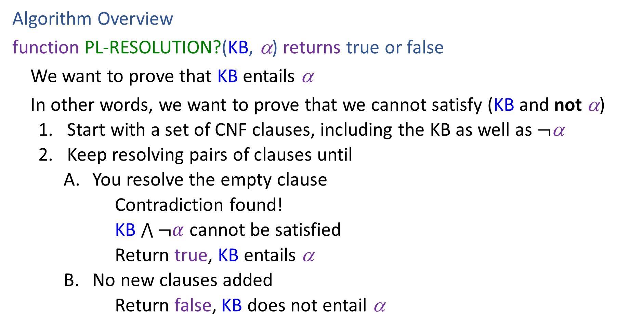
Resolution
Algorithm Overview
function PL-RESOLUTION?(KB, α) returns true or false
We want to prove that KB entails α
In other words, we want to prove that we cannot satisfy (KB and not α)
Start with a set of CNF clauses, including the KB as well as $¬$α
Keep resolving pairs of clauses until
You resolve the empty clause
Contradiction found!
KB $\bigwedge{¬α}$ cannot be satisfied
Return true, KB entails α
No new clauses added
Return false, KB does not entail α

Slide 57
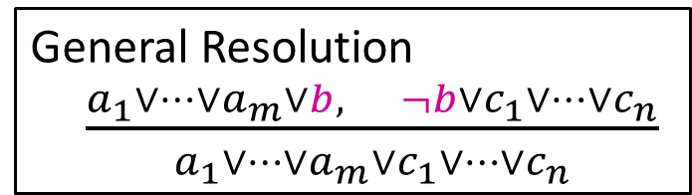






Resolution
General Resolution
$\frac{a_{1}∨…∨a_{m}∨b, ¬b∨c_{1}∨…∨c_{n}}{a_{1}∨…∨a_{m}∨c_{1}∨…∨c_{n}}$
Example trying to prove $¬P_{1,2}$
Knowledge Base
$$¬P_{2,1}∨B_{1,1}$$
$$¬B_{1,1}∨P_{1,2}∨P_{2,1}$$
$$¬P_{1,2}∨B_{1,1}$$
$$¬B_{1,1}$$
$$¬¬P_{1,2}$$

Slide 58







Resolution
General Resolution
$\frac{a_{1}∨…∨a_{m}∨b, ¬b∨c_{1}∨…∨c_{n}}{a_{1}∨…∨a_{m}∨c_{1}∨…∨c_{n}}$
Example trying to prove $¬P_{1,2}$
Knowledge Base
$$¬P_{2,1}∨B_{1,1}$$
$$¬B_{1,1}∨P_{1,2}∨P_{2,1}$$
$$¬P_{1,2}∨B_{1,1}$$
$$¬B_{1,1}$$
$$P_{1,2}$$
$$¬B_{1,1}∨P_{1,2}∨B_{1,1}$$
$$P_{1,2}∨P_{2,1}∨¬P_{2,1}$$
$$¬B_{1,1}∨P_{2,1}∨B_{1,1}$$
$$P_{1,2}∨P_{2,1}∨¬P_{1,2}$$
$$¬P_{2,1}$$
$$¬P_{1,2}$$

Slide 59
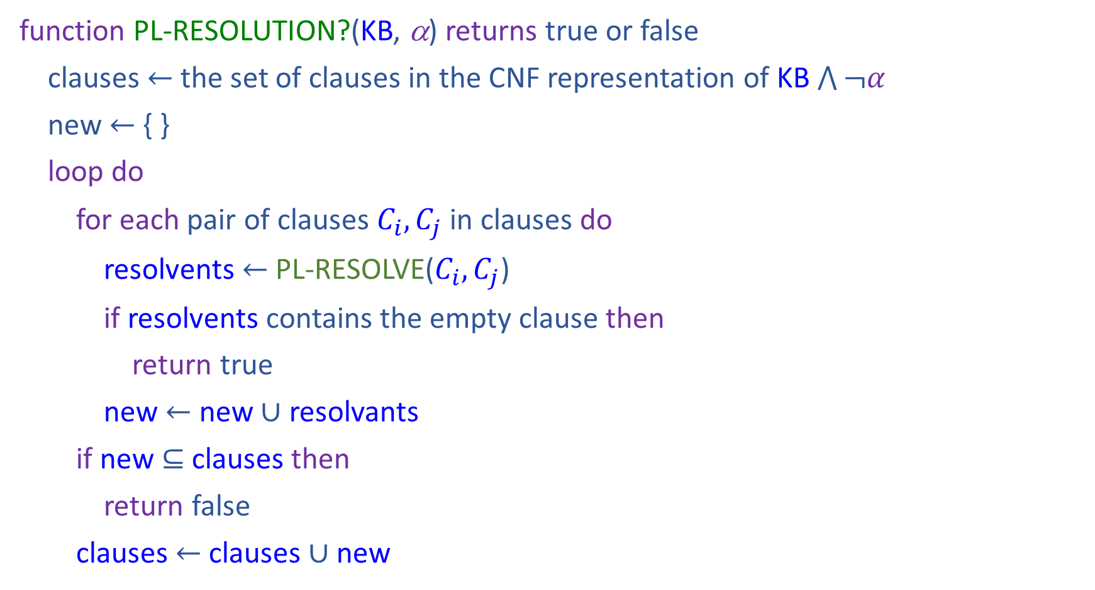
Resolution
function PL-RESOLUTION?(KB, α) returns true or false
clauses $←$ the set of clauses in the CNF representation of KB $\bigwedge{¬α}$
new $←${ }
loop do
for each pair of clauses $C_{i}, C_{j}$ in clauses do
resolvents $←$ PL-RESOLVE($C_{i}, C_{j}$)
if resolvents contains the empty clause then
return true
new $←$ new $∪$ resolvants
if new $⊆$ clauses then
return false
clauses $←$ clauses $∪$ new

Slide 60
Properties
Forward Chaining is:
Sound and complete for definite-clause KBs
Complexity: linear time
Resolution is:
Sound and complete for any PL KBs!
Complexity: exponential time ☹

Slide 61


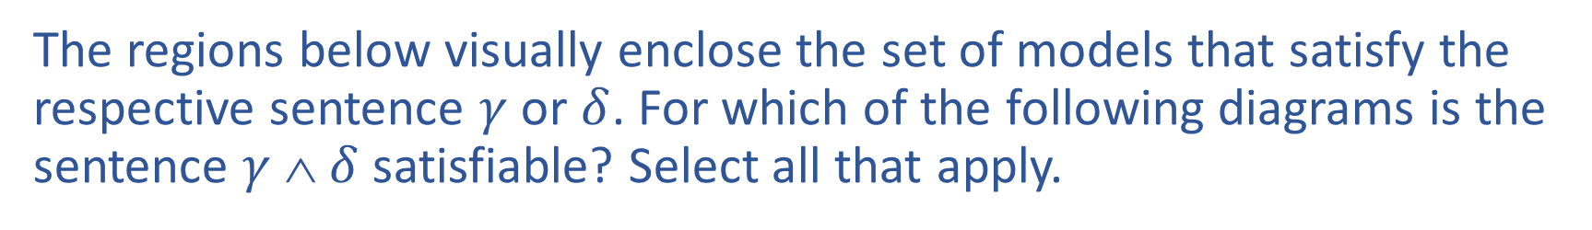








Poll 4
The regions below visually enclose the set of models that satisfy the respective sentence $γ$ or $δ$. For which of the following diagrams is the sentence $γ$ ∧ $δ$ satisfiable? Select all that apply.
A)
B)
C)
$$γ$$
$$δ$$
$$γ$$
$$δ$$
$$γ$$
$$δ$$
D)
E)
$$γ$$
$$δ$$
$$δ$$
$$γ$$
Notes:
A, C, D, E

Slide 62
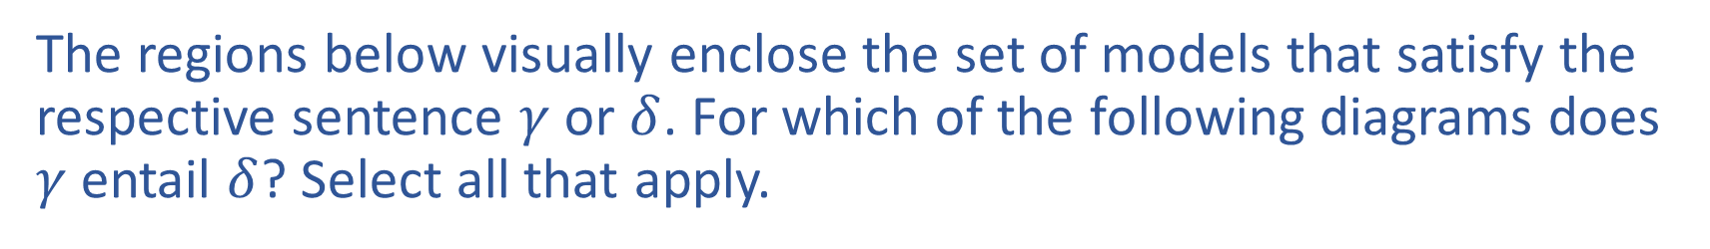
Poll 5
The regions below visually enclose the set of models that satisfy the respective sentence $γ$ or $δ$. For which of the following diagrams does $γ$ entail $δ$? Select all that apply.
A)
B)
C)
$$γ$$
$$δ$$
$$γ$$
$$δ$$
$$γ$$
$$δ$$
D)
E)
$$γ$$
$$δ$$
$$δ$$
$$γ$$
Notes:
C and E

Slide 63
Satisfiability and Entailment
A sentence is satisfiable if it is true in at least one world (e.g., CSPs!)
Suppose we have a hyper-efficient SAT solver; how can we use it to test entailment?
Suppose α |= β
Then α ⇒ β is true in all worlds
Hence ¬(α ⇒ β) is false in all worlds
Hence α ∧ ¬β is false in all worlds, i.e., unsatisfiable
So, add the negated conclusion to what you know, test for (un)satisfiability; also known as reductio ad absurdum
Efficient SAT solvers operate on conjunctive normal form

Slide 64
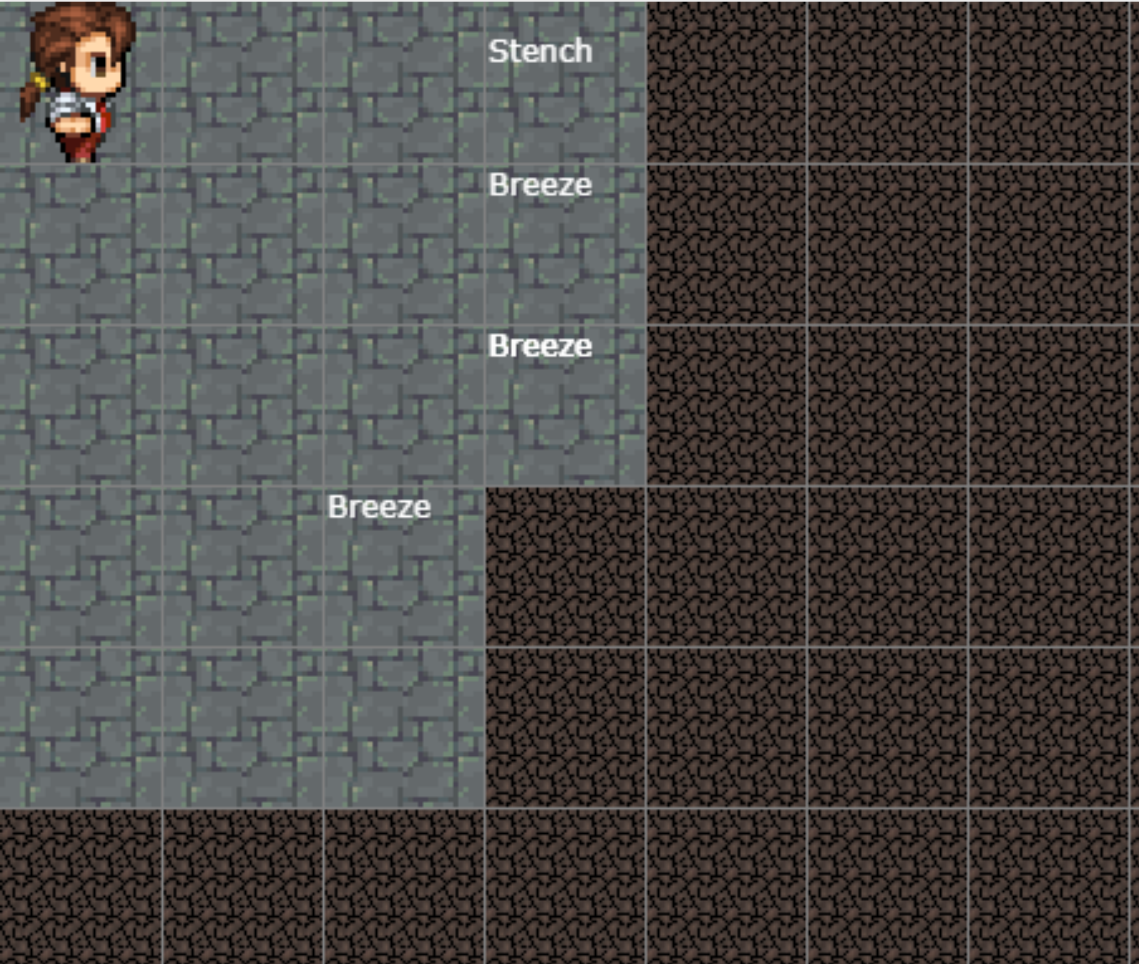
Satisfiability and Entailment
http://thiagodnf.github.io/wumpus-world-simulator/

Slide 65
Conjunctive Normal Form (CNF)
Replace biconditional by two implications
Every sentence can be expressed as a conjunction of clauses
Each clause is a disjunction of literals
Each literal is a symbol or a negated symbol
Conversion to CNF by a sequence of standard transformations:
At_1,1_0 ⇒ (Wall_0,1 ⇔ Blocked_W_0)
At_1,1_0 ⇒ ((Wall_0,1 ⇒ Blocked_W_0) ∧ (Blocked_W_0 ⇒Wall_0,1))
¬At_1,1_0 v ((¬Wall_0,1 v Blocked_W_0) ∧ (¬Blocked_W_0 v Wall_0,1))
(¬At_1,1_0 v ¬Wall_0,1 v Blocked_W_0) ∧ (¬At_1,1_0 v ¬Blocked_W_0 v Wall_0,1)
Replace α ⇒ β by ¬α v β
Distribute v over ∧

Slide 66
Efficient SAT solvers
DPLL (Davis-Putnam-Logemann-Loveland) is the core of modern solvers
Essentially a backtracking search over models with some extras:
Early termination: stop if
all clauses are satisfied; e.g., (A ∨ B) ∧ (A ∨ ¬C) is satisfied by {A=true}
any clause is falsified; e.g., (A ∨ B) ∧ (A ∨ ¬C) is falsified by {A=false, B=false}
Pure literals: if all occurrences of a symbol in as-yet-unsatisfied clauses have the same sign, then give the symbol that value
E.g., A is pure and positive in (A ∨ B) ∧ (A ∨ ¬C) ∧ (C ∨ ¬B) so set it to true
Unit clauses: if a clause is left with a single literal, set symbol to satisfy clause
E.g., if A=false, (A ∨ B) ∧ (A ∨ ¬C) becomes (false ∨ B) ∧ (false ∨ ¬C), i.e. (B) ∧ (¬C)
Satisfying the unit clauses often leads to further propagation, new unit clauses, etc.

Slide 67
DPLL algorithm
function DPLL(clauses, symbols, model) returns true or false
if every clause in clauses is true in model then return true if some clause in clauses is false in model then return false
P, value ←FIND-PURE-SYMBOL(symbols, clauses, model) if P is non-null then return DPLL(clauses, symbols–P, model∪{P=value})
P, value ←FIND-UNIT-CLAUSE(clauses, model) if P is non-null then return DPLL(clauses, symbols–P, model∪{P=value})
P ← First(symbols)
rest ← Rest(symbols)
return or(DPLL(clauses, rest, model∪{P=true}),
DPLL(clauses, rest, model∪{P=false}))

Slide 68
Planning as Satisfiability
Given a hyper-efficient SAT solver, can we use it to make plans?
Yes, for fully observable, deterministic case: planning problem is solvable iff there is some satisfying assignment for actions etc.

Slide 69
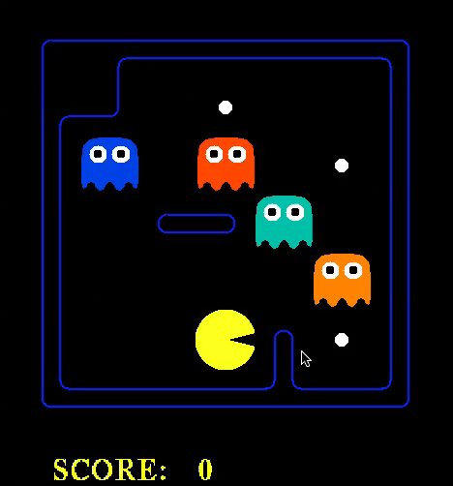


Slide 70
Planning as Satisfiability
Given a hyper-efficient SAT solver, can we use it to make plans?
Yes, for fully observable, deterministic case: planning problem is solvable iff there is some satisfying assignment for actions etc.
For T = 1 to infinity, set up the KB as follows and run SAT solver:
Initial state, domain constraints
Transition model sentences up to time T
Goal is true at time T
Precondition axioms: At_1,1_0 ∧ N_0 ⇒ ¬Wall_1,2 etc.
Action exclusion axioms: ¬(N_0 ∧ W_0) ∧ ¬(N_0 ∧ S_0) ∧ .. etc.

Slide 71
Initial State
The agent may know its initial location:
At_1,1_0
Or, it may not:
At_1,1_0 v At_1,2_0 v At_1,3_0 v … v At_3,3_0
We also need a domain constraint – cannot be in two places at once!
¬(At_1,1_0 ∧ At_1,2_0) ∧ ¬(At_1,1_0 ∧ At_1,3_0) ∧ …
¬(At_1,1_1 ∧ At_1,2_1) ∧ ¬(At_1,1_1 ∧ At_1,3_1) ∧ …
…

Slide 72
Fluents and Effect Axioms
A fluent is a state variable that changes over time
How does each state variable or fluent at each time gets its value?
Fluents for PL Pacman are Pacman_x,y_t , e.g., Pacman _3,3_17

Slide 73
Fluents and Successor-state Axioms
A fluent is a state variable that changes over time
How does each state variable or fluent at each time gets its value?
Fluents for PL Pacman are Pacman_x,y_t , e.g., Pacman _3,3_17
A state variable gets its value according to a successor-state axiom
X_{t} ⇔ [X_{t-1} ∧ ¬(some action_{t-1} made it false)] v
[¬X_{t-1} ∧ (some action_{t-1} made it true)]

Slide 74
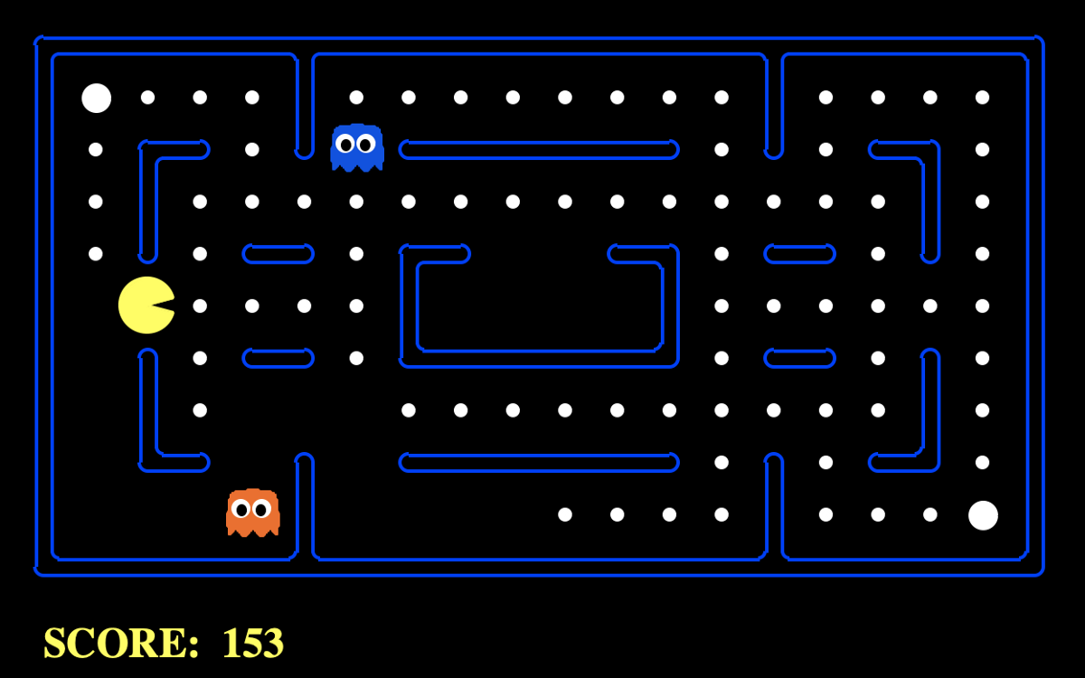
Fluents and Successor-state Axioms
Write the successor-state axiom for pacman’s location

Slide 75
Planning as Satisfiability
For T = 1 to infinity, set up the KB as follows and run SAT solver:
Initial state, domain constraints
Transition model sentences up to time T
Goal is true at time T
Why?
If I can find a satisfying set of variables that meet the constraints, then I have also found a plan as the set of action variables.

Slide 76
EXTRA SLIDES

Slide 77
Logical Agent Vocab
Model
Complete assignment of symbols to True/False
Sentence
Logical statement
Composition of logic symbols and operators
KB
Collection of sentences representing facts and rules we know about the world
Query
Sentence we want to know if it is provably True, provably False, or unsure.

Slide 78
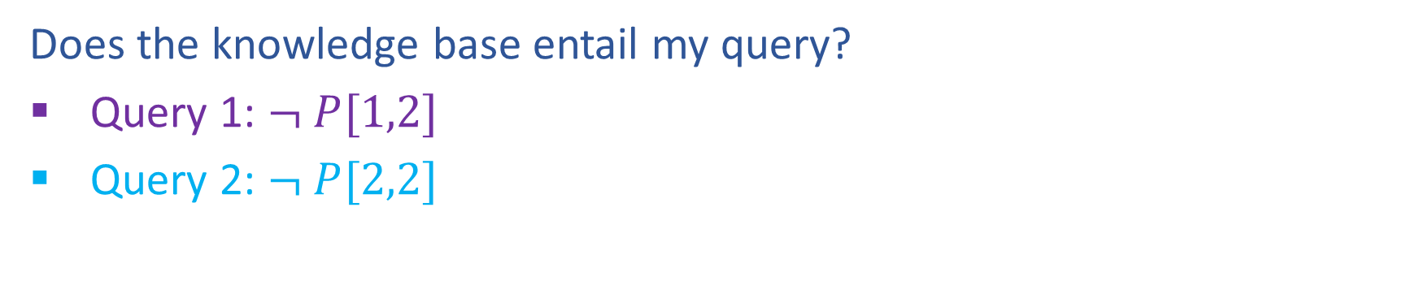

Entailment
Does the knowledge base entail my query?
Query 1: $¬ P[1,2]$
Query 2: $¬ P[2,2]$

Slide 79
Provably True, Provably False, or Unsure
http://thiagodnf.github.io/wumpus-world-simulator/

Slide 80
Logical Agent Vocab
Entailment
Input: sentence1, sentence2
Each model that satisfies sentence1 must also satisfy sentence2
"If I know 1 holds, then I know 2 holds"
(ASK), TT-ENTAILS, FC-ENTAILS, RESOLUTION-ENTAILS
Satisfy
Input: model, sentence
Is this sentence true in this model?
Does this model satisfy this sentence
"Does this particular state of the world work?’
PL-TRUE

Slide 81
Logical Agent Vocab
Satisfiable
Input: sentence
Can find at least one model that satisfies this sentence
(We often want to know what that model is)
"Is it possible to make this sentence true?"
DPLL
Valid
Input: sentence
sentence is true in all possible models

